Slide 1







That was the NuMass 2026!
KIT, April 13–16, 2026
Silver sponsors:
Bronze sponsors:

Slide 2
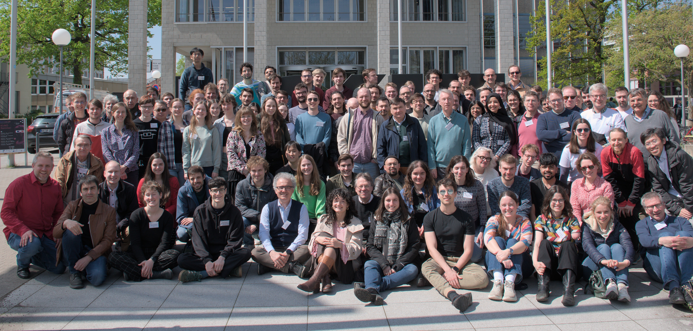

Slide 3
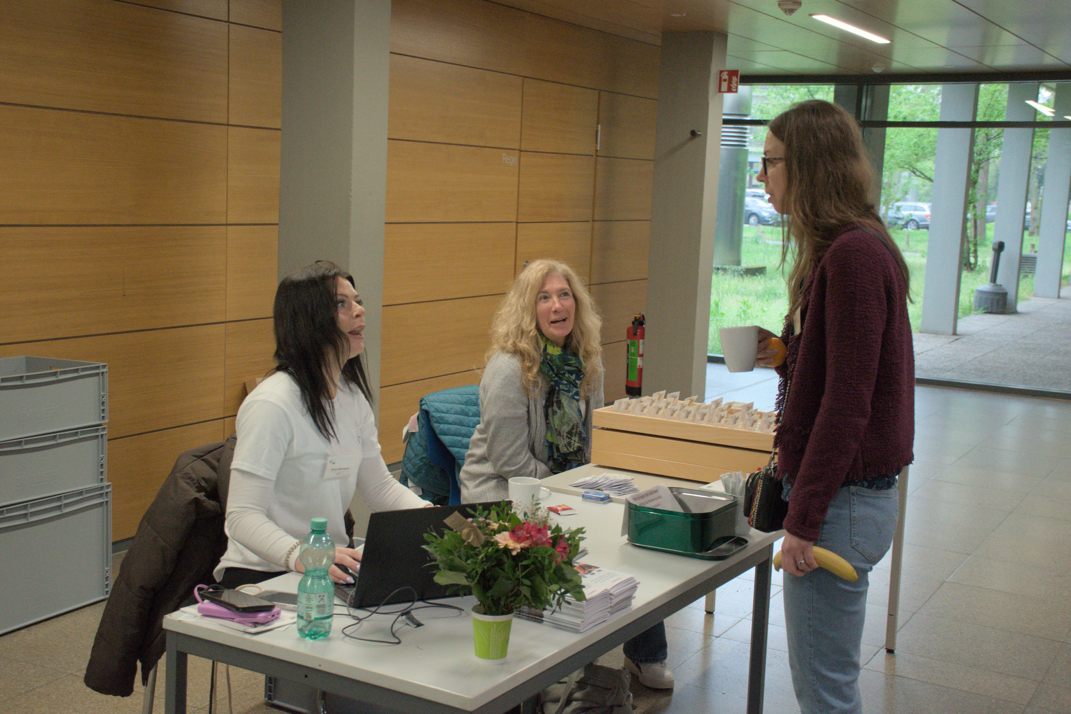

Slide 4
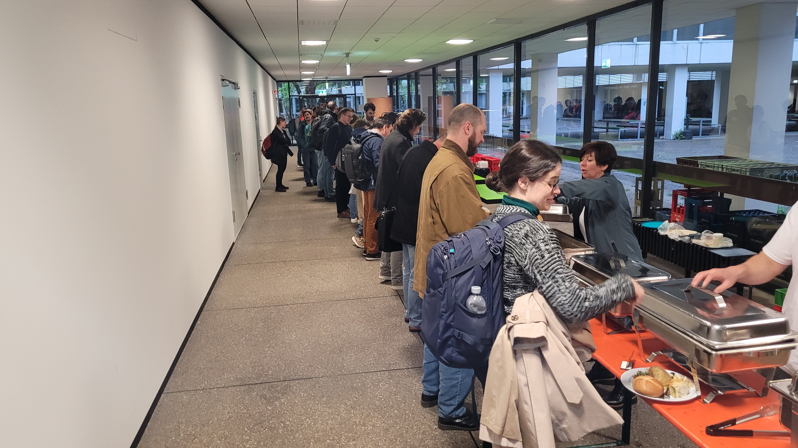
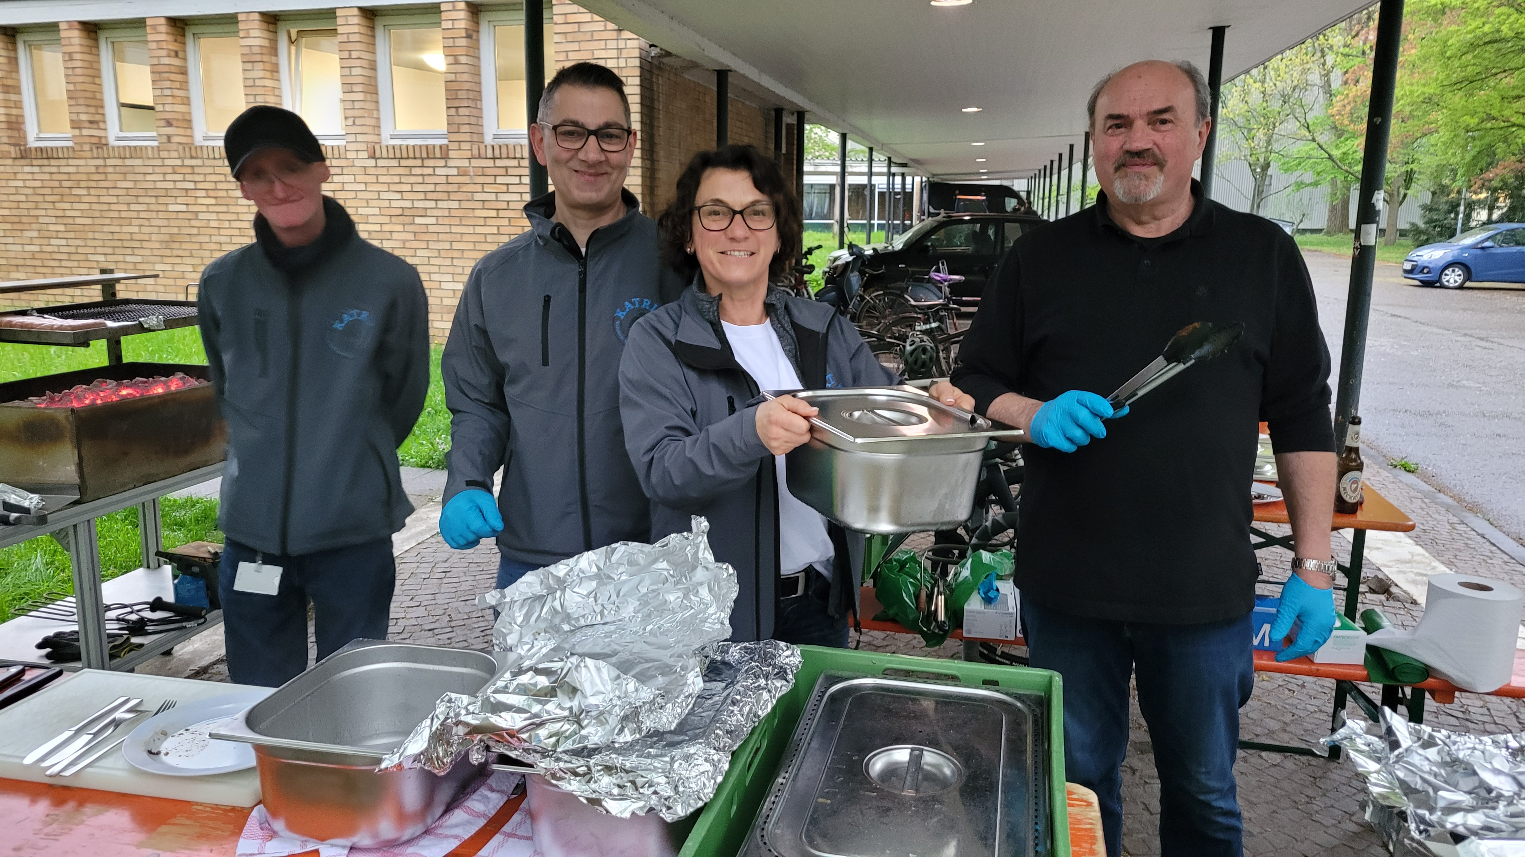

Slide 5
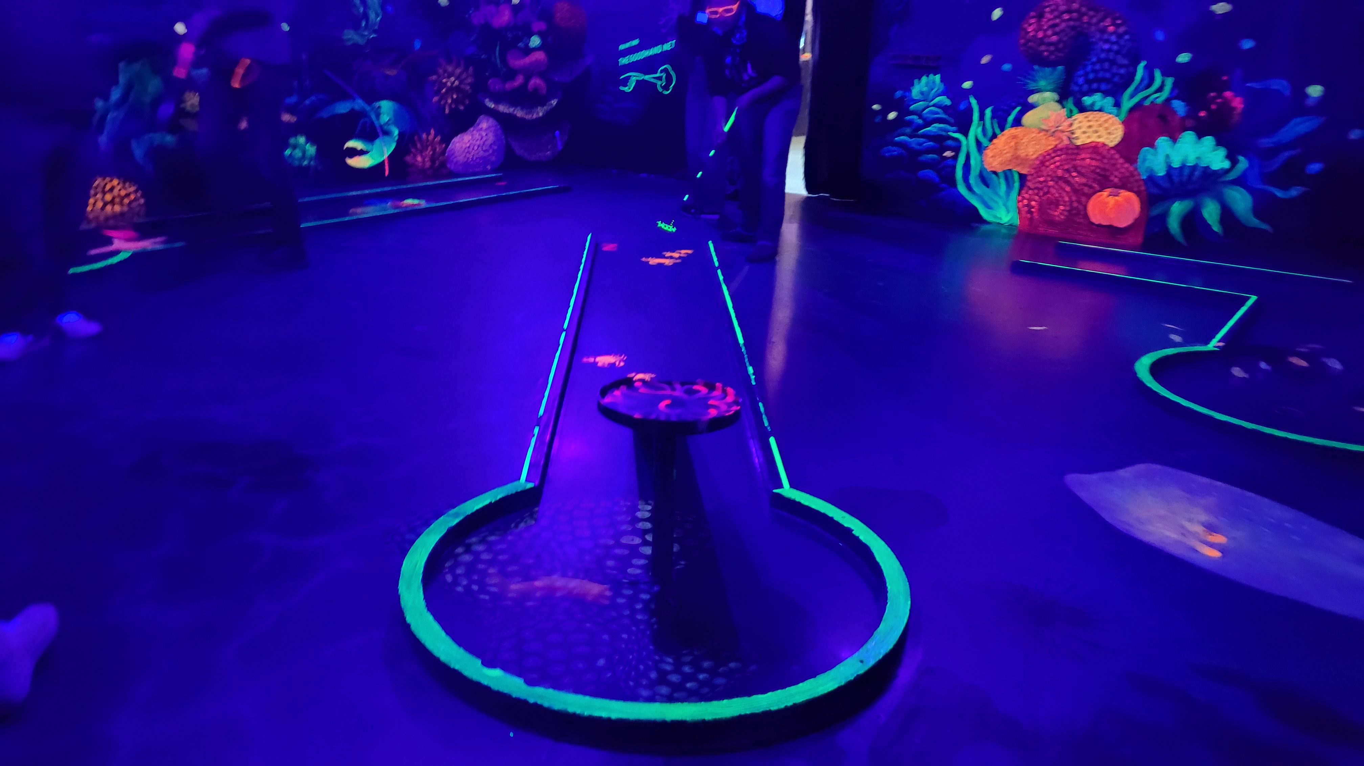
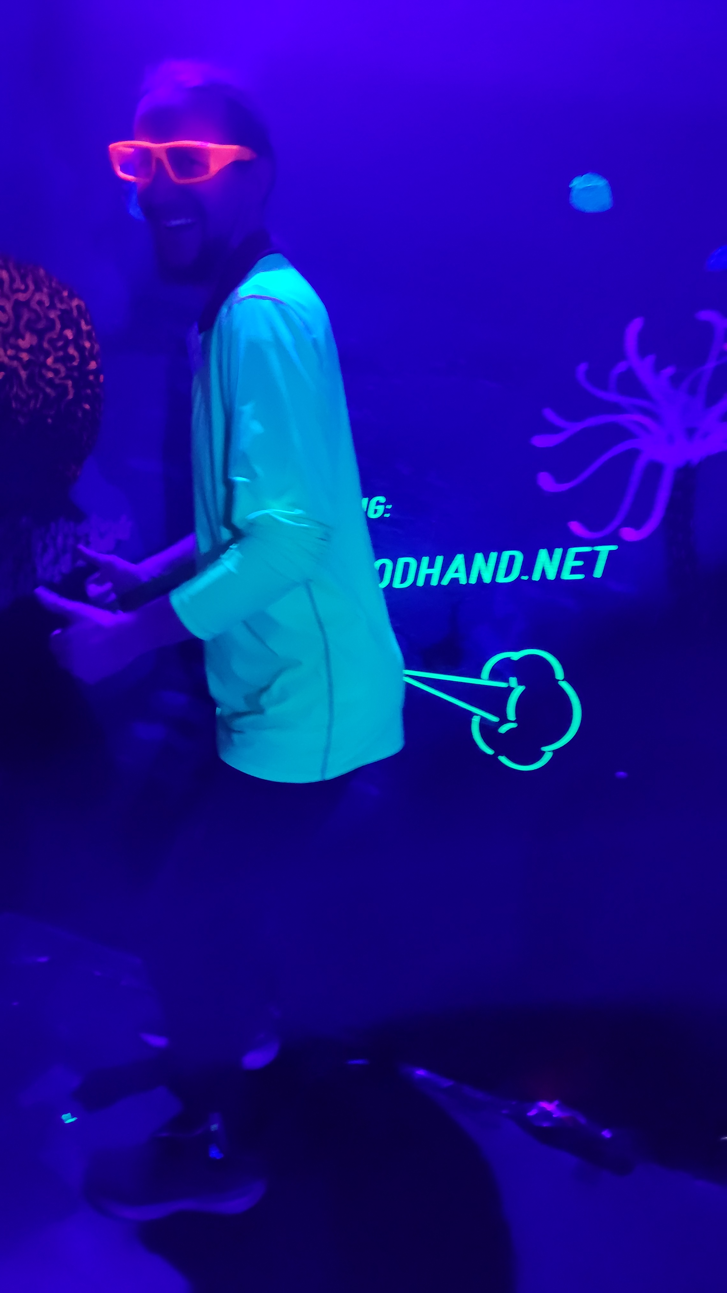

Slide 6
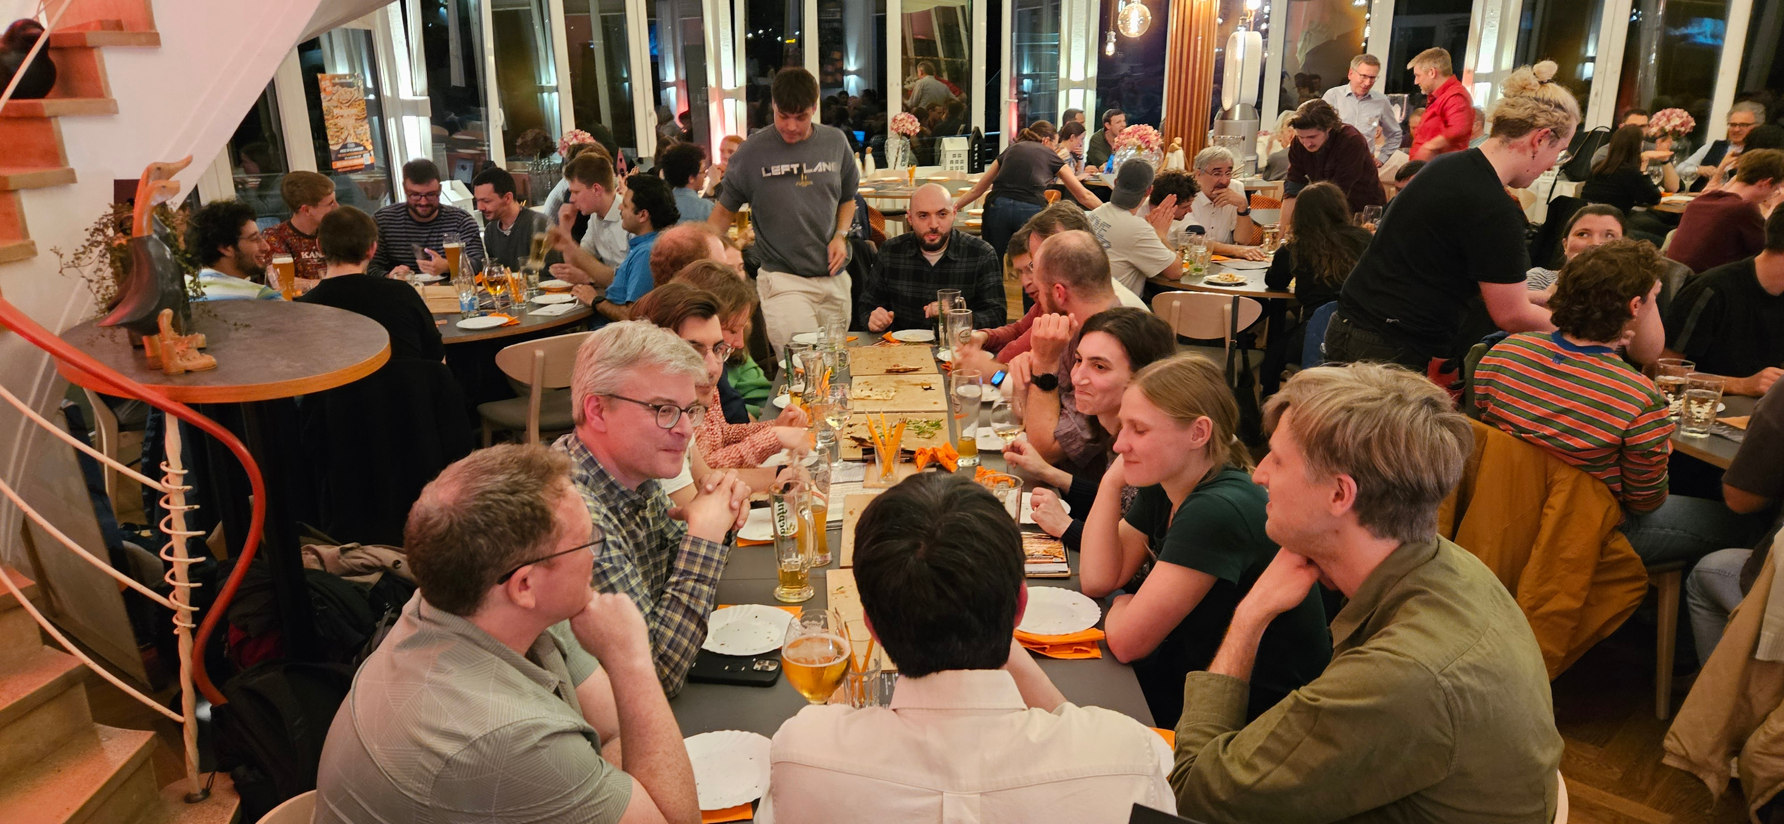
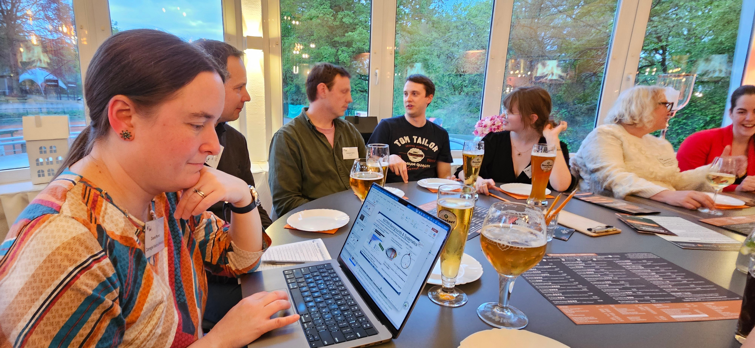

Slide 7
Many thanks to the sponsors for a generous support
Silver sponsors
Bronze sponsors
Please meet them at the booth during the coffee break, the poster session, lunch
and during the social activities

Slide 8

Thanks to KIT Center Elementary Particle and Astroparticle Physics

Slide 9






Programme Advisory Comittee
Kathrin Valerius
Juliana Stachurska
Ruben Saakyan
Elena Ferri
Loredana Gastaldo
Nicolo de Groot
Magnus Schlösser, Chair
Outlining of the conference (main talks, topical focus sessions, poster session, invited talks)
Suggestion and contacting of speakers
Communication back to the collaborations

Slide 10
Local organisation comittee
Conference chairs: Magnus Schlösser (IAP - KIT), Kathrin Valerius (ETP - KIT)
Technical chair: Emma Malcherek (IAP - KIT)
LOC Members
Marion Behechti (ETP - KIT), Yanina Biondi (IAP - KIT), Fiona Braun (IAP - KIT), Carlotta Buchner, (IAP - KIT), David Frese (IAP - KIT), Chloé Goupy (MPIK), Nicholas Tan Jerome (IPE - KIT), Neven Kovac (IAP - KIT), Alexey Lokhov (ETP - KIT), Beatrix von Puttkammer (IAP -KIT), Rudolf Sack (IAP - KIT), Markus Schultz-Ritz (IAP - KIT), Thomas Thümmler (IAP - KIT), Sarah Untereiner (IAP - KIT), Joachim Wolf (ETP - KIT)
BBQ-Chefs
Jörg Bohn, Adalbert Braun, Monika Kaiser, Daniel Kling, Judith Schneider
Name
Affiliation

Slide 11

Poster prize
(voted by 31 participants)
Workshop on the
Determination of the Absolute Electron (Anti-)Neutrino Mass
April 13–16, 2026
Karlsruhe
Institute of technology

Slide 12
2nd poster prize
Workshop on the
Determination of the Absolute Electron (Anti-)Neutrino Mass
April 13–16, 2026
Karlsruhe
Institute of technology
Ab initio calculations of the electron capture spectrum in Ho
by Vera Butz, Maurits W. Haverkort, Martin Braß
Presented by Vera Butz
16.04.2026
Magnus Schlösser
Chair of NuMass2026

Slide 13
Workshop on the
Determination of the Absolute Electron (Anti-)Neutrino Mass
April 13–16, 2026
Karlsruhe
Institute of technology
2nd poster prize
Development of KICS multiplexing lines for HOLMES+ experiment
by E. Bogoni, S. Gamba et al [HOLMES Collaboration]
Presented by Sara Gamba
16.04.2026
Magnus Schlösser
Chair of NuMass2026

Slide 14
Workshop on the
Determination of the Absolute Electron (Anti-)Neutrino Mass
April 13–16, 2026
Karlsruhe
Institute of technology
2nd poster prize
Studies on Ho implantation efficiency and upgrades for the HOLMES+ experiment
by F. Bianco, et al [HOLMES Collaboration]
Presented by Federico Bianco
16.04.2026
Magnus Schlösser
Chair of NuMass2026

Slide 15
Workshop on the
Determination of the Absolute Electron (Anti-)Neutrino Mass
April 13–16, 2026
Karlsruhe
Institute of technology
2nd poster prize
Atomic Hydrogen Beam Characterization Techniques for the KAMATE Collaboration
by Aya El Boustani, Brunilda Mucogllava for the KAMATE collab
Presented by Aya El Boustani,
Brunilda Mucogllava
16.04.2026
Magnus Schlösser
Chair of NuMass2026

Slide 16
Poster prize
(voted by 31 participants)
Workshop on the
Determination of the Absolute Electron (Anti-)Neutrino Mass
April 13–16, 2026
Karlsruhe
Institute of technology

Slide 17
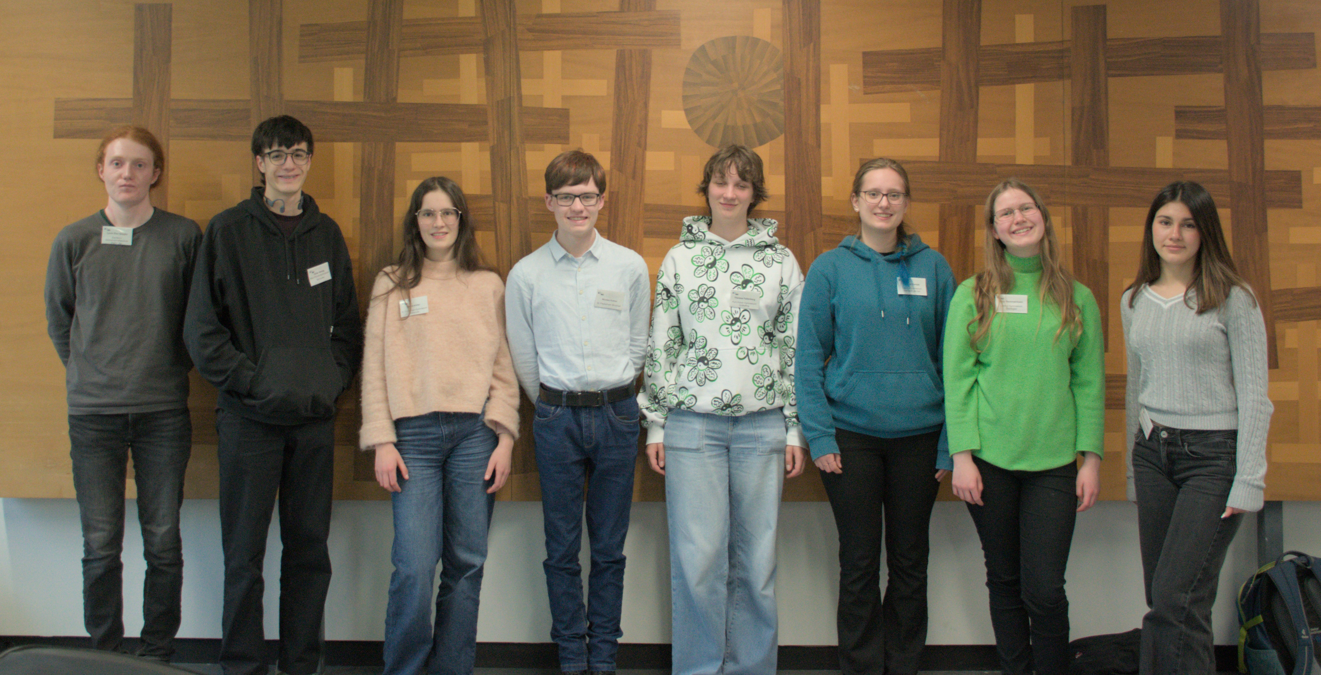

Slide 18
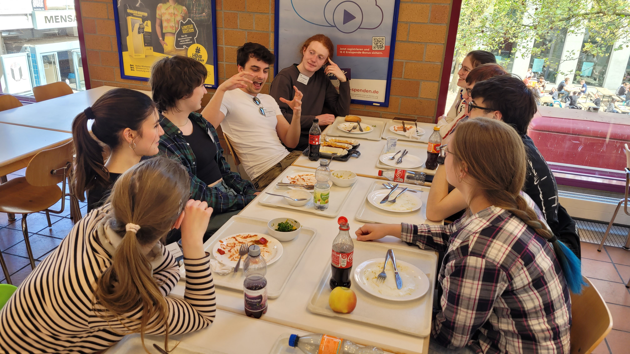
Sandro!!!

Slide 19
Final words
Thanks

Slide 20


Good news: Real Karlsruhe experience

Slide 21
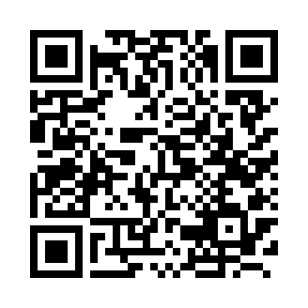
Good news: Real Karlsruhe experience
Bad news: changes in public transportation routes, closures and construction sites…
KVV route planner

Slide 22
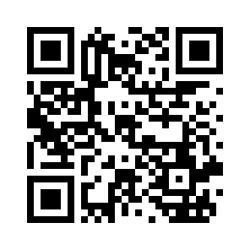
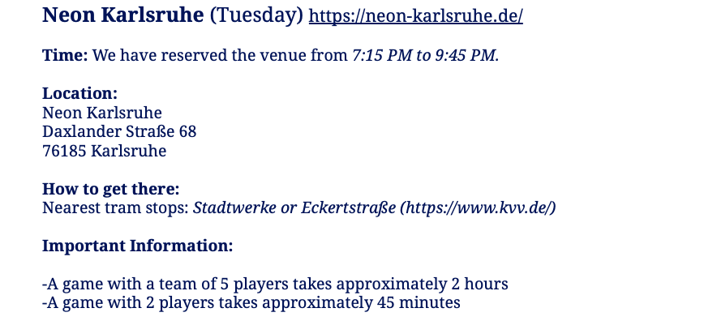

Tuesday
Eckenerstraße
Eckenerstraße
Neon

Slide 23
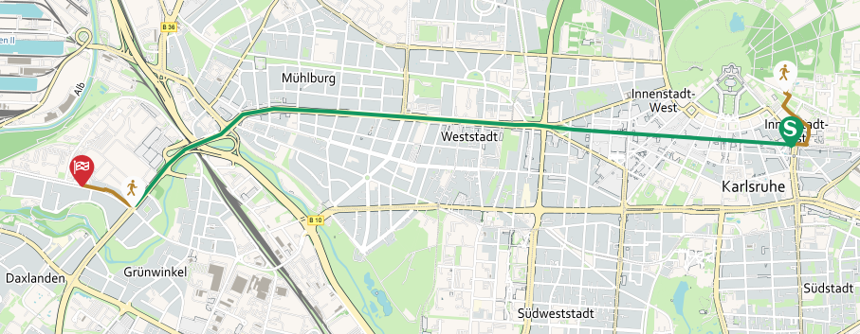
Tuesday
S2 (Rheinstrandsiedlung) | Karlsruhe Kronenplatz | Eckenerstraße
 | 06:48 pm | 07:00 pm
 | 06:58 pm | 07:10 pm
 | … | …
 | 07:48 pm | 08:00 pm
 | 08:00 pm | 08:12 pm
 | 08:20 pm | 08:32 pm
Eckenerstraße
Eckenerstraße
6 min by foot

Slide 24
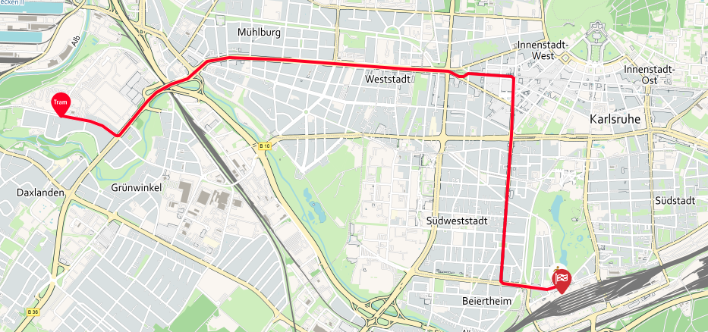
Tuesday
3 (Rintheim über Hbf) | Karlsruhe Stadtwerke | Karlsruhe Hauptbahnhof
 | 08:40 pm | 09:02 pm
 | 09:00 pm | 09:22 pm
 | 09:20 pm | 09:42 pm
 | … | …
 | 00:40 am | 01:02 am
 | 04:10 am | 04:32 am
Eckenerstraße
Eckenerstraße

Slide 25
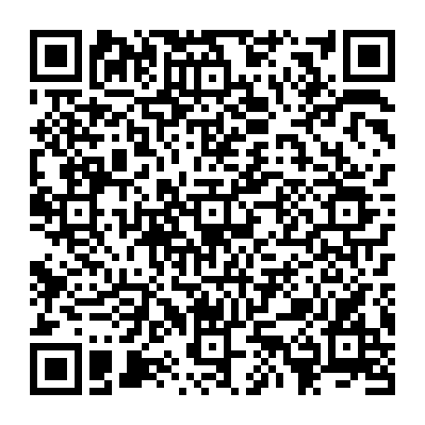
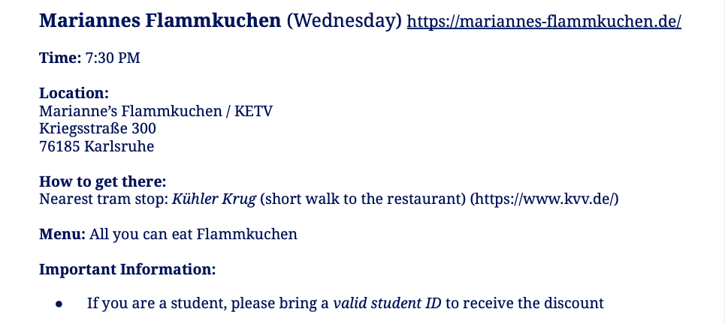

Wednesday
Food till 10:30 pm
MENU

Slide 26
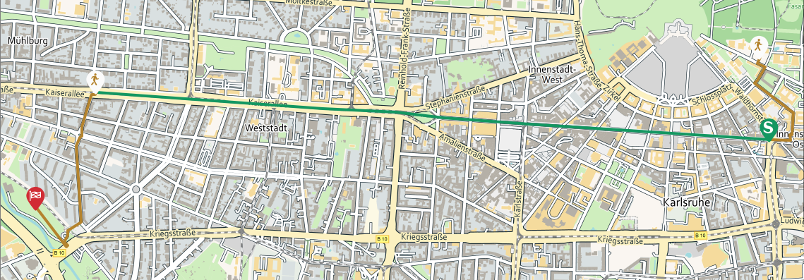
Wednesday
 | Karlsruhe Kronenplatz | Händelstraße
S51 (Germersheim, Bahnhof) | 07:05 pm | 07:13 pm
S2 (Rheinstrandsiedlung) | 07:08 pm | 07:16 pm
S2 (Rheinstetten) | 07:18 pm | 07:26 pm
12 min by foot

