Slide 1
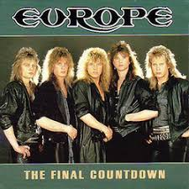


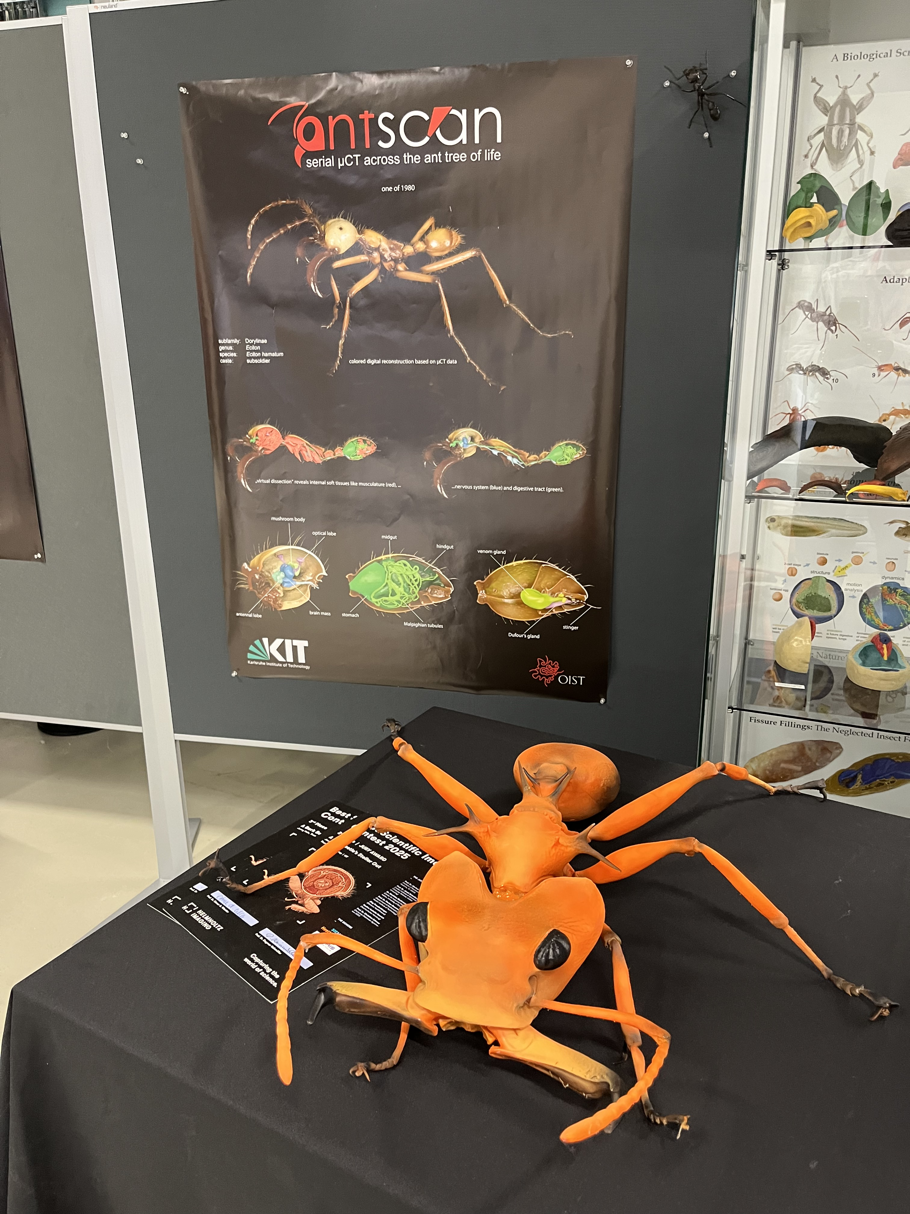
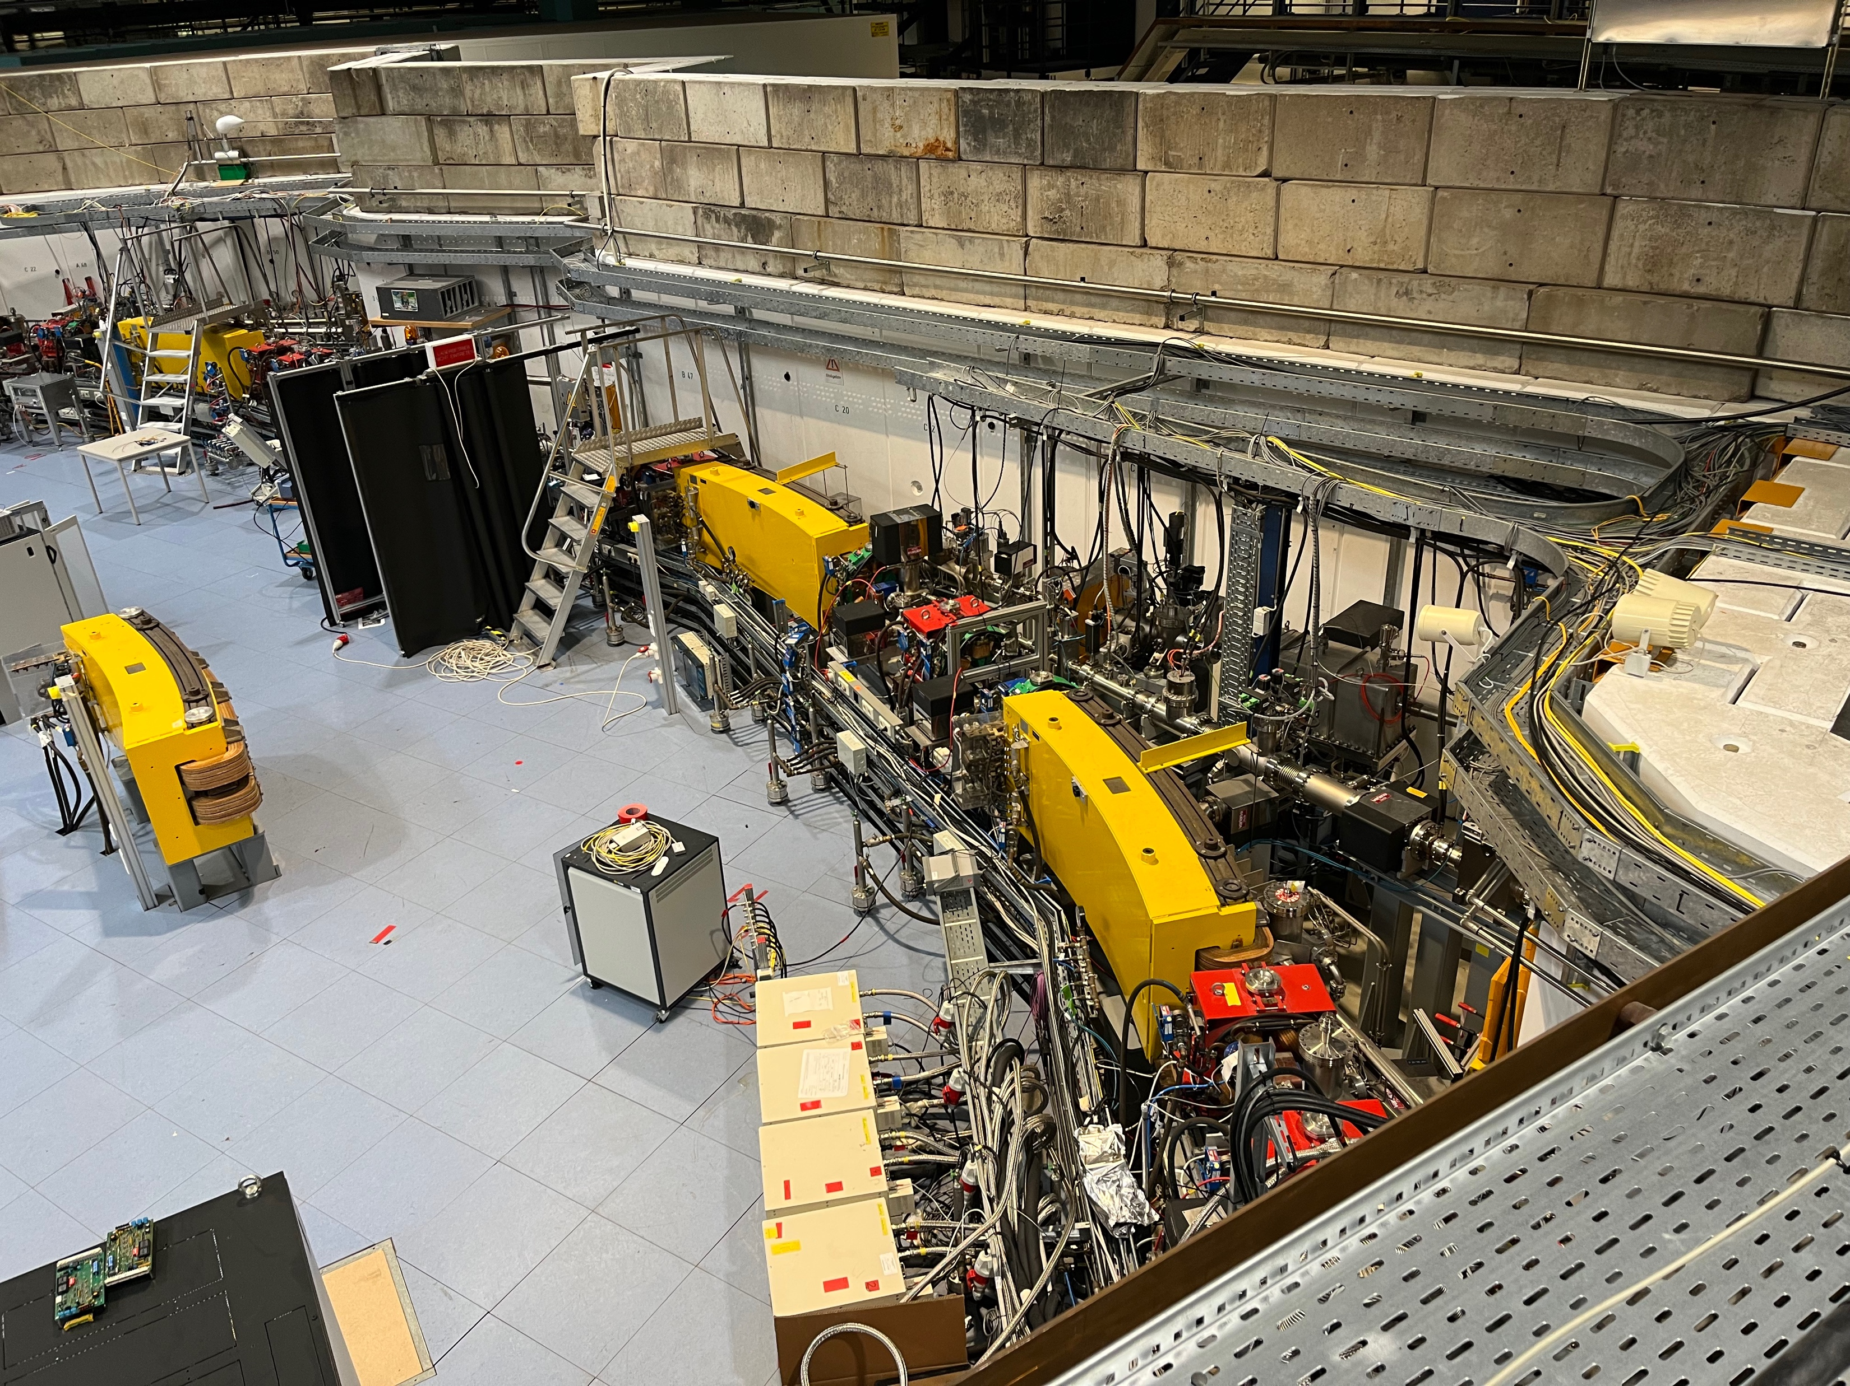
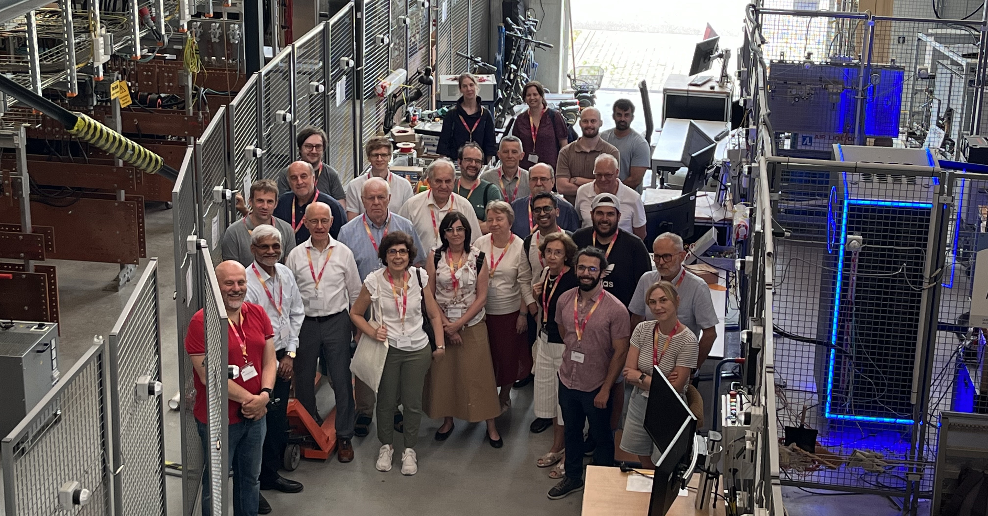
A. Navin on behalf of the EURO-LABS team
Grand Accélérateur National d'Ions Lourds, Caen, France
Welcome

Slide 2

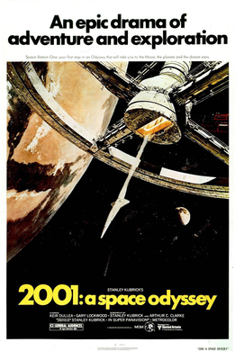
LAST SLIDE
1968 film
scientifically accurate depiction of spaceflight, pioneering special effects, and ambiguous themes
AI + Space travel
EURO-LABS Pioneering for EU 2021
HAL (Heuristically Programmed Algorithmic Computer) is a sentient artificial general intelligence computer that controls the systems of the Discovery One spacecraft and interacts with the ship's astronaut crew.
the potential GRAVE dangers of artificial intelligence when given too much control.
A Simple solution to finally tackle HAL’s control
PULL …

Slide 3
September 2021: Proposal
TODAY
Pioneering proposal in Europe
To bring together three communities engaged
in Nuclear Physics and accelerator/detector technology for High Energy Physics
We are at an evolutionary stage in Europe both in Nuclear and Particle Physics.
The recent advances are thanks to the highly performant accelerators and detection systems constructed in the past decade and are presently in operation.
At the same time there is need to design and construct the next generation of particle accelerators and detectors to make a smooth transition into the future.
Innovations develop new sustainable accelerators and advanced detector technologies capable of reaching the required high performance.
More Focus for FCC (as HL-LHC is too “old”) + ….
It is of paramount importance to simultaneously optimize the use of Research Infrastructures in Europe constructed the acquired expertise in the field and new facilities, to conduct curiosity-driven research to address fundamental questions. Their efficient use will be a key element in this endeavour, that will maximise the investment put in by the EC.
The success of Transnational Access and the large number of results and publications
Continued progress in development of new or refined theoretical approaches is necessary to go hand in hand with experimental efforts to take our understanding to the next frontier.
Theo4Exp ….
The management of big data and the strong coupling between experimental and theoretical frameworks to make substantial progress in unravelling the secrets in nature are the challenges ahead. Open data and data preservation including the training of the next generation, in the years to come to simultaneously open the Research and Technology Infrastructures to other. disciplines, applications and industry.
Availability of new services which can be exploited by all EURO-LABS facilities and beyond
Hands on training
A continuous improvement of the tools and their wide usage is critical for Europe to maintain its leadership in this field.
These improvements require various facilities to test and characterize accelerator and detector components both for proof of principle and for their performances and thus to improve the
selectivity and sensitivity of our scientific efforts.
Detectors reliability
ML for SFRS-FAIR (Facility for Antiproton and Ion Research) + ISOLDE ..
To fostering the sharing of knowledge and technologies across scientific fields.

Slide 4

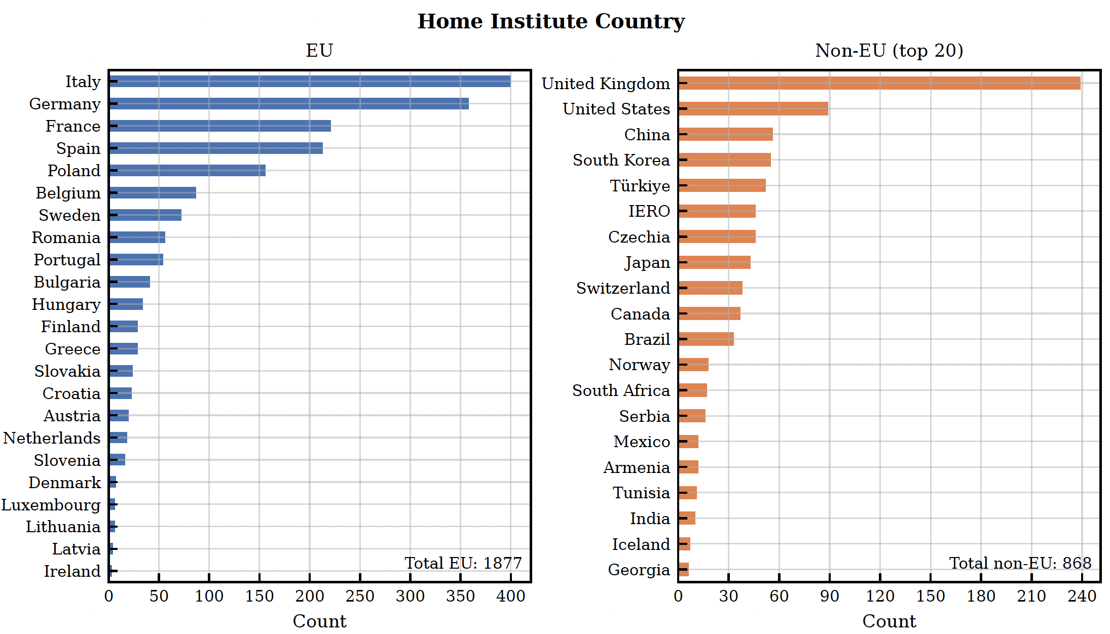
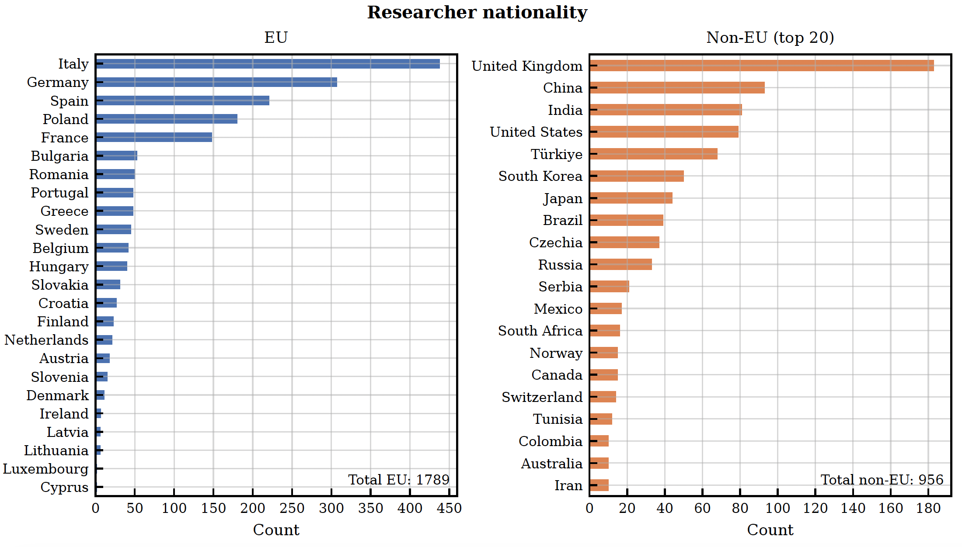
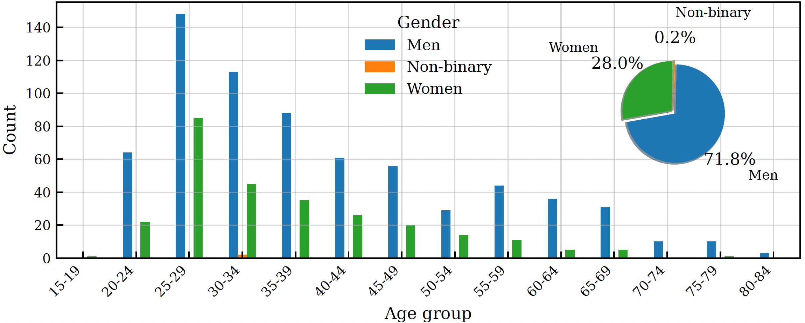
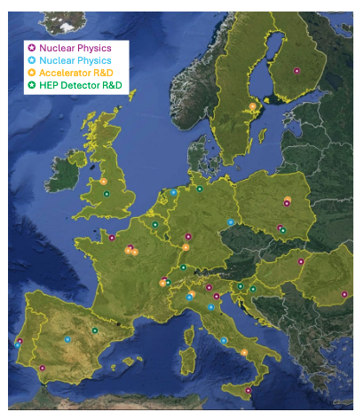
Large
Users/experiments

Slide 5

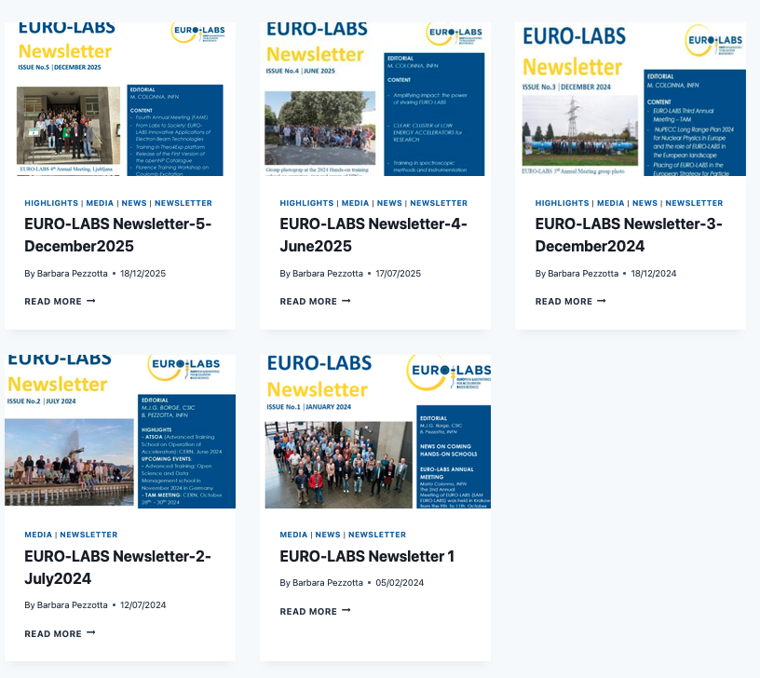

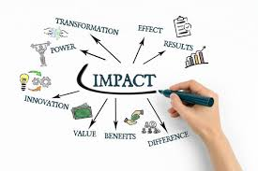
REAL IMPACT MILESTONES and Deliverables
YOUR INPUTS FOR
THE LAST ISSUE
NEWSLETTER

Slide 6


Service (Intellectual, hard and software ) improvements higher impact
Beneficial to more than one lab
Ion sources
New and intense beams
Diagnostics
Targets
Detectors
Training+ Basic and specialized
Remote access
Machine learning
Health FLASH
MOST IMPORTANT OF ALL
Natural intelligence

Slide 7
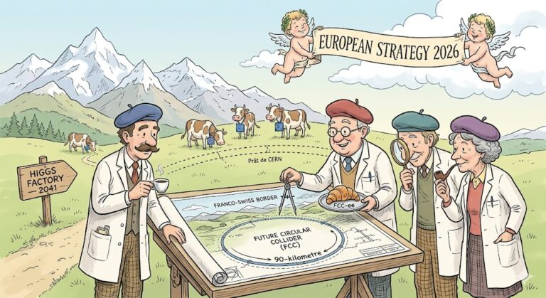
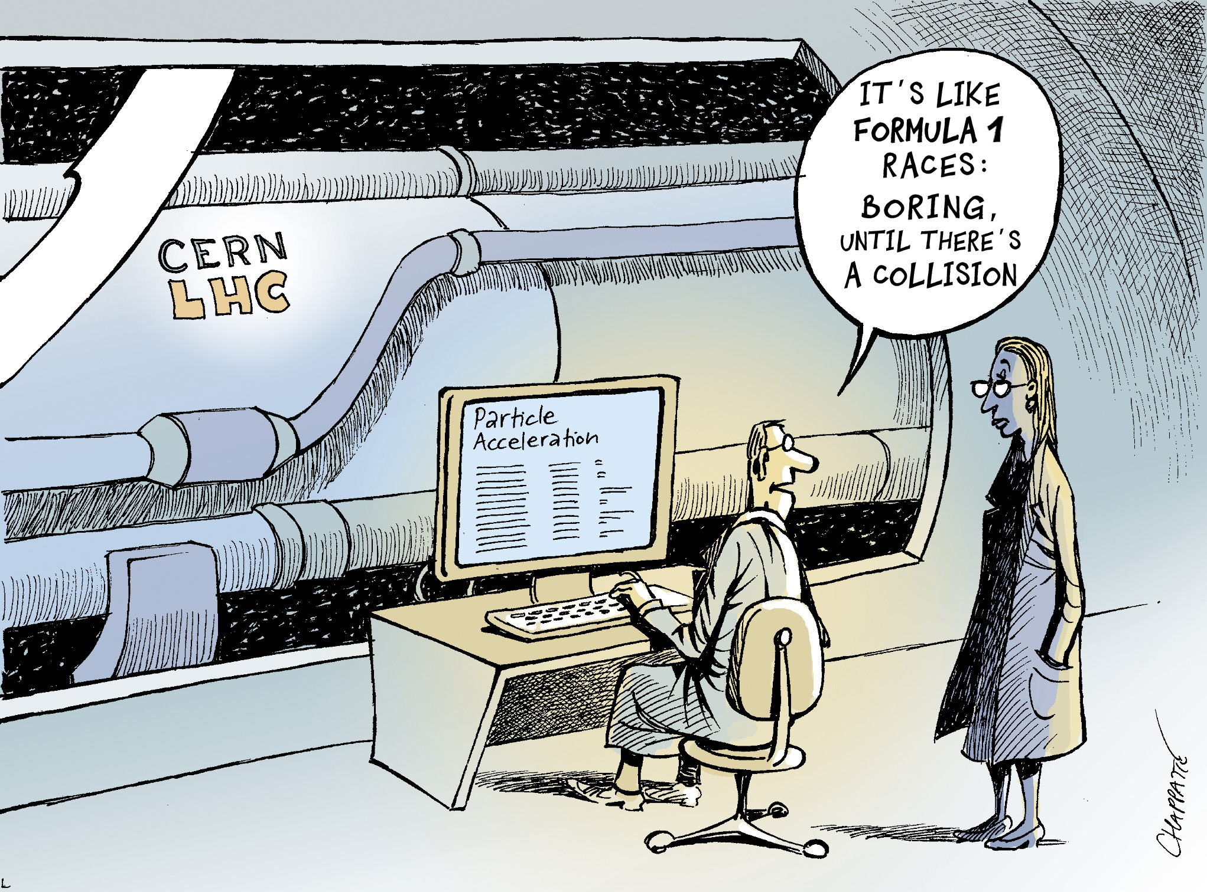
Monolithic active pixel sensor (MAPS) is a type of CMOS active-pixel sensor high radiation environment FCC-hh
Out Host
Resonant depolarization to measure the beam energy at FCC-ee
Measurement of spin pression frequency (related to Lorentz factor)
Effect of beam-induced synchrotron
radiation (SR) PSD for several beam screen and vacuum chamber prototypes.
reduce the cryogenic power consumption and to guarantee vacuum stability,
FCC-hh

Slide 8
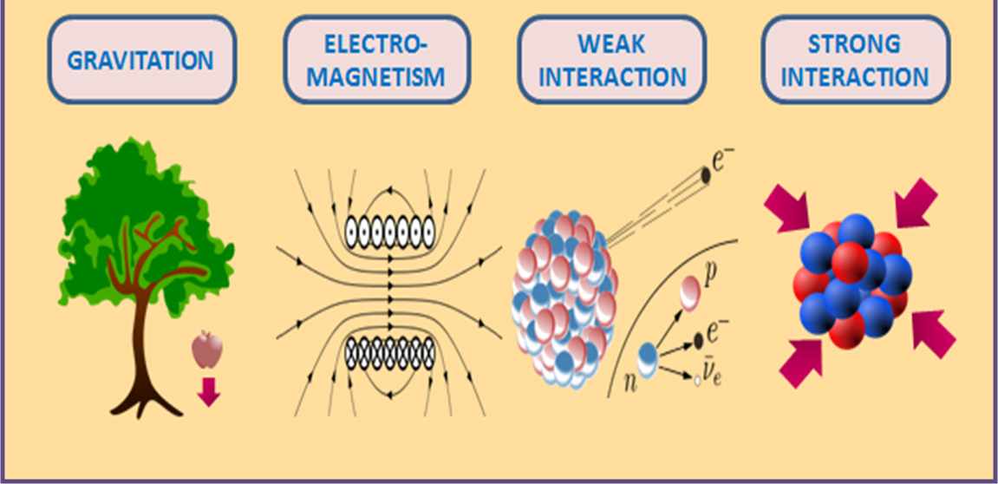
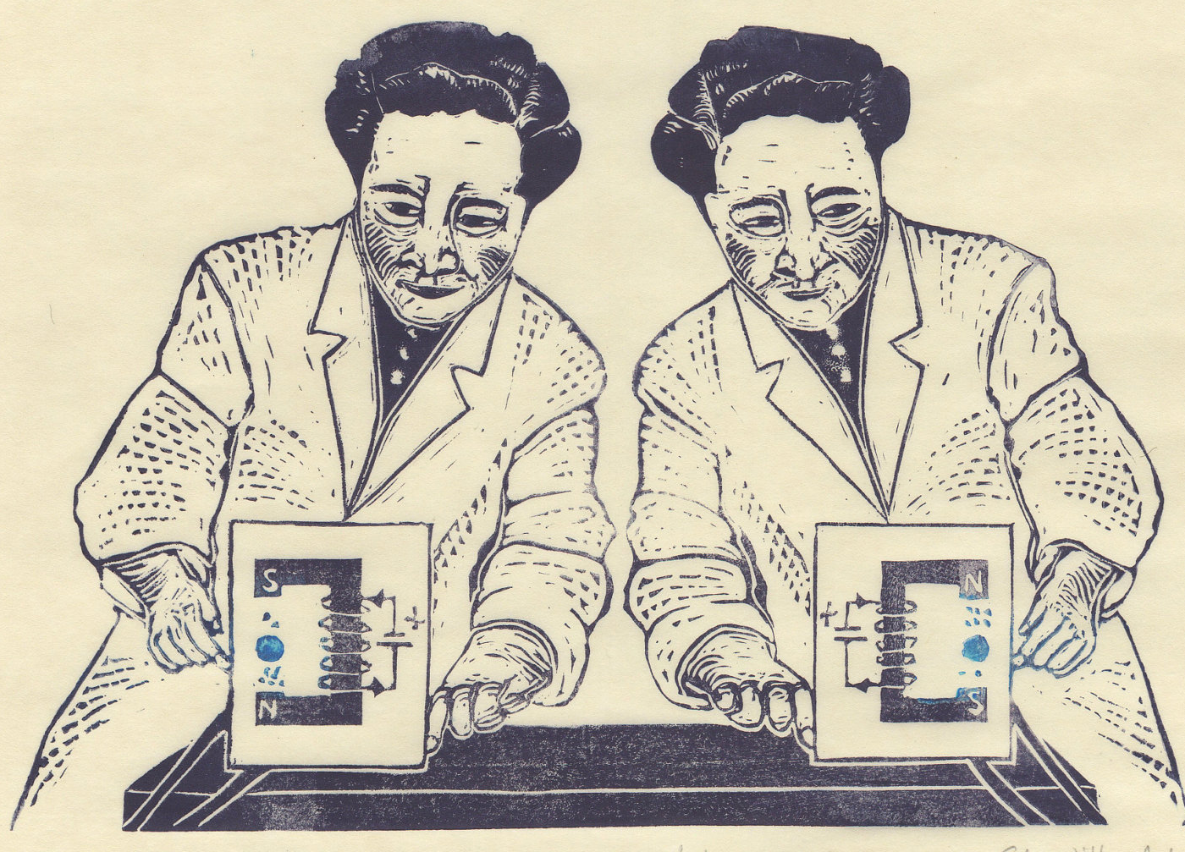
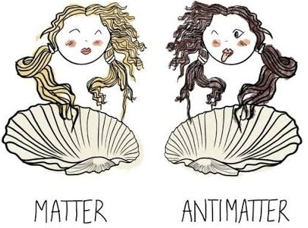
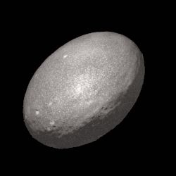
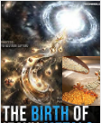
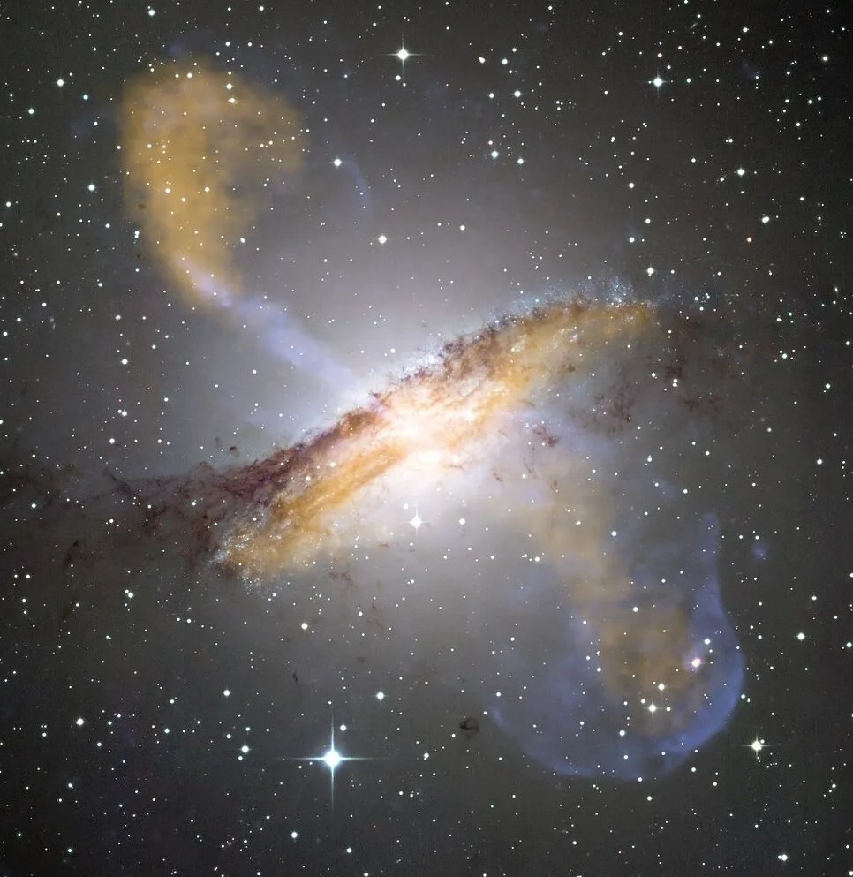
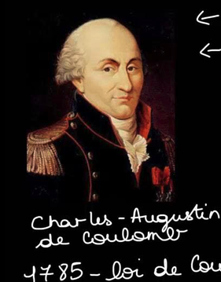

Weak interactions
Strong interactions
Optimizing the transnational access in EURO-LABS in WP2 measure the temperature and isospin dependence of the oscillations of the neutron skin to obtain also information on the equation of state in neutron star mergers and to understand the isotope abundance the universe.
Search for New Physics
Direct constraints on CP-violating Wilson coefficients in the nucleon-level EFT
The MORA setup traps and polarizes radioactive ions, then measures the geometry of their beta decay with extreme precision to search for tiny symmetry violations that could help explain why matter exists in the Universe. 10⁻⁴
^{GANIL@JYL}
i/p’s Theo4EXP
Uses AGATA
Gravitiy
Bringing black hole jets down to Earth
Relativistic electron-positron (e±) pair PLASMAS
HIRADMAT
To look and charecterize multiple shapes
Using
shape the dynamics and energy budget of the black hole and its environment
Study it in the lab at HIRADmAT

Slide 9
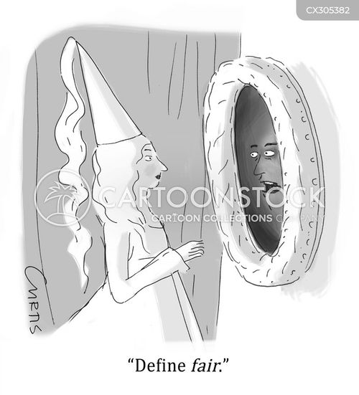
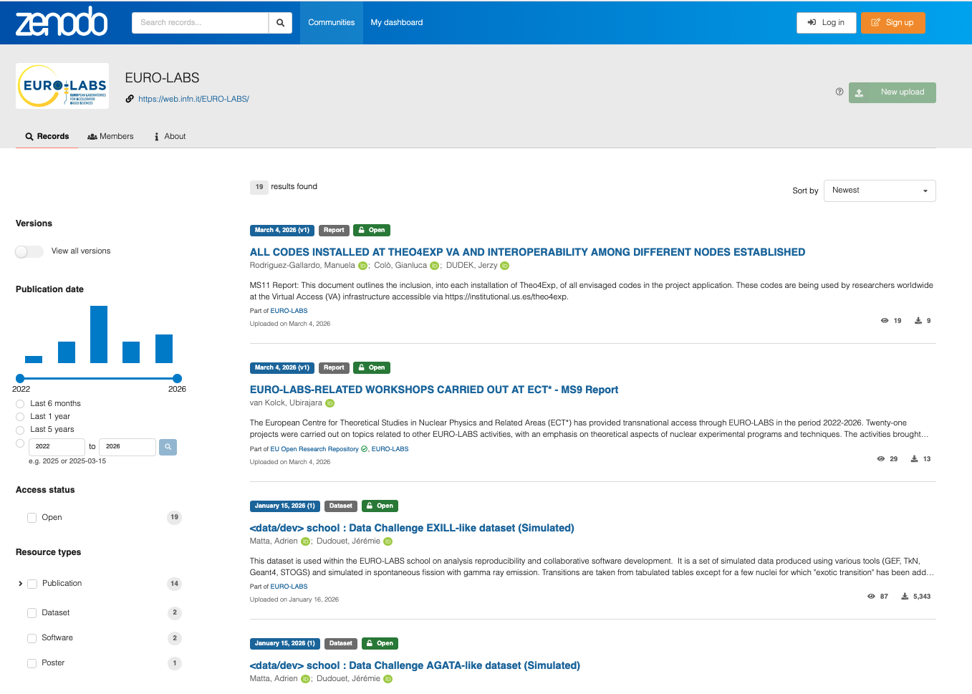
IMPORTANT TO EU and US
Gain due to being part of the “big” subatomic cross fertility
Great progress in Nuclear Physics in Open Science
Availability of new services which can be exploited by all EURO-LABS facilities and beyond
Beyond promised services EURO-LABS cultivated the concept / training
Made this subject important and put especially into young researchers the importance of Open Science and provided skills
2 schools attended
EURO-LABS zenodo repository
Reports, deliverable Software, data-sets …

Slide 10

Training / Education
Training often concentrates on developing specialized abilities essential for particular tasks.
Educational programs provide comprehensive insight aimed at developing a deeper understanding of a field.

Slide 11






Slide 12
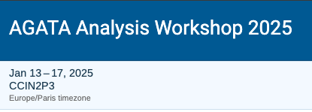
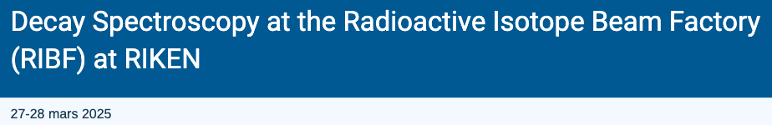
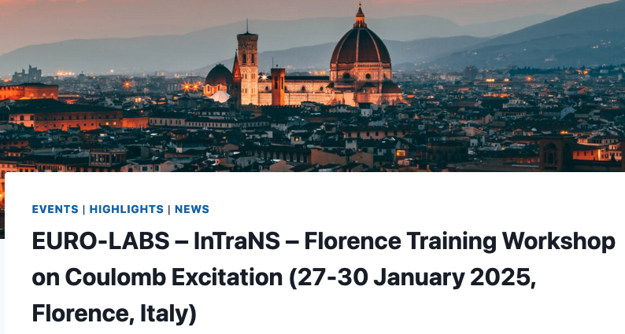

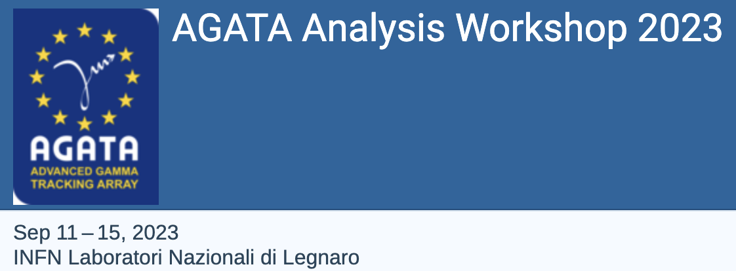
Instrumentation and Training for Nuclear Spectroscopy
and Reaction Dynamics

Slide 13
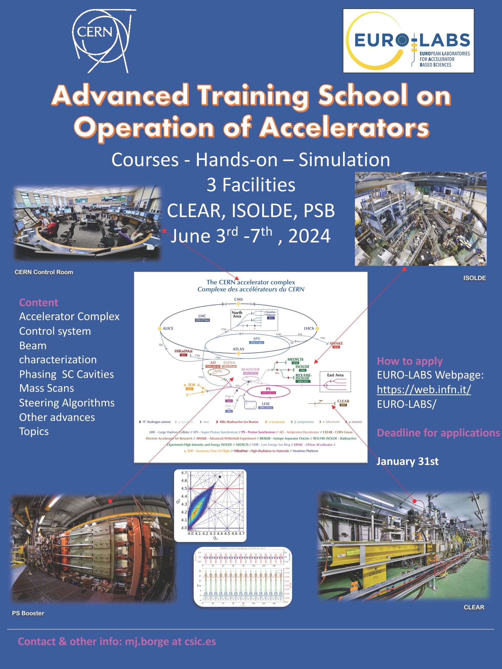
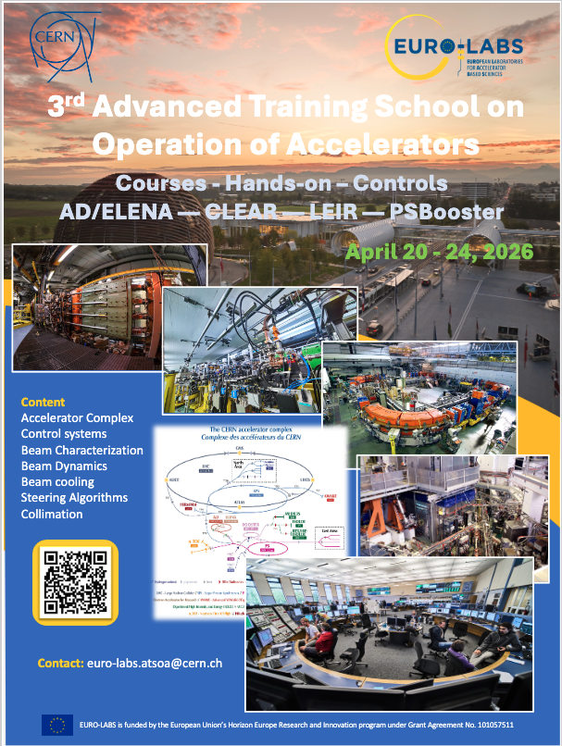
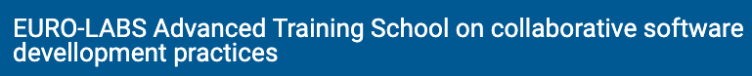


Slide 14
Financial Allocation
Effect of BREXIT
14.5-0.32
14.17k€+0.32
Project | [kEuros] | 14,500.00
Access Activities |  | 9,900.00 | 68%
Service Improvement |  | 2,600.00 | 18%
Open Diverse and Inclusive Science |  | 1,300.00 | 9%
Management |  | 700.00 | 5%
* No loss of money
Budget |  | Access |  | Service Improvement
Nuclear Physics RI Facilities (WP2) | kEuros | 5,000.00 |  | 1,200
HEP Facilities RI Facilities |  | 4,900.00 |  | 1,400
Accelerators (WP3) |  | 2,450.00 |  | 700
Detectors (WP4) |  | 2,450.00 |  | 700

Slide 15
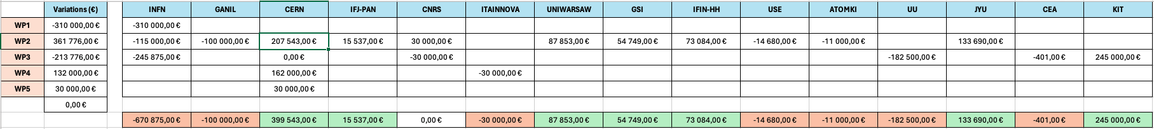
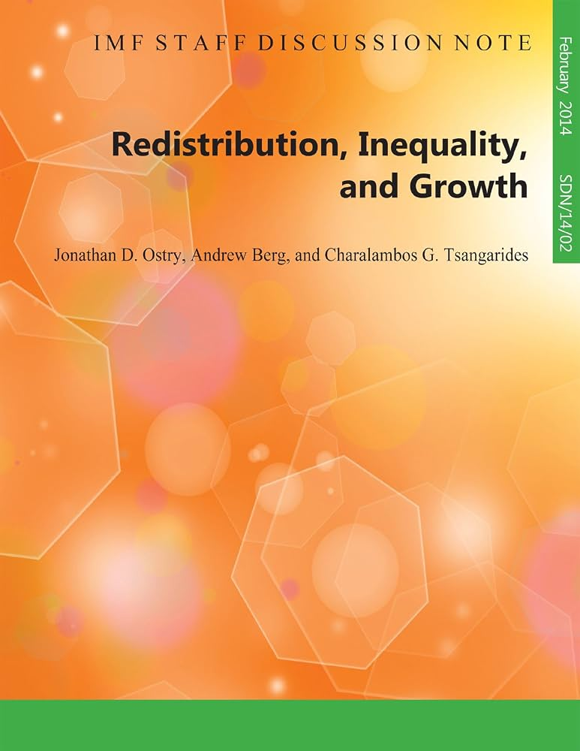
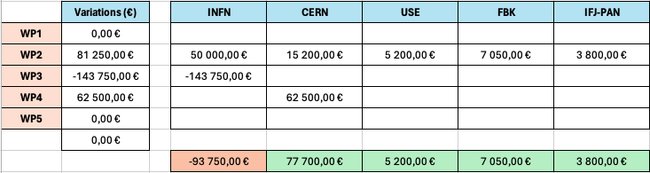
Financial Amendment: Optimum Utilization of funds by us
Additional ammendment

Slide 16

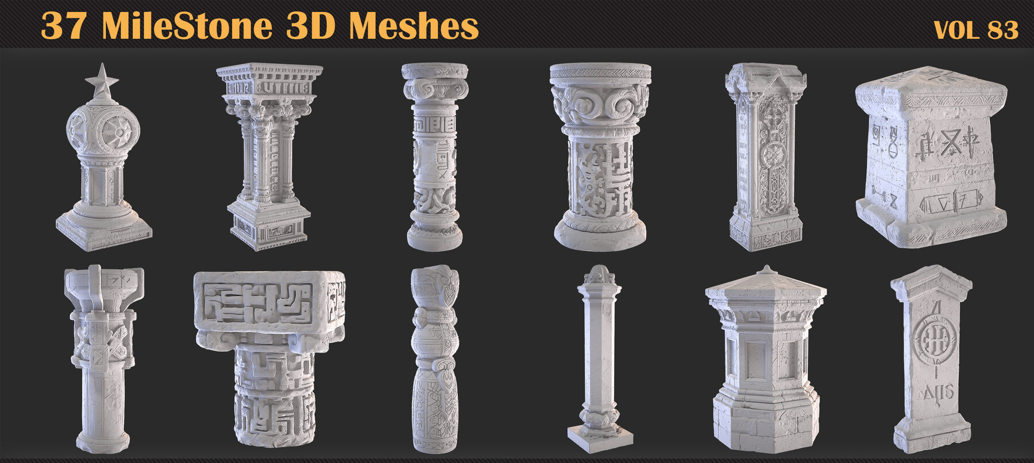
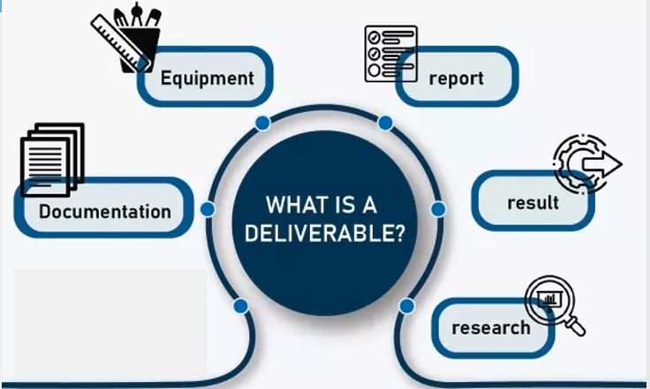

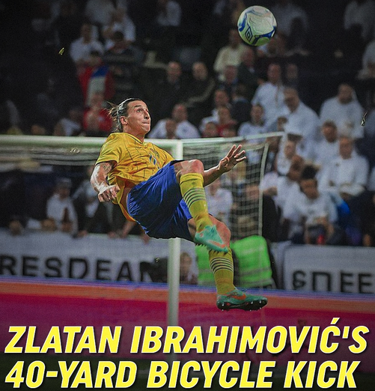
Real work behind these
Resting of
33
10 milestones/deliverables are to be delivered by tomorrow !!
EU reads this very carefully

Slide 17

The first “mixed” EU call EURO - LABS
Based on our pioneering success EU has gone for bigger stakes

Slide 18
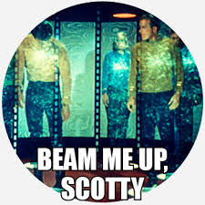
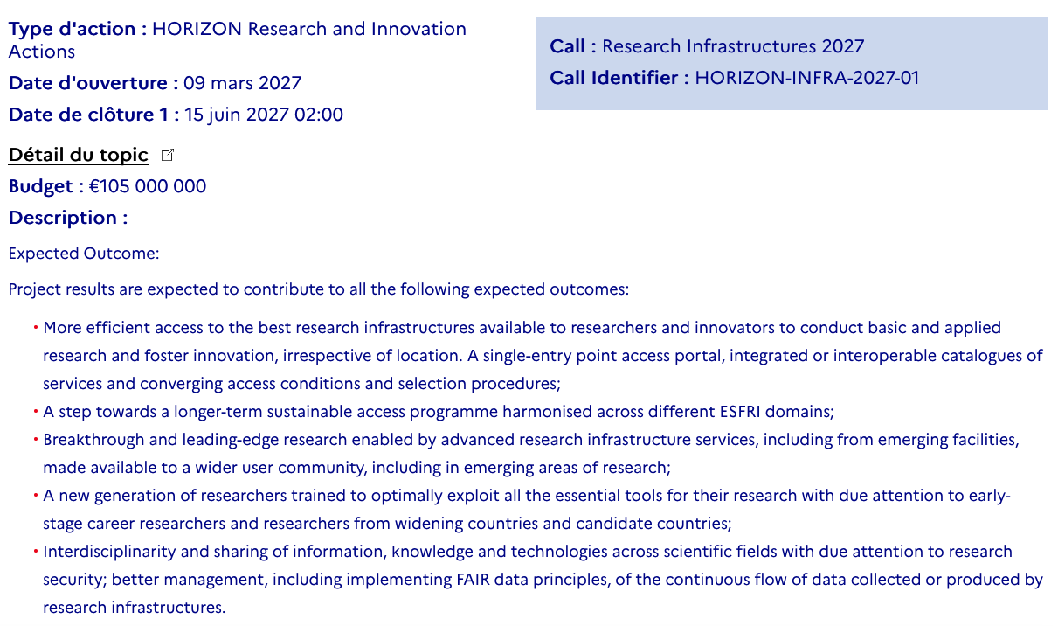

Slide 19
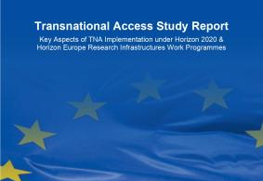

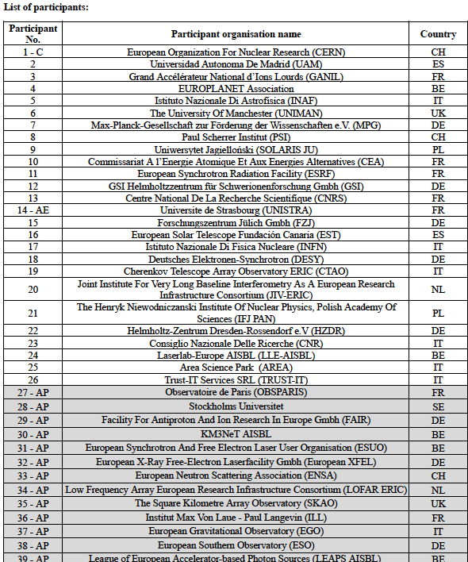
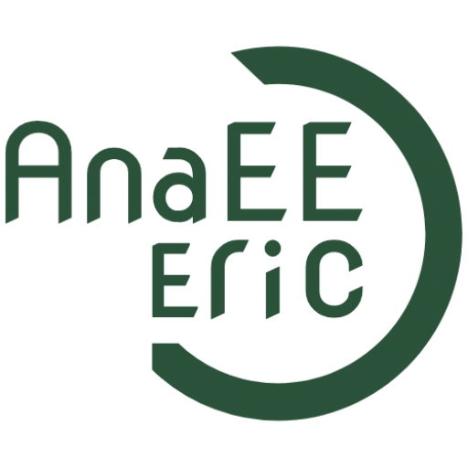











Pilots
HORIZON-INFRA-2025-01-DEV-05
(Preparatory actions exploring future frameworks for
RI’s investment plans and funding streams, for integrated and sustained scheme for access and for joint technology development)
HORIZON-INFRA-2026-DEV-01-02
Physical Sciences & Engineering
Networked Thematic
Research Infrastructure Cluster
Submitted June 15
RequestING 30 months 8 M€
StartED June 1st 2026
Duration: 20 months | Budget: €1.3M

Slide 20






ACCESS2ACCESS
Goal: To design and prepare the foundation for a sustainable, integrated, and user-centric EU-wide access framework for all Research Infrastructures.
O1. Build Evidence Base: Map and analyse current access models and identify gaps.
O2. Stakeholder Engagement: Capture needs from RI managers, users, funders, and policymakers.
Full coverage of scientific
domains
Strong scientific, policy and technical expertise
17 partners and 20+ supporting partners representing ERICs, ESFRI-RIs, industry, RTOs, user communities for consultation, validation, and dissemination support
Duration: 20 months | Budget: €1.3M
O3. Co-Design Governance & Funding: Develop scenarios for sustainable governance and co-funding models.
O4. AI-Assisted Access Concept: Design a mock-up for an AI-powered "one-stop-shop" portal.
O5. Equity & Sustainability: Ensure inclusive, efficient, and sustainable access to RIs.
Access2Access
Courtesy Amanda Olander. Analysis and Experimentation on Ecosystems-ERCI

Slide 21
HORIZON-INFRA-2026-DEV-01-02
Consolidation of the research infrastructure landscape – pilots for strategic coordination, synergies and simplified access pathways, by large thematic clusters of pan-European research infrastructures (8 MEur).
This call aims at equipping large thematic clusters of research infrastructures of European interest with a policy arm combined with a technical arm, to increase awareness, findability and accessibility, better matching user needs.
Building on the clusters under Horizon 2020 and Horizon Europe (such as ESCAPE for Astrophysics, Particle and Nuclear Physics).
Thematic clustering aligned with ESFRI domains they address: 1. Data, Computing and Digital Research Infrastructures; 2. Energy; 3. Environment; 4. Health & Food; 5. Physical Sciences and Engineering (PSE); 6. Social Sciences & Humanities.
PSENTRIC (Physical Sciences & Engineering Networked Thematic Research Infrastructure Cluster) submitted
for the PSE domain.
PSE is defined as a thematic area that covers three sub-domains: Astronomy, Astrophysics and Space Science (AAS), Analytical Physical Sciences (APS) and Particle and Nuclear Physics (PNU). Collectively, the PSE domain covers hundreds of facilities and upwards of 100,000 users.
Giovanni Lamanna (CERN) and Giorgio Rossi (CNR) coordinators.
G. LAMANNA. CNRS/CERN

Slide 22
PSENTRIC Three key objectives
(A) Establish a coherent identity of the PSE domain through the development of policy and technical arms that strengthen coordination, complementarity, strategic alignment, and collaboration amongst PSE Research Infrastructures and support European competitiveness in Research and Innovation (R&I).
(B) Design the foundations of a federated, interoperable and user‑oriented European portfolio of PSE RI services (Knowledge Platform), with a common front page and thematic entry points to the PSE RI services, that improves visibility, findability and access, aligns with Open Science and FAIR practices, and integrates with the evolving EOSC ecosystem.
(C) Demonstrate how a federated PSE domain can stimulate the uptake of RI services by users, improve inter‑ and trans‑domain access, strengthen interoperability (data, software and workflows) and showcase high‑impact services for curiosity driven fundamental research and for mission- or application-oriented innovation.
G. LAMANNA 23 june 2026

Slide 23

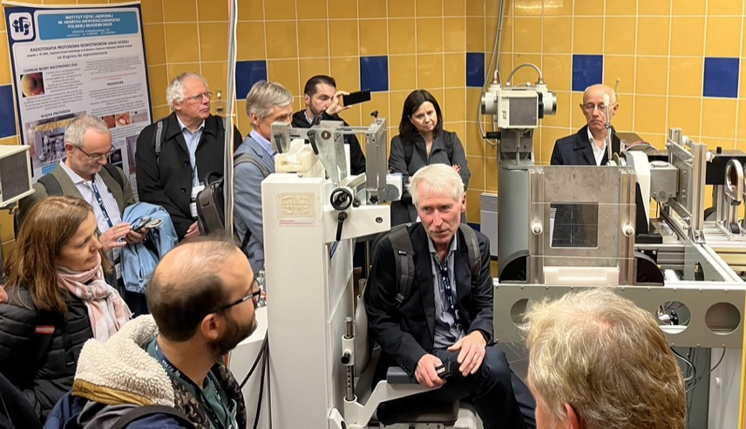
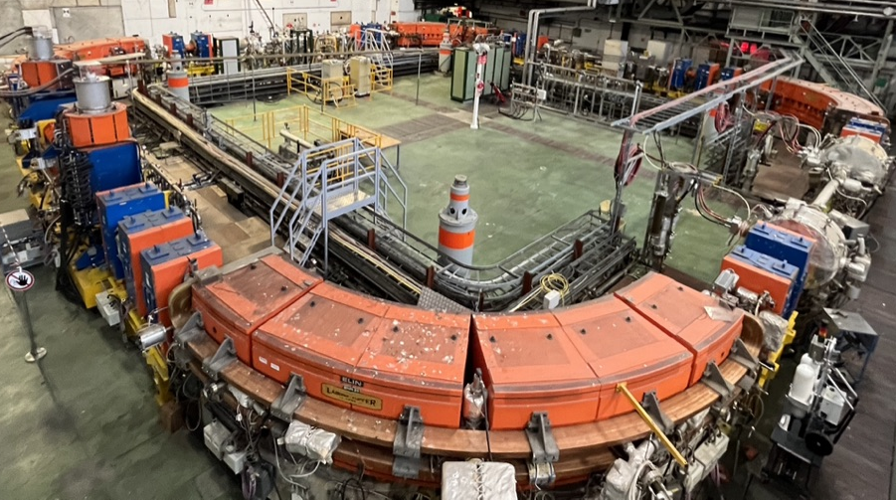
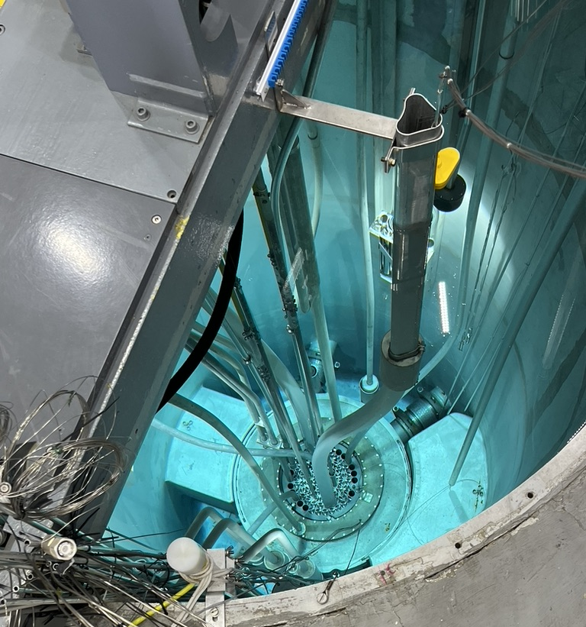
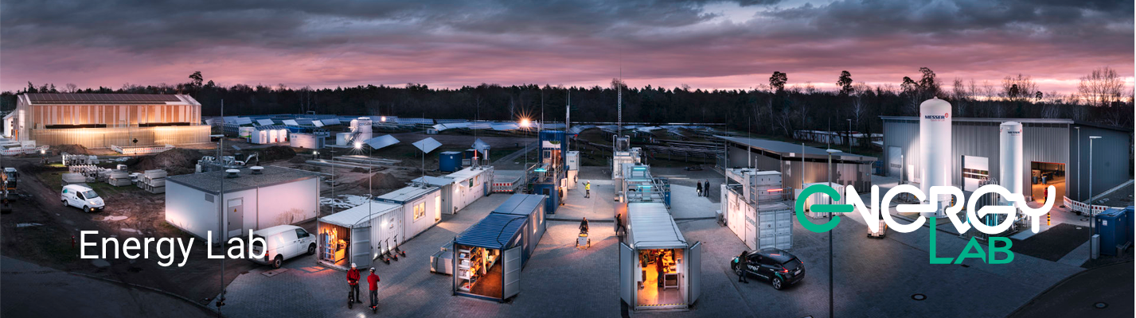
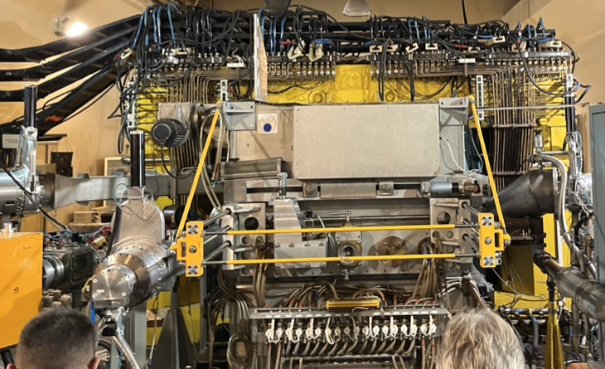
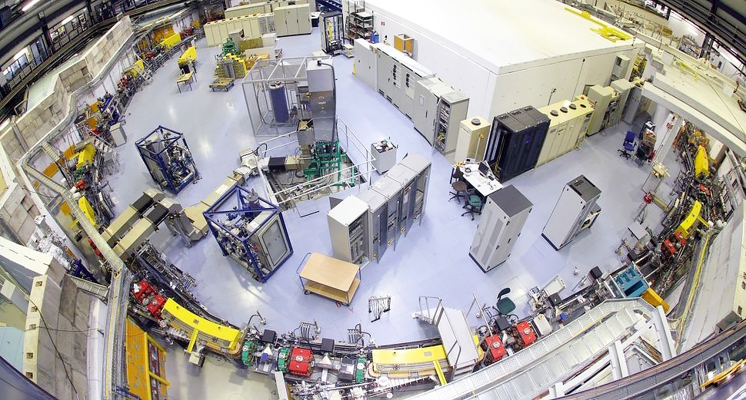
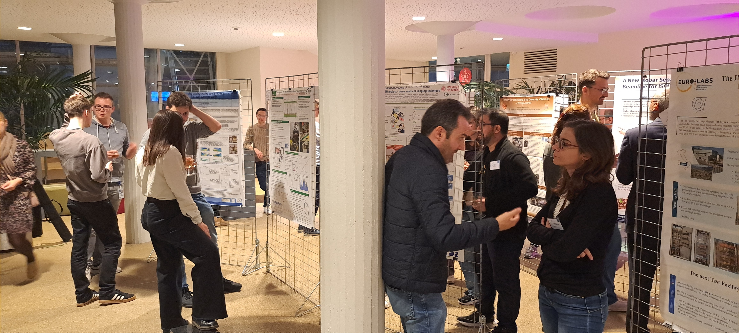
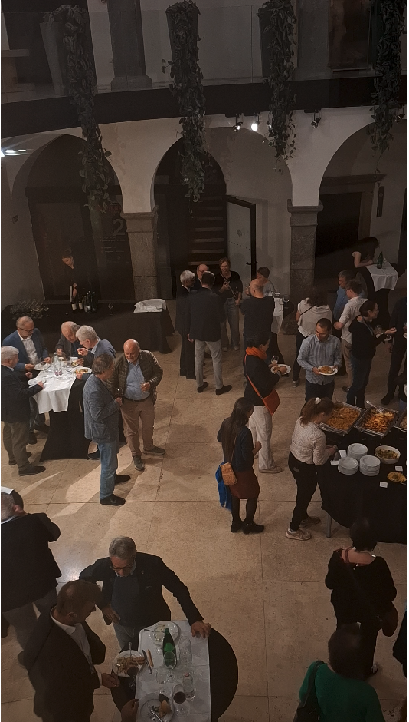
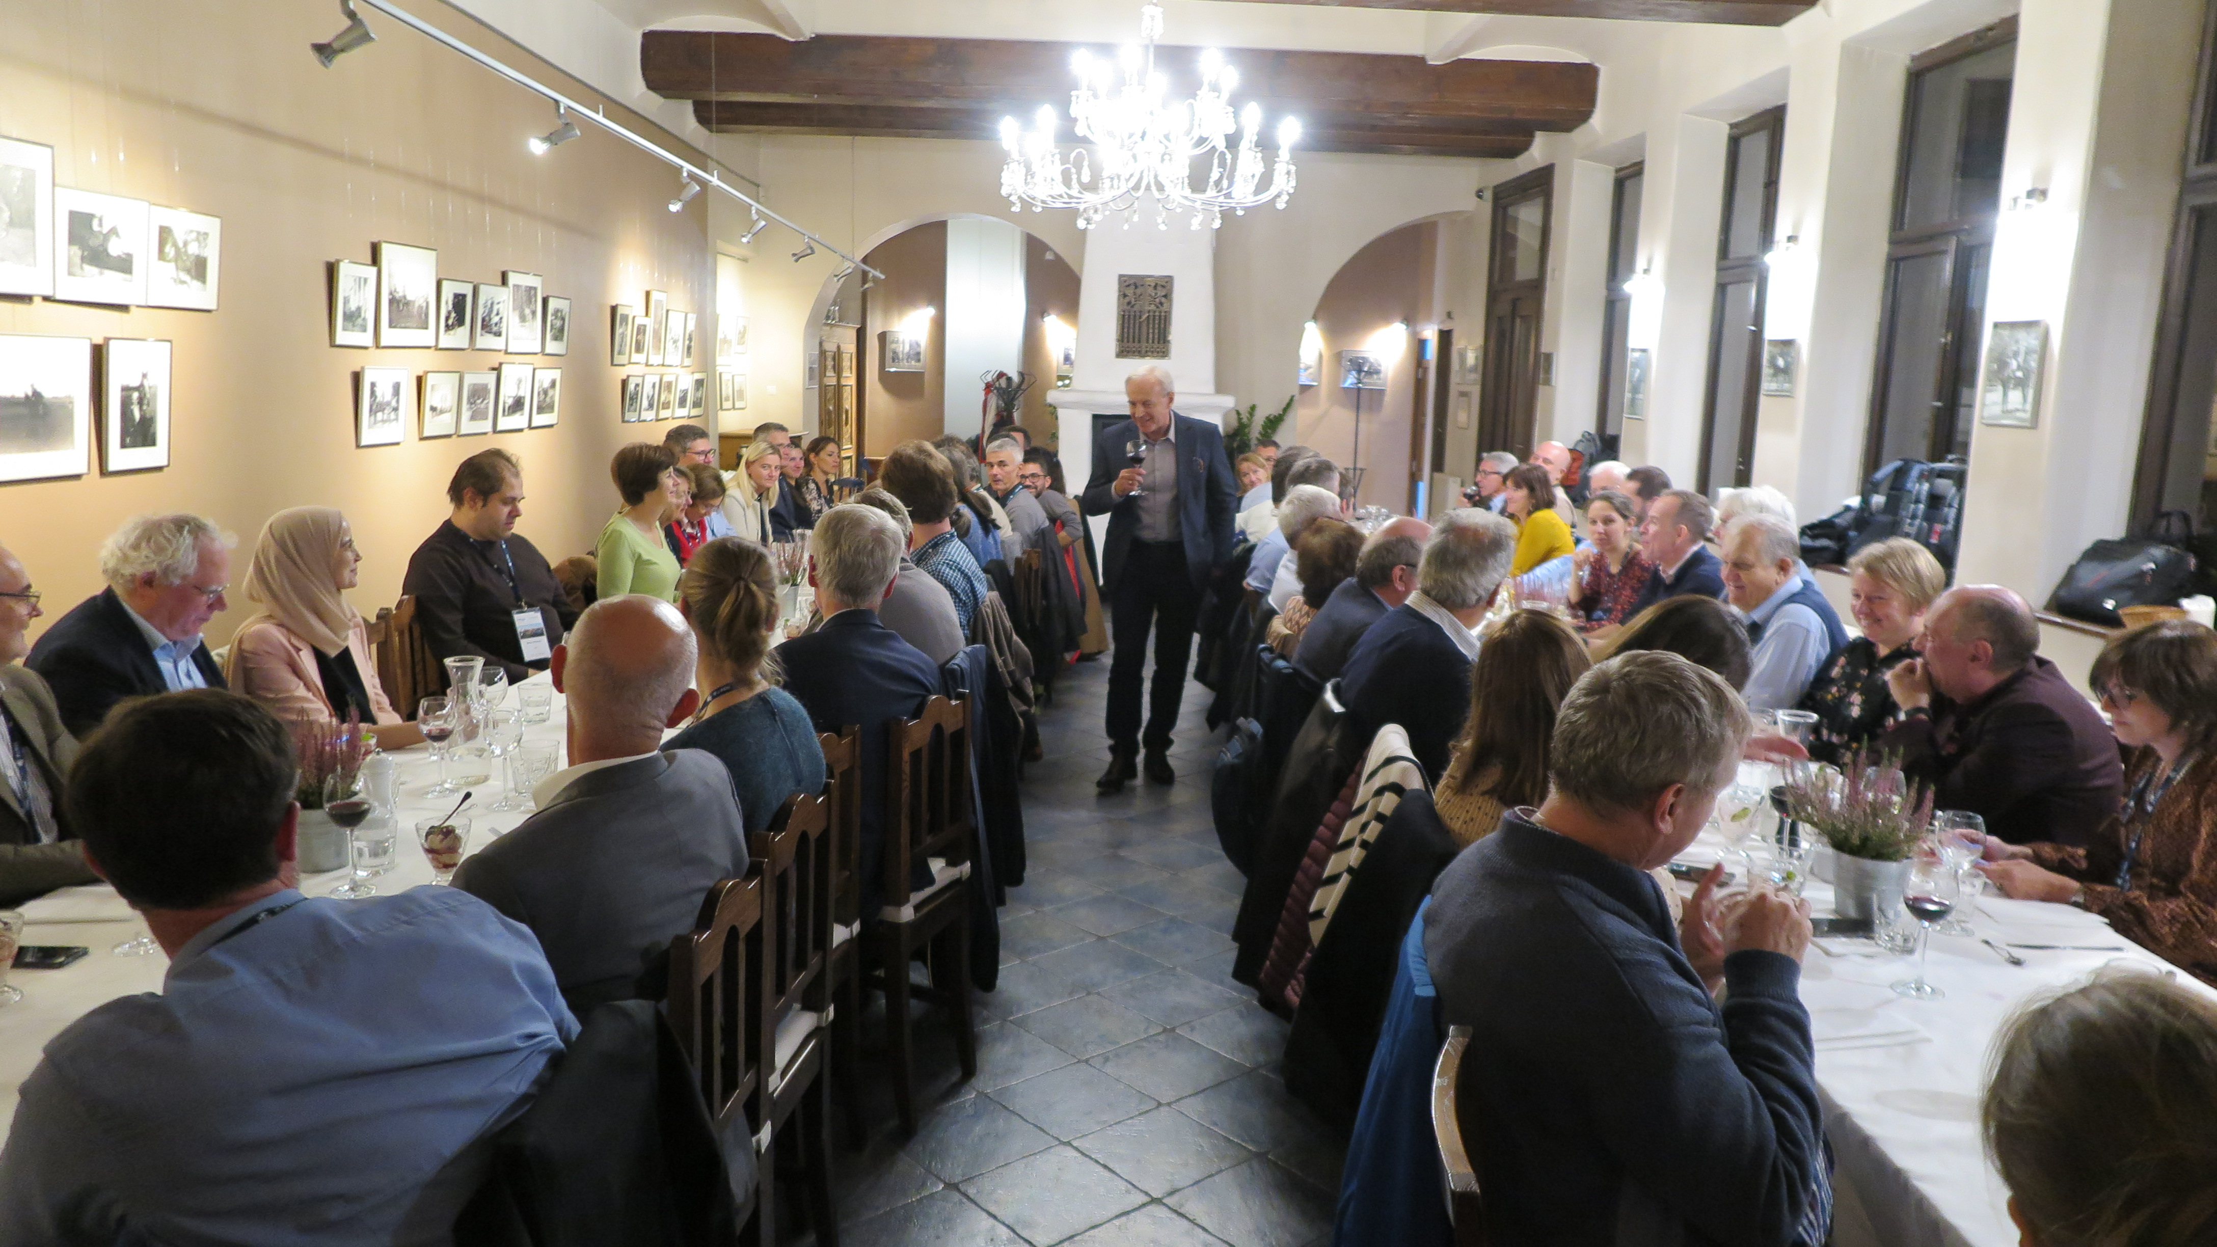
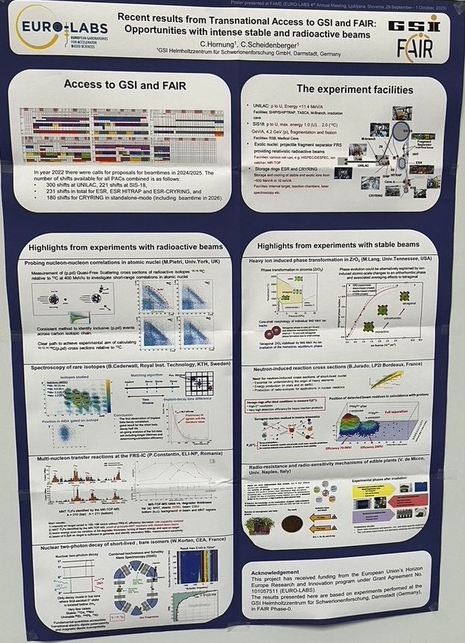

Site-seeing

Slide 24










Sightseeing

Slide 25










Slide 26




Bringing Life to Science and Science to Life
In the rest of FINE you will see how fine we have been
OURS 31/08
WC FINAL 19/07

