Slide 1
WP2 Task 2.3
TA to Research Infrastructures delivering Neutron Beams
alberto.mengoni@cern.ch

Slide 2


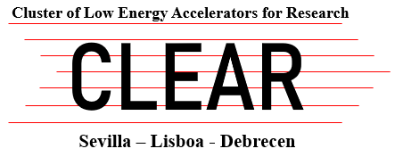


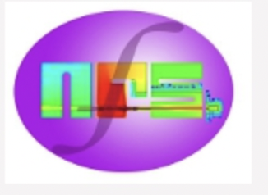


WP2 - Task 2.3: TA to Research Infrastructures delivering Neutron Beams. This task brings together state-of-the-art European laboratories in which neutron beams are produced by a wide range of generators, such as high-energy proton synchrotrons as well as by small Van de Graaff accelerators, in an extremely wide range of neutron kinetic energies (from sub-meV up to GeV), for measurements of high-resolution neutron-induced reactions. Neutron beams are especially required, among others, for the investigations of processes taking place in astrophysical scenarios and for applications in advanced nuclear technology developments (nuclear fusion and emerging fields of medicine).
Task co-ordinator: CERN/n_TOF
Partners: GANIL/NFS, IJCLab/ALTO-LICORNE, INFN/LNL-LNS, CLEAR (Seville)

Slide 3
TA objectives [keywords]
Nuclear astrophysics (nucleosynthesis of the heavy elements, s-process), advanced nuclear technologies (nuclear data for accelerator driven systems, safety of nuclear facilities), basic nuclear science (neutron induced nuclear reaction process, neutron-nucleus interactions, nuclear reaction dynamics)
Fundamental research and applications in fields related to nuclear medicine and radiation damage studies.
Neutron capture cross section measurements on stable and radioactive nuclei, neutron induced fission, (n,xn) and (n,lcp) reaction studies.
The complementarity of the neutron beam characteristics at the different facilities allow for establishing a wide range of interests and objectives. A few keywords for the expected projects’ activities are:

Slide 4

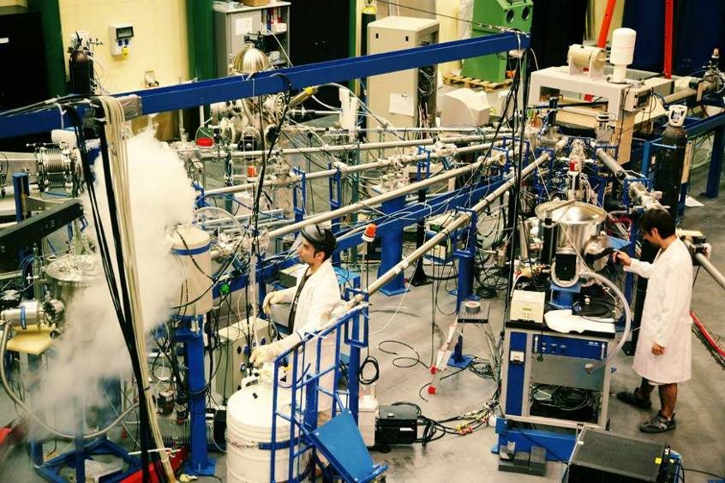
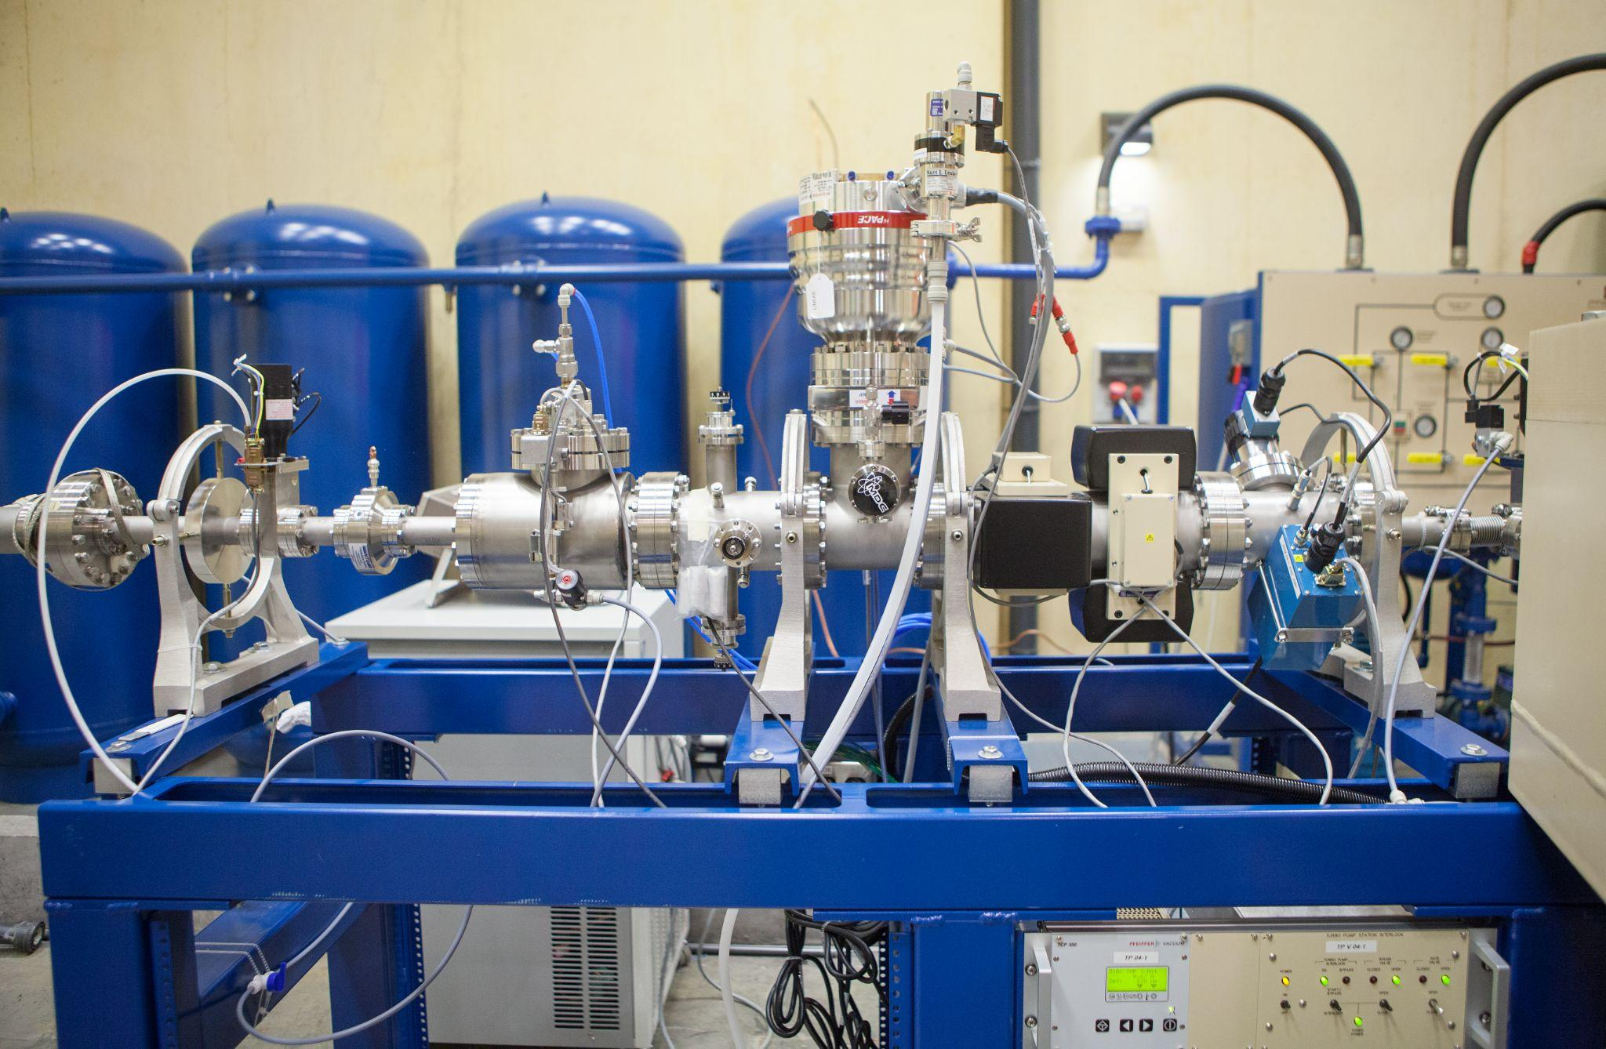
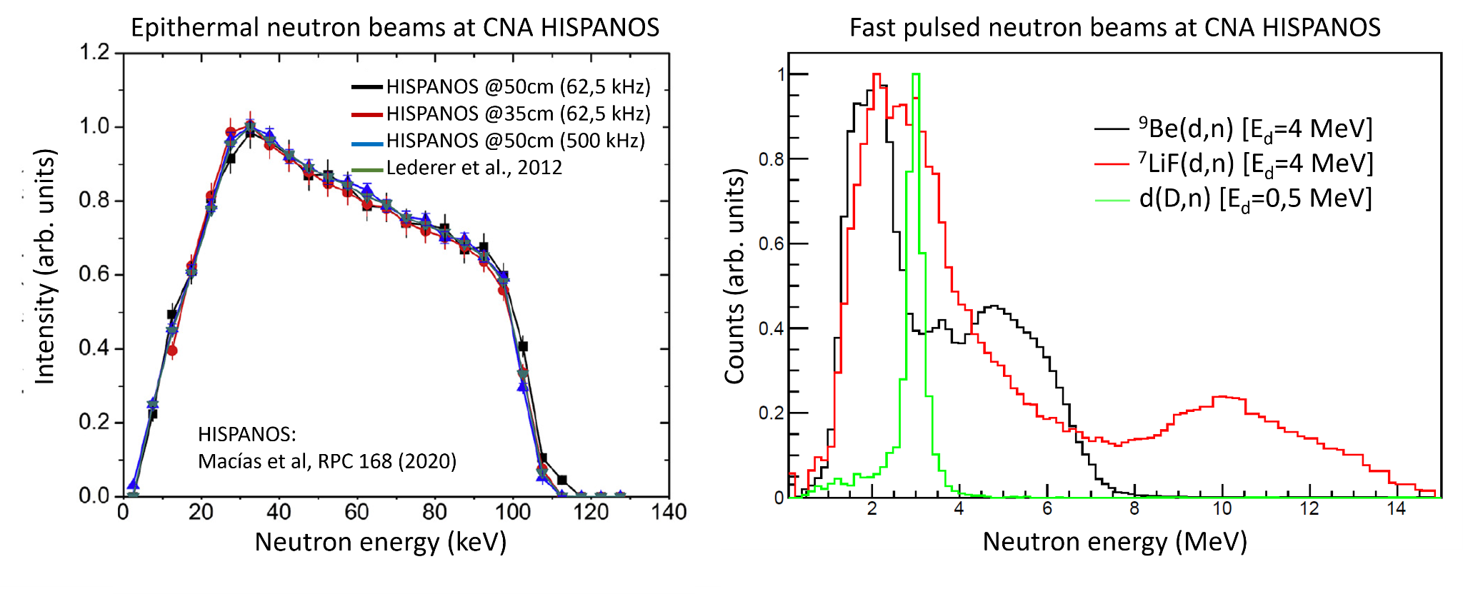
Accelerators
3 MV Tandem, 9/18 MeV Cyclotron
Neutron beams @CNA/HISPANOS
Pulsed (TOF) and continuous
From thermal to fast neutrons (E_{n} < 15 MeV)
d(D,n), ⁷Li(p/d,n), and ⁹Be(p/d,n)
3MV Tandem with 8 lines
neutron beam line
EURO-LABS Access provided
https://institucional.us.es/clear/
Contacts
Joaquín Gómez Camacho (gomez@us.es)
Carlos Guerrero (cguerrero4@us.es)
Notes:
Centro mixto U.Sevilla-J.Andalucia-CSIC
Instalaciones principales: 4 aceleradores, 1 irradiador, 1 Tomógrafo PET-CT.
ICTS: Instalación orientada a usuarios. Más de 100 solicitudes de uso al año. Comité científico regula el acceso al centro.
Personal: 48 trabajadores.
19 fijos. 20 temporales. 9 en formación.
13 doctores de plantilla (12 US, 1 CSIC),
10 doctores contratados (2 R&C, 8 postdocs).
Financiación externa por empresas: SAS, IBA, ALTER, ENRESA …además de proyectos autonómicos, nacionales y europeos, y facturación por el uso de las instalaciones.
4

Slide 5
Neutron spectroscopy measurements with TENIS
Centro Nacional de Aceleradores
Performance indexes
- Total Access Units (AUs) delivered: 696
- Planned AUs: 640
- Number of experiments executed: 14 (all supported through EURO-LABS)
- Total number of users: 46 (all supported through EURO-LABS)
- Number of user groups: 14
Impact
Alignment with EU priorities, scientific relevance
The CLEAR consortium has carried out a pioneering experience in developing a common entry point for applications as well as a common panel for access to three different facilities. The experience of the CLEAR consortium may be a relevant step in the coordination of common access procedures for the users of European nuclear physics facilities.
A significant number of projects in the CLEAR facilities (CNA, IST, ATOMKI), which are medium-sized, are connected to projects carried out in larger European facilities within EURO-LABS, as Ias SOLDE, LNL, LNS and n_TOF.
Impact on the community: new users, training
Notes:
Centro mixto U.Sevilla-J.Andalucia-CSIC
Instalaciones principales: 4 aceleradores, 1 irradiador, 1 Tomógrafo PET-CT.
ICTS: Instalación orientada a usuarios. Más de 100 solicitudes de uso al año. Comité científico regula el acceso al centro.
Personal: 48 trabajadores.
19 fijos. 20 temporales. 9 en formación.
13 doctores de plantilla (12 US, 1 CSIC),
10 doctores contratados (2 R&C, 8 postdocs).
Financiación externa por empresas: SAS, IBA, ALTER, ENRESA …además de proyectos autonómicos, nacionales y europeos, y facturación por el uso de las instalaciones.
5

Slide 6
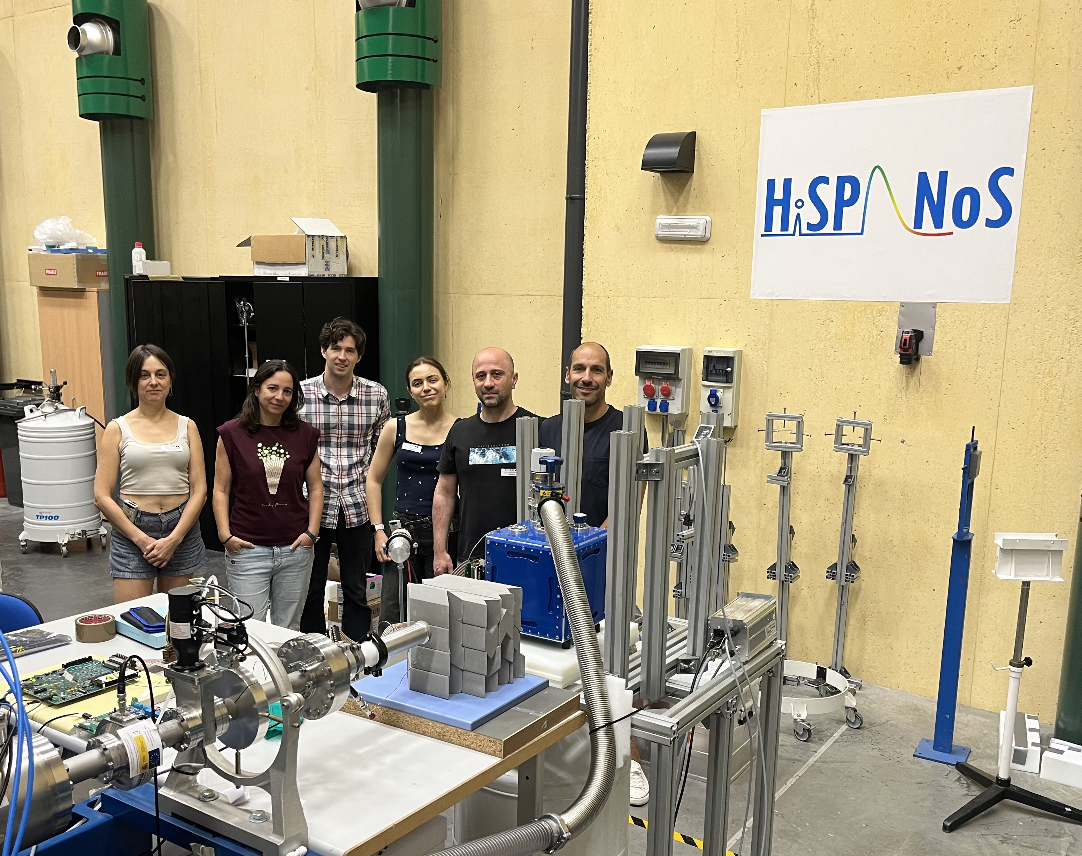
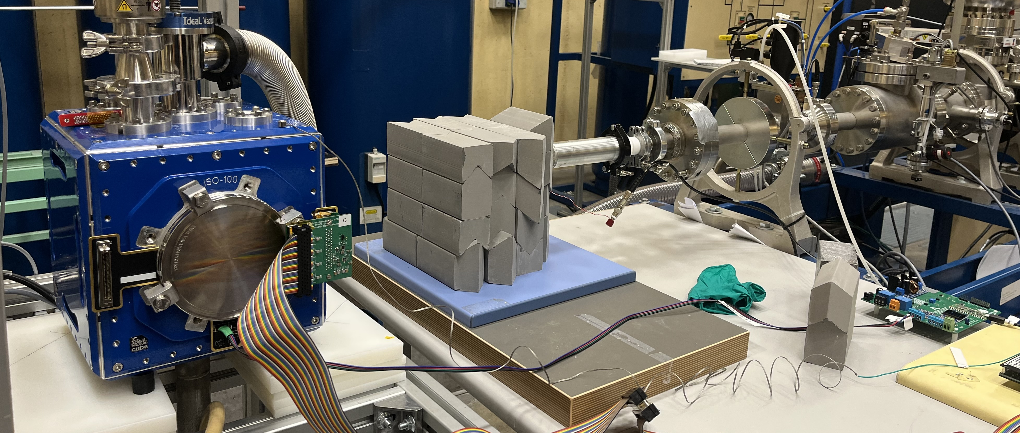
Neutron spectroscopy measurements with TENIS
Centro Nacional de Aceleradores
Highlighted experiment: Determination of the Quenching Factor in Silicon Using Skipper-CCD
Motivation: Neutrino (e.g., CONNIE, Atucha-II) and dark matter (e.g., SENSEI, DAMIC-M, OSCURA) experiments employ a new generation of CCD sensors known as Skipper-CCDs.
=> revolutionary technology reducing readout noise to arbitrarily low levels, lowering detection thresholds to 1.1 eV.
Problem: Ionization efficiency of Si nuclear recoils measured up to 700 eV only.
Proposal: Use Skipper-CCD and epithermal neutrons to measure the quenching factor down to tens of eV.
Principle: Iterative deconvolution of the response to epithermal neutrons
Dario P. Rodrigues¹, José Gomez², Javier S. Tiffenberg³,
Sol Hartzstein¹, Eliana Depaoli¹ & Santiago E. Perez¹
¹ Universidad de Buenos Aires, Argentina
² Technische Universität München Germany
³ FERMILAB, USA
⁷Li(p,n) + γ−shielding
Notes:
Centro mixto U.Sevilla-J.Andalucia-CSIC
Instalaciones principales: 4 aceleradores, 1 irradiador, 1 Tomógrafo PET-CT.
ICTS: Instalación orientada a usuarios. Más de 100 solicitudes de uso al año. Comité científico regula el acceso al centro.
Personal: 48 trabajadores.
19 fijos. 20 temporales. 9 en formación.
13 doctores de plantilla (12 US, 1 CSIC),
10 doctores contratados (2 R&C, 8 postdocs).
Financiación externa por empresas: SAS, IBA, ALTER, ENRESA …además de proyectos autonómicos, nacionales y europeos, y facturación por el uso de las instalaciones.
6

Slide 7
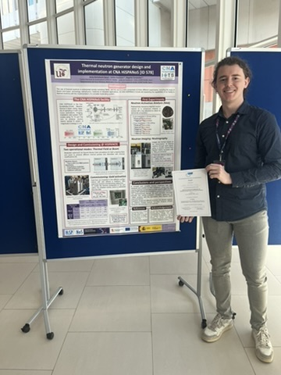


Neutron spectroscopy measurements with TENIS
Centro Nacional de Aceleradores
Thermal Neutron Generator Design and Implementation
at CNA HiSPANoS
by Jesús Bartolomé Sarsa et al.
Notes:
Centro mixto U.Sevilla-J.Andalucia-CSIC
Instalaciones principales: 4 aceleradores, 1 irradiador, 1 Tomógrafo PET-CT.
ICTS: Instalación orientada a usuarios. Más de 100 solicitudes de uso al año. Comité científico regula el acceso al centro.
Personal: 48 trabajadores.
19 fijos. 20 temporales. 9 en formación.
13 doctores de plantilla (12 US, 1 CSIC),
10 doctores contratados (2 R&C, 8 postdocs).
Financiación externa por empresas: SAS, IBA, ALTER, ENRESA …además de proyectos autonómicos, nacionales y europeos, y facturación por el uso de las instalaciones.
7

Slide 8

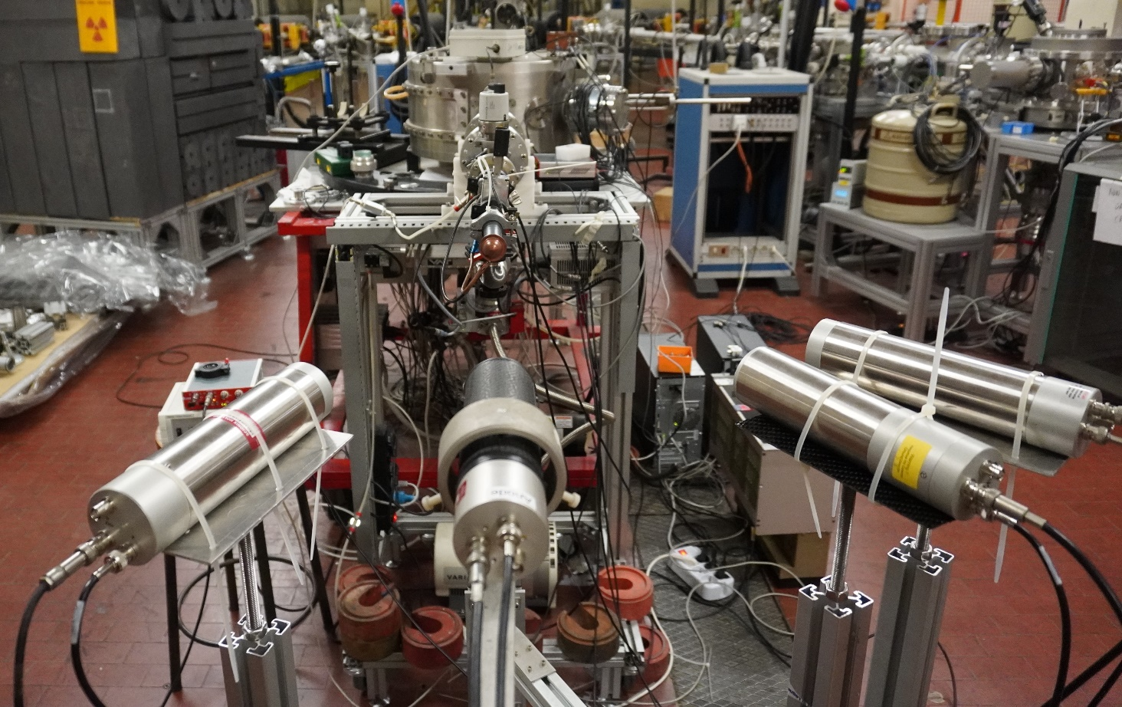
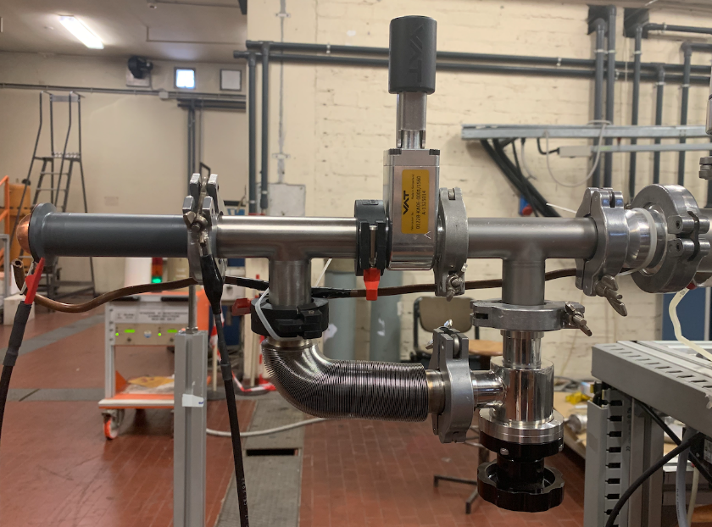
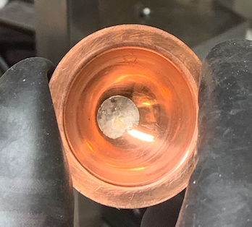
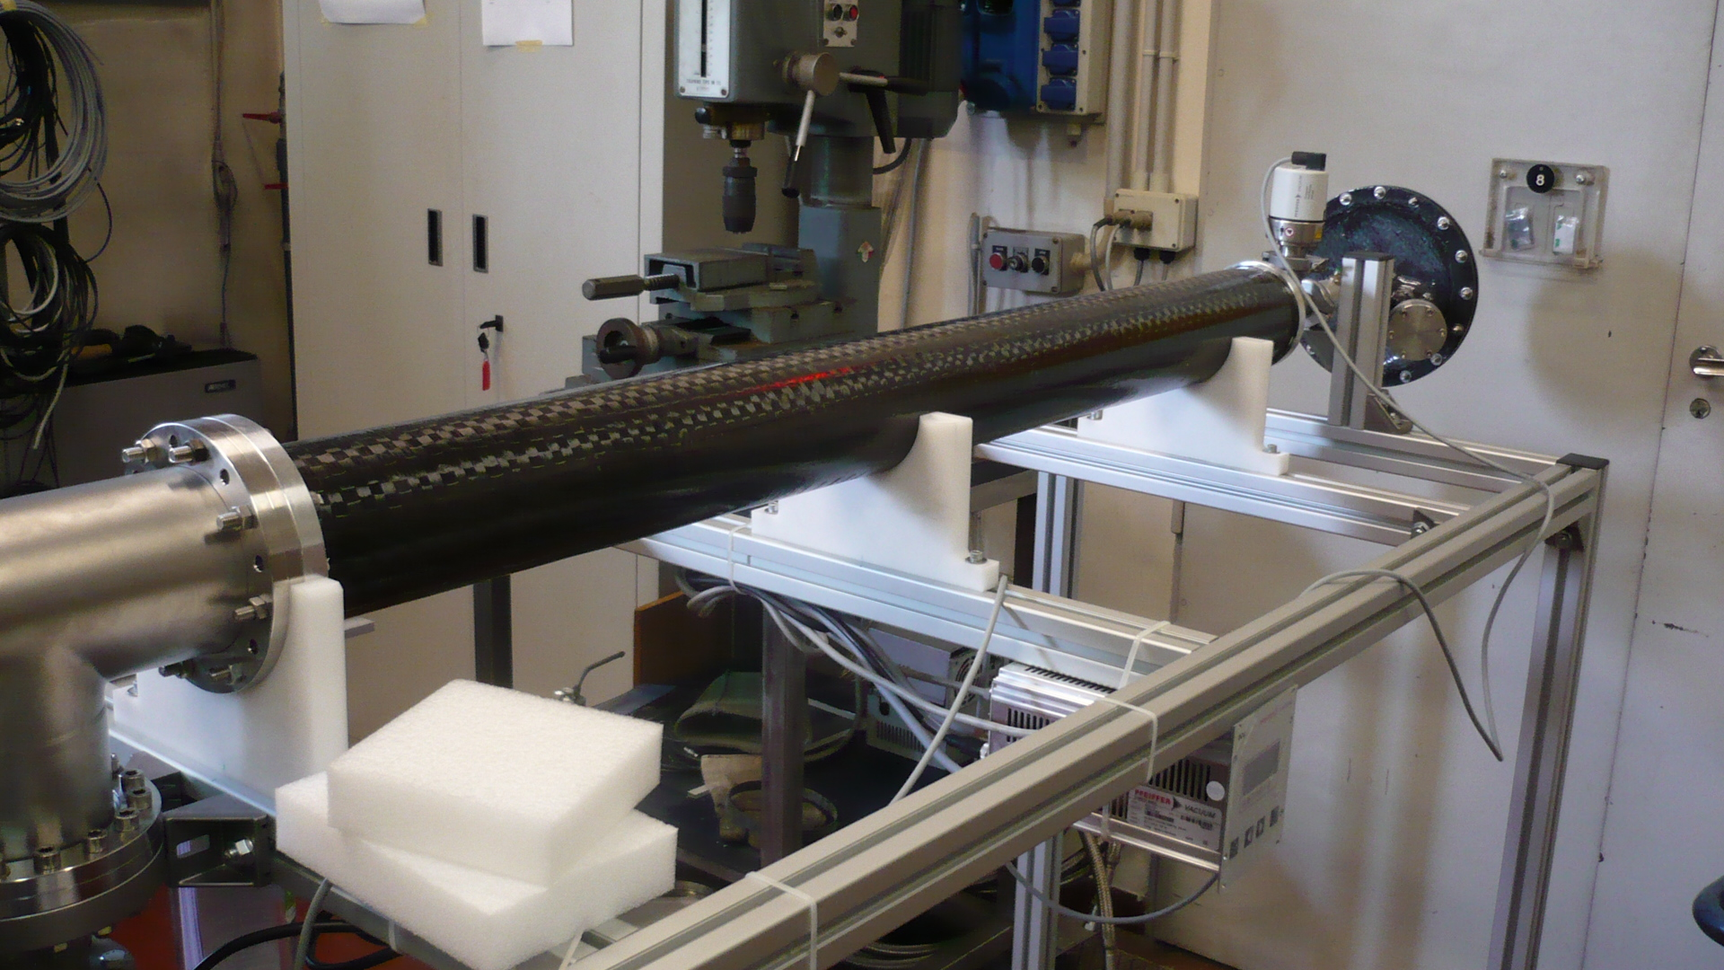
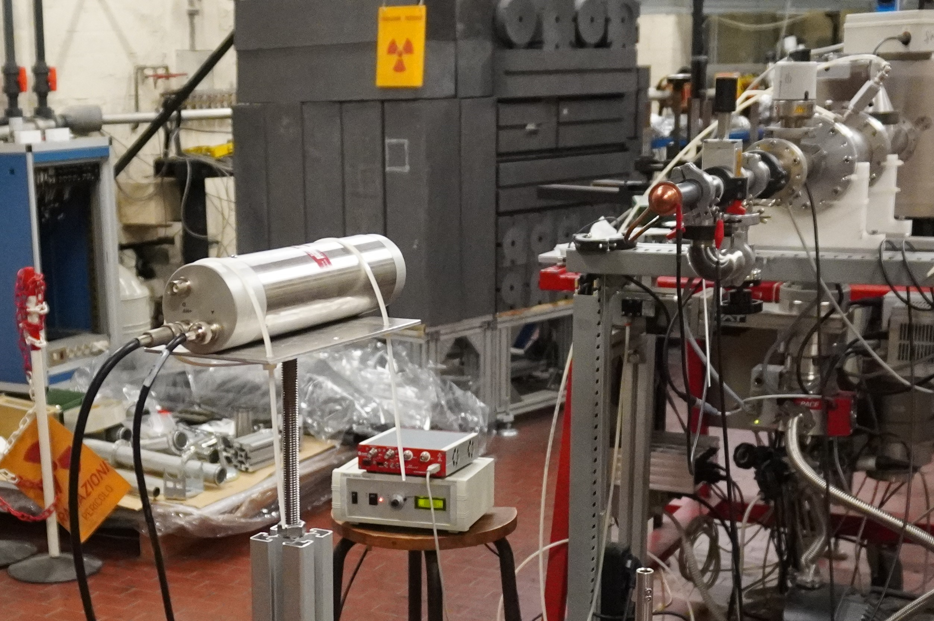
CN Van de Graaff accelerator (LNL-INFN)
Available setups
Metal Li target
Low mass
target assembly
Four movable ⁶Li detector (0.5 inch, 1 inch and 3 mm thickness available)
Low background Al and carbon fiber goniometers for precise detector positioning
Carbon fiber end beam pipes

Slide 9
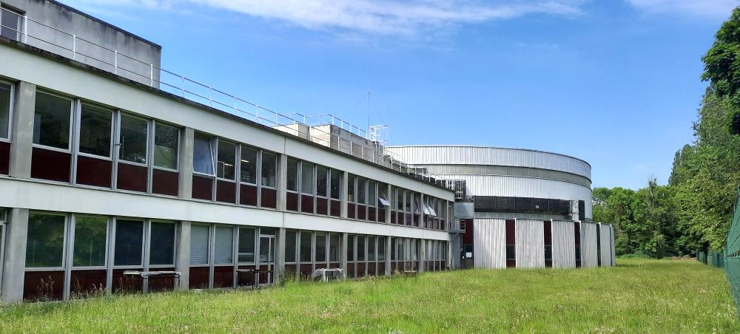
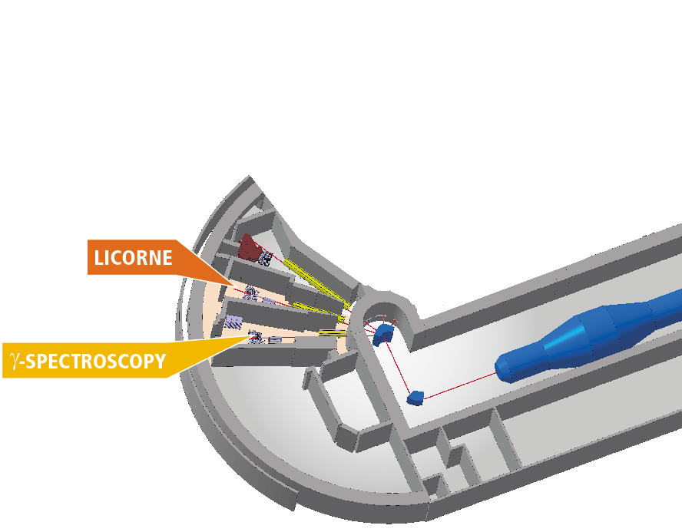
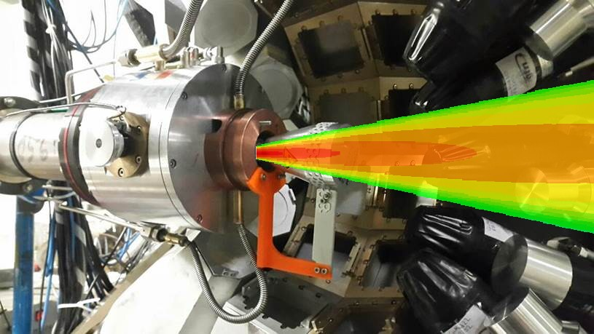
The ALTO facility of IJC Lab, Orsay
LICORNE: Unique, naturally directional
quasi monoenergetic neutron source
H gas target
γ
n
- p(⁷Li,n)⁷Be reaction
for neutron production
In inverse kinematics
- Permits precision
spectroscopy of neutron induced reactions
n
Low background
High flux: 10⁸ n/s/steradian
E_{n}= 0.5 – 4 MeV
Neutron cones between 5° and 30°
n
0.5 µA ⁷Li
13-18 MeV
n
γ
Sample
Participation in European TNA Networks
ARIEL + EUROLABS
Potential 2-3 TNA projects/year
M. Lebois, J.N. Wilson et al., Nucl. Instrum. Meth. 735, 145 (2014)
M. Lebois, J.N. Wilson et al., Phys. Rev. C 92, 034618 (2015)
LICORNE

Slide 10
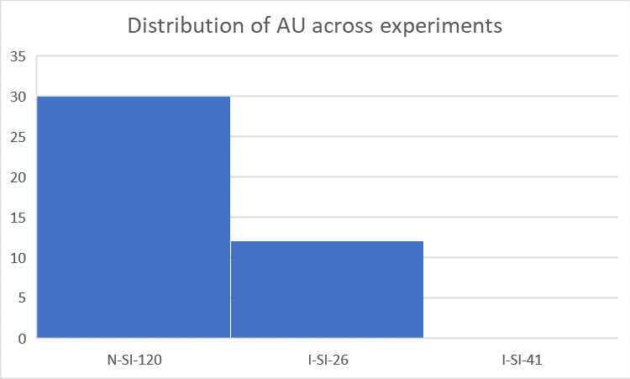
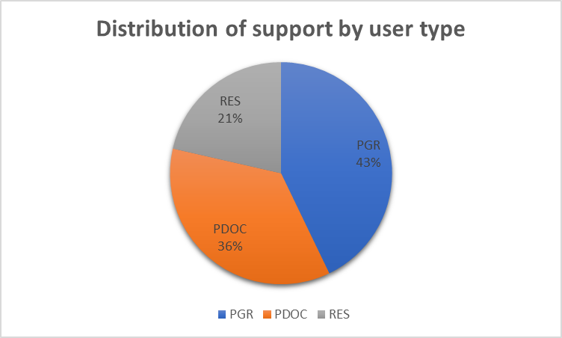
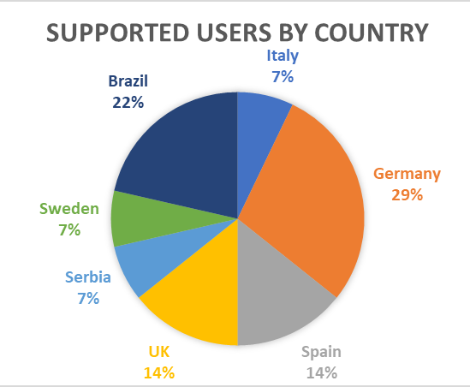
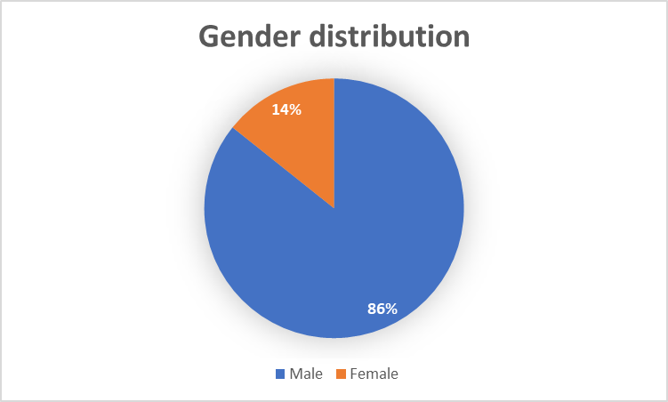
Performance indexes
Total Access Units (AUs) delivered: 42
Planned AUs: 1860 (ALTO total for Stable, Radioactive and Neutron beams)
Number of experiments executed: 2
Funded by EURO-LABS: 3 (2 executed)
Total number of users: 45
Number of users supported: 14

Slide 11
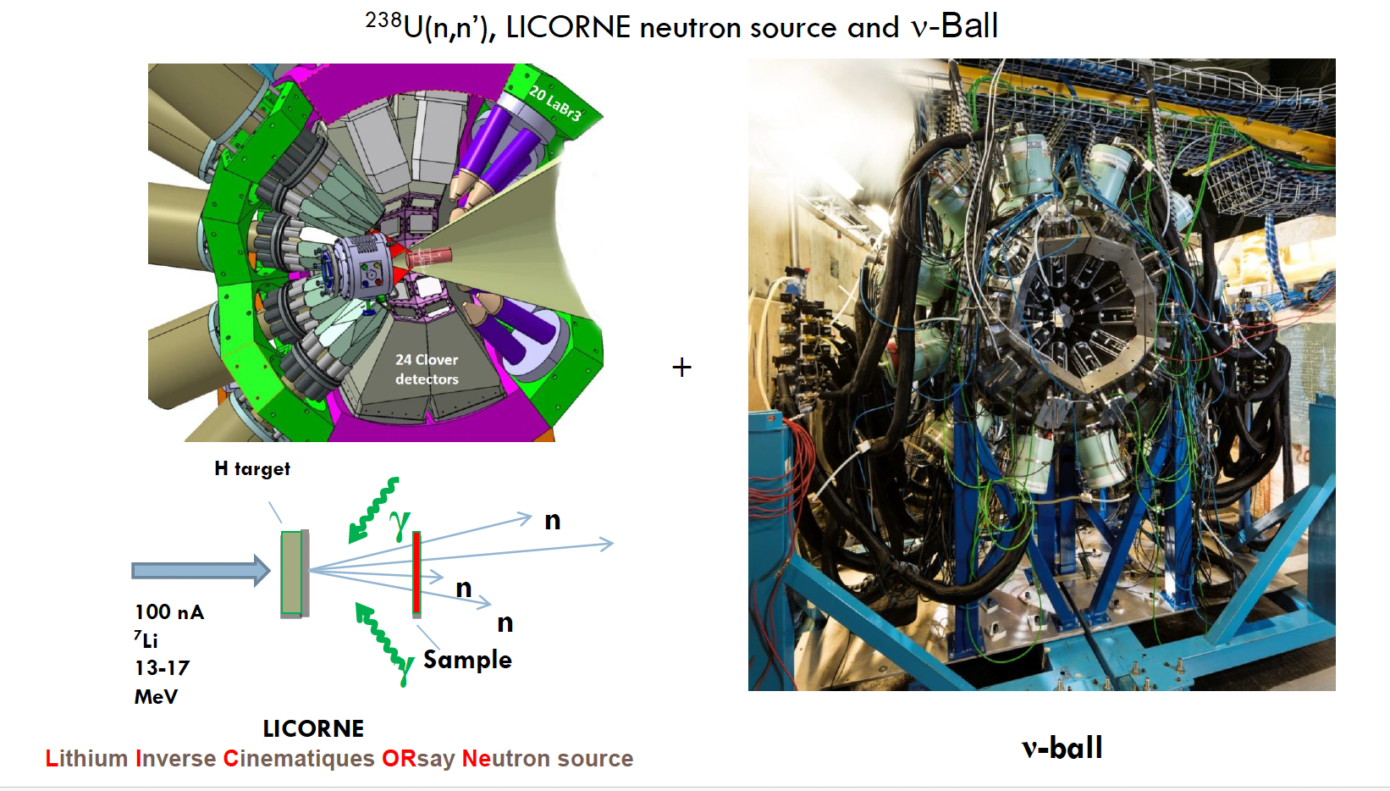

Slide 12








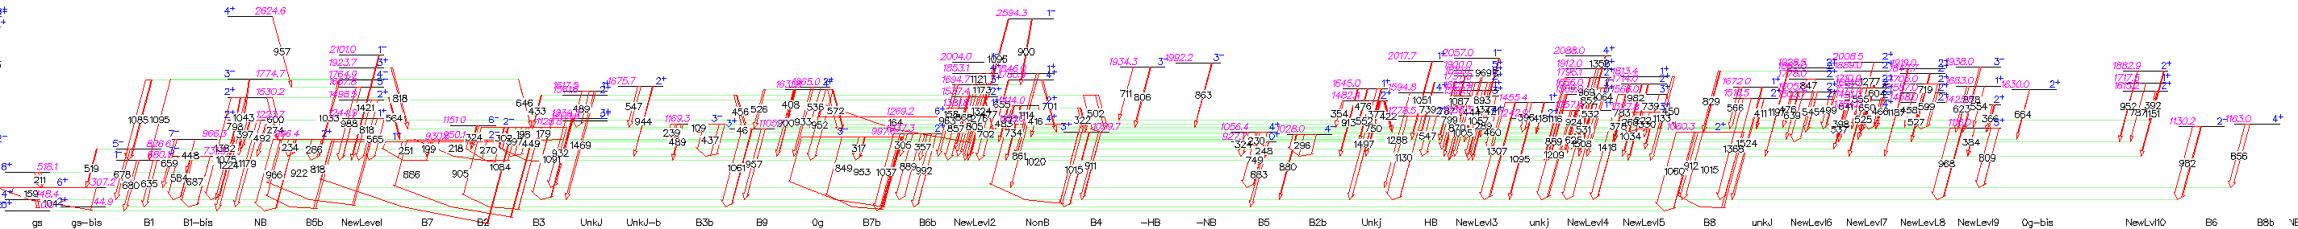
Analysis of the ν-Ball data –
²³⁸U level scheme - results
Carole Chatel^{1, 2, 3, 4, 5, 6}
Jonathan Wilson⁷, Philippe Dessagne¹, Greg Henning¹, Maëlle Kerveno¹, Olivier Bouland†⁵, Gilles Noguère⁵ and Maria Diakaki⁵, Ludovic Mathieu⁶, Mourad Aïche⁶, Peter Möller⁸
103 levels identified
  Including 52 already listed in ENSDF
211 γ identified
  Including 86 already listed in ENSDF
39 new γ depopulating levels already known in ENSDF
51 new levels (not known in ENSDF)
86 new γ (de)populating these new levels
12

Slide 13
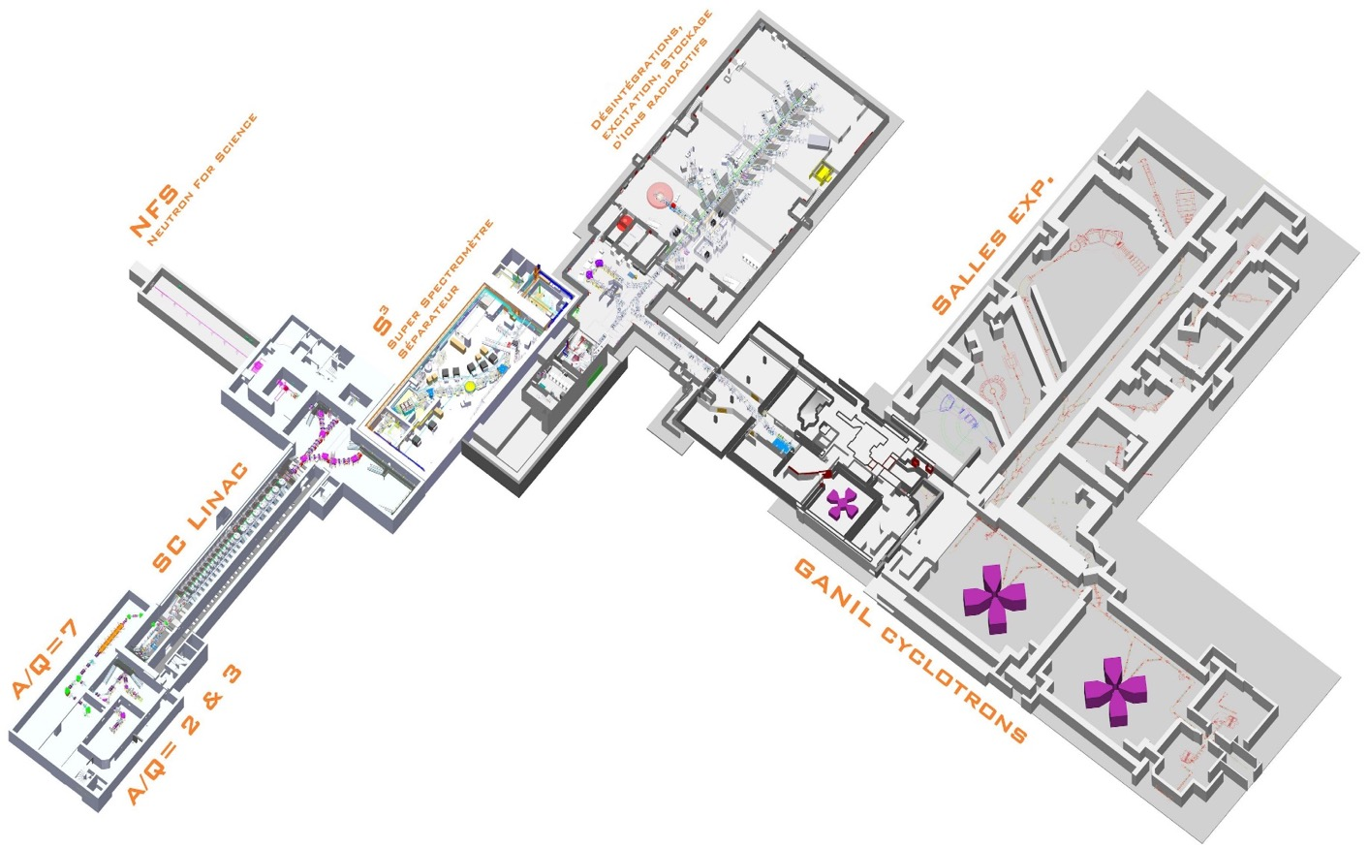
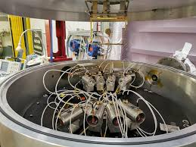
GANIL – Neutron
MEDLEY
Medley is an advanced experimental setup used to study how neutrons interact with matter. In 2020, it has been moved to the Neutrons For Science (NFS) facility, which is located at GANI. The main goal of Medley at NFS is to measure the production of light ions, like protons and alpha particles, when materials are hit by fast neutrons.
High beam intensity was achieved which allowed us to irradiate the enriched Cu-63 target, CH₂, and to measure background in reverse and normal configurations without further delays.
The setup demonstrated excellent energy resolution
13

Slide 14
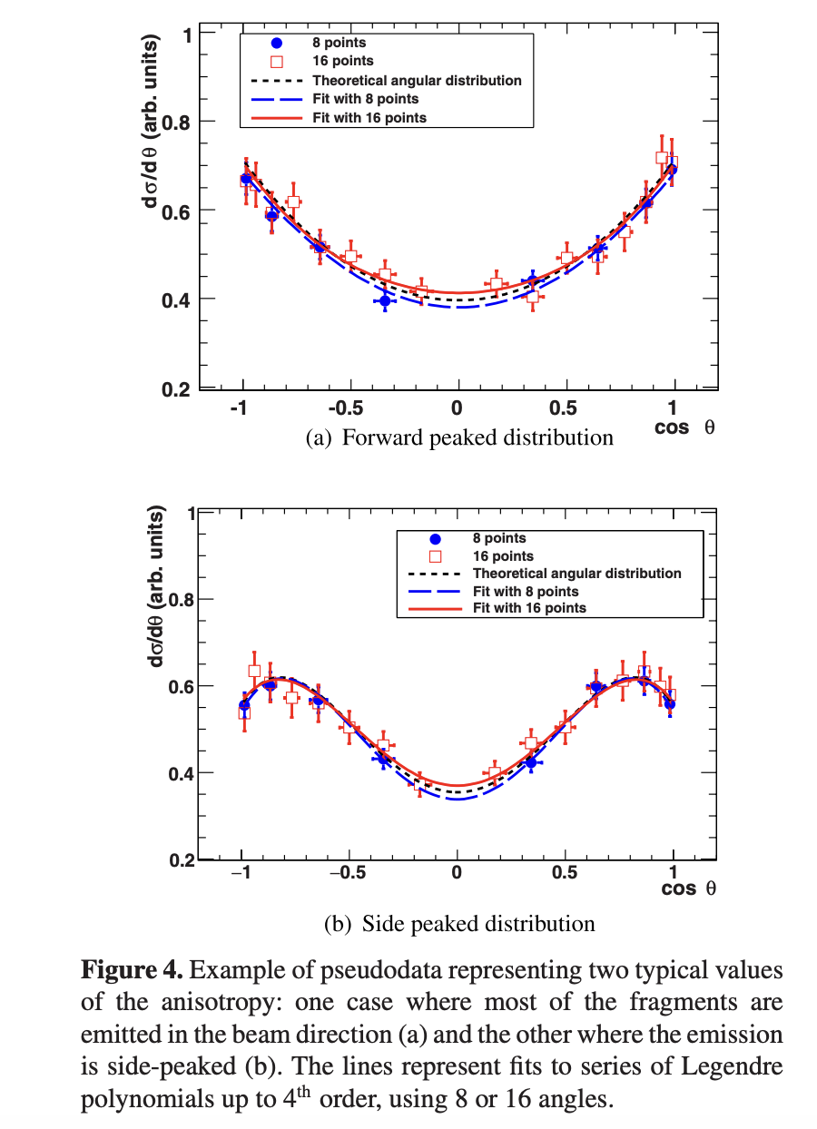
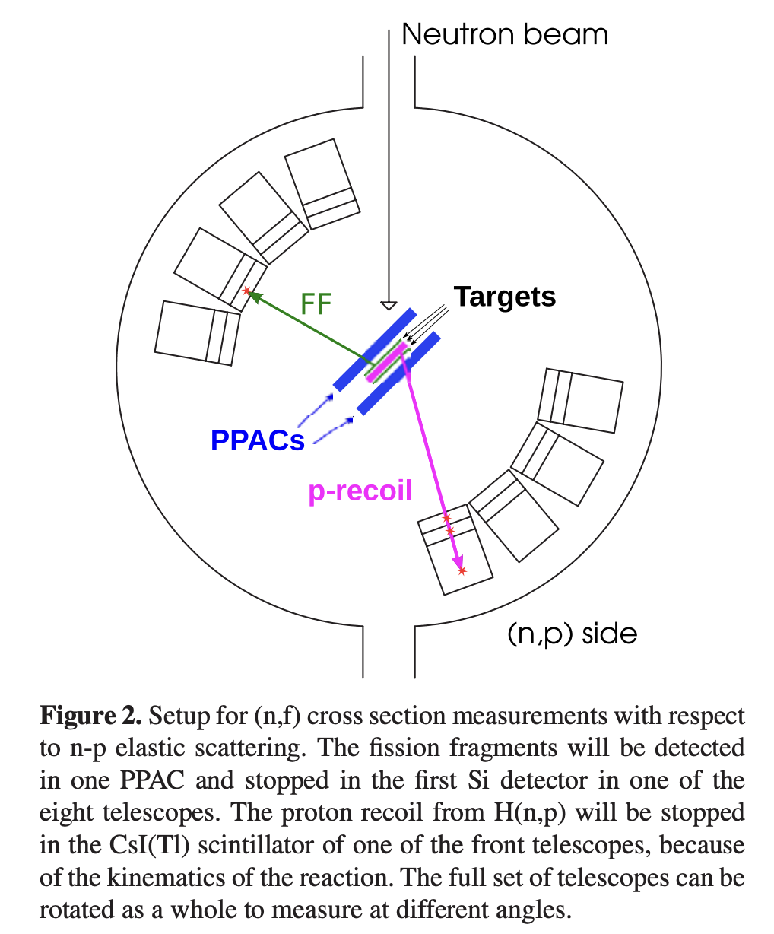
GANIL – Neutron
Characterization of the Medley setup for measurements of
neutron-induced fission cross sections at the GANIL-NFS facility
Diego Tarrio, Alexander V. Prokofiev, Cecilia Gustavsson, Kaj Jansson,
Erik Andersson-Sunden, Ali Al-Adili, and Stephan Pomp
EPJ Web of Conferences 146, 03026 (2017)
14

Slide 15
GANIL – Neutron
Performance indexes
Access Units (AUs) delivered: 92
Number of experiments executed: 30
Number of experiments funded (neutrons): 5
Number of users supported (neutrons): 21
Number of user groups (neutrons): 6
Distribution of Access
Distribution of AUs across experiments: 92 UT, 171 days covers, 21 users
Distribution by user type : 16 EXP, 1 PD, 2 PGR, 2 TEC
Gender distribution : 17 Males, 4 Females
Country distribution : 7 CZ, 1 ES, 1 GB, 2 OT, 3 PL, 1 RO, 6 SE
Scientific Output of Users
Total number of publications: 3
Conference proceedings: 3
PhD Theses: 1
Master Theses: 1
Highlight key publications: ~ 10
15

Slide 16

n_TOF@CERN
16

Slide 17
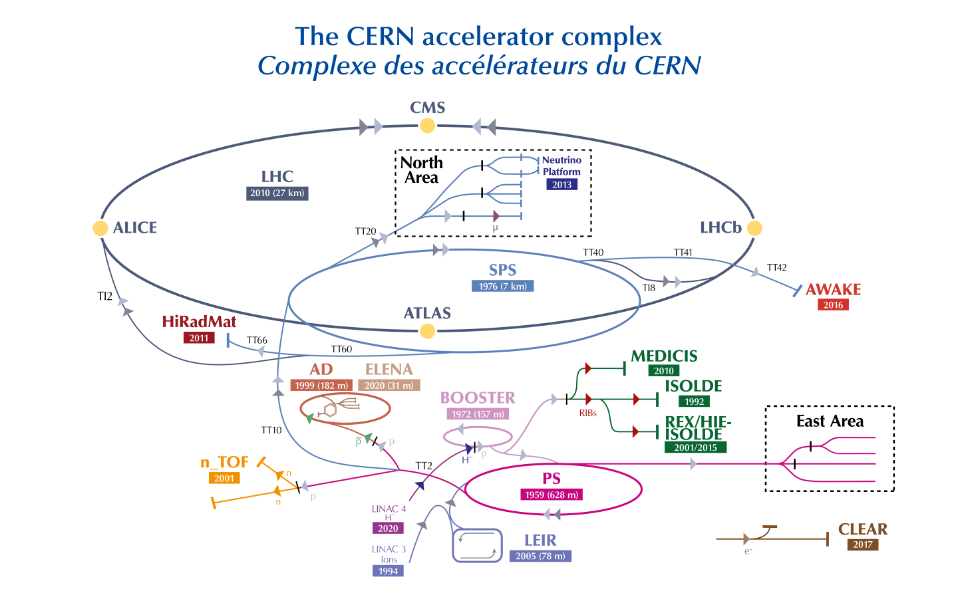
n_TOF@CERN
C. Rubbia et al., A high resolution spallation driven facility at the CERN-PS to measure neutron cross sections in the interval from 1 eV to 250 MeV
CERN/LHC/98-02(EET) 1998
n_TOF
17

Slide 18
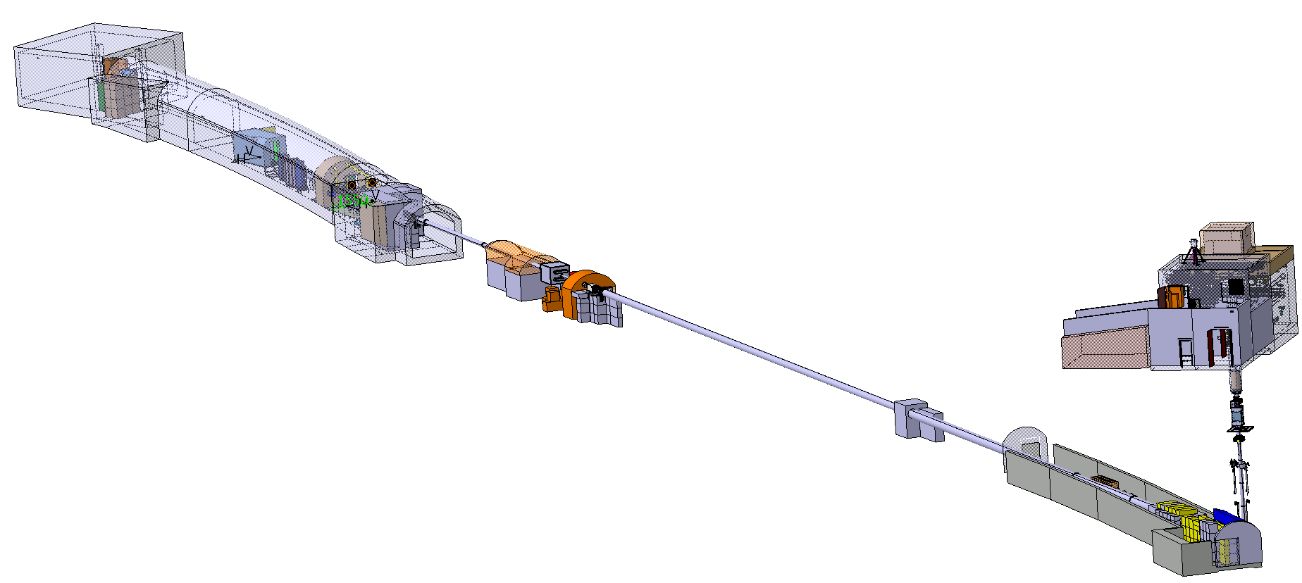
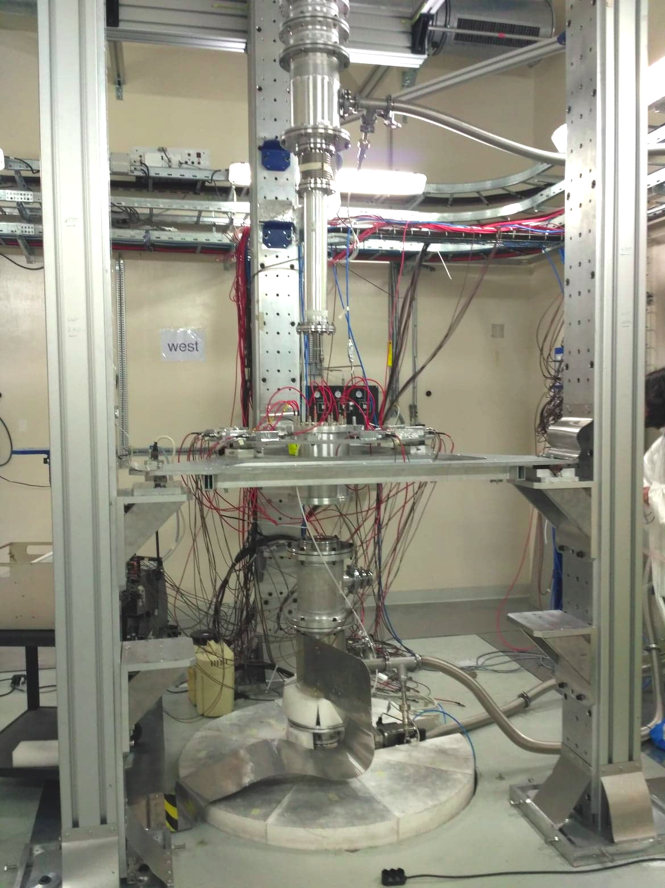
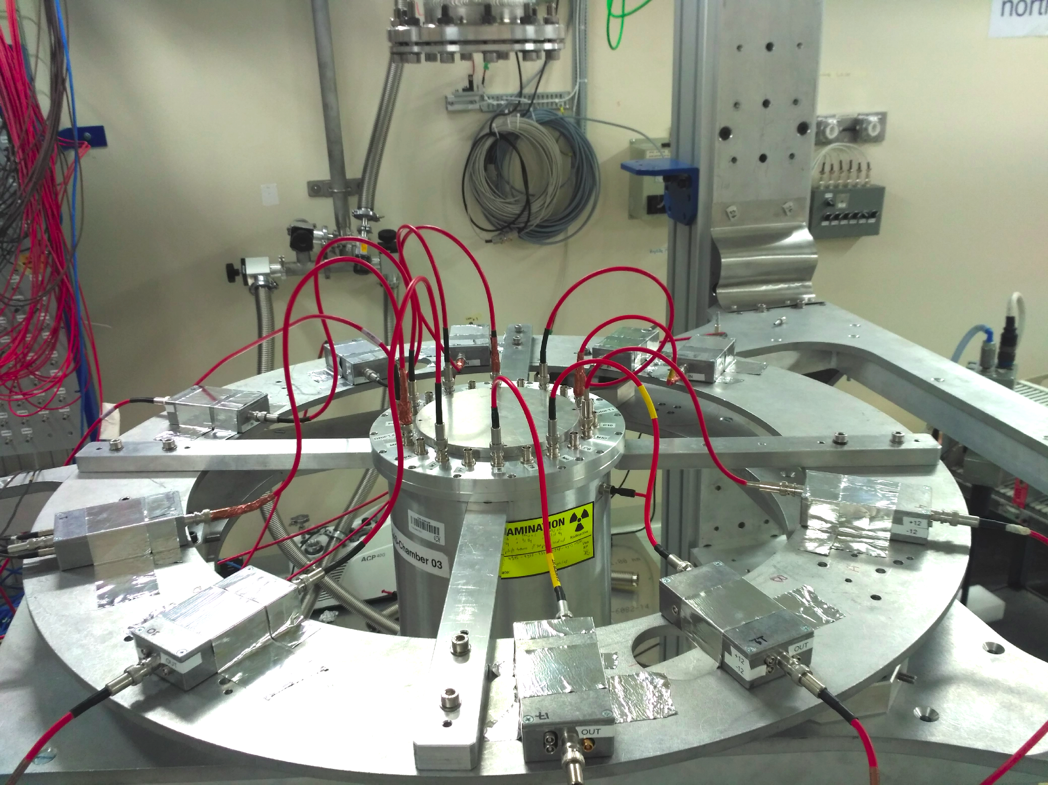
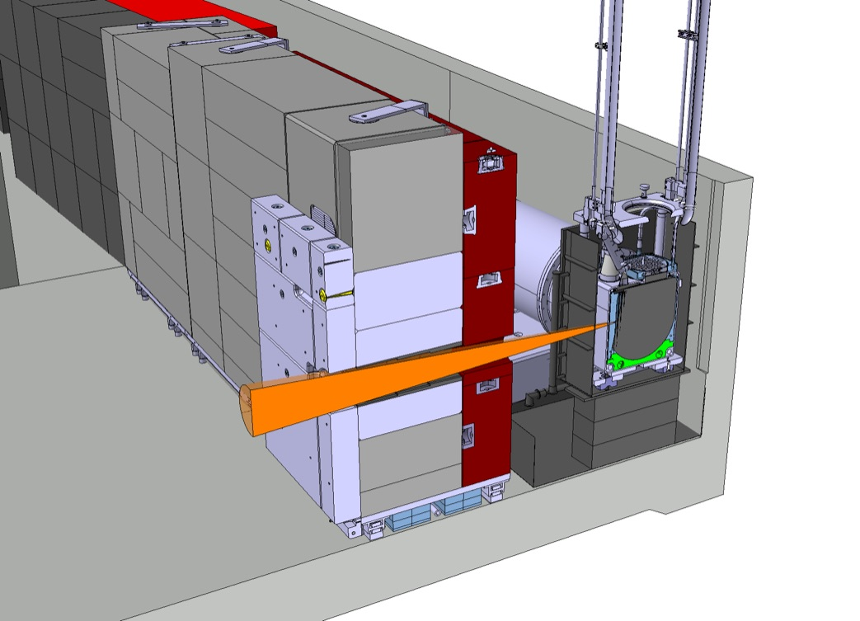
n_TOF@CERN
EAR2
@186 m
@20 m
NEAR
EAR1
@2.5 m
20 GeV/c proton beam from the PS
18

Slide 19
n_TOF@CERN
Performance indexes
Planned Access Units (AUs): 503
Effective AUs delivered: 2144
Number of experiments funded: 40
Number of users supported: 102
All users participating in projects: 274
19

Slide 20
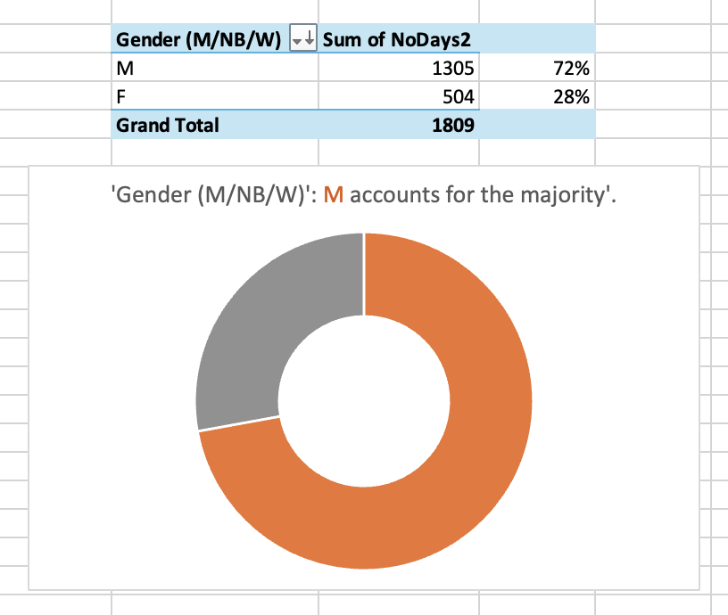
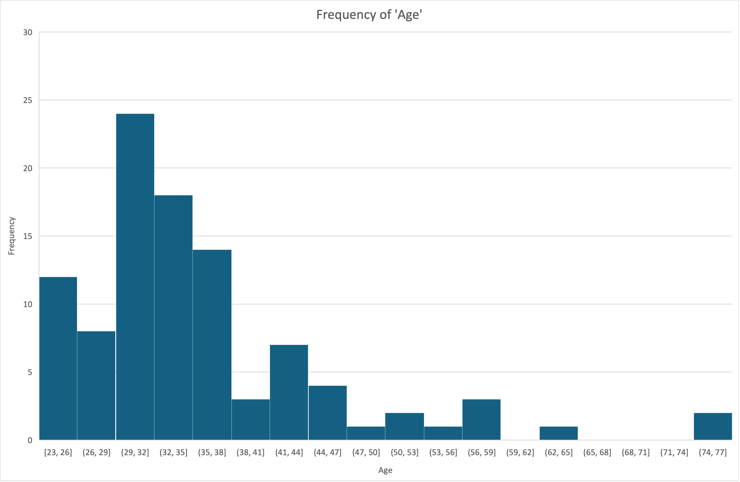
n_TOF@CERN
1809 days of support
102 users
20

Slide 21
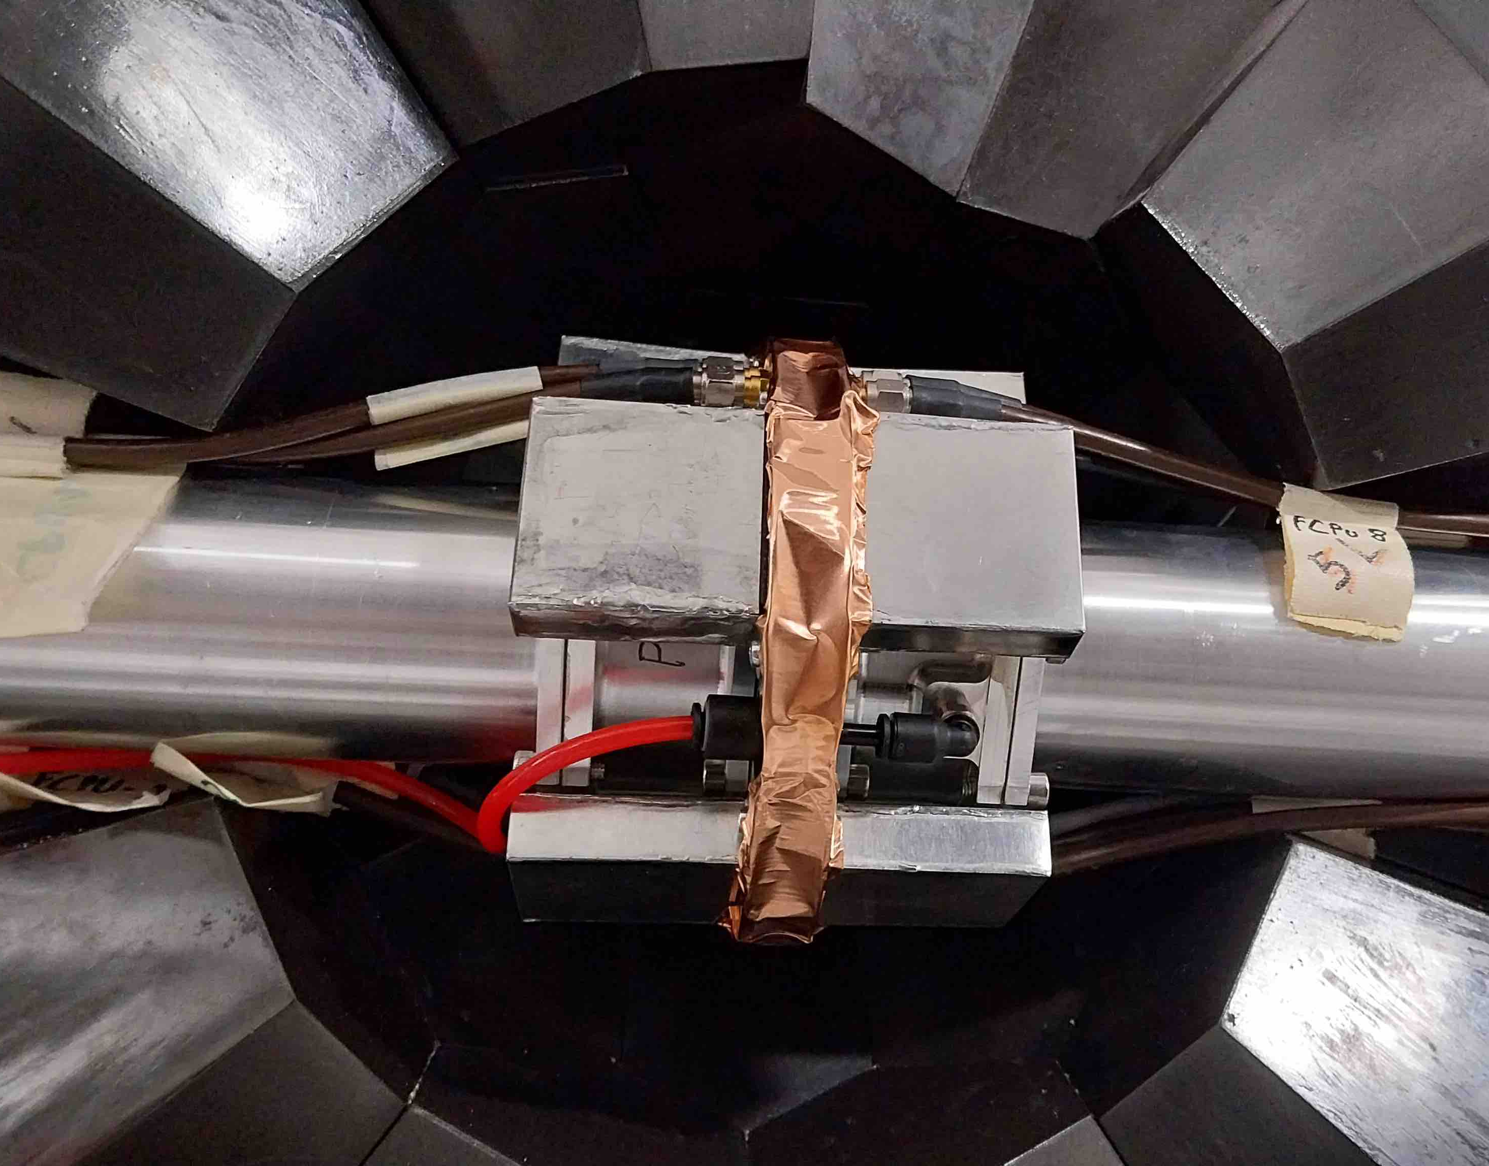
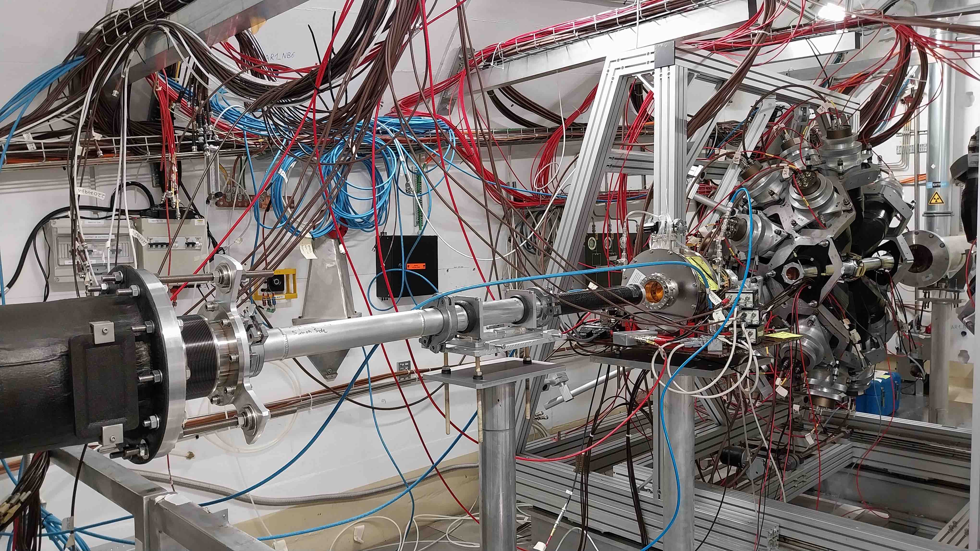

²⁴¹Pu(n,𝛾) in presence of fission
γ₁
TAC (open)
n
γ₂
γ₃
8 cm
Zoom on FICH-Pu241
inside the TAC (open)
FICH-Pu241
n
FICH-U235 (reference)
²³⁵U PTB LMFC (ref.)
SiMon (reference)

Slide 22
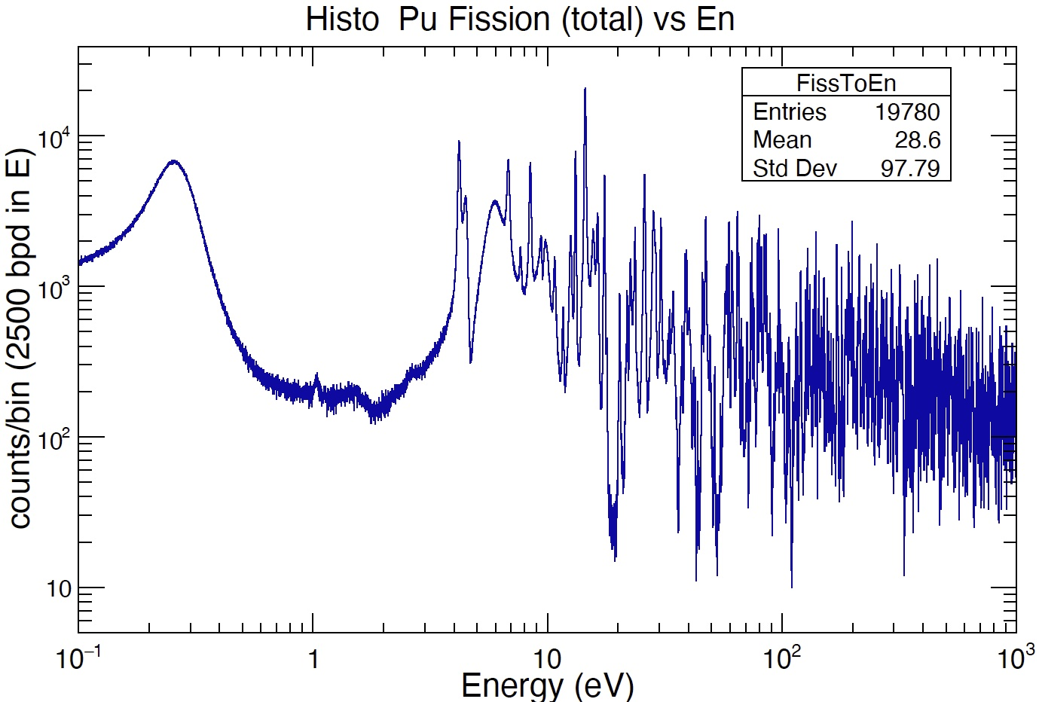
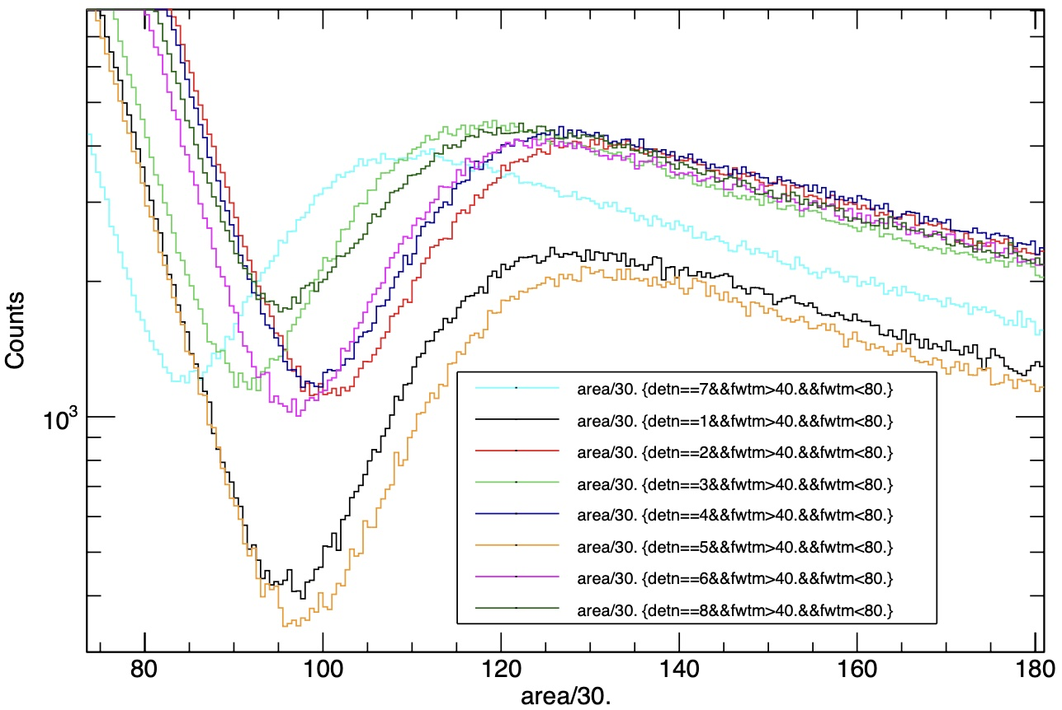
²⁴¹Pu(n,𝛾) in presence of fission
Little effect of β activity (<E_{β}> ~5 keV)
Good α-fission separation
Separation of α and fission events

Slide 23
²³⁵U(n,f) FiFI

Slide 24
X17
n_TOF@CERN
A significant anomaly has been observed in the emission of electron-positron
pairs, from in the ⁷Li(p,e⁺e⁻)⁸Be, ³H(p,e⁺e⁻)⁴He and ¹¹B(p,e⁺e⁻)¹²C reactions
This anomaly has been interpreted as the signature of a BOSON
(hereafter X17) not foreseen in the standard model of particle physics
The X17 boson could be a mediator of a fifth force, characterized by
a strong coupling suppression of protons compared to neutrons
This evidence/scenario is presently not confirmed nor (fully) excluded
by other experiments or groups
24

Slide 25
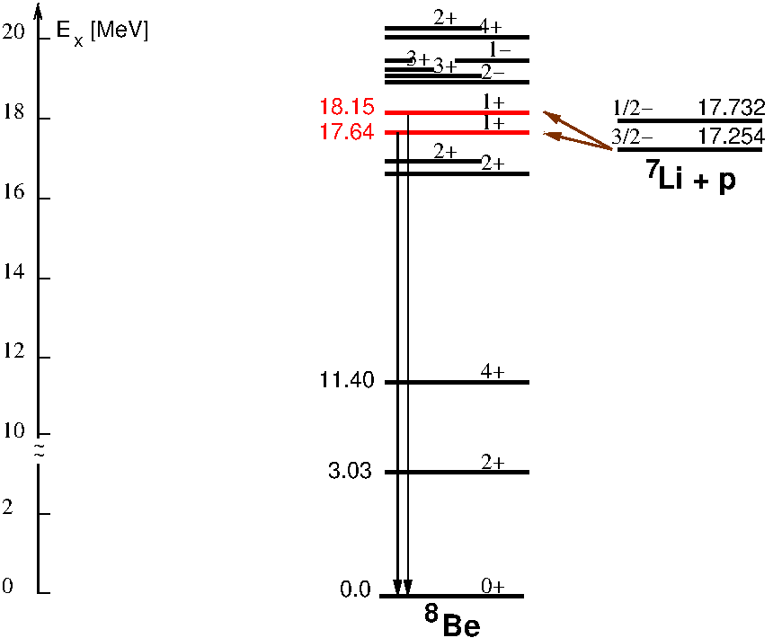
⁷Li(p,e⁺e⁻)⁸Be
e⁺e⁻ pairs created by M1 (IS+IV) transitions
from the two 1⁺ states to the ground-state
(converted to e⁺e⁻ pairs)
M_{X17} = 16.70 ± 0.35_{stat} ± 0.70_{syst} MeV
statistical evidence: 5𝜎
Observation of Anomalous Internal Pair Creation in ⁸Be: A Possible Indication of a Light, Neutral Boson
Krasznahorkay, A.J. et al.
Physical Review Letters 116, 042501 (2016)

Slide 26
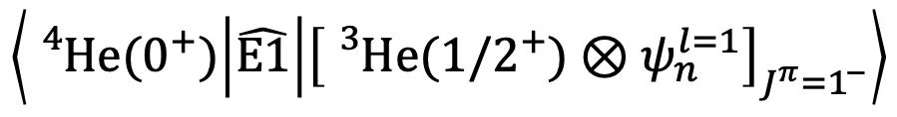
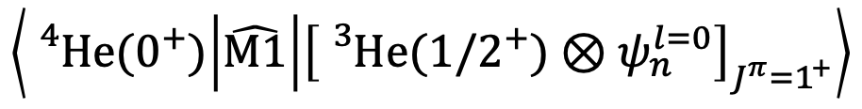
³He(n,e⁺e⁻)⁴He
e⁺e⁻ pairs created by DRC M1 + E1 transitions
E0 transition from the 0⁺ state (only IPC)
No M0 transitions from the 0⁻ state
$$\left\langle {}_{}^{4}{He}(0^{+}) | \hat{M1} | {\left[{}_{}^{3}{He({1/2}^{+})⊗ψ_{n}^{l=0}}\right]}_{J^{π}=1^{+}}\right\rangle$$
$$\left\langle {}_{}^{4}{He}(0^{+}) | \hat{E1} | {\left[{}_{}^{3}{He({1/2}^{+})⊗ψ_{n}^{l=1}}\right]}_{J^{π}=1^{−}}\right\rangle$$
Searching for the X17 Particle using the novel n+³He Reaction
CERN-INTC-2025-001 INTC-P-727
Carlo Gustavino et al. (The n_TOF Collaboration)

Slide 27
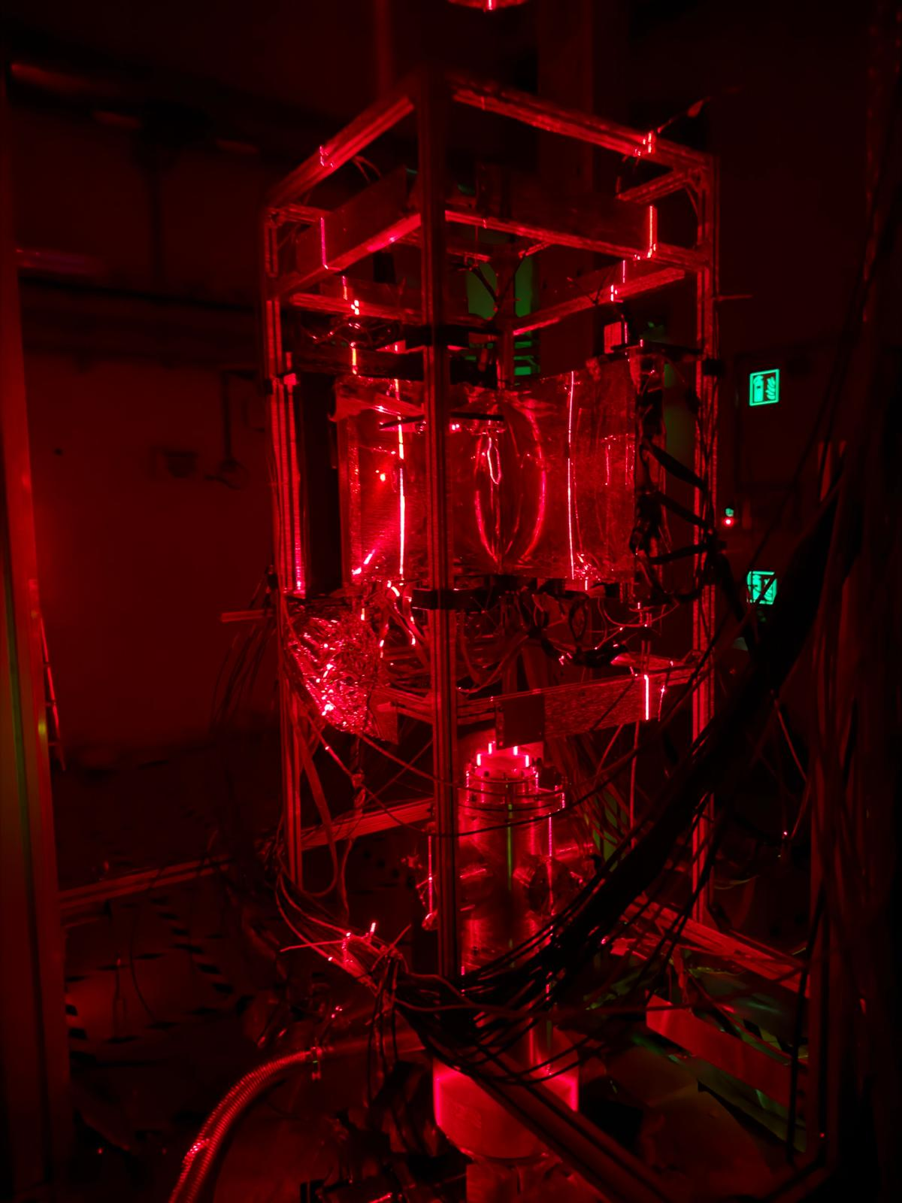
Experimental setup
May 2026
Four 40 x 40 cm² resistive Micromegas detectors to measure the angle between e⁺ and e⁻
  3 cm drift gap for micro-TPC 3D reconstruction
  (look for tracks pointing back to source)
  1024 strips per detector, pitch of ̴800 μm
Read out of ̴4k channels with DREAM electronics
MMs backed by scintillator walls – vertical strips
  extra point for timing and tracking
³He
e⁻
Mylar window
Mesh
Readout

Slide 28
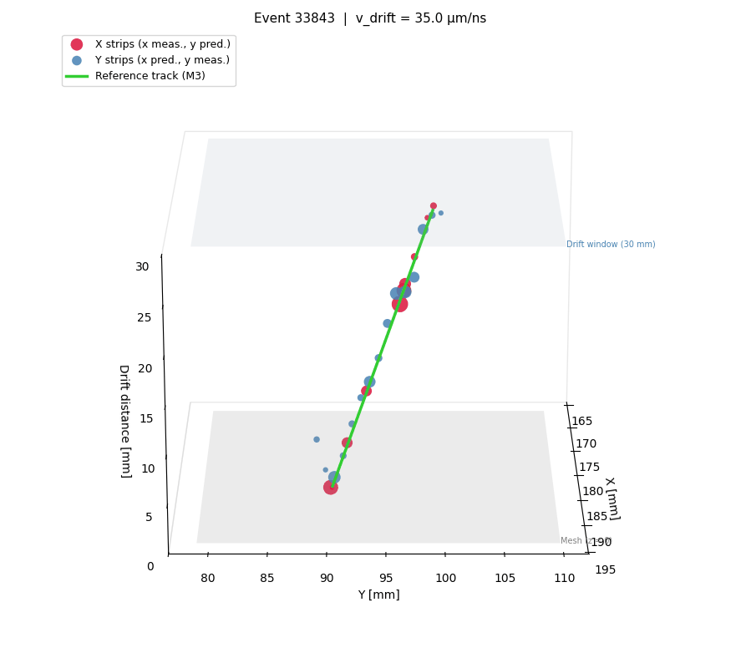
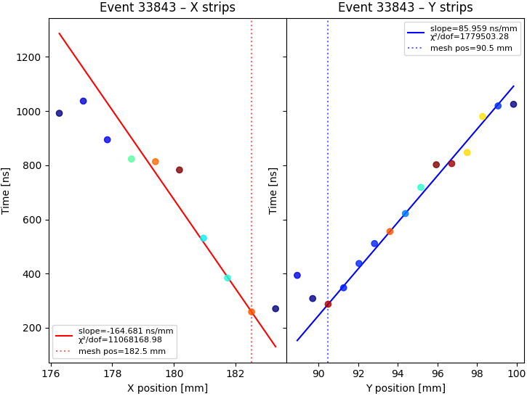
Tracks reconstruction in 𝜇-TPC mode
source: Dylan Neff, April 2926
Cherry-picking a nice event, can reconstruct a track in agreement with the reference tracker

Slide 29
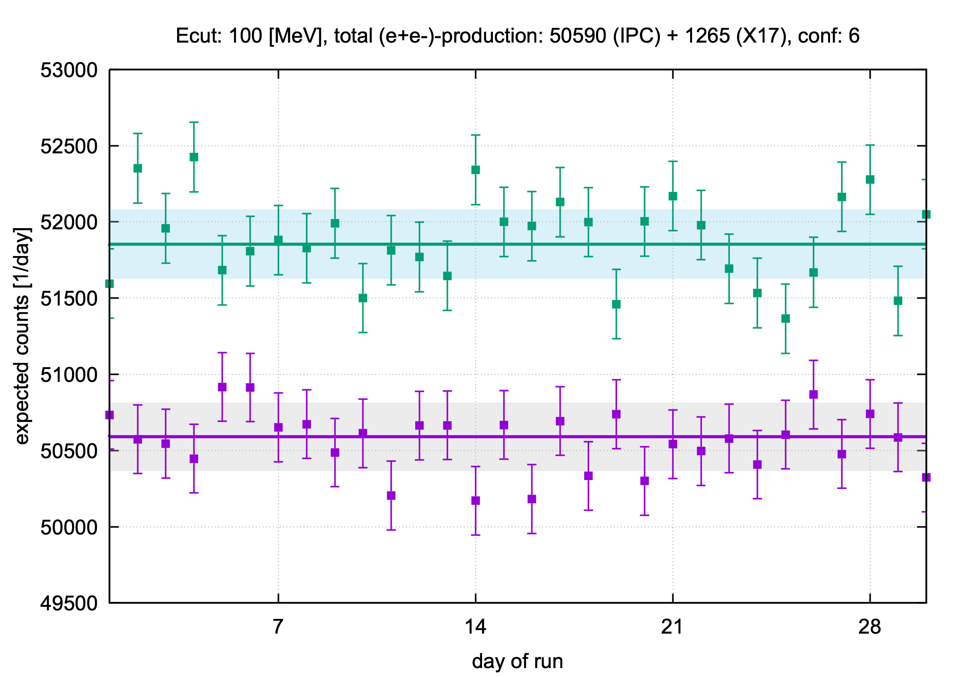
X17 expected: no cut (100 MeV)
n_TOF@CERN
### totals for the run ###
#days of run : 30
#Emax [MeV]: 100
#neutron fraction [%]: 100.0
#e+e- (IPC) : 50590 +/- 225
#X17 : 1265 +/- 36
#confidence level : 6
29

Slide 30
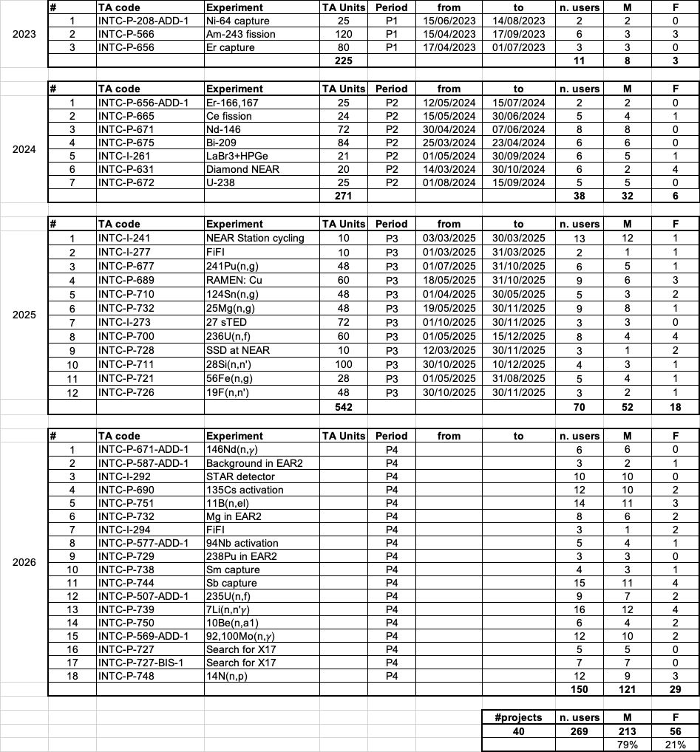
n_TOF@CERN
30

Slide 31
neutrons for EURO-LABS
 | TOTAL | n_TOF2 | GANIL/NFS | IJC Lab/ALTO | CLEAR/CNA
Planned Access Units (AUs): |  | 503 | - | - | 640
Effective AUs delivered: | 2974 | 2144 | 92 | 42 | 696
Number of experiments funded: | 62 | 40 | 5 | 3 | 14
Number of users supported: | 192 | 102 | 30 | 14 | 46
All users participating in projects: | 395 | 274 | 30 | 45 | 46
31

Slide 32
The End

Slide 35
⁷Li(p,e⁺e⁻)⁸Be
e⁺e⁻ pairs created by M1 (IS+IV) transitions
from the two 1⁺ states to the ground-state
(converted to e⁺e⁻ pairs)
M_{X17} = 16.70 ± 0.35_{stat} ± 0.70_{syst} MeV
statistical evidence: 5𝜎
Observation of Anomalous Internal Pair Creation in ⁸Be: A Possible Indication of a Light, Neutral Boson
Krasznahorkay, A.J. et al.
Physical Review Letters 116, 042501 (2016)

Slide 36
¹¹B(p,e⁺e⁻)¹²C
e⁺e⁻ pairs created by E1 transitions 1⁻ -> 0⁺
M_{X17} = 17.03 ± 0.11_{stat} ± 0.20_{syst} MeV
New anomaly observed in ¹²C supports the existence and the vector character
of the hypothetical X17 boson
Krasznahorkay A.J. et al.
Phys. Rev. C 106, L061601 (2022)

Slide 37
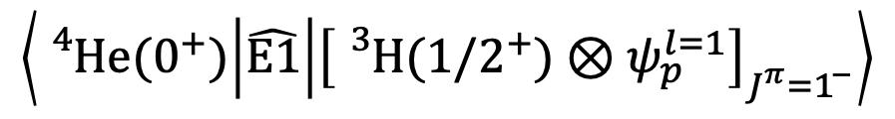
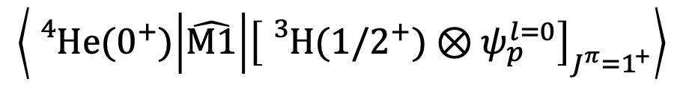
³H(p,e⁺e⁻)⁴He
e⁺e⁻ pairs created by DRC M1 + E1 transitions
$$\left\langle {}_{}^{4}{He}(0^{+}) | \hat{M1} | {\left[{}_{}^{3}{H({1/2}^{+})⊗ψ_{p}^{l=0}}\right]}_{J^{π}=1^{+}}\right\rangle$$
$$\left\langle {}_{}^{4}{He}(0^{+}) | \hat{E1} | {\left[{}_{}^{3}{H({1/2}^{+})⊗ψ_{p}^{l=1}}\right]}_{J^{π}=1^{−}}\right\rangle$$
New evidence supporting the existence of the hypothetic X17 particle
Krasznahorkay A.J. et al.
Phys. Rev. C 104, 044003 – Published 18 October 2021

Slide 38
³H(p,e⁺e⁻)⁴He
e⁺e⁻ pairs created by DRC M1 + E1 transitions
E0 transition from the 0⁺ state (only IPC)
New evidence supporting the existence of the hypothetic X17 particle
Krasznahorkay A.J. et al.
Phys. Rev. C 104, 044003 – Published 18 October 2021

Slide 39
³H(p,e⁺e⁻)⁴He
e⁺e⁻ pairs created by DRC M1 + E1 transitions
M_{X17} = 16.84 ± 0.16_{stat} ± 0.20_{syst} MeV
E0 transition from the 0⁺ state (only IPC)
statistical evidence: 9𝜎
No M0 transitions from the 0⁻ state
New evidence supporting the existence of the hypothetic X17 particle
Krasznahorkay A.J. et al.
Phys. Rev. C 104, 044003 – Published 18 October 2021

