Slide 1
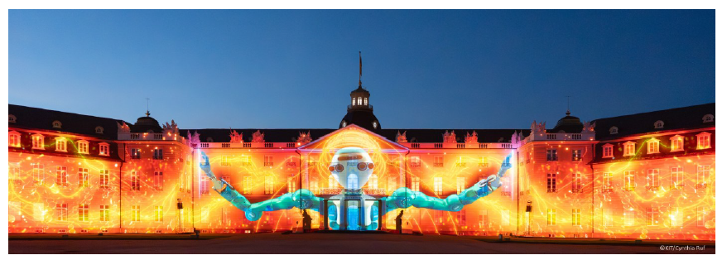
Impact of EURO-LABS
M.Colonna
INFN - Laboratori Nazionali del Sud (Catania, Italy)
FINal EURO-LABS meeting (FINE)
KIT, Karlsruhe (Germany)
June 29th- July 2nd 2026

Slide 2
Outline
EURO-LABS expected Outcome and Impact
short (not exhaustive) summary of results and achievements
(material from EURO-LABS NewsLetters)
→ looking ahead
what to stress in the Final Report
M.Colonna - EURO-LABS

Slide 3
EURO-LABS goals and outcomes
EURO-LABS main goals:
Well-coordinated TA to a large number and broad variety of state-of-the-art RIs to address key questions in Nuclear Physics and technological challenges in detector and accelerator technology for HEP
Target groups:
- The scientific community belonging to the area of Nuclear and HEP
- Society, through results of societal and environmental oriented research
- Industrial users and groups from the nuclear medicine
TA/VA Outcomes:
- Increased coordination and targeted efforts to best exploit the RIs for
advancing frontier knowledge
- Enhanced sustainability of the RIs
- Enhanced collaborations and cross-disciplinary exchanges
M.Colonna - EURO-LABS

Slide 4
Results and Impact
Expected Results:
- Fostering cutting-edge research in nuclear and HEP, including applications
- Facing new challenges in the field
Contributions to conference proceedings and referred journals about the results
of the discoveries made during this project
- Training of young researchers, including providing data for PhD theses.
M.Colonna - EURO-LABS

Slide 5

Results and Impact
Expected Results:
- Fostering cutting-edge research in nuclear and HEP, including applications
- Facing new challenges in the field
- Contributions to conference proceedings and referred journals about the results
of the discoveries made during this project
- Training of young researchers, including providing data for PhD theses.
Publications
Impacts:
Scientific: Breakthrough scientific results in the area of nuclear and HEP
Training of a new generation of researchers to exploit the RIs optimally
Economic: Invigorating high-technology activities and startups
Societal: Enhancing the availability of highly-qualified and skilled personnel for employment
in research as well as in industry
- Applications of nuclear science for medicine and multidisciplinary purposes
Publications
sustainability
Training
M.Colonna - EURO-LABS

Slide 6
Results and Impact
Expected Results:
- Fostering cutting-edge research in nuclear and HEP, including applications
- Facing new challenges in the field
Contributions to conference proceedings and referred journals about the results
of the discoveries made during this project
- Training of young researchers, including providing data for PhD theses.
Impacts:
Scientific: Breakthrough scientific results in the area of nuclear and HEP
Training of a new generation of researchers to exploit the RIs optimally, sustainability of RIs
Economic: Invigorating high-technology activities and startups
Societal: Enhancing the availability of highly-qualified and skilled personnel for employment
in research as well as in industry
- Applications of nuclear science for medicine and multidisciplinary purposes
D & C measures to advertise and maximise impact:
- Communication through social media, non-specialized aspects of the project website,
open days and visits to RIs. Visit by researchers to schools
- Dissemination through talks at conferences, organization of workshops and schools
M.Colonna - EURO-LABS

Slide 7
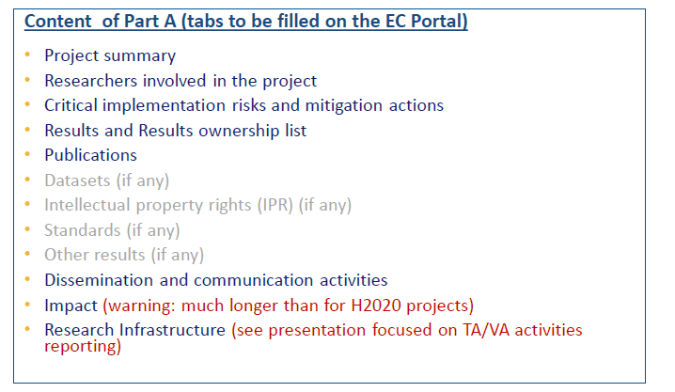
Technical Report (TR)
Context, Work and Results (short description)
Part A
(Tables to be filled online)
reporting on
P3: from March 1st, 2025 to August 31st, 2026
Submission deadline: end of October 2026
M.Colonna - EURO-LABS

Slide 8
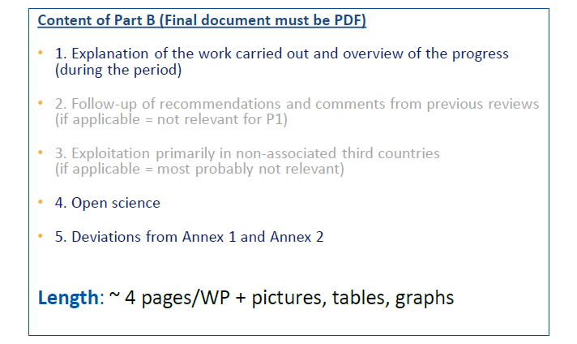
Technical Report (TR)
for each WP
+ Impact
+ Description of TA and VA activities
Part B
(narrative)
P3: from March 1st, 2025 to August 31st, 2026
Submission deadline: end of October 2026
M.Colonna - EURO-LABS

Slide 9

Some examples of EURO-LABS results
(from NewsLetters)

Slide 10
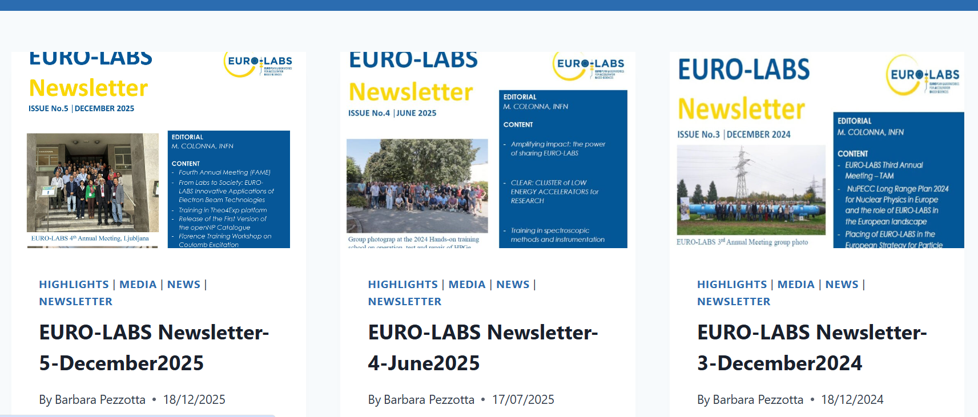
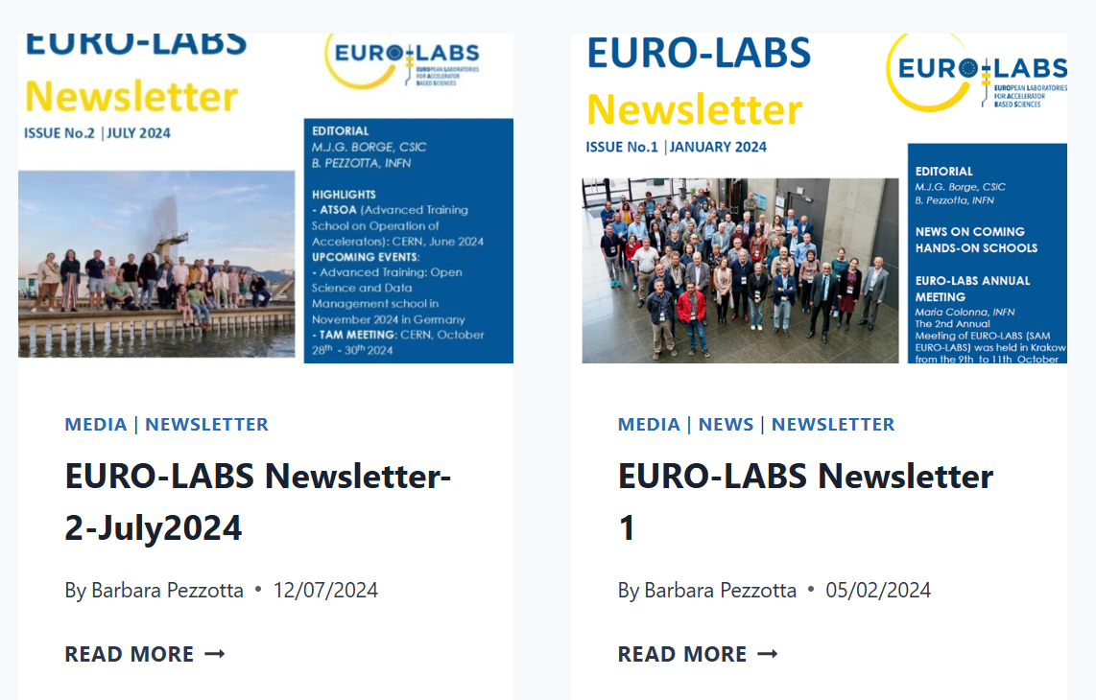
https://web.infn.it/EURO-LABS/category/news/newsletter/

Slide 11
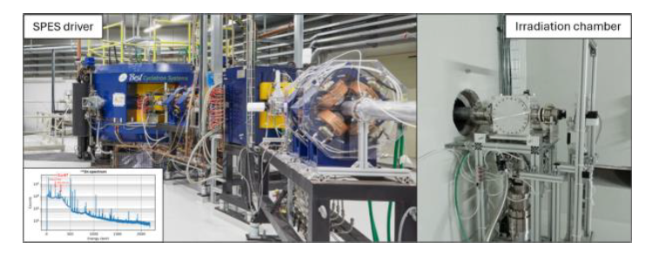
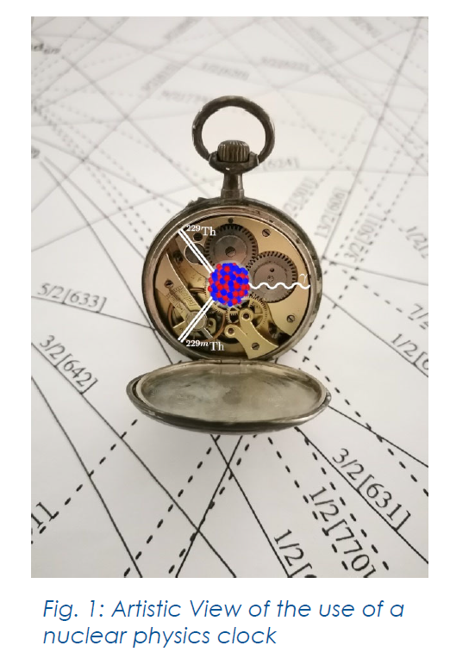
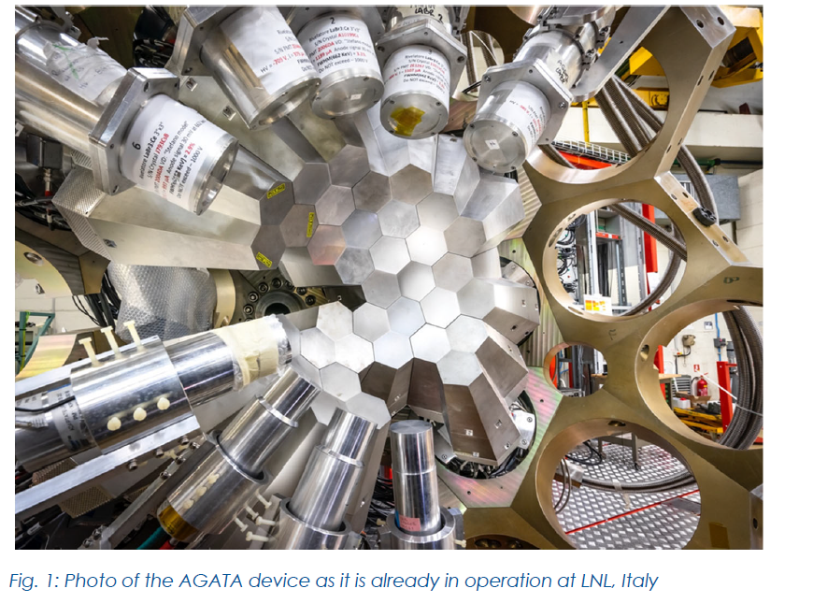

Activities and Results: nuclear physics
The acceleration of primary proton beams
at INFN-LNL for the production of
radioisotopes at SPES
The AGATA detector operating at
LNL for nuclear spectroscopy
Measurements of excitation energy and decay half-life
of ²²⁹Th isomeric states (8.3 eV) at CERN-ISOLDE
Sandro Kraemer et al., Nature 617, 706 (2023)

Slide 12
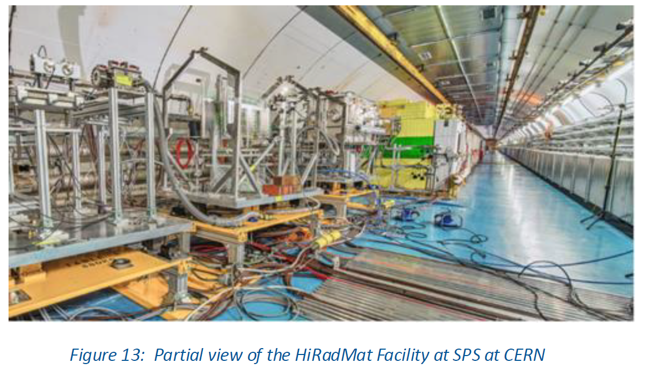
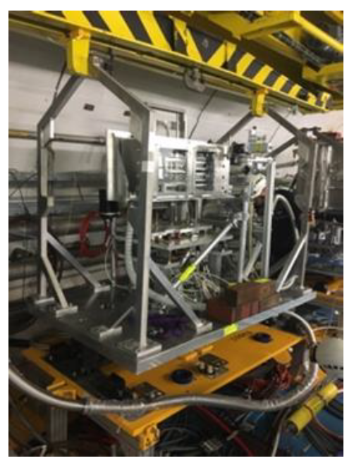
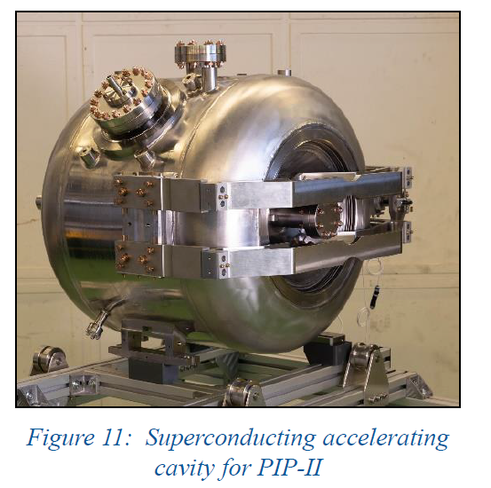

Activities and Results: accelerator technology for HEP
Thermal shock studies of various materials at CERN’s HiRadMat:
advancing our understanding of material tolerance and contributing to the development of more resilient high-power accelerator target systems (RaDIATE collaboration - Fermilab)
K.Ammigan,S.Bidharetal.,PRAB22,044501(2019)
Astrophysical jets of matter and antimatter at CERN's HiRadMat - SPS
→ plasmas of electron-positron pairs (Fireball Collaboration)
C.D. Arrowsmith et al., Nature Com.
https://doi.org/10.1038/s41467-024-49346-2
R&D activities at the SUPRATECH platform (IJCLab-France):
accelerator components design and fabrication, for the
Proton Improvement Plan II (PIP-II)
→ provide an intense neutrino beam for the future
Deep Underground Neutrino Experiment (DUNE) at FermiLab.
Setup installed
at HiRadMat

Slide 13
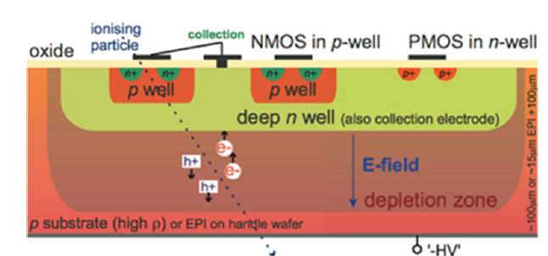
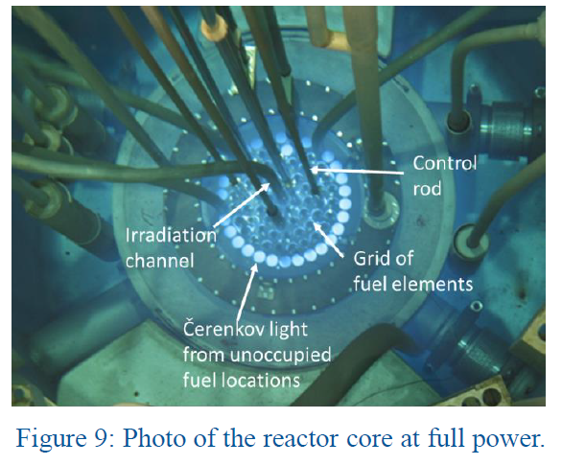
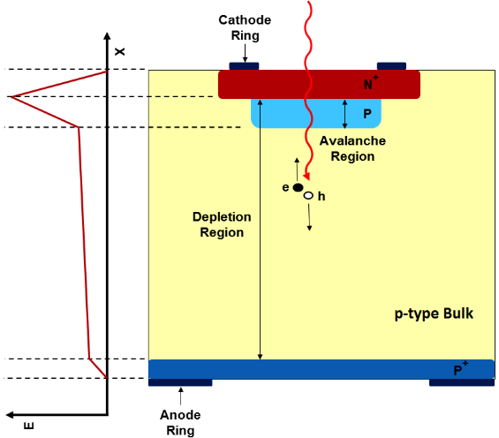
Activities and Results: detector technology for HEP
D-MAPS (Monolithic Active Pixel Sensors) for outer regions
of the pixel tracker upgrades for HL-LHC - FCC
(within DRD3 - Detector R&D - collaboration at CERN)
M.Addison et al.,
https://doi.org/10.3389/fphy.2024.1497267
LGAD – Low Gain Avalanche Detectors
a novel type of particle sensors
with internal gain
timing detectors for ATLAS and
CMS at HL-LHC - FCC
Tested at CERN-SPS and DESY
(also used for proton dosimetry
at CCB-Krakow)
Radiation damage: a critical issue also for silicon detectors in
charged particle tracking. The Ljubljana reactor is a key facility for studying radiation effects on particle detectors

Slide 14
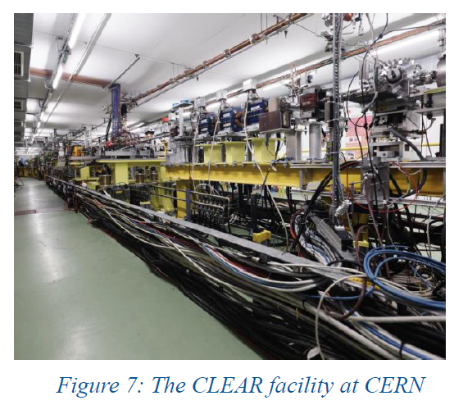
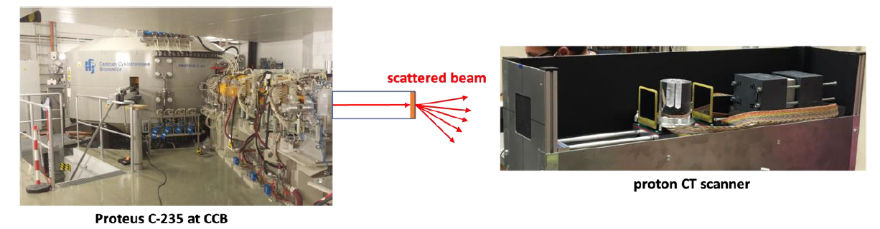
Applied physics in EURO-LABS
A new proton Computed Tomography (CT) scanner at the
CCB proton therapy centre in Krakow (by a Spanish Coll.):
Double-Sided Silicon-Strip Detectors (DSSD) + a scintillator calorimeter to produce high-quality images and accurate proton relative stopping power (RSP) maps
E. Nácher, J.A. Briz, A. Nerio et al., Eur. Phys. J. Plus (2024) 139: 404
A broad range of studies at the INCT-RAPID
electron-beam facility (Warsaw) →
electron accelerators to spur innovation and improve quality of life
FLASH therapy @ EURO-LABS
electrons at CLEAR - CERN
protons at CCB – Krakow
¹²C at GSI

Slide 15
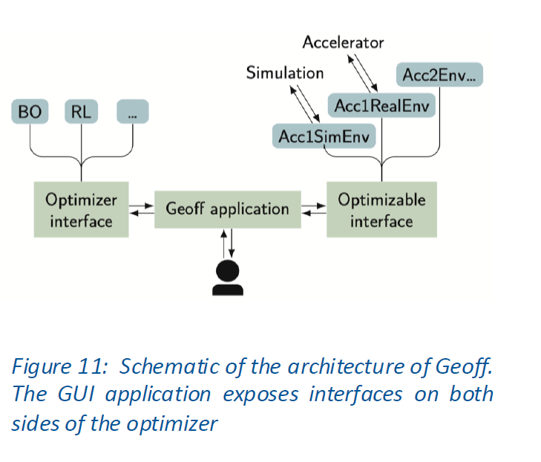
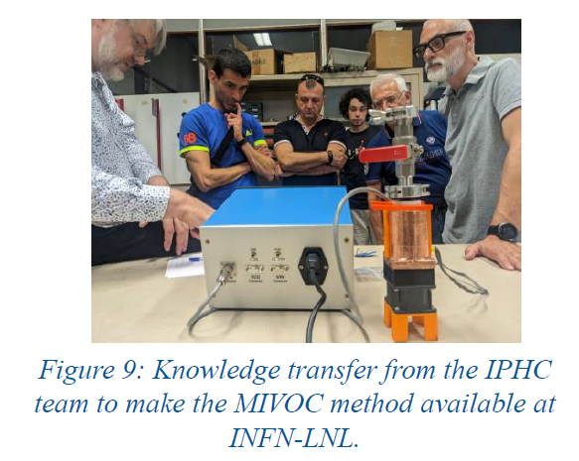
Improved services and technologies @ EURO-LABS RIs
Machine Learning:
Maximizing operational efficiency in accelerator laboratories
(optimal use of beam time for experiments)
→ New machine learning toolkit
- Generic Optimization Framework and Front-End (Geoff) -
developed at CERN and installed at GSI
https://gitlab.cern.ch/geoff/geoff-app/
Geoff integrates a wide range of optimization algorithms,
leveraging the extensive Python ecosystem
Geoff's success at both CERN and GSI highlights its potential to become a standard → KIT and GANIL
Remote Access:
- A user-friendly database on remote-access tools currently in use
at EURO-LABS facilities available at https://eurolabs-remote.gsi.de/
- Tools of remote control of the experimental irradiation setup implemented at the PARTREC facility, to minimize the amount
of personnel needed on-site
New beams and targets for NP experiments:
ERIBS coll.: improve the variety and intensity of
metal ion beams
- MIVOC (Metal Ions from VOlatile Compounds) coll.
enriched ion beams available to partner institutes
- A database for targets available and
newly developed in the EURO-LABS Ris
soon available on the web

Slide 16
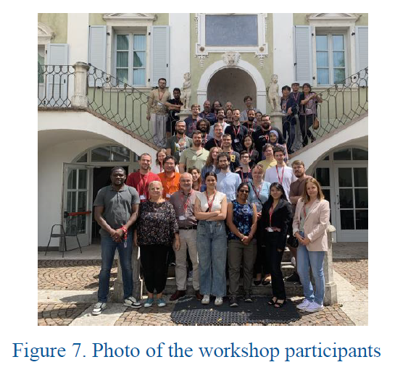
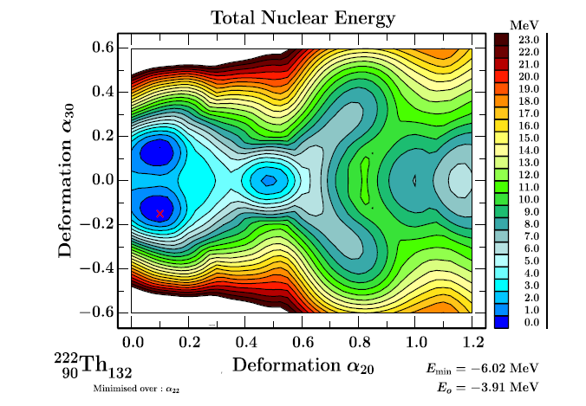
Theoretical support: a sustainable effort
A major achievement of EURO-LABS: the Theo4Exp Virtual Access facility offers user-friendly access to cutting-edge theoretical tools, software, and datasets relevant to the NP community
ECT* hosting the Theo4Exp workshop
https://institucional.us.es/theo4exp
+ continuous support for TA at ECT* - Trento for
collaboration meetings and workshops!

Slide 17
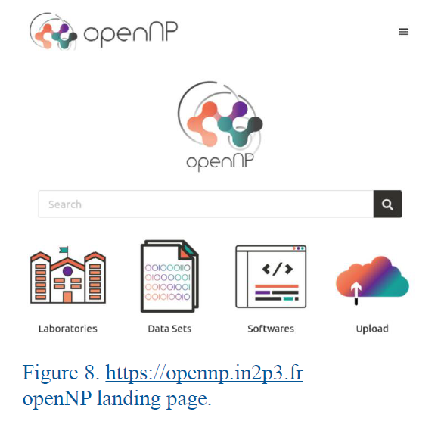
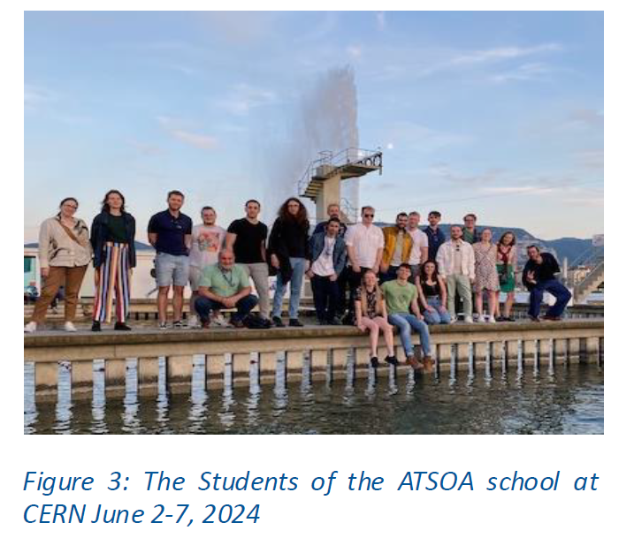
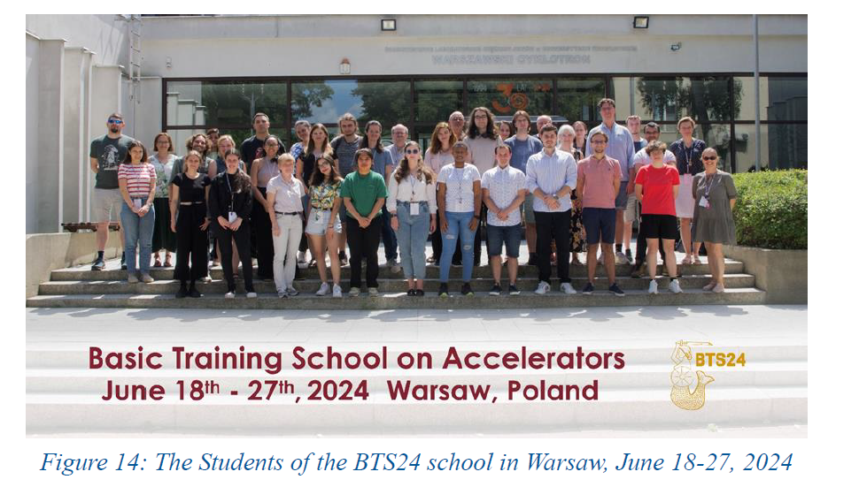
Open Science and Training
Open Science in EURO-LABS:
- harmonised, FAIR-compliant (Findable, Accessible,
Interoperable, Reusable) practices
- creation of a tailored dataset catalogue for RIs
involved in nuclear physics experiments; IAM authentication
Training the next generation of researchers:
4 Basic Training Schools (INFN-HH, Warsaw, Sevilla)
3 Avanced Schools on Accelerators (CERN)
2 Advanced Schools on Open Science (GSI, GANIL)
A sustainable effort!
A Governing Board and a Curator Board
have been established
INTRANS: Training the next generation of researchers:
to enhance expertise in nuclear structure methodologies across European RIs (spectroscopic tools and data-analysis frameworks)

Slide 18
Impact: touchable evidences
Results: publications, talks and workshops and conferences
Sustainability: many efforts will remain beyond EURO-LABS:
- New integrated infrastructures (CLEAR), The4Exp, Open Science, Machine Learning,
service improvements
- Cross-fertilization, collaborative efforts for applied research
Training the new generation of researchers
Societal impact: communication activities to foster knowledge in science,
Training, nuclear science for medicine and multidisciplinary purpouses

