Slide 1
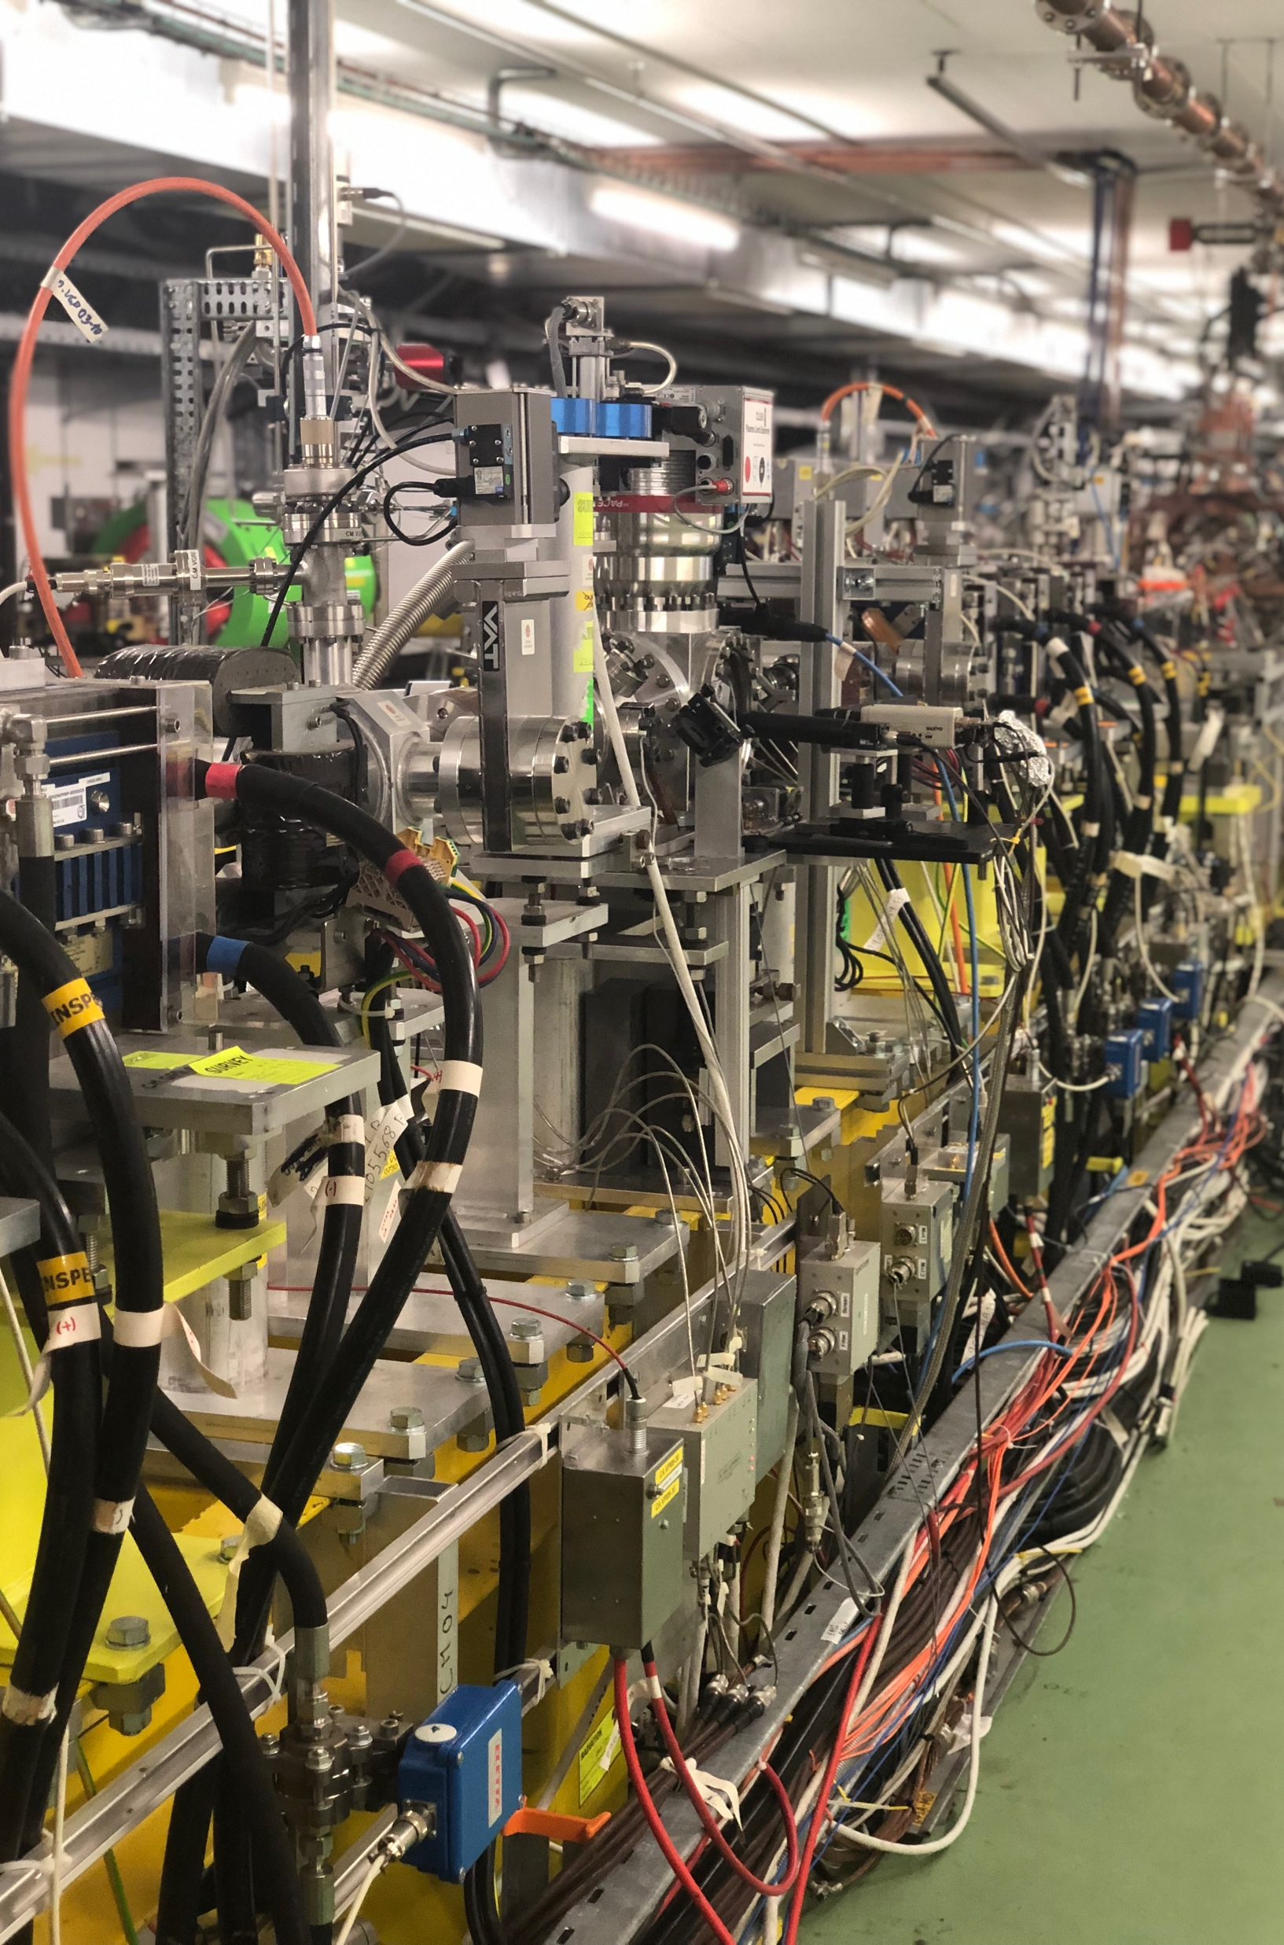




EURO-LABS@CLEAR: Experiments, Infrastructure, and Training at a Cutting-Edge Accelerator Facility
FINal EURO-LABS
Antonio Gilardi
On behalf of the CLEAR team
This project has received funding from the European Union’s Horizon Europe Research and Innovation programme under Grant Agreement No 101057511.
FINal EURO-LABS - 2026 antonio.gilardi@cern.ch 01/32

Slide 2
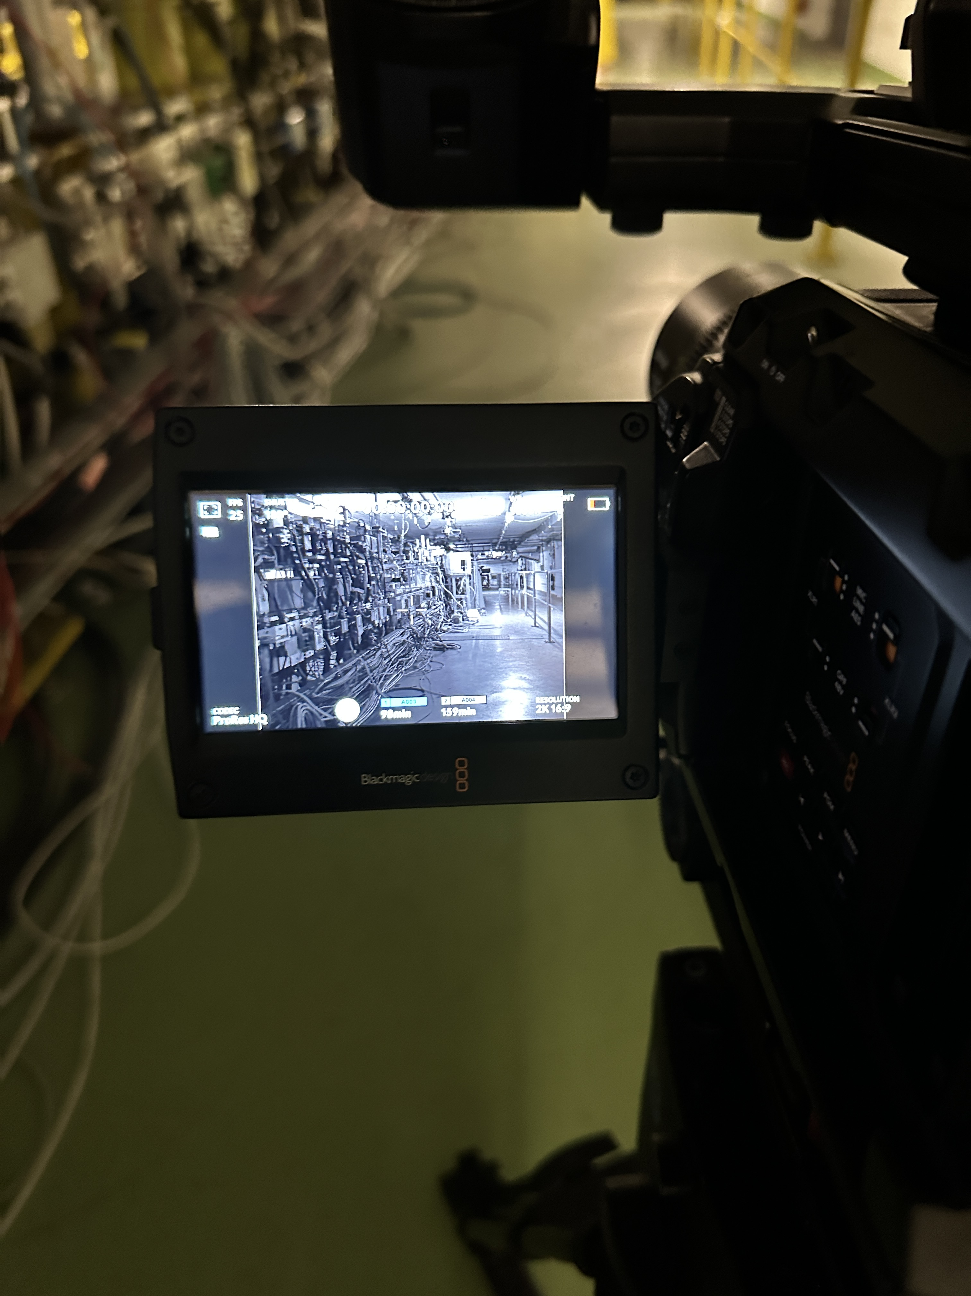
Table of Contents
The CLEAR facility
03
Where we stand currently and how the facility looks like
Main features & parameters
13
In a nutshell the facility capability
EURO-LABS Experiments
15
Selected results from activities/experiments
Infrastructural upgrades
24
Selected facility improvement
EURO-LABS Trainings
31
Training activities carried out over the last 3-years
Conclusion & Outlook
32
Summary
Everything I am reporting here is the result of a tremendous team effort.
None of this would have been possible without the hard work, dedication, and collaboration of our team.
FINal EURO-LABS - 2026 antonio.gilardi@cern.ch 02/32

Slide 3

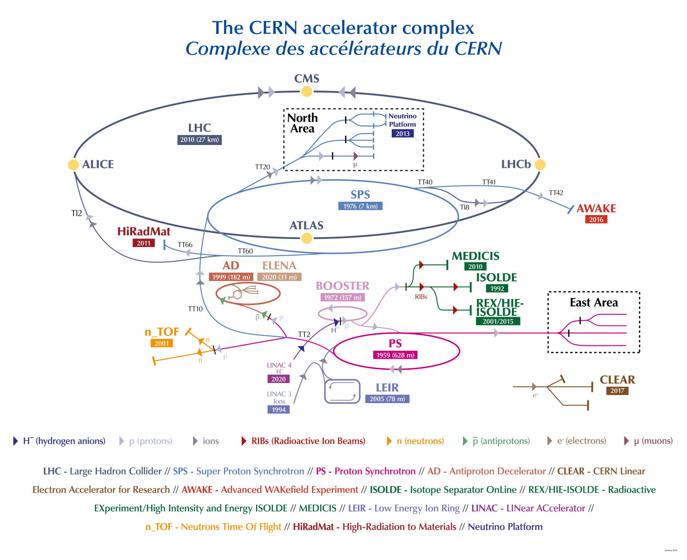


The CLEAR facility
WHAT WE DO
CLEAR operates as an independent accelerator, which allows it to run even when the broader CERN accelerator complex is shut down (e.g., LS3) .
Each year, CLEAR typically operates for about 30–40 weeks, usually from March through December.
FLEXIBLE
https://cds.cern.ch/record/2953421
FINal EURO-LABS - 2026 antonio.gilardi@cern.ch 03/32

Slide 4
The CLEAR facility
ACCOMPLISHED THIS YEAR
~20m
~20m
FINal EURO-LABS - 2026 antonio.gilardi@cern.ch 04/32

Slide 5


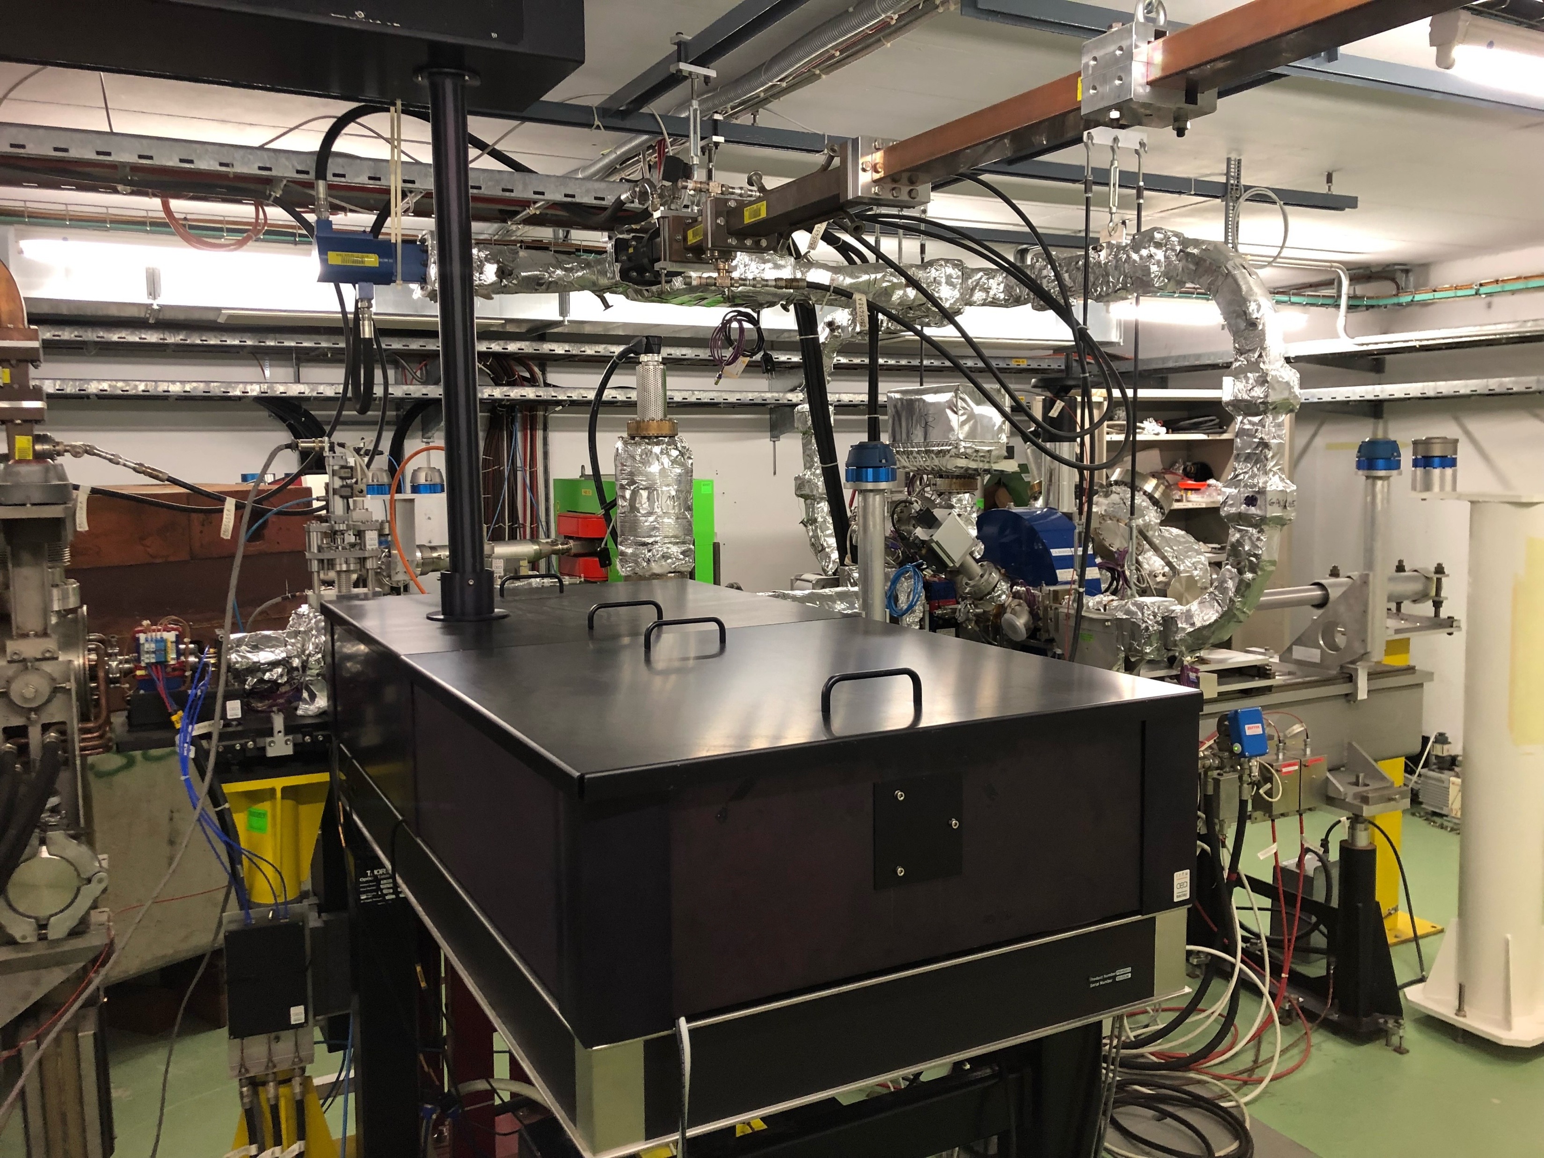
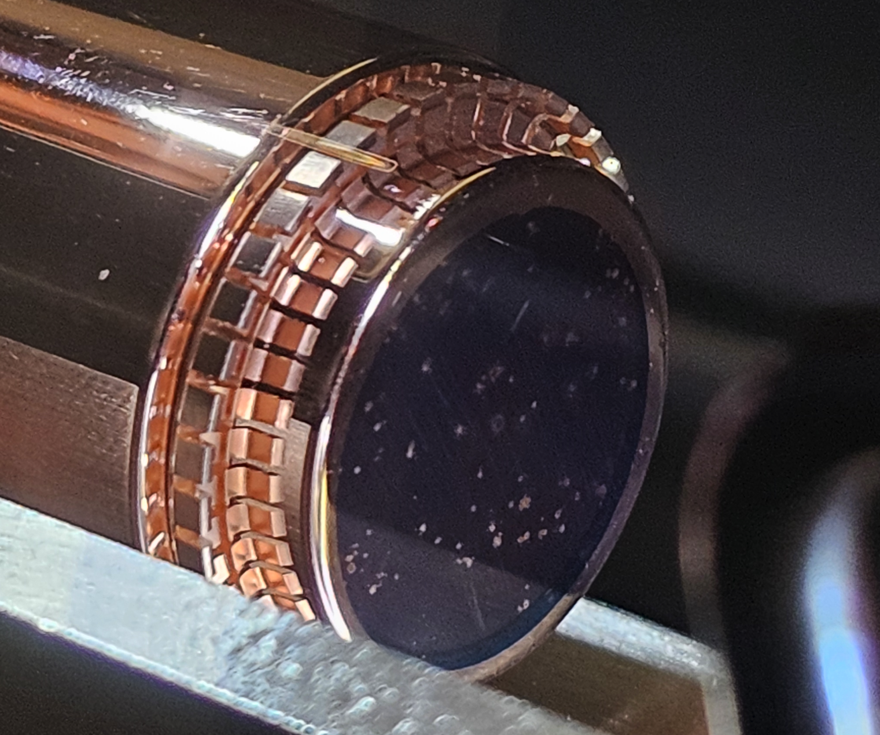
The CLEAR facility
ACCOMPLISHED THIS YEAR
~20m
~20m
FINal EURO-LABS - 2026 antonio.gilardi@cern.ch 05/32

Slide 6
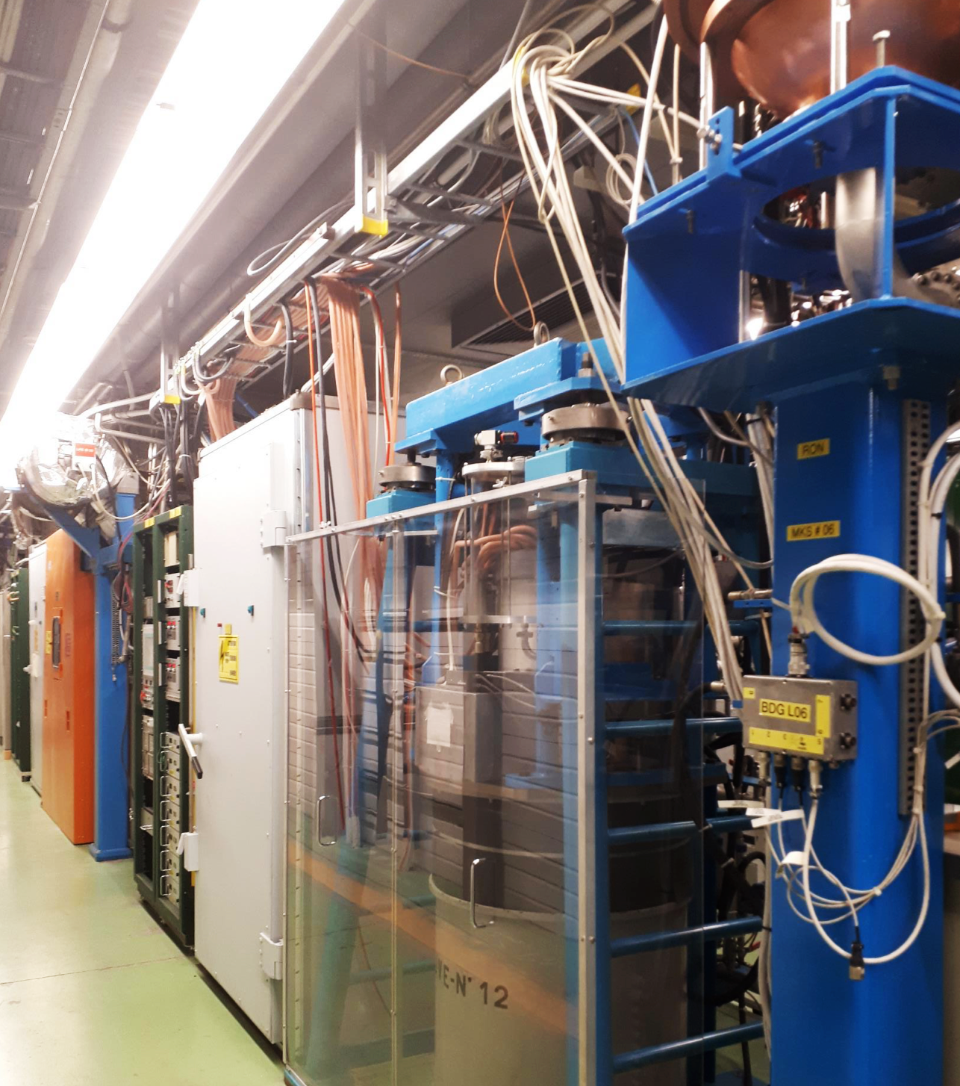
The CLEAR facility
ACCOMPLISHED THIS YEAR
~20m
~20m
FINal EURO-LABS - 2026 antonio.gilardi@cern.ch 06/32

Slide 7
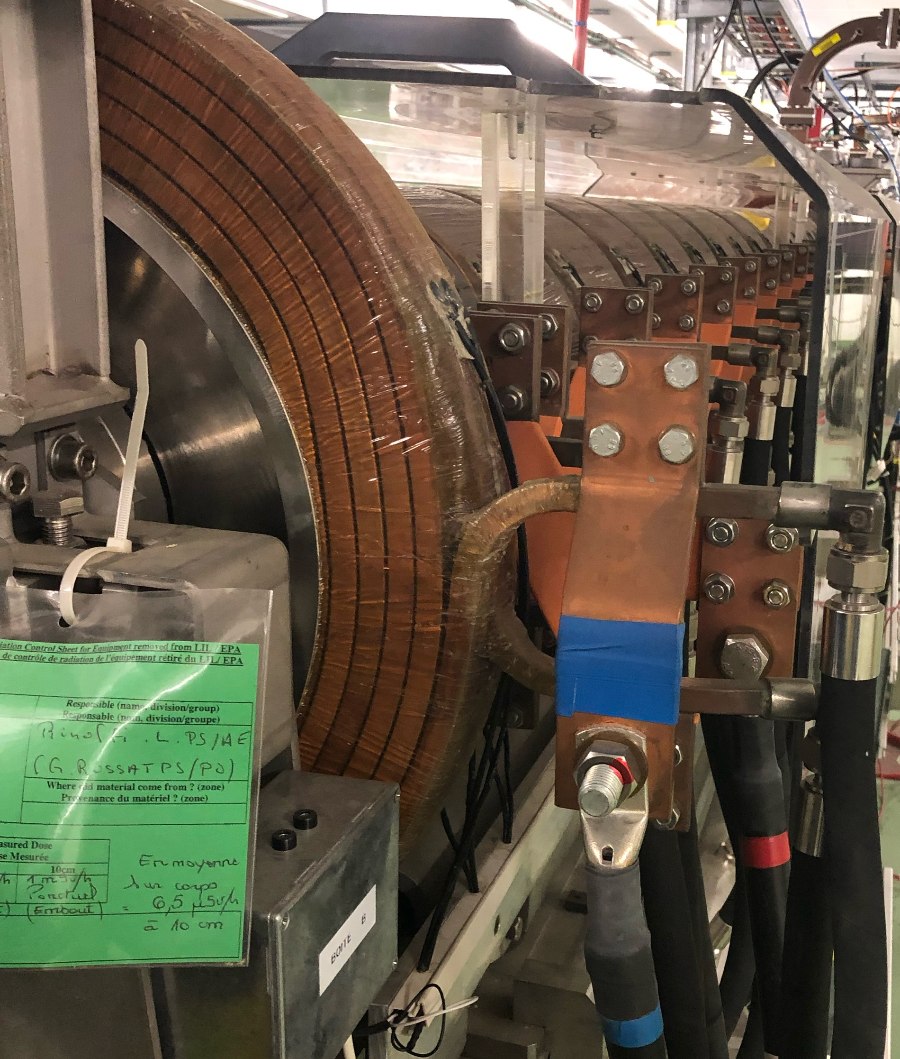
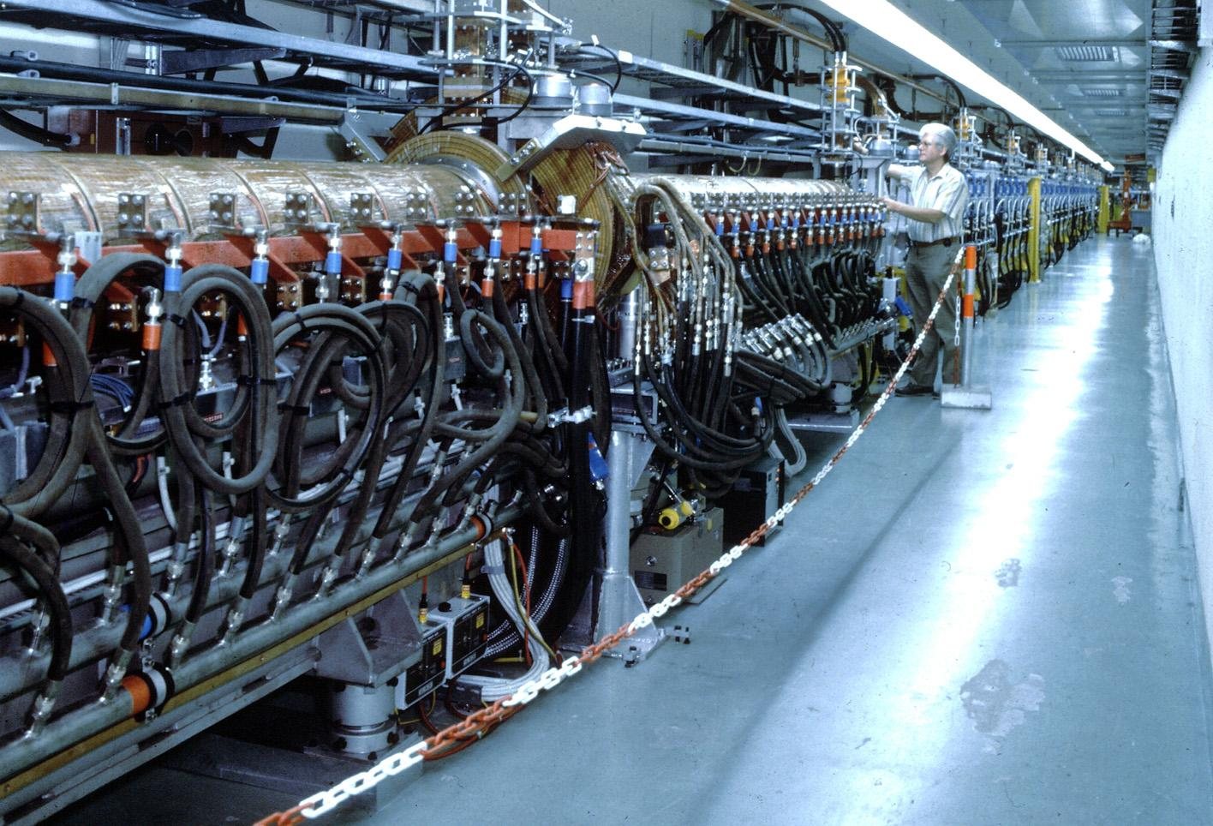

The CLEAR facility
1986
ACCOMPLISHED THIS YEAR
~20m
~20m
FINal EURO-LABS - 2026 antonio.gilardi@cern.ch 07/32

Slide 8

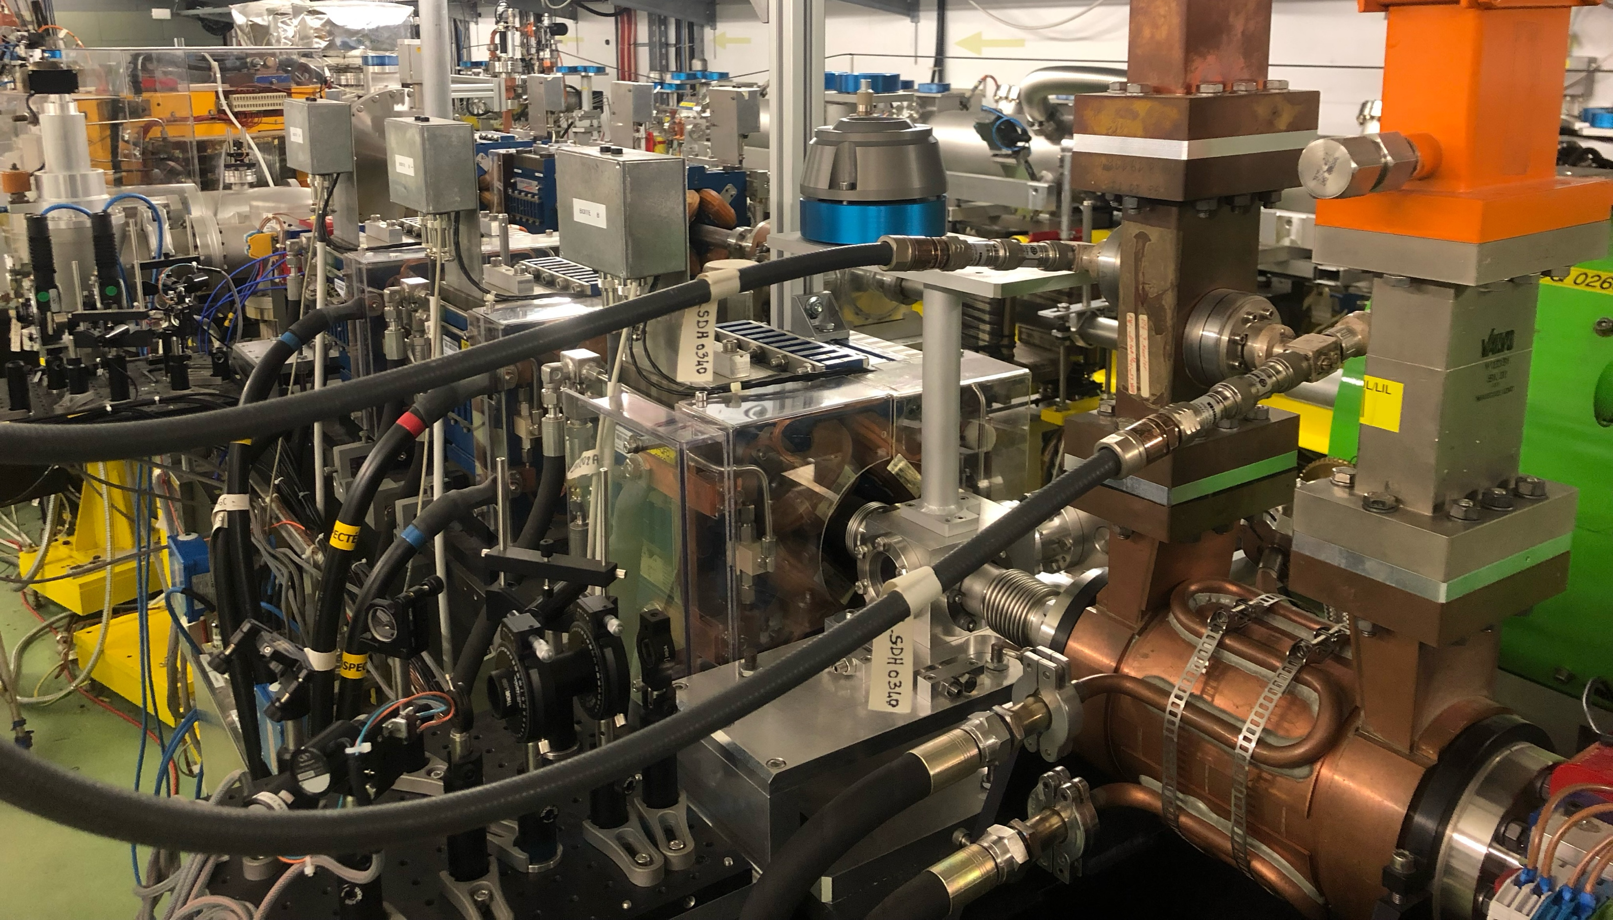
The CLEAR facility
ACCOMPLISHED THIS YEAR
~20m
~20m
~20m
FINal EURO-LABS - 2026 antonio.gilardi@cern.ch 08/32

Slide 9

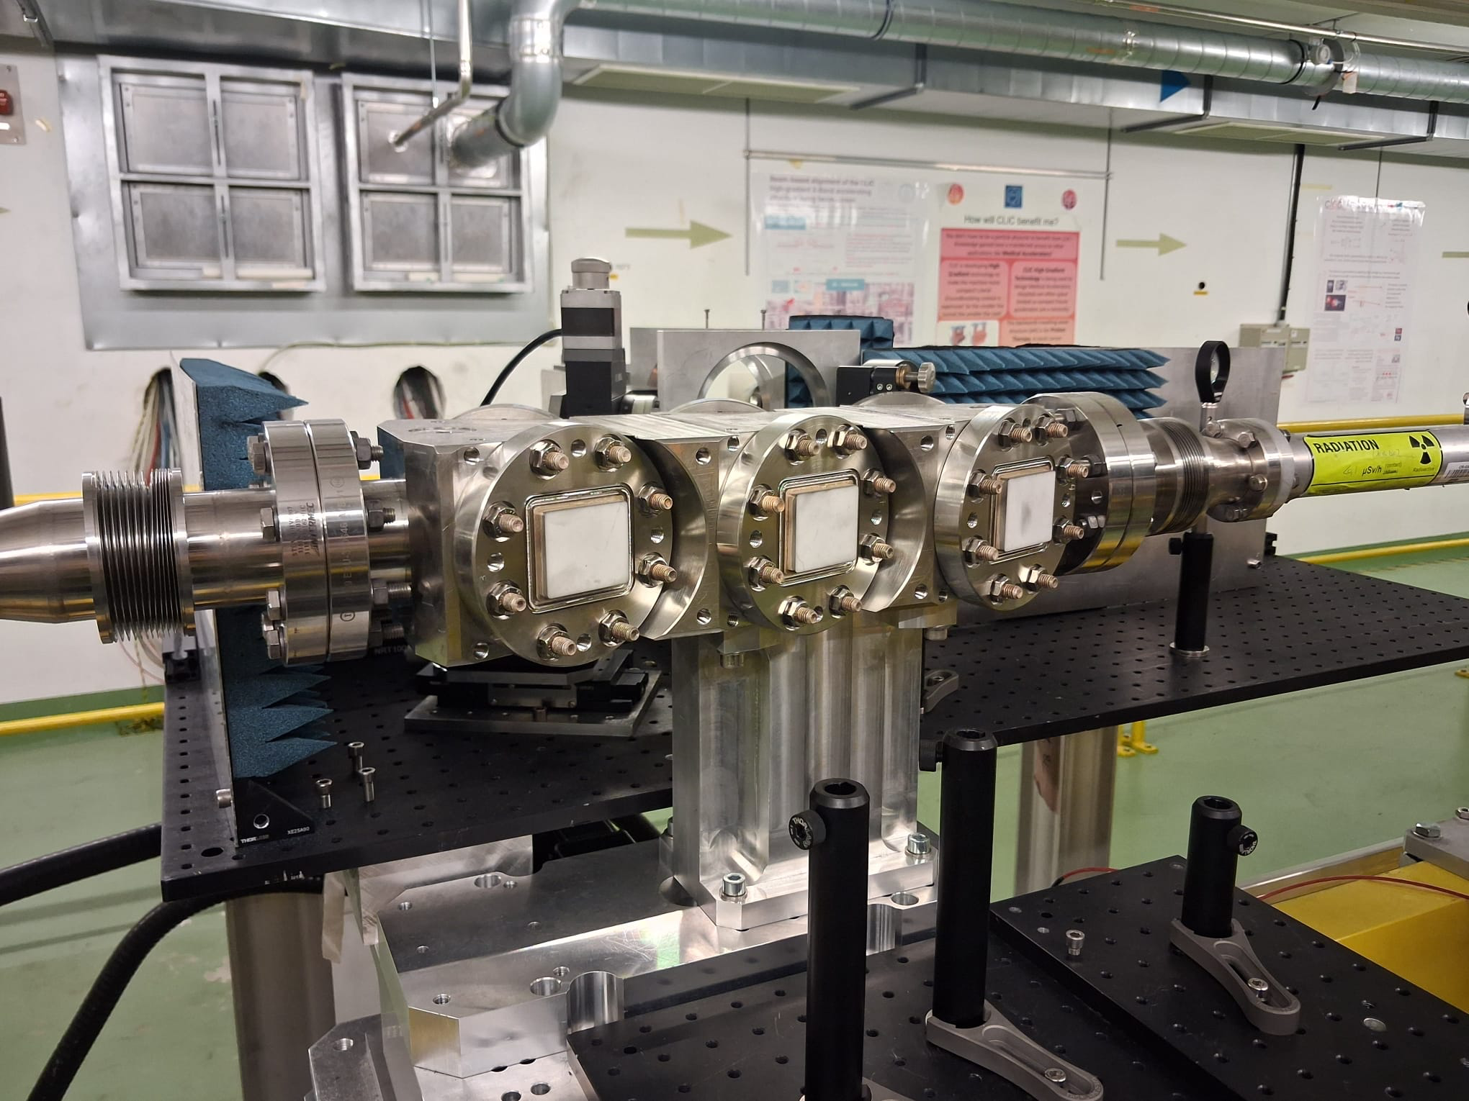
The CLEAR facility
ACCOMPLISHED THIS YEAR
~20m
~20m
FINal EURO-LABS - 2026 antonio.gilardi@cern.ch 09/32

Slide 10
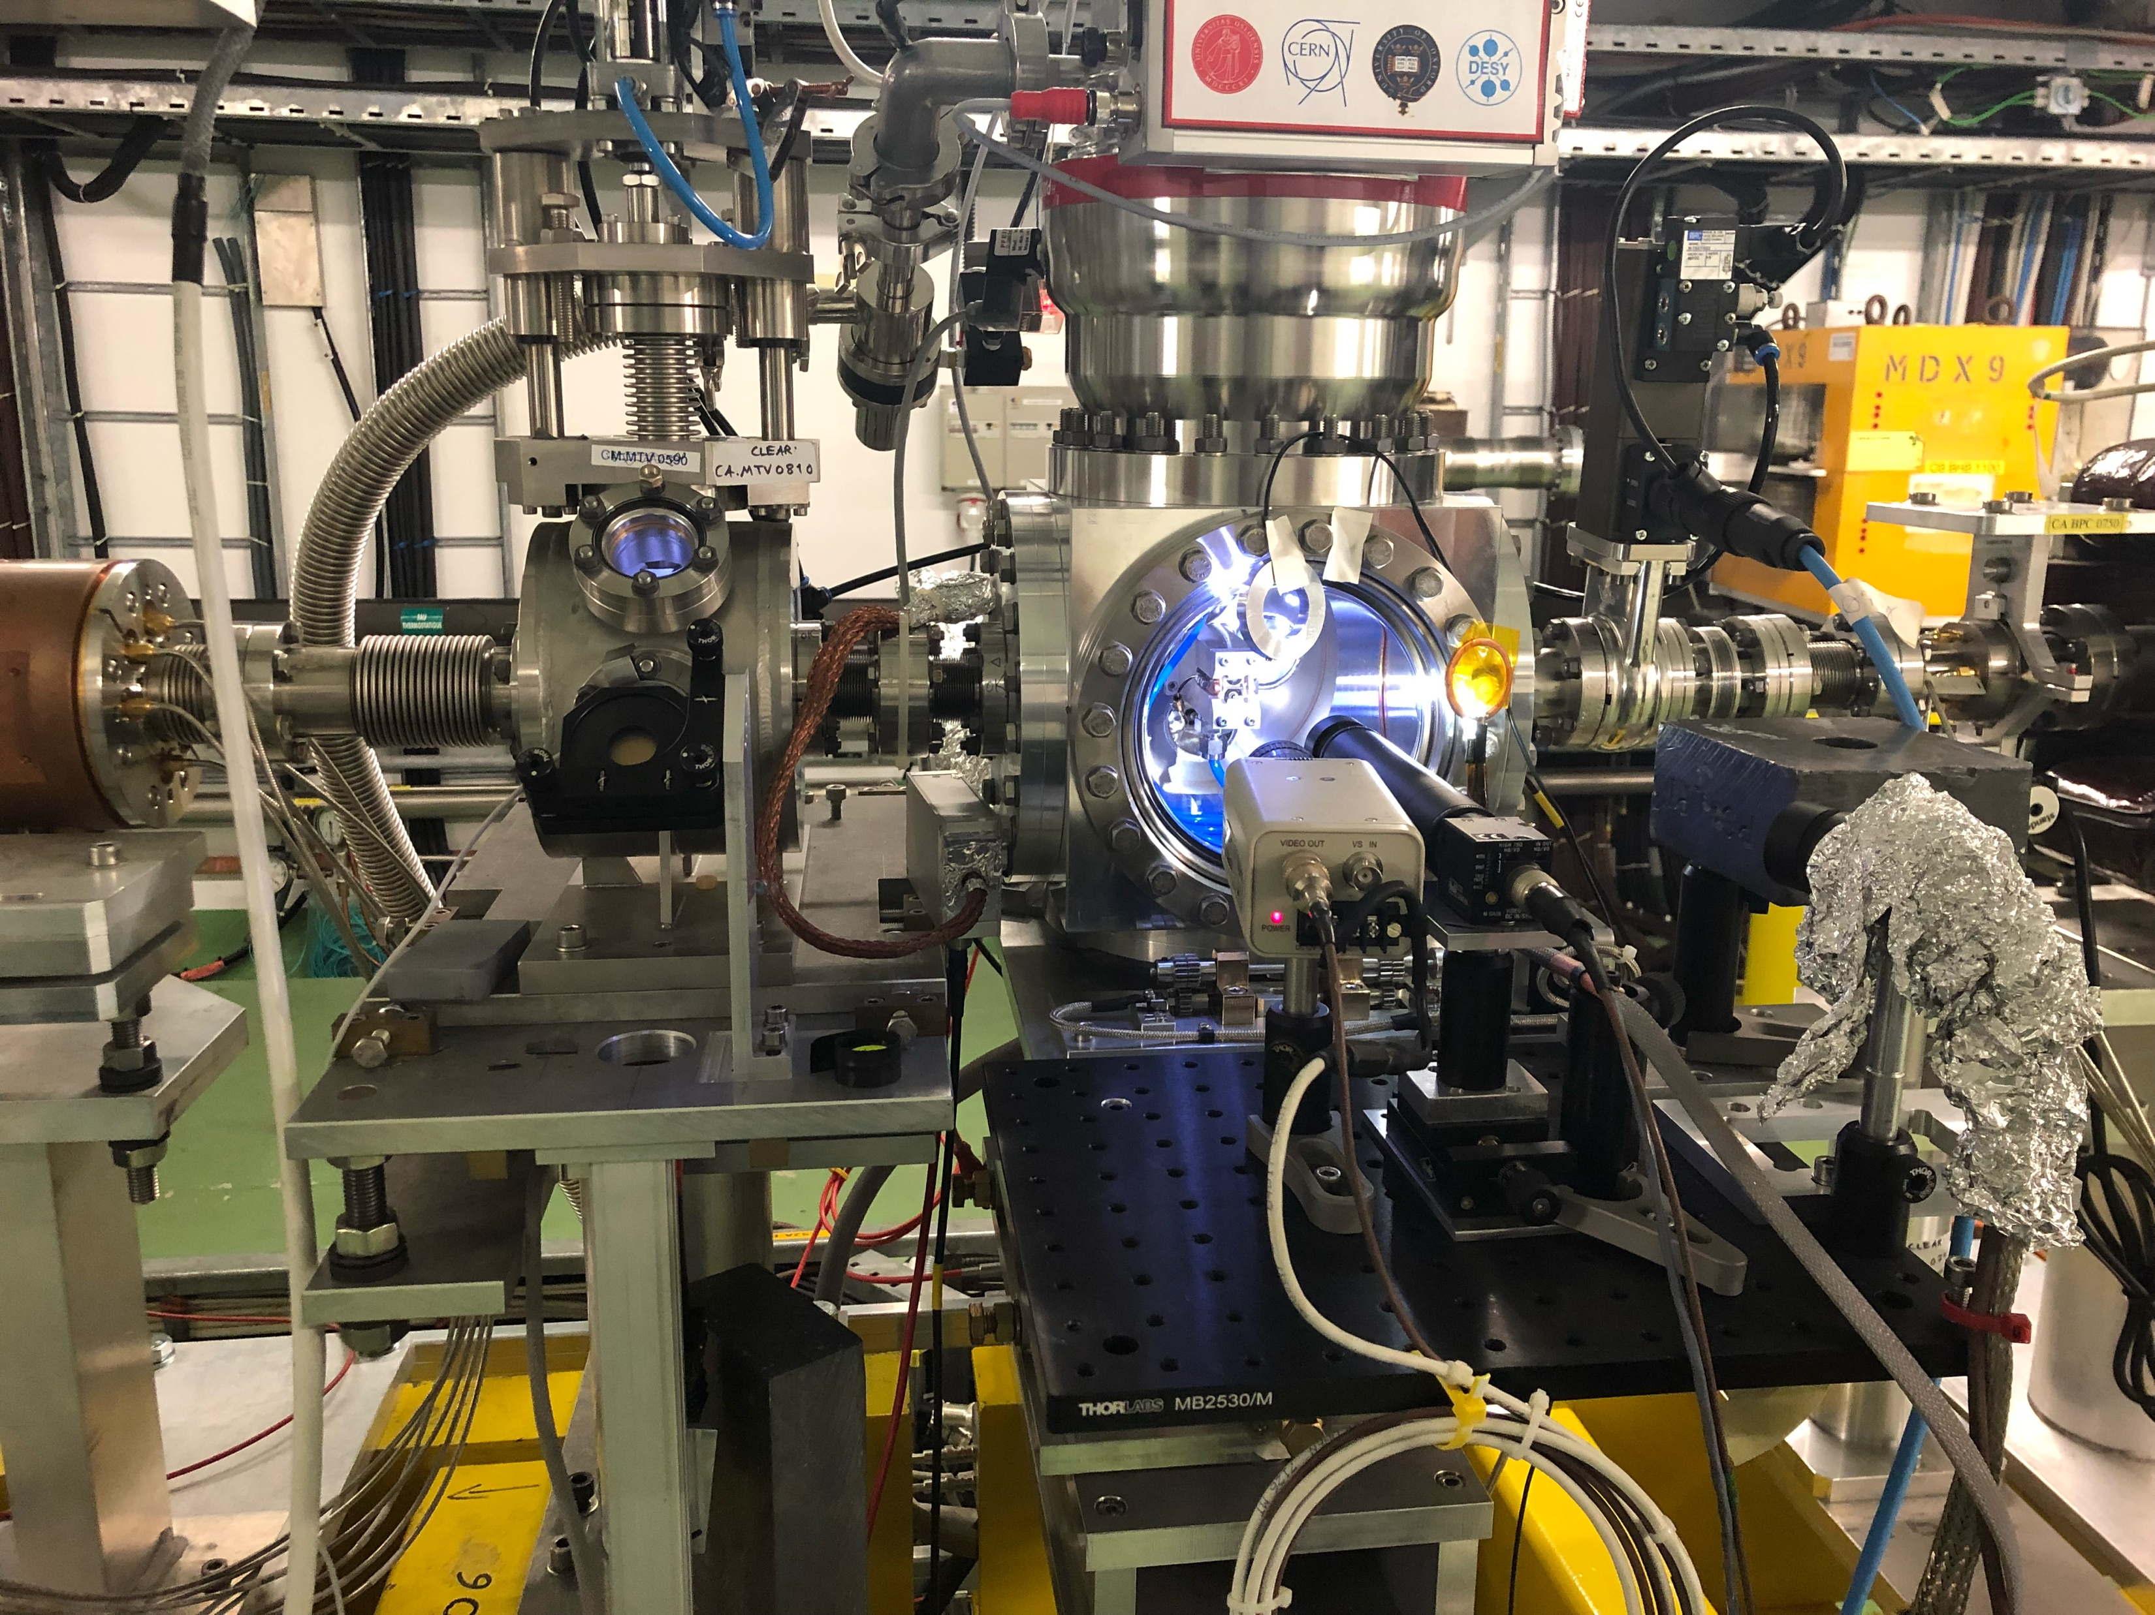

The CLEAR facility
ACCOMPLISHED THIS YEAR
~20m
~20m
FINal EURO-LABS - 2026 antonio.gilardi@cern.ch 10/32

Slide 11

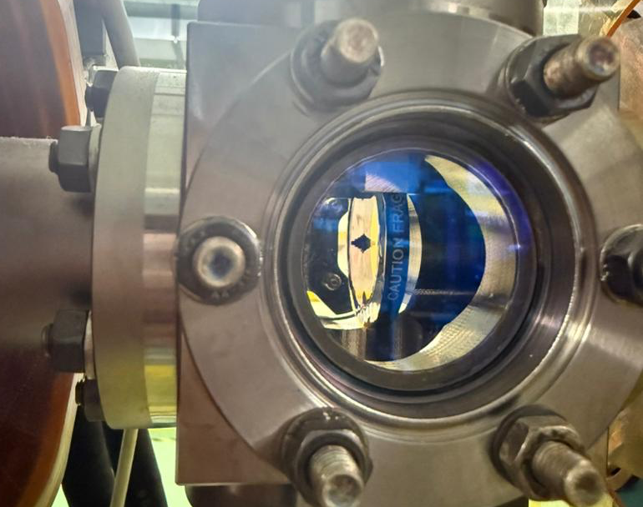
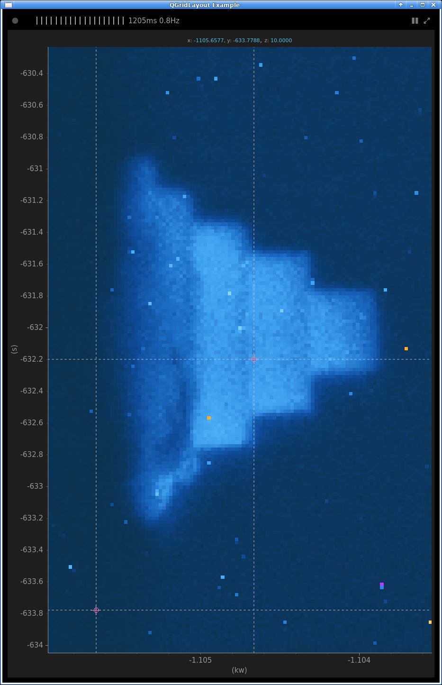
The CLEAR facility
ACCOMPLISHED THIS YEAR
~20m
~20m
FINal EURO-LABS - 2026 antonio.gilardi@cern.ch 11/32

Slide 12

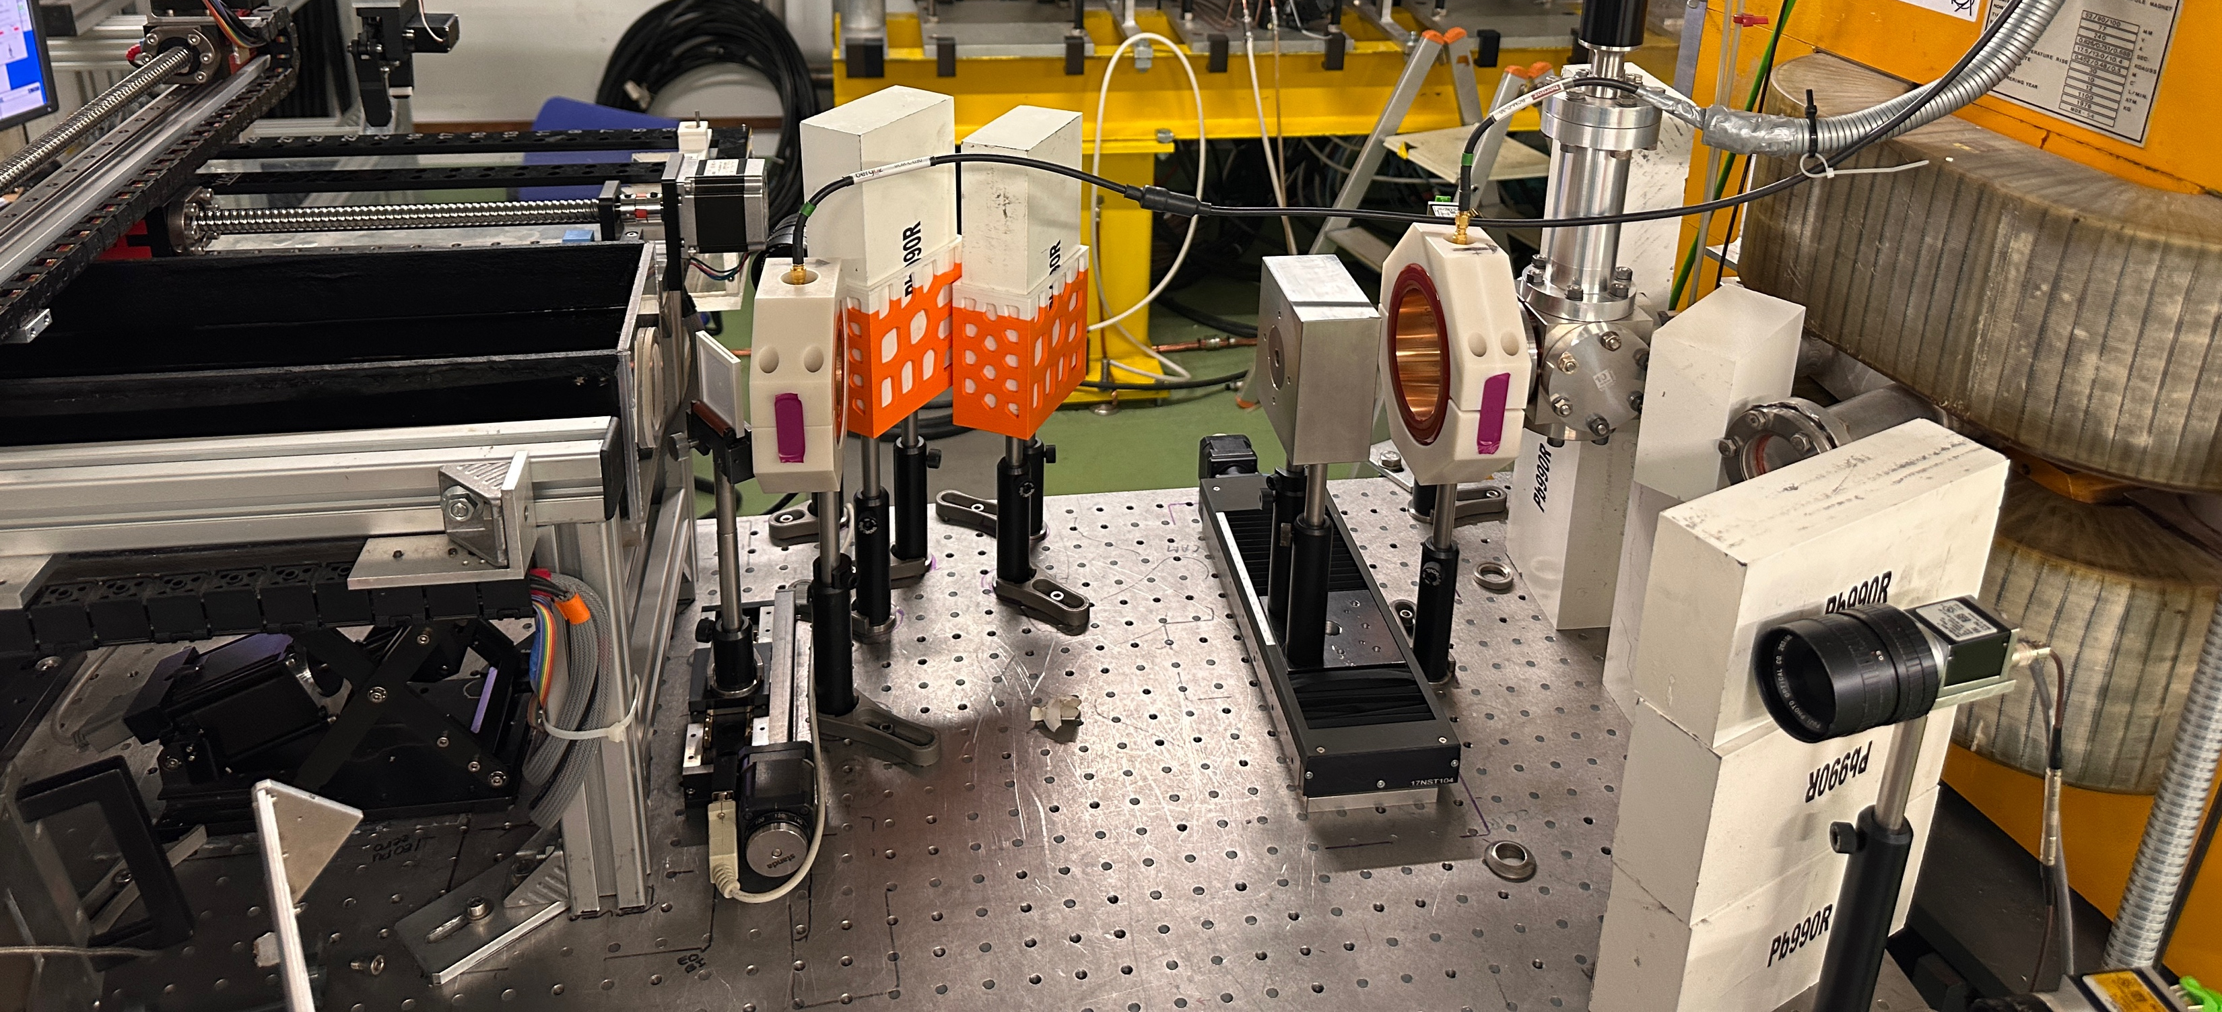
The CLEAR facility
ACCOMPLISHED THIS YEAR
~20m
~20m
20m
FINal EURO-LABS - 2026 antonio.gilardi@cern.ch 12/32

Slide 13
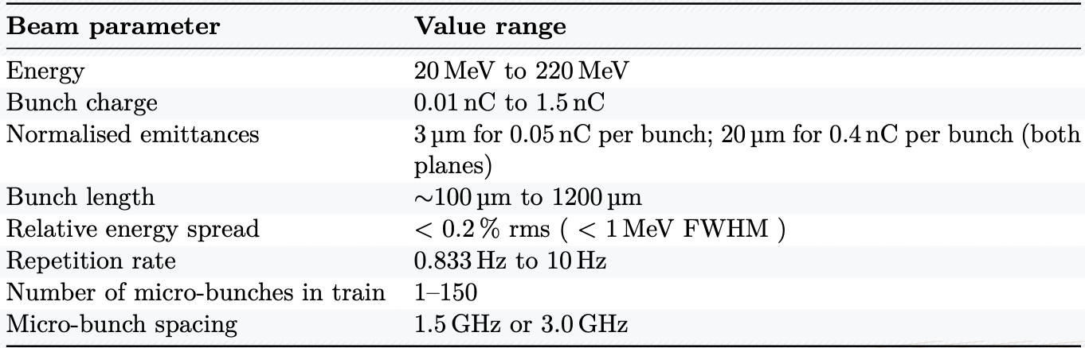
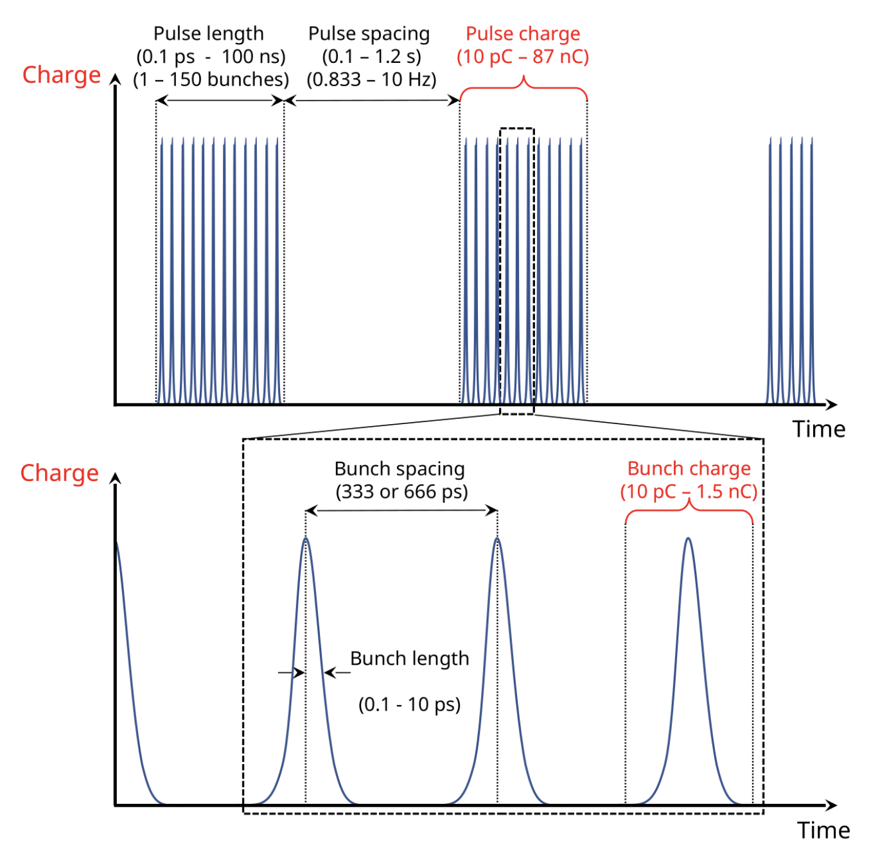
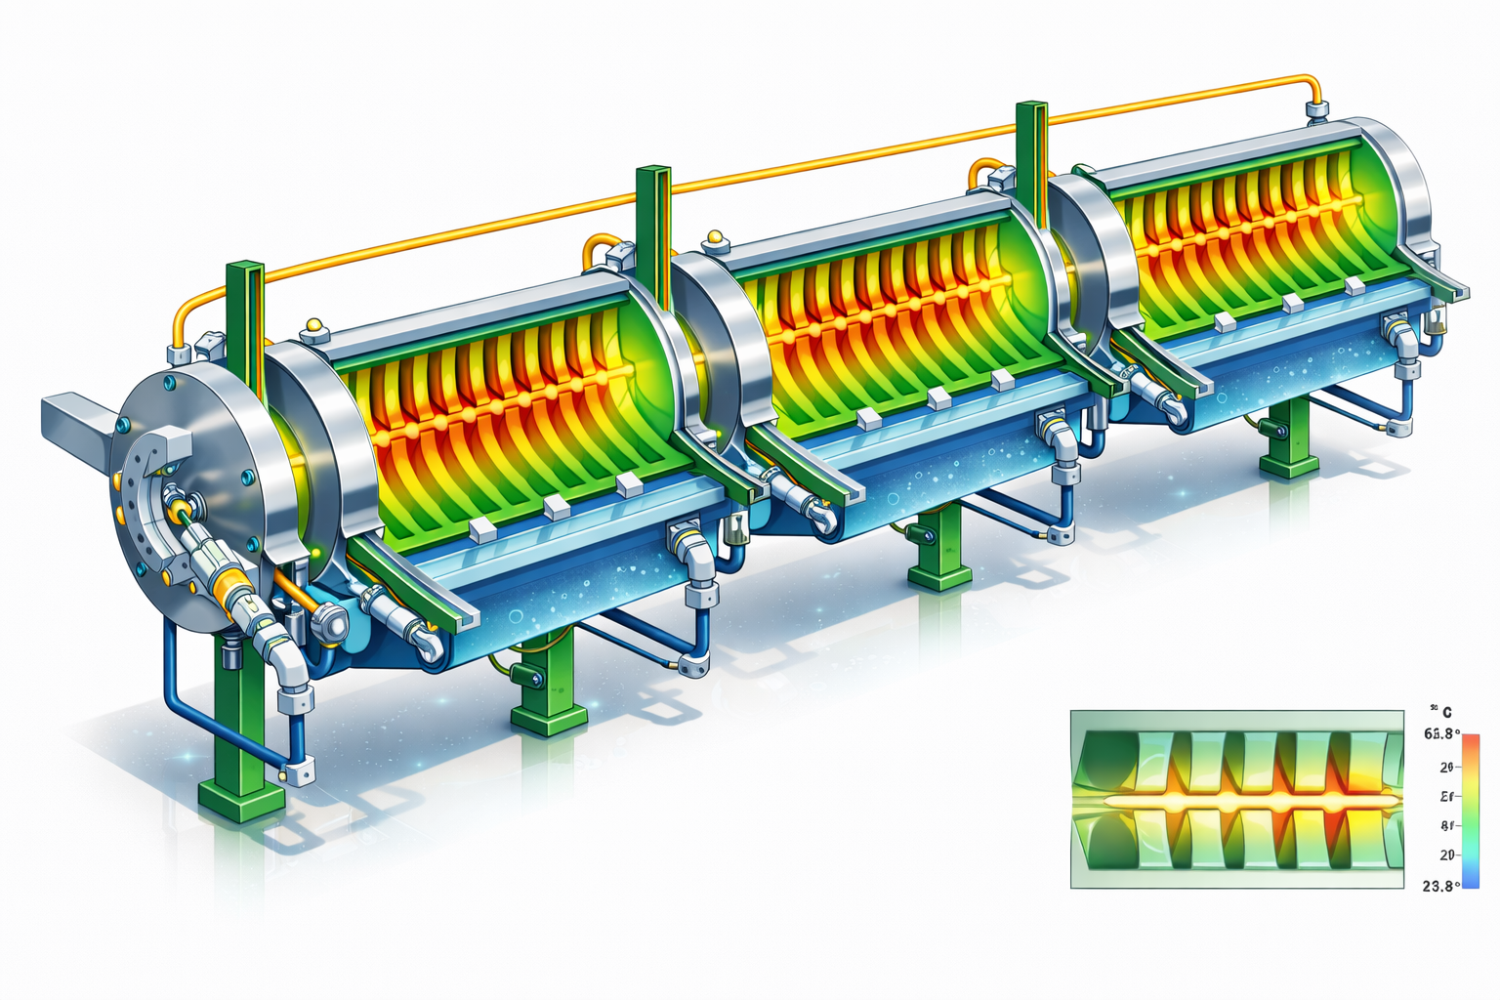
Main features & parameters
0.833 Hz
1.667 Hz
5 Hz
10 Hz
FINal EURO-LABS - 2026 antonio.gilardi@cern.ch 13/32

Slide 14
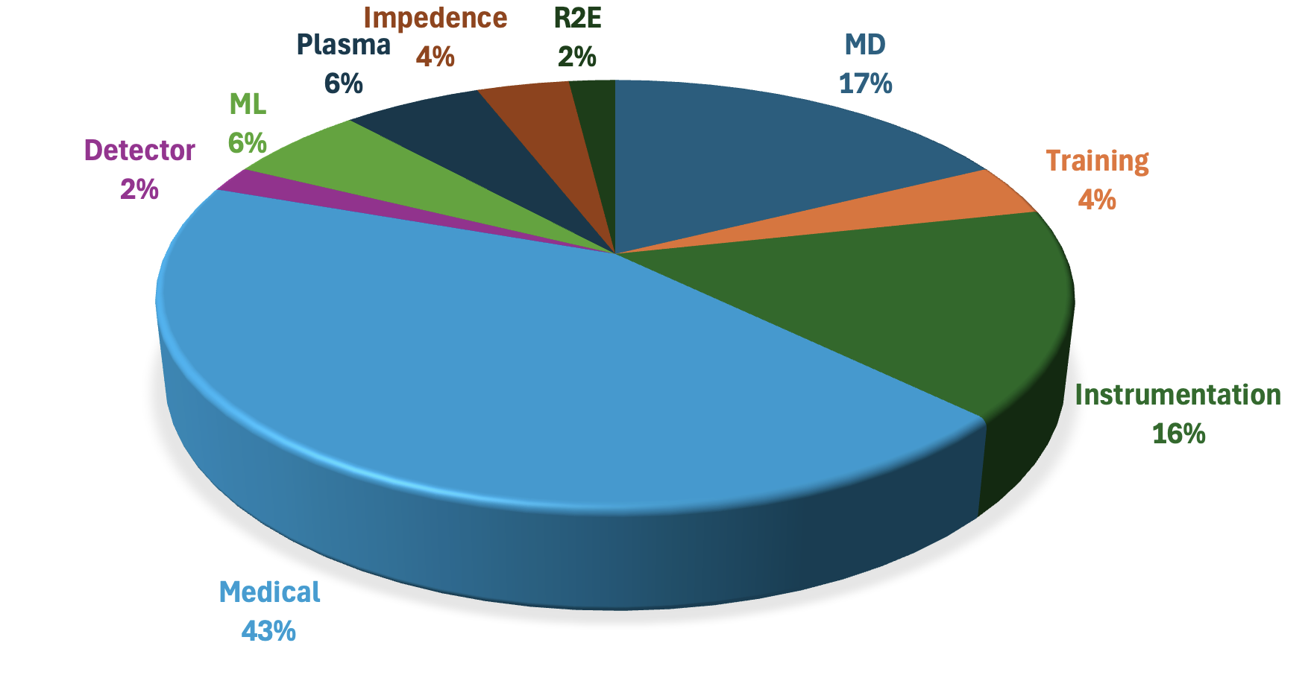
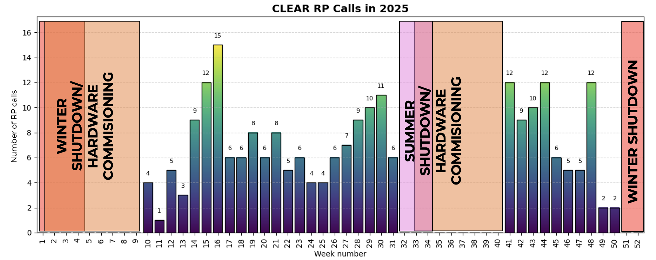
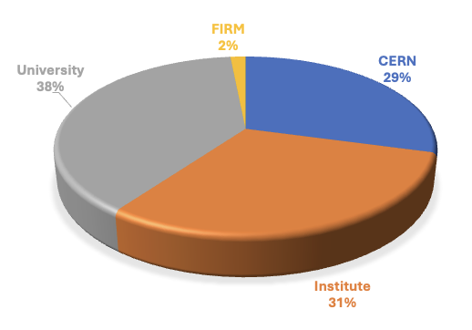
Main features & parameters
EXPERIMENT TYPE DISTRIBUTION
EXPERIMENT ORIGIN DISTRIBUTION
FINal EURO-LABS - 2026 antonio.gilardi@cern.ch 14/32

Slide 15
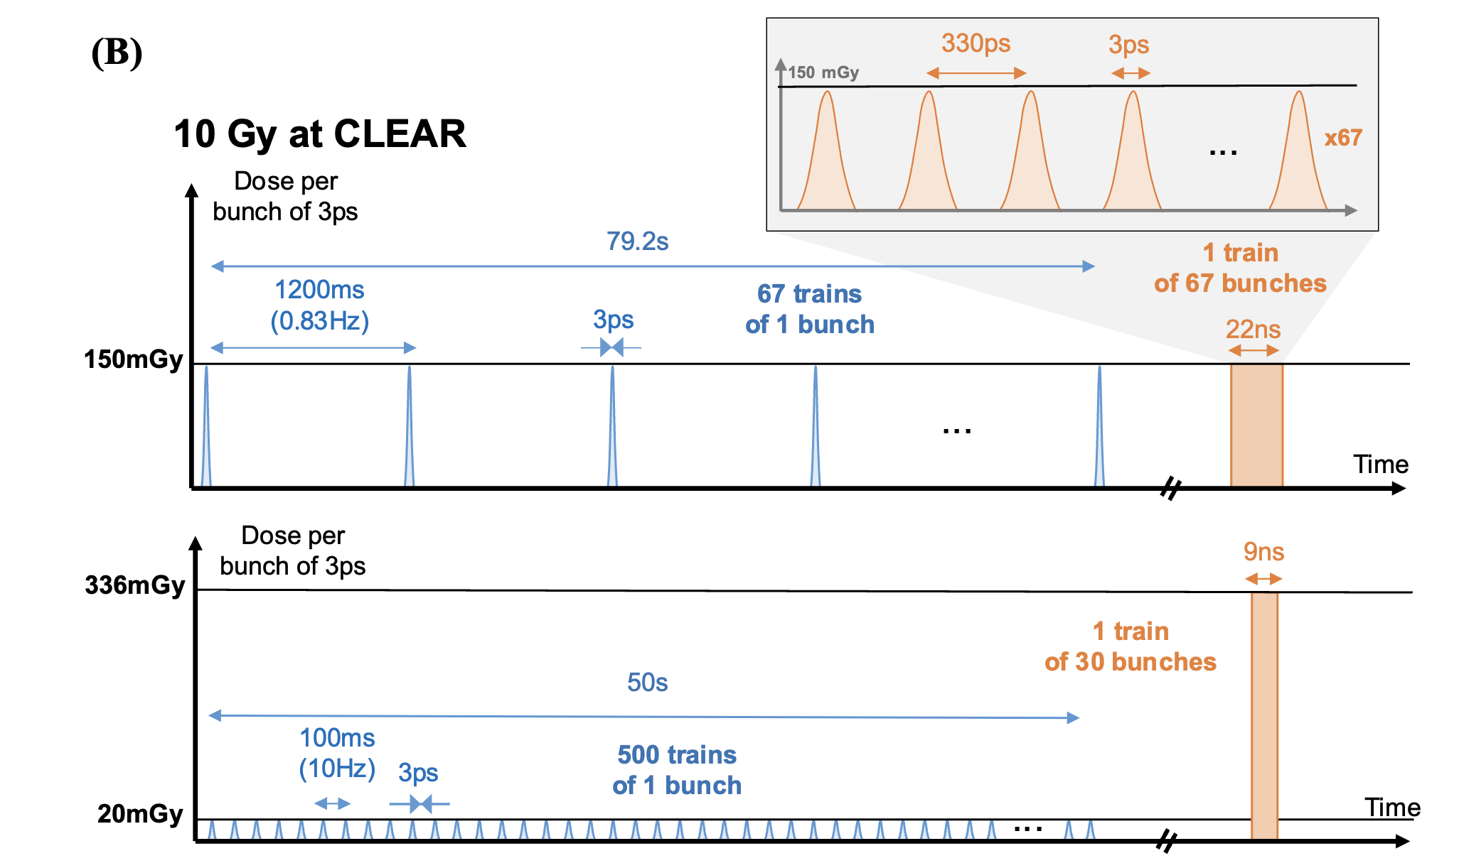
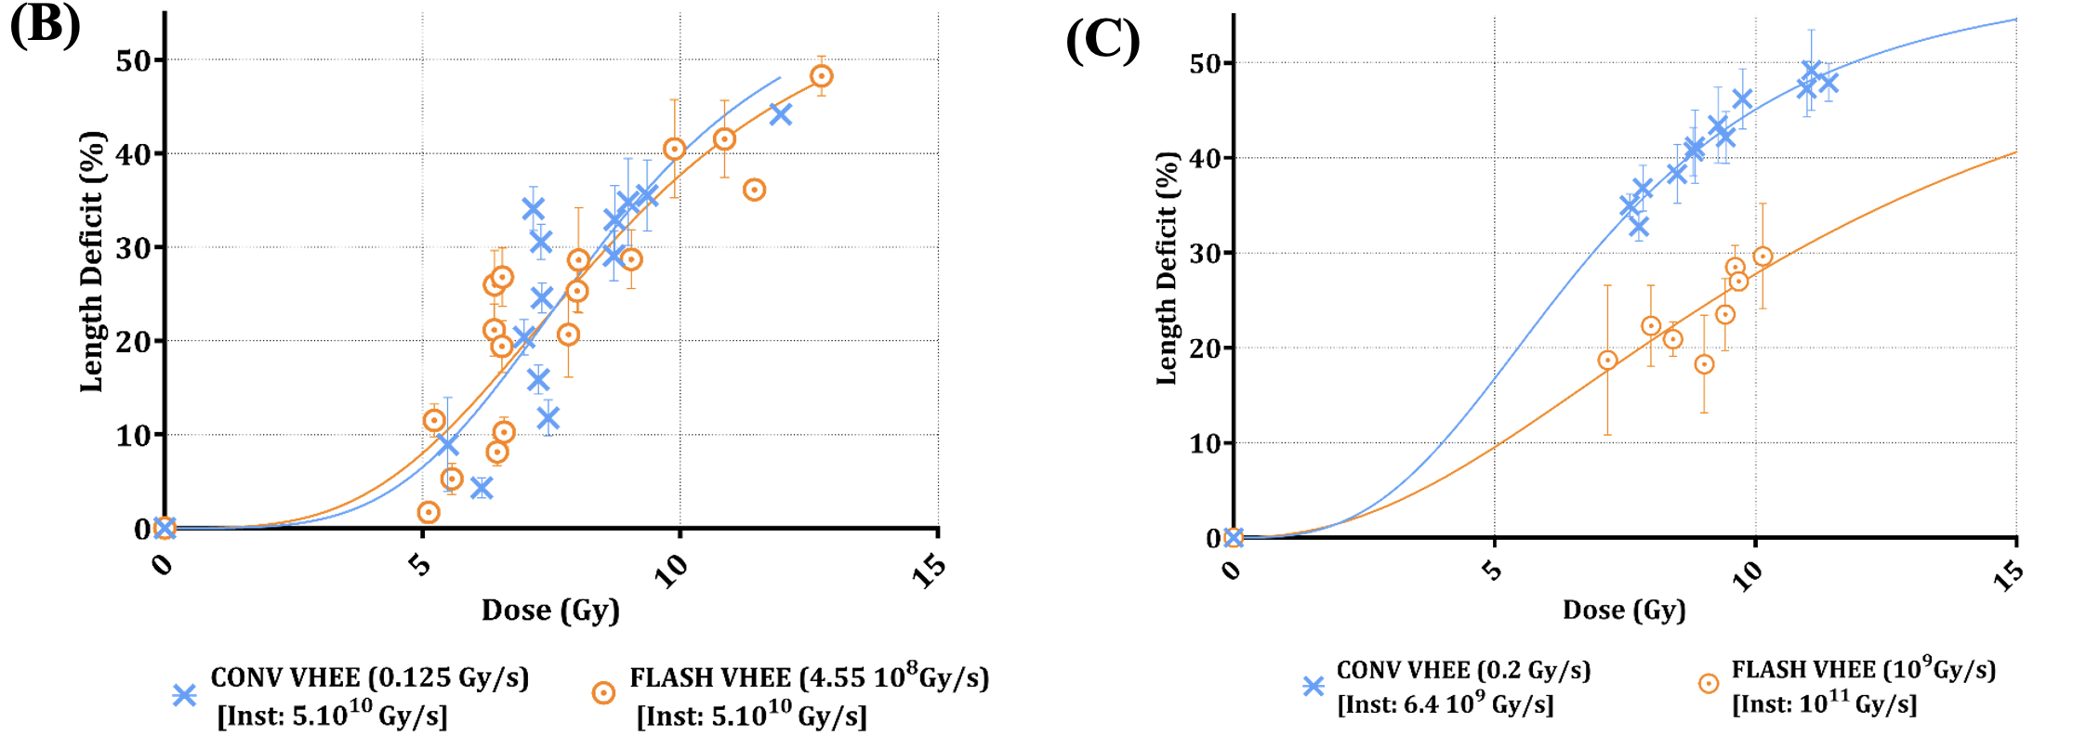
EURO-LABS Experiments
MEDICAL EXPERIMENT
Same “instantaneous” dose rate
Factor ~ 15 in “instantaneous” dose rate
Kacem, Houda, et al. "Modification of the microstructure of the CERN-CLEAR-VHEE beam at the picosecond scale modifies ZFE morphogenesis but has no impact on hydrogen peroxide production." Radiotherapy and Oncology 209 (2025): 110942.
FINal EURO-LABS - 2026 antonio.gilardi@cern.ch 15/32

Slide 16
EURO-LABS Experiments
MEDICAL EXPERIMENT
Same “instantaneous” dose rate
Factor ~ 15 in “instantaneous” dose rate
UNIFORM DOSE DELIVERY
DOSIMETRY FOR HIGH DOSE RATE
Kacem, Houda, et al. "Modification of the microstructure of the CERN-CLEAR-VHEE beam at the picosecond scale modifies ZFE morphogenesis but has no impact on hydrogen peroxide production." Radiotherapy and Oncology 209 (2025): 110942.
FINal EURO-LABS - 2026 antonio.gilardi@cern.ch 16/32

Slide 17

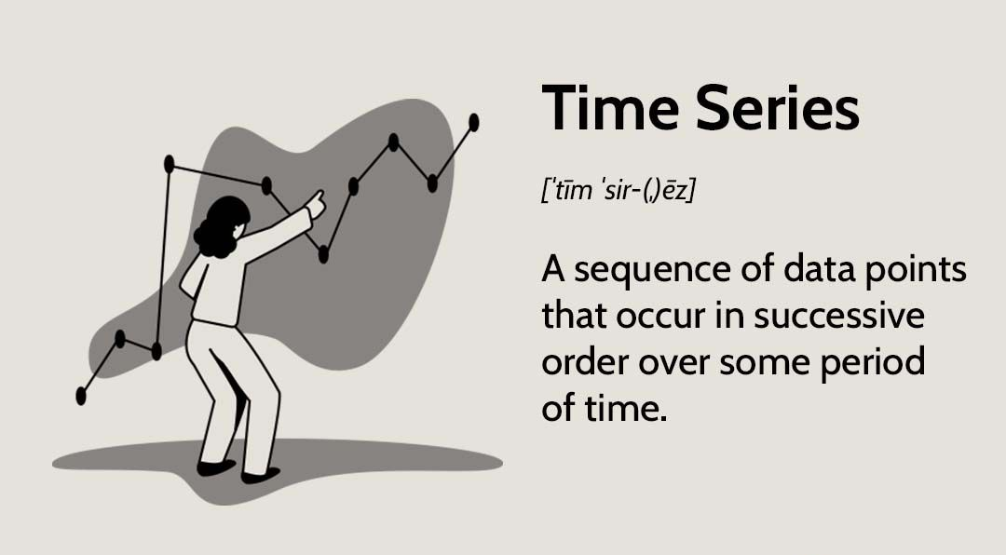
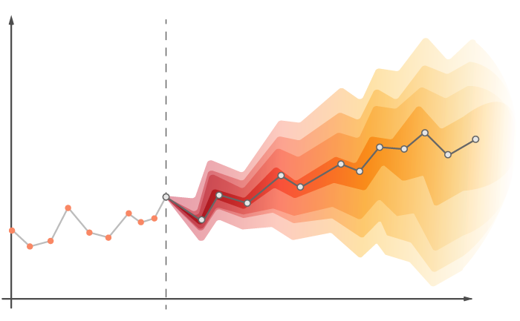
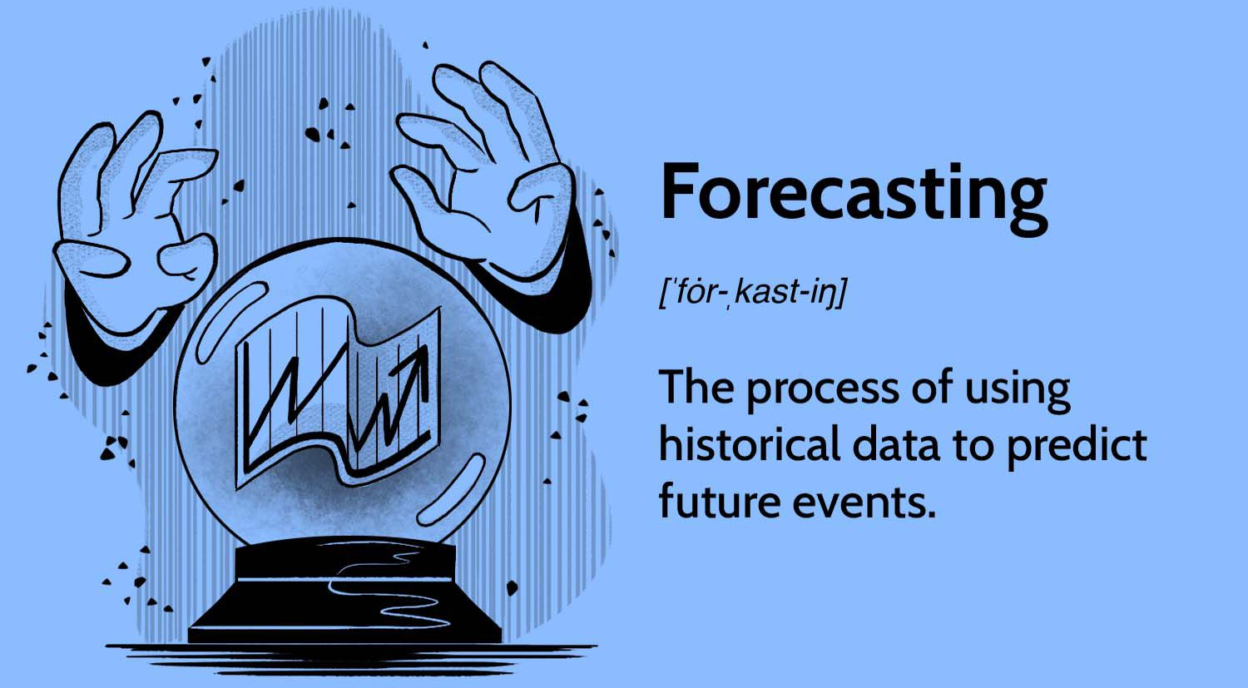



EURO-LABS Experiments
ML/AI EXPERIMENT
$$y$$
$$t$$
$$t^{∗}$$
FINal EURO-LABS - 2026 antonio.gilardi@cern.ch 17/32

Slide 18
EURO-LABS Experiments
ML/AI EXPERIMENT
$$y$$
BEAM PARAMETER FORECASTING
ACCELERATOR OPTIMIZATION
$$t$$
$$t^{∗}$$
FINal EURO-LABS - 2026 antonio.gilardi@cern.ch 18/32

Slide 19
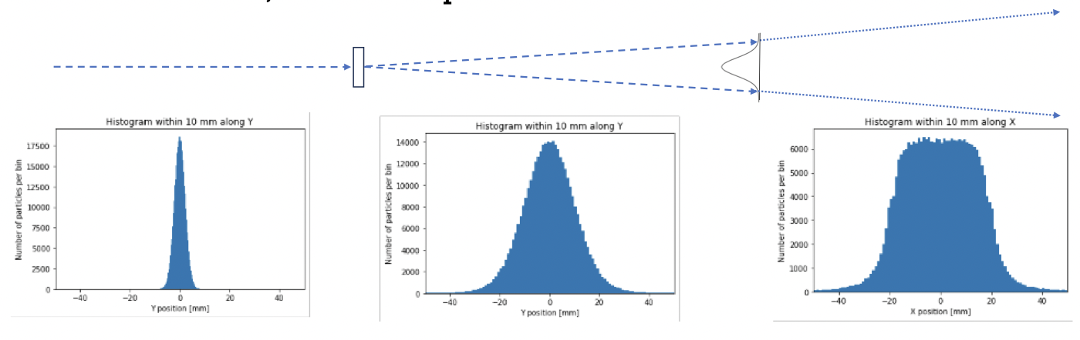
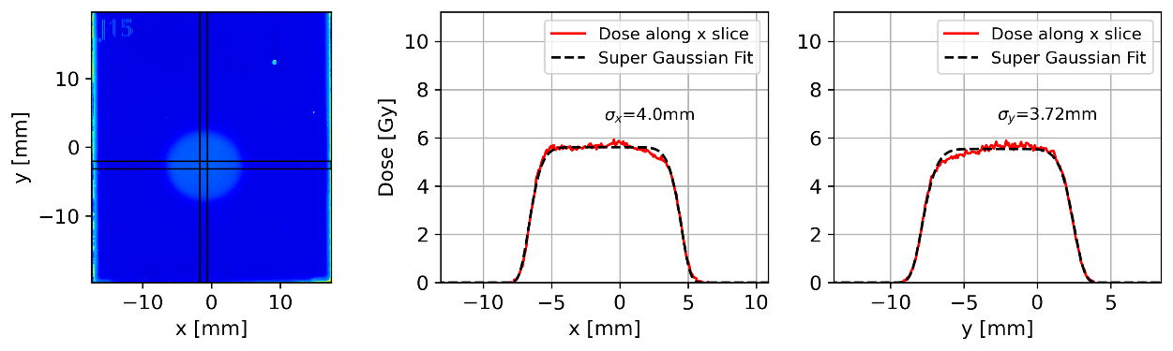
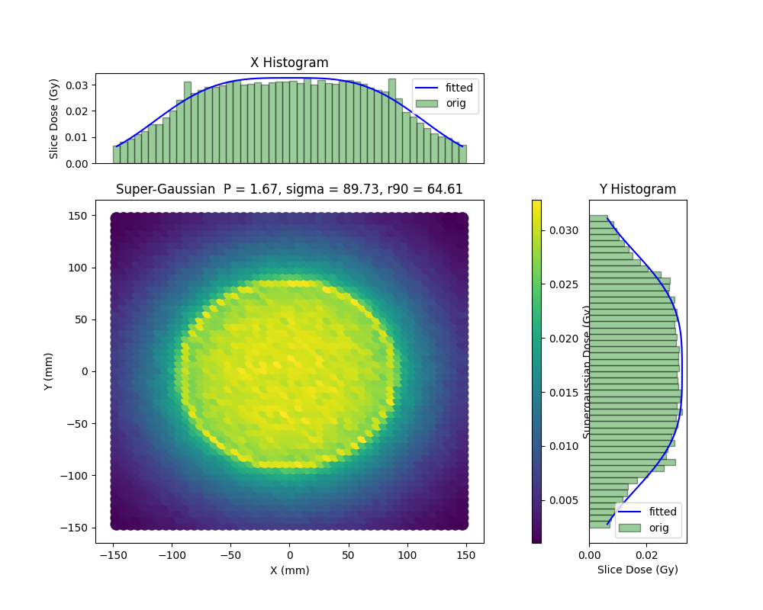
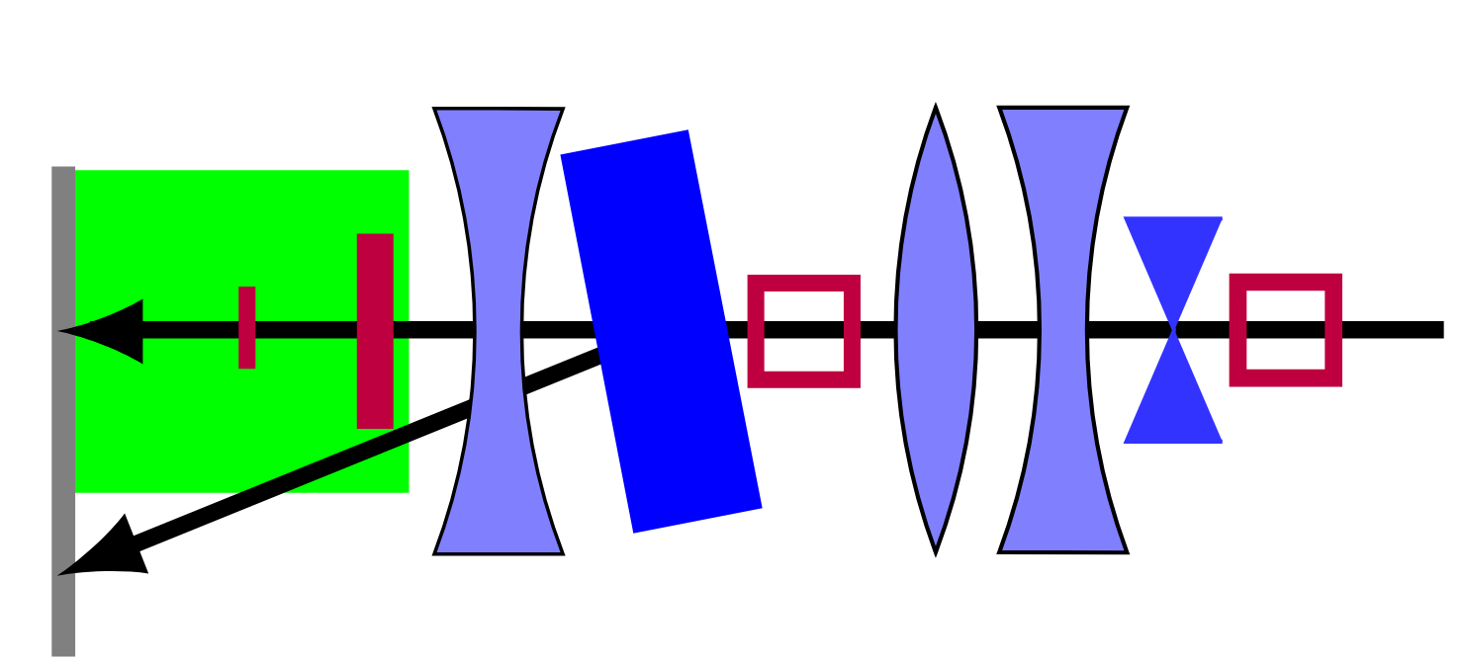
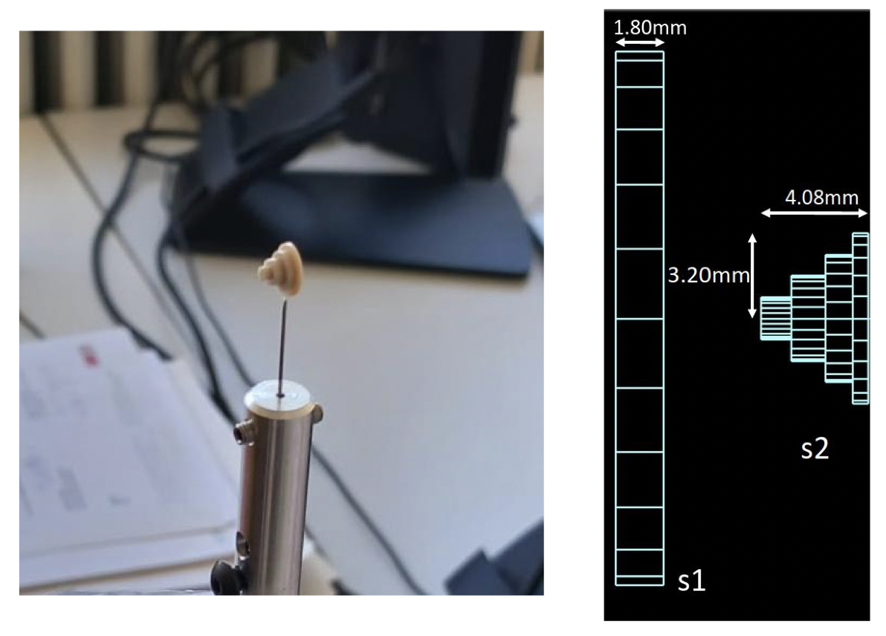
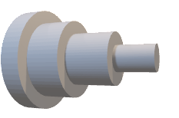
EURO-LABS Experiments
UNIFORM DOSE DELIVERY
beam image
X and Y beam profile
e⁻
Robertson C, Korysko P, Rieker V, Malyzhenkov A, Gerbershagen A, Farabolini W, Dosanjh M, Latina A, Corsini R, Bateman J, Aksoy A. JACOW: Dual-scattering foil installation at CLEAR. JACoW IPAC. 2023;2023:THPM073.
YAG
Screen
Collimator
Now routinely used in CLEAR operation
FINal EURO-LABS - 2026 antonio.gilardi@cern.ch 19/32

Slide 20
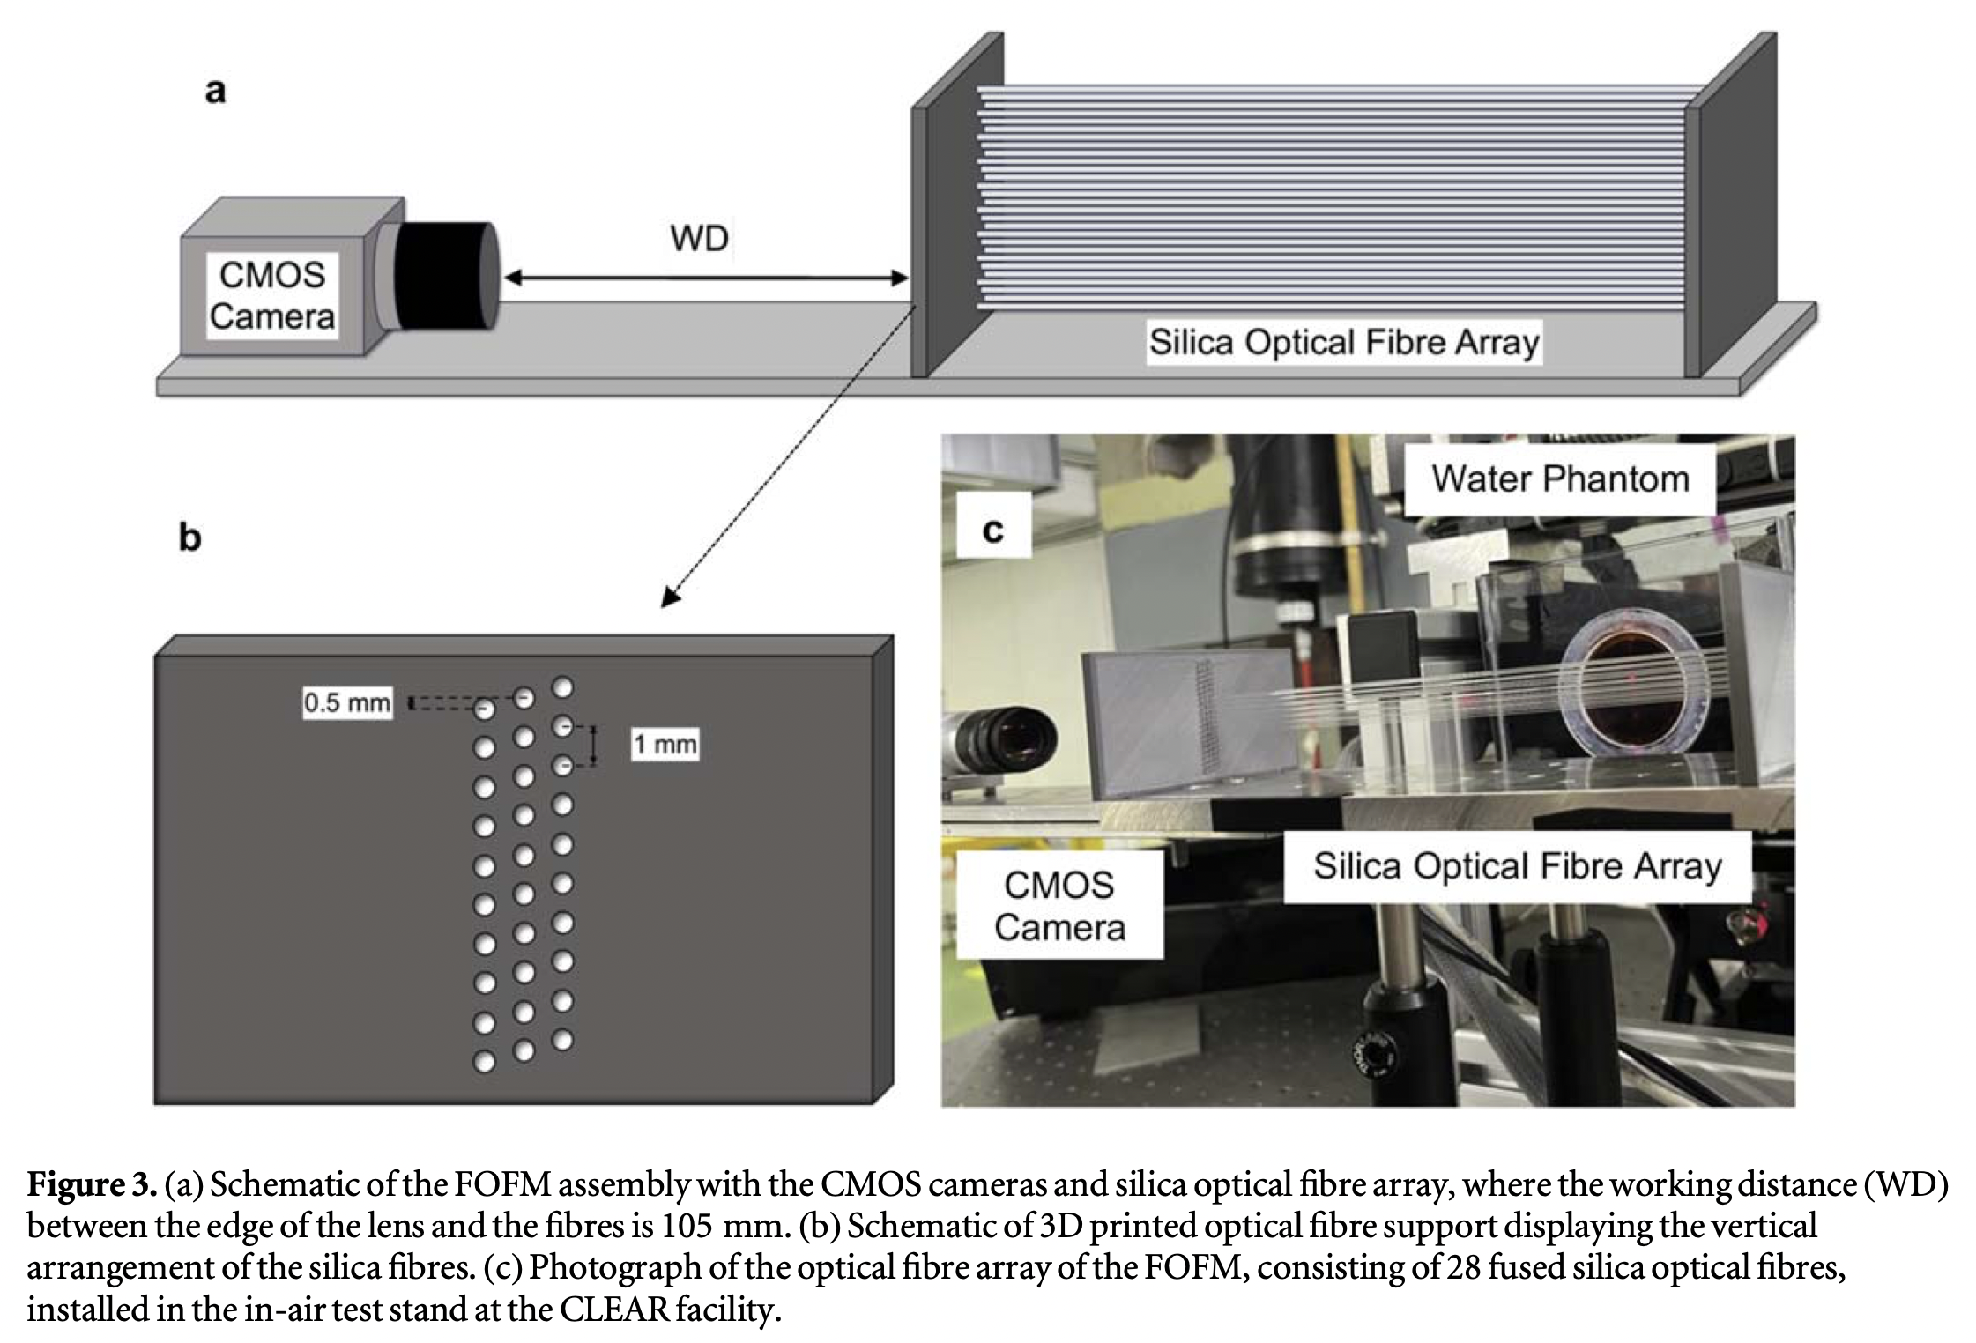
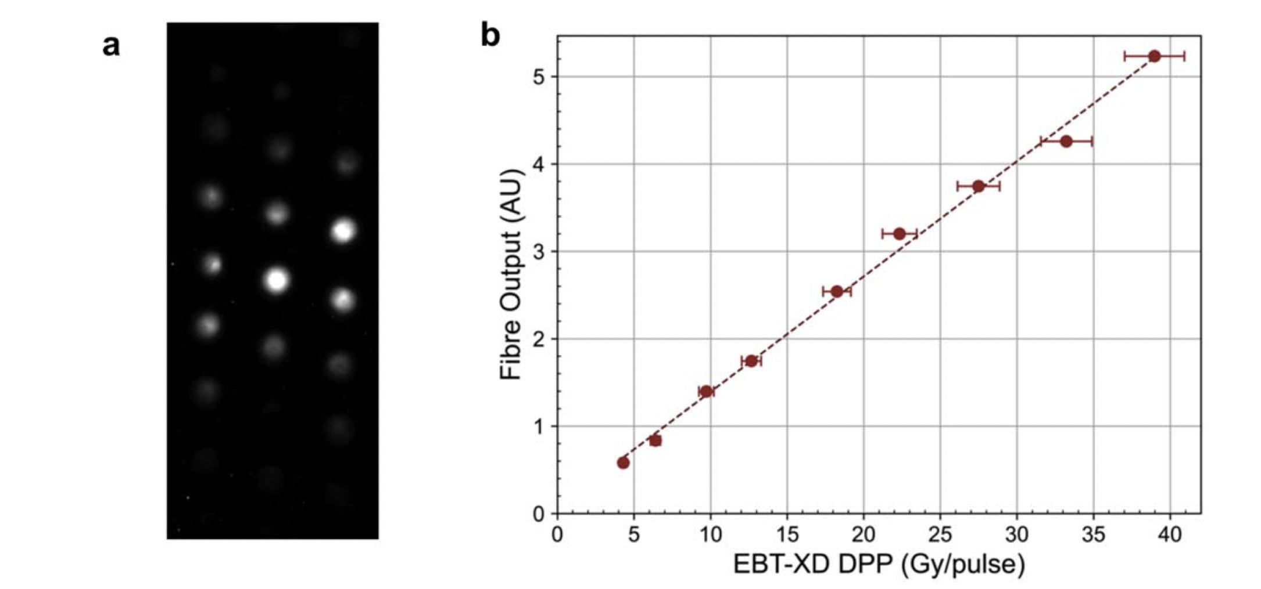
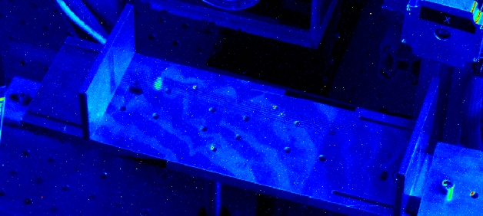
EURO-LABS Experiments
DOSIMETRY FOR HIGH DOSE RATE
Bateman, Joseph J., et al. "Development of a novel fibre optic beam profile and dose monitor for very high energy electron radiotherapy at ultrahigh dose rates." Physics in Medicine & Biology 69.8 (2024): 085006.
FINal EURO-LABS - 2026 antonio.gilardi@cern.ch 20/32

Slide 21
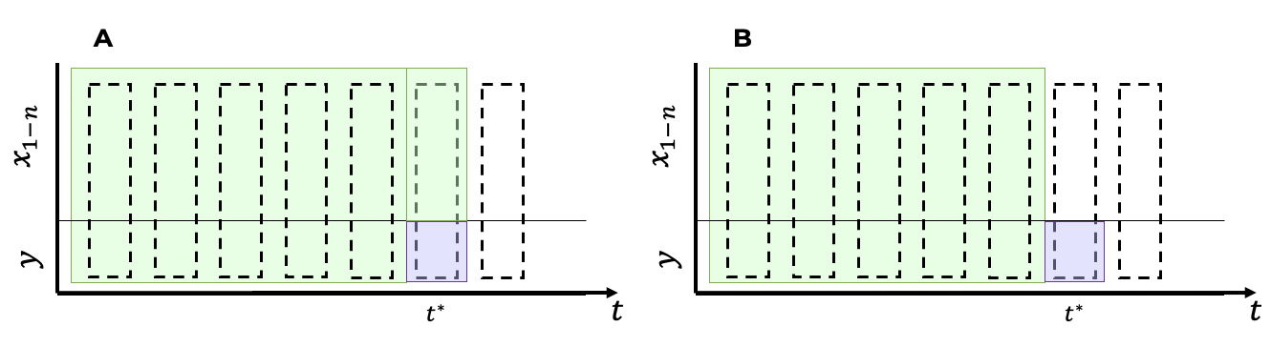
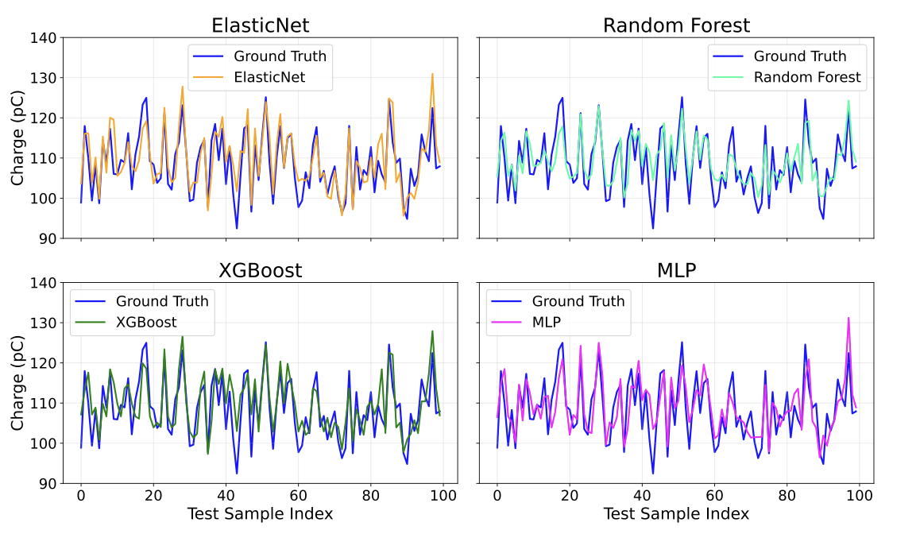
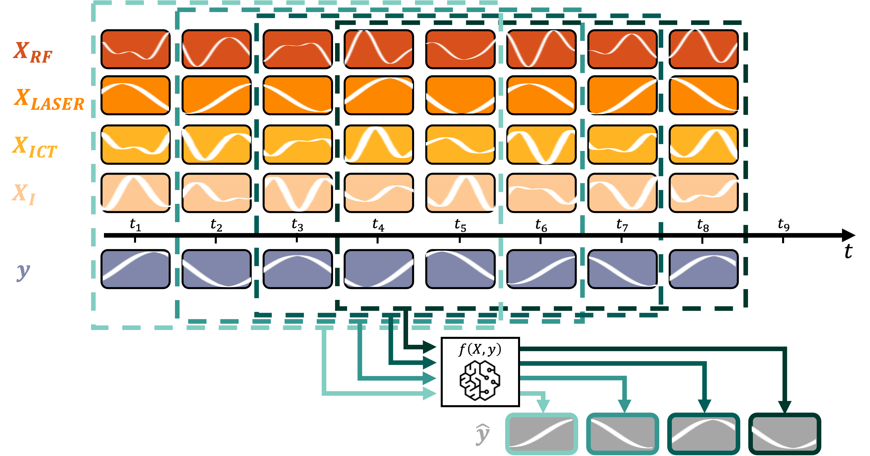





EURO-LABS Experiments
BEAM PARAMETER FORECASTING
Aim: Virtual Diagnostic
1
Variables Family:
RF
$$+$$
MAGNETS
$$+$$
LASER
$$+$$
AMBIENT
$$+$$
CHARGE
$$≅60$$
FINal EURO-LABS - 2026 antonio.gilardi@cern.ch 21/32

Slide 22
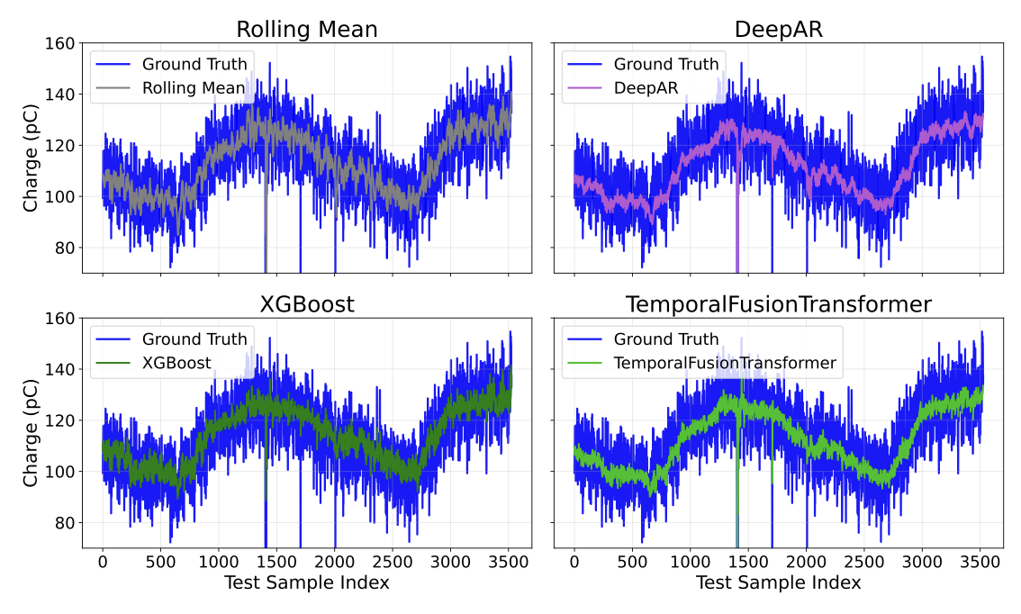
EURO-LABS Experiments
Aim: Fast and adaptive stabilization tool!
BEAM PARAMETER FORECASTING
1
Variables Family:
RF
$$+$$
MAGNETS
$$+$$
LASER
$$+$$
AMBIENT
$$+$$
CHARGE
$$≅60$$
FINal EURO-LABS - 2026 antonio.gilardi@cern.ch 22/32

Slide 23
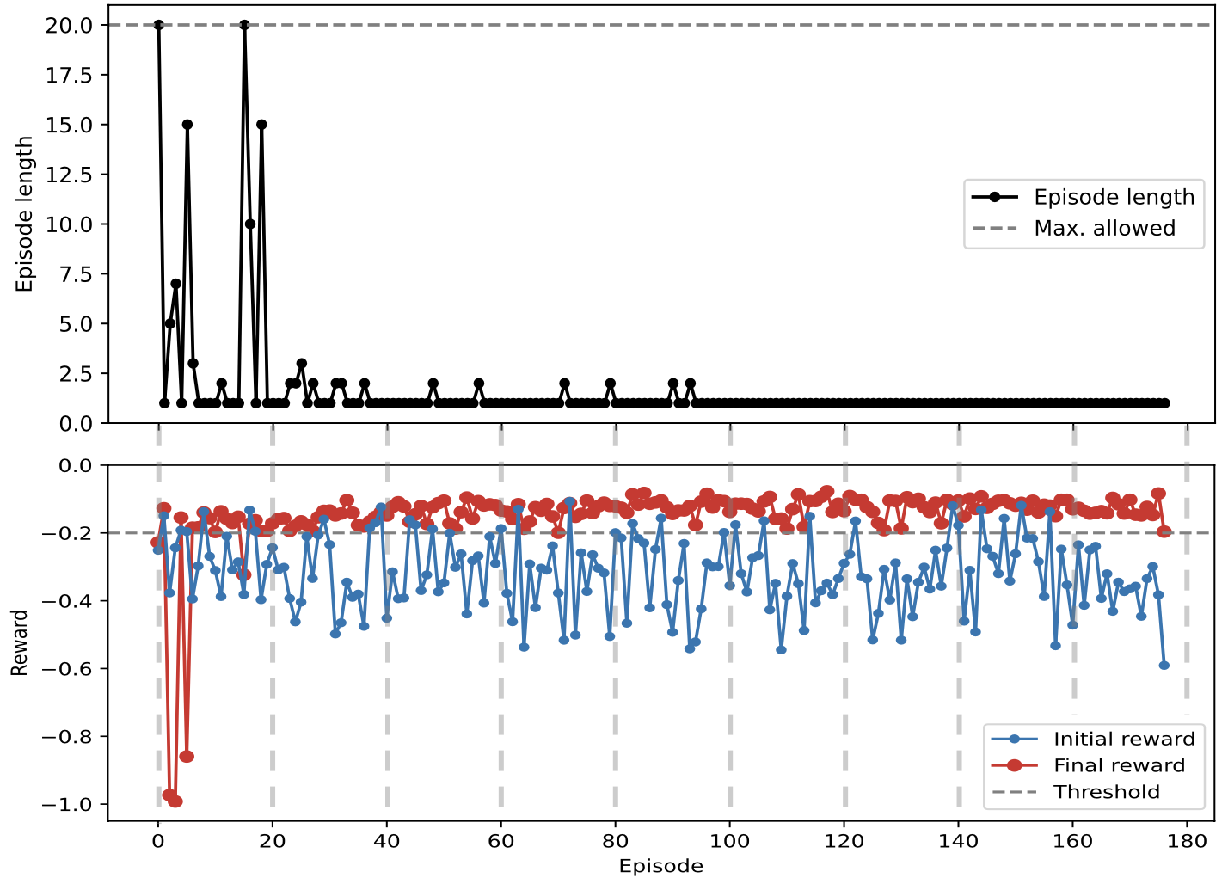
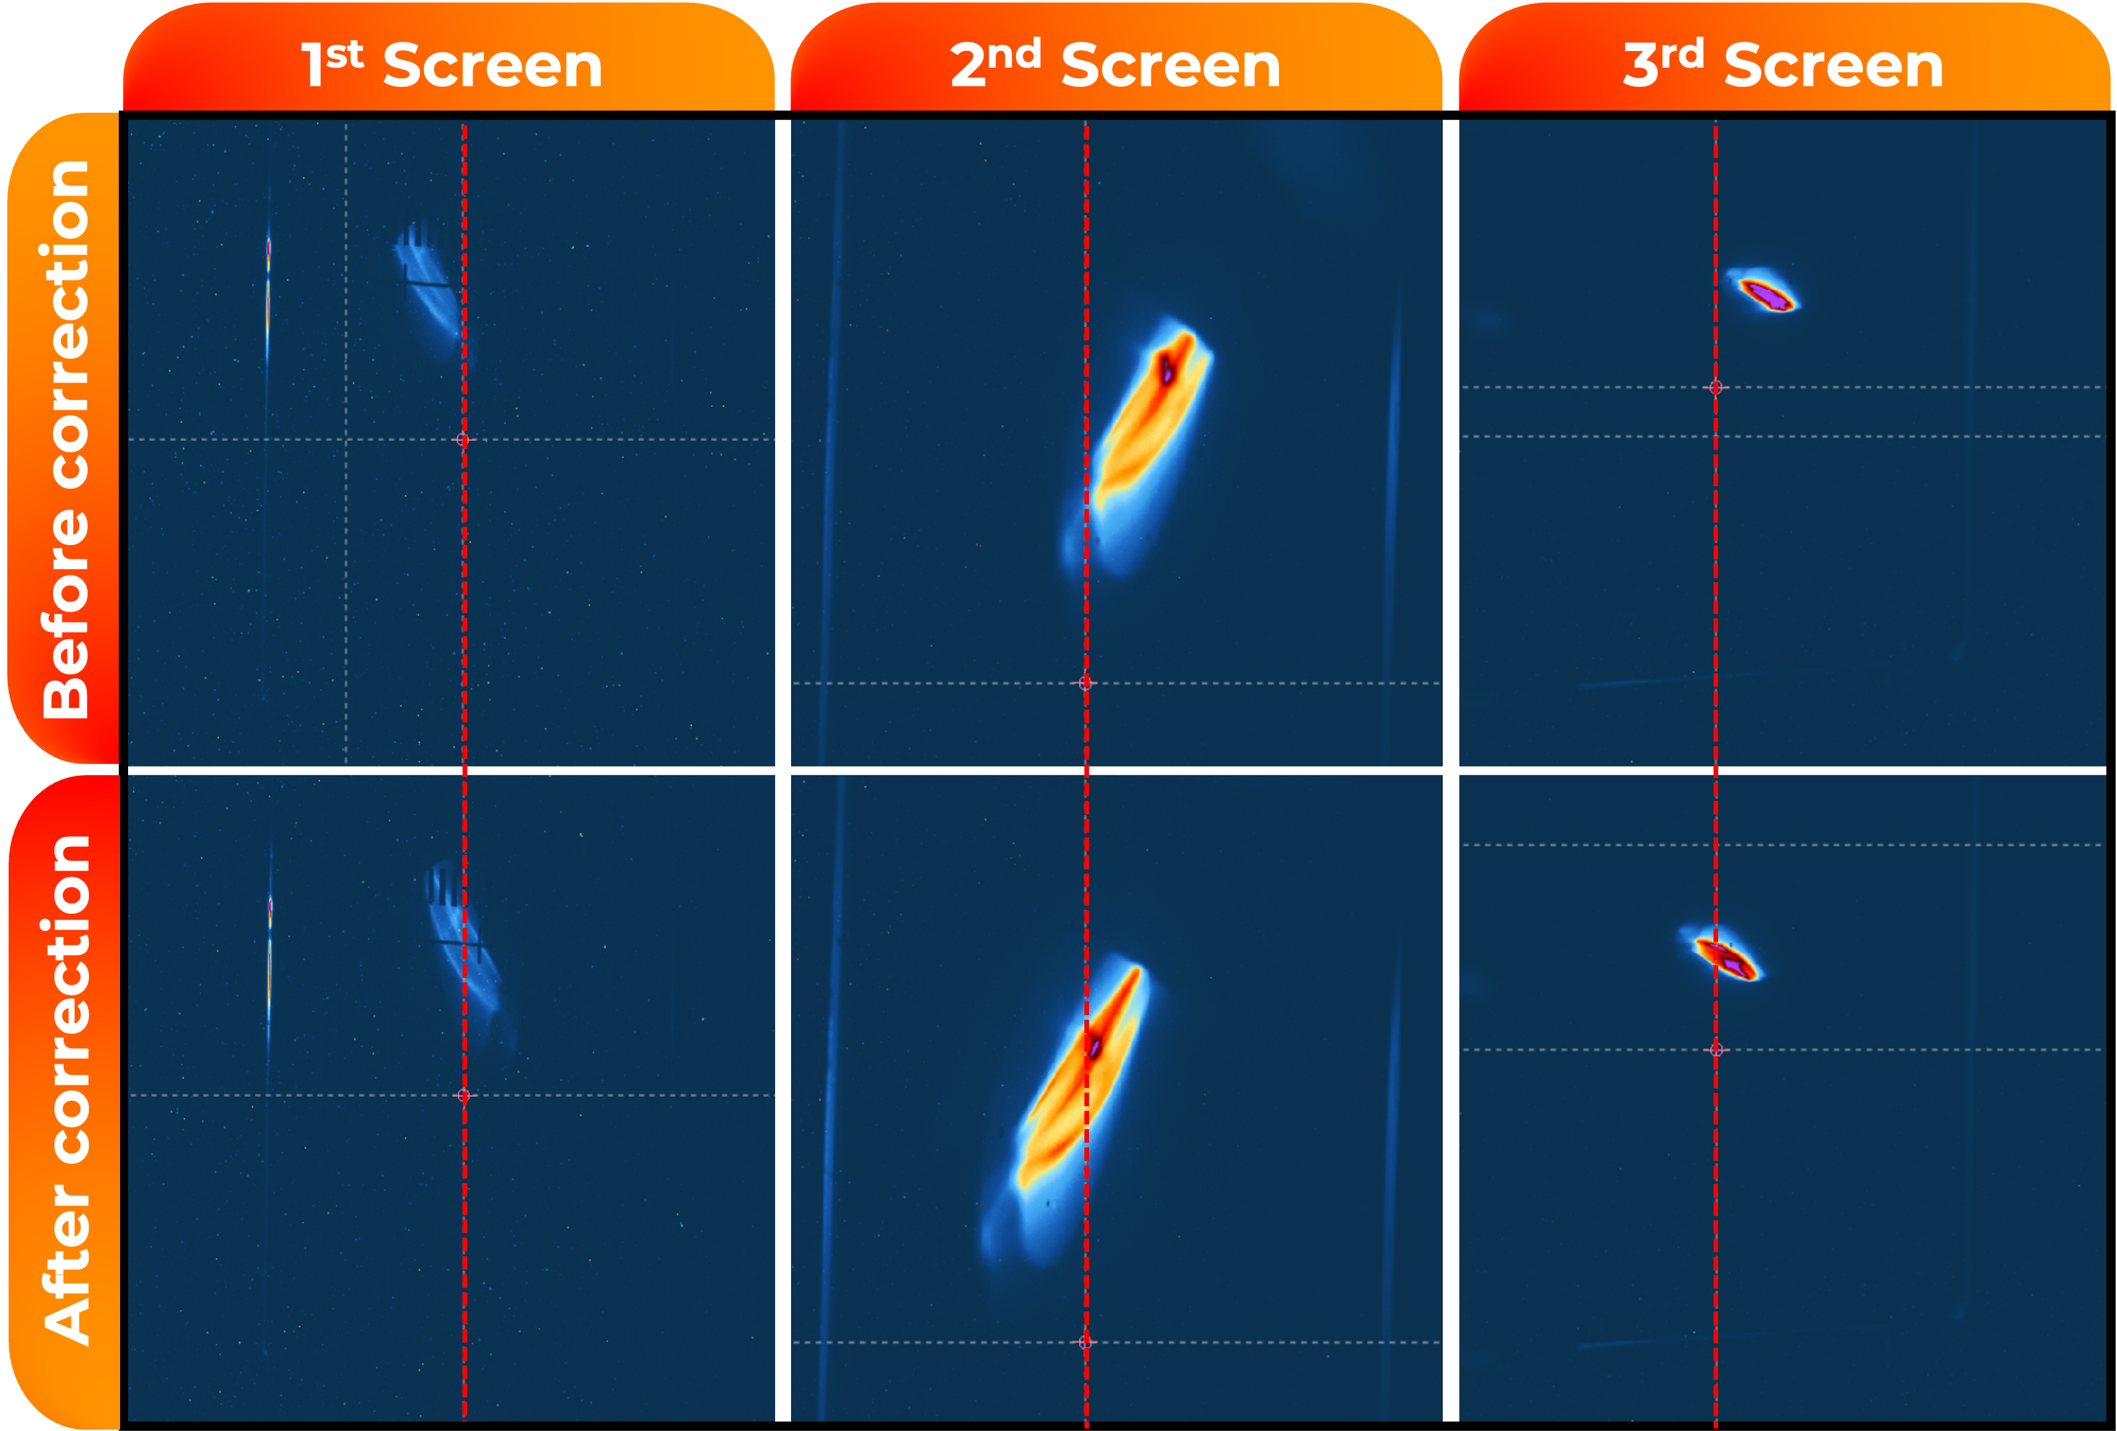
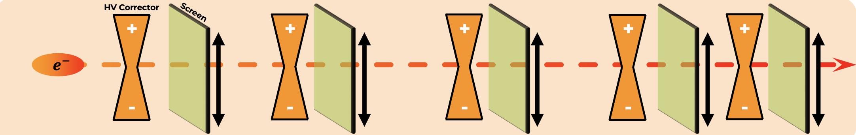
EURO-LABS Experiments
ACCELERATOR OPTIMIZATION
Autonomous beam steering achieved
After few hours → single-step correction possible
FINal EURO-LABS - 2026 antonio.gilardi@cern.ch 23/32

Slide 24
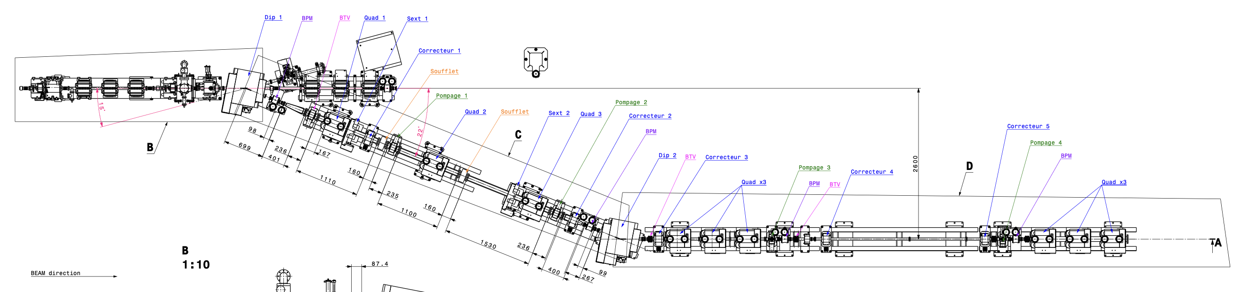
Infrastructural upgrades
FINal EURO-LABS - 2026 antonio.gilardi@cern.ch 24/32

Slide 25
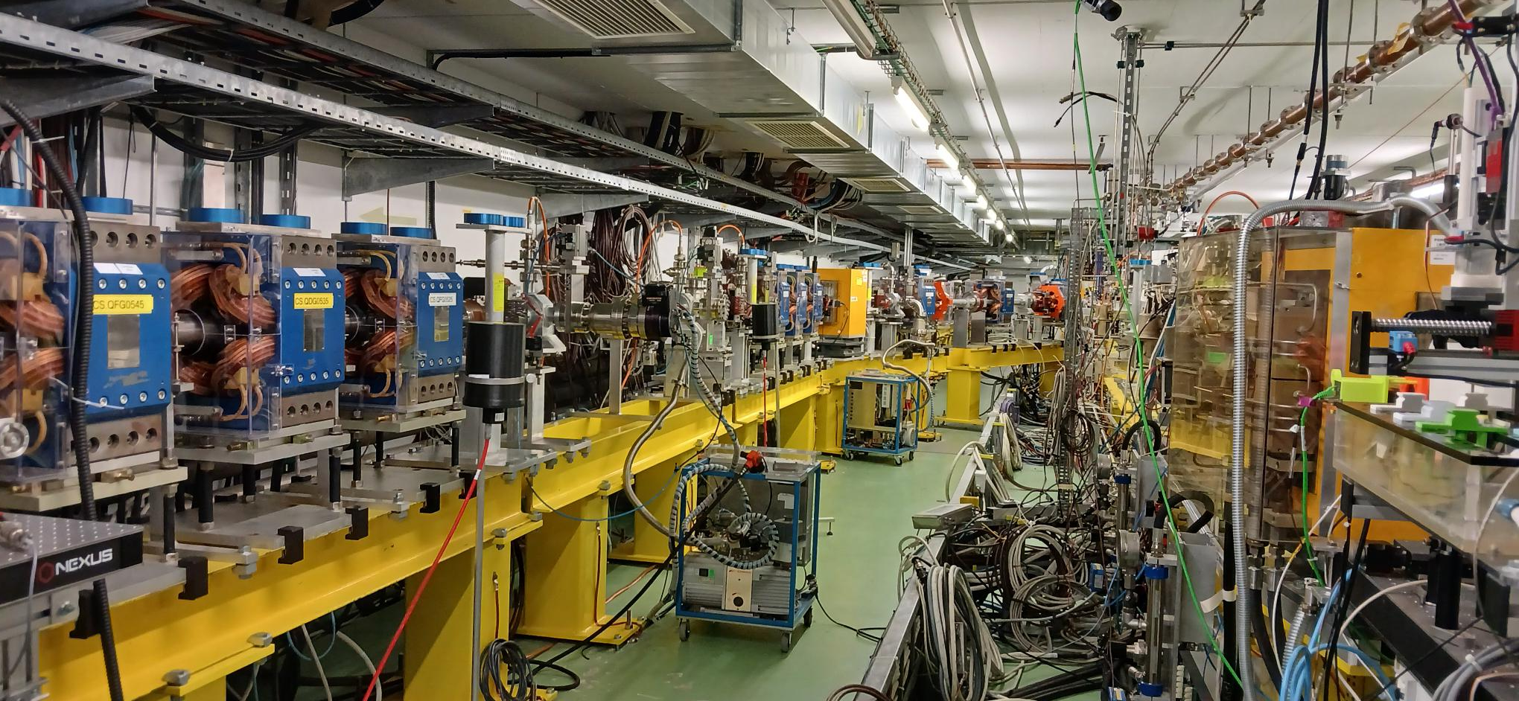
Infrastructural upgrades
FINal EURO-LABS - 2026 antonio.gilardi@cern.ch 25/32

Slide 26
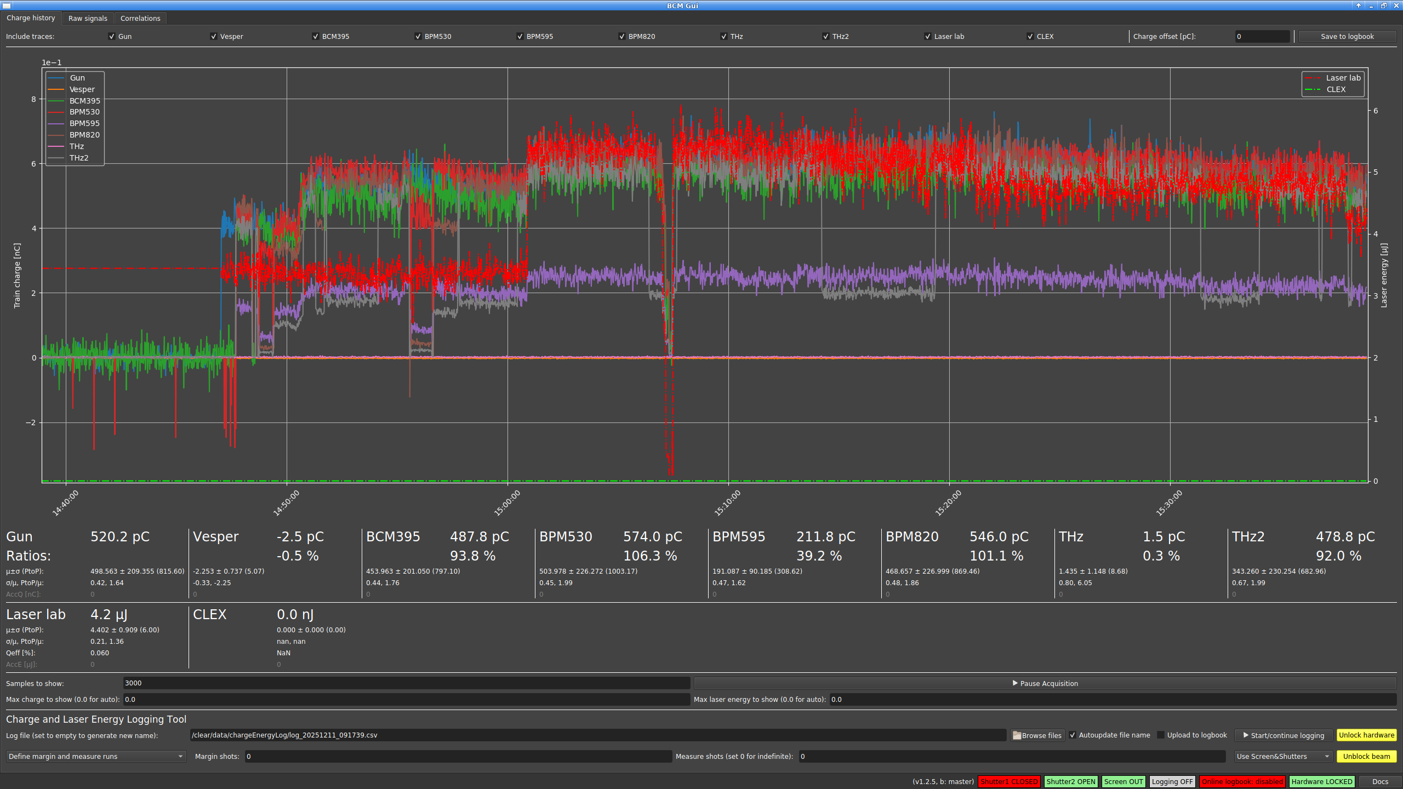
Infrastructural upgrades
92 % transport, showing that the line is well conceived and aligned
FINal EURO-LABS - 2026 antonio.gilardi@cern.ch 26/32

Slide 27
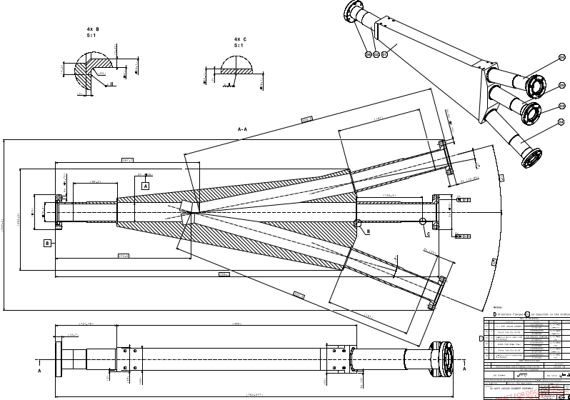
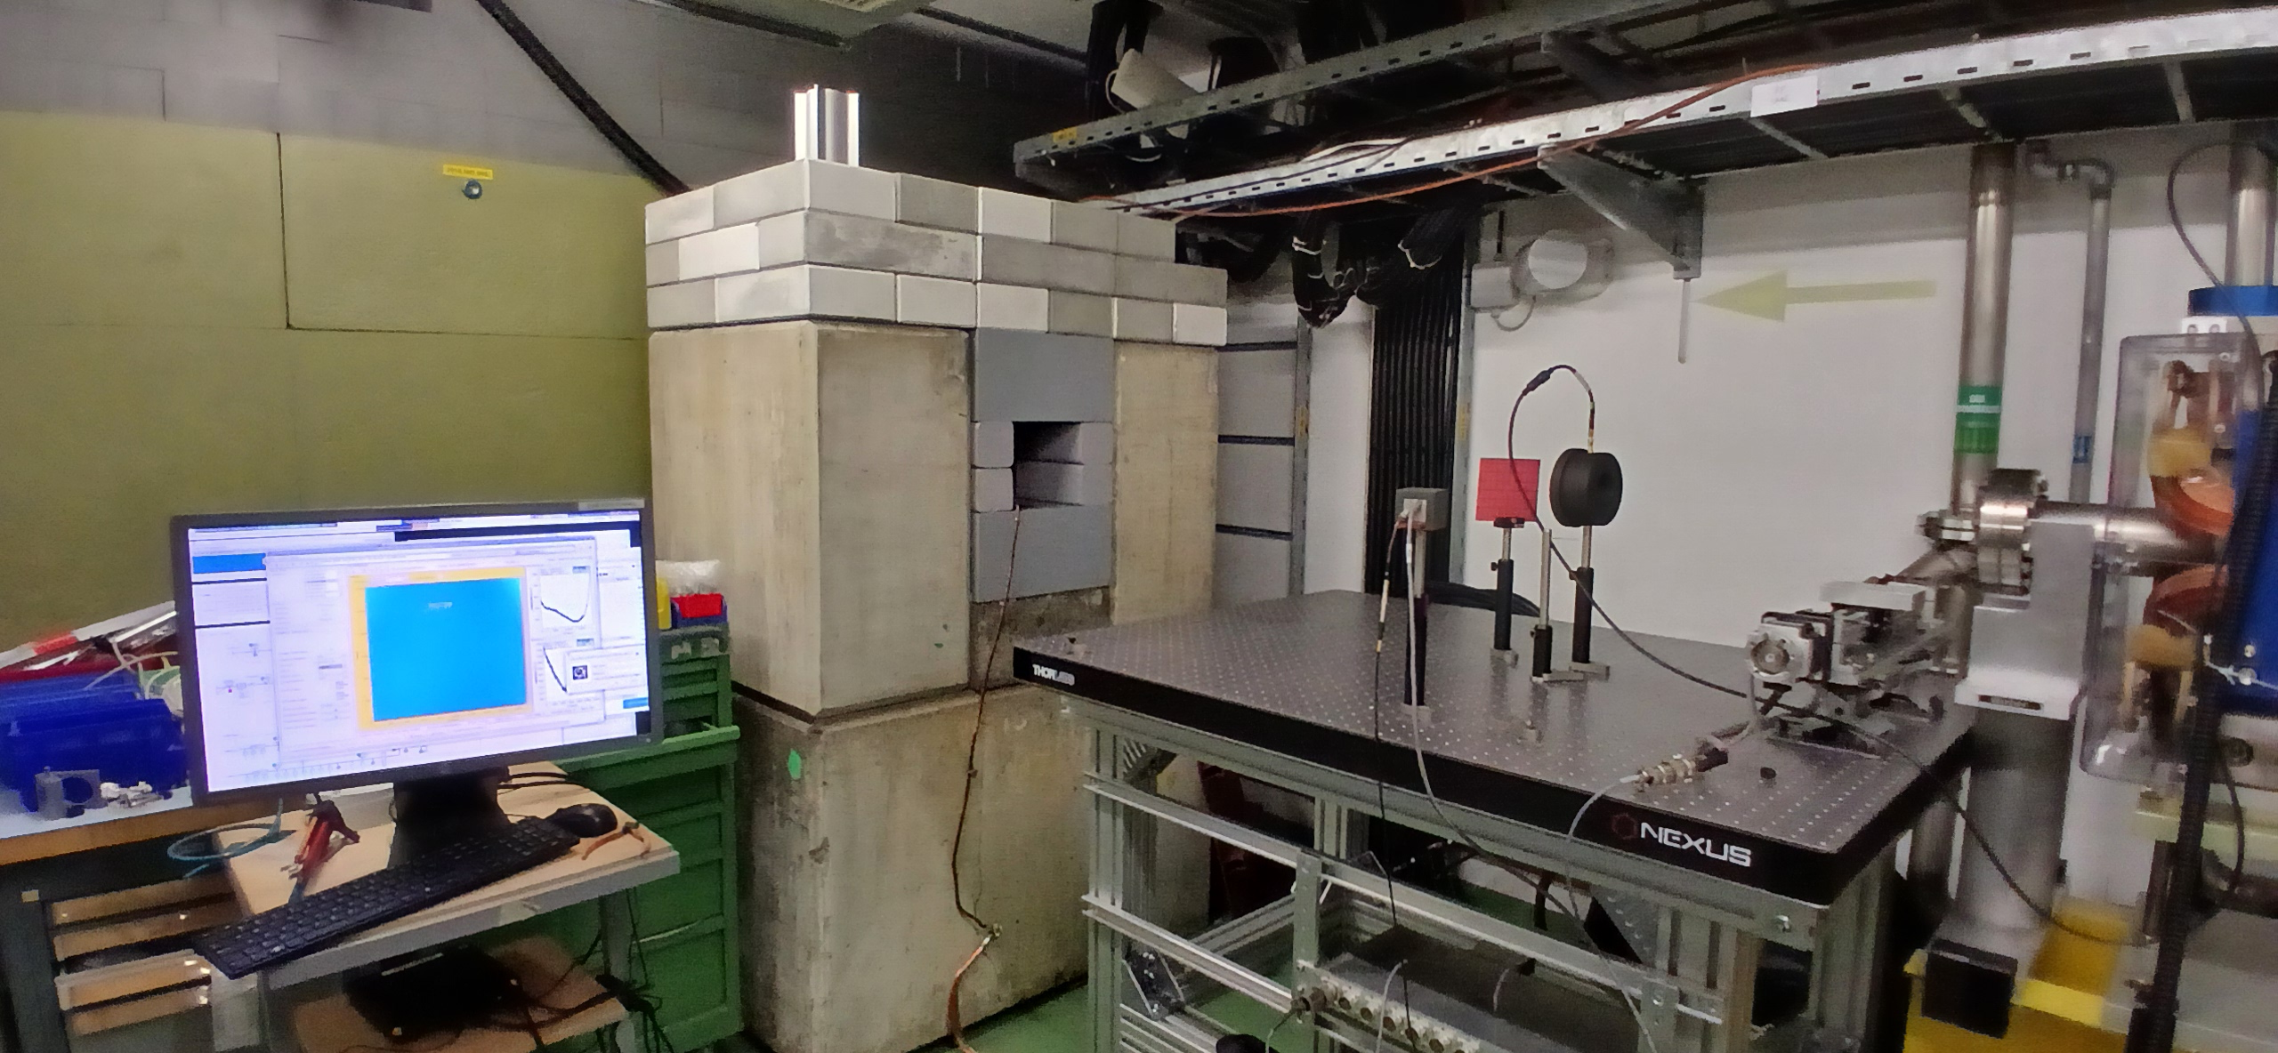
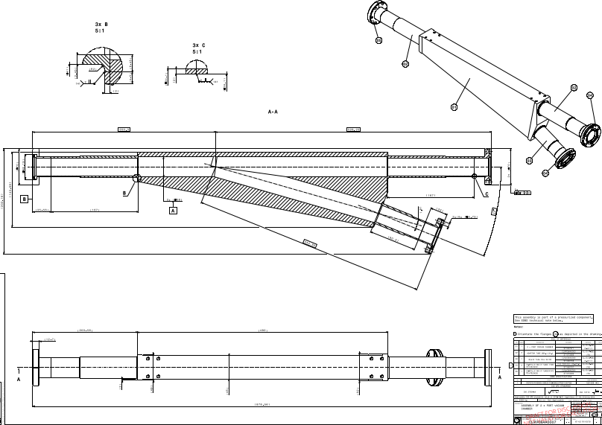
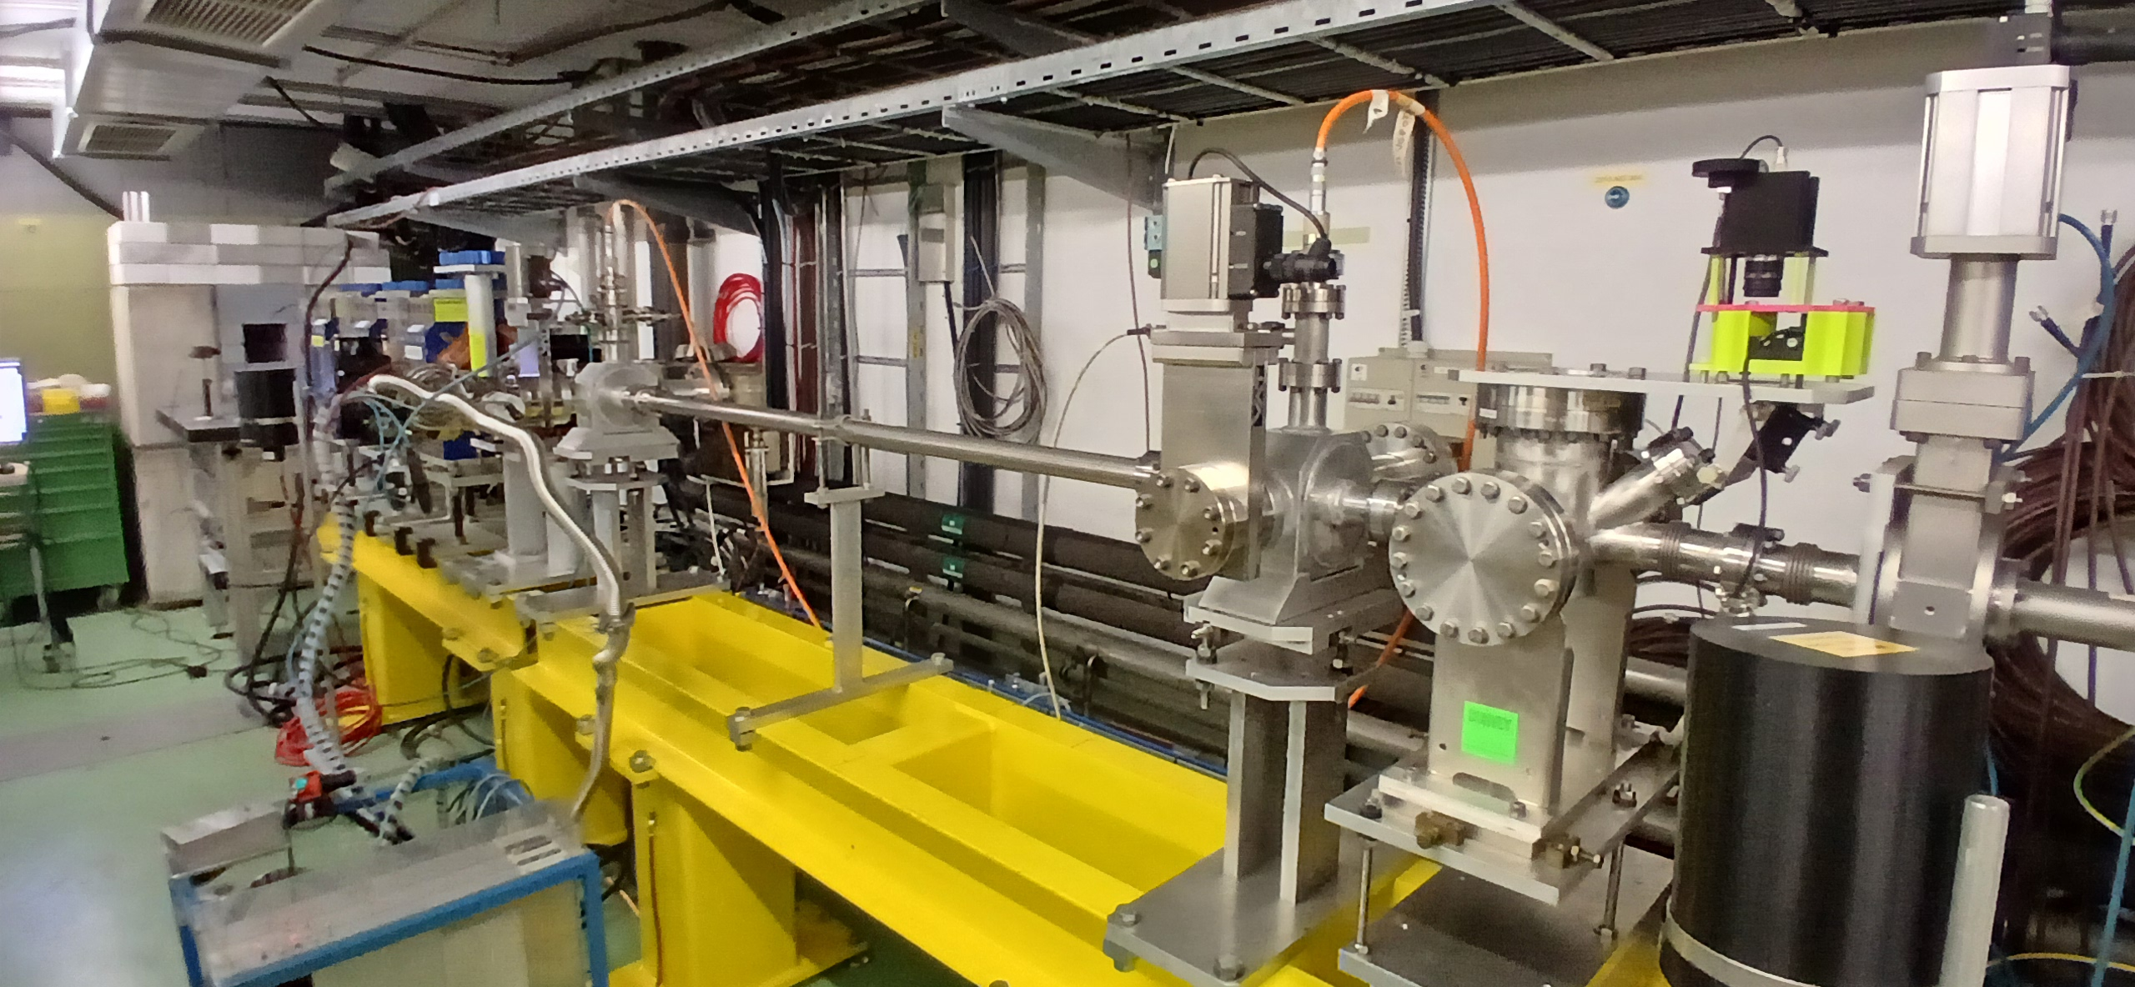
Infrastructural upgrades
In-air test stand with large diameter final chamber
In-vacuum test stand, 1.7m long
FINal EURO-LABS - 2026 antonio.gilardi@cern.ch 27/32

Slide 28
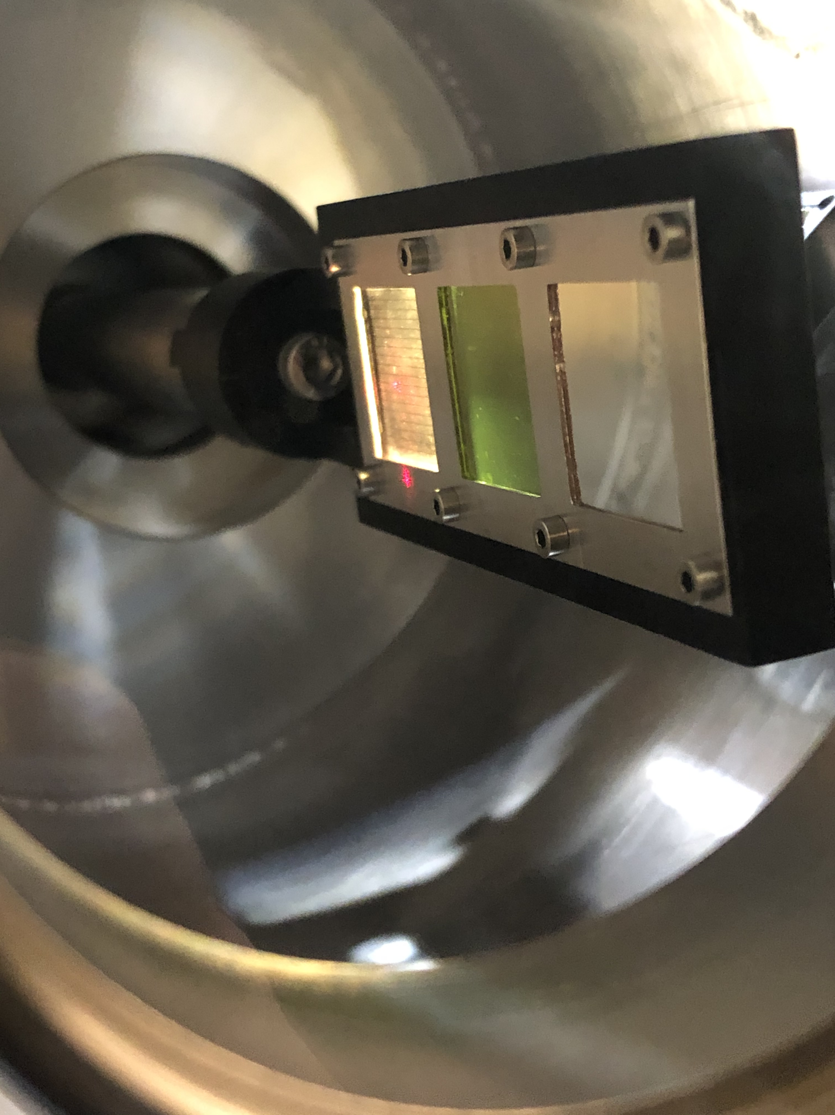
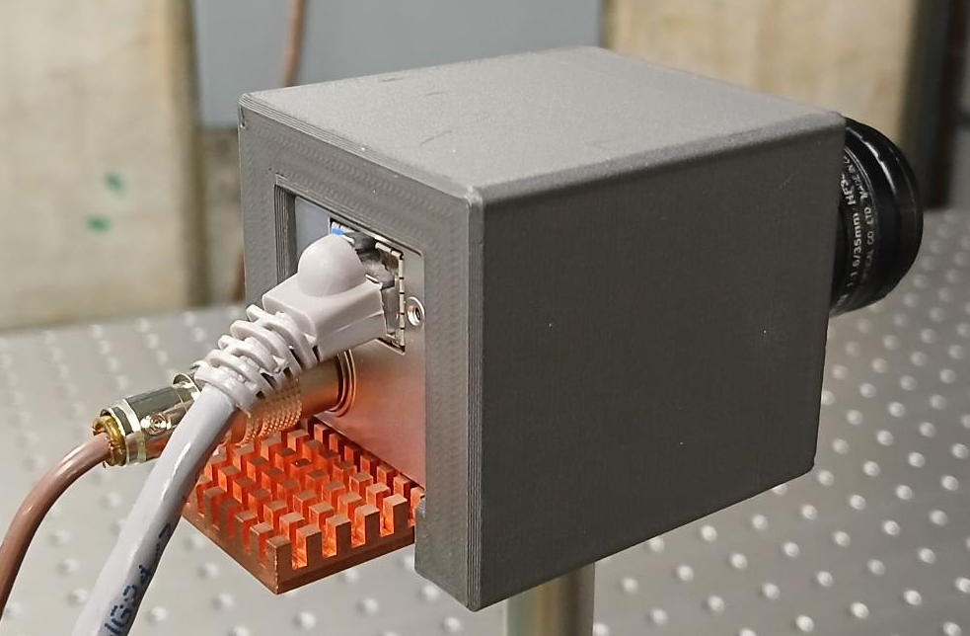






Infrastructural upgrades
$$30 x30 μm$$
acA1920-40gm
Resolution of $\sim 3 μm$
Cooling plate and tungsten 3D printed shielding
FINal EURO-LABS - 2026 antonio.gilardi@cern.ch 28/32

Slide 29





Infrastructural upgrades
FINal EURO-LABS - 2026 antonio.gilardi@cern.ch 29/32

Slide 30



Infrastructural upgrades
https://ats-news.web.cern.ch/novel-alignment-solutions-a-structured-laser-beam-at-the-clear-accelerator-facility/
FINal EURO-LABS - 2026 antonio.gilardi@cern.ch 30/32

Slide 31


EURO-LABS Trainings
FINal EURO-LABS - 2026 antonio.gilardi@cern.ch 31/32

Slide 32
Conclusion & Outlook
CLEAR is a unique and highly flexible testbed for a wide range of accelerator studies. The team and the facility together enable rapid iteration from idea to beam test.
CLEAR will operate at least through 2030, with no long shutdown currently foreseen — a stable platform for future studies.
The facility welcomes new experimental proposals from anyone with a strong idea to test of course including the EURO-LABS users.
EURO-LABS funding and network enabled important new experiments for the field, several have already become operational tools.
Thanks to the funding also helped developing new infrastructure, and the new beamline will soon become an important facility asset.
FINal EURO-LABS - 2026 antonio.gilardi@cern.ch 32/32

Slide 33


This project has received funding from the European Union’s Horizon Europe Research and Innovation programme under Grant Agreement No 101057511.
Thanks
for the attention!
Grazie mamma e papa!

Slide 34



ADDITIONAL SLIDES
TEAM

Slide 35


EURO-LABS Experiments
DOSIMETRY FOR HIGH DOSE RATE
FINal EURO-LABS - 2026 antonio.gilardi@cern.ch 20/32

Slide 36



ADDITIONAL SLIDES
MEDICAL SETUP
RADIO-CHROMIC FILMS

Slide 37



ADDITIONAL SLIDES
SINGLE ELECTRON EXPERIMENT
Hypothesis from L. de Broglie 1925 : ν₀ = m_{e} c²/h = 1.2 x 10²⁰ Hz,
Alternative hypothesis from Schrödinger 1930 : Zitterbewegung frequency
Effect is reachable with the energy range available at CLEAR.
Expected anomaly in the scattering by a crystal superposed to the channelling effect (LAL)
Preliminary test with collimator to assess the ability of delivering single electron beam with very accurate energy resolution (50 keV)

Slide 38


ADDITIONAL SLIDES
EXPERIMENT LIST
Double Scatterer
Fiber dosimeter
ML (RL and Forecasting)
LUXE
Single electron study
EO monitor for FCC-ee
THz sources
2017
2018
2019
2020
2021
2022
2023
2024
2025
2026
2027
2028
2029
2030
...

Slide 39


ADDITIONAL SLIDES
ACCELERATOR TUNING

Slide 40



ADDITIONAL SLIDES
LUXE DETECTOR IRRADIATION
Irradiate the probe with a beam spot area of 1 mm², a 2 nA beam to get a local dose rate of 1 MGy/hour. Repeat this 10 times for each sensor.
Total Charge delivered: 2.748 mC
Total Dose delivered: 14.0355 MGy (Target = 14 MGy)

