Slide 1


HiRadMat Facility: Overview of EURO-LABS supported experiments
EURO-LABS Task Force 3.1​
N. Charitonidis & P. Alexaki [CERN, BE-EA] on behalf of the HiRadMat Operations Team
30 June 2026 – FINE 2026, Karlsruhe

Slide 2
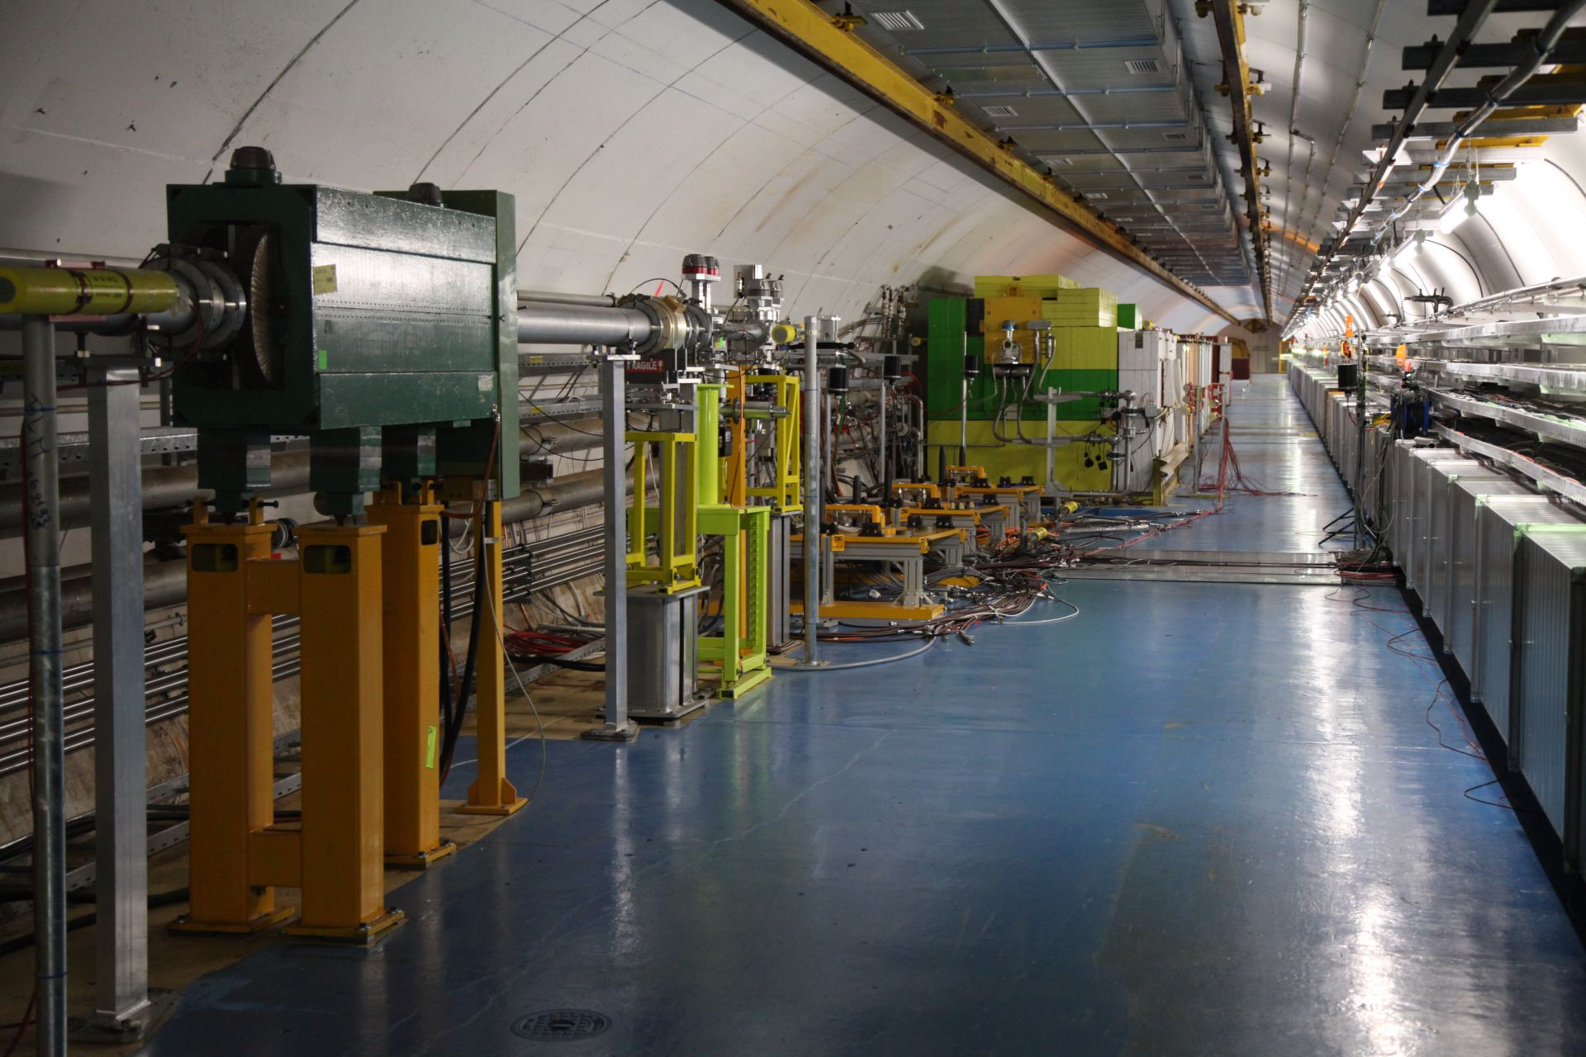
Overview
HiRadMat Facility at CERN
Overview of EURO-LABS supported experiments
2 highlights of large experiments
EURO-LABS supported technical workshops
Outreach & events
Gender & age statistics
Future

Slide 3
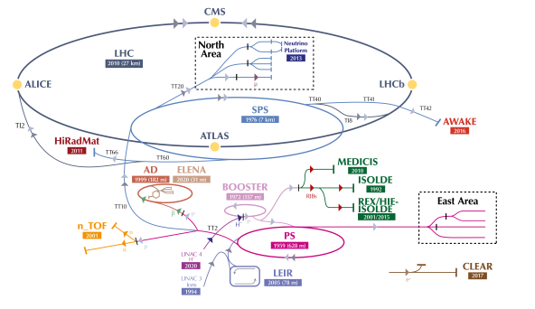
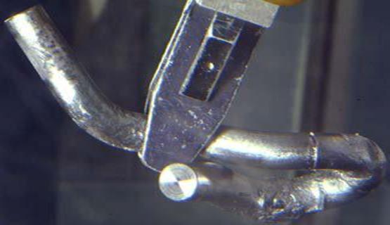
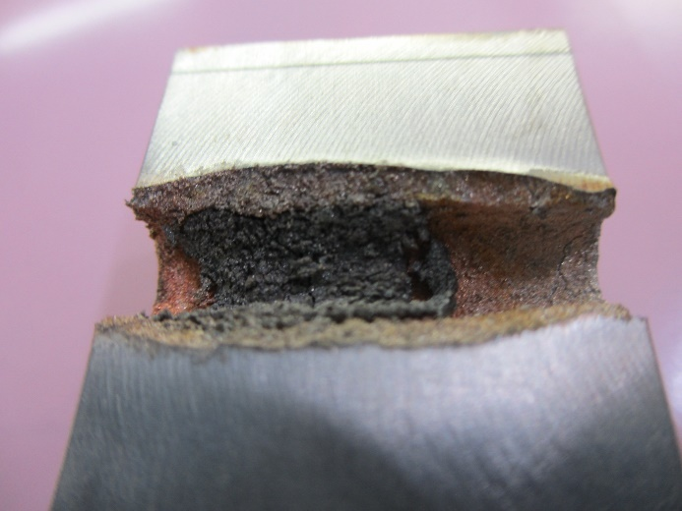

HiRadMat: a test-bench facility at CERN
HiRadMat is a unique facility at CERN, providing a high-energy, high-intensity, LHC-type beam to study beam–matter interactions under extreme conditions.
The proton beam available in HiRadMat is extracted from the CERN Super Proton Synchrotron (SPS) :
  440 GeV/c proton beam
  Up to $6×{10}^{13}$ protons per pulse
  4.3 MJ power in only 7.95 μs

Slide 4
4 years of EURO-LABS support

Slide 5
EURO-LABS supported experiments
 | Experiments | Field
2023 | HRMT-55 | Ionisation chamber production verification
 | HRMT-60 | Single pulse effects in (pre-irradiated) targetry materials
 | HRMT-62 | Magnetic field generation associated with collisionless beam-plasma instabilities
2024 | HRMT-64 | Extreme Astrophysics with laboratory electron-positron jets – Follow up of HRMT-62
 | HRMT-66 | Vacuum windows behaviour for high brightness beams and high transparency materials
2025 | HRMT-63 | Measurement of displacement cross section at HiRadMat for 440-GeV protons
 | HRMT-67 | Follow up of HRMT-60
 | HRMT-68 | Follow up of HRMT-64
 | HRMT-71 | Follow up of HRMT-55
2026 | HRMT-71 - II | Follow up of HRMT-55
 | HRMT-76 | Follow up of HRMT-68
 | HRMT-74 | Evaluation of Novel Materials for High-Intensity Beam Diagnostics
Notes:
These may look a few, but actually eurolabs did support all the phases of the experiments. Meaning the preparation, meetings with experts, setting up of instrumentation, the installation, the beamtime and then finally the de installation.

Slide 6
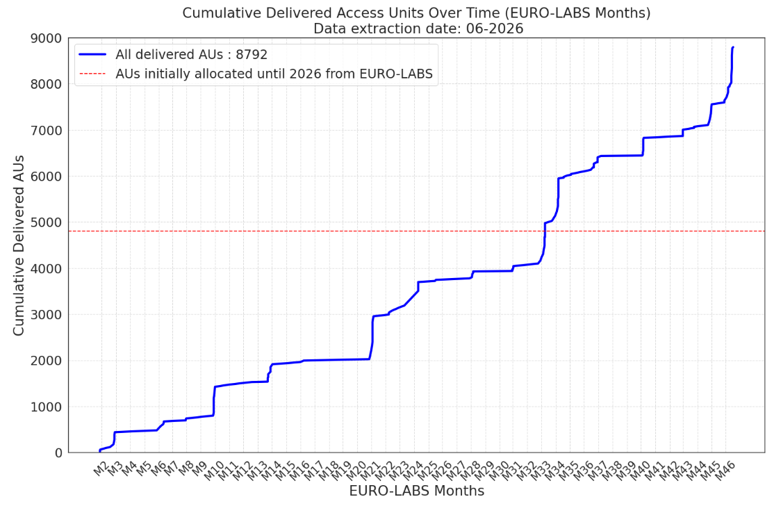
EURO-LABS supported experiments
 | Experiments | Field
2023 | HRMT-55 | Ionisation chamber production verification
 | HRMT-60 | Single pulse effects in (pre-irradiated) targetry materials
 | HRMT-62 | Magnetic field generation associated with collisionless beam-plasma instabilities
2024 | HRMT-64 | Extreme Astrophysics with laboratory electron-positron jets – Follow up of HRMT-62
 | HRMT-66 | Vacuum windows behaviour for high brightness beams and high transparency materials
2025 | HRMT-63 | Measurement of displacement cross section at HiRadMat for 440-GeV protons
 | HRMT-67 | Follow up of HRMT-60
 | HRMT-68 | Follow up of HRMT-64
 | HRMT-71 | Follow up of HRMT-55
2026 | HRMT-71 - II | Follow up of HRMT-55
 | HRMT-76 | Follow up of HRMT-68
 | HRMT-74 | Evaluation of Novel Materials for High-Intensity Beam Diagnostics
More than 44 sub projects throughout the EURO-LABS lifetime !
Notes:
These may look a few, but actually eurolabs did support all the phases of the experiments. Meaning the preparation, meetings with experts, setting up of instrumentation, the installation, the beamtime and then finally the de installation.

Slide 7
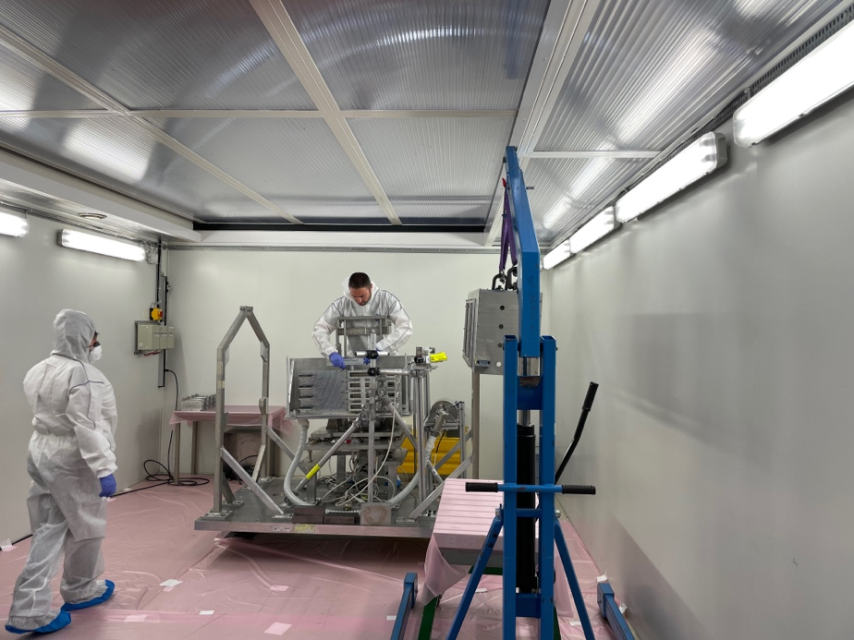
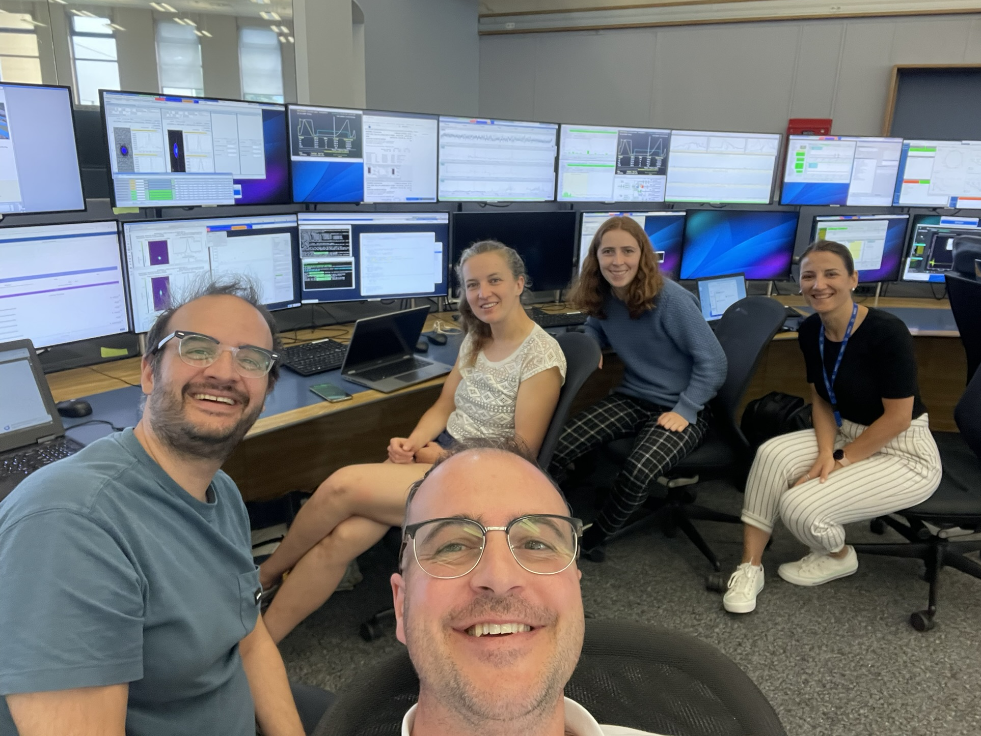
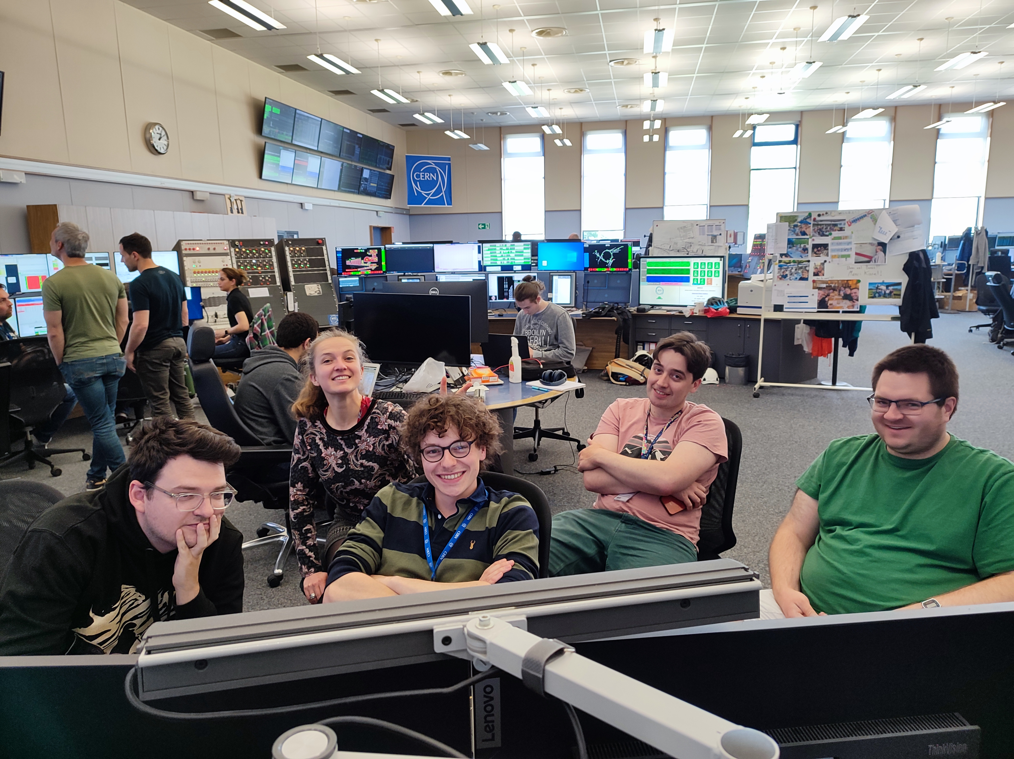
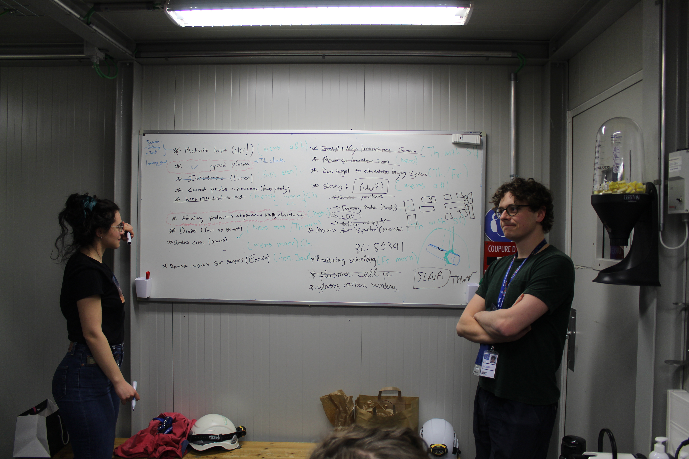
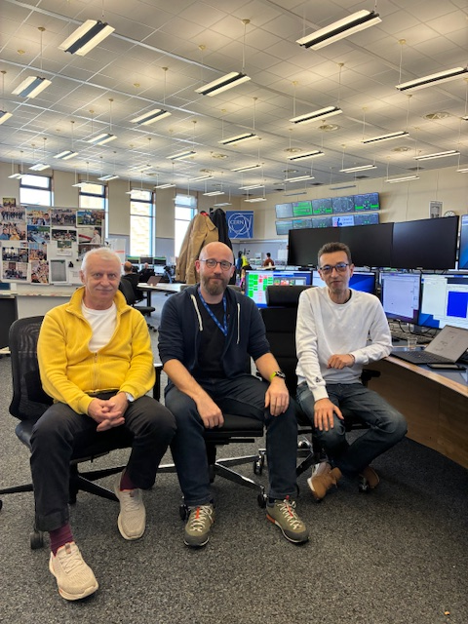
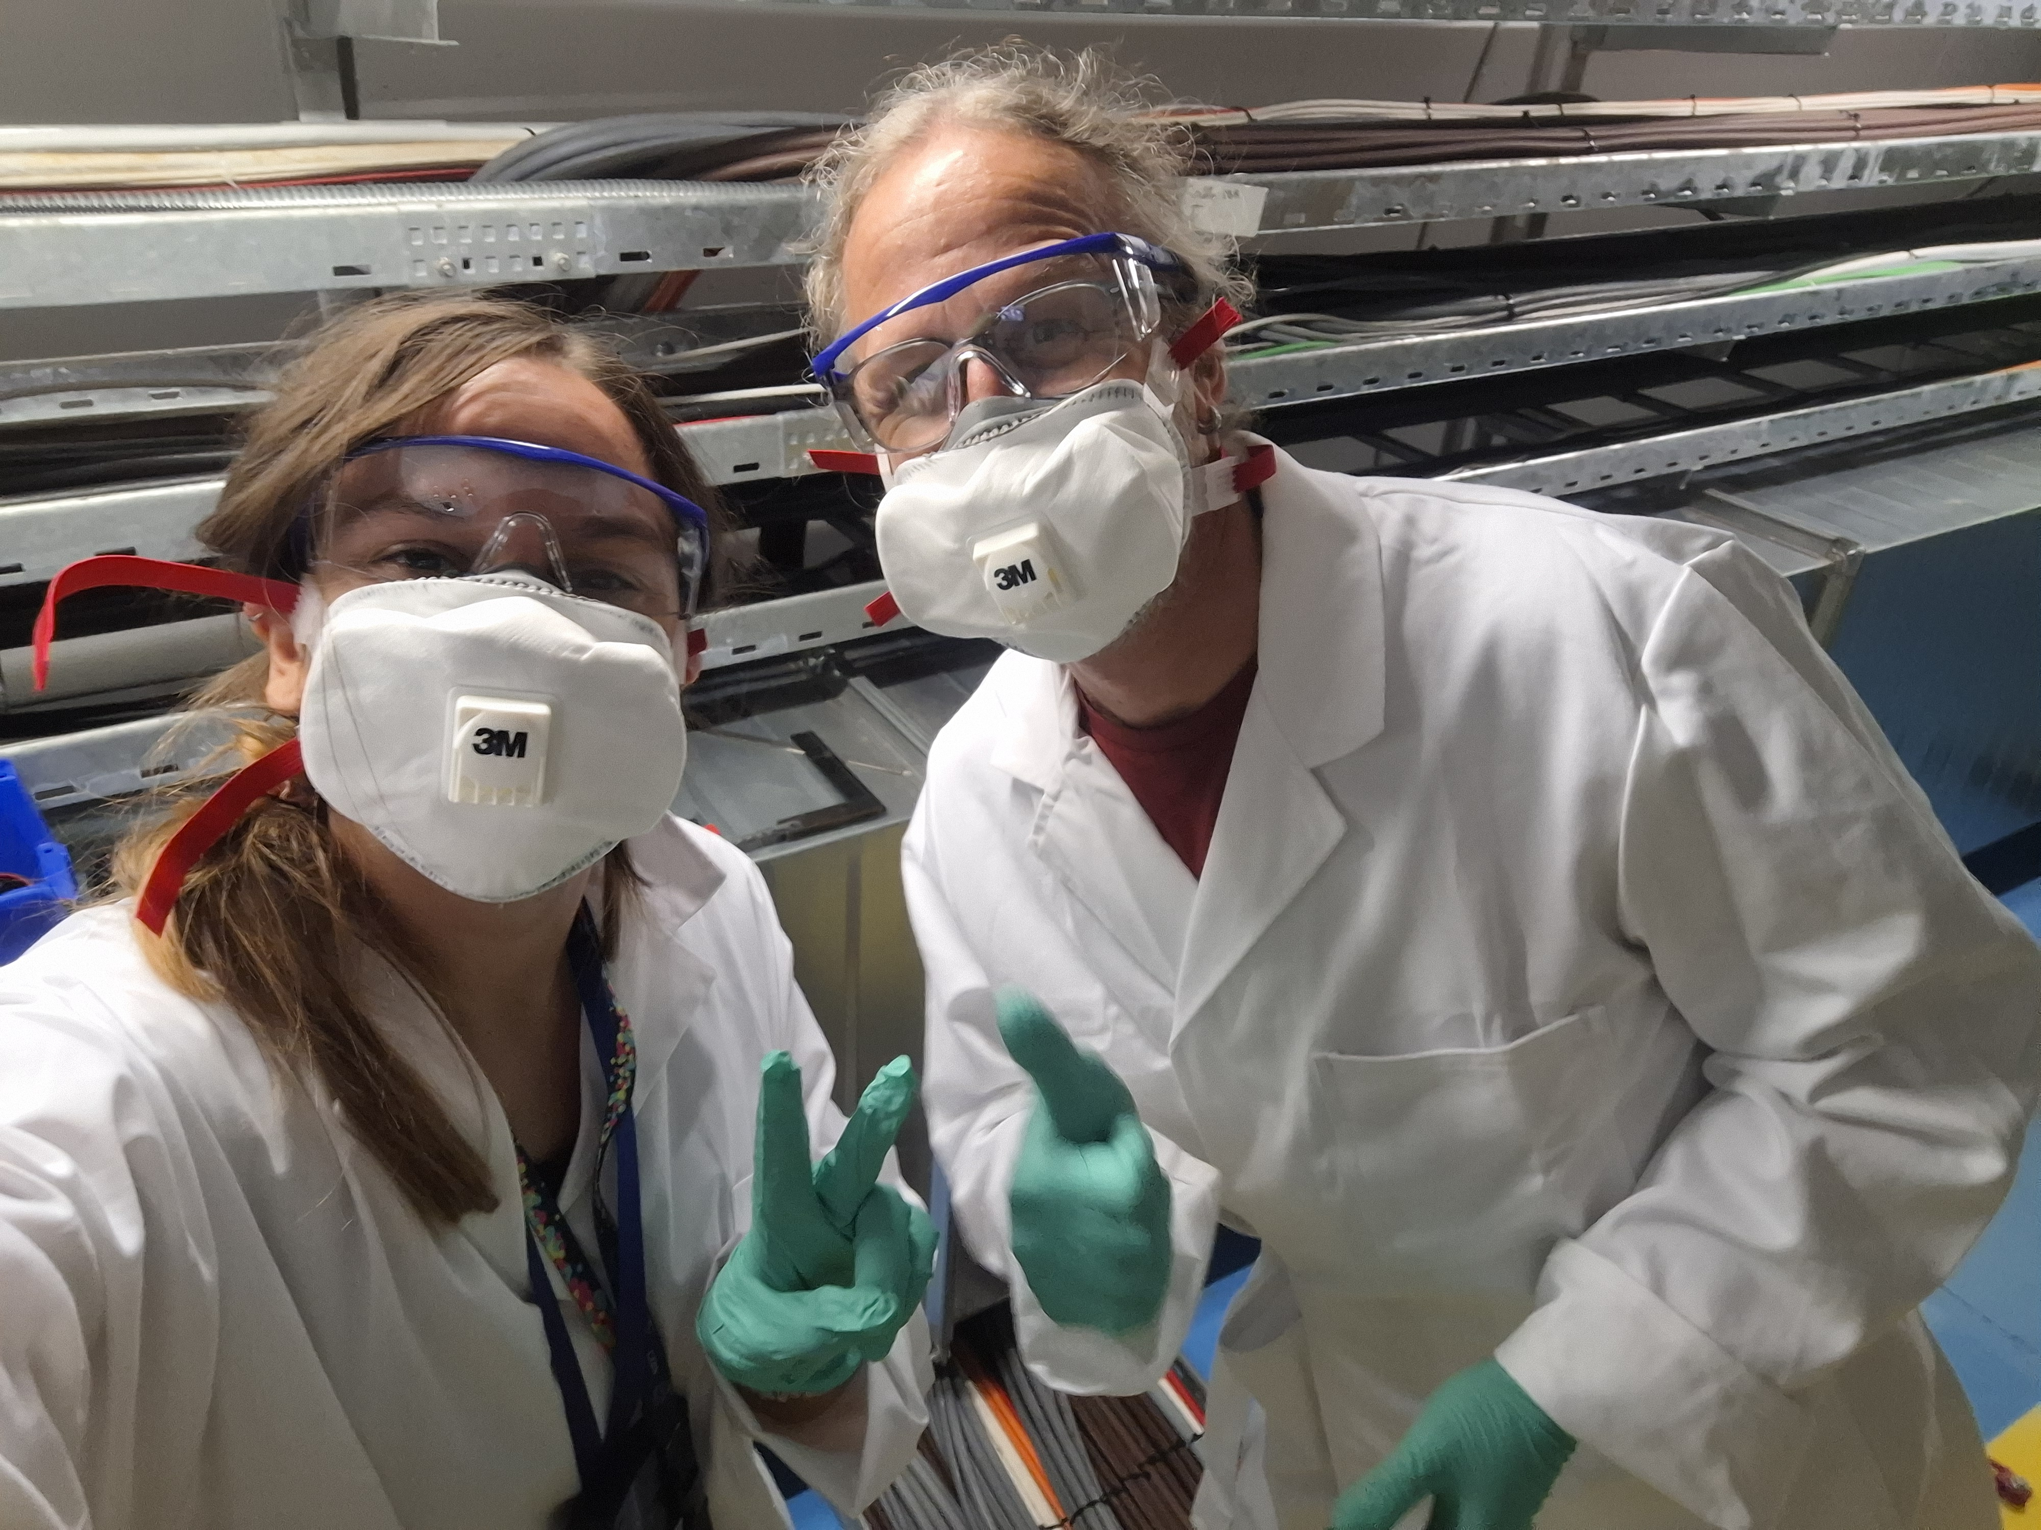
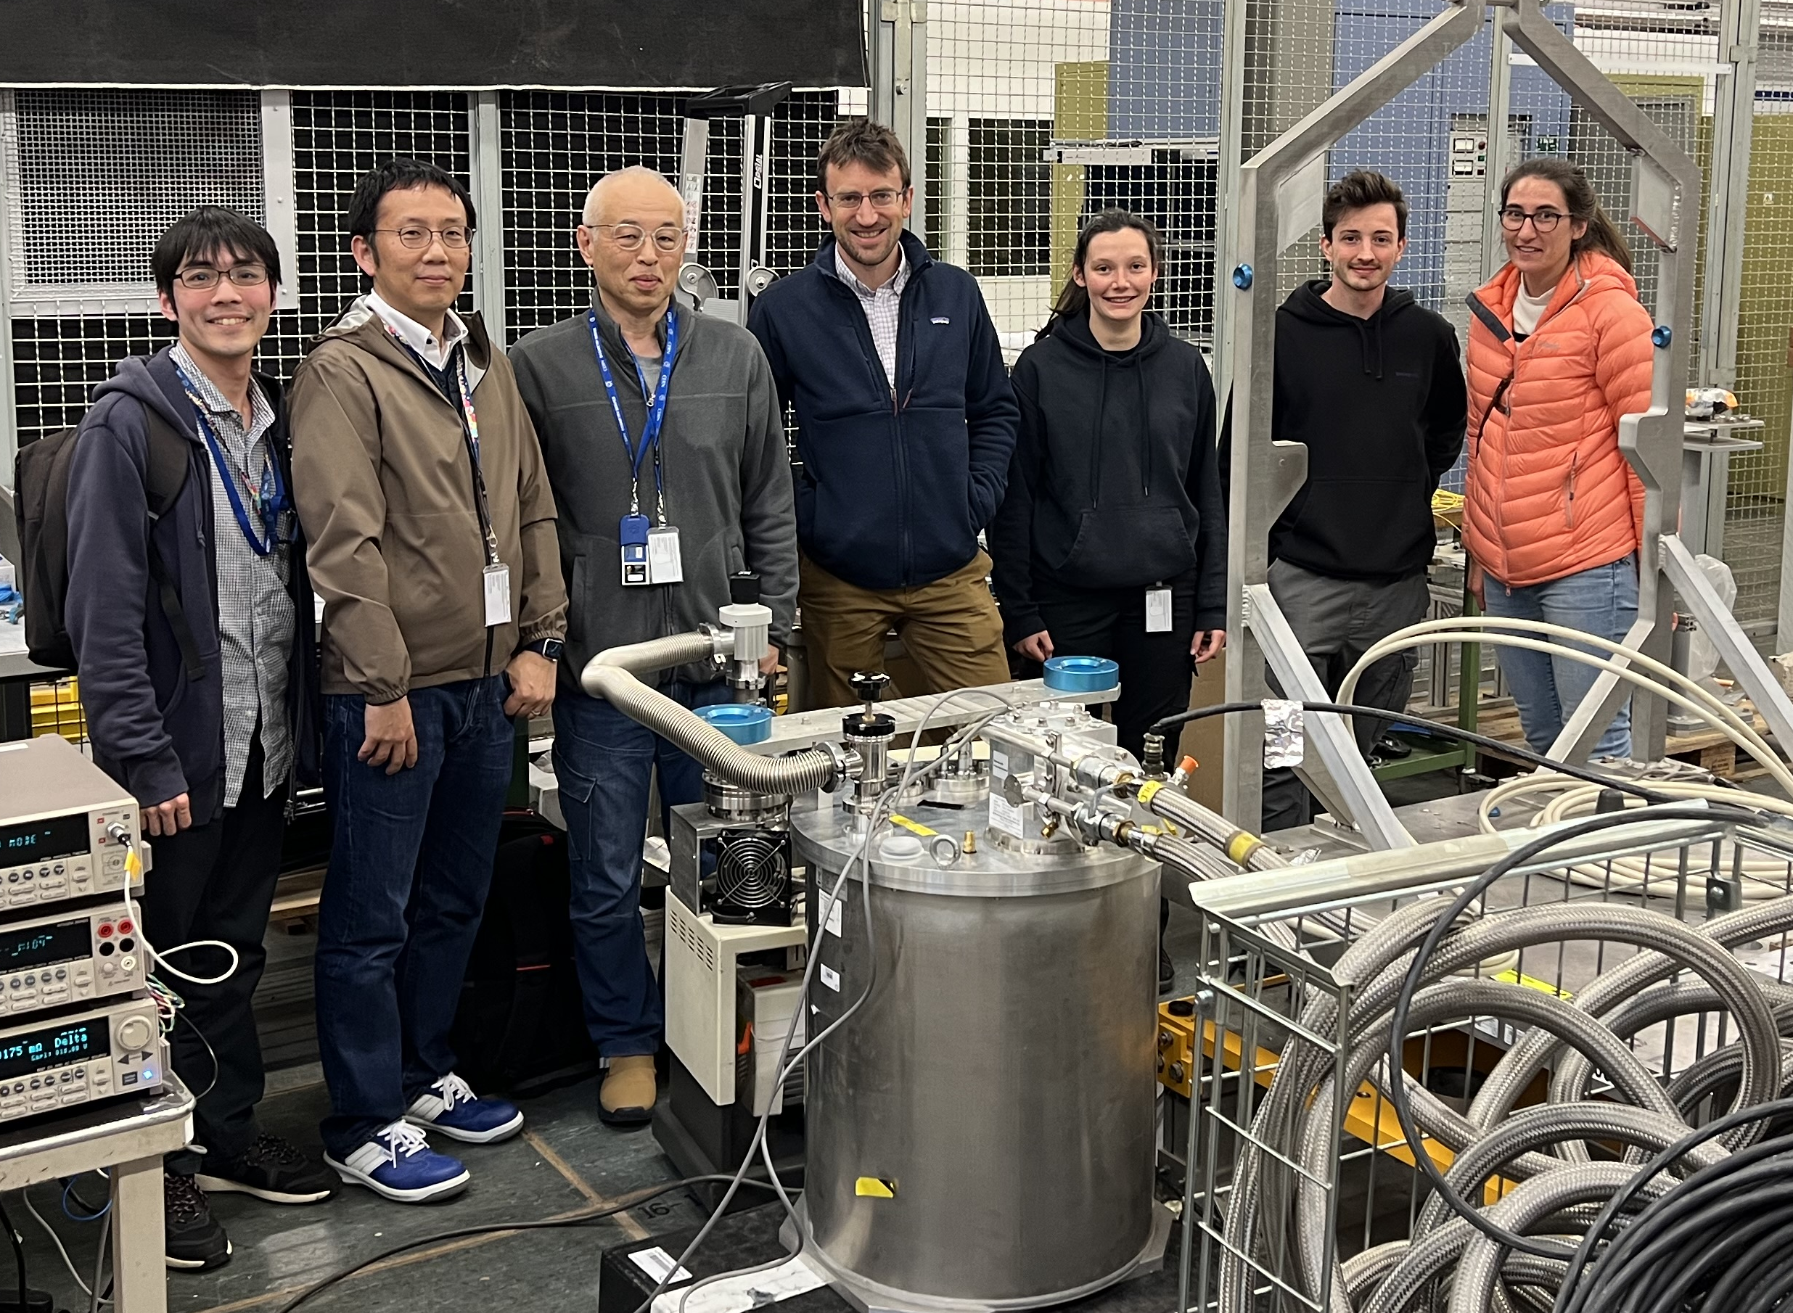
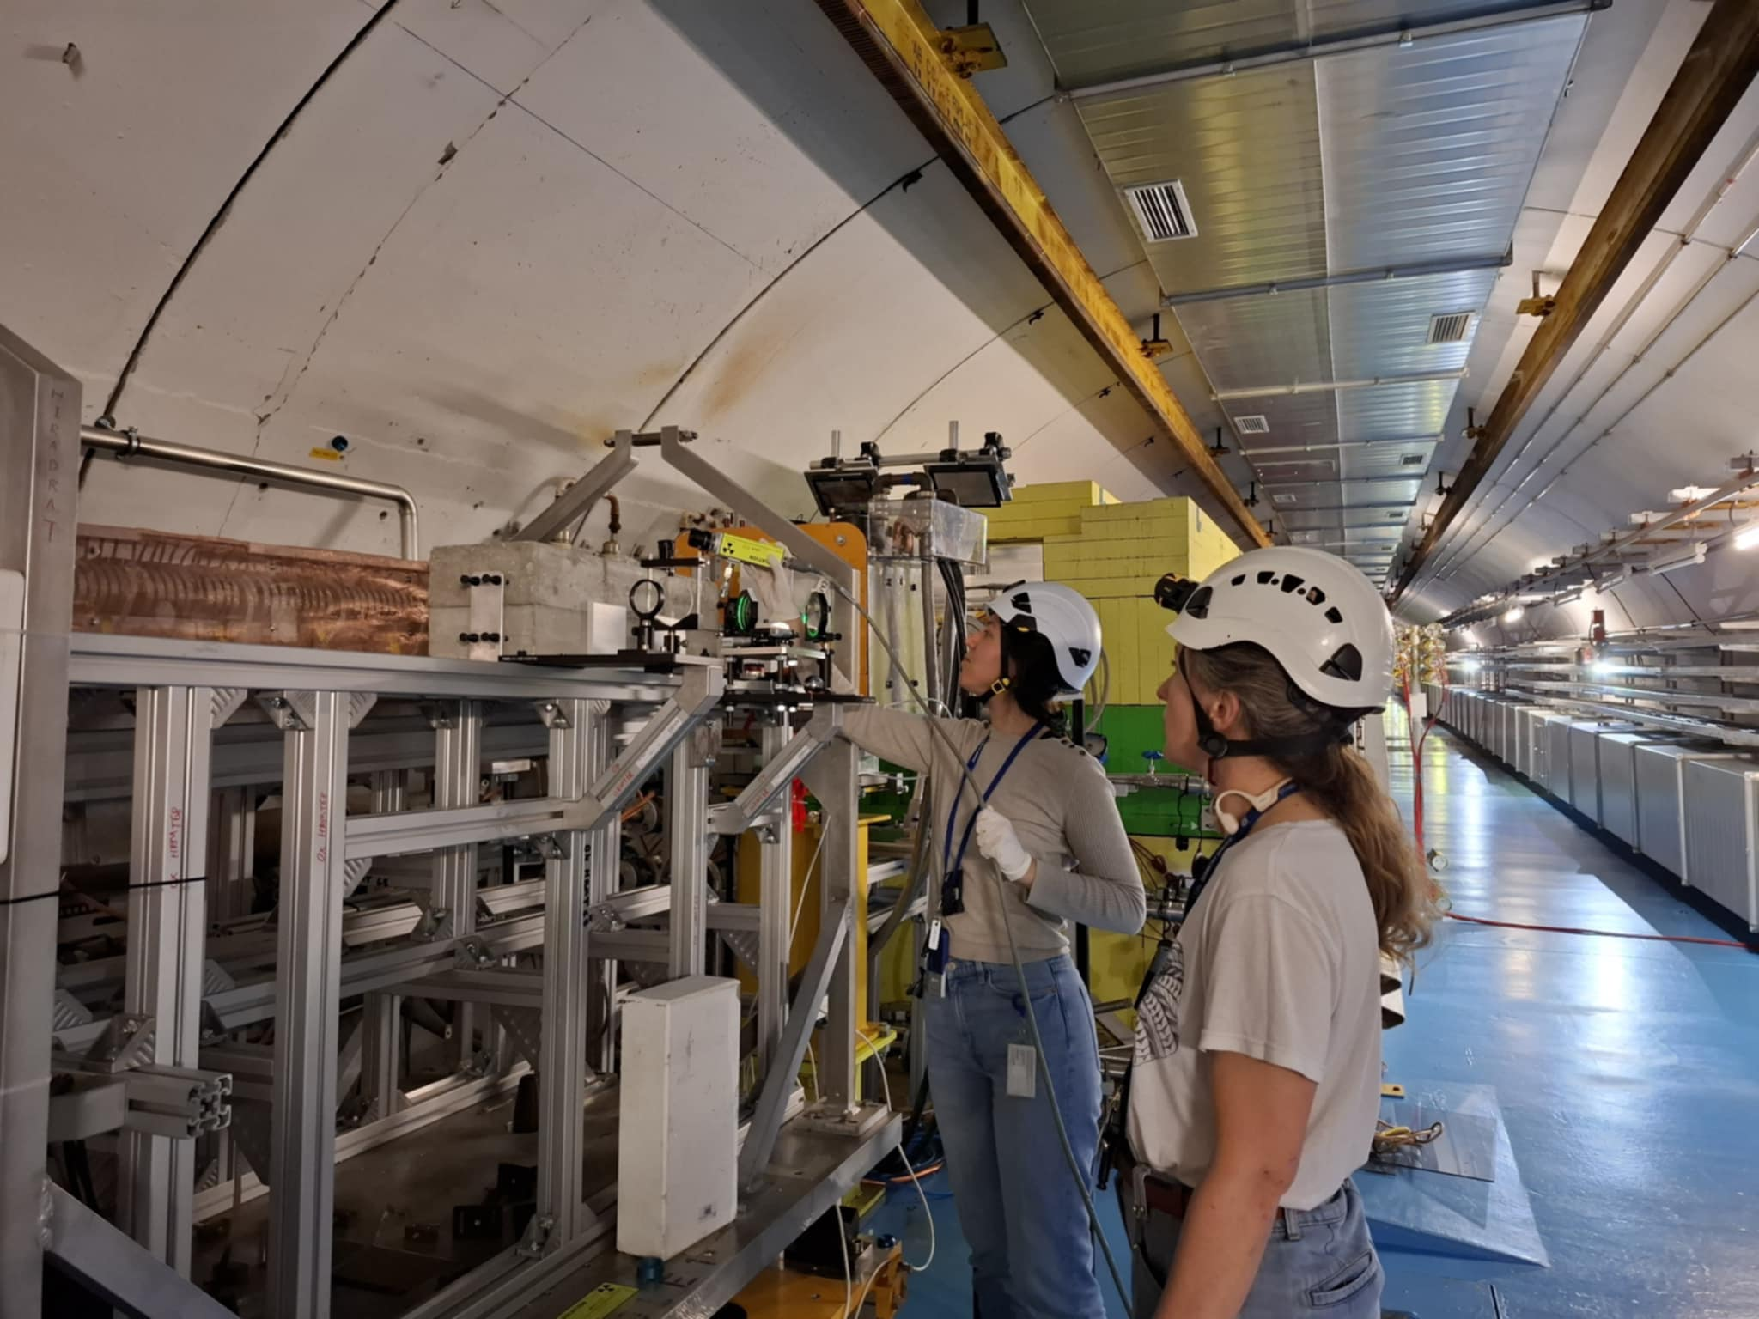
HRMT-60 (RaDIATE), 2022
HRMT-66 (SMAUG), 2024
HRMT-62 (FIREBALL-I), 2023
HRMT-64 (FIREBALL-II), 2024
HRMT-63 (DPA), 2025
HRMT-71 (BLM), 2026
HRMT-74 (BTVmat), 2025
HRMT-68 (FIREBALL-III), 2025

Slide 8
Focusing on two highlights: FIREBALL & RaDIATE

Slide 9
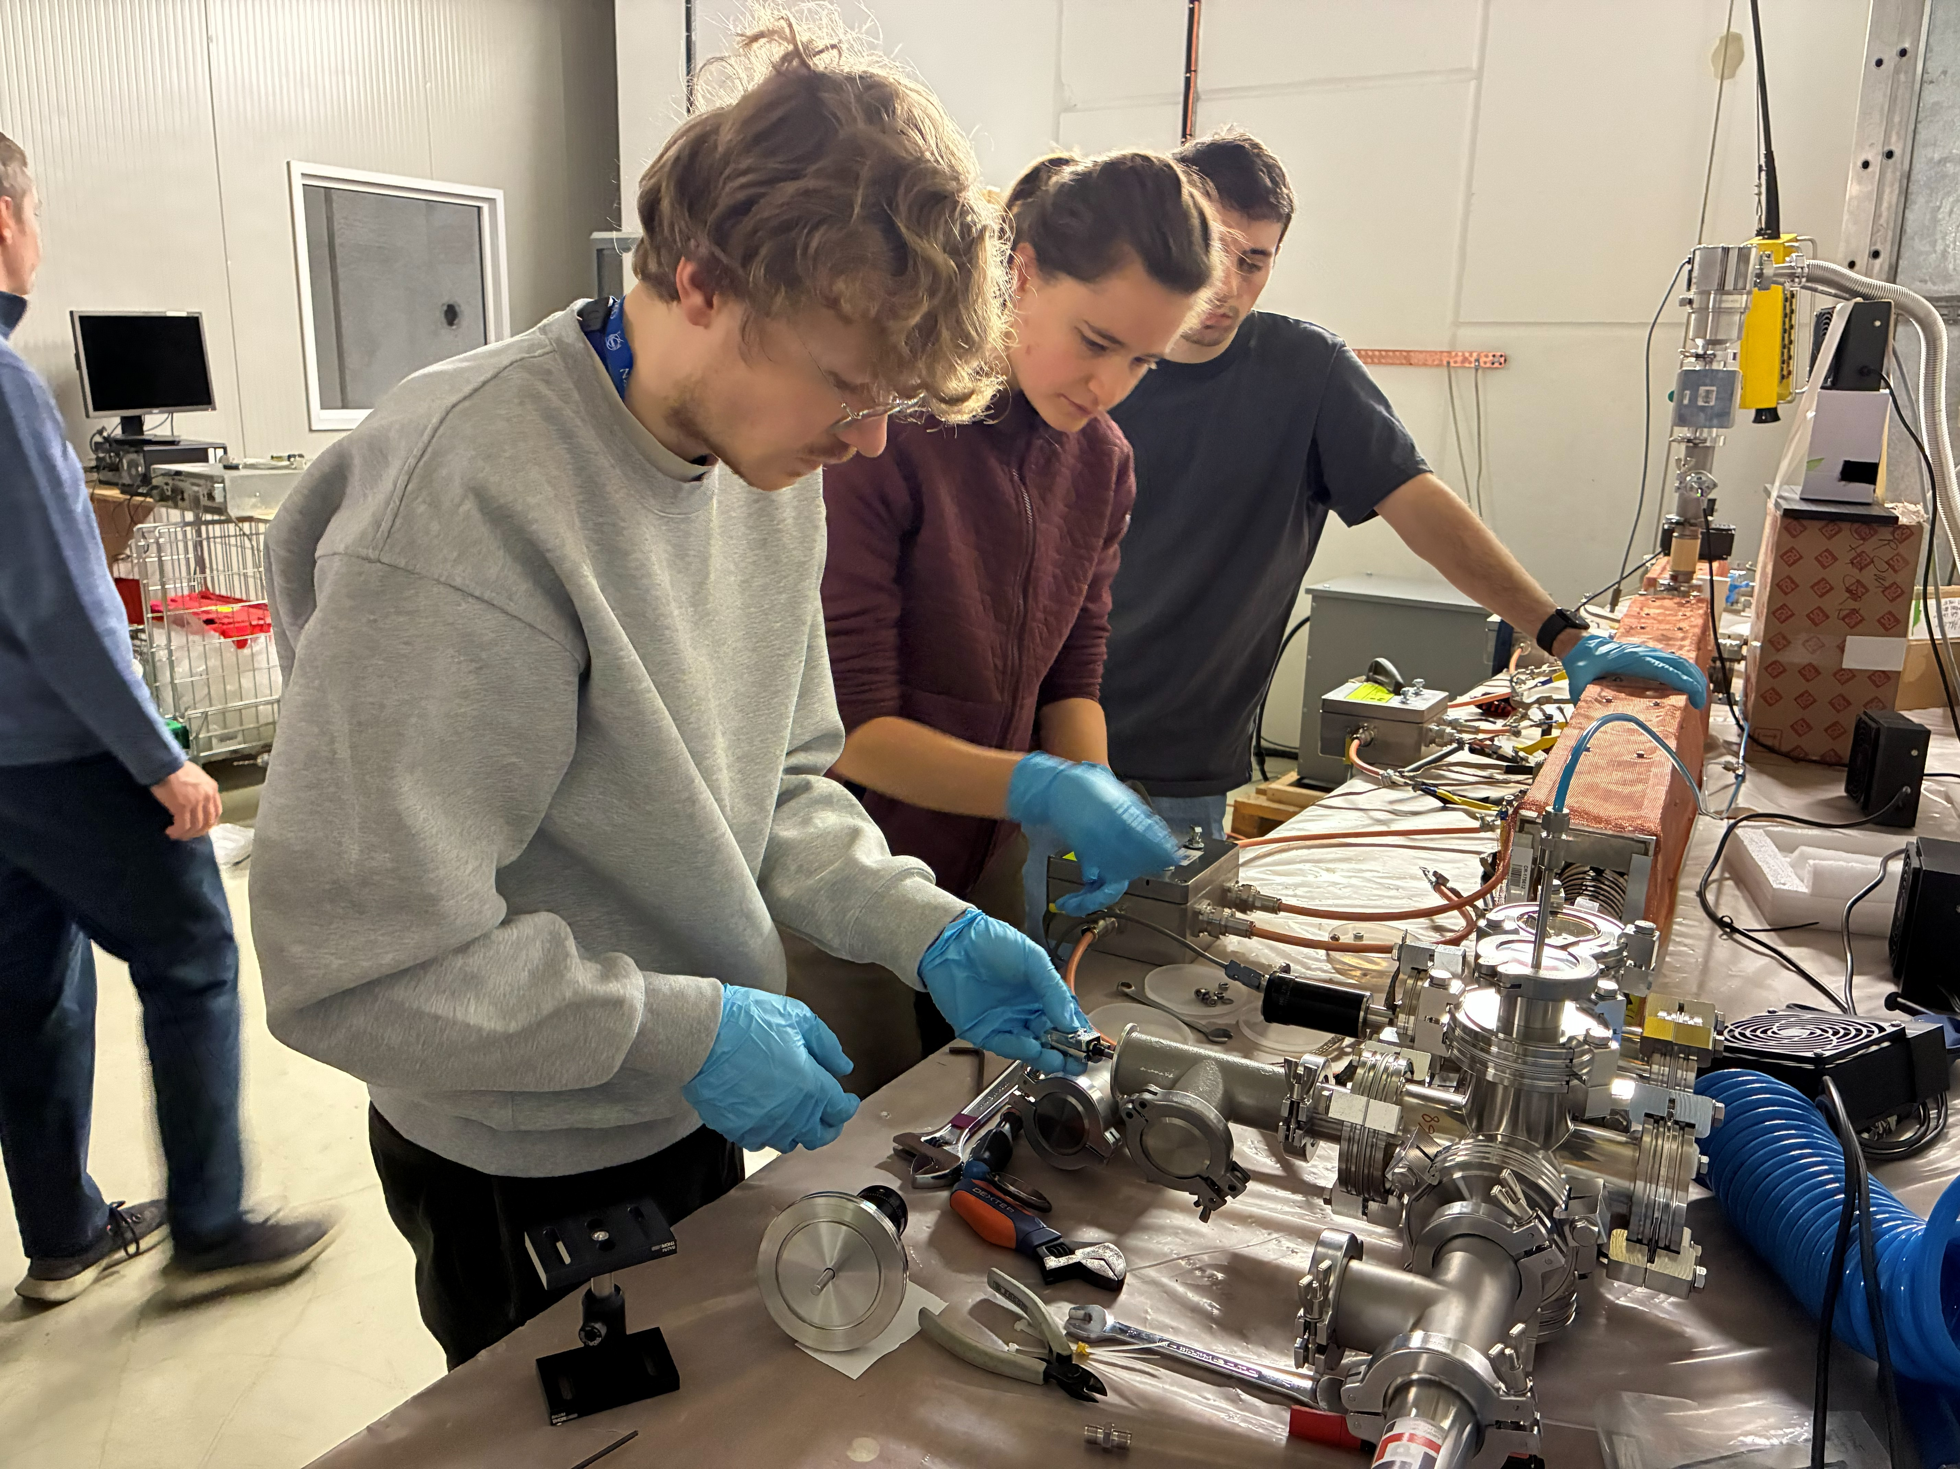
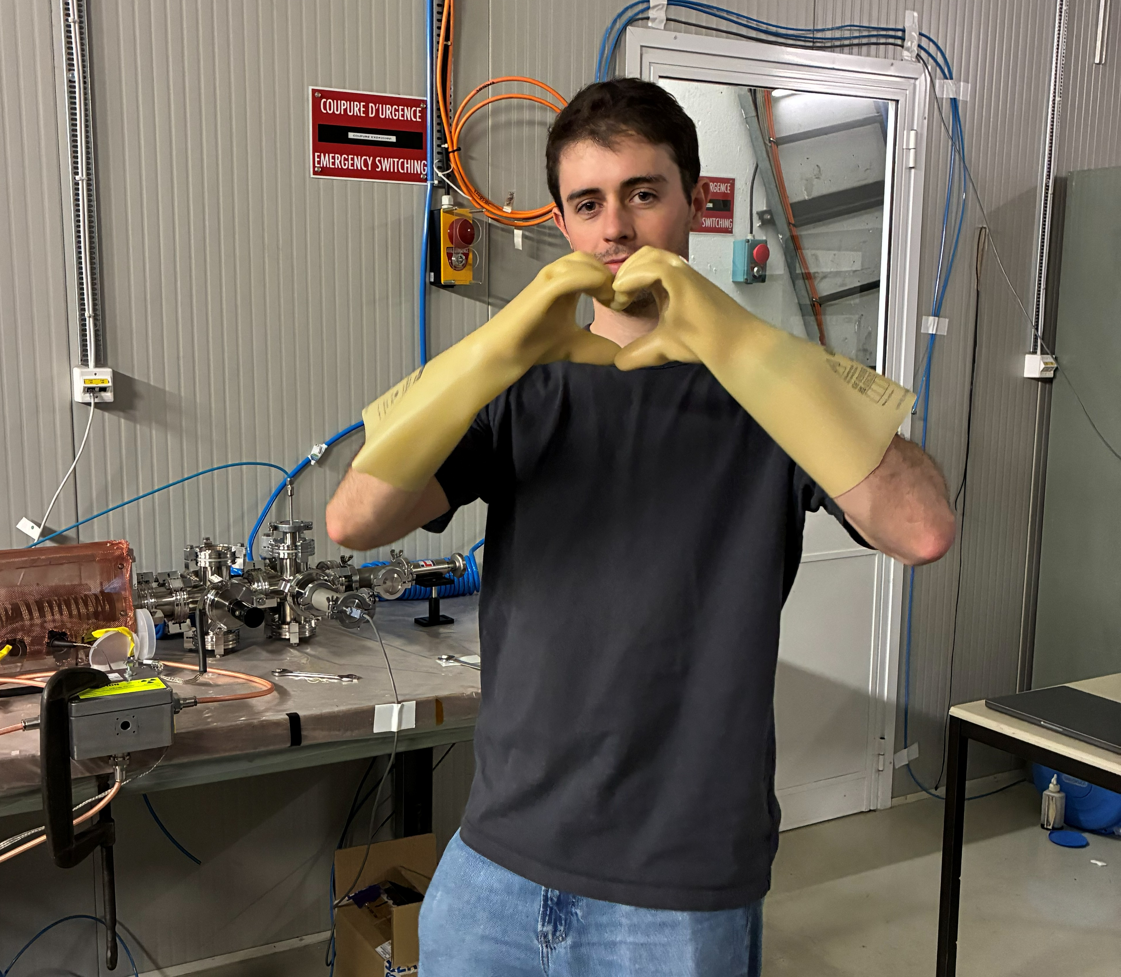
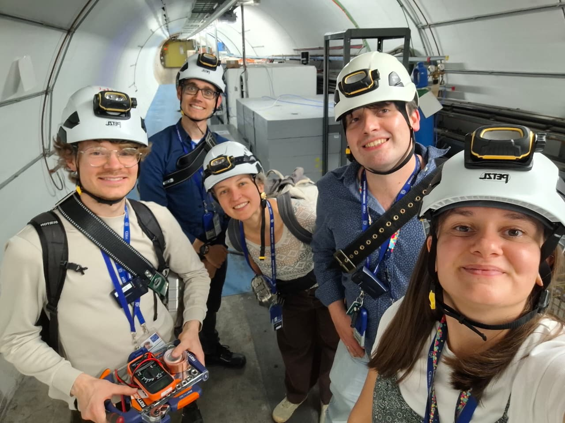
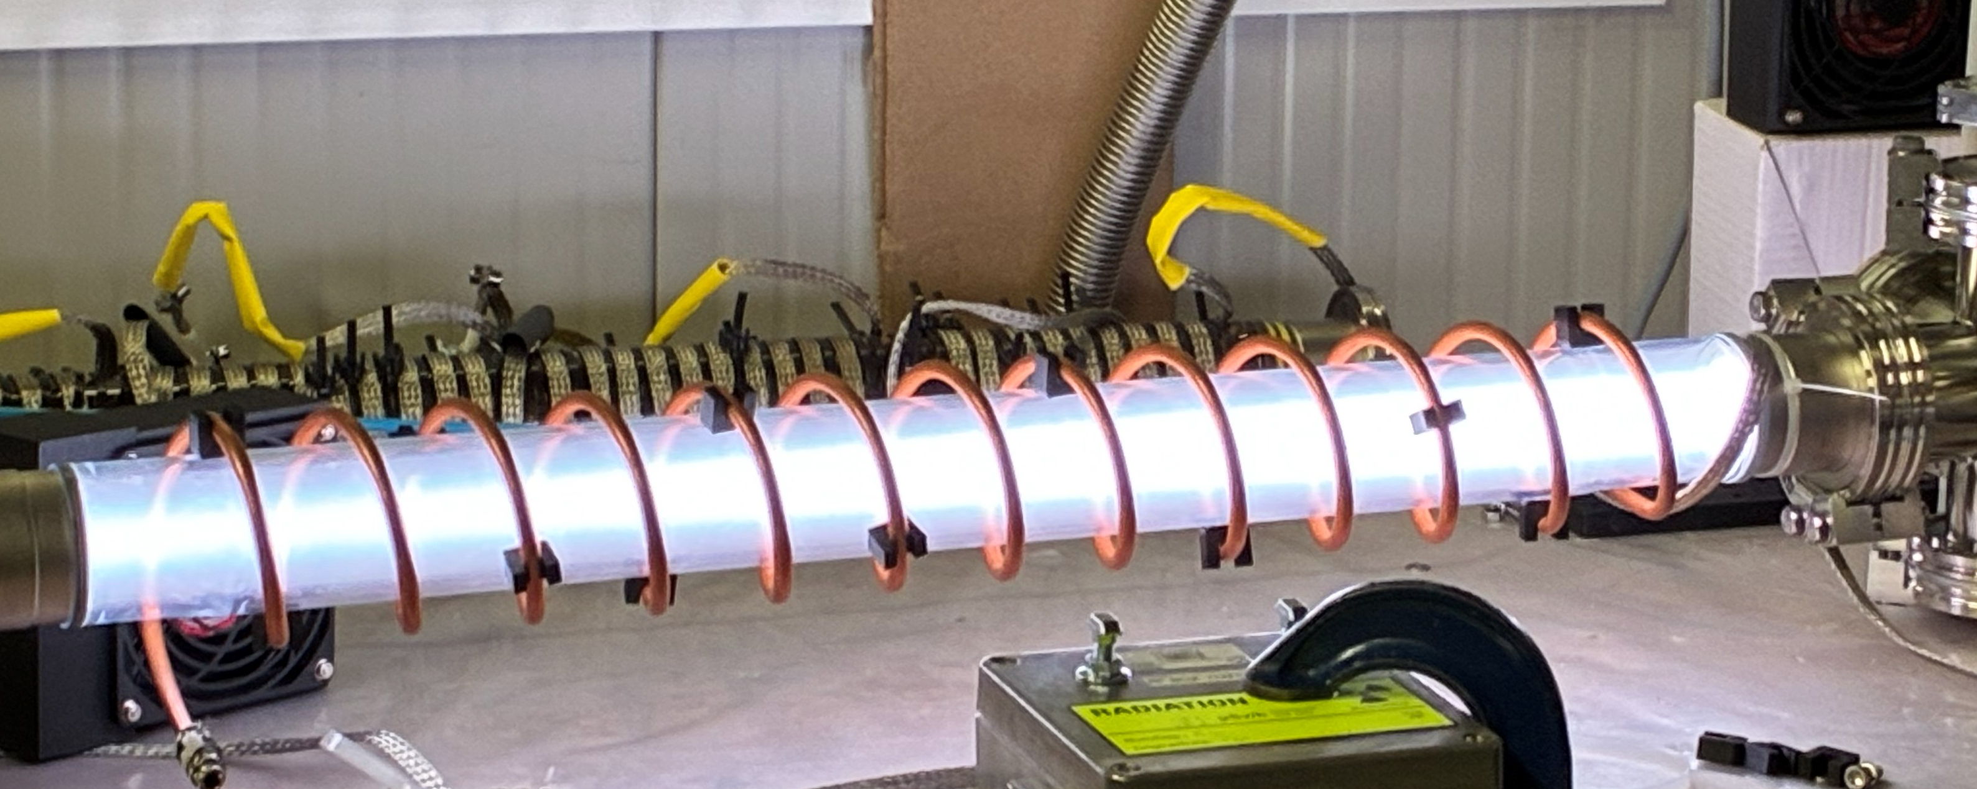
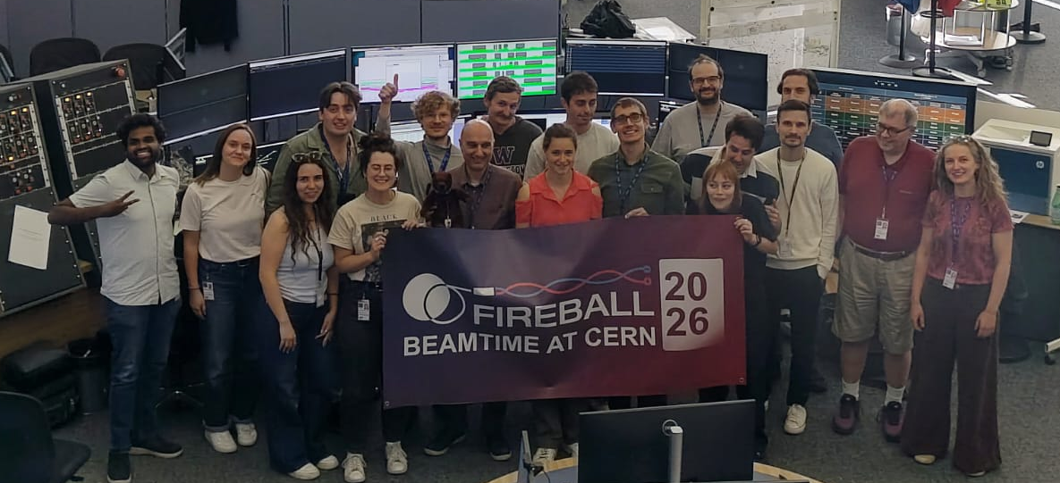
The FIREBALL Collaboration

Slide 10
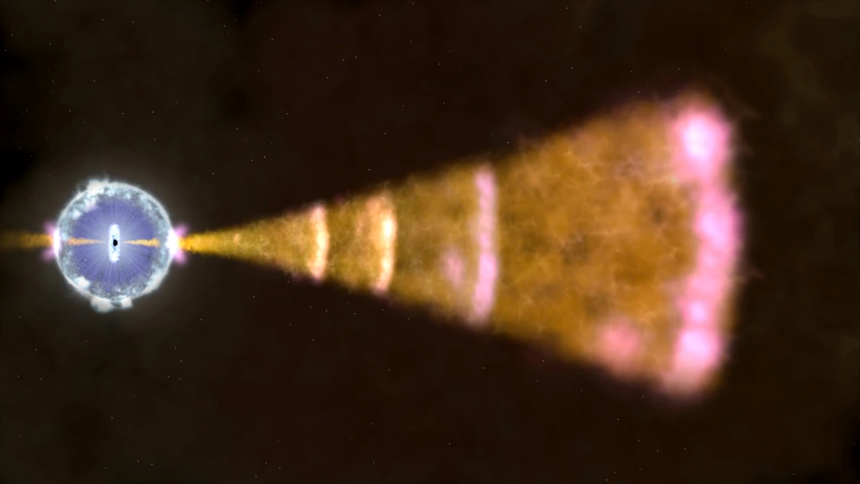
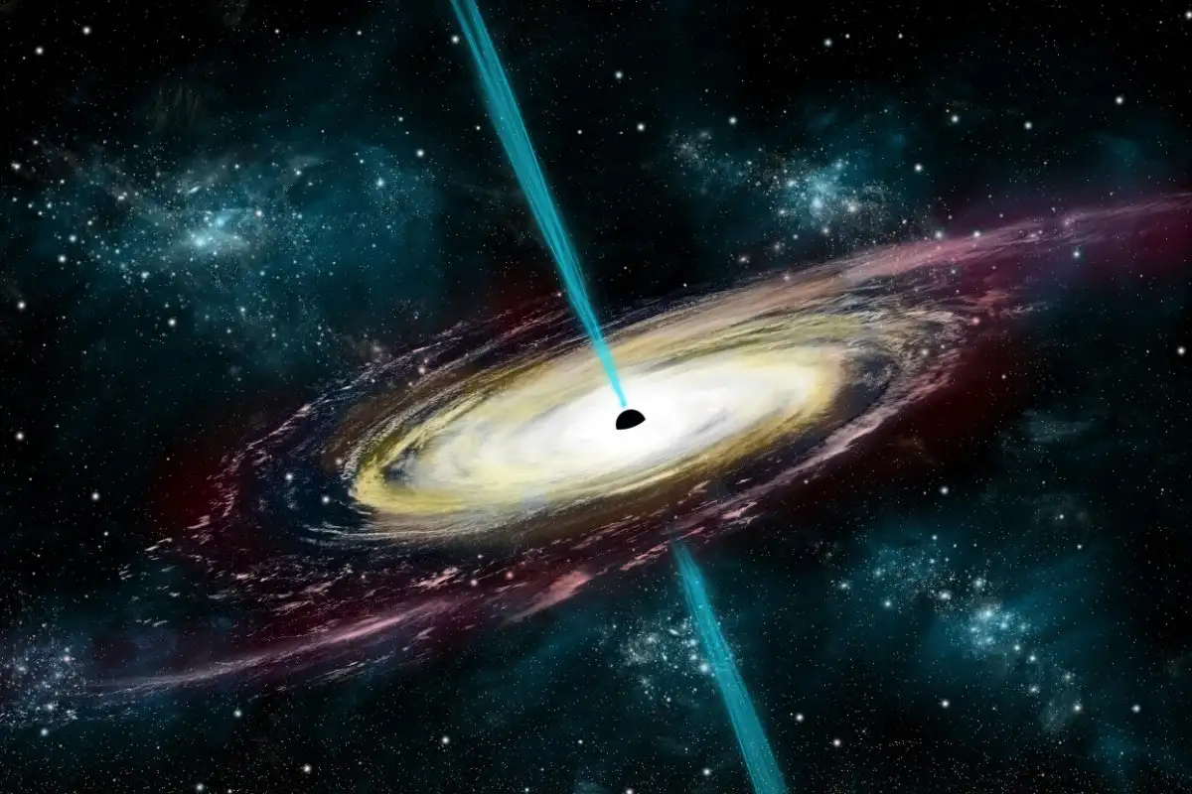
Purpose of FIREBALL experiments
Studies of e⁻e⁺ plasmas are of great interest in astrophysics → Black holes, gamma-ray bursts (GRBs), blazar jets, etc.
Plasma instabilities are theorized to develop through the intergalactic medium originating in ”pair beams” → Mechanisms involved not well understood.
  Density modulations, beam filamentation, and magnetic-field growth → measurable effects
  How to create so dense, quasi neutral beam propagating through a plasma?
  → HiRadMat !!
Illustration of a GRB. Source: NASA's Goddard Space Flight Center
Illustration of a blazar jet. Source: Stocktrek Images, Inc. / Alamy Stock Photo
Notes:
e-e+ all over the universe. Experimental studies could improve our understanding of such radiative signatures observed on Earth. Create an electron positron beam that propagates through plasma to reproduce astrophysical jet propagation

Slide 11
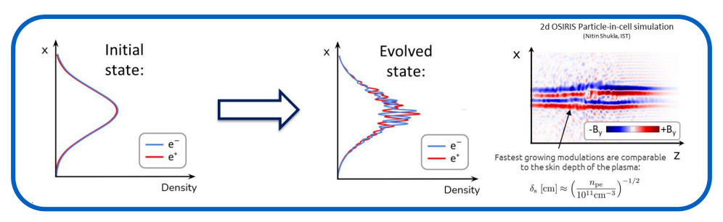
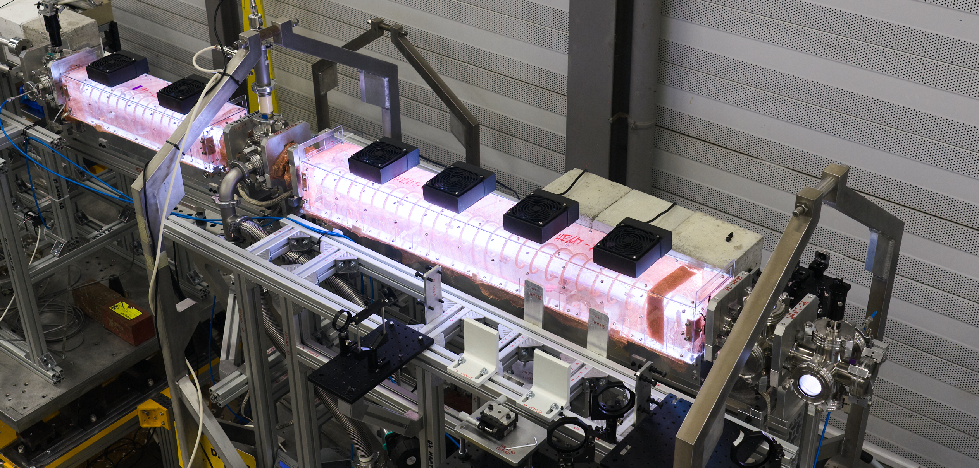
FIREBALL @ HiRadMat
FIREBALL–I (2023) : successful production of stable quasi-neutral beam (e- / e+).
FIREBALL–II (2024): first measurements of the growth rate (and magnetic field strength) of the oblique instability in a plasma & first meteorite sample
FIREBALL–III (2025): studied the effect of plasma instabilities on the longitudinal structure of the pair beam and investigated whether particle acceleration can be initiated & a new meteorite sample
FIREBALL-IV (2026): investigate the seeding and amplification of plasma instabilities and particle acceleration.
Letter of Intent submitted to SPSC

Slide 12
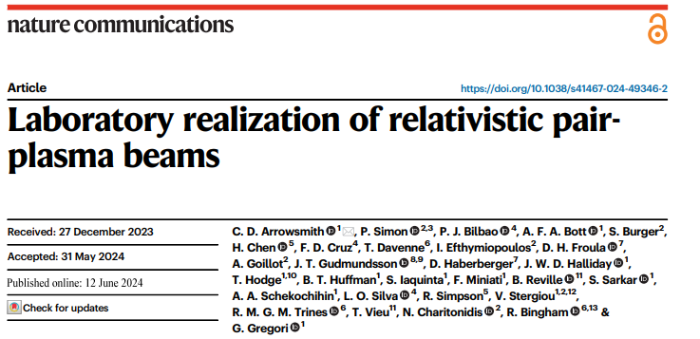
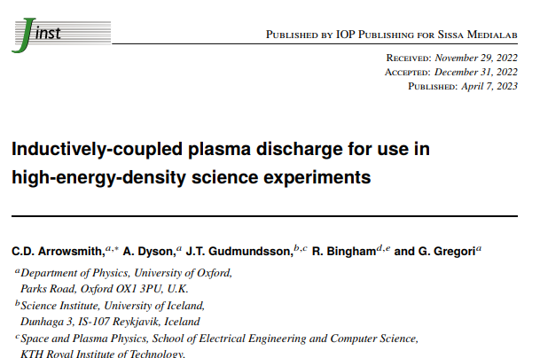
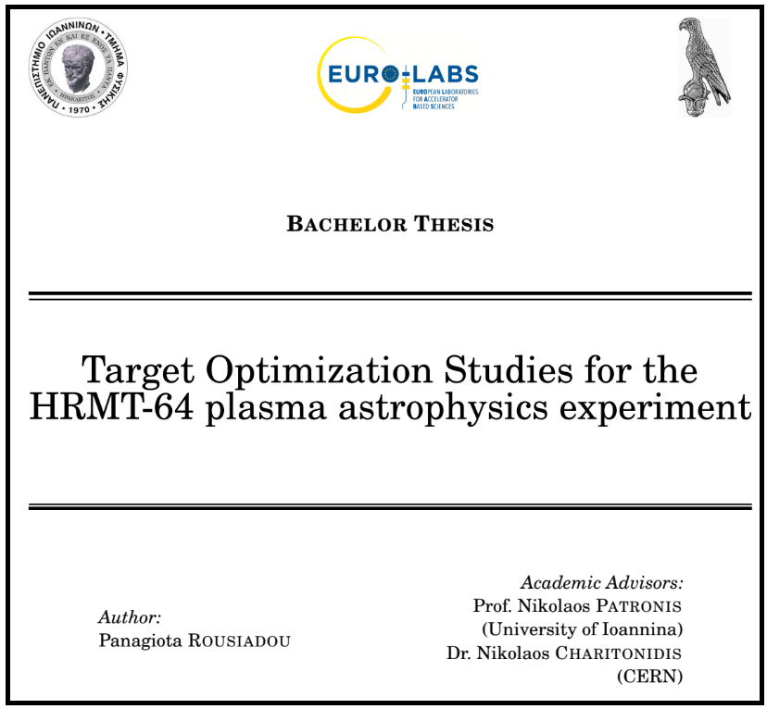
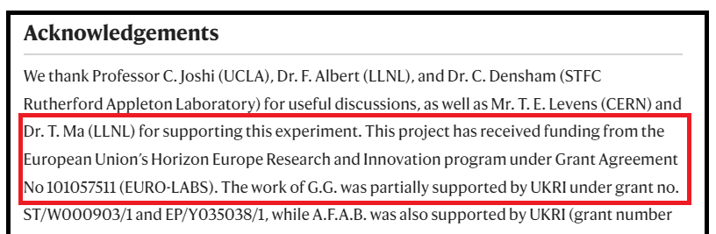
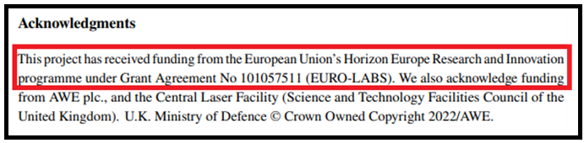
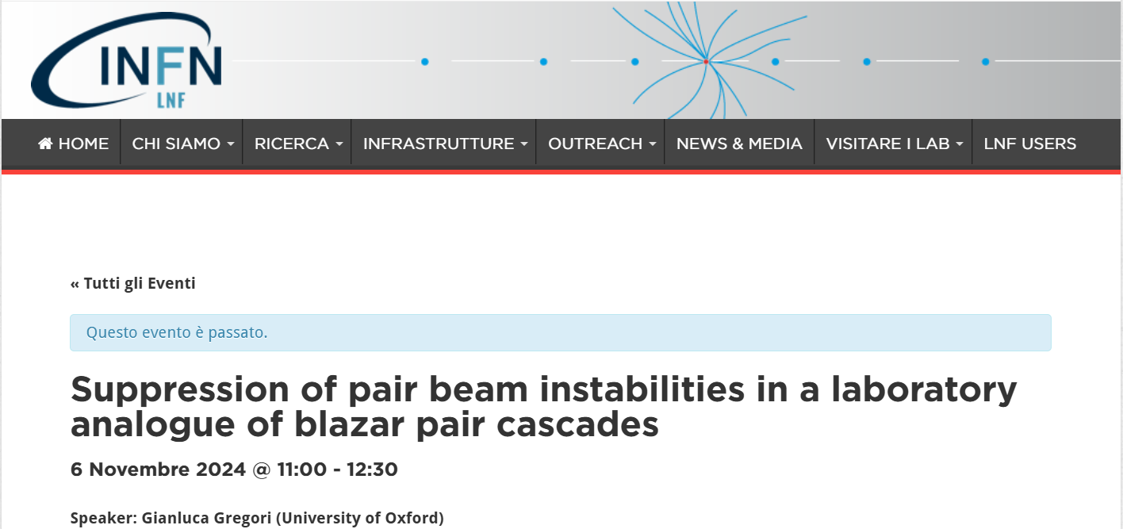
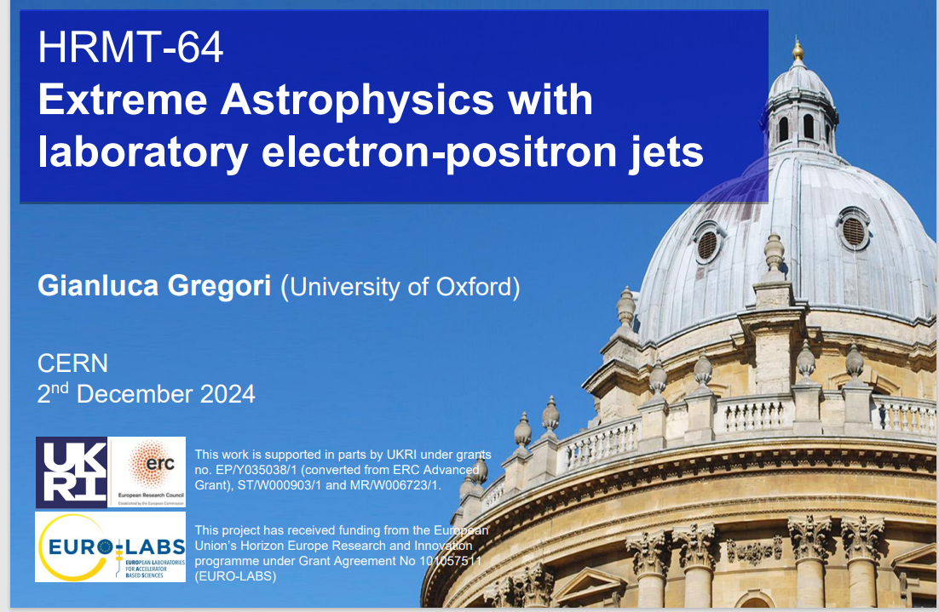
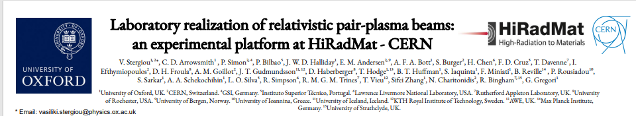

FIREBALL Collaboration
Publications

Slide 13
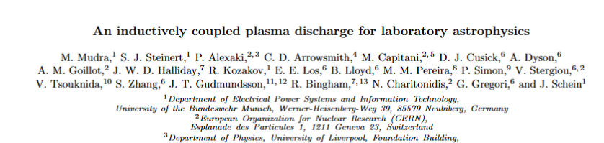
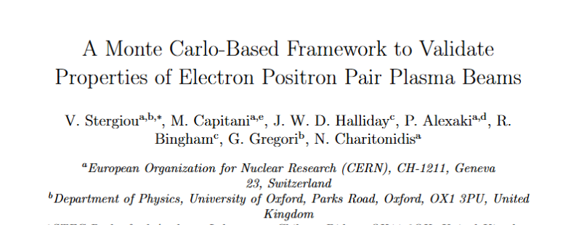
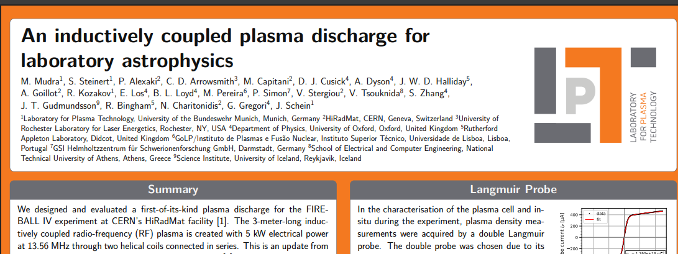
Fireball Collaboration
Publications in preparation
FIREBALL would not have been possible without material & TA support from EURO-LABS.
Typical case of how TA helps small experiments grow to impactful collaborations.

Slide 14
RaDIATE

Slide 15
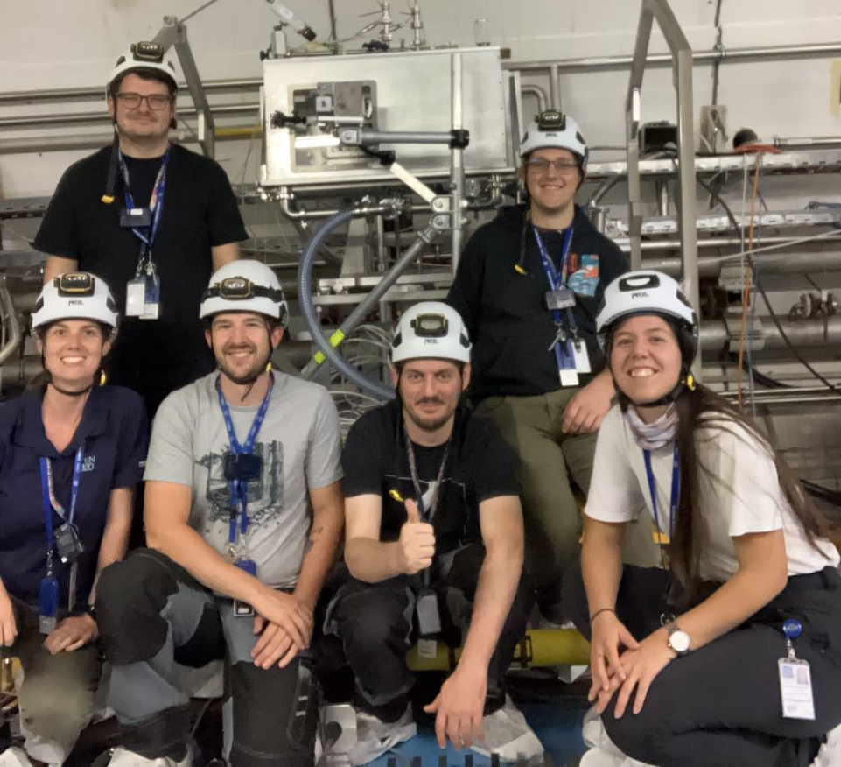
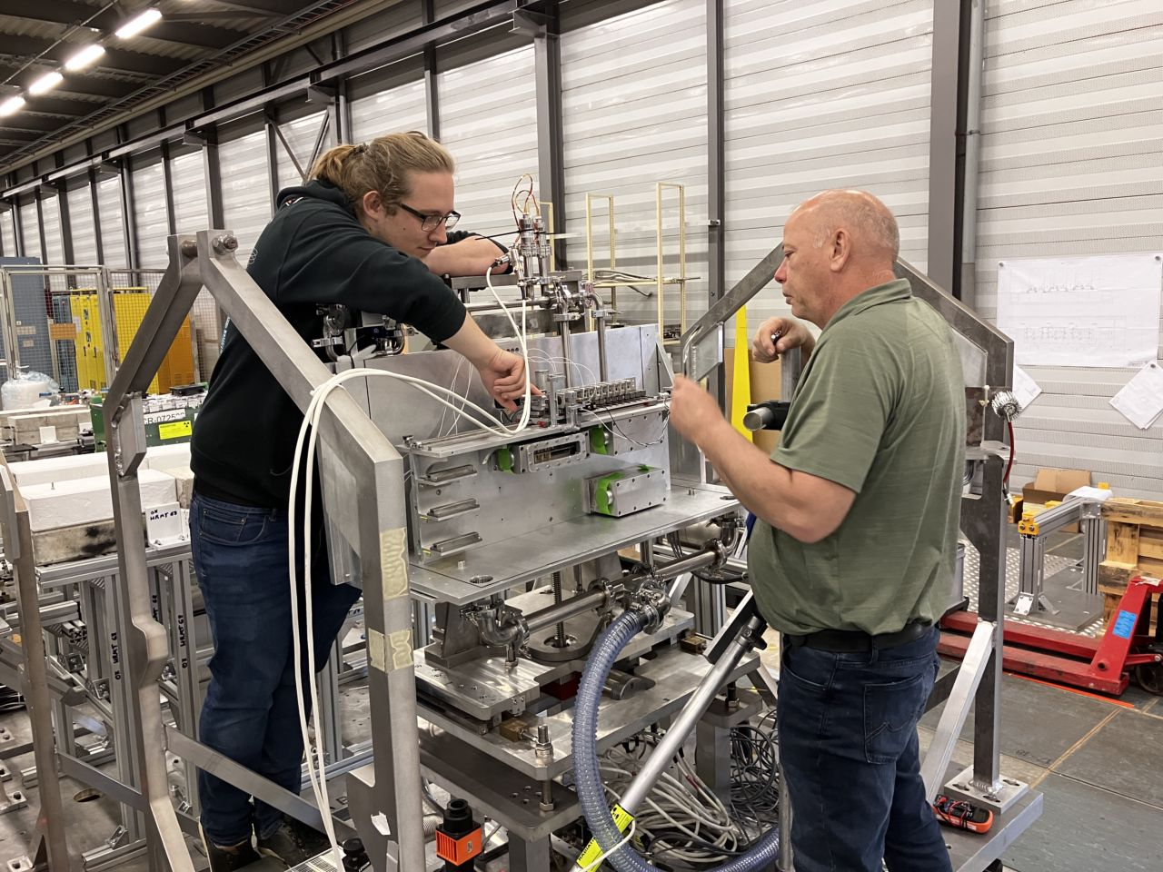
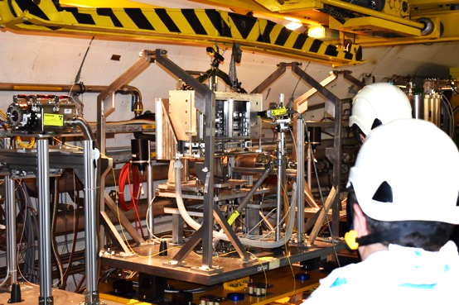
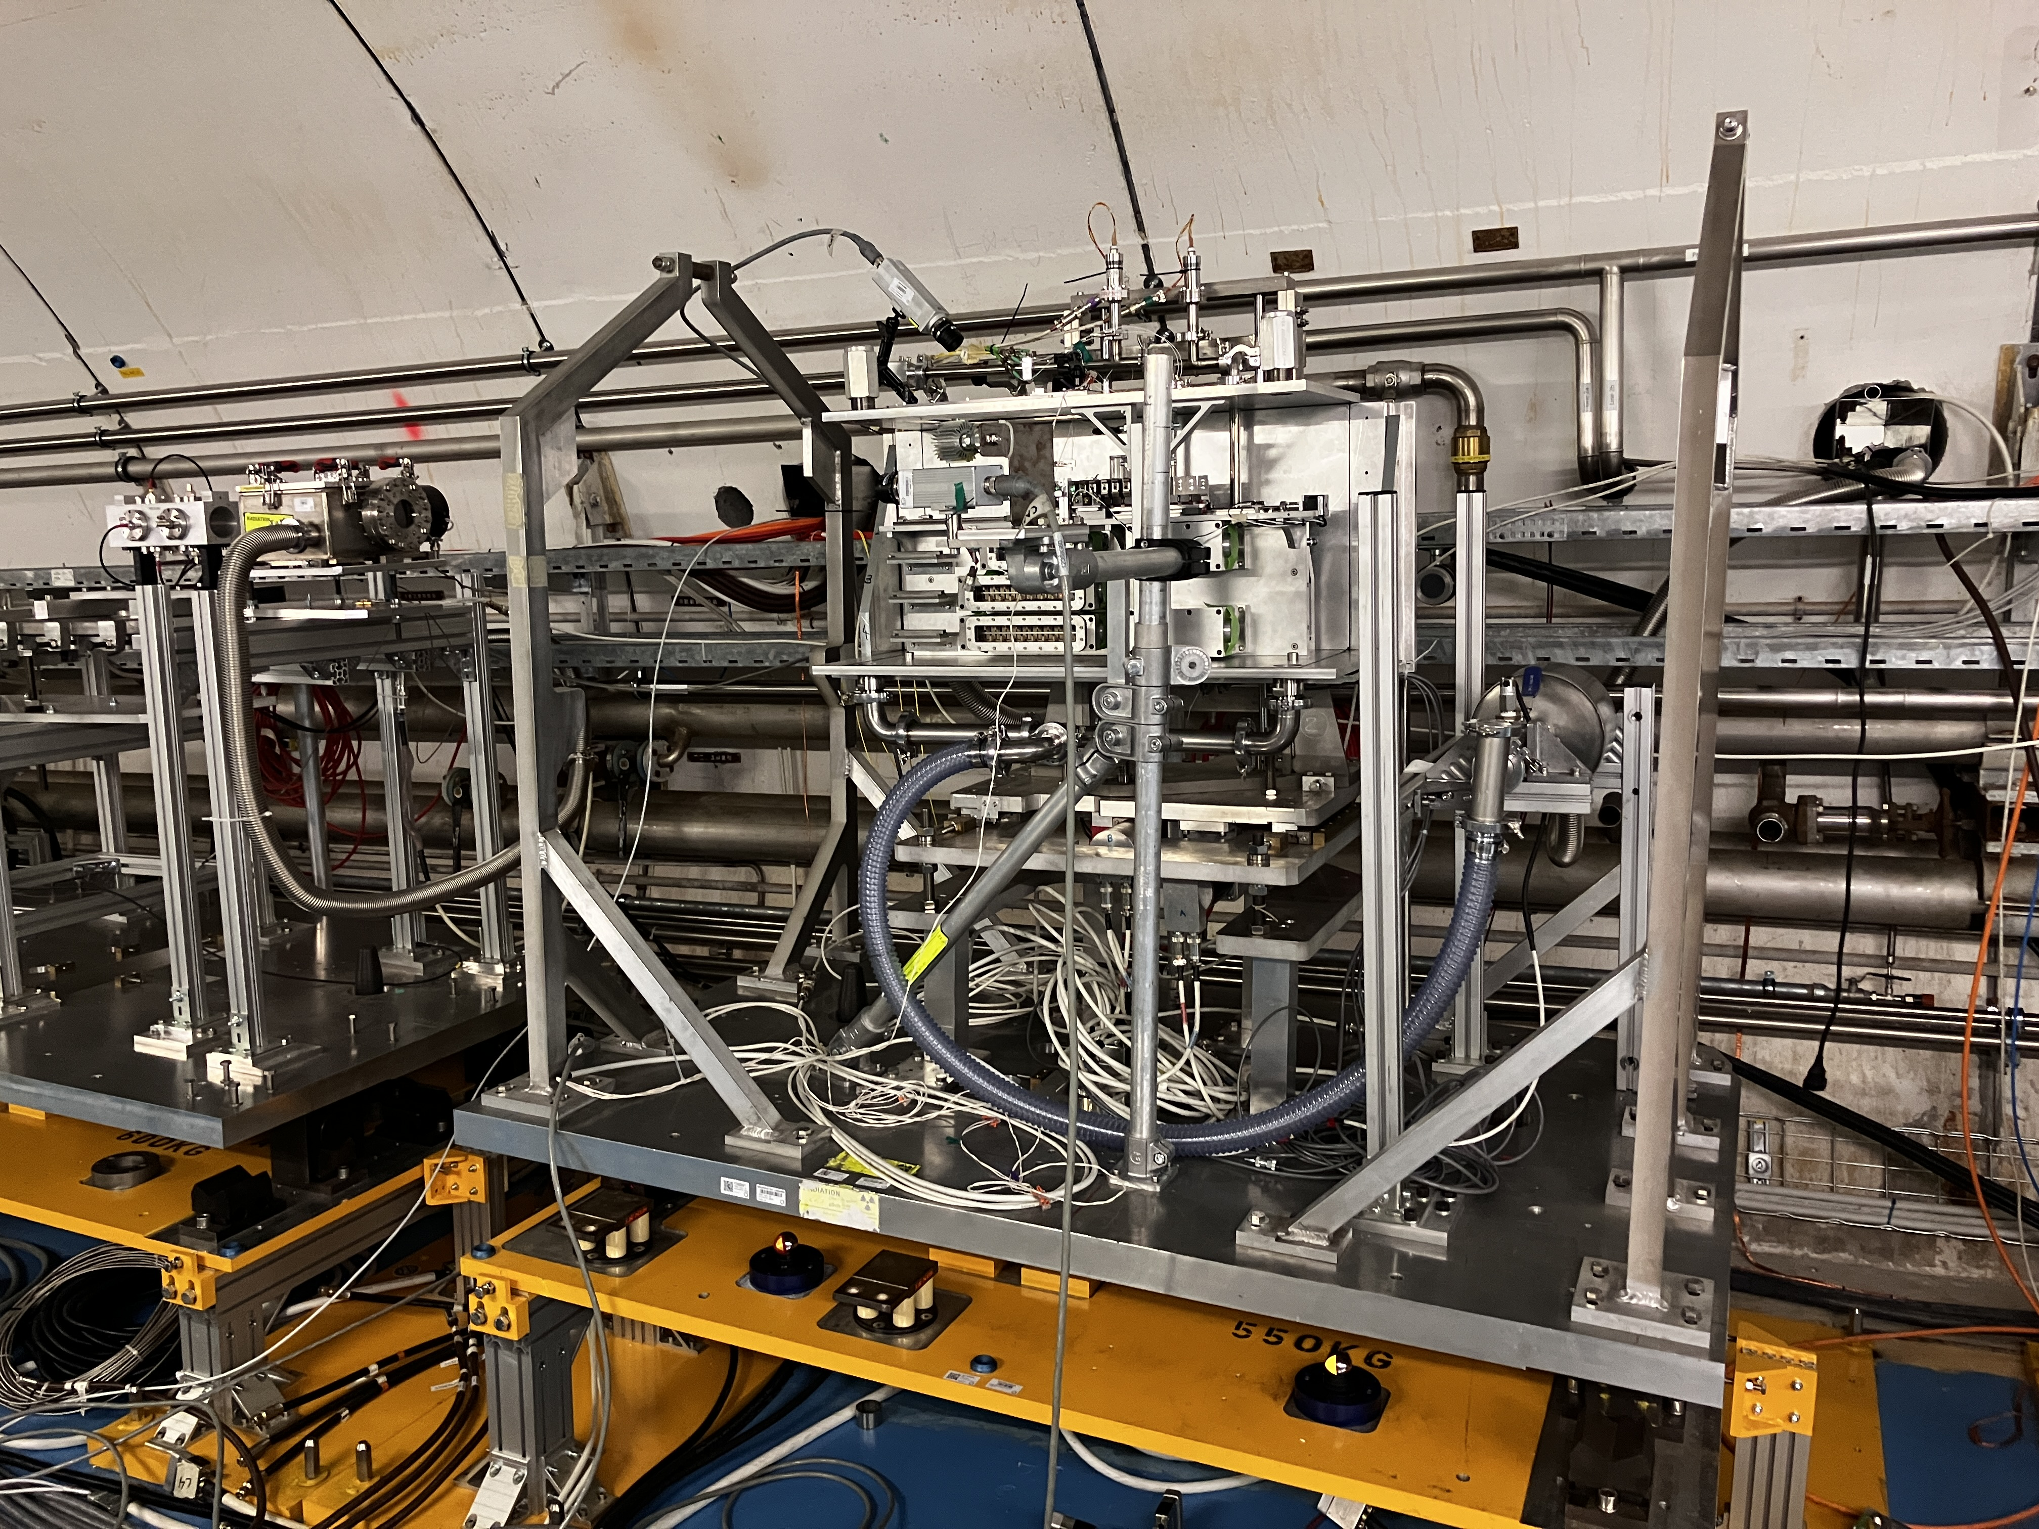
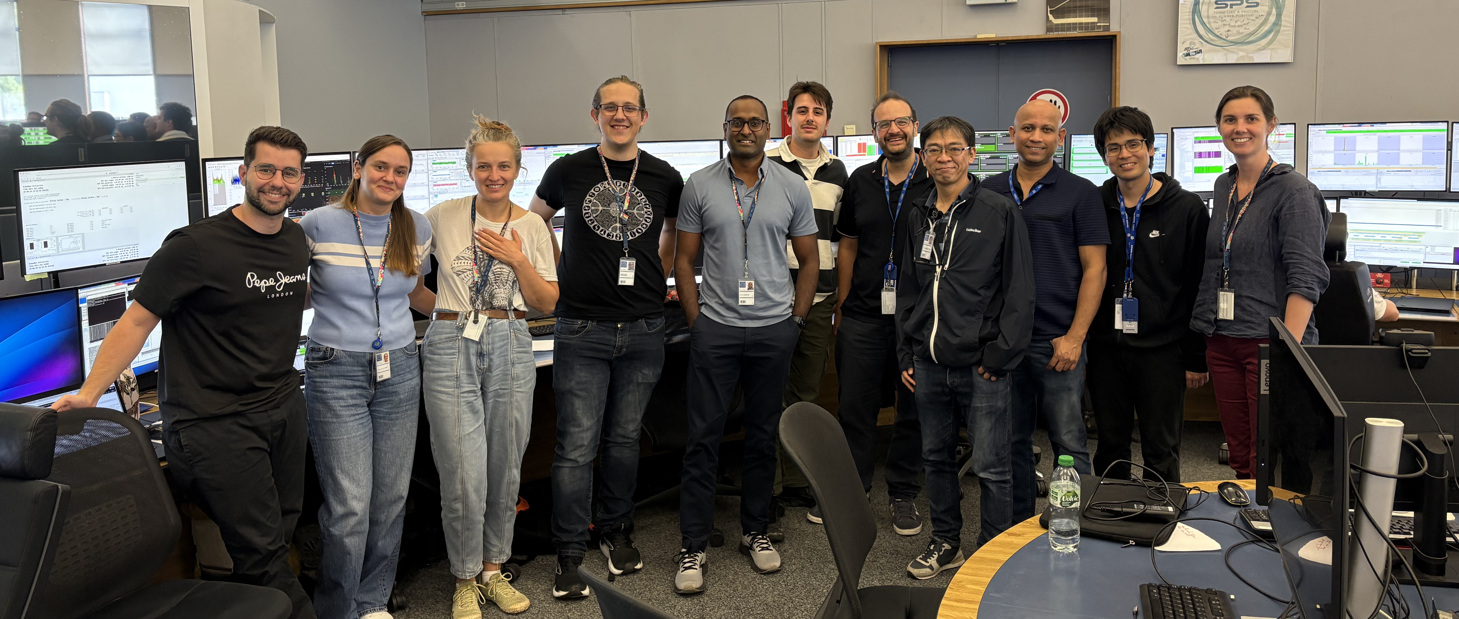
The RaDIATE Collaboration

Slide 16
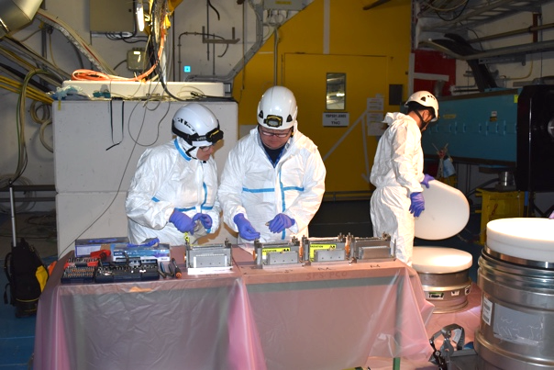
Purpose of RaDIATE experiments
Develop and qualify materials for future high-power accelerator targets, beam windows, and beam-intercepting devices
Understand material response to extreme thermal shock and dynamic stress generated by intense pulsed proton beams.
Evaluate both conventional and novel materials for use in next-generation multi-megawatt accelerator facilities
Establish material performance limits and failure mechanisms to improve reliability and operational lifetime.
Handling of the samples during RaDIATE-I (2022)

Slide 17
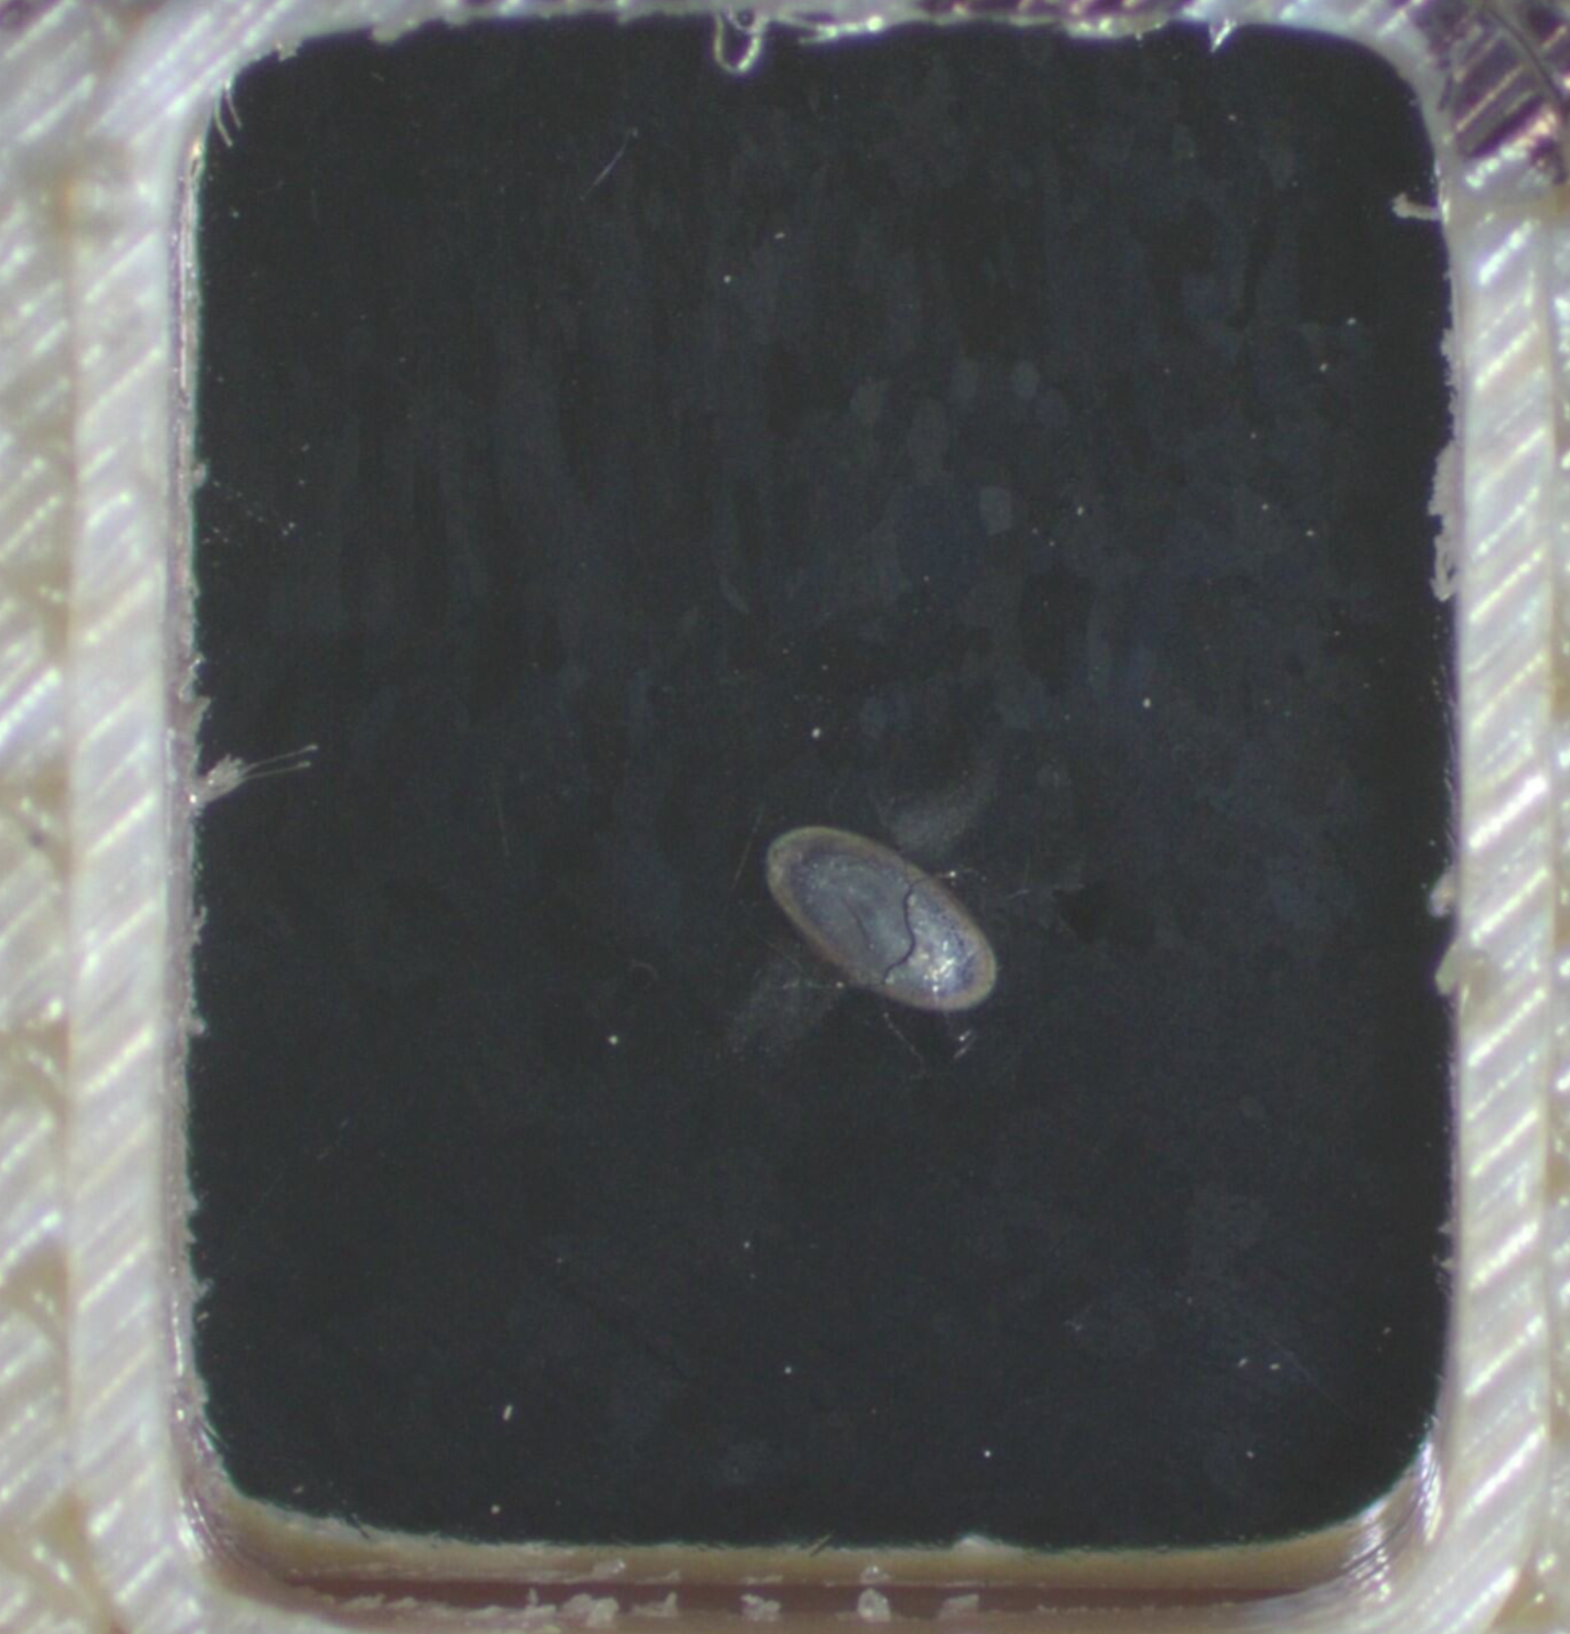
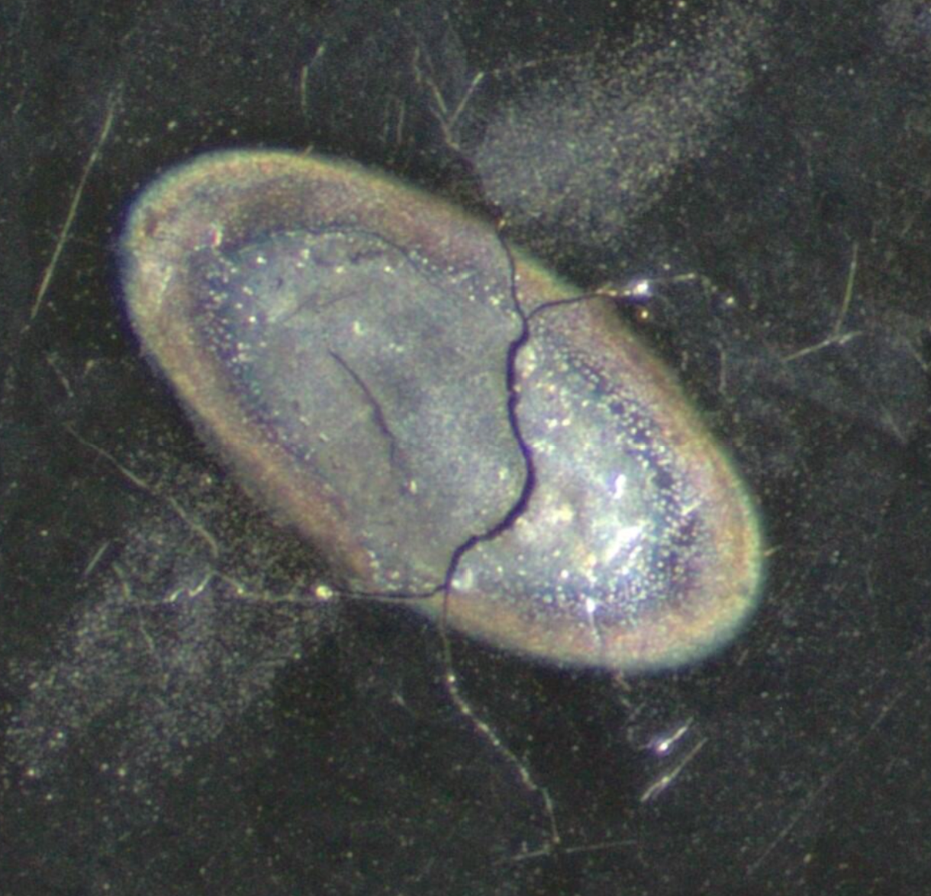
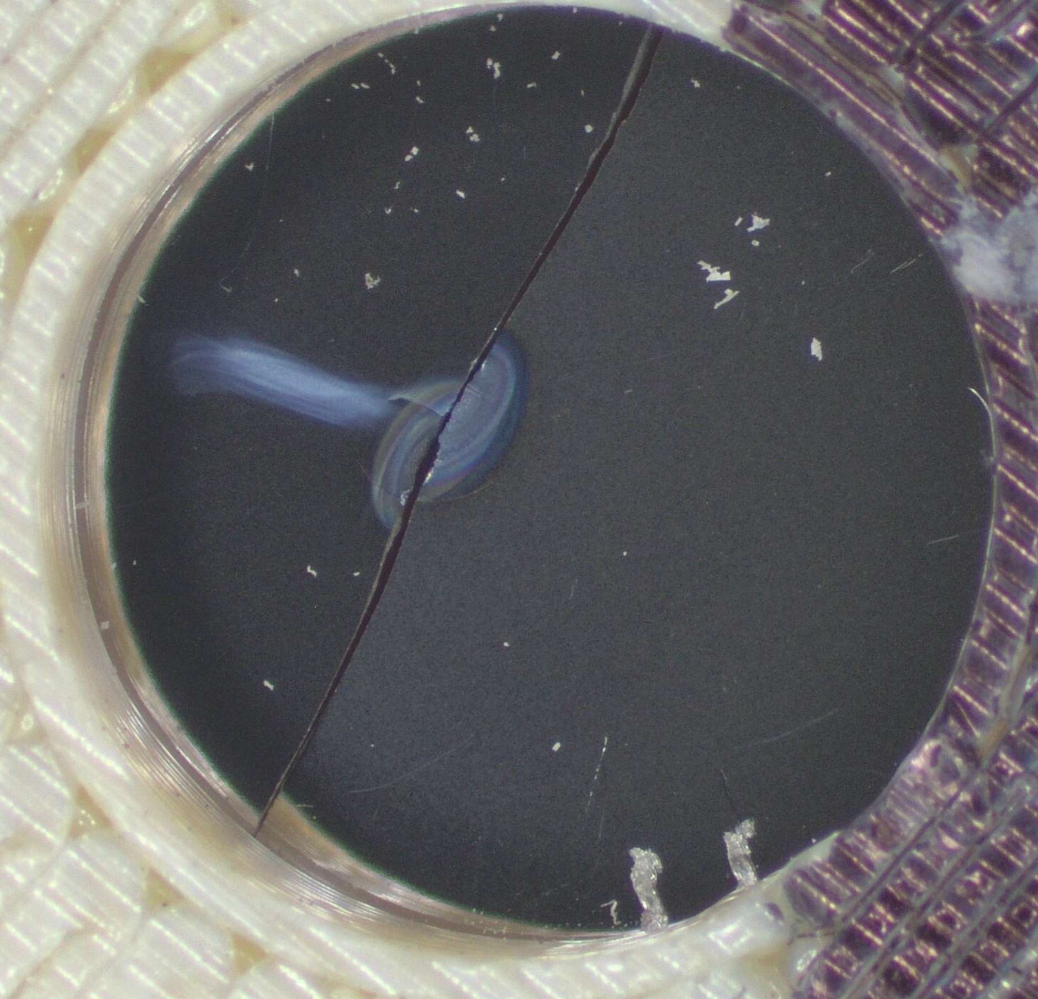
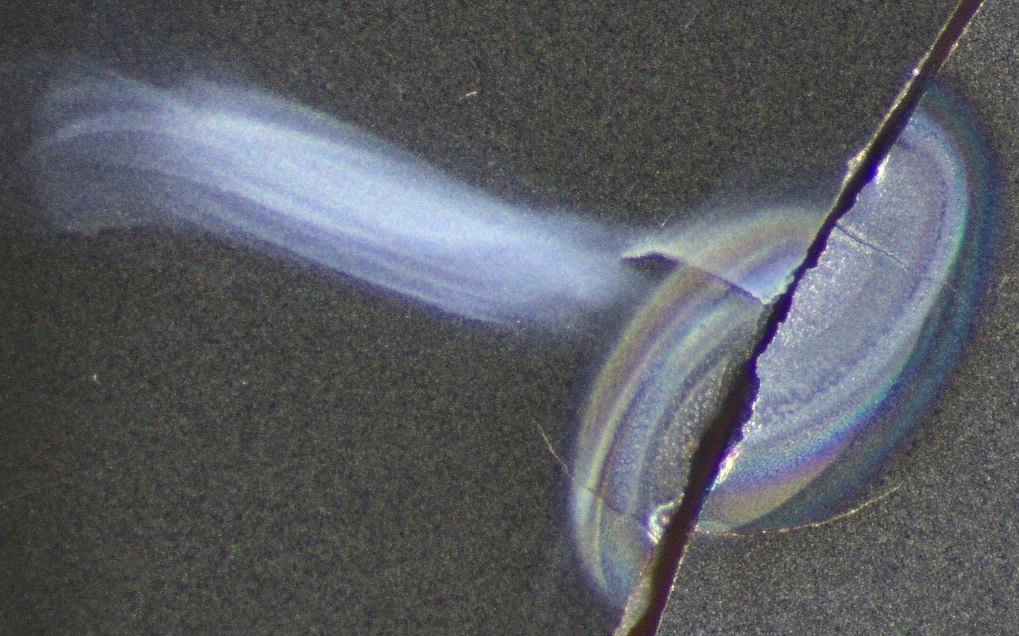
RaDIATE @ HiRadMat
Supported by EURO-LABS and its predecessor EUCARD-2 !!
BeGrid (2015) : Observed thermal shock in Be grades, detected plastic ratcheting under multi-pulse beams
BeGrid2 (2018) : First tests on pre-irradiated materials (Be, C, Ti, Si), and novel structures (nanofibers, metal foams like SiC, ZrO, Al₂O₃, RVC)
RaDIATE-I (2022) : Compared thermal shock in pre- and un-irradiated materials (Be, C, Ti), including beam windows, LHC beam dump (Sigraflex), neutrino targets, and novel materials (HEAs, nanofibers).
RaDIATE-II (2025) : Studied dynamic fracture in W and Ti using pre-cracked samples; tested whether beam-driven stress waves can propagate cracks.
HEA samples from RaDIATE-II, 10 shots @ 3.75e13 ppp, beam size 0.5 mm (1σ)

Slide 18
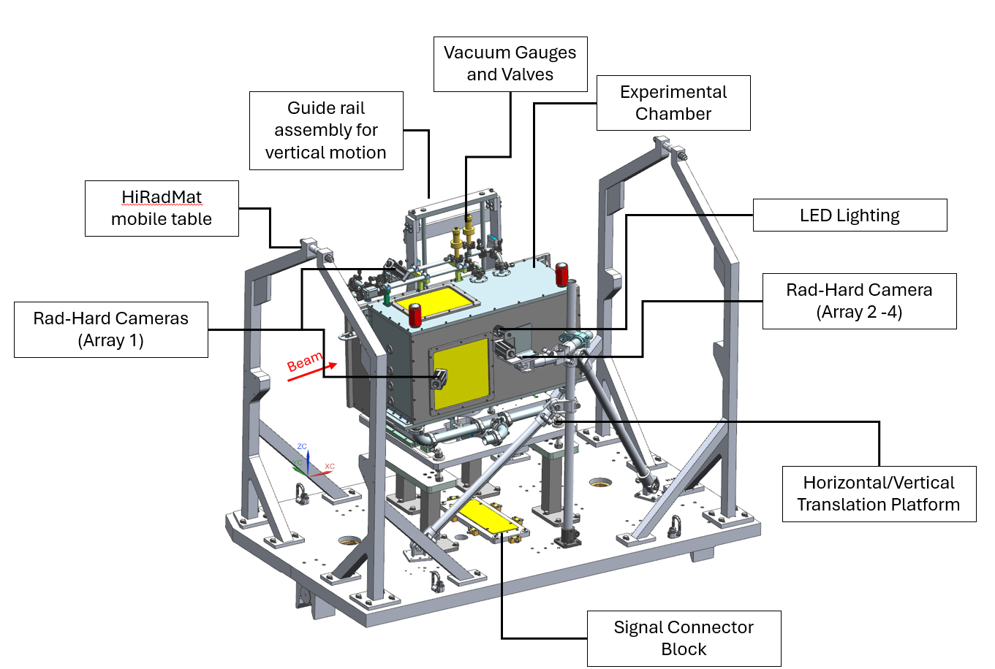
RaDIATE-II
Experimental setup
Double containment design with outer chamber with a dynamic secondary containment.
Outer chamber maintained at slightly negative pressure using vacuum cleaner.
Hermetically sealed and vacuum sealed inner containment boxes.
→ Typical example of the facility's flexibility

Slide 19
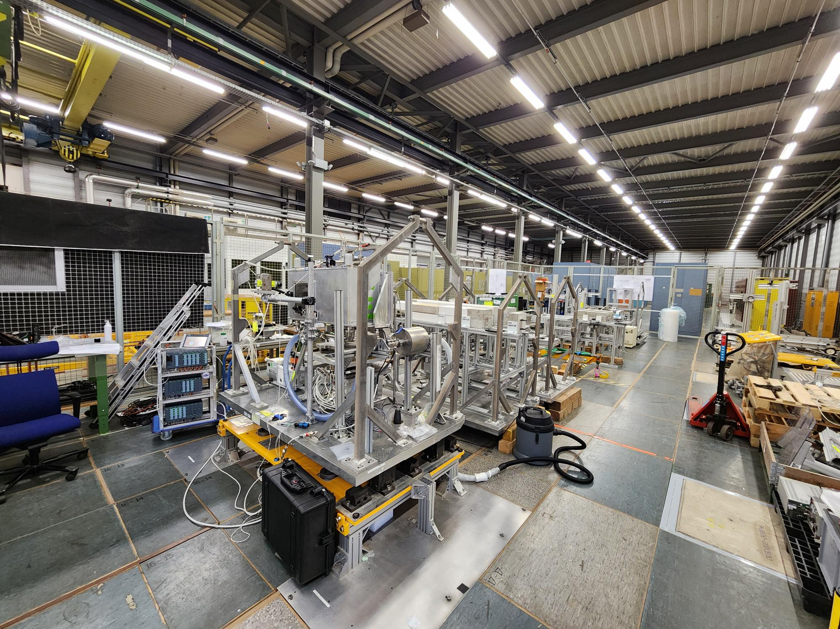
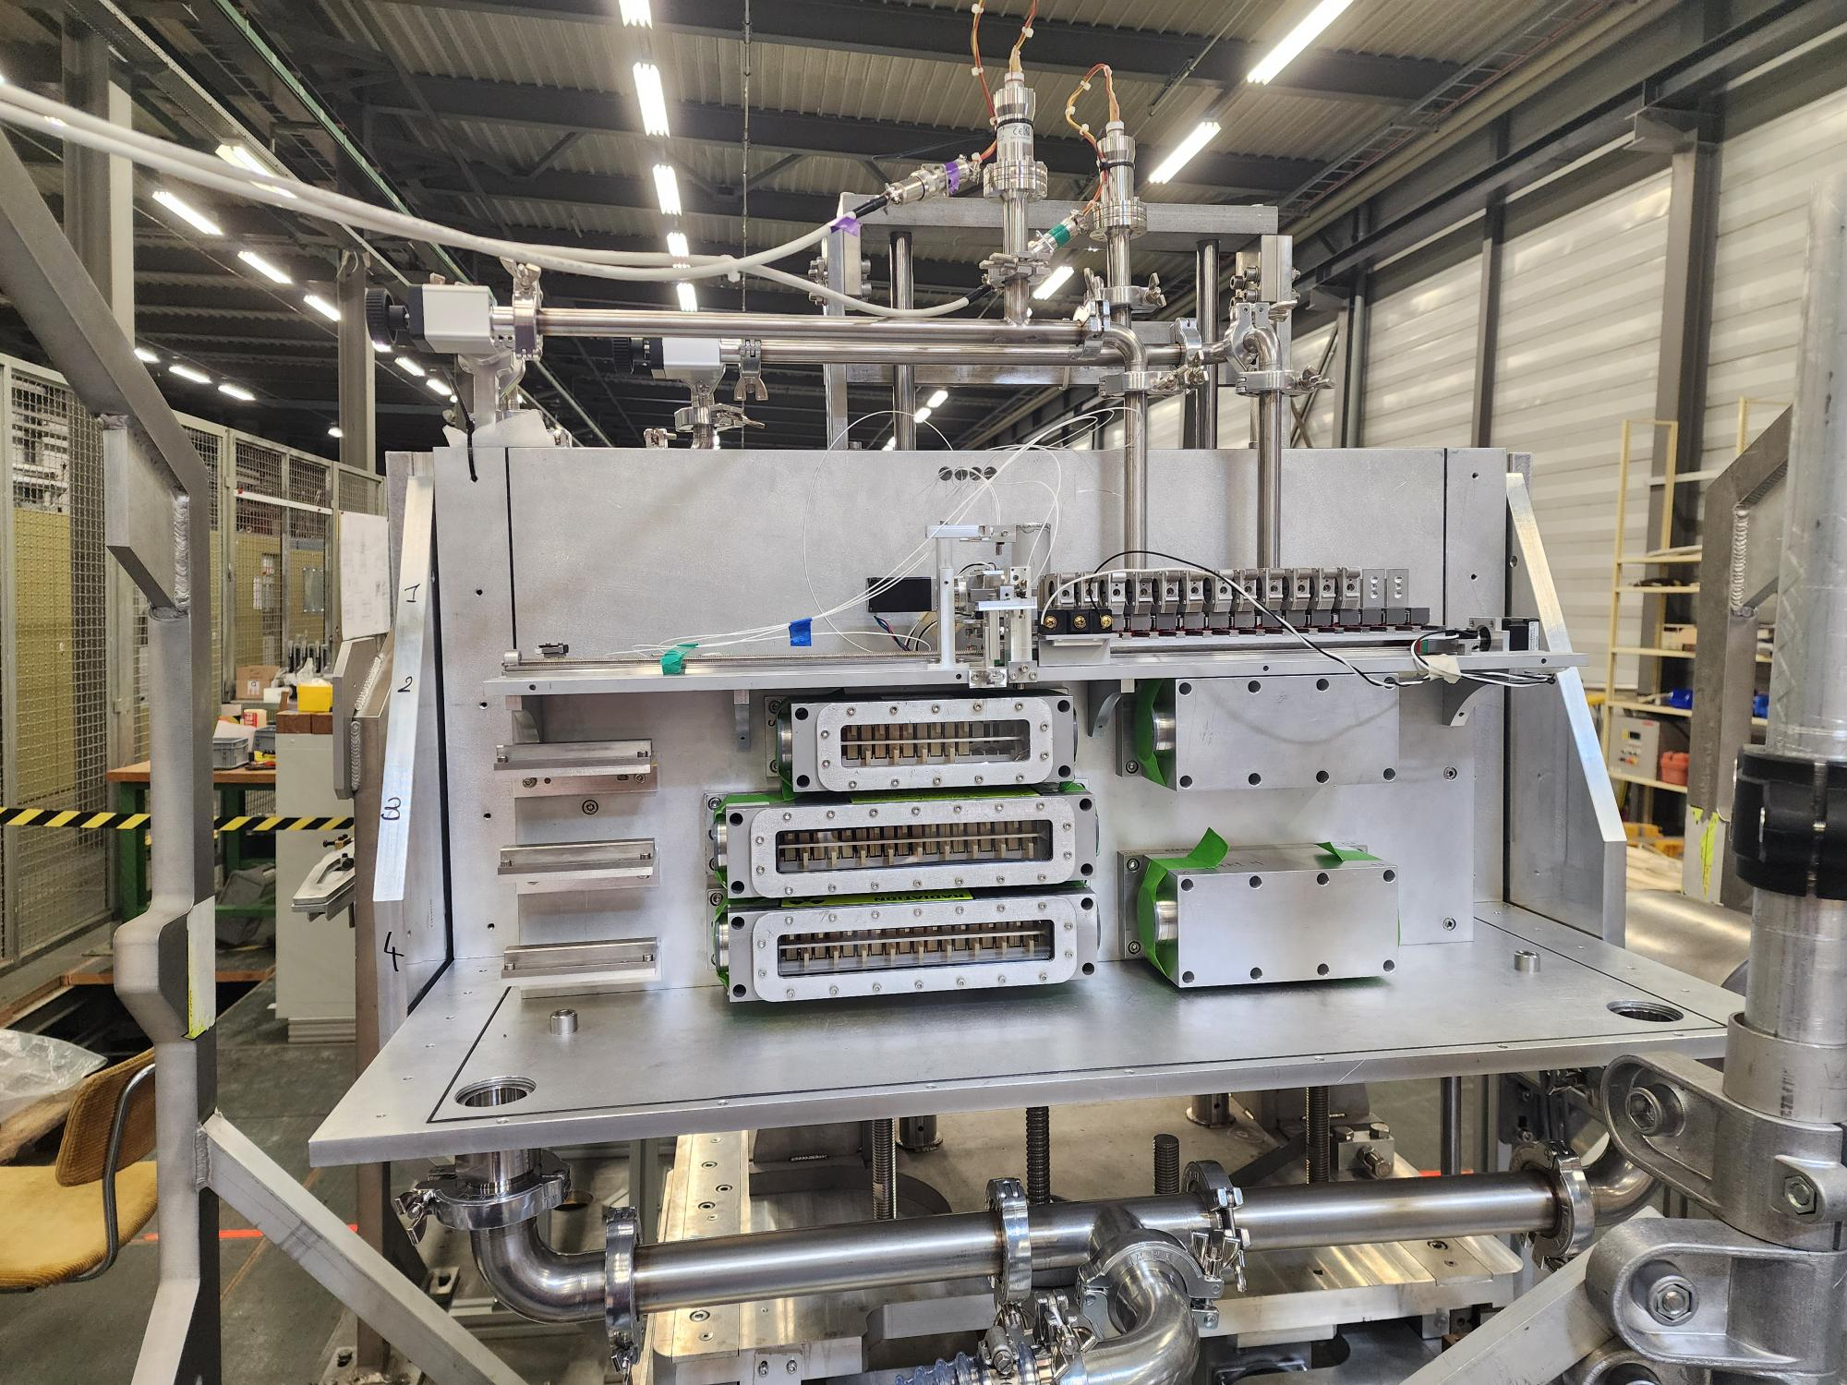
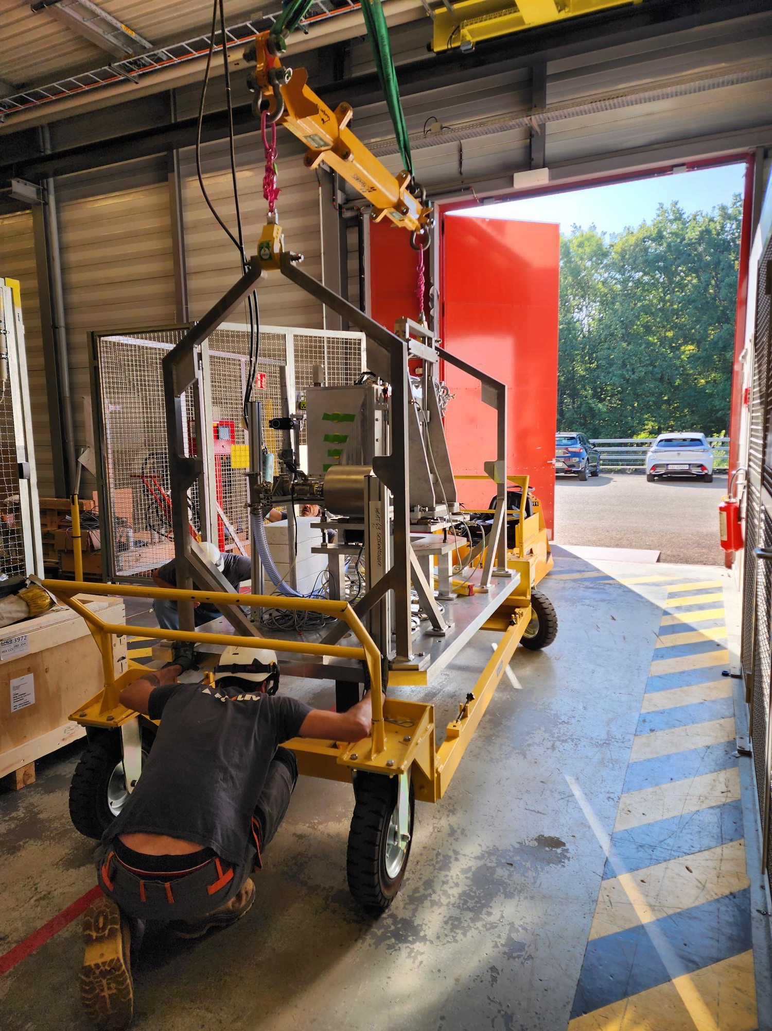
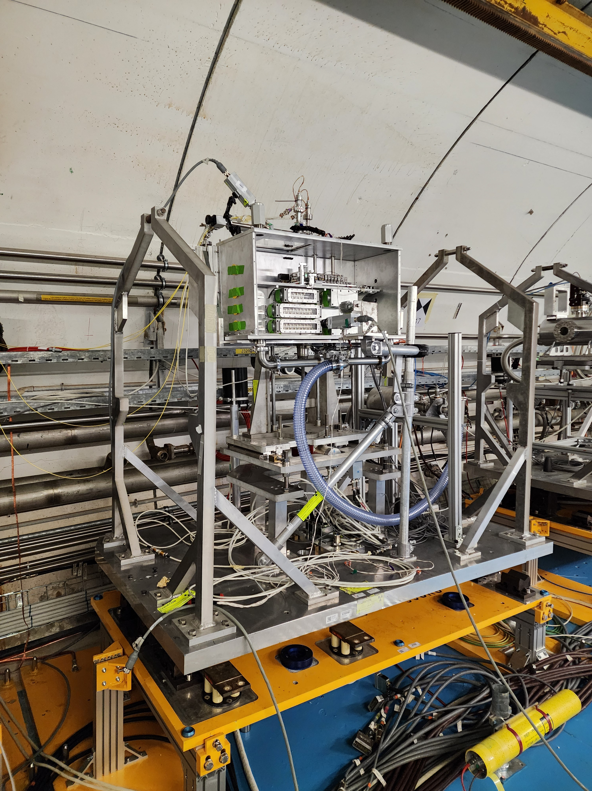
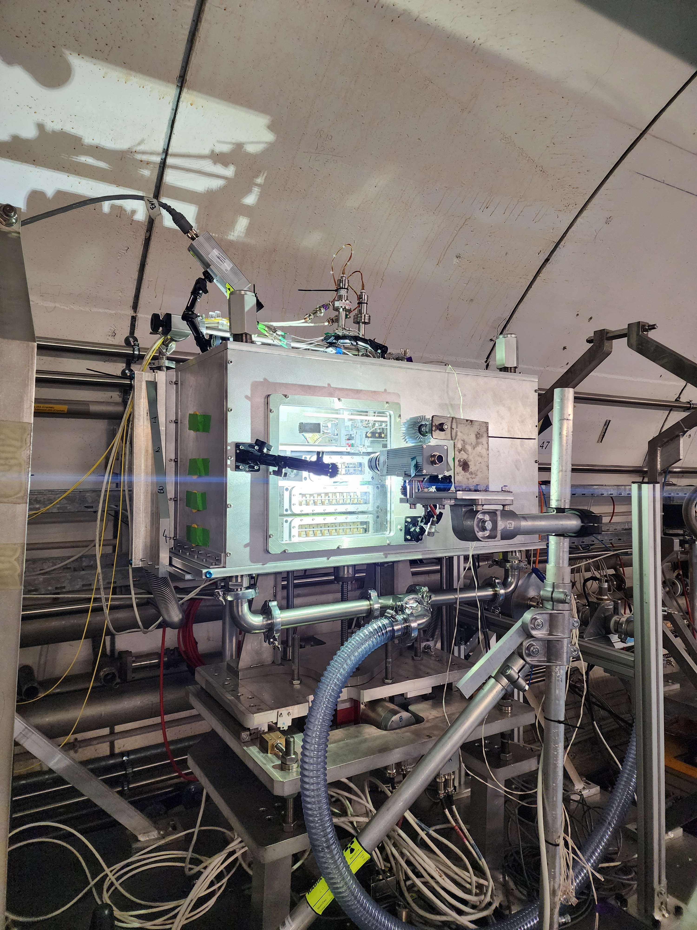
RaDIATE-II
Installation

Slide 20




RaDIATE Collaboration
Publications, Presentations & Outreach

Slide 21

RaDIATE Collaboration
Publications

Slide 22

Summary of experiments over the years
Over the 4 years, 12 very complicated experimental projects have been successfully completed.
The facility remains in high demand also given the upcoming LS3
But not only experiments in the facility…

Slide 23
Technical Workshops – Critical activities supported by EURO-LABS
Putting external teams together with CERN experts

Slide 24


Technical Workshops
Radiation Protection Studies
Courtesy of Lorenzo FORLANI
Update of the FLUKA model of HiRadMat’s beam dump geometry using traditional and unstructured mesh methods, and comparison of resulting particle fluence spectra for radiation protection studies.

Slide 25


Technical Workshops
Software
Courtesy of Vasiliki TSOUKNIDA
Image analysis of facility diagnostics: framework to estimate median background, identify camera systematic noise, and subtract it from the signal.

Slide 26
Outreach & Events

Slide 27


Outreach
Two professional videographers covered the FIREBALL-IV experiment with material published by CERN’s official channels (more than 1.2 m followers)

Slide 28







Outreach & Networking
https://indico.cern.ch/event/1189290/
https://indico.cern.ch/event/1302657/
https://indico.cern.ch/event/1419944/
https://indico.cern.ch/event/1559225/

Slide 29


Gender & Age statistics
Majority of EURO-LABS supported scientists are below the age of 35!
Gender distribution for funded users.
Date extraction 06-2026

Slide 30





Future
2026 schedule
Three big experiments have been supported by EURO-LABS in 2026.
All allocated AUs are scheduled to be spent by 31st August.
Studies & tests organized for low energy beam (26 GeV/c) & for ²⁰⁸Pb Ion beam
Already 8 proposals under preparation for 2029+
BLM4
FIREBALL
BTVmat
ION TEST

Slide 31
Conclusions
Over the past four years, EURO-LABS has supported more than 50 scientists in conducting experiments and contributing to upgrades & improvements of the HiRadMat facility.
The majority of the supported researchers have been early-career scientists (students and postdocs), with 26% being women.
The supported experiments have led to numerous high-impact publications (e.g., Nature Comms, Science) as well as diploma theses and conference proceedings.
For more information, you can visit our website: https://hiradmat.web.cern.ch/
EURO-LABS support has been critical for the operation of the HiRadMat facility, and we are looking forward for the successor program.

Slide 32
Thank you
☺
Questions?

Slide 33

This project has received funding from the European Union’s Horizon Europe Research and Innovation programme under Grant Agreement No 101057511.

