Slide 1
EPICS – Advanced Topics
Edmund Blomley
3.12.2025

Slide 2
Outline
Part I: Record files
Part II: Data flow and control logic
Part III: Communication with hardware
Part IV: IOC Structure

Slide 3
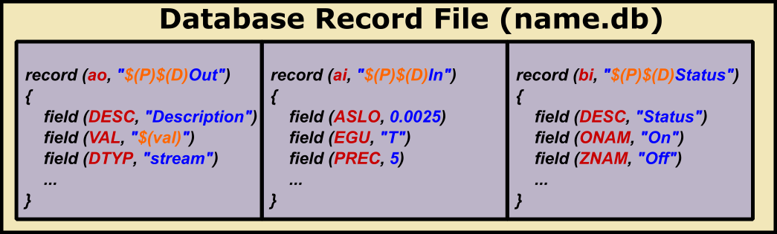

Database Record Files
Core component of an IOC
Template file containing multiple database records
Macros/variables $(MACRO_NAME) which will be replaced
P=A:SR:TM:,D=01,val=4
A:SR:TM:01:Out
A:SR:TM:01:In
A:SR:TM:01:Status
P=A:SR:TM:,D=02,val=989
A:SR:TM:02:Out
A:SR:TM:02:In
A:SR:TM:02:Status
P=A:BO:TM:,D=01,val=1
A:BO:TM:01:Out
A:BO:TM:01:In
A:BO:TM:01:Status

Slide 4
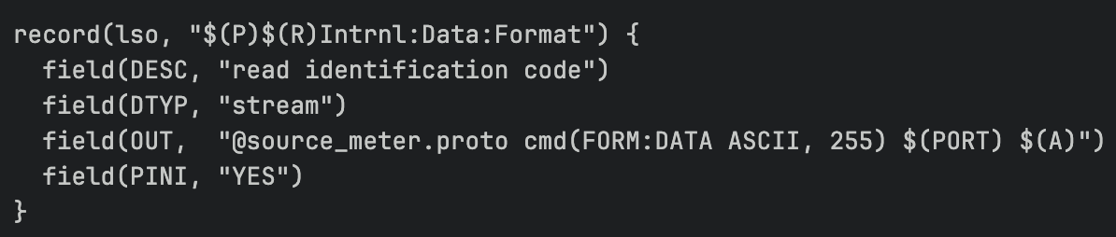
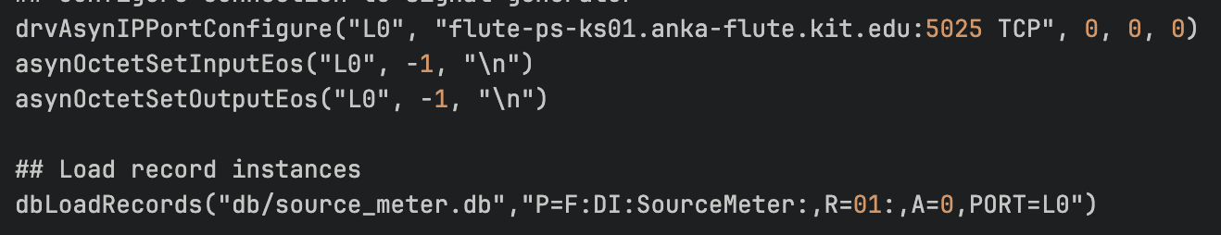
Macro Replacement on IOC Startup
Can be adjusted without rebuilding
Common use case:
device prefix
hardware connection handlers
dbLoadRecord()
Single load of one .db file
source_meter.db
startup file

Slide 5
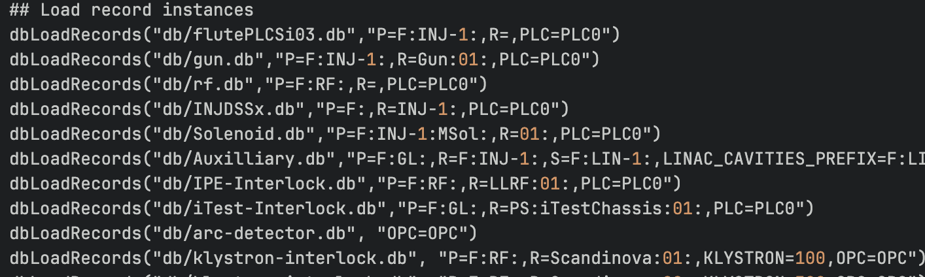
Another Example

Slide 6
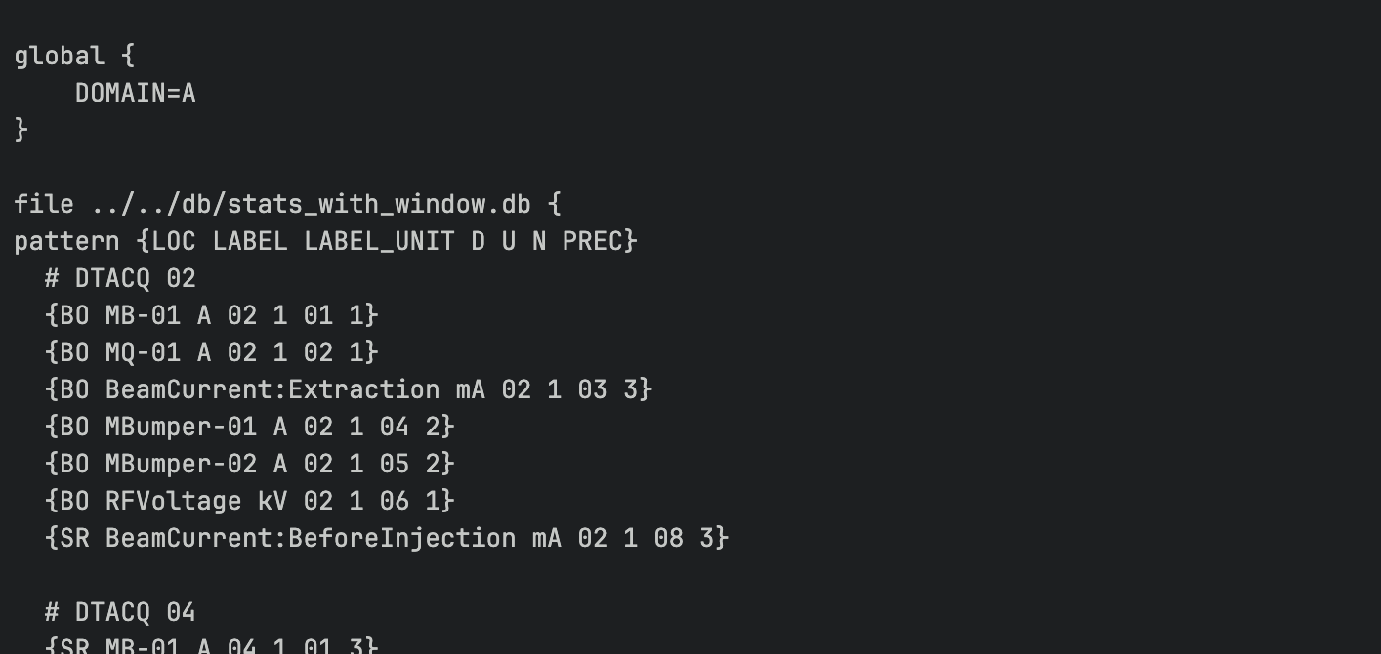
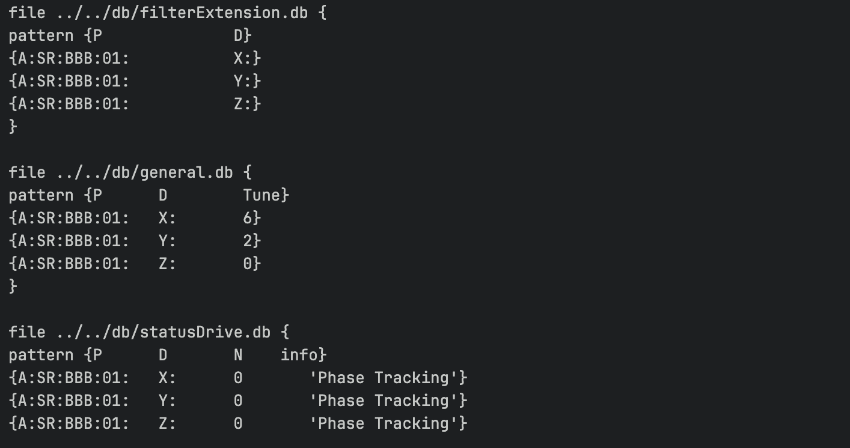
IOC Startup with Substitutions file
Replacement of the same .db file many times: substitutions file
dbLoadTemplate(„FILENAME.substitutions");
Global replacements
db file pattern replacements
Replacing multiple .db files

Slide 7
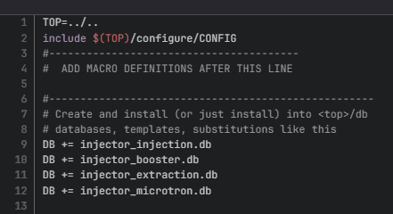
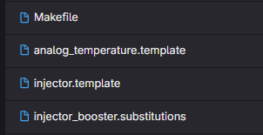
Advanced Macro Substitions
Default values will used if macro is not replaced: $(MACRO=default)
Lower level replacement
Requires build / Makefile
.db file does not exist
Multi-level:
Not replace prefix during Make

Slide 8
Data flow and control logic

Slide 9
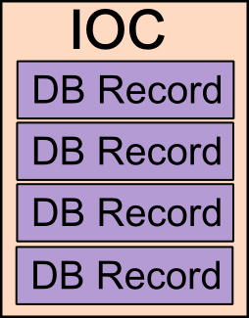


Record Processing
One IOC usually has many records
When are these records „processed“?
In which order?
Option 1: Regular intervals
pv.SCAN – options: .1, .2, .5, 1, 2, 5, 10 seconds interval
Default: passive
Record
field(SCAN, „1 second“)
Hardware
Option 2: Triggered / on demand
By user
Writing on pv.PROC field
Other records
Send to record
Record

Slide 10
Record Information Exchange
How do records exchange data / information?
Option 1: Record requests data - input
Record
Hardware
field(INP, „@GET_DATA“)
Option 2: Record sends data – output
Record
field(OUT, „PV“)
Many record types are either INPUT or OUTPUT records
Some records can also collect/send from/to multiple sources
Important distinction between processing and sending/recieving data
Exchange data without processing
Force processing without data exchange
Trigger processing by data exchange

Slide 11
Database Links
Certain fields are links (to other PVs, fields or hardware)
Most links can also be constant values
Links to hardware usually start with @
Link fields:
INP – input to get data
OUT – output to send data
LNK – link for general purposes
FLNK – forward link to trigger processing
DOL – desired output location, input link without hardware support

Slide 12
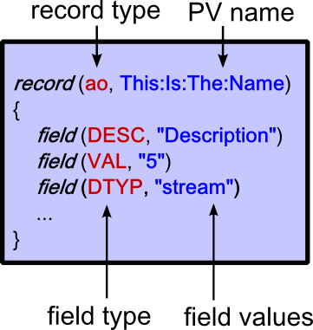
Record Types
In this context the relevant record types can be seen in terms of programming as:
„Variables“ (can also talk to hardware)
bo/bi – binary: boolean
ao/ai – analog: double
longout/longin: integer
stringout/stringin: string
waveform: array
„Functions“
fanout
sequence
calculation
subroutine

Slide 13
Fanout Record
Trigger processing of up to 6 records
Usage example: switching on multiple power supplies
record(fanout, PS:Cmd:AllOn)
{
field(LNK1, „PS1:Cmd:On“)
field(LNK2, „PS2:Cmd:On“)
…
field(LNK6, „PS6:Cmd:On“)
field(SELM, „All“)
field(SELN, „“)
}
PV of the record to process
LNK = Link
Optional fields: SELM & SELN – trigger only some links
SCAN also possible
Fanout can trigger other fanouts

Slide 14
Data Fanout Record
Send data to 8 records (on default no processing)
DOL: Desired Output Location – input parameter
PV to read from (example: on/off toggle)
Constant value
record(dfanout, PS:Cmd:Output)
{
field(DOL, „PS:Bool“)
field(OUTA, „PS1:Cmd:Output“)
field(OUTB, „PS2:Cmd:Output PP“)
…
field(OUTH, „PS6:Cmd:Output“)
field(SELM, „All“)
field(SELN, „“)
}
Forces processing after sending the value
Output

Slide 15
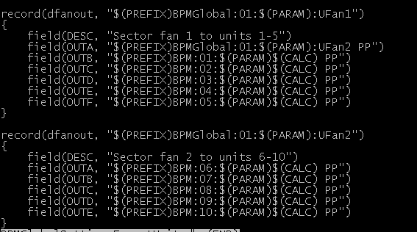
Data Fanout Example
Send data to 40 BPMs, 10 per sector
Full record file – being called for each sector
$(PARAM) provides support for different BPM settings
Use cases: send settings, trigger synchronization…

Slide 16
Sequence Record
Go through a sequence of 10 steps of getting data from X and sending to Y
record(seq, Sequence:Chain)
{
field(DOL1, „source 1“)
field(LNK1, „target 1“)
field(DLY1, „delay 1“)
…
field(DOL9, „source 9“)
field(LNK9, „target 9“)
field(DLY9, „delay 9“)
field(DOLA, „source 10“)
…
}
Can also be constant
DLY: Optional delay of this step by given number in seconds
Use case: actions which have to happen in specific order
Use case 2: As a fanout with varying data per location

Slide 17
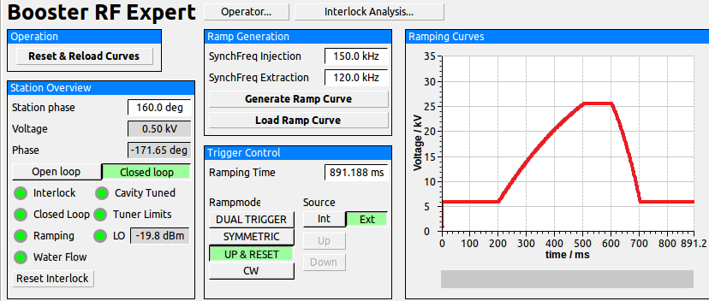
Sequence Record Example – Booster LLRF
Sequence of commands to get LLRF back to operation after interlock
sequence record
2
3
4
6
1
5

Slide 18
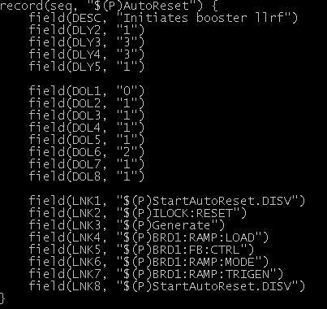
Sequence Record Example – Booster LLRF
Sequence of commands to get LLRF back to operation after interlock
Some delays
Order of fields irrelevant
Only constants
Example for mixture of PVs from different IOCs but same namespace
(full UPPER letters are not allowed in our naming convention, coming from embedded device)
Access to fields possible
DISV=0 prevents record from processing

Slide 19
Calc Record
Takes up to 12 input links
Performs calculation
record(calc, Simple:Calc)
{
field(INPA, „source 1“)
field(INPB, „source 2 CP“)
field(INPC, „source 3“)
…
field(INPL, „source 12“)
field(CALC, „Calc Expression“)
}
Forces processing if this source changes
Use case: many! One of the most used record type

Slide 20
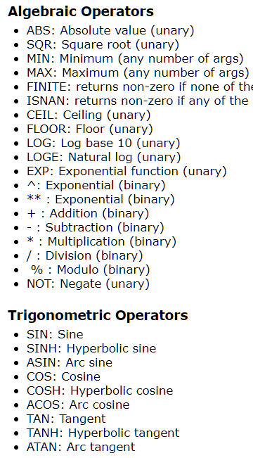
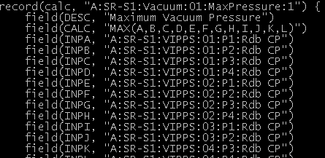
Calc Expression
CALC field also limited to 40 characters
Examples:
„A + B + 10“
„(A + B) / 2“
„MIN(A,B,C,D,E,F)“
Use cases
Error sums
Master/slave setups
Maximum/average vacuum pressure
…
…
…

Slide 21
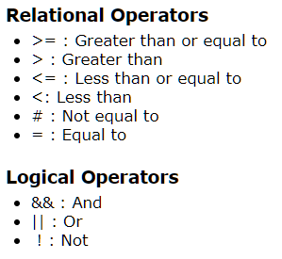
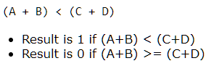
Calcout Record & Conditionals
Extends calc record by output location
Relational expressions
Conditional expressions
„if-statement“
Syntax: Condition ? True result : false result
((A + B) < (C + D)) && G ? !E : F + L + 10

Slide 22
Calcout Record – Conditional Example
Calcout example with condition and conditional output
send output only in certain conditions OOPT
When zero/non-zero („do it as long as…“)
Transistion To Zero/Non-Zero („do it once“)
„As soon as A gets bigger than B send „5“ once to output location“
record(calcout, Conditional:CalcOut)
{
field(INPA, „source 1“)
field(INPB, „source 2“)
…
field(CALC, „A > B ? 5“)
field(OUT, „out:location“)
field(OOPT, „Transition To Non-zero“)
}

Slide 23
Example – Beam Lifetime
A:SR:BeamInfo:01:Current
compress, 60s Ring Buffer
ai, :OldestCurrent
ai, :LastCurrent
calc, :DiffCurr
Zero if current below 1
Zero if current diff is to small
record(calc, :Lifetime) {
field(INPA, „:DiffCurr“)
field(INPB, „:LastCurrent“)
field(INPC, „1“)
field(INPD, „0.0001“)
field(CALC, „(B<C?0:(A<D?0:(60/A*B)))“)
field(FLNK, „:fanout“)
}
Lifetime is linear slope between
now and 60 seconds ago!
record(fanout, :fanout) {
field(LNK1, „:hours“)
field(LNK2, „:minutes“)
field(LNK3, „:seconds“)
}
(B < C ? 0
:(A < D ? 0
:(60 / A * B)))

Slide 24
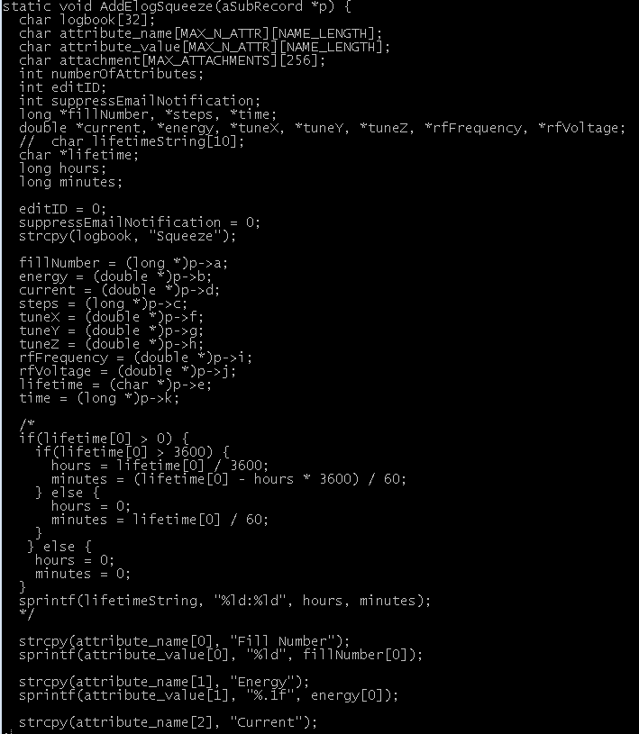
Subroutine Record
Up to 12 input channels
Executes custom c/c++ functions
record(sub, Subroutine:Record)
{
field(INPA, „source 1“)
field(INPB, „source 2“)
…
field(INPL, „source 12“)
field(SNAM, „name-of-routine“)
}
Advantge: being able to write raw C code
Disadvantage: being able to write raw C code

Slide 25
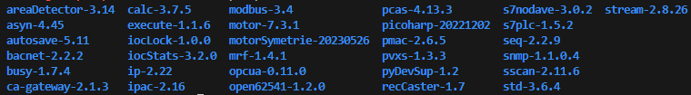
How to do more complex things?
Calling any scripts: special module developed by us
https://gitlab.kit.edu/kit/ibpt/controls/epics/modules/execute
Integrating Python
Mostly “normal” IOC: pydevsup module to integrate “a bit of Python”
Mostly Python: Special Python SoftIOC
IBPT Python Tools module for easy use will be available soon™
More complex and C/C++
Create your own “EPICS module”
ASYN: low level async communication with hardware
Streamdevice: use asyn for text based communication
areaDetector: use asyn for GigE communication

Slide 26
Summary Part II: Data flow and control logic
Record processing: External triggers and internal scanning
Data exchange between IOC and IOC/Hardware via links
Record types
„Variables“: ai, longin, stringin, waveform
„functions“: fanout, dfanout, calc, calcout, sequence, subroutine
Part III
Communication with hardware

Slide 27
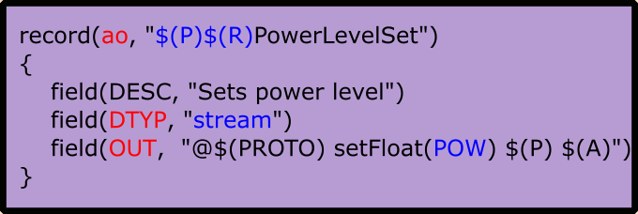
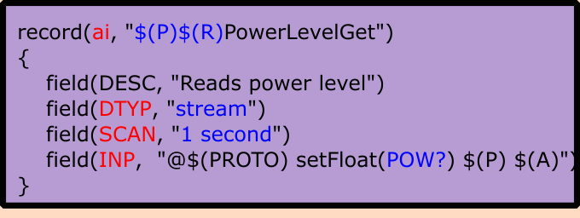
General Concept
Interface
Operator
5
Control system / IOC
Hardware
every second
5
POW?
3
5
RF Generator

Slide 28
Device Driver
Record field DTYP (device type) specifies which driver/interface should be used for this record
STREAM
Streamdevice
Most used driver at IBPT
All forms of text based serial communication
Ethernet/Moxa boxes/USB
SCPI
AreaDetector
Many cameras supported out of the box
MOTOR
Many common motor controller are supported by the EPICS motor modules
Newport XPSC8 is supported
OPC-UA
PLC communication
pyDevSup
Supports interactions with python scripts

Slide 29
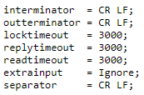
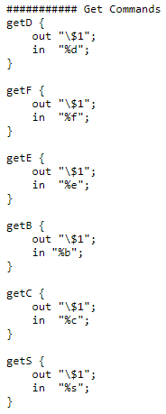
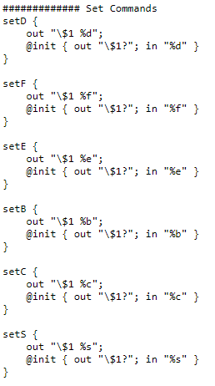
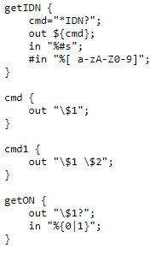
Stream Device
Generic driver for byte stream based communication
ASCII or binary
Serial (RS 232, 485)
IEEE-488 (GPIB)
TCP/IP
Protocol file defines interpretation of strings

Slide 30
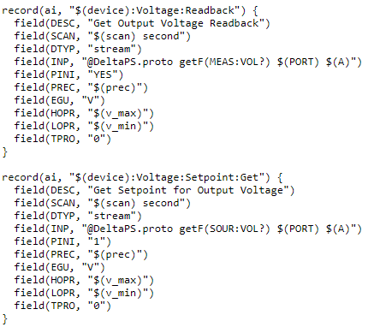
Stream Device
MEAS:VOL? sent to device
return interpreted as float
written to VAL field of the record

Slide 31
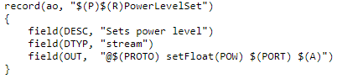

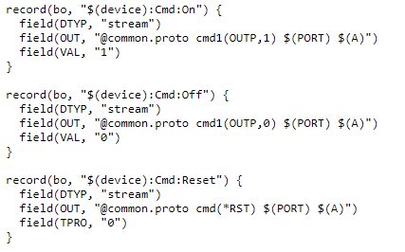
Stream Device
POW 5.0 is sent to device
VAL is not even used

Slide 32
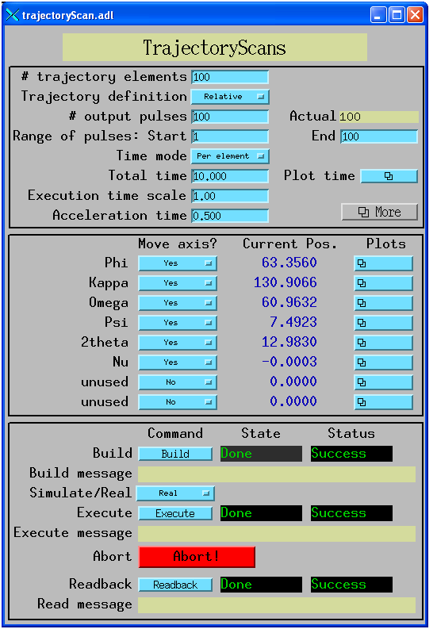
Motor Support
Specific driver for certain motor controller
Usually full API is already integrated
Basically one just have to specify how to connect to motor
Includes default GUIs
Newport XPSC8 is supported

Slide 33
Summary Part III
EPICS supports various methods of communication with hardware
Motors are well supported
PLCs are well supported
Text based communication via streamdevice
Most used driver at IBPT
For SCPI one can just use existing protocol files
Part IV
IOC structure

Slide 34
IOC Envoirnment
Every IOC is an independant C programm
Has to be compiled
EPICS Base and relevant modules (streamdevice, motor support) have to be installed
IBPT envoirnment provides EPICS debian packages
Custom modifications (like PV length)
Once installed one can directly build and run IOCs

Slide 35
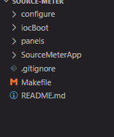
IOC File Structure
IOCName/
iocBoot/
common/
st.cmd
iocLinux/
IOCNameApp/
Db/
Makefile
recordFile1.db
recordFile2.db
src/
Makefile
configure/
RELEASE
db/
dbd/
bin/
Compiled folders

Slide 36
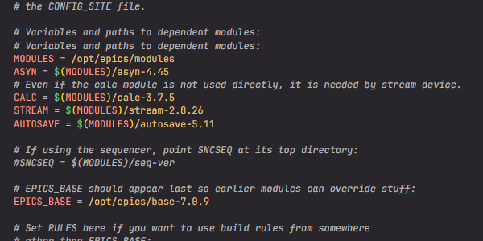
IOC Configuration
IOCName/configure/RELEASE
Define path to EPICS base (version)
Define which modules are used (version)
For modifying IOCs this does not have to be touched
Makes the modules available to the IOC

Slide 37
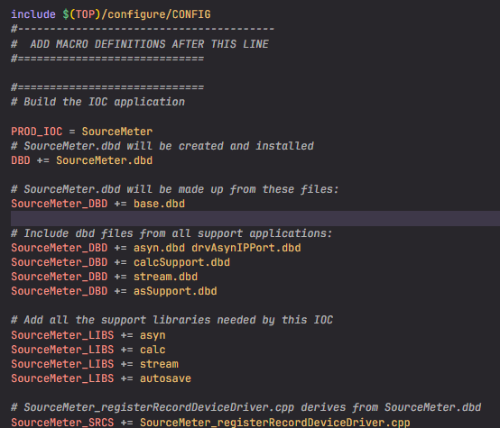
IOC Source Folder
IOCName/IOCNameApp/src/
Makefile „loads“ the actual modules and libraries
Only needs adjustments if you need different modules
If RELEASE is changed
*.dbd defines record structure
Which fields exist, etc.
_LIBS
The actual c(++) code

Slide 38
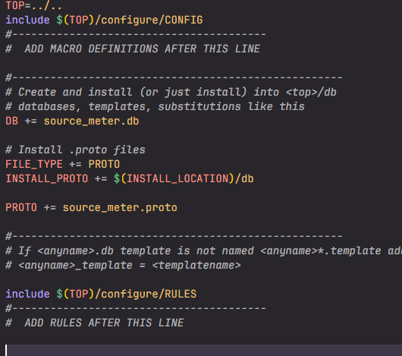
Database Record Files
IOCName/IOCNameApp/Db/
Place for all database record files
Most used area
Makefile
Add all .db files
(autosave) .req files
(stream) .proto files
Substitution files

Slide 39
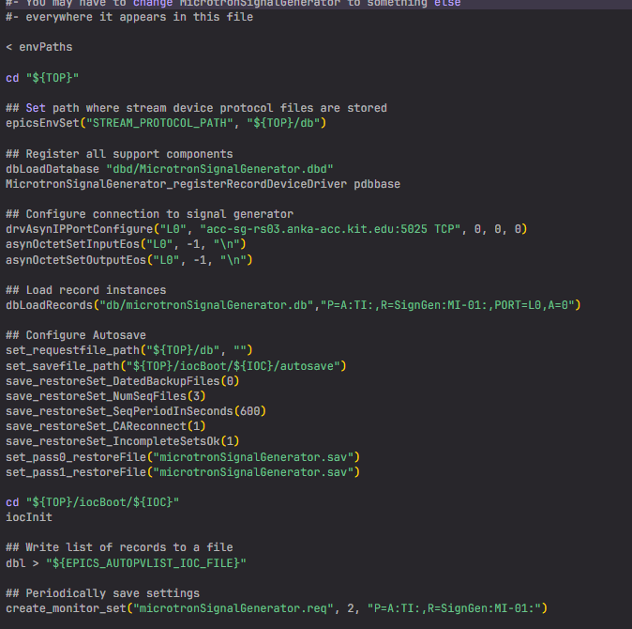
IOC Start Up Configuration
IOCName/iocBoot/common/st.cmd
Set up network connections
Load .db files
Module specific features
Initialize IOC

Slide 40
Summary Part IV
EPICS envoirnment
IOC structure
Configuration of modules
List of database record files
Start up config (loading records, establishing communication to hardware)

Slide 41
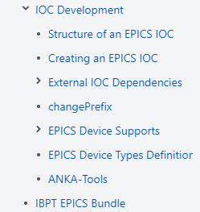
IBPT Features
IBPT EPICS bundle
Extended PV name length (change to EPICS base)
All relevant modules (motor, streamdevice, autosave, etc…)
changePrefix script adjusts IOCName string
Makes creating IOCs by copying existing IOCs very simple
Autotab completion for PV names
SALT to deploy, build and integrate IOC
Runs as system.d process in the background
Easy start and stop routines
SVN repository hosting all IOCs
Creating IOCs based on closed match saves a lot of time
Documentation and how-to‘s
Archive system
IBPT CSS bundle
Very easy installation to powerful GUI

Slide 42
Part IV.2
Example: Create IOC for LASMagLab – Senis Teslameter
Step 1 - Get similar IOC
Step 2 - Build IOC
Step 3 - Establish hardware communication

Slide 43
Example – Get Similar IOC
Active IBPT or KARA VPN required
https://scm.anka.kit.edu/scm/svn/kara/epics
svn export https://scm.anka.kit.edu/svm/svn/kara/epics/Teslameter/trunk ./SenisTeslameter
scp –r SenisTeslameter XXX:~/applications/epics/apps/
Use changePrefix script to adjust local name
In $TOP folder: changePrefix OldName NewName
Create start/stop scripts (by copying and adjusting existing scripts)
~/.config/systemd/user/ioc-IOCNAME.service
If this IOC should be started automatically with PC boot create symlin in default.target.wants subfolder
~/bin/ioc-IOCNAME

Slide 44
Example – Build IOC
Adjust configure/RELEASE
Correct EPICS base version
Correct module versions
Adjust modules if other modules are needed
(Adjust **App/src/Makefile if other modules are loaded)
Adjust **App/Db/Makefile and .db/.proto files for basic tests
Build IOC
make in top folder
Start IOC
./iocBoot/iocLinux/run in top folder

Slide 45
Example – Connect to Device and Basic Test
Protocol file (**App/Db/*.proto)
Set basic configuration (line termination etc)
Create protocol for basic test command
Usually basic identification string (*IDN) or simple status flag
Database file (**App/Db/*.db)
Create basic record using the basic test protocol
Use make in $(TOP)
Adjust start up script (iocBoot/iocLinux/st.cmd)
drvAsynSerialPortConfigure ("PS1","/dev/ttyS1")
asynSetOption ("PS1", 0, "baud", "9600")
Load DB file
Adjust local path for PV export
Run IOC in local terminal ./iocBoot/iocLinux/run for debugging

Slide 46
Example – Build Database
Create all records which you want to support
Not every feature of the hardware has to be implemented
For more complex files consider using tools for record file generation
Epicsdbbuilder from Diamond (python)
Write python code, which will be executing while building IOC to create .db files
https://github.com/Araneidae/epicsdbbuilder
Run IOC with „ioc-IOCNAME start|stop|attach|restart“ command

