Slide 1
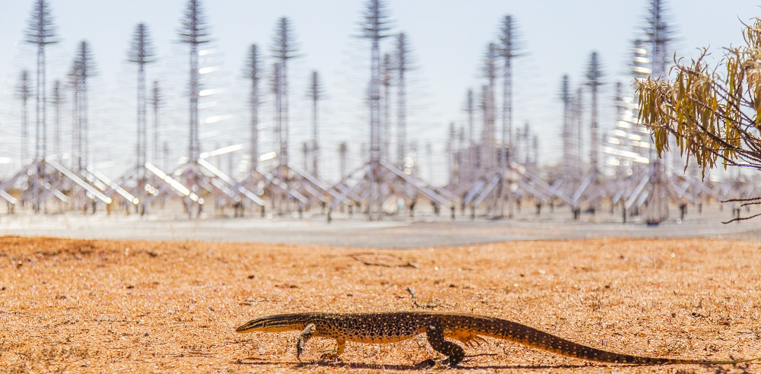
Reconstruction of anomalous air showers with SKA-Low
for the SKA SWG on High-Energy Cosmic Particles
Vital De Henau
Vital.De.Henau@vub.be

Slide 2
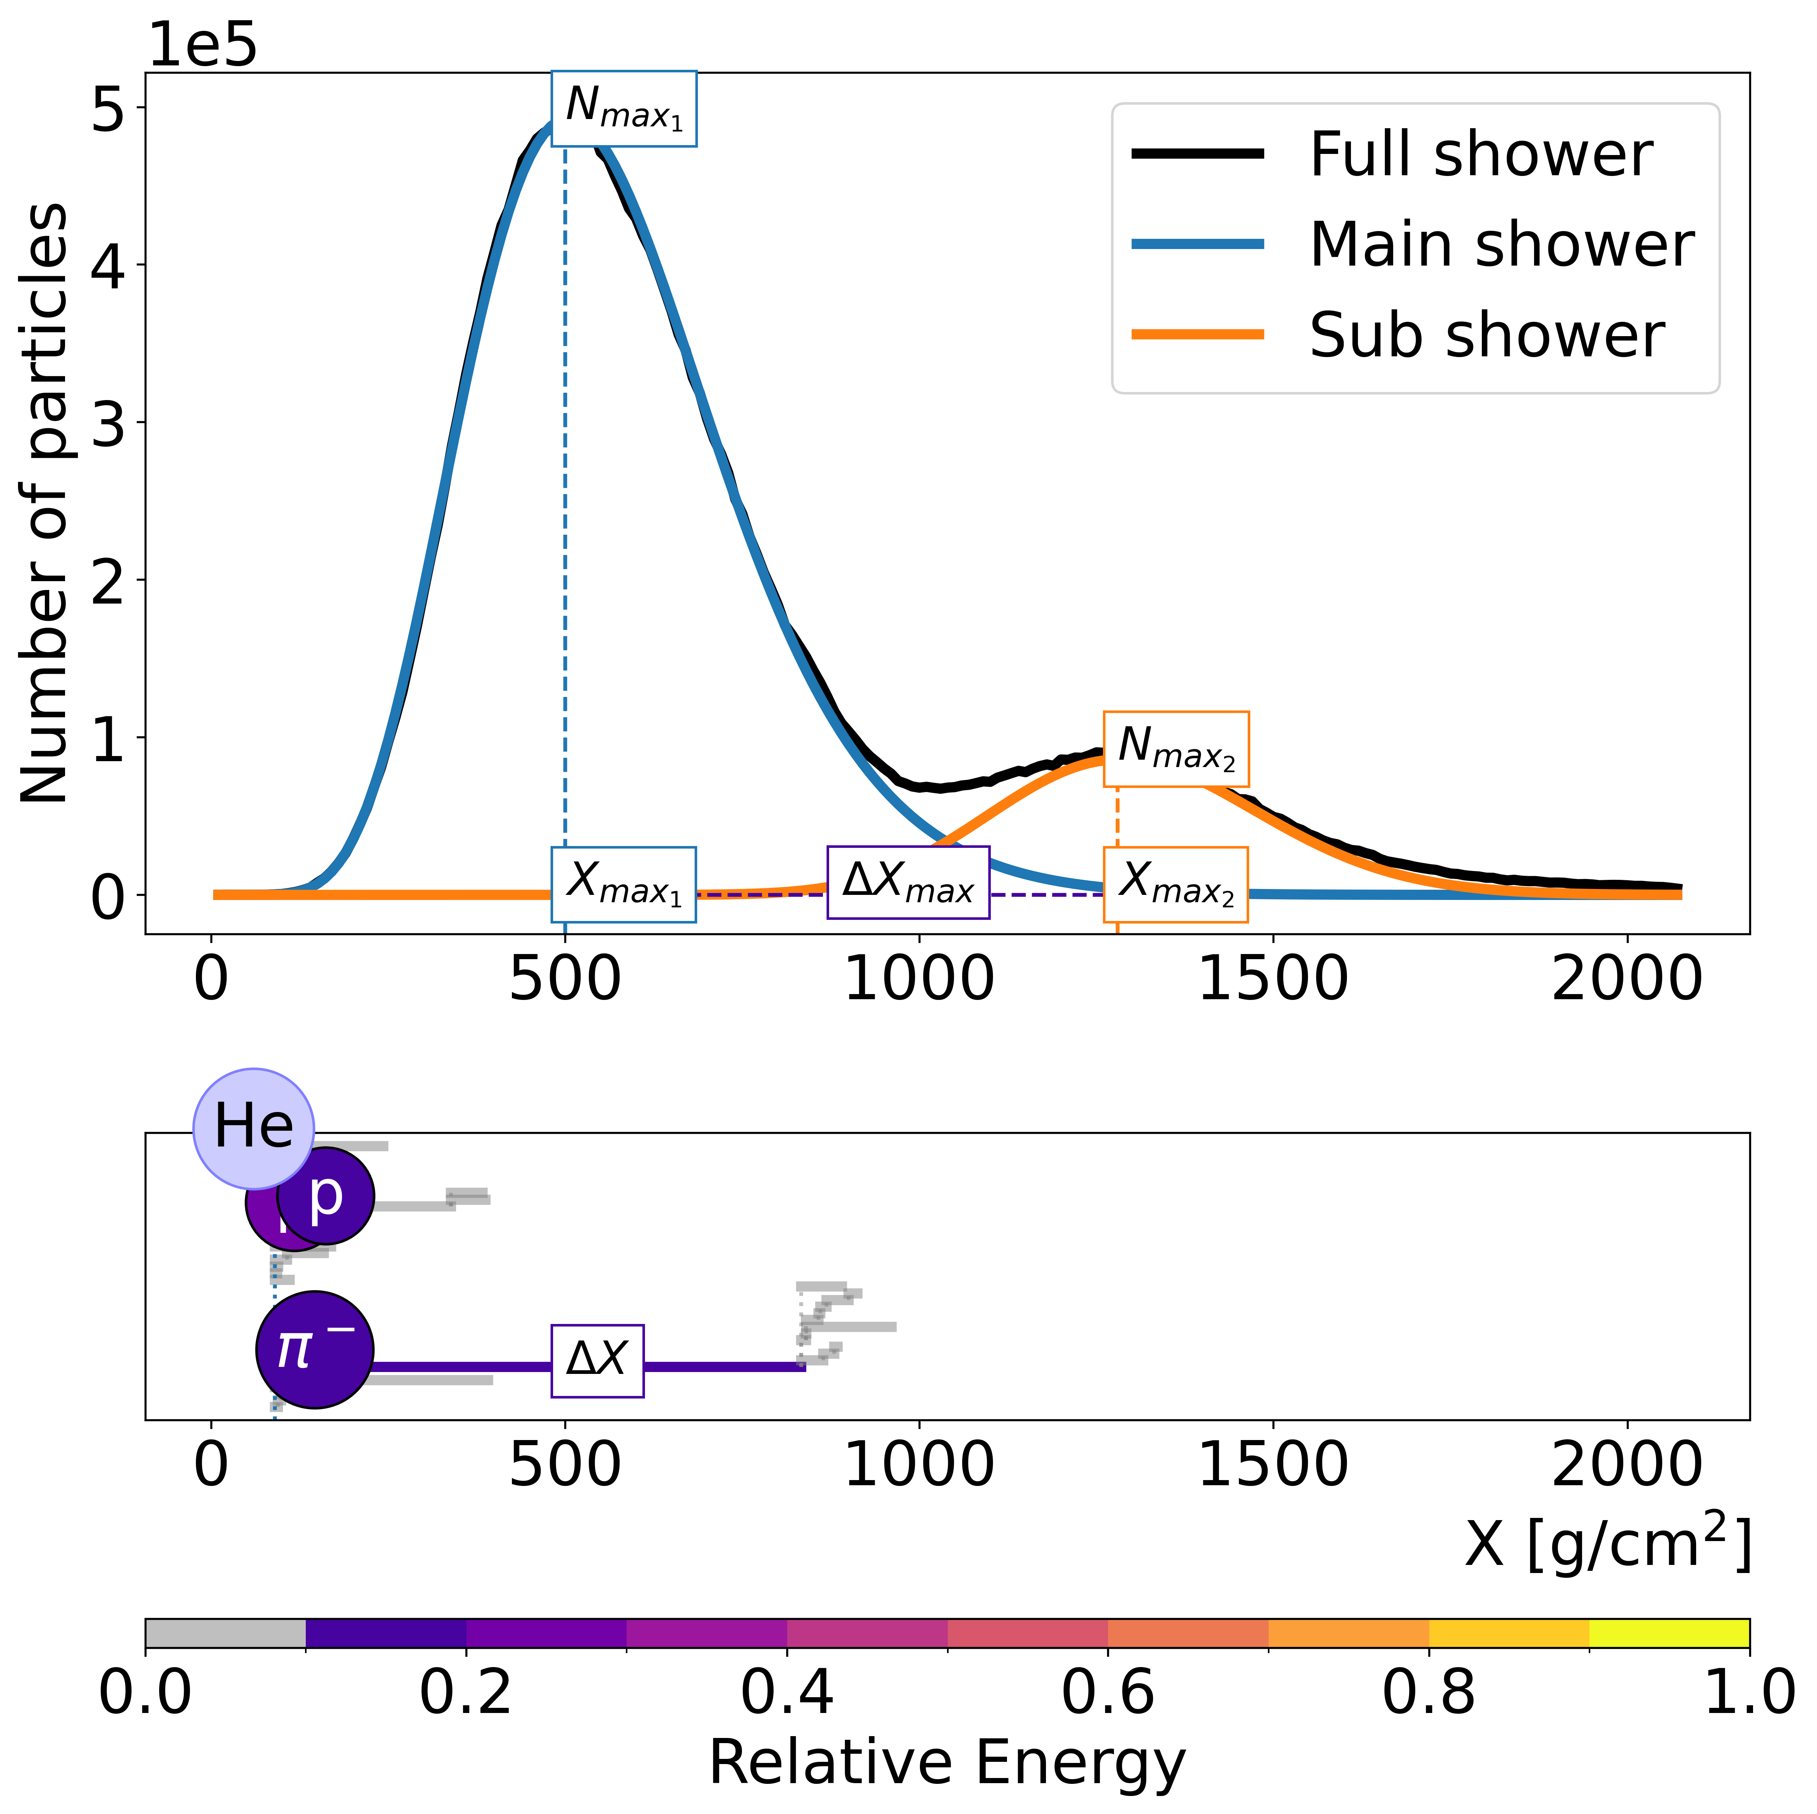
anomalous air showers¹
A double-bump shower* is caused by energetic secondary particle(s) travelling a significant distance in the atmosphere compared to the other high-energy secondaries.
Double bump shower parameters:
$$∆X_{max}= \left|X_{\max_{1}}−X_{\max_{2}}\right| ≈ ∆X_{leading particle}$$
$${N_{\max_{2}}}/{N_{\max_{1}}}≈ {E_{leading particle}}/{E_{primary}−E_{leading particle}}$$
Leading particle (energetic secondary)
*Prepare for trouble!
Make it double!
-Team rocket
¹The case for studying anomalous showers with the Square Kilometre Array
by Stijn Buitink on 10 Jun 2026 at 09:30

Slide 3
Simulating the radio emission
Radio emission simulated with CoREAS:
Star-shape antenna pattern
Observation level of $7.6$m
Time resolution of $0.2$ ns
We also have multiple sliced showers.
Slice size of $5 g/{cm}^{2}$
For the rest the same as above
We live in MC-dreamland!

Slide 4

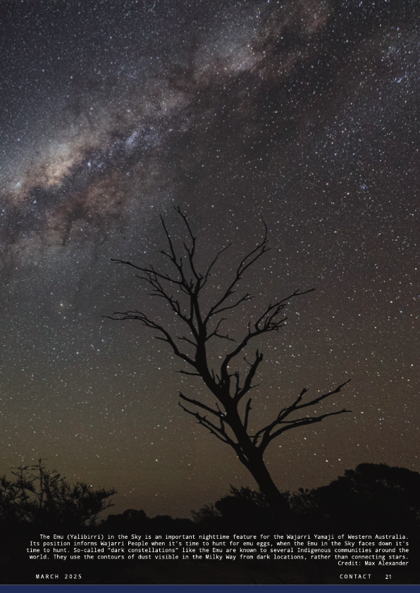
SKA-Low in numbers²
Location: Western Australia's Murchison
Size: 131,072 log-periodic antennas spread between 512 stations
Collecting area: 419,000 m²
Maximum distance between antenna stations: 74 km
Frequency range: 50 MHz - 350 MHz
²Towards air shower observations with SKA-Low by Katie Mulrey on 9 Jun 2026 at 16:00

Slide 5
Let’s study a single antenna

Slide 6
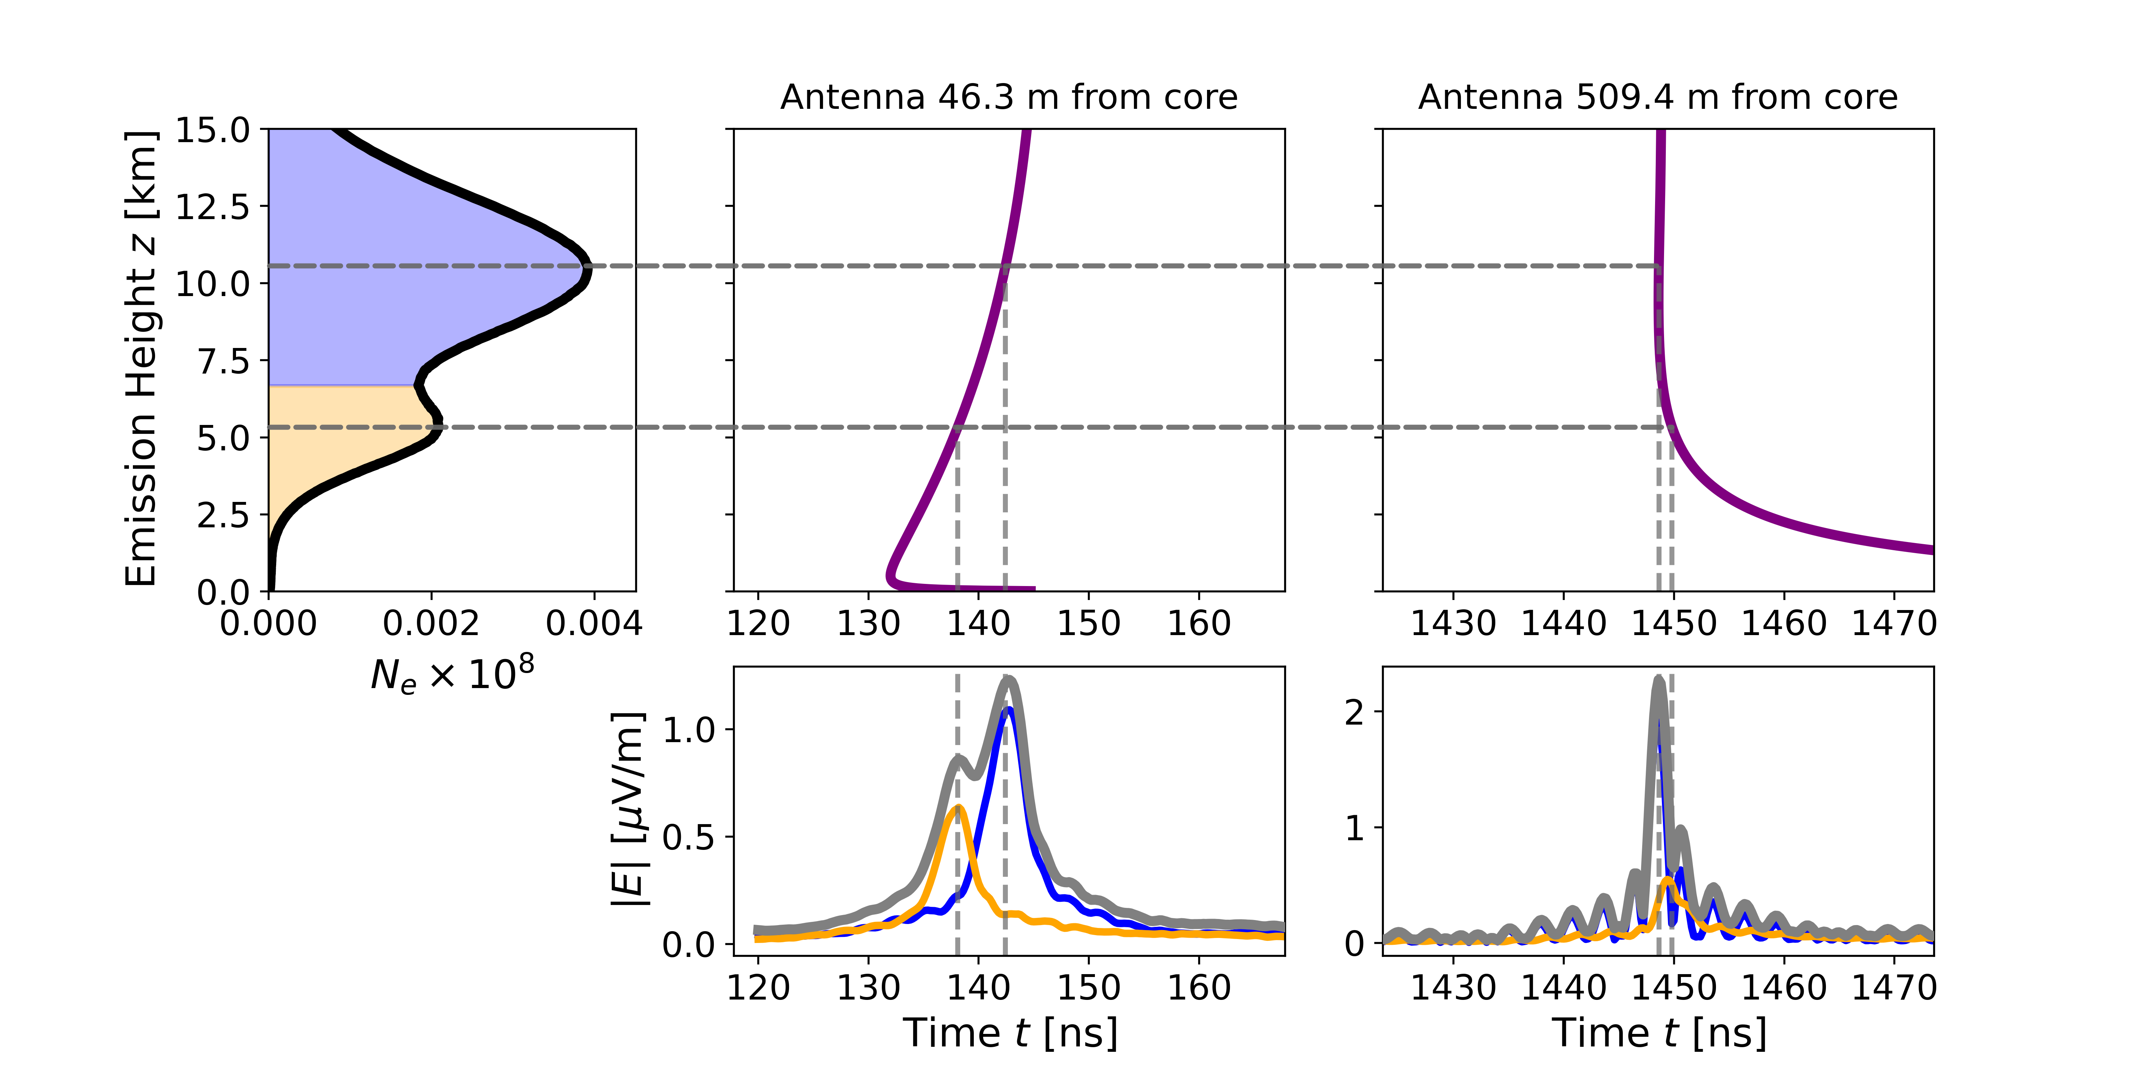
the trace of a bump bump
Cherenkov map
We get two pulses displaced in time depending on the antenna distance.

Slide 7
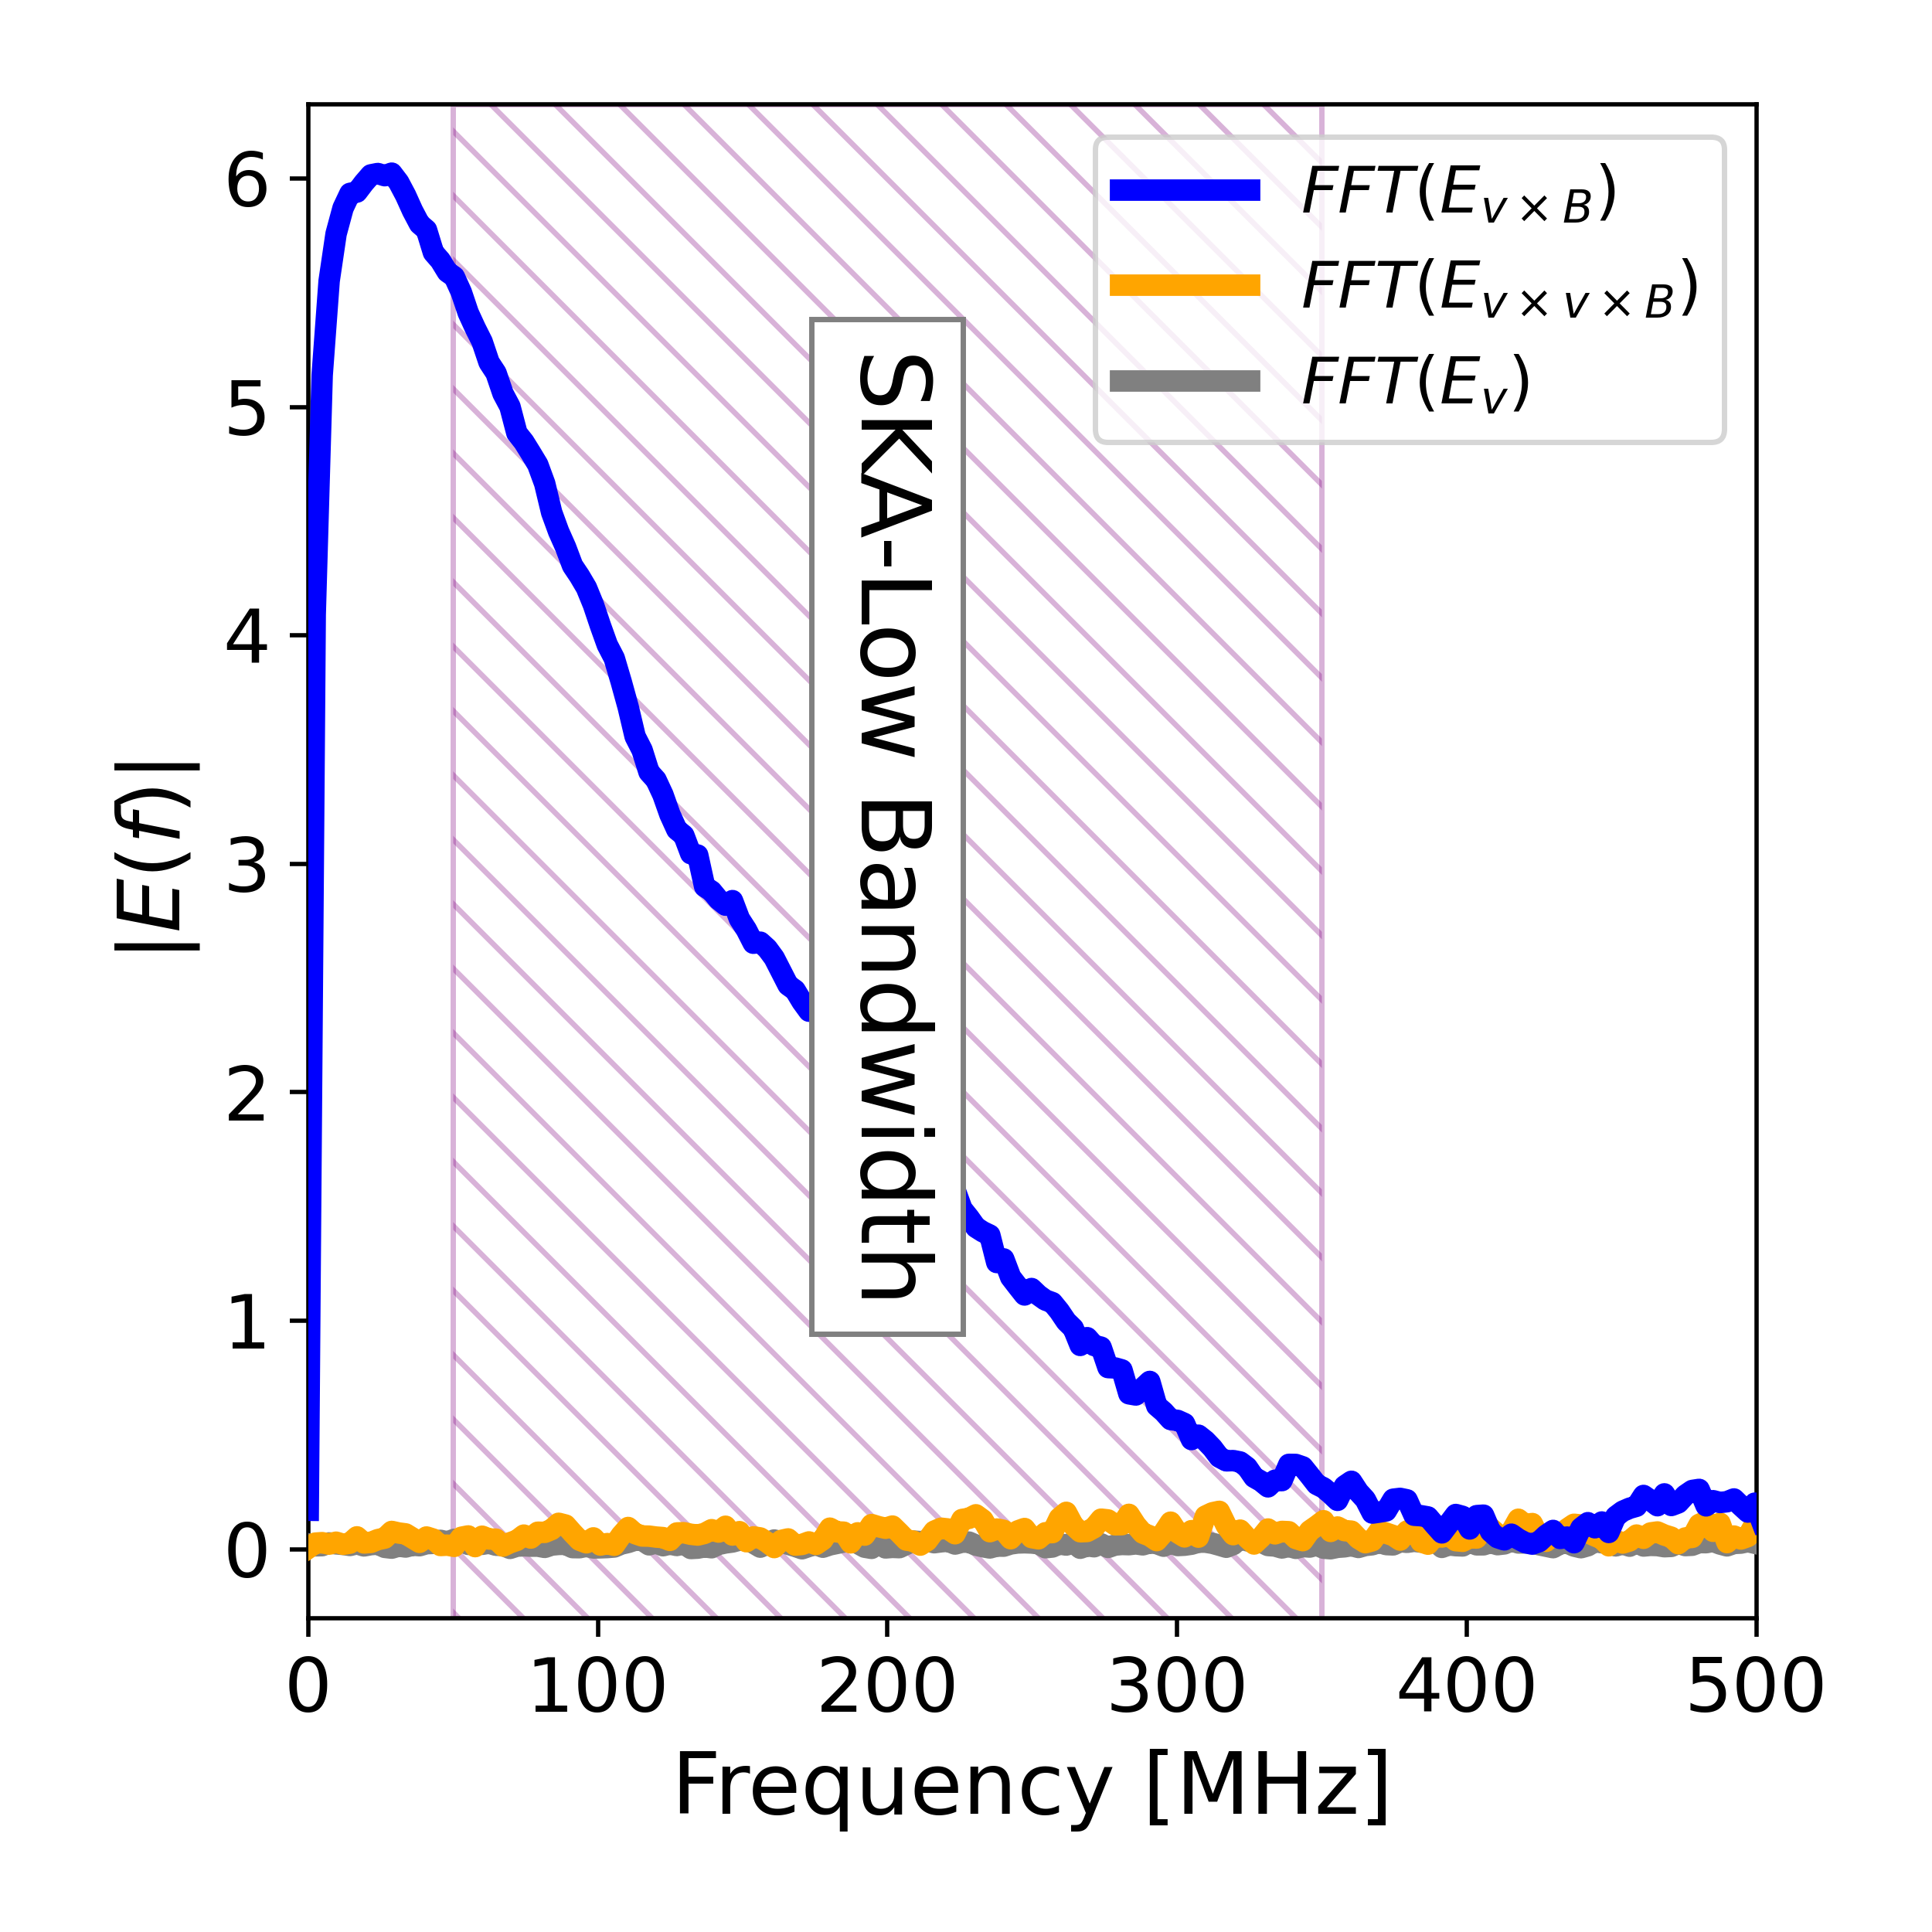
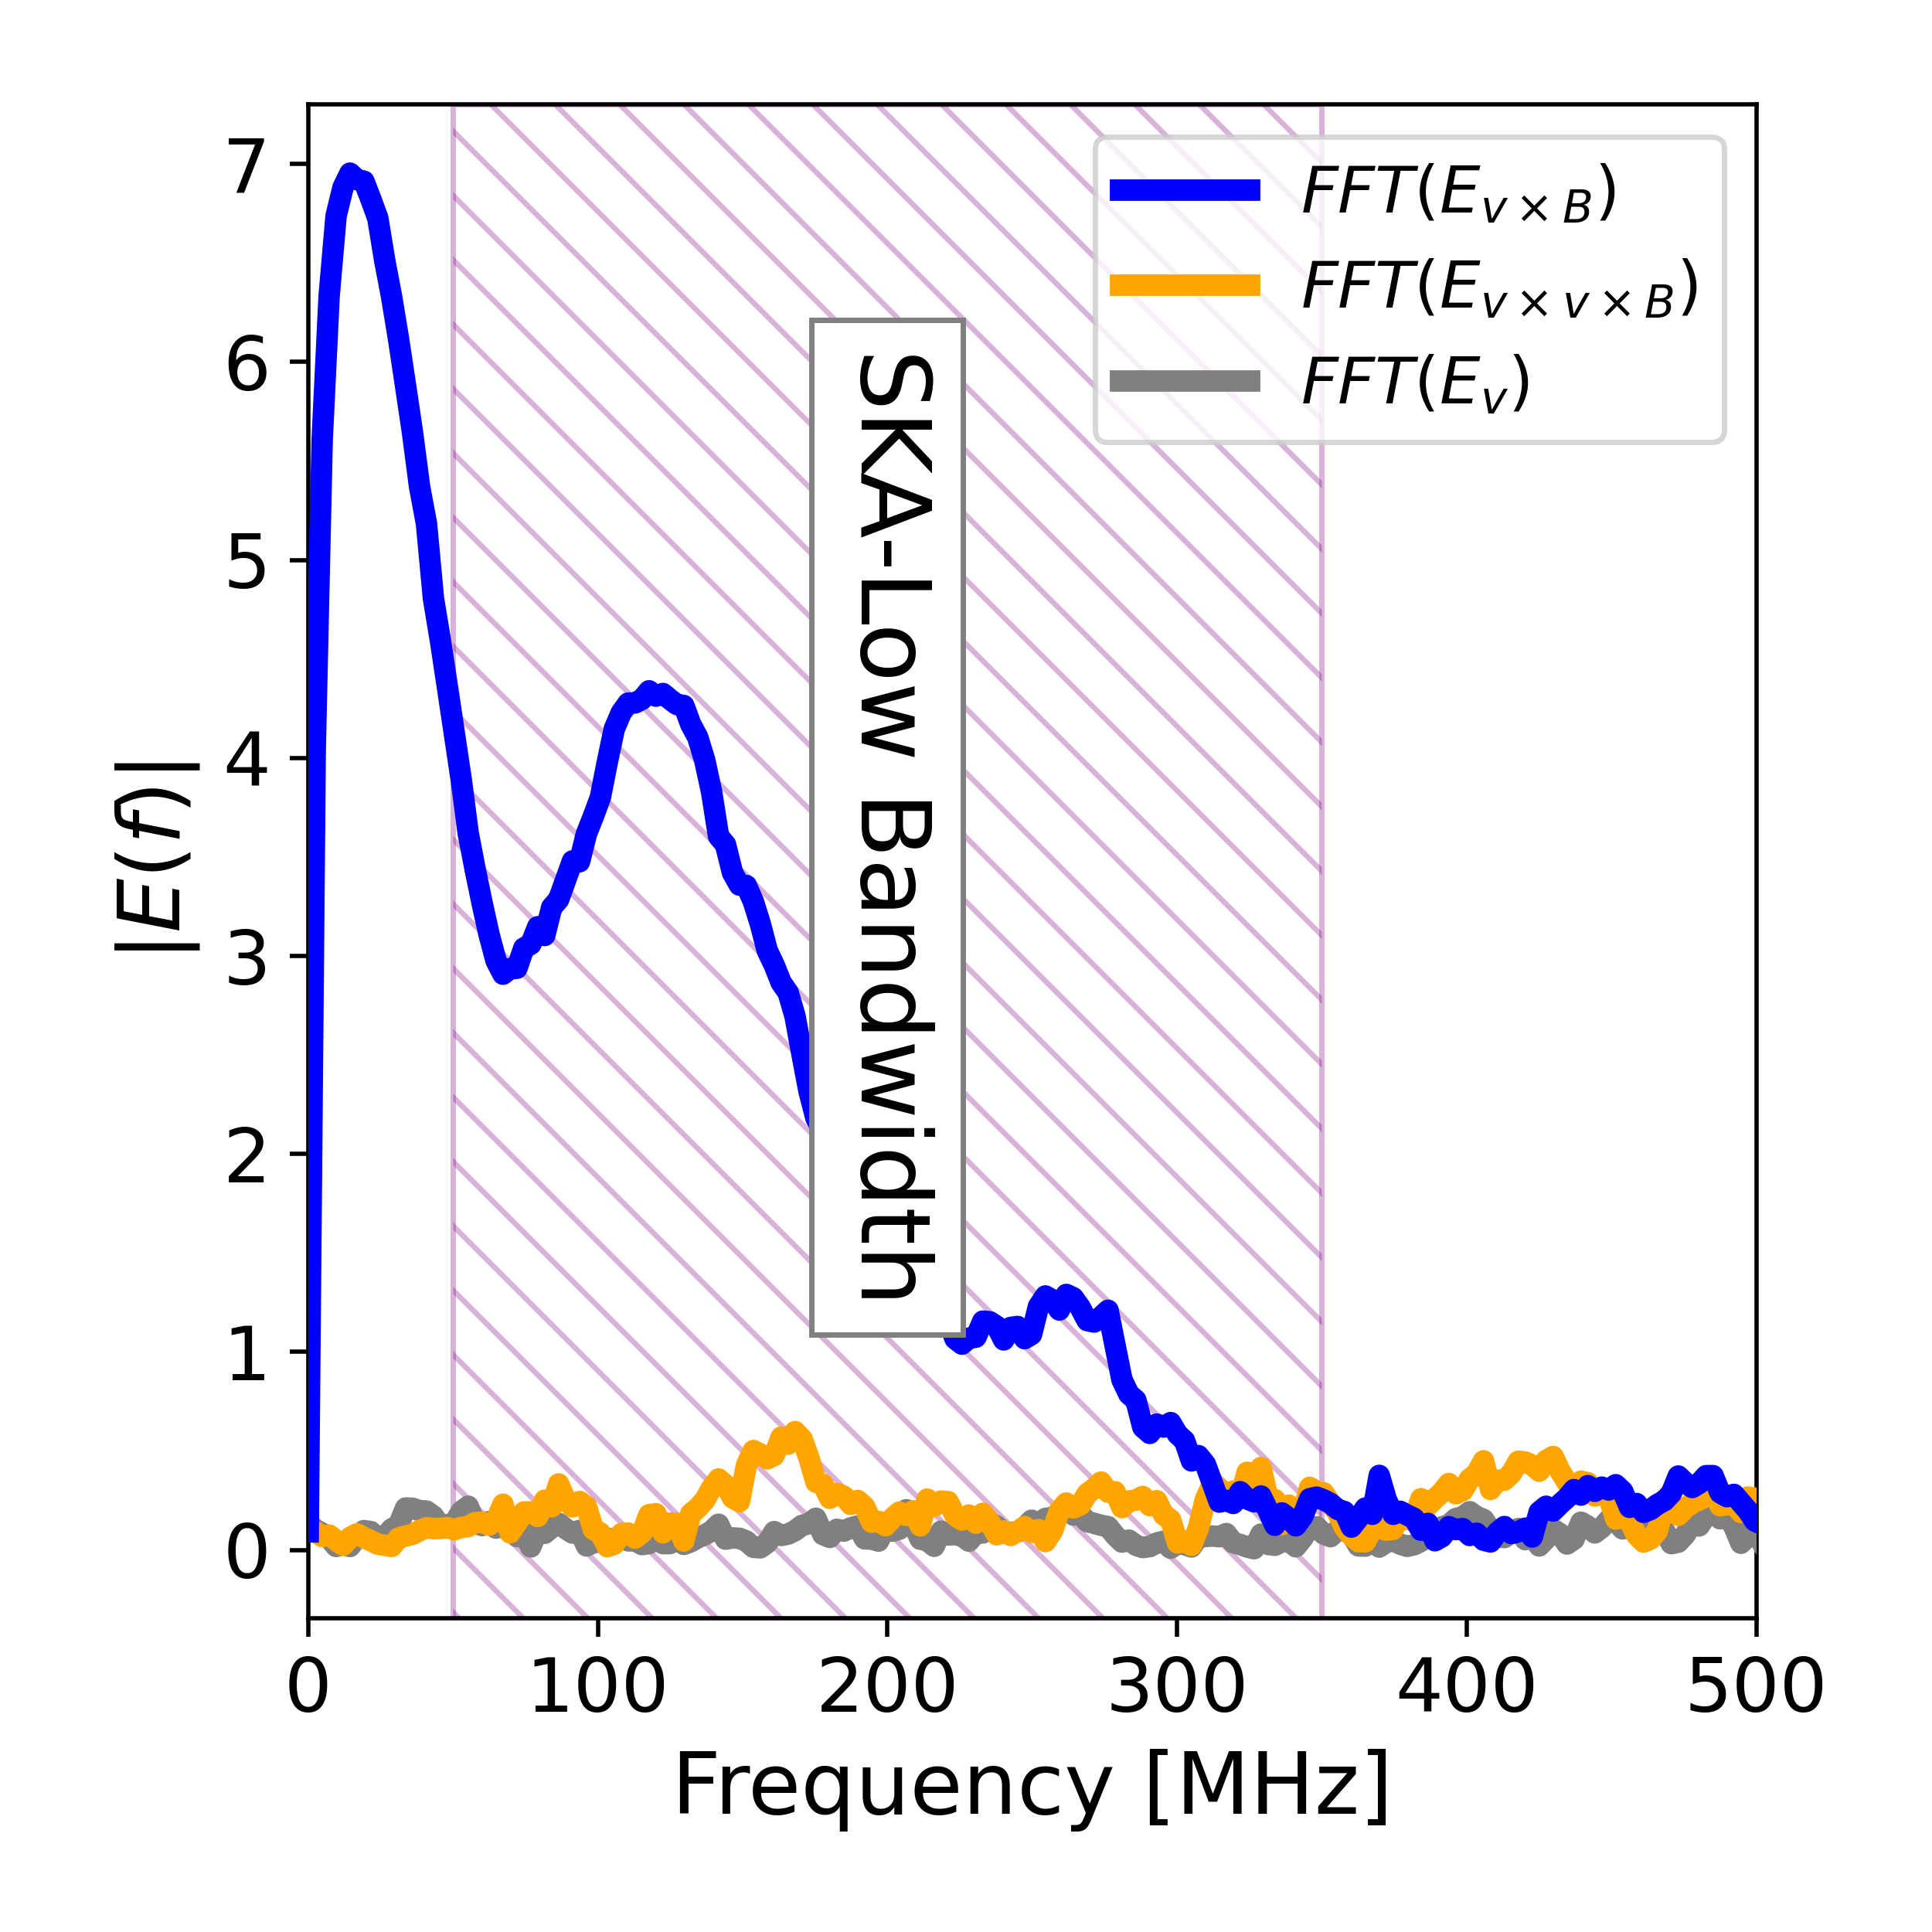
the frequency spectra
Single Bump
Double Bump

Slide 8
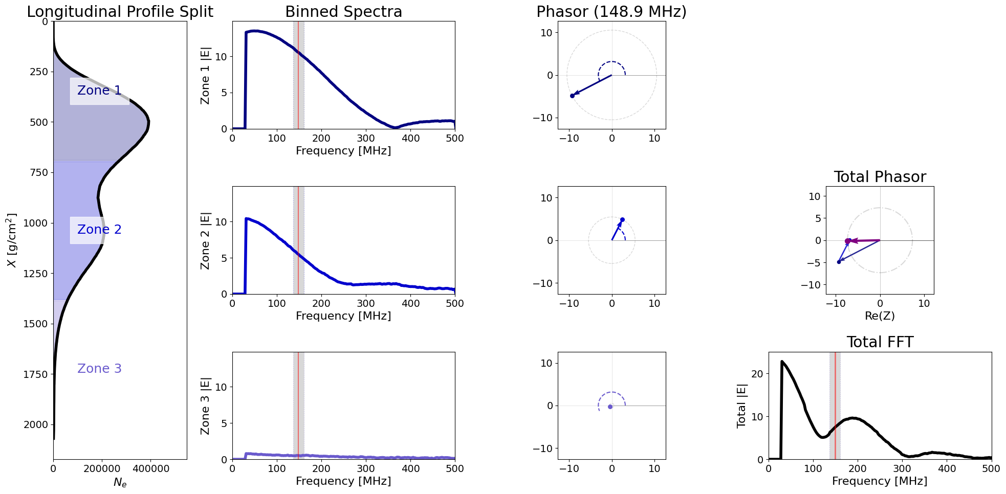
Understanding the freq. spectra
By using a sliced shower we can add the phase from each slice to study the freq. spectra.

Slide 9
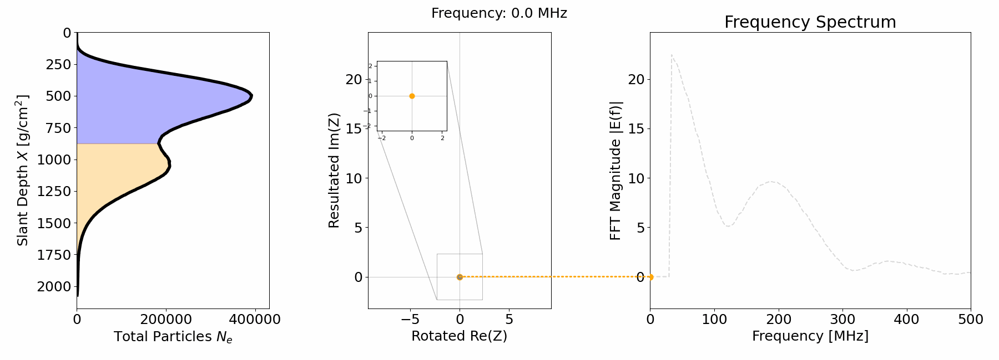

Understanding the freq. spectra but animated
The interference can be understood due to the difference in phase.
Antenna at $150$ m from the core

Slide 10
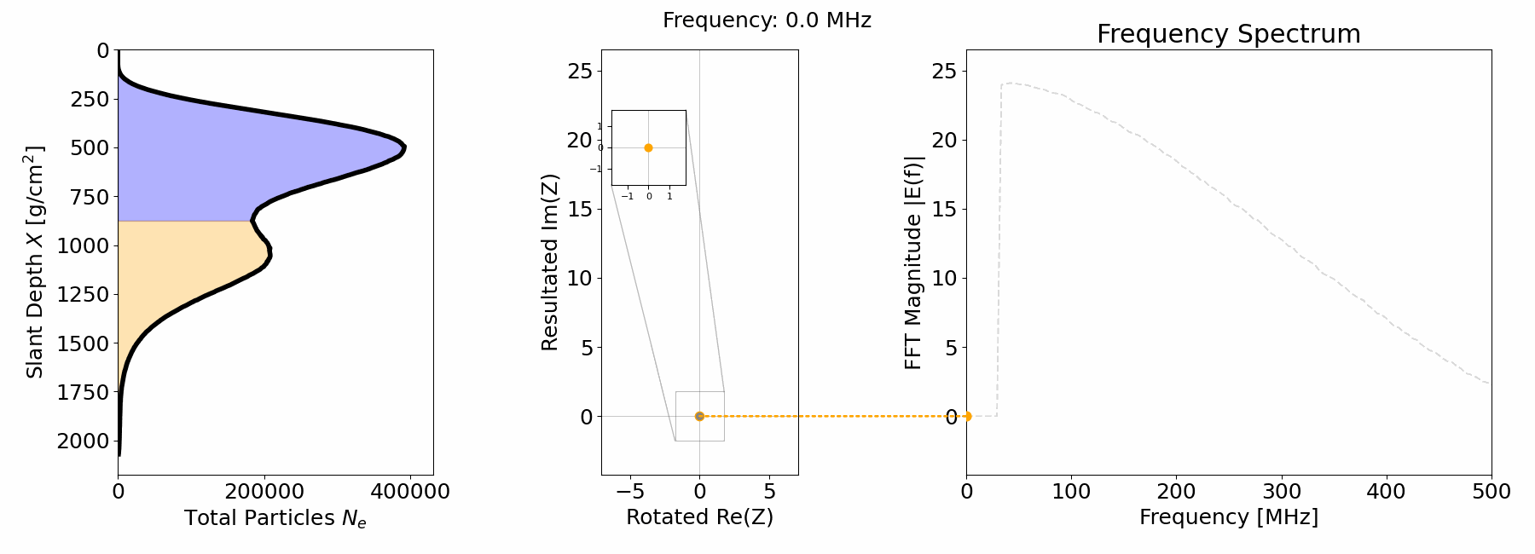

Understanding the freq. spectra but animated²
Moving the antenna further away the phase difference is reduced
Antenna at $400$ m from the core

Slide 11
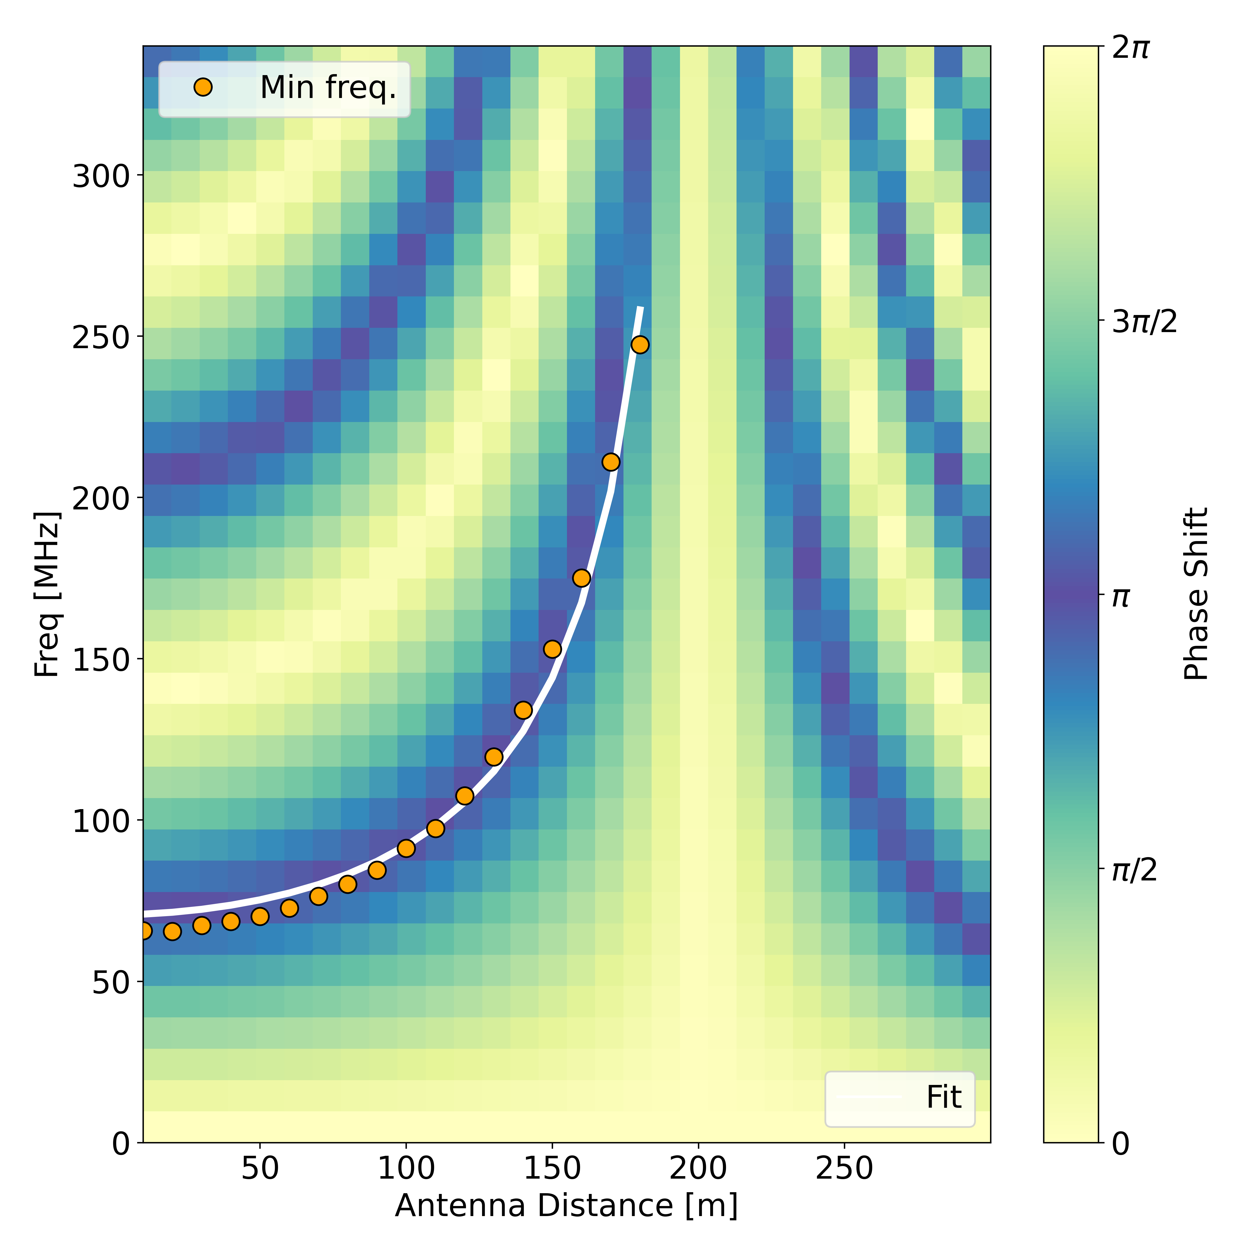
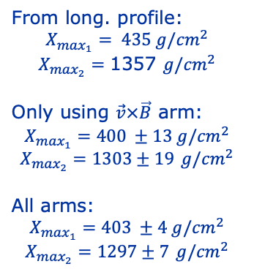

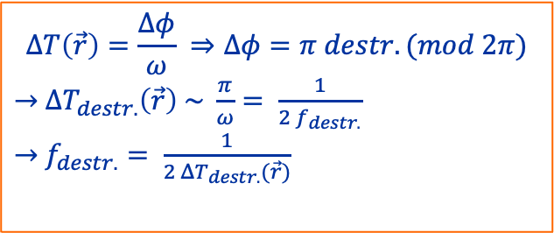


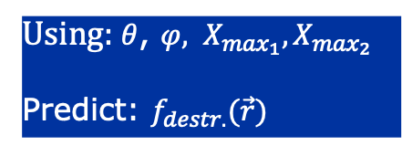


2 point emission model
Using: $θ$, $φ, X_{\max_{1}}{, X}_{\max_{2}}$
Predict: $f_{destr.}(\vec{r})$
From long. profile:
$$X_{\max_{1}}= 435 g/{cm}^{2}$$
$$X_{\max_{2}}=\text{1357} g/{cm}^{2}$$
Only using $\vec{v}×\vec{B}$ arm:
$$X_{\max_{1}}=400 ±13 g/{cm}^{2}$$
$$X_{\max_{2}}=\text{1303}±19 g/{cm}^{2}$$
All arms:
$$X_{\max_{1}}=403 ±4 g/{cm}^{2}$$
$$X_{\max_{2}}=\text{1}\text{297}±\text{7} g/{cm}^{2}$$
$$ΔT\left(\vec{r}\right)=\frac{Δφ}{ω} ⇒Δφ=π destr.(mod 2π)$$
$→$ $ΔT_{destr.}\left(\vec{r}\right) \sim \frac{π}{ω}= \frac{1}{2 f_{destr.}}$
$→$ $f_{destr.}= \frac{1}{2 ΔT_{destr.}(\vec{r})}$
$$X_{\max_{1}}$$
$$T_{1}$$
$$X_{\max_{2}}$$
$$∆T$$
$$T_{2}$$
$$\vec{r}$$

Slide 12
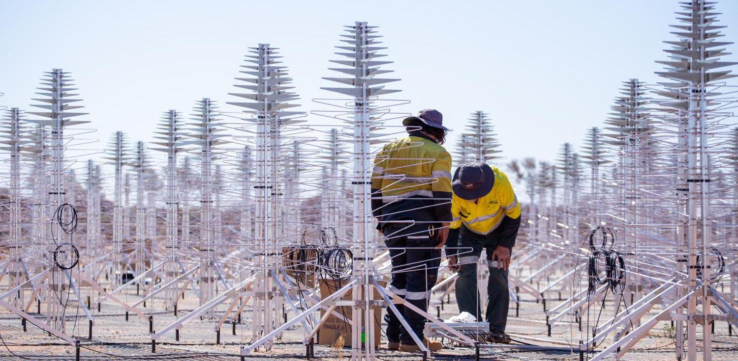
Let’s study a lot of antennas

Slide 13
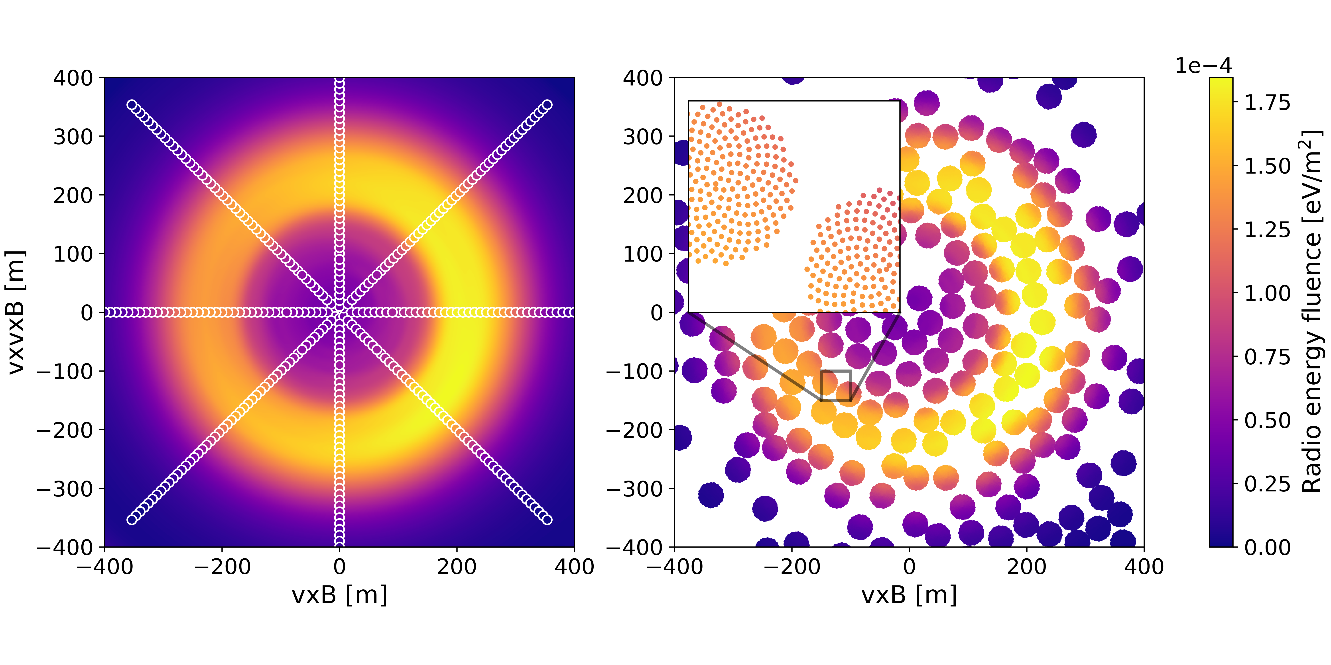
Interpolation to SKA-Low
Filtered: 50-350 MHz
We are studying the fluence in each antenna $f\sim \sum{E^{2}}$

Slide 14
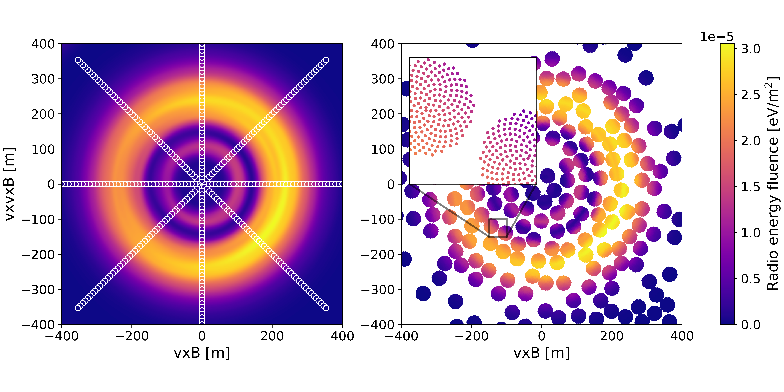
Interpolation to SKA-Low
Filtered: 200-250 MHz
By looking at a higher bandwidth we get a second Cherenkov like ring.

Slide 15
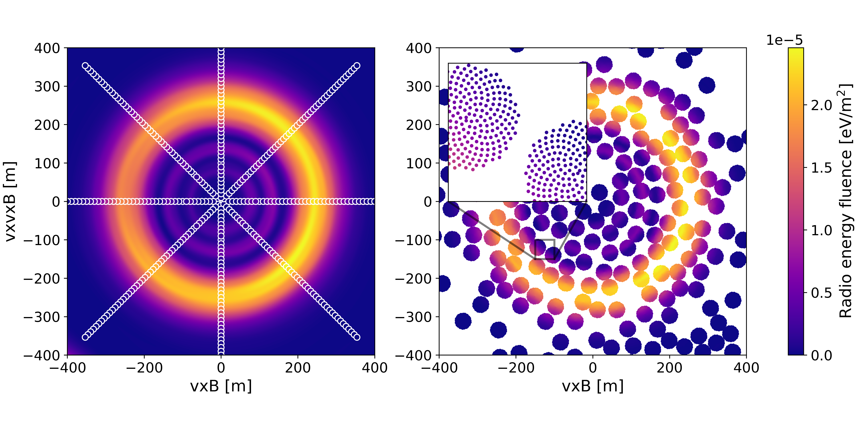
Interpolation to SKA-Low
Filtered: 300-350 MHz
“There is another” –Master Yoda

Slide 16
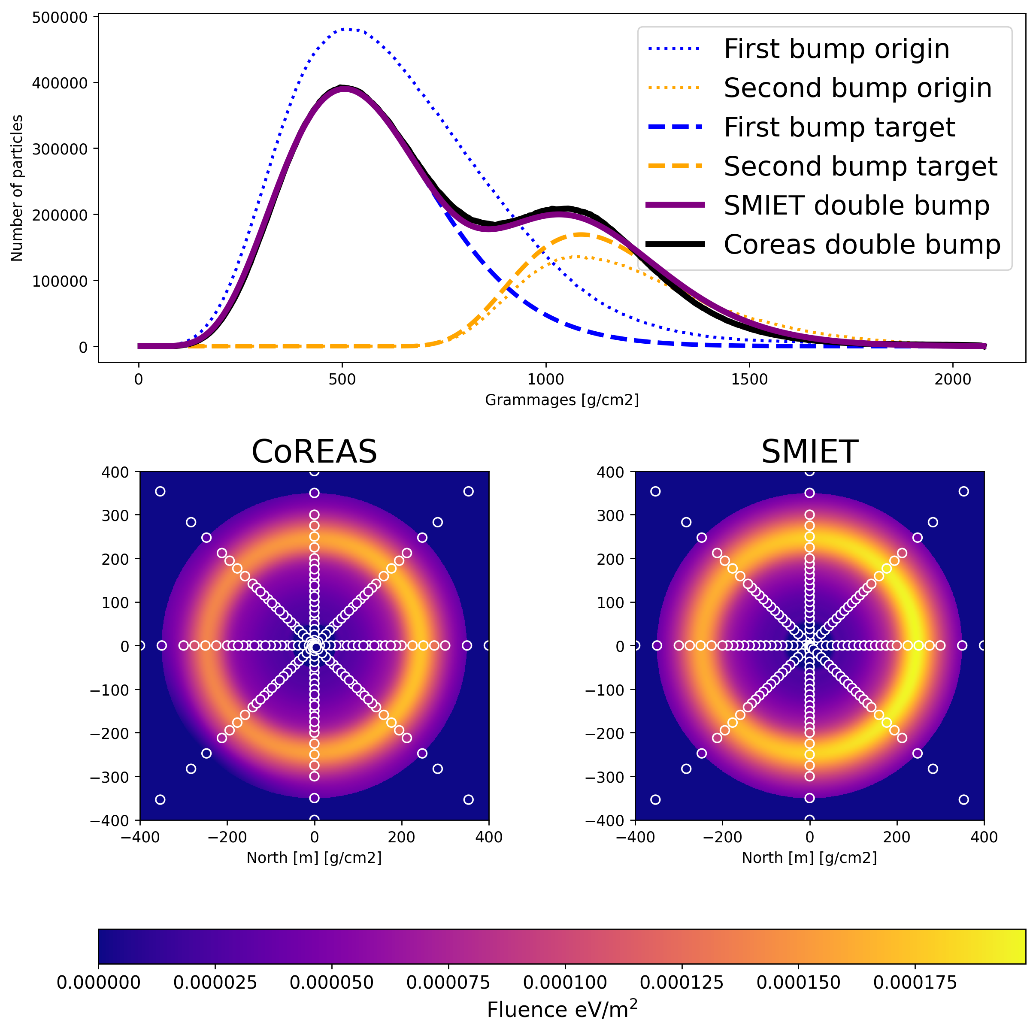
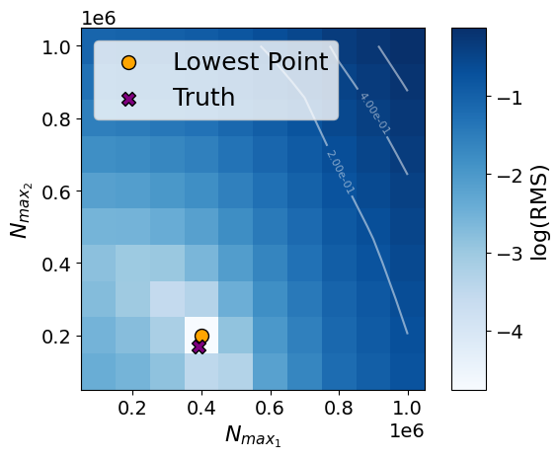
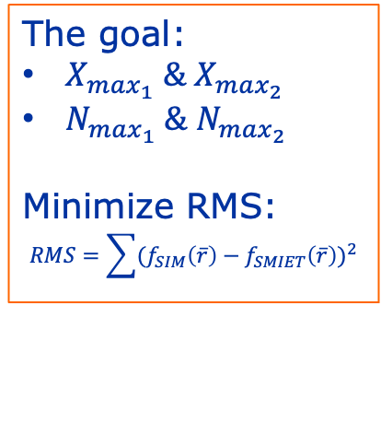
USE SMIET³ for full reconstruction example
The goal:
$X_{\max_{1}} \& X_{\max_{2}}$
$N_{\max_{1}} \& N_{\max_{2}}$
Minimize RMS:
$$RMS=\sum{(f_{SIM}\left(\overline{r}\right)−f_{SMIET}\left(\overline{r}\right))^{2}}$$
³Beyond X_max: Reconstructing Air Shower Profiles with
Information Field Theory with SKA-Low
by Keito Watanabe on 11 Jun 2026 at 10:15

Slide 17
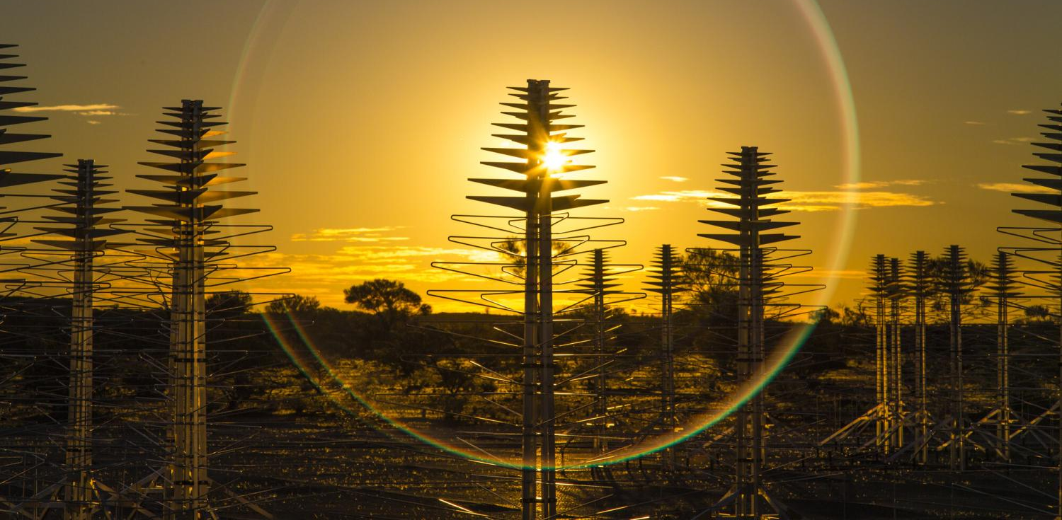
Conclusion
We understand the signal produced by anomalous showers.
We can reconstruct the parameters of anomalous showers using radio.
SKA-Low will be the first to detect these shower!!!

Slide 18
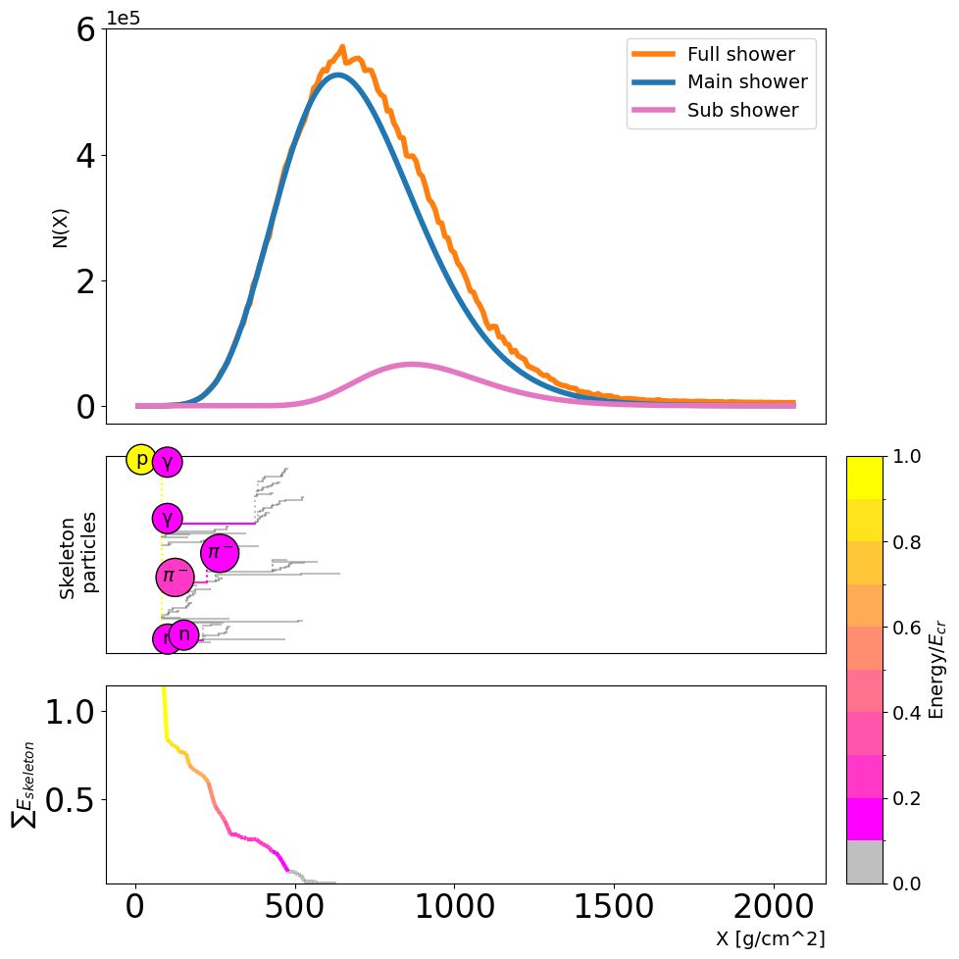
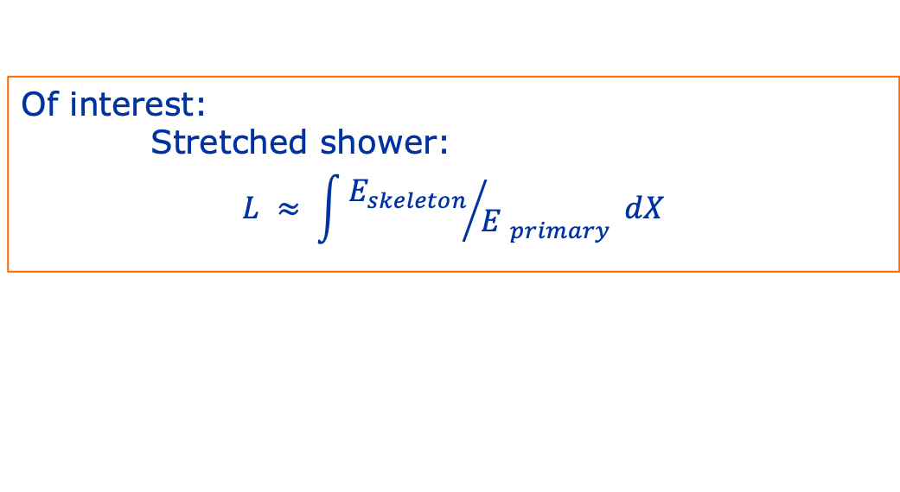
anomalous air showers¹
These are showers where the longitudinal profile gets significantly influenced by highly energetic secondaries.
Of interest:
Stretched shower:
$$L ≈ \int{{E_{skeleton}}/{{E }_{primary}} dX}$$
¹The case for studying anomalous showers with the Square Kilometre Array
by Stijn Buitink on 10 Jun 2026 at 09:30

Slide 19
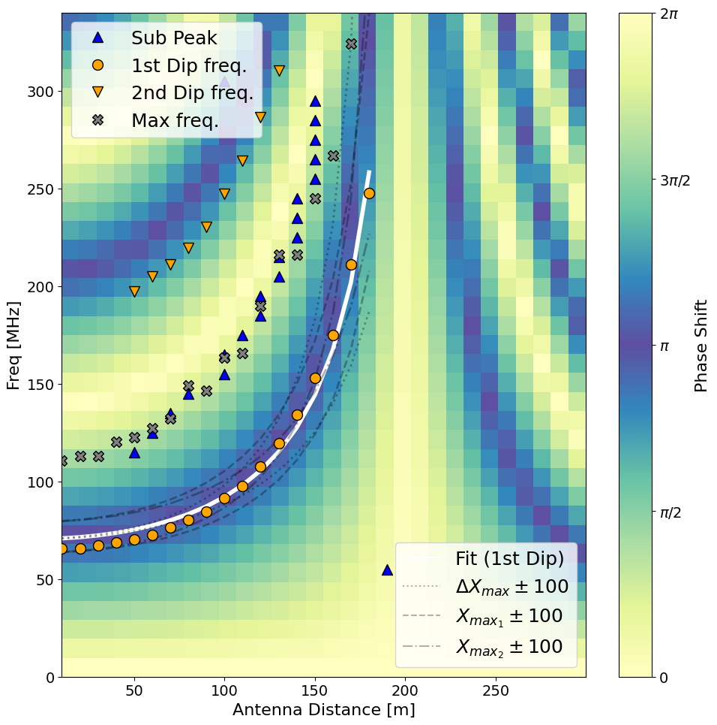
the frequency spectra
Double Bump

Slide 20
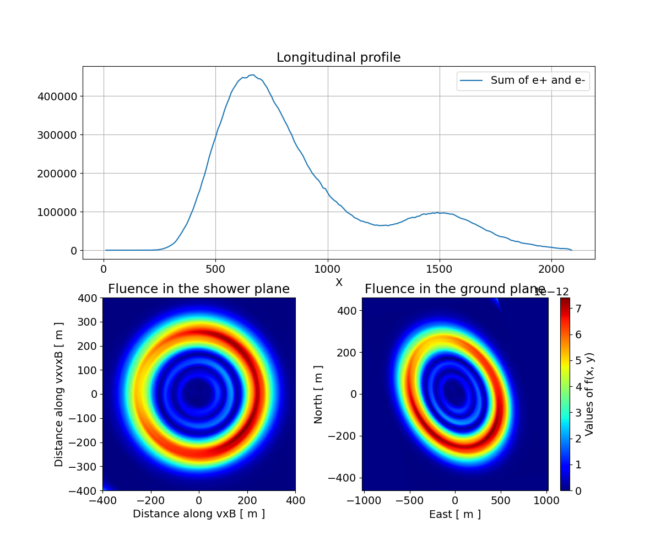
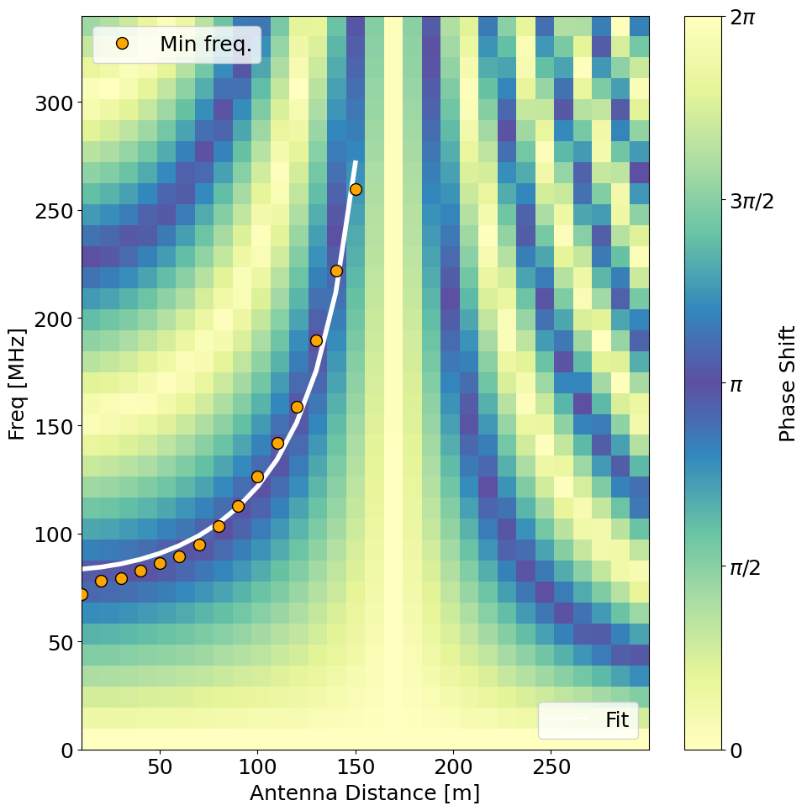
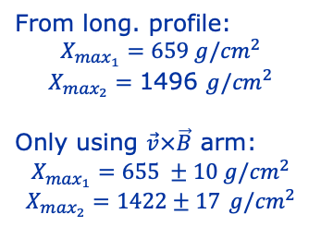
Some more examples
From long. profile:
$$X_{\max_{1}}=659 g/{cm}^{2}$$
$$X_{\max_{2}}=\text{1}\text{496 }g/{cm}^{2}$$
Only using $\vec{v}×\vec{B}$ arm:
$$X_{\max_{1}}=655 ±10 g/{cm}^{2}$$
$$X_{\max_{2}}=\text{1}422±1\text{7} g/{cm}^{2}$$

Slide 21
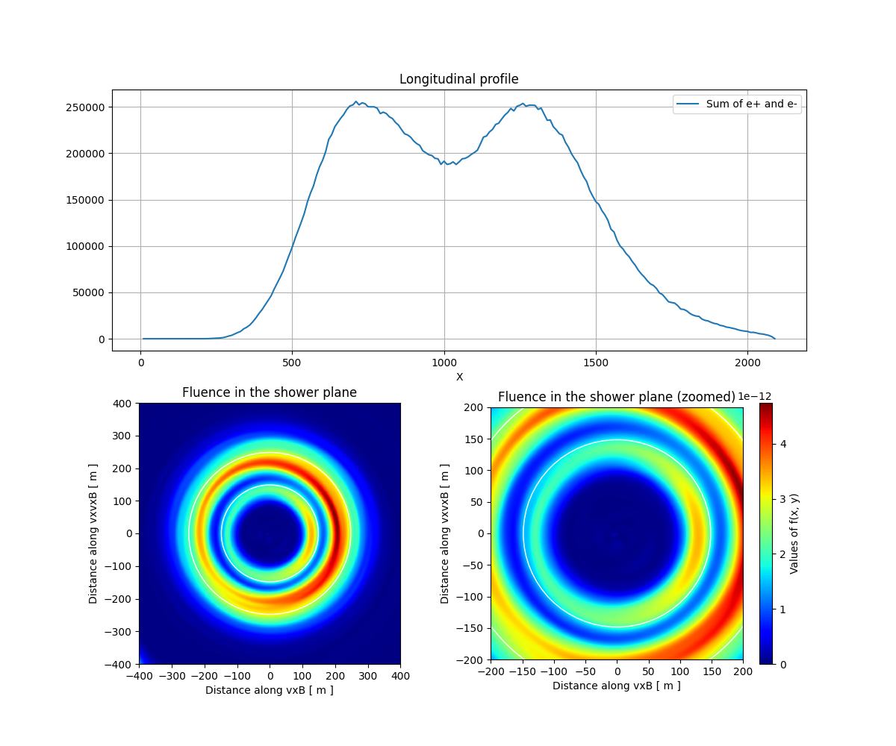
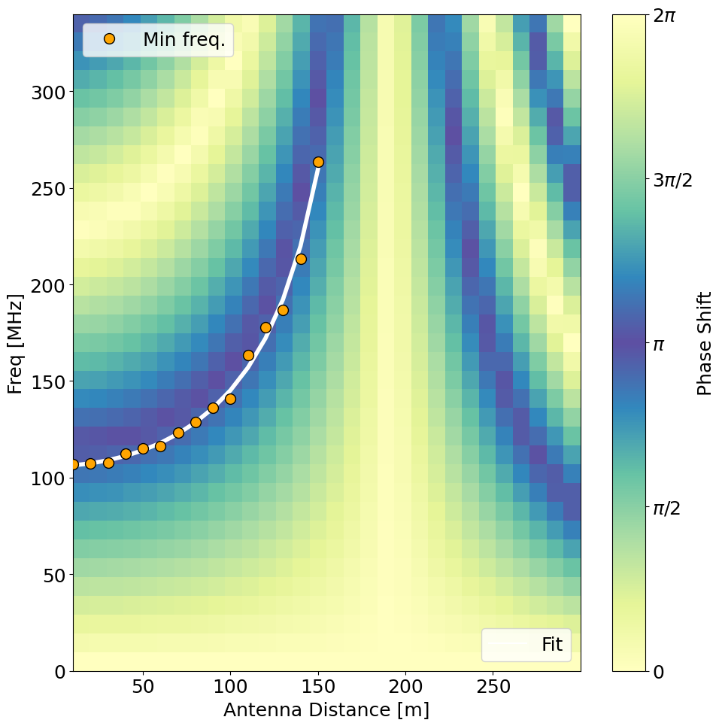
Some more examples
From long. profile:
$$X_{\max_{1}}=738 g/{cm}^{2}$$
$$X_{\max_{2}}=\text{1}\text{292 }g/{cm}^{2}$$
Only using $\vec{v}×\vec{B}$ arm:
$$X_{\max_{1}}=686 ±11 g/{cm}^{2}$$
$$X_{\max_{2}}=\text{1}288±\text{22} g/{cm}^{2}$$

Slide 22
USE SMIET for full reconstruction
How to make a Double Bump with SMIET³:
Fit Double Bump using restricted fit¹
Take 2 origin showers -> 2 target bumps
Shift traces to the same time scale
Sum Traces to mimic Double Bump
³Beyond X_max: Reconstructing Air Shower Profiles with
Information Field Theory with SKA-Low
by Keito Watanabe on 11 Jun 2026 at 10:15

Slide 23
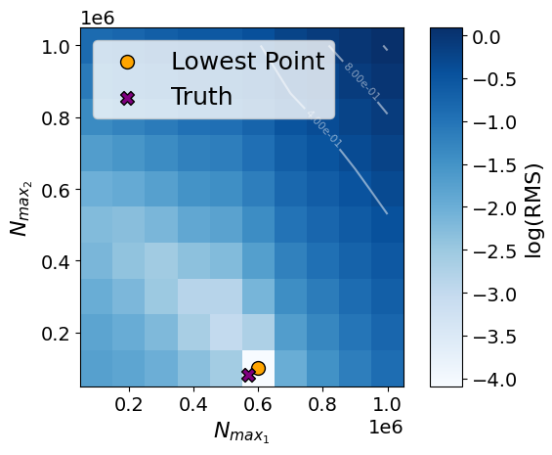
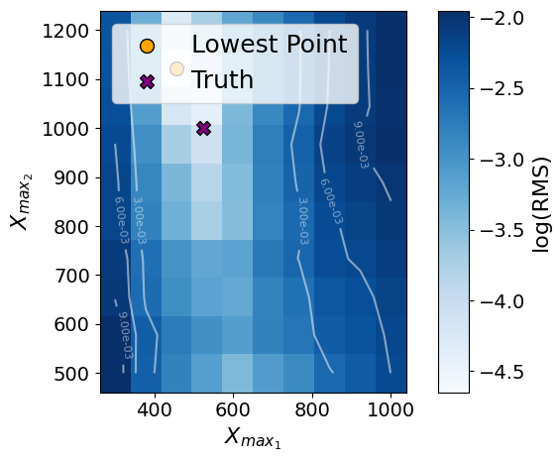
SIM000141
$X_{\max_{1}} \& X_{\max_{2}}$ slice
$N_{\max_{1}} \& N_{\max_{2}}$ slice

Slide 24
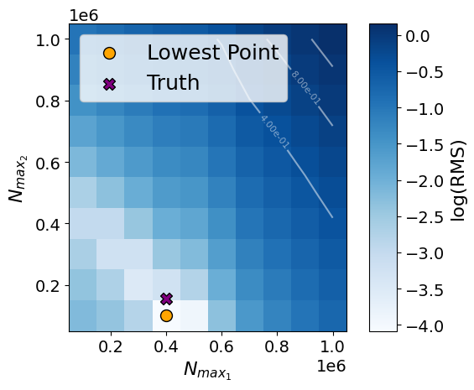
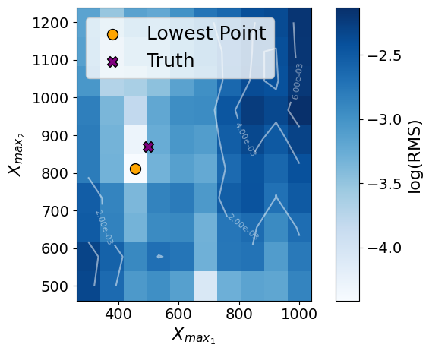
SIM000302
$X_{\max_{1}} \& X_{\max_{2}}$ slice
$N_{\max_{1}} \& N_{\max_{2}}$ slice

Slide 25
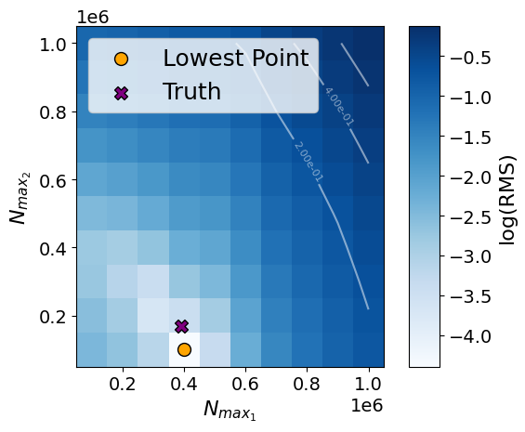
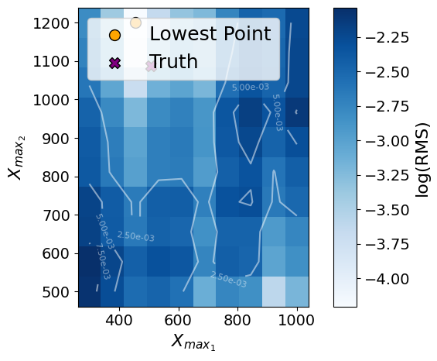
SIM000304
$X_{\max_{1}} \& X_{\max_{2}}$ slice
$N_{\max_{1}} \& N_{\max_{2}}$ slice

Slide 26
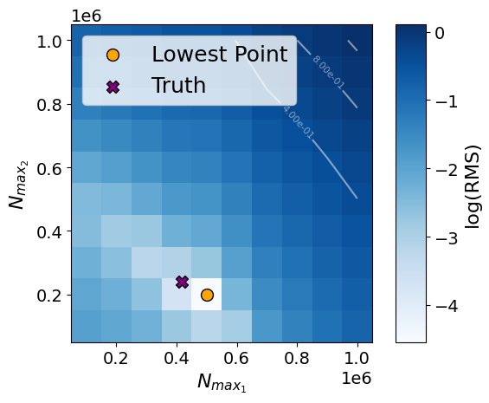
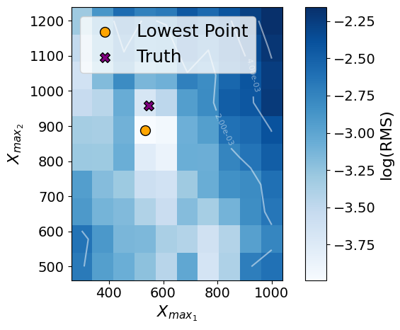
SIM000377
$X_{\max_{1}} \& X_{\max_{2}}$ slice
$N_{\max_{1}} \& N_{\max_{2}}$ slice

Slide 27
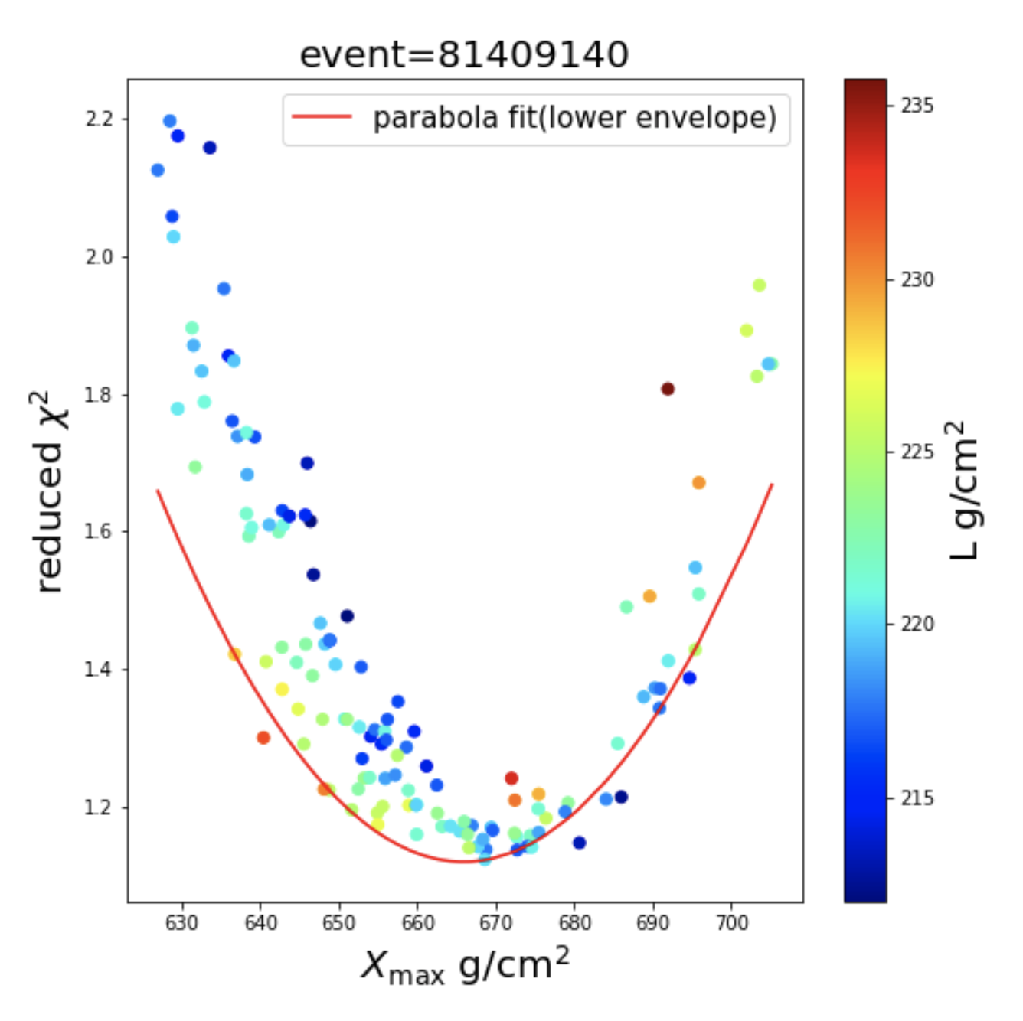
Reconstruction of the L parameter
Proof of $L$ sensitivity using SKA-Low⁵
Beamforming+Aperture correction⁶
IFT (again)^{3,4}
⁵Constraining the cosmic-ray mass composition by
measuring the shower length with SKA by Buitink et. al.
⁶Aperture correction for Beamforming in radiometric detection of ultra-high energy cosmic rays by Scholten et. al.

