Slide 1

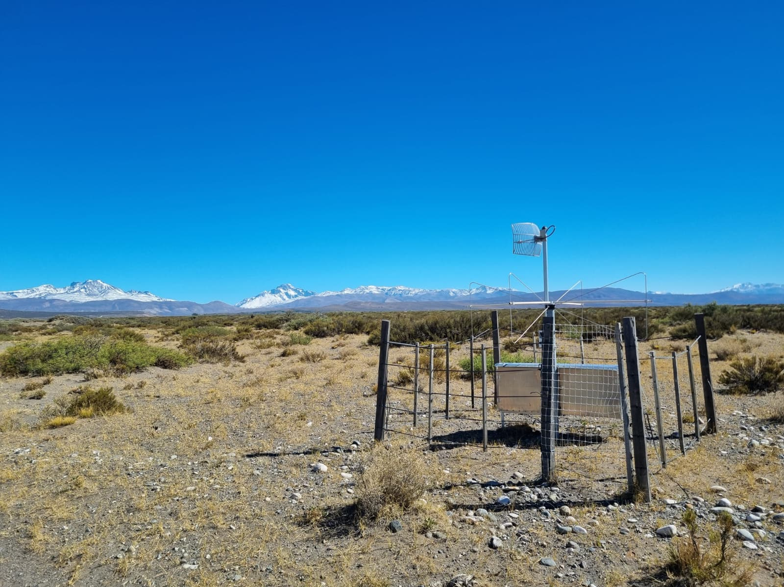
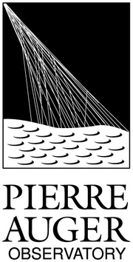

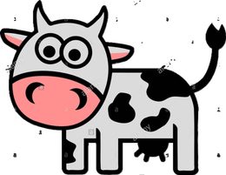


Radio interferometric air shower reconstruction at the Pierre Auger Observatory
Pim van Dillen
, for the Pierre Auger Collaboration
Notes:
1

Slide 2
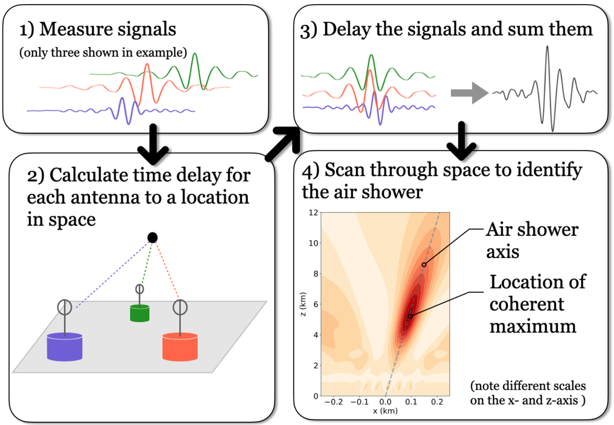

Radio Interferometry Technique (RIT)
  Combine the individual waveforms by exploiting the relative time difference
  Very accurate timing of the signal needed
1 ns
    Clock synchronisation
    Positional accuracy (< 30 cm)
  Reconstruct air showers initiated by ultra-high-energy cosmic rays
DOI: 10.22323/1.444.0380
2

Slide 3
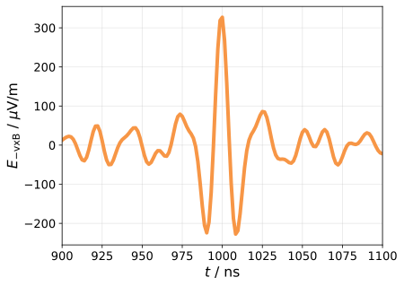


Air Shower Interferometric Reconstruction Algorithm¹
  Input:
    Single waveform:
      Projection on -vxB
    Initial guess:
      Surface detector reconstruction
3
¹ Air Shower Interferometric Reconstruction Algorithm: https://gitlab.com/harmscho/asira

Slide 4

Air Shower Interferometric Reconstruction Algorithm¹
  Input:
    Single waveform:
      Projection on -vxB
    Initial guess:
      Surface detector reconstruction
SD axis
4
¹ Air Shower Interferometric Reconstruction Algorithm: https://gitlab.com/harmscho/asira

Slide 5
Air Shower Interferometric Reconstruction Algorithm
  Calculate travel time to each antenna
  t1, t2, t3, t4
5

Slide 6
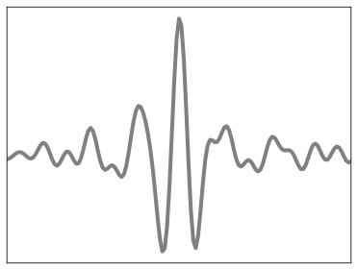
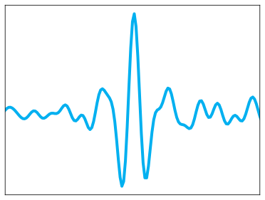
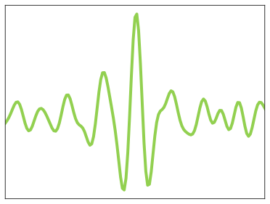
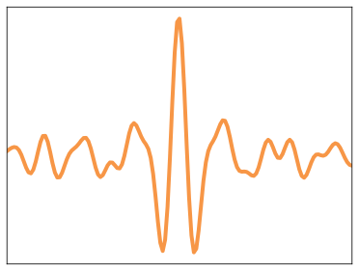
Air Shower Interferometric Reconstruction Algorithm
  Subtract travel time from waveforms
  Add them up
  Integrate
t1
t2
t3
t4
t
6
Notes:
auger_140324536400__rd_100796.214274__sd_25440914

Slide 7
Air Shower Interferometric Reconstruction Algorithm
  Subtract travel time from waveforms
  Add them up
  Integrate
t
7
Notes:
auger_140324536400__rd_100796.214274__sd_25440914

Slide 8
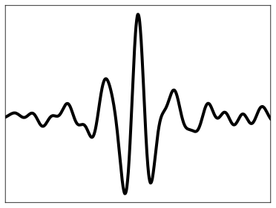
Air Shower Interferometric Reconstruction Algorithm
  Subtract travel time from waveforms
  Add them up
  Integrate
8
Notes:
auger_140324536400__rd_100796.214274__sd_25440914

Slide 9
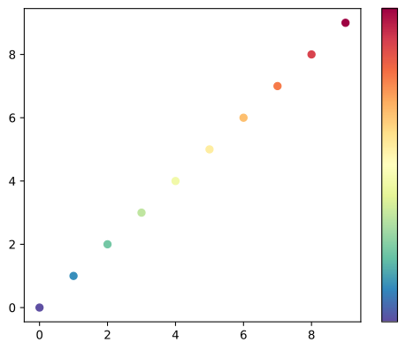
Air Shower Interferometric Reconstruction Algorithm
  Subtract travel time from waveforms
  Add them up
  Integrate
9
Notes:
auger_140324536400__rd_100796.214274__sd_25440914

Slide 10
Air Shower Interferometric Reconstruction Algorithm
  Subtract travel time from waveforms
  Add them up
  Integrate
10
Notes:
auger_140324536400__rd_100796.214274__sd_25440914

Slide 11
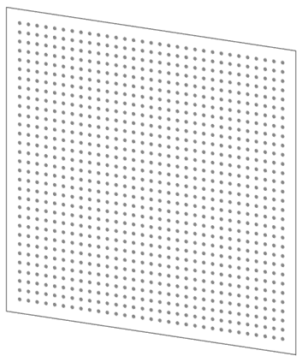
Air Shower Interferometric Reconstruction Algorithm
  Slices with grid of points
    31 x 31 points
    2° width
2°
11

Slide 12
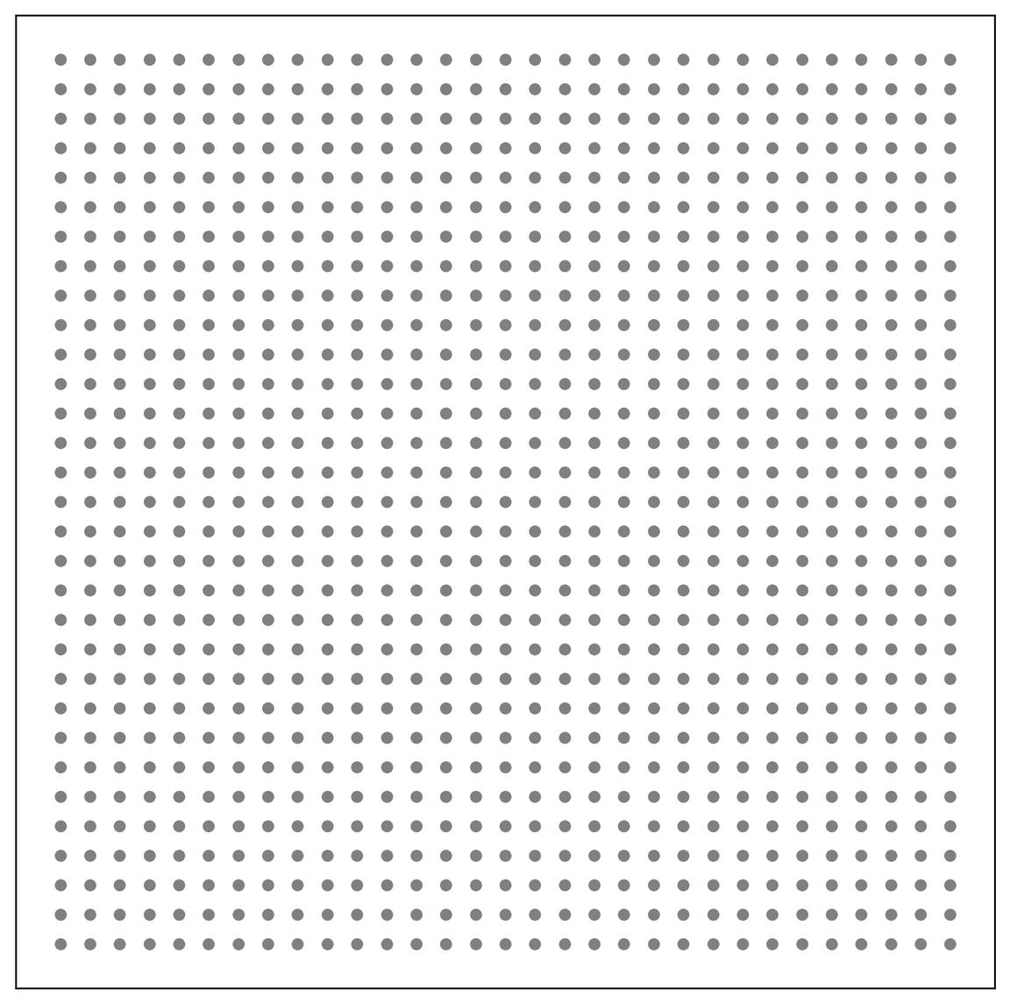
Air Shower Interferometric Reconstruction Algorithm
  Determine intensity for every point
12

Slide 13
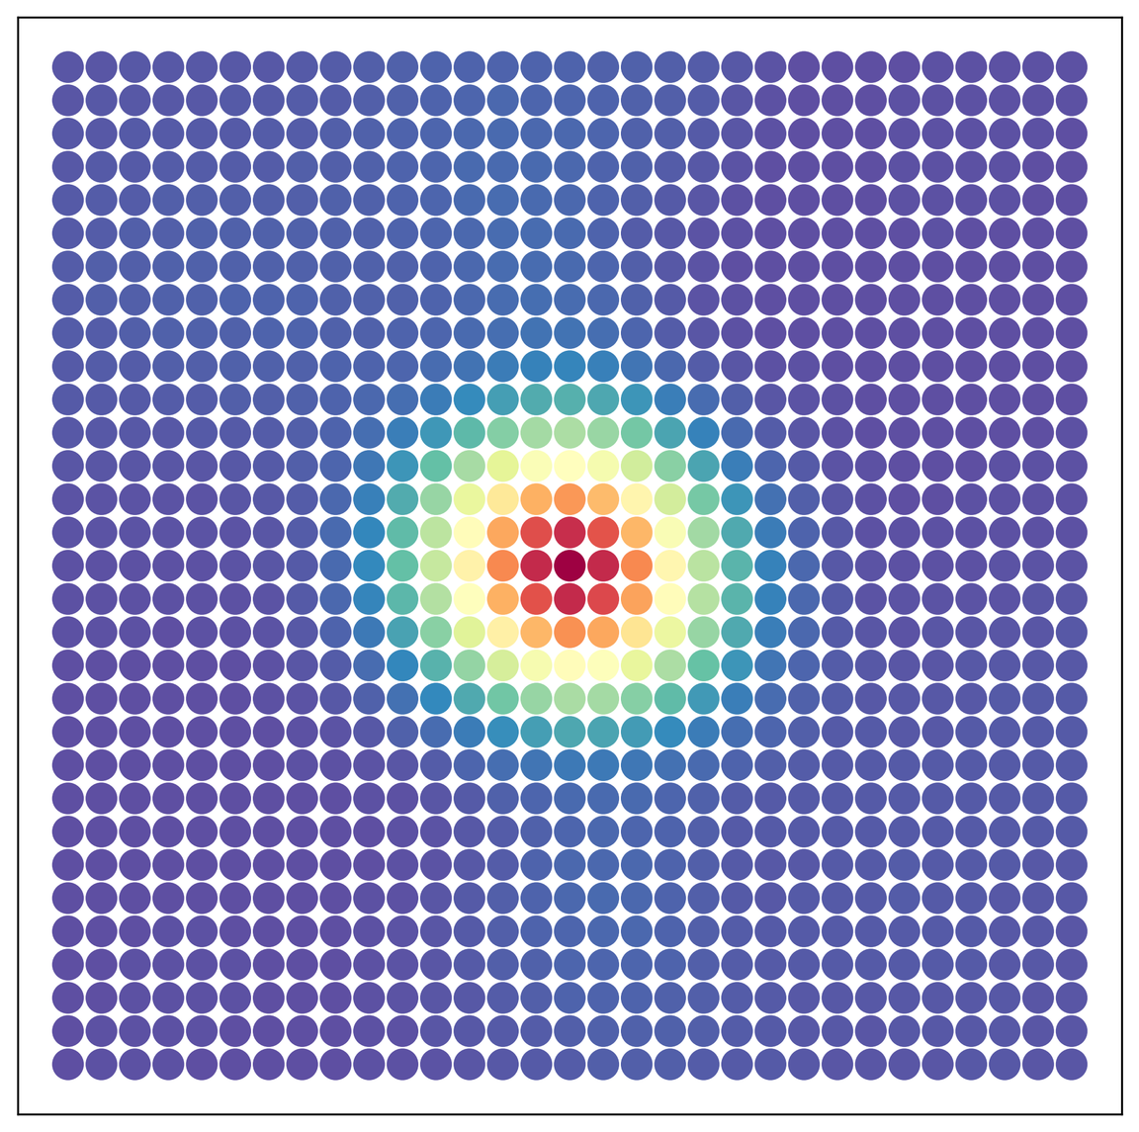
Air Shower Interferometric Reconstruction Algorithm
  Determine intensity for every point
13
Notes:
Top_events[1] aera simulations X = 550

Slide 14
Air Shower Interferometric Reconstruction Algorithm
  Determine intensity for every point
  Locate maximum
14

Slide 15
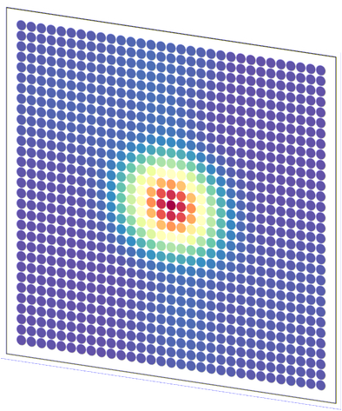
Air Shower Interferometric Reconstruction Algorithm
  15 slices at depths between X = 200 - 1000 g/cm2
  Determine maximum points
15
Notes:
Top_events[1] aera simulations X = 550, 500, 450
Remake

Slide 16
Air Shower Interferometric Reconstruction Algorithm
  15 slices at depths between X = 200 - 1000 g/cm2
  Determine maximum points
16
Notes:
Top_events[1] aera simulations X = 550, 500, 450
Remake

Slide 17
Air Shower Interferometric Reconstruction Algorithm
  15 slices at depths between X = 200 - 1000 g/cm2
  Determine maximum points
17

Slide 18
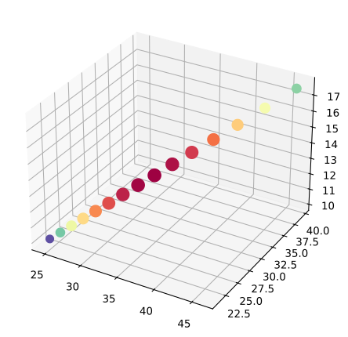
Air Shower Interferometric Reconstruction Algorithm
  Fit axis through points
  Free parameters:
    Zenith angle
    Azimuth angle
    Core position (x,y)
z (km)
y (km)
x (km)
18
Notes:
auger_142807366300__rd_100903.106096__sd_29511437

Slide 19
Air Shower Interferometric Reconstruction Algorithm
  Fit axis through points
  Free parameters:
    Zenith angle
    Azimuth angle
    Core position (x,y)
z (km)
y (km)
x (km)
19
Notes:
auger_142807366300__rd_100903.106096__sd_29511437

Slide 20
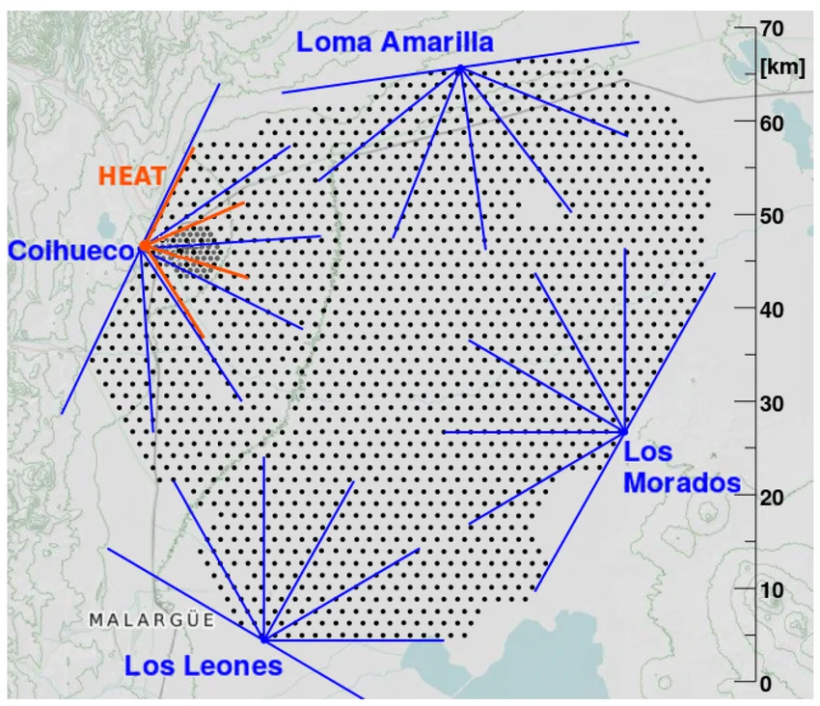
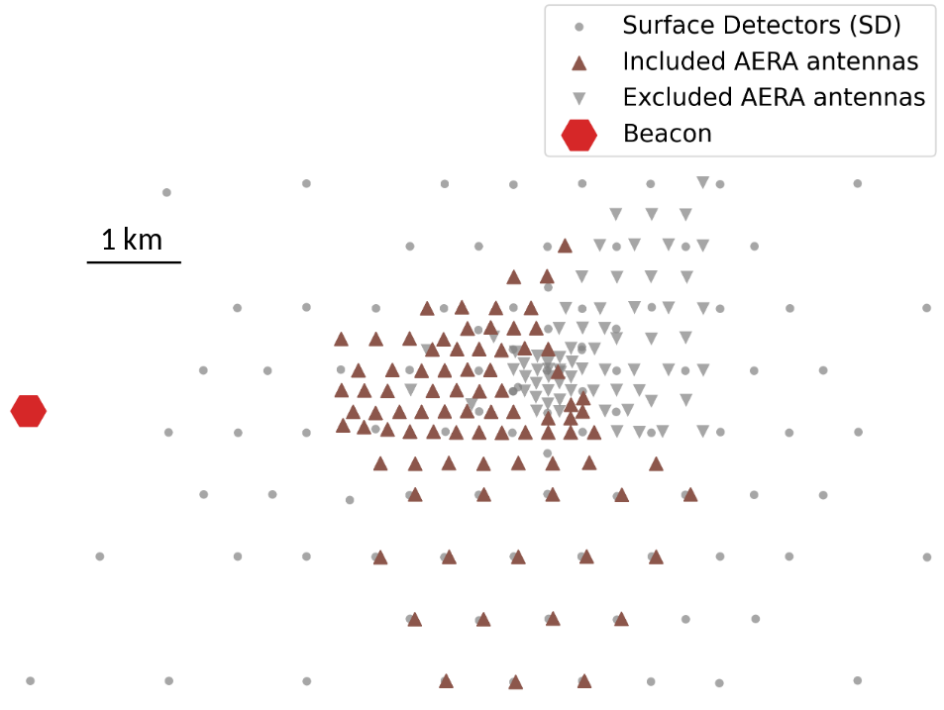

Auger Engineering Radio Array (AERA)
  Apply to measured data with the Auger Engineering Radio Array
  Triggers on Surface Detector
  1 ns timing accuracy:
    Clock synchronisation: Beacon
    Positional accuracy: Differential GPS
AERA
20

Slide 21
Auger Engineering Radio Array (AERA)
  Apply to measured data with the Auger Engineering Radio Array
  Triggers on Surface Detector
  1 ns timing accuracy:
    Clock synchronisation: Beacon
    Positional accuracy: Differential GPS
21

Slide 22
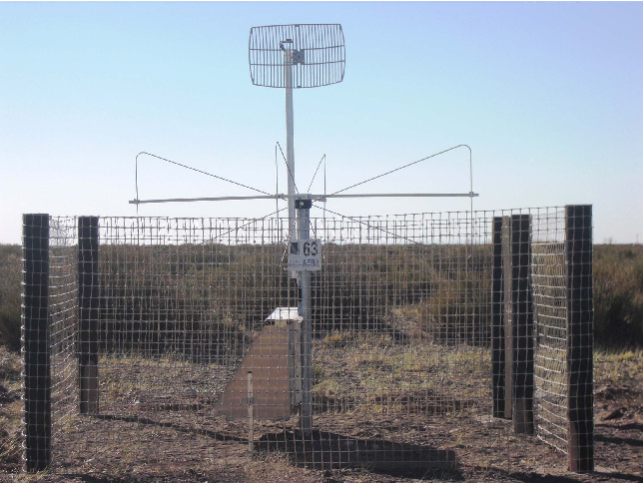
Auger Engineering Radio Array (AERA)
  Apply to measured data with the Auger Engineering Radio Array
  Triggers on Surface Detector
  1 ns timing accuracy:
    Clock synchronisation: Beacon
    Positional accuracy: Differential GPS
https://api.semanticscholar.org/CorpusID:166218997
22

Slide 23
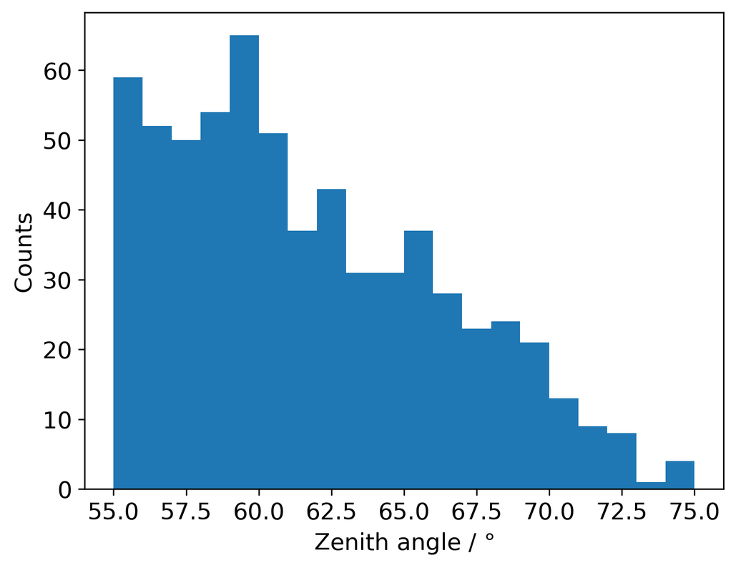
AERA dataset
  Inclined air showers
  Measured with surface detector as well as AERA
  4847 events without thunderstorm conditions
  After quality cuts:
    641 events
    Biggest cut (85%): containment of footprint
    See backup for other cuts
23
Dataset created by Marvin Gottowik & Felix Rhien

Slide 24
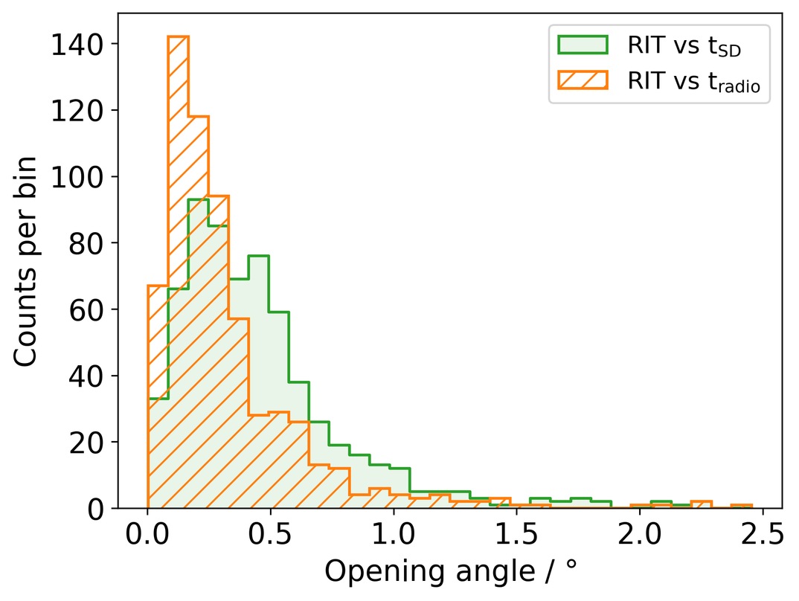
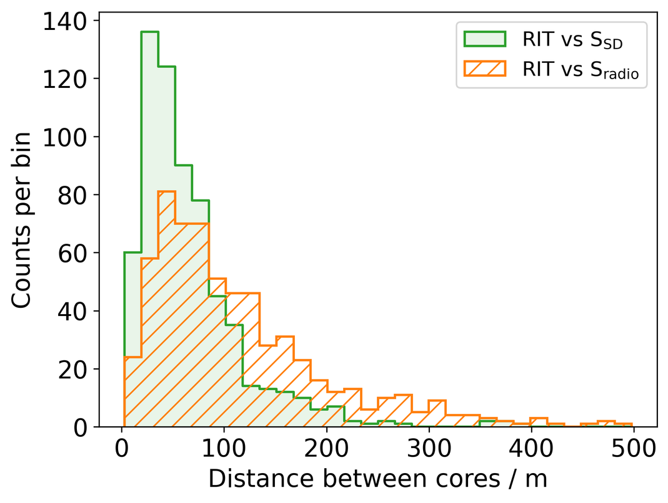
Results – Data
  Correct for interferometric bias (see backup)
  Comparable with surface detector and conventional radio reconstructions
Preliminary
Preliminary
24

Slide 25
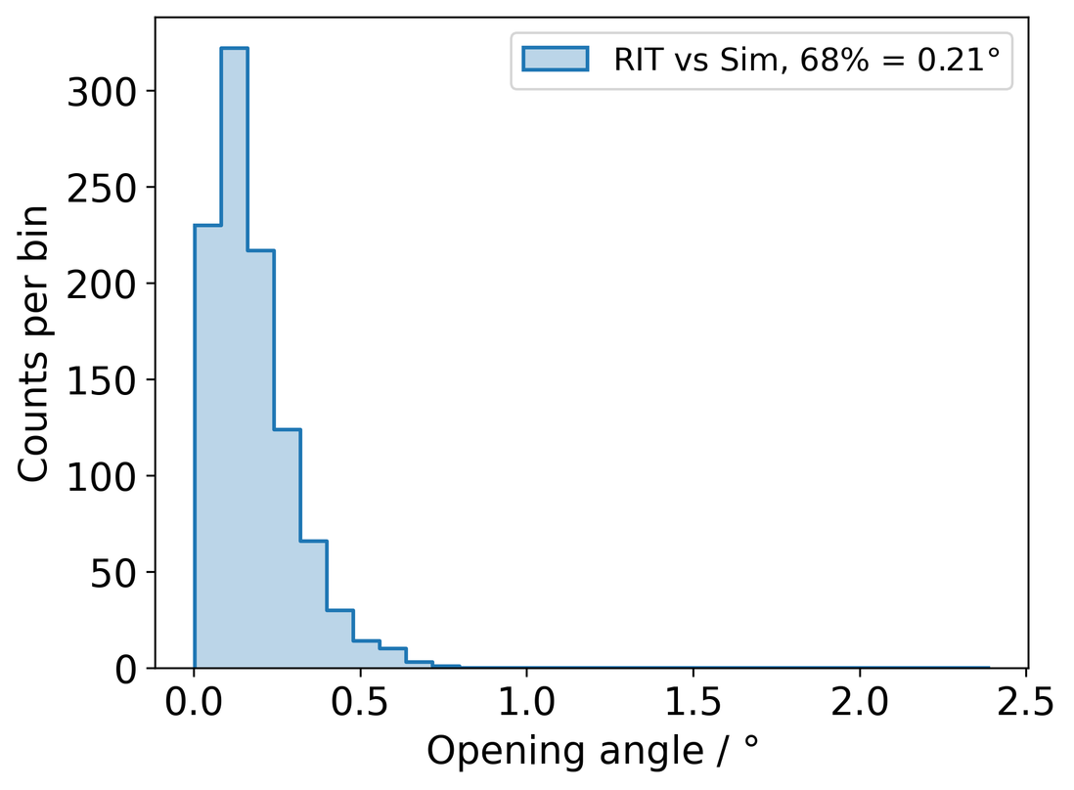
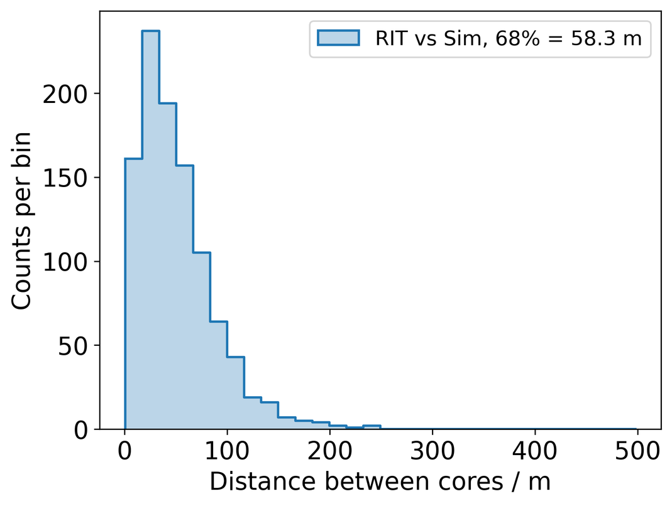
Simulation set
  Core:
  Particles:
  Azimuth:
  Zenith:
  Energy:
Same antenna selection as for data set
Same quality cuts as for data set
Randomly distributed
H, He, N, Fe
Uniform
55 - 85 (sin2 )
1017.2 - 1019 eV (E-1)
Results – Simulations
  Correct for interferometric bias (see backup)
  Reconstruction on simulations close to Monte-Carlo truth
Preliminary
Preliminary
25

Slide 26
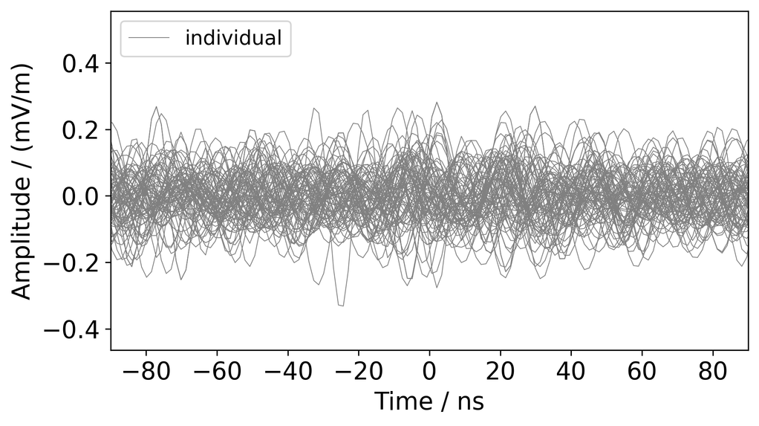
Low energy application
  Use interferometry to ‘dig up’ the signal out of the noise
  New dataset: Very inclined events with a lot of antennas
  Selection for RIT:
    SNR > 7 (max/std) of the summed waveform
26

Slide 27
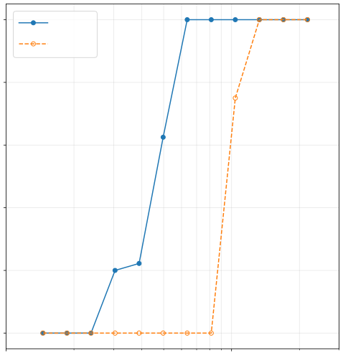
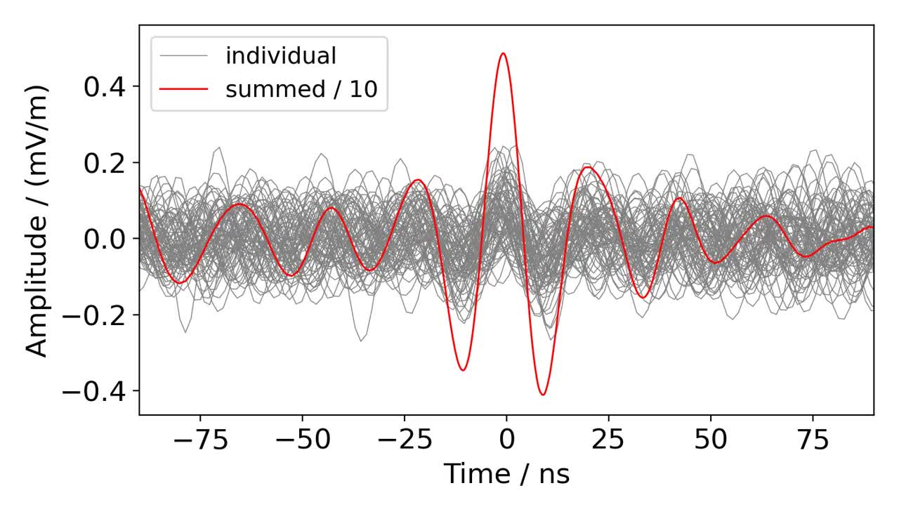
Simulations
Low energy application
  Use interferometry to ‘dig up’ the signal out of the noise
  New dataset: Very inclined events with a lot of antennas
  Selection for RIT:
    SNR > 7 (max/std) of the summed waveform
100
RIT t
radio
80
Preliminary
60
Events:
  RD reco:
  RIT reco:
194
17
57
Reconstruction efficiency / %
40
20
Data
0
10
17
1018
Primary energy / eV
27

Slide 28
Interferometry with AugerPrime
  Next step: expand to the full 3000 km2 array ( 1660 detectors)
  Same 1 ns accuracy needed:
    Clock synchronisation
    Positional accuracy (< 30 cm)
AERA
DOI:10.3390/universe10080327
28
Notes:
Los morados beacon

Slide 29
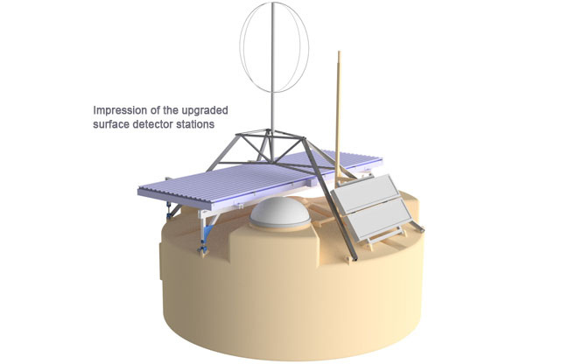

Interferometry with AugerPrime
  Next step: expand to the full 3000 km2 array ( 1660 detectors)
  Same 1 ns accuracy needed:
    Clock synchronisation
    Positional accuracy (< 30 cm)
https://www.auger.org/observatory/augerprime
DOI:10.3390/universe10080327
29
Notes:
Los morados beacon

Slide 30
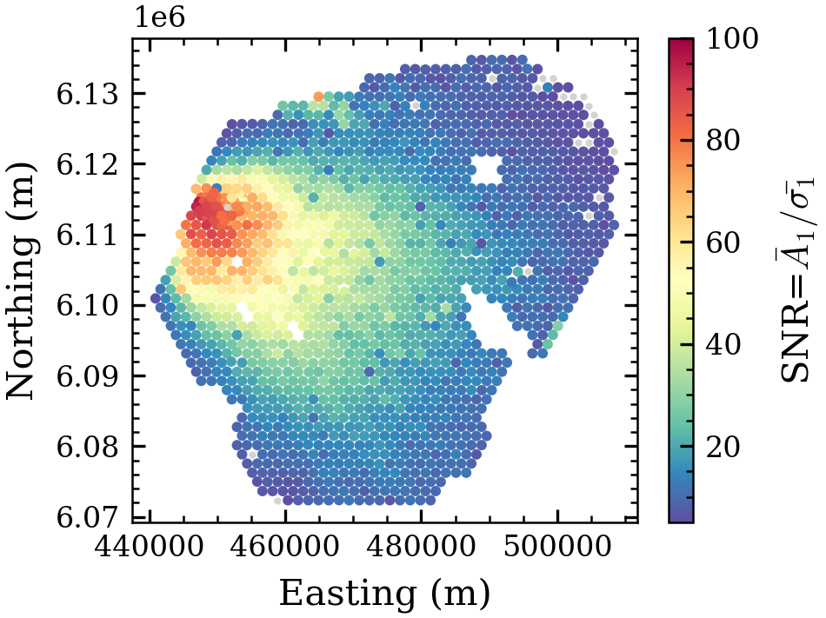

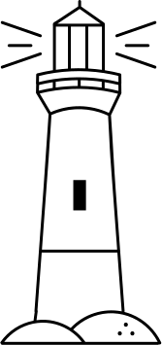
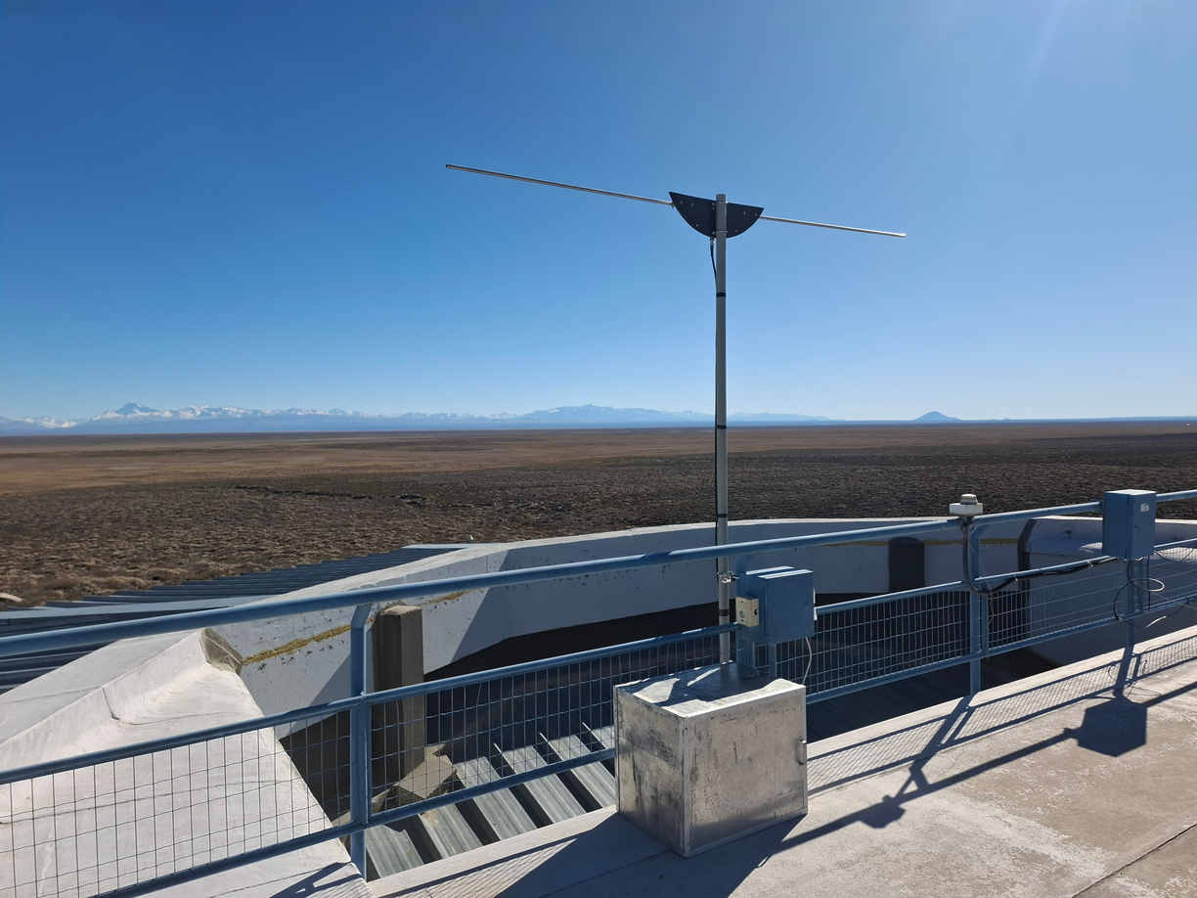
Interferometry with AugerPrime
Beacon
  Clock synchronisation
  Beacons
    50 MHz
  Synchronise based on 1 frequency
Credit: Andres Travaini
30
Notes:
Los morados beacon

Slide 31
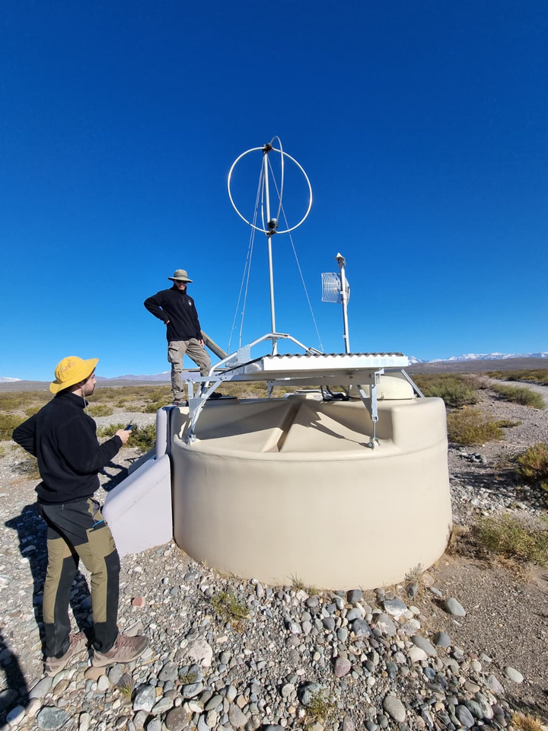
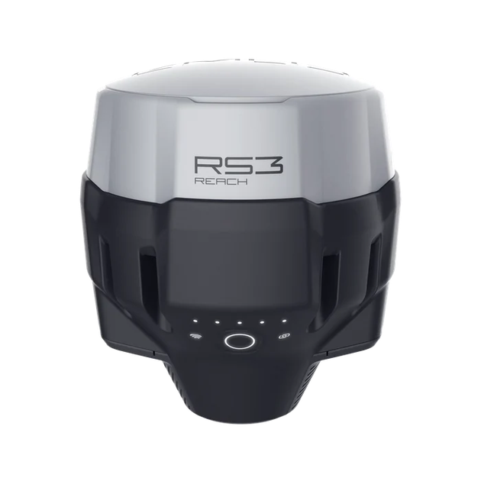
Interferometry with AugerPrime
  Positional accuracy (< 30 cm)
  Differential GPS survey
    Few centimeter accuracy
    6-12 months
31
Notes:
Los morados beacon

Slide 32
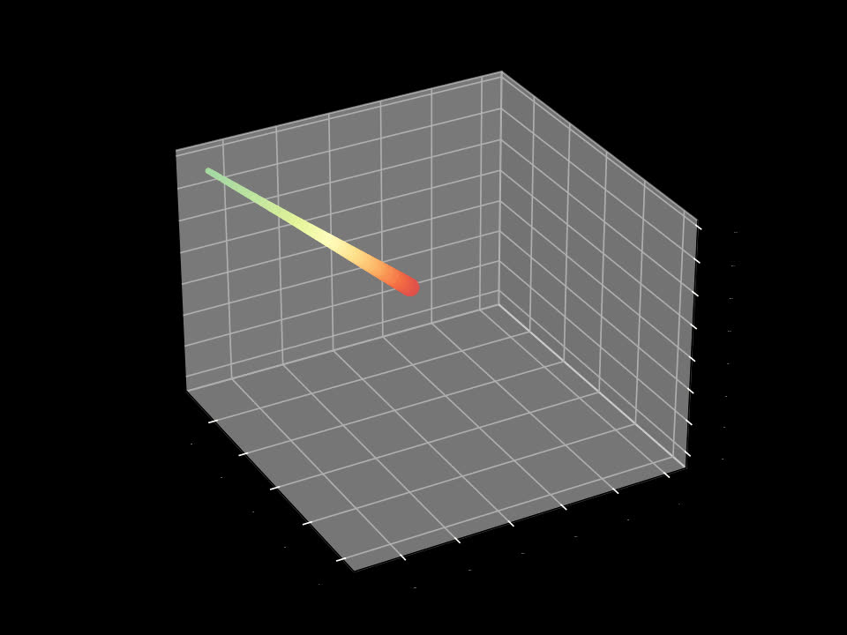
Summary
  Interferometric reconstruction was performed on a large AERA dataset
    Results comparable with existing reconstructions
    Successful reconstruction of low energy events
    Collaboration wide paper in preparation
  Next step: Expand to AugerPrime
    Preparations being made → Beacons + DGPS survey
Email: pim.vandillen@ru.nl
P. van Dillen is funded by the European Union. Views and opinions expressed are how- ever those of the author(s) only and do not necessarily re- flect those of the European Union or the European Research Council Executive Agency. Neither the European Union nor the granting authority can be held responsible for them. This work is supported by ERC grant (CR-INTERFEROMETRY 101170979).
32

Slide 33

BACKUP
33

Slide 34
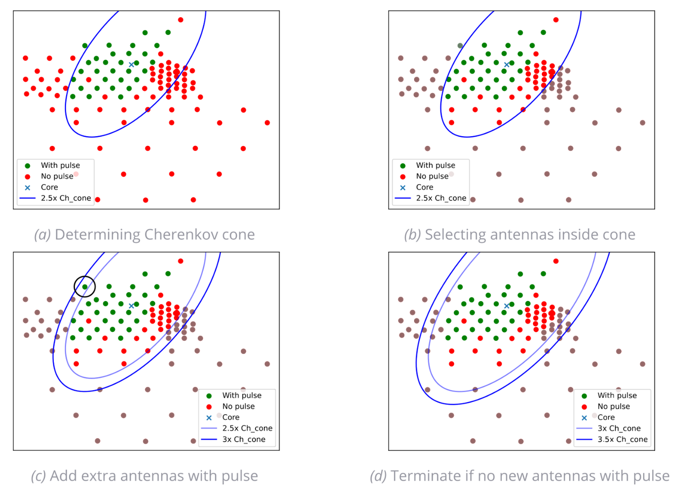
Antenna selection
  Axis and core by SD reconstruction
  All antennas within 2.5x Cherenkov cone (at reference depth of 625 g/cm2) are selected
  Antennas ‘with pulse’; SNR >= 10 (quadratic), close to the 2.5x Cherenkov cone are included as well
34

Slide 35
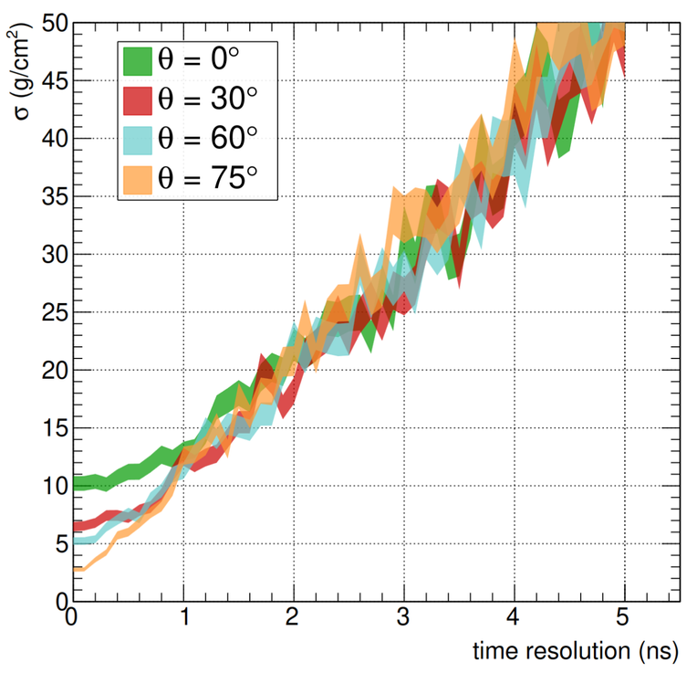
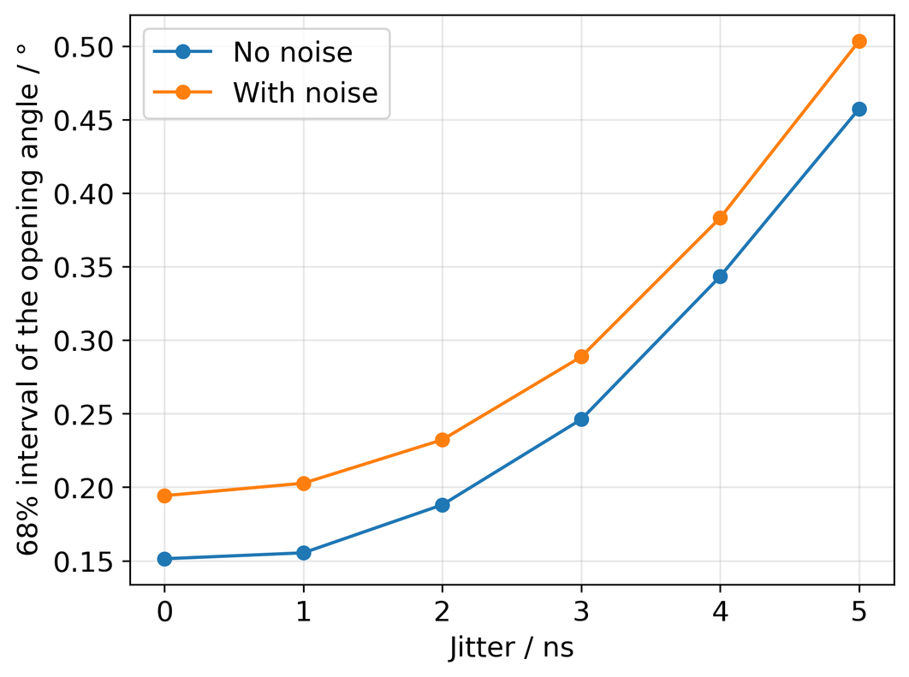
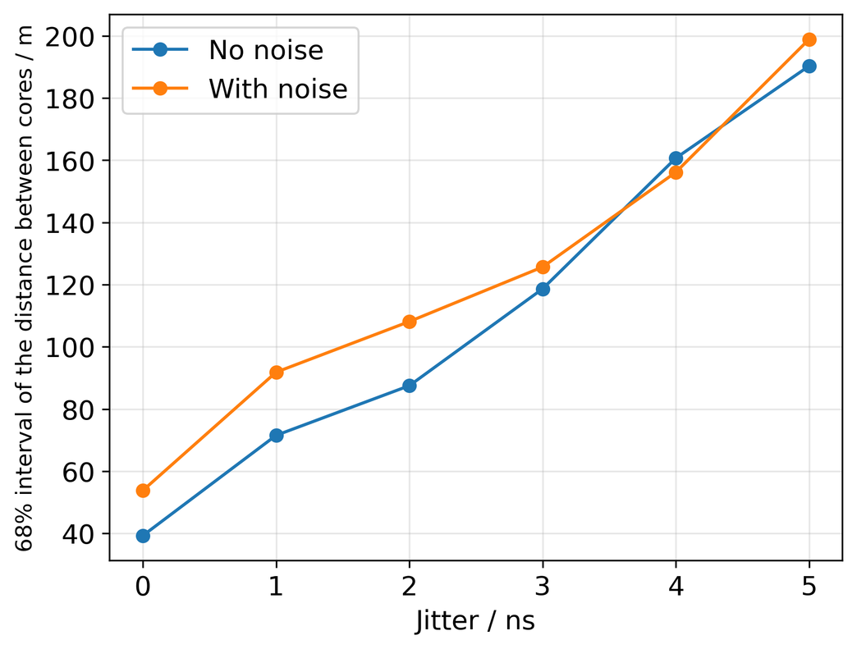
Timing jitter
  AERA simulation set both with and without noise
  Gaussian jitter
https://doi.org/10.48550/arXiv.2006.10348
35

Slide 36
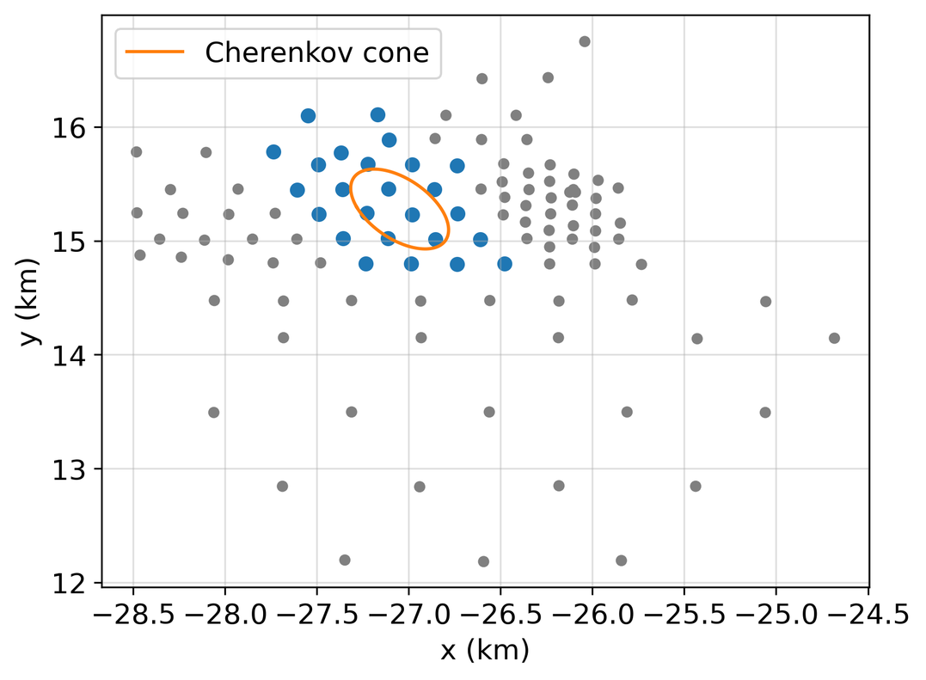
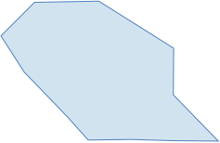
AERA dataset - Cuts
  Select usefull events
    No thunderstorm flag (6%)
    Full containment of radio footprint (85%)
    High contrast in slice (13%)
      At least for 6 slices
    Good fit through axis points (2%)
The percentage (...%) shows the fraction of events that are discarded due to the cut
36

Slide 37
AERA dataset - Cuts
  Select usefull events
    No thunderstorm flag (6%)
    Full containment of radio footprint (85%)
    High contrast in slice (13%)
      At least for 6 slices
    Good fit through axis points (2%)
The percentage (...%) shows the fraction of events that are discarded due to the cut
37

Slide 38
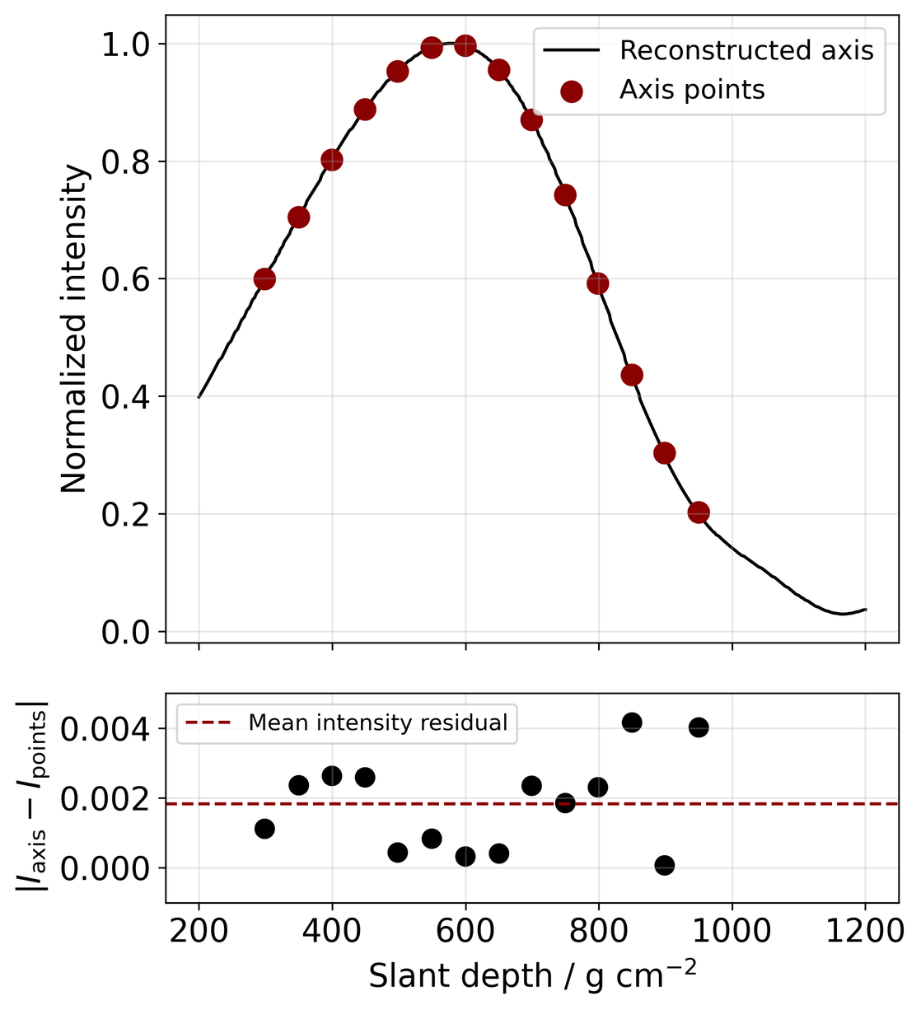
AERA dataset - Cuts
  Select usefull events
    No thunderstorm flag (6%)
    Full containment of radio footprint (85%)
    High contrast in slice (13%)
      At least for 6 slices
    Good fit through axis points (2%)
The percentage (...%) shows the fraction of events that are discarded due to the cut
38

Slide 39
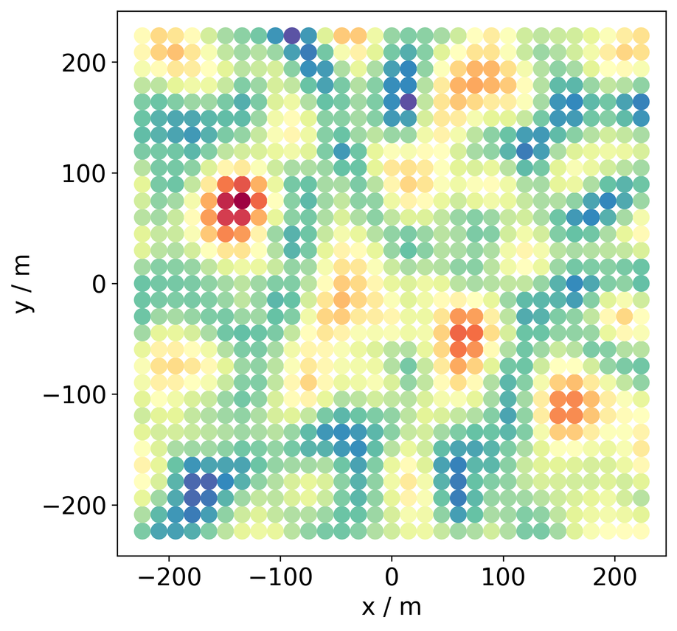
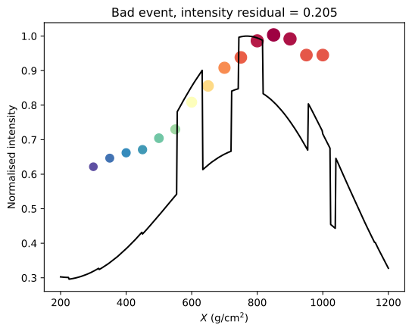
AERA dataset - Cuts, bad examples
  High contrast in slice
  Good fit through axis points
39

Slide 40
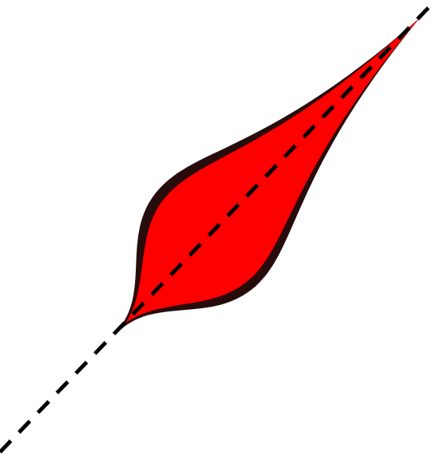
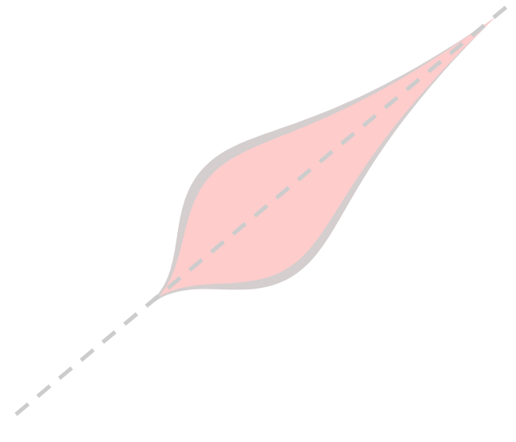
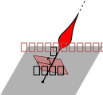
Biases
  Air shower projected differently due to interferometric method
  Depending on the mean antenna position/barycenter/centre-of-mass of the antenna
  Shower ‘pushed’ away from actual shower axis
  Both bias in core as angle reconstruction
Coordinate system for mean antenna position
40

Slide 41
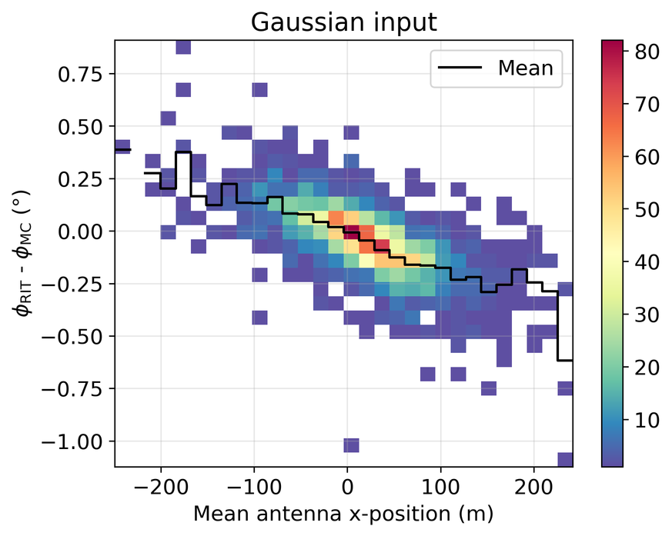
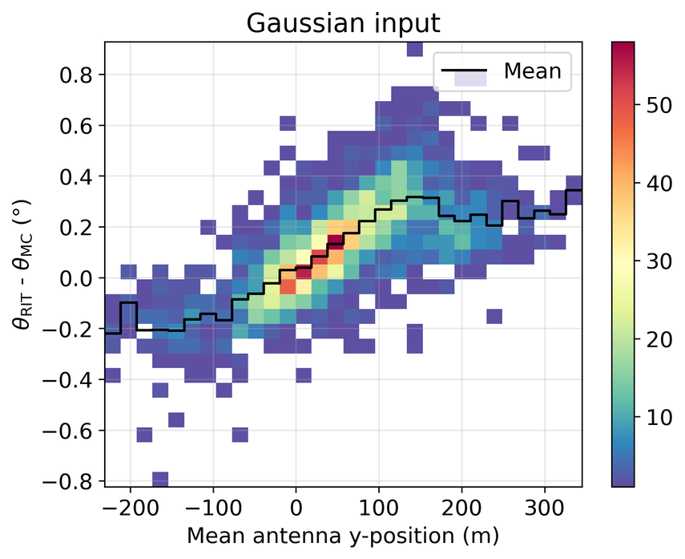
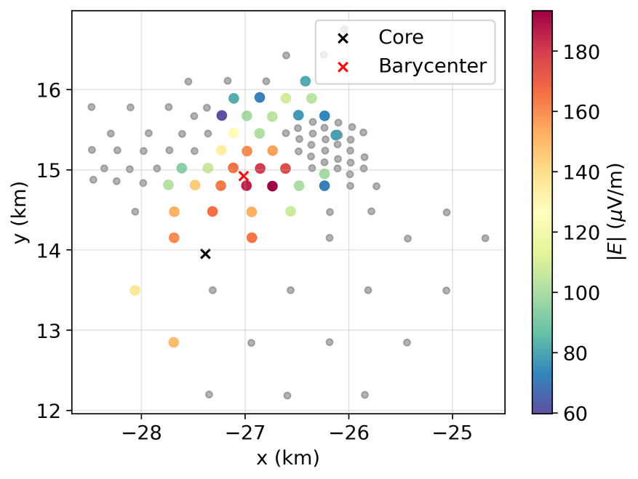
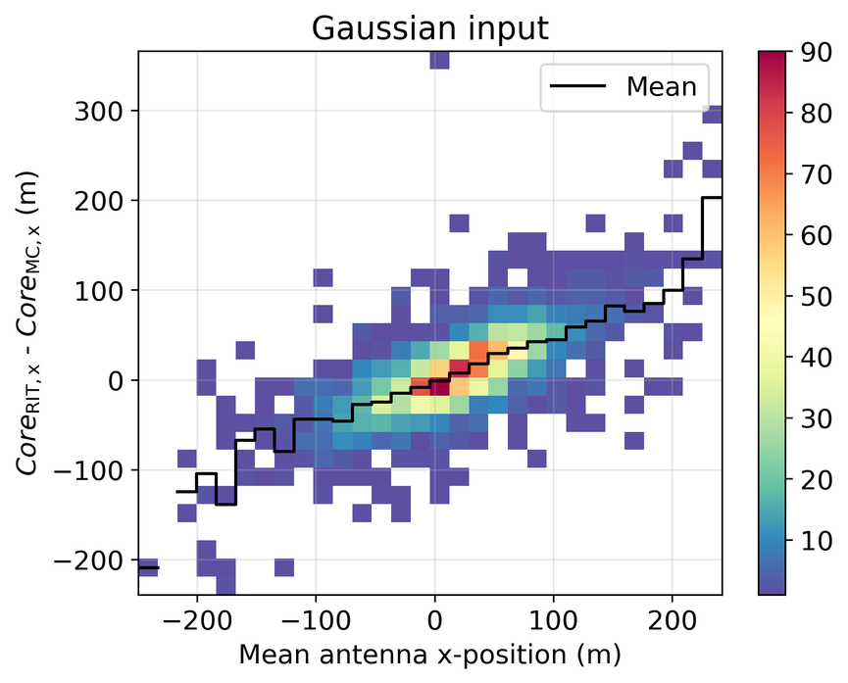

Biases – Simulations
  Compared to MC
41

Slide 42




Biases – Data
  Compared to SD
42

Slide 43




Xmax reconstruction
  Get XRIT from reconstruction
    Not the same as Xmax!
  Conversion dependent on:
    Zenith angle
    Antenna layout
  Difficult for AERA
    Irregular grid
https://doi.org/10.48550/arXiv.2006.10348
z (km)
y (km)
x (km)
43

Slide 44







XRIT
Reconstructed profile highly dependent on antenna layout/antennas included in reconstruction
44
Notes:
auger_143220576600__rd_100922.85757__sd_30140846
26

Slide 45

Low energy application
Event selection
  Zenith angle: 75˚ < θ < 82˚
  Energy: 1 EeV
  SD quality: < 0.5
  Stations: > 60 (in 2x Cherenkov cone @750 g/cm²)
45
Notes:
163.3, 0.4
44.5, 1.4
25

