Slide 1

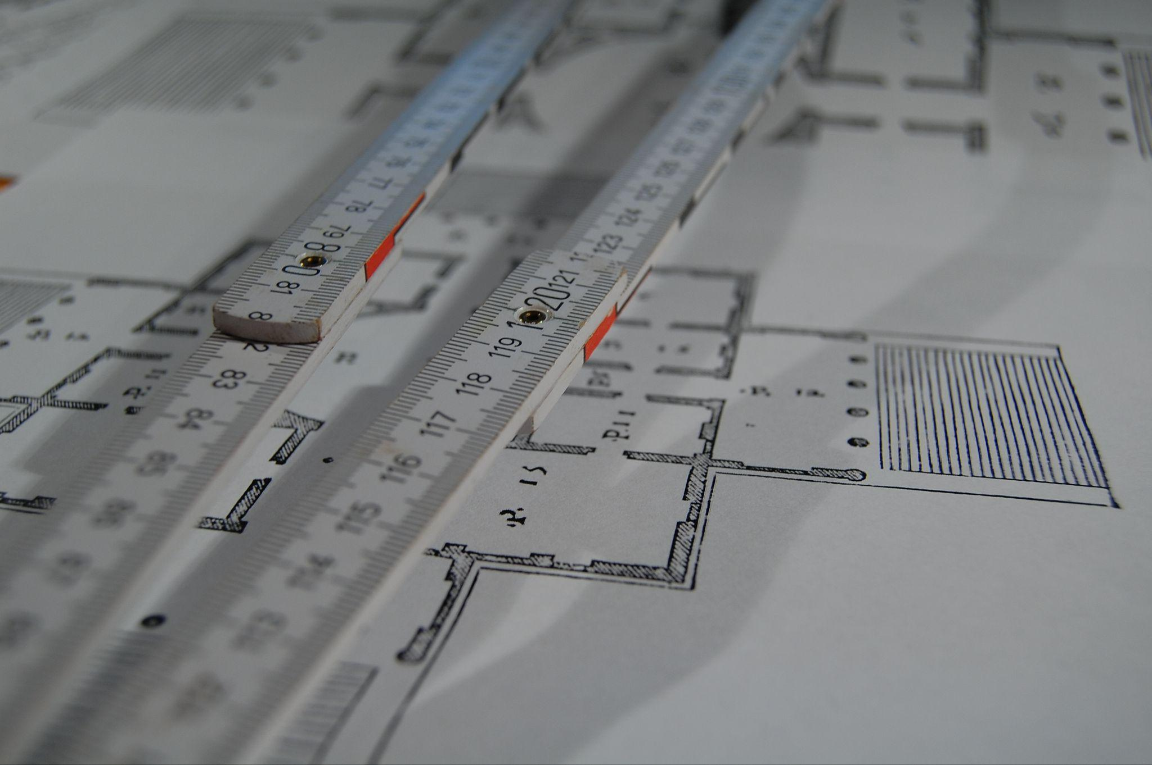

Advanced FPGA Course for KSETA
KSETA Topical Courses Mars 2026- Day 1
IPE Team : H. Krause, O. Manzhura, L. Scheller, A. Qamesh

Slide 2
Agenda
Introduction
TCL Scripting in Vivado
Introduction to AXI

Slide 3

Advanced FPGA Development
About Us
Team
Ahmed Qamesh — Postdoctoral Researcher (Physics)
Hendrik Krause — PhD (Electrical Engineering)
Olena Manzhura — PhD (Electrical Engineering)
Lukas Scheller — PhD (Electrical Engineering)
Affiliation
Members of the Institut für Prozessdatenverarbeitung und Elektronik (IPE) (Institute for Data Processing and Electronics)
What We Do
At IPE, we develop next-generation data acquisition systems that empower scientific experiments with advanced instrumentation and innovative methodologies

Slide 4
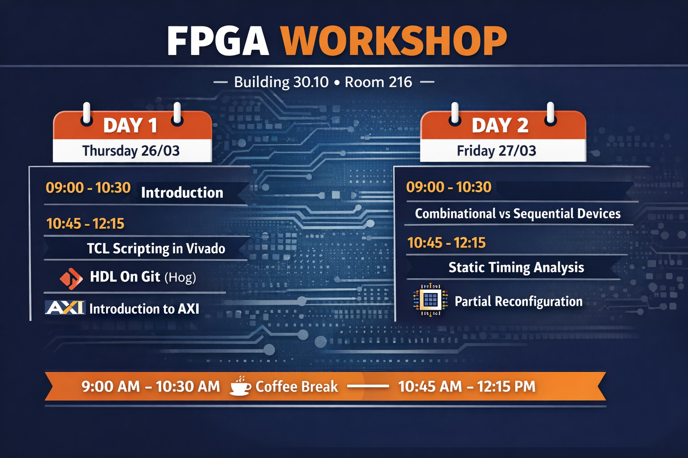


Advanced FPGA Development
Course Agenda
9:00 AM - 10:30 AM
Introduction
TCL Scripting in Vivado
FPGA Build Frameworks
10:45 AM - 12:15 PM
Introduction to AXI
9:00 AM - 10:30 AM
Combinational vs Sequential
Static Timing Analysis
10:45 AM - 12:15 PM
Timing and Critical Path
Partial Reconfiguration
9:00 AM - 10:30 AM - Coffee Break - 10:45 AM - 12:15 PM

Slide 5







Advanced FPGA Development
Course Material
What is Expected From you?
@kseta-fpga/ipe-fpga-advanced.git
Detailed description of each Exercise
Course Slides
Keep Your Phone On SILENT
Don't Panic - Focus on the key TAKEAWAY
Take Notes - but not TOO MANY
You have ALL the Time at Home to revisit this
“Try to enjoy the process (optional but recommended)”

Slide 6


Introduction

Slide 7

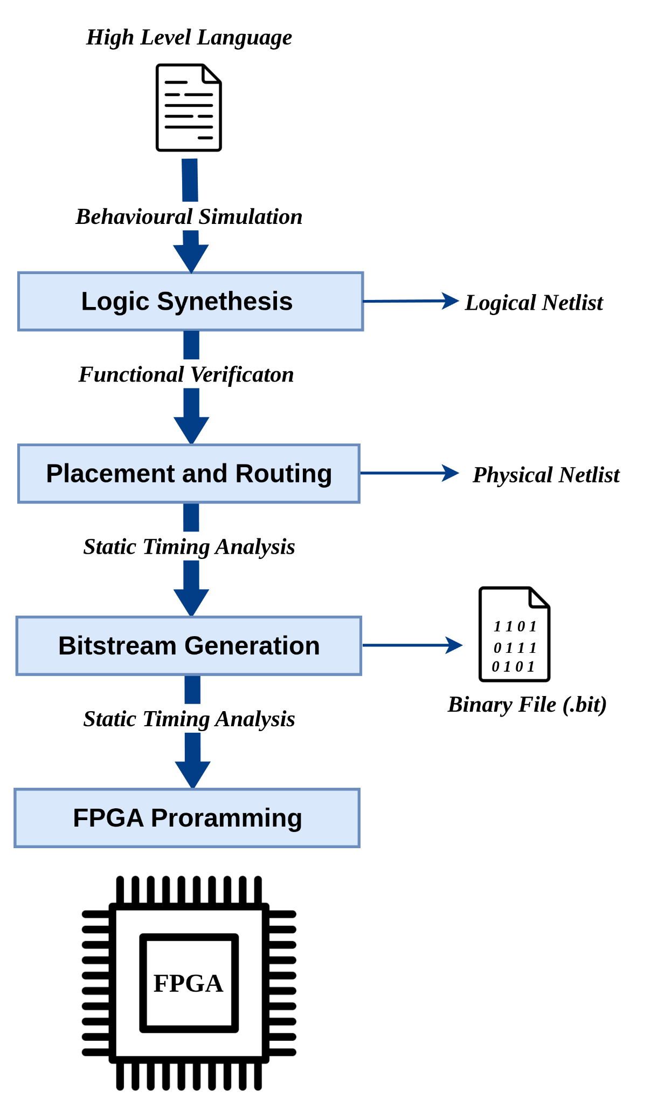


Introduction
What You Already Know from Previous Course
What You Already Know from Previous Course (Brief Introduction to FPGAs)
Hardware Architecture & Concepts
FPGA Fundamentals: reconfigurable logic (CLBs, LUTs, Flip-Flops) and specialized hardware (DSPs, BRAM).
System-on-Chip (SoC): Working with the Zynq Architecture, integrating PS-PL
VHDL & Design Flow
The Workflow: Simulation - Synthesis - Implementation (Place & Route) - Bitstream Generation.
VHDL Essentials: Entity/Architecture, Signals vs. Variables, and the Sensitivity List.
Modular Design: Using Generics for parameterization and instantiating modules.
Constraints: Mapping logical ports to physical pins via XDC files and defining basic clock timing.
Verification & Practical Application
Simulation: Writing Testbenches to verify logic before hardware deployment.
Red Pitaya Hands-on:
Deploying bitstreams to the Linux-based Red Pitaya environment.
Interfacing: Driving LEDs, generating waveforms via DAC, and capturing data via ADC.
DSP Basics: Implementation of a Numerically Controlled Oscillator (NCO) and digital mixing.

Slide 8
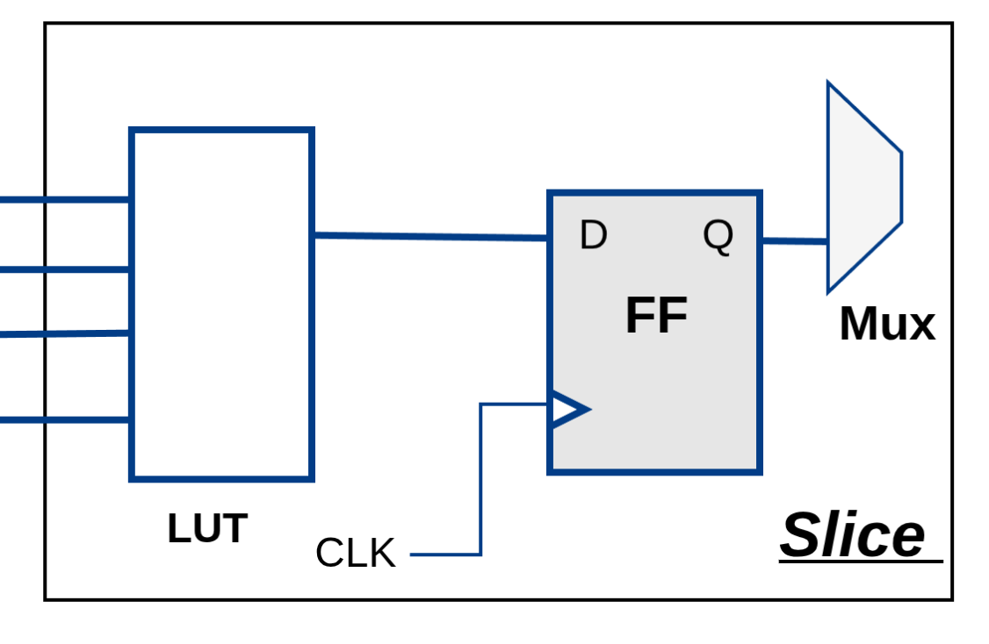
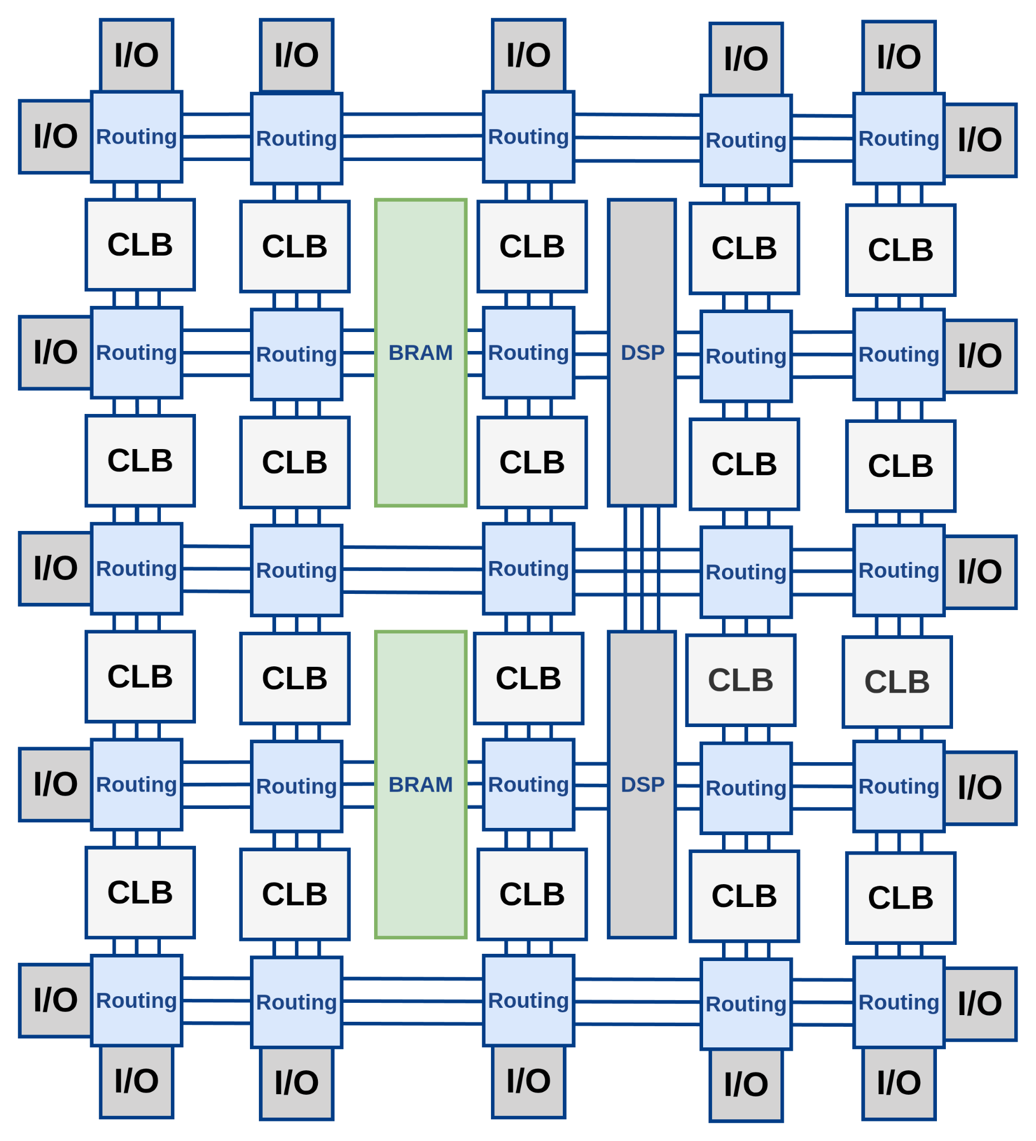
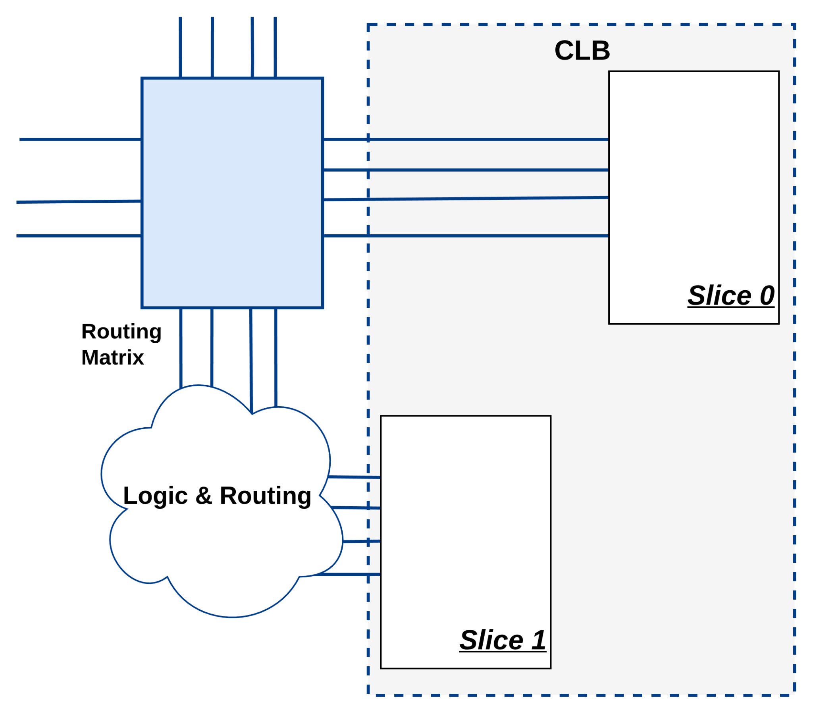
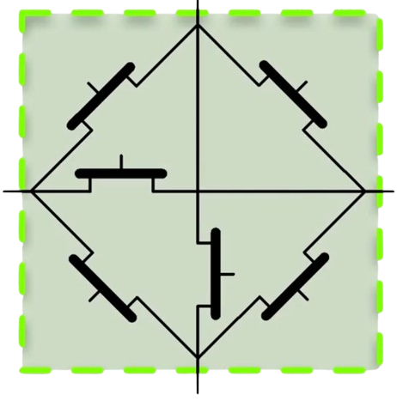
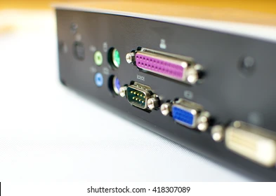
Introduction
FPGA Basic Blocks
Configurable Logic Blocks (CLBs)
CLBs are the main components of an FPGA.
Can implement combinational or sequential logic.
CLBs → Comprised of Slices → Comprised of Look-Up Tables (LUTs)
Number of slices varies by FPGA model:
Virtex-E, V5, 7 Series → 2 slices per CLB
Virtex II Pro, Virtex 4 → 4 slices per CLB
LUTs implement arbitrary logic functions.
4-input, 1-output LUT → 16 memory cells
in 7 Series:
6-input, 2-output LUTs.
Switching Matrix

Slide 9
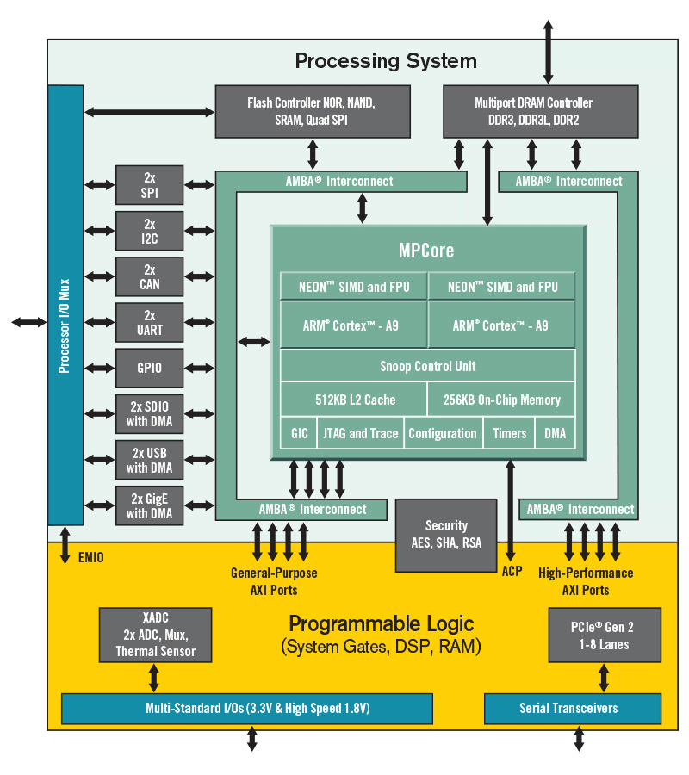
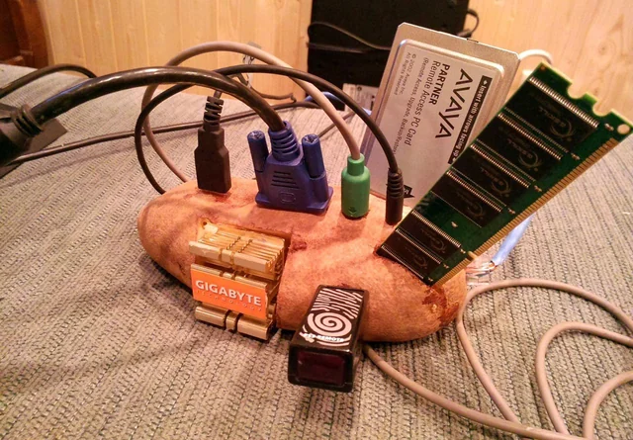

System on Chip (SoC)
Combining FPGAs with Processors
What is SOC?
A device that integrates a processing system and programmable logic on a single chip
CPU subsystem (runs software, OS, drivers)
FPGA fabric (custom hardware acceleration)
Both parts communicate through high-speed on-chip interconnect
Why We Pair CPUs with FPGAs?
Control and complex decision logic run in software on the CPU
Time-critical or parallel tasks are implemented in hardware in the FPGA
Requires Hardware Software Co-Design

Slide 10

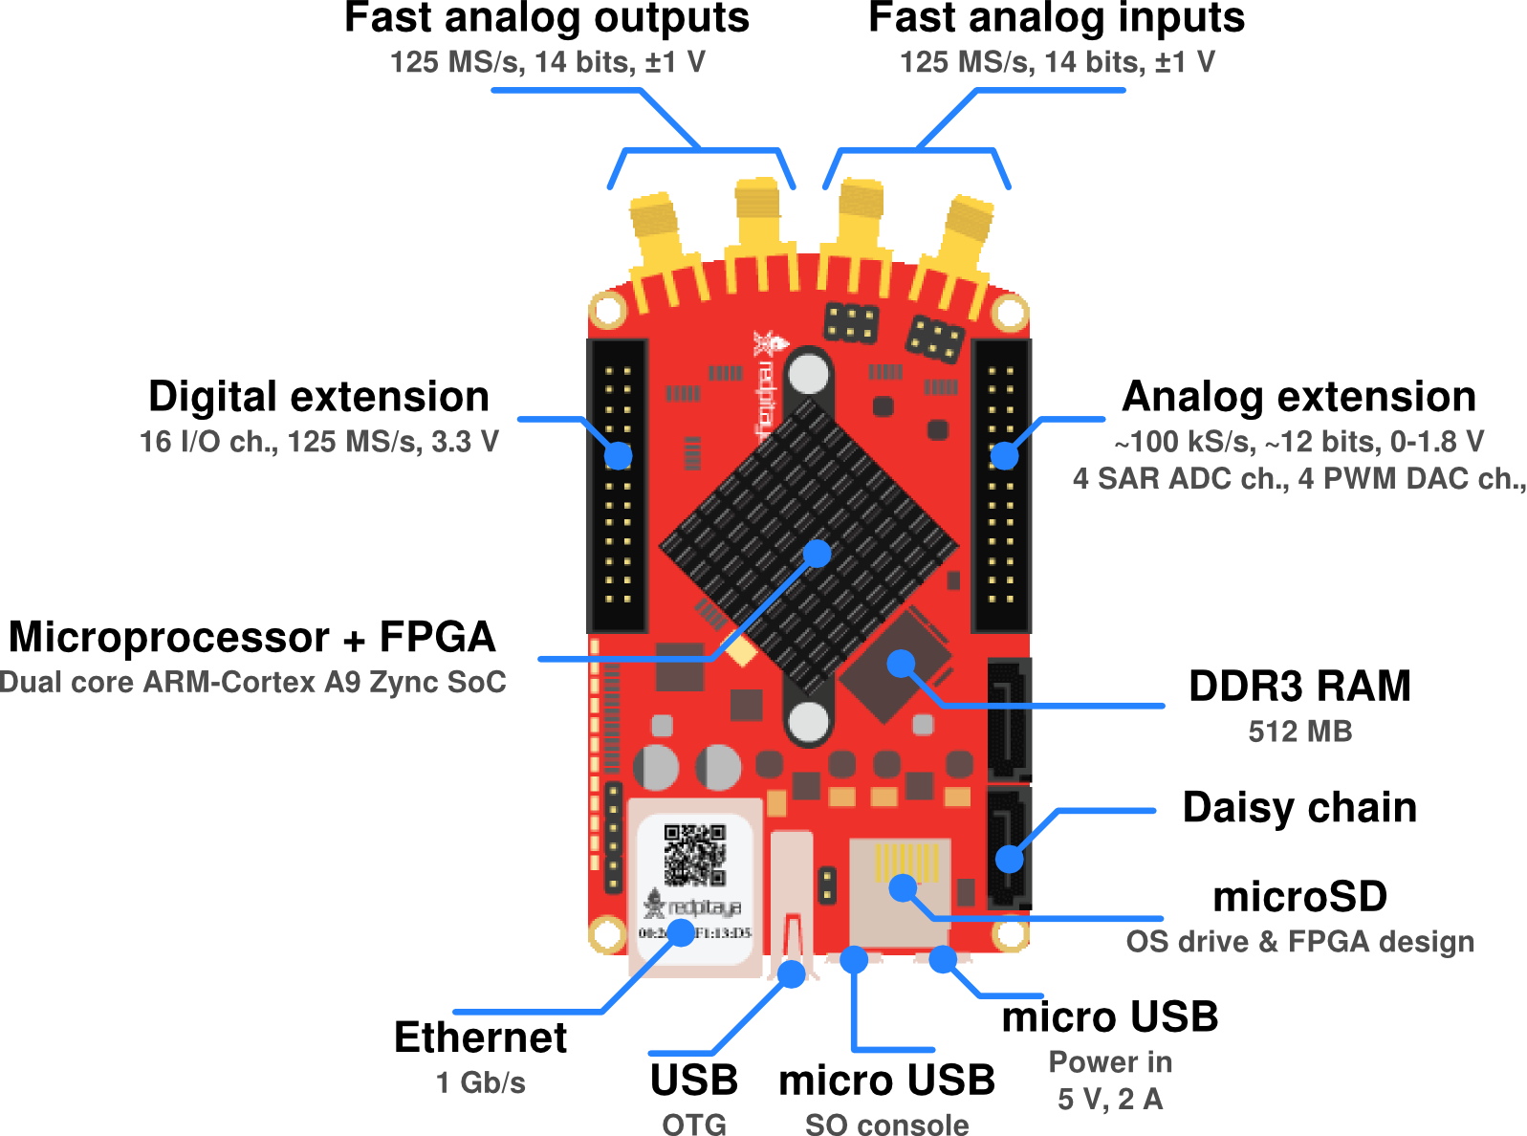
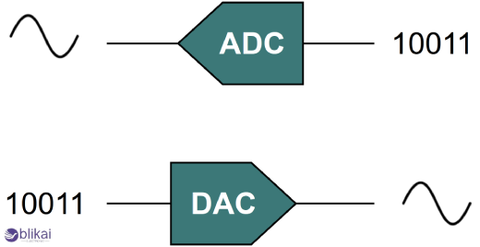


The Red Pitaya STEMlab 125-10 is a SoC
Zynq 7010 SoC
2x 125 MSps 10 bit DAC
2x 125 MSps 10 bit ADC
Open Source Ecosystem
Successor: STEMlab 125-14
Relatively cheap ~500€

Slide 11
Initial setup
Clone the exercise repository
git clone https://gitlab.kit.edu/kit/ipe-sdr/teaching/kseta-fpga/ipe-fpga-advanced.git
To load Vivado
In the terminal: module load xilinx/vivado/2021.2
vivado
To Access the Pitaya
ssh root@rp-XXXXXX
passwort: root

Slide 12




&
TCL Scripting and Reproducible FPGA Workflows
Controlling Vivado using TCL
Automating FPGA build flows
Structuring projects for version control
Exercise: 1.1
Exercise: 1.2
Exercise: 1.3

Slide 13
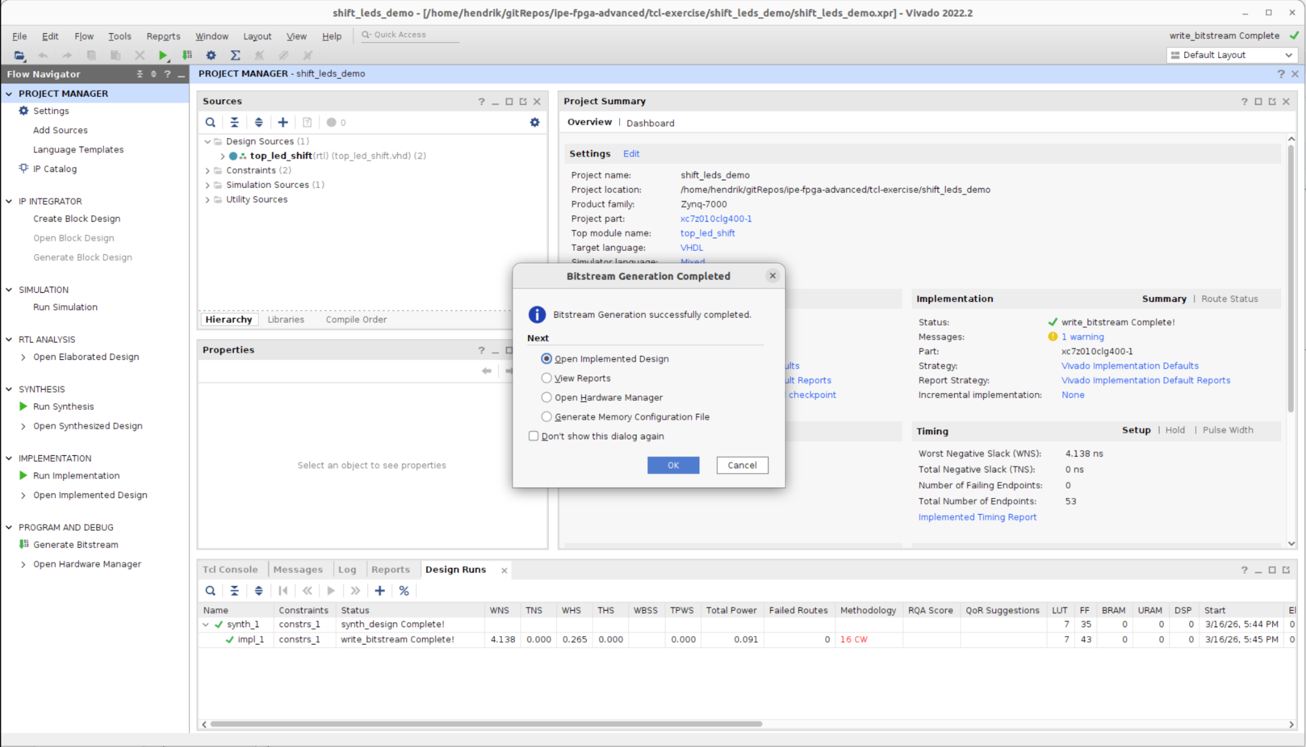
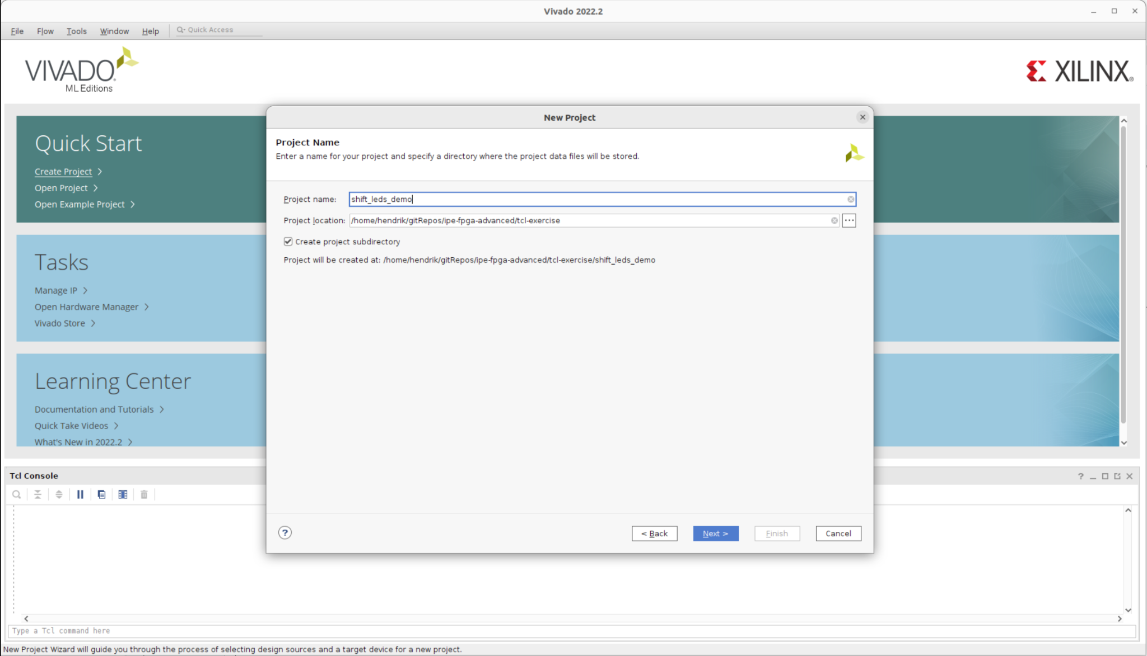
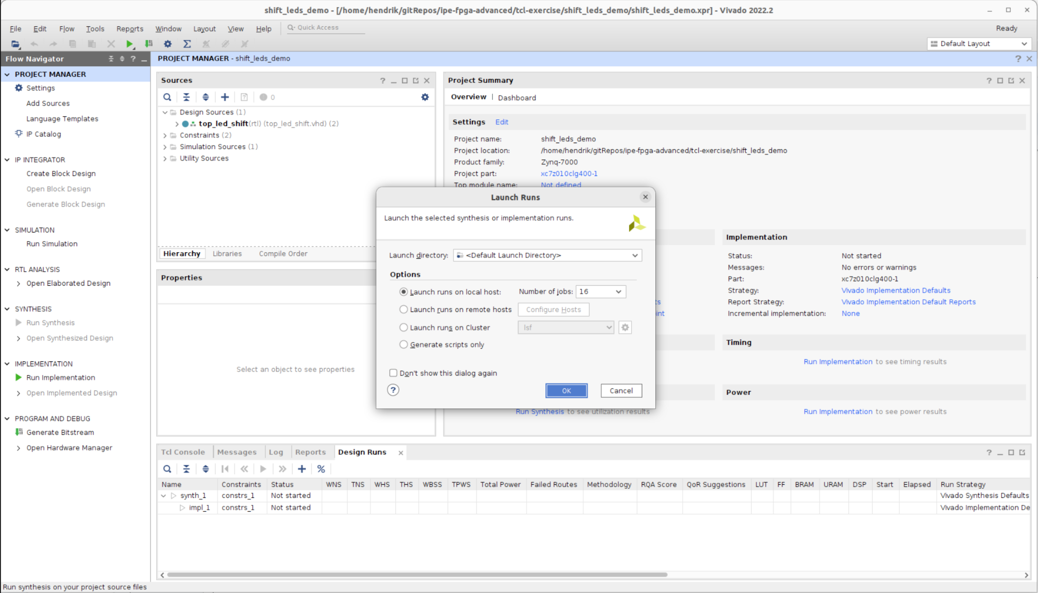
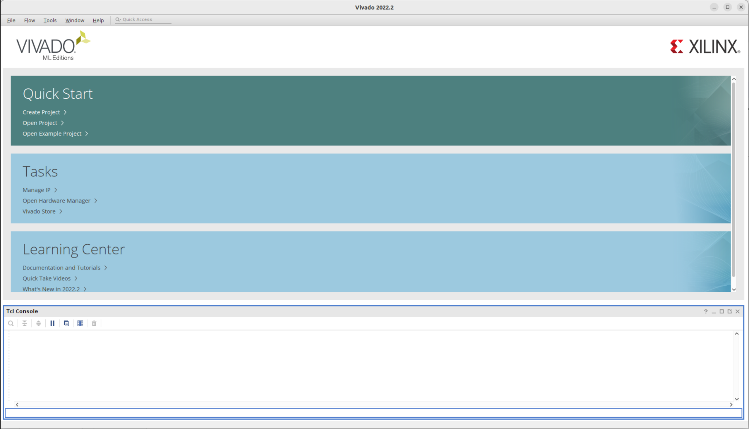
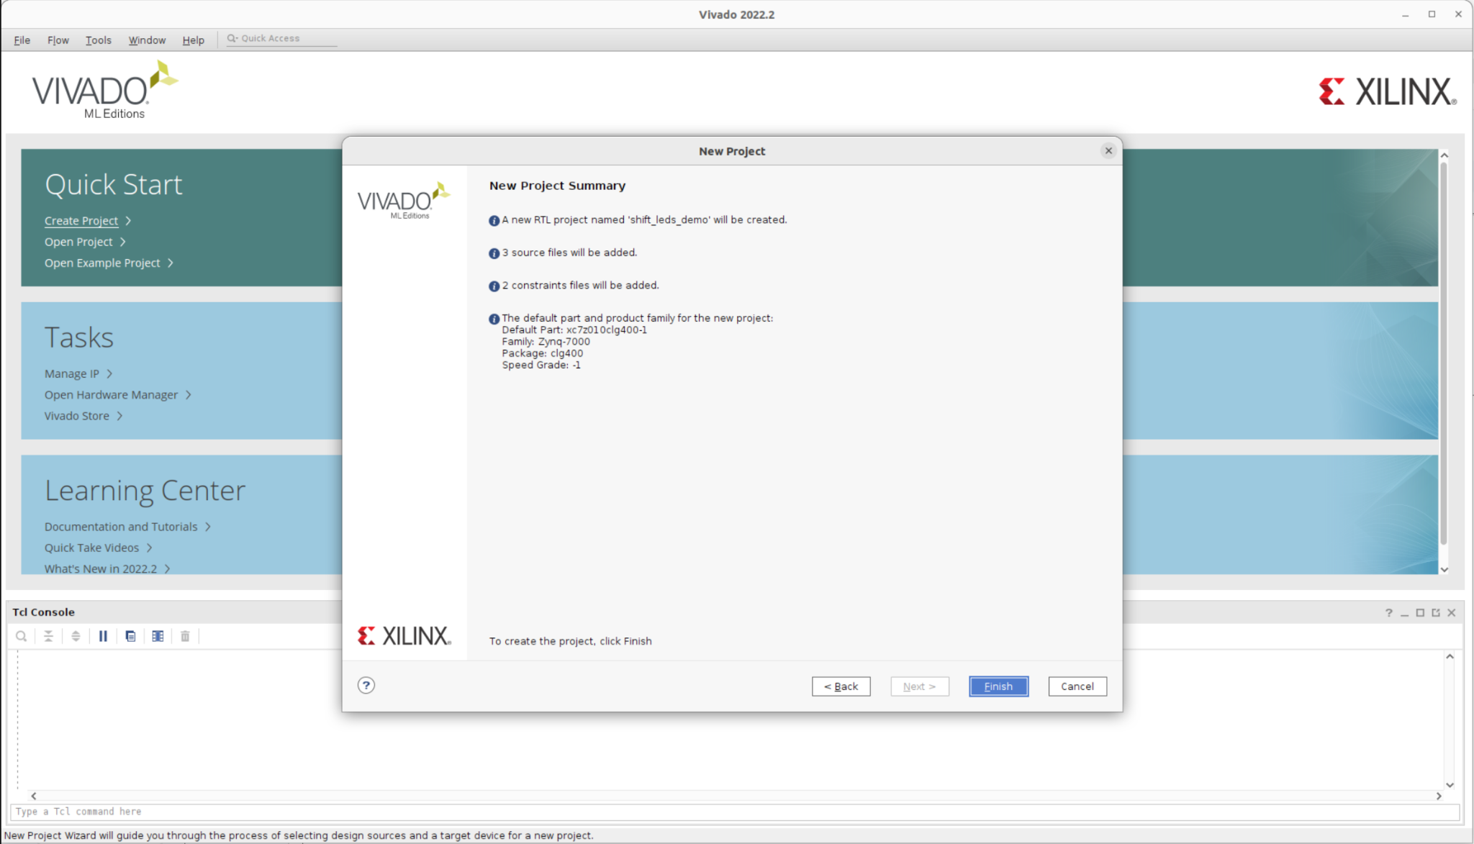
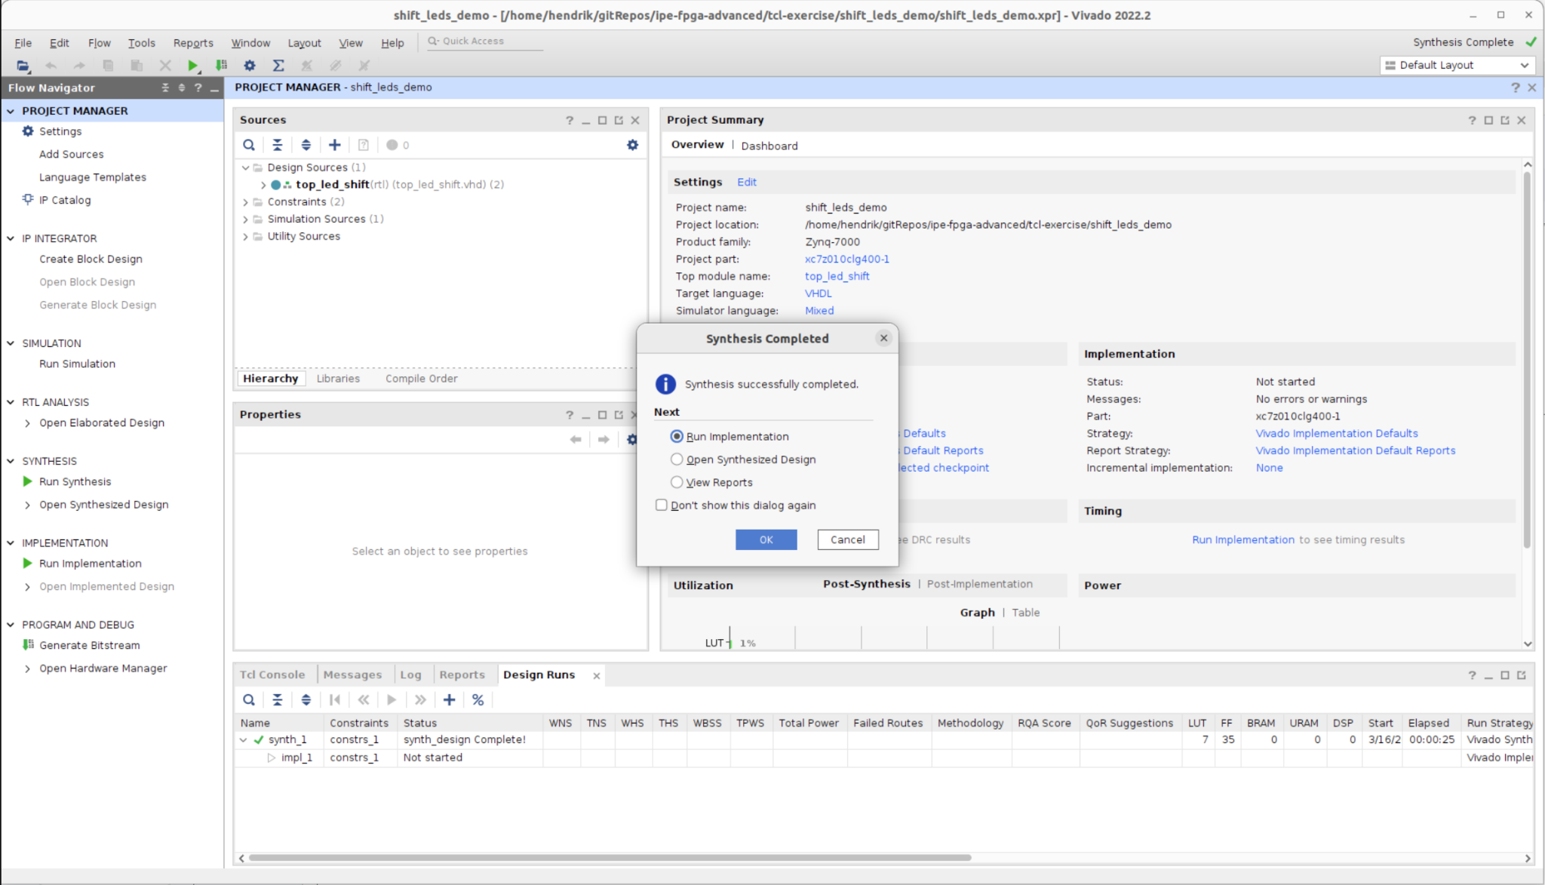
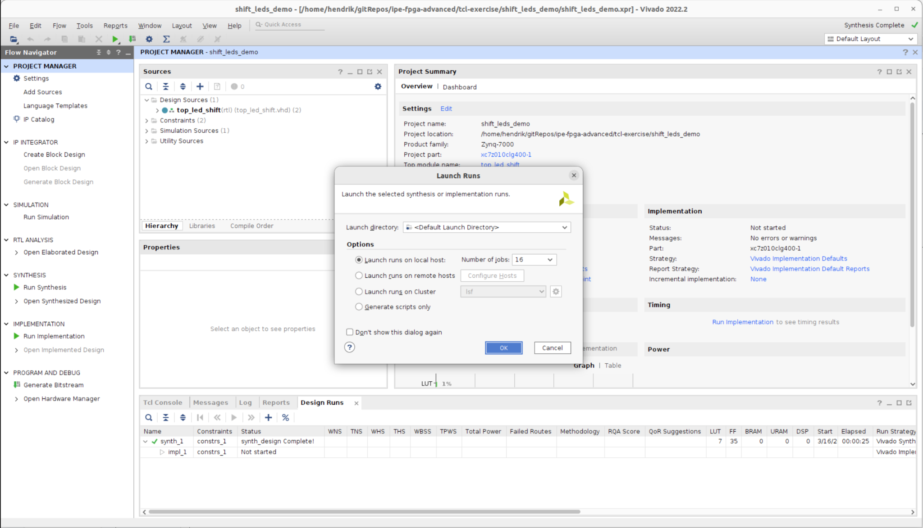
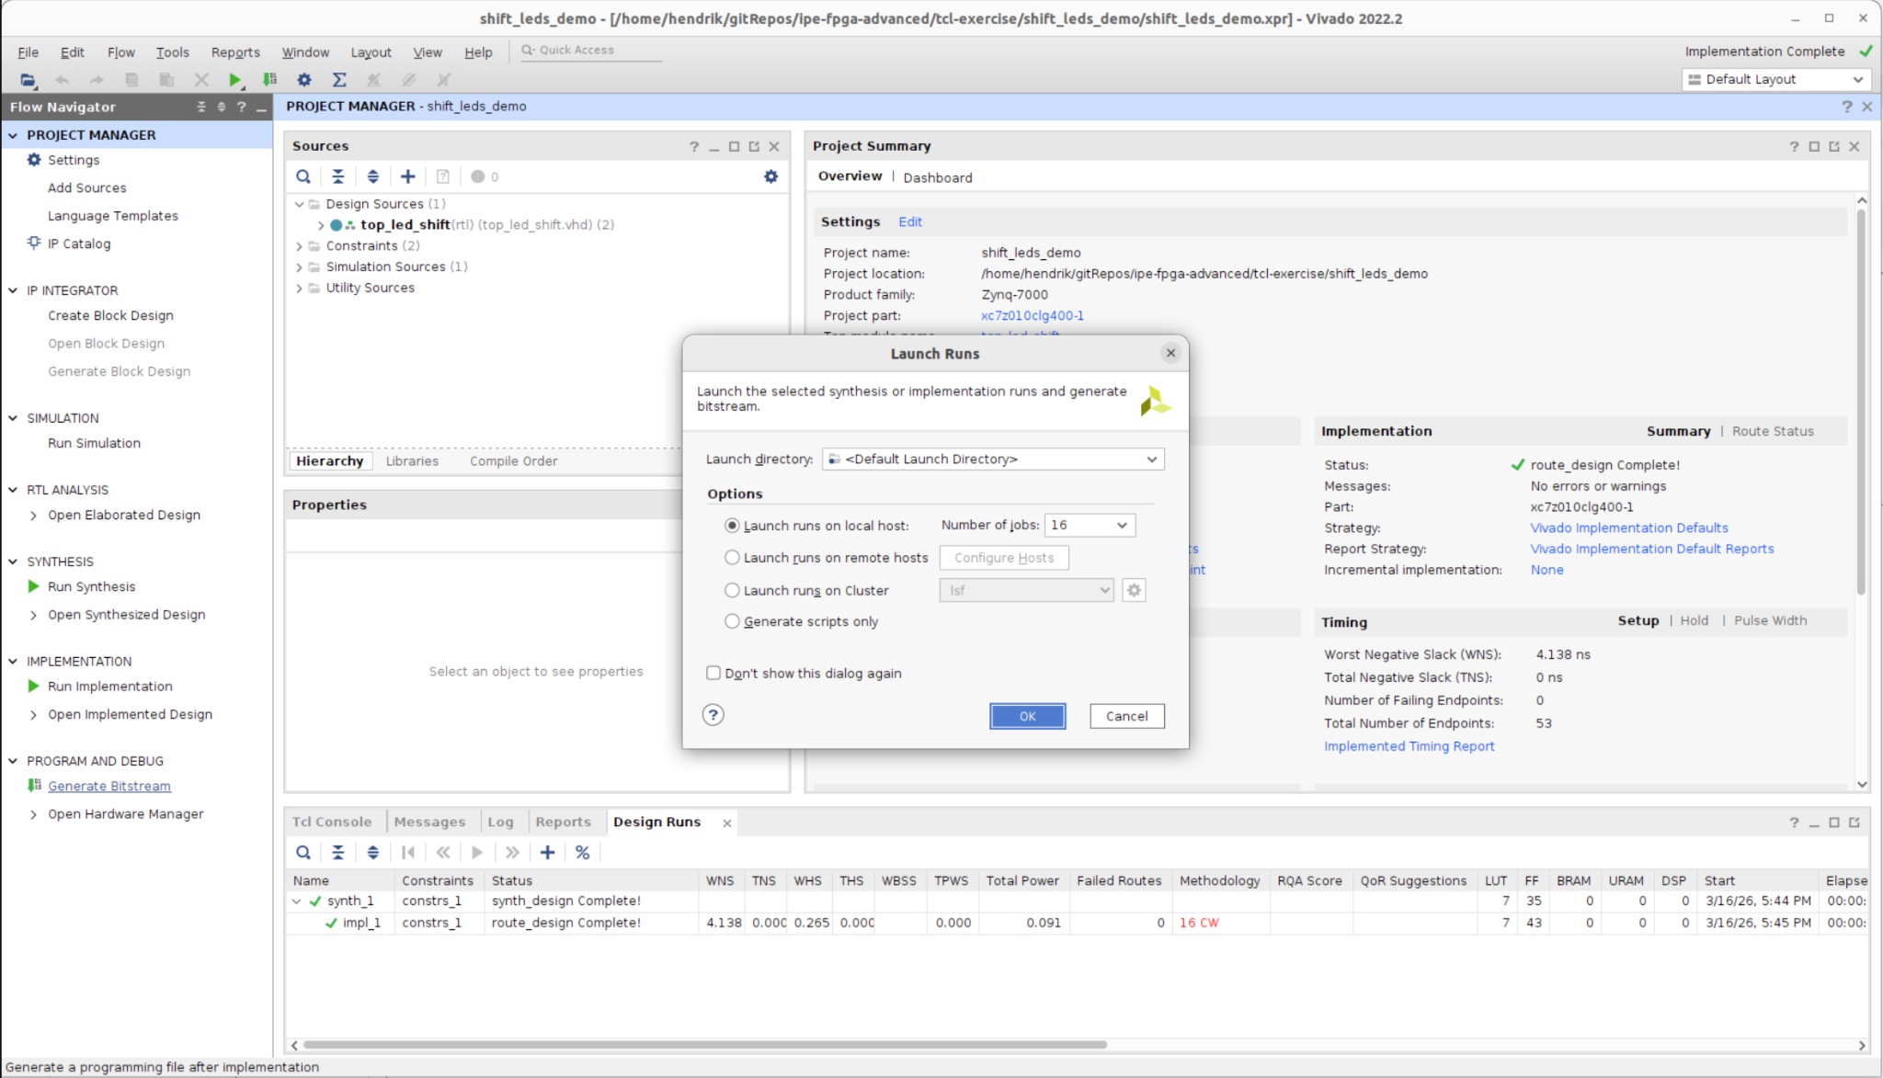
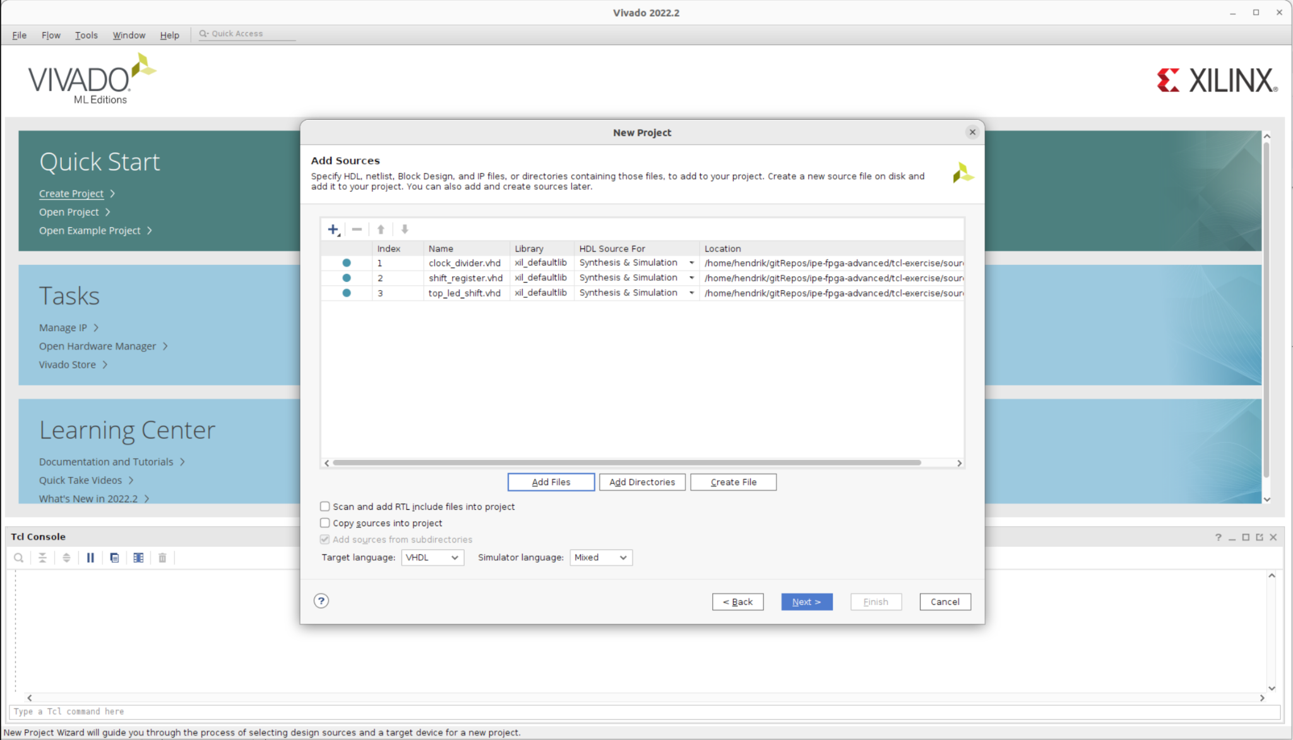
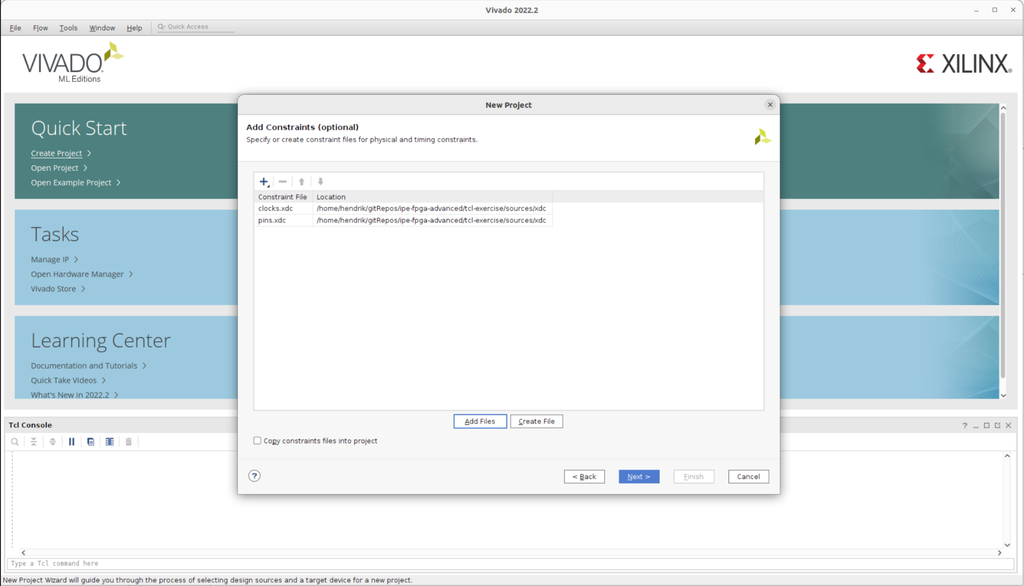
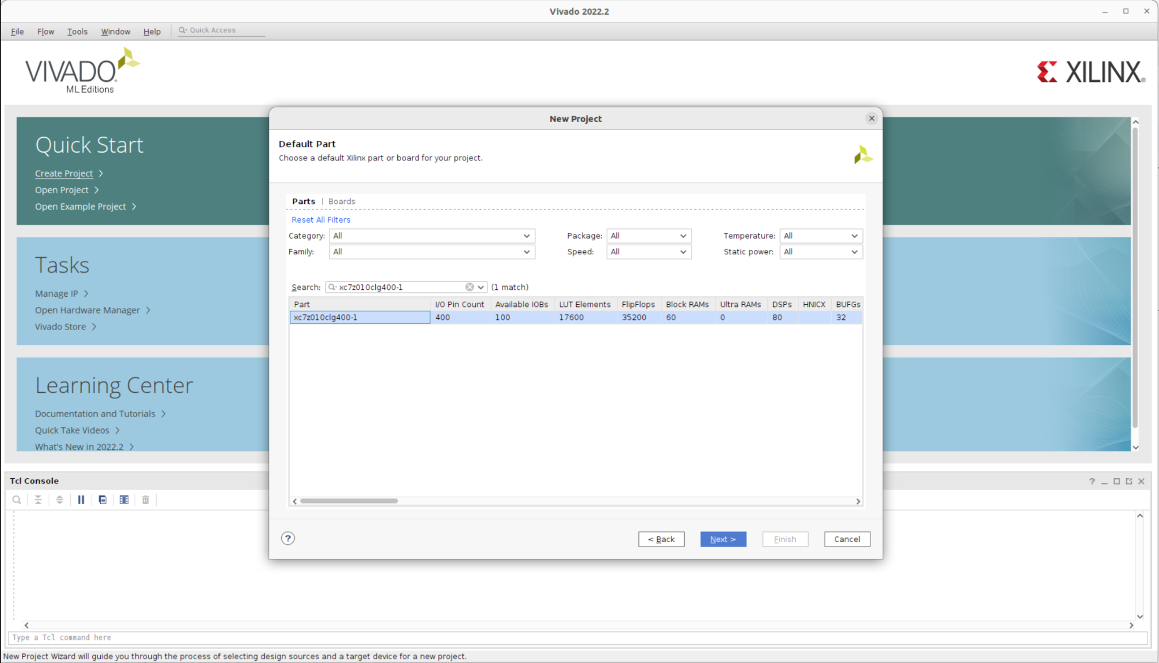
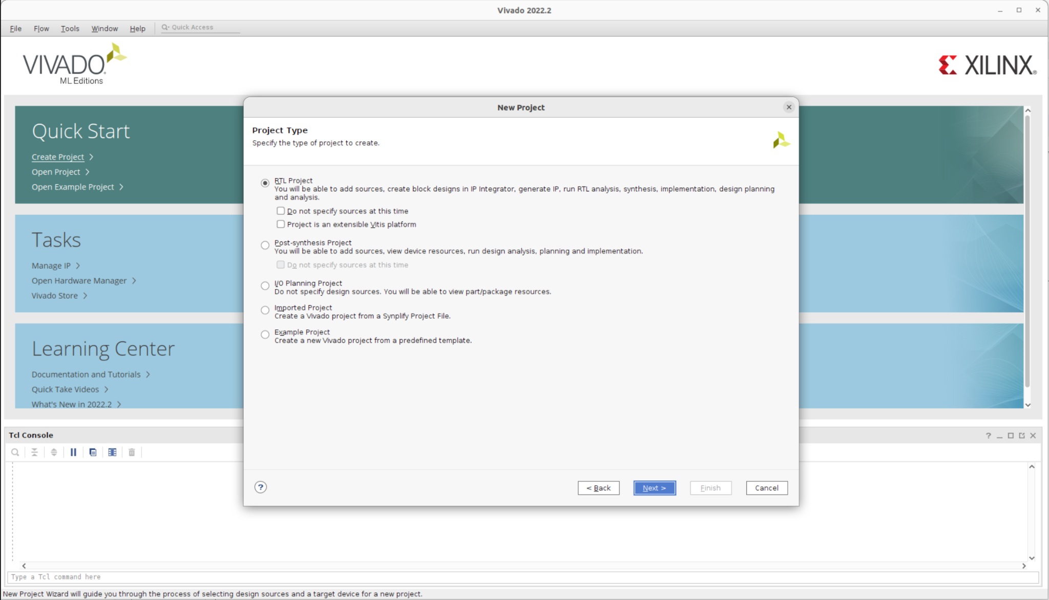
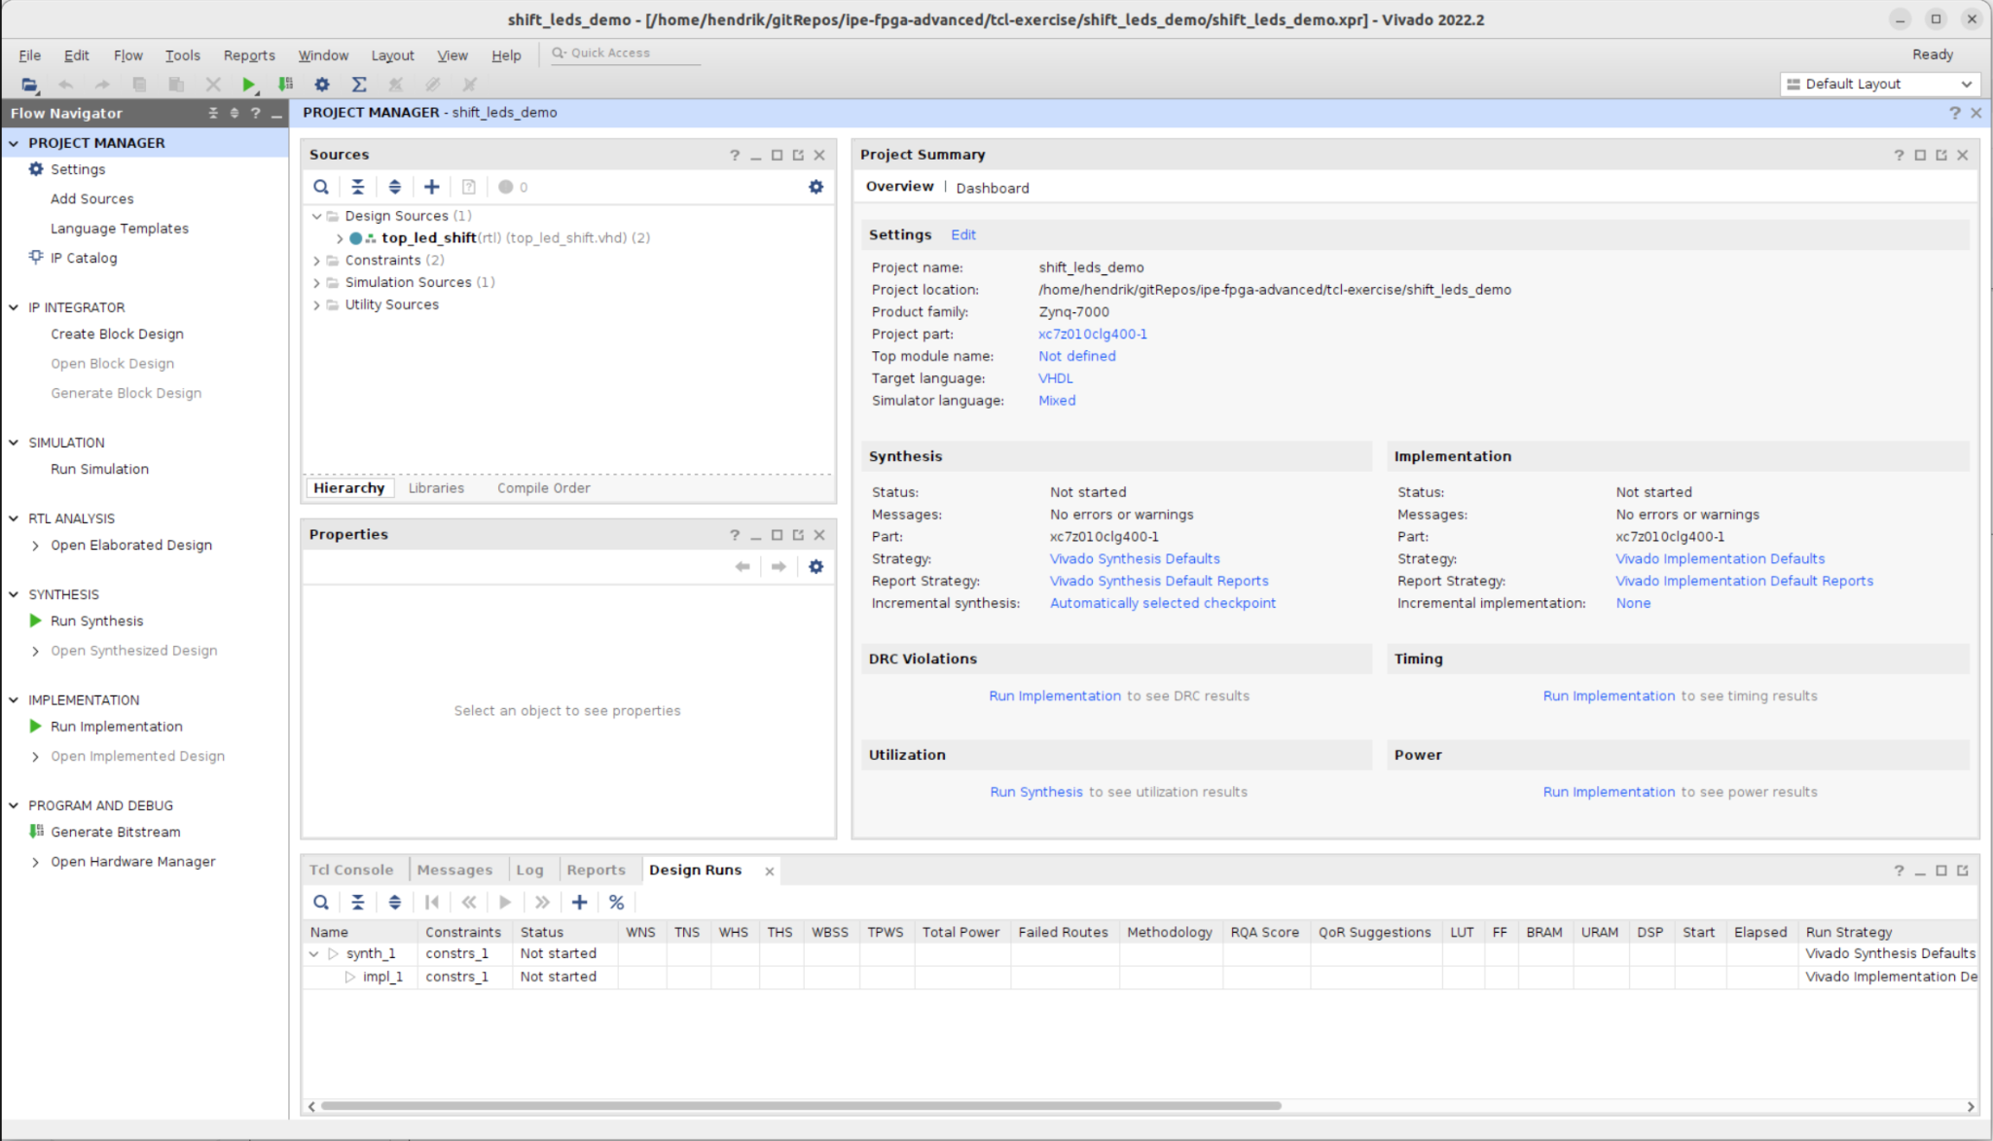
The GUI Workflow
How many clicks does it take to build a bitstream?
Typical GUI workflow:
Create project
Add RTL sources
Add constraints
Select device
Run synthesis
Run implementation
Generate bitstream
Problem:
repetitive
error-prone
hard to reproduce
How can we automate this?

Slide 14
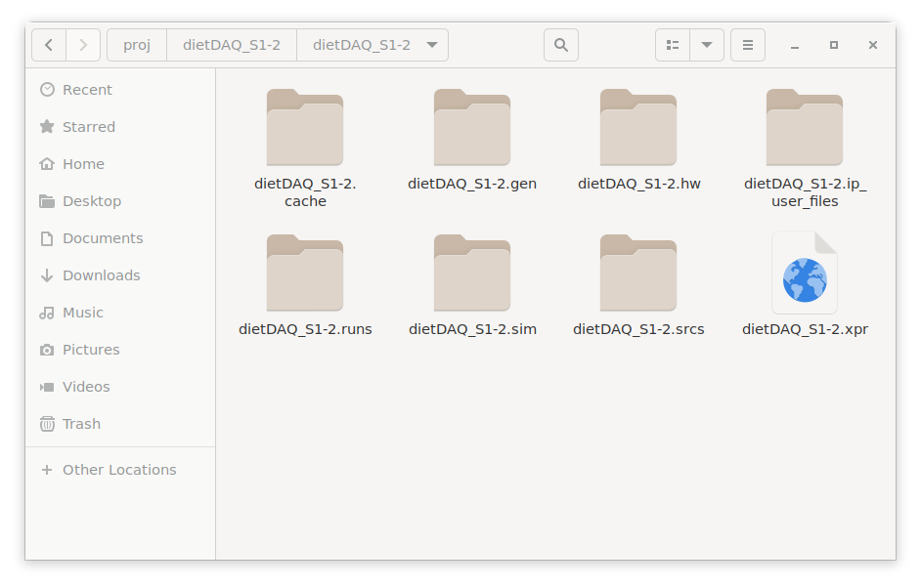
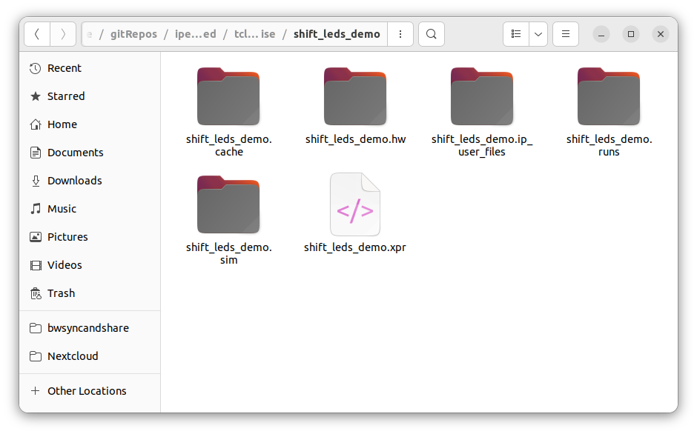
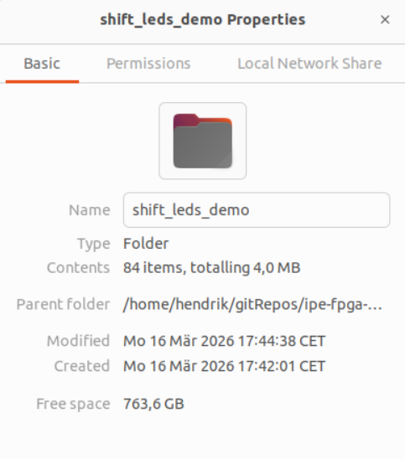
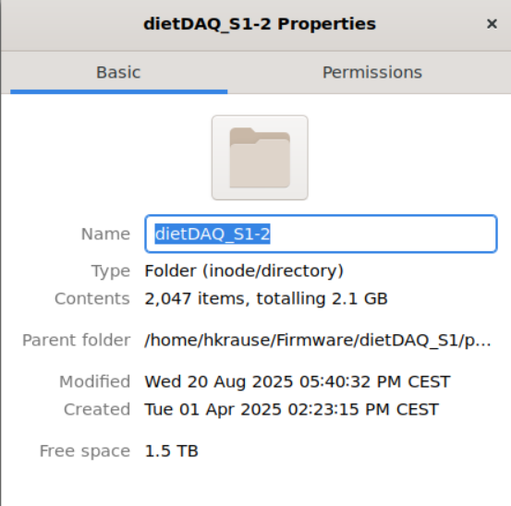
The Real Problem (Version Control)
Why GUI projects don’t work well with Git
Let's have a closer look at the project directory
We started wit 5 source files…
Now we have 84 build artifacts and a complex project structure
Issues:
machine-specific paths
generated build artifacts
huge repositories
merge conflicts
…
Looking at some real world example it gets even worse…
A Vivado project is not a good source artifact

Slide 15
The Solution
GUI-driven project vs. Source-based project
GUI-driven project
shift_leds_demo
├─ shift_leds_demo.cache
├─ shift_leds_demo.hw
├─ shift_leds_demo.ip_user_files
├─ shift_leds_demo.srcs
├─ shift_leds_demo.sim
├─ shift_leds_demo.gen
├─ shift_leds_demo.runs
└─ shift_leds_demo.xpr
Source-based project
shift_leds_demo
├─ sources
| ├─ rtl <- VHDL source files
| ├─ bd <- Block design files
| ├─ sim <- Simulation testbenches
| └─ xdc <- Constraint files
└─ scripts
├─ create.tcl
├─ simulate.tcl
└─ build.tcl
How is it done? With TCL!
Only put your source files and recipes under source control.
The project is generated, not stored.

Slide 16




What is TCL?
Tool Command Language
TCL (pronounced ”tickle”) is a standard language in the semiconductor industry for application programming interfaces (APIs).
This includes:
Vivado
Quartus
Cadence tools
Synopsis tools
Characteristics:
Interpreted scripting language
Simple syntax
Designed for tool automation
Also used for constraints (XDC / SDC)

Slide 17
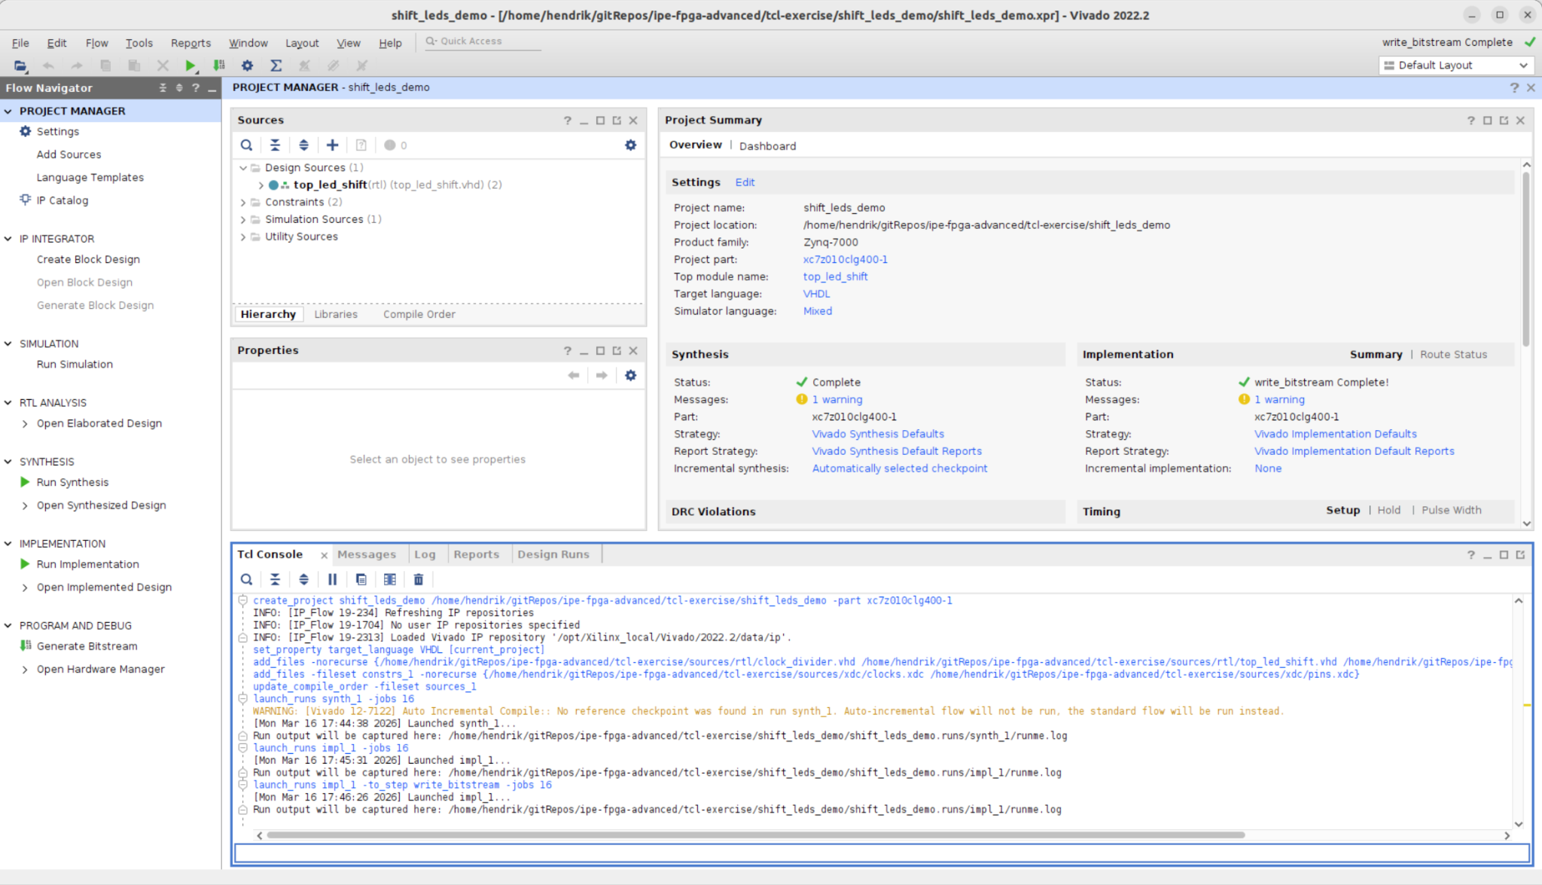
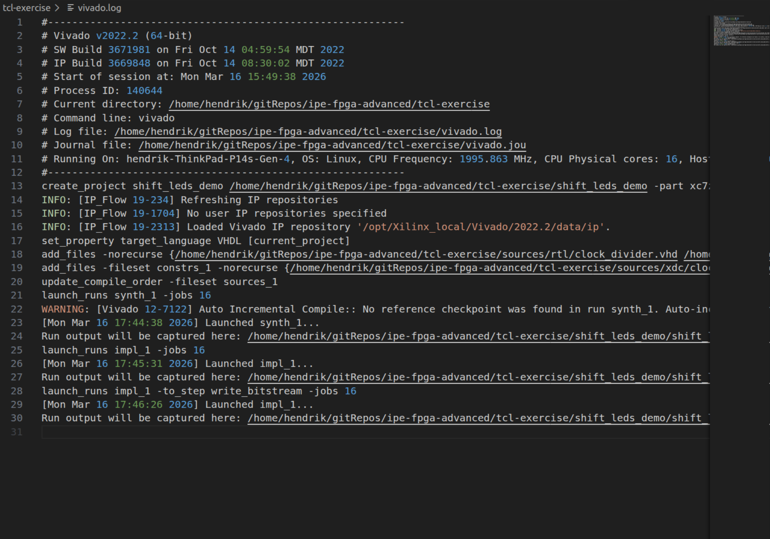
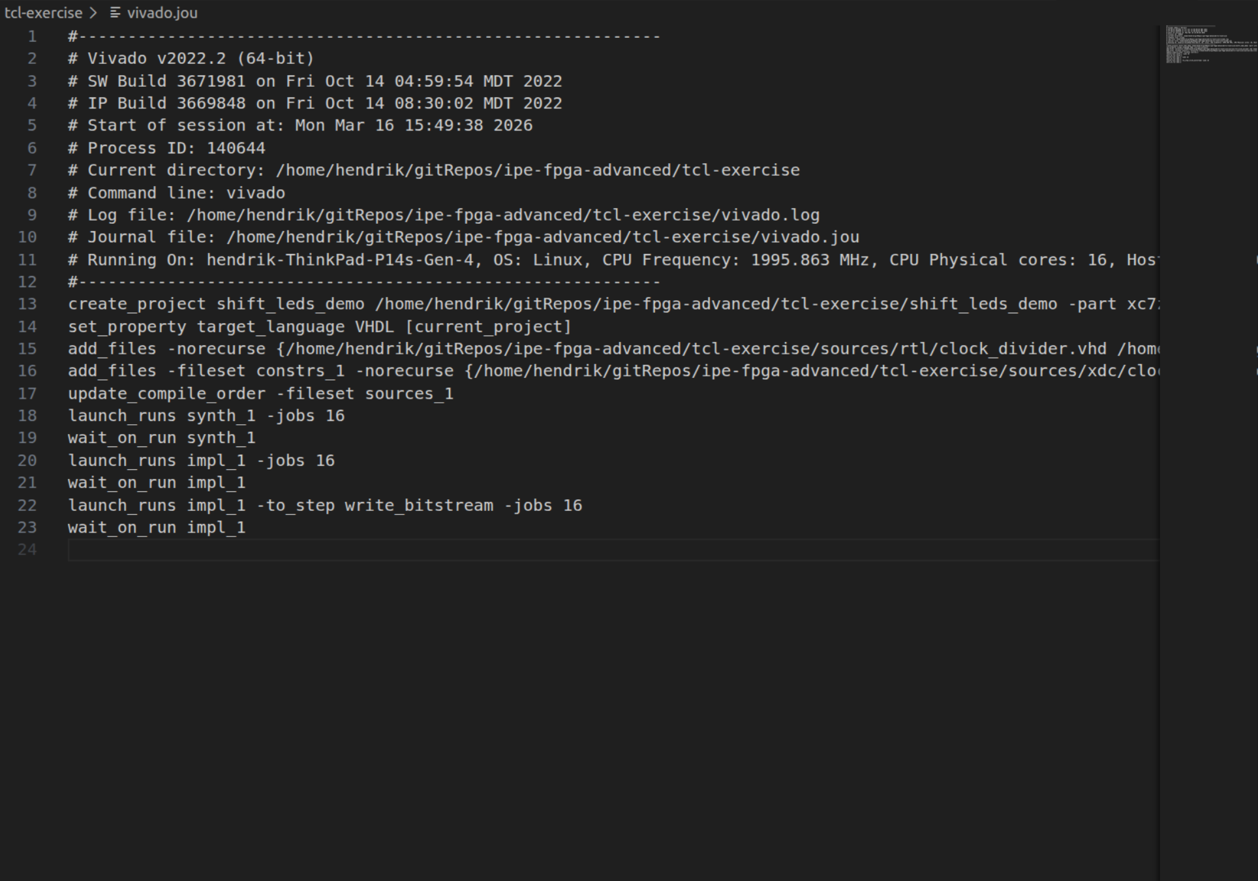
GUI vs TCL
The Vivado GUI is just a TCL Frontend
Every button, menu, or wizard in Vivado triggers one or more TCL commands
Vivado logs everything in two files: vivado.jou and vivado.log
vivado.log
vivado.jou

Slide 18
TCL Syntax Essentials
TCL Basics (Let's start with a small subset)
Basic TCL Syntax
A TCL command = command arg1 arg2 arg3
Everything is a command
Strings are the fundamental data type
Tcl evaluates commands in two steps:
Perform substitutions
Execute the command
Substitution rules:
$var → variable substitution
[command] → command substitution
{...} → prevents substitution
"..." → substitution + keep spaces
# define a variable
set a 10
# print the variable
puts “Value of a is $a”
# let’s do some simple arithmetic
set sum [expr { $a + 20 }]

Slide 19
TCL Control Flow
If you want to do more advanced stuff
Control structures are commands
e.g. foreach, if, while,...
Blocks are passed as arguments
{...} delays evaluation
Control-flow commands decide when to execute them
Control-flow commands
Conditional: if
Loops: foreach, while, for
Early exit: return, break, continue, error
# Iterate over input files
foreach f $files {
# Skip missing files
if { ![file exists $f] }
{
puts "Skipping $f"
continue
}
# Process only .vhd files
if { [file extension $f] ne ".vhd" }
{
continue
}
puts "Processing $f"
# your code here…
}

Slide 20
TCL Procedures
If you want to have reusable and structured code
Encapsulate commands into reusable blocks
Like functions in Python, C/C++
Procedures can return values using return
Variables inside a procedure are local by default
# define a procedure
proc greet {name} {
puts "Hello, $name!"
}
# call procedure
greet "Alice"
# local variables
proc add {a b} {
set sum [expr {$a + $b}]
return $sum
}
set result [add 3 4]
puts "Result: $result"

Slide 21
TCL in Vivado:
From Language to Real Power
Minimal core language
Variables, control flow, procedures, basic arithmetic,...
Everything else comes from the tool
Tools define the domain
Vivado injects commands like get_cells, set_property
Commands operate on tool objects (cells, nets, runs, constraints)
TCL as a glue layer
The language orchestrates the tool’s internal API
Scripts automate sequences of commands, loops, and procedures
Minimal TCL Language
set, if, while, proc, expr, …
Tool Extension Layer
get_cells, set_property, create_project, launch_runs
Vivado GUI
Project Creation, Synthesis, Implementation, Bitstream Generation

Slide 22
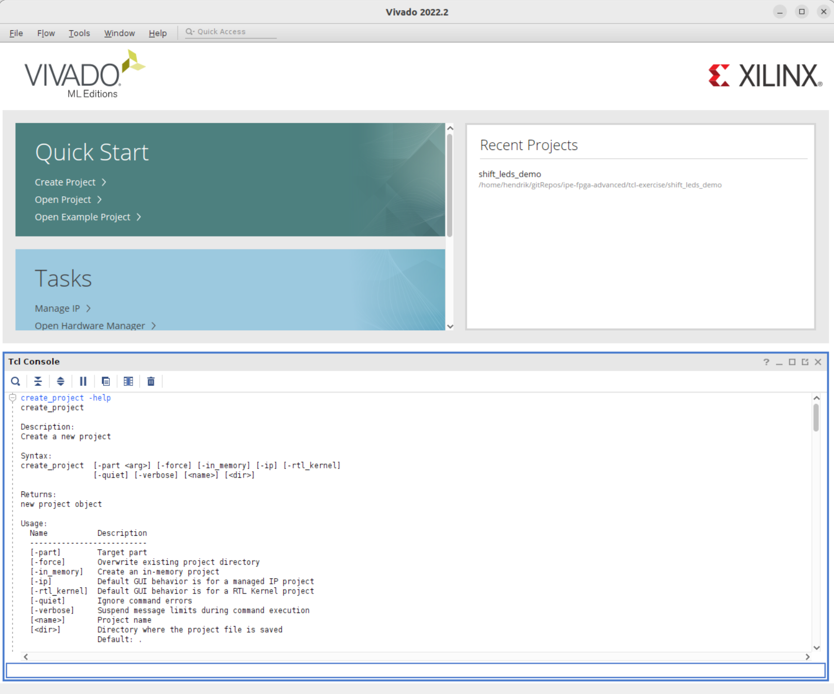
Working with TCL in Vivado
Useful Tips
Two Workflows
Use the TCL console in the GUI
Launch Vivado in TCL mode
vivado -mode tcl -source build.tcl
start_gui launches the GUI
Practical tip:
Use the GUI once → extract commands from the journal
Documentation: command -help

Slide 23

Exercise Time
Now it’s your turn!

Slide 24
Exercise Time
Automate Standart flows with TCL
Task 1: Project Creation
Extend ex1_1_project_create.tcl to create the vivado project
Task 2: Run the build flow
Extend ex1_2_project_build.tcl to generate the bitstream
Task 3: Run the simulation flow
Extend ex1_3_project_simulate.tcl to simulate one submodule of the project
./1-tcl-exercise
├─ sources
| ├─ rtl <- VHDL source files
| ├─ sim <- Simulation testbenches
| └─ xdc <- Constraint files
└─ scripts
| ├─ ex1_project_create.tcl
| ├─ ex2_project_build.tcl
| └─ ex3_project_simulate.tcl
├─ vivado <- Generated projects
├─ output <- Output products
└─ README.md <- Exercise instructions

Slide 25
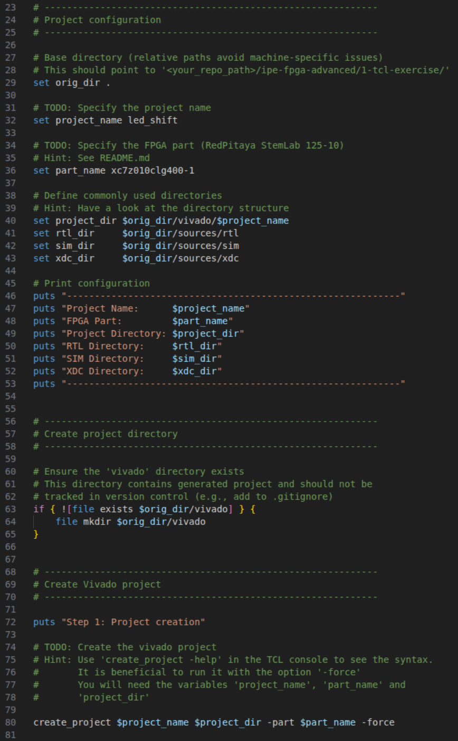
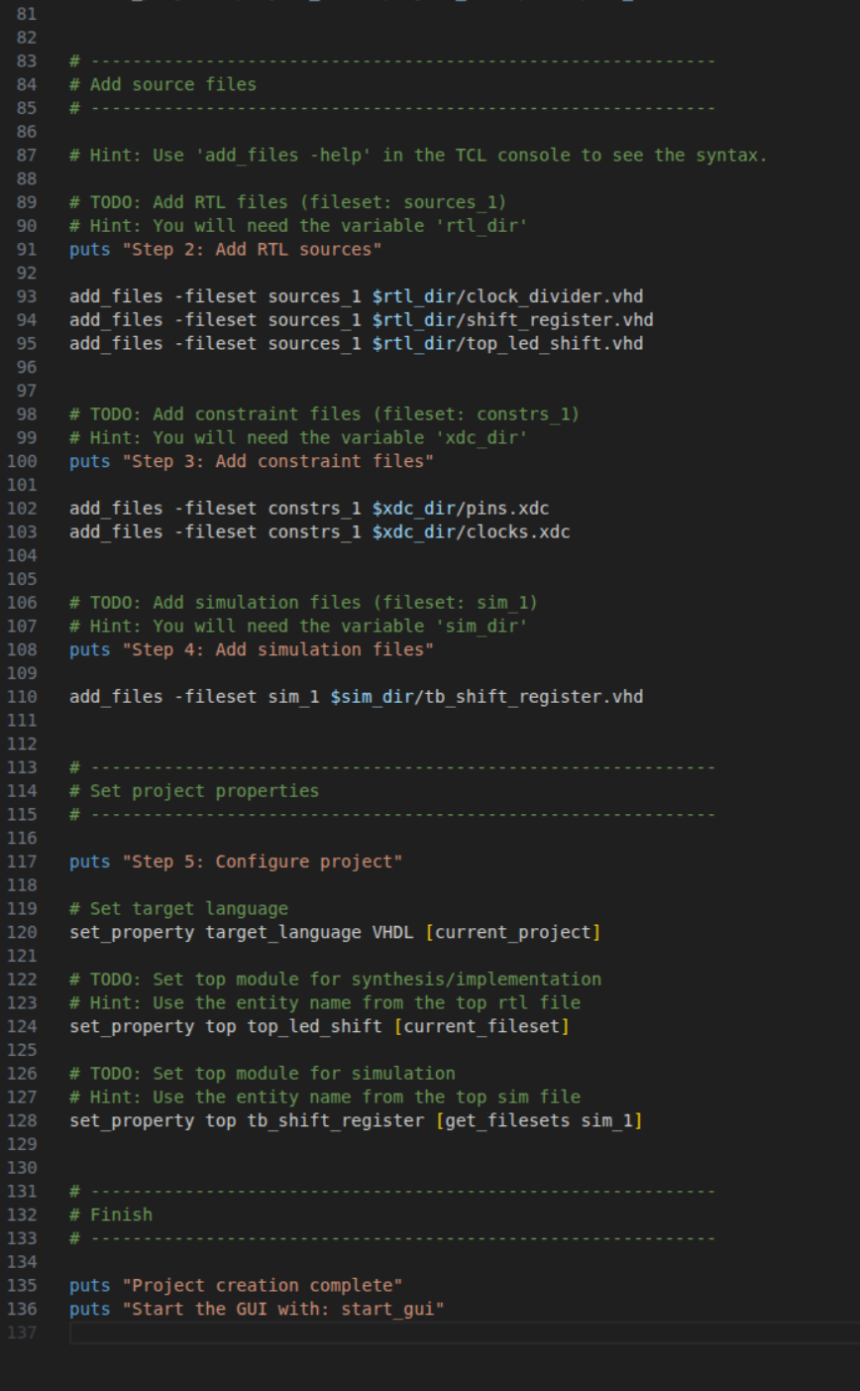
Task 1.1: Example Solution
Project Creation with TCL

Slide 26
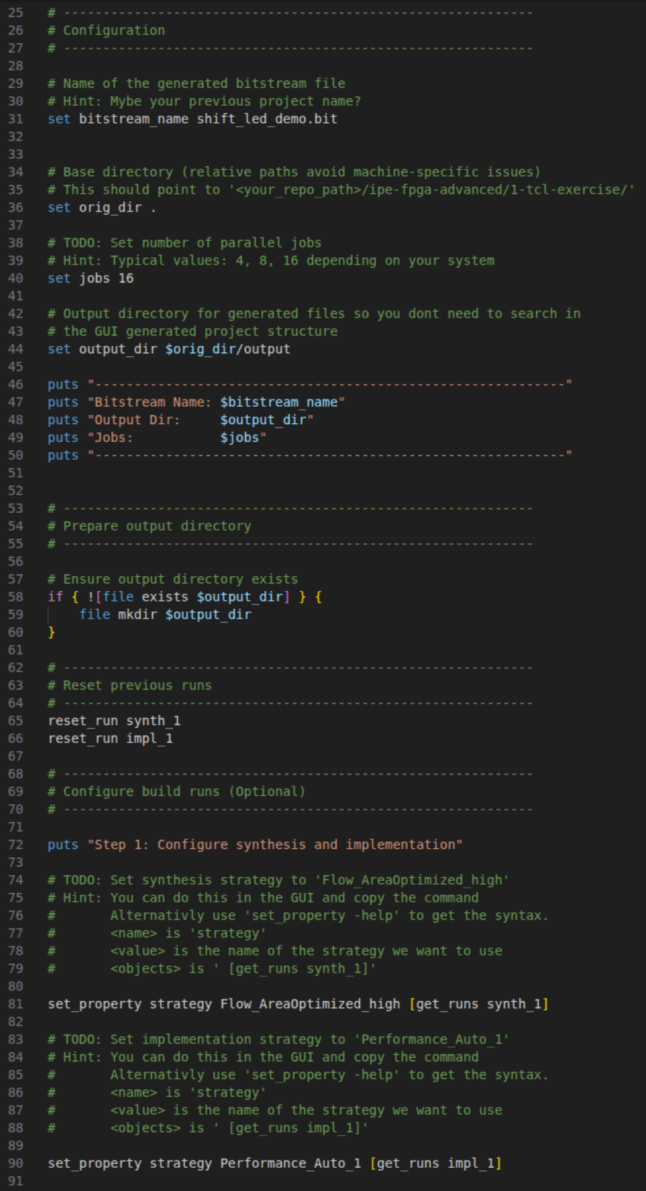
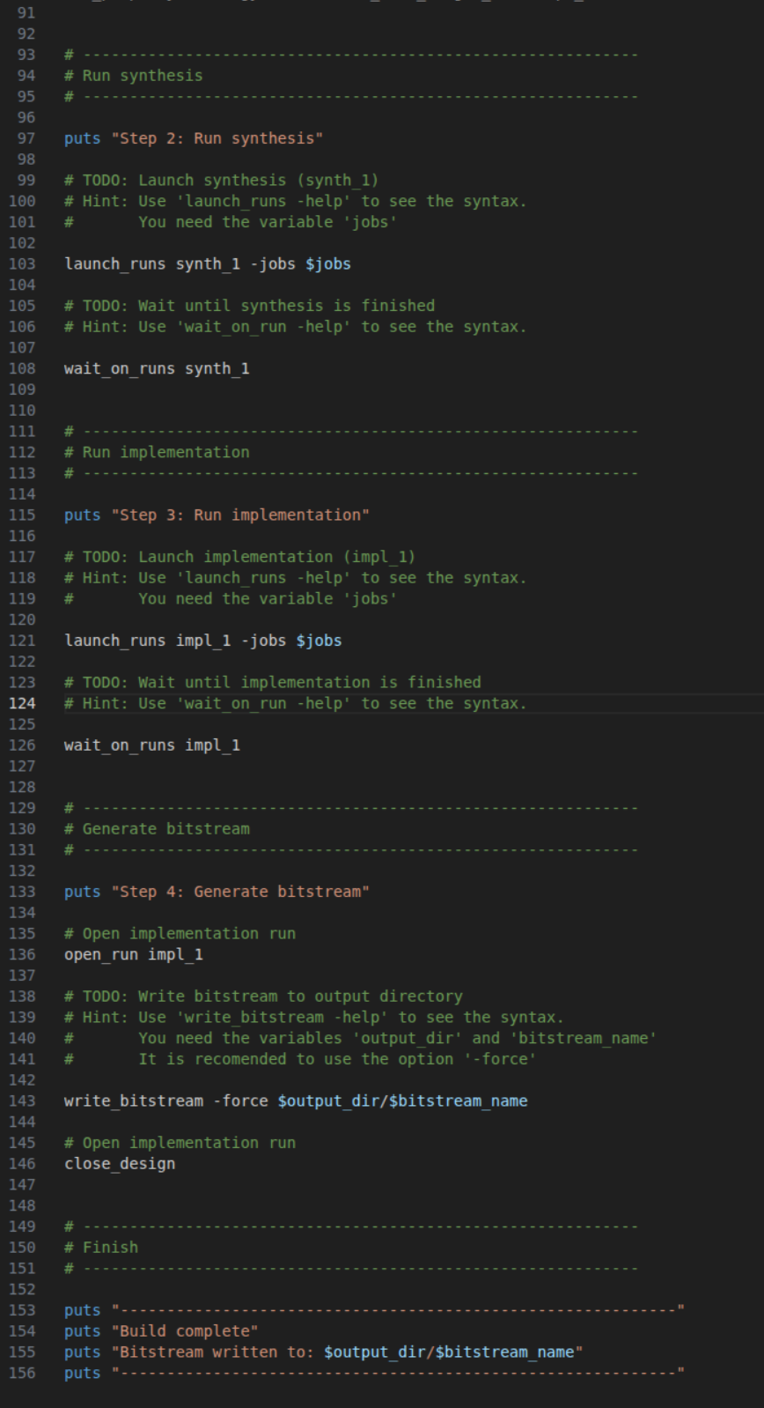
Task 1.2: Example Solution
Control Synthesis and Implementation with TCL

Slide 27
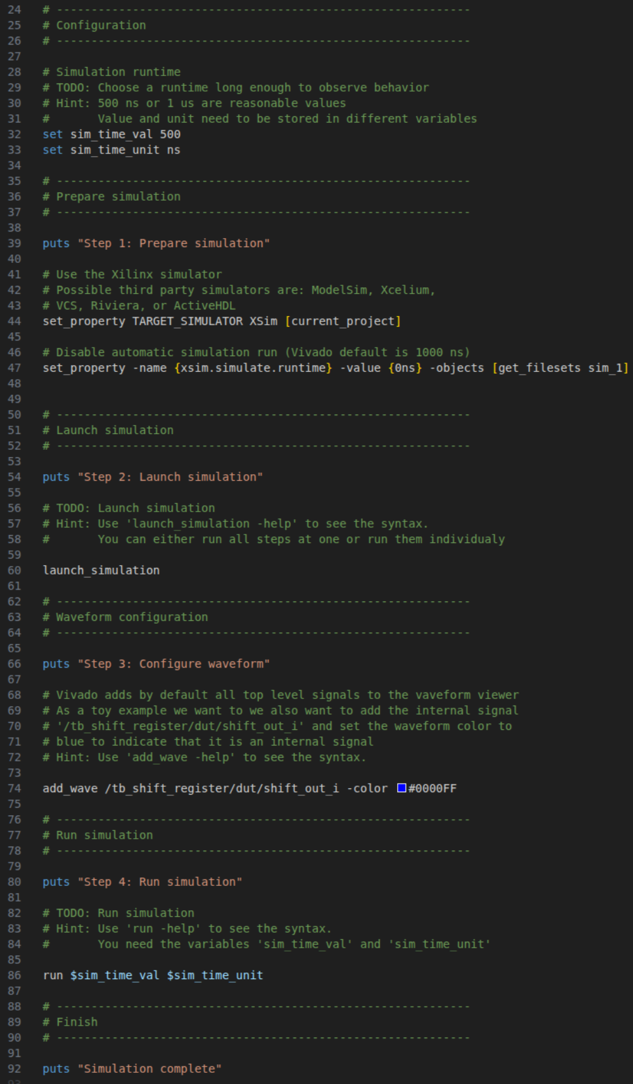
Task 1.3: Example Solution
Testbench Creation and Simulation using TCL

Slide 28

Key Takeaways
What you should have learned
FPGA projects should store sources, not generated projects
Vivado can be fully controlled via TCL
GUI actions correspond to TCL commands
TCL scripts allow automation and reproducibility

Slide 29

HDL on Git (Hog)
Beyond Simple Scripts: Full FPGA Build Frameworks
Open-source framework built around TCL-based FPGA flows
What it enables:
reproducible FPGA builds
versioned bitstreams (Git commit embedded in binary)
automated build workflows
CI pipelines (GitHub / GitLab)
shared code across multiple FPGA projects
Supports Xilinx Vivado, Xilinx ISE and Intel Quartus
Well documented + video tutorials
Hog = TCL + mythology
# Example workflow
git clone --recursive <repo>
cd repo
./Hog/Do CREATE my_project
./Hog/Do WORKFLOW my_project

Slide 30
IPBus Builder (IPBB)
Beyond Simple Scripts: Full FPGA Build Frameworks
Open-source firmware build and project management tool
Used for all firmware projects for the CERN CMS Phase-2 upgrade
Key Features:
Manage complex / large FPGA firmware projects
Integrate multiple repositories in one firmware project
HDL files are organised with modules and linked via dependent files
Automate Vivado project creation and builds
Generate IPbus address decoder logic during build
Documentation exists but it is not entry friendly
There is also some example in the exercise repo
# Example workflow
ipbb init my-work-area
ipbb add git <firmware_repo_1>
ipbb add git <firmware_repo_2>
ipbb proj create vivado my_project top.dep
ipbb vivado synth
ipbb vivado impl

Slide 31
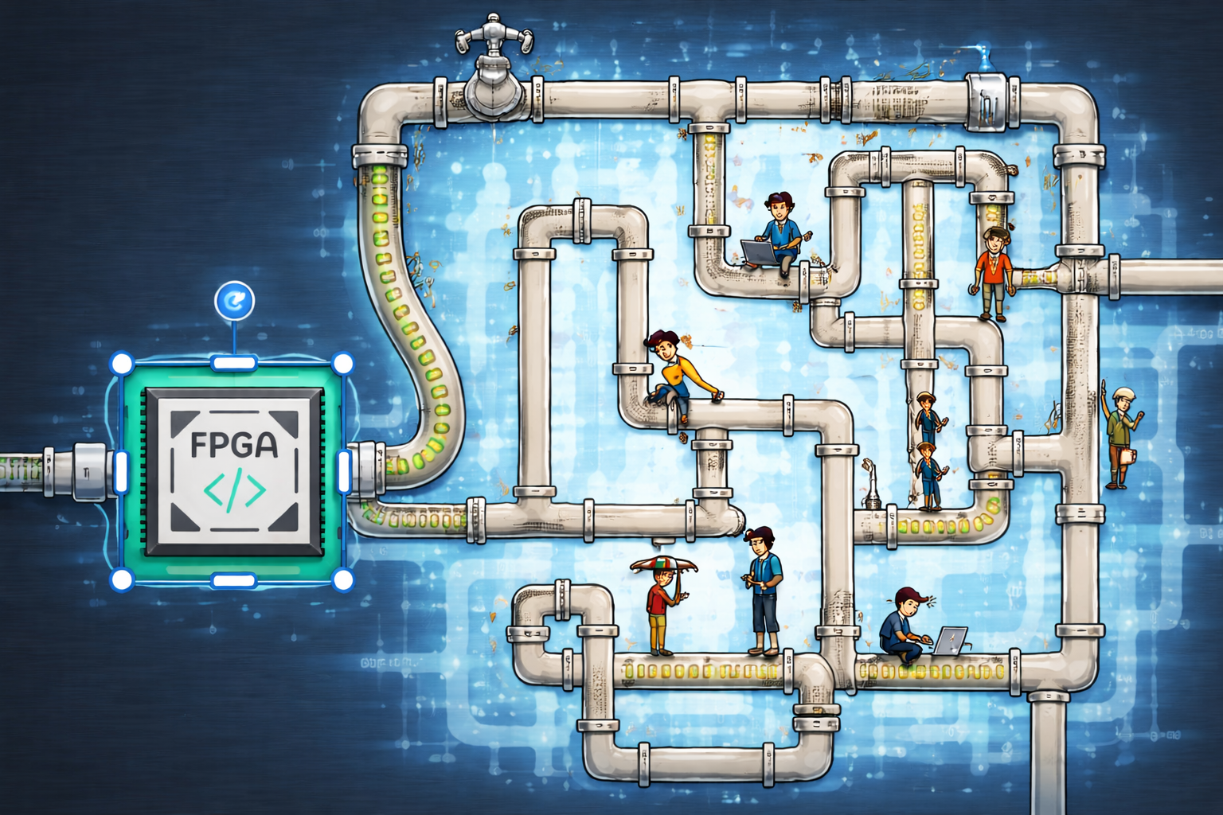
Introduction to AXI
Basics of AXI
Explore the AXI interface/protocol
Interface from PS to PL via AXI
Exercise: 2.1
Exercise: 2.2
Exercise: 2.3

Slide 32
Introduction to AXI
What is AXI?
Advanced eXtensible Interface
Interface protocol defined by ARM
Part of AMBA (Advanced Microcontroller Bus Architecture) standard
Prevalent in Zynq devices → interface between processor and programmable logic
Point-to-point connection
Separate memory/data channels → parallelization
Master/Slave → Handshaking!
Three types: Memory-Mapped, Lite, Stream

Slide 33
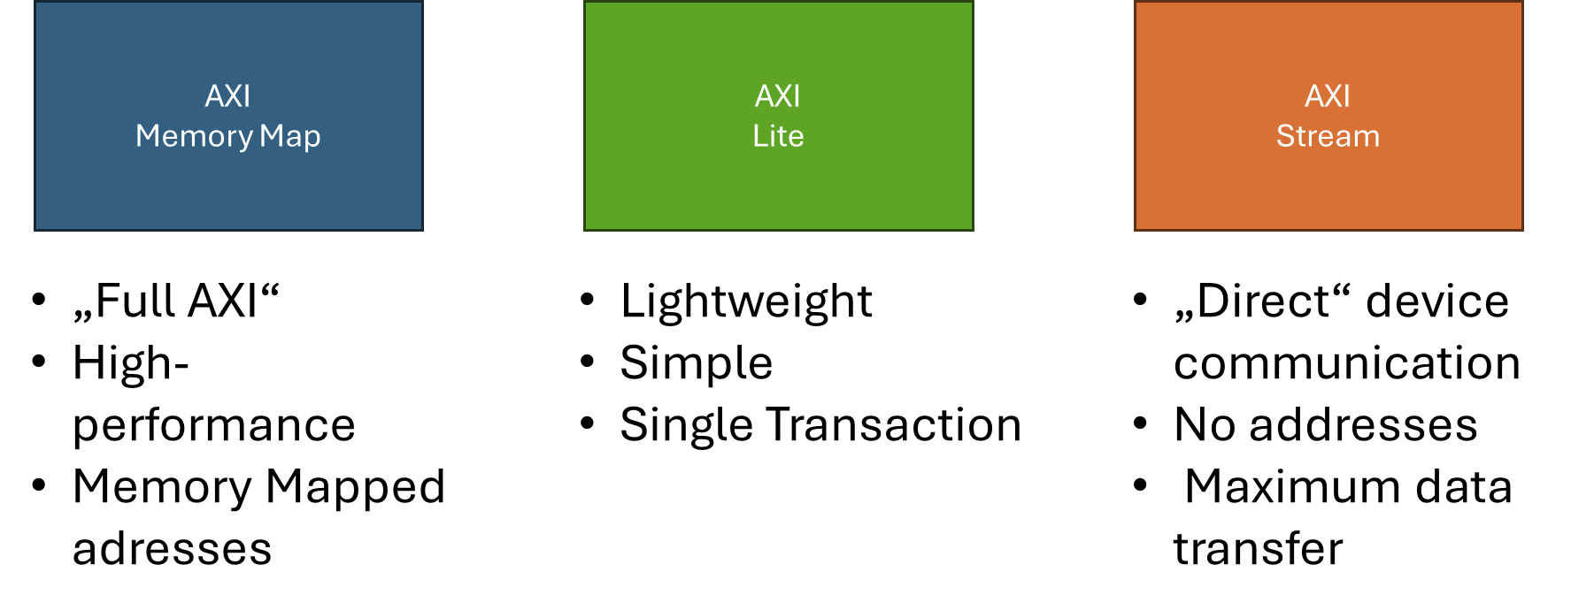
Introduction to AXI
AXI Types

Slide 34
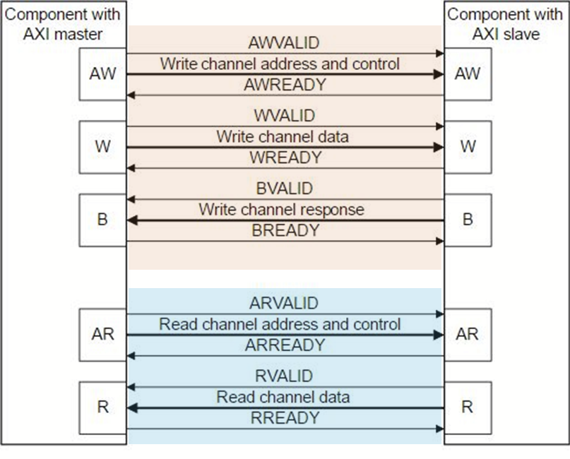
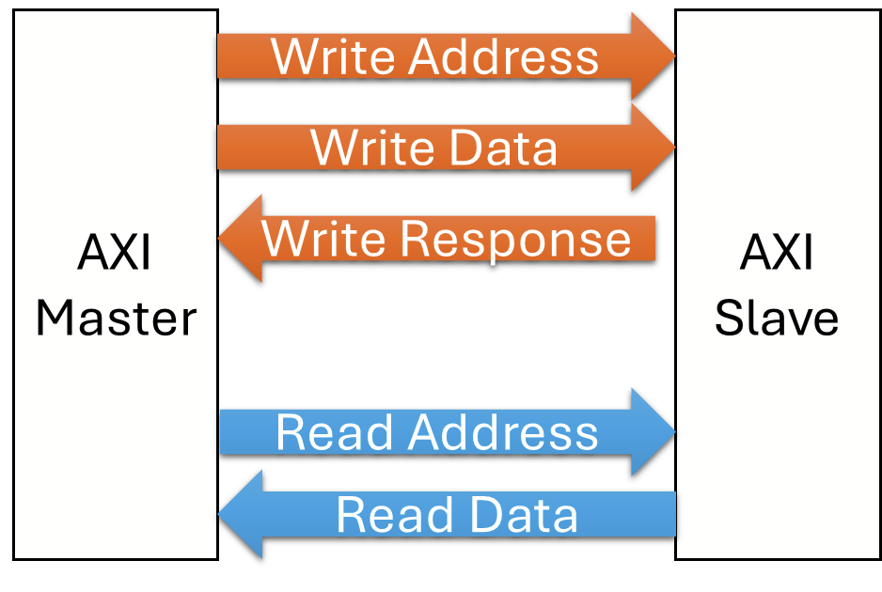
Introduction to AXI
AXI Architecture

Slide 35
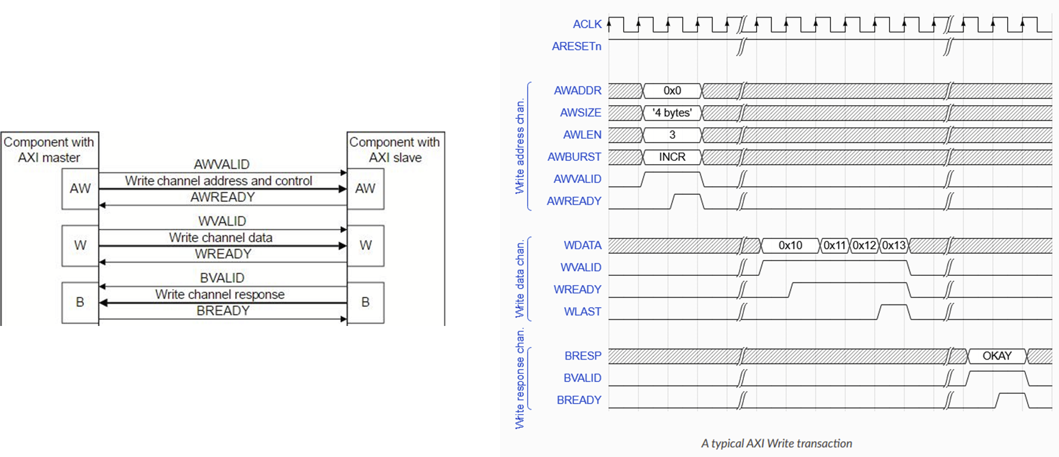
Introduction to AXI
AXI Write Transaction

Slide 36
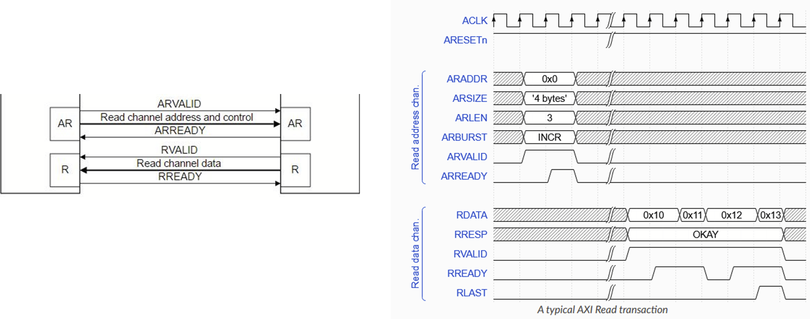
Introduction to AXI
AXI Read Transaction

Slide 37
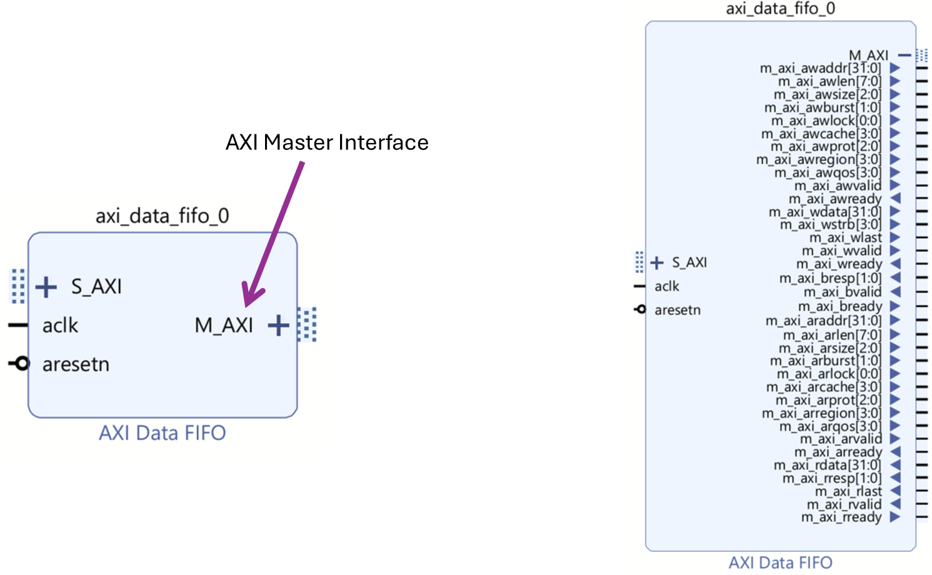
Introduction to AXI
AXI in Real Life
AXI Memory Map

Slide 38
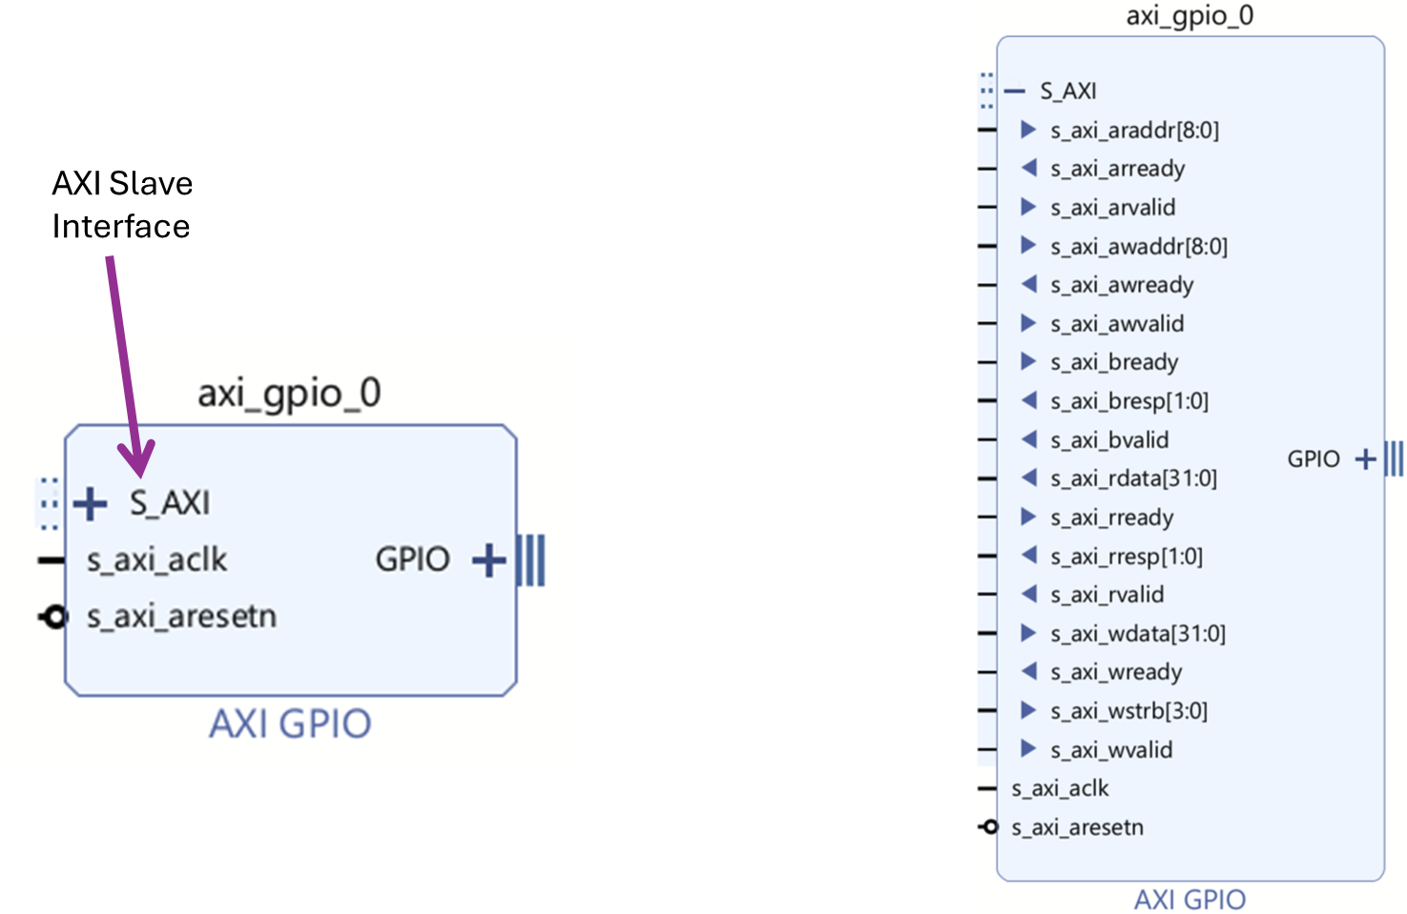
Introduction to AXI
AXI in Real Life
AXI Lite

Slide 39
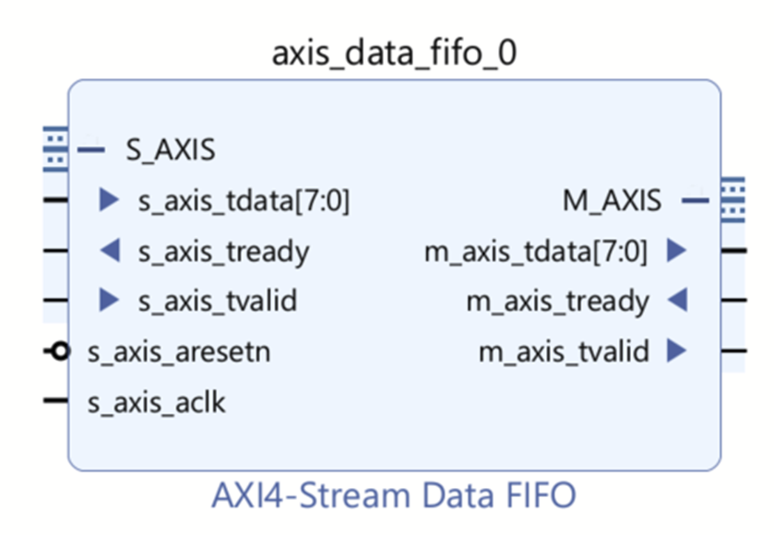
Introduction to AXI
AXI in Real Life
AXI Stream

Slide 40
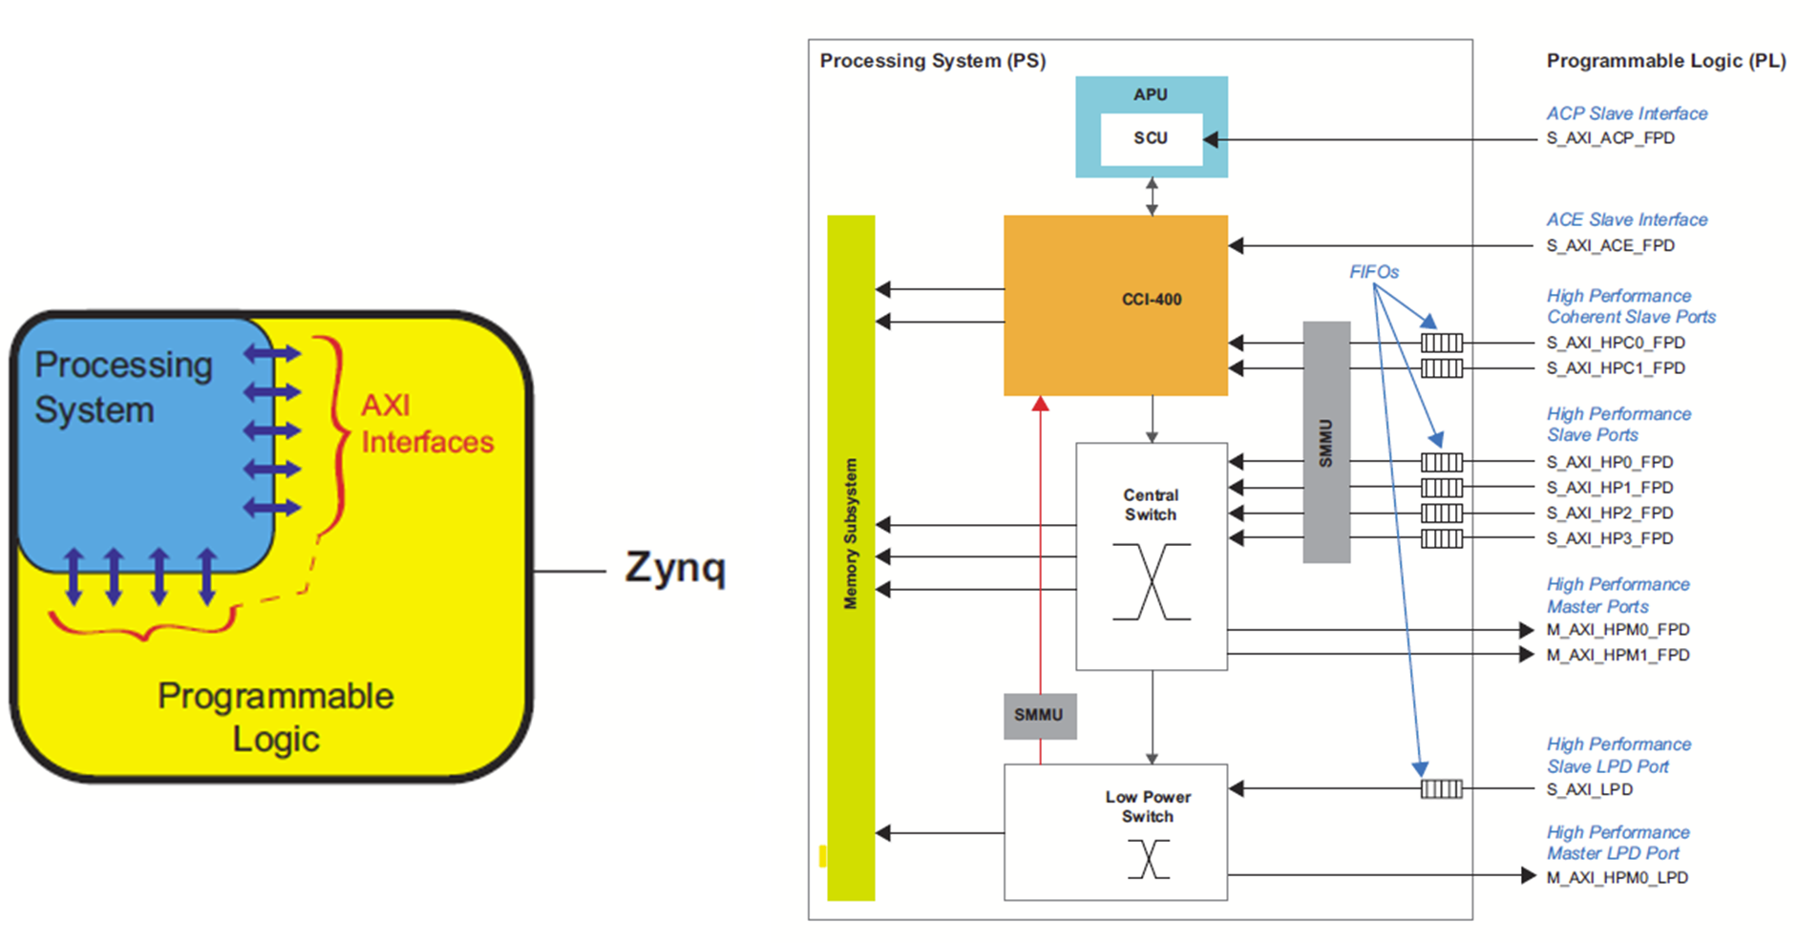
Introduction to AXI
PS-PL AXI Interface

Slide 41
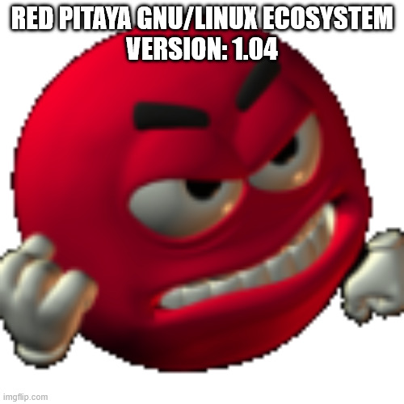
Exercise: 2.1
Exercise: 2.2
Exercise: 2.3
Exercise Time
Now it’s your turn!
Make a git pull !!!!!!!! Read the README in the respective sub-exercise!!!

Slide 42
Exercise Time
Explore the AXI interface
Task 1: AXI LED Control
Control LEDs via software on the PS
Explore the protocol via Integrated Logic Analyzer (ILA)
Task 2: AXI Register Readback
Create a counter which writes to a register
Readback register value from the PS
Task 3: AXI Stream
Create a data generator following the AXI Stream protocol
Write the data to an AXI Stream Data FIFO
Inspect the interface via ILA
ssh root@rp-XXXXXX
passwort: root

Slide 43
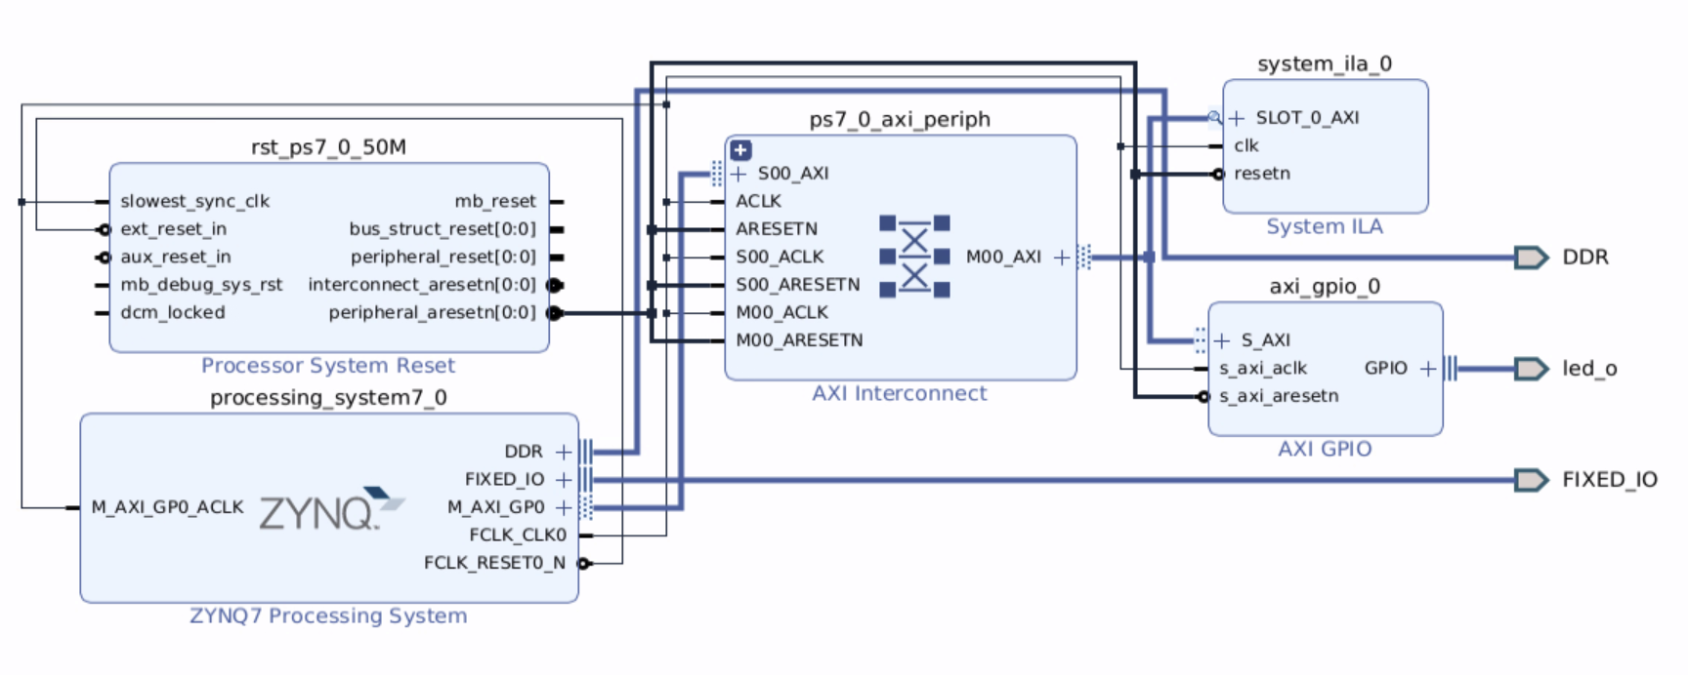
2.1 AXI LED Control
Control LEDs from the processor
Set the right trigger to examine the protocol
Check the address in the Address Editor!!

Slide 44


2.1 AXI LED Control
Go to “Open Implemented Design” → “Layout” → “I/O Ports”

Slide 45


2.2 AXI Register Readback
Read hardware data from the processor
gcc axi_leds.c -o axi_leds
→ This will open another project, modify the code, re-package the IP and update the IP in the project.

Slide 46

2.2 AXI Register Readback
Read hardware data from the processor
→ This will open another project, modify the code, re-package the IP and update the IP in the project.

Slide 47

2.3 AXI Stream
Moving data fast between modules
Create your own data generator.
Expose it to the AXI Stream interface following the protocol rules.
The ILA supports all types of AXI, making it a great tool for quick debugging
Feel free to try out other stuff beyond the scope of these exercises!

Slide 48
Thank
You

