Slide 1

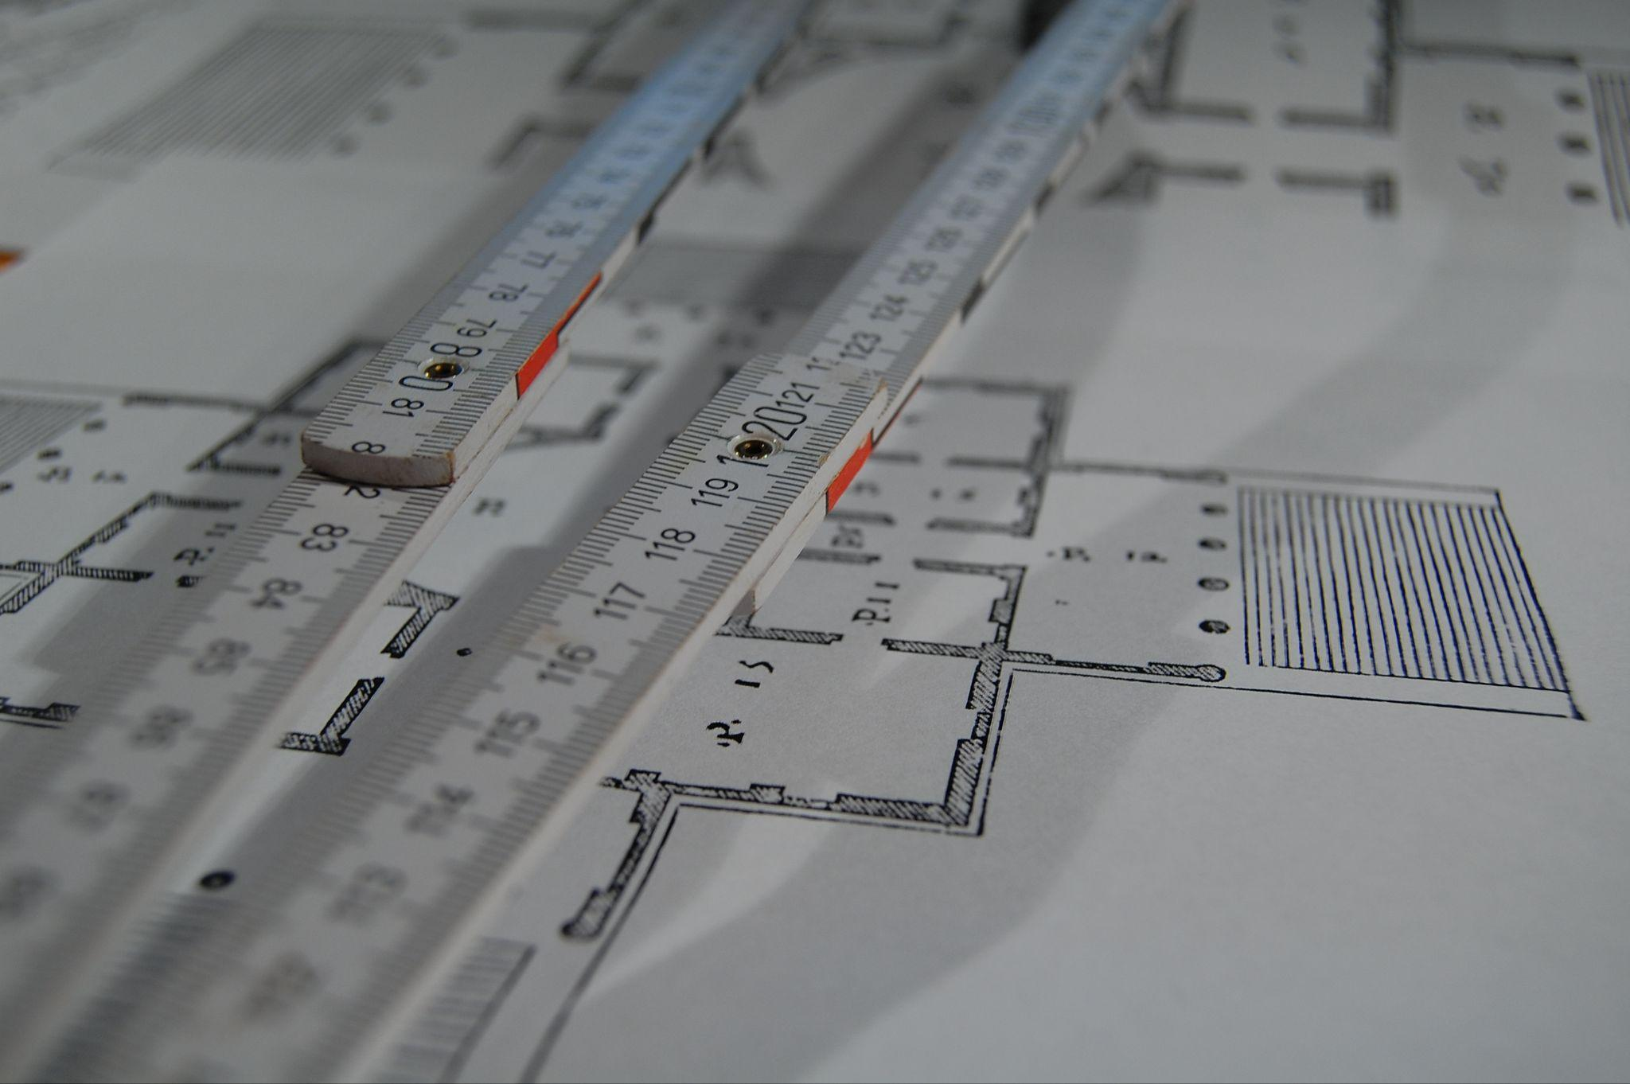

Advanced FPGA Course for KSETA
KSETA Topical Courses Mars 2026- Day 2
IPE Team : H. Krause, O. Manzhura, L. Scheller, A. Qamesh

Slide 2
Agenda
Combinational vs. Sequential Devices
Static Timing:
Static Timing Analysis
Timing and Critical Path
Partial Reconfiguration

Slide 3
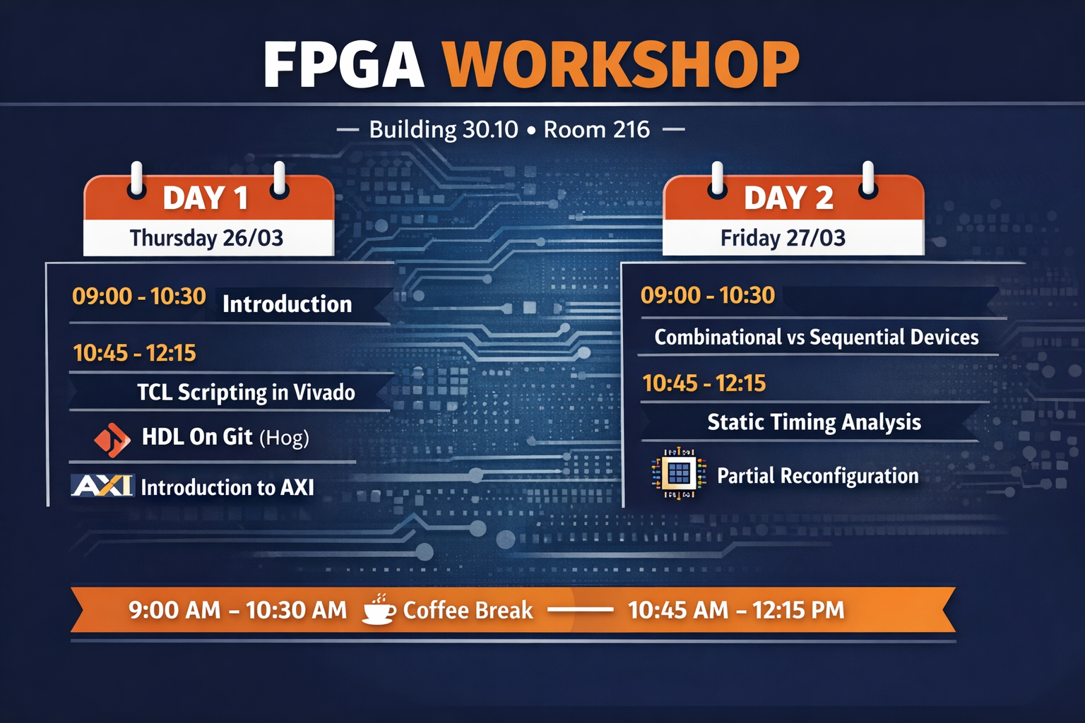


Advanced FPGA Development
Course Agenda
9:00 AM - 10:30 AM
Introduction
TCL Scripting in Vivado
FPGA Build Frameworks
10:45 AM - 12:15 PM
Introduction to AXI
9:00 AM - 10:30 AM
Introduction
TCL Scripting in Vivado
FPGA Build Frameworks
10:45 AM - 12:15 PM
Introduction to AXI
9:00 AM - 10:30 AM
Combinational vs Sequential
Static Timing Analysis
10:45 AM - 12:15 PM
Timing and Critical Path
Partial Reconfiguration
9:00 AM - 10:30 AM - Coffee Break - 10:45 AM - 12:15 PM

Slide 4
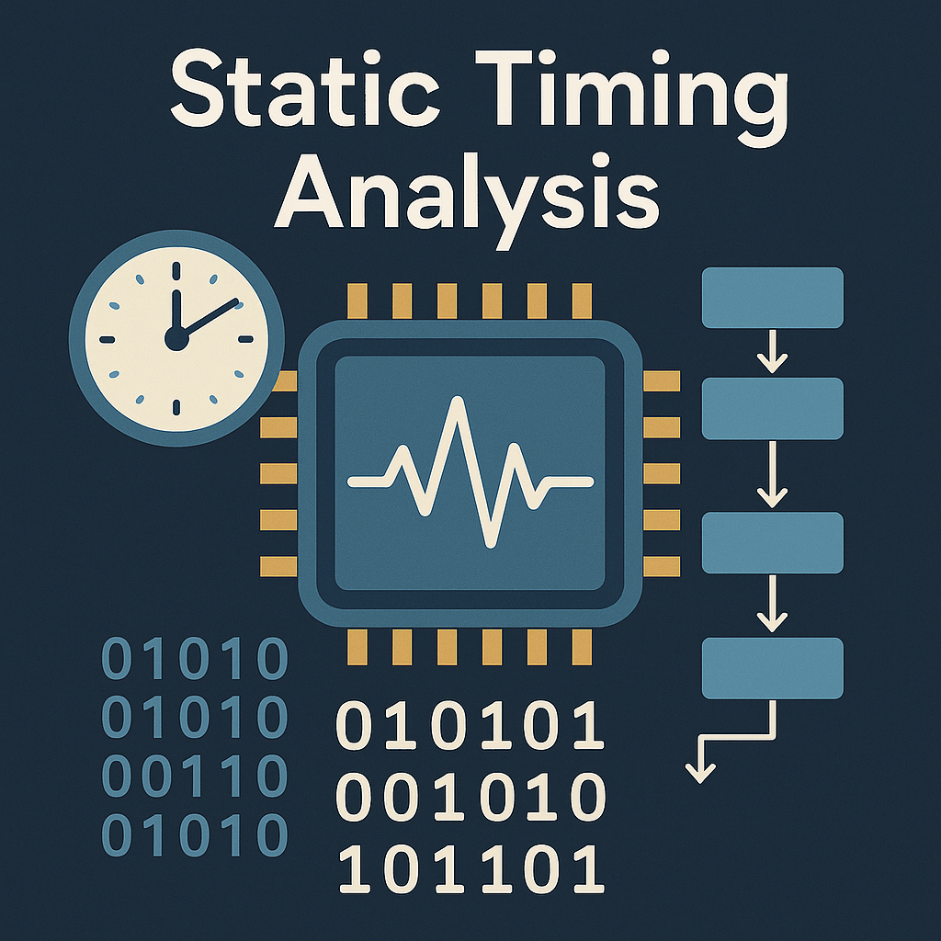
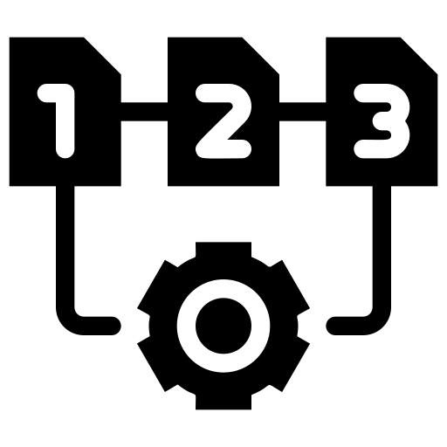

Combinational vs. Sequential Devices
Difference between Combinational and Sequential logic
Asynchronous and Synchronous Devices
Latches and Flip flops
Exercise: 3.1
Exercise: 3.2
Exercise: 3.3

Slide 5



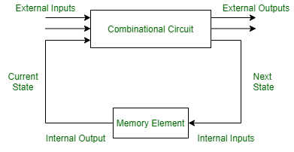
Combinational vs. Sequential Devices
Overview
Logic Characteristics
Feature | Combinational Device | Sequential Device
Definition | Output depends only on the current inputs | Output depends on current inputs and past history
Memory | No Memory | Has Memory
Feedback | No Feedback path | Has a Feedback path
Examples | Adder, Multiplexers, Decoders | Flip-flops, Counters, Shift registers, Memory units
Use Cases | Arithmetic operations, logic functions, data routing | State machines, sequence control, data storage

Slide 6

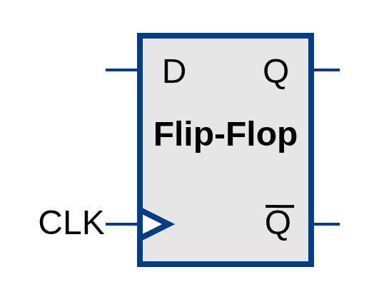
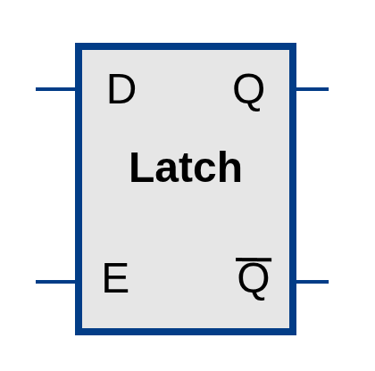
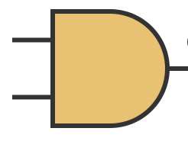
Combinational vs. Sequential Devices
Overview
Entity & Architecture
entity ENTITY is
Port (
SIGNAL : in STD_LOGIC;
SIGNAL : OUT STD_LOGIC;
);
end ENTITY;
architecture Behavioral of ENTITY is
declarations
begin
combinational statements
[label:] process (sensitivity list)
declarations
begin
Statement
end process;
end Behavioral
Synthesis
The simplest one-bit memory element
The simplest combinational device
sequential statements
Sensitivity list Only includes the Clock (and an asynchronous Reset if used)
Nonblocking assignment: (<=) "scheduled" to update
Statements
Combinational statements
Sensitivity list include ALL input signals read by the process (e.g., process(A, B, Sel))
Blocking assignment: (:=) Updates immediately.

Slide 7
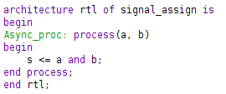
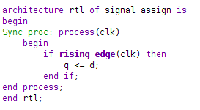
Combinational vs. Sequential Devices
Asynchronous and Synchronous
Asynchronous devices
All inputs are of the same priority,
Any change in the signal at any input can cause changes in the signals at any outputs.
Synchronous devices
Have one dedicated synchronization input (clk)
The input signals can affect the digital device only if there is a certain signal at this input

Slide 8

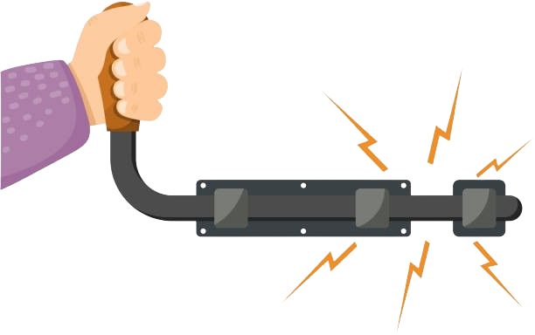




Combinational vs. Sequential Devices
Latches vs Flip-Flops
Latches and flip-flops are used to build complex sequential devices: registers, counters, RAMs, etc.
In complex designs it can lead to performance degradation
Poor synthesis and rooting of the design and
Can even cause unpredictable errors (difficult to detect)
It is important that the states of all sequential cells change simultaneously with a certain period.
Use a synchronization (or clock) signal → clock is GOOD
Several latches are with dynamic control (i.e., controlled by clock edges) are called flip-flops

Slide 9
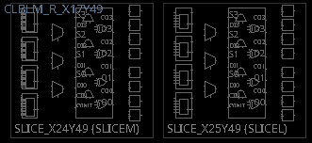
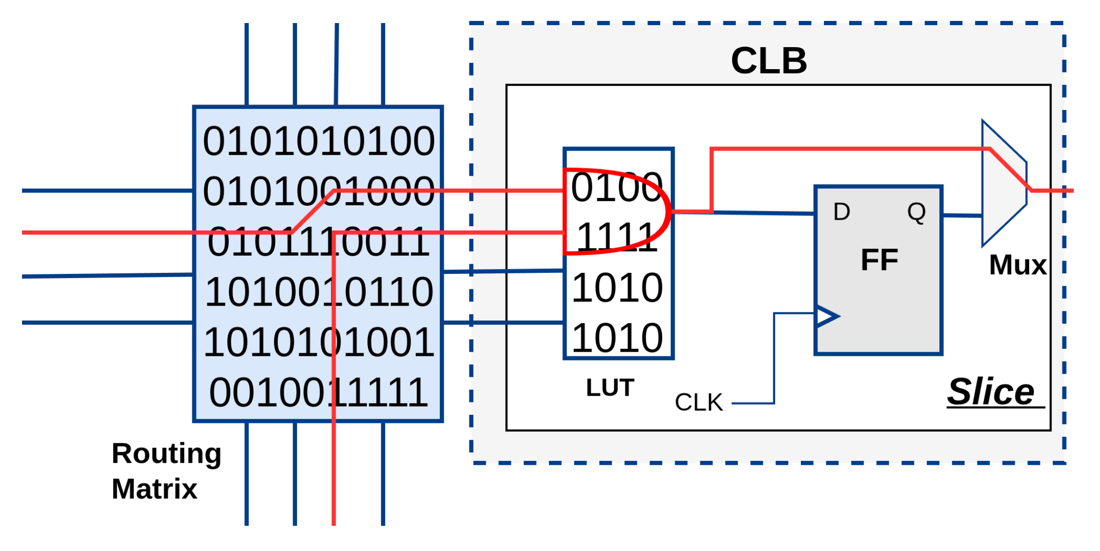
Combinational vs. Sequential Devices
Latches vs Flip-Flops
Flip-flops inside Xilinx FPGAs
LUTs
Carry Chain
Flip-Flops
Xilinx 7-Series ( Zynq-7000)
2 slices (SLICEM, SLICEL) per CLB
4 LUTs and 8 flip-flops/Slice
6-input, 2-output LUTs.

Slide 10

Combinational vs. Sequential Devices
The Sequential Timing Error: Signal Update Lag
In VHDL, signals within a process are updated only when the process suspends (reaches the end process or a wait).
During the execution of the process, all signals retain their "old" values from the previous time step.
process (clk)
begin
if rising_edge(clk) then
Q <= D; -- Schedules Q to become D
QB <= not Q; -- ERROR: Uses the OLD value of Q (from before this clock edge)
end if;
end process;
What is actually happening?
At Time T (Clock Edge): The process wakes up.
At Time T + δ : Both Q and QB update simultaneously.
Result: QB is now the inverse of what Q used to be, not what it just became.
process (clk)
begin
if rising_edge(clk) then
Q <= D;
QB <= not D; -- Both update to reflect the new state of D
end if;
end process;

Slide 11

Exercise Time
Now it’s your turn!
Combinational vs. Sequential Devices
Exercise 3.1: Ring Counter Implementation
Exercise 3.2: If-elsif-else vs. Case
Exercise 3.3: Latches vs. Flip-Flops

Slide 12



Combinational vs. Sequential Devices
Exercise Time
Execute the Command
source scripts/ex3-combinational-vs-sequential-exercise.tcl
3.1 Ring Counter Implementation
You are provided with three Ring Counter Architectures
Have a look at each implementation and note the differences
Synthesis the design
Check the resources needed for each implementation
Which one would you choose for your design
ex31a_ring_edgedet.vhd
ex31b_ring_overflow.vhd
ex31c_ring_msbreset.vhd
Modular decomposition produces smaller, faster, and more debuggable hardware
Functional correctness alone is not enough for a good design.

Slide 13
Combinational vs. Sequential Devices
Exercise Time
3.2 If–Elsif–Else vs Case
You are provided with two Multiplexer Architectures
Have a look at each implementation and note the differences
have a look at the elaborated design then synthesis the design
Check the resources needed for each implementation
Which one would you choose for your design
ex32a_mux_if.vhd
ex32b_mux_case.vhd
Both constructs produce identical synthesis resources for a 4-to-1 mux.
if--elsif--else statements create priority logic and long cascaded multiplexer chains, while case statements allow balanced, parallel implementations.
For small multiplexers, both methods perform similarly, but for wide multiplexers the case implementation generally achieves better timing due to reduced logic depth

Slide 14
Combinational vs. Sequential Devices
Exercise Time
3.3 Latches vs. Flip-Flops
You are provided with different Architectures for Combinational logic
Have a look at each implementation and note the differences
have a look at the elaborated design then synthesis the design
Check the resources needed for each implementation
Which one would you choose for your design
ex33a_src_comb.vhd
ex33b_src_latch.vhd
ex33c_src_ff_clocked.vhd
ex33d_src_ff_clocked_not_full.vhd
Incomplete combinational logic infers unintended latches, while synchronous clocked processes rely on FF and never generate latches.
Covering all branches in combinational logic is essential to avoid unstable behavior and resource inefficiencies in FPGA designs.
A missing branch in a combinational process always infers a latch.

Slide 15
Static Timing Analysis
Acceleration computation
PART 1
Exercise: 4.1
Exercise: 4.2
Exercise: 4.3
Exercise: 4.4
Exercise: 4.5

Slide 16

Static Timing Analysis
Motivation: Computing Acceleration
Sensor delivers a new velocity measurement every clock cycle
Goal: real-time acceleration output
Strategy:
Compute the difference between current and previous velocity
Divide by time step Δt
accel
clk
v_in
a_out
dt
a = Δv / Δt

Slide 17
Exercise Time
Now it’s your turn!
Move to the 4-timing-exercise folder
Open a terminal and run vivado -source scripts/ex4_timing-exercise.tcl
Implement the acceleration computation in VHDL
Check your results in simulation using the provided testbench
accel
clk
v_in
a_out
dt
Hints:
Use the existing ex41_accel.vhd file as template
You should know how to delay a signal by one clock cycle from the previous sections
VHDL has the “/” operator to divide two numbers
a = Δv / Δt

Slide 18
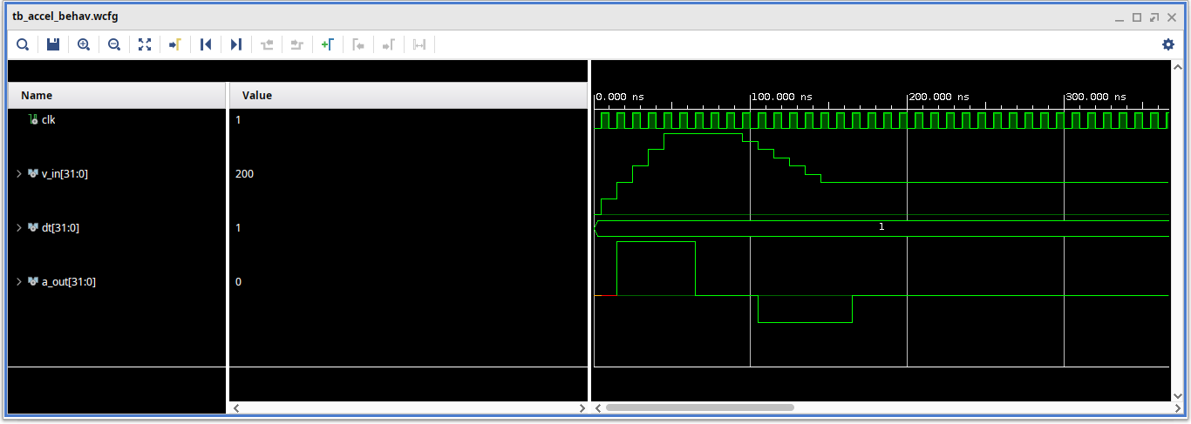
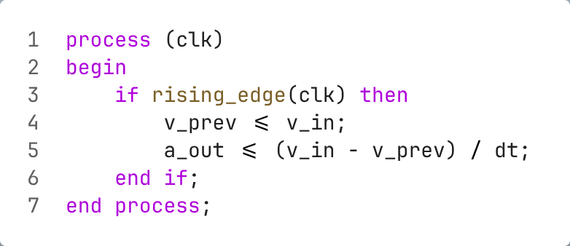
Exercise 4.1: Solution
Naive Acceleration Computation
Key Observations
Direct translation of the equation
v_prev stores the previous velocity sample
Subtraction, division, and register update all in one clock cycle

Slide 19
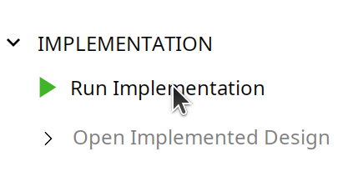
Exercise Time
Now it’s your turn!
Run the full implementation flow
Open the implemented design when finished
Check the Timing Summary – does the design meet timing?

Slide 20
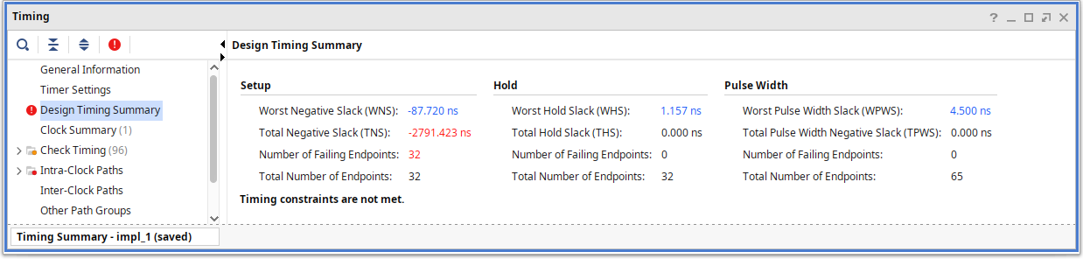
Timing Has Failed!

Slide 21
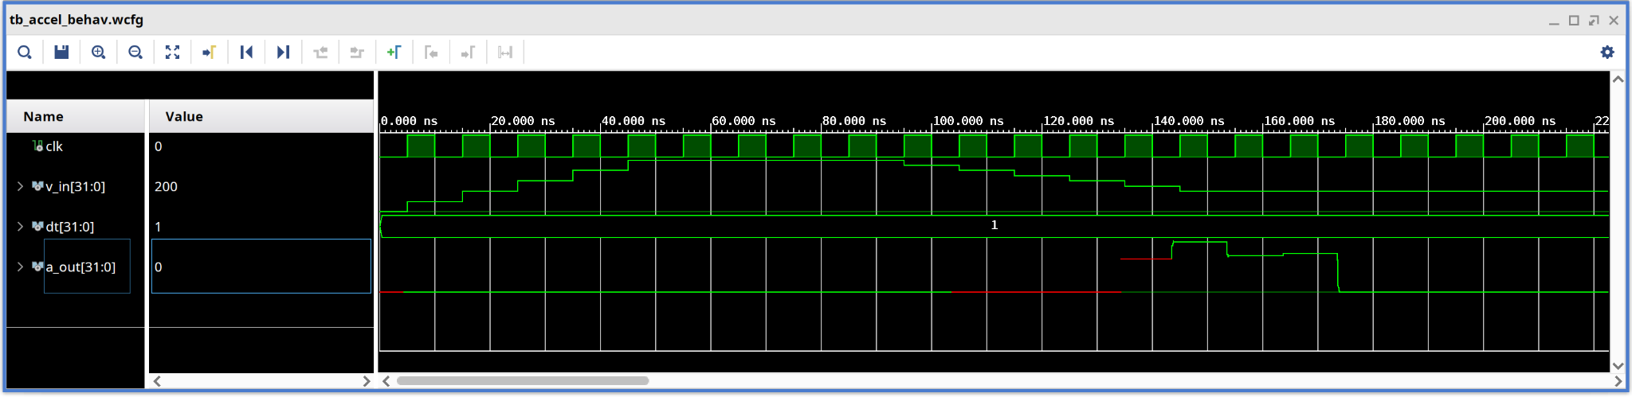
What could possibly go wrong?
Post Implementation Timing Simulation

Slide 22
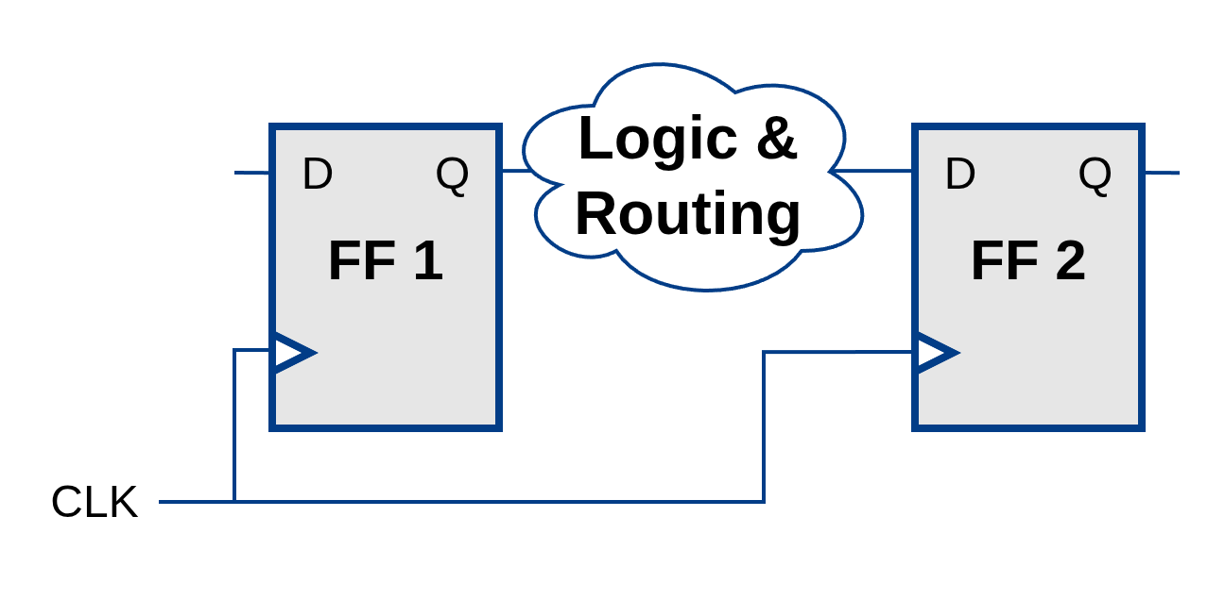
Static Timing Analysis
Propagation Delay
Propagation Delay
Time it takes for a signal to travel from a source to a destination
Voltages in wires takes time!
Intra-logic element delay: ~10–100 ps per logic gate or LUT (lookup table).
Interconnect delay: ~100–500 ps per segment, depending on routing length and FPGA family.
Example: A long route uses 20 interconnect segments × 200 ps each
→Total delay ≈ 4 ns.
The longer the propagation delay, the slower your clock is able to run
Critical Path: The path in a digital circuit that has the longest delay, determining the maximum operating frequency of the device.

Slide 23
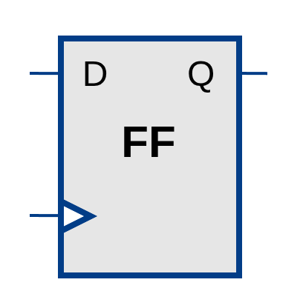
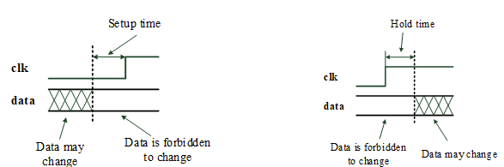
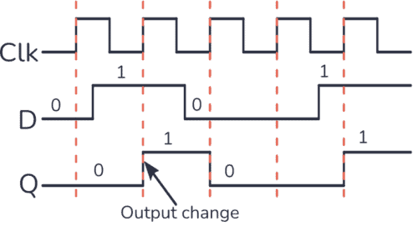
Static Timing Analysis
Setup & Hold Time
Modern digital devices are usually synchronous
Synchronous sequential elements (e.g. . flip-flops) are characterized by two time parameters:
setup time and hold time
If data signal changes inside a special time window, the flip-flop may go into metastable state
D-Type Flip-flop
Setup time
Minimum time required before clock edge for stable data capturing.
Hold time
Minimum time required after the clock edge for stable data keeping.

Slide 24
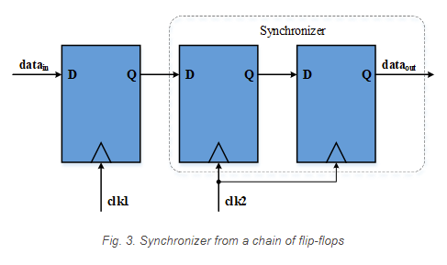

Static Timing Analysis
Metastability
Metastable State
An unstable state of a flip-flop where it cannot resolve the input signal, leading to unpredictable output states.
During that time, the output of the Flip-Flop is undefined and might even oscillate.
In most cases, the flip-flop will return to the allowed state fairly quickly (Depends on the FPGA technology).
Mean time between failures
No way to fully eliminate metastability in case of asynchronous signals capture
Mean Time Between Failures (MTBF)
C1 and C2 are constants determined by semiconductor technology
Fclk : clocking frequency of capturing flip-flop
FDATA : data signal change average frequency
tMET :time available to exit the metastable state
~tens 𝝁s
Probability of failure can be reduced by using Synchronizers
Synchronizers are a chain of Flip-flops located close to each other.
Asynchronous FIFOs based on dual-port RAM are used to capture asynchronous multi-bit signals
FIFO: First In First Out

Slide 25
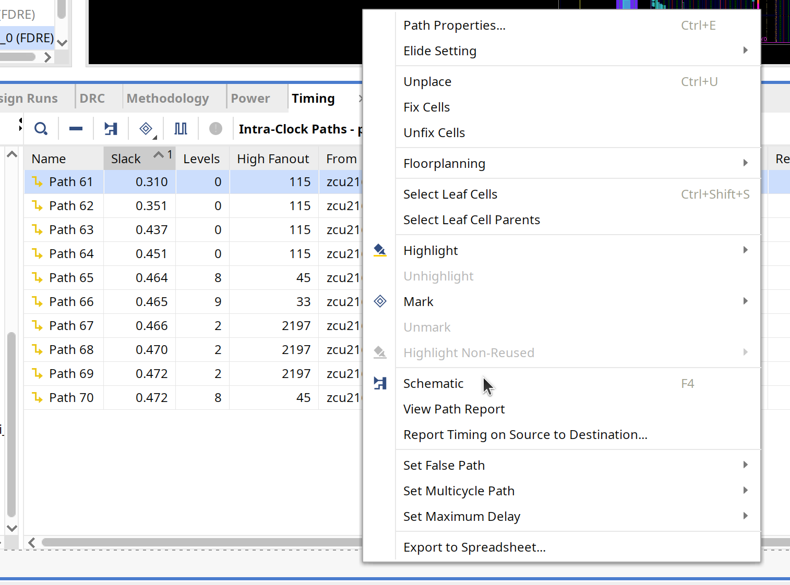
Exercise Time
Now it’s your turn!
Open the timing report and sort by worst slack
Identify the source and destination registers of the critical path
Why is timing failing?
Hints:
Right-clicking a path →Schematic (F4) shows the critical path

Slide 26
Critical Path Analysis
The logic generated by the division operator generates a very long chain of logic gates
All of this combinational logic must settle within a single clock period
Key Takeaway
Division, multiplication of wide operands, trigonometric functions, etc. synthesize into deep combinational logic that is very likely to cause timing violations at typical FPGA clock rates
Addition, subtraction and bit-shifting are the notable exceptions–they are fast and cheap

Slide 27
Resolve Timing Issues (critical path constrained)
Lower the clock frequency
Pipelining
parallelize operations
More advanced methods (constrained placement, multicycle paths, retiming) → not covered here

Slide 28


Static Timing Analysis
Timing Errors
Tell the tool (place & route)
your clock frequency
Fixing Time Errors:
The clock Period is controlled by
T_{clk} ≥ T_{Setup} + T_{Hold} + T_{Propagation}
Fix timing error
setup/hold times
violation ?
Dictated by the FPGA
Can be controlled
Timing error
Basic Fixes
Slow down the clock frequency
Break your logic up into stages (Pipeline)
Very common

Slide 29
Exercise Time
Now it’s your turn!
Reduce the clock frequency to fix timing violations
Hints:
Clock frequencies are defined in the constraints
It will likely suffice to make the clock ~10x slower

Slide 30
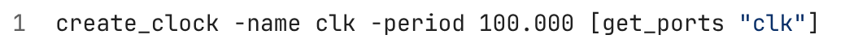
Exercise Time
Solution 4.4: Reduce the clock frequency
Key Takeaway
Meets timing
But: design now runs at 1/10th of the original clock rate and processes samples 10x slower!

Slide 31
Static Timing Analysis
Pipelining
Long Combinational Chain
S1
S1
S1
FF
FF
FF
FF
FF
FF
Without Pipelining
With Pipelining
Key Takeaway
Pipelining introduces additional latency
Breaks up long combinational chains by inserting additional register stages

Slide 32
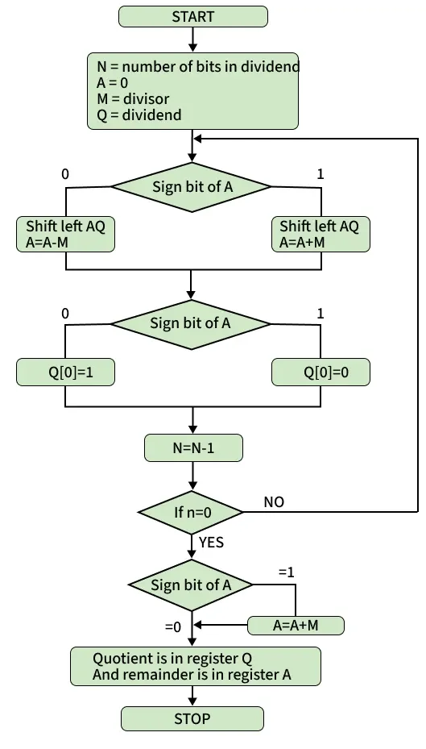
Static Timing Analysis
Non-restoring division algorithm
Dividend
Divisor
FF
Shift, add or subtract
FF
Shift, add or subtract
FF
Quotient
Remainder

Slide 33
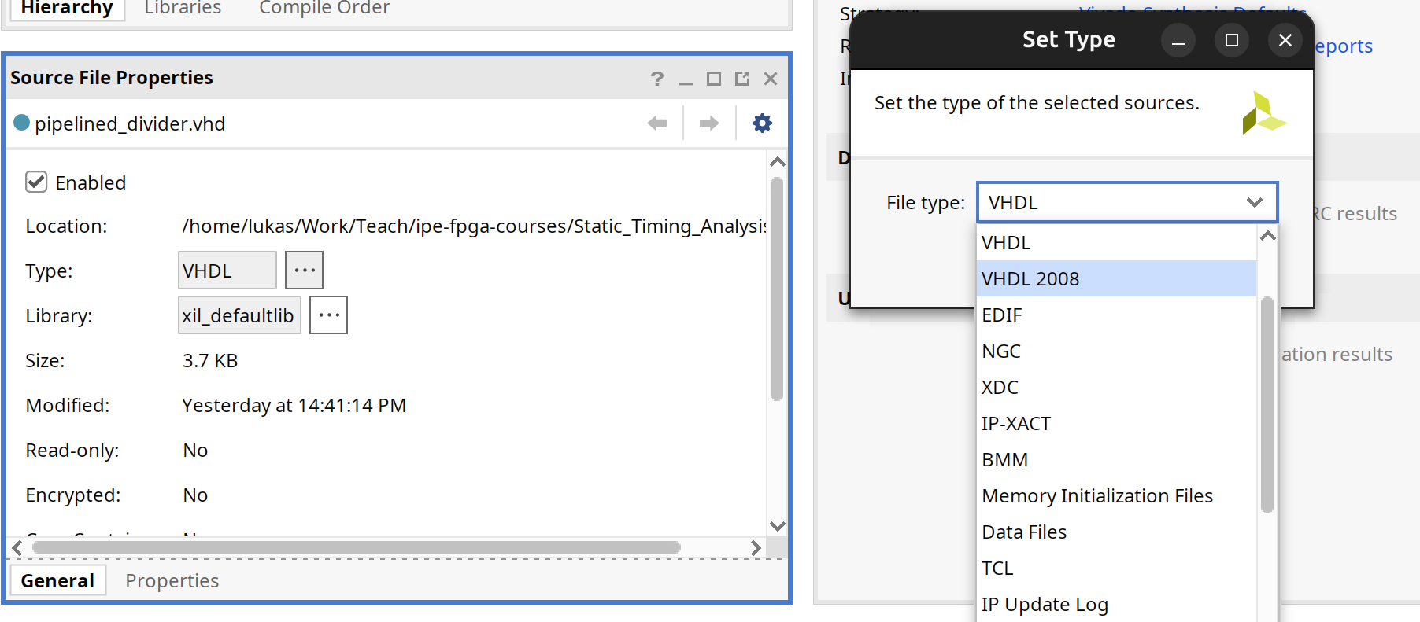
Exercise Time
Now it’s your turn!
Add the ex42_pipelined_divider.vhd file
Change file type from VHDL to VHDL 2008
Integrate the pipelined divider and replace the division operation (replace your previous solution)
Check by simulating the design
Hints:
Leave the reset signal at ‘0’. We don’t use a reset in this exercise
Similarly, drive valid_in high (set it to constant ‘1’), and ignore valid_out

Slide 34
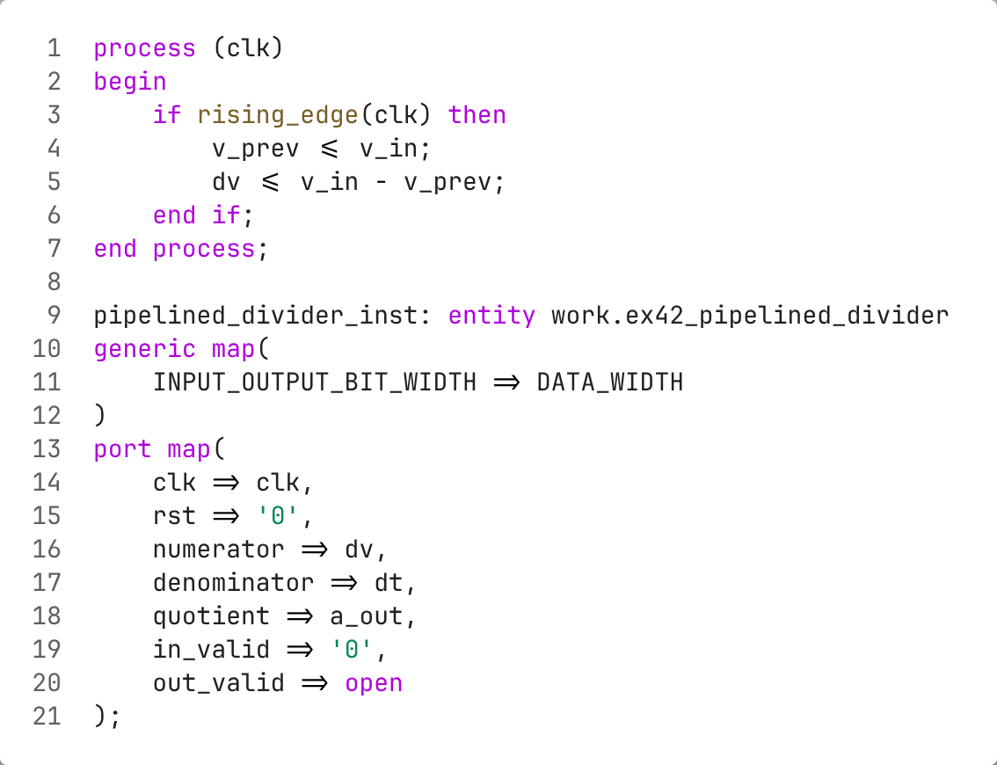
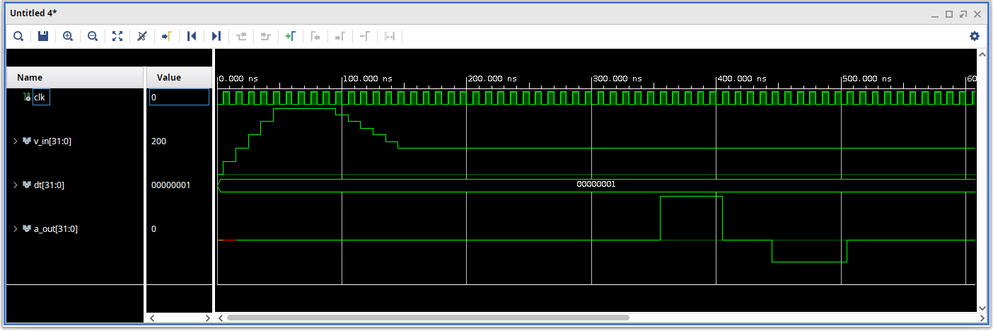
Solution 4.5: Simulation runs, now with additional delay

Slide 35
Exercise Time
Now it’s your turn!
Implement the new design
Does timing still fail?

Slide 36
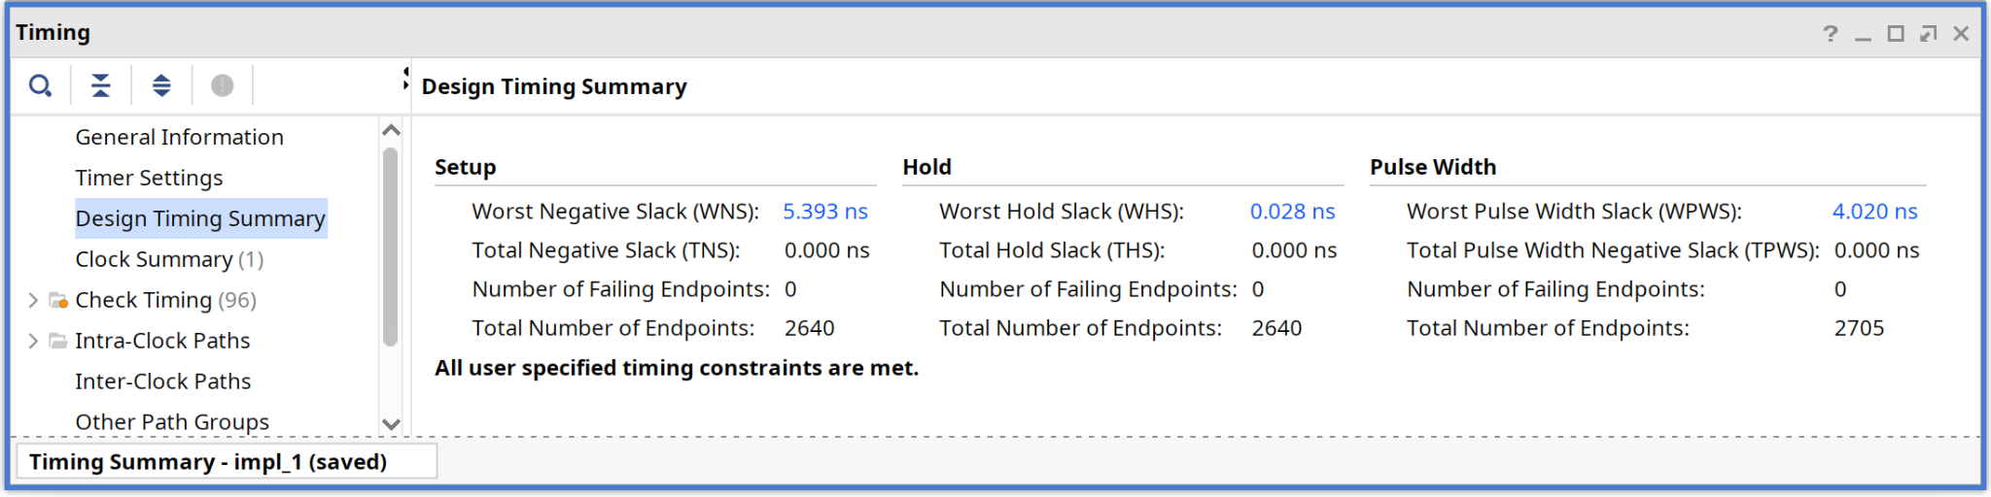
Solution 4.6: Timing now succeeds

Slide 37
Recap: What we have learned
Timing is important: A design that behaves correctly in simulation can fail in hardware
Complex calculations in FPGA, if implemented in a naive way, will impact timing negatively
Reducing the clock speed can help fixing timing issues
Pipelining is the most common way to fix timing issues

Slide 38
Timing and Critical Path
Using Parentheses for Summation
PART 2
Exercise: 4.3

Slide 39
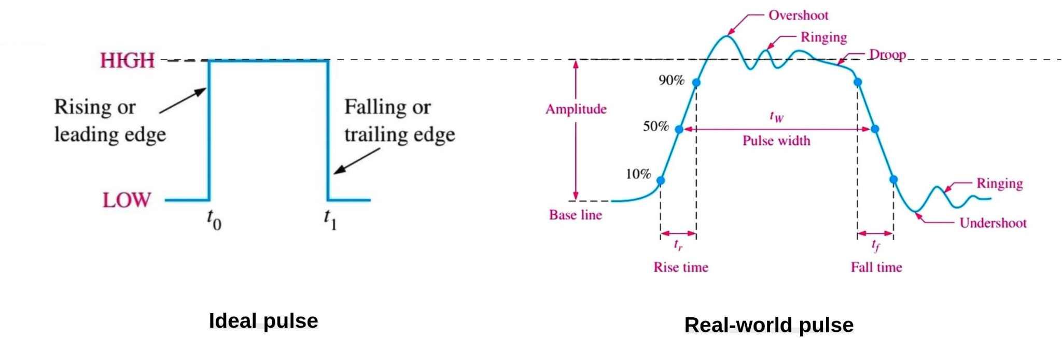
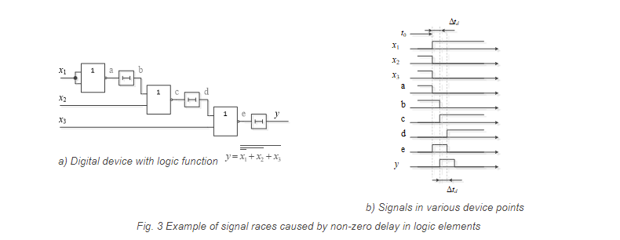
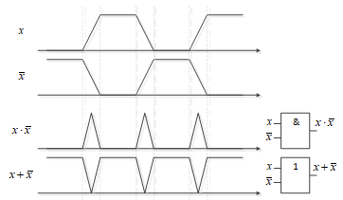
Timing and Critical Path
Signal Races in Digital Devices
“Asynchronous circuits are infamous for having race conditions where the behavior of the circuit depends on which of two paths through logic gates is fastest. “
Digital Design and Computer Architecture by D. Money H. & S. L. Harris. p.114
Real-world pulses—unlike ideal ones—often show overshoot, undershoot, and ringing.
The pulse width stays the same ideally, but edges are rounded and may shift in timing
Signal Races
An event when the digital device operates not according to Boolean algebra rules due to transients.
1. Non-zero duration of pulse edges
2. Non-zero delay of logic elements
Change in the input logic levels
“strange” pulses appear
Digital logic with logic function
y=0 before and after inputs change (Ideal).
The inner signals renewal after inputs change will occur with a delay Δt_{d} (Real)
Signal raсes in AND and OR logic gates

Slide 40
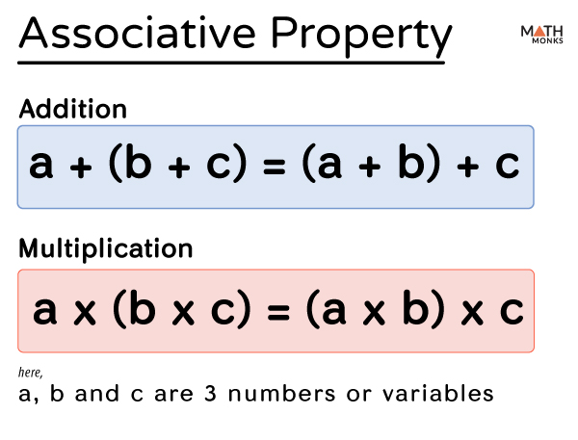

Timing and Critical Path
Impact of Operation Grouping on Timing
In math, addition and multiplication are always associative
With real fruits, mixing isn’t associative
The same fruits in a different mixing order can give you a different taste and texture
Try it with the Orange-Cranberry Cocktail
In digital design, changing the grouping of operations can lead to different hardware structures and different performance, even if the final mathematical result is the same.
Example: Grouped addition vs ungrouped addition:
Adding the four signals (X1, X2, X3, X4)
Ungrouped Addition
Grouped Addition
(((X1 + X2) + X3) + X4)
((X1 + X2) + (X3 + X4))

Slide 41

Timing and Critical Path
Coding structure and FPGA Performance
In FPGA design, the way operations are structured in code directly affects how the hardware is synthesized.
Even when resource usage remains unchanged, different coding styles can lead to significant differences in performance.
So, just like in cooking, the order of operations in coding matters a lot!
key points:
Critical Path:
– The ordering and grouping of operations influence the critical path
– A shorter critical path enables higher clock frequencies and better performance.
Resource Utilization:
– The number of resources (e.g., adders or registers) may stay the same,
but their interconnection and placement can vary.
– Different architectures can optimize for speed, latency, or timing closure.
it is necessary to break up the critical path with flip-flops and, thereby, increase device latency to increase the device maximum clock frequency.
It is necessary to parallelize the signal processing algorithm to reduce latency, which leads to resources number increase, or combinational logic usage, which reduces the maximum clock frequency.

Slide 42
Exercise Time
Now it’s your turn!
Static Timing Analysis
Exercise 4.2: Using Parentheses for summation

Slide 43
Timing and Critical Path
Exercise Time
Execute the Command
source vivado/ex47-timing-parentheses.tcl
4.7 Using Parentheses for Summation
You are provided with two architectures for the same Mathematical operation ( 𝑦 = 𝑥1, 𝑥2, 𝑥3, 𝑥4)
Have a look at each implementation and note the differences
Synthesis the design
Check the resources needed for each implementation
Which one would you choose for your design
ex43a_sum_no_prnths.vhd
ex43b_sum_w_prnths.vhd
Without grouping using parentheses
With explicit grouping
The way operations are grouped in digital design has a direct impact on the hardware structure.
Different groupings lead to different arrangements of logic elements, which in turn affect the length of the critical path and the achievable clock frequency.

Slide 44



Partial Reconfiguration
Partial Reconfiguration
Dynamic Function eXchange
Internal Configuration Access Port (ICAP)
Exercise: 5.1
Exercise: 5.2

Slide 45
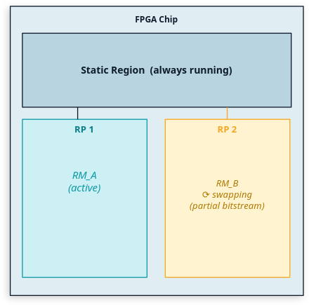

Partial Reconfigurations
Overview
Definition
The ability to reconfigure specific regions of an FPGA — called Reconfigurable Partitions (RPs) — while the static portion of the design continues running normally.
Key Terminology
Static Region: Always-on logic, never touched during PR
Reconfigurable Partition (RP): The "island" that gets swapped
Reconfigurable Module (RM): A specific implementation loaded into an RP
Dynamic Function eXchange (DFX): Vivado's brand name for Partial Reconfiguration
Typical applications
Design of flexible systems wrt algorithms, protocols etc.
Resource usage reduction if not all parts are used all the time
Run different algorithms on the same physical gates at different times.

Slide 46

Partial Reconfigurations
"Partial Reconfiguration is like swapping the engine while the car is running on the highway"

Slide 47
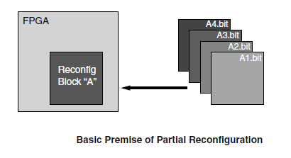
Partial Reconfigurations
Vivado Workflow
Synthesize the static and Reconfigurable Modules separately.
Create physical constraints (Pblocks) to define the reconfigurable regions.
Set the RECONFIGURABLE property on each Reconfigurable Partition
Implement a complete design:
Static Module
Reconfigurable Module per Reconfigurable Partition)
Save a design checkpoint for the full routed design.
Create bitstreams for each configuration.
Full Bitstream: Configures the entire FPGA from scratch.
Partial Bitstream: A small file containing only the configuration frames for a specific Pblock.

Slide 48

Partial Reconfigurations
Configuration Interfaces
In today's exercise
ICAP
(Internal Configuration Access Port)
JTAG
PCAP
(Processor Configuration Access Port)
(SelectMAP or Serial for In-System-Configuration)
See ICAP Interface from Xilinx
See PCAP Interface from Xilinx
See SelectMAP Interface from Xilinx

Slide 49
Exercise Time
Now it’s your turn!

Slide 50
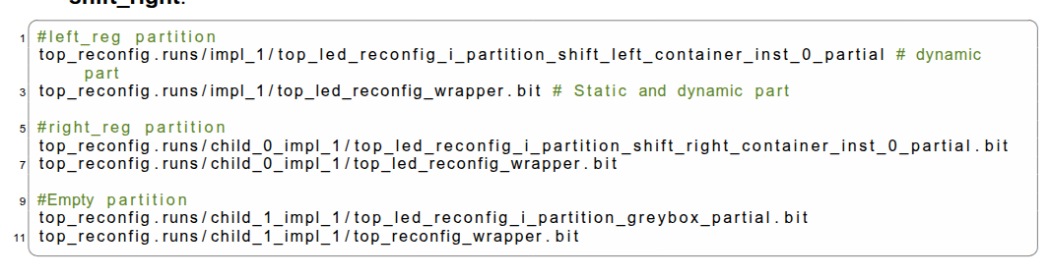
Partial Reconfigurations
Exercise Time
Execute the Command
source vivado/ex5_create_partial_reconfig_design.tcl
5 Creating Partition block
Follow the instructions in the provided Pdf document
Create bitstreams for your configurations
How many bitstreams you have
4. Test each bit stream on your board by configuring the Red Pitaya using JTAG
It is possible to reconfigure specific regions of an FPGA — called Reconfigurable Partitions (RPs) — while the static portion of the design continues running normally.
Careful floorplanning, partition boundary definition, and interface locking are important to ensure reliable operation of dynamically reconfigurable modules

Slide 51

General Advices

Slide 52

General FPGA Programming Advices
Take away message
Device Design Principles
View FPGA design as creating a device, focus on components and their connections rather than writing a program.
Maintaining a clear hierarchy of components simplifies debugging and enhances resource efficiency.
Design Validation
simulate the operation of the developed device in simulator before loading the bitstream into FPGA.
Verify your critical signals with ILA:
Probe the raw combinational net.
Probe the registered output.
Confirm no spikes appear after the register.
Resource Management
In general, it is better to use signals, rather than variables.
This will provide more predictable synthesis results. Operations with variables are done with 0-delay, immediately. It is sometimes not so easy to predict, which logic scheme would be created from variables.

Slide 53
General FPGA Programming Advices
Take away message
Pay attention to the completeness of the analyzed conditions when implementing combinational blocks with conditional statements (if, case). Otherwise, latches will be generated.
Reset Signals
Avoid global reset, set, and data enable signals. Otherwise, routing resources overusage happen.
Not all FPGA resources have a built-in reset signal (e.g. SLICEM (Slice Memory) in Xilinx FPGAs).
Using a reset signal with a logic that uses SLICEM (e.g. shift register ) will significantly increase the required FPGA resources
Clock Signal Management
Each component should have a single clock signal,
Avoid the generation of new clocks from the main clock frequency divider on the counter.
Use built-in FPGA resources to create a new clock signal from the main one (for Xilinx, these are DCMs and PLLs).
Clock signals should directly connect to flip-flops, bypassing combinational logic for proper timing.
In complex digital devices it is important that the states of all sequential cells change simultaneously with a certain period. To solve this problem, it is necessary to select a special synchronization signal and provide bistable cells

Slide 54
General FPGA Programming Advices
Take away message
Overcoming of signal races
Never rely on pure combinational logic for timing‑critical paths.
Use registered (synchronous) logic wherever possible,
i.e. place a flip‑flop after each combinational block that drives downstream logic.
The flip‑flop filters out glitches because it only samples the signal on a clock edge.
Maintain synchronization between logic elements.
Logic elements update is allowed only at special clocking signal edges (rising, falling or both).
The combinational device switching must take place in less time than clock period.
ALWAYS REGISTER the output of any multi‑input combinational block y_reg <= comb_logic;
Factoring reduces the number of parallel product terms
yy <= a and (b or c); is FINE, y <= (a and b) or (a and c); is BAD
The FPGA IDEs usually contain the IP-cores repository (Vivado IP repository).
IP-cores are strictly tested and checked for resources and performance, use them
BALANCE the arrival times of inputs that change together.
Use BUFH / BUFIO for clock‑tree like distribution.
Add a small buffer (BUFH) on the faster path if needed

Slide 55
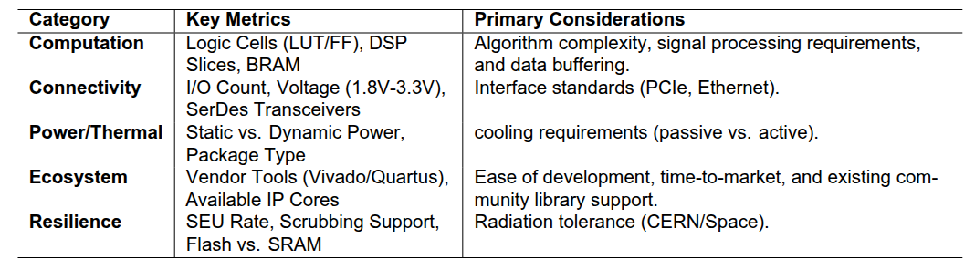

General FPGA Programming Advices
FPGA Selection Decision
Rule of Thumb:
“ As a general heuristic for FPGA design, it is recommended to select a device where your initial design utilizes no more than 70% of the available resources”

Slide 56
Thank
You

Slide 57

Backup Slides

Slide 58

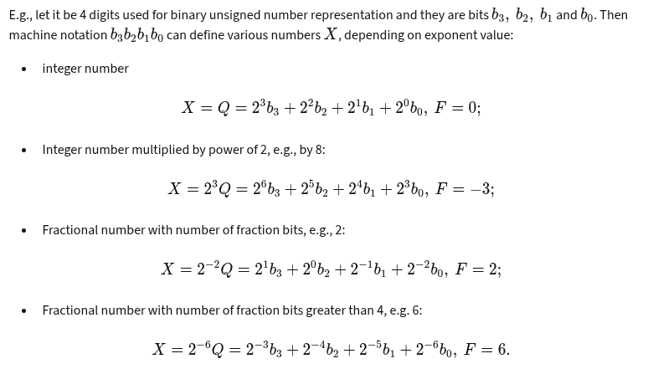


Fixed-point numbers representation
Real World Example
A real-world value of a number is:
Where:
Q is the raw integer value stored in hardware (binary sequence of N bits).
F is the scaling factor, or the fractional bits, determining where the binary point sits.
The exponent, also called weight, that scales Q to get the real-world value X.
Example 1: represent the real number 22.375 digitally using fixed-point scaling.
N = 8 (8-bit integer)
Q = 10110011 = 179 decimal
F = 3 (binary point between bit 3 and 4 counting from MSB)
Example 2: represent the real number 0.0146484375 digitally using fixed-point scaling.
N = 8 (8-bit integer)
Q = 0011 1100 = 60 decimal
F = 12 (binary point between bit 3 and 4 counting from MSB)
Here:
The point itself and its location exist only in the developer's head
A convenient and common representation is:
(sgn,N,F) = (0,16,10)
Meaning:
unsigned, 16 total bits, 10 fractional bits

Slide 59







Fixed-point numbers representation
How to choose scaling
Define the expected numeric range
Signed or unsigned
unsigned if X ≥ 0
signed if X can be negative
integer bits define the range.
Choose N (bit width), defined by
Hardware interface
Memory width
DSP block size (8, 16, 24, 32 bits)
Compute the MAXIMUM safe F (to avoid overflow)
Check resolution (quantization error)
Fractional bits define the resolution;
Normalize signals to −1 ≤ X < 1
X = 0.0146484375
N = 16
Q Max binary sequence of N bits stored in hardware

Slide 60


Fixed-point numbers representation
Resolution
The same real number can be represented with many valid scalings.
Format: (1, 16, 15) (Q1.15)
Stored integer range:
numeric range
Dynamic range: (Max value ≈ 1, Smallest step 2−15)

Slide 61

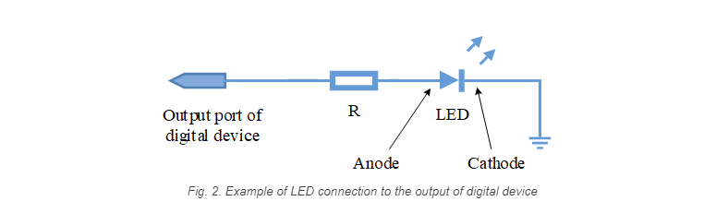


Digital Signal Basics: Inputs and Outputs
Switches and LEDs
Switch and LEDs : the simplest sources and receivers of digital signals that we use in laboratory works
Generate a voltage level corresponding to logic zero or one.
The switch has two pins:
One connected to ground
One connected to the input of the digital device
The input port is connected to the supply voltage via a pull up resistor
If positive voltage is applied between the anode and cathode > nominal value (1.5 V) → LED lights up
The logical 1 at the output port → high voltage level.
current flows through the resistor R
The LED is on.
The logical 0 at the output port → Zero voltage level.
no current flows through LED
The LED is off
V_{A}= VDD
V_{A}= 0

Slide 62



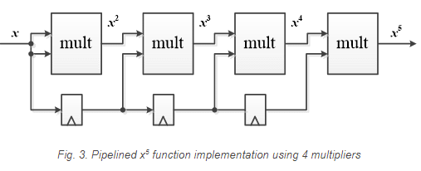
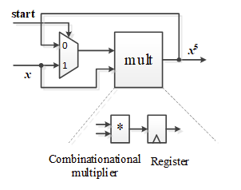
Static Timing Analysis
Device throughput vs Number of resources
Device throughput
It is the number of bits or N-bit words, which are processed per unit of time (one clock cycle)
Example: digital filter has a throughput of 0.1 sample per clock cycle (1/10 clock cycles)
if the Sample width: 16 bits (this does not affect throughput, only data size)
Given clock frequency 500 MHz
Maximum achievable sample rate
Therefore, the filter can process a 16-bit input signal only if its sampling frequency does not exceed 50 MHz.
Can this be improved?
yes, using Pipelining
Latency = time for one sample to go from input to output
Throughput = how many samples per second you can process
Pipelining:
❌ Increases latency (more stages)
✅ Greatly increases throughput

Slide 63
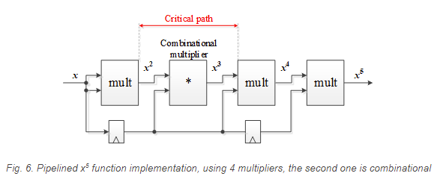
Static Timing Analysis
Latency vs Maximum clock frequency
time it takes to calculate the result is determined by:
the number of clock cycles during which the necessary operations are performed
the value of the clock frequency at which the device operates
The HIGH the clock speed, the LOW the latency.
The FEWER clock cycles per operation, the LOWER the latency
combinational multipliers can be used to reduce latency in the pipeline
I.G. perform multiplication without results latching.
The price of flip-flops removal is critical path length increase
The latency reduced to three clock cycles,
the critical path length increased.

