Slide 1
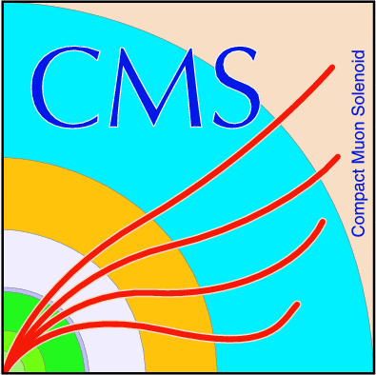
“Measurements of very-forward energy with the CASTOR calorimeter of CMS “
Presented by
Mahmoud Attia Mahmoud
Research Assistant at AEA

Slide 2
Outlines
LHC and its experiments
CMS Experiment
Tracker
Electromagnetic calorimeter ECAL
Hadron calorimeter
Magnet
Muon detectors
CASTOR detector
Jets in CASTOR

Slide 3
LHC and its Experiments
In Geneva near the France-Switzerland border, the European Organization for Nuclear Research (CERN) operates and maintains the LHC collider.
With a diameter of 8.5 km and a circumference of 26.7 km the LHC is the largest hadron accelerator in the world. It is installed in the existing tunnel system of the CERN LEP machine and located between 45m and 170m below the surface.
There are four major experiments placed at the interaction points (IP) where the beam particles collide.

Slide 4
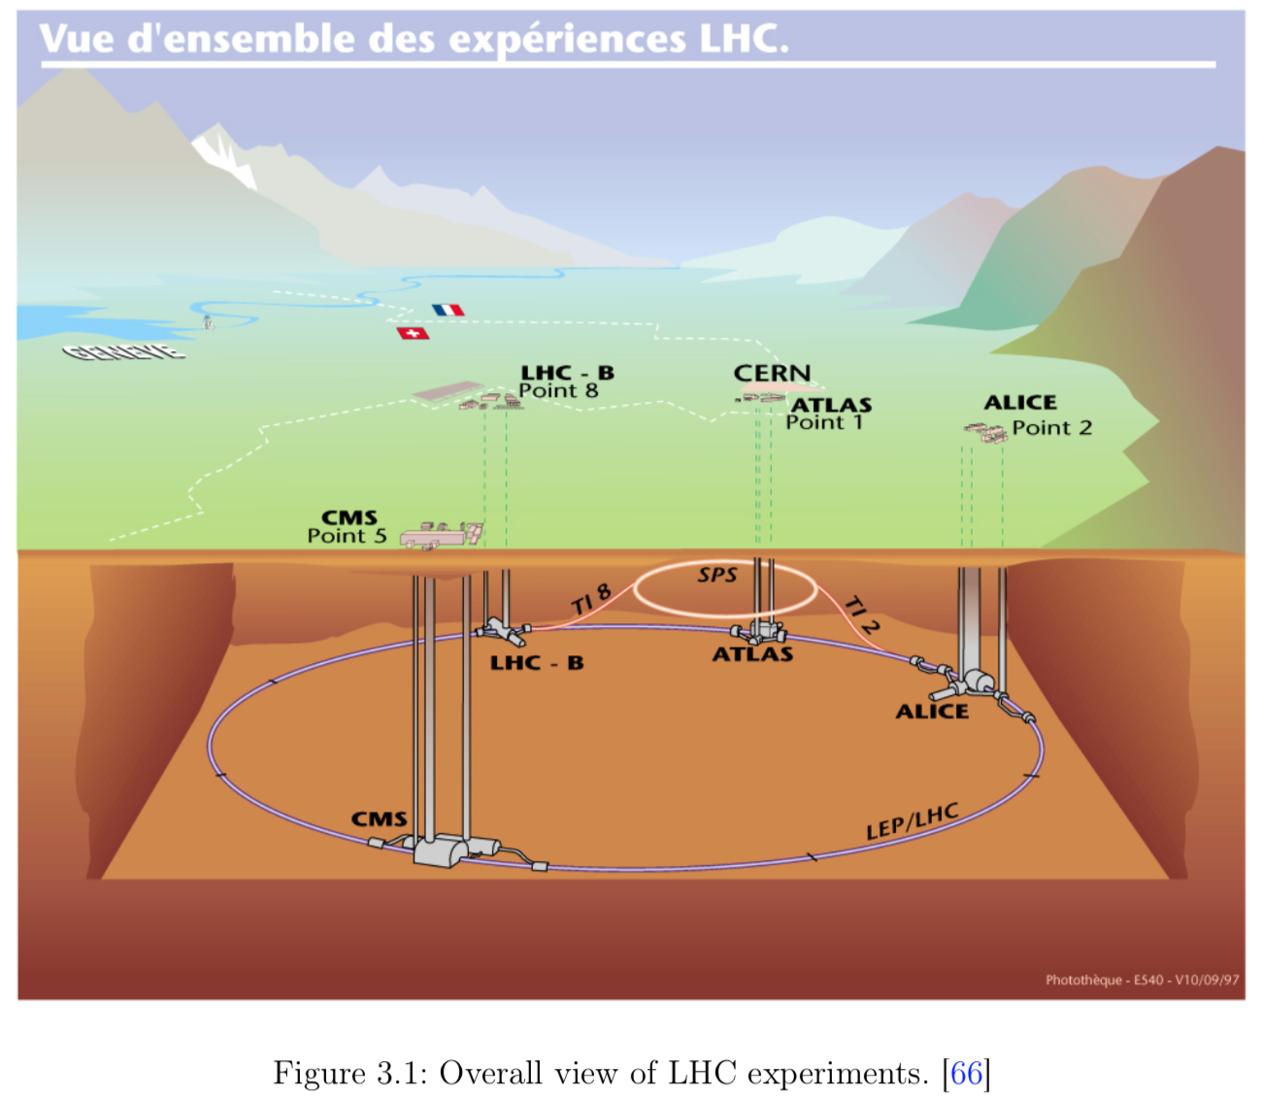

Slide 6
LHC and its Experiments
ALICE (A large Ion Collider Experiment), a detector designed to investigate collisions of lead nuclei at center of mass energy of 5.3 TeV per nucleon when LHC beams 14 TeV for protons. Under these extreme conditions, a new state of matter, called quark-gluon plasma is expected to be observed.
LHCb (LHC beauty), the only asymmetrical detector at the LHC, specializes in investigating the production and decay of particles containing b-quarks. The central focus lies on providing the best possible resolution of secondary vertices along the beam-line which are a typical signature of b-quark decays.
ATLAS (A Toroidal LHC Apparatus) and CMS (Compact Muon Solenoid) are two multi-purpose detectors with different construction principles and magnetic field designs. Both have a broad physics program including Standard Model and new physics.

Slide 7
The main goals of the experiments are:
to explore particle physics cross-sections in the TeV scale.
discover the Higgs boson, the gauge boson particle thought to be responsible for the property of mass. ➔ Higgs discovered 2012 ➔ Noble price 2013
look for evidence of supersymmetry which would confirm the theory that explains the non-existence of anti-matter in the universe.
search for extra dimensions, showing up as missing transverse energy .
using Pb nuclei, study heavy ion collisions.
make more accurate measurements of already discovered particles, such as, the top quark.
Search for new physics.
Rewriting physics.

Slide 8
CMS Experiment
The Compact Muon Solenoid (CMS) is one of the four major experiments using the data of LHC.
CMS is installed in a cavern 100 m below the surface at P5.
With the CMS detector various aspects of elementary particle physics can be studied. For this purpose, the CMS detector measures high energy collisions of protons or heavy ions with up to 100 collisions in one single beam crossing.
The detector consists of different layers of subdetectors to achieve a good performance and reconstruction of the outgoing products of a collision.
Overall, the detector has a length of 21.6m, a diameter of 14.6m and a total weight of 12.5 kt. Since the beams can cross up to every 25 ns the detector materials and electronics have to withstand the radiation damage caused by this high particle flux.
Additionally, the electronics and computing power have to handle a huge amount of information in short time for readout and preselecting events.

Slide 10
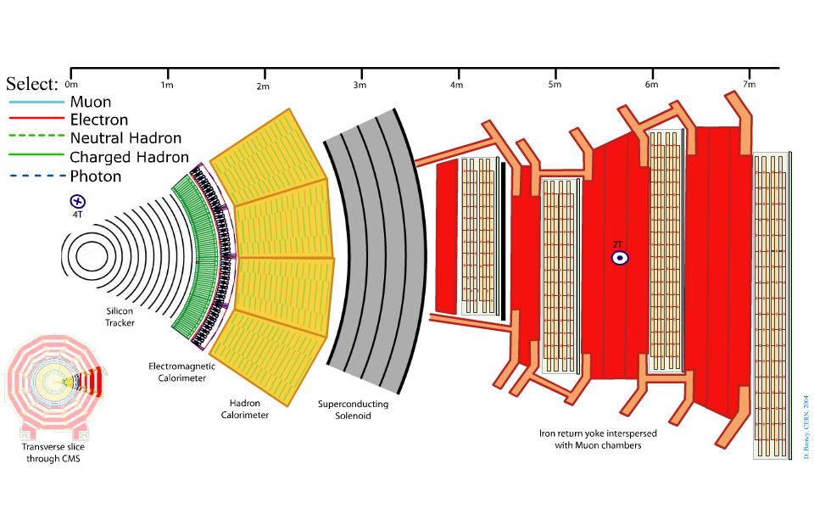
Detection of particles produced from collisions

Slide 11
Silicon Tracker
Finely segmented silicon sensors (strips and pixels) enable charged particles to be tracked and their momenta to be measured.
Pixel detector: consists of 3 barrel layers with 2 endcap disks on each side on them.
Silicon: The barrel tracker consist of TIB (Tracker Inner Barrel) and a TOB(Tracker Outer Barrel). The endcaps are divided into the TEC (Tracker End Cap) and TID (Tracker Inner Disks).
Similar to a 70 Megapixel digital camera taking 40 million pictures per second!
Purpose: measure trajectories & momenta of charged particles

Slide 12
Acceptance |η|<2.5, 200 m² silicon area, 1440 pixel and 15148 strip modules.
pixel: 100x150 μm²; Inner silicon: 10cm x 80μm; outer silicon: 25cm x 180 μm

Slide 13
The electromagnetic calorimeter
The electromagnetic calorimeter in CMS is a hermetic homogeneous calorimeter made of 61200 lead tungstate (PbWO4) crystals in the central barrel and closed by 7324 crystals on each side of the two endcaps.
The material is very appropriate for LHC collisions due to its short radiation length (8.9 mm) and small Molière radius (2.2 cm) which results in a compact and high resolutive calorimeter.
61200 crystals of PbWO₄(lead tungstate) produce light from incident particles.
The amount of light depends on the energy of the incoming particle.
The ECAL endcaps cover a pseudorapidity range 1.479 < |η| < 3.0.
Purpose: measure energy of electrons, positrons and photons

Slide 14
Hadron calorimeter (HCAL)
Particles which pass through the ECAL will be absorbed by the hadron calorimeter (HCAL).
The purpose of the HCAL is to measure jets and reconstruct neutrinos or other exotic particles via missing transverse energy. Hence it is important that the whole energy of the other particles is reconstructed.
Designed as sampling calorimeters the wedges consist of alternating layers of brass plates as absorber and scintillator plates.
The layers are aligned in parallel to the beam axis while the scintillator is segmented into 16 sectors in pseudorapidity.

Slide 15
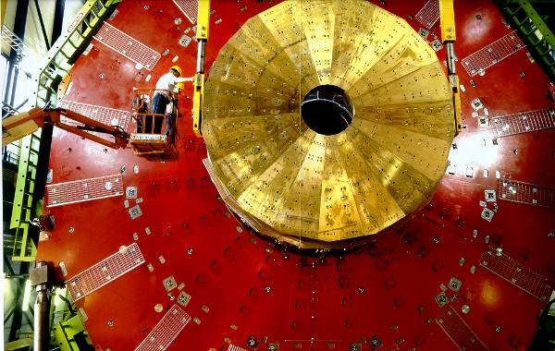
Hadron Calorimeter (HCAL)
Layers of dense material
(brass or steel) interleaved
with plastic scintillators or
quartz fibres.
HCAL consists of four parts:
1-Hadron Barrel (HB)
2-Hadron outer (HO)
3-Hadron endcap (HE)
4-Hadron Forward (HF)
Purpose: measure energy of hadrons (e.g. protons, neutrons..)

Slide 16
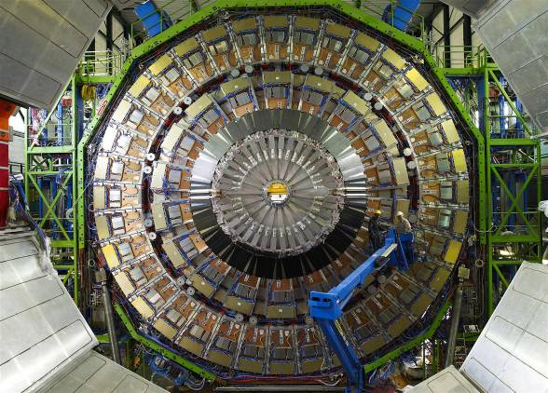
Muon Detectors
CMS uses three types of
muon detector:
drift tubes:250 chambers organized in 4 layers
cathode strip chambers: CSCs in the 2 endcaps
and resistive plate chambers.
Purpose: identify muons and measure their momenta

Slide 17
The forward parts of the detector

Slide 18
Forward Calorimeters
In the very forward region after the muon endcap the hadron forward calorimeter (HF) is installed.
With HF the acceptance range of the CMS calorimetric is extended up to |η| < 5.2.
In this pseudorapidity region the flux of produced particles will be very high. Hence HF was designed to survive this high radiated environment by using a steel absorber with embedded quartz fibres as active medium. The fibres are made of a fused silica quartz core with 600 ±10 μm as diameter and polymer hard cladding.
Inside the fibres the light is produced by charged particles via the Cherenkov mechanism and collected through air-core light guides by the photomultipliers at the end.

Slide 19
The CASTOR forward calorimeter
The name of the CASTOR forward detector is an acronym of "Centauro And Strange Object Research".
The detector is a sampling calorimeter made of tungsten and quartz plates and measures the Cherenkov radiation emitted by the particles passing through the detector.
CASTOR is designed to measure the produced particles in heavy-ion and proton-proton collisions at very small angles.
The calorimeter is positioned 14.38m away from the nominal interaction point on the negative z side of the CMS detector covering the range in ηfrom -6.6 to -5.2.
As shown in figure CASTOR is directly behind the TOTEM tracker T2.
With a combined data taking of CMS together with TOTEM it is possible to combine reconstructed T2 tracks with information about the energy from CASTOR.

Slide 20
Figure 4.1: Here the CASTOR detector embedded in the forward environment of CMS is shown

Slide 21
The hadronic forward calorimeter is in front of the T2 tracker. Hence HF is also a common source of background radiation escaping from its back for CASTOR and T2.
Because of the forward acceptance (-6.6 < η< -5.2) of the CASTOR calorimeter it is able to measure QCD physics at small-x. Furthermore, CASTOR is very sensitive to underlying event processes and MPI, Therefore the CASTOR detector is ideal for measuring variables such as energy or jets to test generators concerning the related physics.
Together with the other detectors of CMS the measurable pseudorapidity acceptance is expanded to -6.6 < η< -5.2 including CASTOR.
No other experiment is able to investigate physics over such a huge range.

Slide 22
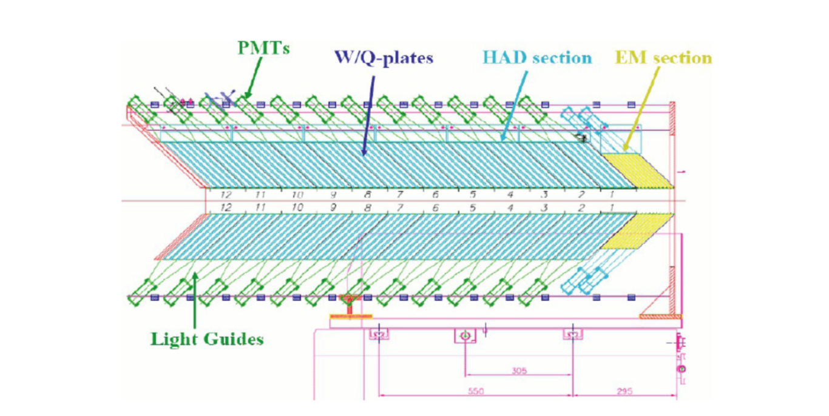
Design and hardware :
Figure 4.2: Scheme of the CASTOR calorimeter made of tungsten (W) and silica quartz (Q) plates shown with the collision point heading to the right side, the electro magnetic (EM) section is highlighted in yellow, the hadronic (HAD) section in cyan [75].

Slide 23
In Ø the calorimeter is made of 8 symmetrically shaped octants each of which is divided into two sectors.
Along the beam axis the electromagnetic part is also divided into two modules with 10 X₀ each and the hadronic part into 12 modules with a depth of 0.77 λ for one module. Therefore CASTOR is separated into 224 readout units grouped in 16 sectors and 14 longitudinal modules.
To maximize the collected amount of Cherenkov photons the tungsten and quartz plates are tilted by 45⁰ with respect to the beam axis (see figure 4.3). Since the refraction index of n ≈1.45 for the silica quartz plates and assuming a velocity of β≈1 the emission angle θof the Cherenkov light given by Cosθ = 1/nβ.
Since the particles produced in a shower have different angles not parallel to the beam the produced Cherenkov light is also tilted to the plates.
By total internal reflection at the border of the plates the light is guided outside.

Slide 24
Scheme of CASTOR including the induced shower particles and the produced Cherenkov photons in the silica quartz plates.

Slide 25
The silica quartz plates of each of the 224 readout units are then connected to a PMT (made amplification for signal) via an air-core light guide.
The light guides collect the Cherenkov light produced in the quartz
plates of the corresponding readout unit and direct it to the photo multipliers. They are made of thin stainless steel sheets where the inside is filled with air and the surface is covered with a highly reflective foil.

Slide 26
Forward jet measurement
Jet reconstruction :
The description of LHC physics is for the most part based on QCD calculation in terms of quark and gluon scattering. However, quarks and gluons are not directly observable particles.
After hadronization they produce a collimated bunch of hadrons, a so-called jet, which conserves the direction, energy and quantum numbers of the parton.
These hadrons can then be observed by the experiments at LHC as well as CMS.
Therefore, a stable jet algorithm is needed to regain information about the involved partons.
At generator level this algorithm clusters final state particles into a jet and at detector level it uses position and energy deposit of calorimeter cells or hits in the tracker.

Slide 27
.
There are two major kinds of jet algorithms:
1- the iterative cone
2- the sequential clustering algorithms .
Iterative cone algorithms build up cones around the constitutions with the highest p_{T} to create jets.
On the other hand clustering algorithms : They are based on a distance measurement between the constitutions to cluster them until a breakup condition is fulfilled.
In the LHC experiments the sequential clustering algorithms, in particular anti-k_{t} as well as SIS, are commonly used. In this very forward jet measurement the jets are defined by the anti-k_{t} algorithm.

Slide 28
1.1 The anti-kt jet clustering algorithm :
As a special case of the sequential cluster algorithms, the anti-k_{t} algorithm also fulfils the important requirement of being infrared and collinear-safe.
In general the sequential cluster algorithms, which are characterized by the integer like parameter p, combine particles into jets by introducing the distance measure between the particles i and j as in equation 1
for a jet of cone-size R and with the radial distance between the particles in eq 2
where k_{ti}, η_{i} and ø_{i} are the transverse momentum, rapidity and azimuth of the particle i.

Slide 29
The distance of the particles to the beam is then in eq 3
The cluster algorithm is looking for the minimal distance of all d_{ij} and d_{iB}. If d_{ij} is the minimum, then the particles i and j are merged into a single object i, which is then treated as new particle. Otherwise, if d_{iB} is the smallest, the object i is considered as jet and removed from the list of generated particles.
This procedure is repeated on the remaining particles until no particle is left.
In eqs. (1) and (3) the size of the jets is defined by the radius parameter R while the parameter p governs the relative power of the distance versus the energy and determines different subclasses of clustering algorithms.
For the parameter value p = 1 this is the k_{t} clustering algorithm while for p = 0 the procedure corresponds to the Cam- bridge/Aachen algorithm .
In this analysis the anti-k_{t} algorithm is used as jet finding procedure, which corresponds to a negative value of p = -1.

Slide 30
One major difference between the anti-k_{t} and the other cluster algorithm: is that the anti- k_{t} algorithm creates a regular cone like shape for the jet area while the others generate jets with very irregular shapes .
The regular cone like shape created by the anti- k_{t} algorithm is generally not influenced by the soft particles in the event.
Especially the anti-k_{t} algorithm cannot create ghost jets by soft particles as it is possible in the k_{t} algorithm, This is reasonable since the k_{t} algorithm starts with the softest particles in 1 to cluster jets.
The anti-k_{t}, on the other hand, starts with the highest p_{T} particles for the jet clustering. In terms of jet energy calibration or pile up subtraction a stable cone shape generation of the jet area is favourable.
For this reasons as well, the anti-k_{t} algorithm is commonly used for jet reconstruction at CMS, but other jet finding algorithms are supported, too.

