Slide 1
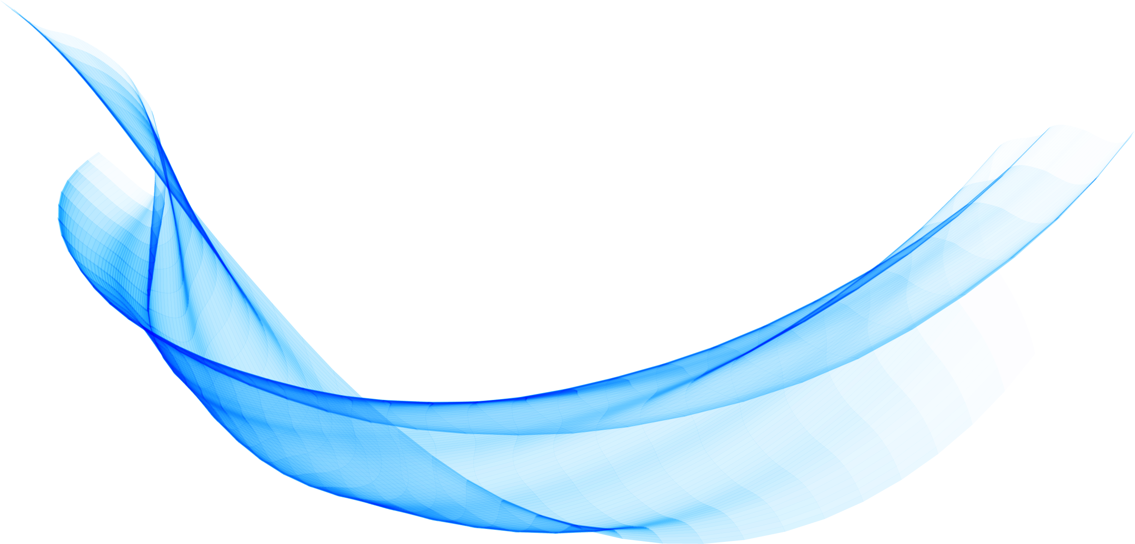
EPR introduction

Slide 2
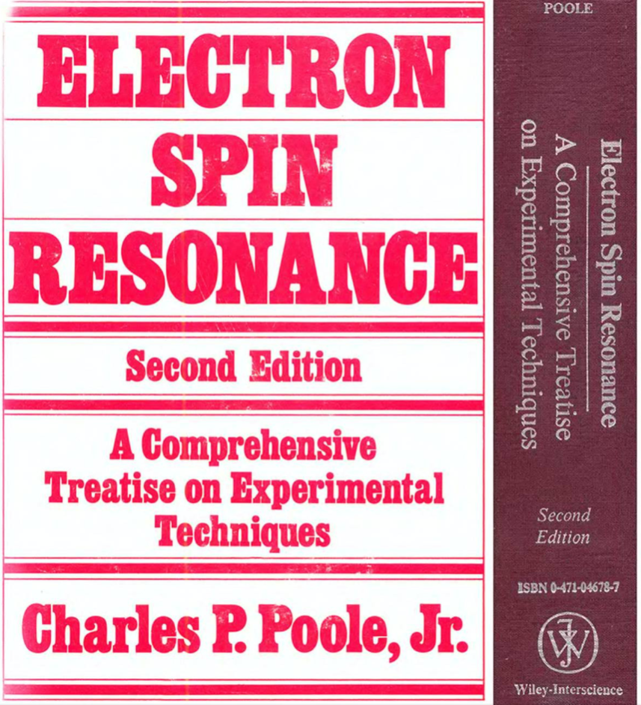
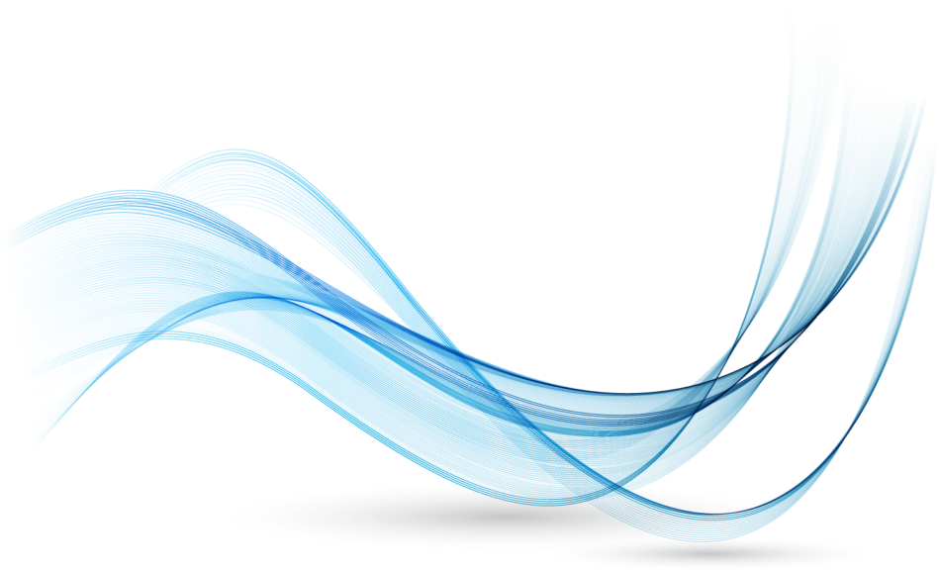
Bibliography
1st ed. 1967
Electron Paramagnetic Resonance Instrumentation
Edward Reijerse & Anton Savitsky
eMagRes, 2017, Vol 6: 187–206.

Slide 3
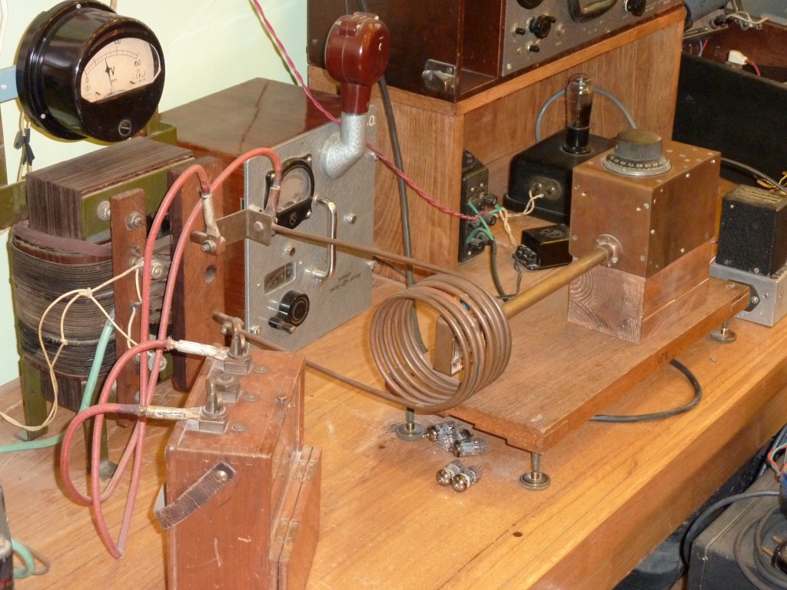
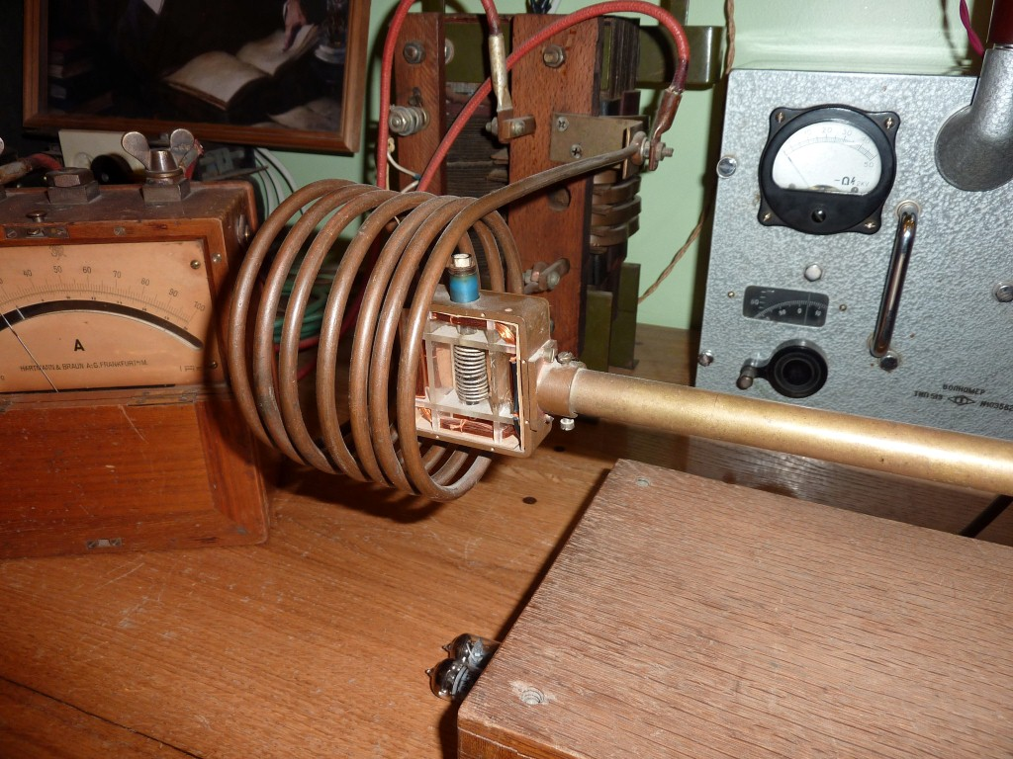
The one
1944 - Zavoiski
© S. Bertaina

Slide 4
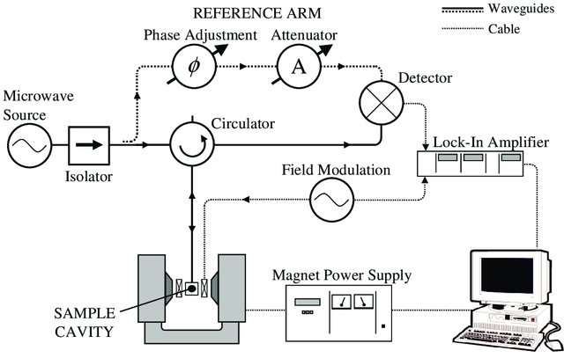
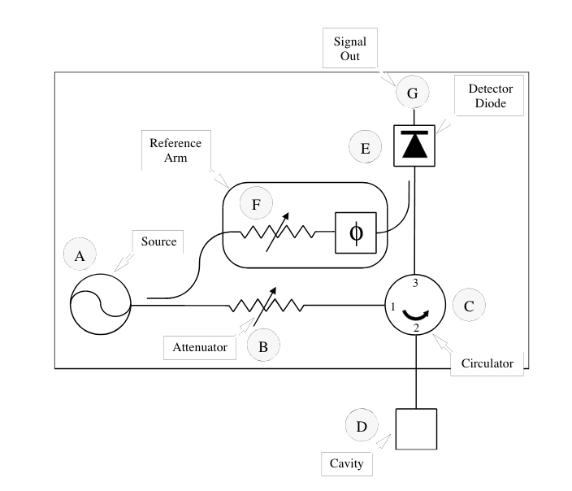
Standard Bridge
Petr Neugebauer

Slide 5
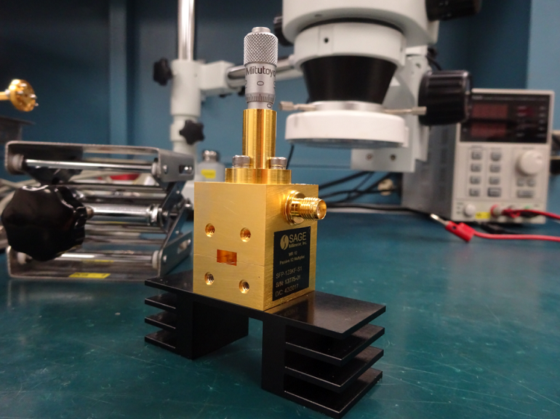
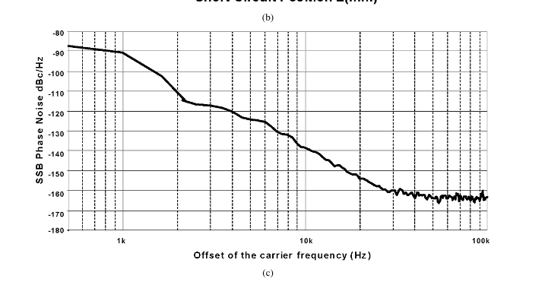
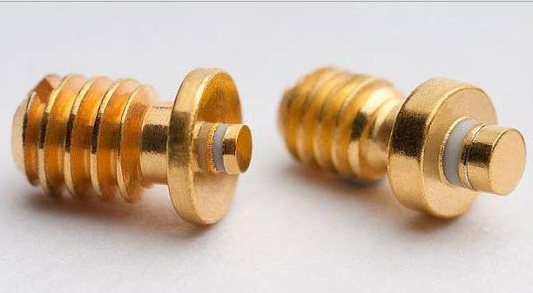
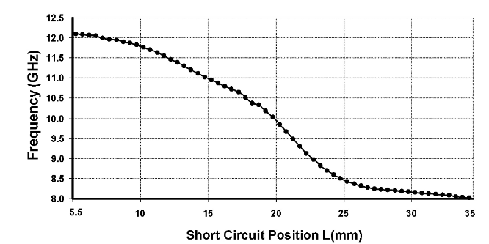
Source: Gunn diode
Noise figure
1/f noise
White noise

Slide 6
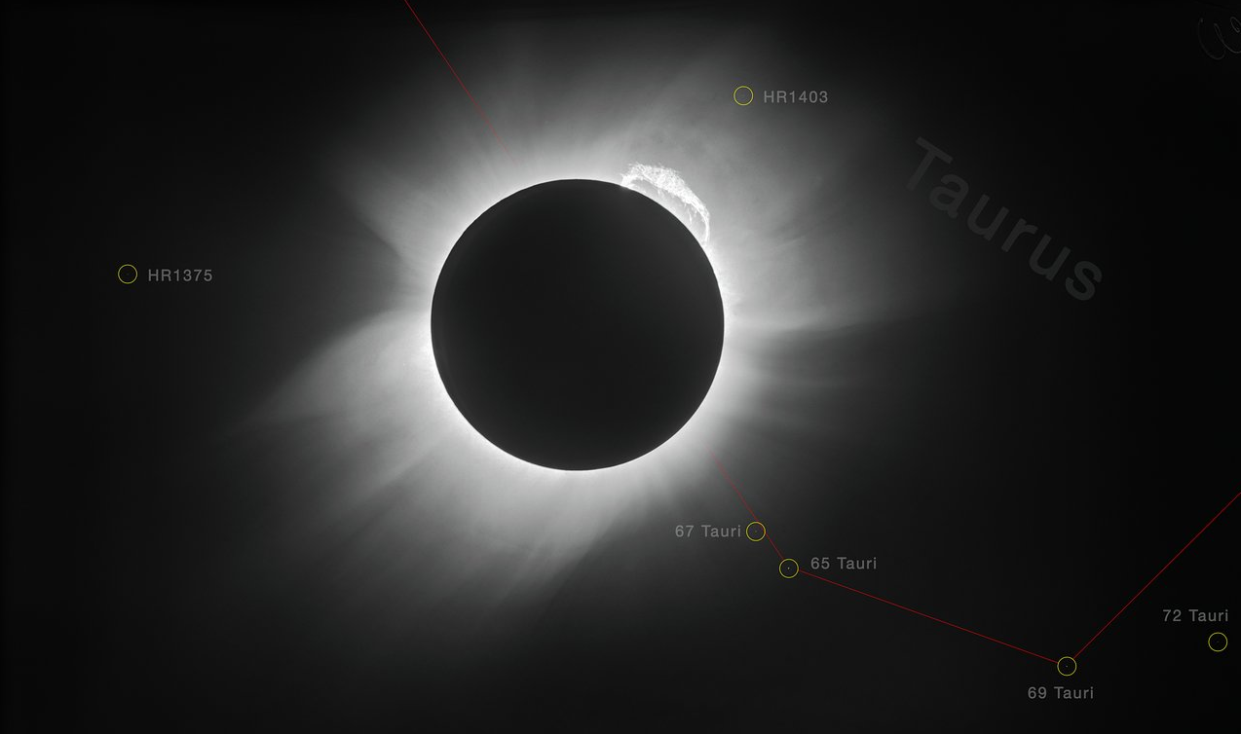
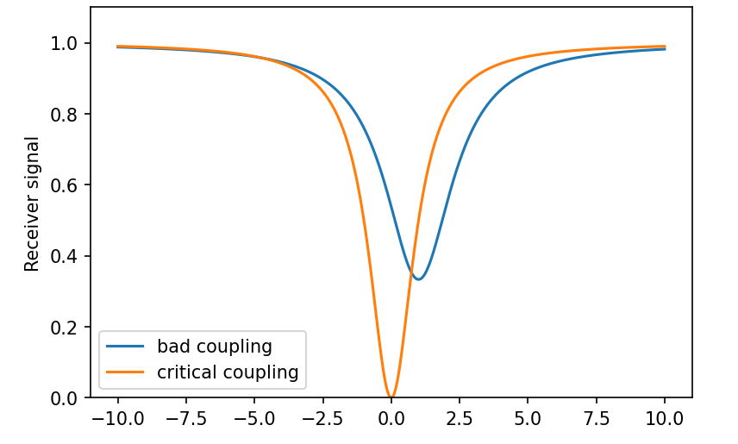
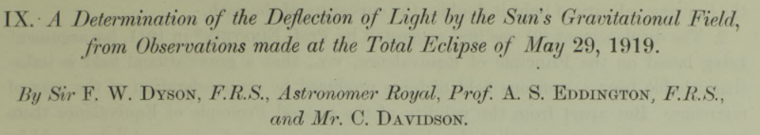
Why use a cavity
Eclipse: a good way to null the sun
Nulling the source to avoid saturation of the detector

Slide 7
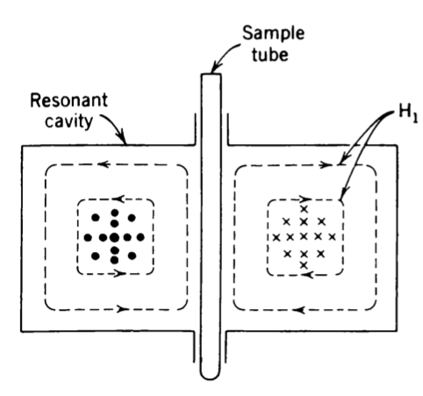
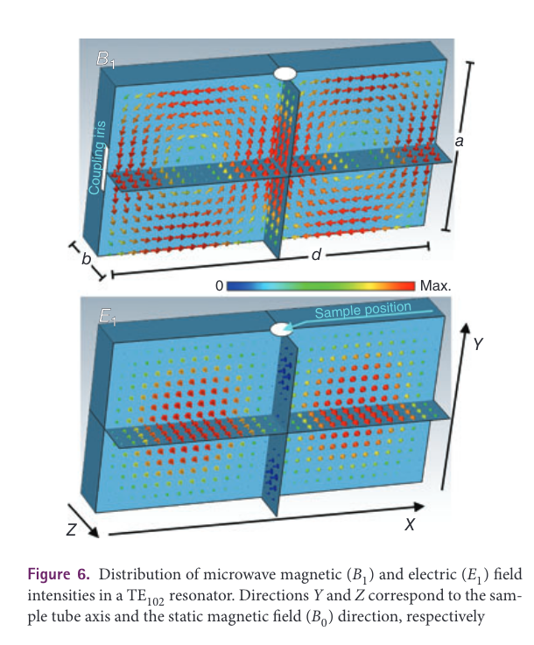
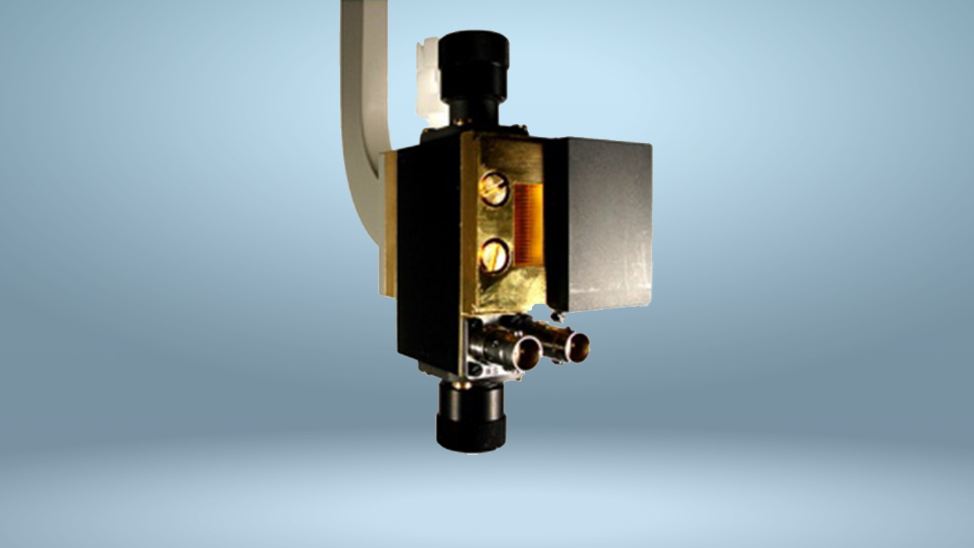
The cavity

Slide 8
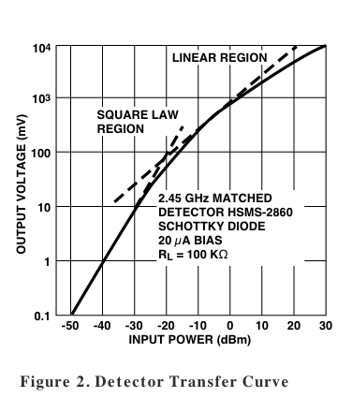
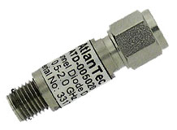


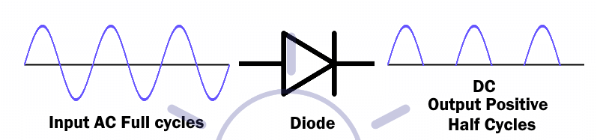
Diode detector - Schottky

Slide 9
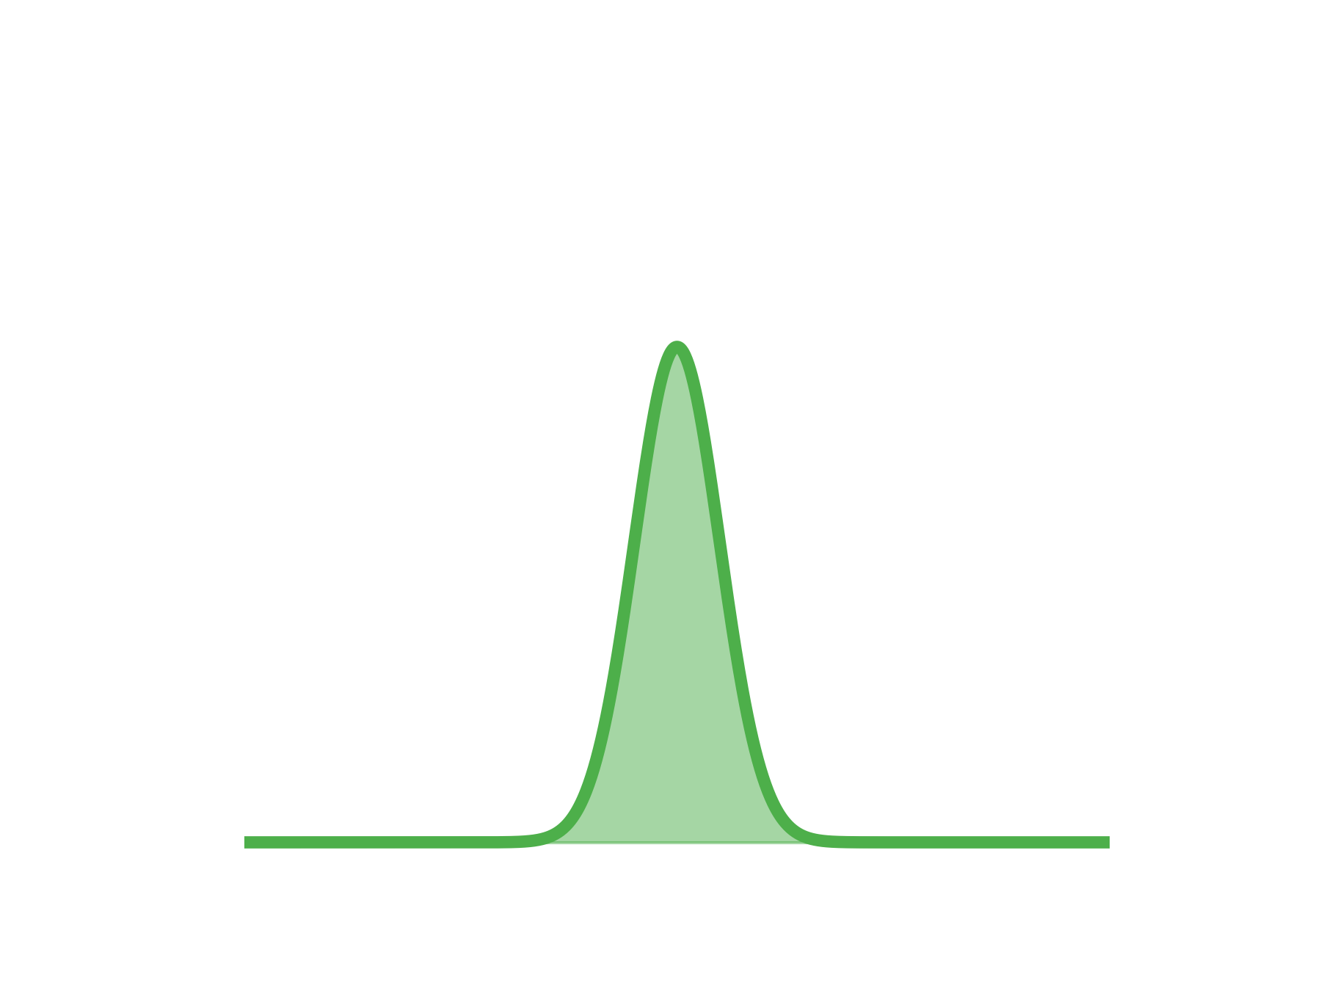
Why use a lock in ?

Slide 10
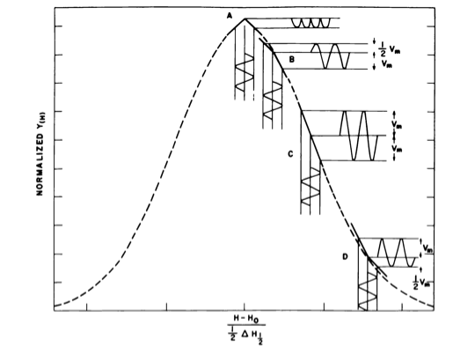
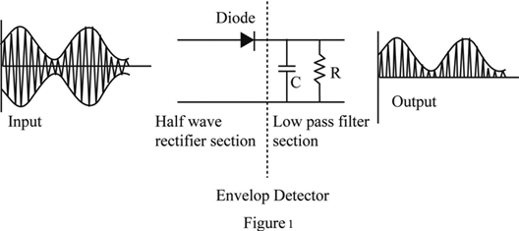
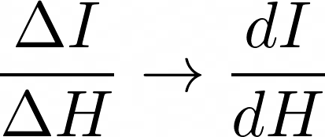
Field modulation

Slide 11
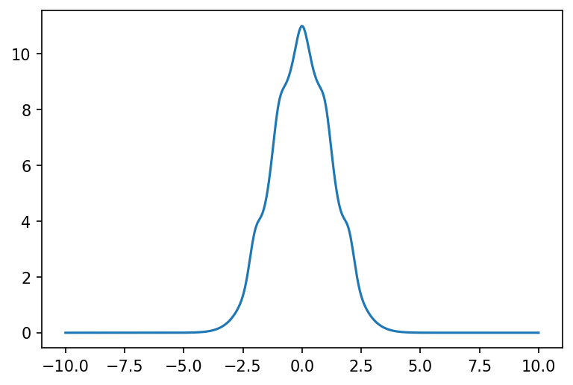
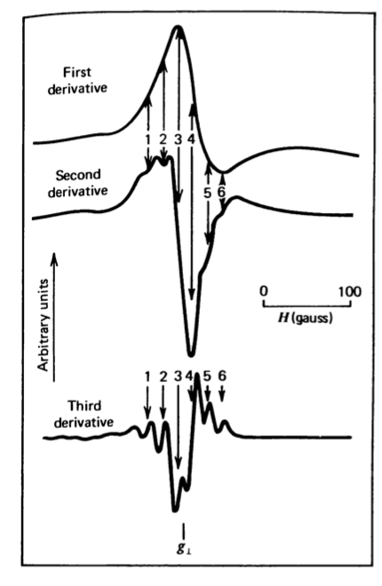
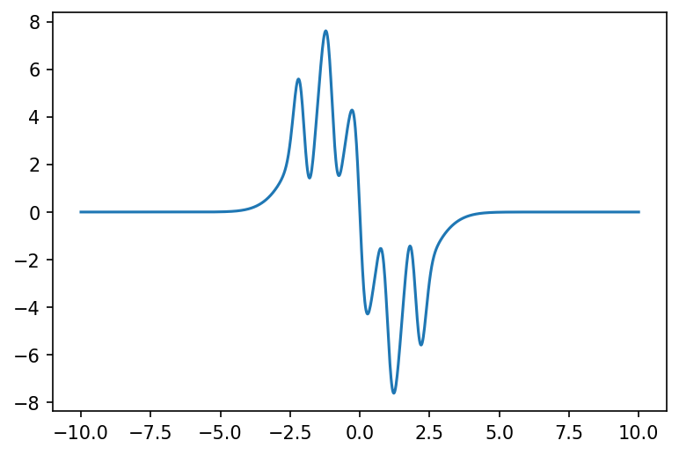
Derivative of the signal

Slide 12
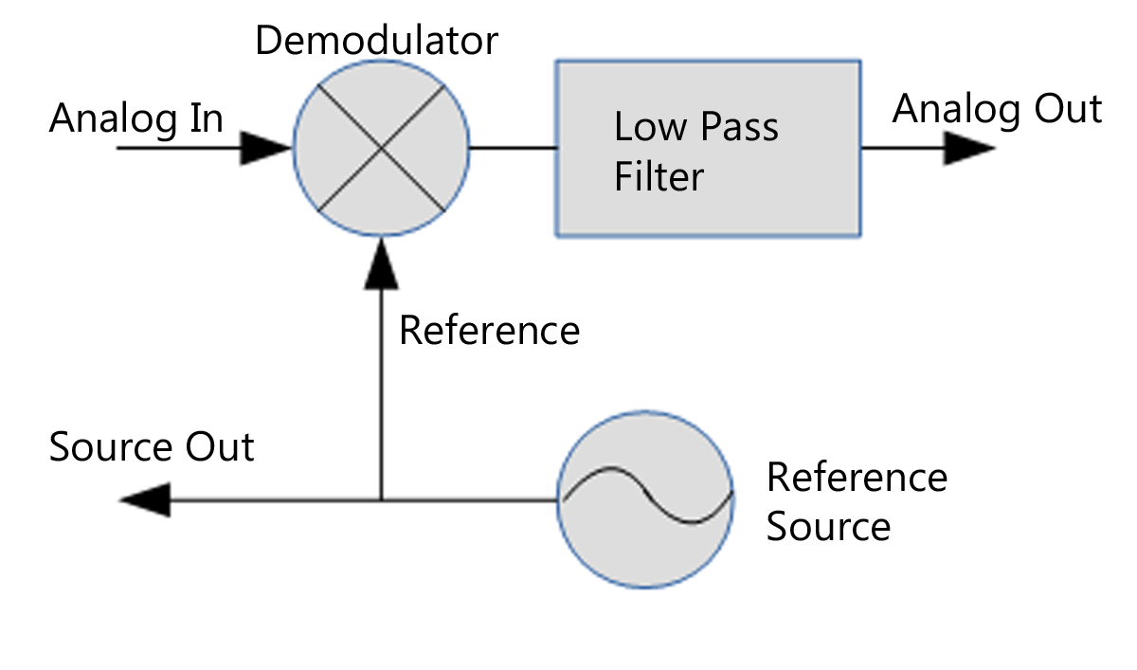
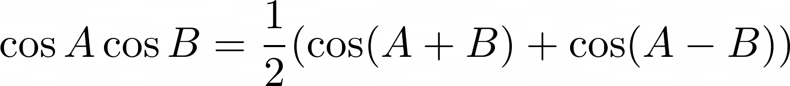
Lock in amplifier

Slide 13
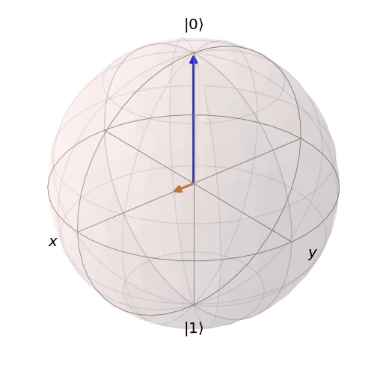
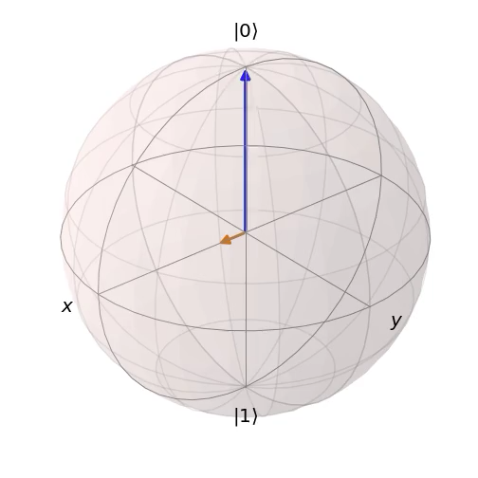
Electron Spin Resonance
CW ESR :
Frequency fixed
Magnetic field swept
Pulsed ESR:
Frequency fixed
Magnetic field fixed
Recorded in time
Relaxation time << experiment time: Transient regime or coherent
Relaxation time >> experiment time: Steady state regime or incoherent
J. R. Johansson, et al. QuTiP 2: Comput. Phys. Commun. 184, 1234–1240 (2013).

Slide 14
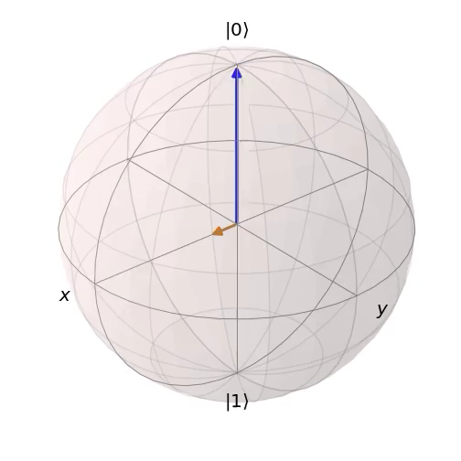
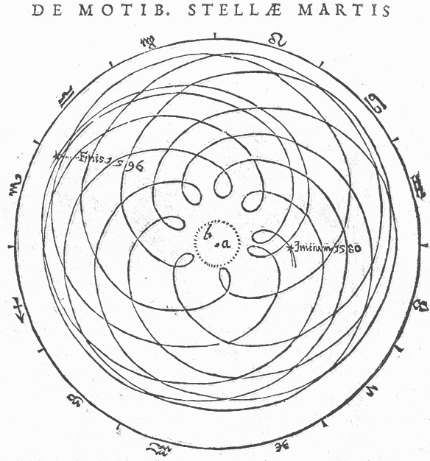
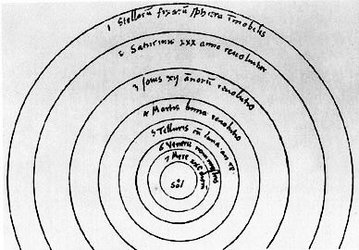
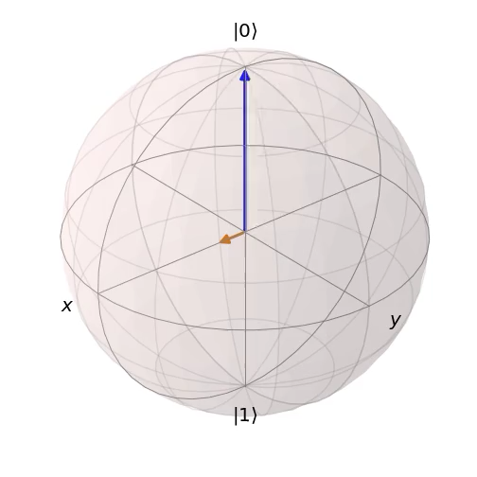
Choice of the frame
Copernic (1530)
De Revolutionibus orbium coelestium
Brahe – Kepler (1609)
Astromia nova

Slide 15
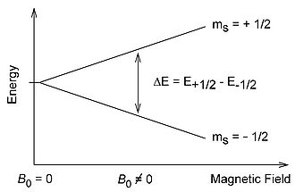
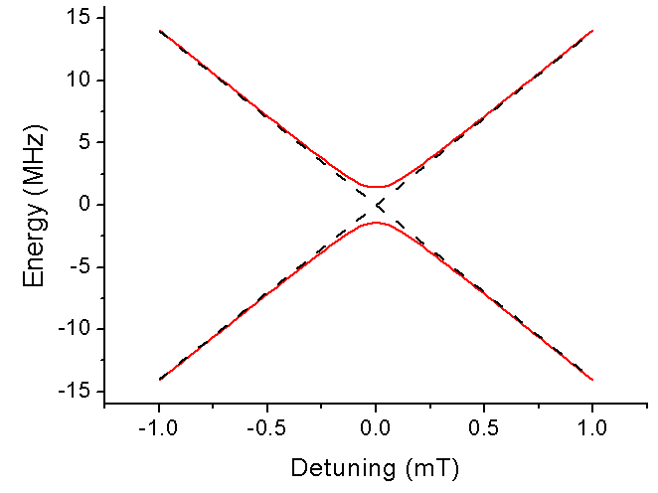
Rotating frame transformation
Time dependant
Time independant
Right unitary transformation → problem solved

Slide 16
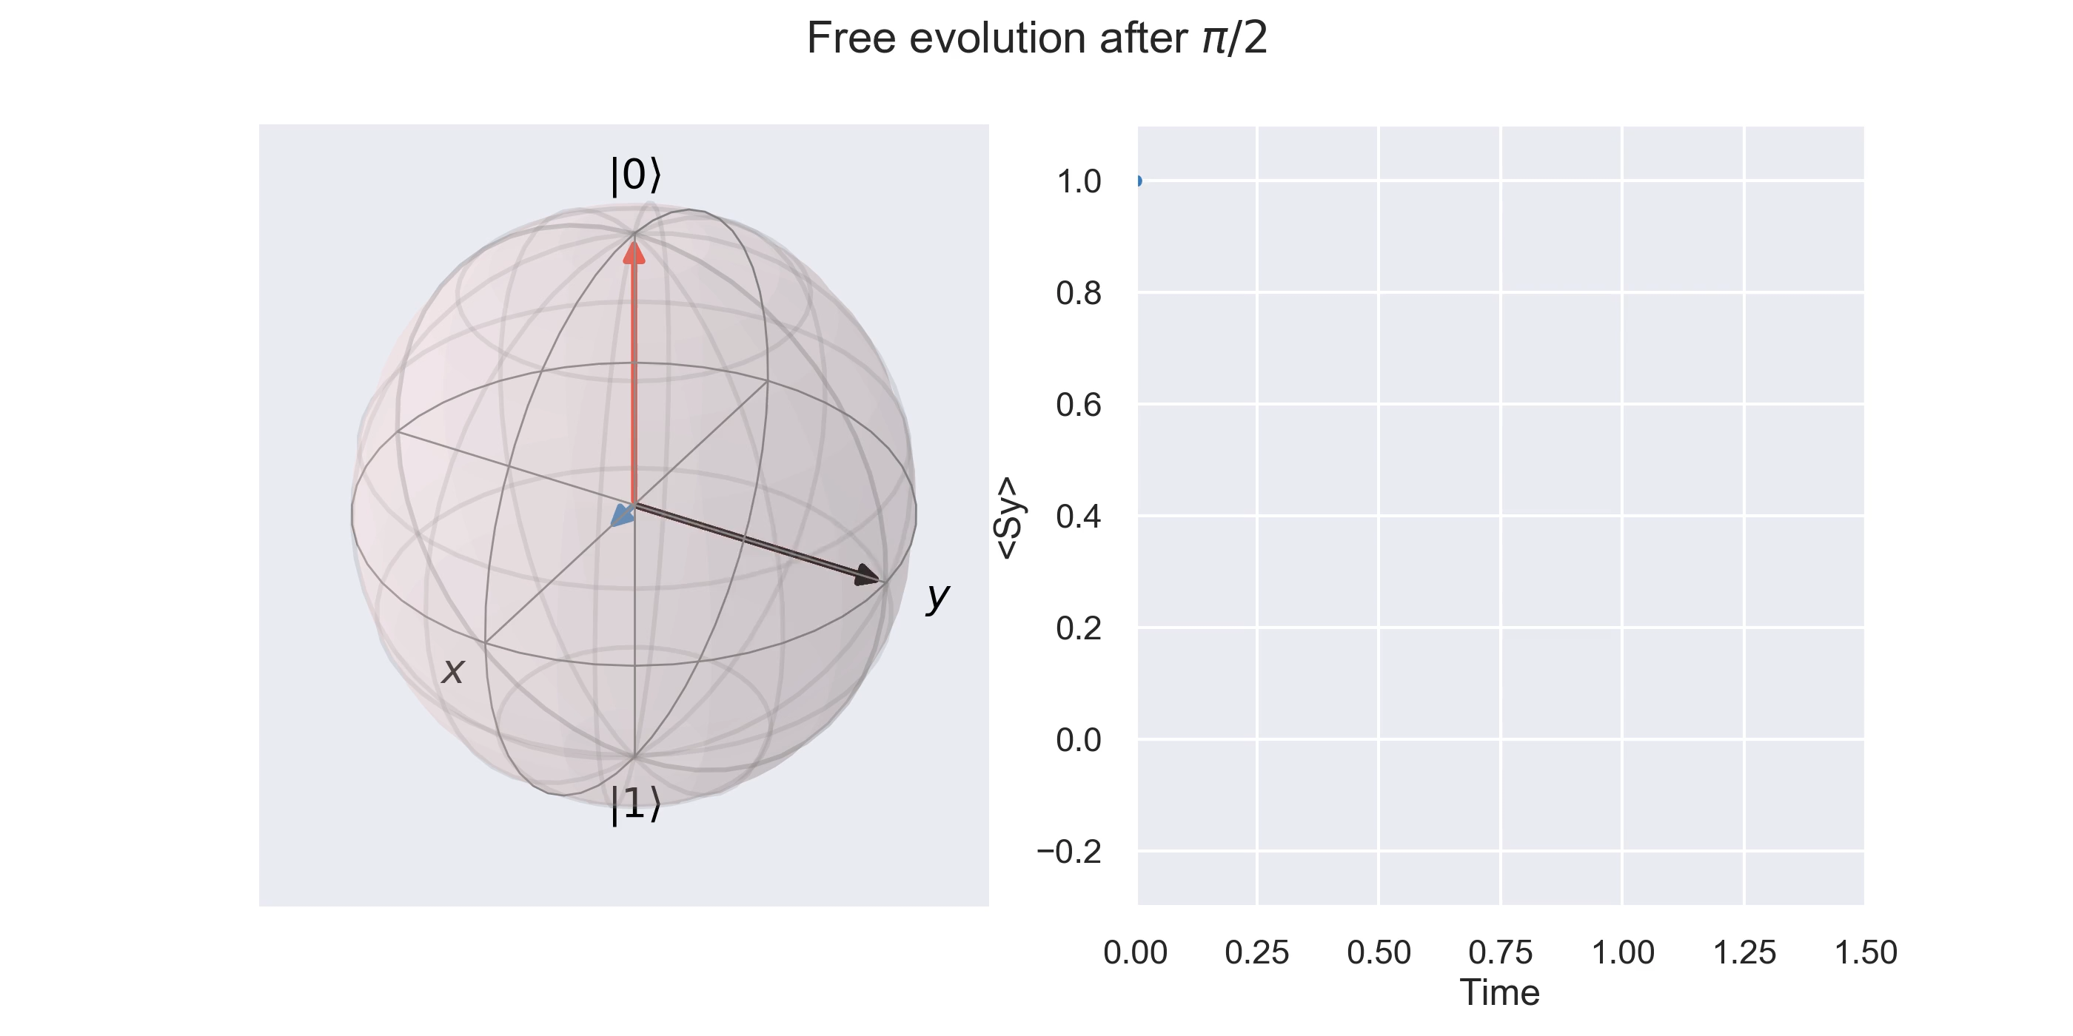
Inhomogeneous line – in the rotating frame

Slide 17
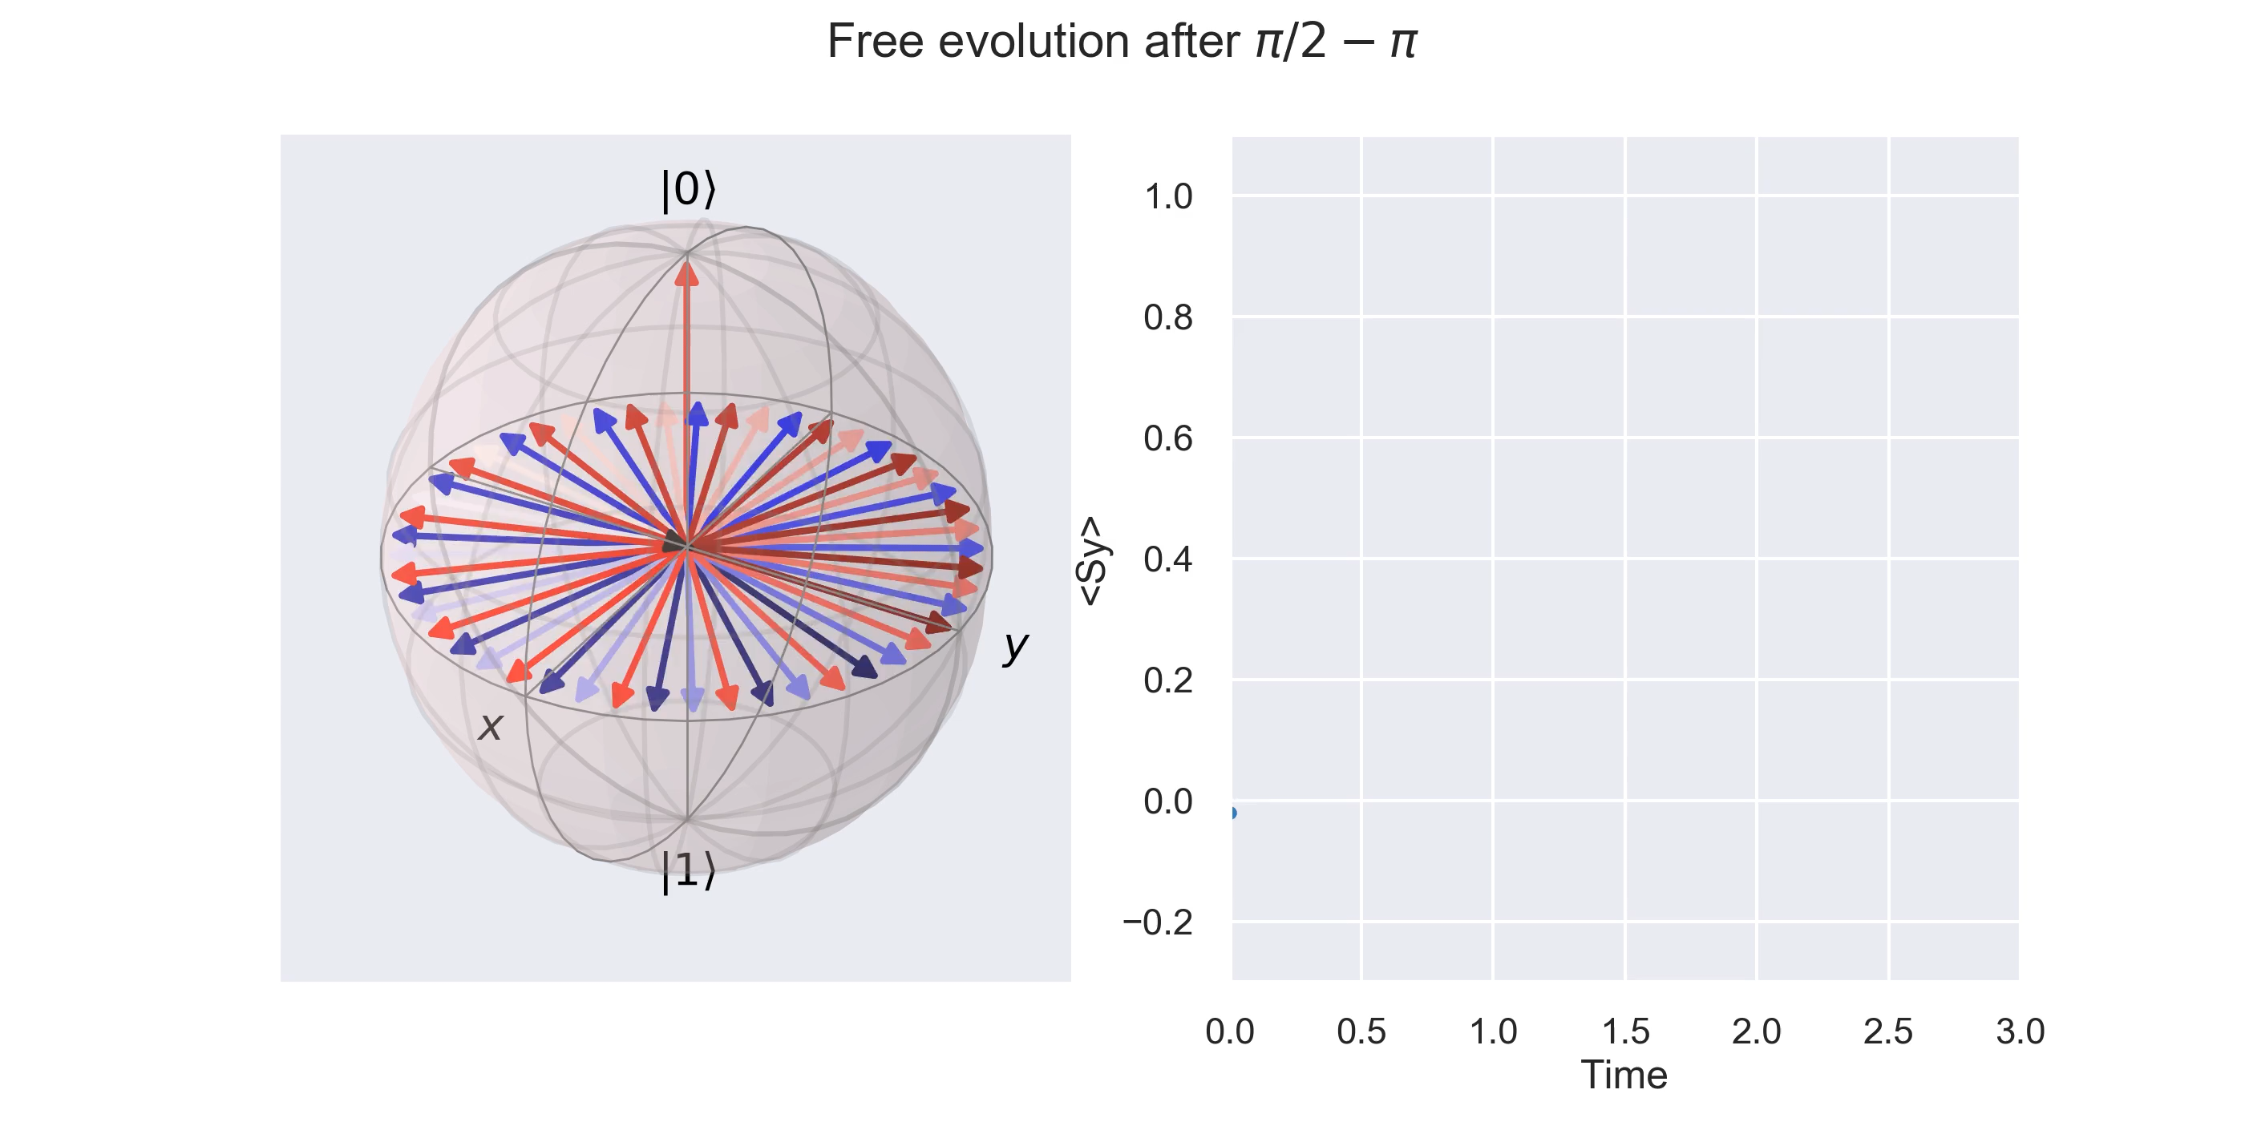
Inhomogeneous line – in the rotating frame

Slide 18

Hahn echo sequence – Hard pulses

Slide 19
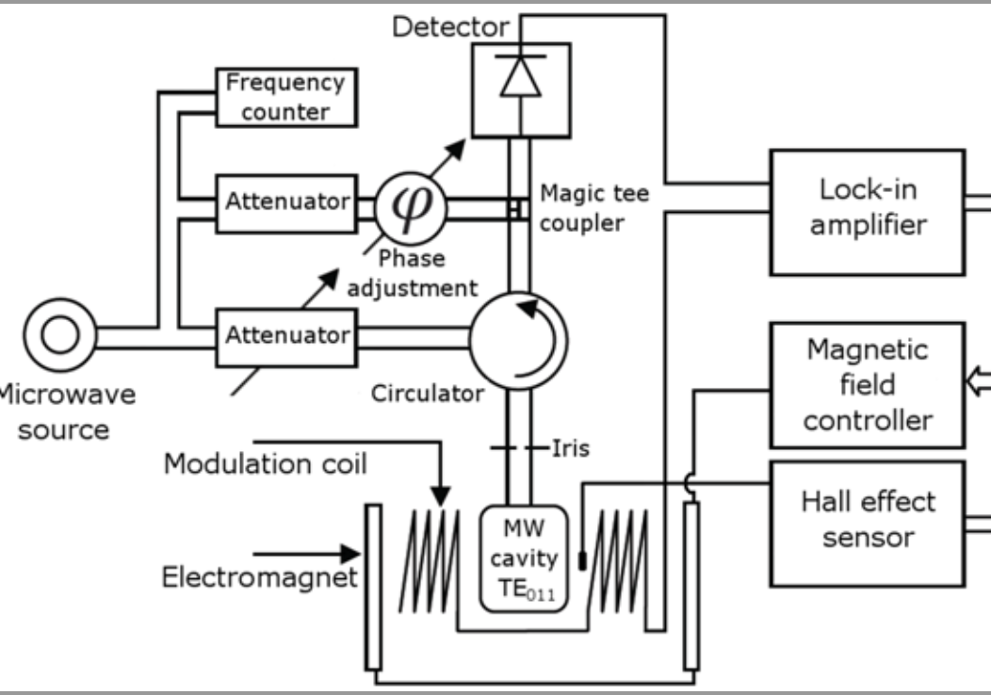
CW spectrometer
100 kHz
Q=3000-5000

Slide 20
Pulsed spectrometer
arXiv:1706.09259

Slide 21
Resonator issues
Critical coupling → Q ~ 3000 , 100% EM power inside cavity
High Q resonator deforms square pulses
→ Decrease Q

Slide 22
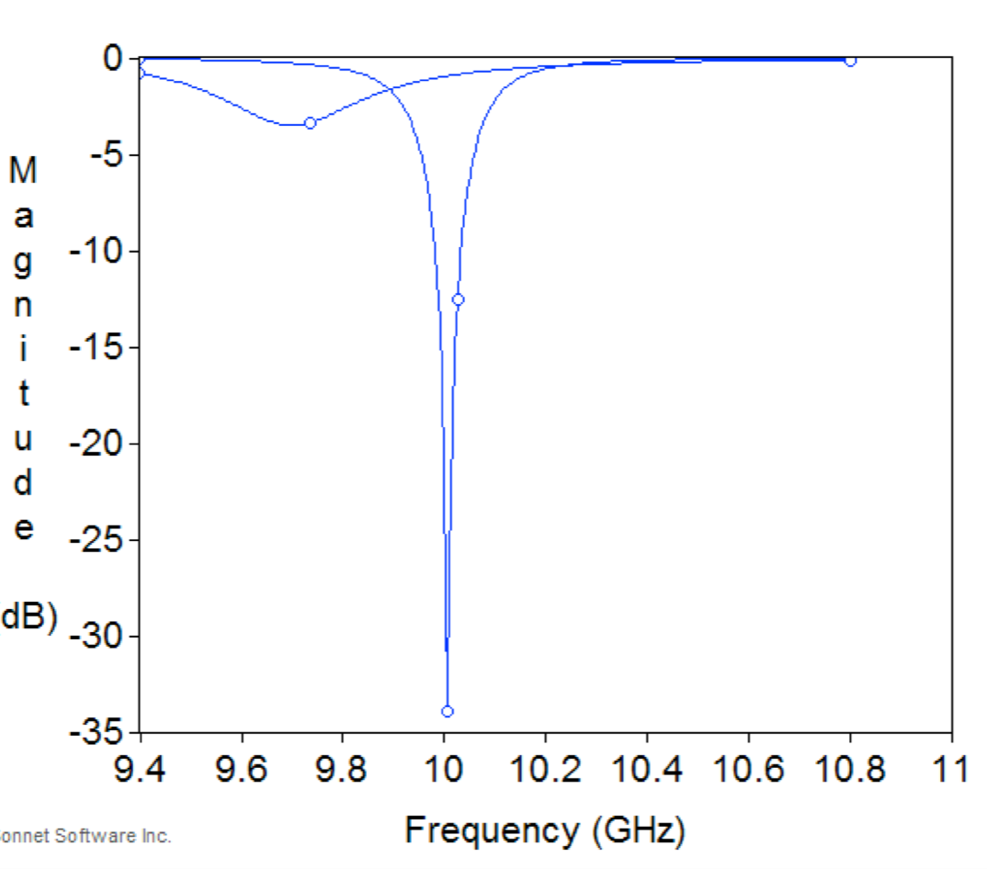
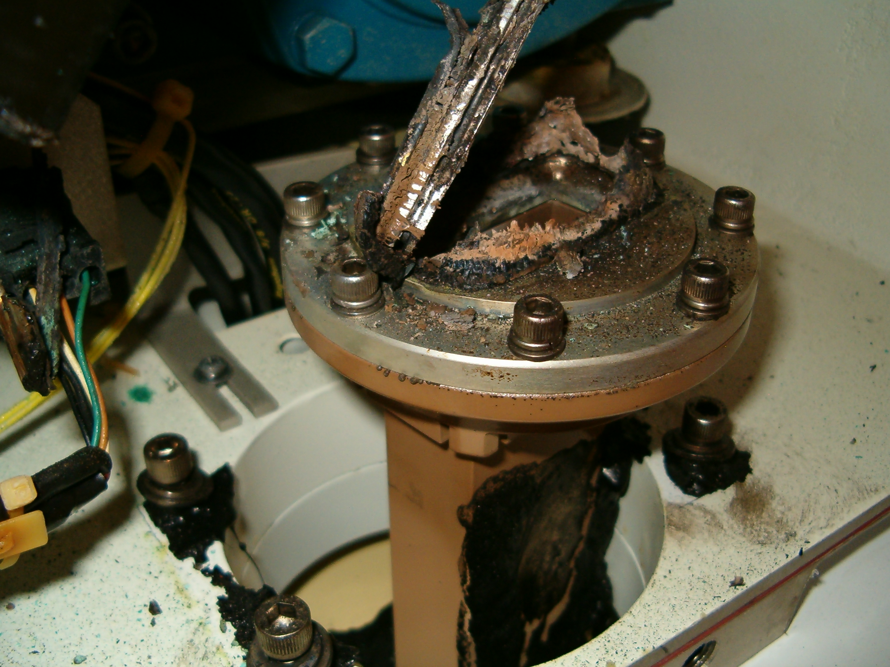
Resonator issues
Q factor | h_{mw} | Power
3000 | 1G | 200mW
3000 | 5G | 0.2*5²=5W
300 | 5G | 5x10=50W
300 | 5G | 50*4²=800W
Over coupled 75% reflected
Critical coupling 0.01% reflected

Slide 23
Defense pulse
Donald J Hirsh & Gary W BrudvigNature Protocols volume 2, pages 1770–1781 (2007)

Slide 24
