Slide 1
TRISTAN Readiness
Data taking and processing
TRISTAN HW Review
September 30th, 2026
Andrew Gavin on behalf of the DAQ team

Slide 2
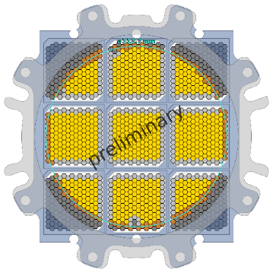
TRISTAN DAQ System
TMB-1
TMB-2
Serenity-S1
operator
TMB-3
TMB-4
TMB-5
Operating Server
Serenity-S1
TMB-6
TMB-7
Data Storage
TMB-8
Serenity-S1
analyst
TMB-9
analog
waveforms
digital
waveforms
triggered
event data
energy
histograms

Slide 3
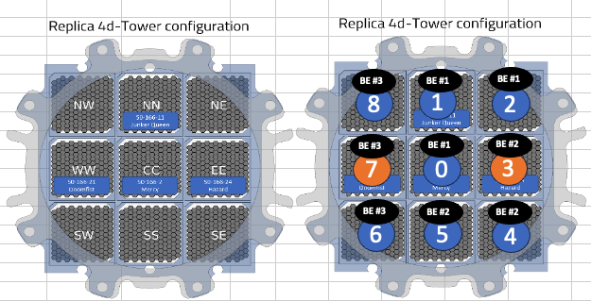
TMB system readiness
Tile Main Board population
  10 TMB V2.0s prepared, 4 currently in use at the replica
  4 TMB V1.0s partially populated, with 1 prepared for MPIK operation
Each detector gets assigned a TMB which is adapted with necessary submodules to the requirements of operation
  Ex. S0-166-21/24 in replica require bias modification for elevated IGR currents
  Ex. S0-166-11/2 in replica require modification for V_ASIC to 4.3V
*overview of replica components and equipment to be added to KATRIN wiki

Slide 4
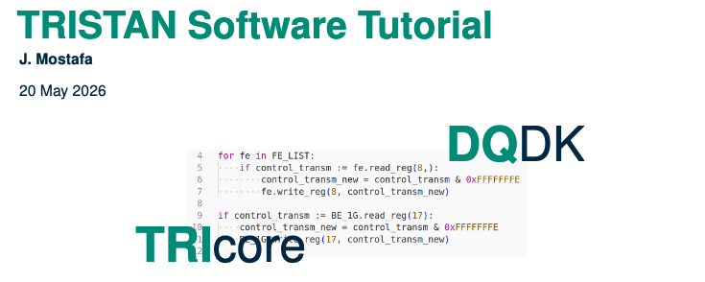
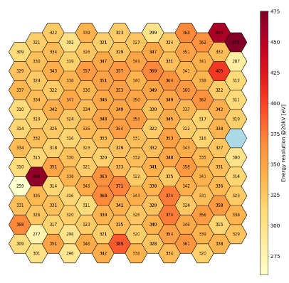
Data taking with 1 detector module
Completed – single module operation and data readout at the replica
Operation tutorial recording
Look out for presentation from Simon at 51st CM on replica analysis with data from TMB system on Thursday at our Replica mini-workshop
Upcoming – refinement of operation scripts and referencing standards

Slide 5
Data taking with 1+ detector modules
Ongoing – installation of 4 detectors all operated with TMB systems at the replica
  3 modules operating at high rates through one Serenity-S1 readout path
  Development of operator skills and system knowledge
  Known unknowns
Unique test stand that should not be taken for granted
  After disassembly of the replica tower the prospects for testings a similar high-density readout is low until tower operation
  Need to ensure we’re making the best use of the replica time

Slide 6
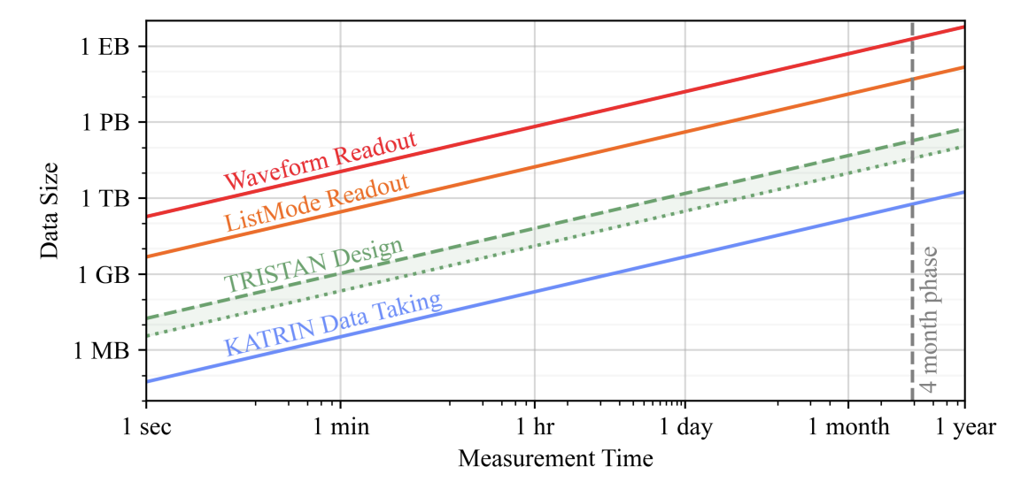
Data handling and storage
Data flow design
  Architecture design to minimize external connections to data
  In discussion and will be presented to KATRIN board soon
Data storage sites
  KIT LSDF, but contingency needed for down times
  Max Planck LSF, planned meeting following collaboration meeting to cover resources at MPIK

Slide 7
Operation tests and development of user instruction and guidelines
Necessary development of user-friendly operating manual and interface
  Taking lessons learned from replica operation
  Built out in parallel with TMB operation at MPIK test stand
Development of data loading and analysis pipelines in collaboration with analysis team
operator
Operating Server
Data Storage
analyst

Slide 8
Prospects of data processing status in
March 2027
Hardware ready for operation of full detector tower
Adjustments for detector operation requirements possible from modular design
Oct | Nov | Dec | Jan | Feb | Mar
replica operation
transport box tests
MPIK operation
Available test stands to refine detector operation standards and procedures

Slide 9
Prospects of data processing status in
March 2027
Oct | Nov | Dec | Jan | Feb | Mar
replica operation
transport box tests
TMB performance benchmarks
HeTris operation
Preliminary List | Replica | Box (light) | Box (radioactive) | HeTris
3 module operation at high rates | ✅ | ❌ | ❌ | ❌
Cooled detector operation | ✅ | ❌ | ❌ | ✅
”Neighbor” pixel map trigger/inhibit | ✅ | ✅ | ✅ | ✅
Pile-up rejection and filter efficiency | ✅ | ❌ | ✅ | ✅
Single detector high rate readout | ✅ | ✅ | ✅ | ✅
Online/offline event comparison | ✅ | ✅ | ✅ | ✅
User interface for run operation and montoring | ✅ | ✅ | ✅ | ✅
Crosstalk | ✅ | ❌ | ✅ | ✅

