Slide 1
The Safe Harbor
The following is intended to outline our general product direction. It is intended for information purposes only, and may not be incorporated into any contract. It is not a commitment to deliver any material, code, or functionality, and should not be relied upon in making purchasing decisions. The development, release, and timing of any features or functionality described for Oracle’s products remains at the sole discretion of Oracle.

Slide 2
From Grid to Cloud
Franz Haberhauer
Chief Technologist
Hardware Sales Consulting Northern Europe
Notes:
Good afternoon and welcome to today’s session about Oracle’s cloud computing strategy.
It is great to be here with you today. My name is <NAME> and I am <TITLE>.
Cloud computing is an important trend in the industry today, and Oracle is truly unique in its ability to provide a broad portfolio of cloud computing products and services to meet the different needs of customers.
Today, I will explain what Oracle sees customers doing in the cloud and what our strategy is to serve customers’ needs.

Slide 3
Abstract
With its latest product releases Oracle went from the term "grid" to "cloud", e.g. from Enterprise Manager Grid Control 11g to Enterprise Manager Cloud Control 12c. Franz Haberhauer, Chief Technologist Oracle Hardware Northern Europe, talks about the technical background beyond the marketing aspect and addresses current topics in cloud computing especially in the context of commercial enterprise IT.

Slide 4
„What the Hell is Cloud Computing“
Oracle CEO Larry Ellison in an analysts‘ briefing 09/2008
Is Cloud Computing really something new?
Software as a Service, Service Oriented Architectures, Virtualization already done.
„The computer industry is the only industry that‘s more fashion driven than women‘s fashion.“
“I don’t understand what we would do differently in the light of cloud computing, other than marketing.”

Slide 5
NIST Definition of Cloud Computing
Cloud computing is a model for enabling convenient, on-demand network access to a shared pool of configurable computing resources (e.g., networks, servers, storage, applications, and services) that can be rapidly provisioned and released with minimal management effort or service provider interaction.
This cloud model promotes availability and is composed of:
5 Essential Characteristics
Broad network access
Resource pooling
Rapid elasticity
On-demand self-service
Measured service
3 Service Models
SaaS
PaaS
IaaS
4 Deployment Models
Public Cloud
Private Cloud
Community Cloud
Hybrid Cloud
Source: NIST Definition of Cloud Computing v15

Slide 6
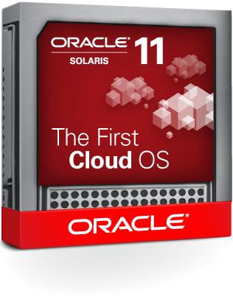
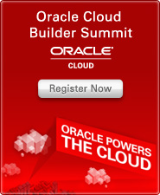
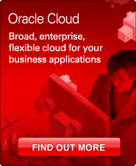
From Grid to Cloud @ Oracle
2011: From 11g to 12c and some „First‘s“
Oracle OpenWorld – October 2011
From Oracle Enterprise Manager Grid Control 11g to 12c Cloud Control
„the industry‘s first solution to combine management of the full Oracle stack with complete enterprise cloud lifecycle management”
„Oracle Enterprise Manager 12c is the first product in Oracle‘s portfolio numbered „12c“ where „c“ stands for Oracle‘s significant investment in delivering cloud-ready products.“
From Oracle WebLogic Suite 11g to 12c
the Foundation for Cloud Applications and Application Infrastructure Consolidation
Nevertheless: Oracle 11 – The First Cloud OS
Oracle Cloud – June 2012
PaaS and SaaS Public Cloud Offerings
What‘s in it beyond marketing?

Slide 7
Evolution of Computing
Paradigm | Abstract | from
Programming Languages | Algorithms | Machine instructions
Operating Systems | Application environment | Hardware
Filesystems & volume managers | Unstructured data | Physical storage
Databases | Structured data | Storage
Virtual machines | Operating System | Physical hardware
OS Containers | Application environment | Operating system
(Java) Application Server | J2EE Application Environment | Operating system & middleware
Grid Computing | Distributed application | Distributed platform
Cloud Computing | Application | Infrastructure

Slide 8
Abstraction Layers in Cloud Computing
IaaS, PaaS, SaaS
Different Users
IT Professional
Developer
Business End User
Customizations
Customizations
Customizations
Consumer
Application
Application
Consumer
Platform
SaaS Cloud
Service Provider
PaaS Cloud
Service Provider
IaaS Cloud
Notes:
Clouds are provided at different levels:
IaaS – computing servers, storage, networking and the associated virtualization and OS
PaaS – application development and deployment environment
SaaS – end-user applications
<CLICK>The more the cloud service provides, the less the consumer must provide.
For IaaS, the consumer needs to provide the application platform, the application and any customizations.
For PaaS, the consumer can take advantage of the platform, and provide only the application and customizations.
For SaaS, the consumer can simply customize the application that the cloud is providing.
IaaS is the most flexible because users can put almost any software onto it (as long as it’s compatible with the underlying hardware), but it also requires the most work, since the user has to provide all the software and manage and maintain it. The cloud provider manages only the hardware and data center.
PaaS is less flexible than IaaS, because the platform software is fixed, so things like programming language is platform-specific, but PaaS are generally designed to be flexible enough to support many different application types. Application developers benefit from having the platform services, such as database services or Java appserver services) available to them, so they need not re-invent those wheels. The service provider is managing those platform services, doing things like data backup, software patching and updating, etc., so the user does not have to.
SaaS is the least flexible because it is a ready-to-run application requiring only customer-specific customizations to use. The cloud service provider is managing the entire app.
<CLICK>Note that in each of these cases, the primary target user is different. Typically “IT Professionals” including operations folks and developers use IaaS. “Developers” use PaaS. “Business end users” use SaaS. In all these cases, the service provider (whether it’s internal IT department or an external service provider) takes care of managing the cloud, and the users do not need to worry about all the details of all the cloud’s components, how they are integrated, configured and managed. However, I will point out that the service provider needs to worry about these things.
Today’s Oracle event will address topics of interest to BOTH service providers and consumers of different types.

Slide 9
Choice of Deployment Models
Private, Public, Hybrid (and Community)
Exclusive
Shared by multiple organizations
Private Cloud
Hybrid Cloud
Public Cloud
CapEx & OpEx
Lower total costs
Control & visibility
Multiple apps sharing resources
Cloudbursting – overdraft for peak loads
Dev/test vs. production
B2B integration
OpEx
Fast & inexpensive to start
Outsourced services
Multiple tenants sharing resources
Notes:
Today, customers have a choice of cloud models. They can choose among private clouds, public clouds and hybrid clouds.
A private cloud is for the exclusive use of a single organization and is typically controlled and managed by in-house IT
A public cloud is shared by multiple tenants on a shared basis, and it hosted and managed by someone else (a service provider). It’s a form of outsourcing.
There are some basic trade-offs when deciding between private and public clouds.
Public clouds are purchased out of operating expense, avoiding capital expenditures. Public clouds are faster and cheaper to get started, providing a “low barrier to entry.” However, private clouds can offer lower costs over some breakeven period. For IT projects, this tends to range from 2 to 4 years, averaging about 3. This is the similar to the decision some people make between owning vs. renting.
Another trade-off is between public cloud outsourcing everything to a service provider, which is great if you don’t have the datacenter, hardware or employees, versus how in a private cloud, you are able to maintain control and visibility over security, regulatory compliance and quality of service.
Both public and private clouds involved sharing or pooled resources, but in a private cloud, the sharing is different apps using shared platform or infrastructure all within a single organization. In a public cloud, the sharing may be the same or different apps among different tenants.
Hybrid: fuzzy term with different meanings.
Cloudbursting – steady state in private cloud, but when a spike or peak happens, use a public cloud, then return capacity to the pool when it’s no longer needed
Hybrid across app lifecycle – dev/test in one cloud, production in another
Hybrid can also mean different functions are performed in different clouds, such as for a business process that spans clouds, requiring B2B integration between them

Slide 10
What Are Customers Doing?
Notes:
We have talked about the different choices in the cloud computing space. So what are customers actually doing?
Oracle works hard to understand customers and what they need. I wanted to share with you what we see our customers doing.

Slide 11
Public Cloud Adoption Is Increasing
2010
2011
21% use public clouds in 2011 (+50% from 2010)
Source: IOUG ResearchWire member studies on Cloud Computing, conducted in Aug-Sept 2010 and Aug-Sept 2011
Notes:
Public cloud adoption is also increasing significantly among our customers.
In the same survey, we also asked how many use public clouds. In August 2011, 21% said yes, compared to only 14% a year ago. This is a 50% increase in a year.
It’s clear that both private and public cloud adoption are increasing rapidly. Private cloud adoption is significantly higher than public cloud adoption, but the rate of increase is higher for public clouds. Our survey results are consistent with findings from various analyst firms.
This rapid adoption of private and public clouds is broad based across organizations of different sizes, industries and regions of the world.
And the types of cloud adoption are also quite varied. Both private and public. At the Software-as-a-Service application level, at the Platform-as-a-Service level, and at the hardware Infrastructure as a Service level.

Slide 12
Private Cloud Adoption Is Increasing
2010
2011
37% have private clouds in 2011 (+28% from 2010)
Source: IOUG ResearchWire member studies on Cloud Computing, conducted in Aug-Sept 2010 and Aug-Sept 2011
Notes:
Among our customers, private cloud adoption is increasing significantly. No surprise.
In a survey we ran in August 2011, we found that 37% of customers already have a private cloud. One year prior in August 2010, 29% said they had a private cloud. This is a 28% increase in just one year.
Optional:
This is based a survey of approximately 300 customers conducted by the IOUG, the Independent Oracle Users’ Group.
Because these are IOUG members, they are primarily Oracle customers.
There is a large percentage of large companies (approximately 1/3 are from organizations larger than 10,000 people, while 17% are from organization less than 100 people).
The majority of respondents are from IT, with a small number of business folks. The level of the respondent varies from IT admin to CIO/CTO.

Slide 13
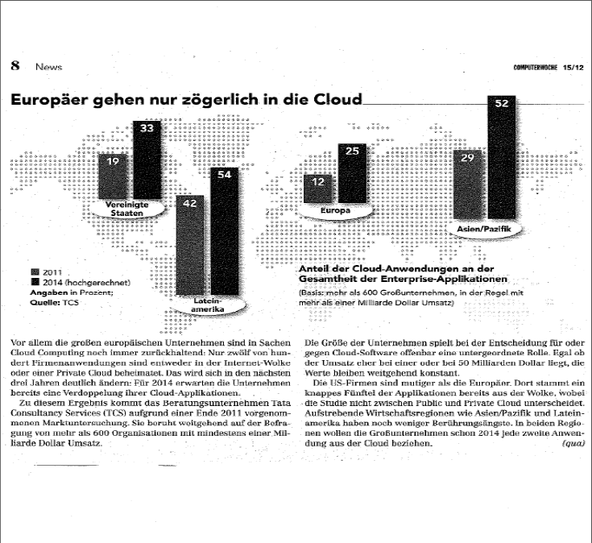

Slide 14
PaaS Outpacing IaaS
Platform as a Service (PaaS)
Infrastructure as a Service (IaaS)
Source: IOUG ResearchWire member study on Cloud Computing, conducted in Aug-Sept 2011
Notes:
One last important finding:
Our customers are adopting Platform-as-a-Service significantly more than Infrastructure-as-a-Service. As you can see from this graphic, the platform level services, such as app server, database, identity, are more prevalent than the infrastructure level services, such as raw compute, storage and dev/test (which is IaaS because it’s primarily the use of virtualization technology to share dev/test hardware).
The rise of PaaS is something that others in the industry have also observed, but this survey really gives us quantitative evidence of this. When you think about the reasons for this, it makes sense. PaaS provides higher level of standardization, component re-use and sharing, with lower levels of heterogeneity, complexity and cost. PaaS also enables faster development, because developers can leverage the platform instead of re-inventing the wheel themselves. In contrast, IaaS enables sharing of hardware and some cost savings in hardware, power, cooling and data center space, but it does nothing to minimize high cost of managing the heterogeneous, complex and brittle environments above the hardware layer.

Slide 15
Consolidation as a First Step to Private Cloud
Consolidate onto standard, shared and elastically scalable PaaS
App
App
App
PaaS
Standardized PaaS for all applications reduces heterogeneity, cost and complexity
Accelerated new application development
Cost savings from less hardware, power and data center space
App
App
App
vs.
App
App
App
Software stack heterogeneity, cost and complexity persists
No administration (O&M) cost savings
Consolidate onto shared IaaS without standardization
IaaS
Cost savings from less hardware, power and data center space
Notes:
Consolidation means moving multiple applications onto pooled or shared computing resources. You have a very strategic decision here. You can move onto shared, standardized platforms or shared infrastructure.
<CLICK>Consolidating at the infrastructure level is typically done using virtualization technologies to share compute servers, and it can be done without standardization of the software stack. Sharing hardware enables you to run at higher utilization rates, which delivers cost savings from using less total hardware, power, cooling and data center space. However, the software stacks are unchanged, which means you still have the cost and complexity of these heterogeneous software stacks.
<CLICK>Consolidating at the platform level means standardizing on a common Middleware and/or Database architecture for multiple or all applications. This standardization reduces the heterogeneity of applications, which is the real driver of complexity and cost. At the same time, a standardized platform speeds development of new applications.
As the IOUG survey and customer examples show, more of our customers are consolidation at the PaaS level. Although it’s more difficult to standardize, but customers are doing it because there’s more value to do it, in terms of cost, efficiency and speed.

Slide 16
Building a Private Cloud
5 Essential Characteristics
Broad network access
Resource pooling
Rapid elasticity
On-demand self-service
Measured service

Slide 17
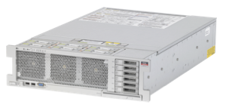
Resource Pooling and Elastic Scalability
Delivered through Server Virtualization and Clustering
Server Virtualization
Clustering
Make one physical resource look like many
Make many physical resources look like one
for scalability and/or availability
Both server virtualization and clustering are key technologies for cloud
Notes:
It’s very common these days to think of consolidation as using virtualization technology run multiple applications on shared hardware.
<CLICK>VM technology does enable resource pooling by making a single physical resource look like many, and it enables scalability by resizing the VM but the limit with VM technology alone is still the single physical resource. Some virtualization vendors will have you believe that virtualization is always the right solution for consolidation and cloud, and that virtualization is necessary and sufficient.
<CLICK>There’s a complementary technology that’s been around for years called clustering. Clustering makes multiple physical resources look like one, so it’s also a way to create shared resource pools, and the way to scale a cluster is easy – one can add new physical nodes to the cluster with no interruption in service. Clusters are also continuously available even if individual hardware or software fails, whereas virtual machines are only able to move and restart after a failure is detected. Oracle offers world-class clustering at many levels of the stack.
<CLICK>Our point is that you need both virtualization and clustering for consolidation and for cloud, and that these two technologies are, in fact, highly complementary and can be used together.

Slide 18
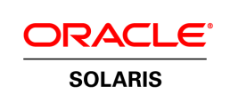
Server Virtualization Options
Centralized Virtualization Lifecycle Management
Dynamic Domains
Oracle VM for SPARC
Oracle VM for x86
Zones
HYPERVISOR
HYPERVISOR
M-Series
T-Series
All x86
All SPARC & x86
Broad choice of server virtualization technologies
Notes:
For server virtualization, it turns out that there are multiple forms, each with different characteristics. In fact, most organization are already using different types of virtualization in their shops.
Oracle offers several choices, including Oracle VM for x86 and Oracle VM for SPARC (formerly known as “Logical Domains” or LDoms). Both are bare-metal hypervisors that allow you to run multiple operating system instances in each VM. Compared to VMware, Oracle VM for x86 is significantly lower cost and more scalable solution. Oracle VM for SPARC is available for all T-Series servers and is part of Solaris.
We also offer container technology called “Zones” (part of Solaris) which is very, very efficient because they run on top of a Solaris instance. They have nearly zero overhead and are a great way to do consolidation of multiple applications, even older Solaris apps alongside newer ones.
In our higher end machines (M-Series), we offer “Dynamic Domains” which provides complete electrical isolation of workloads.
All of this is centrally managed in a uniform manner through our management tool, Ops Center.

Slide 19
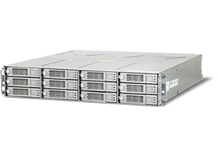
Clustering Options Throughout Stack
Oracle Cloud Application Foundation
Oracle WebLogic Server
Oracle Coherence In-Memory Data Grid
Oracle Exalogic Elastic Cloud
Oracle Database Real Application Clusters
Oracle In-Memory Database Cache (TimesTen)
Oracle Exadata Database Machine
Oracle Clusterware
Oracle Solaris Cluster
Oracle SPARC SuperCluster
Sun Servers
Sun Storage
Broad choice of clustering technologies
Notes:
In terms of clustering, Oracle offers this capability up and down the stack, enabling customers to scale out, provide high throughput and high availability. Examples of clustering include the popular Real Application Clusters (RAC) option of Oracle Database, the TimesTen In-Memory Cache, WebLogic Java EE application server, Coherence In-Memory Data Grid, Solaris Cluster for servers, and more.

Slide 20
Enterprise Cloud Architecture
Cloud Management Layer
Self Service APIs
Policy Manager SLA Management, Distributed Resource Scheduling, Distributed Power Management
Chargeback & Capacity Planning
Self Service Provisioning
Software Library
Assembly Builder
Chargeback and billing APIs
Config. Mgmt.
Monitoring
Provisioning
Zone A
IaaS Resource Pool
DBaaS Resource Pool
Zone B
PaaS Resource Pool
Storage Array
Storage Array
Cloud Infrastructure Layer

Slide 21
New Administrator Roles in Clouds (IaaS)
Cloud Administrator
Self Service Administrator
1
Provision bare metal hypervisor
Configure storage arrays and network (VLAN)
Create server pools
Define zones based on functional and operational boundaries
Configure software library
1
Define allowable VM sizes
Assign quotas to users and roles
Define access boundaries (map roles to zones)
Setup chargeback plans
Make software available for deployment by self-service users
2
2
3
3
4
4
5
5
Notes:
21

Slide 22
Oracle Enterprise Manager 12c Total Cloud Control
The complete management solution for Oracle-based clouds
Consolidation Planner
Cloud Design and Setup
Self-Service Provisioning
Elastic Workload Management
Metering and Chargeback

Slide 23
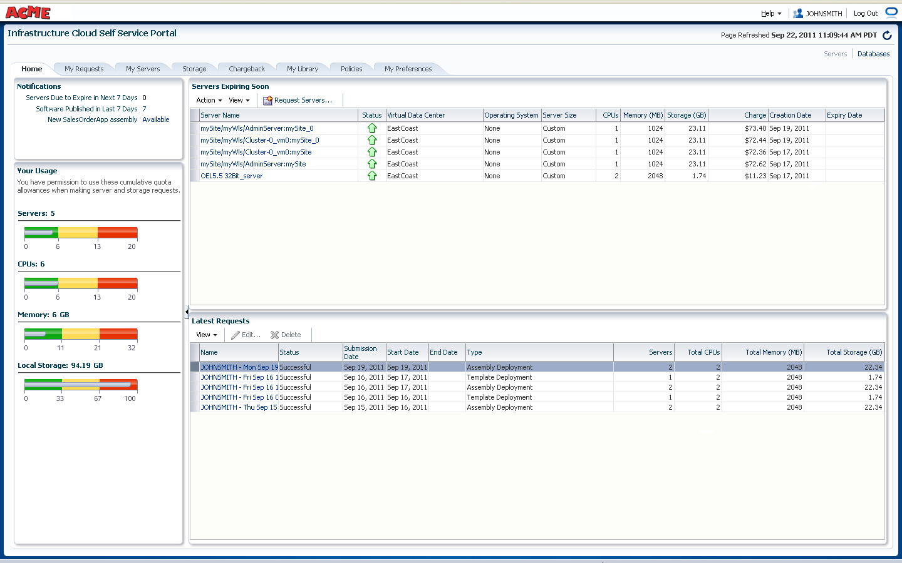
Self-Service Provisioning
Out-of-Box, Self-Service Portal
Part of the base product, no additional setup required
Rich service catalog:
VM Templates, Assemblies
Database service
Java applications
Full Operational Control
Start/stop services, request additional resources, backup/restore
Basic resource monitoring
Chargeback information
Quota monitoring
Programmatic Access using APIs
RESTful APIs and CLI (Submitted to DMTF)
Notes:
Representational state transfer - And finally, [touch of humor], if you do not like our Self-Service Console, you can use our APIs or put your own branding on the Console.
Oracle recently announced the Oracle Cloud Resource Model Application Programming Interface (Oracle Cloud API) for managing cloud computing infrastructure. Oracle has also contributed the Oracle Cloud Elemental Resource Model API, a subset of the Oracle Cloud API, to the Distributed Management Task Force (DMTF) for consideration in DMTF’s proposed Infrastructure as a Service Cloud API standard.
23

Slide 24
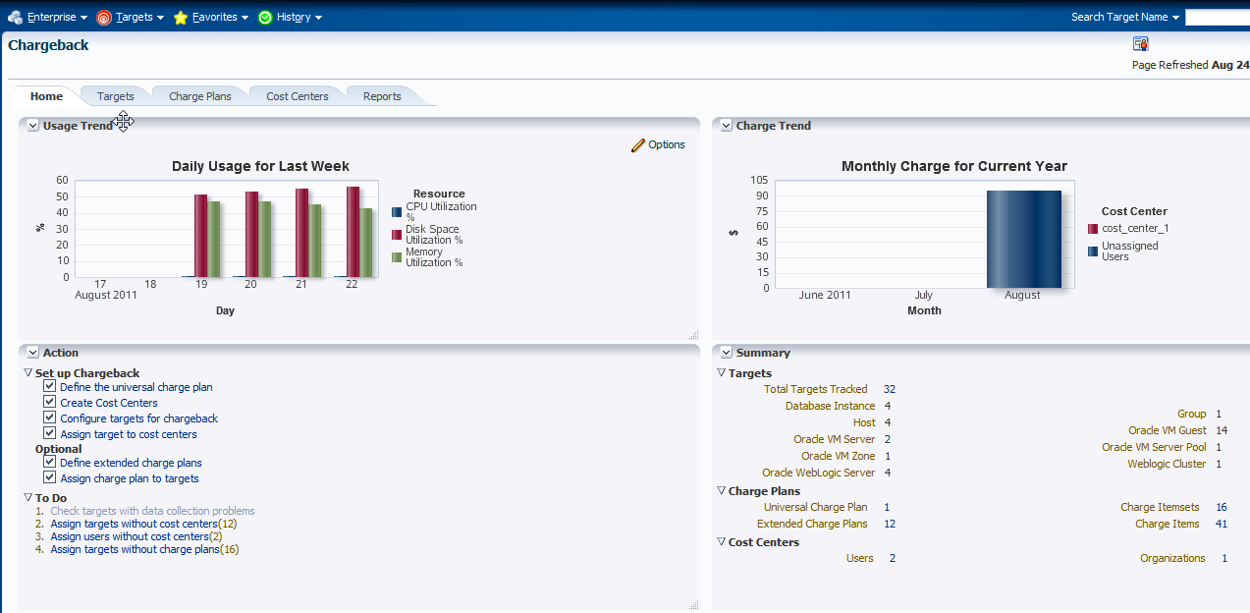
Metering and Chargeback
App-to-Disk Resource Metering
VM Guests, Database, Web Logic Server, Host
Composite Target: aggregation over supported target types
CPU, Memory, Storage, Network Bandwidth
Database transactions, SQL Executions, etc.
Mid Tier resource usage
Application/Activity metering (planned)
User Defined Chargeback Plan
Usage-based items (Resource and Activity)
Configuration-based items
Fixed-cost items

Slide 25
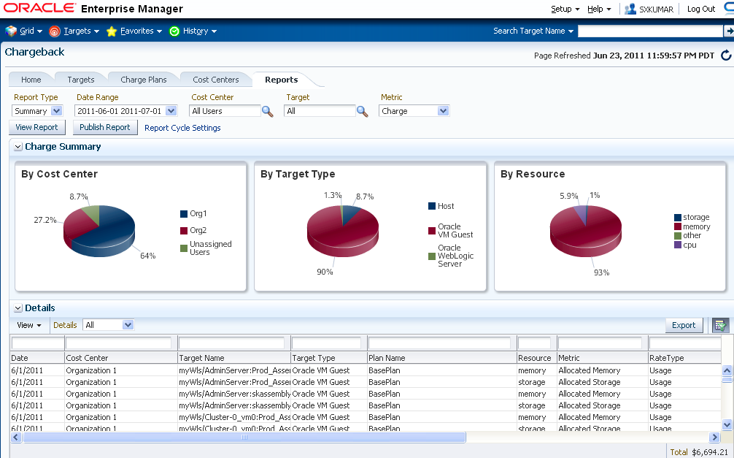
Chargeback Reporting
Rollup based on LDAP hierarchy
Generate reports in variety of formats (Excel, Work, PowerPoint, HTML, PDF)
Accessible from self service portal
Integrated with BI Publisher
Generate and email reports to recipients on defined schedule (e.g. monthly)
Notes:
Finally, chargeback has integration with BI Publisher.
This enables the chargeback administrator to generate charge and usage reports in a variety of formats such as excel, pdf, and html.
The reports can run on a scheduled basis and be distributed to users who don’t have access to the Enterprise Manager environment.

Slide 26
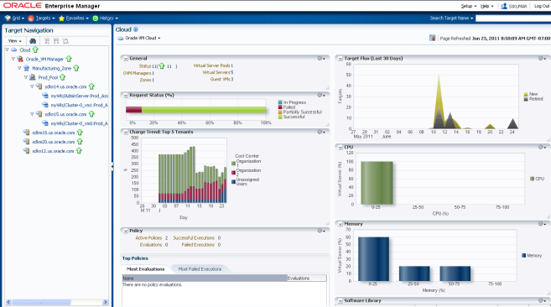
Monitor and Manage Cloud Operations
Track resource flux, tenants, policy violations, etc
Monitor requests and failures
Manage resource and capacity utilization
Automatic, policy driven elasticity
Notes:
Once the Cloud is operational, it needs to be monitored and managed on a continuing basis. With Enterprise manager 12c, we provide persona-specific views for the cloud administrators and cloud consumers so that they can monitor what’s going on. The Administrators, who are responsible for the health of the Cloud can track the incoming requests and fulfillment status. They can drill down into the database, middleware, server or storage layer and detect potential bottlenecks. We also provide necessary automation out-of-the –box so that they can add more servers and storage into the cloud infrastructure.
The Cloud consumer (Application owner) can monitor the overall service level and scale out resources if needed. Enterprise manager 12c lets them define policies based on either schedule or performance, and associate automated remediation actions such as scale-up or scale-down or power-off with those policies. [Provide one or two examples of schedule and performance based policies like shutdown during weekends to avoid higher metering].

Slide 27
Package Multi-tier Enterprise Applications
Oracle Virtual Assembly Builder
Capture Complete
Application Topology
Package Into
Single Assembly
Upload to Software Library
Deploy Self-Service
HTTP
HTTP
Oracle Enterprise Manager
OVM
OVM
WLS
OVM
DB
Metadata
OVM

Slide 28
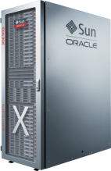
Oracle Platform for Private Clouds
Oracle Enterprise Manager 12c
Optimize
Plan
Applications and Business Services
Setup
3rd Party Apps
Oracle Apps
ISV Apps
Meter &
Charge
Platform as a Service
Integration: SOA Suite
Process Mgmt: BPM Suite
Security: Identity Mgmt
User Interaction: WebCenter
Applications and
Business Services
Build
Oracle Fusion Middleware
Manage
Platform as a Service
Oracle Database
Database-as-a-Service
Infrastructure-as-a-Service
Infrastructure-as-a-Service
Test
Oracle Solaris
Oracle Linux
Monitor
Operating Systems: Oracle Enterprise Linux
Oracle VM for SPARC (LDom) Solaris Containers
Oracle VM for x86
Deploy
Servers
Storage
Notes:
- j

Slide 29
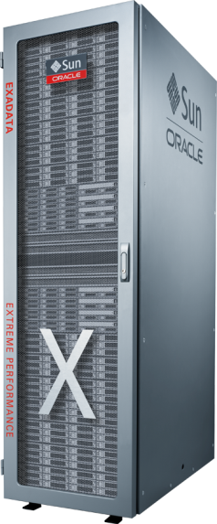
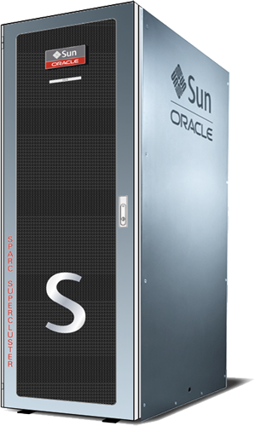
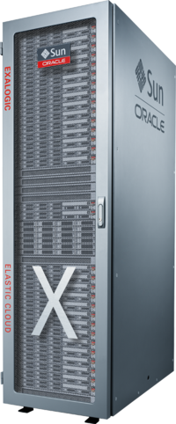
Oracle’s Engineered Systems
Exalogic Elastic Cloud
Exadata
SPARC SuperCluster

Slide 30
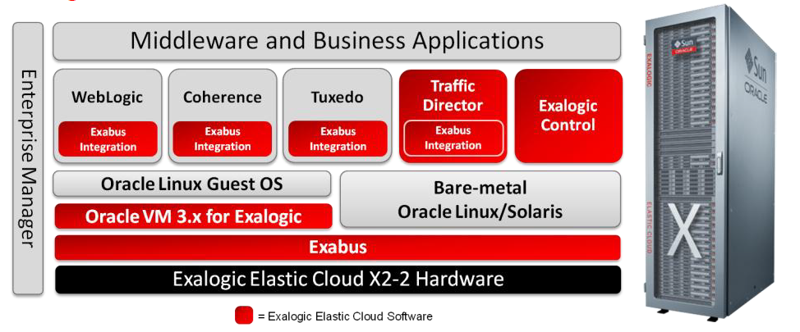
Exalogic Elastic Cloud Software
www.oracle.com/us/products/middleware/exalogic

Slide 31
Oracle Public Cloud

Slide 32
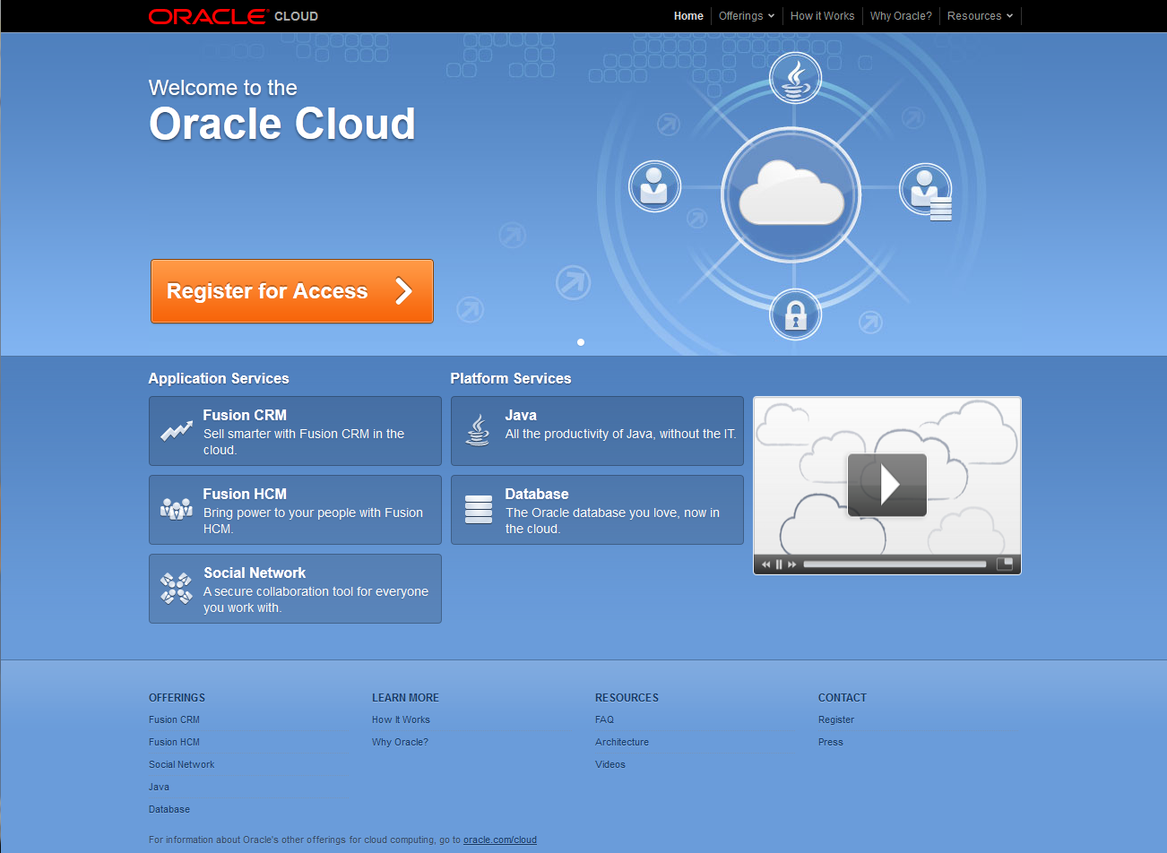
cloud.oracle.com

Slide 33
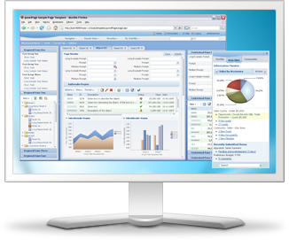
Oracle Cloud SaaS
Customer Relationship Management
Sales Planning
Installed Base
Accounts & Contacts
Sales Prediction
Territories
Sales Management
Quotas
Commissions
Forecasting
Partners
CRM
Marketing
Campaigns
Google Ad-Words
E-mail & Web
Leads
Sales Execution
Opportunities
Sales Contracts
Sales Intelligence
Mobile Sales
Notes:
TK: Please use the content in Spreadsheet 1 for this Slide – I have reduced the word count significantly but it will be good if you see if we can come with a better graphic than this red and gray circle.

Slide 34
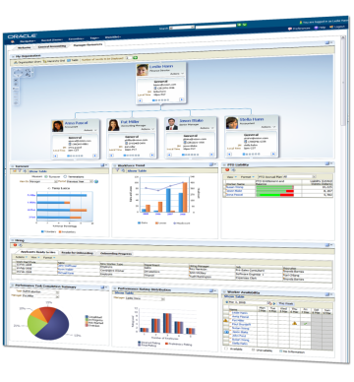
Oracle Cloud SaaS
Human Resources
Workforce Management
Workforce Planning
Lifecycle Management
Workforce Prediction
Workforce Intelligence
Compensation
Compensation
Benefits
Payroll
Absence
Human Resources
Employee Self-Service
Worker Directory
Network@Work
Worker Portrait
Mobile Self-Service
Talent Management
Performance Management
Goal Management
Talent Review
Personal Profile
Notes:
TK: Please use the content in Spreadsheet 1 for this Slide – I have reduced the word count significantly but it will be good if you see if we can come with a better graphic than this red and gray circle.

Slide 35
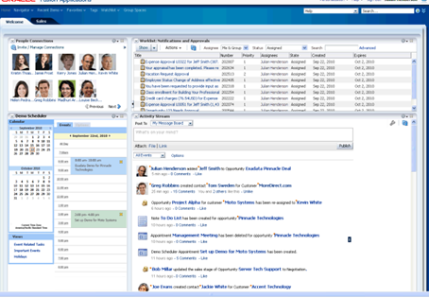
Oracle Cloud SaaS
Oracle Social Network
Social Network
Enterprise Social Graph
Facebook
Linked-In
Expertise Identification
Document Sharing
Workspaces
Sharing
Co-Editing
Tags, Topics, Search
Oracle Social Network
Feeds
Activity Streams
Application Feeds
Recommendations
Conversations
Real-Time Communications
Discussion Forums
Presence & Chat
Conferencing
Mobile Social

Slide 36
Application Services: 100+ Cloud Applications
Complete Suite, Best-of-Breed, Enterprise Grade
Human Capital
Management
Talent Management
Sales & Marketing
Customer Experience
Financial Management
Procurement, Sourcing, Inventory
Project Management
Governance, Risk, Compliance
Common Infrastructure Services
Notes:
Re-iterate the Application Services design goals
Broadest applications offering – enterprise customers
Built on industry standards – Java, standards-based middleware
Service-Oriented Architecture – simplifies integration
Self-service control for business users – configure, extend
Built in business intelligence, social and mobile
Complete data isolation and flexible upgrades
Modern user interface – Web, mobile, HTML5

Slide 37
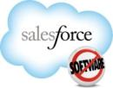
Runs In The Cloud And On Premise
CRM Only
HCM Only
Talent Only
Cloud Only Silos
SAP Business Suite
Complete Suite In Cloud AND On Premise
On Premise Only Suite

Slide 38
cloud.oracle.com

Slide 39
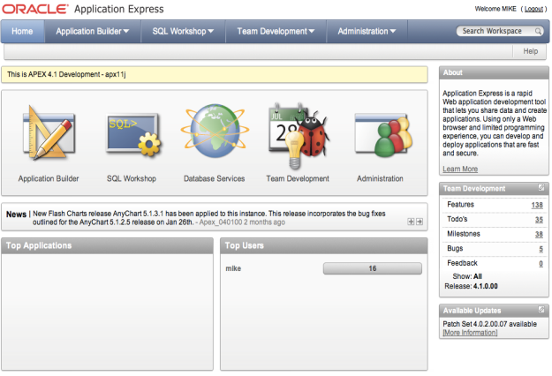
Oracle Cloud PaaS
Database Service
Runs Oracle Database on the cloud
Runs any Oracle DBMS Application
SQL & PL/SQL
Java & REST APIs
Web-based application development
Oracle Application Express (APEX)
Seamless: from cloud to on-premise
Secure: data, schema, & table-space isolation

Slide 40
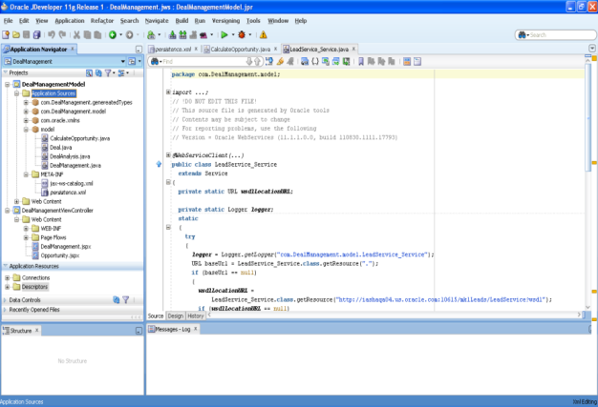
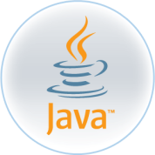
Oracle Cloud PaaS
Java Cloud Service
Runs any Java application in the cloud
Complete Java EE Support
SOAP & RESTful Web Services
Eclipse, NetBeans, & JDeveloper Tools
Auto-generate Database Schemas
Secure: application and data isolation
dedicated virtual machines

Slide 41
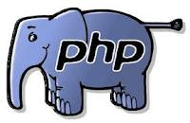
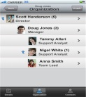
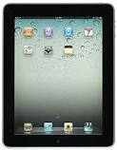
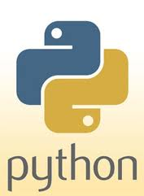
Platform Services
Develop
Web
Mobile
Enable development teams
Lifecycle management
Script in popular languages
Fast, secure, reliable
Native or HTML5 applications
Cross-platform and device
Notes:
In addition to Java and Database Services for cloud apps we will continue to build out a rich of developer services to enable web and mobile scenarios and workloads. Support for scripting languages like Ruby, PHP, Python will be offered in the future as well. They are integrated with popular IDEs including JDeveloper, Eclipse and NetBeans and support multiple platforms and devices. Developers will be able to manage their complete development lifecycle using tasks, wiki, source repository, continuous build, etc., all in an integrated and agile manner.

Slide 42
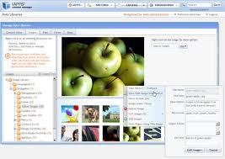
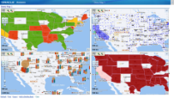
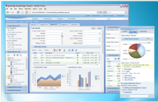
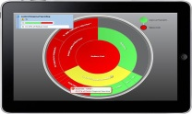
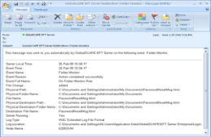
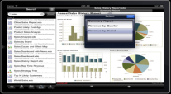
Platform Services
Documents
Sites
Analytics
Team collaboration
Document workspaces
File & device synchronization
Build rich media sites
Visual drag & drop design
Self-service publishing
Load data and model KPIs
Build reports and dashboards
Publish to Web, mobile
Notes:
In addition to services for developers there will services for business users as well that will allow
1. Teams in different functions like Finance, HR etc. can use these services for secure document & team collaboration
2. Marketing professionals will be able to quickly build rich media sites integrated with social capabilities with drag & drop capabilities
3. Sales operations teams can use these services for highly scalable analytics and reporting

Slide 43
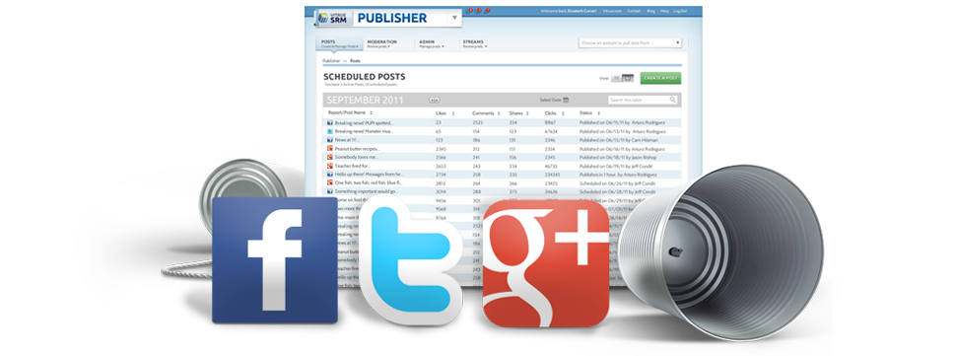
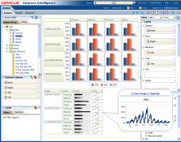
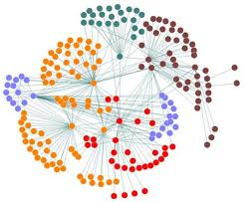
Social Services
Social Marketing & Engagement
Social Intelligence
Social Relationship Marketing
Build brands on social
Market, engage, transact socially
Social media monitoring
Collect and analyze social streams
Respond and service
Notes:
Highlight – Vitrue and Circuit acquisitions.
Vitrue – Establish, build and grow brands via Social Media
Deliver timely response through integrated workflow and view of global holistic information on customer social interaction
Enable targeted communication to any device across all social networks
Provide comprehensive view of social activities across marketing, sales and customer service
Measure influence, engagement and relationships across all media
Circuit – To be added

Slide 44
cloud.oracle.com

Slide 45
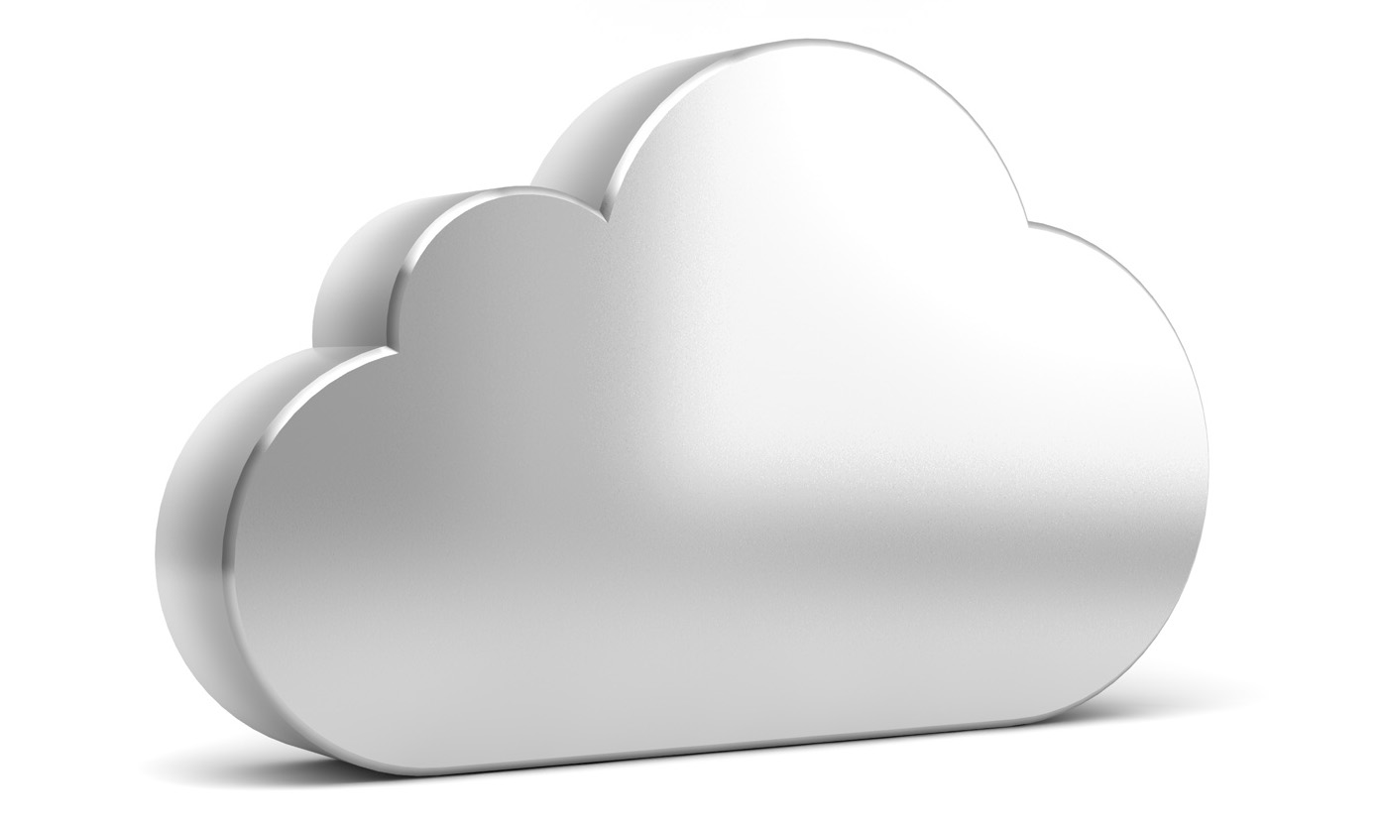
Oracle Cloud
Platform Services
Application Services
Social Services
Common Infrastructure Services
Notes:
Oracle is aggressively investing in the cloud business. At OpenWorld last year we announced 5 services. Today you will hear about many more and how they will transform the way you can build applications and also run your business.

Slide 46
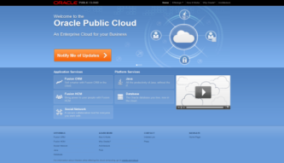
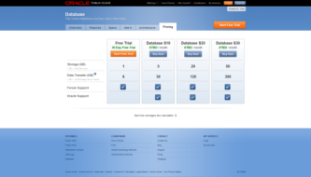
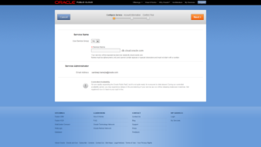
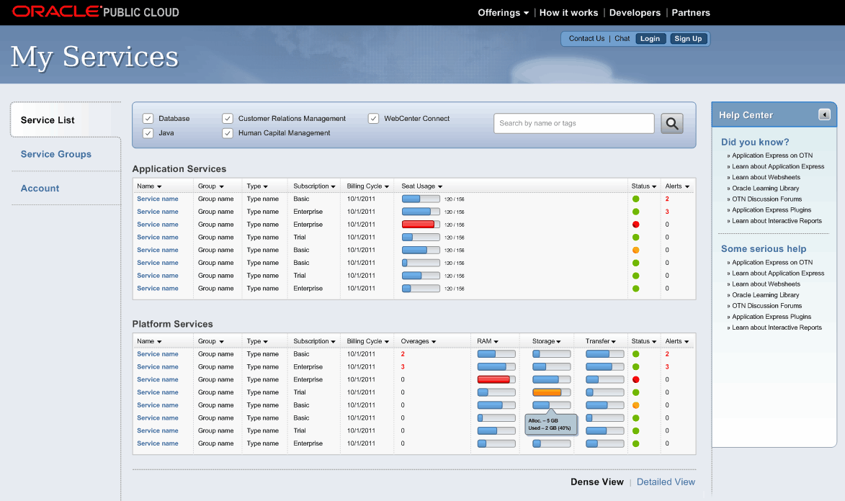
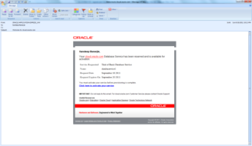
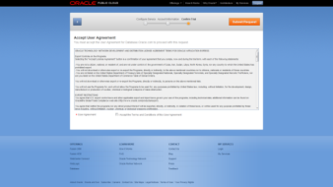
Oracle Cloud Extremely Easy-to-Use
1. Pick Service
2. Select Plan
3. Configure Service
cloud.oracle.com
6. Use and Manage
5. Get Credentials
4. Submit Request
Notes:
46

Slide 47
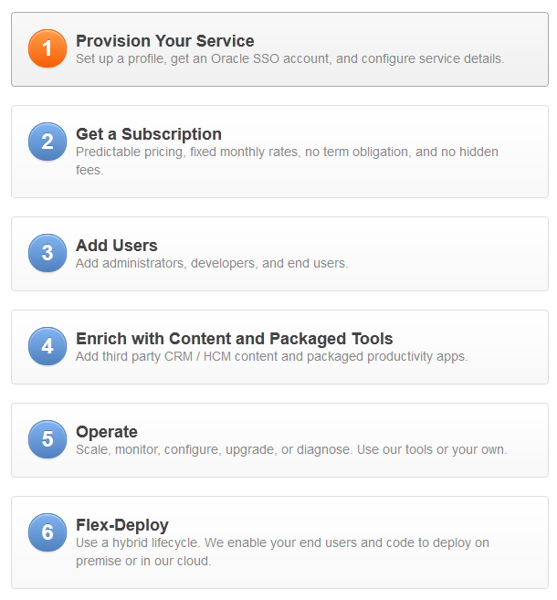
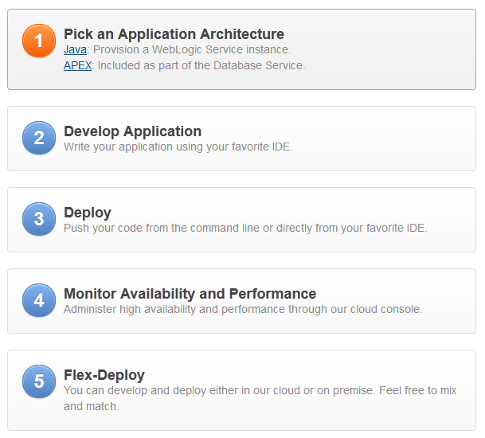

Slide 48
Evolution of Private and Public Clouds
Public Cloud Evolution
Service Providers
Public Clouds
Hybrid
MSP
CSP/ Telcos
ISP
IaaS
PaaS
IaaS
SaaS
ASP
ISV
PaaS
SaaS
Private Cloud Evolution
On-Premise to Cloud and Back
Virtual Private Cloud
App1
App2
App3
App1
App2
App3
App1
App2
App3
App1
App2
App3
Consolidate
Standardize
Private PaaS
Private PaaS
Private PaaS
Private IaaS
Private IaaS
Private IaaS
Silo’d
Consolidated
Private Cloud
Hybrid
Physical
Dedicated
Static
Heterogeneous
Virtual
Shared services
Dynamic
Standardized appliances
Self-service
Policy-based resource mgmt.
Chargeback
Capacity planning
Federation with public clouds
Interoperability
Cloud bursting

Slide 49
Oracle Cloud Offerings – Complete Choice
Private Cloud Products
Private & Public Cloud Services
Applications
Oracle Cloud Services
Oracle Cloud
Cloud Control
Oracle Applications
Oracle Applications On Demand
Oracle Cloud Applications Services
Platform as a Service
SOA Suite & BPM Suite
Data Integration & GoldenGate
Identity & Access Mgmt
WebCenter User Engagement
Middleware On Demand
Exalogic On Demand
Cloud Application Foundation: WebLogic Server, Coherence, JRockit, Exalogic Elastic Cloud
Oracle Cloud Social Services
Cloud Management
Oracle Enterprise Manager
Oracle Database, MySQL,
Exadata Database Machine, SPARC SuperCluster
Database On Demand
Exadata On Demand
Oracle Cloud Platform Services
Infrastructure as a Service
Ops Center
Oracle Solaris
Oracle Linux
Oracle VM for SPARC (LDom) Solaris Zones
Oracle VM for x86
Servers, SPARC SuperCluster
Storage
Network Fabric
Notes:
Segue to breakouts:
We have a great line-up of sessions for you today that will cover the wide range of offerings Oracle has for cloud computing. To help map that out for you, I wanted to share this diagram with you.
On the left, you can see our products to help customers build and operate private clouds. We offer cloud applications, cloud platform, cloud infrastructure, and cloud management.
On the right, you can see the services we offer, including our Managed Cloud Services and the new Oracle Public Cloud.
You’ll see this diagram in the other breakouts, and we hope it’ll serve as a guide to all the solutions Oracle offers for cloud computing.

Slide 50
oracle.com/cloud
www.facebook.com/OracleCloudComputing
@OracleCloudZone #oraclecloud
Notes:
For more information about Oracle’s overall cloud computing strategy, please go to oracle.com.
And follow us on Facebook and Twitter.
Thank you.

