Slide 1
Monitoring: Present and Future
Pedro Andrade (CERN IT)
pedro.andrade@cern.ch
31st August 2012
GridKa School – Karlsruhe, Germany

Slide 2
Outline
What’s / Why Monitoring ?
Terminology and Architecture
Technologies and Tools
WLCG and CERN Examples
Current Problems & Future Solutions

Slide 3
What’s Monitoring ?
“Observe and check the progress or quality of something over a period of time.”
Google define ☺
“Capability to execute continuous observance and analysis of the operational state of systems and provide decision support regarding situational awareness and deviations from expectations.”
US National Institute of Standards and Technology

Slide 4
Why Monitoring ?
It’s a core IT function
The value of a service to an organization is proportional to the availability of the service
It’s powerful
Understanding and using monitoring data correctly gives a competitive advantage
It’s fun
Many people enjoy looking to nice dashboards and graphs of service status and availability

Slide 5
What’s the challenge ?
Define the monitoring scope and coverage
Understand the services dependencies
Define the correct monitoring toolchain
Define what to do with monitoring data
Do not forget the evolving infrastructure
Notes:
Several independent monitoring activities in IT
similar overall approach, different tool-chains, similar limitations
High level services are interdependent
combination of data from different groups necessary, but difficult
Understanding performance became more important
requires more combined data and complex analysis
Move to a virtualized dynamic infrastructure
comes with complex new requirements on monitoring
Easy to aggregate and share monitoring data
Select well established existing solutions
Challenges
Find a shared architecture and tool-chain components while preserving our investment in monitoring

Slide 6
Terminology
Many tools in the market… vast terminology !
collection
probes
metric
context
analytics
dashboards
correlation
event
resource
probe

Slide 7
Terminology
Terms must be categorized
Monitored Elements
Services
Monitoring Code
Probes
Monitoring Tasks
Aggregation
Monitoring Outputs
Notifications
Nodes
Network
Data
…
Tests
Sensors
Agents
…
Collection
Reporting
Probation
Alarms
Dashboards
Reports
…
…

Slide 8
Terminology
Probe
Context
Event
probe execution result (numeric/boolean data point)
metadata about a metric
metric combined with the context
Metric
test code to check the status of a given attribute
Notification
result of processing an event

Slide 9
Architecture
Probation
Probes
Continuous
Collection
Computation
Trending
Presentation
Dashboards
Synchronization
Repository
Catalog
Filtering
Grouping
Tagging
Correlation
Reports
APIs
Active/Passive
Aggregation
Sensors
Alarms
Notifications
Tests

Slide 10
Architecture
Monitoring data is the core
Data transport, data storage, data format
Probes should be kept as simple as possible
Clear focus with simple computing logic
Scalability can be addressed in different ways
Horizontally scaling
Adding other layers: pre-aggregation, pre-processing
Different tools for different layers of the architecture
Many tools available in the market
Each individual tool must be easily replaced
Based on standard protocols

Slide 11
Technologies and Tools
Monitoring frameworks are the core technology
Configure the environment you want to monitor
Schedule the execution of probes
Provide some degree of reporting/notification
Several types of solutions available
More complex scenarios may require other technology
Messaging for data transport and data aggregation
ActiveMQ, Apollo, RabbitMQ, etc.
NoSQL for data analysis and data storage
Hadoop, HBase, Cassandra, etc.
Many tools available for data analysis/presentation

Slide 12
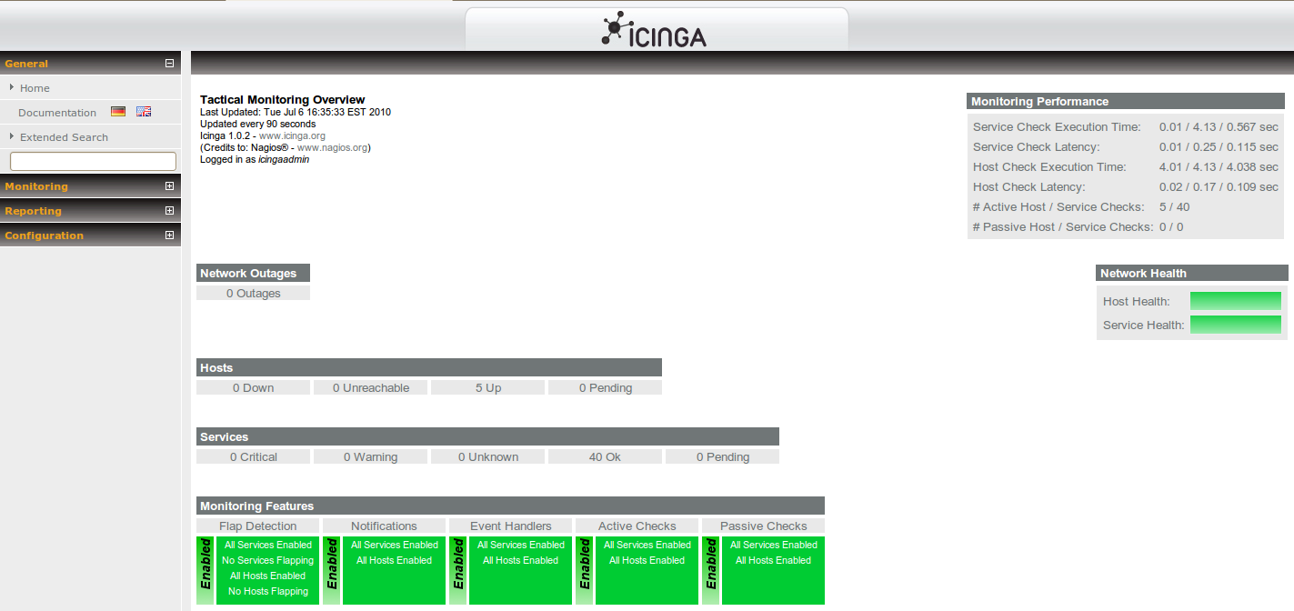
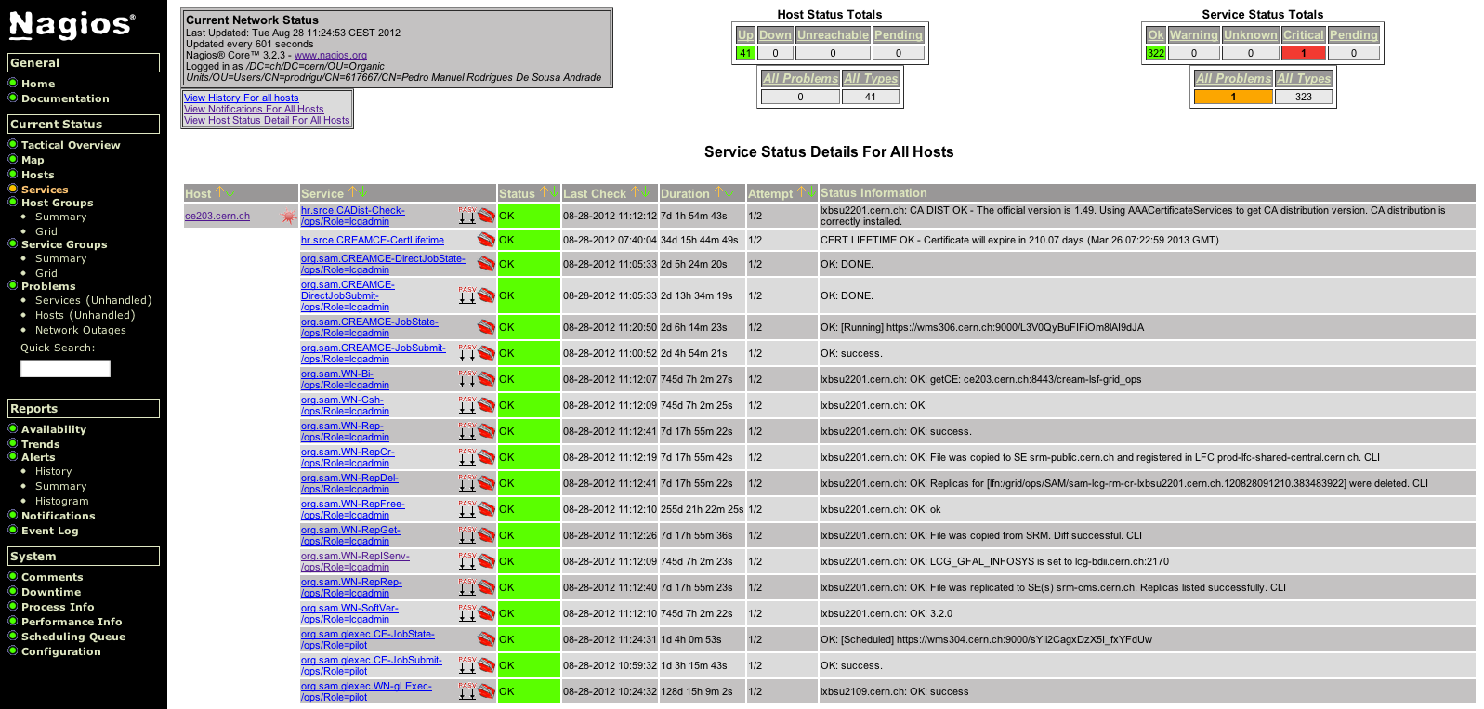
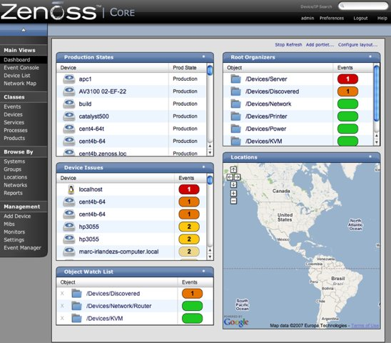
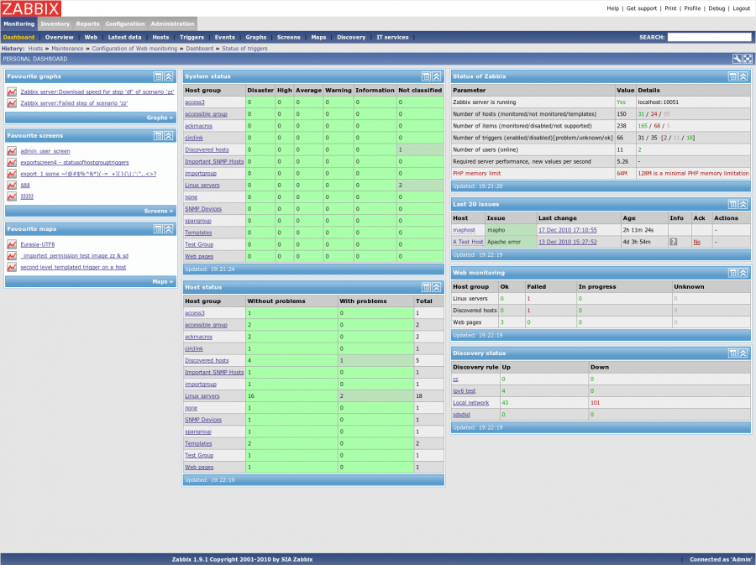
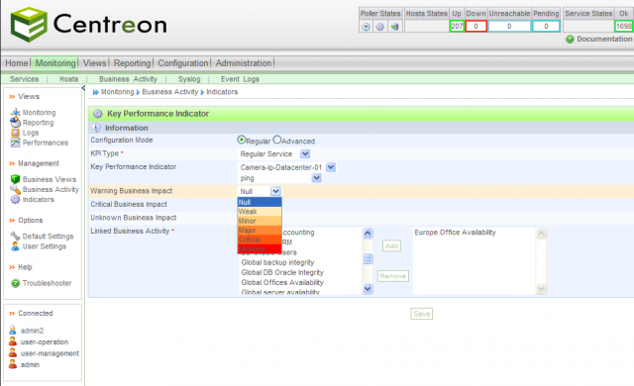
Technologies and Tools
Notes:
Icinga – a fork of nagios
Centreon – a fork of nagios
Zenoss – compatible with nagios plugins
Zabixx – more focused on network monitoring

Slide 13
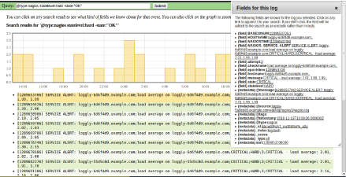
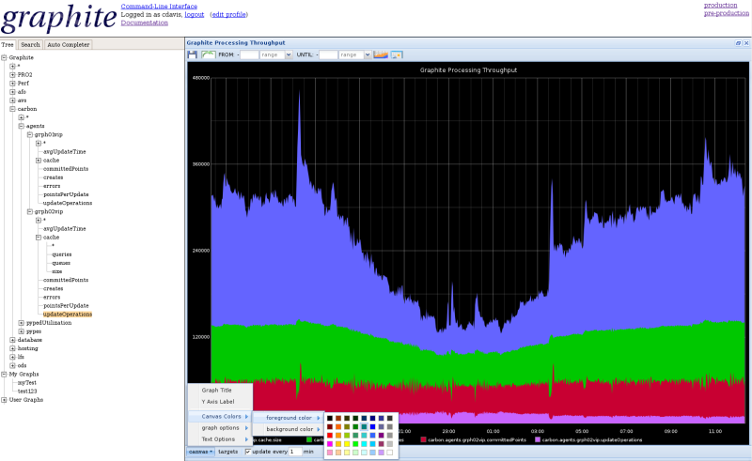
Technologies and Tools
New Relic
Librato Metrics
Pingdom
PagerDuty
Splunk
Graphite
Statsd
Riemann
Logstash
…
SaaS
Open Source
Notes:
Pigdon - tracks the uptime, downtime, and performance of websites
PagerDuty - takes alerts from almost all monitoring tools and manages your on-call schedule, escalation and incident resolution

Slide 14
Monitoring @ WLCG
The Worldwide LHC Computing Grid (WLCG) is a distributed infrastructure composed by 152 sites and >320,000 logical CPUs serving the computing needs of WLCG VOs. It brings together resources provided by the EGI and OSG infrastructures.
Multi-organization infrastructure, few services.
Monitoring is based on the SAM system:
SAM-Nagios testing sites and services (for VOs/NGIs)
SAM-Gridmon aggregating/computing monitoring data
WLCG Dashboards providing dedicated portals to VOs

Slide 15
Monitoring @ WLCG
WLCG Dashboards
MYWLCG
SAM-Gridmon
External Sources (EGI, OSG)
ActiveMQ
Italy NGI
SAM-Nagios
France NGI
SAM-Nagios
ATLAS VO
SAM-Nagios
Site A
(Italy, CMS)
Site B
(France, CMS)
Site C
(France, ATLAS)

Slide 16
Monitoring @ WLCG
Some statistics
236 probes for operations and VO checks
+4000 service endpoints being tested
41 NGI SAM-Nagios + 4 WLCG VO SAM-Nagios
500k metrics results processed per day
Key features
Based on open source systems: Nagios, ActiveMQ
Distributed responsibility for tests execution: NGIs, VOs
Centralized computation of status and availability
Supports integration of 3rd party monitoring systems
Provides web REST API to consume monitoring data

Slide 17
Monitoring @ CERN
CERN Computer Centre houses servers and data storage systems for the WLCG Tier-0, physics analysis, and other CERN services. It currently provides 30 PB storage on disk and 65,000 cores (plus 20,000 cores and 5,5 PB of storage from new Computer Centre in Budapest).
Single-organization infrastructure, many services.
Monitoring is based on the Lemon system plus many application specific tools. A new monitoring architecture is being defined under the AI project.

Slide 18
Monitoring @ CERN
Splunk
WepApp1
SNOW
Hadoop
Analysis/Storage
Feed
Alarm
Feed
Custom Feed
Apollo
Sensor1
Sensor2
Application1
Application2
Notes:
Producer:
Published to messaging using common libraries
May also be produced as a result of pre-aggregation or post-processing tasks
Support and integrate closed monitoring solutions
Aggregation:
Support for multiple configurations, Provide a network of messaging brokers
The needs of each monitoring application must be clearly analyzed and defined
Storage/Analysis
Allows sharing of monitoring data and analysis tools
Allows correlations between different data sets
Allows feeding into the system data already processed
NoSQL technologies are the most suitable solutions, focus on column/tabular solutions
Visualization:
Provide an efficient delivery of notifications
Notifications directly sent to correct consumer targets. Possible targets: operators, service managers, etc.
Provide powerful dashboards and APIs. Complex queries on cross-domain monitoring data.

Slide 19
Monitoring @ CERN
Prototype system for new architecture being implemented and tested (no statistics for now).
Key features
Based on open source systems: Hadoop, Apollo, etc.
Distributed responsibility for probes execution
High scalability based on messaging: Apollo
Centralized storage and analysis cluster: Hadoop
Powerful and highly configurable dashboard: Splunk
Real time feed for notifications and alarms

Slide 20
Current Problems
Tools complexity
Web interfaces full of “traffic lights” !
Can we actually get anything out of there ?
No automation of configuration
Should be better integrated with configuration systems
Toolchain diversity
One single tool is not enough (most of the time!)
Orchestration of different tools difficult to implement
Low quality of processed monitoring data
Incorrect notifications can be easily seen as SPAM

Slide 21
Current Problems
Monitoring granularity
Most of the times based on hosts
Why can’t we have other 1st class monitoring elements?
Sources of truth
Different tools hold different databases of hosts/services
Is there a master? Are there copies? Cache data?
Timing (depends of tool!)
Long intervals between checks, high latency

Slide 22
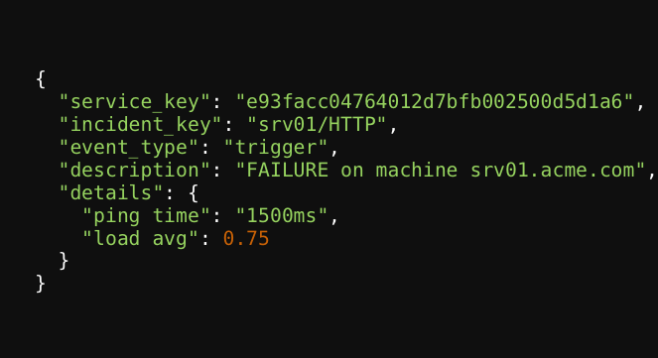
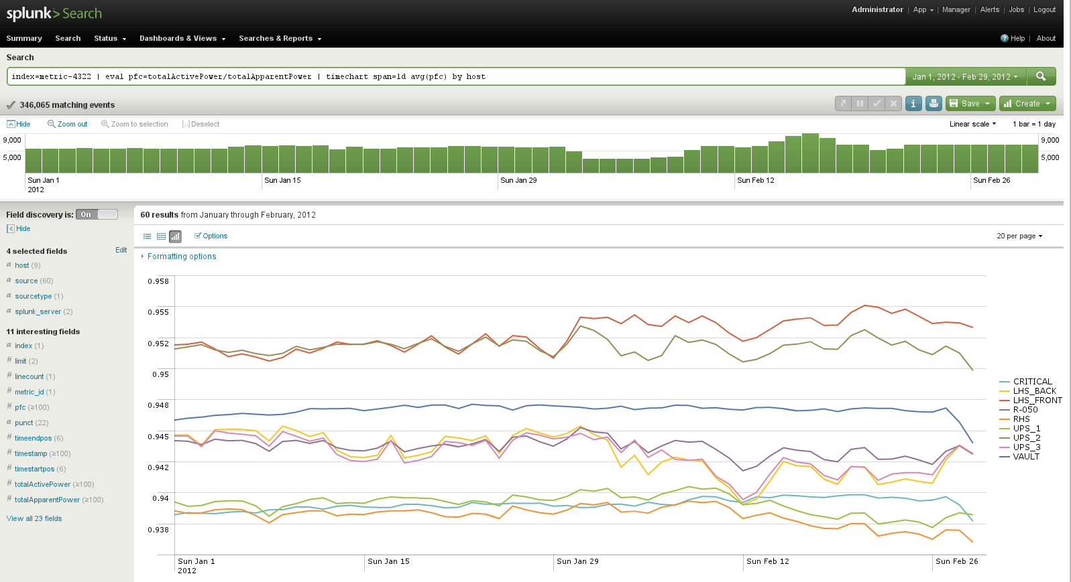
Future Solutions
Should target at
Easy and reliable access to monitoring data
Simple and reliable dashboards and APIs
Correctly targeted real-time notifications
Enable complex queries between different data sets

Slide 23
Future Solutions
Well designed monitoring toolchain
Appropriate for the infrastructure being monitored
Consider alternatives to monitoring frameworks
Messaging infrastructure as transport layer
Give top priority to the monitoring data !
Single data format, flexible schema
Store all monitoring data (incl. historical) for analysis
Feed the system with curated monitoring data

Slide 24
Thank You !

