Slide 4
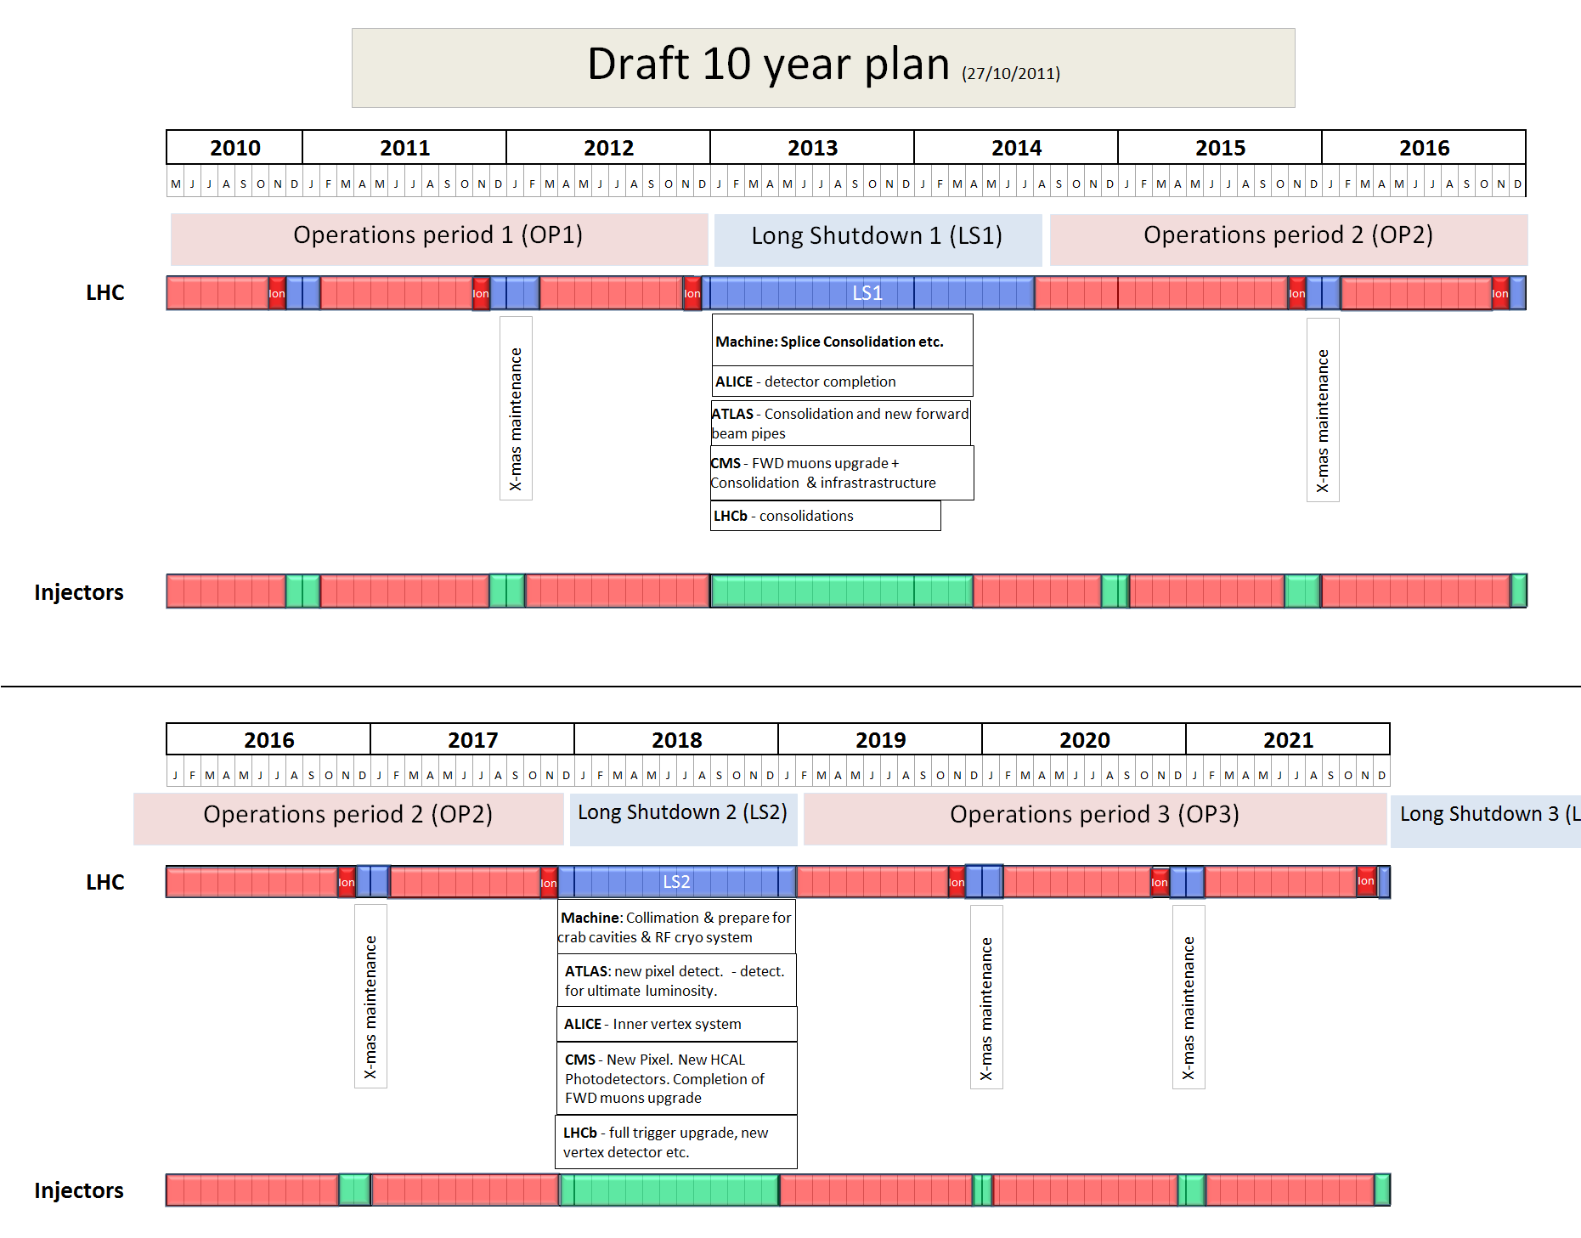
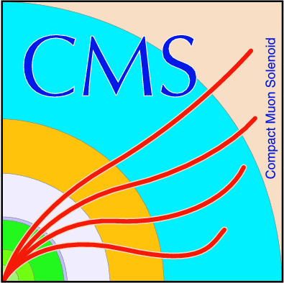

Slide 5
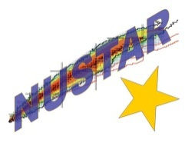
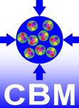
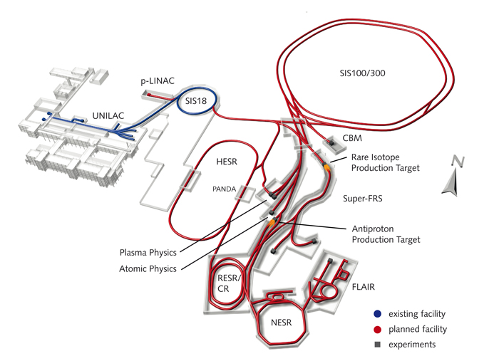

Slide 6
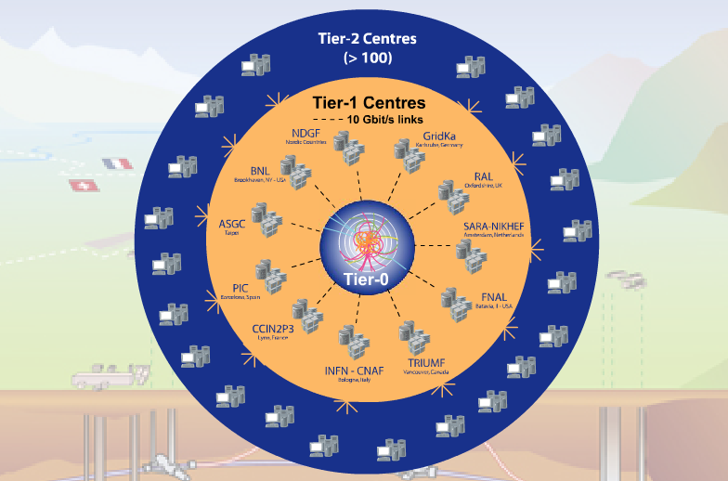
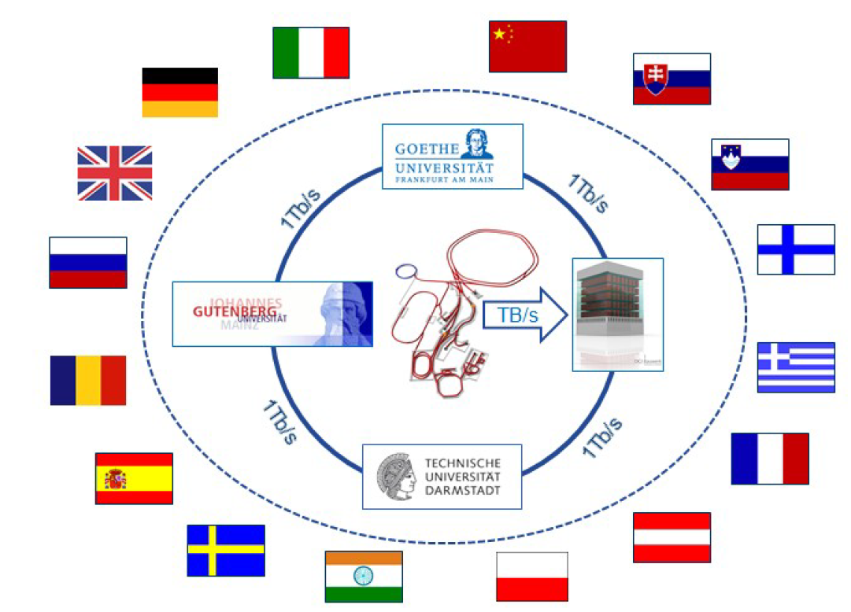

Slide 9
Grids

Slide 10
The skeptic can be forgiven for wondering if there is more to the Grid than … a ‘funding concept’
Ian Foster, “What is the Grid? A Three Point Checklist”

Slide 11
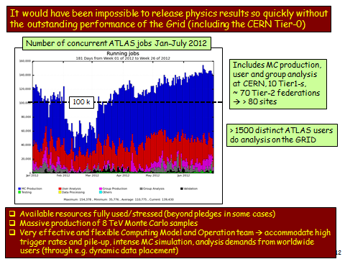
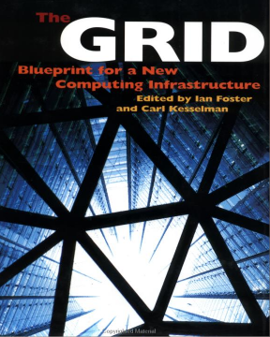
Concept Crystallised
“A computational grid is a hardware and software infrastructure that provides dependable, consistent, pervasive and inexpensive access to high-end computational capabilities”

Slide 12
What problem is being solved?
Clearly: “access to high-end computational capabilities”
In 1990s, many supercomputing and national computing centres existed, but these were disconnected from researchers. Users needed a dedicated account at each centre they wanted to use and had to connect to a front-end system.
The Grid model foresaw integration of such facilities with the researcher’s local environment: the end-user’s PC plugged into electricity on tap via the power socket and computing on tap via the network socket.

Slide 13
Who owns the resources?
The end-user
Perhaps not directly, but certainly indirectly: end-users have a right to use the facilities that exist either because they have been given a grant or because they are part of a community that has purchased the resources.
Interestingly, “The Grid” also presents proposals for integration of data-collection systems (e.g. electron microscopes) into the grid as well as data processing (and data storage) systems.

Slide 14
Enabling technology?
Affordable high-speed networking.
From “The Grid”: “Furthermore we are starting to see the construction of large-scale, high-performance national- and international-scale networks.” and “Existing high-speed networks … have enabled extensive experiments with … the coupling, usually by heroic efforts, of geographically distributed supercomputers.” My emphasis.
Grid middleware was designed and introduced to remove the need for heroic efforts and place high-end computational capabilities within easy reach for mere mortals.

Slide 15
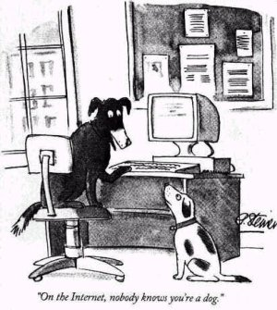
Clouds
http://www.citrix.com/English/NE/news/news.asp?newsID=2328309

Slide 16
The skeptic can be forgiven for wondering if there is more to Clouds than a ‘revenue concept’
Tony Cass, “Grid and Cloud Computing; an Overview”

Slide 17
What problem is being solved?
How do I monetise my idle resources?
Services we would recognise today as “Cloud services” (notably remote data storage) existed in the early 2000s but were not sold as such.
The hype around “Cloud Computing” really started with the introduction of Amazon’s EC2, a service that could be introduced because Amazon had free capacity since their computing facilities were sized to meet peek demand.
This, however, is the cynic’s (or sceptic’s) view.

Slide 18
What problem is being solved?
User view
I have a computing need but cannot afford to build the necessary infrastructure myself—but I can afford to “pay as I go”.
System View
Applications are isolated from the underlying hardware and operating system.
Unlike the Grid, there is no need for the CPU consumer to have any knowledge of the environment at the supplier.
Suppliers can be isolated from user complexity
Schedule only virtual machine images; users choose the image contents according to need.
compare CERN batch system where we have many subclusters for different VO needs, e.g. production vs analysis.

Slide 19
Who owns the resources?
No question: the service provider!
Users pay according to usage…

Slide 20
Enabling technology?
(x86) Virtualisation
Easily available, low-overhead virtualisation enables users to provide their own computing environment running on an unknown (and irrelevant) substrate
Virtualisation overhead is
low for CPU and network I/O, likely to be needed by users
high for I/O to local disk, but this is less likely to be an issue
A view slanted towards IaaS…
… but virtualisation doubtless also helps SaaS and PaaS providers, removing the link between the physical hardware and the logical service as seen by the users
c.f. comments in Ulrich Schwickerath’s presentation.

Slide 21
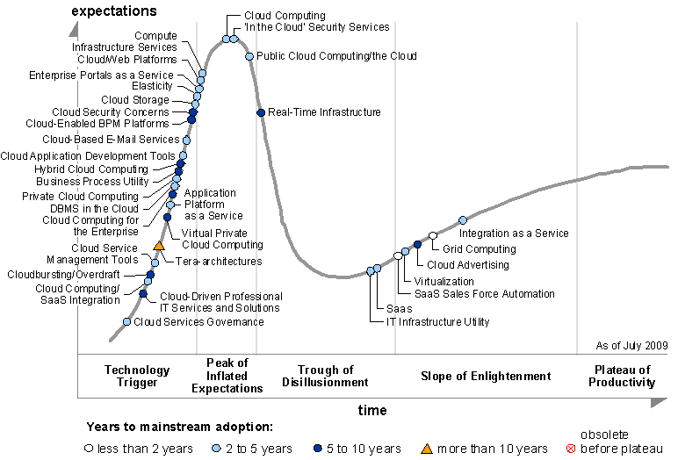
Gartner’s View

Slide 22
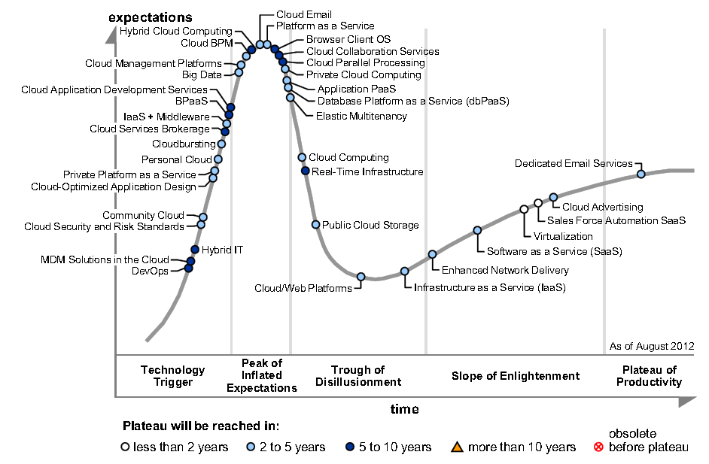
Gartner’s View

Slide 24
Computing Systems for the LHC Era
CERN School of Computing 2007
Dubrovnik
August 2007

Slide 25
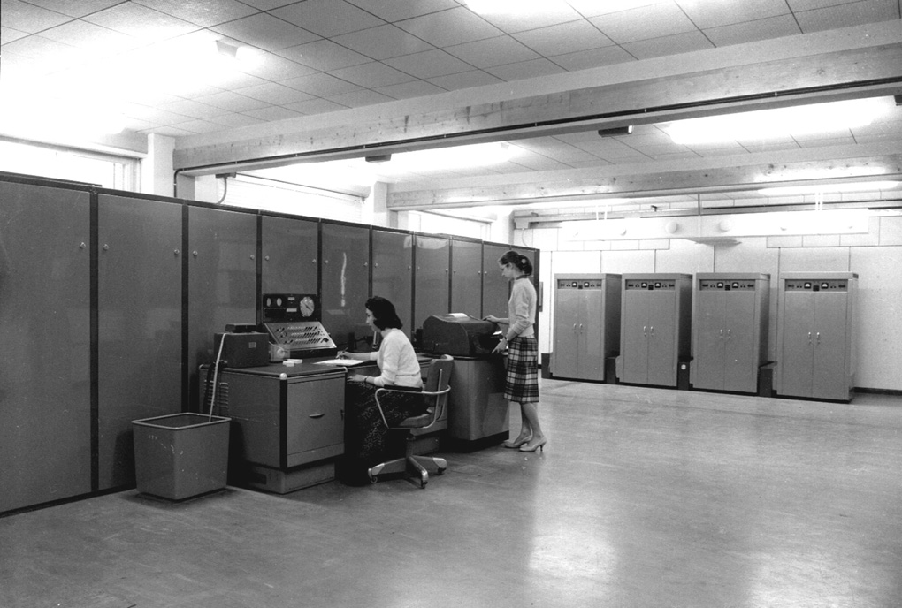
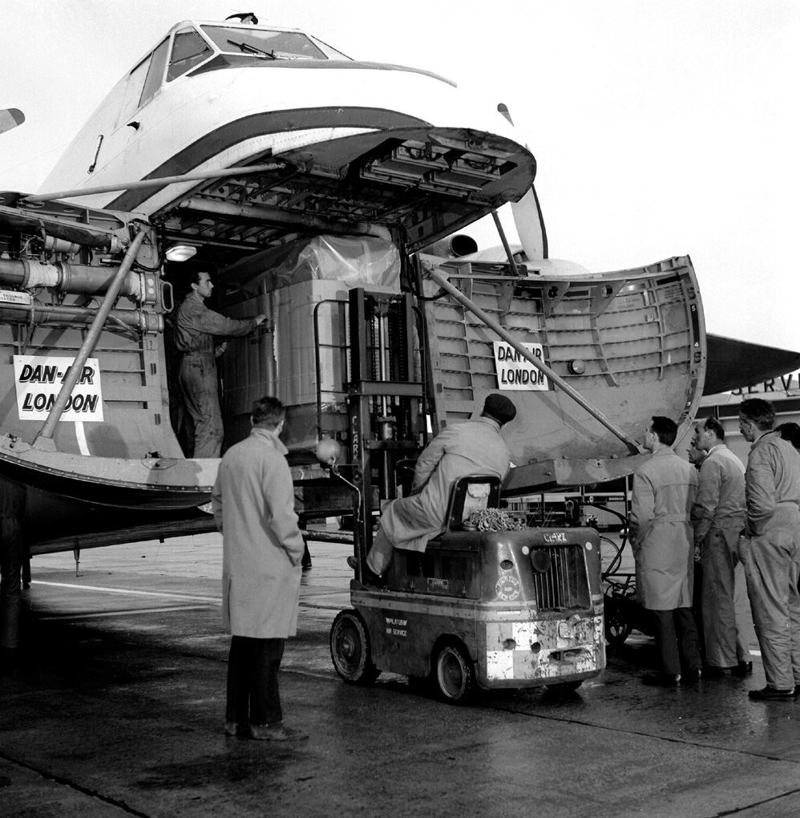
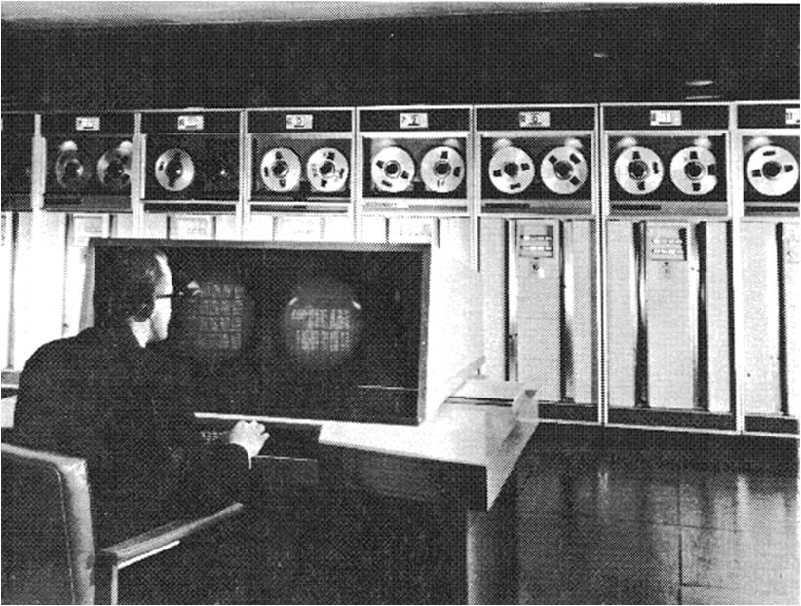
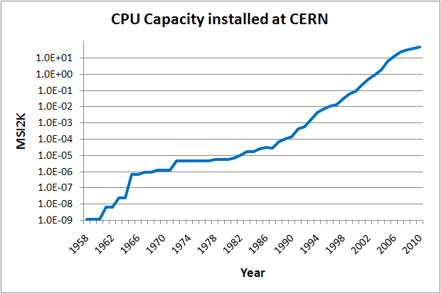
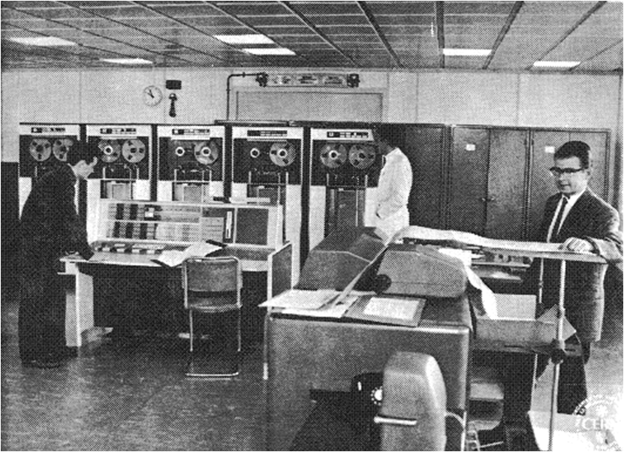
Evolution of CPU Capacity at CERN
The early days
The fastest
growth rate!
Technology-driven
Ferranti Mercury
IBM 709
Ferranti Mercury 1958 5 KIPS
IBM 7090
IBM 709 1961 25 KIPS
First Supercomputer
CDC 6600
IBM 7090 1963 100 KIPS
SC (0.6GeV)
PS (28GeV)
CDC 6600 - the first supercomputer 1965 3 MIPS
3 orders of magnitude in 7 years

Slide 26
The Mainframe Era
budget constrained proprietary architectures maintain suppliers’ profit margins → slow growth
CDC 7600
CDC 7600 1972 13 MIPS for 9 years the fastest machine at CERN, finally replaced after 12 years!
Ferranti Mercury
<--- IBM Mainframes--->
IBM 709
IBM 7090
First Supercomputer
CDC 6600
Last Supercomputer Cray X-MP
First Supercomputer
CDC 6600
IBM 168 1976 4 MIPS
IBM 3081 1981 15 MIPS
ISR (300GeV)
ppbar (540GeV)
SPS (400GeV)
CRAY X-MP - the last supercomputer 1988 128 MIPS
Ken Thompson & Denis Ritchie 1969 – Unix 1972 – C
1981 – first Unix service at CERN
2 orders of magnitude in 24 years

Slide 27
Clusters of Inexpensive Processors
requirements driven
We started this phase with a simple architecture that enables sharing of storage across cpu servers
that proved stable and has survived from RISC thru Quad-core
Parallel, high throughput
Sustained price/perf improvement ~60% /yr
First PC systems
CDC 7600
Ferranti Mercury
<--- IBM Mainframes--->
IBM 709
IBM 7090
First RISC systems
Last Supercomputer Cray X-MP
Apollo DN10.000s 1989 20 MIPS/proc
First Supercomputer
CDC 6600
First Supercomputer
CDC 6600
1990--- SUN, SGI, IBM, H-P, DEC, .... each with its own flavour of Unix
LHC (14 TeV)
LEP II (200GeV)
LEP (100GeV)
1996 – the first PC service with Linux
2007 – dual quad core systems → 50K MIPS/chip → 10**8 MIPS available == 2.3 MSI2K
5 orders of magnitude in 18 years

Slide 28
Evolution of CPU Capacity at CERN
Costs (2007
Swiss Francs)
Includes infrastructure costs (comp.centre, power, cooling, ..) and physics tapes
SC (0.6GeV)
ppbar
(540GeV)
LEP II (200GeV)
ISR (300GeV)
PS (28GeV)
SPS (400GeV)
LEP (100GeV)
LHC (14 TeV)

Slide 29
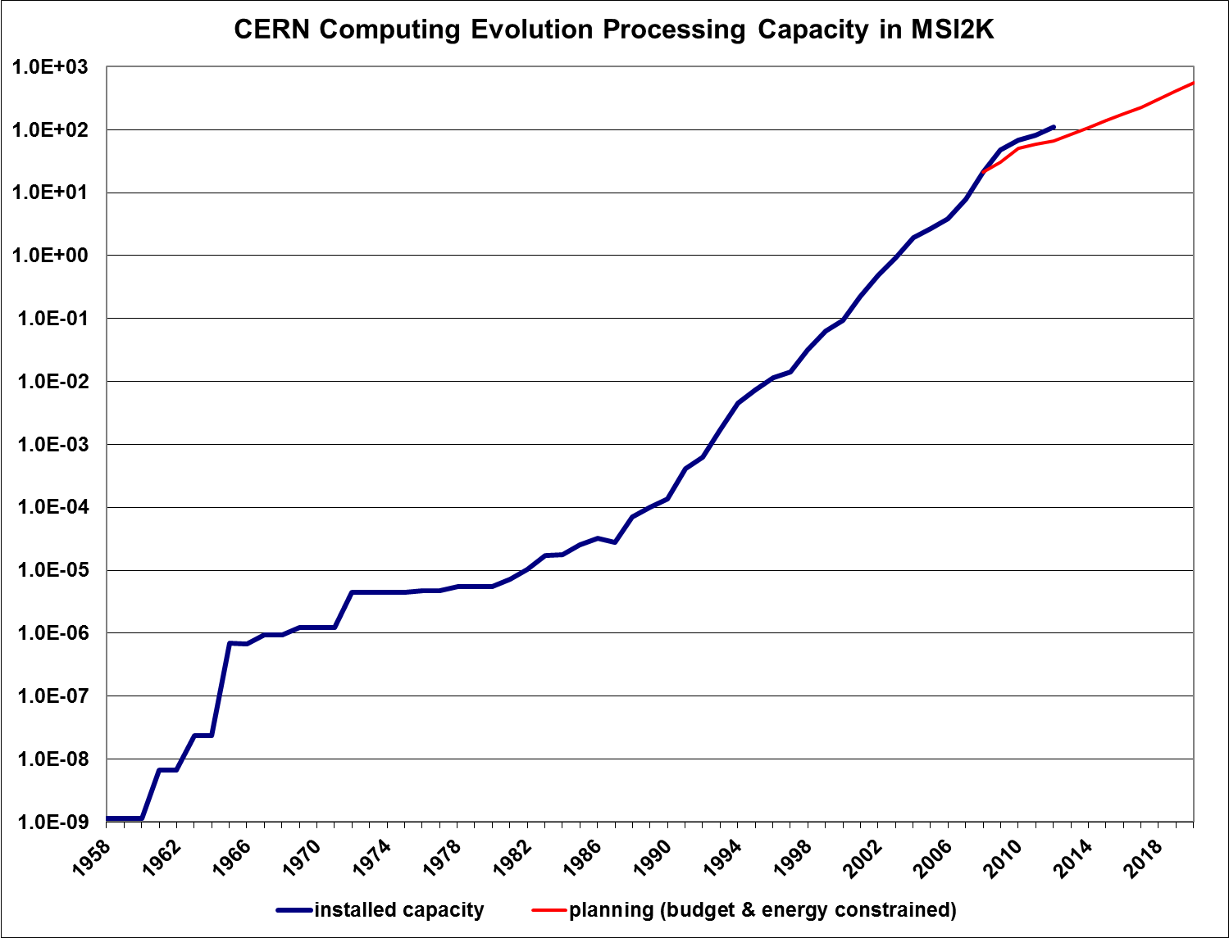

Slide 31
Notes:
But this is CERN, now WLCG…

Slide 32
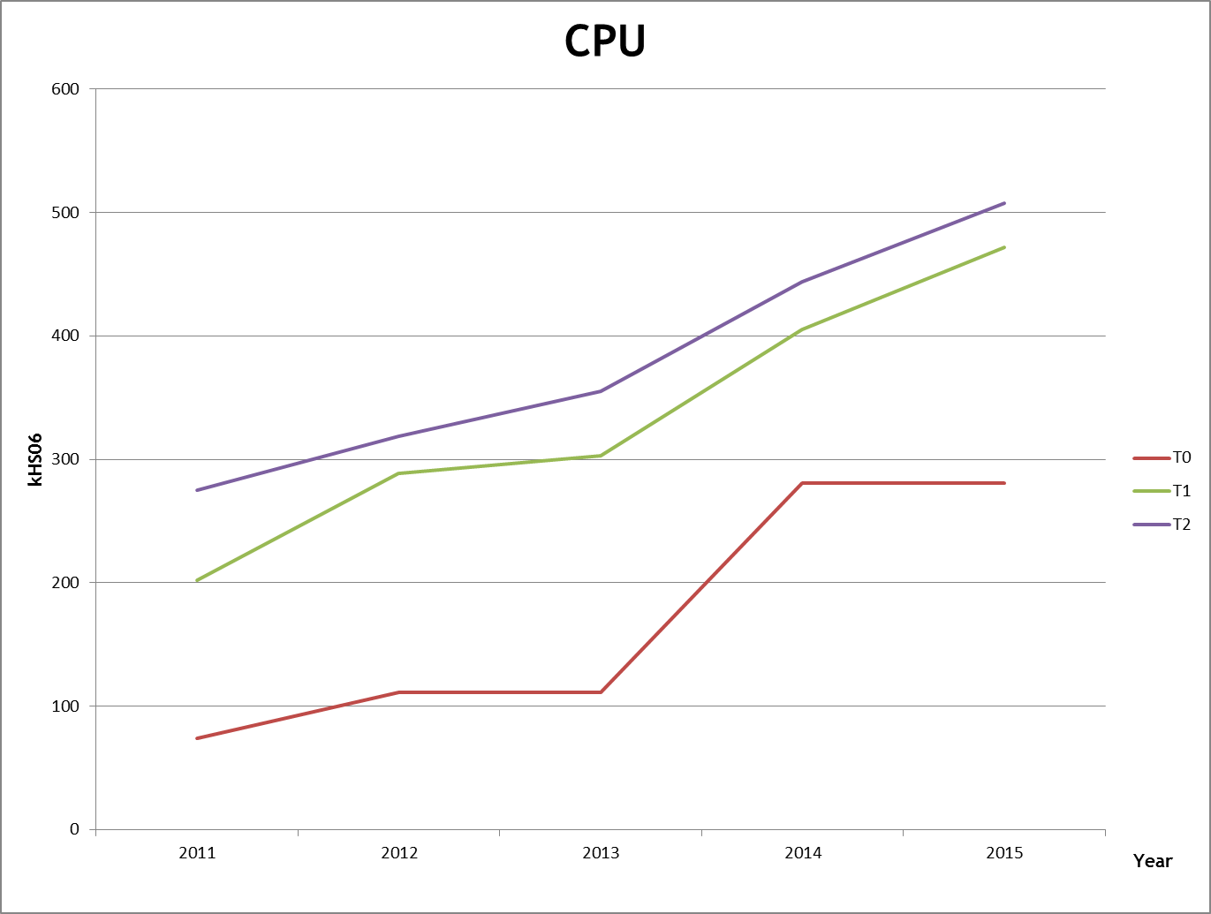
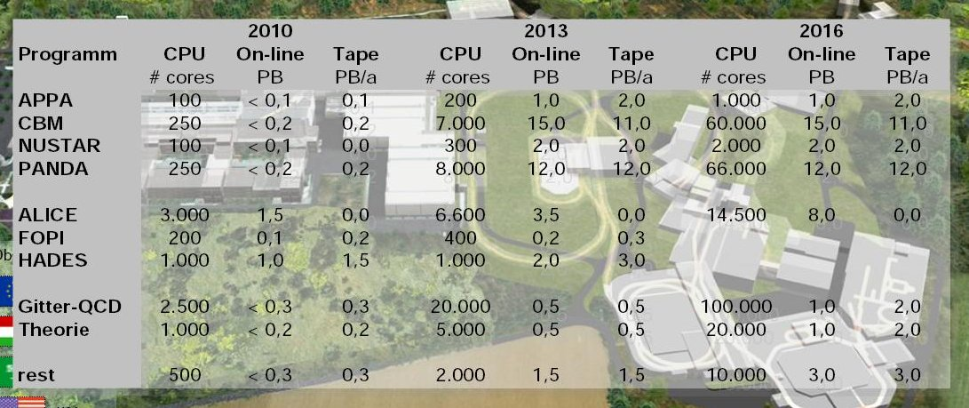
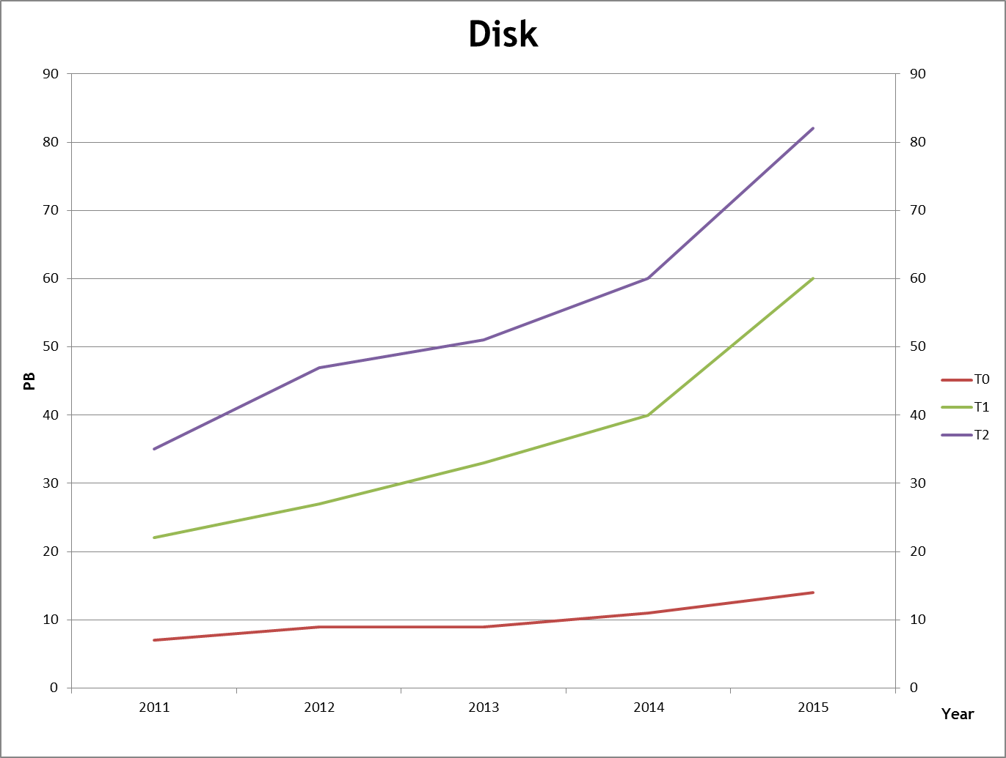

Slide 33
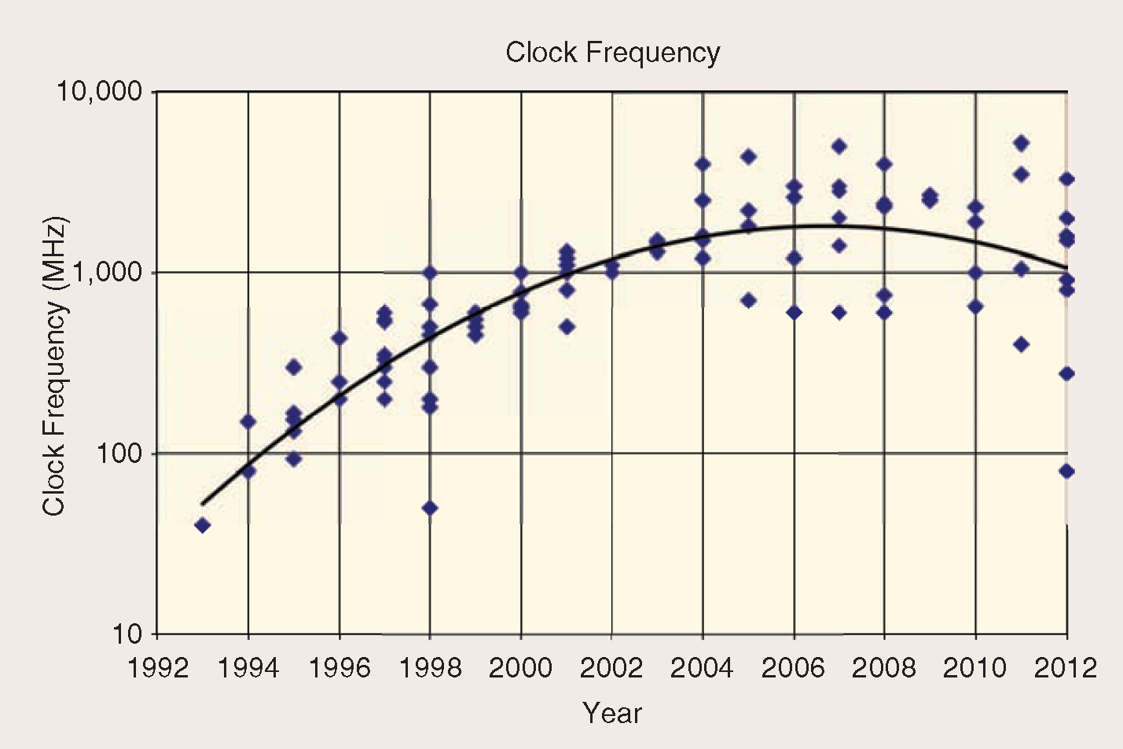
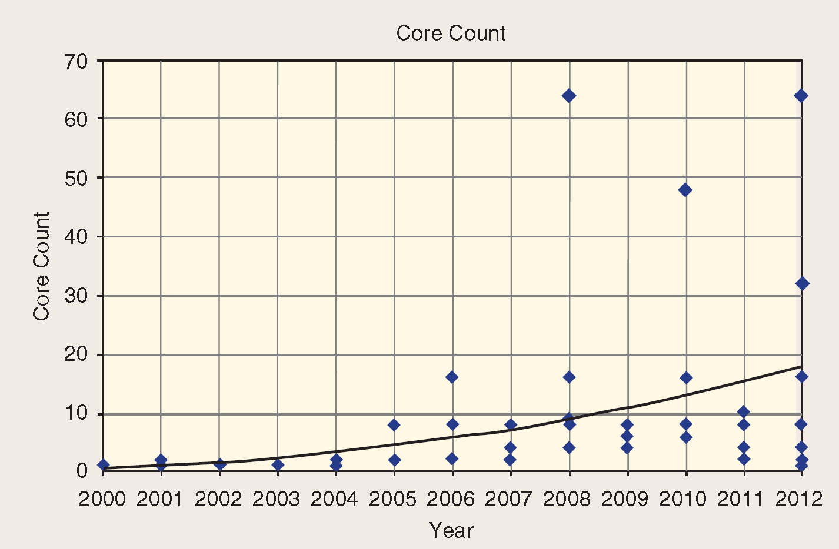
International Solid-State Circuits Conference 2012 Trend Report
http://isscc.org/trends/index.html
cern.ch/concurrency

Slide 36
Figures courtesy of Bernd Panzer. Micro instance is 0.25 capacity of small with cost greater than 0.25x small.

Slide 38
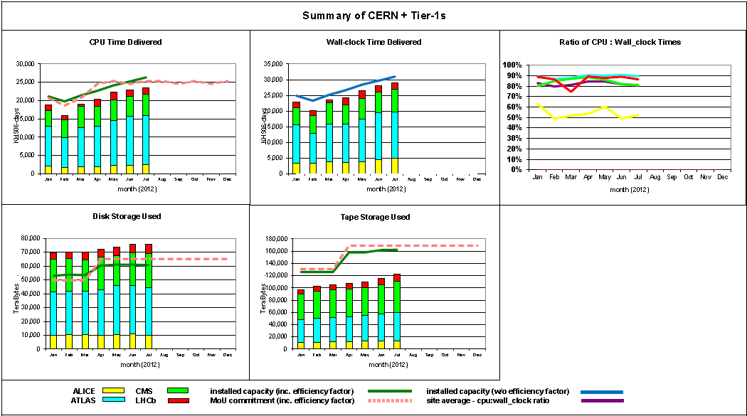
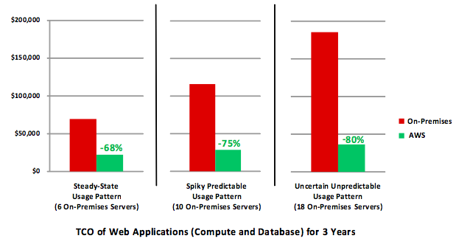
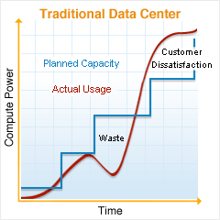
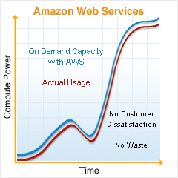
http://www.allthingsdistributed.com/2012/08/tco-and-return-on-agility.html and http://aws.amazon.com/economics/

Slide 40
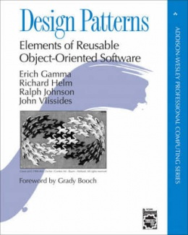
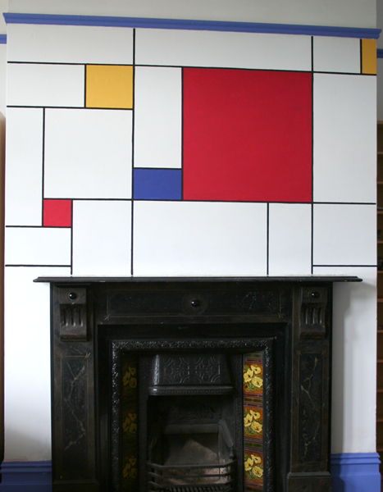
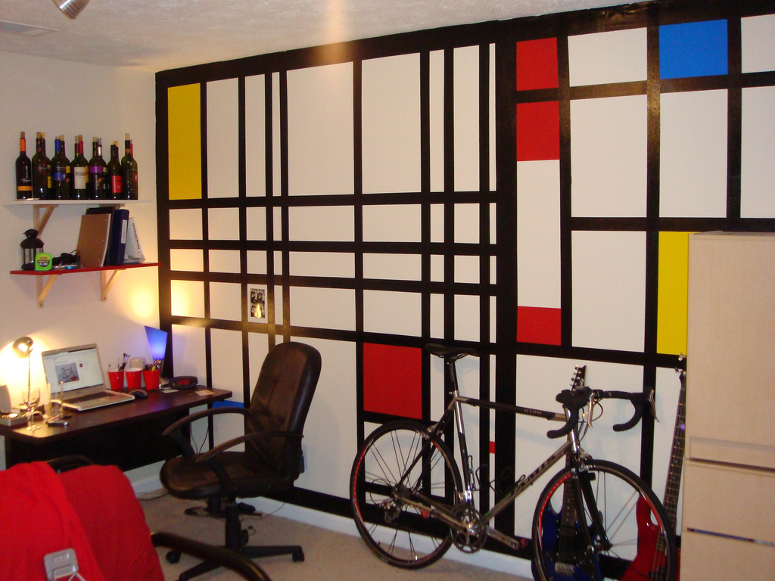
http://stuffjendid.blogspot.ch/2011/09/how-to-paint-mondrian-mural.html
flickr/Holycao86

Slide 41
http://www.infoworld.com/print/199930

Slide 42
Software as a Service
Platform as a Service
Infrastructure as a Service

Slide 43
Software as a Service
Platform as a Service
Infrastructure as a Service

Slide 44
Software as a Service
Platform as a Service
Infrastructure as a Service

Slide 45
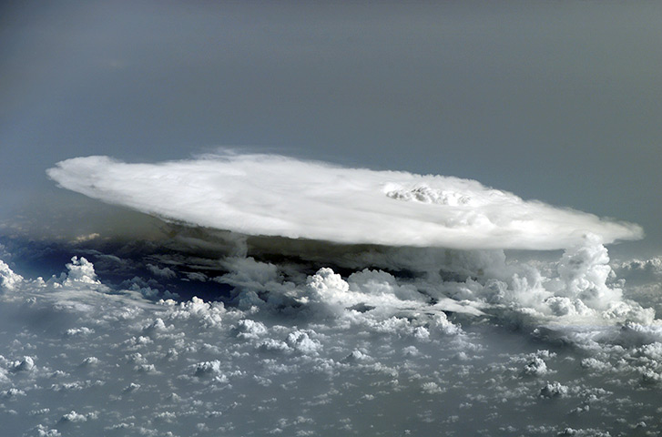
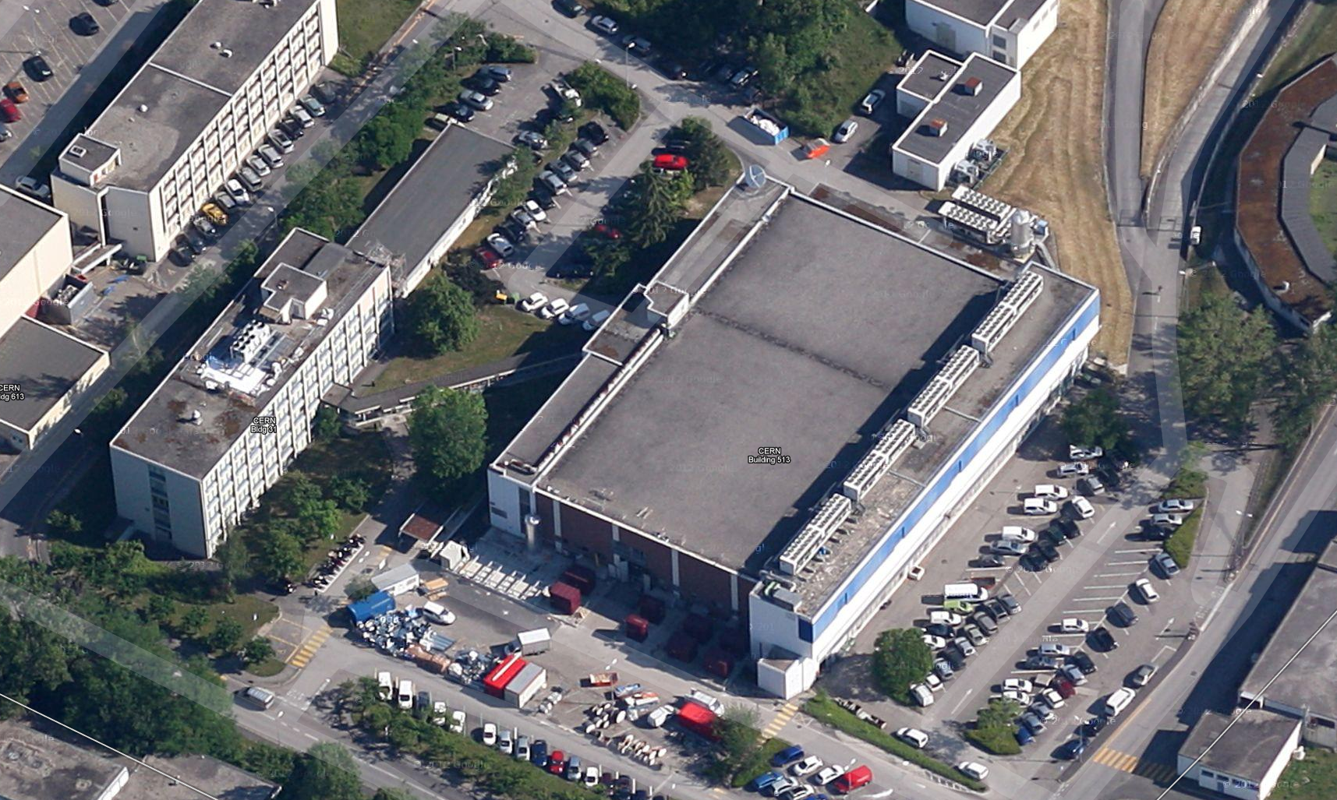
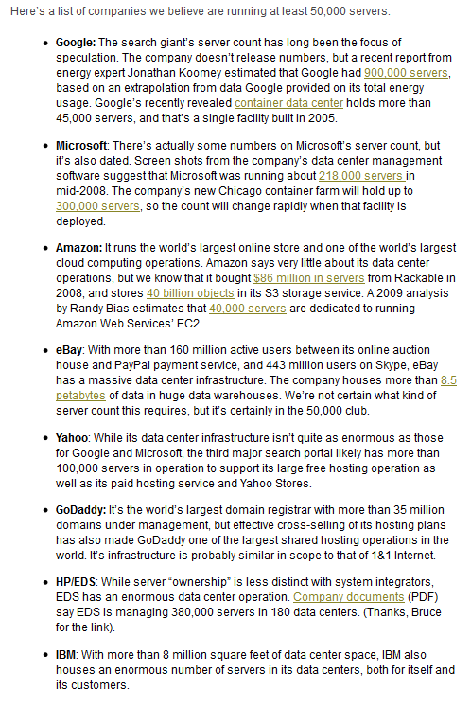
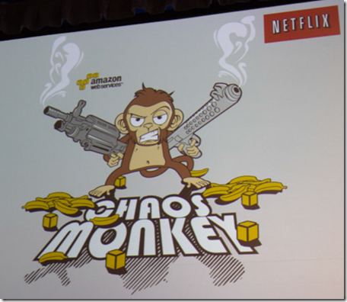
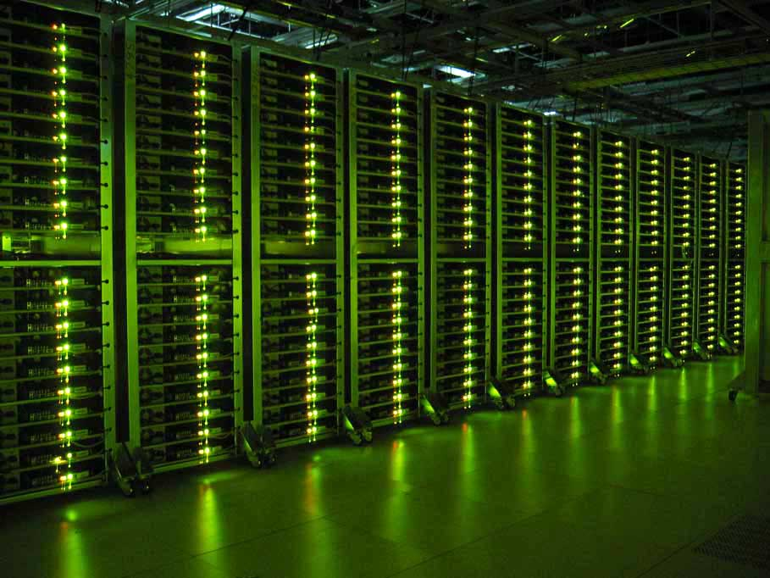
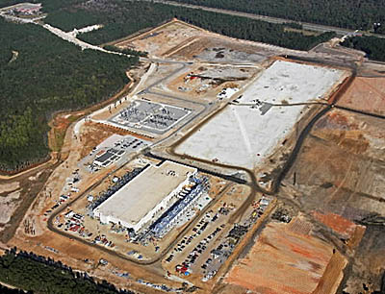
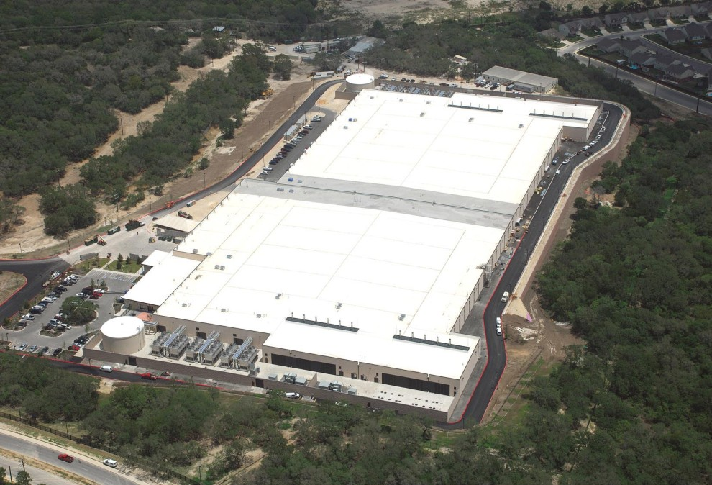
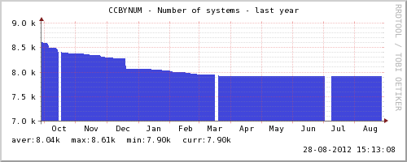
Software as a Service
Platform as a Service
Infrastructure as a Service
http://www.slideshare.net/randybias/architectures-for-open-and-scalable-clouds

Slide 46
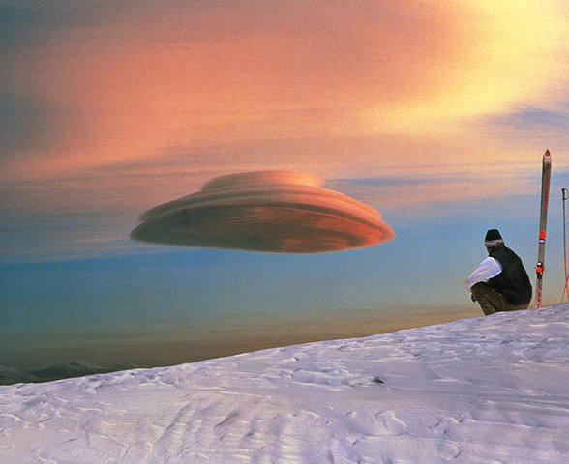
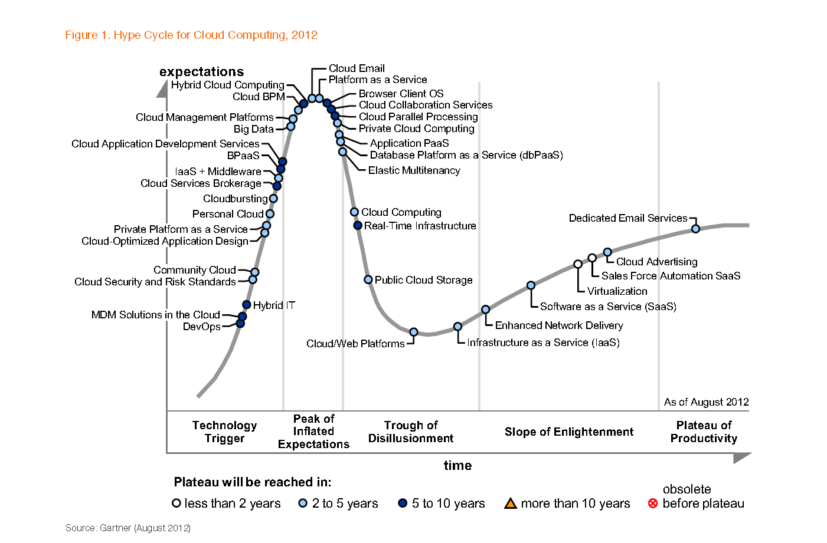
Gartner’s View
https://www.usenix.org/blog/lisa-11-keynote-devops-transformation

Slide 47
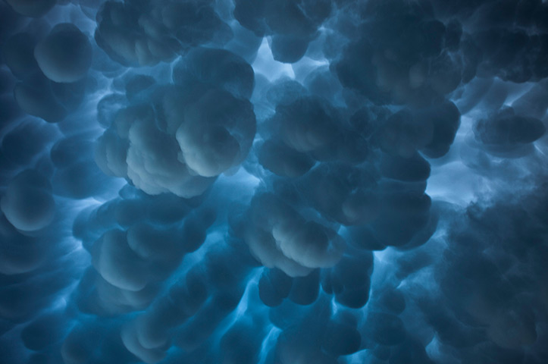
Software as a Service
Platform as a Service
Infrastructure as a Service

Slide 48
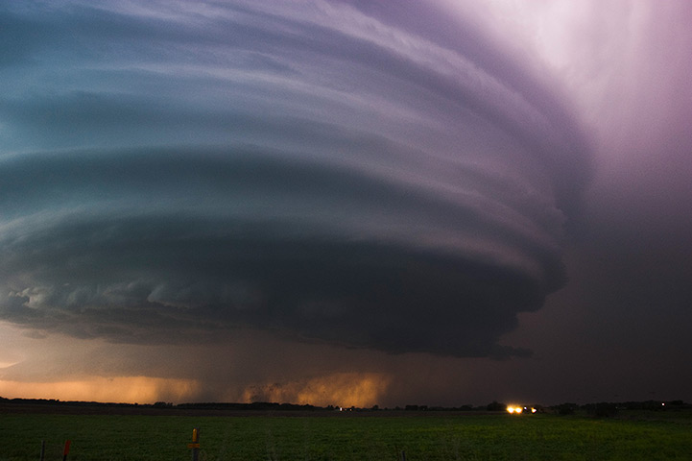
Software as a Service
Platform as a Service
Infrastructure as a Service

Slide 53
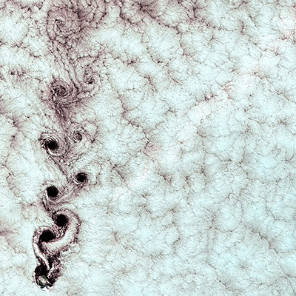

Slide 54
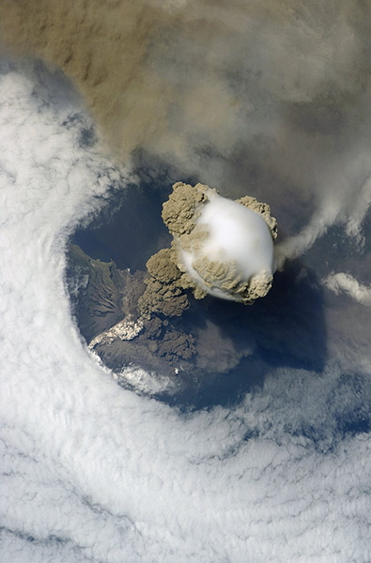
Andreas Peters, Tuesday

Slide 55
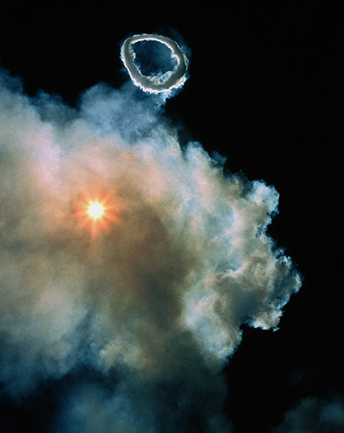
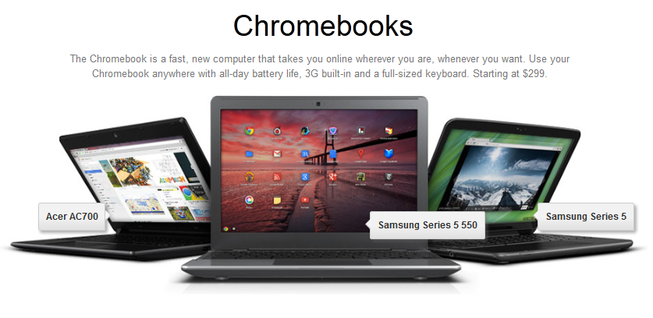
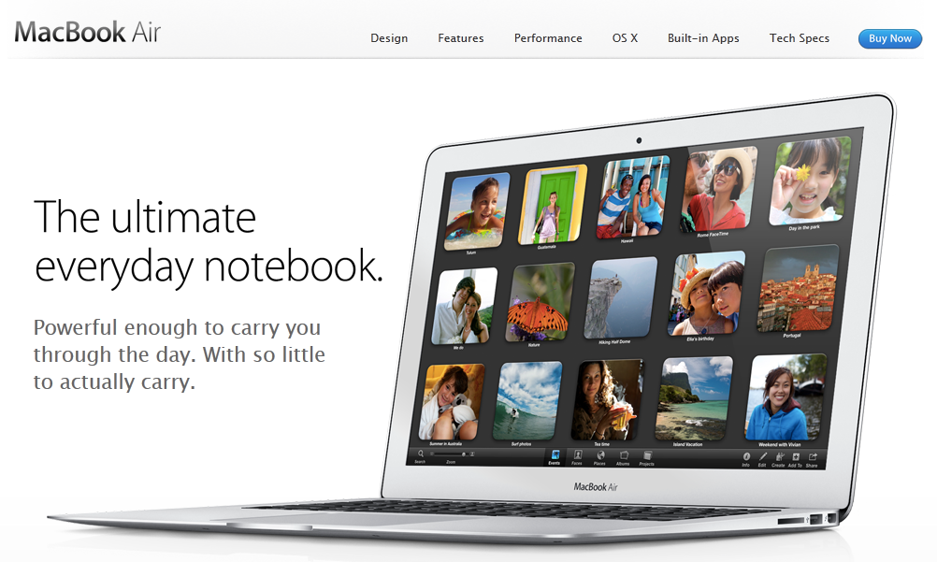
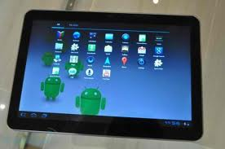
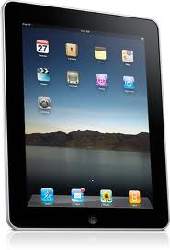
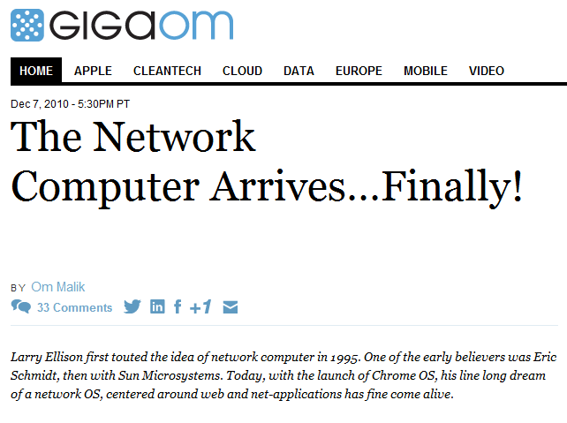

Slide 56
http://www.infoworld.com/print/199930

Slide 58
User
Site A
Payload pull
Shared
Image
Repository
(VMIC)
Central
Task
Queue
Site B
Instance requests
Site C
VO service
Image
maintainer
Diagram courtesy of Ulrich Schwickerath
Cloud bursting
Commercial cloud

Slide 59
Grid Middleware Basics
Compute Element
Standard interface to local workload management systems (batch scheduler)
Storage Element
Standard interface to local mass storage systems
Resource Broker
Tool to analyse user job requests (input data sets, cpu time, data output requirements) and route these to sites according to data and cpu time availability.
None of this works without…
Many implementations of the basic principles:
Globus, VDT, EDG/EGEE, NorduGrid, OSG

Slide 60
Trust!

Slide 64
Thank You!
And thanks to Ian Bird, German Cancio, John Harvey, Sverre Jarp, Roger Jones, Pere Mato, Kilian Schwarz, Ulrich Schwickerath and Romain Wartel
Special thanks to Sue Foffano, Bernd Panzer, Les Robertson and Wayne Salter
Cloud photo: Science Photo Library/Rex Features; see http://www.guardian.co.uk/science/gallery/2012/aug/23/meteorology-cloud-shapes-in-pictures

