Slide 1



LHC Computing, Experiences so far, and outlook for the future
Ian Bird, CERN
GridKa Summer School
27th August 2012
Accelerating Science and Innovation
Notes:
1

Slide 2
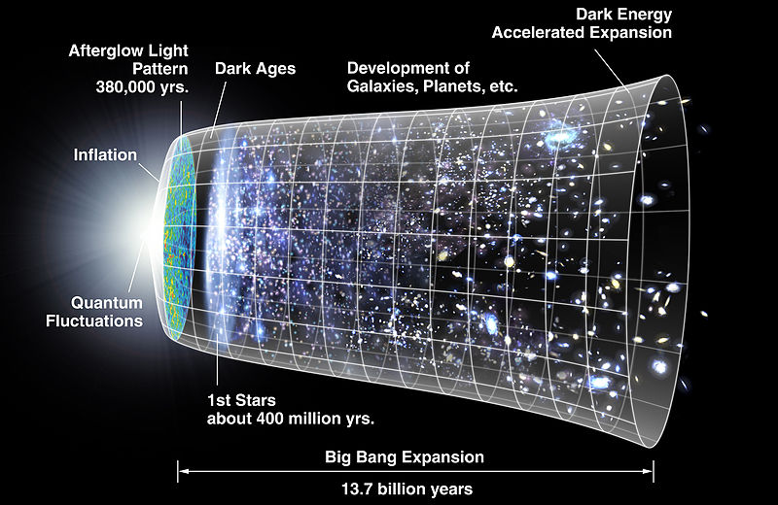
Evolution of the Universe
Big Bang

Slide 3
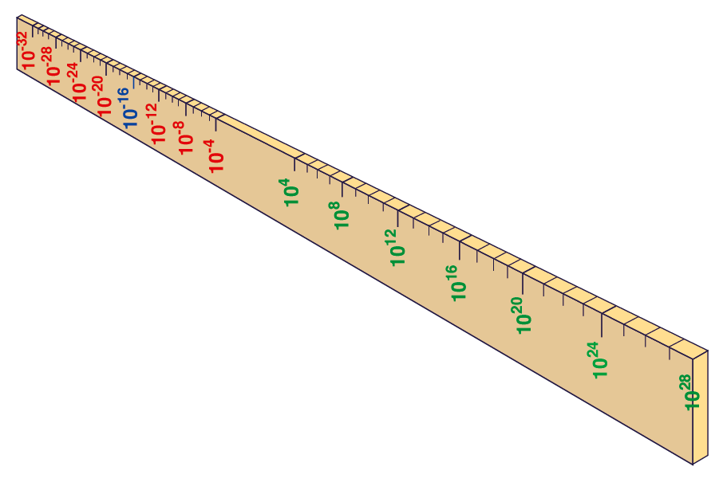
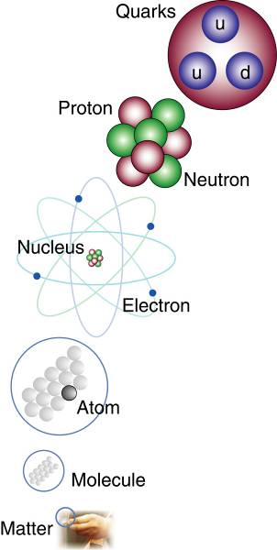
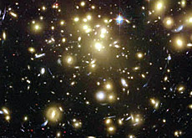
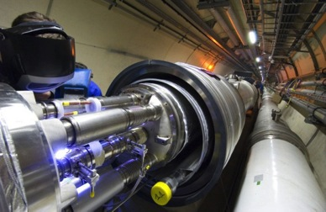
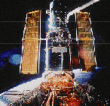
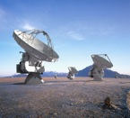

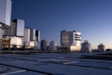
Big Bang
Proton
Atom
Radius of Earth
Earth to Sun
Radius of Galaxies
Universe
LHC
Super-Microscope
Hubble
ALMA
cm
Study physics laws of first moments after Big Bang
increasing Symbiosis between Particle Physics,
Astrophysics and Cosmology
AMS
VLT
Notes:
3

Slide 4
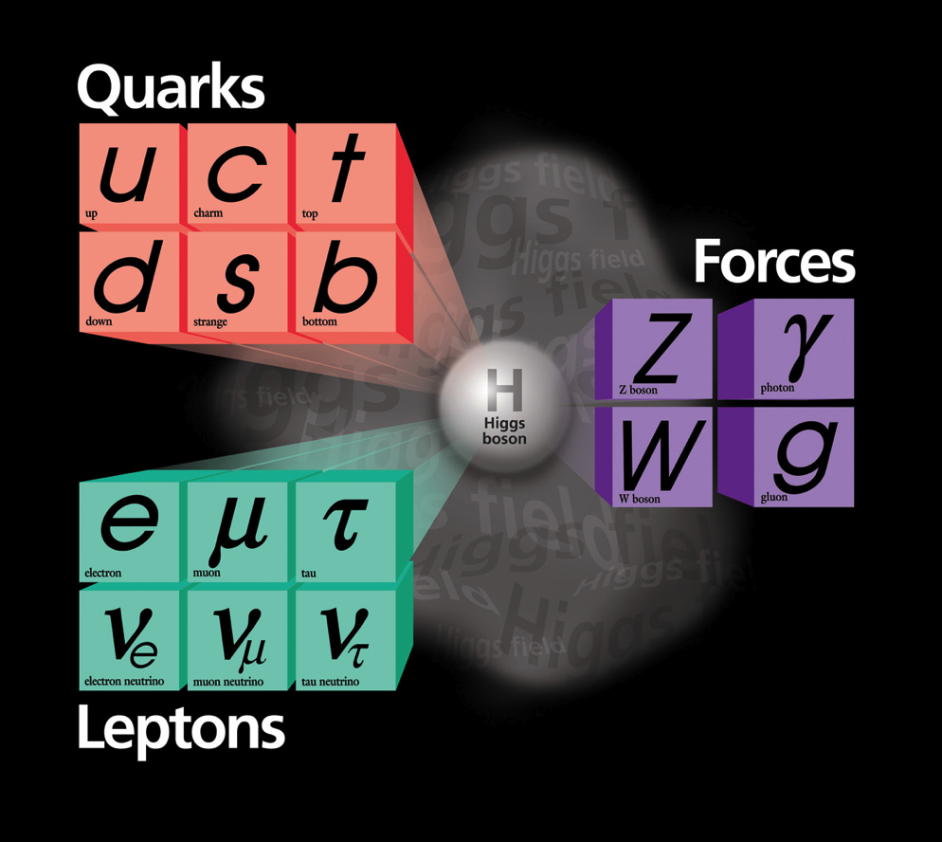
Standard model
BUT:
Has been very successful …

Slide 5
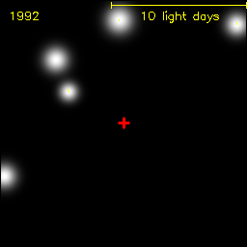
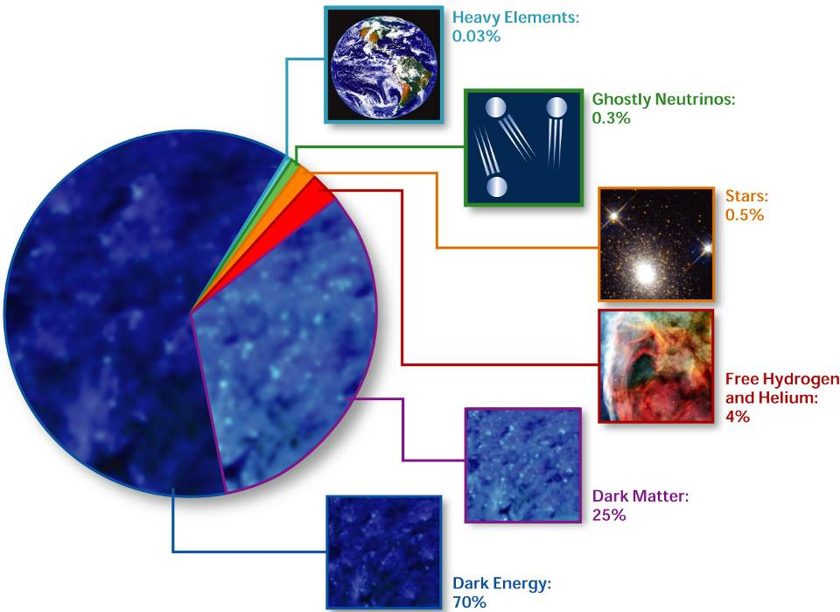
Black hole
> 95%
UNKNOWN
STUFF
OUT THERE
Discrepancy between observed mass of stars & galaxies and their gravitational motion
To explain accelerating expansion of the universe

Slide 6
Fundamental Physics Questions
Why do particles have mass?
  Newton could not explain it - and neither can we…
What is 95% of the Universe made of?
  We only observe a fraction! What is the rest?
Why is there no antimatter left in the Universe?
  Nature should be symmetrical ?
What was matter like during the first second of the Universe, right after the "Big Bang"?
  A journey towards the beginning of the Universe gives us deeper insight
CERN has built an accelerator, the Large Hadron Collider (LHC), enabling us to look at microscopic big bangs to understand the fundamental laws of nature

Slide 7
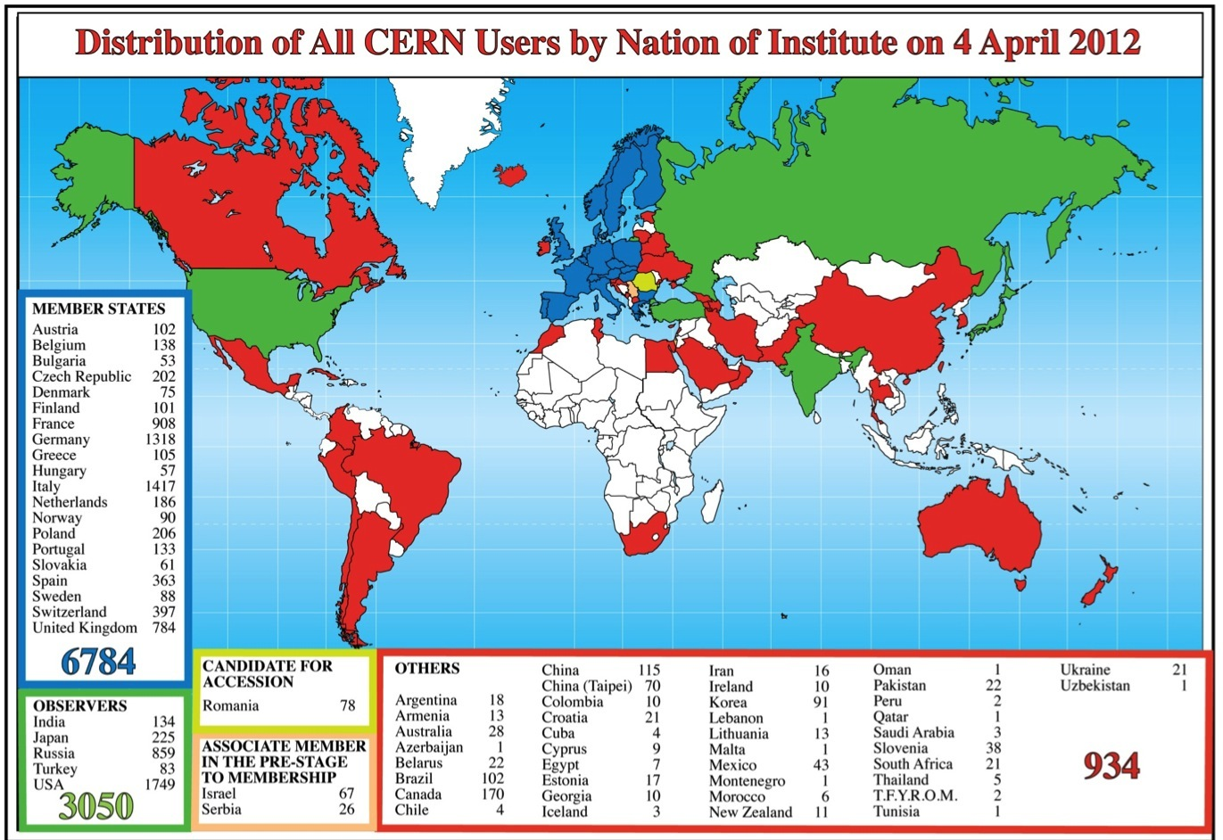
Science is more and more global
Notes:
7
7

Slide 8
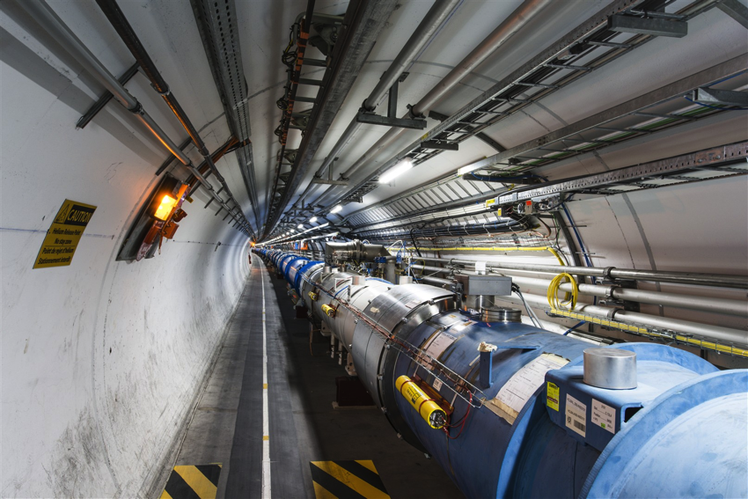
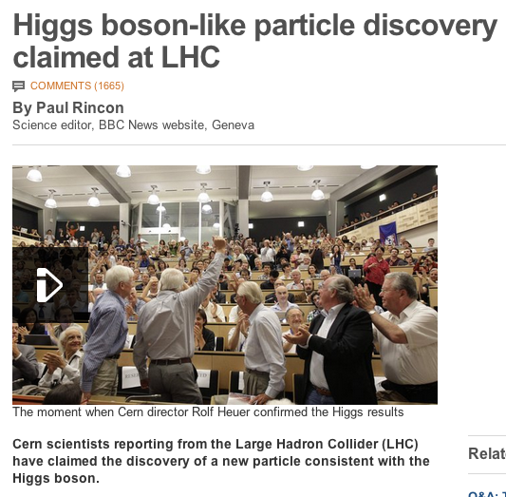
So…
How do you get from this
to this

Slide 9
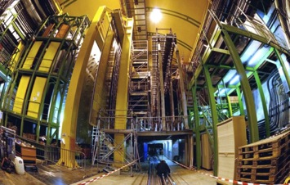
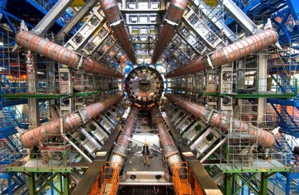
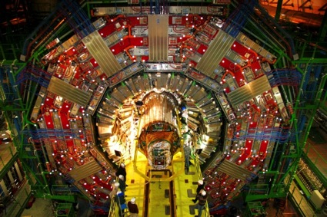
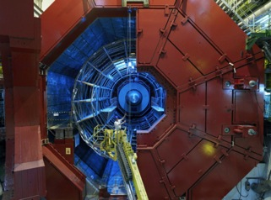
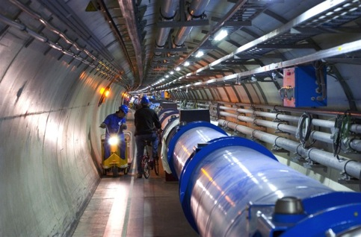

Tools: LHC and Detectors
pp, B-Physics, CP Violation
(matter-antimatter symmetry)
LHCb
CMS
ATLAS
General Purpose,
proton-proton, heavy ions
Discovery of new physics:
Higgs, SuperSymmetry
Exploration of a new energy frontier
in p-p and Pb-Pb collisions
ALICE
LHC ring:
27 km circumference
Heavy ions, pp
(state of matter of early universe)
Notes:
9

Slide 10
Some facts about the LHC
Biggest accelerator (largest machine) in the world
  27 km circumference, 9300 magnets
Fastest racetrack on Earth
  Protons circulate 11245 times/s (99.9999991%c)
Emptiest place in the solar system – high vacuum inside the magnets:
  Pressure 10⁻¹³ atm (10x less than pressure on the moon)
World’s largest refrigerator (need only 1/8 of LHC magnets to qualify): -271.3 °C (1.9K)
Hottest spot in the galaxy
  During Lead ion collisions create temperatures 100 000x hotter than the heart of the sun; new record 5.5 Trillion K
World’s biggest and most sophisticated detectors
  150 Million “pixels”, 60 Million times per sec;
Most data of any scientific experiment
  15-30 PB per year (as of today we have about 60 PB)

Slide 11
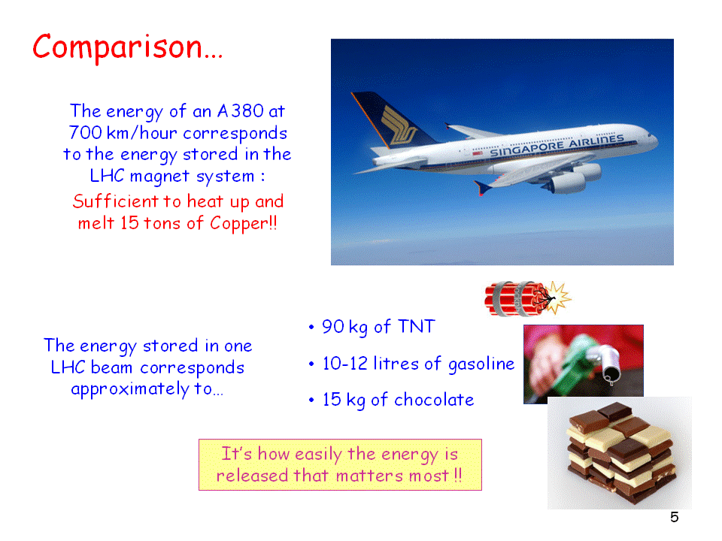

Slide 12
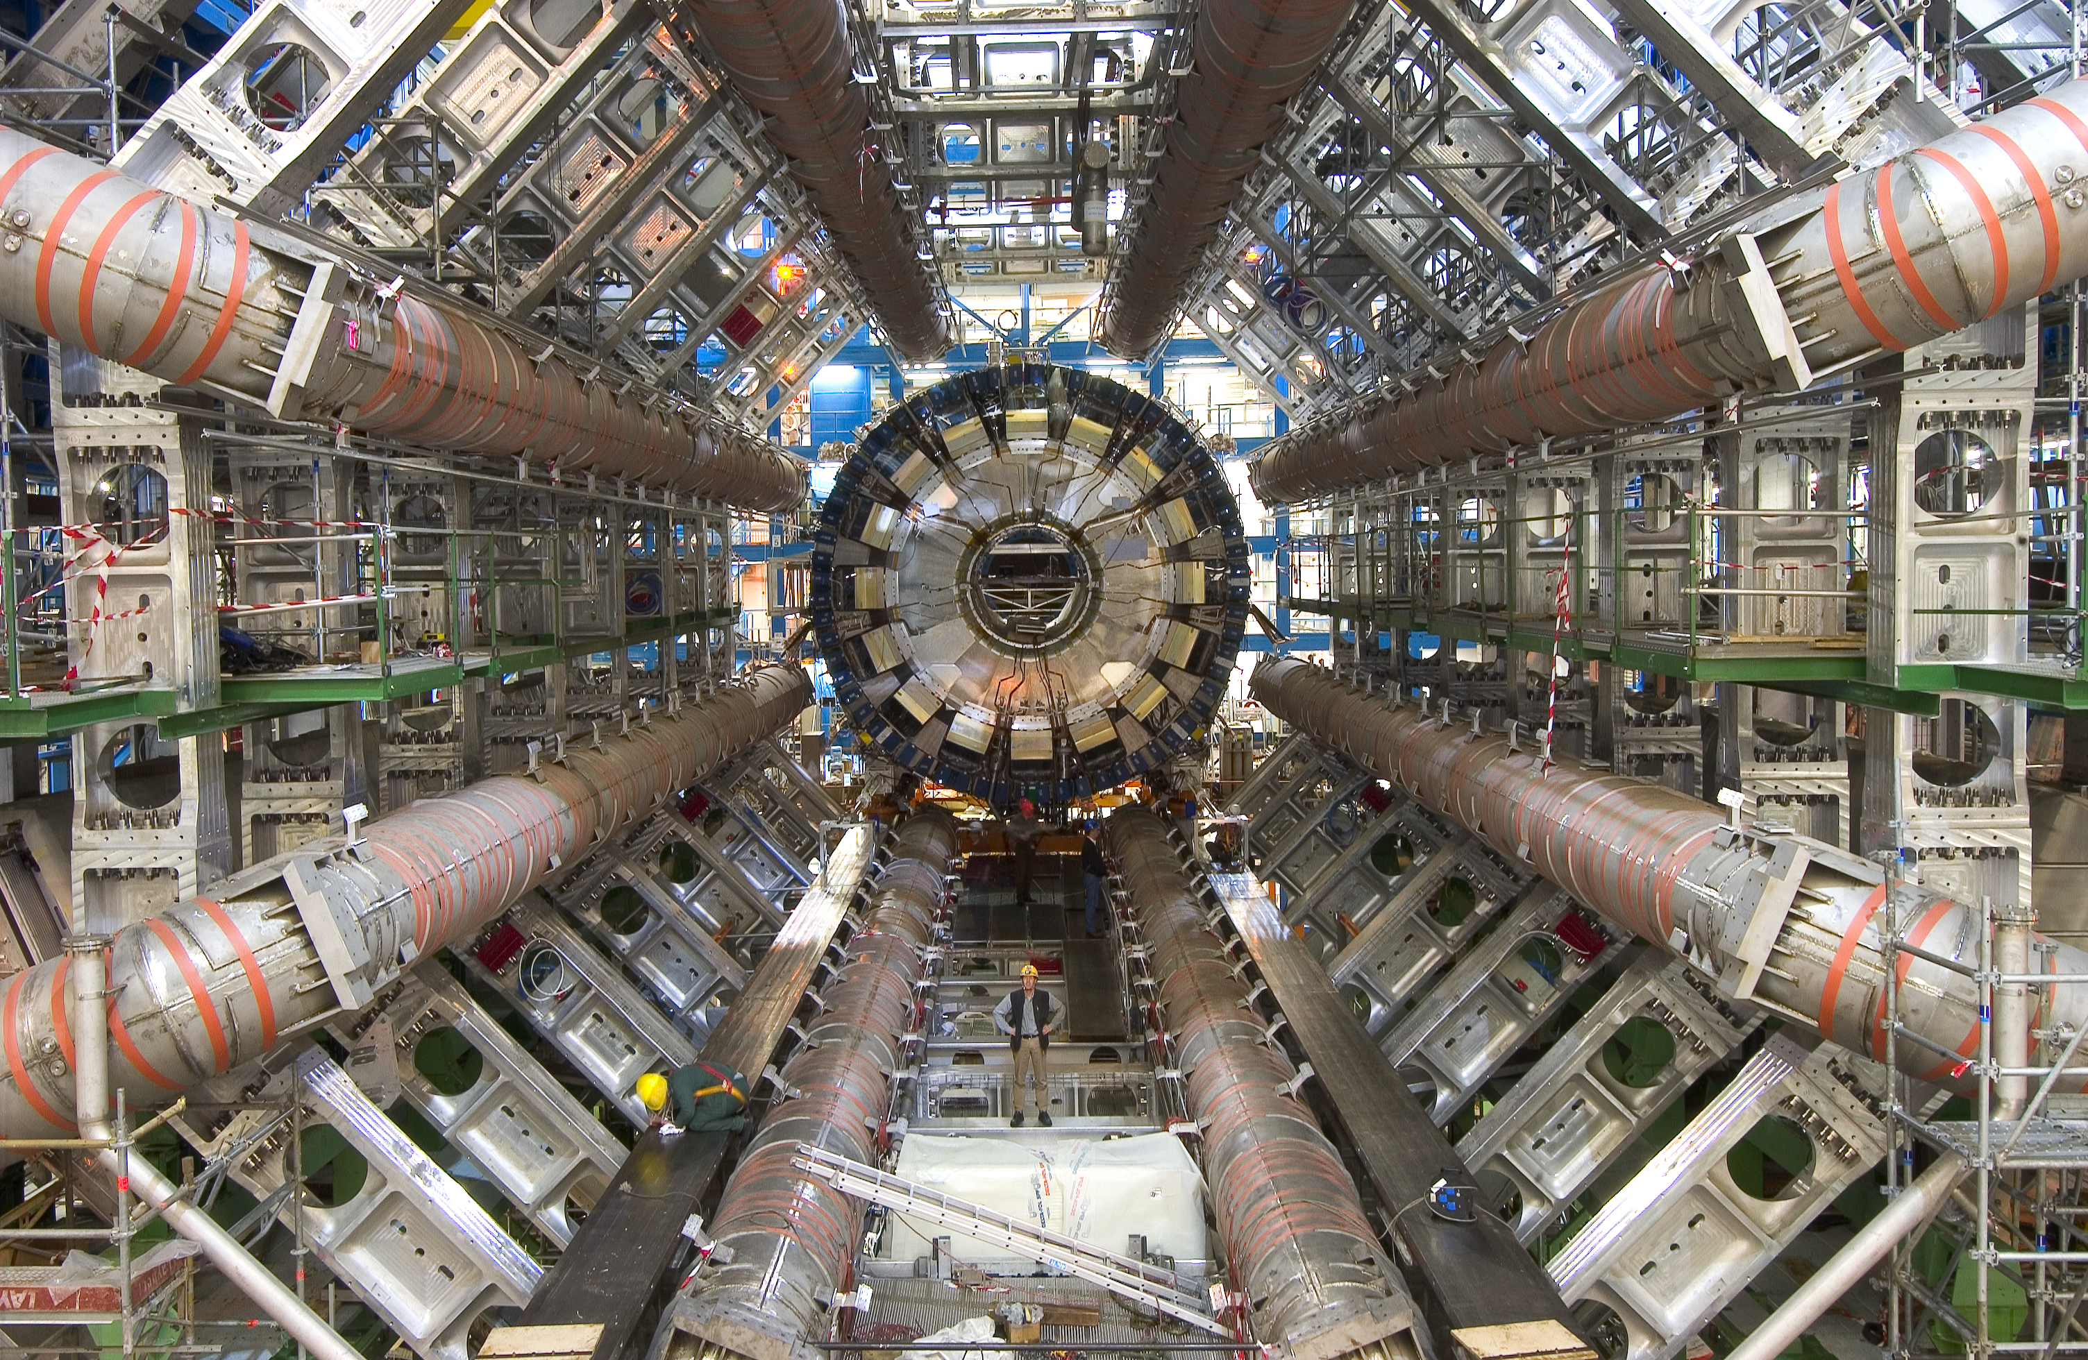
The “ATLAS” experiment during construction
7000 tons, 150 million sensors, 1 petabyte/s

Slide 13
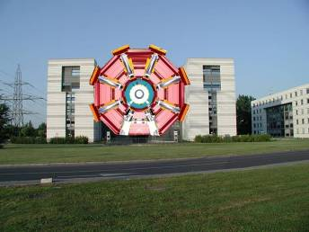
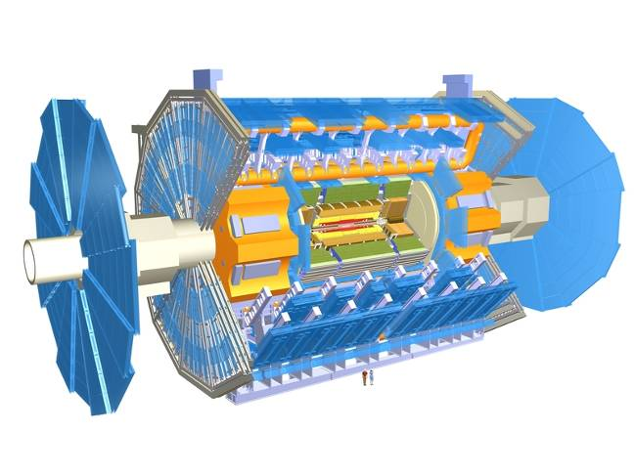
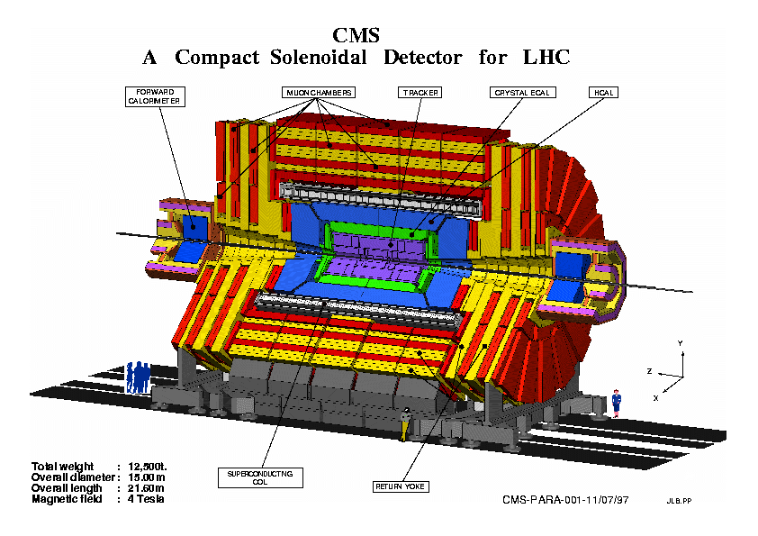
Scale of ATLAS and CMS?
ATLAS superimposed to
a CERN 5-storey building
CMS
ATLAS
ATLAS CMS
Overall weight (tons) 7000 12500
Diameter 22 m 15 m
Length 46 m 22 m
Solenoid field 2 T 4 T

Slide 14
Some history of scale…
Date | Collaboration sizes | Data volume, archive technology
Late 1950’s | 2-3 | Kilobits, notebooks
1960’s | 10-15 | kB, punchcards
1970’s | ~35 | MB, tape
1980’s | ~100 | GB, tape, disk
1990’s | 700-800 | TB, tape, disk
2010’s | ~3000 | PB, tape, disk
For comparison:
1990’s: Total LEP data set ~few TB
Would fit on 1 tape today
Today: 1 year of LHC data ~25 PB
CERN has about 60,000 physical disks to provide about 20 PB of reliable storage
Where does all this data come from?

Slide 15
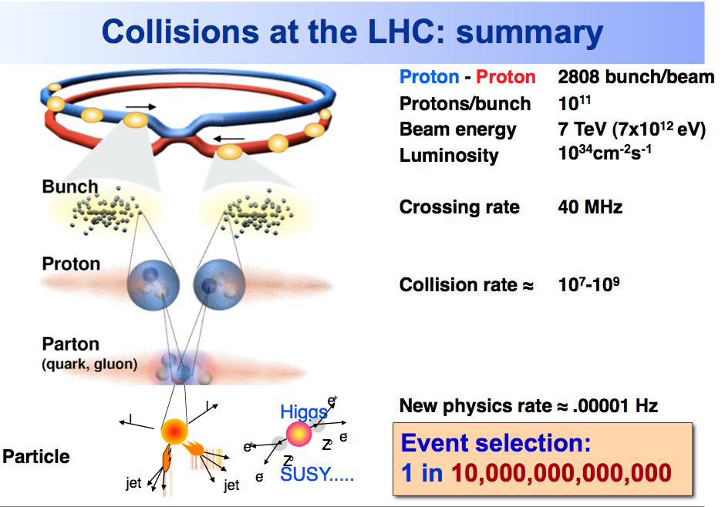

Slide 16
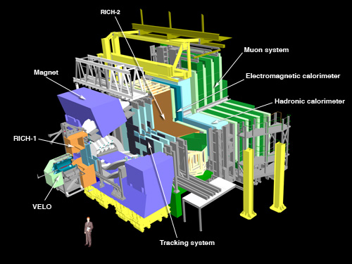
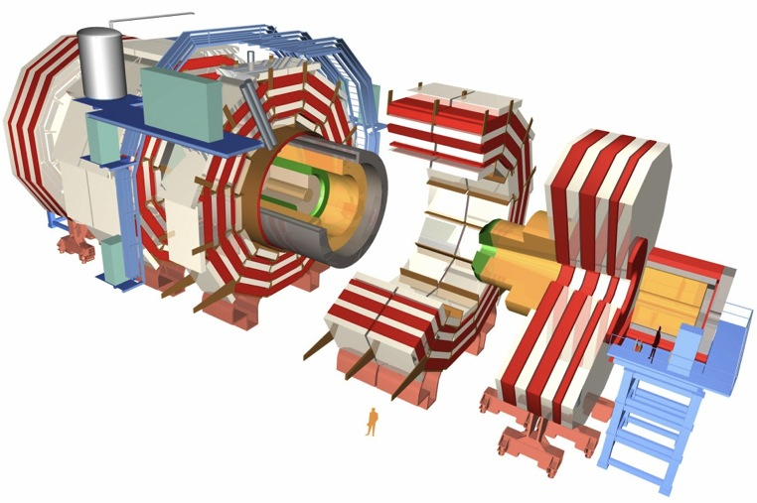
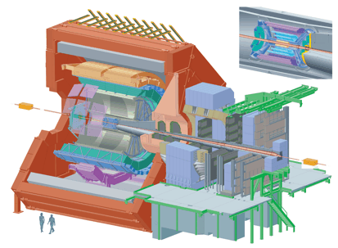
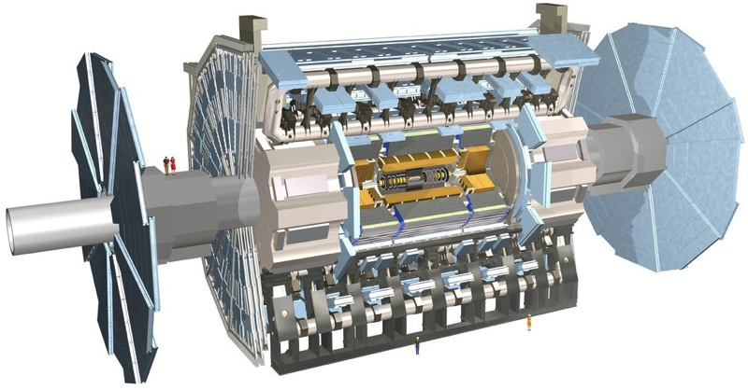
150 million sensors deliver data …
… 40 million times per second

Slide 17
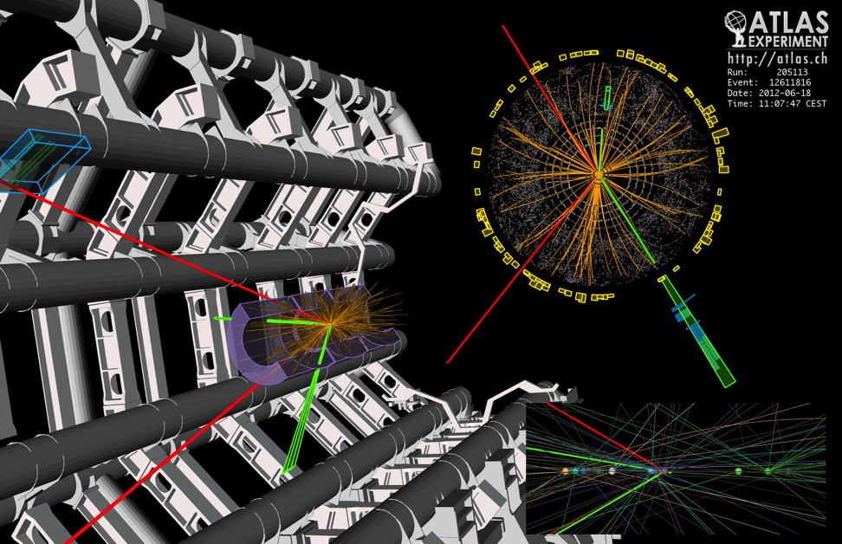
What is this data?
Raw data:
  Was a detector element hit?
  How much energy?
  What time?
Reconstructed data:
  Momentum of tracks (4-vectors)
  Origin
  Energy in clusters (jets)
  Particle type
  Calibration information
  …

Slide 18
Data and Algorithms
HEP data are organized as Events (particle collisions)
Simulation, Reconstruction and Analysis programs process “one event at a time”
  Events are fairly independent → Trivial parallel processing
Event processing programs are composed of a number of Algorithms selecting and transforming “raw” event data into “processed” (reconstructed) event data and statistics
RAW
Triggered events
recorded by DAQ
Detector digitisation
~2 MB/event
ESD/RECO
Reconstructed
information
Pseudo-physical information:
Clusters, track candidates
~100 kB/event
AOD
Physical information:
Transverse momentum,
Association of particles, jets,
id of particles
Analysis
information
~10 kB/event
TAG
Classification
information
Relevant information
for fast event selection
~1 kB/event

Slide 19
Data and Algorithms
Example from CMS
RAW
Triggered events
recorded by DAQ
Detector digitisation
15.6 PB
~2 MB/event
ESD/RECO
Reconstructed
information
Pseudo-physical information:
Clusters, track candidates
~100 kB/event
AOD
Physical information:
Transverse momentum,
Association of particles, jets,
id of particles
Analysis
information
2.5 PB; 1.2 M files
~10 kB/event
This is what the physicist works with
TAG
Classification
information
Relevant information
for fast event selection
From simulated data; AOD: 5.4 PB; 2.7 M files
~1 kB/event

Slide 20
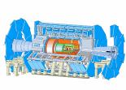

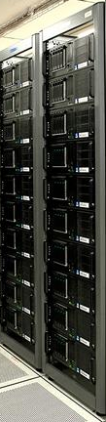

Data Handling and Computation for Physics Analysis
Online
Offline Reconstruction
Online trigger
and filtering
Selection &
reconstruction
detector
Processed
Data (Active tapes)
Event
summary
data
Offline Analysis w/ROOT
Raw
data
10%
100%
Batch
physics
analysis
Event
reprocessing
1%
Offline Simulation
w/GEANT4
Event
simulation
Analysis objects
(extracted by physics topic)
Interactive
analysis

Slide 21
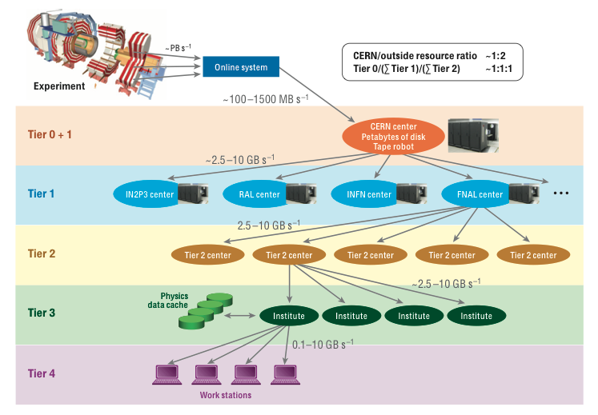
Original Computing model
Notes:
Original model was strictly hierarchical

Slide 22
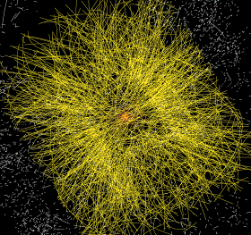
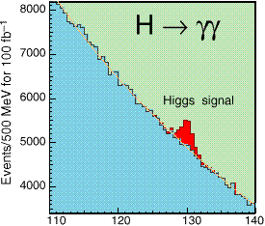
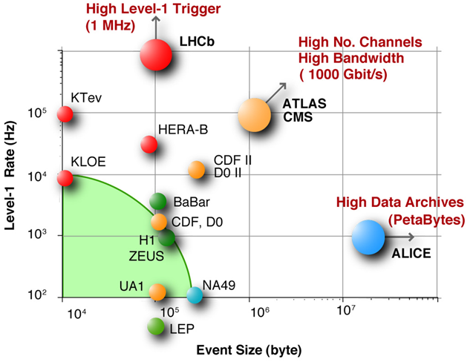
The LHC Computing Challenge
Signal/Noise: 10⁻¹³ (10⁻⁹ offline)
Data volume
  High rate * large number of channels * 4 experiments
  ➔ 15 PetaBytes of new data each year
Compute power
  Event complexity * Nb. events * thousands users
  200 k CPUs
  45 PB of disk storage
Worldwide analysis & funding
  Computing funding locally in major regions & countries
  Efficient analysis everywhere
  ➔ GRID technology
→ 30 PB in 2012
→ 300 k CPU
→ 170 PB
Notes:
The challenge faced by LHC computing is one primarily of data volume and data management. The scale and complexity of the detectors – the large number of “pixels” if one can envisage them as huge digital cameras, and the high rate of collisions – some 600 million per second – means that we will need to store around 15 Petabytes of new data each year. This is equivalent to about 3 million standard DVDs.
In order to process this volume of data requires large numbers of processors: about 250,000 processor cores are available in WLCG today, and this need will grow over the coming years, as will the 45 PB of disk currently required for data storage and analysis.
This can only be achieved through a worldwide effort, with locally funded resources in each country being brought together into a virtual computing cloud through the use of grid technology.

Slide 23
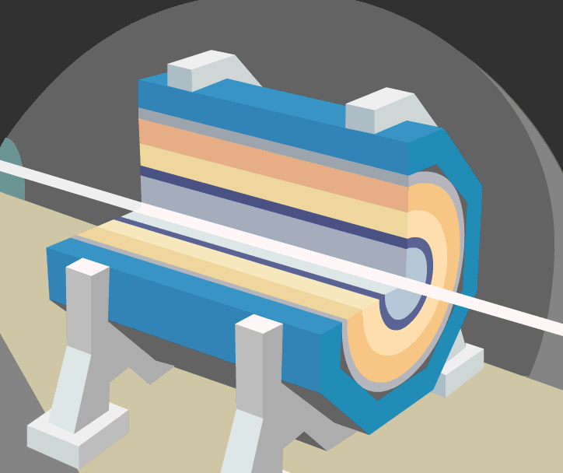
A collision at LHC

Slide 24
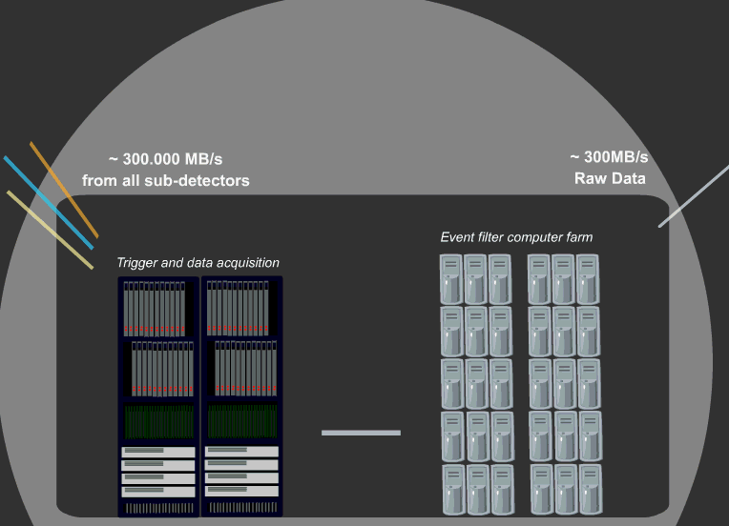
The Data Acquisition

Slide 25
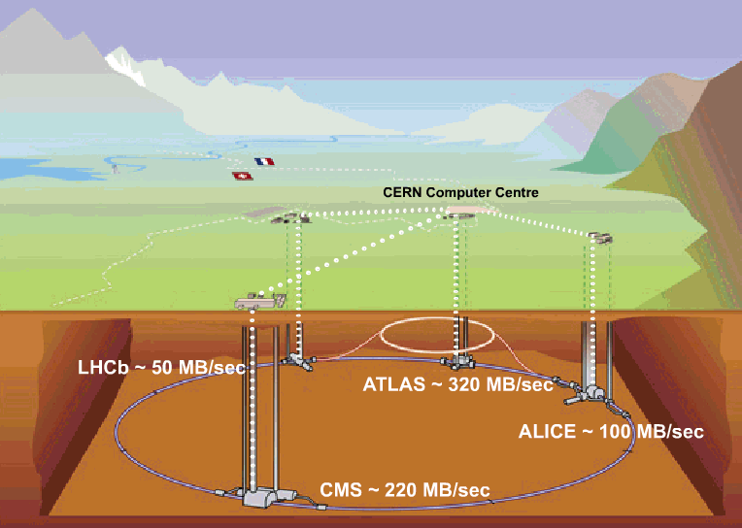
Tier 0 at CERN:
Acquisition, First pass reconstruction, Storage & Distribution
2011: 4-6 GB/sec
2011: 400-500 MB/sec
1.25 GB/sec (ions)

Slide 26
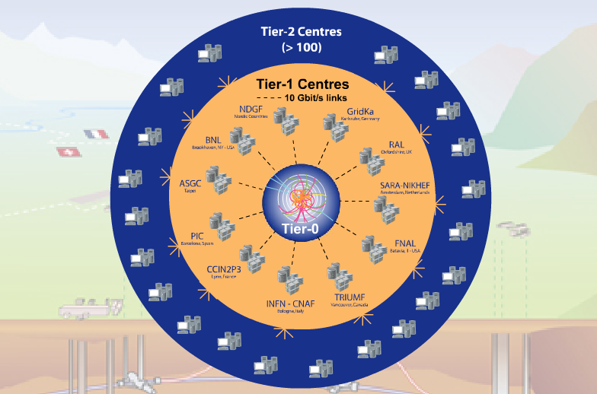
WLCG – what and why?
A distributed computing infrastructure to provide the production and analysis environments for the LHC experiments
Managed and operated by a worldwide collaboration between the experiments and the participating computer centres
The resources are distributed – for funding and sociological reasons
Our task was to make use of the resources available to us – no matter where they are located
Tier-0 (CERN):
  Data recording
  Initial data reconstruction
  Data distribution
Tier-1 (11 centres):
Permanent storage
Re-processing
Analysis
Tier-2 (~130 centres):
Simulation
End-user analysis
Notes:
The Tier 0 centre at CERN stores the primary copy of all the data. A second copy is distributed between the 11 so-called Tier 1 centres. These are large computer centres in different geographical regions of the world, that also have a responsibility for long term guardianship of the data. The data is sent from CERN to the Tier 1s in real time over dedicated network connections.
In order to keep up with the data coming from the experiments this transfer must be capable of running at around 1.3 GB/s continuously. This is equivalent to a full DVD every 3 seconds.
The Tier 1 sites also provide the second level of data processing and produce data sets which can be used to perform the physics analysis. These data sets are sent from the Tier 1 sites to the around 130 Tier 2 sites.
A Tier 2 is typically a university department or physics laboratories and are located all over the world in most of the countries that participate in the LHC experiments. Often, Tier 2s are associated to a Tier 1 site in their region. It is at the Tier 2s that the real physics analysis is performed.

Slide 27
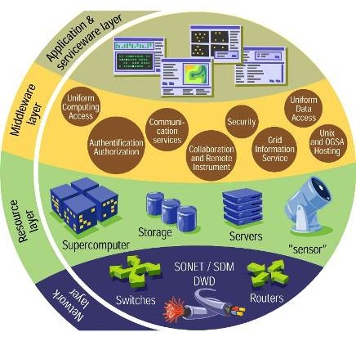






e-Infrastructure: Grids
Notes:
Here we see a schematic of a grid infrastructure. At the lowest level we have the physical networks providing the underlying communication. These are supported by large national or international projects and organisations, such as Geant in Europe, and many National Research and Education Networks (NREN) organisations.
At the next layer we have the resources that are to be shared – these may be computing clusters, storage systems, supercomputers, or even scientific instruments. At the next layer we see the implementation of the “grid” through the layer of software – or grid middleware. This is what binds together the underlying physical resources into a collaborative structure, providing all of the elements necessary to do so. At one extreme we have supercomputer grids such as DEISA or Teragrid that link supercomputers, while at the other we have more general cluster-based grids such as Open Science Grid in the USA and EGI (EGEE) in Europe.
Finally on the upper layer we have the applications – which may or may not need to have been modified to make use of the underlying software. Reliable services, monitoring, etc are also implemented at this layer.

Slide 28
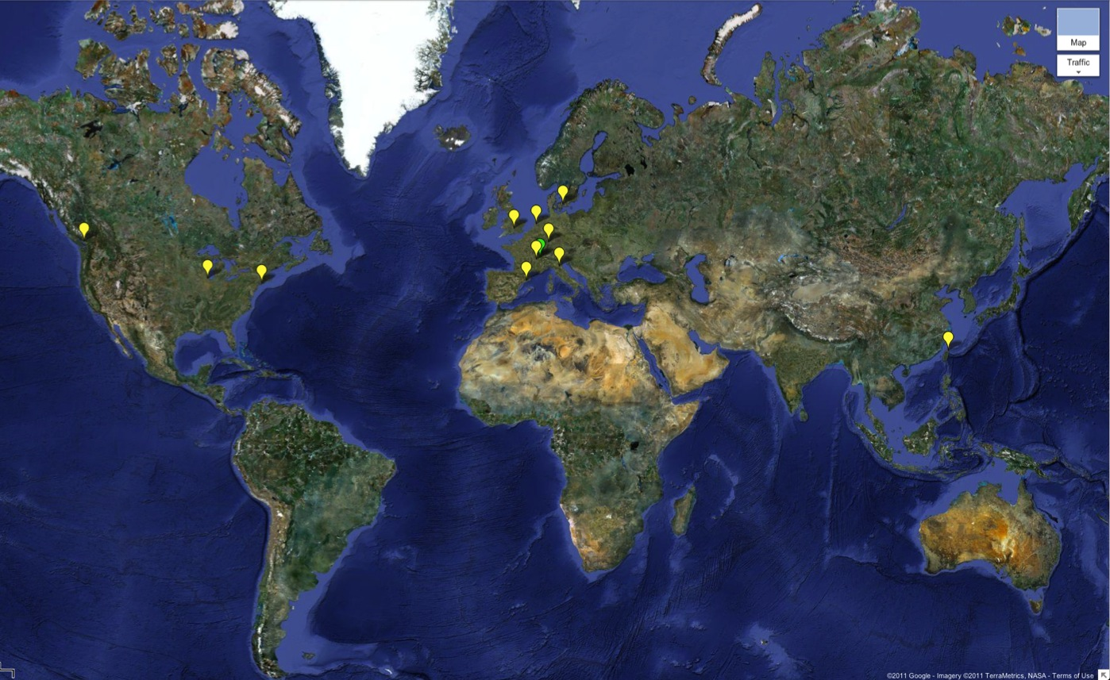

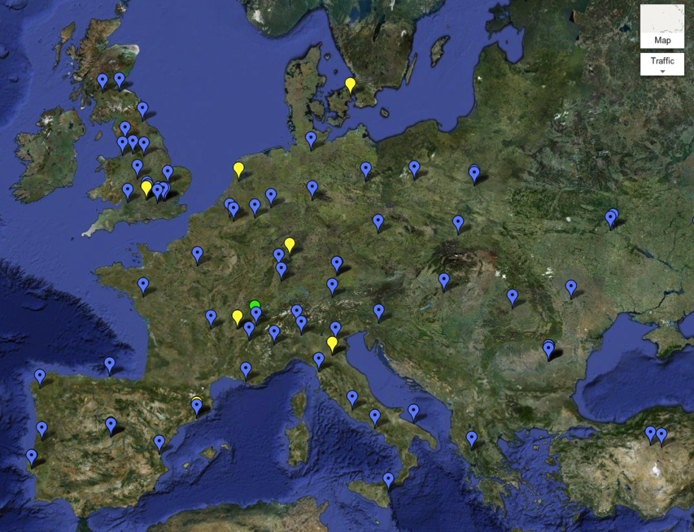
WLCG Grid Sites
Today >140 sites
>250k CPU cores
>150 PB disk
Tier 0
Tier 1
Tier 2

Slide 29
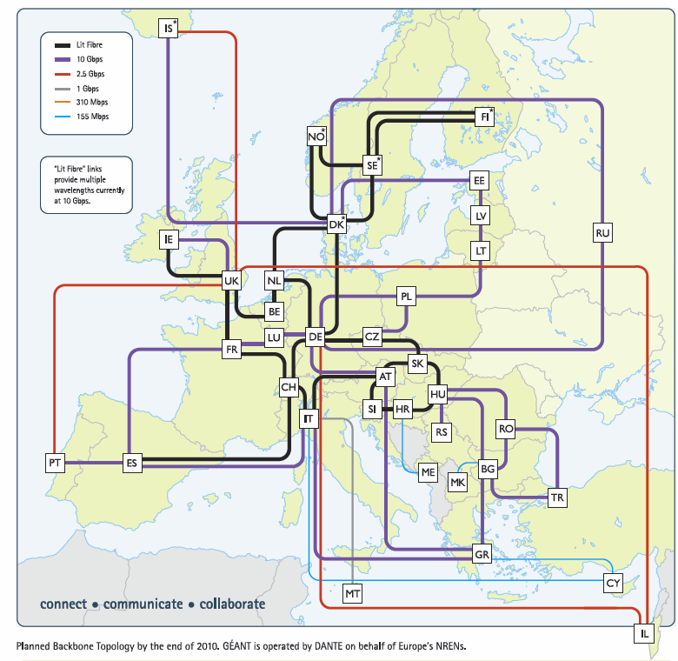
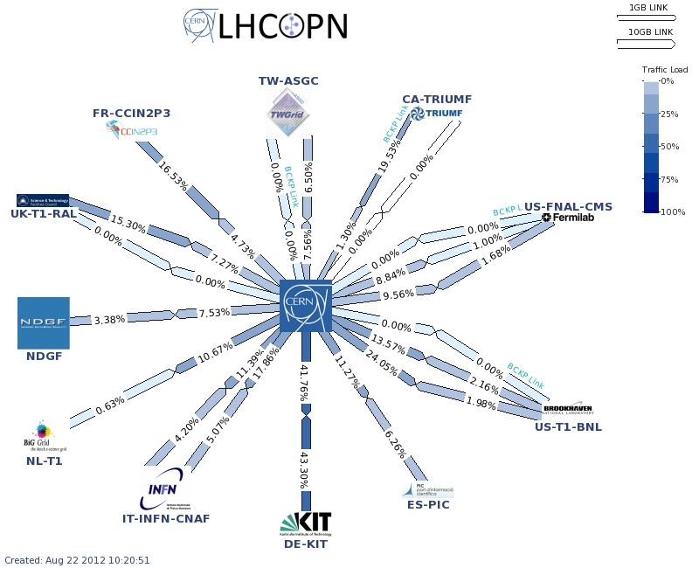
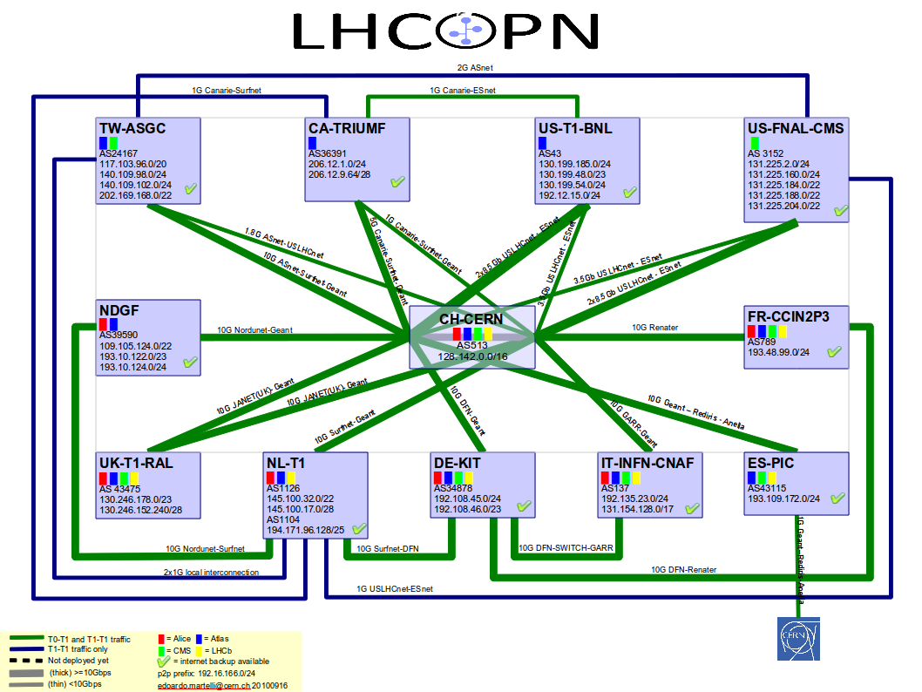
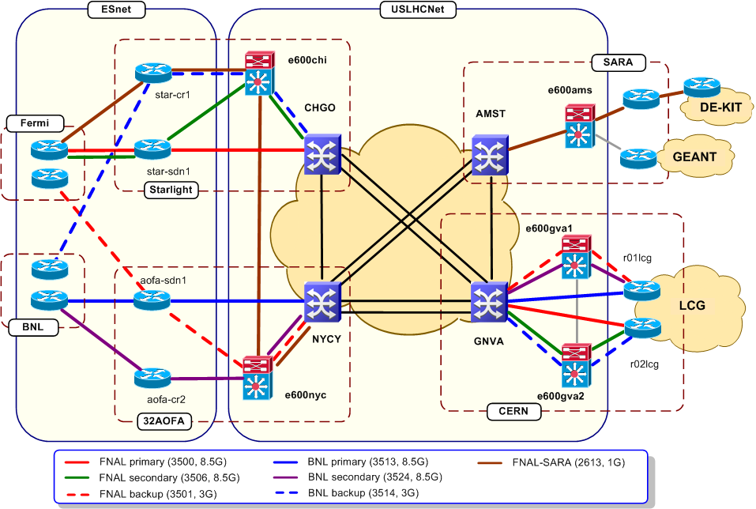
LHC Networking
Relies on
  OPN, GEANT, US-LHCNet
  NRENs & other national & international providers

Slide 30
From testing to data:
e.g. DC04 (ALICE, CMS, LHCb)/DC2 (ATLAS) in 2004 saw first full chain of computing models on grids
Independent Experiment Data Challenges
2004
SC1 Basic transfer rates
Service Challenges proposed in 2004
To demonstrate service aspects:
  Data transfers for weeks on end
  Data management
  Scaling of job workloads
  Security incidents (“fire drills”)
  Interoperability
  Support processes
2005
SC2 Basic transfer rates
SC3 Sustained rates, data management, service reliability
2006
SC4 Nominal LHC rates, disk→ tape tests, all Tier 1s, some Tier 2s
2007
Focus on real and continuous production use of the service over several years (simulations since 2003, cosmic ray data, etc.)
Data and Service challenges to exercise all aspects of the service – not just for data transfers, but workloads, support structures etc.
2008
CCRC’08 Readiness challenge, all experiments, ~full computing models
2009
STEP’09 Scale challenge, all experiments, full computing models, tape recall + analysis
2010
Notes:
To give a sense of how grids have developed over the last 10 years, the testing timeline of WLCG is instructive. Already in 2004 the experiments were using the grid infrastructure as their main means of producing simulated data – relying on it as their main production system. In parallel a series of data and service challenges were proposed and executed, in order to demonstrate increasing levels of performance and service. Two aspects were particularly important for WLCG – data transfers and overall service reliability. Partly the challenges could only be executed once the Tier 1 sites had ramped up their resources to an appropriate level, and partly it was necessary to learn how to manage and schedule data transfers to maximise the throughput. The grid service was continually used for real work – culminating in cosmic ray data and finally real LHC data.

Slide 31
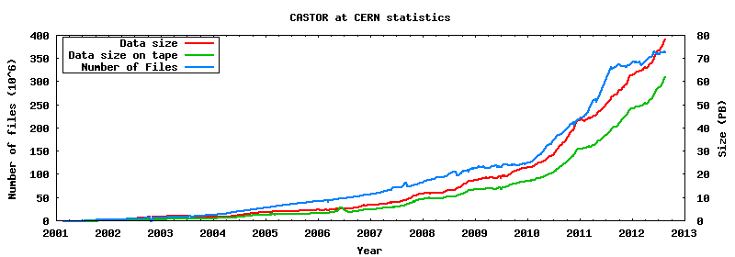
Data in Tier 0
62 PB on tape
370 M files
In 2010+2011 ~38 PB of data have been accumulated, expect about 30 PB more in 2012
2 PB/month in 2011;
3.5 PB/month in 2012 (1 PB/week)
More in HI runs
>30 PB in 2012?
15 PB in 2010
23 PB in 2011
p-p data
Pb-Pb data

Slide 32
Data access at Tier 0 in 2012
Data written to tape, 2012
Data accessed from tape, 2012

Slide 33
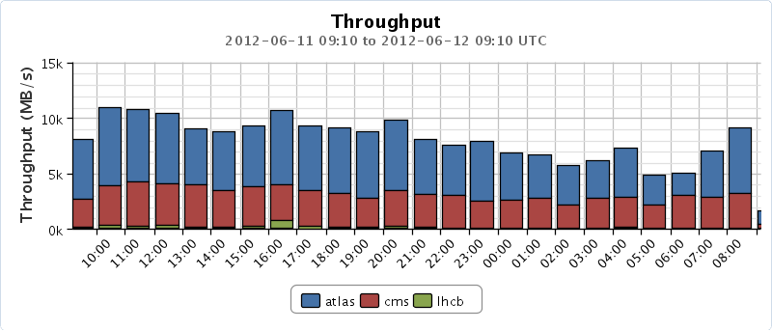
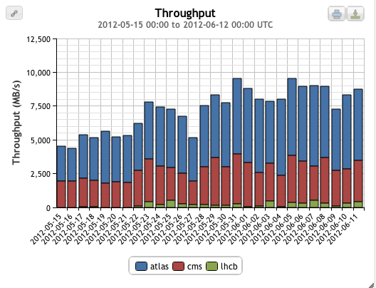

Data transfers
Global transfers (May-June)
Global transfers > 10 GB/s (1 day)
CERN → Tier 1s (with LHC on): 2 GB/s
Planned rates:
Tier 0 – Tier 1: 650 MB/s + margin

Slide 34





Data Transfers
A key technology for LHC
Worldwide data traffic
Export from CERN data traffic
Total data movement inside CERN
Last month:
4 PB, 2.6M files exported from CERN to Tier 1s
20 PB, 33M files moved worldwide
Data movement inside Tier 0:
Data in: 4.3 GB/s (peak 13 GB/s)
Data out: 11.5 GB/s (peak 25 GB/s)
~1.5 PB/day data movement at CERN

Slide 35
Scale of Tier 1s with data
Tier 0 + 1 Data received & served; last month
Tier 0 | Receive PB (M files) | Serve PB (M files)
CERN | 1.0 (1.3) (+3.5 PB !) | 4.8 (3.1)
Example of a Tier 1 – KIT is one of the largest and supports all 4 experiments
Tier 1 | Receive PB (M files) | Serve PB (M files)
Germany (KIT) | 1.4 (2.8) | 1.2 (2.0)

Slide 36
Processing on the grid
Usage continues to grow…
# jobs/day
CPU usage
1.5M jobs/day
~ 150,000 years of CPU delivered each year
10⁹ HEPSPEC-hours/month
(~150 k CPU continuous use)
This is close to full capacity
We always need more!

Slide 37
CPU – around the Tiers
The grid really works
All sites, large and small can contribute
  And their contributions are needed!
Notes:
The distribution of delivered CPU between the various tiers has also been according to the design, with tier 2s providing in excess of 50% of the total. If this is broken down we see that countries deliver close to what they pledged. Thus the grid concept really does work on this scale, and enables institutes worldwide to collaborate, share data, and provide resources to the common goals of the collaboration. Early worries that people would simply ignore the grid and use CERN for analysis were unfounded – Tier 2s are used extensively and exclusively.

Slide 38

  Grid computing enables the rapid delivery of physics results

Slide 39
Impact of the LHC Computing Grid
WLCG has been leveraged on both sides of the Atlantic, to benefit the wider scientific community
  Europe:
    Enabling Grids for E-sciencE
    (EGEE) 2004-2010
    European Grid Infrastructure
    (EGI) 2010--
  USA:
    Open Science Grid (OSG)
    2006-2012 (+ extension?)
Many scientific applications ➔
  Archeology
  Astronomy
  Astrophysics
  Civil Protection
  Comp. Chemistry
  Earth Sciences
  Finance
  Fusion
  Geophysics
  High Energy Physics
  Life Sciences
  Multimedia
  Material Sciences
  …
Notes:
WLCG has driven the development of multi-science grids in Europe and in the US. In Europe the EGEE projects, followed recently by EGI support very many different applications other than LHC, while in the US the Open Science Grid has played a similar role, although also with LHC as a main stakeholder. In both cases many different application communities have benefitted from the advent of grid infrastructures.

Slide 40
Growth and evolution
WLCG – a 10 year program of development and implementation
Today the WLCG grid has delivered on its promise and LHC is producing unprecedented physics output
BUT: challenges remain!
  We have a >20 year program for the LHC and experiments
  Technology evolves: grids, clouds, CDN’s etc
  Physics hunger for resources continues to increase!

Slide 41
Evolution of capacity: CERN & WLCG
Modest growth until 2014
Anticipate x5 requirement >2015
Anticipate x10-100 after 2018 ???
What we thought was needed at LHC start
What we actually used at LHC start!

Slide 42


Computing model evolution
Evolution of computing models
Hierarchy
Mesh

Slide 43
Original Grid Services
Data Management Services
Security Services
Job Management Services
Storage Element
Certificate Management Service
VO Membership Service
Compute Element
File Catalogue Service
Workload Management Service
Authentication Service
Grid file access tools
VO Agent Service
Authorization Service
File Transfer Service
Application Software Install Service
More complex than (eventually) really needed
GridFTP service
Information Services
Database and DB Replication Services
Information System
Messaging Service
Experiments invested considerable effort into integrating their software with grid services; and hiding complexity from users
POOL Object Persistency Service
Accounting Service
Site Availability Monitor
Monitoring tools: experiment dashboards; site monitoring
Notes:
Overview of what is included today in “grid middleware”
Experiments invested significant effort in their software frameworks to hide this complexity from their users

Slide 44
Consolidation & evolution
WLCG is on ongoing (and successful) operation, but:
Computing models have evolved
Far better understanding of requirements now than 10 years ago
  Significant experience with data now
Experiments have developed (different!) workarounds to manage weaknesses in middleware
Pilot jobs and central task queues (almost) ubiquitous
Operational effort often too high; lots of services were not designed for redundancy, fail-over, etc.
Technology evolves rapidly, rest of world also does (large scale) distributed computing – don’t need entirely home grown solutions
Must be concerned about long term support and where it will come from

Slide 45
Technical Evolution
6 working groups set up last Autumn
  Data and storage management
  Workload management
  Databases
  Security
  Operations and tools
Recommendations for evolution of technical infrastructure
  Very good opportunities for gaining commonality between experiments, & interest in doing so
  Also between EGI, OSG, etc grid flavours
General theme:
  Reduction of complexity
  Less operational effort
  Adaptation to new models (networks, pilot jobs, etc)
Several longer term areas of work identified and started

Slide 46

Tier 0:
Wigner Data Centre, Budapest
New facility due to be ready at the end of 2012
1100m² (725m²) in an existing building but new infrastructure
2 independent HV lines
Full UPS and diesel coverage for all IT load (and cooling)
Maximum 2.7MW

Slide 47

Evolution of Tier 0

Slide 48

CERN CC management tools
Updating all CC infrastructure tools
  Moving to Open Source tool chain, for all aspects of hardware lifecycle, OS management etc
  No longer justified to have home-grown solutions – readily available tools to work at very large scale
  Includes updated monitoring infrastructure; with Hadoop tools to allow new analysis of operations data
Also virtualising most of the CC infrastructure
  Will manage with OpenStack and associated tools
  Needed for management of remote Tier 0
  Will also allow to consolidate existing CVI service and LXCloud pilot
  Will provide a cloud service to CERN users
    New models of service provision as well as IaaS
Will also investigate new batch systems
  LSF scaling concerns with O(300k) VMs
  Not obvious LHC work will need a traditional LRMS (?)
  What does IaaS provide?

Slide 49
Clouds & Virtualisation
Several strategies:
Use of virtualisation in the CERN & other CCs:
  Other WLCG sites also virtualising their infrastructure
Investigating use of commercial clouds – “bursting” or direct submission
  Additional resources;
  Potential of outsourcing some services?
  Experiments have various activities (with Amazon, etc);
  Prototype with Helix Nebula project;
Can cloud technology replace/supplement some grid services?
  More speculative: Feasibility? Timescales?

Slide 50
WLCG will remain a Grid
We have a grid because:
  We need to collaborate and share resources
  Thus we will always have a “grid”
  Our network of trust is of enormous value for us and for (e-)science in general
We also need distributed data management
  That supports very high data rates and throughputs
  We will continually work on these tools
How much can come from open source community (or …)?
  We should determine what we can actually take from the open source world
  Focus our (shrinking) efforts on the areas that we must develop ourselves
    But continue to question why we need to do that

Slide 51
Cloud Context
Site Virtualisation
For efficiency, service provision, etc
(CERN for remote Tier 0)
Use of Cloud interfaces to sites:
Provide new services; In addition to grid interface
Data processing; bursting
Academic Cloud infrastructure(s)
Use of Commercial clouds
Helix Nebula Project
General IT services – “outsourcing”

Slide 55
Conclusions
First years of LHC data – WLCG has helped deliver physics rapidly
Just the start of a >20 year exploration of new physics
Entering a phase of consolidation and evolution
  LS1: opportunity for disruptive changes and scale testing of new technologies
Challenges for computing – scale & complexity – will continue to increase dramatically

Slide 56

Thank You!

