Slide 1
GridKa School:
A Decade Behind
Pavel Weber
Steinbuch Centre for Computing

Slide 2
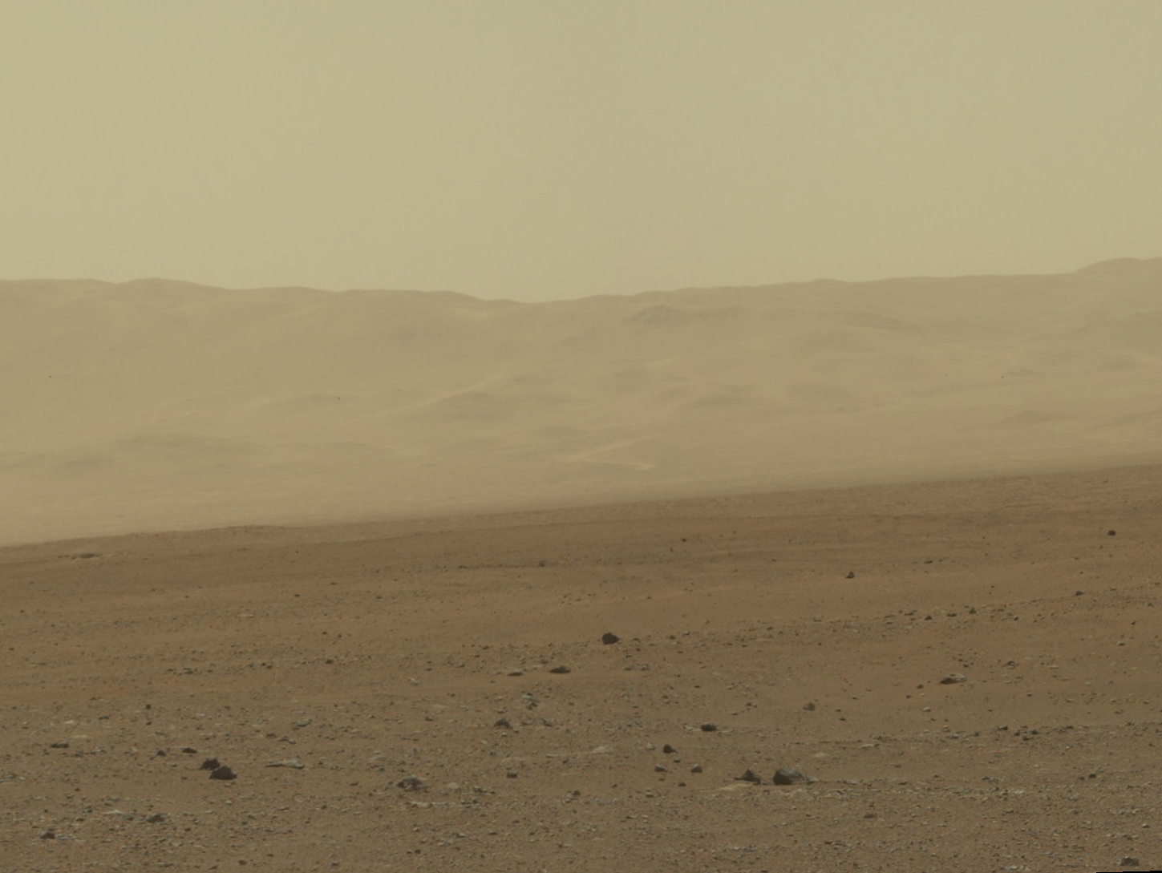
Wall of Gale Crater

Slide 3
Wall of Gale Crater
Mars mission was mentioned first in 2003 in
“New Frontiers in the Solar System: An Integrated Exploration Strategy”
First GridKa School held in September 2003

Slide 4
GridKa School: At Start
2001/2: Regional Data and Computing Centre in Germany (RDCCG)
In July 2002 the center is renamed to GridKa and
serves as Tier-1 centre for the LHC experiments
provides resources to non-LHC HEP and astroparticle experiments
New Grid technology required education and training
In October 2002 the decision was taken to establish a regular workshop/school for GridKa users
First school held in September 2003
60 participants
Main audience: nuclear and particle physicists

Slide 5
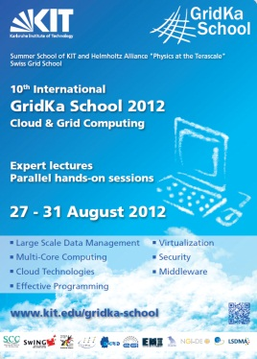
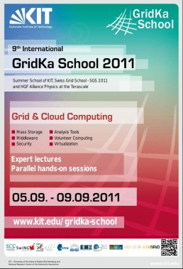
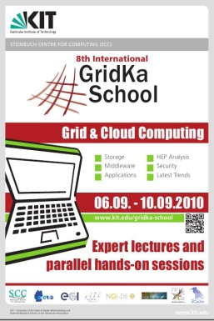
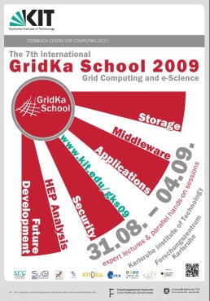
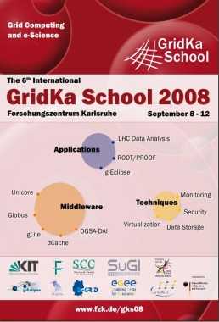
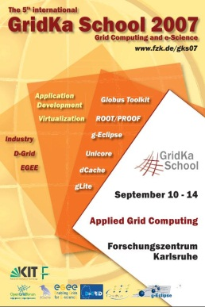
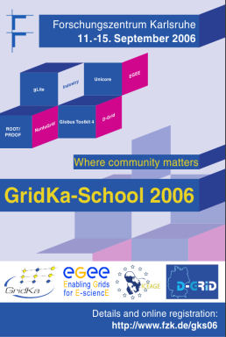
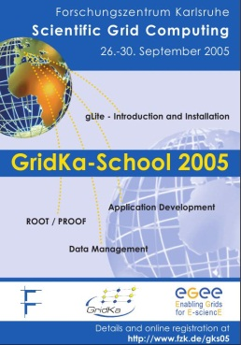
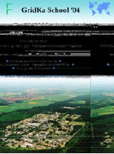
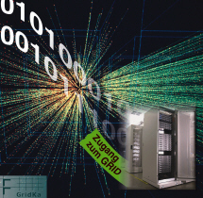
GridKa School: Over Decade
2012:...
2011: Effective
programming
2010: cloud computing
talks&tutorials
2009: Cloud computing talks
2008: more focus on data management
2007: first time security workshop
2006: more on virtualization. Middleware flavors
2005: focus on gLite, ROOT/PROOF, virtualization mentioned, 5 days
2004: first usage of Grid in tutorial, 4 days
2003: mainly HEP Applications, ROOT, 2.5 days
In total more than 1200 participants over 10 years.
More than 70 hands on tutorials given + 15 hands on this week.

Slide 6
Impressions: 2005

Slide 7
Impressions: 2009

Slide 8
Impressions: 2009

Slide 9
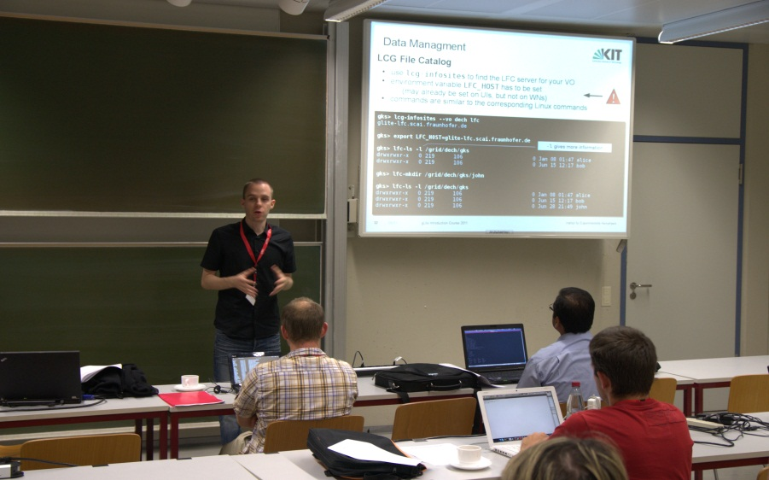
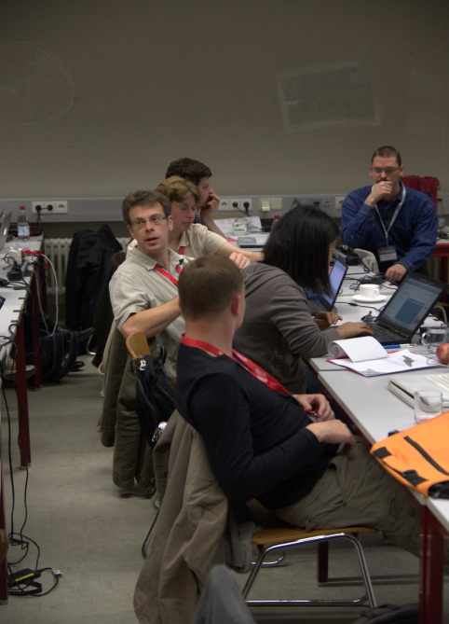
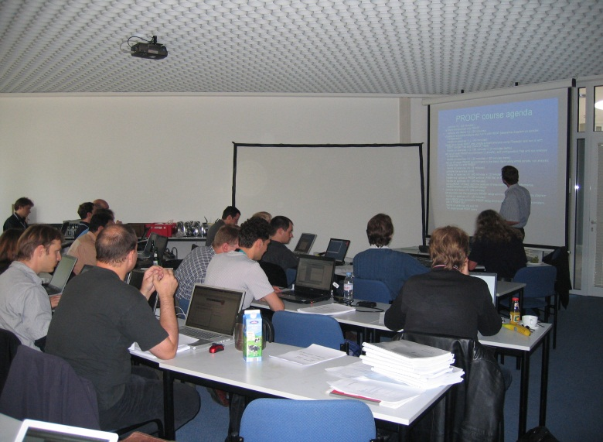
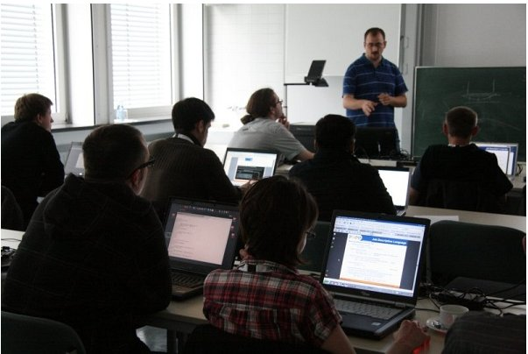
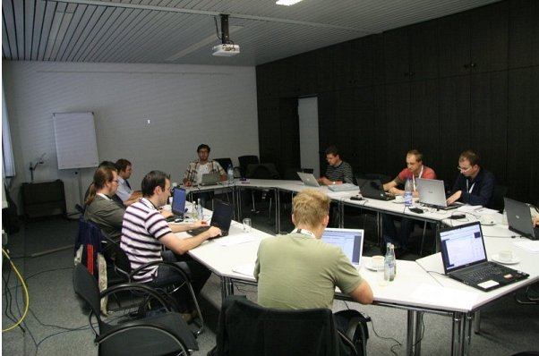
Impressions: Hands on Tutorials

Slide 10
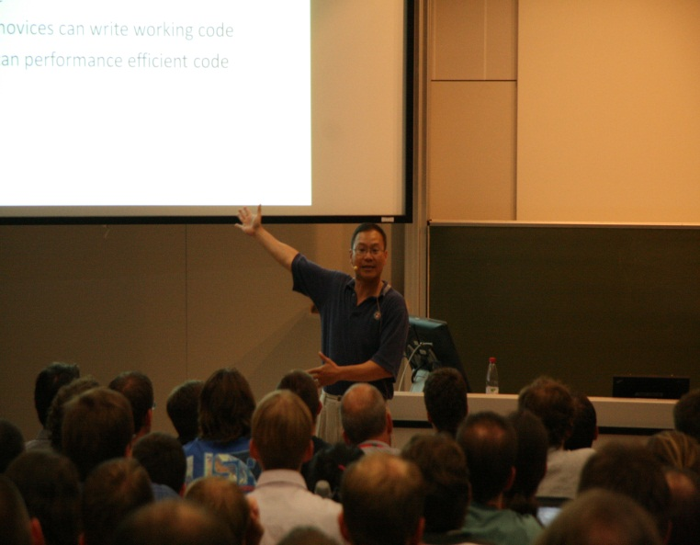
Impressions: 2011

Slide 11
Impressions: 2011

Slide 12
GridKa School This Week: Overview
Location
Lunch
Bus Shuttle
Evening program
Miscellaneous
Supporters and cooperating projects

Slide 13
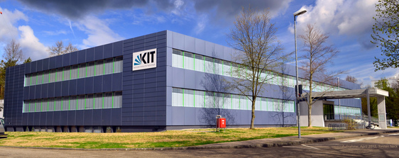
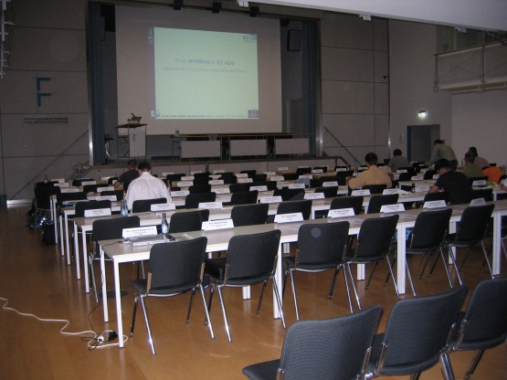
Location
All courses and lectures with exception of evening lecture are in the building you are in right now (FTU, which is the training center of KIT).
All lectures take place in Aula
FTU
Aula

Slide 14
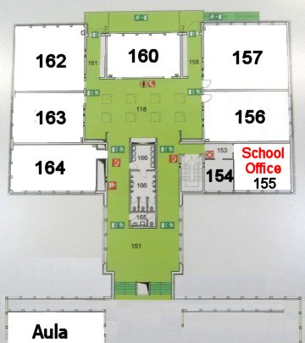
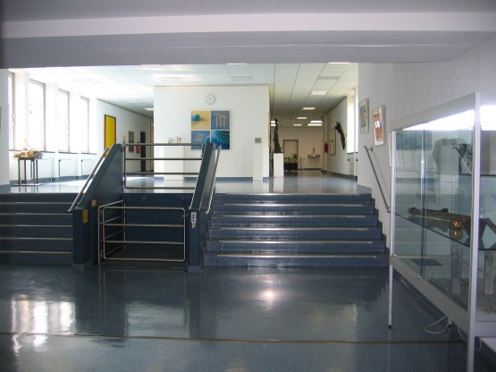
More on Location
School Office in room 155
The central place for questions, help or requests
Tutorials/workshops take place in Aula and in rooms 156, 160, 162, 163 and 116 for Security Workshop
162
163
164
156
155
156
116

Slide 15
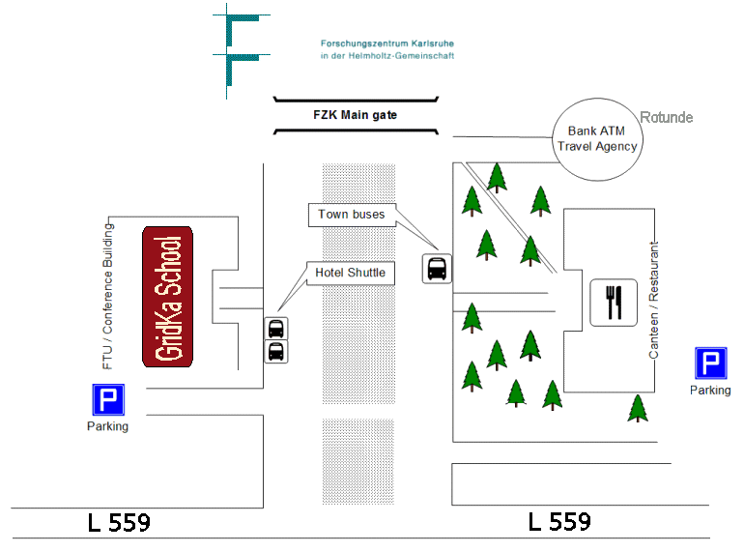
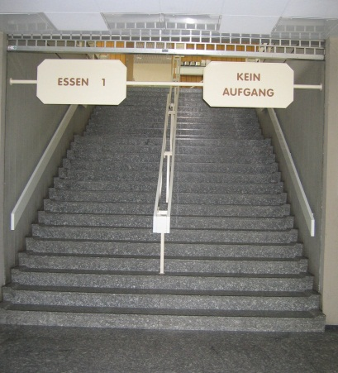
Lunch
Lunch (Tue, Wed, Thu) takes place in KIT North staff canteen (building opposite of FTU)
Line 1 (ESSEN 1) upstairs
We will lock the rooms during the lunch

Slide 16
Bus Shuttle
Connects Queens Hotel and GridKa School
Schedule is given on information sheets:
http://gridka-school.scc.kit.edu/2012/62.php
Tonight: we will offer another kind of transport (via mini bus to tram stop; from there via tram to “Augartenstraße“ tram stop (tram tickets will be provided )
It takes 5 minutes by mini bus to tram stop + 40 minutes to Queens Hotel by tram

Slide 17
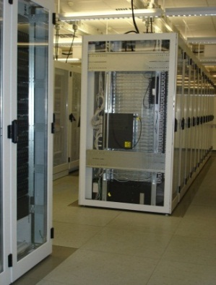
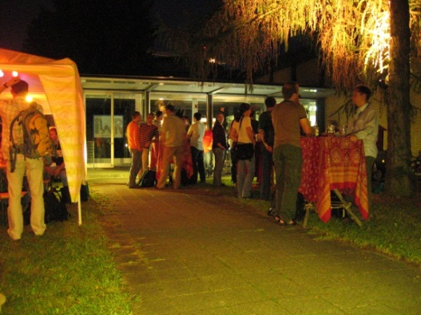
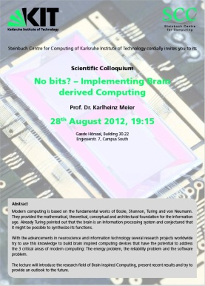
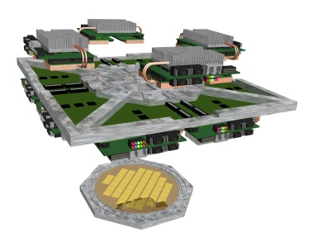
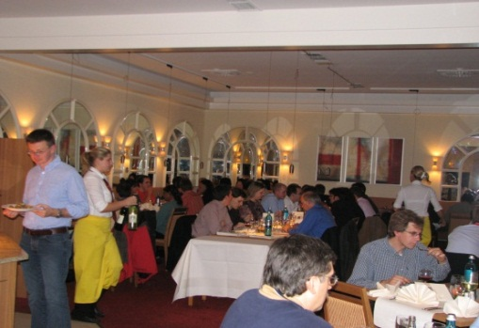
Evening program
This evening:
guided tour of GridKa Tier-1
Tonight: ‘Tarte Flambee evening’ at SCC
After the sessions around 17:30 we’ll go all together through the KIT North gate to the place
Tuesday evening at 19:15:
The evening lecture “No bits? – Implementing Brain derived Computing“ by Prof. K. Meier at Gaede-Hörsaal, Campus South.
Thursday at 20:00: School Dinner at Queens Hotel (~500 m from central station)

Slide 18
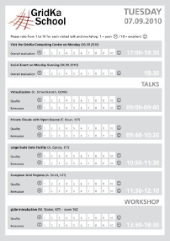
Miscellaneous
WLAN
Network /vpn/web/belwue
Eduroam is also available
School picture:
Will be taken on Tuesday during the coffee break (10:20 – 10:50) in front of FTU building
For any question
School office room 155
Or send a mail to GridKa-School@scc.kit.edu
Evaluation sheets
One per day
Please fill the out, it will helps us a lot to
improve the school quality

Slide 19
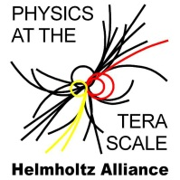
Cooperating projects
A special ‘thank you’ goes to

Slide 20
Any questions?
Let us start !
Enjoy

