Slide 1
ROOT and PROOF Tutorial
Arsen Hayrapetyan | Martin Vala
Yerevan Physics Institute, Yerevan, Armenia; European Organization for Nuclear Research (CERN) Arsen.Hayrapetyan@cern.ch | Institute of Experimental Physics, Slovak Academy of Sciences; European Organization for Nuclear Research (CERN) Martin.Vala@cern.ch

Slide 2
Outline
Introduction to ROOT
ROOT hands-on exercises
Introduction to PROOF
PROOF hands-on exercises

Slide 3
What is ROOT?
Object-oriented data handling and analysis framework
Framework: ROOT provides building blocks (root classes) to use in your program.
Data handling: ROOT has classes designed specifically for storing large amount of data (GB, TB, PB) to enable effective data analysis.
Analysis: ROOT has complete collection of statistical, graphical, networking and other classes that user can use in their analysis.
Object-oriented: ROOT is based on OO programming paradigm and is written in C++.

Slide 4
Who is developing ROOT?
ROOT is an open source project started in 1995 by René Brun and Fons Rademakers.
The project is developed as a collaboration between:
Full time developers:
7 developers at CERN (PH/SFT)
2 developers at Fermilab (US)
Large number of part-time contributors (160 in CREDITS file included in ROOT software package)
A vast army of users giving feedback, comments, bug fixes and many small contributions
~5,500 users registered to RootTalk forum
~10,000 posts per year

Slide 5
Who is using ROOT?
All High Energy Physics experiments in the world
Astronomy: AstroROOT (http://www.isdc.unige.ch/astroroot/index)
Biology: xps package for Bioconductor project
(http://prs.ism.ac.jp/bioc/2.7/bioc/html/xps.html)
Telecom: Regional Internet Registry for Europe, RIPE (Réseaux IP Européens) NCC Network Coordination Centre
(http://www.ripe.net/data-tools/stats/ttm/current-hosts/analyzing-test-box-data)
Medical fraud detection, Finance, Insurance, etc.
ROOT is used in a many scientific fields as well as in industry.

Slide 6
What can I do with ROOT?
You can:
Store large amount of data (GB, TB, PB) in ROOT-provided containers: files, trees, tuples.
Visualize the data in one of numerous ways provided by ROOT: histograms (1, 2 and 3-dimensional), graphs, plots, etc.
Use physics analysis tools: physics vectors, fitting, etc.
Write your own C++ code to process the data stored in ROOT containers.

Slide 7
ROOT features: Data containers
ROOT provides different types of data containers:
Files, folders
Trees, Chains, etc.

Slide 8
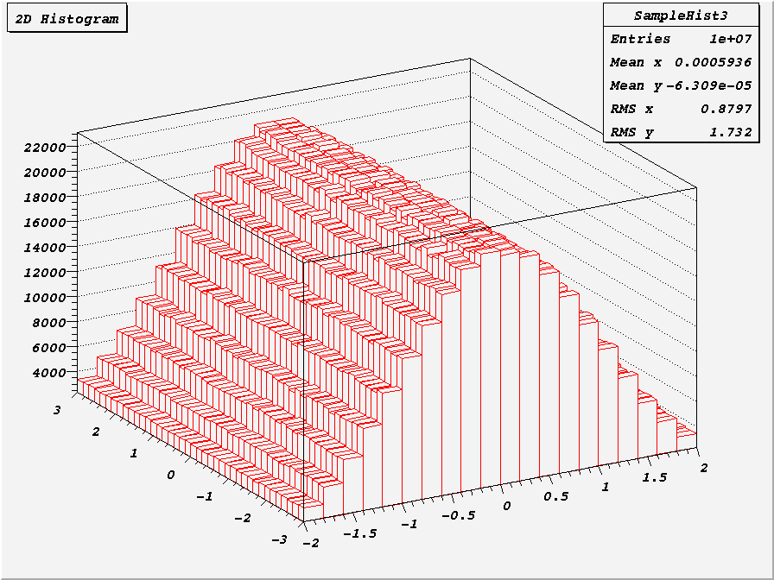
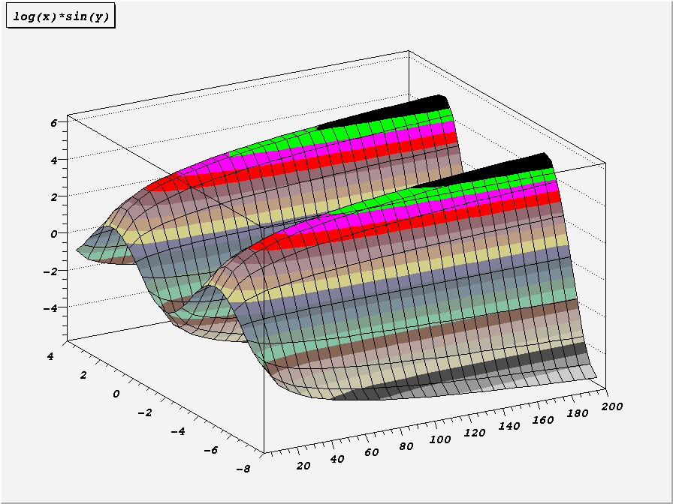
ROOT features: Data visualization
ROOT provides a range of data visualization methods: histograms (one- and multi-dimensional), graphs, plots (scatter, surface, lego, …)

Slide 9
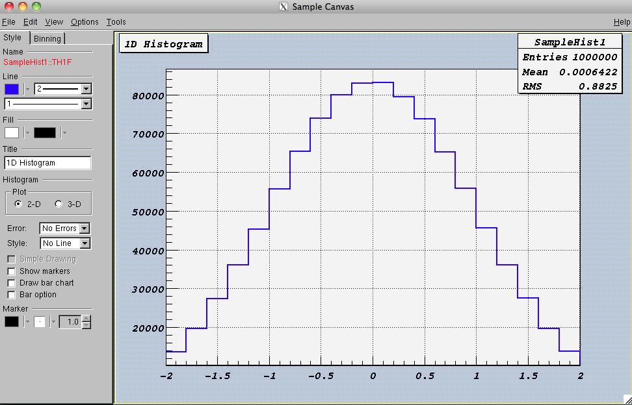
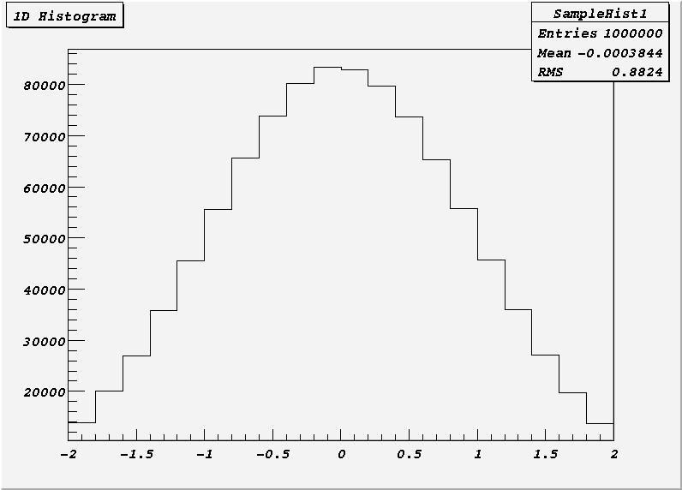
ROOT features: GUI
The Graphical User Interface (CLI) allows you to manipulate graphical objects (histograms, canvases, graphs, axes, plots, …) clicking on buttons and typing values in text boxes.

Slide 10
ROOT features: CLI
The Command Line Interface (CLI) allows you to type in the commands (C++, root-specific, OS shell) and processes them interactively via CINT – C++ interpreter.

Slide 11
Trees (class TTree)
A tree is a container for data storage
It consists of several branches
These can be in one or several files
Branches are stored contiguously (split mode)
Set of helper functions to visualize the content (e.g. Draw, Scan)
Compressed
Tree
Branch
Branch
Branch
1 "Event"
Branches
File
point
x y z
x
x
x
x
x
x
x
x
x
x
y
y
y
y
y
y
y
y
y
y
z
z
z
z
z
z
z
z
z
z
Events

Slide 12
Events
Events are units of data which are stored in trees and can be
processed independently from each other (PROOF’s event
level parallelism is based on these properties).

Slide 13
Chains (class TChain)
A chain is a list of trees (in several files)
TTree methods can be used
Draw(), Scan(), etc.
→ these iterate over all elements of the chain
Selectors can be used with chains
Process(const char* selectorFileName)
Chain
Tree1 (File1)
Tree2 (File2)
Tree3 (File3)
Tree4 (File3)
Tree5 (File4)

Slide 14
Selectors (class TSelector) Local analysis case
Classes derived from TSelector can run locally
Begin() and SlaveBegin()
Init(TTree* tree)
Process(Long64_t entry)
Terminate()
once on your client
for each tree
for each event

Slide 15
ROOT Features: Data Analysis

Slide 16
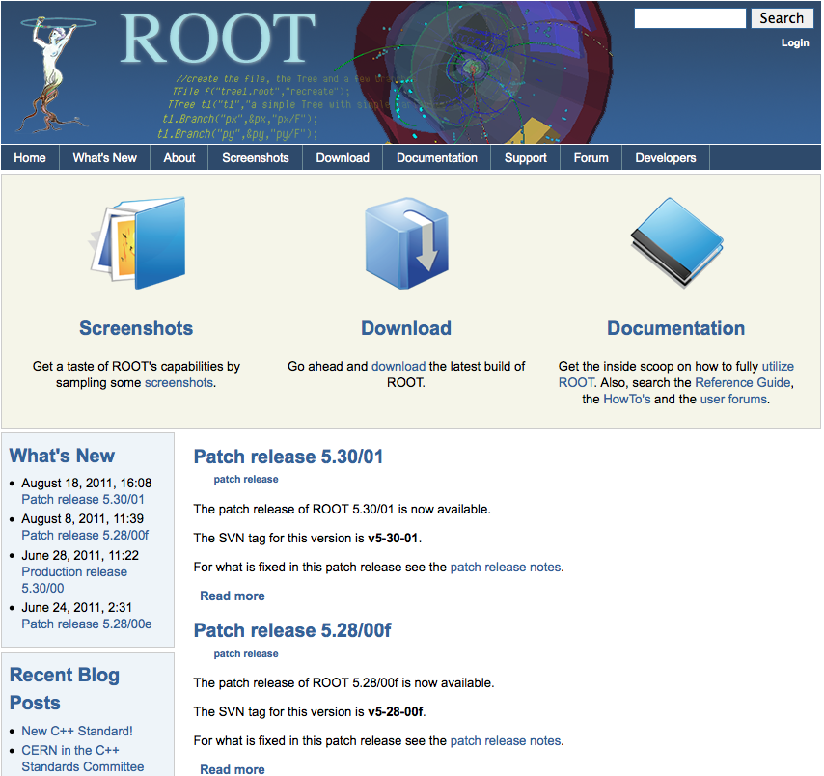
More information on ROOT
http://root.cern.ch
Download
binaries, source
Documentation
User’s guide
Tutorials
FAQ
Mailing list
Forum

Slide 17
ROOT Tutorial

Slide 18
http://mon1.saske.sk/peac/doc/peac-tut/PEACTutorial_PROOFtutorial.html
http://root.cern.ch/drupal/content/peac
In this tutorial you will learn how to…
Use CLI and GUI
Create functions and histograms
Visualize (draw) them
Create and explore files
Create and explore trees
Create chains
Write a selector class
Analyze data contained in trees and chains on your machine

Slide 19
Preparations for the tutorial
Connect to your UI login server
Attention! Use –Y option for SSH:
e.g. ssh –Y –p 24 gks098@gks-211.scc.kit.edu
Connect to machines gks-NNN.scc.kit.edu
e.g. ssh –Y gs023@gks-032.scc.kit.edu
We will tell you the number of machine you should connect to
Verify that you have connected to proper machine running “hostname –f”
Run the following command:
source /opt/PEAC/sw/current/VO_PEAC/ROOT/v5-34-01/peac-env.sh
It will set system paths to include ROOT binary and the libraries
Start root:
root
You should see ROOT start screen with logo and the ROOT version: 5-34-01

Slide 20
Macros for tutorial
Go to the page http://mon1.saske.sk/peac/doc/peac-tut/PEACTutorial.html
Download the archive by the link specified in section 1.1, “Tutorials”
Unpack the archive:
$> tar -zxvf GridKa2012.tar.gz
Directory GridKa2012 will be created containing tutorial macros.
We strongly recommend you to type the code you find at tutorial documentation page!

Slide 21
What is PROOF? Why PROOF?
PROOF stands for Parallel ROOt Facility
It allows parallel processing of large amount of data. The output results can be directly visualized (e.g. the output histogram can be drawn at the end of the proof session).
PROOF is NOT a batch system.
The data which you process with PROOF can reside on your computer, PROOF cluster disks or grid.
The usage of PROOF is transparent: you should not rewrite your code you are running locally on your computer.
No special installation of PROOF software is necessary to execute your code: PROOF is included in ROOT distribution.

Slide 22
How PROOF cluster works

Slide 23
How does PROOF analysis work?
Client –
Local PC
Remote PROOF Cluster
Result
stdout/result
root
root
ana.C
node1
Result
ana.C
Data
root
Data
node2
Result
root
Data
node3
root
Result
Proof master
Proof slave
Data
node4

Slide 24
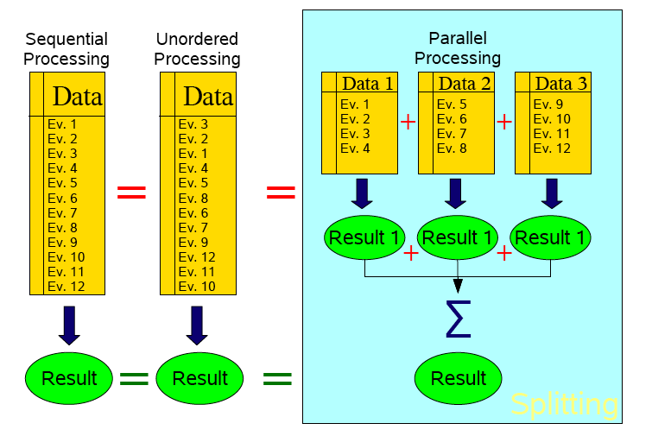
Trivial parallelism

Slide 25
PROOF terminology
The following terms are used in PROOF:
PROOF cluster
Set of machines communicating with PROOF protocol. One of those machines is normally designated as Master (multi-Master setup is possible as well). The rest of machines are Workers.
Client
Your machine running a ROOT session that is connected to a PROOF master.
Master
Dedicated node in PROOF cluster that is in charge of assigning workers the chunks of data to be processed, collecting and merging the output and sending it to the Client.
Slave/Worker
Entity which processes portion of overall data split in packets. Every worker has its own root session controlled by proofserv.exe process.
Query
A job submitted from the Client to the PROOF cluster.
A query consists of a selector and a chain.
Selector
A class containing the analysis code (more details later)
Chain
A list of files (trees) to process (more details later)
PROOF Archive (PAR) file
Archive file containing files for building and setting up a package on the PROOF cluster. Normally is used to supply extra packages used by user job.

Slide 26
What should I do to run a job on PROOF cluster?
Create a chain (dataset) containing the files you want to analyze.
Write your job code and put it in the selector (class deriving from TSelector).
Define inputs and outputs via predefined (by class TSelector) lists (TList objects) fInput and fOutput.
Create extra packages (if any) which you need and put them in PAR file to be deployed on the PROOF cluster.

Slide 27
Selectors (Class TSelector) PROOF analysys case
Classes derived from TSelector can run in PROOF
Begin()
SlaveBegin()
Init(TTree* tree)
Process(Long64_t entry)
SlaveTerminate()
Terminate()
once on your client
once on each slave
for each tree
for each event

Slide 28
Input / Output (1)
Output list
The output has to be added to the output list on each slave (in SlaveBegin/SlaveTerminate) fOutput->Add(fResult)
PROOF merges the results from each slave automatically (see next slide)
On the client (in Terminate) you retrieve the object and save it, display it, or do any other operation on it: fOutput->FindObject("myResult")

Slide 29
Input / Output (2)
Merging
Objects are identified by name
Standard merging implementation for histograms, trees, n-tuples available
Other classes need to implement Merge(TCollection*)
When no merging function is available all the individual objects are returned
Result from
Slave 1
Result from
Slave 2
Merge()
Final result

Slide 30
The structure of the PAR files
PAR files: PROOF ARchive
Gzipped tar file
PROOF-INF directory
BUILD.sh, building the package, executed per Worker
SETUP.C, set environment, load libraries, executed per Worker
API to manage and activate packages
gProof->UploadPackage("package.par")
gProof->EnablePackage("package")

Slide 31
Datasets
A dataset represents a list of files
Users register datasets
The files contained in a dataset are automatically copied from external storage (e.g. grid)
Datasets are used for processing with PROOF
Contain all relevant information to start processing (location of files, abstract description of content of files)
Datasets are public for reading
Dataset is a TFileCollection object

Slide 32
Running locally vs. PROOF Lite vs. PROOF
TProof::Open(“gks-016.scc.kit.edu”);
TChain* ch = new TChain(<tree name>, <chain title>);
ch->AddFile(“<file1.root>”);
ch->AddFile(“<file2.root>”);
ch->AddFile(“<file3.root>”);
ch->Process(”MySelector.cxx+");
TProof::Open(“lite://”);
ch->SetProof();

Slide 33
PROOF Tutorial
http://mon1.saske.sk/peac/doc/peac-tut/PEACTutorial_PROOFtutorial.html
http://root.cern.ch/drupal/content/peac
In this tutorial you will learn how to…
Analyze on PROOF Lite
Create PAR files
Process data stored in dataset
Generate data for analysis
Analyze with PROOF

Slide 34
Installation of PROOF cluster
Install root on all workers
Start xproofd daemon
By hand
Using PoD
http://pod.gsi.de
Using PEAC (using SSH plugin from PoD)
Start xrootd and cmsd daemons
Using PEAC data management setup (available soon)

