Slide 1
Forward Multiparticle Spectrometer for LHC
Mike Albrow (Fermilab)
Proposal: a new subsystem for CMS Run 4 (HL-LHC)
96– 126m downstream of IR-5 (IR-1 option/ATLAS)
Two operational modes:
A) Charged and neutral TeV hadron production spectra
in p + p, p + O, O + O low pileup short runs.
Read out with full CMS detectors
35 Tm spectrometer magnet D1 (will be) already there!
BRIEF MENTION:
B) Search for new light long-lived decaying neutrals
in p + p at high luminosity (LLPs or WILPs)
Independent trigger & read out
> 32 m steel absorber and 35 Tm sweeping magnet D1 (will be) already there!
THIS TALK
SMP-HAD 03.20
Guaranteed physics in
unexplored phase space
EXO – LLP 03.27
BSM discovery potential
23/06/2020
Mike Albrow Forward Multiparticle Spectrometer
<number>

Slide 2
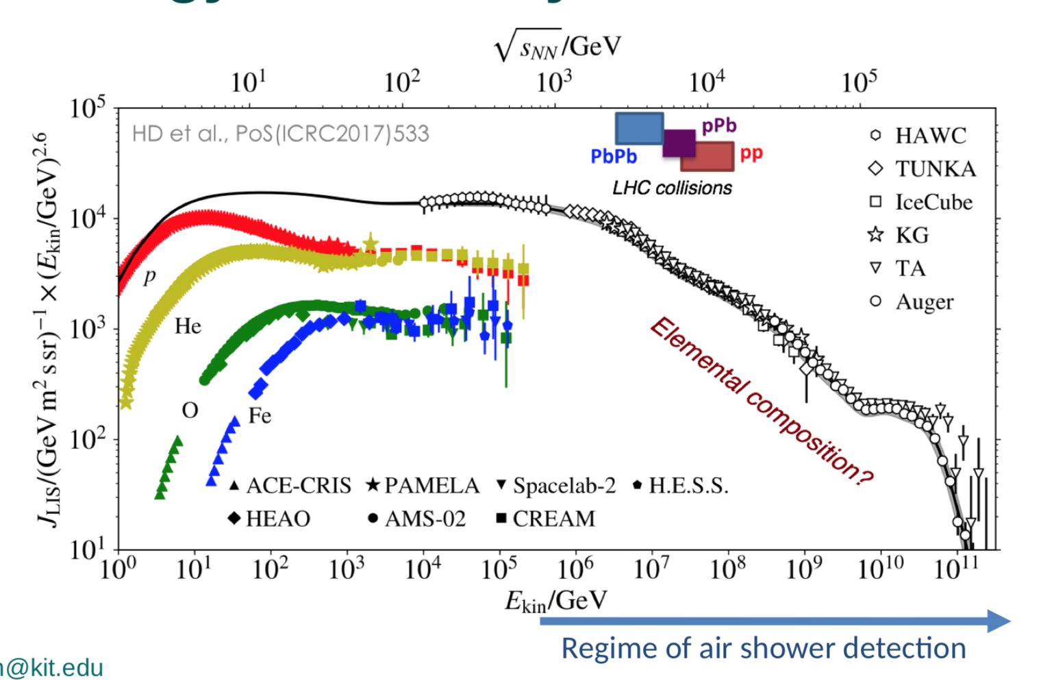
From Ralf Ulrich talk April 16+17 FMS Workshop : Cosmic ray spectrum x E^{2.6}
Highest √s (lab) very forward
charged π± & K± spectra
ISR at CERN
x 220 in √s = x 50,000 in E_{kin}
23/06/2020
Mike Albrow Forward Hadron Spectrometer
<number>

Slide 3
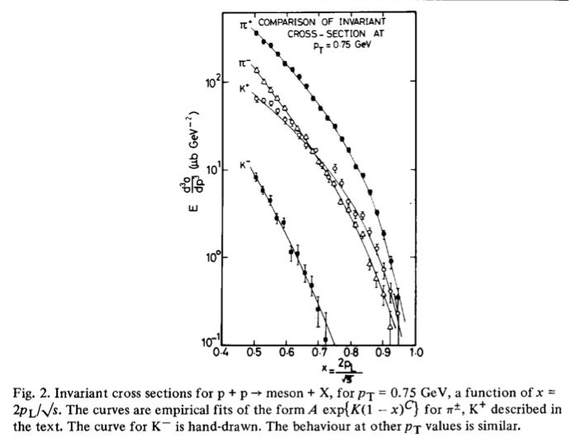
√s = 45 GeV,
CHLM (MGA inter alia) SAS @ ISR
Nucl. Phys. B 140 (1978) 189
√s = 45 GeV
Small transverse momenta
p_{T} = 0.35 – 1.4 GeV/c tables
42 years ago !
Valence quark counting:
π⁺ = u dbar. (2)
π⁻ = ubar d. (1)
K⁺ = u sbar. (1)
K⁻ = ubar s. (0)
Low mass diffraction dissociation
Eg. p → p π⁺ π⁻
Feynman scaling (1969):
Spectra fn(p_{T,} x_{F}) not √s
Non-interacting partons, not QCD
Ignores thresholds (c,b)
Feynman x_{F} = p_{z}/p_{BEAM}
(1 – inelasticity 𝜅)
23/06/2020
Mike Albrow Forward Multiparticle Spectrometer
<number>

Slide 4


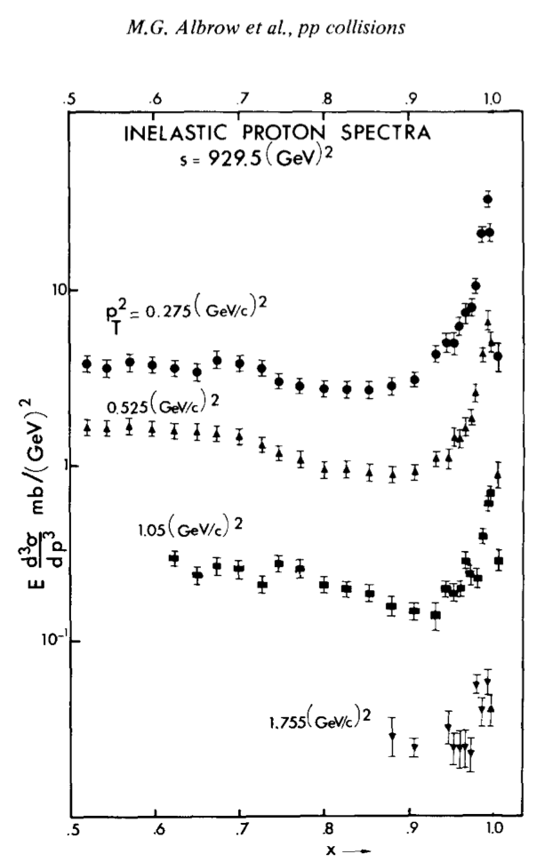
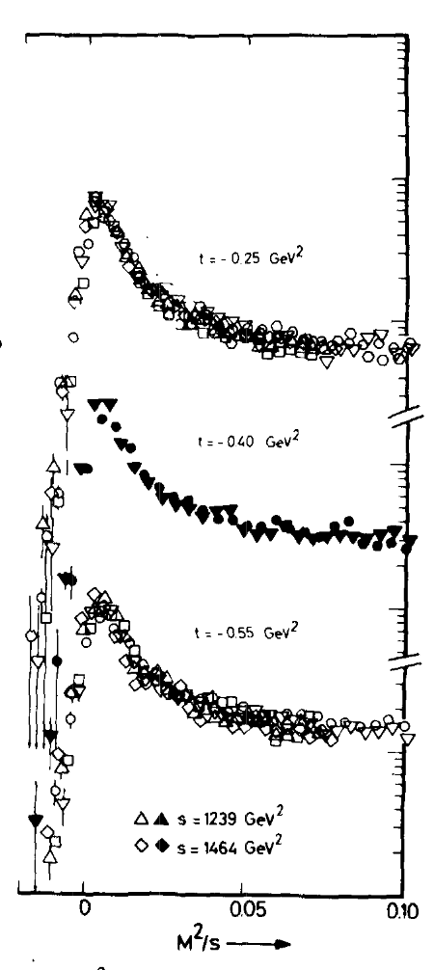
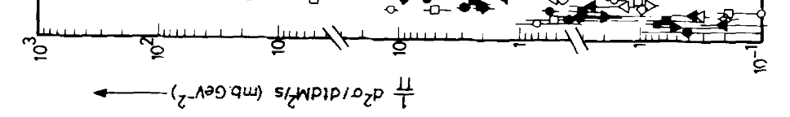
Discovery of scaling high-x_{F} peak:
High mass diffraction M_{max} ~ √s
M.G. Albrow et al.
NO DATA > ISR!
Some DATA
(ROMAN POTS)
Feynman x_{F} = p_{z}/p_{BEAM}
= 1 – 𝜅 (inelasticity)
= 1 – x_{F}
= Inelasticity 𝜅
23/06/2020
Mike Albrow Forward Hadron Spectrometer
<number>

Slide 5
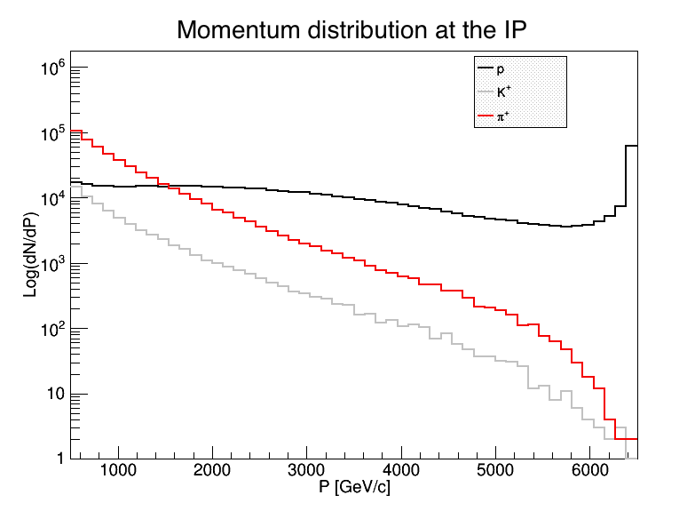
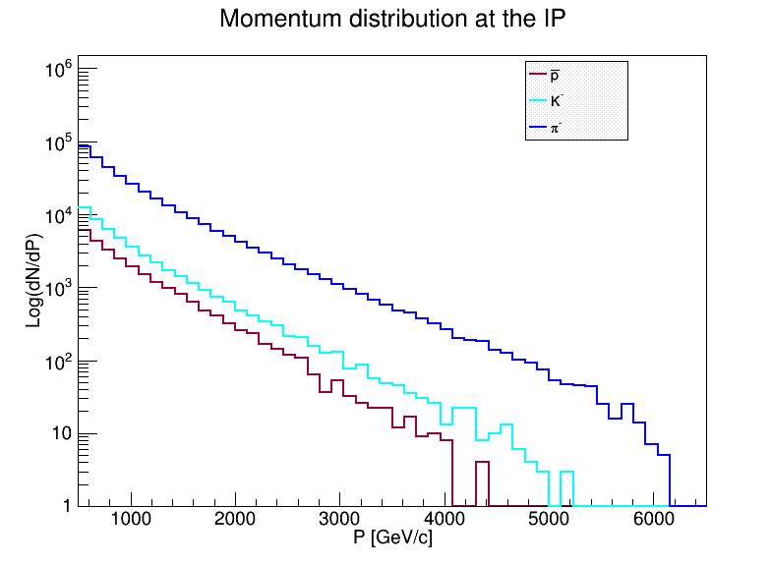
DPMJET prediction
Very uncertain! For illustration only
~ COVERAGE
Spectra generated by /DPMJET-MARS
With 10⁶ pp events, √s = 13 TeV
(N.Mokhov and O.Fornieri)
In 1 second, with 2808 bunches,
Have 30 x 10⁶ bunch crossings and
30 x 10⁶ interactions if μ = 1
Notes:
At 0.5 TeV (~ central)
π⁺ = π⁻ & K⁺ ≅ K⁻ & K/π ~ 10%
p’s > π⁺ above 1.5 TeV and flattish;
High x_{F} peak from diffraction
K⁻(s-ubar) steeper than K⁺ (u-sbar)
π⁻ (d-ubar) steeper than π⁺ (u-dbar)
Antiprotons, anti-deuterons/tritons/He³
can be measured too
p
Number per 125 GeV/c bin
π+
~ 100/bin/sec
All p_{T}, μ = 1
K+
~ COVERAGE
Number per 125 GeV/c bin
π-
~ 100/bin/sec
All p_{T}, μ = 1
p-bar
K-
Protons not = neutrons, π± not = π⁰, K⁰ not = K ±
23/06/2020
Mike Albrow Forward Hadron Spectrometer
<number>

Slide 6
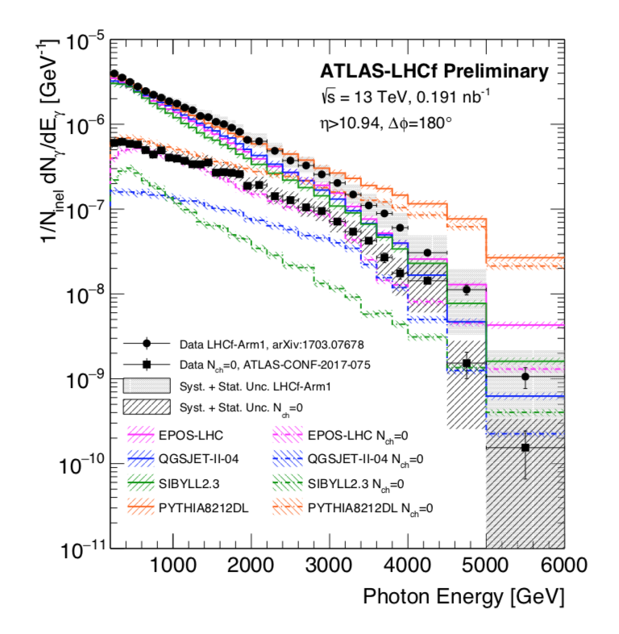
X 40
Photons from π⁰
(also from η⁰)
Neutrons have similar spread
(& contaminated by K⁰)
ZDC in ATLAS&CMS – planning for Run 4
Must be smaller for Run 4
-include it for low-PU runs
23/06/2020
Mike Albrow Forward Multiparticle Spectrometer
<number>

Slide 7

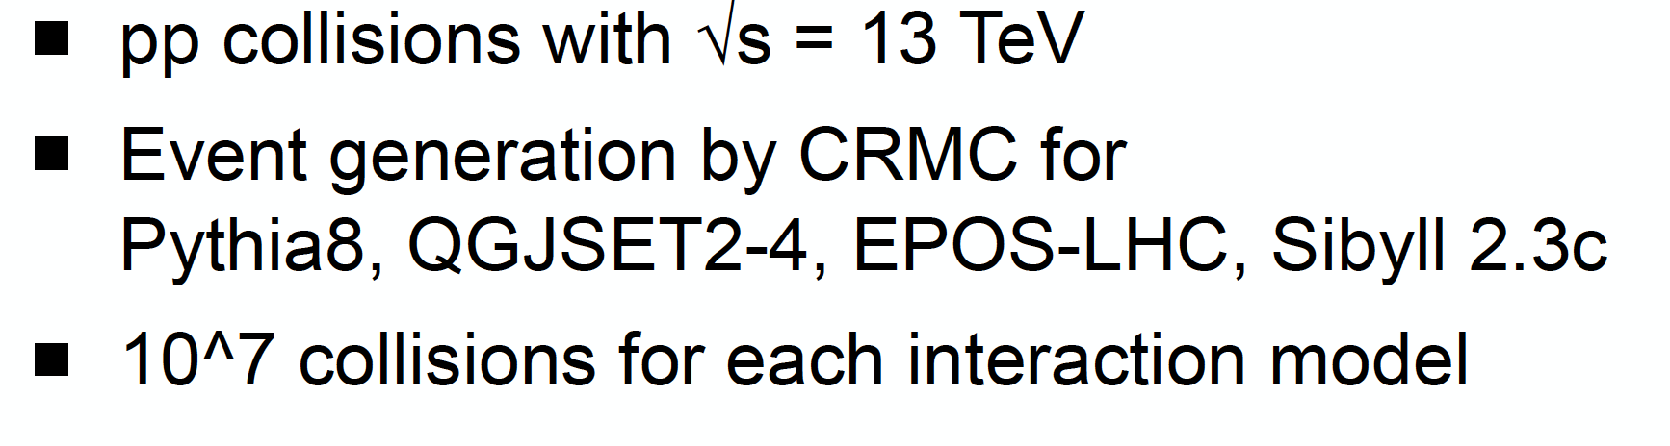
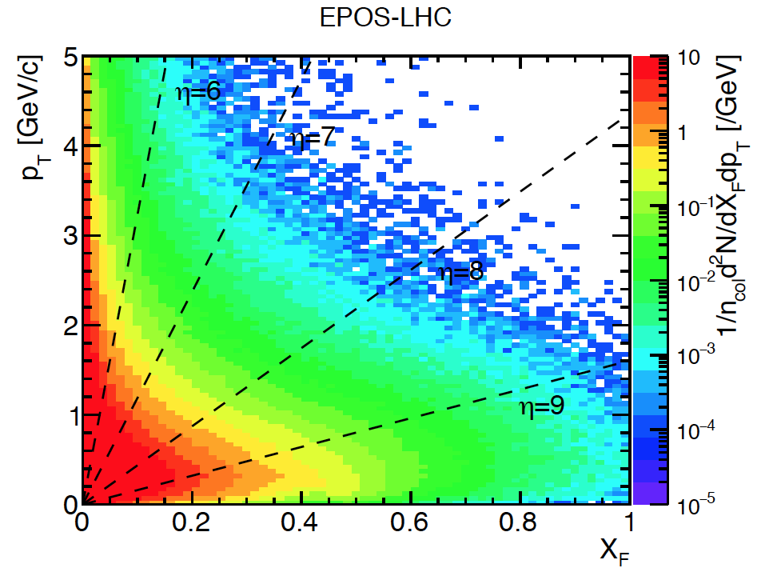
(Dec 5th 2019)
η = 4.5
η = 6
η = 8
Hans Dembinsky’s talk
η = 4.5 (LHCb charm)
is θ =1.3º
x_{F} = 0.033 @ p_{T}=5 GeV/c
is not “very forward”
η = 7
1.4 TeV
Feyman x_{F} = p_{z}/p_{BEAM}
Density of charged pions in p_{T}, x_{F}. Most have p_{T} < 1 GeV/c and |η| > 7 – unexplored region
TOTEM & PPS (p’s at x_{F} > 0.9) and ZDC & LHCf measure neutrals (n + K⁰_{L} , π⁰ →γγ) at θ ~ 0º
23/06/2020
Mike Albrow Forward Multiparticle Spectrometer
<number>

Slide 8
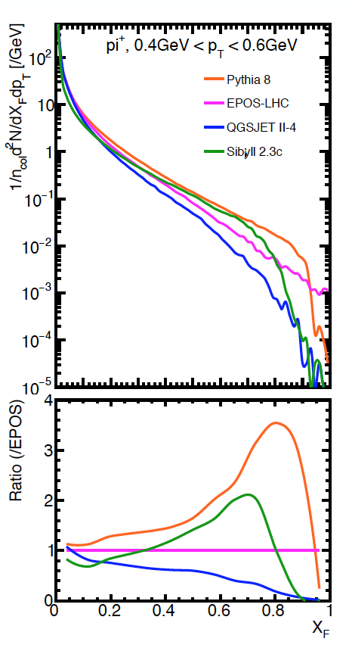
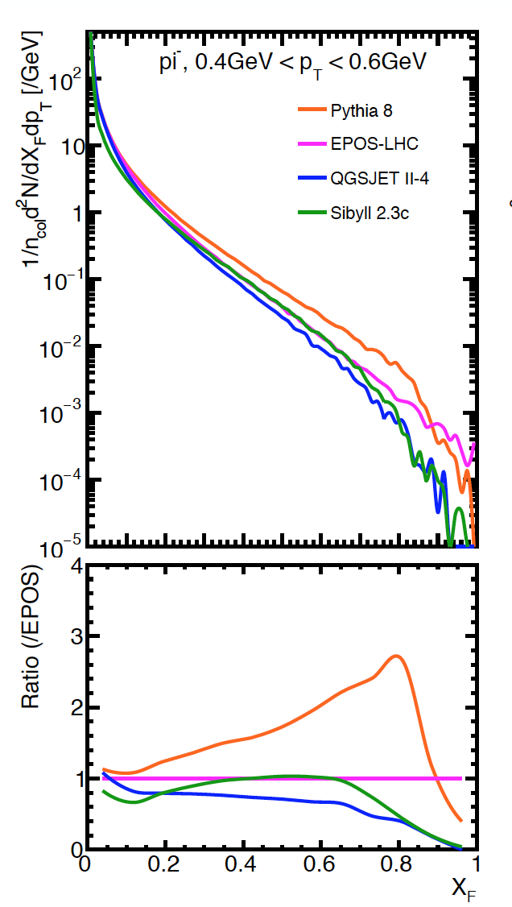
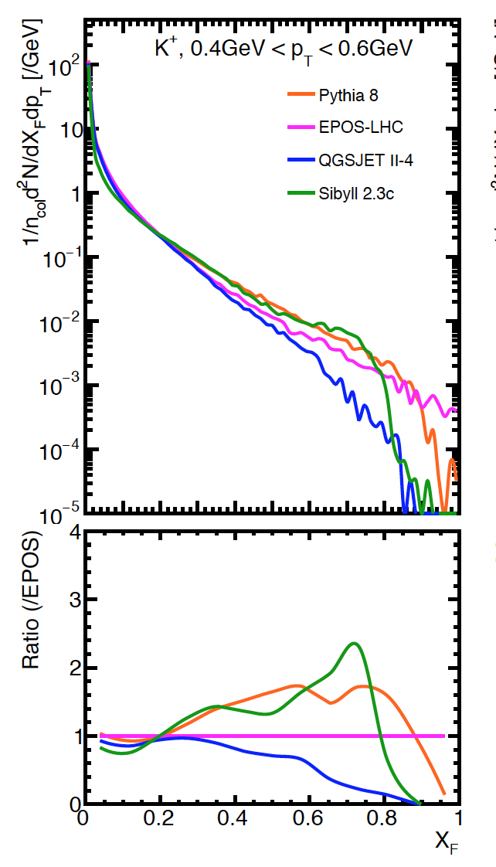
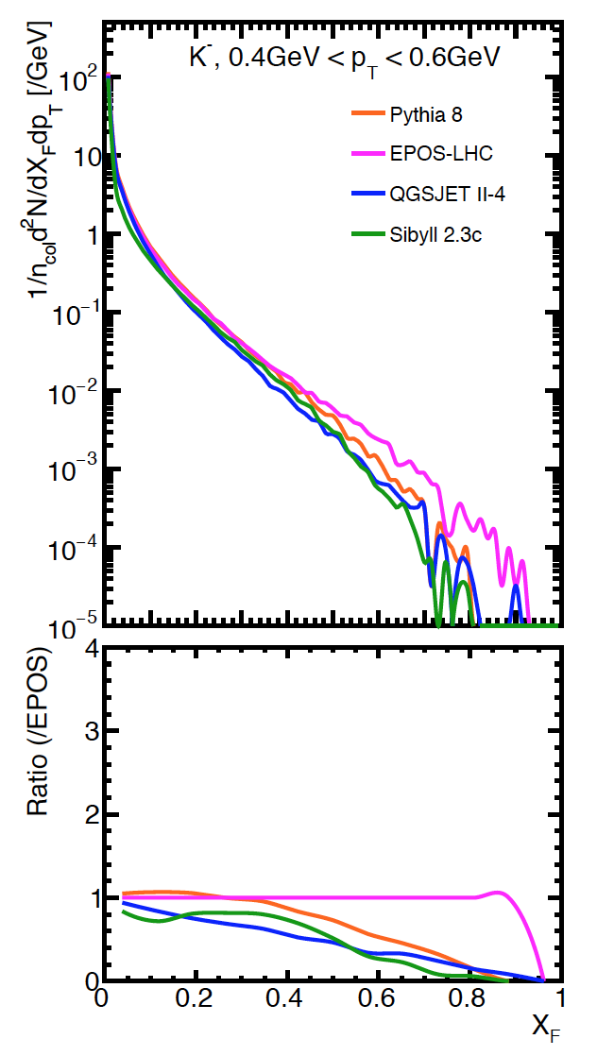
Comparison of Monte Carlo generators, 13 TeV Plots from Menjo Hiroaki
Low-p_{T} π± : PYTHIA ~ 50 x QGSJET II-4 at x_{F} ~ 0.8 – we can measure to x_{F} ~ 0.45
K⁺ and K⁻ (steeper, s-ubar so no valence quarks)
π⁺
π⁻
K⁺
K⁻
Feynman x_{F} = p_{z}/p_{BEAM}
High-x_{F} antiprotons very uncertain, antideuterons even more so!

Slide 9
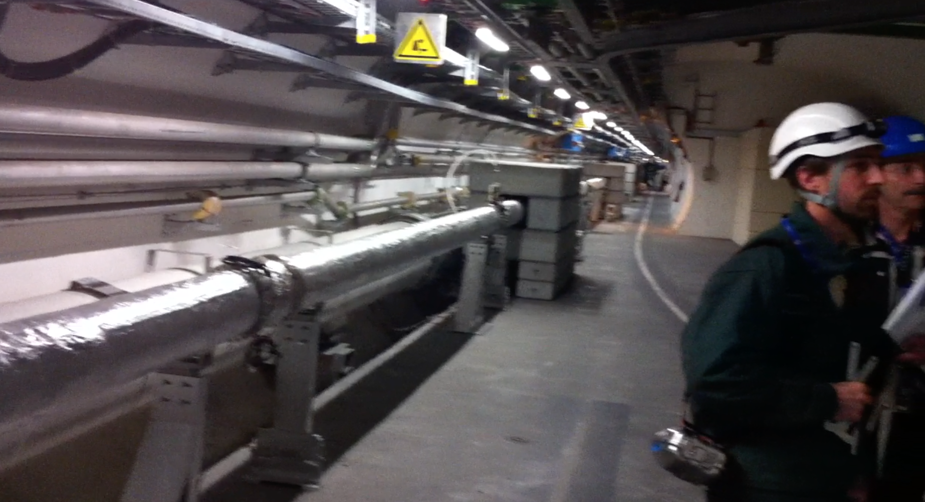
Looking along LHC tunnel, beam separation dipoles & CMS behind me.
20 cm diameter straight pipe with both beams for 50 m. (Cladding)
Make this pipe larger diameter: R = 40 cm (or more, TBD) and 20 – 30m long
OK with LHC (at least provisionally, L = 20m)
23/06/2020
Mike Albrow Forward Hadron Spectrometer
<number>

Slide 10
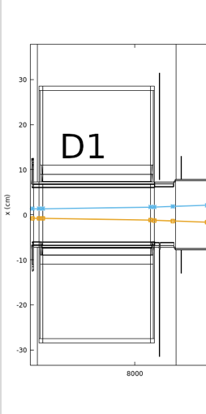
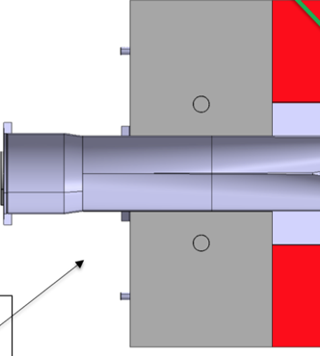
TOP (BENDING) VIEW
Big pipe radius R ~ 30 cm
Large pipe cross section R ~ 30 cm
and back window area 0.25 m²
Transition at z ~ 116m
Circular – thin w/ribs
FRONT VIEW
SCHEMATIC –
Pipe dimensions TBD
NEUTRALS
-ve
+ve
Outgoing beam pipe R ~ 10 cm
(Split inside TAXN)
NEUTRALS
10-12m
Vacuum path
FMS
20cm
~ 30 cm
10cm
-ve 2-3 TeV
K⁰_{s},K⁰_{L} Λ⁰
IP-5
+ve 2-3 TeV
FHS
FMS
TAXN
80m
116m
130m
23/06/2020
Mike Albrow Forward Multiparticle Spectrometer
<number>

Slide 11
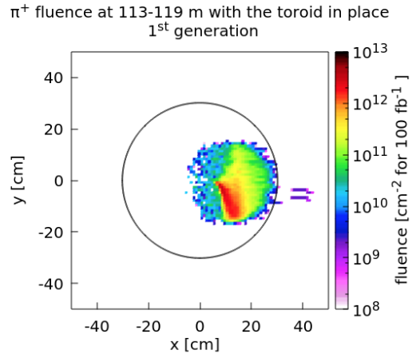
FLUKA: Run 4 configuration
HADRON spectroscopy in L&R quadrants
in low pile-up short runs (Mode A)
Marta Sabate-Gilarte
with Francesco Cerutti
100 fb⁻¹
POSITIVE particles (through D1 aperture)
NEGATIVE particles (through D1 aperture)
POSITIVE PARTICLES
NEGATIVE PARTICLES
CAN PROBABLY HAVE A PIPE with R = 40 cm (V. Baglin)
= OUTGOING BEAM PIPE → TAXN
> ~ 3 TeV charged particles inside
UP & DOWN quadrants swept clean
Neutrals through 35 – 50m steel magnets
LLP search regions
<number>

Slide 12
FMS – Charged L&R arms - OVERVIEW
Very forward charged particle production at LHC – how to measure
Use new superconducting D1 dipole (Integral B.dL = 35 Tm) as a spectrometer magnet.
Downstream of IR 5 as extension of CMS in Run 4 (2027+)
Straight section in vacuum from ~ 82 m to 127 m.
Make larger beam pipe R = 40 cm (R = 7 cm – 12.5 cm planned now)
for charged particles to emerge through thin windows: + & - sides - Low pile-up only
Detectors over 10 – 12 m in front of TAXN at 127 m:
Precision tracking (silicon strips or pixels) over ~ 2 m (θ_{x}, θ_{y} to a few μrad)
[Possible targets + tracking to study multi-TeV π, K, p, p interactions]. --- bonus!
Imaging Hadron Calorimeter for energy and time measurement and muon filter
Muon tracking behind calorimeter (and behind D1)
Transition Radiation Detectors for γ = E/m in 10³ – 2. 10⁴ region (novel)
As developed for CMS at HL-LHC
Being developed by Romaniouk Gp (mainly ATLAS)
23/06/2020
Mike Albrow Forward Multiparticle Spectrometer
<number>

Slide 13
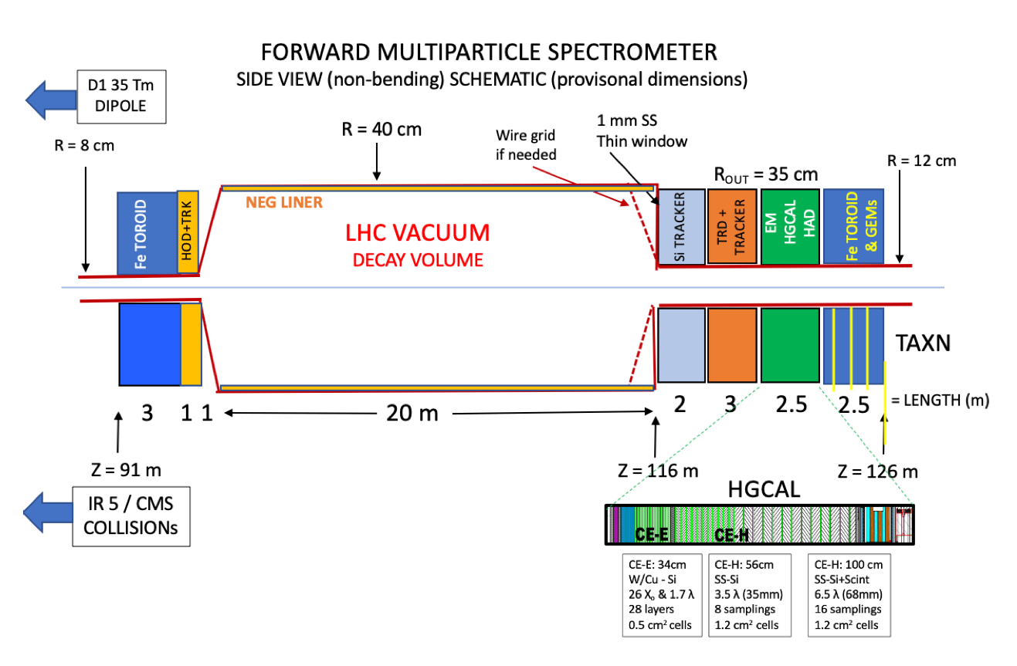
23/06/2020
Mike Albrow Forward Hadron Spectrometer
<number>

Slide 14
PHYSICS GOALS for L&R Charged particles (not complete!)
deuterons, tritons
Precise measurements of Feynman-x (x_{F}) spectra at small p_{T} (< ~2 GeV) of:
π+, π-, K+, K-, p, p, d, d, t, t, … possibly K⁰_{s} → π+π- , Λ⁰ → pπ (acceptance under study).
In p+p and p+O and O+O collisions (for cosmic ray showers in atmosphere)
LHC plans more Pb beams in Run 3, O-beams requested.
Intrinsic charm: p = {uud cc} giving leading D⁰ → K⁺π⁻ & K⁻π⁺
Full reconstruction challenging but also → forward muons
Other reconstruct-able particles: J/ѱ → μ⁺μ⁻ (6%) ; 𝛶(1S) → μ⁺μ⁻ (2.5%)
These are ‘intrinsically’ important + to understand μ and ν in cosmic ray showers.
Energy Frontier and Cosmic Frontier are two US-HEP P5 priorities!
Production of light nuclei and antinuclei – antiprotons, antideuterons, antitritons, He³
Needed to understand background to Galactic Center 𝛾-ray excess (Dark Matter Annihilation?)
Low Q² frontier of QCD needs further understanding.
CAVEAT: Acceptance and Signal::Background for most 2-particle states still to be calculated
Diffraction dissociation – products, e.g. p → p (π+ π-), Λ⁰ K⁺
HELP NEEDED!
23/06/2020
Mike Albrow Forward Multiparticle Spectrometer
<number>

Slide 15
Tracking
Precision tracking immediately behind vacuum pipe window (Be?)
No field so straight tracks.
x, y, dx/dz, dy/dz at z σ(x,y) = 10 μm over 2m -> 5 μrad
Cf bend of 6.5 TeV proton ~ 1500 μrad
Projection of track back → momentum dp/p < ~ 0.5% if from primary vertex.
Can be matched with energy from calorimeter if hadron
Background from showers in upstream pipe etc. can be reduced or even eliminated.
Tracking measures |Q| also.
Θ = 0.3 B.L(Tm) / p (TeV/c)
[x₀,y₀,z₀, p_{x}, p_{y}, p_{z}] [x, y, θ_{x}, θ_{y}, E = p]
at collision at z (Q known)
Areas ~ 20cm x 20cm, Silicon pixels or strips possible.
Can make level-1 trigger on tracks f[p_{T}, x_{F}]
Following TRD may incorporate precision tracking
23/06/2020
Mike Albrow Forward Hadron Spectrometer
<number>

Slide 16
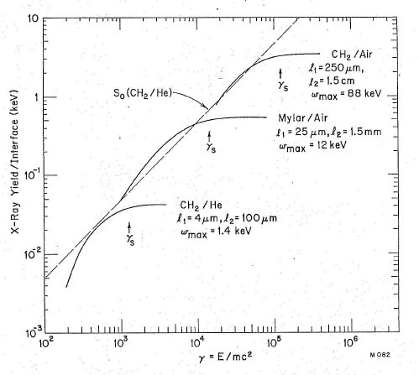
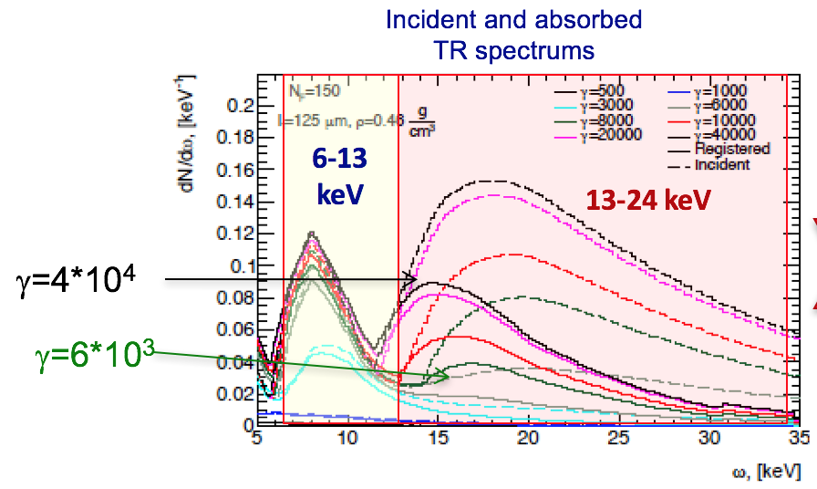
Transition Radiation Detectors - TRD
Anatoli Romaniouk, Mike Cherry et al.
Only known technique for distinguishing π / K / p at multi-TeV energies
Main technical challenge for FMS (hadron mode).
Interface between two materials different ε → X-ray emission ~ 1/137
Function of γ = E/m Know E = p from tracking and calorimeter, hence m.
Fastest hadrons in SAS ~ 4.5 TeV π; γ = 4500/0.14 ~ 3.2 10⁴
Slowest in FMS ~ 1 TeV p; γ = 1000/0.94 ~ 1.1 10³
Can “tune” design
for γ – range : higher γ longer
1 TeV p
4.5 TeV π
23/06/2020
Mike Albrow Forward Hadron Spectrometer
<number>

Slide 17
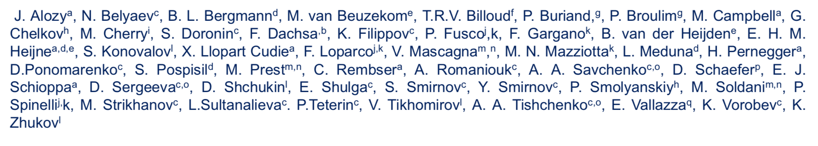
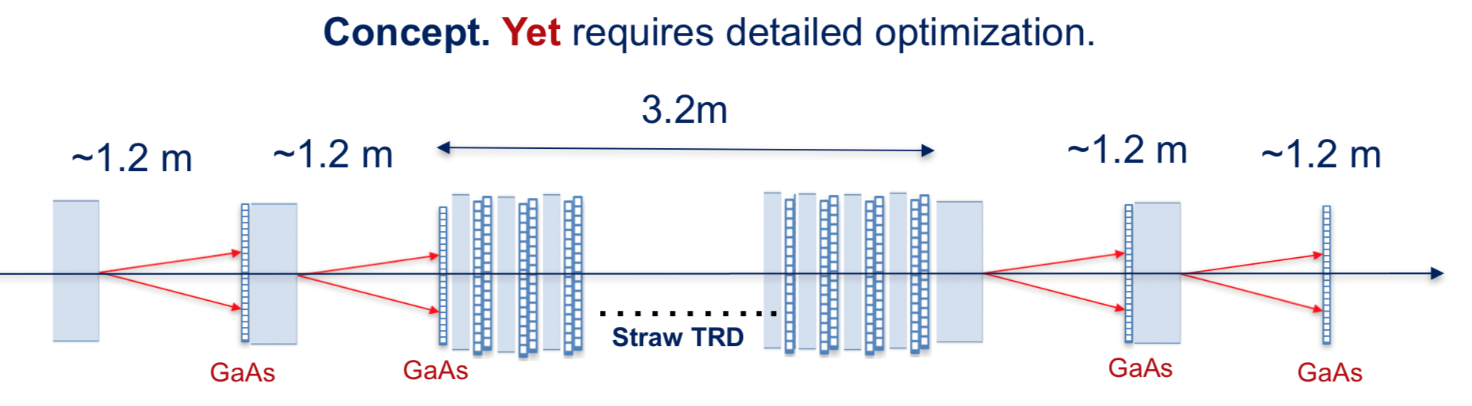
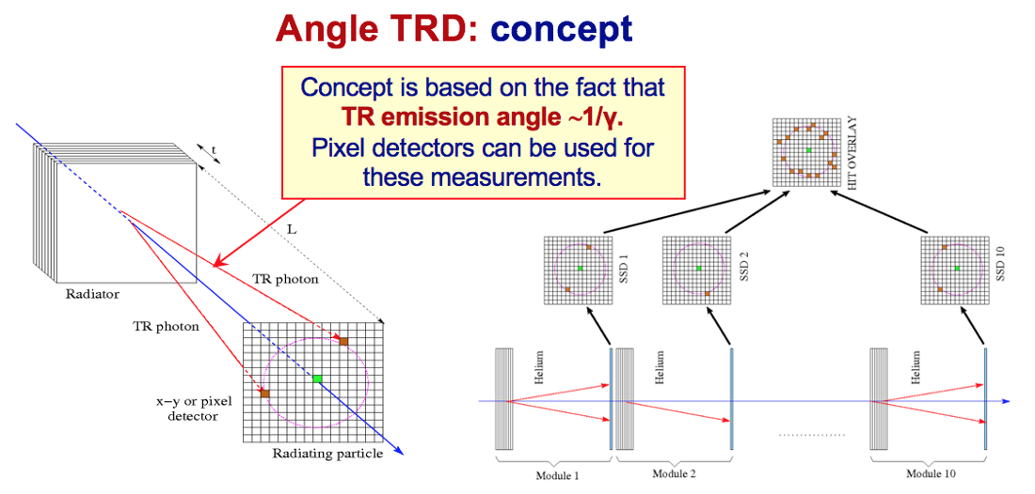
Transition Radiation Detectors : Only known way to identify multi-TeV π/K/p
Anatoli Romaniouk & team (mostly ATLAS):
Interesting develoments
Several years
Test beams & good simulations
Need a CMS team:
Mike Cherry et al.
Hope for NSF funding
Interested?
23/06/2020
Mike Albrow Forward Hadron Spectrometer
<number>

Slide 18
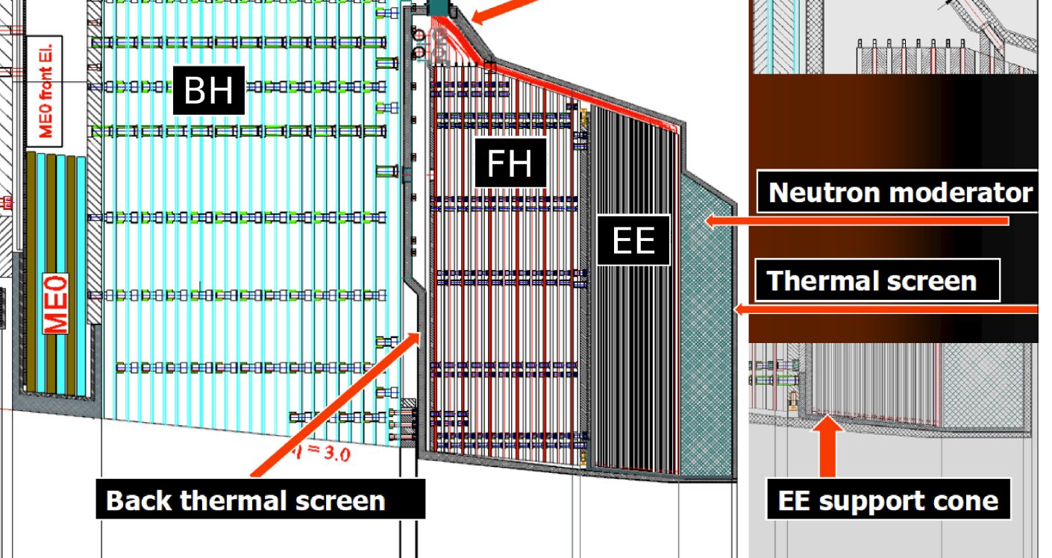
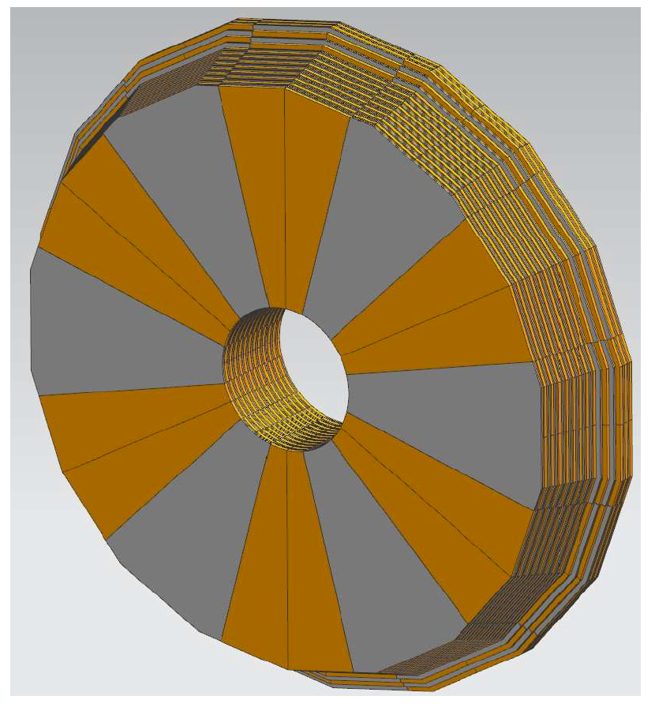
Copy depth arrangement
FHS < hole size
CALORIMETER (toroid for μ deflection)
FH. FMS
Imaging: readout with Si pads/cells ~ 1 cm²
R_{inn} ~ 40 cm. Cf FHS 12.5 cm
R_{out} ~ 180 cm. Cf. FHS 35-40 cm
Area ~ 10 m². Area ~ 0.3 m²
Time resolution on showers ~ 25 ps?
TO DO:
Layout a detector combination with Run 4 detectors as default and simulate / GEANT
23/06/2020
Mike Albrow Forward Hadron Spectrometer
<number>

Slide 19
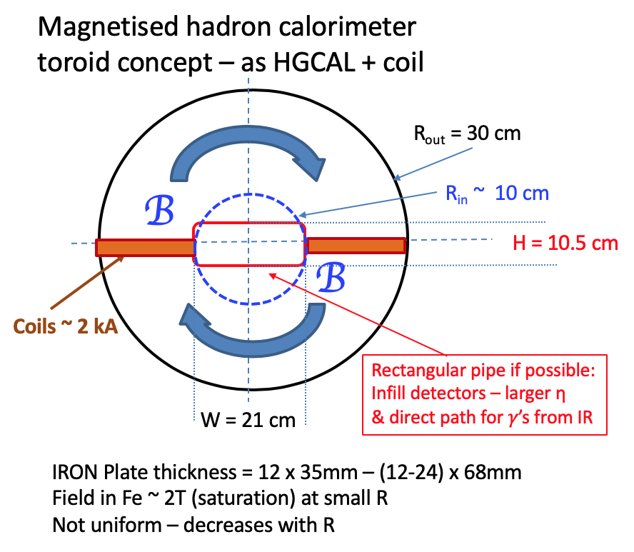
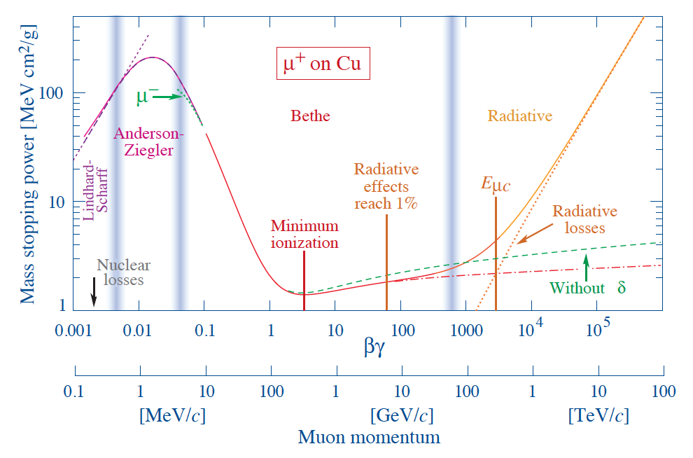
Vladimir Kashikhin, Fermilab
Total signal of μ-track through Calo
40 cm
12.5 cm
Drell-Yan pairs, photo-produced J/ψ, ψ(2S), Υ_{1,2,3} and γγ → μ⁺μ⁻ (especially in AA)
Acceptance??
Prompt muons from c, b decays. Note BR ( D⁰ → μ + X) = 6.7%
Several possible μ-tracking technologies: GEMs, CSCs
0.3 m² x 4 (?) layers
23/06/2020
Mike Albrow Forward Multiparticle Spectrometer
<number>

Slide 20
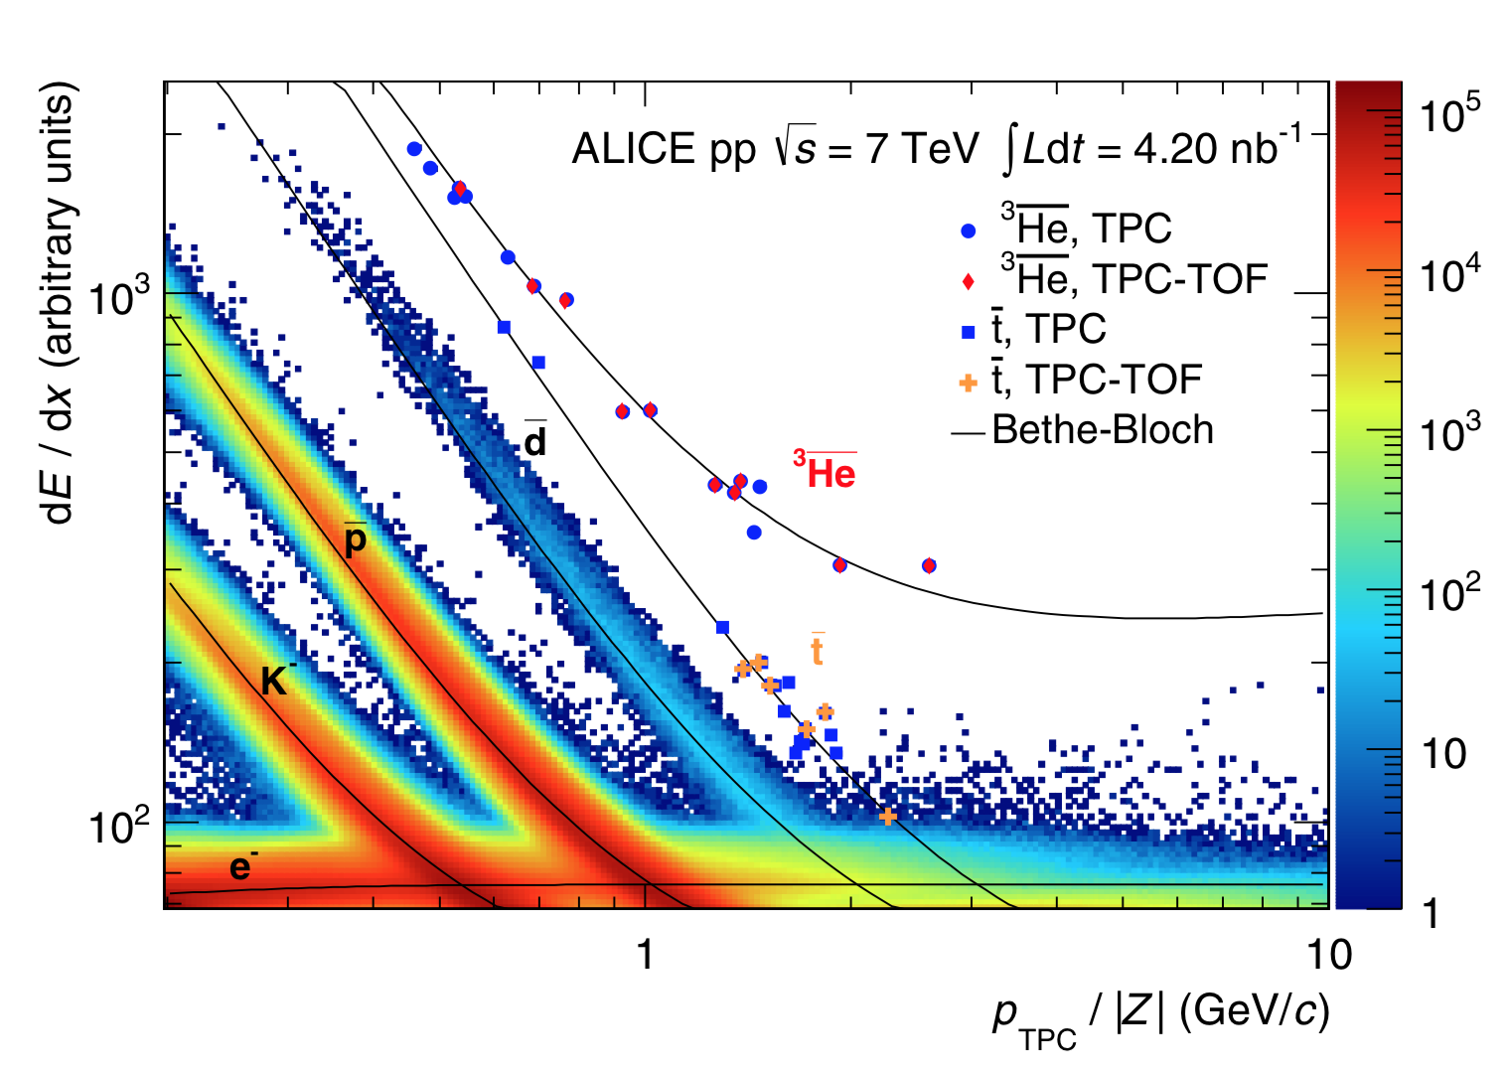
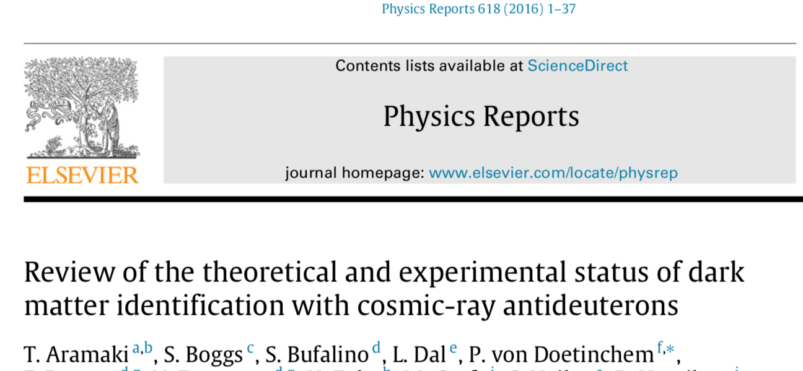
Forward production of antinuclei : antideuterons, anti-He?
At small angles at ISR (pp at √s = 63 GeV):
M.G.Albrow et al., Nucl.Phys.B 97 (1975) p.189 : dbar/π- = (7.6 ) 10⁻⁶
How produced in pp? Coalescence model. p + n close in phase space stick together.
Renewed interest for dark matter annihilations in galaxy center:
Need to know Standard Model production.
Very clean signature in SAS:
Negative curvature - > p/Q, dE/dx - > |Q|, Calorimeter - > E, TRD - > E/m
Anything novel? E.g. strangelets in heavy ion (pO and OO) fragmentation region?
(Light quasi-stable nuclei with s-quarks replacing d-quarks -unusual Q/M)
Trigger on Q >= 2 and/or
« heavier than protons »
& get high statistics even in a day!
CENTRAL
23/06/2020
Mike Albrow Forward Hadron Spectrometer
<number>

Slide 21
Inelastic (& elastic?) cross sections of 1 – 3 TeV π±, K±, etc.
ANOTHER POTENTIAL USE OF FHS (Special run but ~ hours of beam at low luminosity)
{Jan Ebr talk yesterday on MOCHI}
Behind TRD-Tracker have multi-TeV identified π±, K± , p, pbar, d, …
Put in front of calorimeter thin targets followed by short tracker:
TRD
CALORIMETER
π±, K±
Known momenta 1 - 3 TeV
Si-pixel trackers
Thin TARGETs (foils)
CH₄, C - & subtract for p
Space needed?
Move calorimeter out of way?
Remote UP & DOWN motion anyway
Very simple addition:
→ 𝜎_{inel}, N_{ch}, dN_{ch}/dη, 𝜎_{el}
Si-pixel tracker, cells ~ 20 μm spaced 1m
Resolve ~ 40 μm, θ = 4.10⁻⁵ == 40 MeV p_{T}/1 TeV p_{z}
23/06/2020
Mike Albrow Forward Hadron Spectrometer
<number>

Slide 22
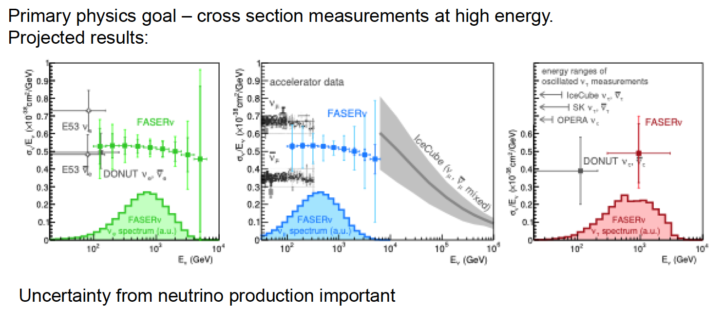
Forward meson spectra at LHC important important for much other physics
E.g. FASER ν Felix Kling’s talk
Jamie Boyd CERN Detector Seminar 17/4/2020
FASER ν : fluxes of TeV neutrinos from π± and K± and charm very uncertain – factors > 10!
FMS can measure π± and K± spectra 1 – 3 TeV ~ % level (? Systematics limited)
and D⁰ ( 13% → ν + X) 4 – 6 TeV – how well? In ~ 50 hours? Study needed.
23/06/2020
Mike Albrow Forward Hadron Spectrometer
<number>

Slide 23
FMS as a Multi-particle Spectrometer
Acceptance for 2 or more particles from same event. (If pile-up, timing can help)
Positive and negative particles on R & L sides of pipe, near horizontal plane.
Details will need to be calculated for real design of system – and backgrounds
Potentially:
J/ψ, ψ(2S) → μ+μ-, χ_{c} → J/ψ + γ, Drell-Yan μ+μ-
K⁰_{s} → π⁺π⁻, Λ → p π. P* → n π+ ?
D⁰ → K⁺π⁻ … χ_{c} → π⁺π, K⁺K⁻, etc.
Λ_{c} → pKπ ??
Have some acceptance (x_{F} higher)
Issue is S:B
Very forward charm and beauty also inferred from single leading e or μ
Leptons can be identified : Track + EM calorimeter & muon chambers behind HCAL
Muons from π, K decay will be known, and their decay lengths are very long!
γcτ (π) = 139 km at 2.5 TeV ! But abundant and - > forward HE μ-neutrinos! (FASERν)
γcτ (K+) = 18.5 km at 2.5 TeV !
γcτ (D⁰) = 16.5 cm at 2.5 TeV !
23/06/2020
Mike Albrow Forward Hadron Spectrometer
<number>

Slide 24
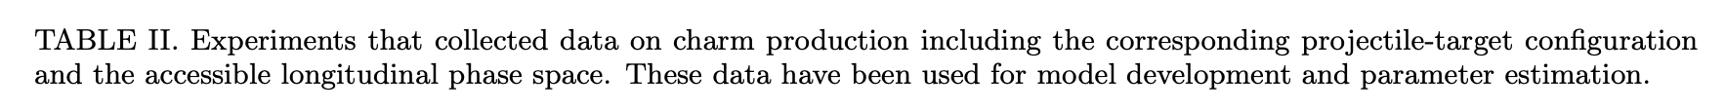
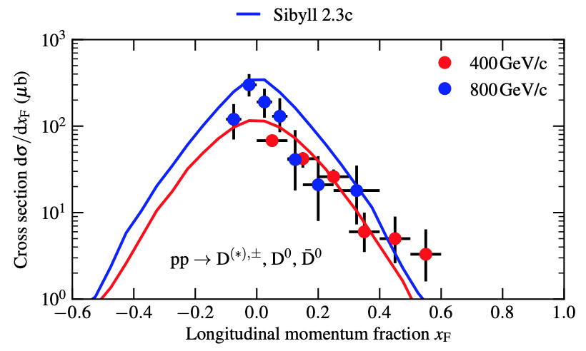
A. Fedynitch, F. Riehn, R. Engel, T.K.Gaisser and T. Stanev, arXiv:1806.04140
All central region
Maximum x_{F} = 0.1 by LHCb, only at high p_{T}
because 2.0 < y < 4.5 (central)

Slide 25
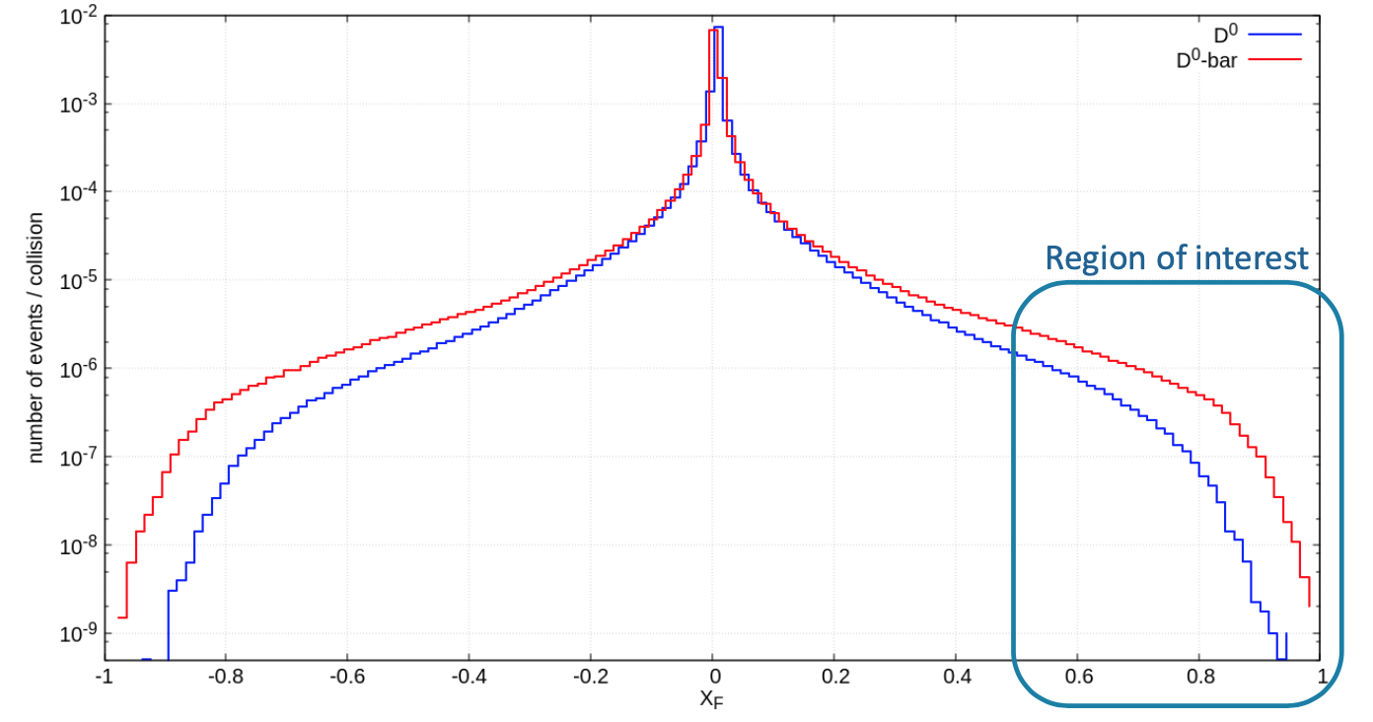
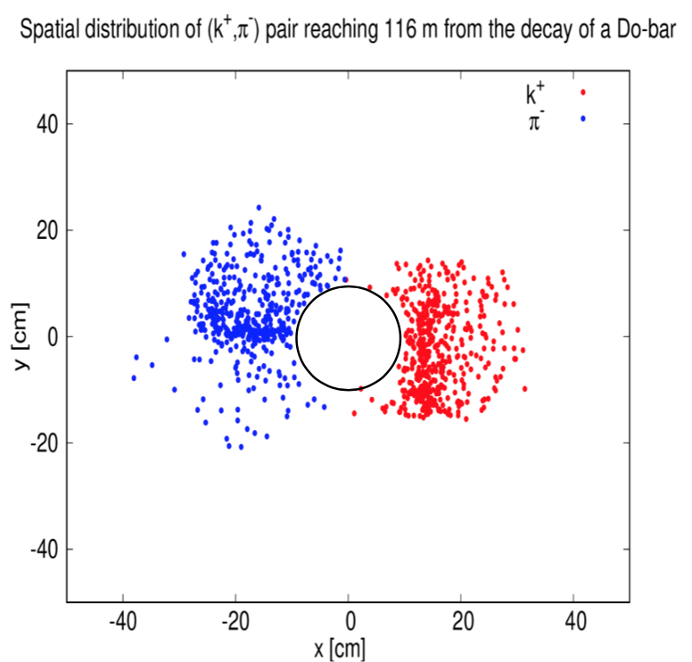
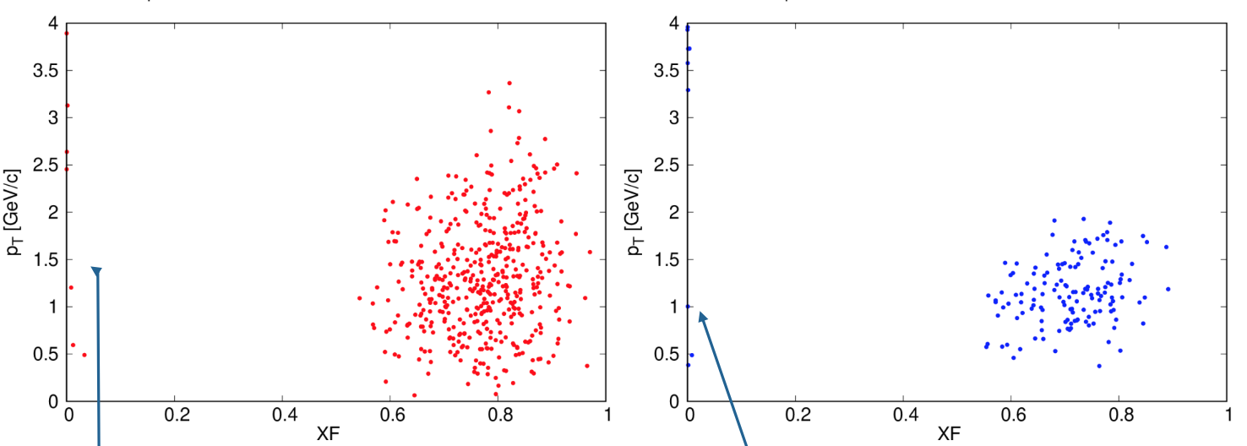
Marta Sabate Gilarte,
And Francesco Cerutti - CERN
Leading charm: D⁰ at high x_{F}, D⁰/D⁰bar → K± π∓
Unique and interesting (intrinsic charm, cosmic ray showers - leptons and neutrinos etc.)
=
FLUKA predictions, p+p at 14 TeV
At z = 116m
u-cbar
c-ubar
-
D⁰
D⁰
Driver of performance for
Tracking precision and PID
In hadron low-lumi mode
23/06/2020
P_{z} (K±, π∓) = 1 – 4 TeV
Mike Albrow Forward Multiparticle Spectrometer
<number>

Slide 26
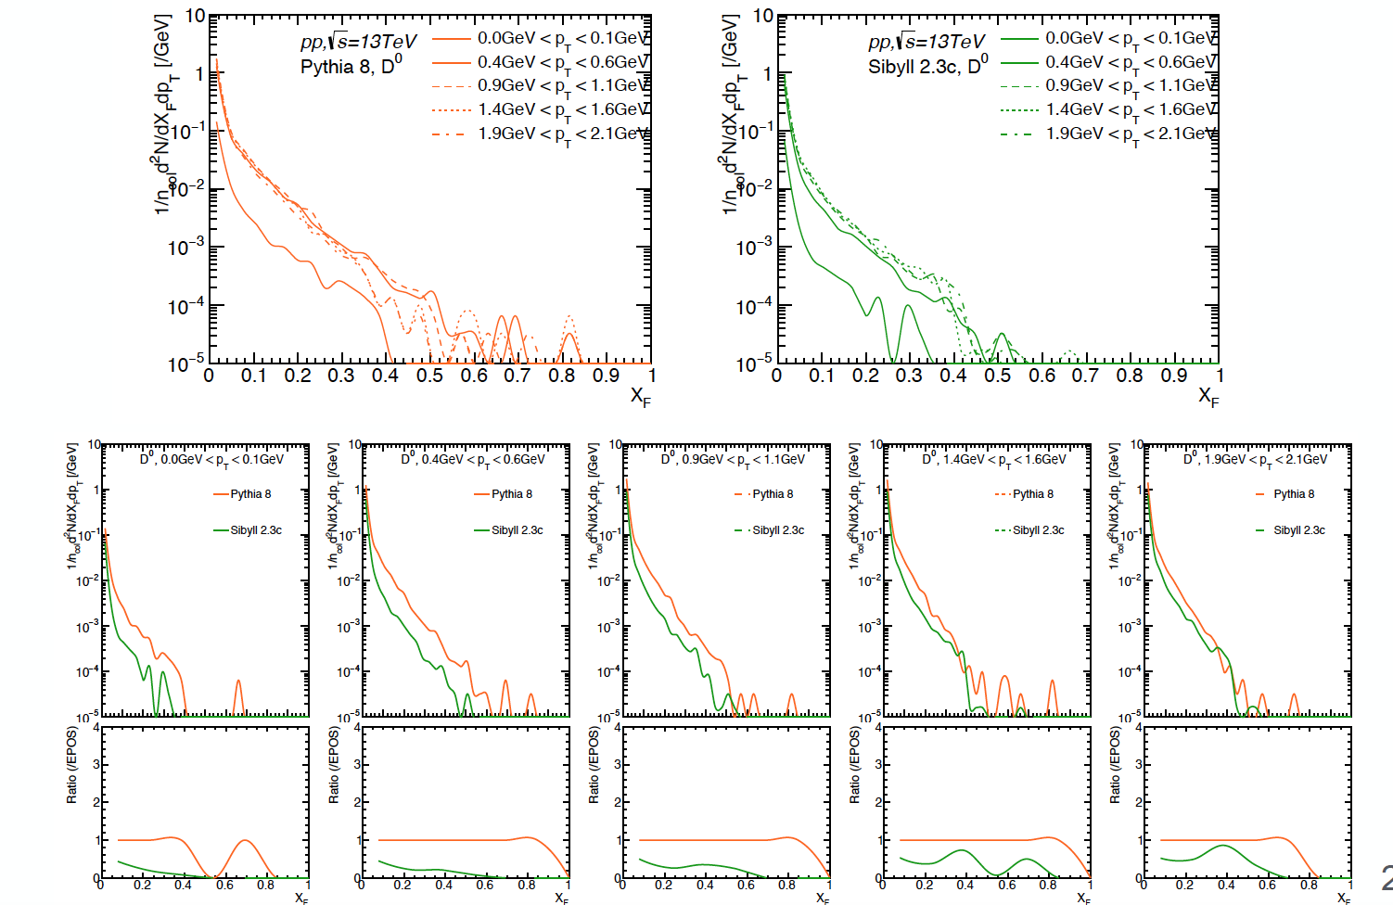
Very forward charm: D⁰. PYTHIA & SIBYLL predictions – Menjo Hiroaki
Charm from g + g → c + cbar all at low-x_{F}.
Intrinsic charm {uudcc] – Fock state (Brodsky) not included. → Leading D⁰, Λ_{c}⁺
23/06/2020
Mike Albrow Forward Hadron Spectrometer
<number>

Slide 27
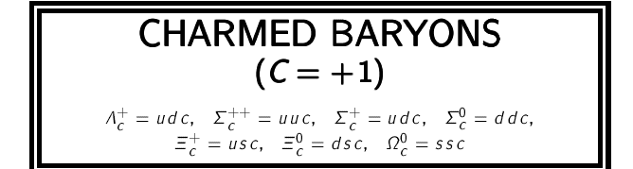
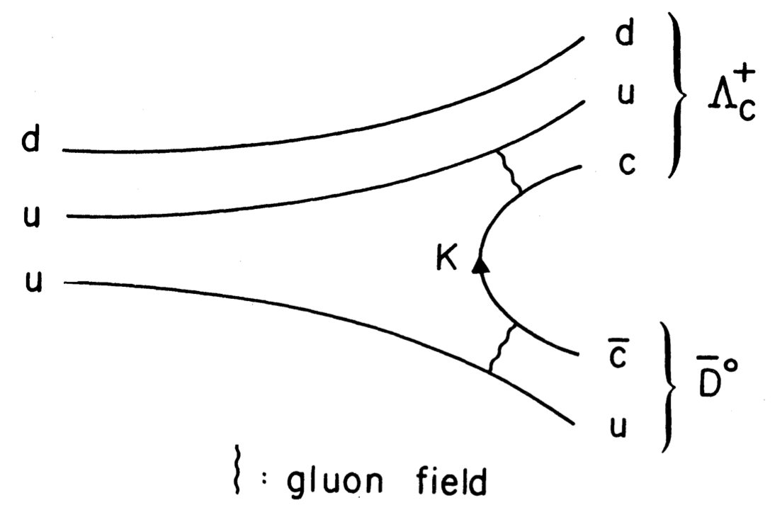
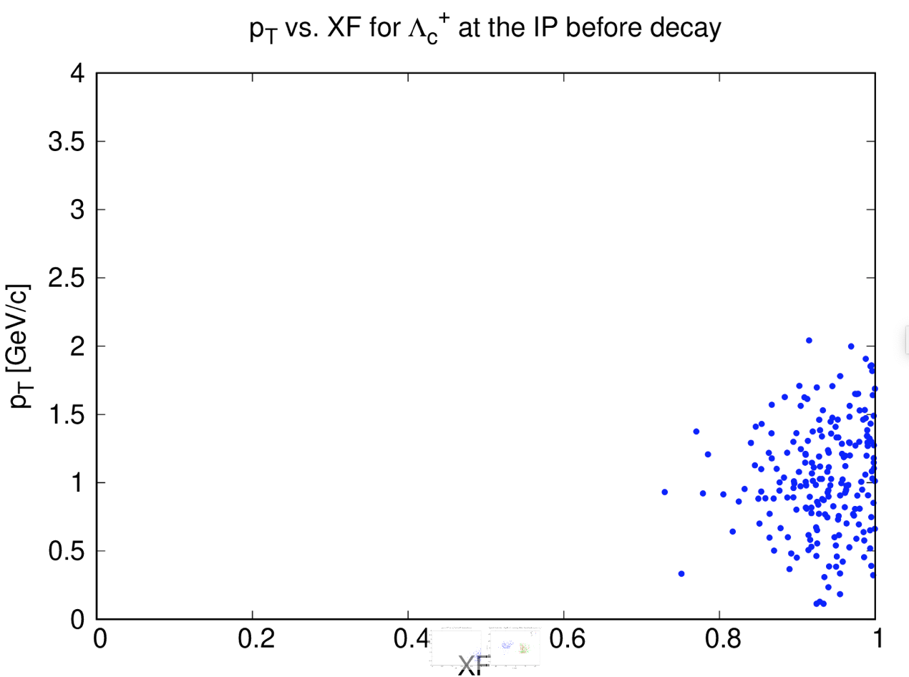
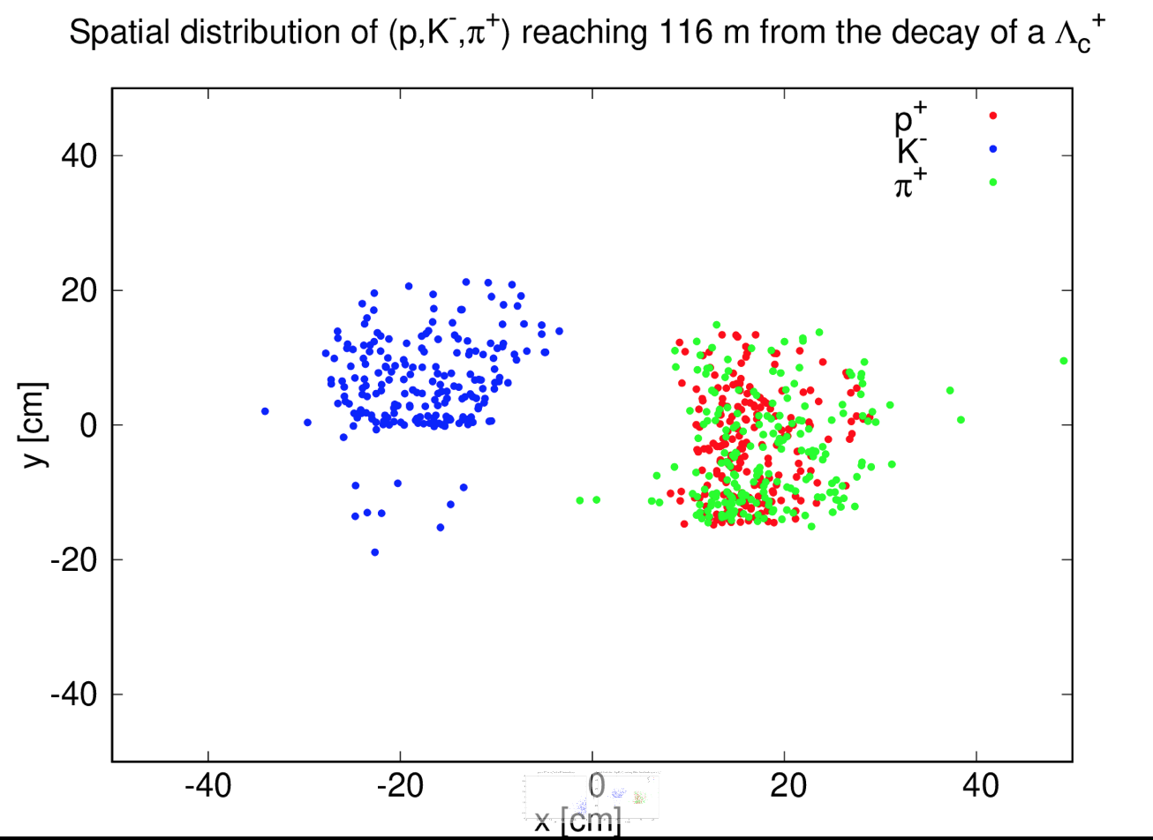
Diffractive production
Λ_{c}⁺ : M = (2286.46 ± 0.14) MeV. udu → udc
𝜏 = (203.5 ± 2) x 10⁻¹⁵ s. (c. 𝜏 = 60 μm)
BR → p K⁻ π⁺ = (6.23 ± 0.33)% about 1/3 as K*
BR → Λ π⁺ = (1.29 ± 0.07)% but c𝜏 (Λ) = 7.89cm X
Σ_{c}⁰ : M = (2453.75 ± 0.14) MeV, --> Λ_{c}⁺ π⁻ 100% but {ddc}

Slide 28
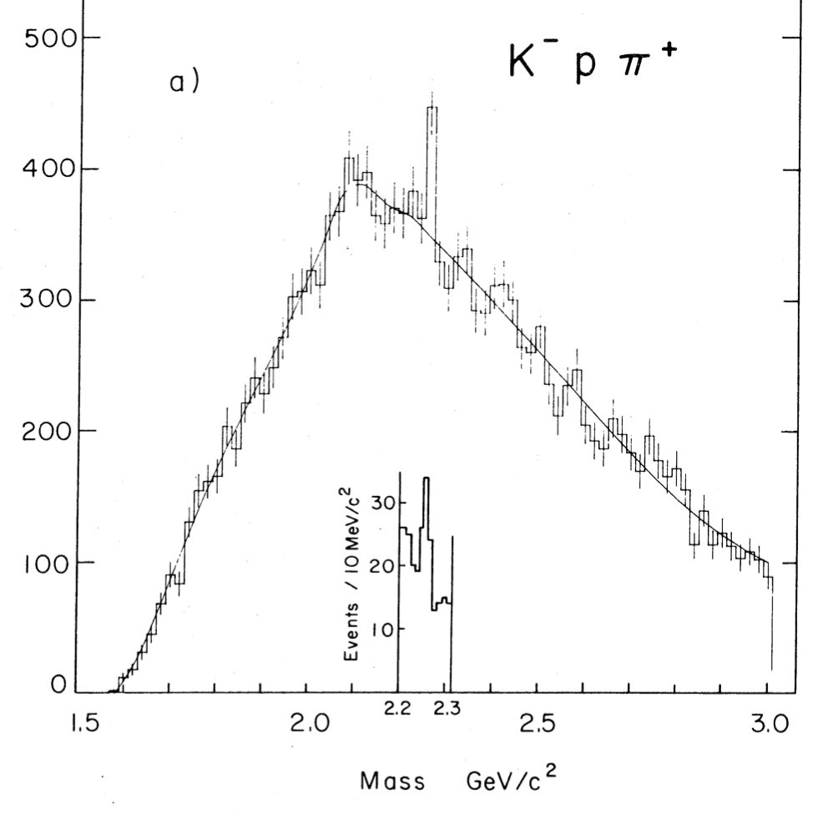
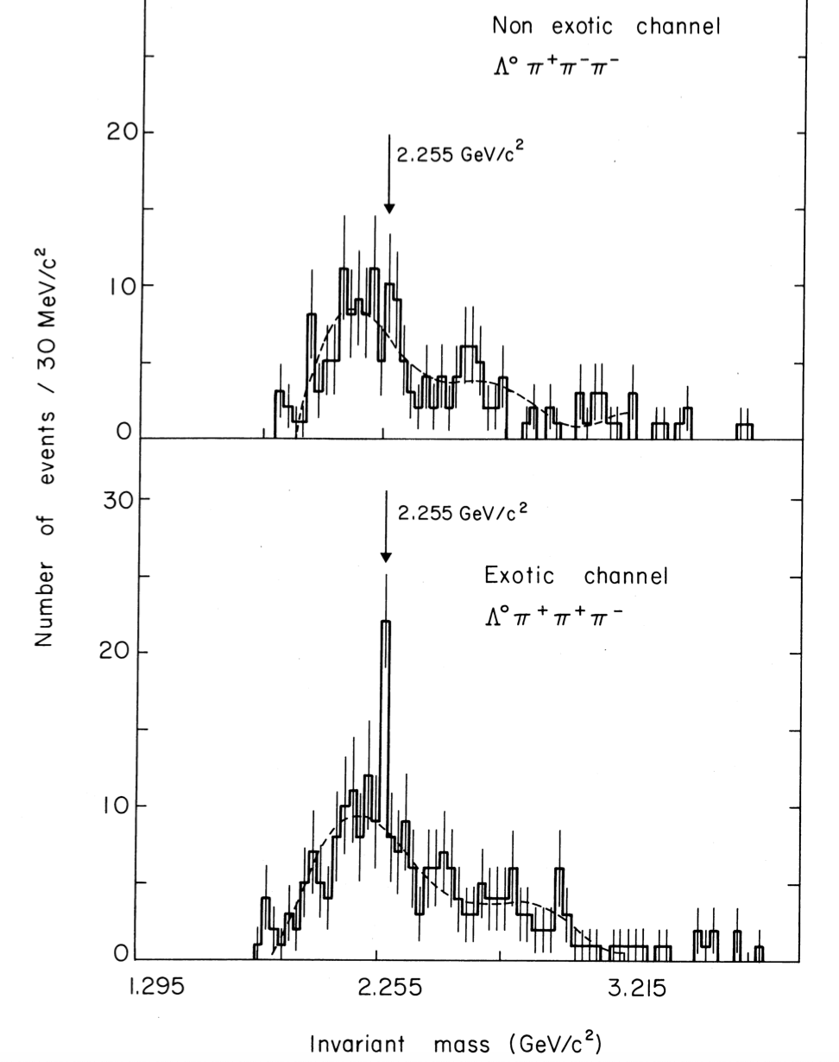
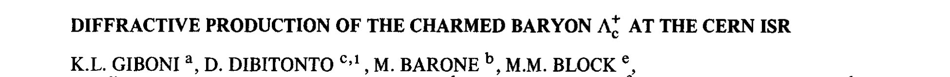
Physics Letters 85B (1979) p.437
1st obs this mode, 𝜎B = 0.7 – 1.8 μb → 𝜎 ~ 30 μb
First observation of charm in pp collider (ISR) – and only in forward direction (?)

Slide 29
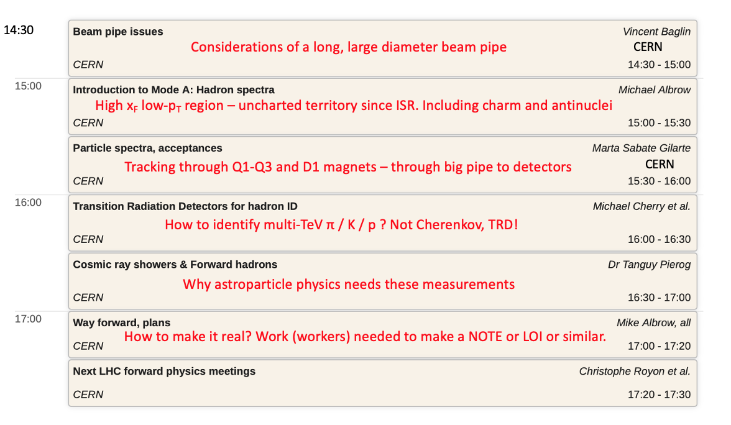
Two half-day meetings on Forward Multiparticle Spectrometer April 16+17 2020
Purpose: present and discuss ideas. Critique and distinguish possible and not possible
Plan next level of studies and especially who will contribute to a write-up / note /doc
===
Friday 17th: Mainly measurement of very forward hadrons in pp, pO, OO at low luminosity
https://indico.cern.ch/event/868473/
23/06/2020
Mike Albrow Forward Hadron Spectrometer
<number>

Slide 30
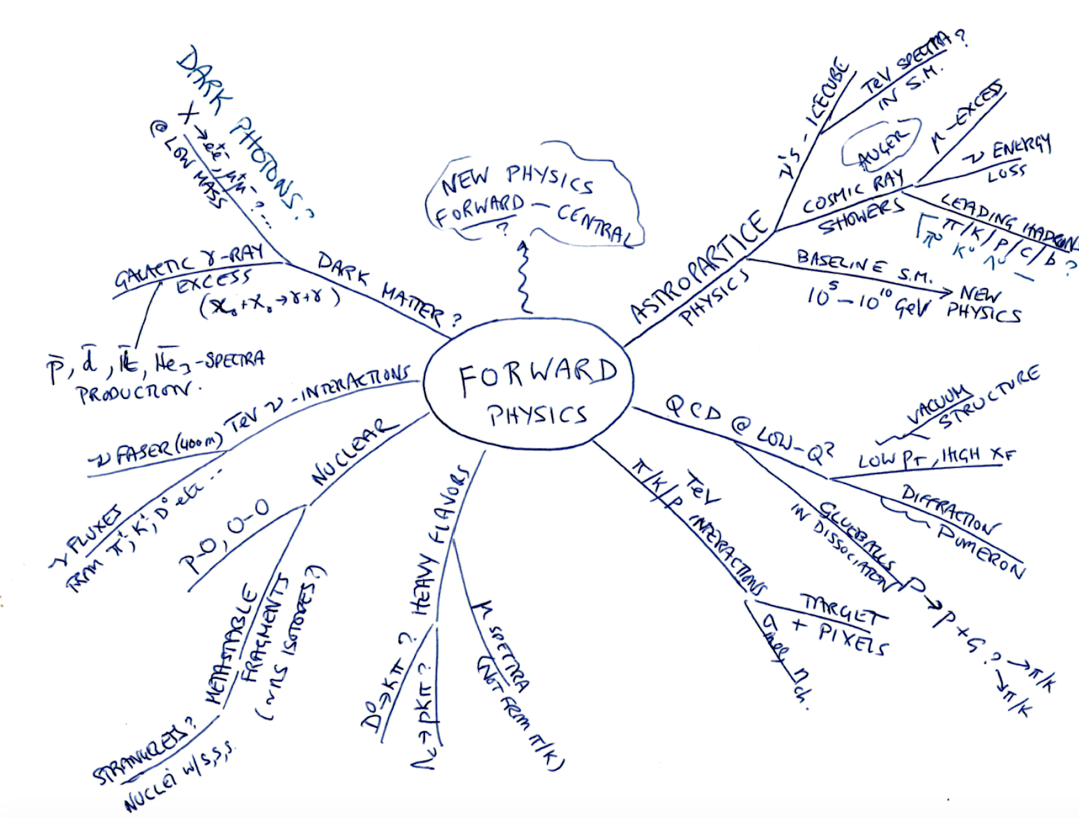
FMS at HL in LLP mode
CORSIKA etc.
Oliver Fischer’s talk
e.g. ANITA events?
Felix Kling’s talk
23/06/2020
Mike Albrow Forward Multiparticle Spectrometer
<number>

Slide 31
HL – LLP Decaying in vacuum search mode
Big pipe radius R = 40 cm
Large pipe cross section
and back window area.
Transition at z ~ 116m
SIDE VIEW
FRONT VIEW
SCHEMATIC –
Pipe dimensions TBD
NEUTRALS
-ve
o
x
+ve
Outgoing beam pipe
(Split inside TAXN)
Fe absorber toroid
VETO HODOSCOPE
NEUTRALS
10-12m
Short muon tracker
20cm
Fe absorber toroid
VETO HODOSCOPE
35-40 cm
FMS - UP
10cm
IP-5
FMS - DOWN
FHS
190-320 λ_{INT}
Absorber path
Fe absorber toroid
VETO HODOSCOPE
??
Short muon tracker
Z = 80m
Z = 116m
130m
23/06/2020
Mike Albrow Forward Multiparticle Spectrometer
<number>

Slide 32
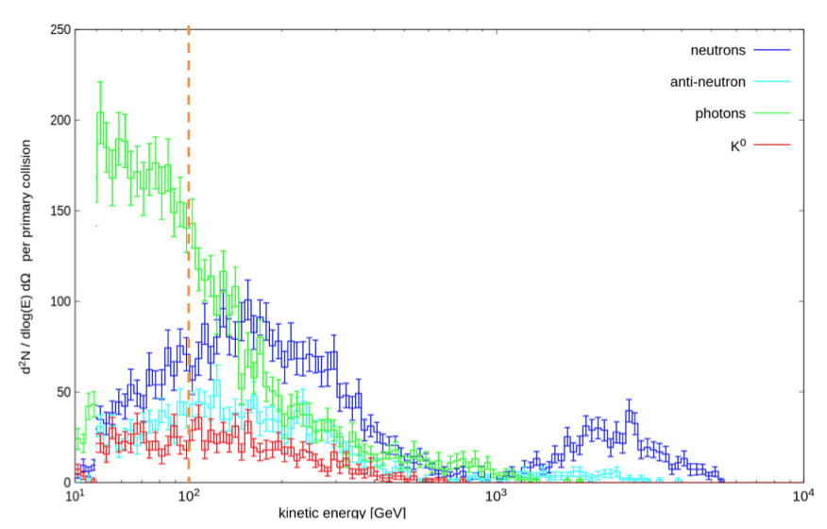
Search for highly penetrating (190-320 λ_{INT} ) neutral decaying in (20m.- 30m) vacuum to:
𝛾𝛾 (no tracks - or conversion - to high granularity EM calorimeter)
e⁺e⁻ if M(X) > 2 MeV (track pair and high granularity EM calorimeter)
e±μ∓ if M(X) > 108 MeV (Muon through calo & muon chambers) not from 𝜏⁺𝜏⁻
μ⁺μ⁻ if M(X) > 212 MeV (Muon pair through calo & muon chambers)
𝜏⁺𝜏⁻ if M(X) > 3600 MeV (e⁺e⁻ or μ⁺μ⁻ or e ± μ∓ or e/μ + hhh ?)
cc if M(X) > ~ 4000 MeV (== e⁺e⁻ charm factory event boosted to TeV!)
OR?? Not decaying but interacting in imaging calorimeter:
Shower direction, energy, depth of interactuon, timing (𝜎_{t} ~ 20-30 ps)!
M(X) = 5 (10) GeV with p = 100 GeV/c arrives at z – 120m 400ps (2 ns) later than n
FLUKA Simulations
(M. Sabate-Gilarte & F. Cerutti)
FLUKA: In 150 interactions/X (HL)
Neutrals exiting front toroid above 50 GeV/c:
0.6 𝛾 0.45 n 0.15 anti-n 0.12 K⁰
Above 200 GeV/c several times less
200 GeV/c
All need proper study: simulation
& realistic set-up and backgrounds.
INVITATION!
23/06/2020
Mike Albrow Forward Multiparticle Spectrometer
<number>

Slide 33


GOALs: Endorsement/Acceptance by CMS as new subsystem
→ Official studies by LHC on feasibility
→ Approval by LHCC
Invitation (all) to collaborate on write-up for main arXiv paper (by Fall)
Sections on impact for cosmic ray showers, LHC neutrinos etc.
Short arXiv note out today: hep-ex
Then for those on CMS (or who could join) – Expression of Interest
Discuss possible contributions etc.
Team to form (and leadership too – I am retired!)
Please contact me at albrow@fnal.gov
New paper:
23/06/2020
Mike Albrow Forward Hadron Spectrometer
<number>
Notes:
<number>

Slide 34
SUMMARY: Propose (EoI) Forward Multiparticle Spectrometer for CMS Run 4
Low PU charged mode : many valuable measurements in unexplored region
Important for understanding UHE Cosmic ray showers, muons, neutrinos
[High Lumi neutral mode: important discovery potential]
Many opportunities to participate towards an arXiv paper → CMS Expression of Interest
Assemble a possible configuration of Run 4 detectors as spectrometer elements,
and possible TRD detectors.
Integrate with full simulation of particles (as started by Marta & Francesco)
Calculate hadron (including c) production spectra in this region with suite of MCs
Trigger and correlations with central detector (low PU)
Infrastructure and engineering, etc.
Opportunity for participation and also leadership!
Rotate from
Imaginary axis
to Real axis
23/06/2020
Mike Albrow Forward Multiparticle Spectrometer
<number>

Slide 35
Thank you!
BACK UPS
23/06/2020
Mike Albrow Forward Hadron Spectrometer
<number>

Slide 36
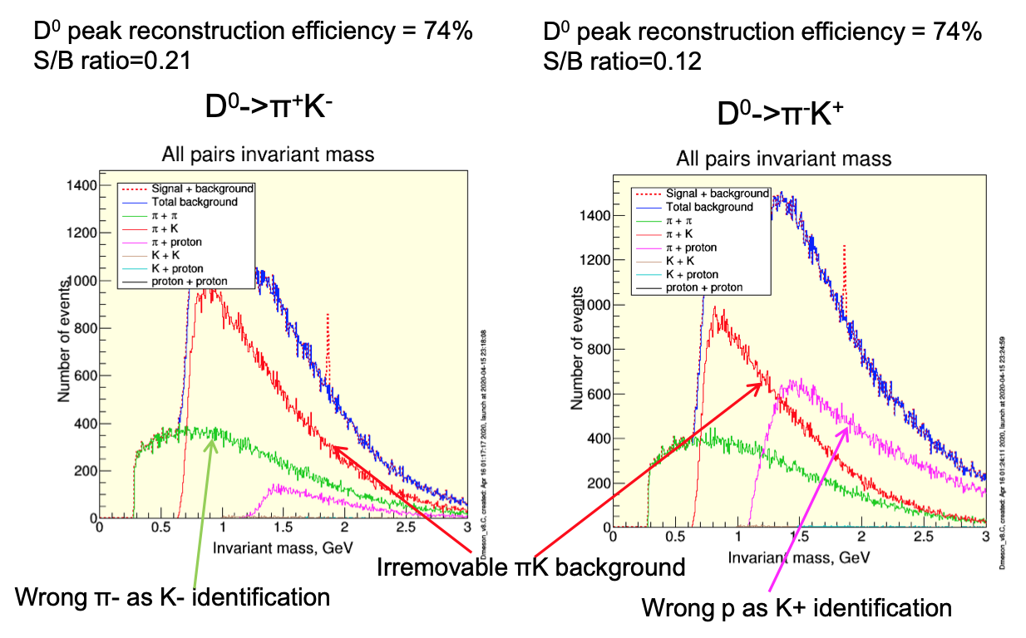
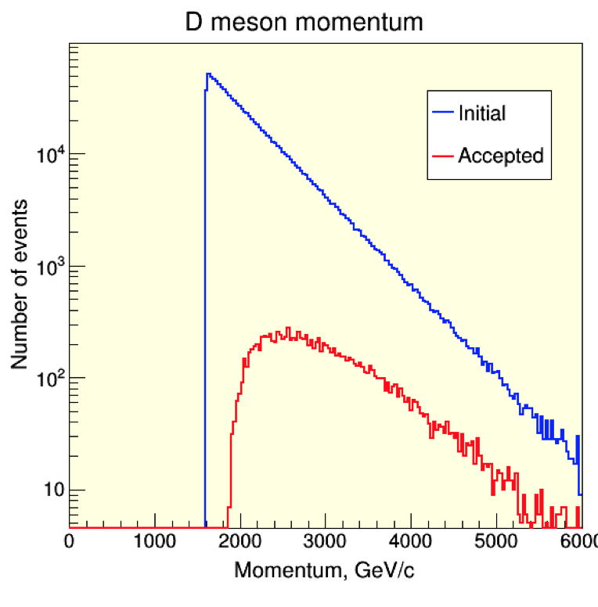
Preliminary study
Some acceptance for D⁰ → K π but very challenging:
Acceptance small – OK if very well known – signal could be much bigger (Brodsky)
p >> π+ >> K+ so mis-identification critical … TRD challenge
Even with perfect identification, irremovable K π continuum is large.
Unlike central production, do not see decay vertex and γcτ (D⁰) = 16.5 cm at 2.5 TeV !
… which smears mass resolution from ~ 6 MeV to ~ 16 MeV
-
Drives both 𝜎(M) and
hadron indentification
23/06/2020
Mike Albrow Forward Hadron Spectrometer
<number>

Slide 37
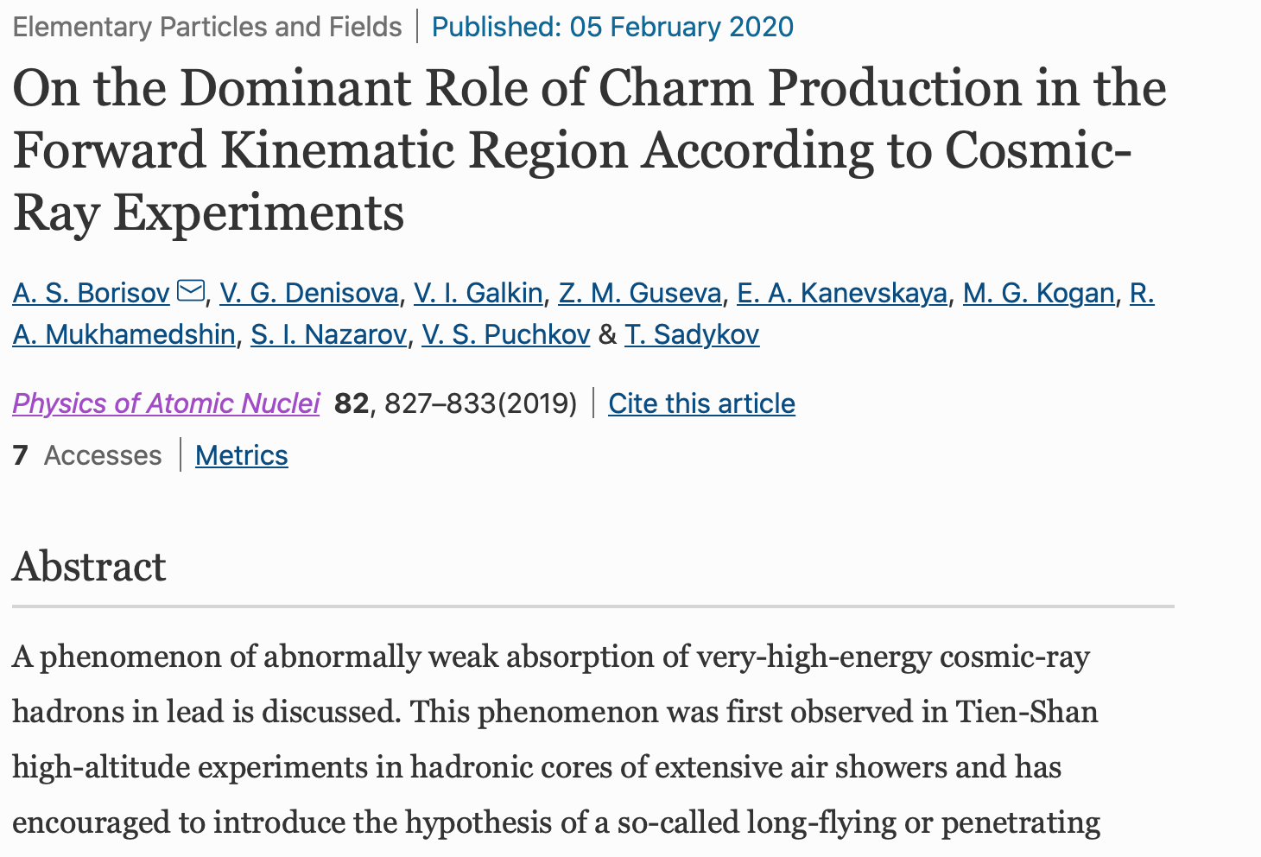


Slide 38





RUN 4 – HL LHC
~21.5 m Fe
~6.25m Fe
IR5, IR1
TAXN
BEAMS
~46m bare pipe (now)
Recombination dipole D2
105 mm diameter bore
OD ~ 56 cm
Separation dipole D1
150 mm aperture,
35 Tm integrated field
OD ~ 40 cm
Thanks G. Apollinari
23/06/2020
Mike Albrow Forward Multiparticle Spectrometer
<number>

Slide 39

Fraction of particles entering decay volume that decay vs. 𝛾c𝜏
0.1
1 km
FMS 96-116m
10
F
F = Fraction decaying
in length of decay volume
in angular acceptance.
(Does not include flux factor)
FASER 480-485m
10
20 km
10
0
200
400
600
Lifetime 𝛾c𝜏 (m)
FASER (Run 3/4) is a short decay volume far away : maximum decay fraction = 0.4% (1.2%)
FMS (Run 4) is much bigger volume closer: maximum decay fraction 13%
23/06/2020
Mike Albrow Forward Multiparticle Spectrometer
<number>

Slide 40

Coverage through steel absorbers
Approximation: Zero crossing angle
R = 30 cm @ 116 m, η = 6.65
R = 11.5 cm @ 125 m, η = 7.7
R = 5.25 cm at 125 m η = 8.46 not all φ
FASER: R = 10 cm at 480 m η > 9.2
23/06/2020
Mike Albrow Forward Multiparticle Spectrometer
<number>

Slide 41


Can we see X⁰ → 𝛾 + 𝛾 ?
From CMS-TDR-019
Critical issue probably shower pointing:
vertex resolution, X⁰ trajectory and ⍺
Single shower position resolution ~ 1mm
Angle resolution < 7 mrad (25 GeV showers)
𝜎(M) probably < ~ few %
> Needs proper simulation
X⁰
𝛾
⍺
d_{min}
L
𝛾
From CMS-TDR-019 Fig 5.2
Simulation two 80 GeV parallel photons separated by about 30mm.
From CMS-TDR-019 Fig 5.1
If conversion in tracker – no field so no spread

Slide 42
Can we see X⁰ → 𝜏 + 𝜏 ?
M(𝜏) = 1776.86 MeV → M(X) > ~ 3600 MeV
Main decays: μ ν ν & e ν ν each about 0.175 so μ μ, e e 3% each, e μ = 6%
Non-pointing because neutrinos missing.
BR (h ν) = 0.115 (mostly π).
BR (h + ) 37%
BR (h h h + 0 neutrals - 3 prong) 15%
e, μ, h
e, μ, h
h
h
e, μ, h
h
Can we see X⁰ → c + c ?
Consider e+e- events above open charm threshold 2 x M(D⁰) = 3730 MeV
Boosted to high p_{z} (acceptance?) and decay in pipe
All need simulation

Slide 43



Can we see X⁰ → Jet + Jet?
CMS Central
1 m → 10 m – 1000 m+
70 cm
LHC VACUUM
Thin window
Precision tracking
Imaging Calorimeter
> = 20 m
OR EVEN?? Not decaying but interacting unusually in calorimeter?

Slide 44


FLUKA predictions from Marta Gilarte 20200605
Examples:

