Slide 1

Implicit Bias
Equal opportunities in the evaluation and decision process
TRR 257 Annual Meeting: Soft Skills and Gender Training
Cosima Schuster, DFG Head Office

Slide 2
Agenda
The DFG – an introduction
Why and how does the DFG promote gender equality in research?
Implicit bias

Slide 3

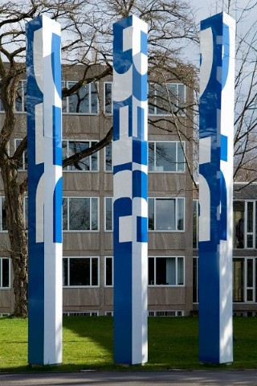
The German Research Foundation - DFG
Germany‘s largest and independent funding organization
Deutsche
Forschungsgemeinschaft
SFB
SBH
FOR
ENP
SPP
DFG head office
in Bonn
Researchers in Germany
Notes:
Die DFG – mehr als Kürzel aus drei Buchstaben…. Gemeinschaft aller Wissenschaftler in Deutschland – deutsche Forschungsgemeinschaft; over 700 empolyees but and about the same number of unpaid honorary members of panels and councils from the researcher community

Slide 4
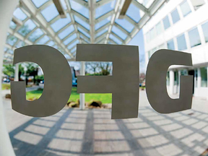
The DFG – About Us
It is an association under private law. Its member organisations include German universities, non-university research institutions, academies of sciences and humanities, ...
It serves all branches of science and the humanities by
funding research projects to support
the best scientific ideas
on a bottom up competitive basis

Slide 5
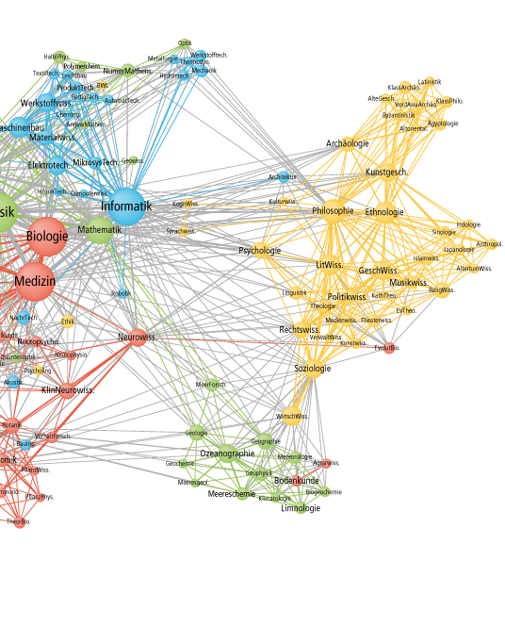
The DFG – In Numbers
In 2018, the DFG’s budget totalled approximately € 3.4 billion.
In that year, the DFG funded around 33,200 projects:
Individual research projects
Research collaborations
Research infrastructure
Coordinated programmes
Notes:
More than half for individual research projects

Slide 6
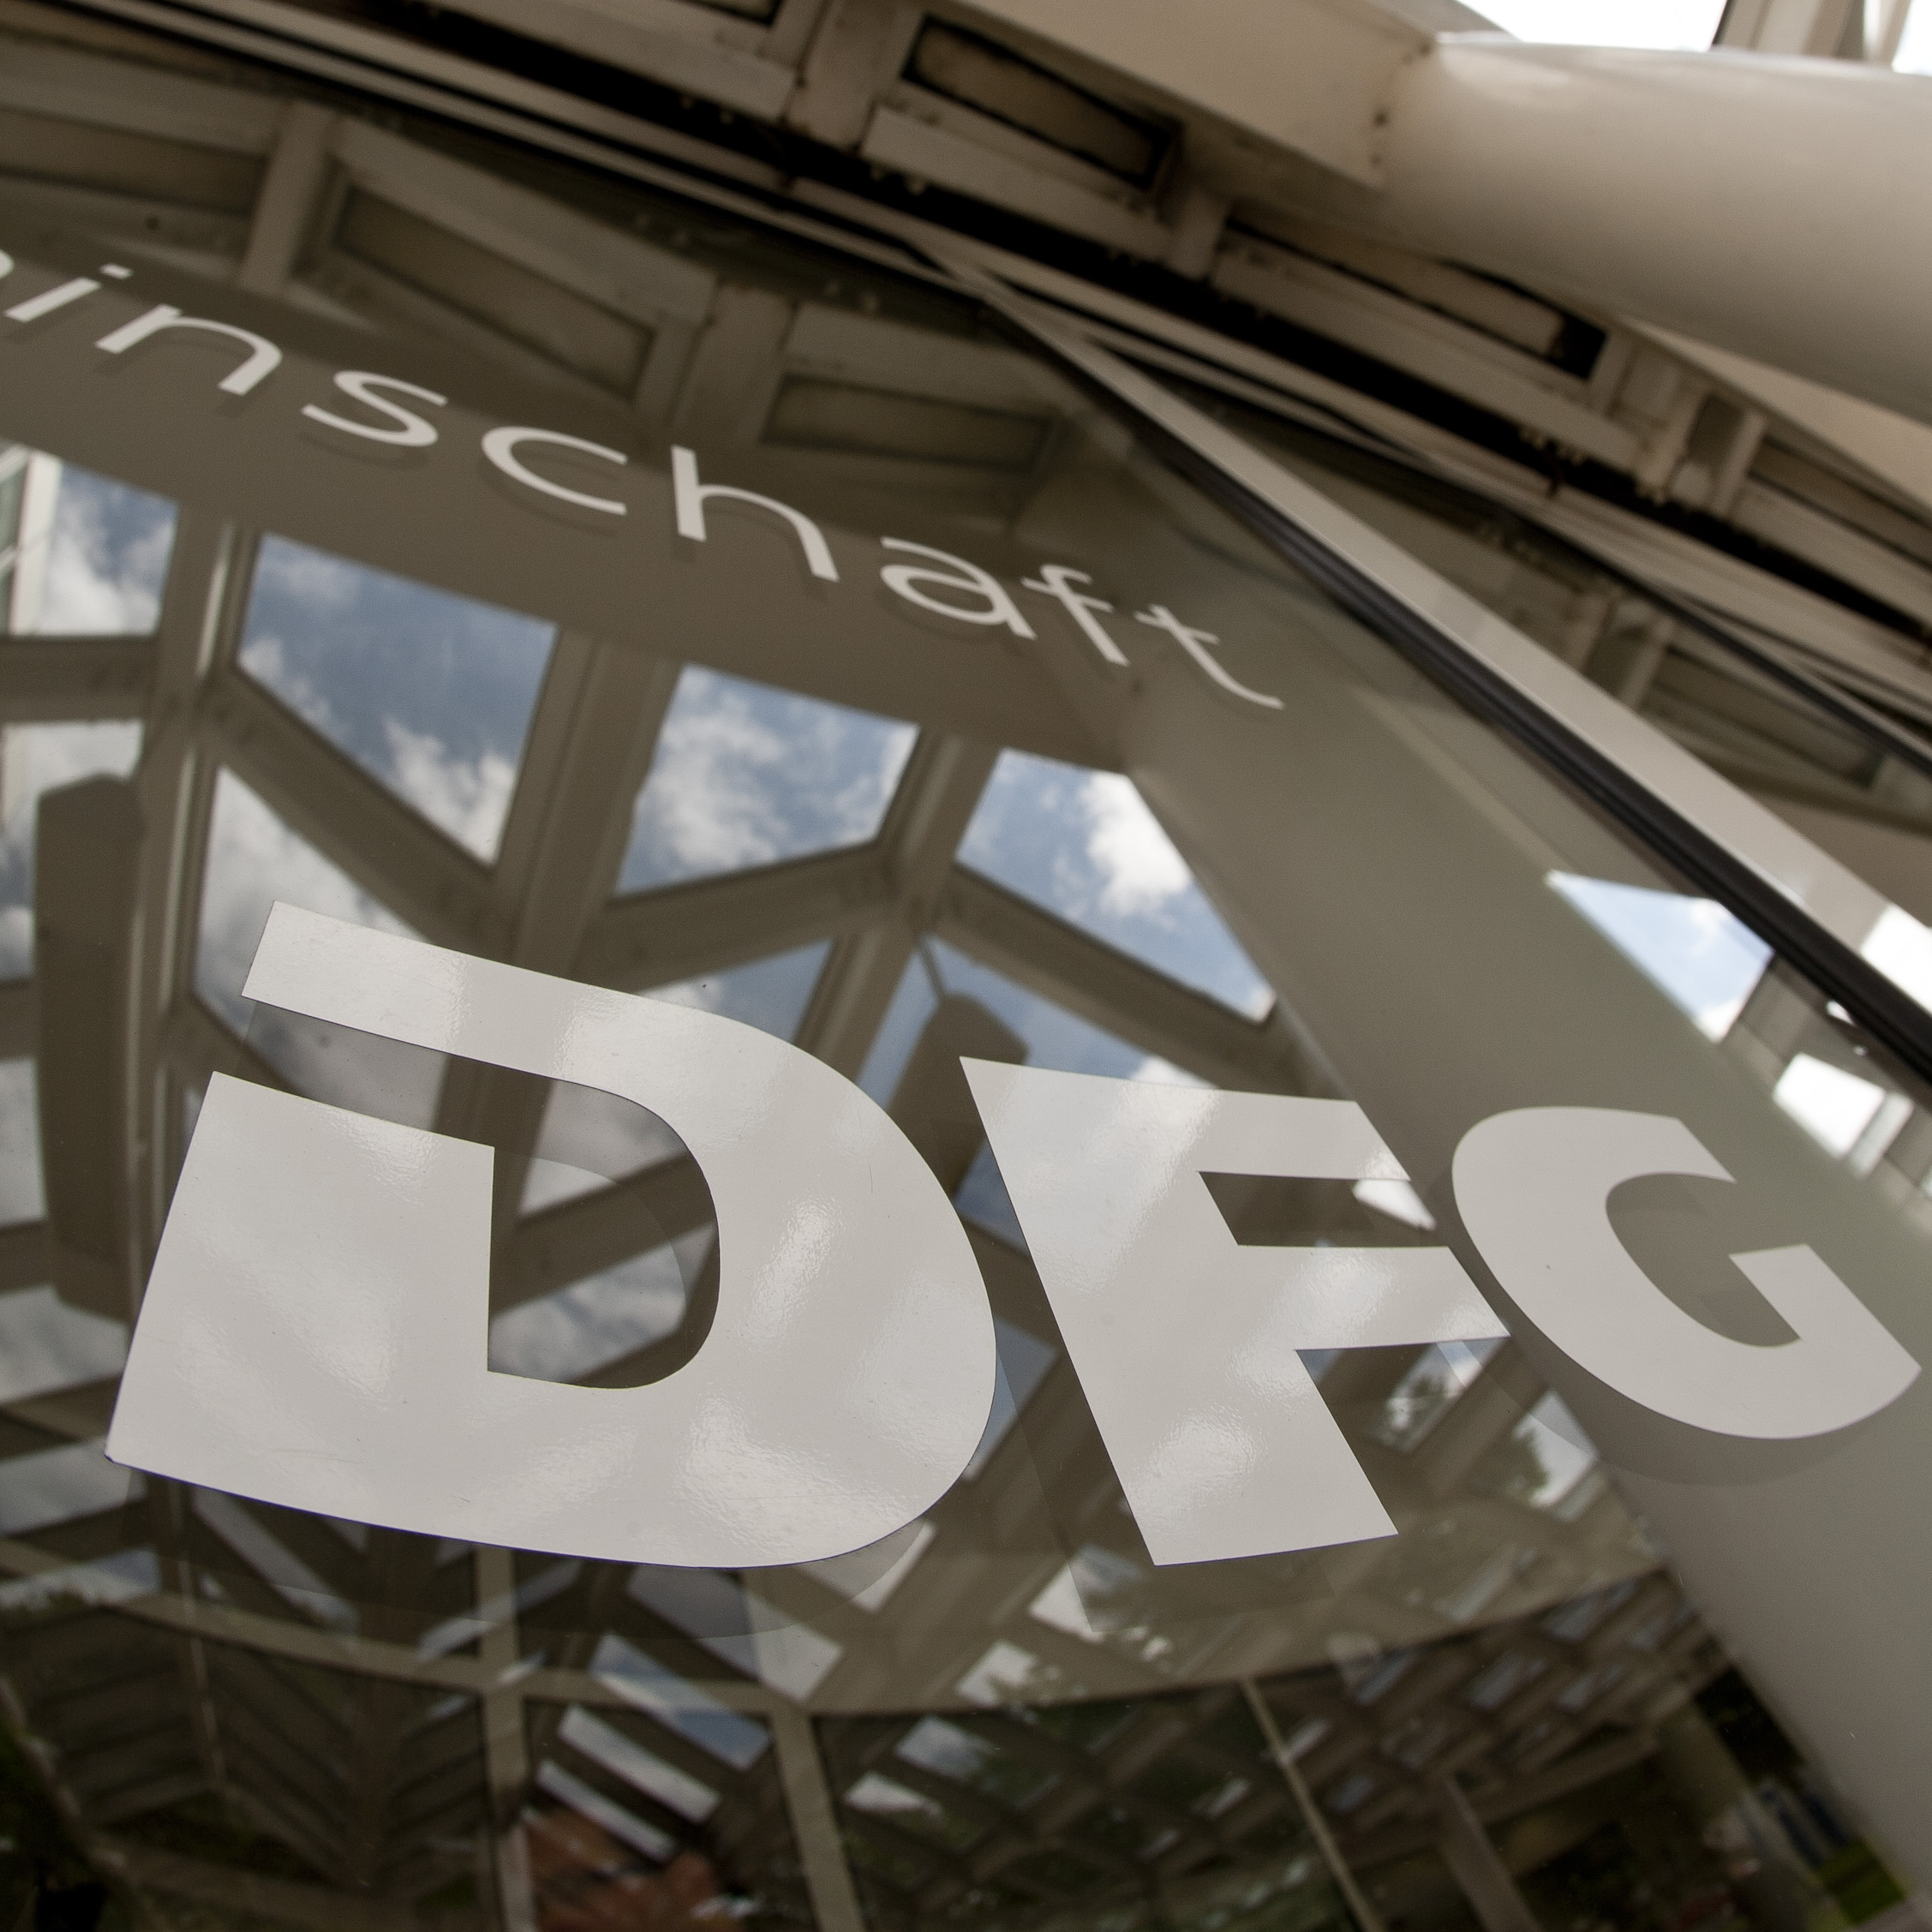
The DFG – Our Mandate
Facilitating national and international cooperation among researchers.
Providing scientific policy advice.
Promoting gender equality in the German scientific and academic communities.
Encouraging the advancement and training of early career researchers.
Notes:
Alternative zu Folie 4

Slide 7
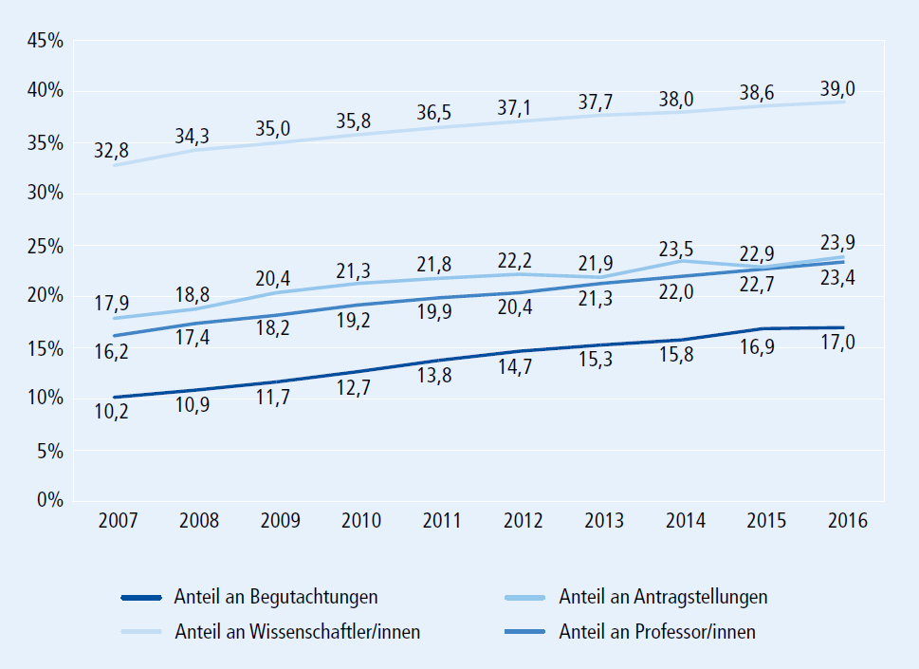
Proportion of women 2007 – 2016 among…
Why does the DFG promote gender equality in research?
Status quo: Research System & DFG-proposals
Researchers at German universities
DFG-proposals
Professors at German universities
Reviews
DFG, Chancengleichheits-Monitoring 2017, Fig. 1:
www.dfg.de/chancengleichheits-monitoring (in German only)

Slide 8
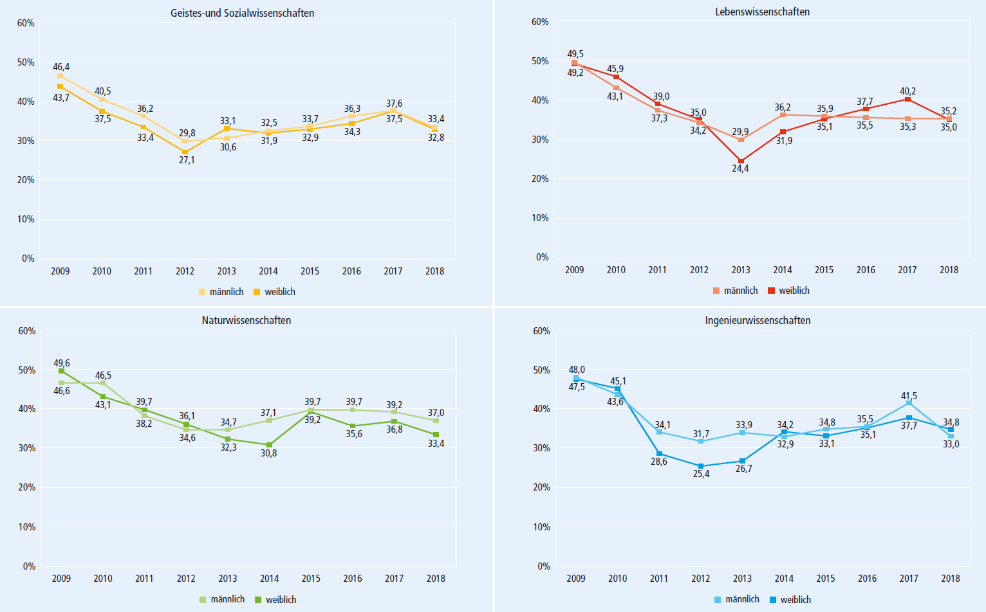
Why does the DFG promote gender equality in research?
Success rates in the individual grants program

Slide 9
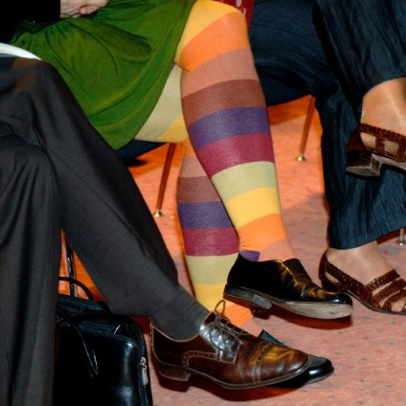
Why does the DFG promote gender equality in research?
DFG position on Diversity: www.dfg.de/diversity/en
“Excellent research requires diversity and originality. To ensure
long-term engagement with all socially relevant areas, it is crucial that
science and academia adequately represent these areas. This applies
not only in an abstract structural sense, but also to the people who
research and teach in these fields.
The DFG believes that no one should be excluded from a career
in research on the basis of academically irrelevant factors such
as gender, ethnic origin, age or health.”

Slide 10
How does the DFG promote gender equality in its area of activity?
Through a qualitative gender equality strategy – four action levels
Principle of “challenge and support”
Instruments: Modules for researchers with clear gender equality objective
Processes: More women in the review process; awareness-raising on implicit bias effects; uniformity in taking relevant factors into consideration
Career/staff development: Workshops, mentoring, examples of best practice, individual career development
Work-life balance: Workload reduction for serving on statutory bodies, allowances for childcare costs
Notes:
Furthermore, in the future the DFG will focus more on its funding activities and thus take concrete steps to promote both gender equality and work-life balance. With a view to both “challenging and supporting”, a qualitative equality strategy is to be drawn up by the end of 2017; the responsible statutory bodies will decide on this in July 2017.
The intention is to analyse funding programmes and instruments to identify any structural obstacles and promote gender equality by means of suitable measures.
The qualitative gender equality strategy addresses four action levels:
1. Instruments
2. Processes
3. Career/staff development, and
4. Work-life balance
Special funding opportunities for researchers are currently being discussed, as well as processes that provide additional clarity and uniformity in the treatment of gender equality within the review system. Processes should be designed to raise awareness of possible distortion effects.

Slide 11
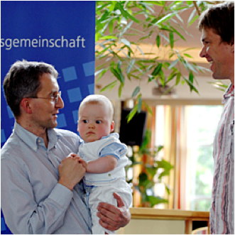
How does the DFG promote gender equality in its area of activity?
Through funding measures in DFG-funded projects
Making allowances for personal situations when
assessing academic achievements in proposals
(periods of childcare, etc.)
Limitation of publication list to a maximum of 10 items
Support for work-life balance
Staff support for part-time work by project leaders for family reasons (children, relatives in need of care)
Funding for temporary replacements for project team members who take temporary leave or reduce working hours for family reasons
Career development measures and promotion of family-friendly structures at funded institutions (remote working, additional childcare)
Notes:
Established measures in DFG-funded projects
Making allowance for the personal situation of applicants when assessing their academic achievements (e.g. periods of childcare)
Limiting the publication list to a maximum of 10 publications per individual applicant
Supporting funding recipients in work-life balance
Additional staff funding to enable part-time work by project leaders for family reasons
Funding for temporary replacements for research project staff during maternity or paternity leave and flexible arrangements for project extensions
Career development measures specifically for women (mentoring programmes, coaching, networking) and promotion of family-friendly structures at funded institutions (telework or work from home, additional childcare)
(remote work; Alternativen: remote working, telework, teleworking, telecomputing, virtual work, work from home)

Slide 12
Implicit bias
Examples
Video of the Royal Society shown at the beginning of review panels http://blogs.royalsociety.org/in-verba/2015/11/17/implicit-and-unconscious-the-bias-in-us-all/
Science, 27.05.2016, report on „forum on implicit bias in peer review“
  Gender ok, international representation not
  → Broaden, diversity, and internationalize the pool of editor and reviewers
  → Professional full-time editors compensate implicit bias
Lindau Nobel Laureates Meeting 2016: Panel disussion „Glass Ceilings – Is German top research male-dominated? “
Gender Bias in the Physics Classroom, Journal of Women and Minorities in Science and Engineering 23(1), 15-36 (2017)
MQST Meeting 2020: Marika Tylor spoke on „Implicit bias in physics“

Slide 13
Implicit Bias
Stereotypes and categorization
Unconscious recourse to stereotypes affects all evaluations
Subconscious categorizations are made by everyone - What is regarded scientific? What is regarded feminine? What is regarded European …?
Traditional role models can also be found in science - How can research be reconciled with being a woman and a mother? Is competition a male behavior?
These stereotypes, categories and role models influence judgements and decision-making behaviour
Test your stereotypes: Implicit Association Test https://implicit.harvard.edu/implicit/swissde/

Slide 14
Implicit Bias
Subconcious processes
Exposed to much more sensory information than can be handled conciuosly, we use mental shortcuts and past knowledge to make assumptions.
automatic and unconscious process
split-second decisions (friend or foe?)
based on incomplete information

Slide 15
Implicit bias
Stereotypes in physics
What is considered a typical requirement to be successful in "physics"?
Experiment: test your stereotypes – what comes up first in your mind?
Physicist
Man
Woman
European
Asian

Slide 16
Implicit bias
Stereotypes in physics
What is considered a typical requirement to be successful in "physics"?
analytical thinking
mathematical understanding
pleasure in handling complex instruments
creativity
persistence

Slide 17

Implict bias
Review and decision process
The more objectively the decision process is structured by explicit criteria, the better an unprejudiced decision is possible.
The more comparably the decision-relevant criteria are preprocessed, the less the danger of a judgement bias exists.
An appropriate self-observation of the selection committees
and more time for decision can compensate prejudice and bias.

Slide 18
Reminder: Funding Principles
Open, bottom-up choice of research topics
Basic research in any field of science and the humanities
No age restrictions
Individual career phases and family-related career breaks are considered in the review process
.

Slide 19

Implicit bias
What specific advice should be taken into account?
The evaluation is based exclusively on clearly defined scientific criteria
Age, gender, ethnic origin, sexual identity, disability, illness, are no criteria and must not be discussed!
CVs are evaluated appropriately (qualification phases, publication record, stays abroad) in relation to the individual situation
Information not relevant to the proposal is not considered in the decision process – no informal discussions!
Possible biases are to be made explicit - all participants are called upon to observe carefully and critically

Slide 20
Vielen Dank für Ihre Aufmerksamkeit
Weitere Informationen
zur DFG: http://www.dfg.de
zum Förderatlas: http://www.dfg.de/foerderatlas
zu allen geförderten Projekten: http://www.dfg.de/gepris
zu den deutschen Forschungseinrichtungen: http://gerit.org

