Slide 1
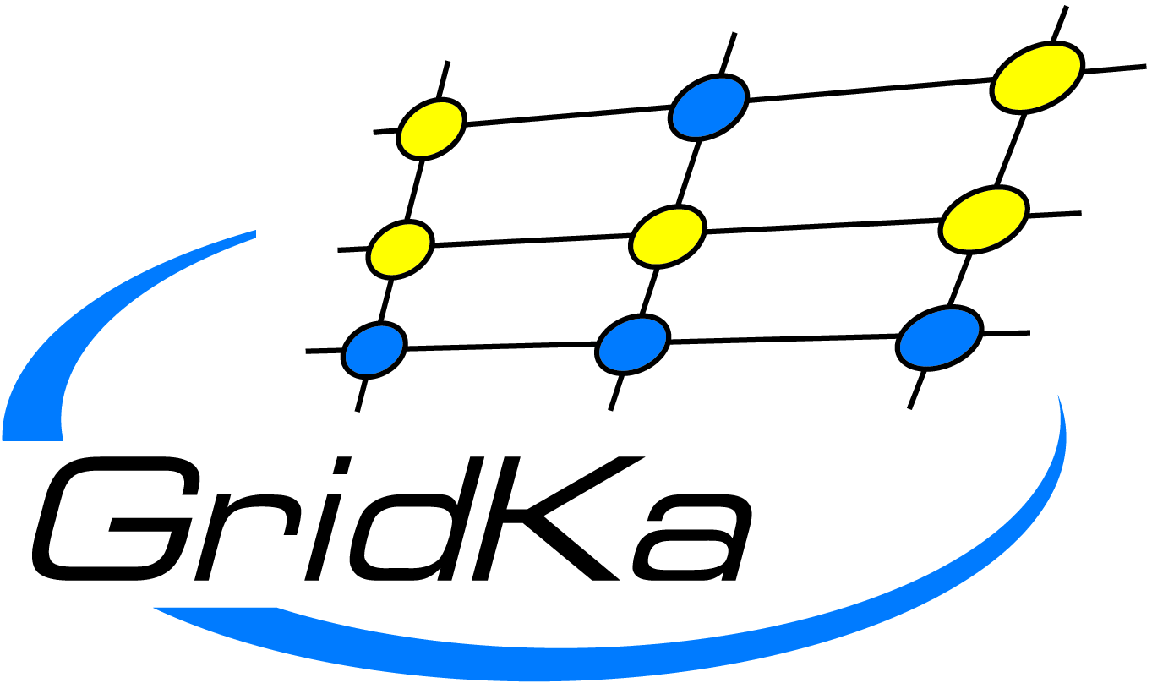
Huge Data: Store, Distribute, and Analyse
Tour of the Big Data Research Facilities

Slide 2
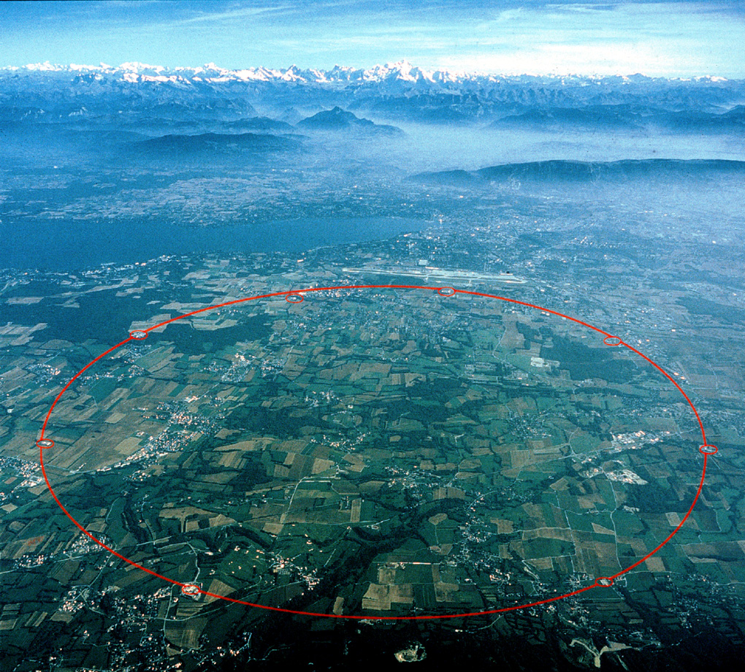
Large Hadron Collider (LHC) Experiments at CERN
Near Geneva, Switzerland
27km circumference
50-150m below ground
Notes:
Flughafen Genf: 4km Landebahn
Durchmesser 8,5km => 150.000 Handys

Slide 3
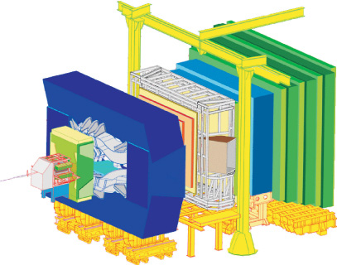
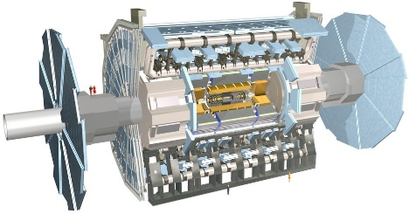
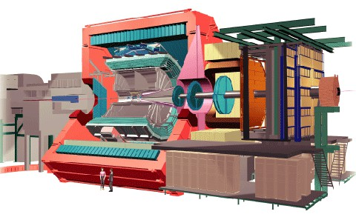
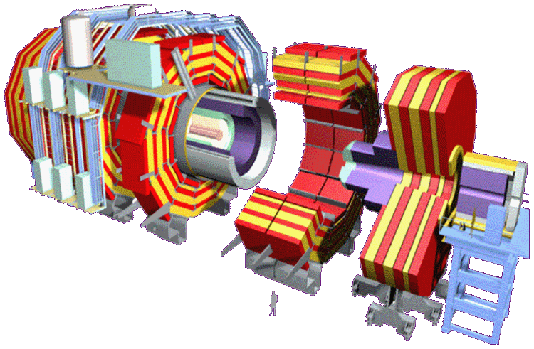
Large Hadron Collider (LHC) Experiments at CERN
4 big experimental setups investigate the results of the collision of two proton beams
This is generating ~ 100+PB research data p.a.
ATLAS
LHCb
CMS
ALICE

Slide 4
Data – Bytes
1 Terabyte
4
1 Petabyte
4,000
1 Exabyte 4,000,000
256 Gigabytes
1GB
1TB
1PB
1EB

Slide 5
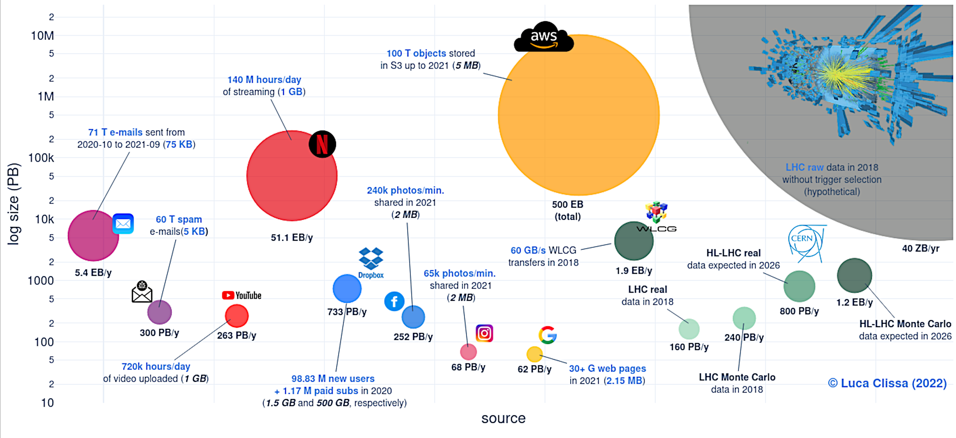
80000
https://arxiv.org/abs/2202.07659

Slide 6
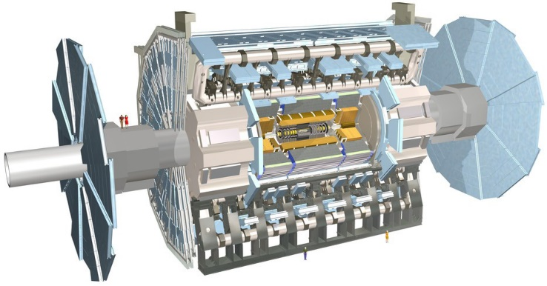
HEP Data Acquisition
1 billion collisions / s @ 13TeV
30MHz bunch crossing rate
1 PB/sec
Rate
reduction:
10⁻⁶
Level 1 - special hardware
75 KHz (75 GB/sec)
Level 2 - Embedded Processors
5 KHz (5 GB/sec)
LHC experiments generate ~ 50 PB per year
for offline analysis
Level 3 – PC Farm (Linux)
200 Hz event rate
800MB/s – 10GB/s per experiment
~25 GB/s all four experiments

Slide 7
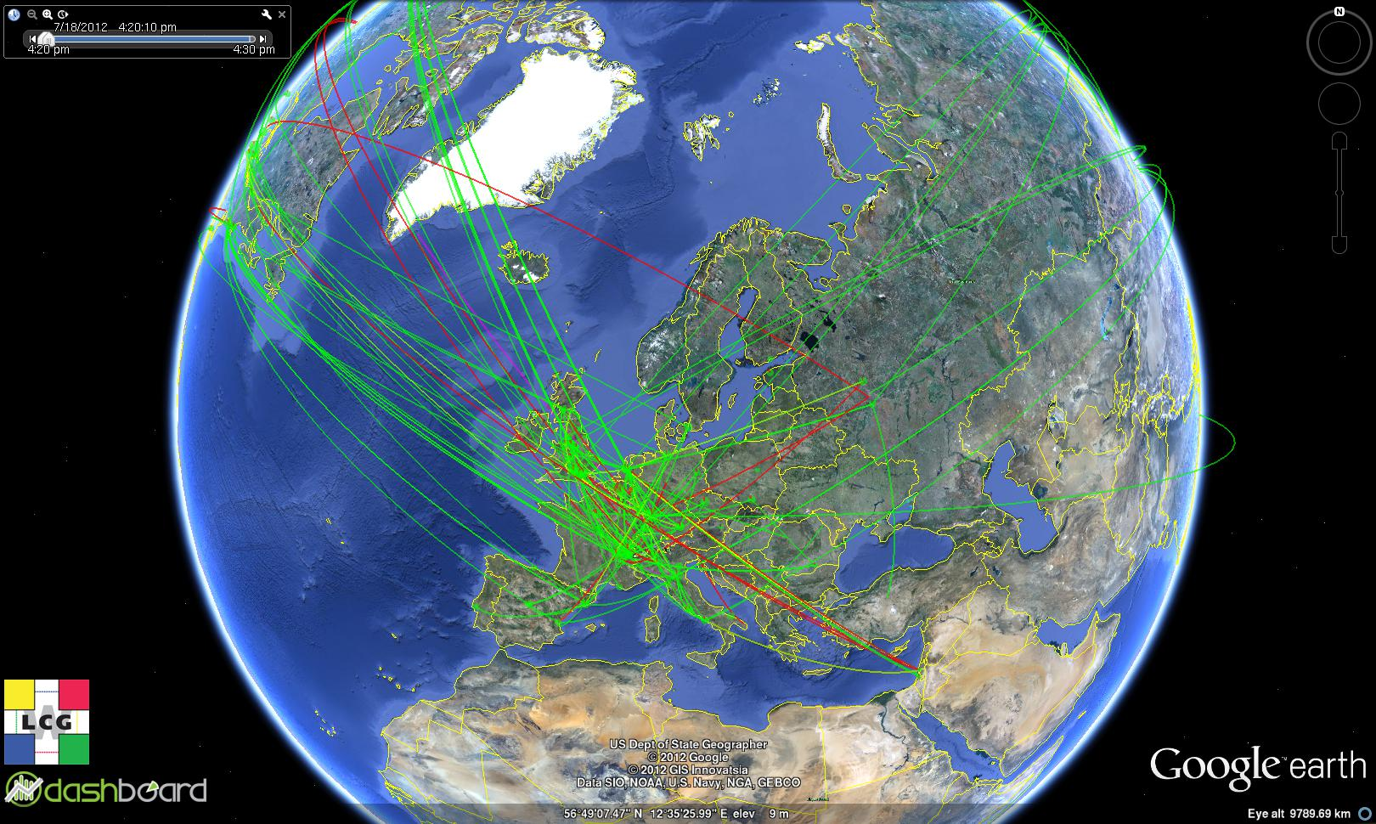
A World-Wide Computing Grid for the LHC

Slide 8
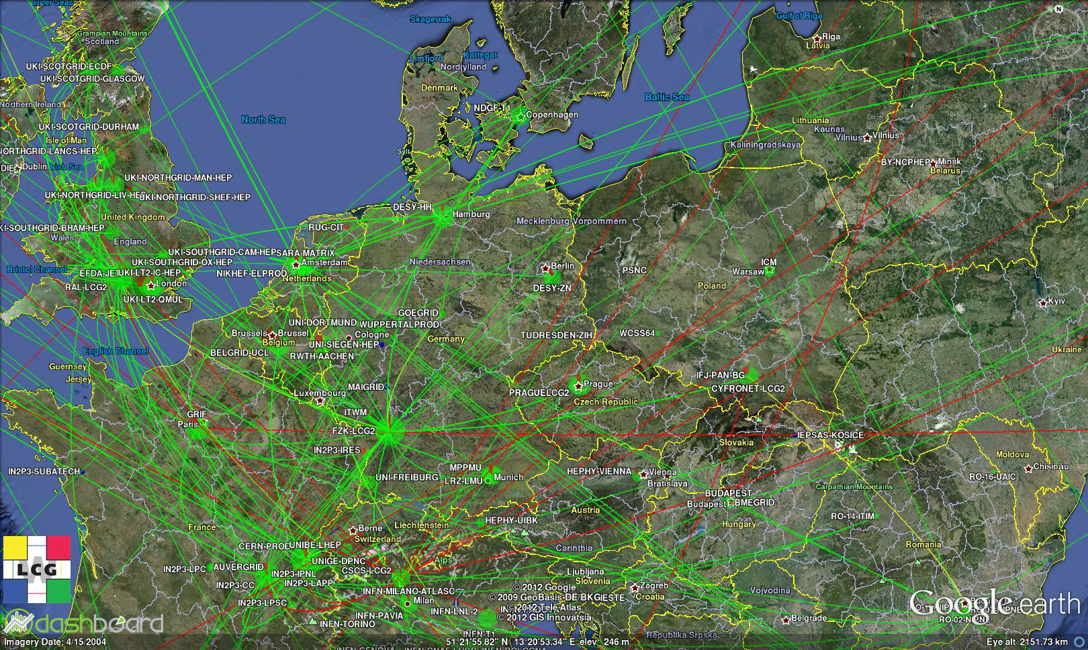

Slide 9
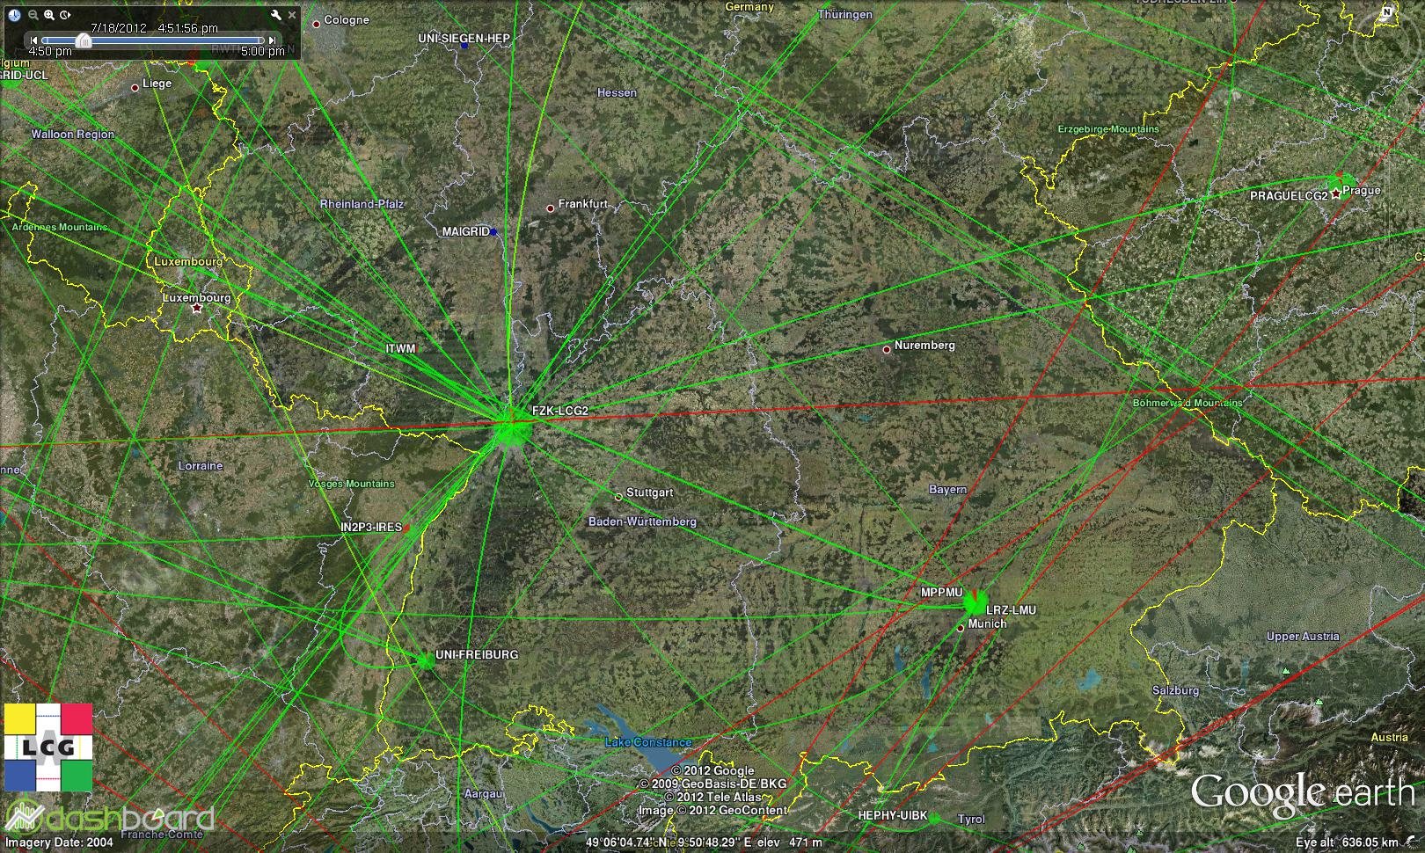
GridKa Tier-1 Datacenter

Slide 10
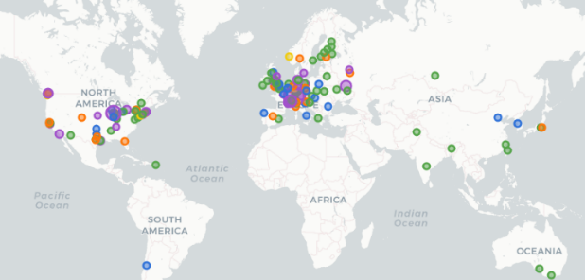
GridKa – Port in the Sea of Data
German Center for Data and Data Analysis in Particle and Astroparticle Physics
~12 000 Physicists globally ~ 1 300 from Germany
Data Transfer from GridKa to WLCG Centres
Embedded in the world-wide LHC computing network, the
WLCG (Worldwide LHC Computing Grid)

Slide 11
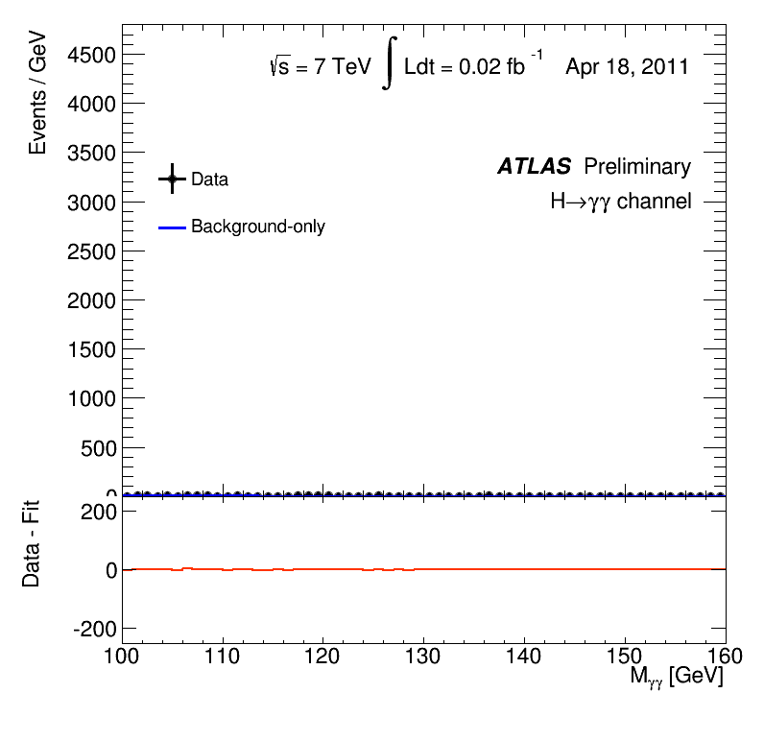
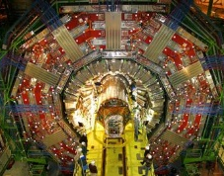
GridKa – Port in the Sea of Data
Fundamental Element of the global LHC Data Processing Chain
© CERN
Roh-daten
Hard Disk
CERN
- Processing of Raw Data, e.g.
Event Reconstruction
- Event Selection - Particle Physics Simulations
- Data Analysis
Daten
Aufträge zur Datenanalyse
Tape Archive
Discovery of Higgs Particle in 2012
Conclusion slide of R.D. Heuer, July 4, 2012

Slide 12
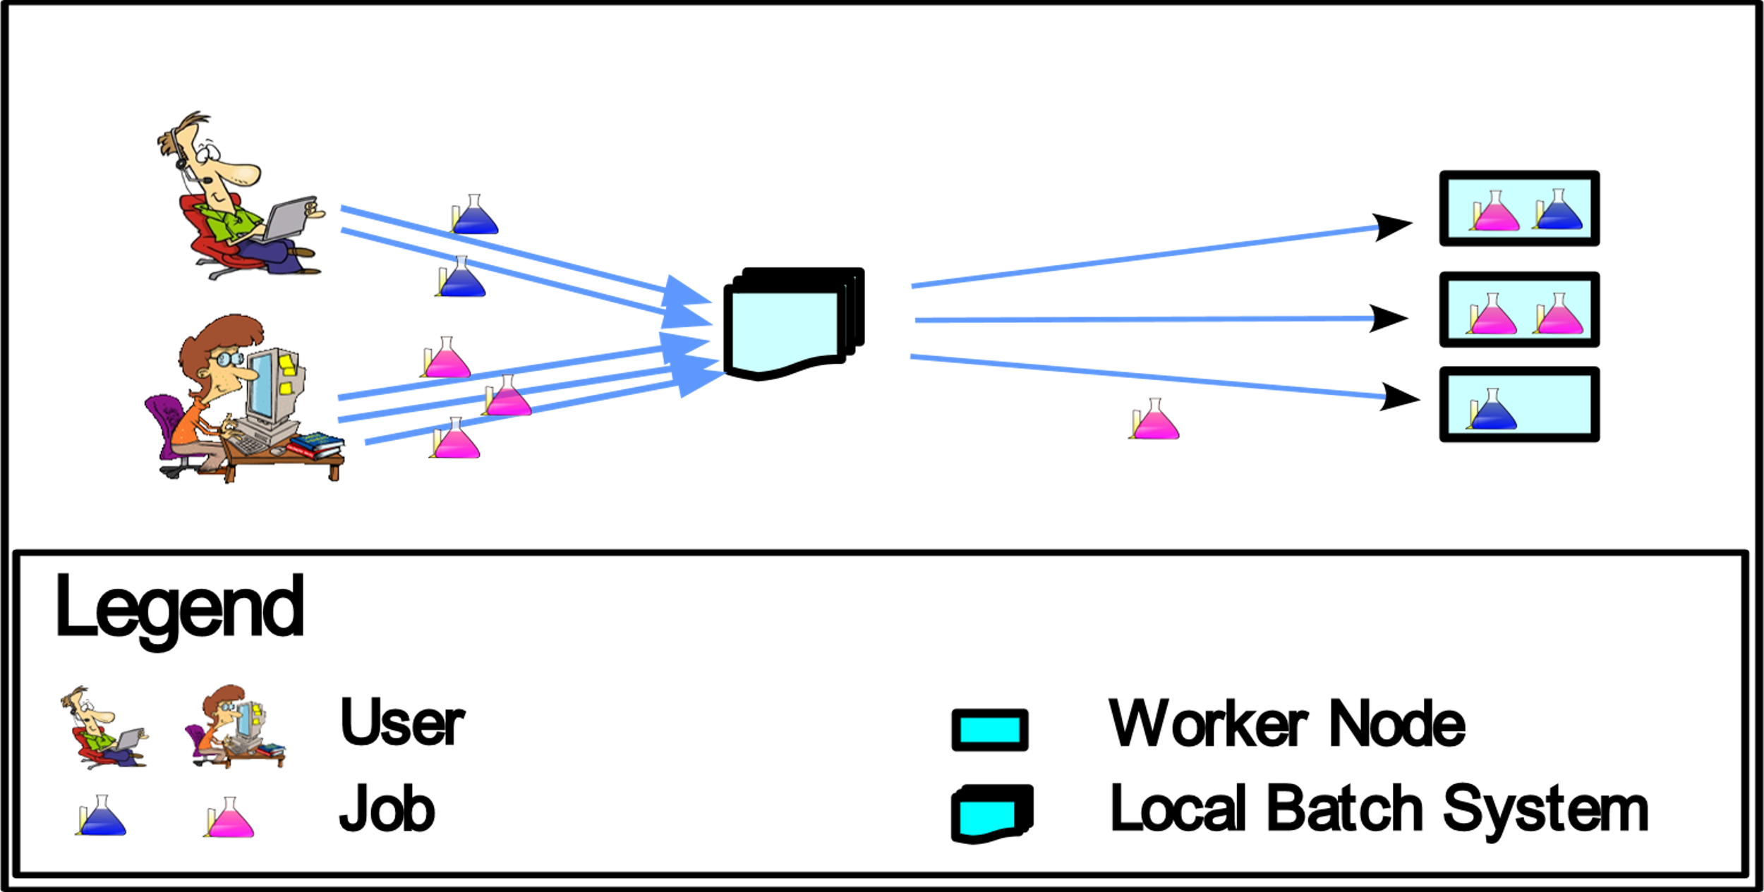
Computing Jobs in Usual Computing Centres
Based upon: The Pilot Way to Grid Resources Using glideinWMS

Slide 13
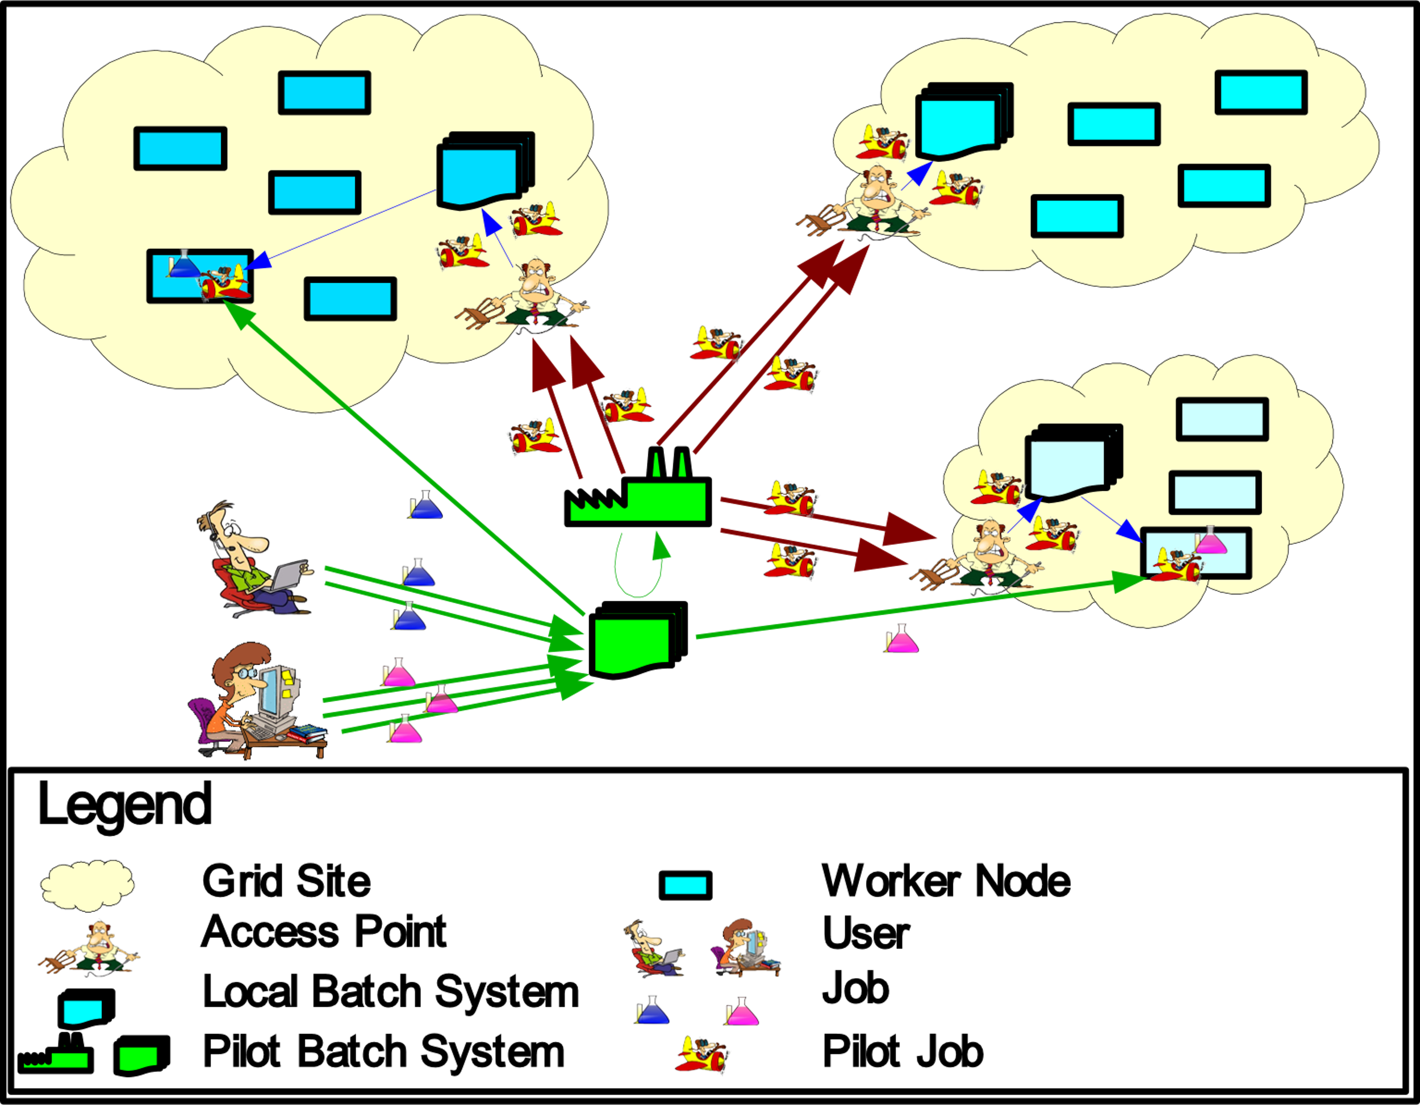
Computing Jobs in WLCG
Based upon: The Pilot Way to Grid Resources Using glideinWMS

Slide 14
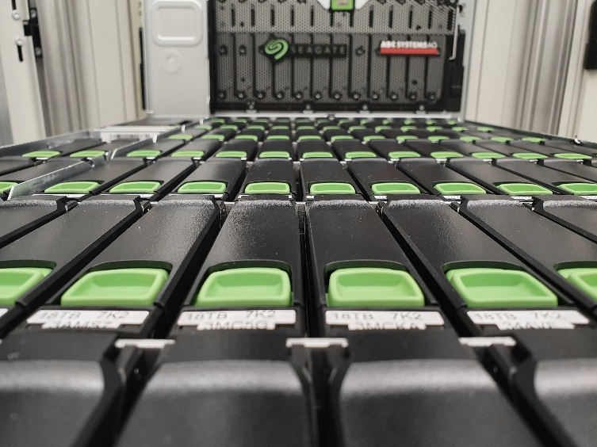
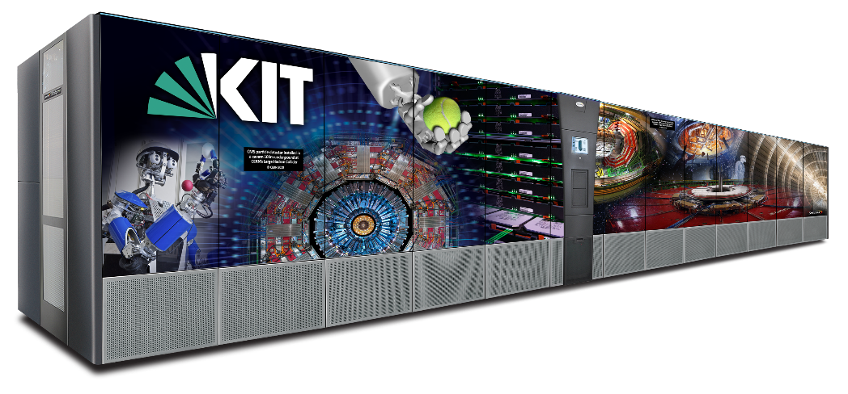
GridKa – Corner Stones
Computing Farm
270 active compute nodes
ARM and x86
54000 compute cores
Online Data Storage (GPFS)
91 PB usable data capacity
6344 HDDs
110 servers
Nearline Data Storage (HPSS)
120PB stored on Tape
145PB available on Tape
Network
2 x 100Gb/s to CERN
2 x 100Gb/s to DFN

Slide 15
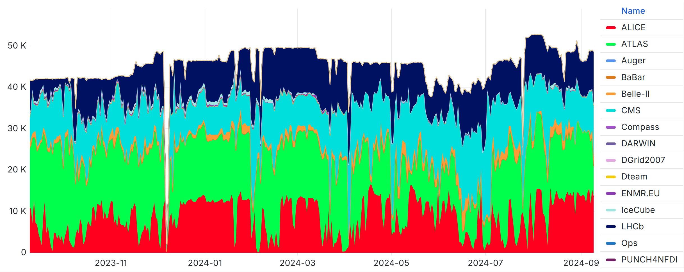
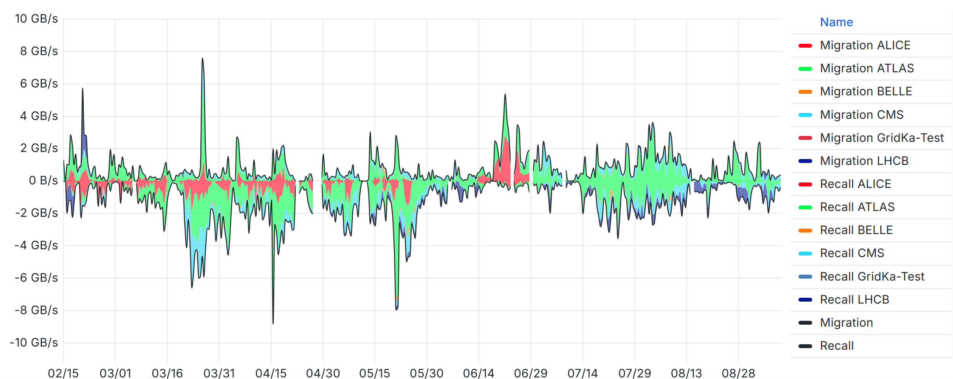
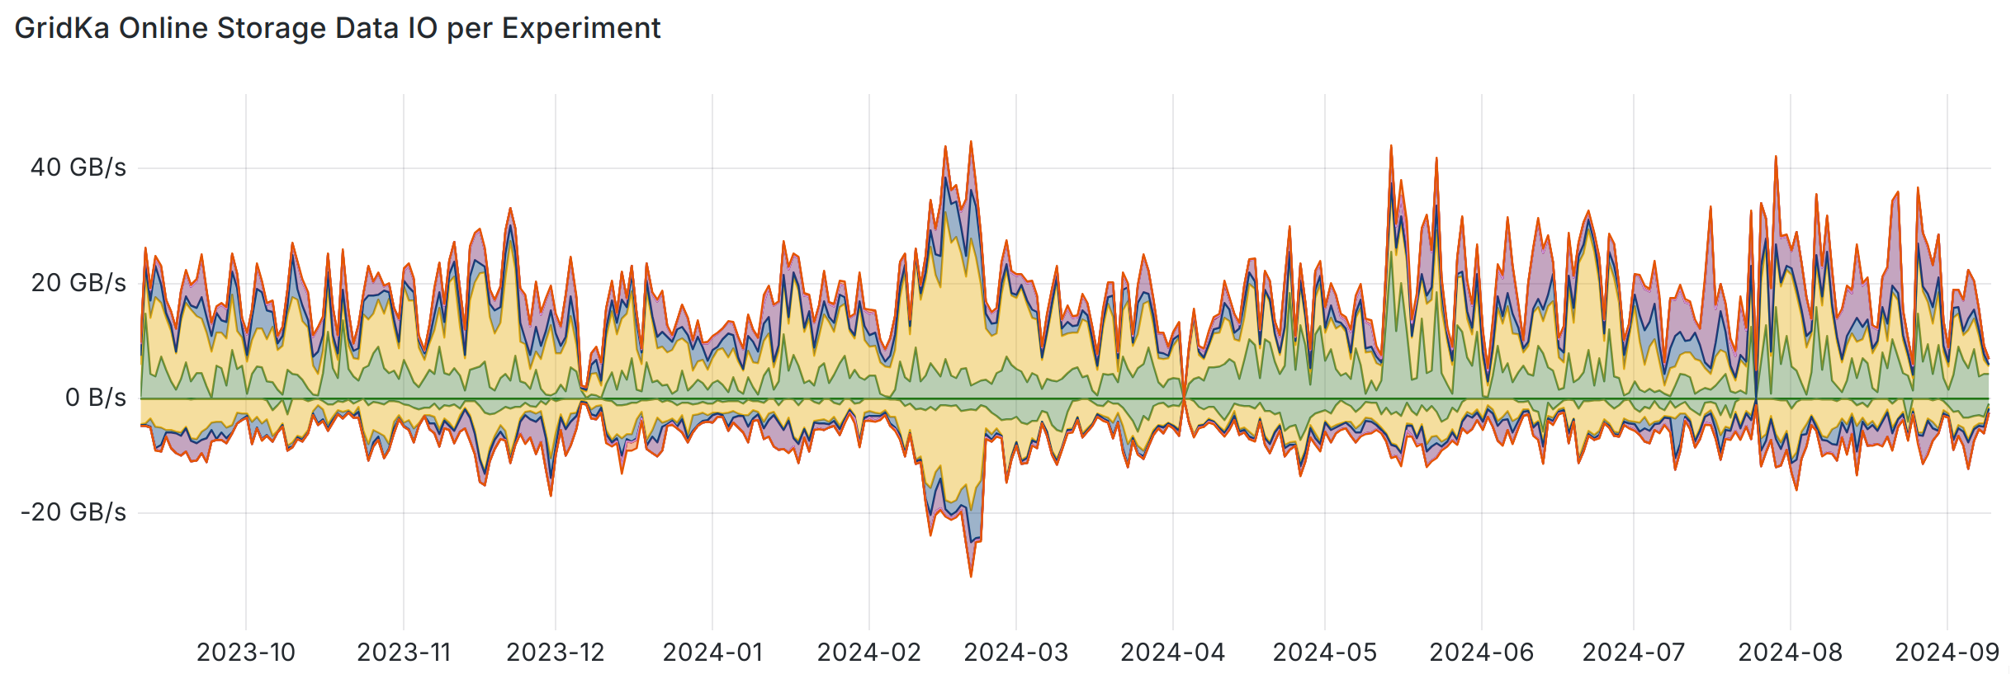
GridKa – Last 12 Months
Batch Farm
23 Million Jobs
463 Million CPU hours delivered
~420 PB read from online storage
~170 PB written to online storage
~45 PB written to tape
To/From Disk
To/From Tape

Slide 16
GridKa – Let's Move
Please,
Stay with the Group!
Ask Your Questions!
Take Photographs!
And, Please:
Do Not Touch Anything!
Do Not Take Drinks Nor Food!

Slide 17
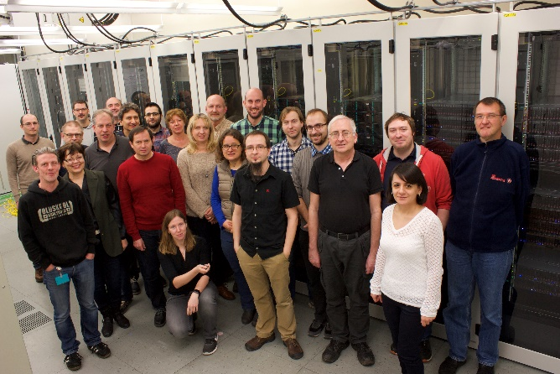
GridKa Team

Slide 18
