Slide 1
Direct Dark Matter Searches With Liquid Noble Elements Part 1: General Considerations Part 2: Experimentall status & Outlook
Rafael F. Lang
Purdue University
rafael@purdue.edu
HAP Dark Matter
Karlsruhe, September 22, 2015

Slide 2
Part 1:
How to build an experiment

Slide 3
Direct Detection Spectrum
Simple nonrelativistic scattering kinematics
Falling exponential spectrum, e.g. Xe target, σ =10⁻⁴⁵cm²
10
m_{χ} = 1000 GeV
m_{χ} = 100 GeV
m_{χ} = 10 GeV
rate
[keV ton year]⁻¹
2
1
0.2
0.1
recoil energy E_{r} [keV]
Acceptance necessarily drops to 0 at E_{r}=0:
Measured signal is a bump after all.

Slide 4
Signal/√Background
It’s about sensitivity, no point in “zero background”
Optimize
Increase Signal
heavy targets
large detectors
Optimize analysis to retain maximum acceptance
Decrease background

Slide 5
Signal/√Background
Background Reduction:
Go underground
lz.lbl.gov

Slide 6
Signal/√Background
Background Reduction:
Go underground
Active shielding
e.g. DarkSide:
Argon detector
Liquid scintillator veto
(pseudocumene plus boron)
Water Cherenkov detector
Shawn Westerdale TAUP 2015

Slide 7
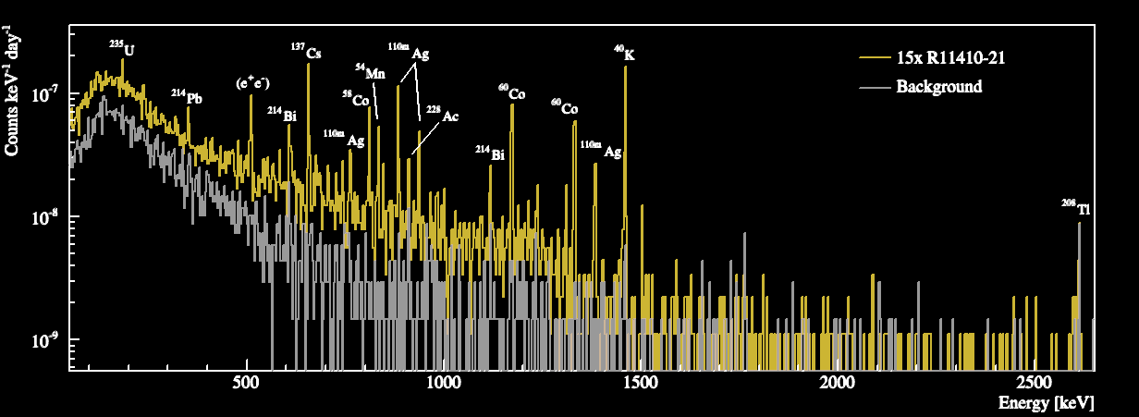
Signal/√Background
Background Reduction:
Go underground
Active veto
Low background materials
XENON 1503.07698

Slide 8
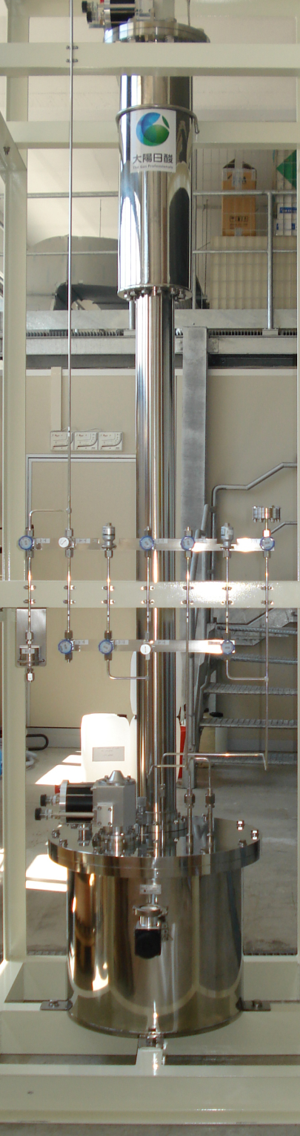
Signal/√Background
Background Reduction:
Go underground
Active veto
Low background materials
Liquids targets
can be purified further on site
XENON 1503.07698

Slide 9
Liquid Noble Element Targets
Heinrich Pniok
(radioactive)
He Ne Ar Kr Xe (Rn)
Z 2 10 18 36 54
Density [g/cm³] 0.1 1.2 1.4 2.4 2.9
Boiling point [K] 4 27 87 120 165
Notable isotopes ³⁹Ar ⁸⁵Kr 50% SD
Scintillation λ [nm ] 78 82 128 146 178

Slide 10
Signal/√Background
Background Reduction:
Go underground
Active veto
Low background materials
Liquid targets
Fiducialization/
self-shielding
(in xenon)
γ-background scales
as exp(-diameter) !
radius / cm
z / cm
fiducial
volume
XENON 1207.5988
radius² / cm²

Slide 11
Fiducialization: Single Phase
Worked great for ν experiments:
PMTs
liquid
hν
hν
Vertex position from scintillation (S1) hit pattern

Slide 12
Fiducialization: Two-Phase
Time Projection Chamber
top PMTs
(position)
Vertex position from S2 hit pattern & drift time with mm resolution
anode
gas
+
liquid
e⁻
e⁻
e⁻
hν
cathode
-
hν
bottom
PMT array
(S1, S2)
S1
drift time
S2

Slide 13
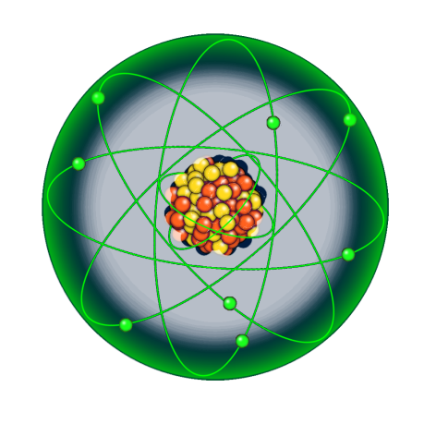
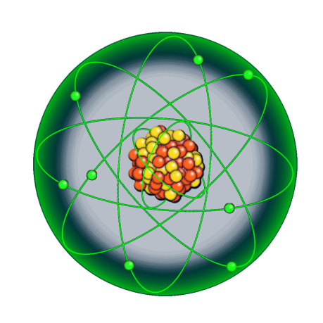
Signal/√Background
Background Reduction:
Go underground
Active veto
Low background materials
Liquid targets
Fiducialization
Discrimination
Signal: mostly
nuclear recoils
Background: mostly
electronic recoils

Slide 14
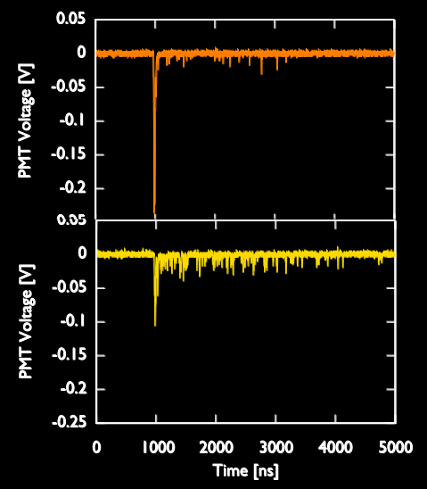
Argon: Pulse Shape Discrimination
Ar₂* dimer
singlet state decays
with 6ns, triplet
state with 1.5μs.
e.g. in DEAP3600:
Excellent performance:
>10⁶ : 1 discrimination
But high
energy threshold
~ 40 keV_{nr} (DarkSide-50)
nuclear
recoil
Berta Beltran TAUP2015
electronic
recoil

Slide 15
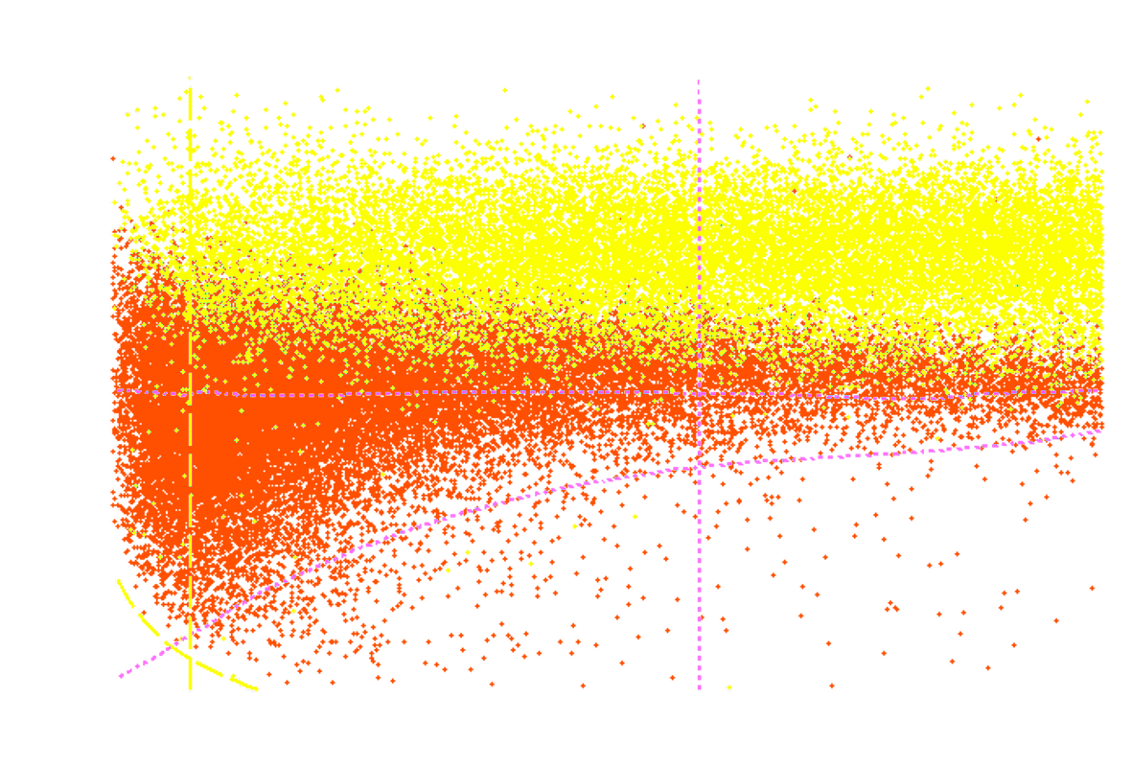
Xenon: S2/S1 Discrimination
⁶⁰Co, ²³²Th and ²⁴¹AmBe calibration
S1 / PE
electronic
recoils
(background)
log₁₀(S2_{b}/S1) – ER mean
nuclear
recoils
(calibration)
energy / keV_{nr}
~99.5% ER rejection @ 50% NR acceptance
energy threshold ~3keV_{nr}

Slide 16
Signal/√Background
Background Reduction:
Go underground
Active veto
Low background materials
Liquid targets
Fiducialization
ER/NR Discrimination
Artefact Discrimination
e.g. surface events, pile up, …
limiting systematic for essentially all experiments
→ extract redundant information from each event
easy to simulate (e.g. GEANT4)
tricky: each detector
is a one-of-a-kind

Slide 17
XENON100 Candidate, E~3keV_{nr}
Ample, redundant information even at lowest energies:
Scintillation S1 size. S1 PMT pattern.
Ionization S2 size. S2 PMT pattern.
Single/Multiple Scatter.
Electronic/Nuclear Recoil.
Vertex position.
S2 width.
Timing.
S1
S2
S1
S2

Slide 18
Part 2:
Existing Experiments:
Status & Outlook
Ar Xe
single phase DEAP-3600 XMASS
double phase DarkSide-50 XENON100
LUX
XENON1T

Slide 19
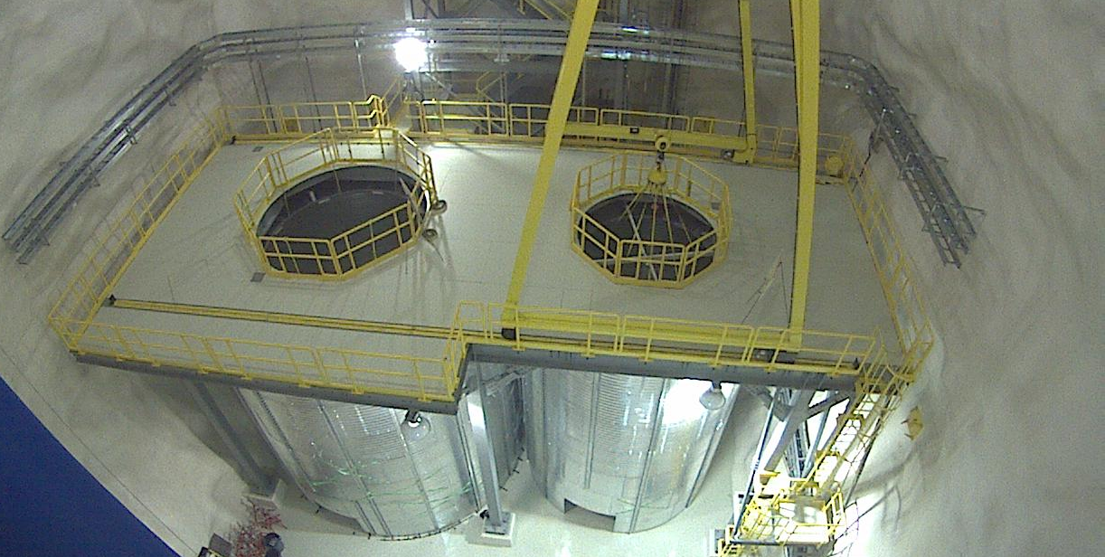
DEAP-3600
Single phase liquid argon
@ SNOLAB (Canada)
Acrylic vessel
3.6t argon total, 1t fiducial
255 8” PMTs
DEAP3600
MiniCLEAN
Twitter @SNOLABscience
snolab.ca

Slide 20
DEAP-3600 Status
Single phase liquid argon
@ SNOLAB (Canada)
Acrylic vessel
3.6t argon total, 1t fiducial
255 8” PMTs
Resurfacer removed 500μm
reduced Rn by factor 2000
Cooldown/filling as
we speak
10⁻⁴⁶cm² sensitivity
after 3 years
Pietro Giampa TAUP2015

Slide 21
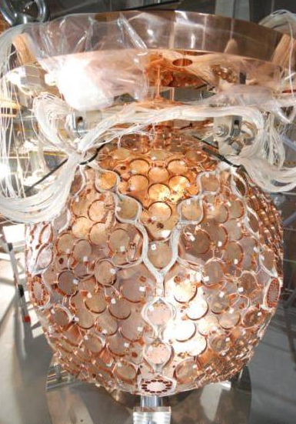
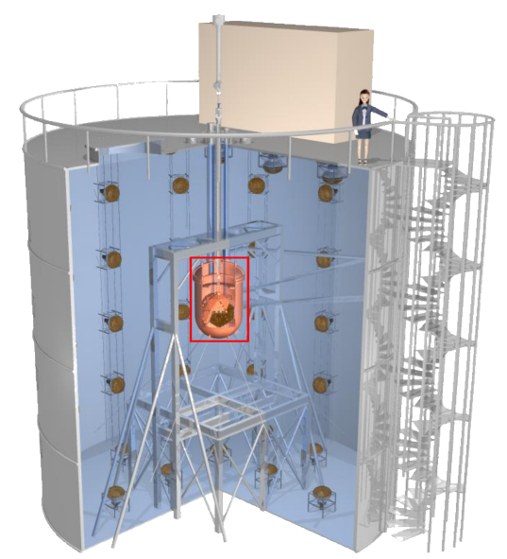
XMASS
Single-phase liquid xenon
@ Kamioka (Japan)
642 2.5” hex PMTs
830kg total, 100kg fiducial
Light yield 14 PE/keVee
Moriyama, IDM2010

Slide 22
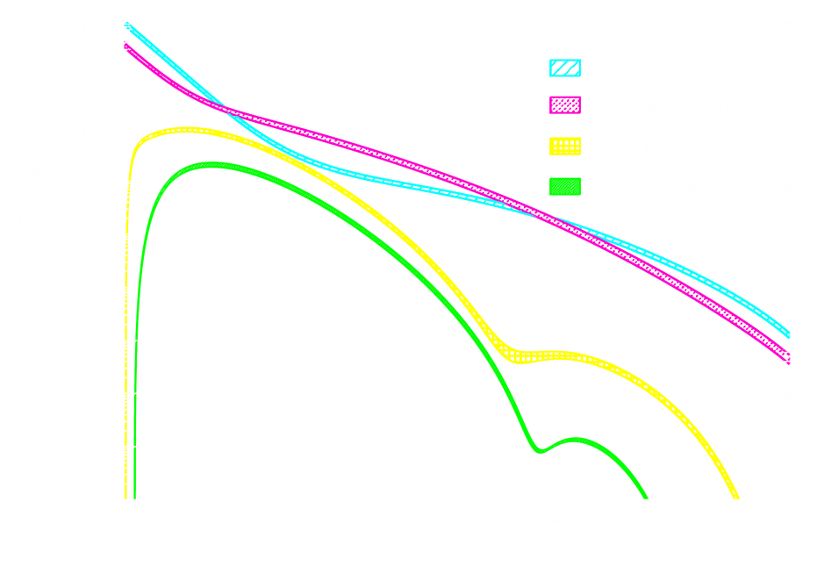
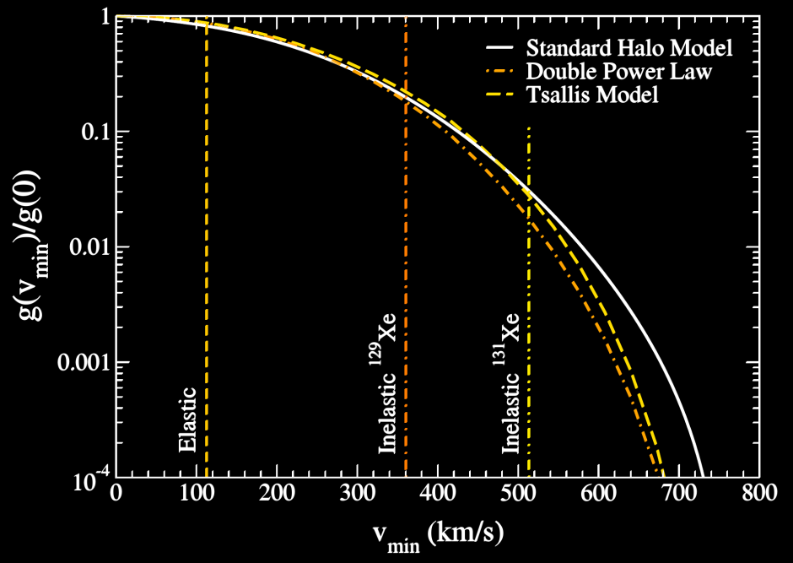
Inelastic Scattering
cross-check limits, measure halo
¹²⁹Xe
¹²⁹Xe*
¹²⁹Xe+γ_{40keV}
Baudis+ 1309.0825
XMASS 1401.4737

Slide 23
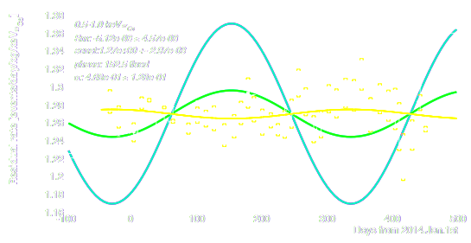
XMASS Modulation Analysis
Presented at TAUP two weeks ago: Exposure & background rate similar to DAMA but not so modulating:
Kazuyoshi Kobayashi TAUP 2015
XMASS
data 0.8 t yr
XMASS
best fit modulation
Naïve DAMA
comparison

Slide 24
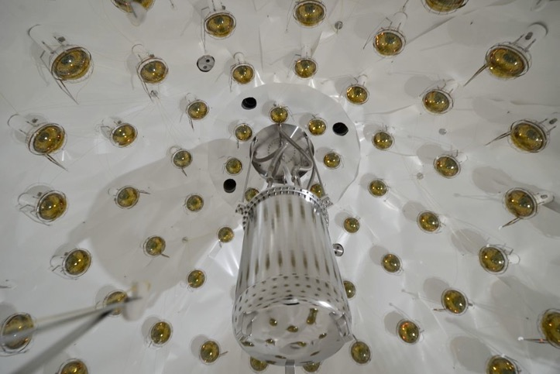
DarkSide-50
Two-phase liquid argon
@ Gran Sasso (Italy)
153kg total, 46kg fiducial
Surrounded by borated
liquid scintillator veto

Slide 25
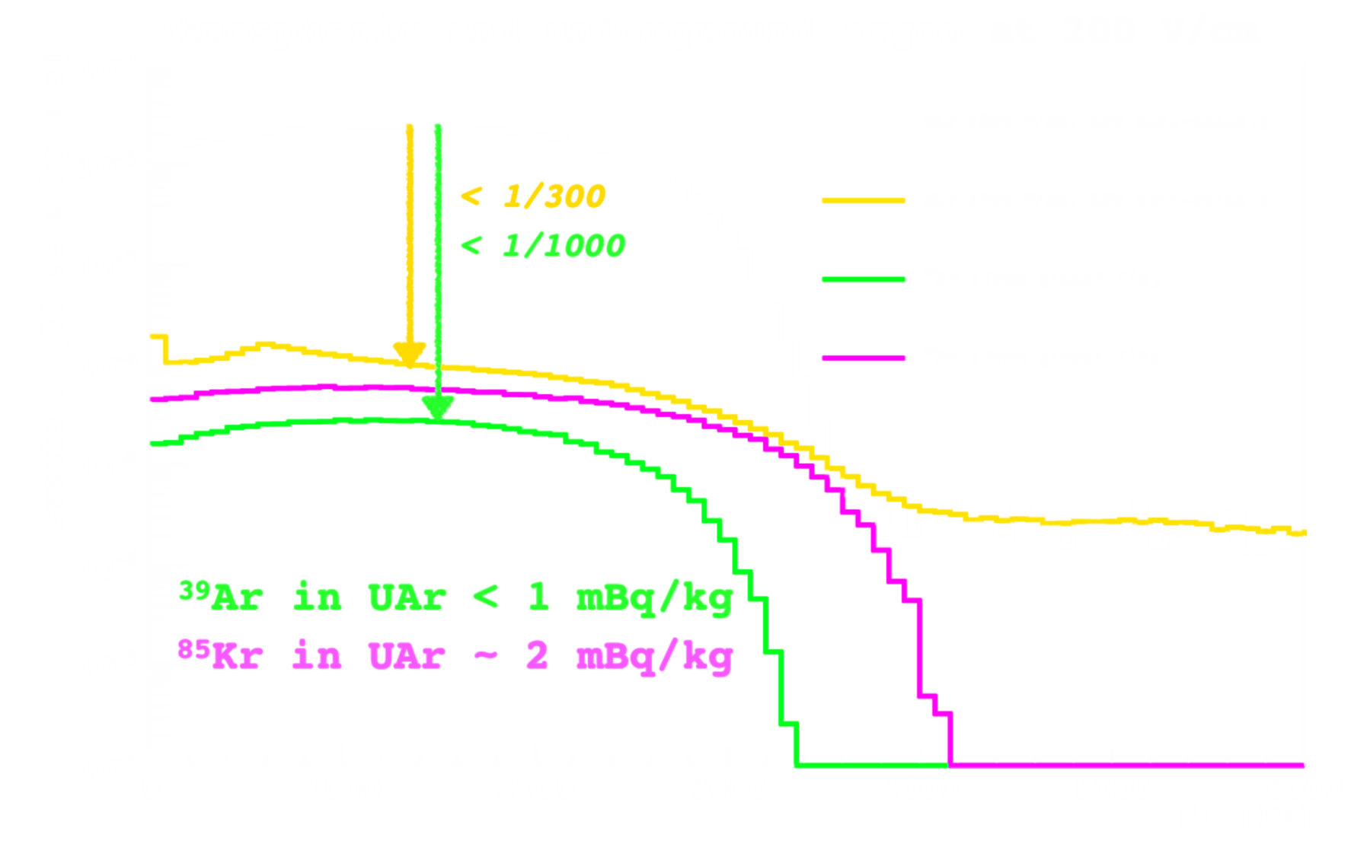
DarkSide-50 Status
Use underground Argon to get rid of 39Ar:
Expect data release “in a few weeks”
Atmospheric
argon
Underground
argon
Stefano Davini, TAUP2015
565keV
687keV

Slide 26
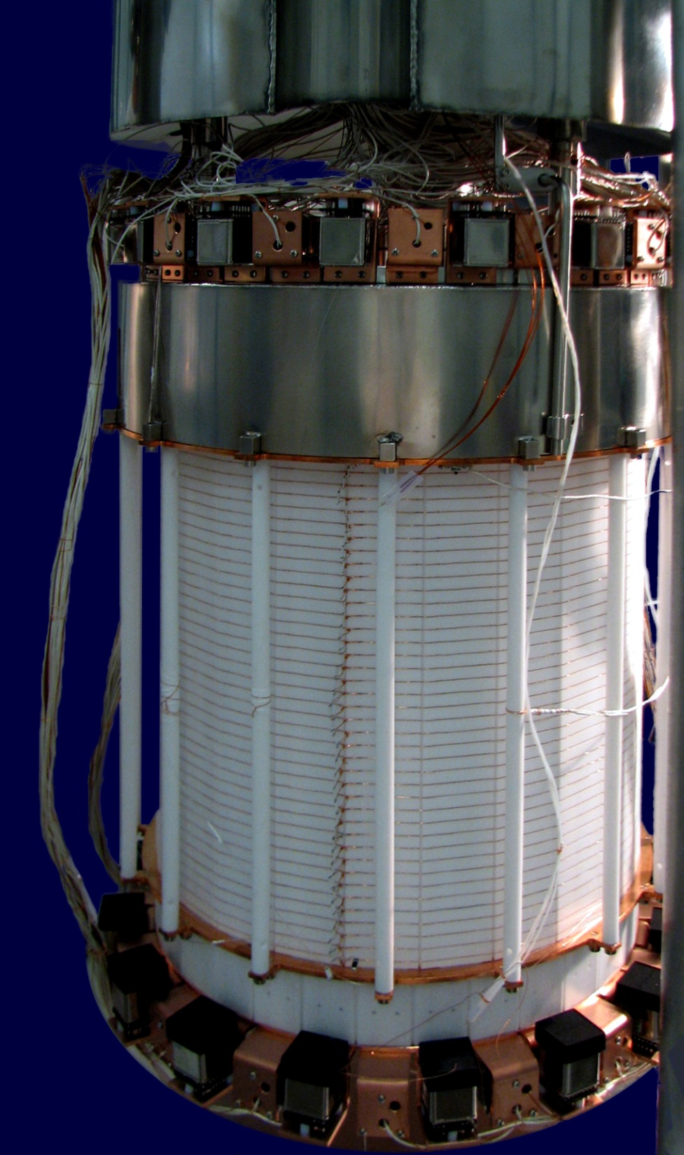
XENON100
Two-phase liquid xenon
@ Gran Sasso (Italy)
161kg total, ~34kg fiducial

Slide 27
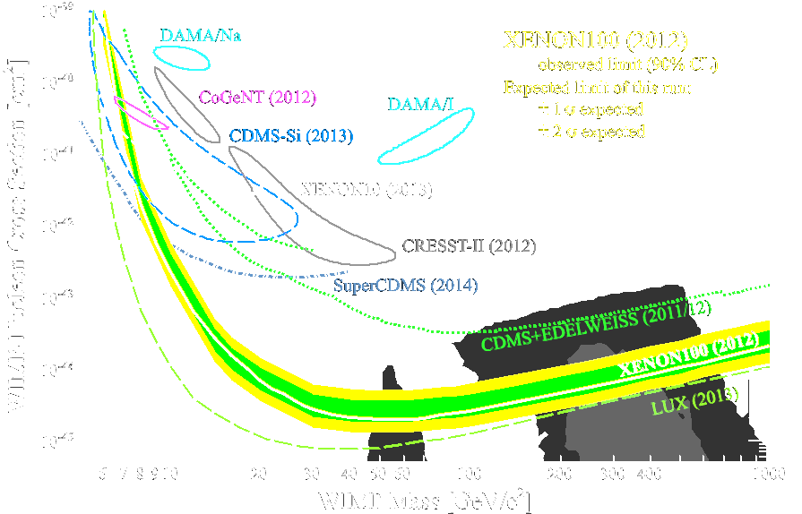
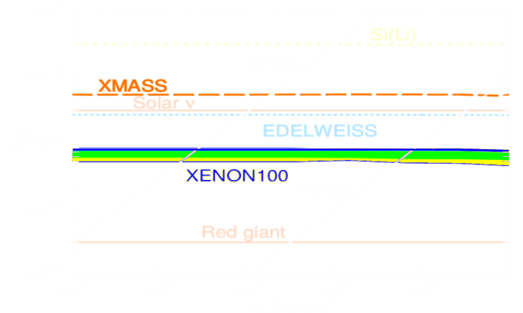
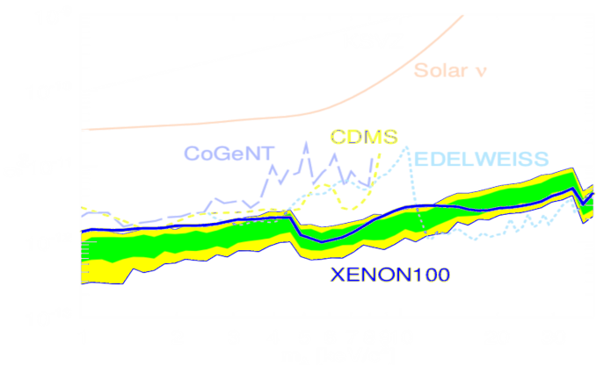
XENON100
spin-independent
Two-phase liquid xenon
@ Gran Sasso (Italy)
161kg total, ~34kg fiducial
Lots of limits…
spin-dependent neutron
solar axions
XENON100 1207.5988, 1301.6620, 1404.1455
axion-like particles
spin-dependent proton

Slide 28
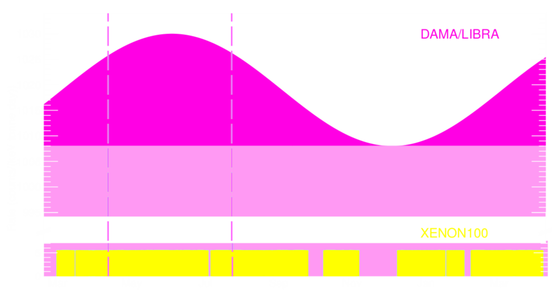
XENON100 excludes DAMA for good
XENON100 background smaller than DAMA/LIBRA modulation amplitude
XENON100 1507.07747
Excludes
axial-vector DM @ 4.4σ
mirror DM @ 3.6σ
luminous DM @ 4.6σ

Slide 29
XENON100 Modulation Analysis
XENON100 1507.07748
Modulation present at ~3 σ,
but also in multiple scatters
and at higher energy:
Some systematic or statistic
Excludes DAMA at 4.8σ

Slide 30
LUX
Two-phase liquid xenon
@ Homestake/Sanford (USA)
122 2” PMTs (R8778)
350kg total, 118/145kg fiducial

Slide 31
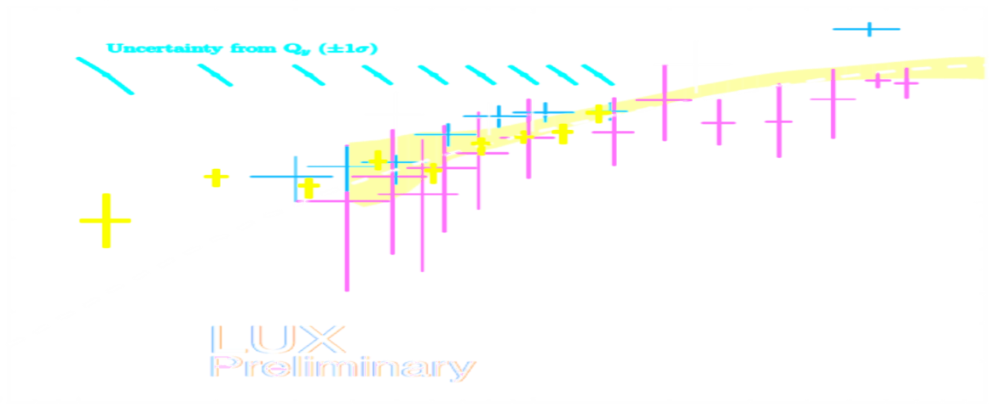
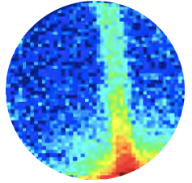
LUX in situ calibrations
in situ nuclear recoil energy calibration
electronic recoil background calibration using tritiated methane
10
Photons / keV_{nrS2}
Currie TAUP2015
2
1
1
2
4
8
Energy / keV_{nrS2}
LUX 1310.8214

Slide 32
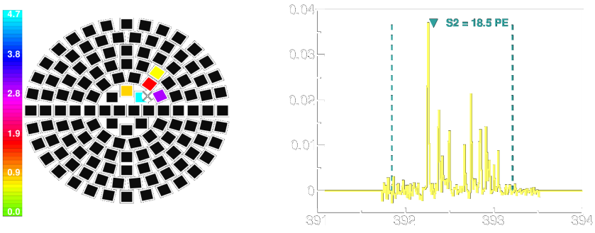
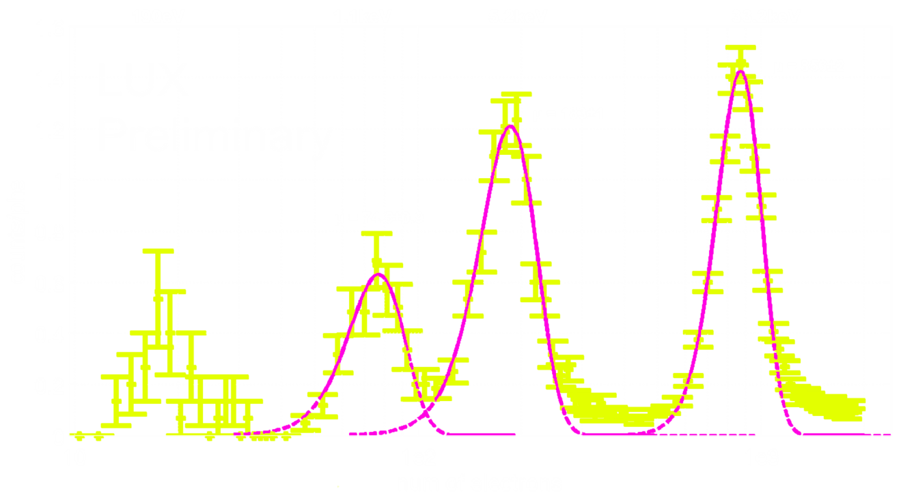
Extreme Low-Energy Sensitivity
Detect even individual electrons liberated in an interaction:
amplitude [V]
XENON100 1311.1088
time [μs]
Activated xenon calibration as low as 190eV !
¹²⁷I
¹²⁷Xe EC
LUX D.Huang APS2015

Slide 33
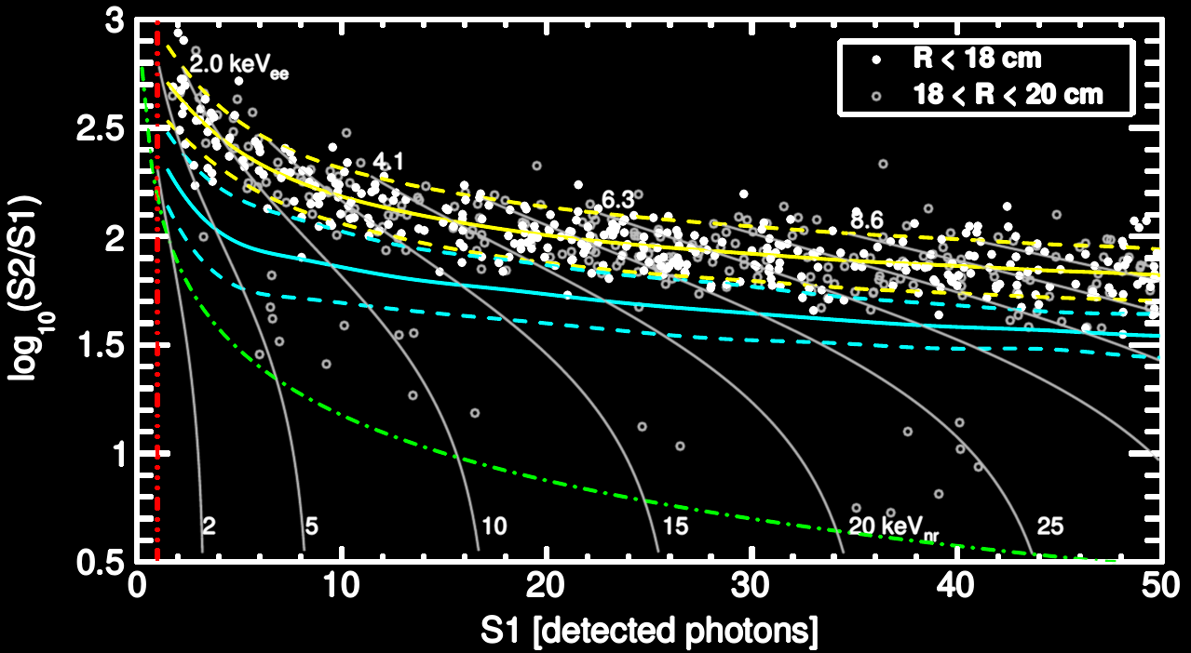
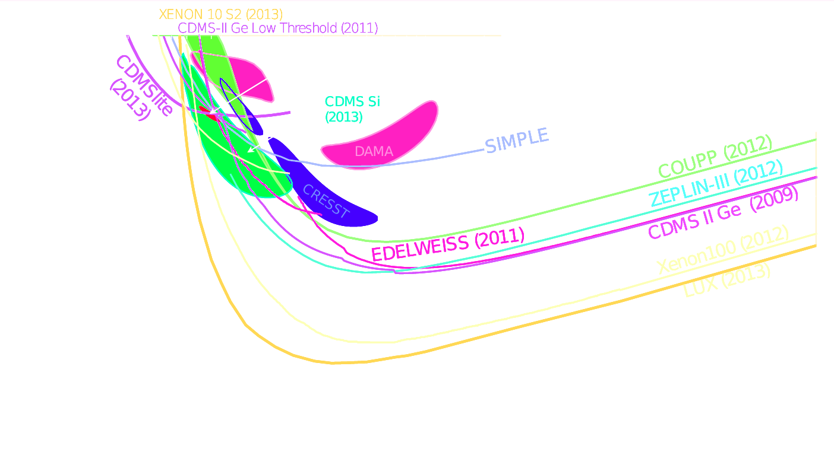
LUX Status: Non-blind Reanalysis
85 → 95 days
118 → 145kg fiducial
3keV_{nr} → 1.2keV_{nr}
energy threshold
Better modeling
Alastair Currie, TAUP 2015
LUX
preliminary
Updated limit “still a few weeks away”
300 days run in progress

Slide 34
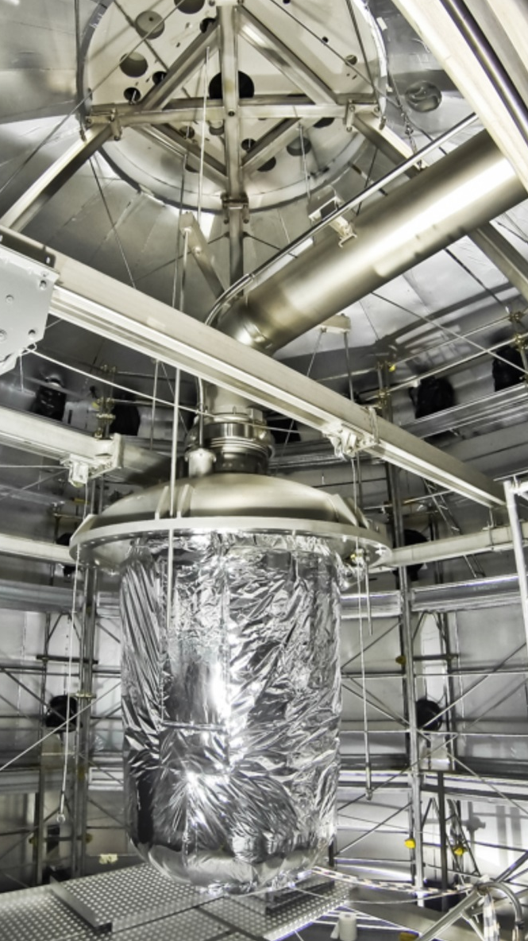
XENON1T
Two-phase liquid xenon
@ Gran Sasso (Italy)
248 3” PMTs (R11410-21)
3300kg total, 2000kg active
Inauguration this year
2 orders of magnitude in sensitivity with 2 live years of operation
And another factor ~10
with offhand upgrade
to XENONnT

Slide 35
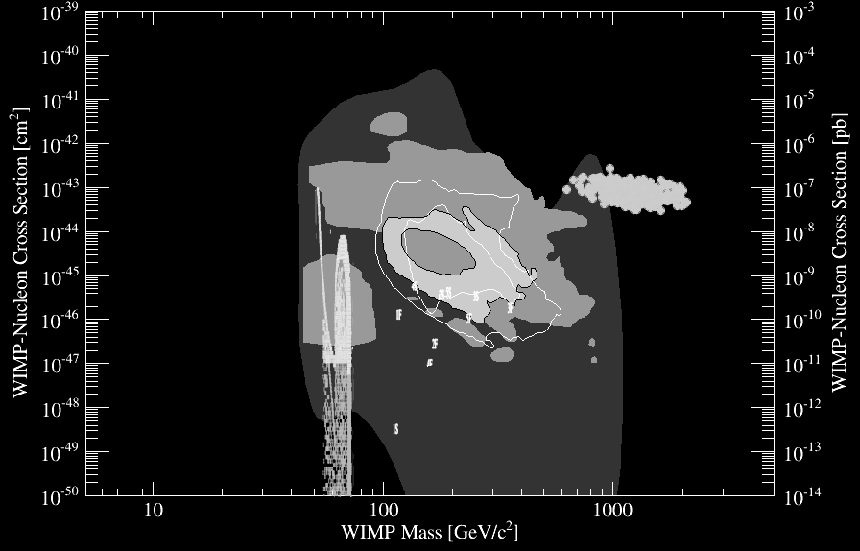
Spin-Independent Channel
cryogenics
ruled out
Baltz&Gondolo,Roszkowski+,
Kadastik+,Buchmueller+,Burgess+
liquid
nobles
WIMP-nucleon cross section [cm²]
SNOWMASS 1310.8327
WIMP mass [GeV/c²]

Slide 36
Outlook – Shown are starting dates
CRESST-III
EDELWEISS
2015+
ruled out
ruled out
Baltz&Gondolo,Roszkowski+,
Kadastik+,Buchmueller+,Burgess+
CDMS*
2018+
LUX 2014+
WIMP-nucleon cross section [cm²]
XENON1T 2015+
SNOWMASS 1310.8327
XENONnT 18+, LZ 19+
DARWIN 30t
WIMP mass [GeV/c²]

Slide 37
Atmospheric Neutrinos Far Away
CRESST-III
EDELWEISS
2015+
ruled out
ruled out
Baltz&Gondolo,Roszkowski+,
Kadastik+,Buchmueller+,Burgess+
CDMS*
2018+
LUX 2014+
WIMP-nucleon cross section [cm²]
⁷Be
⁸B
XENON1T 2015+
SNOWMASS 1310.8327
>4 orders of magnitude
XENONnT 18+, LZ 19+
DARWIN 30t
atm&DSNB
Billard, Strigari
& Figueroa 1307.5458
coherent neutrino-nucleus scattering signal
WIMP mass [GeV/c²]

Slide 38
8B Neutrino CNNS Within Reach
CRESST-III
EDELWEISS
2015+
ruled out
ruled out
Baltz&Gondolo,Roszkowski+,
Kadastik+,Buchmueller+,Burgess+
CDMS*
2018+
LUX 2014+
WIMP-nucleon cross section [cm²]
⁷Be
⁸B
XENON1T 2015+
SNOWMASS 1310.8327
CNNS with XENON1T next year
>4 orders of magnitude
XENONnT 18+, LZ 19+
DARWIN 30t
atm&DSNB
Billard, Strigari
& Figueroa 1307.5458
coherent neutrino-nucleus scattering signal
WIMP mass [GeV/c²]

Slide 39
XENON1T Sensitivity
¼ of electronic recoil background at low energies is due to pp solar ν!
Fair chance to detect nuclear recoils from
⁸B coherent neutrino-nucleus scattering
and even from nearby supernovas
materials
Solar pp ν
²²²Rn 1μBq/kg
¹³⁶Xe 2ν2β 2x10²¹yr
⁸⁵Kr 0.2ppt ^{nat}Kr

Slide 40
XENON: Low Energy Observatory
Liquid Noble Physics
Light and charge yield
Properties of the liquids
Radioactivity Assays
Particle Interaction Modeling
Pushing the Technology
Astrophysics
Measure solar pp ν
Normalization of ⁸B solar rate
Supernovae
Double-Beta
Two-Neutrino Decay of ¹³⁶Xe
Neutrinoless Decay of ¹³⁶Xe
Double-EC on ¹²⁴Xe
Dark Matter
Spin-independent WIMPs
Various couplings
GeV WIMPs (“S2-only”)
Inelastic WIMPs
Magnetic Inelastic WIMPs
Axial-Vector coupling
Mirror, Luminous DM
MeV WIMPs
Axion-Like Particles
Particles Physics
Coherent Scattering
Neutrino Oscillations
Sterile Neutrinos
Solar Axions
Fractionally Charged Particles

Slide 41
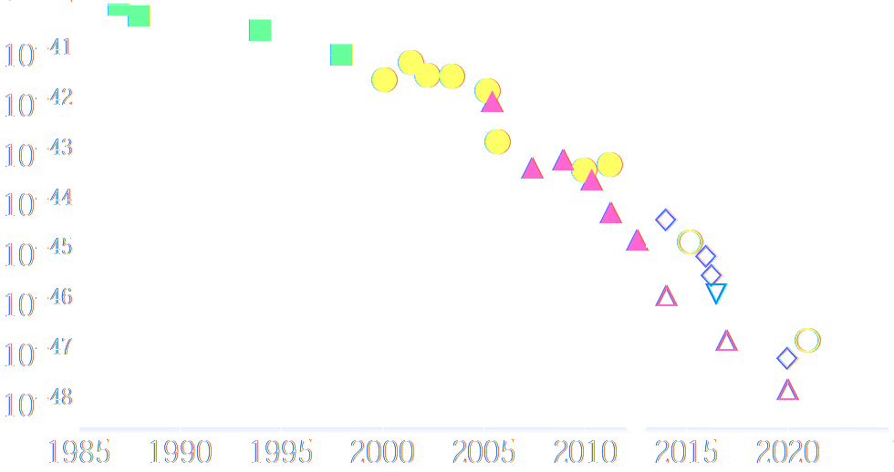
Conclusions
Liquid noble elements make excellent detectors
Sensitivity doubles every year (exceeding Moore’s law)
Very good control of systematic uncertainties (%-level)
Sensitivity to individual quanta (photons, electrons)
Many versatile channels, even neutrinos
2ν0β
CDMS
5TeV SI limit / cm²
XENON
SWONMASS 1310.8327
1990
2000
2010
2020
year

