Slide 1
Opportunities for PoF IV (2021-2027)
Marc Weber

Slide 2
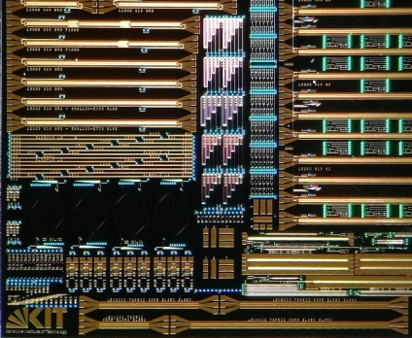
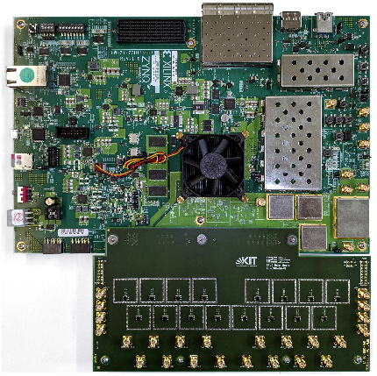
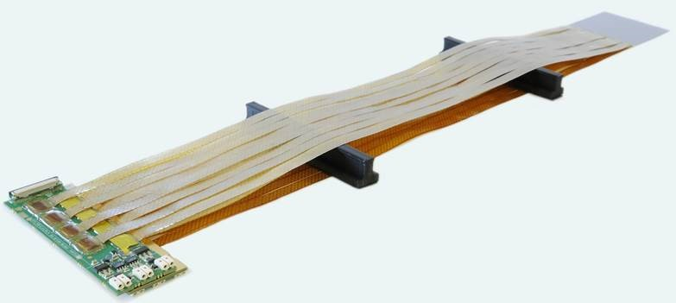
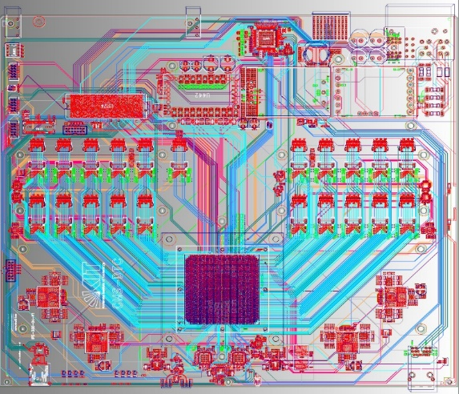
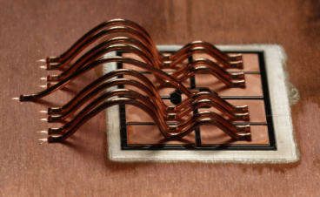
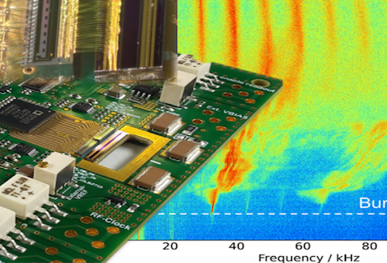
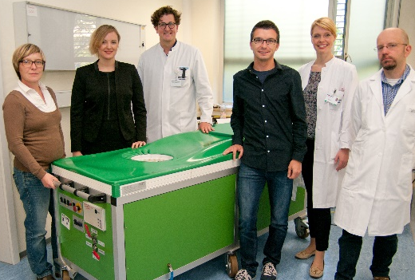
HV-CMOS
Silicon photonics
Superconducting sensors
Silicon module production
ECHo & QC
BMS & power electronics
High-throughput DAQ
THz Beam diagnostics
3D-USCT

Slide 3
Disclaimer
All projects require commitment, competence and creativity
All projects should be good fun
All projects matter for our partners
“All project are equal, but some projects are more equal than others”
George Orwell

Slide 4
Features of the ideal project
High-tech
Builds on core-competence of IPE
World-level or world-leading
Impact and relevance for others
Capable of attracting funding
Attractive for students
Regular publications
Strong partners

Slide 5
Why do good projects matter?
Since the creation of program MT and topic DTS, IPE is constantly being evaluated.
We have come a long way and must remain ambitious and curious.

Slide 6
HV-CMOS
Wonderful technology. World-leading. Must now be smart in getting it into experiment.

Slide 7
3D-USCT
It has been a slog. One of the most nerve-wrecking projects. Huge potential.

Slide 8
Silicon module production
Silicon sensors are ubiquitous. We need module assembly competence at KIT and IPE.
We will plow through CBM.

Slide 9
Silicon photonics
Pioneering approach. Great progress and potential. Need to be fast and smart in getting it used.

Slide 10
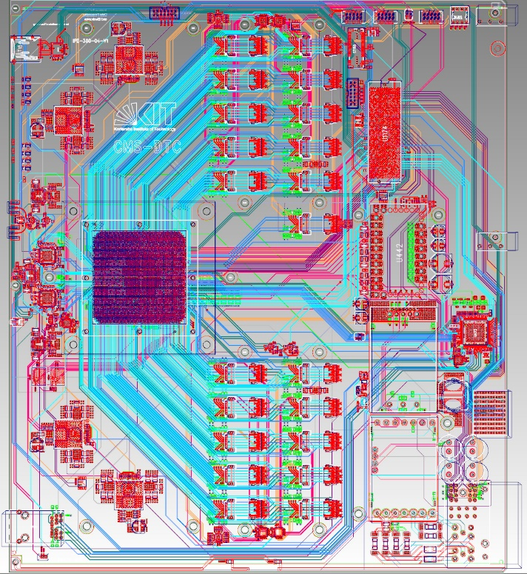
High-throughput DAQ
Core competence of IPE. Projects like the CMS track trigger build on it and help us to stay at the cutting edge. We got > 3 M€ of funding for CMS TT.
Need to see high-throughput DAQ projects through!
Should also get our DAQ into PANDA and hopefully photon detectors at FELs.

Slide 11
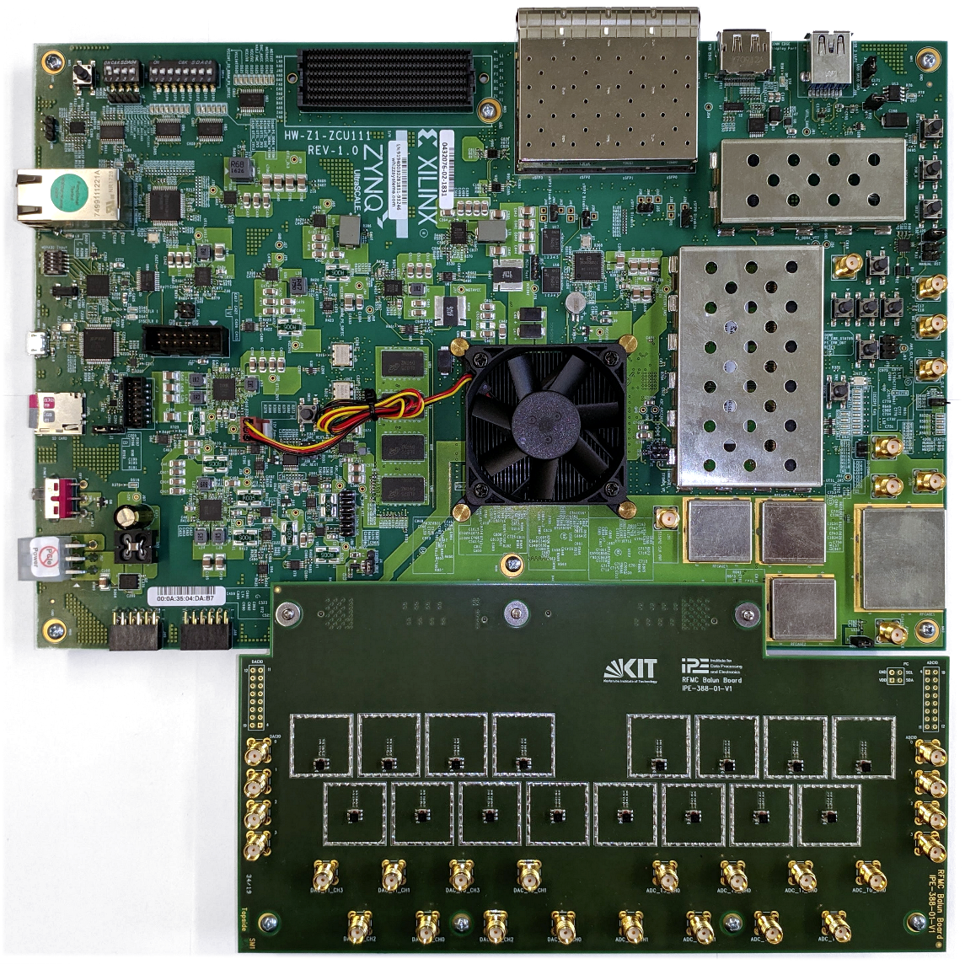
ECHo & Quantum Computing
Readout of superconducting sensors and quantum computing share have many synergies.
Fast-growing projects and huge opportunities.
Wonderful collaboration with Argentina/UNSAM
Time is of the essence to get our readout platform for MMCs accepted as a standard in the low-temperature community.

Slide 12
HSS – High-resolution superconducting sensors
Could become the most high-tech project of IPE. Building block for future excellence clusters. High priority.

Slide 13
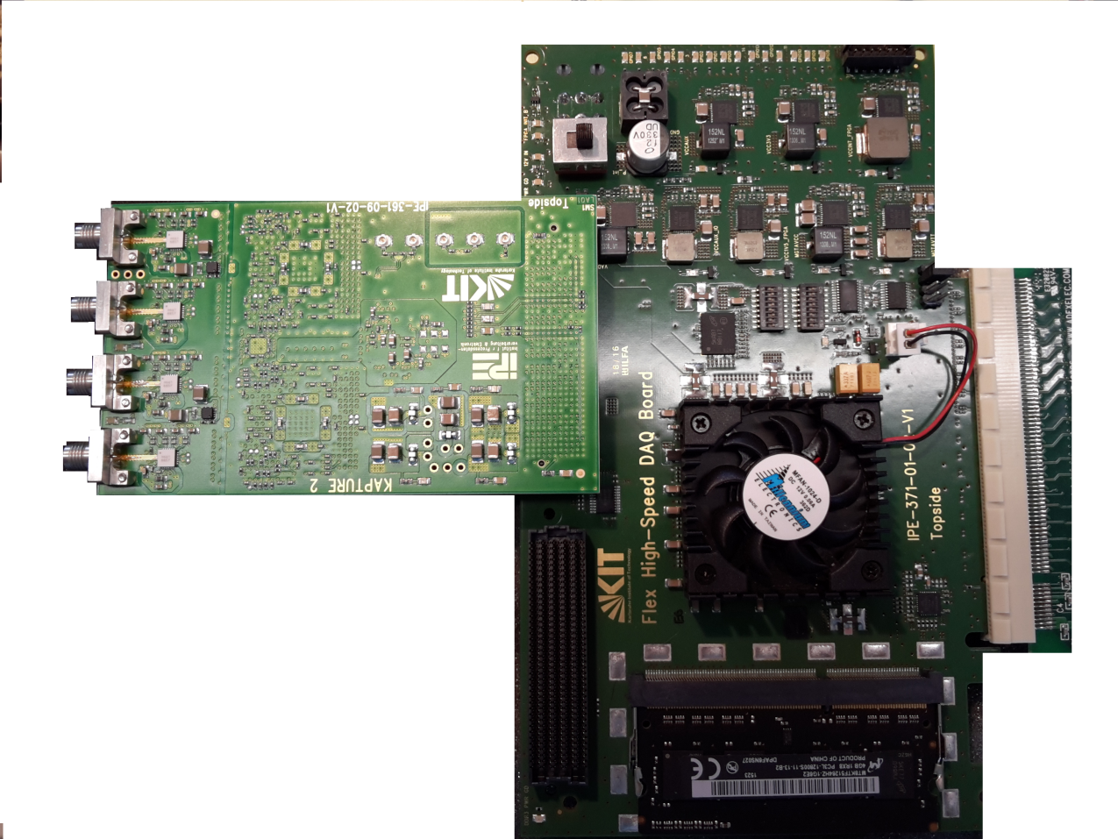
THz beam diagnostics
All is well. High-visibility. Need to consolidate and sort out technology transfer, while entering new pastures.

Slide 14
BMS & power electronics
Delivery of TT project was very successful. Attracts students. Contributes to core mission of KIT.
IPE is very visible in program SCI/ESD.
We contribute to Graduiertenkolleg “Energy status data”.
Industry partners.

Slide 15
Projects | High-tech | Core competences | World-level | Impact | Funding | Students | Publications | Partners
HV-CMOS
3D-USCT
Silicon module production
ECHo & QC
Silicon photonics
Superconducting sensors
THz Beam diagnostics
High-throughput DAQ
BMS & power electronics

