Slide 1
Storage and Cross-Linked Infrastructure (SCI) in der POF-IV
Projektleitertreffen IPE „Räume“
05. März 2020

Slide 2


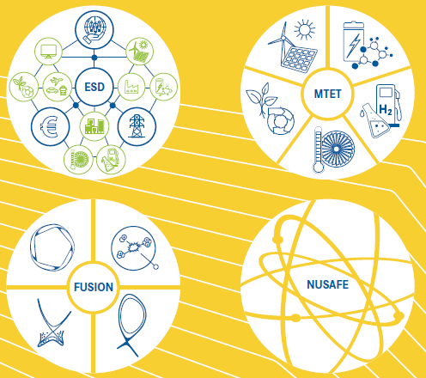
SCI in POF-IV
Research Field Energy
Energy System
Design
Materials & Technologies
for
the Energy Transition
SCI: POF-III (~8 PY)
MTET: POF-IV ~ 4 PY
ESD: POF-IV ~ 4 PY

Slide 3
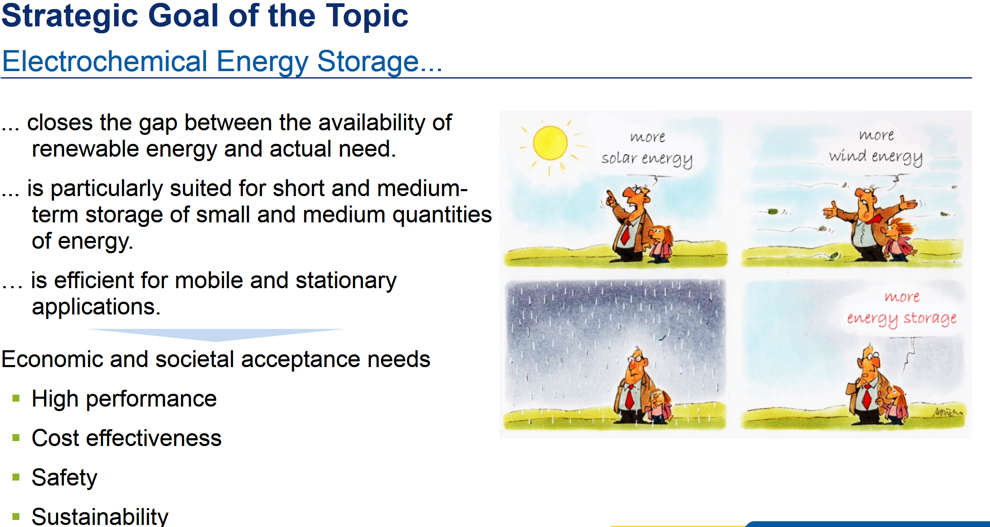
MTET - Batteries in POF-IV

Slide 4
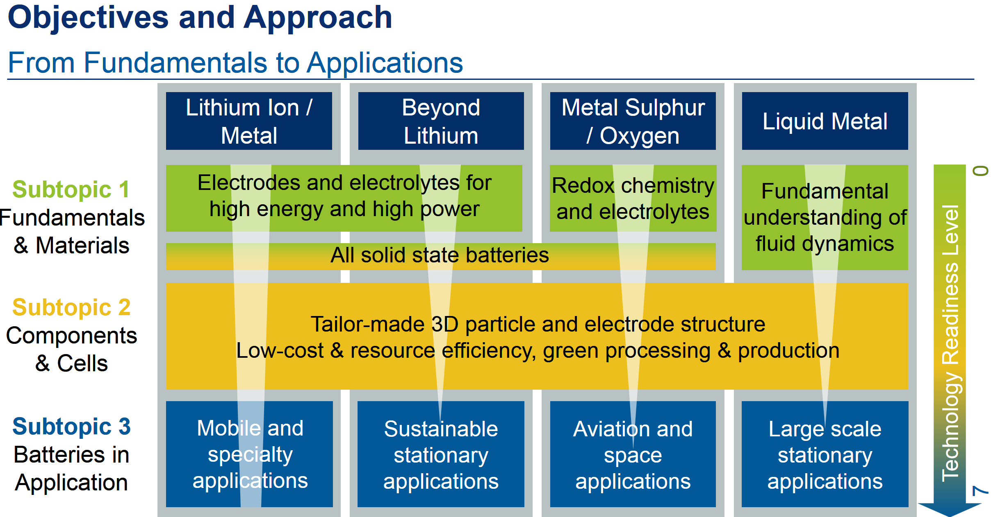
MTET - Batteries

Slide 5
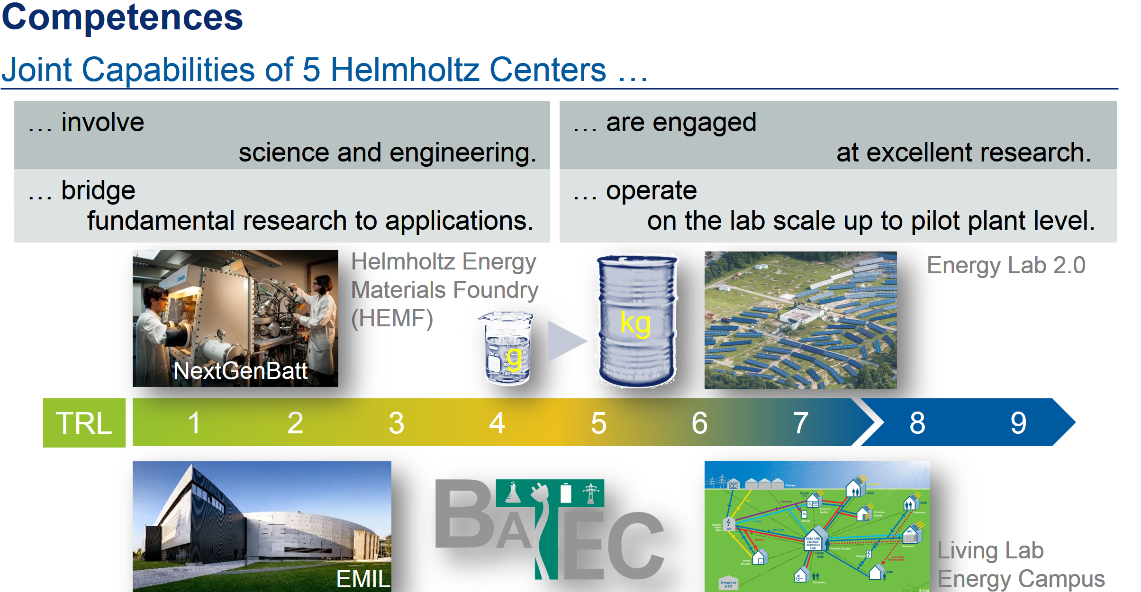
MTET - Batteries

Slide 6
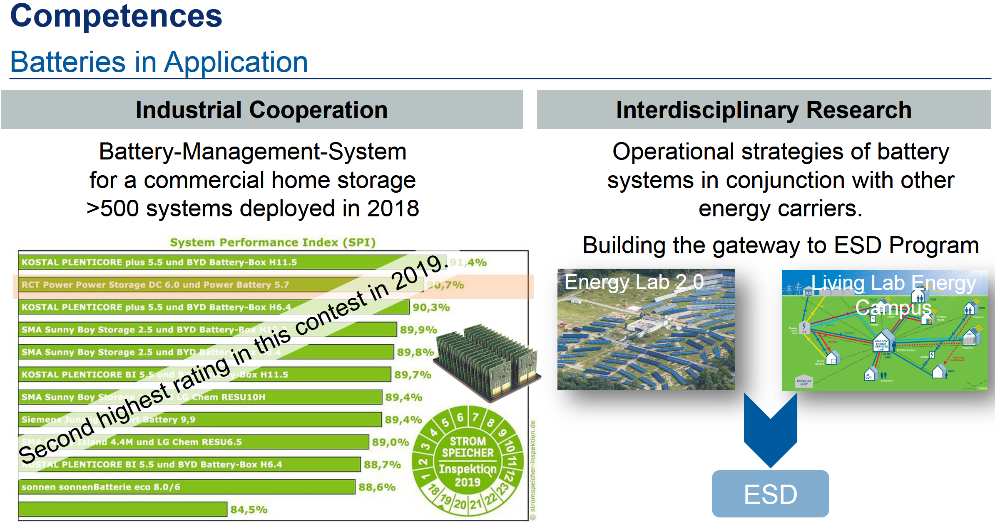
MTET - Batteries
RCT-Battery TT-Projekt; B2B Titelstory März 2020

Slide 7
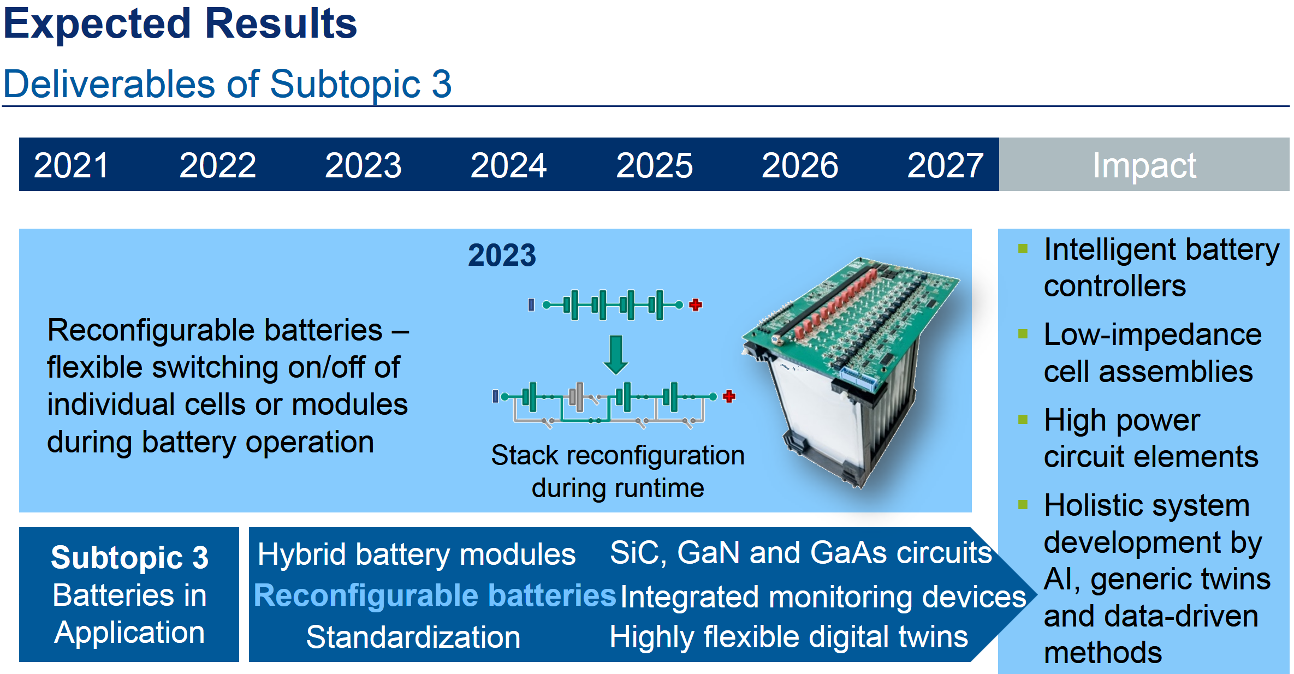
MTET - Batteries
MS-2023: IPE - Simon Bischof (GRK)
IPE – H. Wurst, B. Leyrer, T. Blank

Slide 8
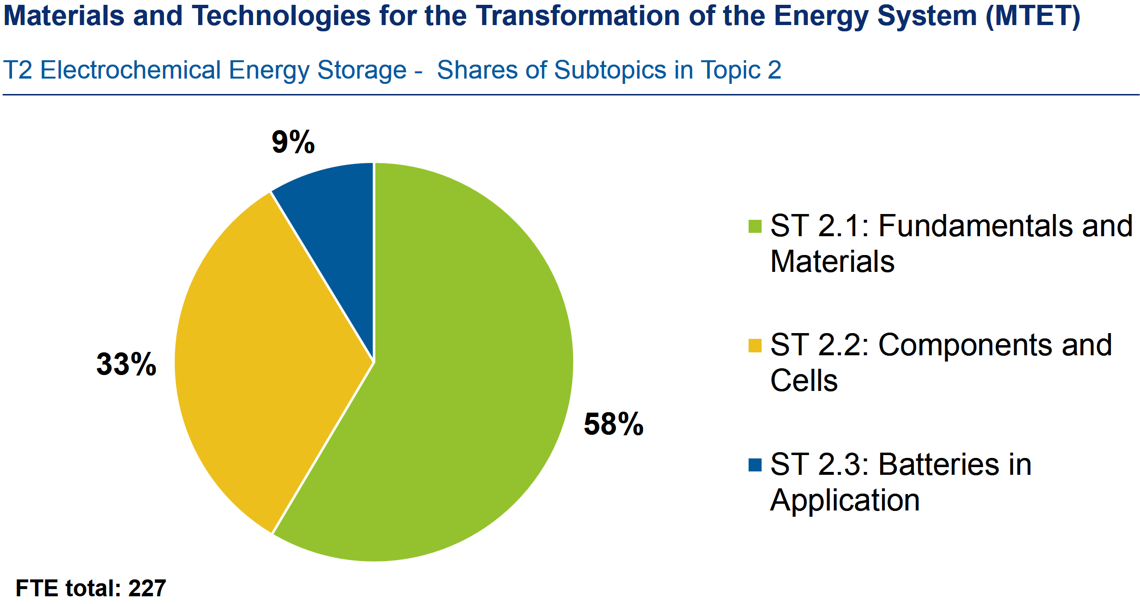
MTET - Batteries
9% = 20.43 PY, 4 PY (IPE) (20%)

Slide 9
ESD – Energy System Design
ESD
Topic 1: Energy System Transformation
Topic 2: Digitalization and System Technology
Strategic Goals
Techno- and socioeconomic
analysis of energy systems
develop methods and technologies to
design and operate
  resilient,
  decentralized and
  sector-integrated
energy systems
demonstrated and validated in smart energy system laboratories under close-to-real conditions
IT-secure coupling of the electricity, gas, heat and mobility sectors

Slide 10
ESD – Digitalization and System Technology
Topic 2: Digitalization and System Technology
Develop and evaluate system technologies (concepts, methods, hard- and software) to enable system integration and operational management of flexibility solution technologies
Integration into energy systems, with the aim of creating a reliable and secure energy system.
Subtopic 2.1: Digitalization and Systems Technology for Flexibility Solutions
Mini-grids and cellular approaches.
Grid-connected heating systems,
Domestic cross-sectional energy converter and storage systems
Grid integration technologies for electric vehicles.
Subtopic 2.2: Design, Operation and Digitalization of Future Energy Grids
IT
Subtopic 2.3: Smart Areas and Research Platforms

Slide 11
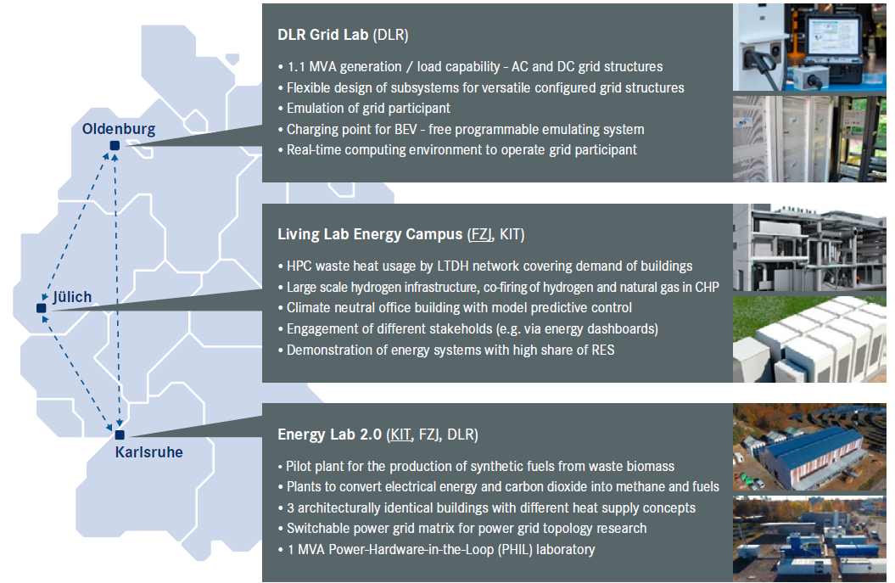
ESD – Digitalization and System Technology
Subtopic 2.3: Smart Areas and Research Platforms

Slide 12
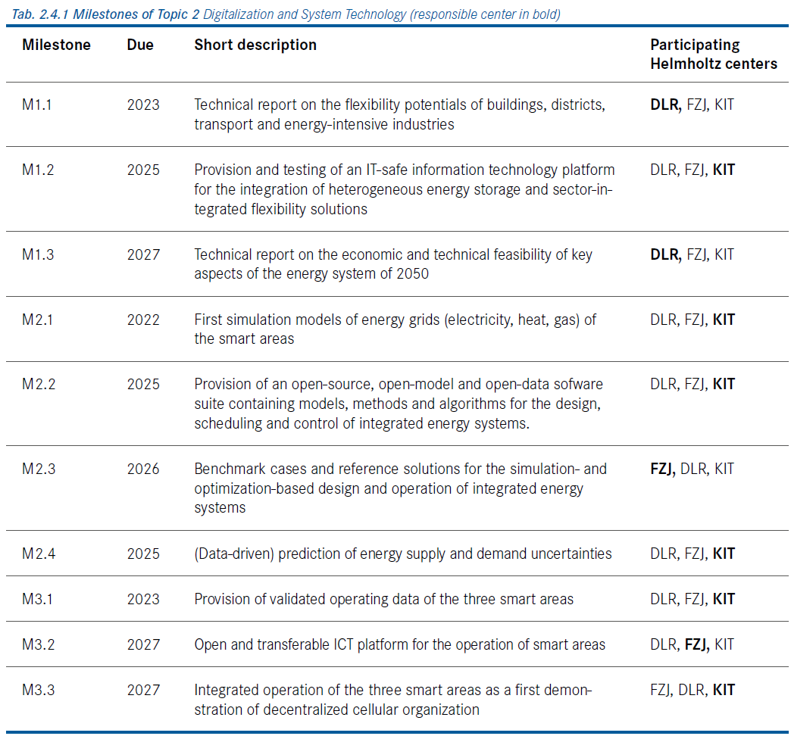
ESD – Digitalization and System Technology
Subtopic 2.3: Smart Areas and Research Platforms
EU-Project: SmILES
PhD: Z. Wu contributes
Electric Vehicle
Bidirectional Battery Operation:
PhD: M. Luh

Slide 13
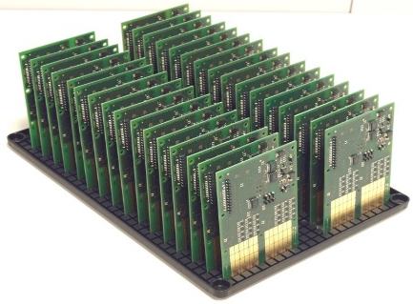
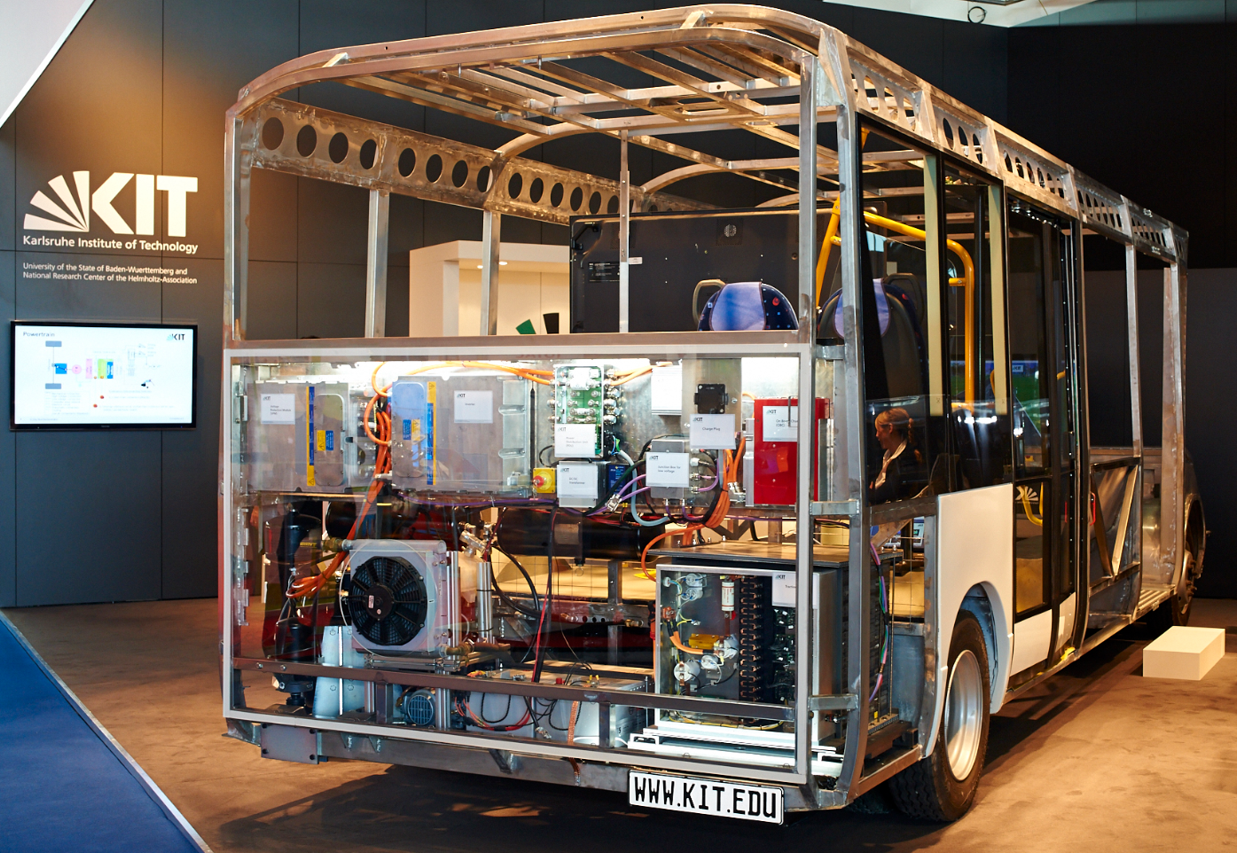
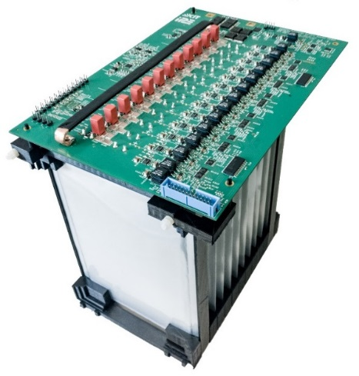
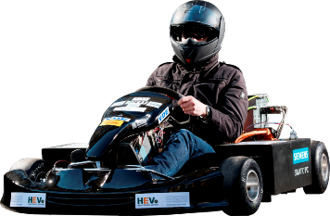
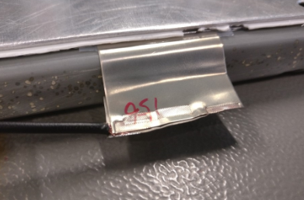
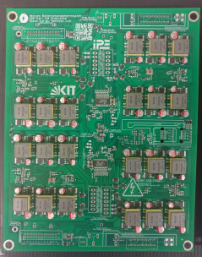
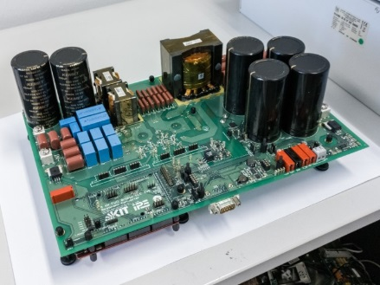
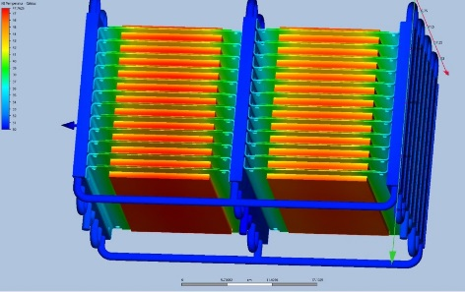
Battery related projects
BMS functional safety
Testing & simulation
Active balancing
automotive batteries
BESS
battery research at IPE
New balancing techno-logies
Battery charger
Battery inter-connects

Slide 14






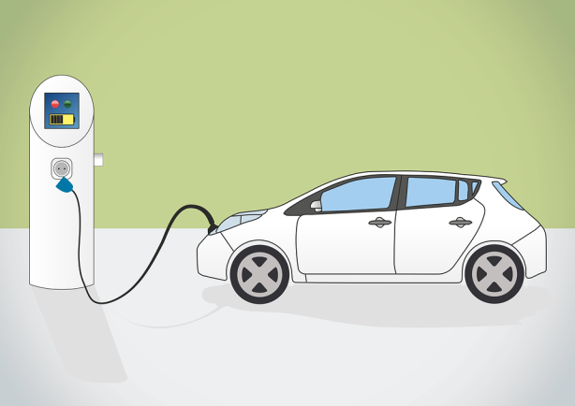





Vehicle-to-grid
What if…
Vehicle-to-Grid (V2G)
Notes:
Bei 30 – 60 kWh durchschnittlicher Akku-Kapazität

Slide 15
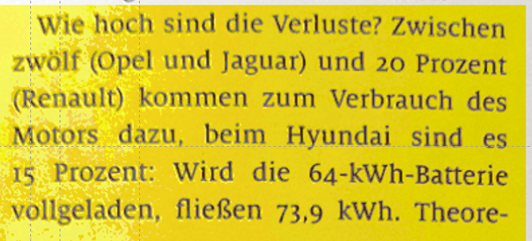
Charging Efficiency
Charging losses vary
between 12-20%
Would you spill 10 liter of gasoline on the floor
when refueling your 50 liter gasoline car ?
Ultra fast charging of EVs requires special care
in designing the electronic and concepts for
the charging infrastructure
the battery

Slide 16
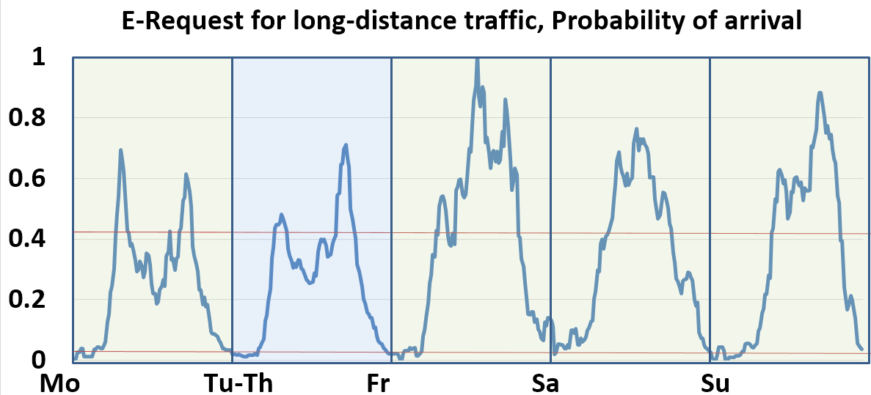

Requirements for Ultra-Fast Charging
Investigation of the probability of arrival on a charging location
in the year 2020 (German autobahn)
07:00
17:00
12:00
Monday
Friday
Saturday
Sunday
Assumption 1
1000 charging events per day
20 charging points
50 charging
events/point
Daily Dwell Time per
Charging Point: 16.7h
Assumption 2
Ultra fast charging: 20 min.
3 events/h
Reliability of Power Electronics

Slide 17

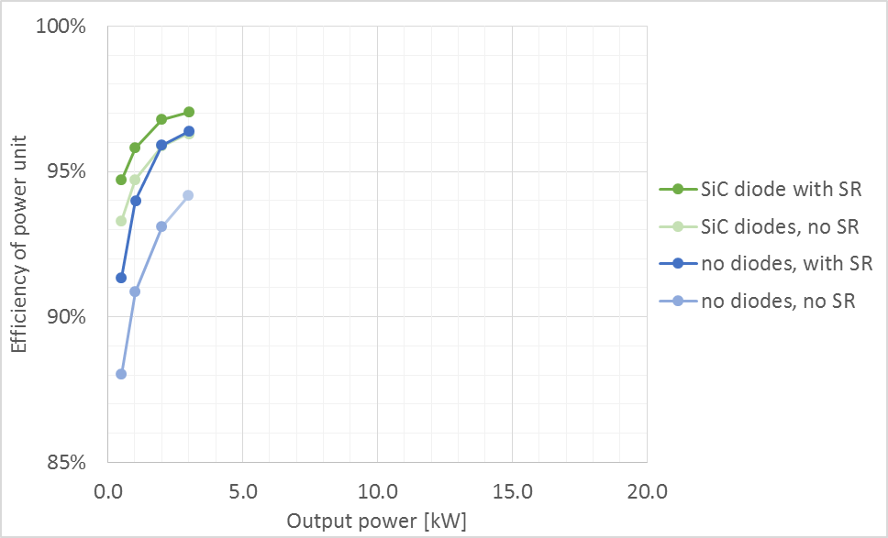
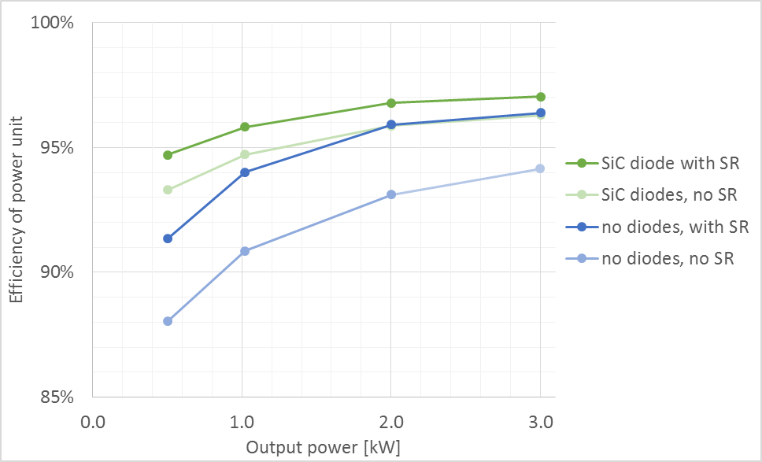
CLLLC converter
Results: Efficiency
η ≈ 97.1 % at 3 kW (air-cooled)
to be determined with liquid cooling
(in development)

Slide 18
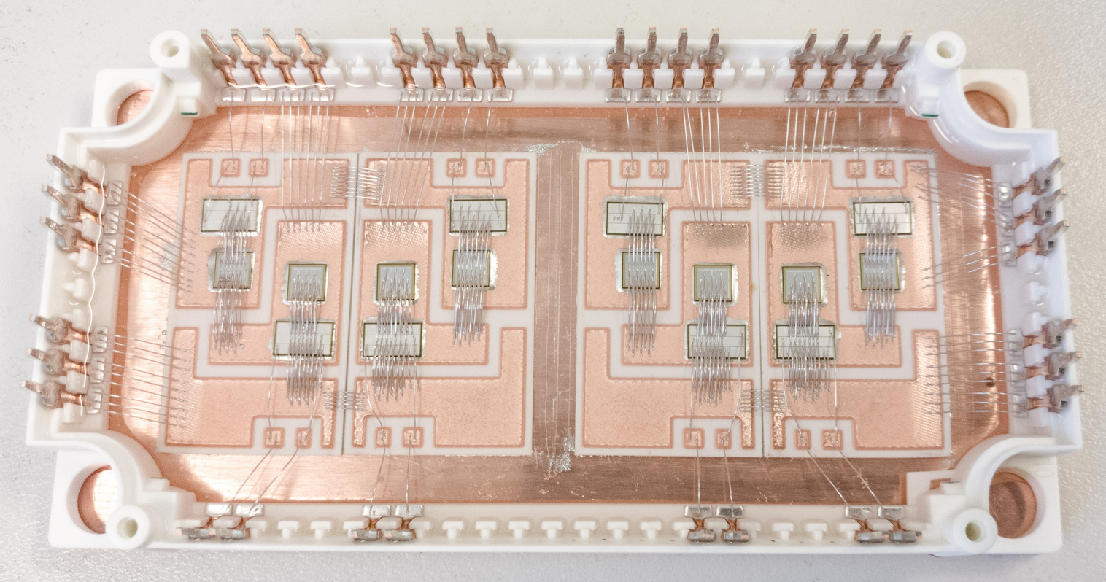
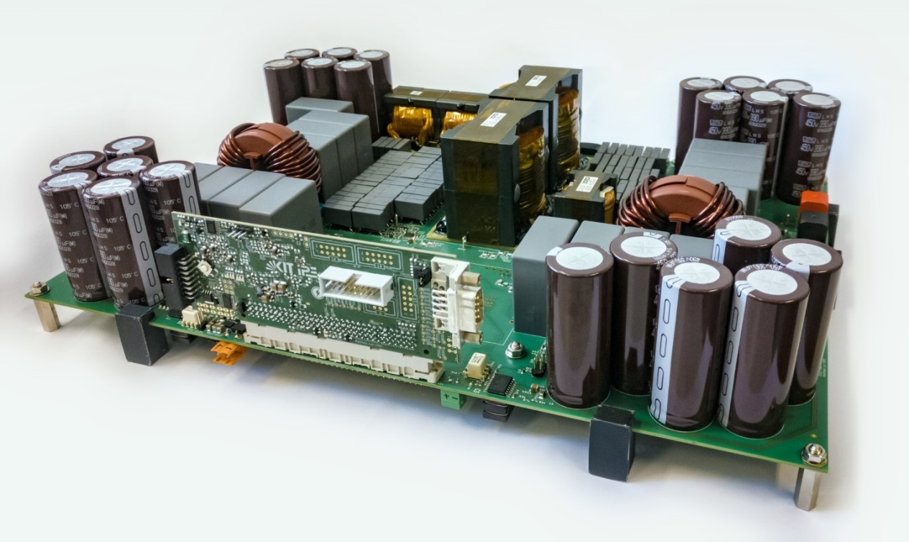
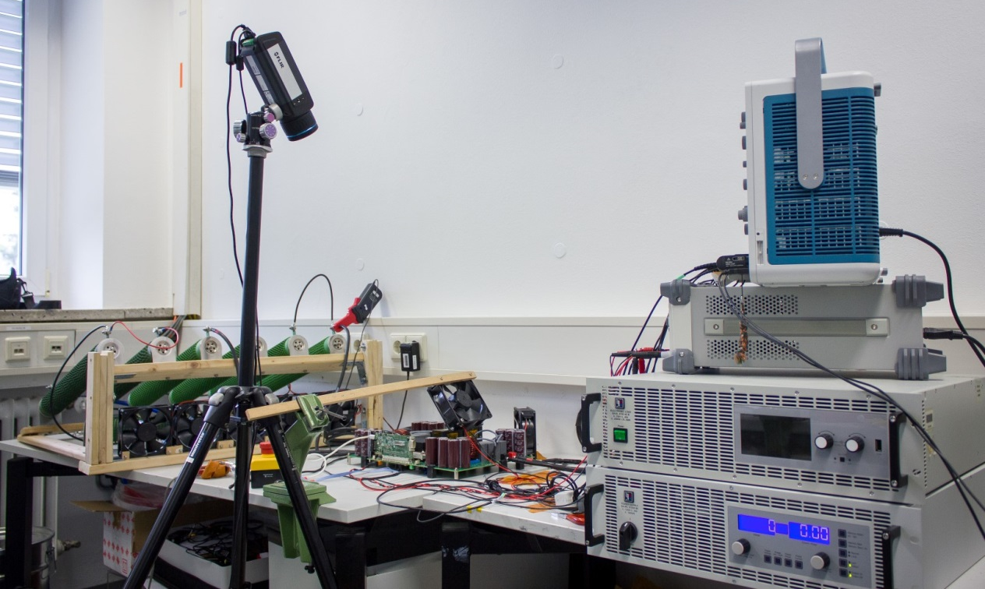
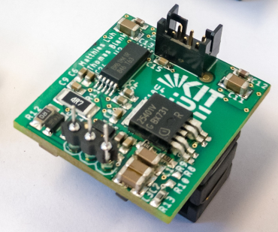
CLLLC converter
Prototype: hardware
20 kW charging/discharging power
200 - 800 V in/out voltage
0 - 40 A in/out current
CLLLC converter
Test bench
Thermal cam
Scope
CLLLC converter
Power module
(2x full-bridge)
SiC MOSFET with:
SiC / GaAs / no diodes
Power supply
Load resistors
Gate driver board

Slide 19
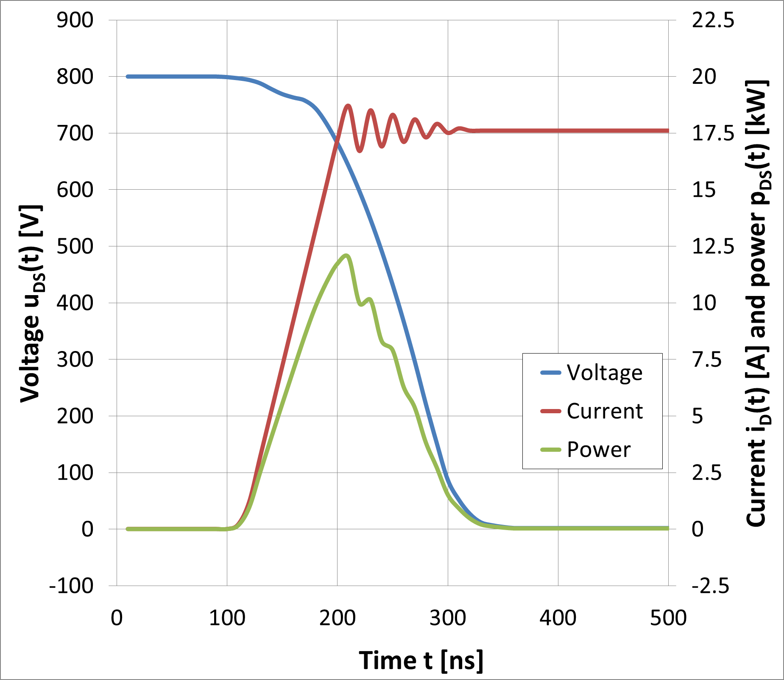
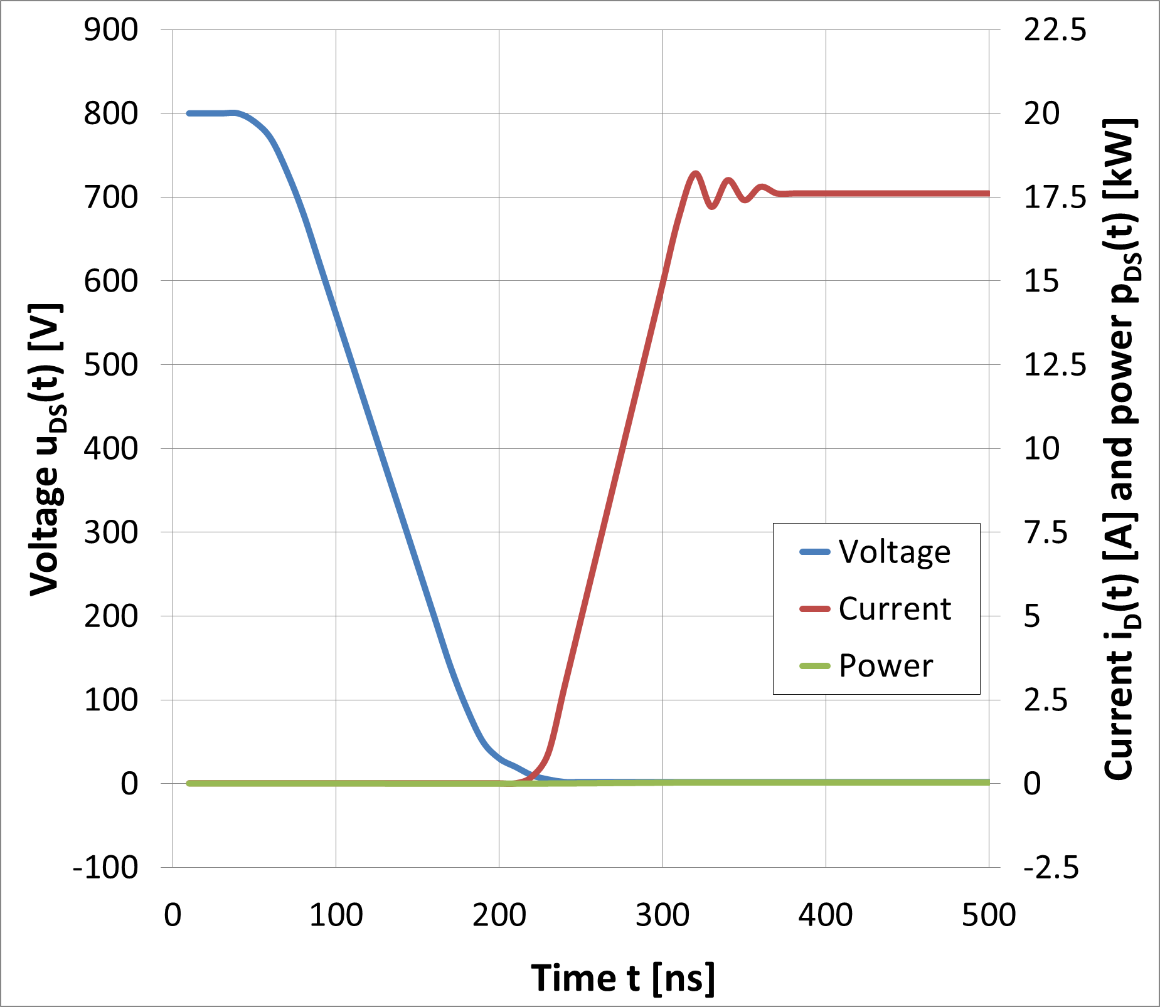
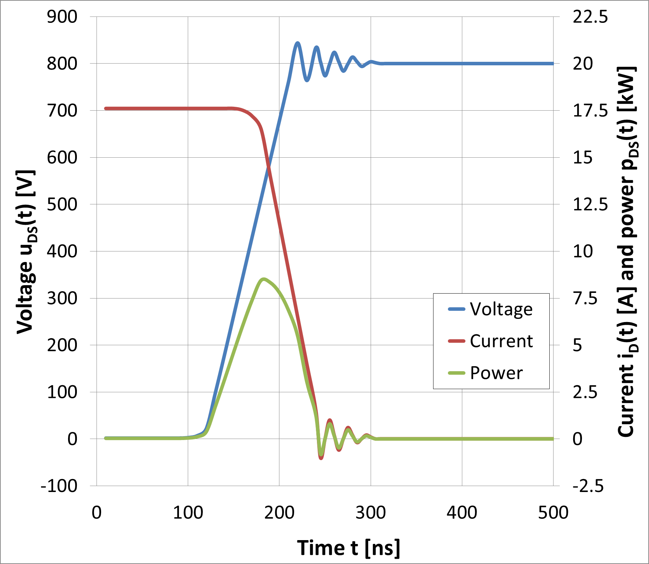
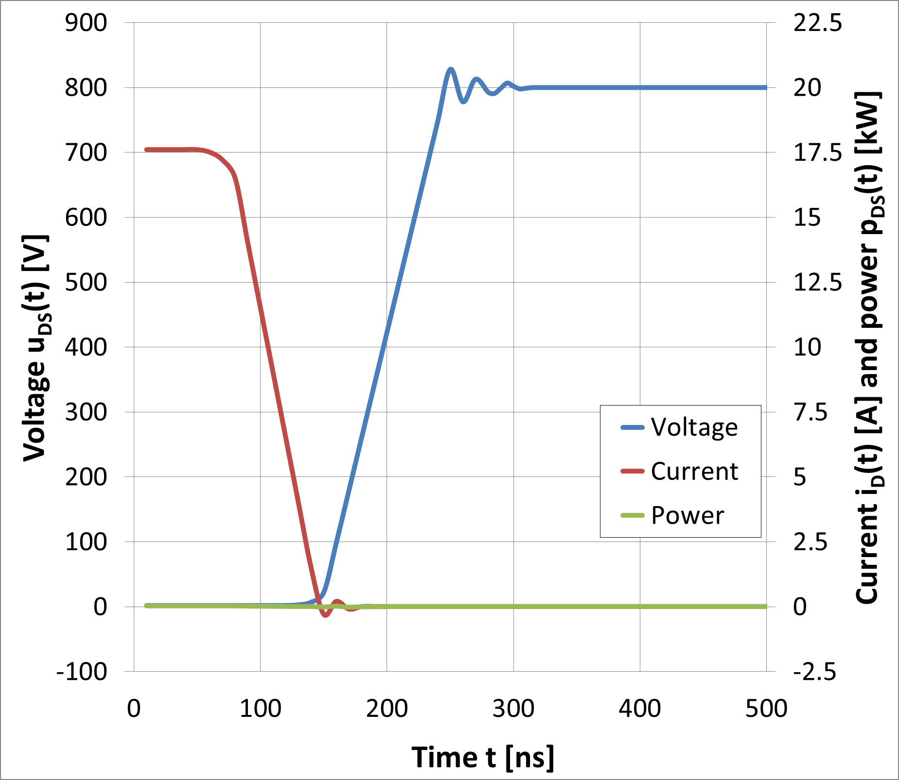
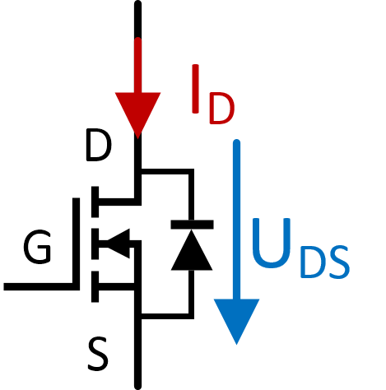
CLLLC converter
Resonant converters
“soft switching“ eliminates switching losses
Zero-Voltage-Switching / Zero-Current-Switching
Turn-on
Turn-off

Slide 20
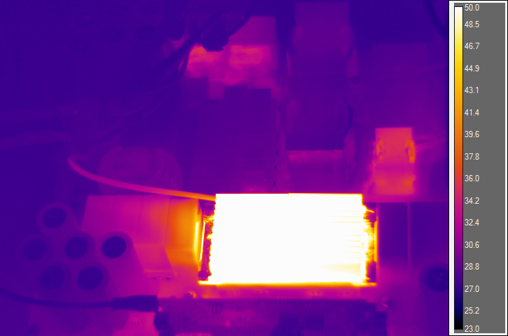
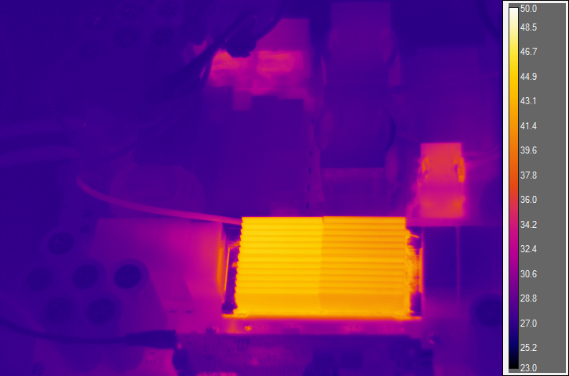
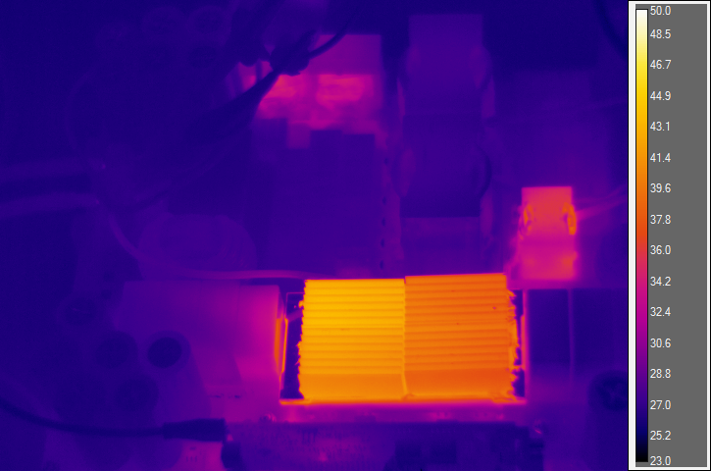
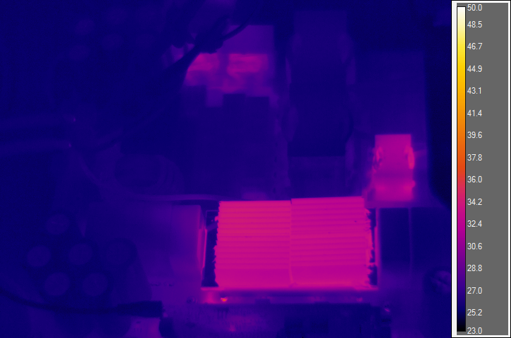
CLLLC converter
Results: Efficiency – module comparison (air-cooled)
P_{out} = 1 kW | No synchronous rectifying | With synchronous rectifying
No extra SiC diodes
Extra SiC freewheeling diodes
T_{max} = 62,8 °C
T_{max} = 45,7 °C
T_{max} = 43,6 °C
T_{max} = 33,9 °C

Slide 21
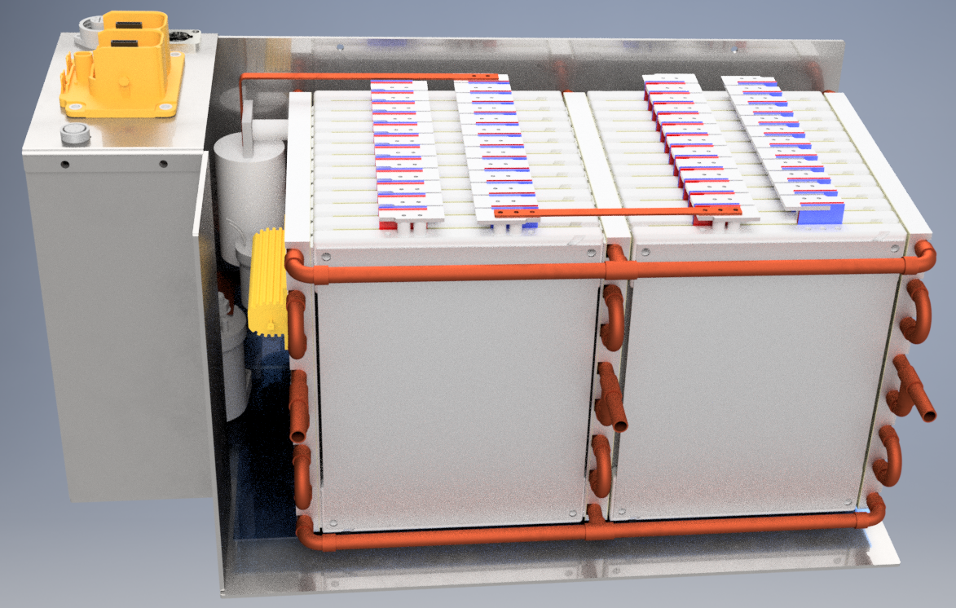
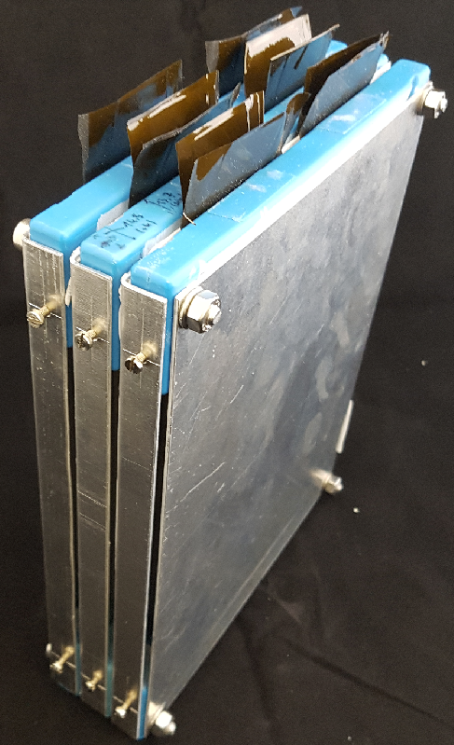
Experimental Battery Setup
48S1P module with BMS and electronic
96S1P water-cooled battery
OCV: 288 V – 400 V
Li-Ion NMC, 20 Ah Cells
Internal Resistance Ri = 2.8 mOhm
Max. Charge Rate: 8 C (160 A)
Sub-module for testing
Cross section of battery module
Acrylic sheet
Electrical insulation
Compensation of mechanical cell expansion
Thermal conduction

Slide 22
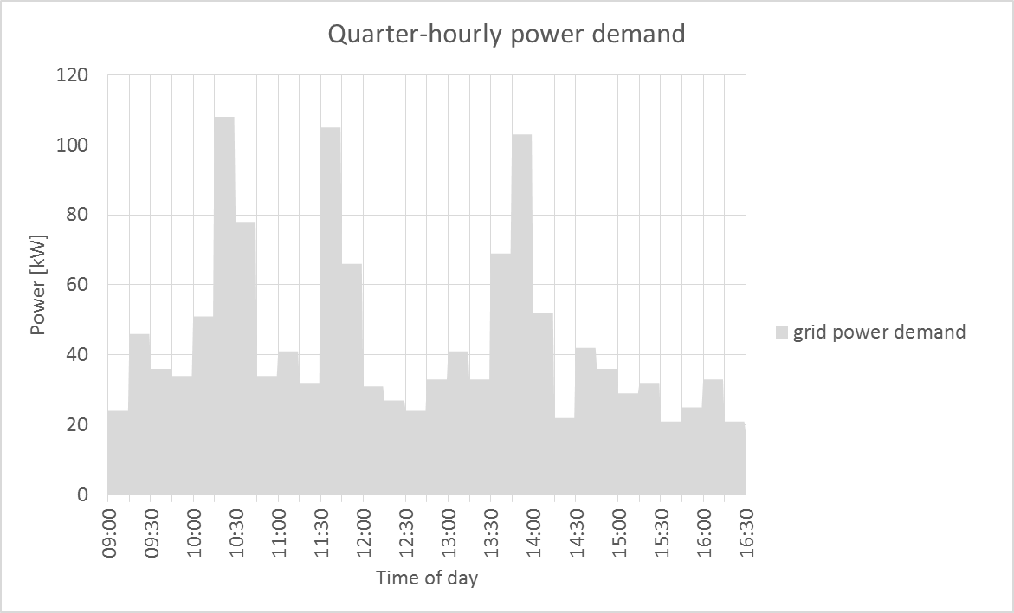
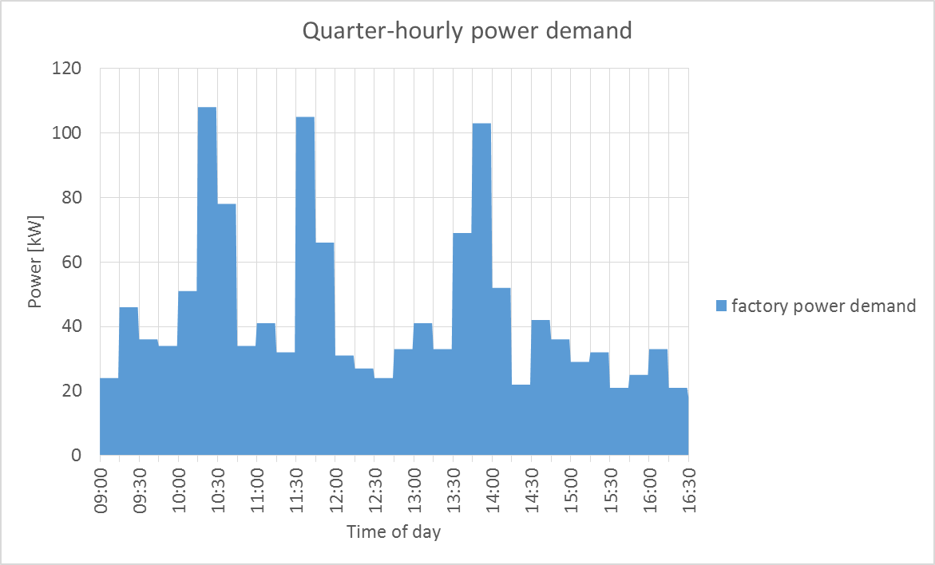
Vehicle-to-grid
Chances
Grid

Slide 23
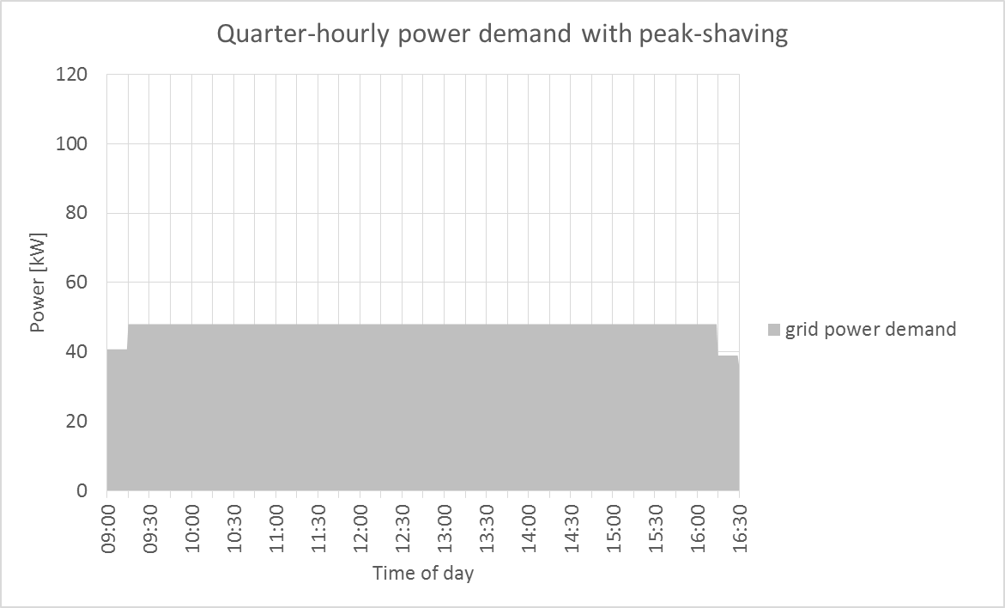
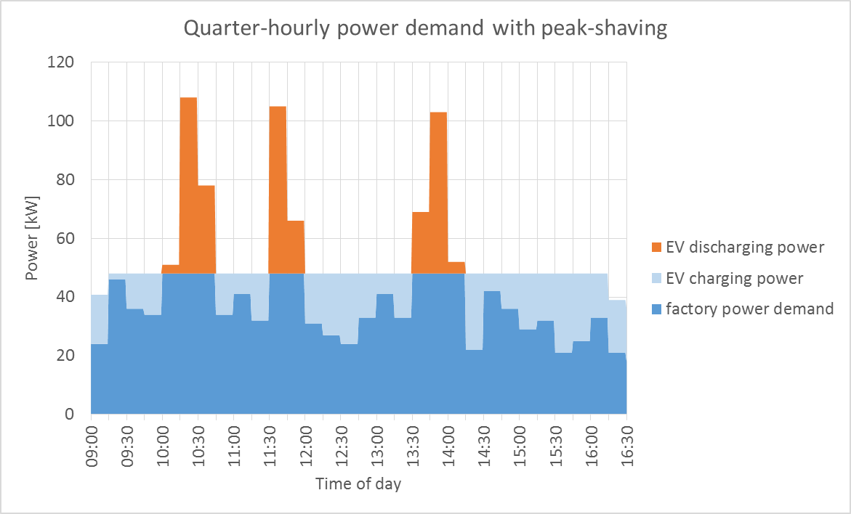
Vehicle-to-grid
Chances
Grid

Slide 24
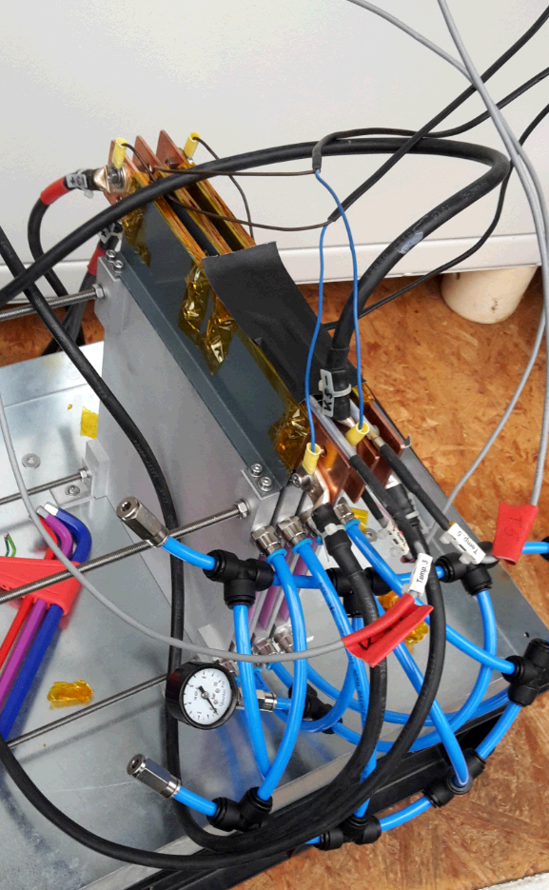
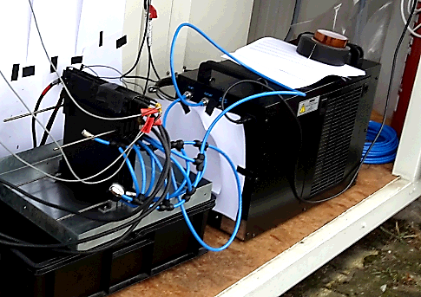
KIT Water Cooled Battery Module
Preparation for thermal characterization of 40 Ah NMC-cells
Cell module is painted black
for thermography
Cooling plates between pouch cells

Slide 25
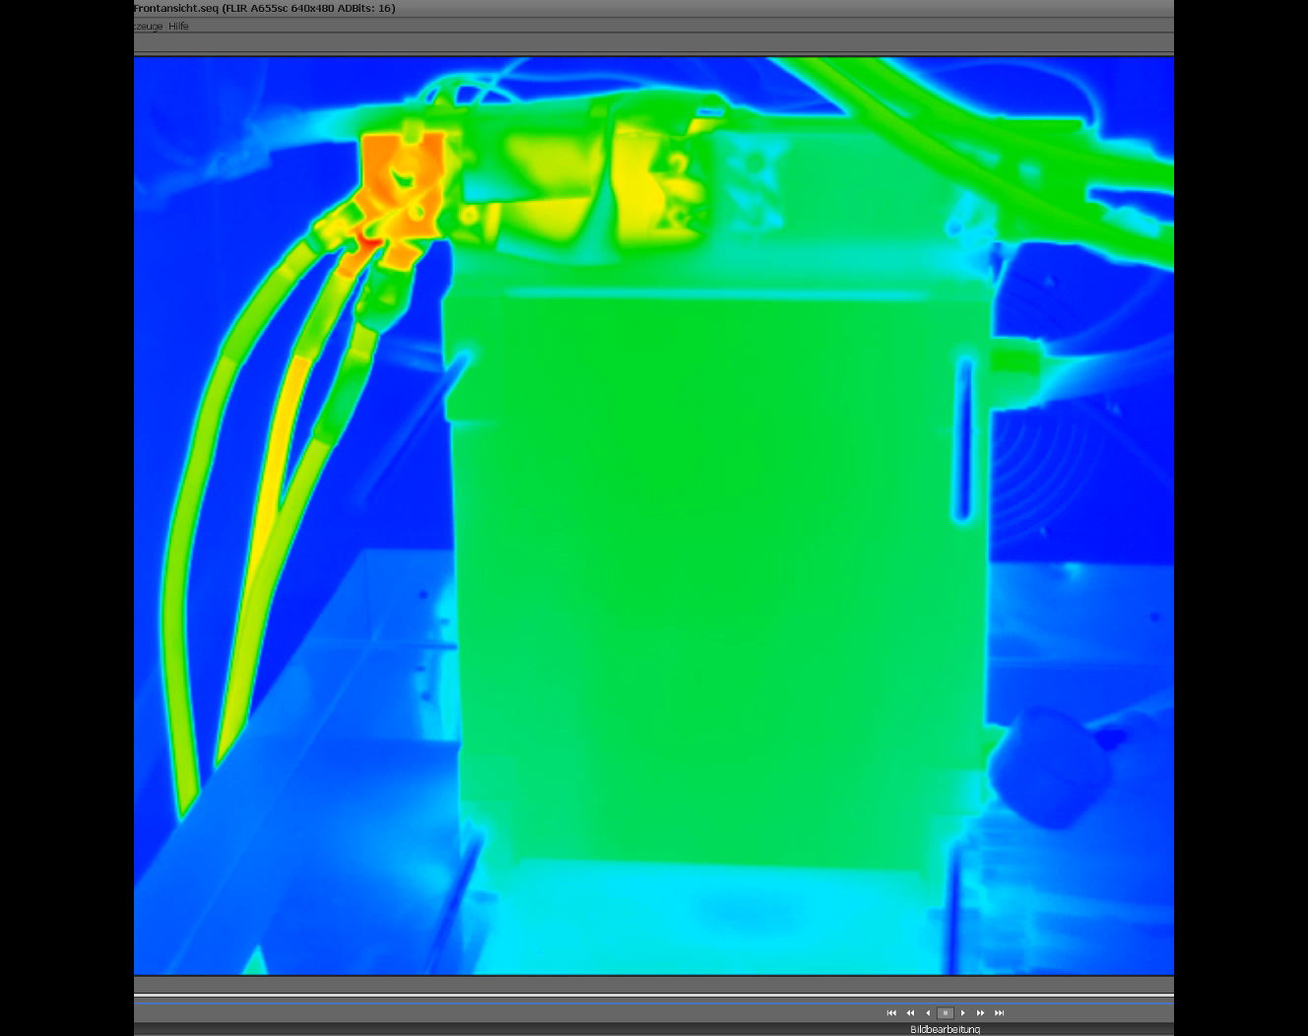
Thermal performance of water cooled system

Slide 26
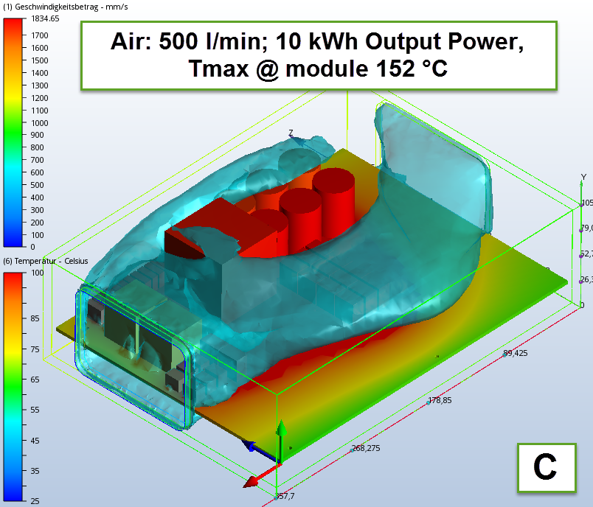
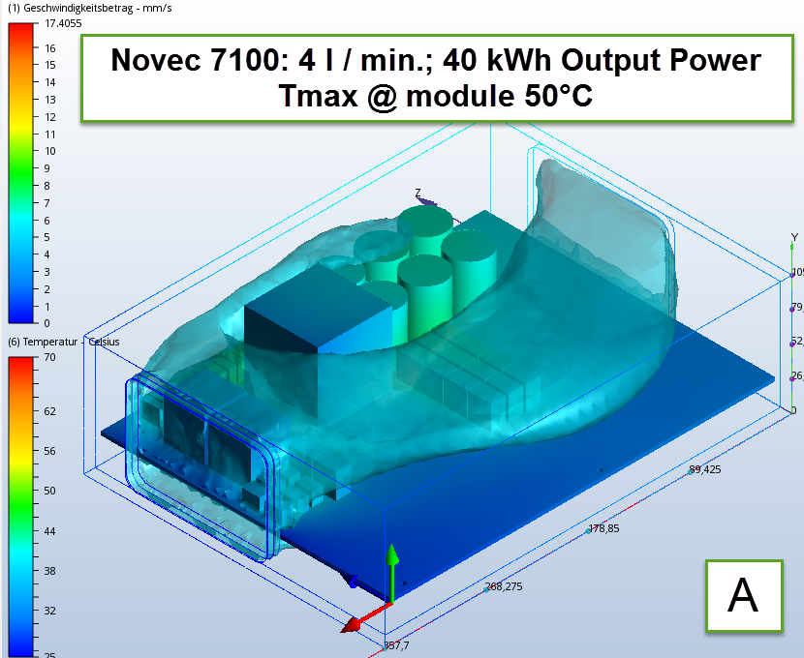
40 kW LLC Converter, CFD
Losses
Goals for final version of power module:
40 kW output power: 800V, 50 A
Worst case 97 % efficiency: 1.2 kW losses
Power module
Passives/Driver
w.c. eff.: 98.7%
~ 750 W losses
Test Case 1: Air-cooled 10 kW
assumed CFD losses
Test Case 2: Liquid-cooled 40 kW
assumed CFD losses
Transformer Primary: ~ 5 W
Transformer Secondary: ~ 11 W
Resonance Inductance: ~ 5 W
Output filter capacitor: ~ 10 W
Transformer Primary: ~ 170 W
Transformer Secondary: ~ 70 W
Resonance Inductance: ~ 150 W
Output filter capacitor: ~ 25 W
Liquid cooling is keeps the passives below 50°C, but magnetic saturation?

Slide 27
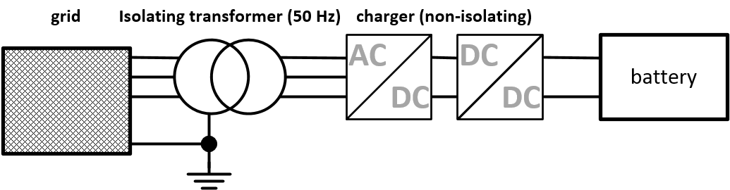
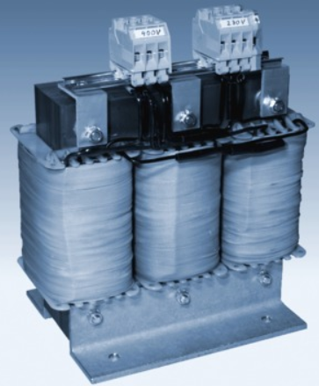
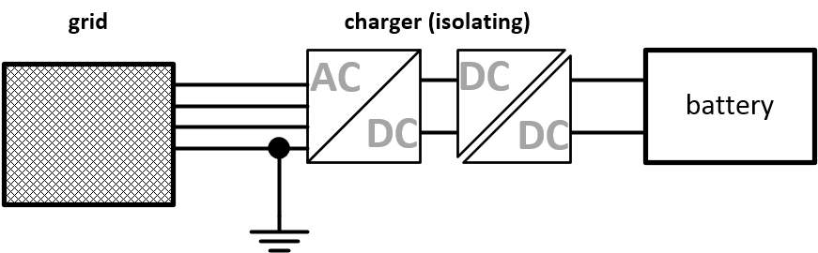
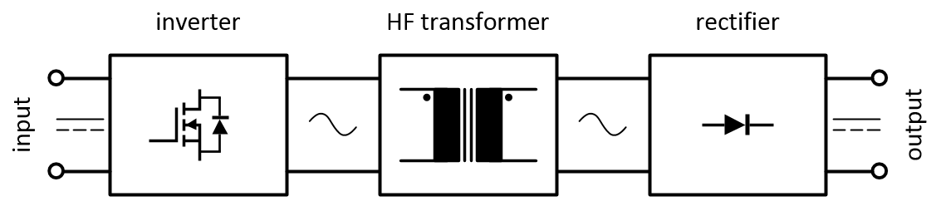


CLLLC converter
Galvanic isolation
490 x 262 x 530 mm, 130 kg
20 kVA isolating transformer (50 Hz)
67 x 62 x 68 mm, 0.68 kg
20 kW transformator (100 kHz)

Slide 28


Vehicle-to-grid
Chances
Additional ancillary services
  Provision of reactive power
  Black-out: Backup power and cold start-up ability
  Symmetry compensation

Slide 29










CLLLC converter Principle of operation
input
output
t₀
t₁
t₂
t₃
t₄
t₅
t₆
charge
discharge

Slide 30







Specific Test Sites
Electrical Insulation Tests
10 kV SiC Half Bridge Module for
testing insulation properties of
organic materials in preparation.
Electrical Characterization
Double Pulse Tests
Thermal Shock Tests
-40°C (-50°C) – 180°C
Liquid-Liquid Tests
Static Characterization
(0..500A, 20..95°C)

Slide 31


Thermal Insulation Sheet
Breakdown Voltage Test with SiC Halfbridge Tester
Sample for Breakdown Voltage Test
Equipment of Breakdown Voltage Test
・in Air, AC 10 kHz, max. 2 kV
・The voltage increased by 100V.
・Pass/Failure: over 3x10⁶ cycles
on each voltage
Tests stopped at 2kV Limit
(Test equipment limit)

Slide 32
Future KIT DSC Leadframe Module
?
Top Side solderable Dies: SiC with Au Top: Cree
1200V / 400A IGBT Double sided cooling Module
Soldering/sintering of the IGBT and diode to both Cu-leadframes
Integrated spacer elements in the Cu-leadframe
Modul encapsulation with dam&fill material
Lamination the leadframe module to the Pin-Fin Cooler with thermally conductive insulation sheets on both sides

Slide 33
Collaborations and Projects
Heraeus
Hitachi Chemicals
Schaeffler – Share am KIT
3-5 PE
3D-Kupferdruck und Keramikdruck für Leistungselektronik (ADD-Power)
GRK-2nd Period
35-PE GaAs und Conti: Modulbau ?
EU-Batterie
CSC-HongPeng (…)
ETI
IAI
IAM-ESS
INT
EU-SmILES
BMBF – ENSURE
Graduiertenkolleg ESD

Slide 34


40 kW Integrated Power Module
R_{th} evaluation of substrate materials
Ceramics:
630 µm
380 µm
250 µm
Cu: 300 µm
Cu: 500 µm
R_{th} for diodes higher than MOSFETs (diode size)
AlN-AMB comparable to Si₃N₄-AMB
For 40 kWh LLC module, 250 µm Si₃N₄-AMB best substrate due to robustness in thermal shocks and thermal conduction

Slide 35




Alternative Thickfilm modules
Warpage is critical
Insulation Layer (blue) on Cu-Thickfilm
Combination DCB and Cu-Thickfilm Intelligent Power Modules

Slide 36





Alternative Thickfilm modules
Reference Module, Cu-Thickfilm
on 635 µm Al₂O₃
Substratintegriete Kühlung: Aufwändig in der Herstellung und schwache Performance -> 3D Druck?

Slide 37
Cu Sinter Paste
Sintering reaction and Features
Sintering reaction
Cu particles (nano, micro)
Organic dispersant
Solvent
Desorption of solvent
and dispersant
Grain growth
Heating
Heating
493 K ~ 573 K
Sintered Cu
Composition of metal pastes
Features
High thermal conductivity
High heat resistance
High bonding strength

Slide 38



Cu Sinter Paste
Cu sinter paste
Pressureless bonding process
1. Printing Cu paste
2. Mounting chips
Si chip
500 nm
Substrate
Cu paste
Cu paste
3. Heating (pressureless, 100% H₂, 300 °C, 1 h)
or (pressure-assist, 100% N₂, 300 °C, 5 min)
Si chip
5 x 5 mm² Si chip
Fig. Cu particles and Cu paste
Sintered Cu
Cu particles size: 100 - 500 nm
Cu contents : 88 wt.%
Substrate
Sintered Cu
Cu substrate
Dr.-Ing. T. Blank - Electronic Packaging, Interconnects and Huge Battery Systems

Slide 39






Cu Sinter Paste
Pressureless Sintering process
Table Sintering process.
Printing | Die-mounting | Sintering
260 °C, 10 min
H₂(100%)
N₂
Fig. Sintering profile of Cu sinter paste.

Slide 40


Cu Sinter Paste
Die-shear strength
Bonding sample
Ag plated Si
Bare Cu-DBC
Sintered Cu
Fig. Relationship of sinter duration and die-shear strength at various sintering temperatures.
~ 15 Min overall process time for pressureless
sintering @ 260°C and 50 MPa shear values!

Slide 41
Sintering Density
Measurement
Sintering density, D_{s}: calculation of fractions of solid metal area about the total cross-section SEM images.
Fig. Cross-section SEM images and D_{s} of the sintered Cu under various sintering conditions.
Fig. Relationship between sintering temperature and D_{s}.
Cu paste can be sintered at 225 ºC under pressureless conditions in 100% H₂.
Dr.-Ing. T. Blank - Electronic Packaging, Interconnects and Huge Battery Systems

