Slide 1
Particle therapy beam monitoring with HV-CMOS sensors
Matthias Balzer, Alexander Dierlamm, Felix Ehrler, Horacio Mateos, Andreas Nürnberg^{ETP}, Ivan Peric, Rudolf Schimassek, Alena Weber
Picture from https://www.klinikum.uni-heidelberg.de/interdisziplinaere-zentren/heidelberger-ionenstrahl-therapiezentrum-hit/leistungsspektrum

Slide 2
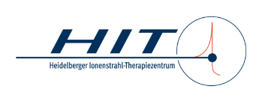
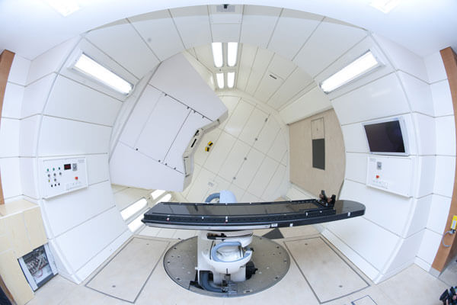
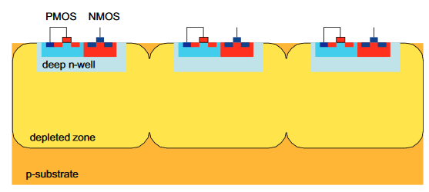
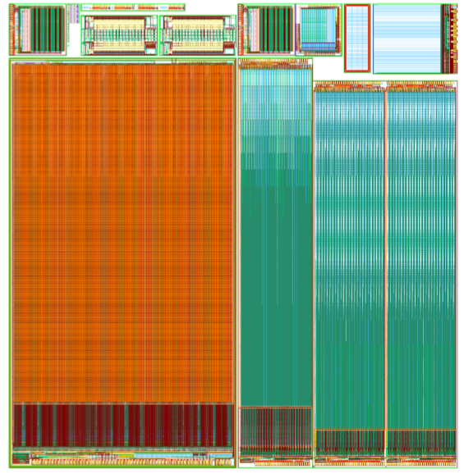
Introduction
Radiotherapy is an important pillar in the therapy of cancers and is prescribed to ~50% of cancer patients.
Standard radiotherapy uses photon radiation, whereas particle therapy uses
high energy protons (50−220MeV; flux<~2x10⁹p/s; FWHM 8−30mm) and
carbon ions (90−430MeV/u; flux<~10⁸p/s; FWHM 3.5−12mm)
[HL-LHC, R~25cm: 10⁷p/(cm²s)]
to destroy tumor cells in the body of patients.
To achieve local tumor control, a well-controlled particle beam in terms of position and dose is of utmost importance for the success of the therapy and the patient’s health.
gas-based wire chambers used so far
We want to develop an HV-CMOS based monitoring system for clinical use
beam position resolution ~200µm
response time ~ 100µs
low mass (<2mm water eq.) and large size (25x25cm²)
radiation hard (<1.5x10¹⁵p/cm² per year at central spot)
magnetic field tolerance ( o(100mT) )

Slide 3
HeiKa Project
We managed to get funding for a first test chip submission from HeiKa
22k/58k to be shared between HIT (Heidelberger Ionenstrahl-Therapiezentrum) and IPE
Project extends over 2020
Goal is to prepare for a larger application likely at DFG
Q1’20
Q2’20
Q3’20
Q4’20
Charac. and design (1,2)
Test-chip evaluation (5)
Concept of scaled DAQ (4)
Modifications of mon. system? (6)
Design of demonstrator (7)
Task 1: Characterization of pixel response to the therapeutic particle beam
Current HV-CMOS chips are used to check their performance in these harsh beams and learn for test chip design
Next beam test on 14/15.3.2020
Task 2: Design and submission of beam monitor test sensor
3-4 approaches are being implemented on an engineering run to be submitted by end of March
Task 3: Development of an in-beam magnetic field test bench
Task for HIT
Task 4: Conceptual development of a dedicated data acquisition system
Extend readout with FPGA evaluation boards to high-performance DAQ system
Task 5: Characterization of the test sensor
Main task during summer
Task 6: Evaluation of possible modification in the beam monitoring system
Task 7: Design of the demonstrator sensor and the full-size system
The demonstrator sensors will follow the test chip design with best performance in the summer test beams scaled to the full reticle size (~100k€)
Conceptual extension towards the final system as basis for next funding application

Slide 4
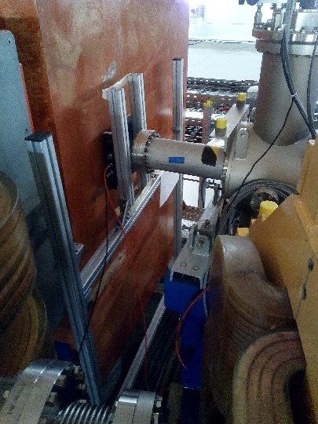
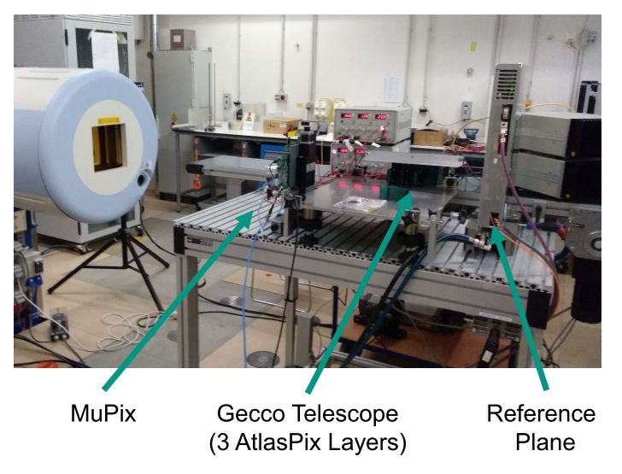
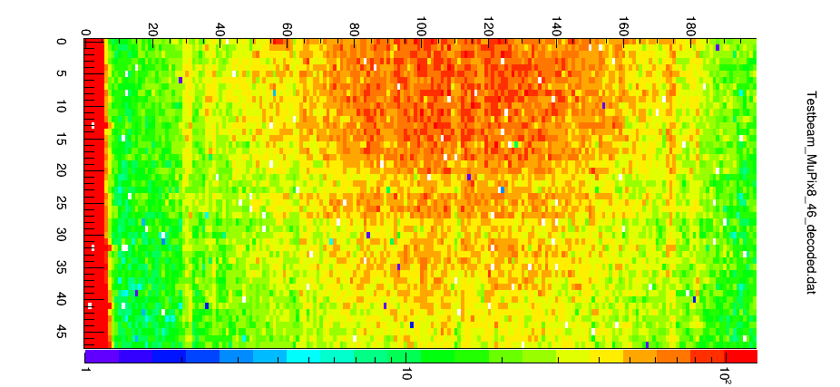
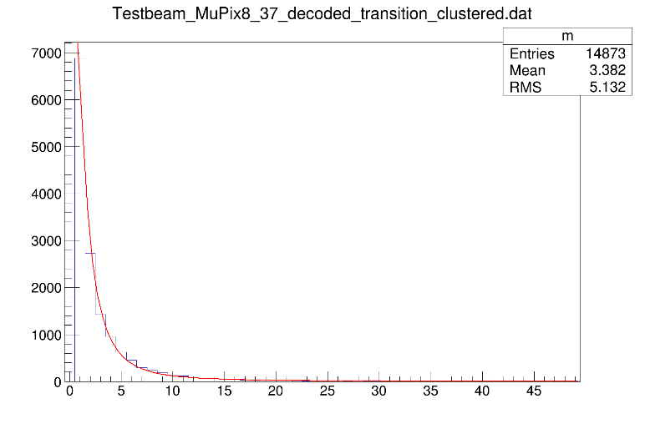
Test beam and currently evaluated chips
Beam test in June‘19 with MuPix8 and ATLASPix1 telescope
Irradiation of ATLASPix3 at beam dump from Monday on
Next beam test with MuPix8 and ATLASPix3 on 14./15.3.
MuPix8:
~1 cm x 2 cm
128 x 200 pixels
Pixel size: 80 μm x 81 μm
Triggerless column drain readout
Analog information: 6 bit
Timestamp: 10 bit
Three readout links: 3x 1hit / 25 ns
soon: MuPix10
~2.1 cm x 2.1 cm
250 x 256 pixels
Pixel size: 80 μm x 80 μm
Triggerless column drain readout
Analog information: 5 bit
Timestamp: 11 bit
Three readout links: 3x 1hit / 25 ns
ATLASPix3:
2 cm x 2 cm
Pixel size: 50µm x 150µm
Radiation hard; will be irradiated at beam stop
It supports hit driven untriggered and triggered readout
~0.5 hits/cm²/25ns
Beam dump
20mm
3mm
Partial beam profile on MuPix8
Cluster size distribution for MuPix8

Slide 5
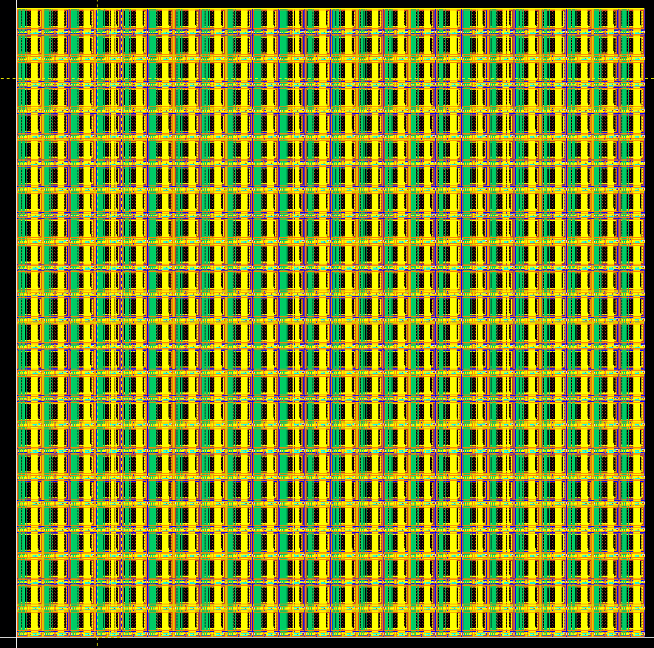
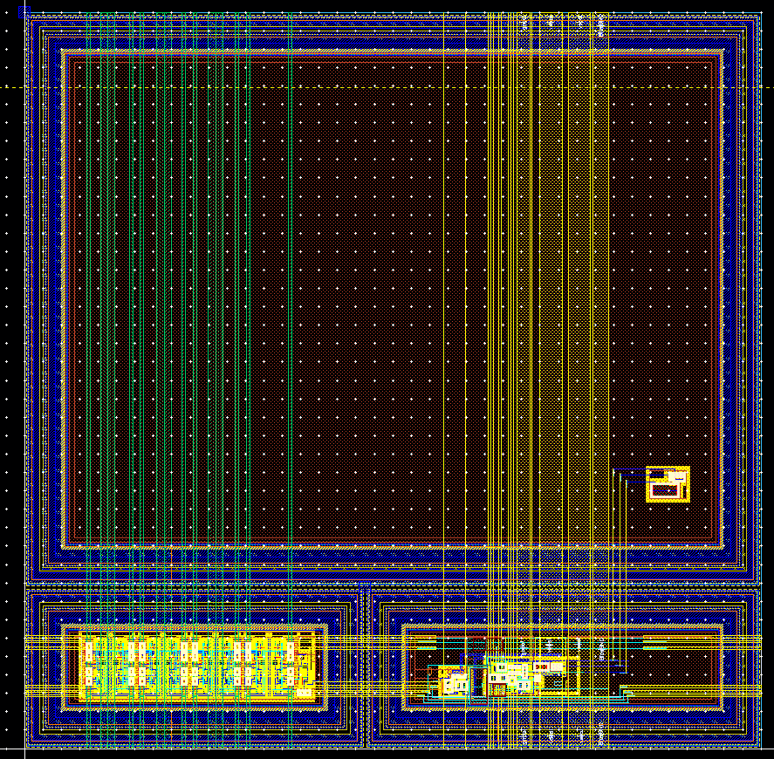
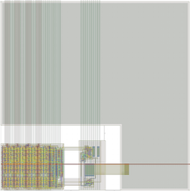
Test-chip concepts
General properties
TSI 180nm process
Charge sensitive amplifier, comparator and 8-bit counter with readout bus driver
Pixel size: ~ 200µm x 200µm
Matrix each 5mm x 5mm
Chip designs
Simple counting design:
counting hits
radiation hard design
90% electrode coverage
Integrating design:
counting hits and integrating signal (~dose)
not radiation hard, yet
~80% electrode coverage
eventually, not integrating each cell, but total signal of matrix to get scaling factor for profile
Extended counting design
counting hits
radiation hard design
100% electrode coverage; requires extra deep p-well, which is new to the company and has some risk
Counting cell
Counting matrix
Integrating cell

