Slide 1
Detection of beam shutdown conditions in TS/LS/AS
Arbeiter et al.
February 2005

Slide 2
Structure of action
Identification of scenarios which require a beam shutdown (BSScnXX) (RAS, others) . (19 scenarios documented)
Discussion of available detection techniques
Compilation and completion of list of sensors in TS/LS/AS
Allocation of detection techniques to BSScn. Important characteristic : time-scales of (a) detection vs. (b) specific system degradation
Action is still ongoing.

Slide 3
The power source
Under normal operation conditions, the beam transports a power P=5MW (by 125mA of D+ particles at 40MeV) to the target on an area of 200x50mm² (q‘‘=0.5E9 W/m²), alternatively 100x50mm² (q‘‘=1.0E9 W/m^2).
This large (particle) power is converted to thermal energy in the flowing lithium, dominantly in the Bragg peak ~19..20mm below the Li free surface (q‘‘‘=8E10 W/m³). The Li bulk temperature increases by ΔT = P / (U tb ρc_{Li}) = 24 K
(Flow velocity U, jet thickness t) . The generated neutrons,gammas+secondary gammas deposit O(100 kW) in the TC components, in the HFTM q_{m}=2..3 W/g, q’’’=16..24E6 W/m³

Slide 4
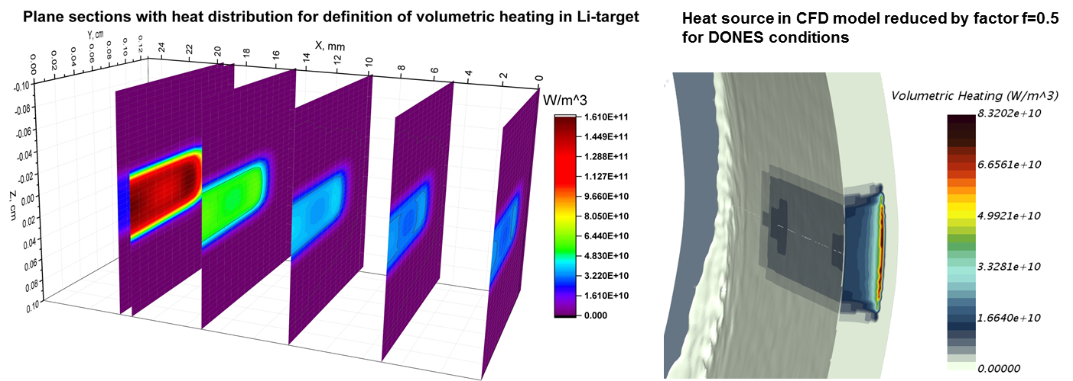

Slide 5
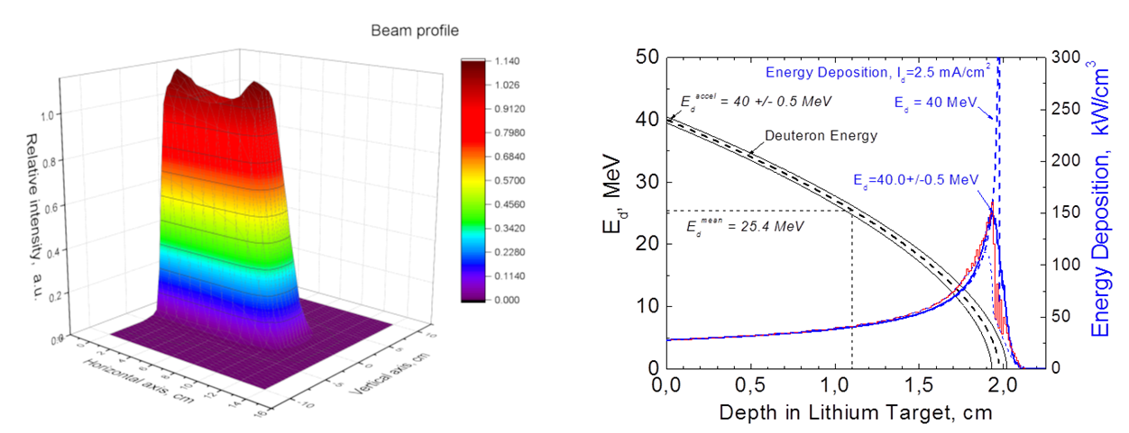

Slide 6
Part I : List of Beam Shutdown Scenarios (BSSc)

Slide 7
Conditions to be avoided/detected (general)
AS-related:
Overpower in the D+ beam
Decrease of beam footprint area
Misplacement of beam centroid (scrapers, beam tubes, LT-frame)
Excessive scattering of beam (i.e. gas ingress – but severity not clear)
LT/LS-related:
Reduction of Li flow thickness
Reduction of Li flow velocity
Increase of Li inlet temperature to the LT
Mechanical break
TC-component (HFTM, STUMM, TC-Liner, TC-bioshield) related:
Direct exposure to beam after LT failure
Reduction of coolant mass flow rate,
Increase in coolant inlet temperature
Mechanical break
increase of q‘‘)

Slide 8
Scenarios concerning LT/LS
N. | Description
BSSc LS01 | RAS#1, FLIL1 : Loss of flow in the Lithium Loop due to EMP trip. Category III
BSSc LS02 | RAS#2, HLIL1 : Loss of heat sink for removal of heat loads from Li loop due to seizure of the Secondary Loop pump, Categoty V
BSSc LS03 | RAS#3, LLLA1: Loss of lithium in Lithium Loop Area due to large break at the electromagnetic pump outlet, Category IV
BSSc LS04 | RAS#4, LTTC1, Loss of lithium in the TC due to large break in piping running inside the cell, Category V
BSSc LS05 | RAS#5, VTVC1, Loss of vacuum in Target Vacuum Chamber, Category III
BSSc LS06 | Evolution of large scale waves/wakes (gravity waves) on the Li surface Δs>2mm by growing disturbance (i.e. deposits, oxides) on the nozzle outlet

Slide 9
Scenarios concerning TS
N. | Description
BSSc TS01 | RAS#6, LHFM1, Loss of helium gas from HFTM cooling circuit inside TC, Category IV
BSSc TS02 | RAS#7, FHCSLP1, Loss of flow in the TC-HCS-LP due to spurious valve closure, Category II
BSSc TS03 | RAS#8, LHFTM2, Loss of helium gas from HFTM cooling circuit inside the cooling room hosting TS-HCS-LP equipment, Category III
BSSc TS04 | RAS#9, FWCS1, Loss of water flow in the TC-WCS due to spurious closure of isolation valve in the loop hot leg, Category II
BSSc TS05 | RAS#10, LWCS1, Loss of cooling water from TC-WCS circuit inside the room hosting the TC-WCS equipment, Category III
BSSc TS06 | Increase of HFTM capsule temperature +15K over setpoint [HFTM DDD sect 4.6]
BSSc TS07 | Increase of HFTM body temperature +15K over nominal level [suggestion]
BSSc TS08 | Increase of TC liner temperature +15K over nominal level [suggestion]

Slide 10
Scenarios concerning AS
N. | Description
BSSc AS01 | RAS#12, LAF1, Cooling water ingress in the accelerator beam duct, Category III
BSSc AS02 | RAS#13, VAF, Loss of vacuum in beam duct and air ingress, Category III
BSSc AS03 | RAS#14, GAF, Loss of D2 or H2 into the Accelerator Vault due to rupture of gas supply system, Category III
BSSc AS04 | RAS#15, VIS, Loss of vacuum in ion source due to containment rupture, Category III
BSSc AS05 | Overpower on beam scrapers
BSSc AS06

Slide 11
Part II : Discussion of selected (non conventional) detection methods

Slide 12
Transient temperature time scales
Surface-heated object:
  steady state level: T_{steady}-T_{coolant} = q‘‘ * (1/HTC_{fw} + s/λ)
  ➔ increases with q‘‘, s, decreases with HTC
  time-constant: τ=(s*ρ*c)/k = (s*ρ*c) * (1/HTC_{fw} + s/λ)
  ➔ increases with s, ρ, c, decreases with HTC
Volumetric-heated object:
  steady state level: T_{steady}-T_{coolant} = q‘‘‘*s * (1/HTC_{fw} + s/λ)
  ➔ increases with q‘‘, s, decreases with HTC
  time-constant: τ=(s*ρ*c)/k = (s*ρ*c) * (1/HTC_{fw} + s/λ)
  ➔ increases with s, ρ, c, decreases with HTC
There is a trade-off between high signal level and short response time
Usable for detection? :
Time-scale of sensing system + reaction time of counter-measure must be smaller than time scale (grace time) of to-be-protected system
Signal level induced by to-be-detected event must be larger than „background“ changes of that signal (drift, oscillation, noise, …) OR must exhibit a specific „fingerprint“ that can be detected automatically or by operator

Slide 13
Annex: heated bodies responses
Convective heat sink:
Heat transfer coefficient HTC [W/m^2/K]
Heat sink/coolant temperature T_{coolant} [K]
s
Heat loads:
Surface HL q‘‘ [W/m^2]
Volumetric HL q‘‘‘ [W/m^3]
q‘‘
q‘‘‘
HTC
T_{coolant}
Solid body properties:
Thickness s [m]
Thermal conductivity λ [W/m/K]
Specific heat capacity c [J/kg/K]
Density ρ [kg/m^3]
Temperature T (time dependent)

Slide 14
Detection by thermocouples
➔ Only few of the listed temperature measurements have acceptable detection capability

Slide 15
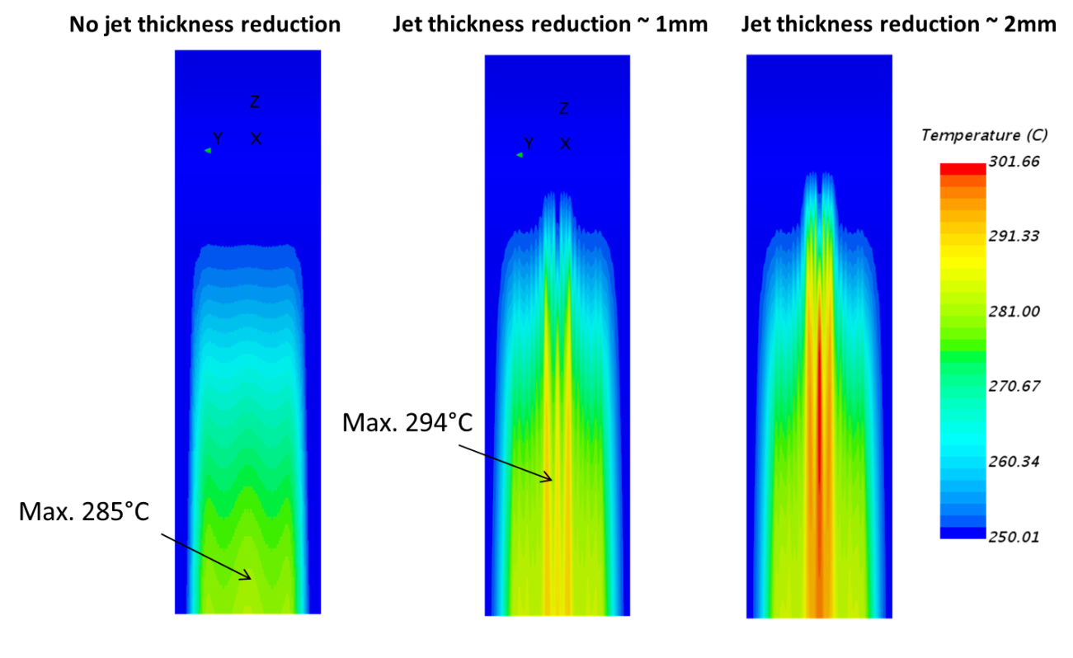
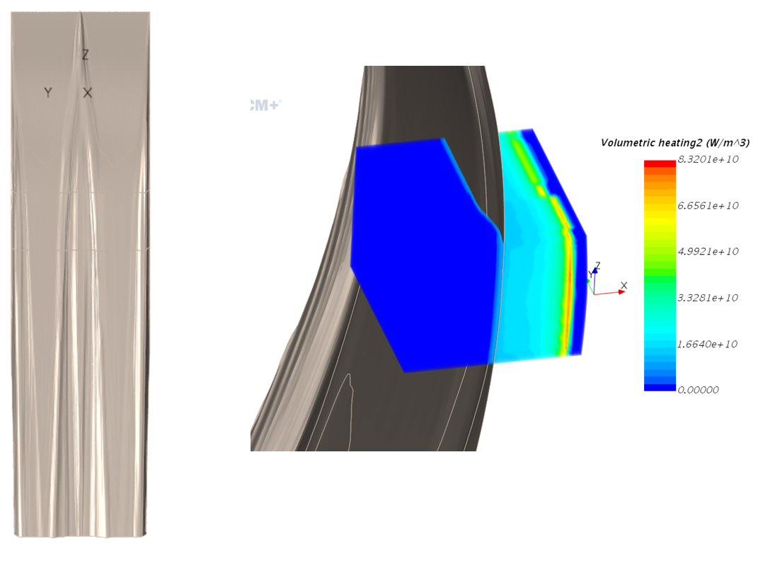
Hot streak in Lithium
In the CFD simulation, a small protrusion is dipped into the flowing Li near the nozle, which creates wakes of 1 or 2mm depth. The maps show the temperature field of the BP/chute
A wake becomes thermally „visible“ in the BP during its growth!
Lateral size: O(centimeters) Intensity: 9K@1mm, 16K@2mm
➔ This effect is very well detectable with an array of thermocouples
A warning for a growing disturbance (precursor of BSS6) is possible!

Slide 16
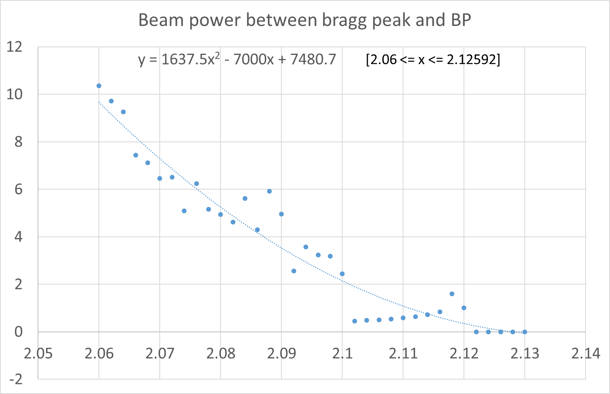
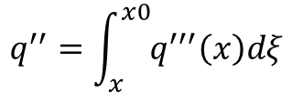
Approach of the Bragg peak towards BP
Integrated beam power
$$q^{′′}=\int_{x}^{x0}{q^{′′′}\left(x\right)dξ}$$
Polynomic fit with a zero-crossing
(real function should be asymptotic)
X0=2.12592cm
Numbers valid for
250mA@5x20cm² or
125mA@5x10cm²
The data for the volumetric power release by D+ in Li is from Simakov, early IFMIF project phase. In the „tail“ region the data is scattered and not fully fit for the purpose of the present study.
If the Li thickness is reduced by (25-21.1592)=3.84mm, BP temp. increases 186K
If the Li thickness is reduced by (25-21.0592)=3.94mm, BP temp. Increases 911K
➔ In this region, there is no „soft“ warning. However, a warning level could be in the range for which there is no data available (yet).

Slide 17
Can we detect a measurable radiation change when the D+ beam approaches the BP?
W. Krolas, IDCM#18 Krakow: „in first approximation, neutron production will not change when Li-thickness decreases, because most neutrons are generated in the surface where E_{d} is still high“
But, maybe we can detect something by the n/gamma ratio? Seems not to be promising, because the Deuteron energy „vanishes“ before the energy deposition reaches a sufficiently low level.
Can we put a „pin“ made from some element on the BP (immersed below the Li) that will emit discernible strong gamma when the deuterons hit it ?
➔ No reliable detection solution has been found in this category up to now.

Slide 18
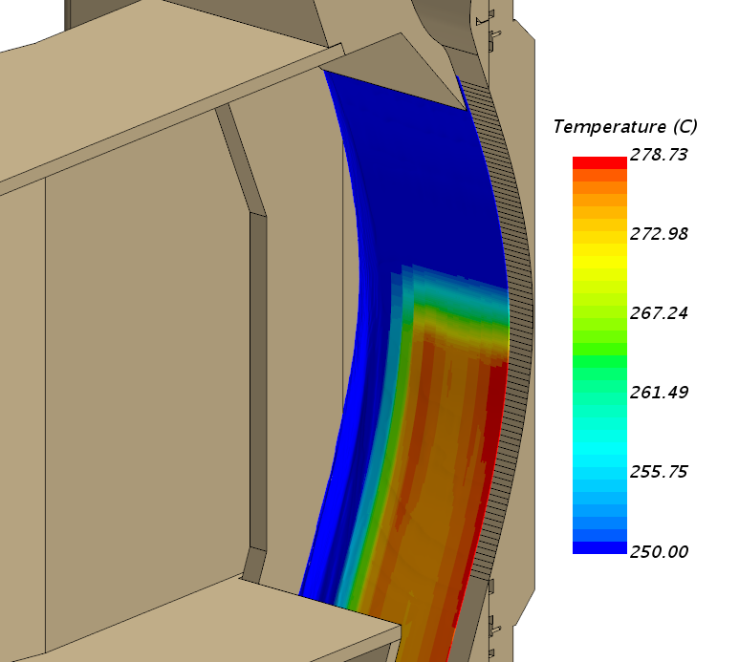
IR observation of footprint on Li
Favourable:
Temperature range is OK for
IR-detection, lambda ~ 5µm
Increase of surface temperature is „immediate“ ~3ms
Issues:
Lifetime or useability at all of
IR camera in radiation is doubtful
Observation position conflicts with the laser distance device in second beam duct
Li-vapor may obstruct view and/or precipitate on optics

Slide 19
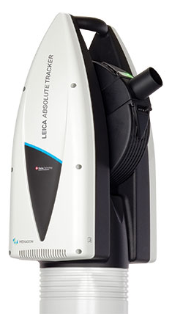
Laser Radar
Based on product „Hexagon ATS600“
Can measure through second BD from TIR
Alternative: optical fibre through TC to TA chamber, but problem of Li deposition on optics
Measures 120 spots in 1s (8.3ms per spot) in „high precision“
In case of disturbance in Li, lateral wavelength peak-to-valley is O(10mm), suggested to measure spots 4mm apart
➔ 200/4=50 spots over footprint, ~0.5s per full scan
Alternative strategy: monitor the surface in „low precision“, but focus on regions where a disturbance >1mm was detected to decrease the time per pass.
Image from
product catalog

Slide 20


Optical monitoring of the Li surface
Allows a qualitative indication of local disturbances almost instantanously
Image analysis must identify growth of coherent structures in the lithium surface image
[B. Brenneis, KIT, imaging from FIDES water loop „target“]

Slide 21
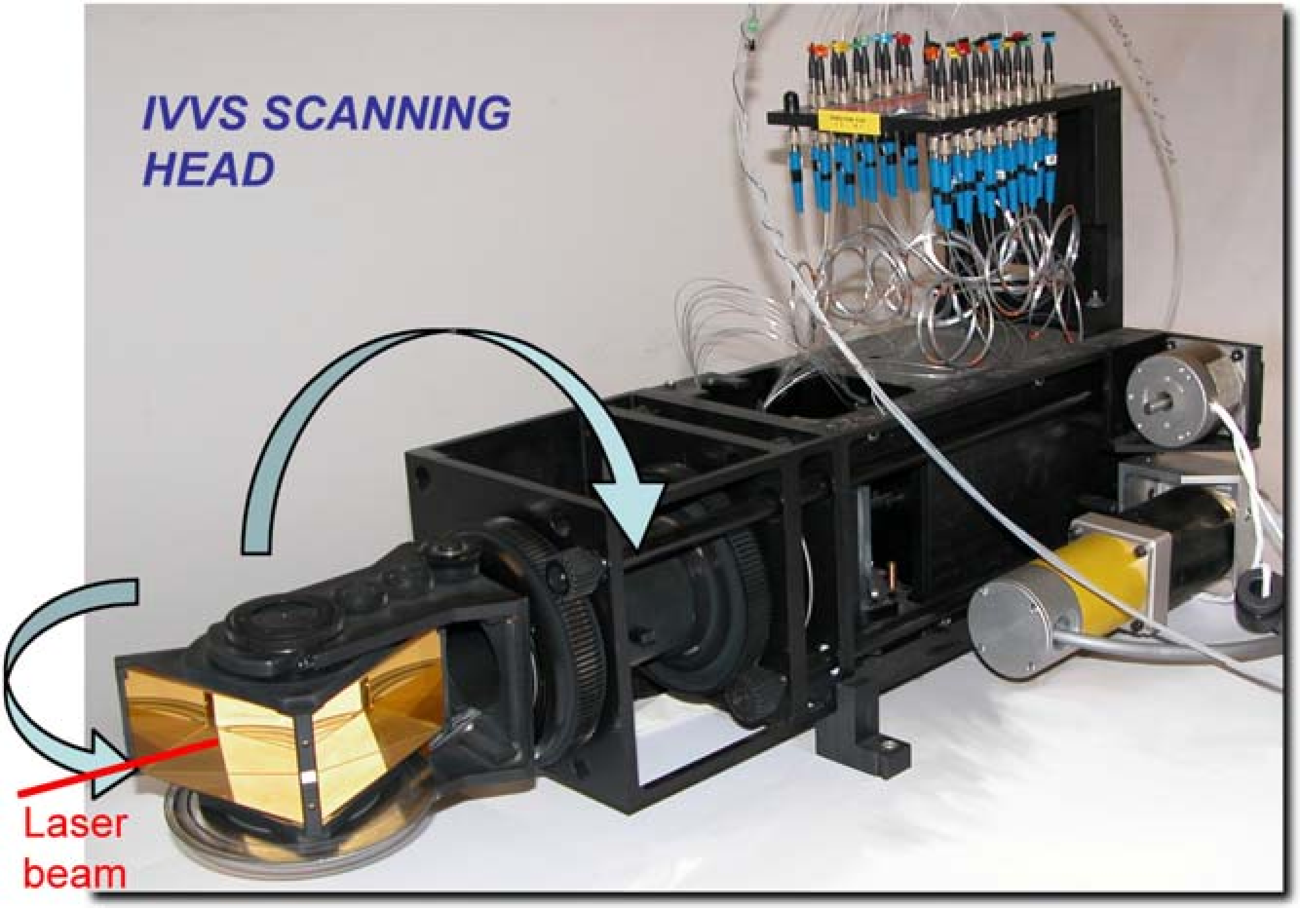
ITER In-Vessel viewing system
Developed for ITER ~10y ago
Distance >10m
Depth resolution 0.3mm
Spot size 3mm @ 10m
40µs per measured spot (optomechanical scanning)
Operation up to 5-10MGy, should allow lifetime >2y in TIR
[2011 C.Neri et al., Iter in vessel viewing system design and assessment activities, Fusion Engineering and Design]

Slide 22
Other sensors
Earthquake sensor suggested (part of PS?)
Fire detectors
Personnell access to forbidden area
RAMSES
…
➔ Can also trigger beam shutdown. Part of PS, not covered by this action (LS/TS/AS). But not to be forgotten.

Slide 23
Part III : Defined instrumentation of systems

Slide 24
List of TS/LS/AS instrumentation, IDCM13
List updated
and completed
by response
timescale

Slide 25
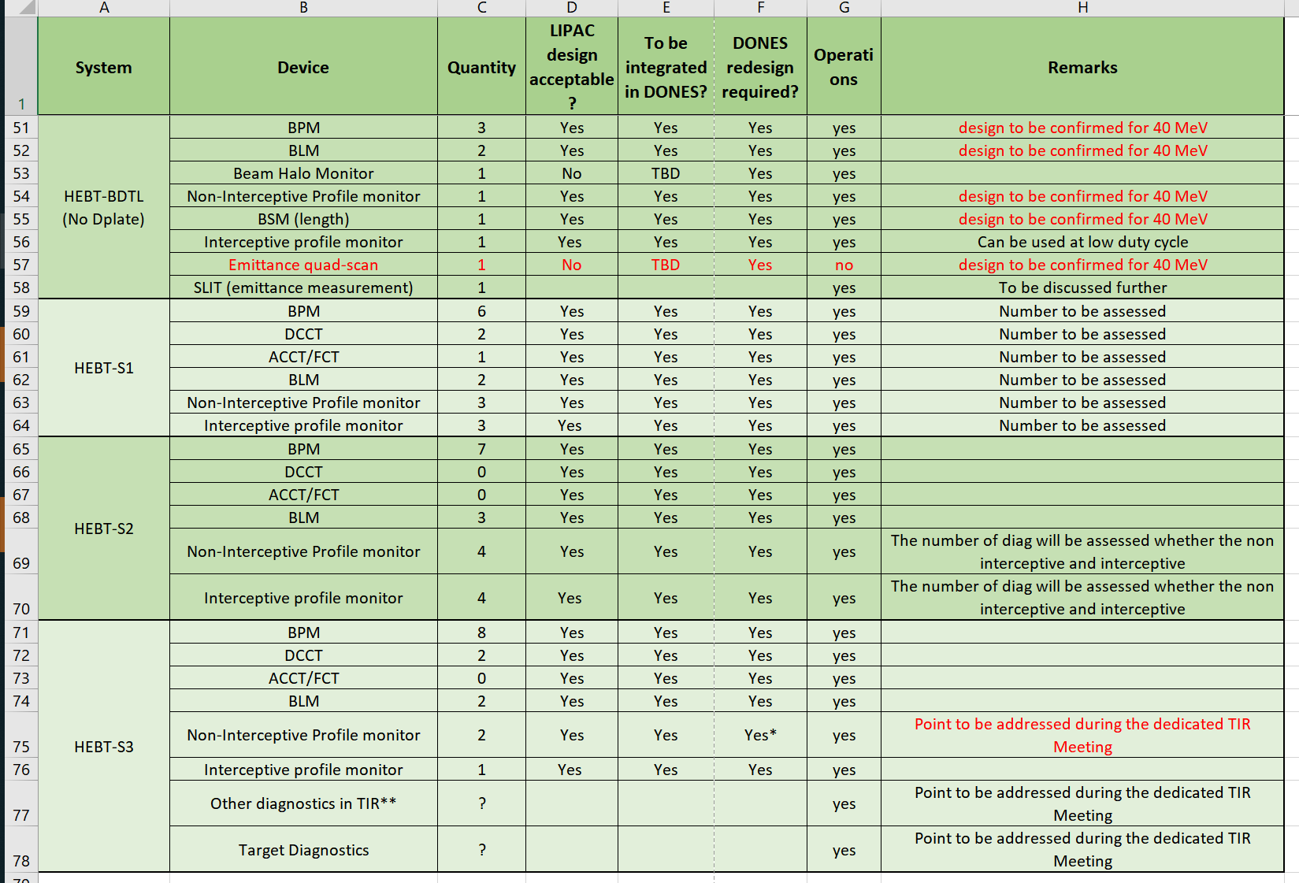
List of AS instrumentation 2MQLFY

Slide 26
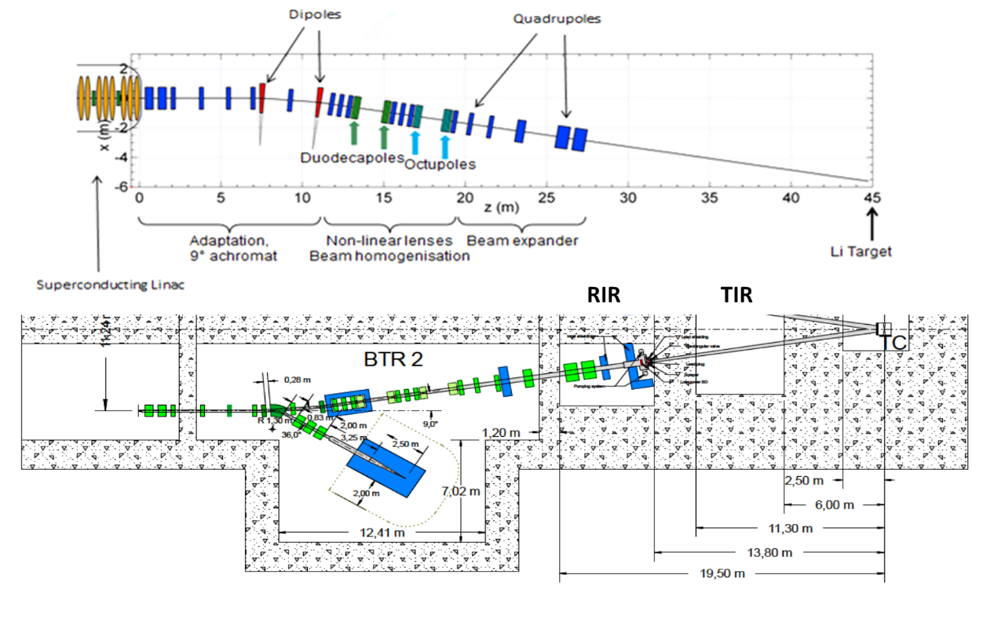

Slide 27
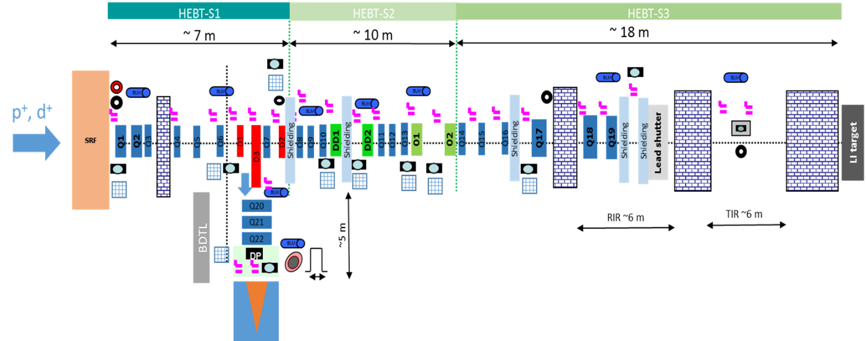

Slide 28
Part IV : Allocating BSSc to detection methods

Slide 29
Detection of BSScLS01 RAS#1, FLIL1 : Loss of flow in the Lithium Loop due to EMP trip.
Assumption: the Li flow (several m³) has an inertia and will not immediately stop due to a pump trip
Decay time for the velocity in the Li-jet is 0.5 - 9s
Li jet velocity will decrease first, and (delayed to velocity) also Li jet thickness
Detection instruments :
  0.5.3.1.4.1_CF_001 ELECTROMAGNETIC FLOW METER
  PT CP001 and PT CP002
  A magnetic sensor checking operation could be installed directly on the pump
  will indicate the drop of flow in O(seconds) . Integration time scales of the transducer electronics have to be defined!
IR surface measurement (application not confirmed) can provide increased Li temperature in O(10ms)
Laser Radar can provide decreased Li jet thickness in O (0.5s) (but
Thermocouples on Li-chute will indicate increased local+bulk Li temperature in O(10s)
Suitable signals for detection
  A fast magnetic sensor(s) on the pump (detection timescale in order of inverse AC frequency) (NOT YET DEFINED)
  A thermocouple array with low thermal inertia, i.e. directly touching the Li flow (NOT YET DEFINED)
  (Maybe) The laser radar (but time between warning and catastrophic failure is not known)
➔ Adequate sensor must still be selected, officially defined and specified in the Li Loop DDD.
Data that should be produced: credible VFR(t) and Li-tickness(t) functions !

Slide 30
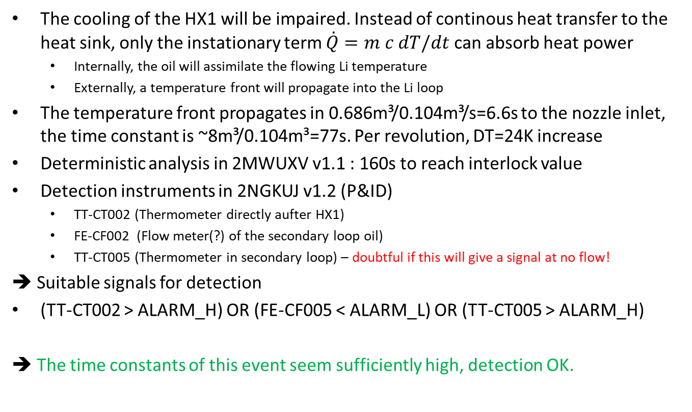
Detection of BSScLS02 RAS#2, HLIL1 : Loss of heat sink for removal of heat loads from Li loop due to seizure of the Secondary Loop pump
The cooling of the HX1 will be impaired. Instead of continous heat transfer to the heat sink, only the instationary term $\dot{Q}=m c dT/dt$ can absorb heat power
  Internally, the oil will assimilate the flowing Li temperature
  Externally, a temperature front will propagate into the Li loop
The temperature front propagates in 0.686m³/0.104m³/s=6.6s to the nozzle inlet, the time constant is ~8m³/0.104m³=77s. Per revolution, DT=24K increase
Deterministic analysis in 2MWUXV v1.1 : 160s to reach interlock value
Detection instruments in 2NGKUJ v1.2 (P&ID)
  TT-CT002 (Thermometer directly aufter HX1)
  FE-CF002 (Flow meter(?) of the secondary loop oil)
  TT-CT005 (Thermometer in secondary loop) – doubtful if this will give a signal at no flow!
➔ Suitable signals for detection
(TT-CT002 > ALARM_H) OR (FE-CF005 < ALARM_L) OR (TT-CT005 > ALARM_H)
➔ The time constants of this event seem sufficiently high, detection OK.

Slide 31
Detection of BSScLS03 RAS#3, LLLA1: Loss of lithium in Lithium Loop Area due to large break at the electromagnetic pump outlet
The driving pressure to the feed leg to the Li nozzle becomes zero ~instantly. Gravity pulls down Li through Target, but also in reverse direction.
Only the Li that is already above the nozzle will probably continue to flow as some kind of jet.
The time constant before the Li screen loses >4mm is very very small,
guessed O(1/10s) ?
Deterministic analysis in 2MWUXV v1.1 : 0.1s to reach mass flow interlock value, target drained in 13s (but what does this mean?)
Detection instruments:
  Conventional flow instrumentation can probably not catch this event. (Mechanical aspects and electronic filtering make the signal slow)
  Maybe a dedicated fast pressure detector could be installed just before the Li enters the TLIC.

Slide 32
Detection of BSScLS04: RAS#4, LTTC1, Loss of lithium in the TC due to large break in piping running inside the cell
Break of the BP / outlet of double red.nozzle
Assumption : loss of Li into TC
Note: due to pressure balance, a small break/crack O(mm) of the BP will not result in large Li flow due to pressure balance. For a large break („window“) we have no prediction, so we assume the effective Li thickness reduces significantly at least locally due to flow instabilities.
The scenario is not fully clear (to FAR), neither magnitude or time constants
Instruments:
  Below the BP on TC side, a spill detector should be installed (not defined in detail!). Reaction time depends inversely on spill size
  The TC atmosphere analysis (mass spectrometry) of TC-GPS could detect Li vapor in the circulated gas in O (minutes), IF the vapour is not lost on surfaces during convective transport. Caution: this function is not contained in the current TSA SRD!
  The Laser Radar is probably not fast enough due to rastering (10ms per spot)
  Optical image analysis could yield fast enough result (not proven)
  IVVS could yield fast enough result (not proven)
➔ Situation not clear / maybe not detectable before spread of damage

Slide 33
“Beam on HFTM” as consequence of progressing BSScLS01/(02)/03/04
2MWUXV v1.1: „it would take 3.3 s to the beam to perforate the HFTM module “ (melting 12cm of stainless steel)
Thermocouples directly in the beam footprint will jump to high temperatures, then lose signal
Thermocouples above the beam footprint (HFTM COMPx-CPSy-T1 and –T2) will go to permanently very high temperatures, timeconstants not calculated
Response of radiation sensors ?
Recommended to dedicate thermocouples (outside) on the container CNT-Ti i=1…8 above the beam footprint to beam shutdown function (tau~3s, but dT/dt should be high)
Possibility to have wire sensors on the HFTM or BP to detect burn-through
(ie. 3 thermocoax wires with a small test-current transversal through the footprint and a 2 out of 3 logic) ? (Function to be carefully assessed)
We should have a heat release profile for the case of beam without Li on BP and HFTM to evaluate thermal responses

Slide 34
Detection of BSScLS05 RAS#5, VTVC1, Loss of vacuum in Target Vacuum Chamber
Postulated: leak from TC into TA chamber
TC during irradiation: 9.18E3 Pa (He) [2N7GAB v 1.0] could equalize with Target Chamber in case of leak
Beam dynamics: Scattering „245 W in case of 10E-2 mbar (Ar, between LT and TIR)“ (if Q~p (?), then 2.45MW @ 10kPa ???)
Instrumentation of TA:
  Beam Duct Temperature
  Backplate Temperature (not sensitive for this event)
  Vacuum Chamber pressure (timescale not known)
  Temperature of the heaters attached to the TS (not sensitive)
  Temperature(s) of TA chamber to be added?
  Pyrometer / Luminescence measurement through beamduct to be added ?
Timescales and magnitude of event not quantified
Short timescale sensors should be added

Slide 35
Detection of BSScLS06 Evolution of large scale waves/wakes on the Li surface Ds>2mm by growing disturbance
Change in edge of nozzle by (a) corrosion or (b) agglomeration of (oxide, nitride etc.) particles ➔ formation of wakes in the Li surface
Assumption: Effect of „slow“, cumulative processes
Detection instruments:
  Laser Radar O(0.5s)
  Image analysis
  IVVS
  Thermocouples on Li-chute will indicate increased local+bulk Li temperature in O(10s)
➔ Detection in case of slow evolution possible

Slide 36
Summary and (preliminary) Conclusions
List of scenarios which necessitate „beam off“ was compiled ➔ please help to complete
Capabilities of certain instrumentation was evaluated
➔ we have only a limited choice which provide fast responses, many still need to be developed to be creditable
The evolution of many scenarios should be better quantified by design analyses
Instrumentation must be more precisely defined (exact location, sensor and transmitter type, timescales of physics, electronics and data acquisition) in the DDDs in order to judge its use to detect specific conditions
Some of the RAS (like double guillotine break of Li pipe) are very challenging – are they realistic ?

