Slide 1
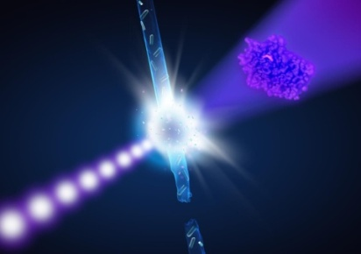
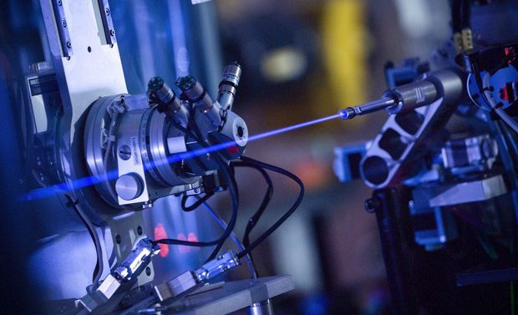
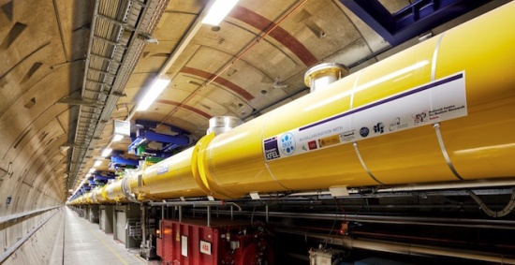
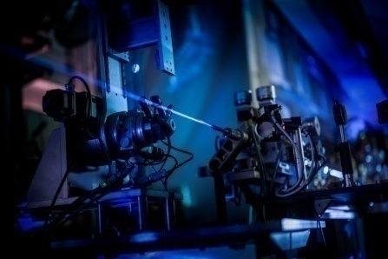
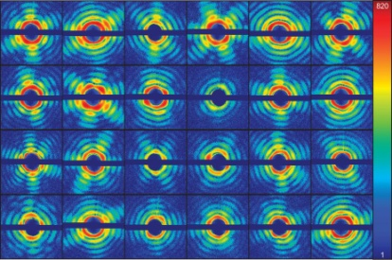


IV International Workshop "Data life cycle in physics", DLC-2020
A review of methods of resolution estimation for 3D reconstructions for nanoscale biological objects from experiments data on super-bright X-ray free electron lasers (XFELs)
Ikonnikova Kseniia
ikonk8@gmail.com
Notes:
1

Slide 2
XFEL: Single-Particle X-ray Imaging
Biomolecule/particle injection
detector
femtosecond X-ray laser pulse
diffraction patterns
different orientations of sample in the collision point
Gaffney, K. J. & Chapman, H. N. (2007). Science, 316, 1444–1448.
Ikonnikova Kseniia, DLC-2020
Notes:
2

Slide 3
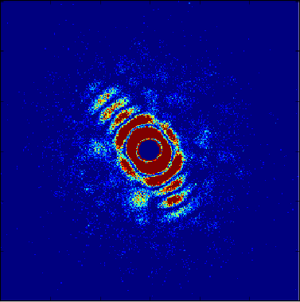
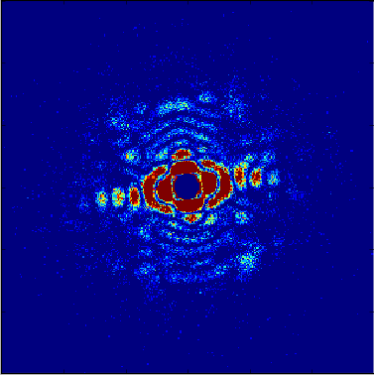
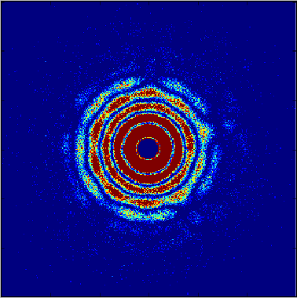
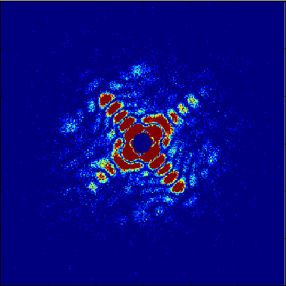
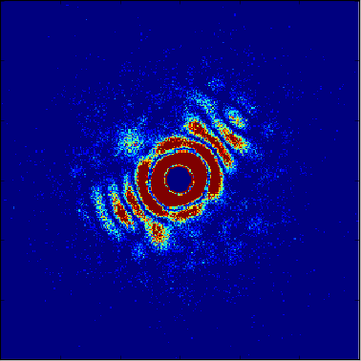
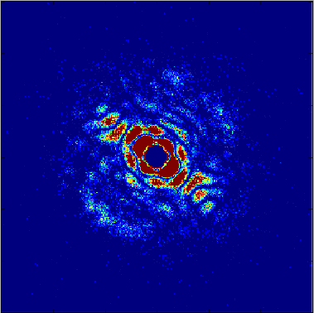
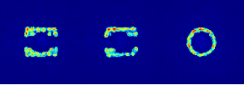
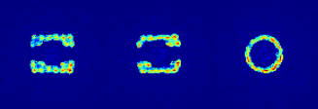
Resolution estimation: Fourier shell correlation
All diffraction images are divided into two sets
YZ plane
XZ plane
XY plane
YZ plane
XZ plane
XY plane
reconstructed 3D
electron density in real space
reconstructed 3D electron density in real space
3D Fourier Transformation
1st (3D) Fourie image of the reconstructed 3D electron density in Fourier space
2nd (3D) Fourie image of the reconstructed 3D electron density in Fourier space
Each 3D electron density is divided into spherical shells and for each shell of radius q the corresponding Fourier shell correlation (FSC) coefficients are calculated.
Marin Van Heel and Michael Schatz (2005), Fourier shell correlation threshold criteria. Journal of Structural Biology 151(3): 25-262.
Ikonnikova Kseniia, DLC-2020

Slide 4
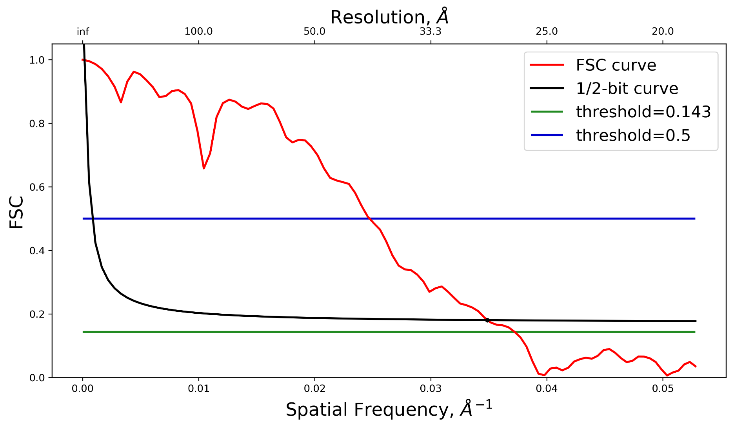
Resolution estimation: Fourier shell correlation
Fourier shell correlation curve
Marin Van Heel and Michael Schatz (2005) Fourier shell correlation threshold criteria. Journal of Structural Biology 151(3): 25-262.
Ikonnikova Kseniia, DLC-2020

Slide 5
Problems related to FSC method
The choice of a threshold value is currently a controversial issue
In addition, this approach can’t account fact that the quality of reconstruction can be uneven and depend on the specific area of ​​the biomolecule
Thus, the issue of effective resolution estimation methods remains open.
Ikonnikova Kseniia, DLC-2020
Notes:
5

Slide 6
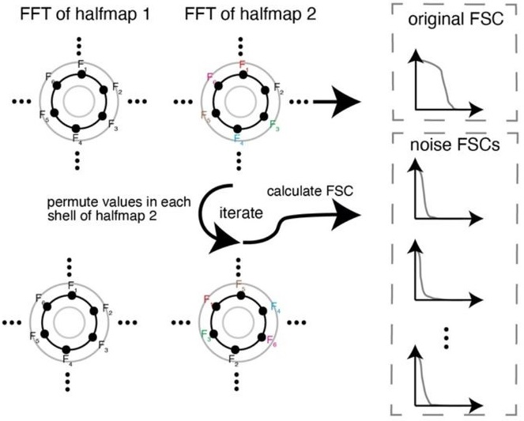
Adaptive thresholding of FSC curves for resolution estimation
1.Sample noise distribution
Beckers, Maximilian (2020). Statistical Inference of cryo-EM Maps. European Molecular Biology Laboratory (EMBL), Heidelberg.
Ikonnikova Kseniia, DLC-2020
Notes:
6

Slide 7
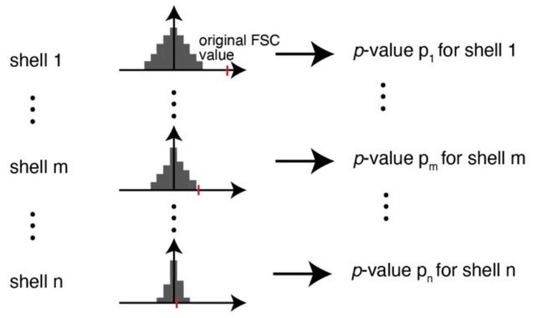
Adaptive thresholding of FSC curves for resolution estimation
2. Conversion to p-values
3. False discovery control (FDC) of p-values
Beckers, Maximilian (2020). Statistical Inference of cryo-EM Maps. European Molecular Biology Laboratory (EMBL), Heidelberg.
Ikonnikova Kseniia, DLC-2020
Notes:
7

Slide 8
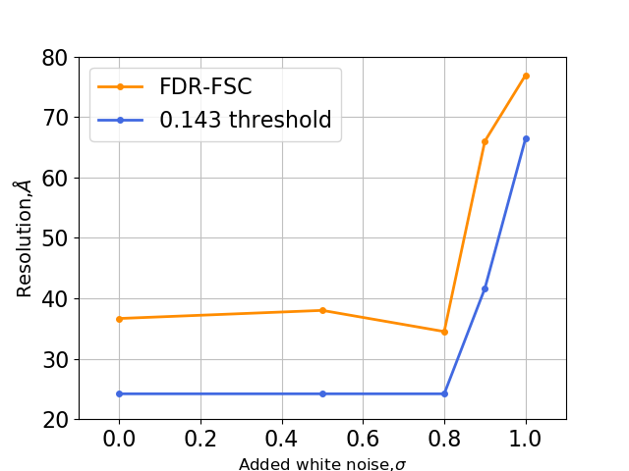
Comparison of the 0.143 cutoff values thresholds
with the FDR-FSC values
number of diffraction images = const = 20 000
The 0.143 cutoff values thresholds and FDR-FSC values are a very similar, but the FDR-FSC resolution estimate is more optimistic.
Ikonnikova Kseniia, DLC-2020

Slide 9
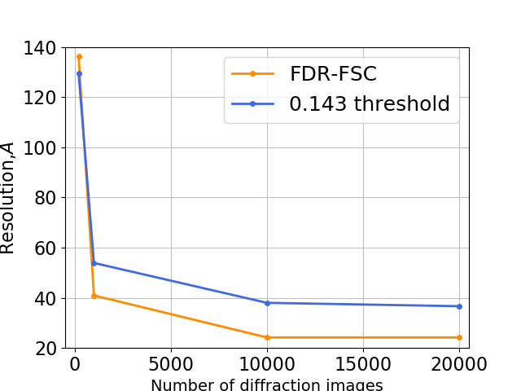
Comparison of the 0.143 cutoff values thresholds
with the FDR-FSC values
level of noise σ = const = 0
The 0.143 cutoff values thresholds and FDR-FSC values are a very similar, but the FDR-FSC resolution estimate is more optimistic.
Ikonnikova Kseniia, DLC-2020

Slide 10
Local resolution method ResMap
The main idea of ​​the ResMap method base on the detection of a sinusoidal wave above the noise level for each point in the volume
A λ Å feature exists at a point in the volume if a three dimensional (3D) local-sinusoid of wavelength λ is statistically detectable above noise at that point.
A likelihood-ratio hypothesis test of the local-sinusoid vs. noise can detect this feature at a given P –value.
Thus the local resolution at a point as the smallest λ at which the local-sinusoid is detectable, accounting for multiple testing with a false discovery rate (FDR) procedure.
Kucukelbir, Alp et al. “Quantifying the local resolution of cryo-EM density maps.” Nature methods vol. 11,1 (2014): 63-5.

Slide 11
Local resolution method ResMap
Ikonnikova Kseniia, DLC-2020

Slide 12
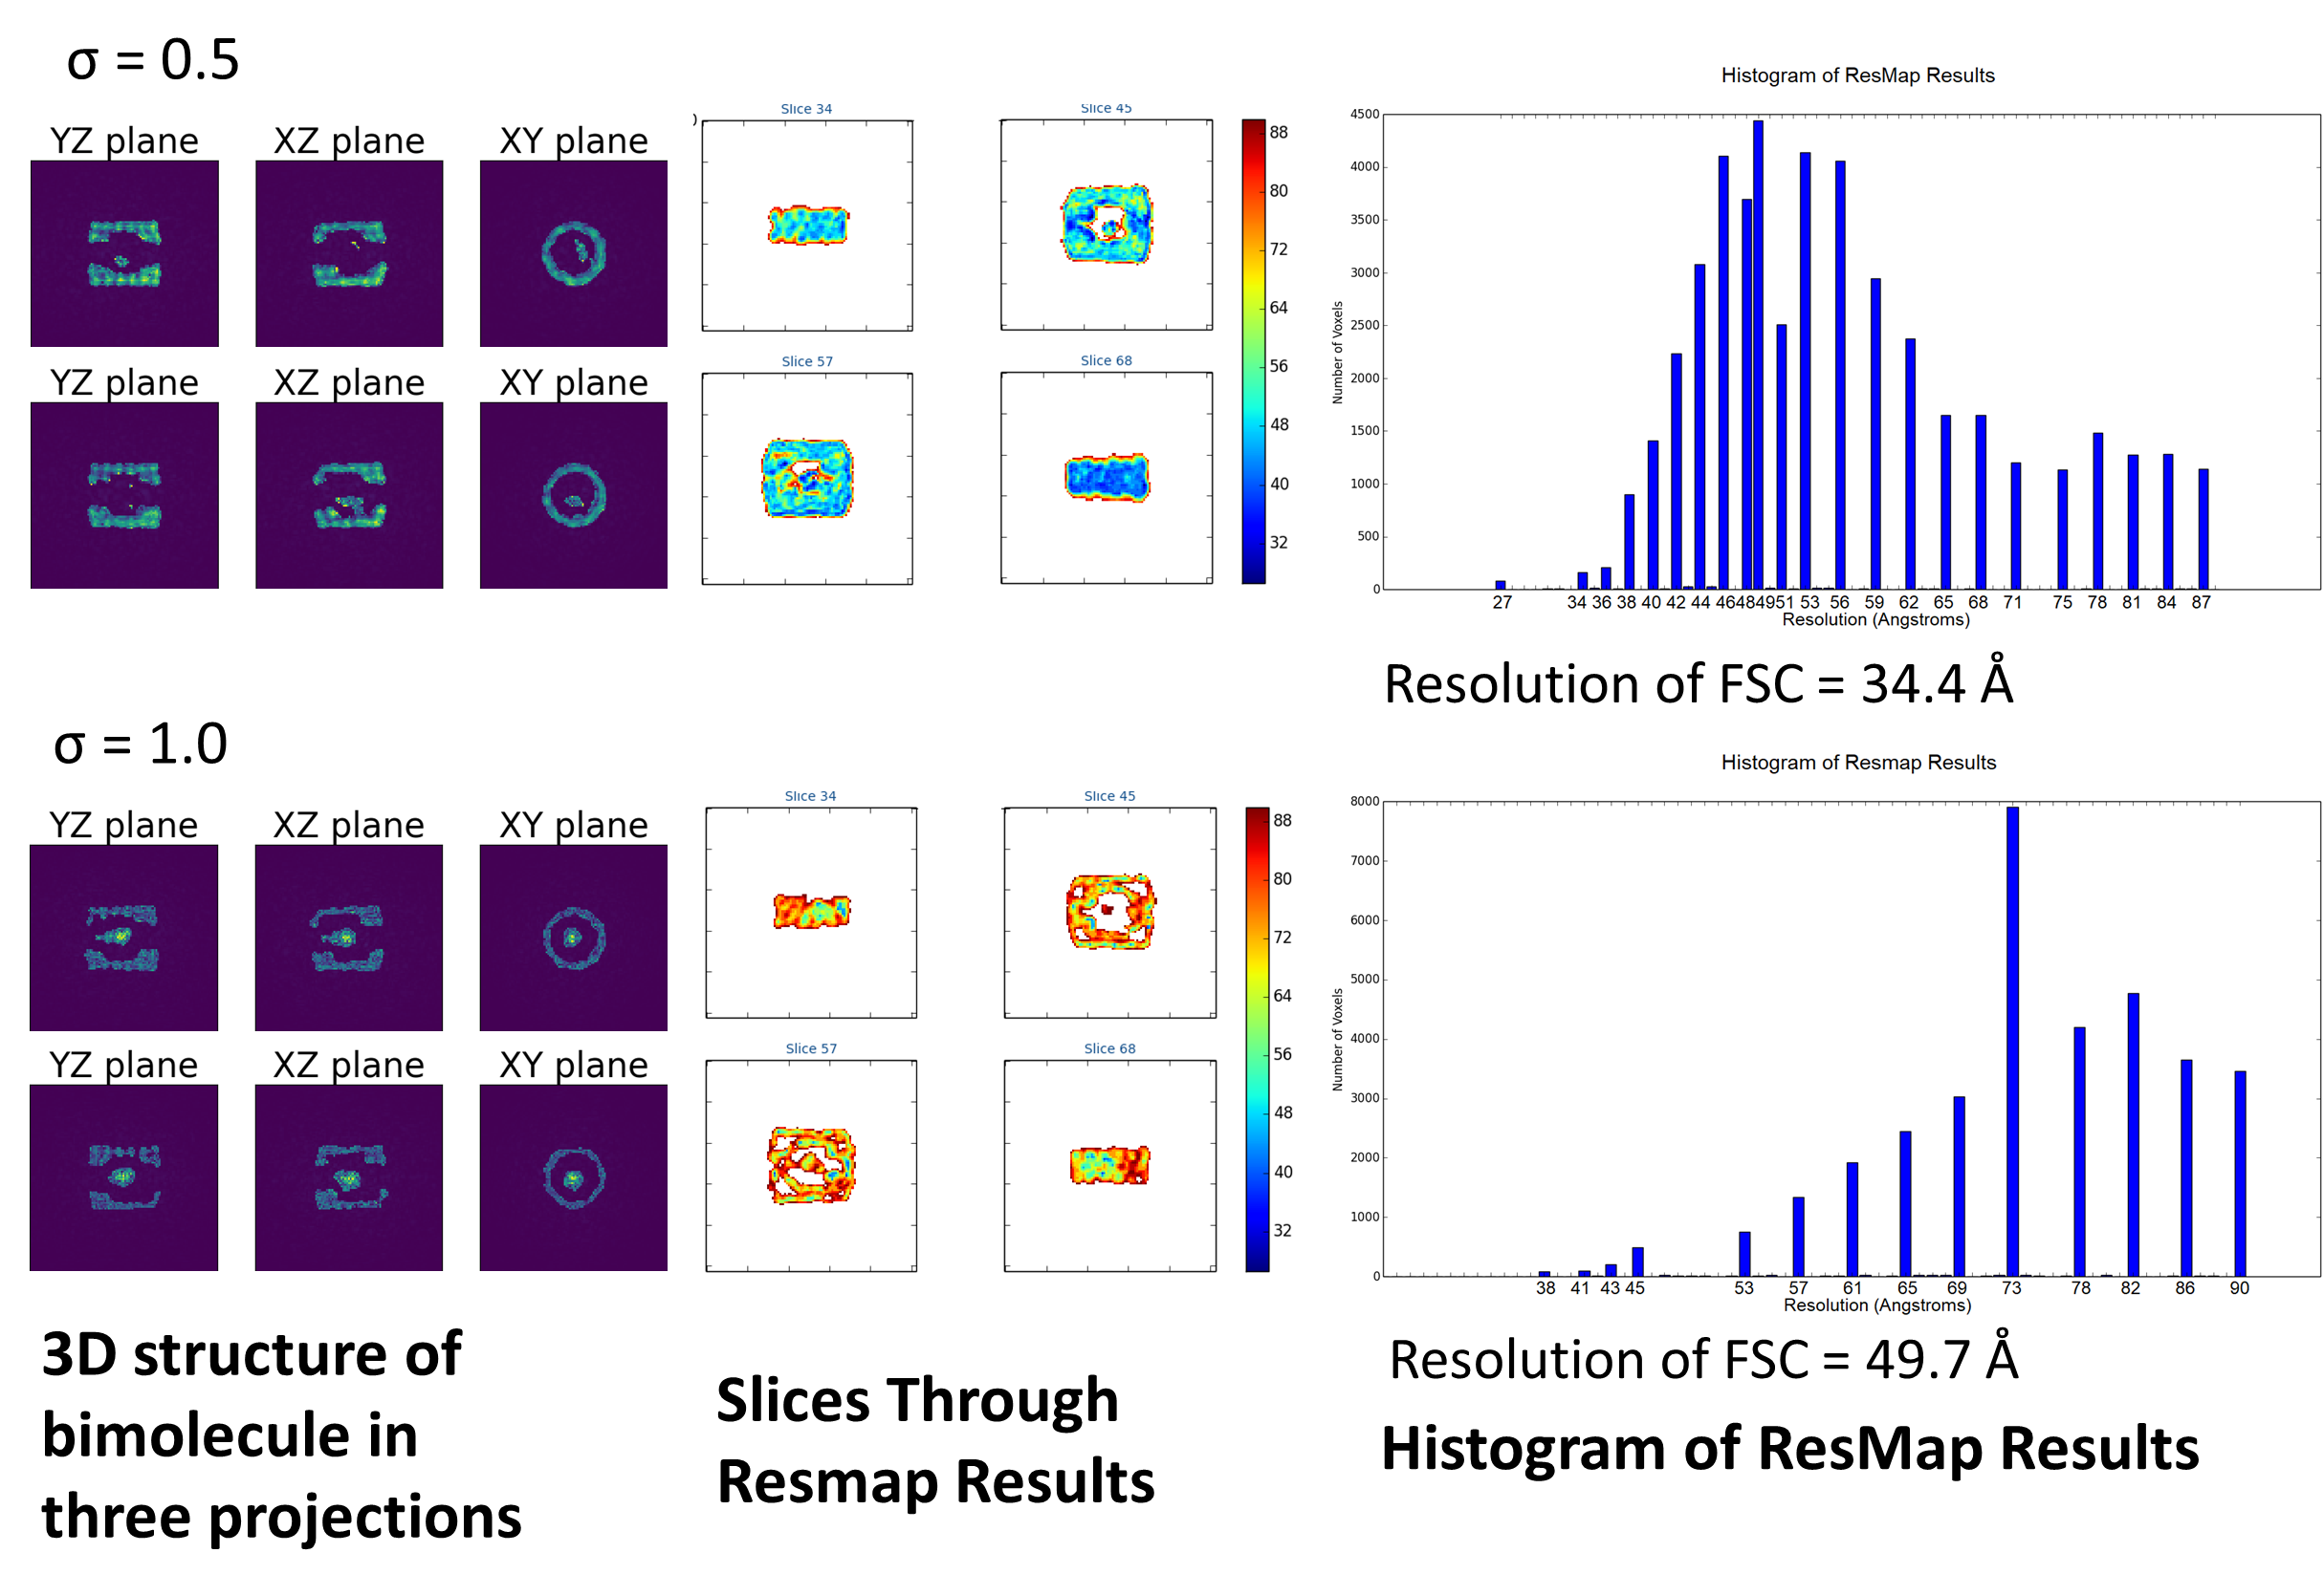
Result of estimation local resolution using ResMap
Results for datasets with different level of noise σ ( number of images = const=20000)
Ikonnikova Kseniia, DLC-2020

Slide 13


Acknowledgments
The research was supported by Helmholtz Association’s Initiative and Networking Fund and Russian Science Foundation (project no. 18-41-06001).
This work has been carried out using computing resources provided by NRC Kurchatov institute project "Development of modular platform for scientific data processing and mining".
Ikonnikova Kseniia, DLC-2020

Slide 14
Thank you for your attention!
Ikonnikova Kseniia, DLC-2020

