Slide 1
Turning convective forecasts into flood warnings that lead to action
RealPEP Conference
October 2020
Linda Speight
University of Reading
l.j.speight@reading.ac.uk @linda_sp8
With thanks to colleagues at University of Reading, Scottish Environment Protection Agency, University of Strathclyde, RAB Consultants and across the FFIR Programme

Slide 2
Who am I?
Currently a Postdoc at University of Reading
Review of surface water flood forecasting approaches from SEPA doi:10.17868/69416
Flooding from Intense Rainfall (FFIR) programme policy and practice review
Previously worked as an operational flood forecaster for the Scottish Flood Forecasting Service
Developed a surface water forecasting pilot for the Commonwealth Games in Glasgow doi:10.1111/jfr3.12281

Slide 3
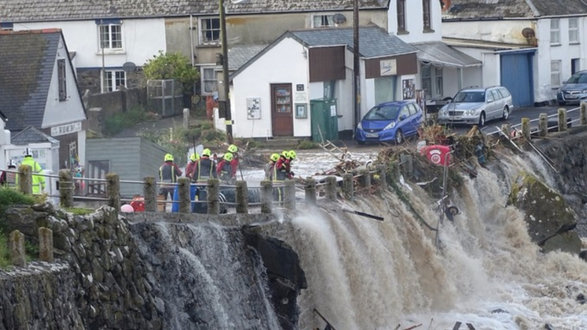
Forecasts that lead to action
Closing the circle of the end-to-end forecasting chain
What do end users need from a forecast?
v’s
What are the scientific limitations?
Approaches to operational surface water flood forecasting
Coverack floods July 2017 (Source ITV)
Note: Surface water or flash flooding?

Slide 4
End-to-End flood forecasting chain
Post processing?
Figure adapted from Speight et al. (2020) Operational and emerging capabilities for surface water flood forecasting, submitted to WIRES Water

Slide 5
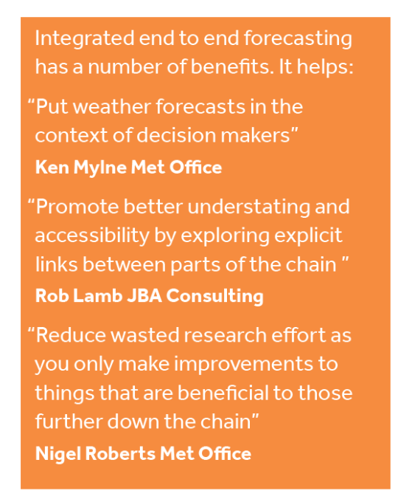
Closing the circle
“Where meteorologists and hydrologists have worked together on the FFIR programme they have started to close the gaps in understanding between disciplines”
Rob Thompson, University of Reading
These are some comments from the Flooding from Intense Rainfall review.
For more details see:
Programme Research Summaries – http://blogs.reading.ac.uk/flooding/files/2013/11/Flooding-From-Intense-Rainfall-Summaries.pdf
Overview paper – Flack et al (2019). Recommendations for Improving Integration in National End-to-End Flood Forecasting Systems: An Overview of the FFIR (Flooding From Intense Rainfall) Programme. Water 11(4), 725. doi: 10.3390/w11040725

Slide 6
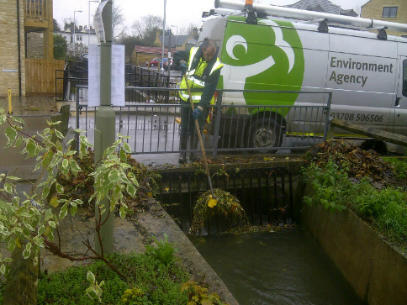
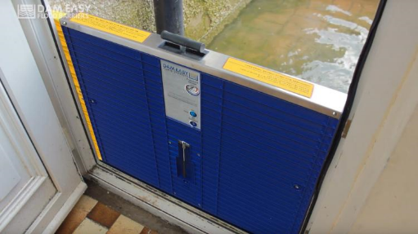
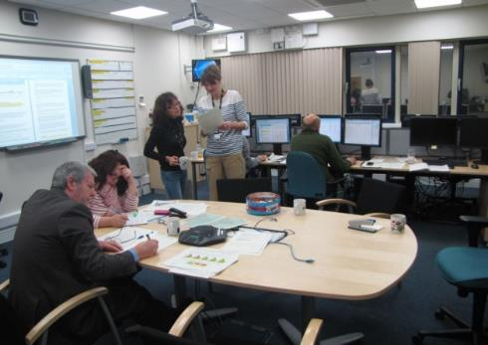
What do end users want from a surface water flood forecast?
Time for proactive preparation. 6–24 hour lead time; ideally 12 hours but some organisations such as the emergency services were happy with 1-2 hours
To provide guidance on event timings, specific locations and possible impacts and severity
To include low likelihood but high impact events to enable proactive low regret actions to be taken
To communicate a stand-down message
Findings from Speight et al (2018) and Rabb et al (2019)
Clear trash screens
Install flood protection
Set up incident rooms
Notes:
https://www.flickr.com/photos/environment-agency/8214525706
https://odditymall.com/dam-easy-flood-barrier
https://www.edp24.co.uk/news/weather/environment-agency-issues-flood-alert-for-north-norfolk-coast-1-3171990

Slide 7
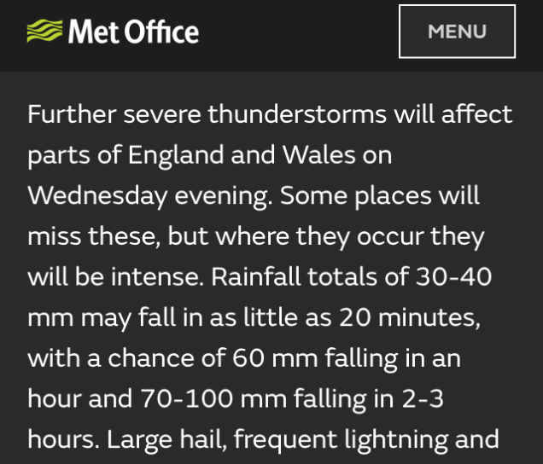
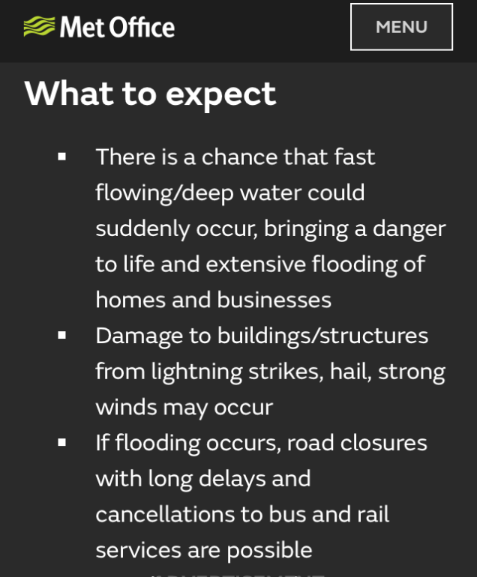
What is feasible?
High uncertainties around predicting the location, timing and impact of what are typically localised events
Probabilistic forecasts essential
Impact based forecasts help communication
Real time flood modelling at the limits of computational ability
Staff resource to interpret and communicate is high
Met Office Weather Warning from August 2020

Slide 8
Approaches
Different approaches have developed as decision-makers have different requirements from a flood forecasting system
The actions they take may require different lead times to activate
they may be willing to accept different levels of risk
Decisions need to be made around appropriate modelling scales, available computational ability, integration with existing systems and available staff support time
There is not a one size fits all solution

Slide 9
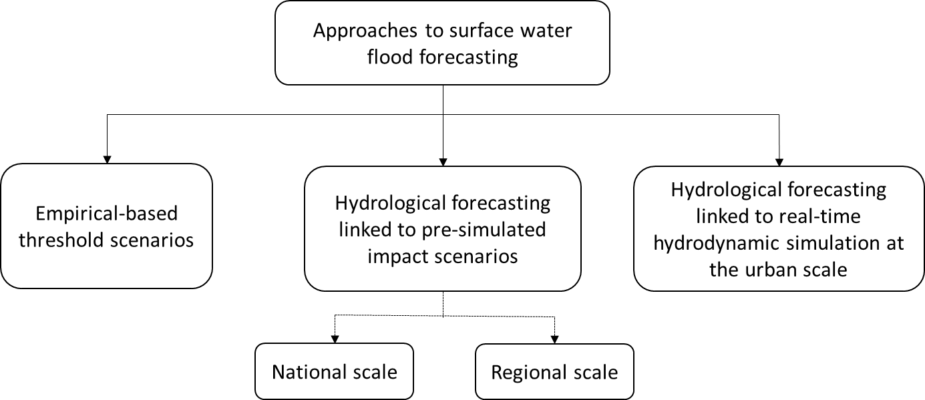
Reviewing approaches to SWFF for SEPA
“What should we know about if we want to improve surface water flood forecasting?”
The full report to SEPA is available here https://doi.org/10.17868/69416
Figure from Speight et al. (2020) Operational and emerging capabilities for surface water flood forecasting, submitted to WIRES Water
Notes:
In particular they wanted to know:
What is the current science around precipitation observations and forecasts
What tools are available for pluvial flood forecasting at multiple scales
What tools are available for monitoring surface water flooding impacts in real time?
What possible approaches could be taken to pluvial flood forecasting in Scotland?

Slide 10
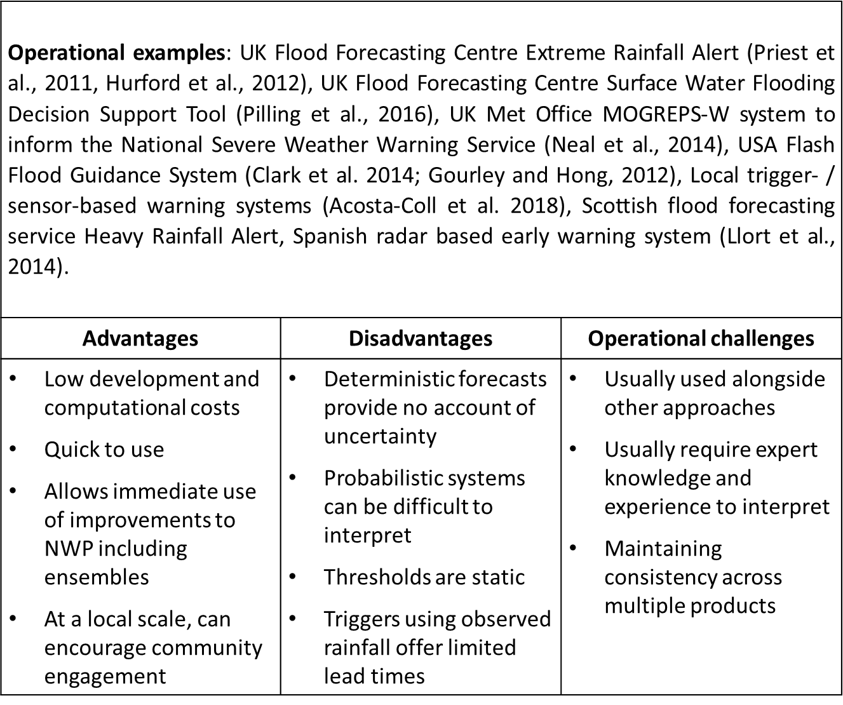
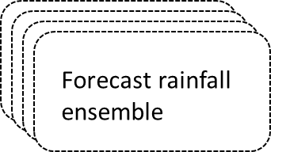
Empirically based rainfall scenarios
or
Figure and Table adapted from Speight et al. (2020) Operational and emerging capabilities for surface water flood forecasting, submitted to WIRES Water

Slide 11
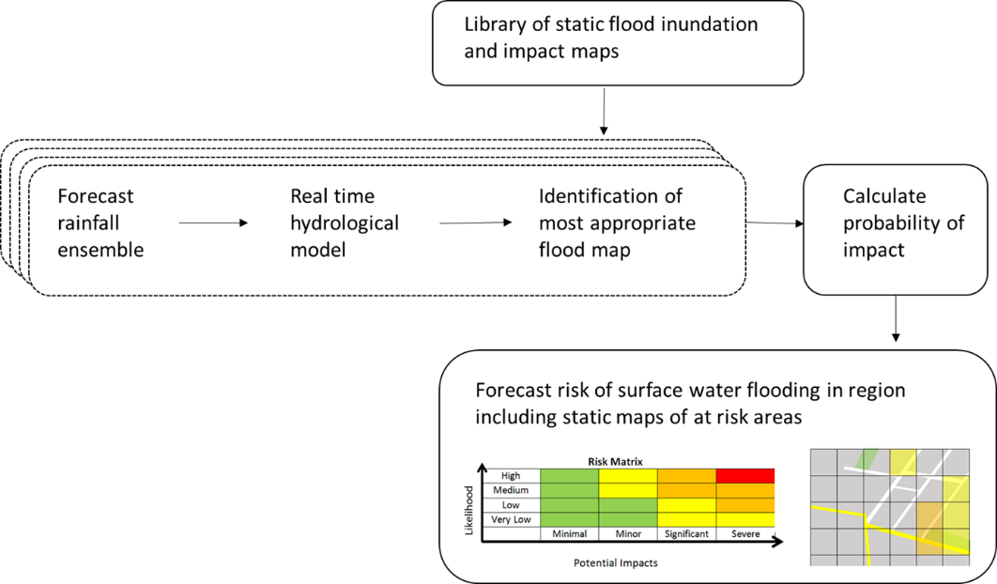
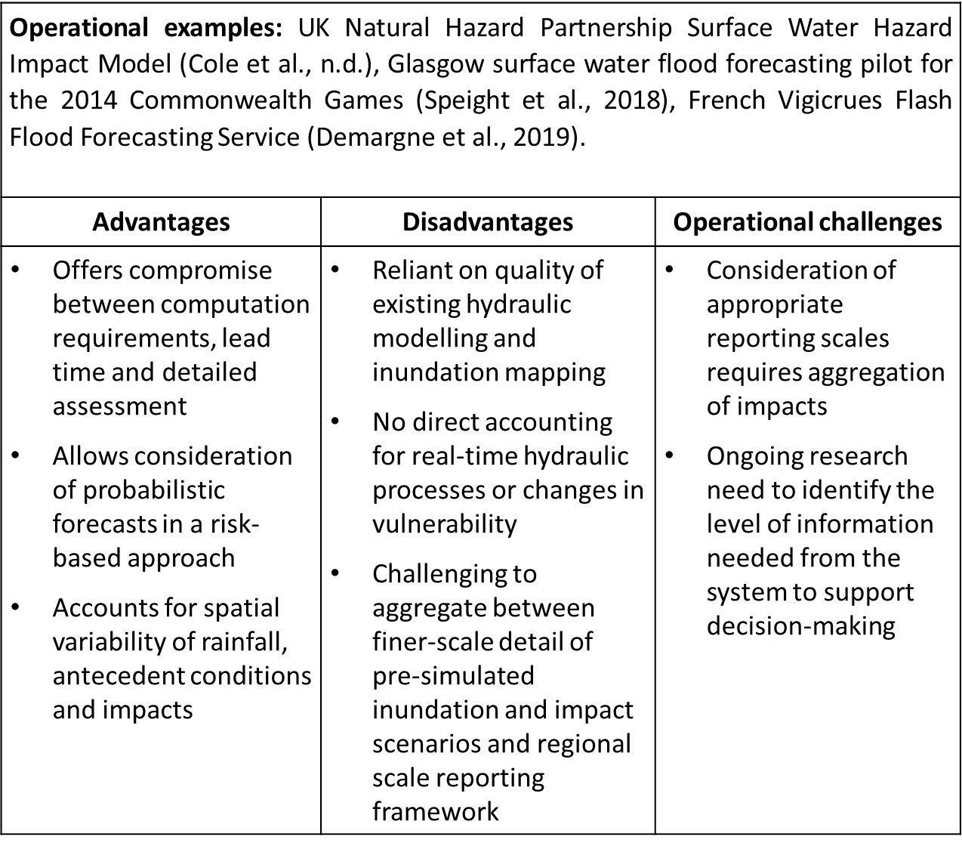
Pre-simulated impact scenarios
Figure and Table adapted from Speight et al. (2020) Operational and emerging capabilities for surface water flood forecasting, submitted to WIRES Water

Slide 12
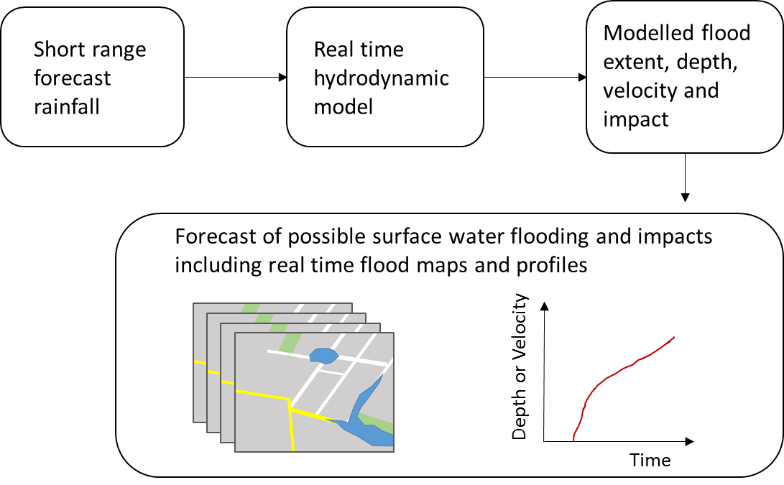
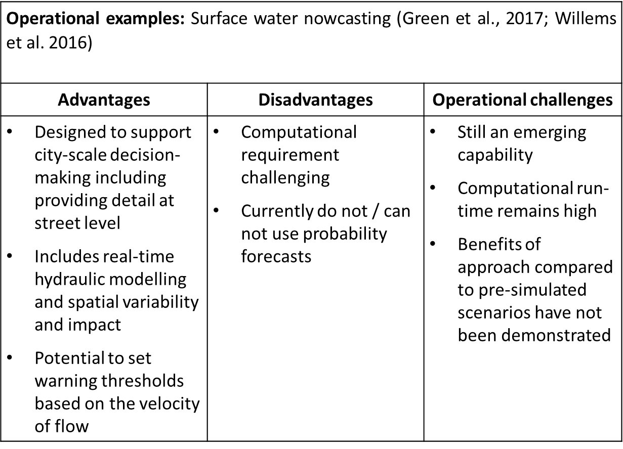
Hydrological forecasting linked to real time hydrodynamic simulation at the urban scale
Figure and Table adapted from Speight et al. (2020) Operational and emerging capabilities for surface water flood forecasting, submitted to WIRES Water

Slide 13
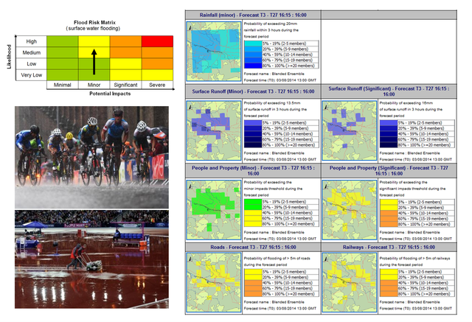
My Experience
What people really want is to know when and where impacts will occur
But there is a good understanding of the limitations of convective forecasting
Consistency across scales
Less is often more
Image from HEPEX blog Developing an Operational Pilot Surface Water Flood Forecasting tool /

Slide 14
Conclusions
Convection permitting NWP has enabled the development of surface water forecasting models
They can not (and will not?) deliver timely and reliable food forecasts in the same way as fluvial and coastal models
But with a clear understanding of strengths and limitations they can be an effective tool
A successful SWFF model requires an interdisciplinary approach and clear communication
Loughborough University Real Time Flood Nowcasts
Thankyou!
l.j.speight@reading.ac.uk @linda_sp8
Notes:
1:20 for video

