Slide 1
On the relationship between lightning activity and convective cell severity
Jordi Figueras i Ventura, Alessandro Hering, Jacopo Grazioli
Precipitation and Flash Flood Prediction from Minutes to Days, 5-7 Oct. 2020, Online Conference

Slide 2
Lightning jump as a storm severity predictor

Slide 3
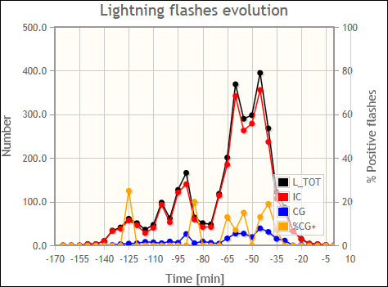
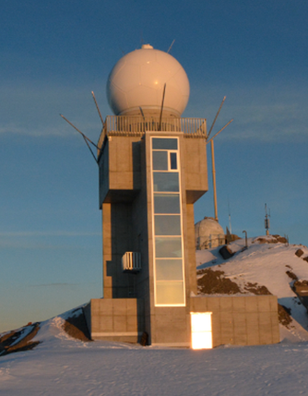
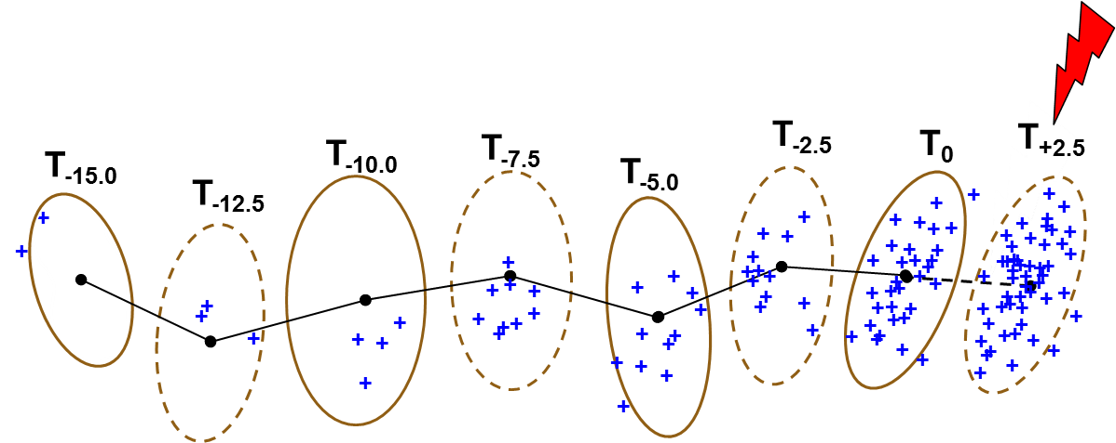
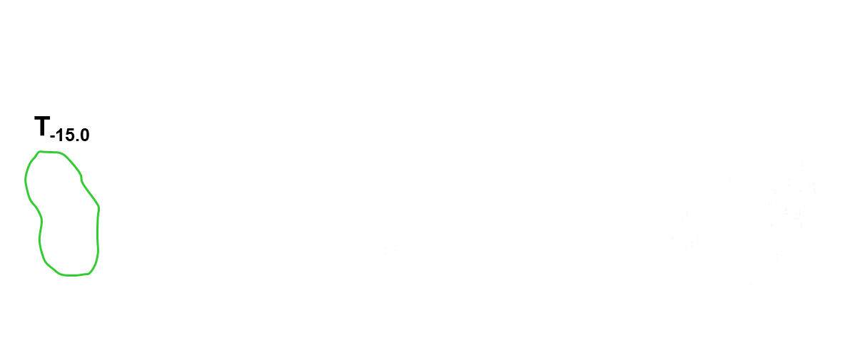
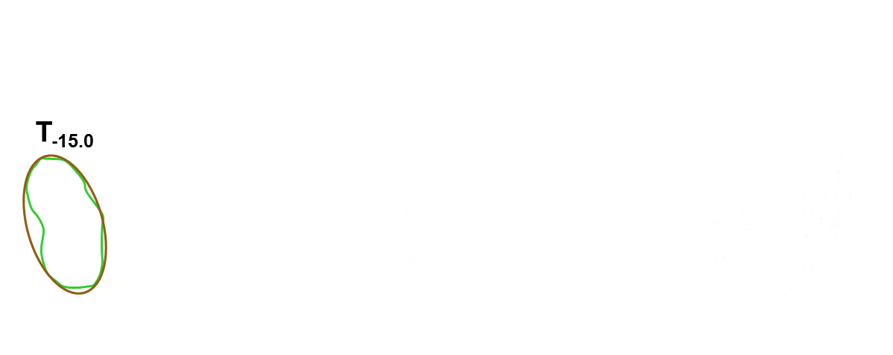
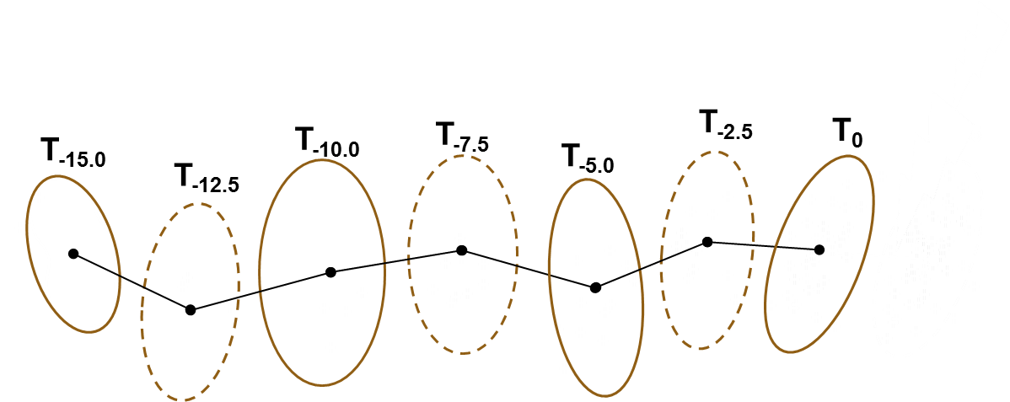
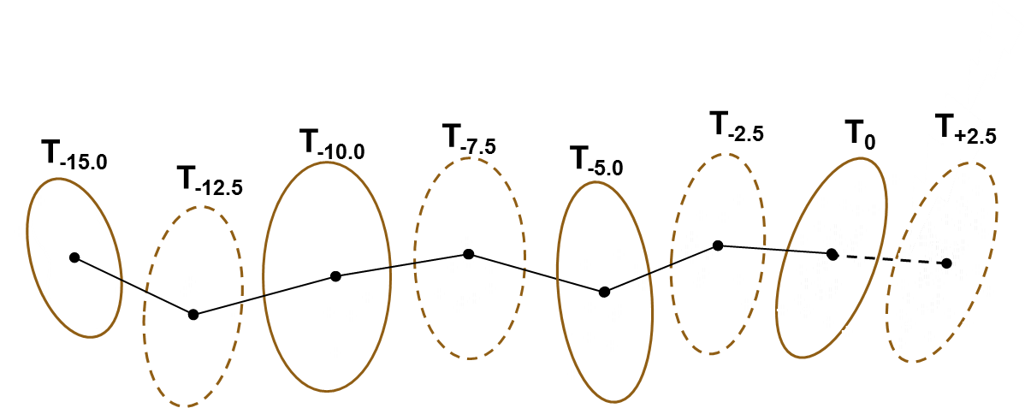
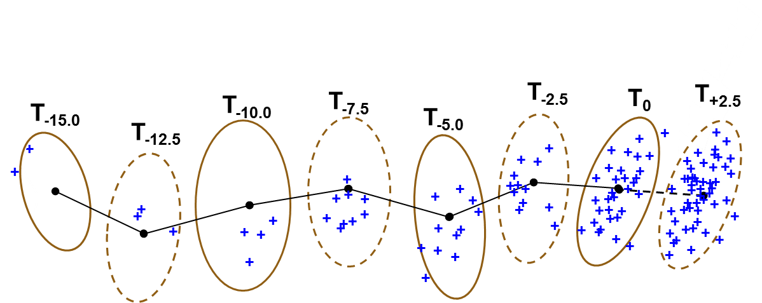
Lightning Jumps: real-time algorithm
total Lightning
Lightning Jumps (LJ): sudden increase in total lightning (CG+IC) flash rate within thunderstorm cells
LJ can occur from few minutes to tenth of minutes before the onset of severe weather (hail, heavy rain, wind gusts,…)
Lightning Jump algo
Vaisala LS7002
MeteoSwiss
(operational)
Δt = 2.5 min
14:47
15:25
15:47
TRT cells

Slide 4
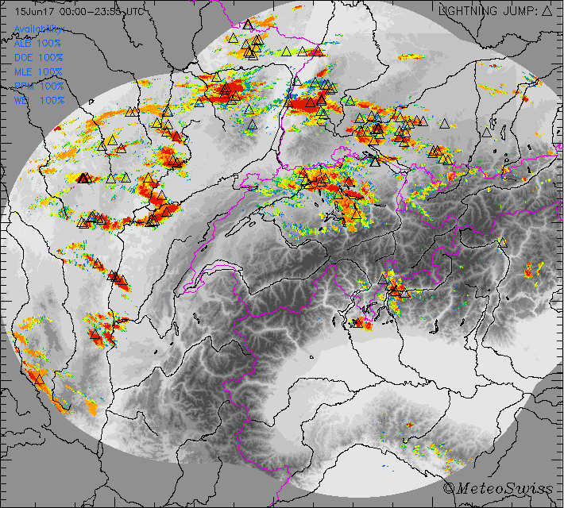
15 June 2017 10:00-21:00 UTC
Δt = 2.5 min
Daily maximum POH
Lightning Jump warning: Δ
Lightning Jump warning:
Complementary nowcasting tool for severe weather
Can increase lead time of real-time TS warnings
90 70 50 30 10
Probability of Hail [%]
100 km
Notes:
Now we superimpose all the Lightning Jumps for this day, represented by the black triangles
We can say that if we have a lightning jump there is also a good chance to have hail
In this case there are only few Ligntning Jumps outside areas with a high probability of hail
For a possible Nowcasting application we are interested also in the dynamic component, especially because of the lead time
Therefore we look now at the animation of the temporal evolution of the hail probability and Lightning Jumps

Slide 5
Lightning Jumps vs. hail storms (2014-2017)
(total lightning: CG + IC; cell duration ≥30min)
LJ before hail initiation (POH ≥ 80%) or MaxEcho (ordinary storms)
0.9
0.8
Preliminary:
POD: 45% FAR: 29% LeadTime: ~18 min
0.7
0.6
0.5
43%
frequency
0.4
0.3
0.2
0.1
3%
0.0
POH
≥80%
MESHS
≥2cm
MESHS
≥4cm
MESHS
≥6cm
ordinary
storms number:
(35673) (3512) (1254) (685) (133)
LJ algorithm: Schultz et al., 2009, modified (LightningRate_{min}: 15 flashes / 5 min; Sigma-level = 1.0)
Nisi et al. (2020)
Notes:
This preliminary statistical analysis was done by Luca Nisi
The LJs over Switzerland are compared to the hail storm occurrence during the 4-Years period 2014-2017
The diagram shows the LJs before the hail initiation (defined by the radar-derived POH > 80%) for hail storms, or before the “maximum of the maximum reflectivity“ for ordinary storms without hail (CLICK)
The analysis includes more than 35’000 ordinary thunderstorms (CLICK) and about 3’500 hail storms (CLICK)
MESHS indicates the radar-derived maximum hail size and therefore increasing severity in this direction
We can see a significant difference between the ordinary storms and the more intense hail storms (CLICK)
Ordinary storms produce only rarely LJs before the maximum reflectivity
Only about 3% of the 35’000 ordinary storms exhibit a LJ while more than 43% of the 3’500 hail storms show a LJ
However, before the hail initiation there is no large difference regarding the hail severity after a LJ
We can not say in advance how severe will be the hail after a LJ (CLICK)
Preliminary skill scores for hail storms with POH > 80% are: POD is 45% and the FAR 29%
The median lead time is around 18 min
These scores are not very high, but they can still be very interesting for an automatic Nowcasting algorithm

Slide 6




Polarimetric radar characteristics of lightning initiation and propagating channels
Jordi Figueras i Ventura, Nicolau Pineda, Nikola Besic, Jacopo Grazioli, Alessandro Hering, Oscar A. van der Velde, David Romero, Antonio Sunjerga, Amirhossein Mostajabi, Mohammad Azadifar, Marcos Rubinstein, Joan Montanyà, Urs Germann, Farhad Rachidi

Slide 7
Research questions
Can polarimetric variables inform us of the likelihood of lightning activity?
Can we distinguish between precipitating conditions producing mostly IC lightning from those producing CG?
What are the environmental conditions leading to upward lightning?

Slide 8
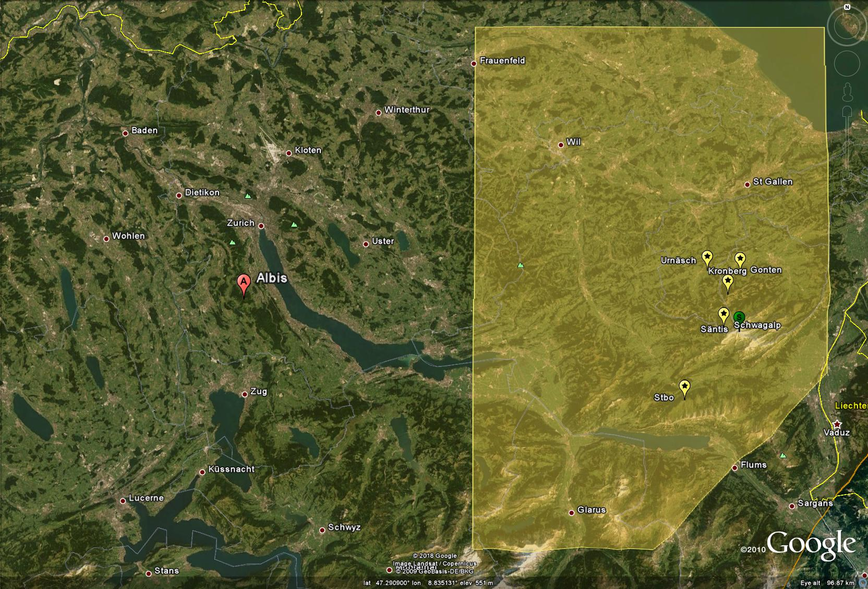
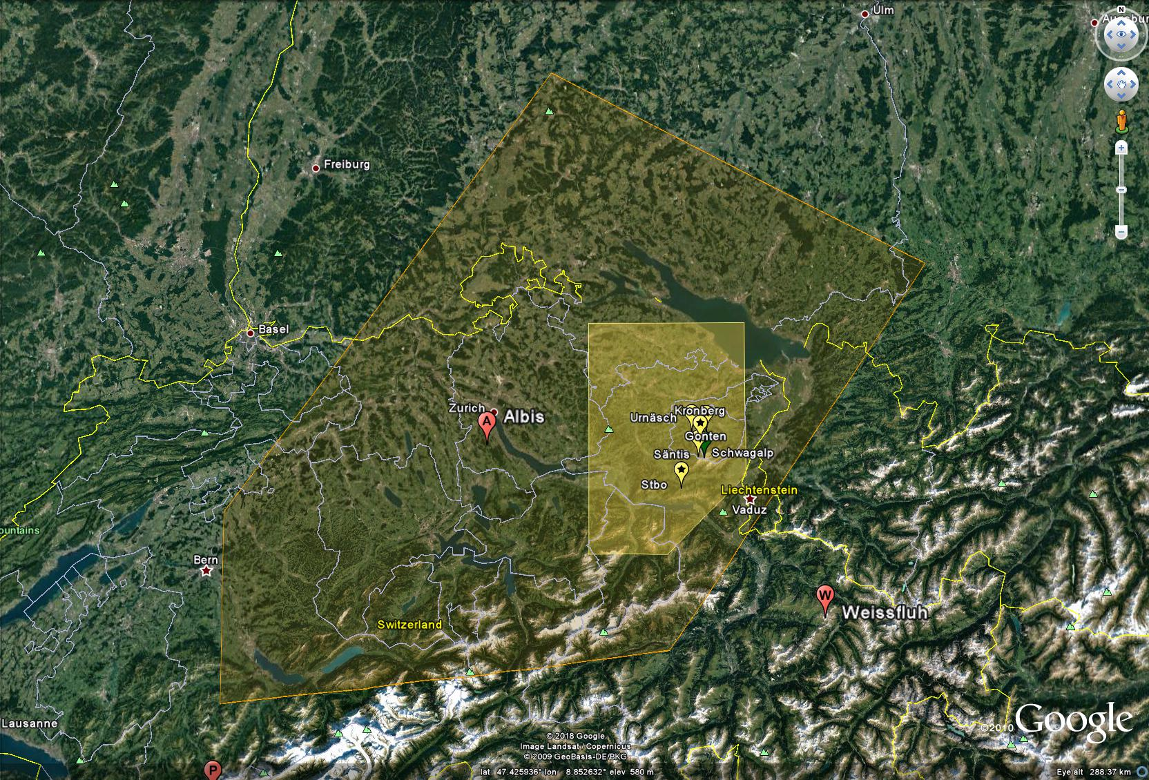
Säntis LMA domain (29 June-15 August 2017)
+ EUCLID Lightning detection network managed by Météorage

Slide 9
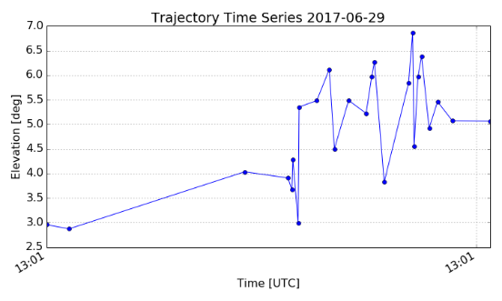
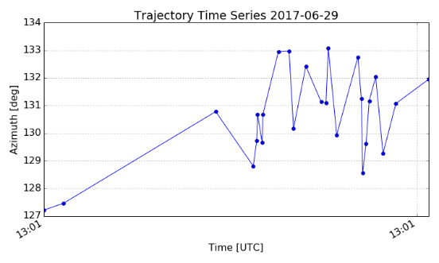
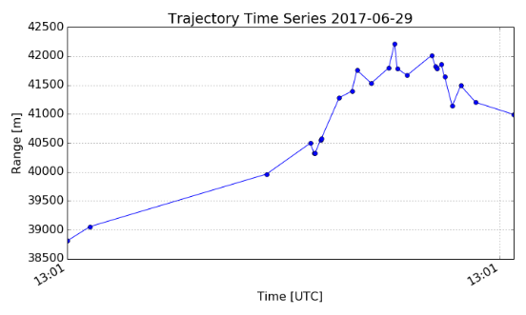
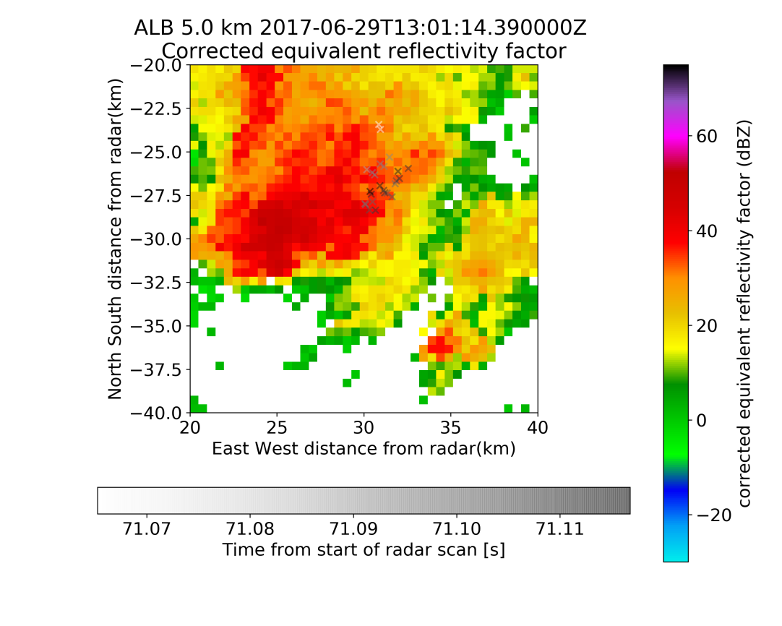
Example single flash
Elevation
Azimuth
Range

Slide 10
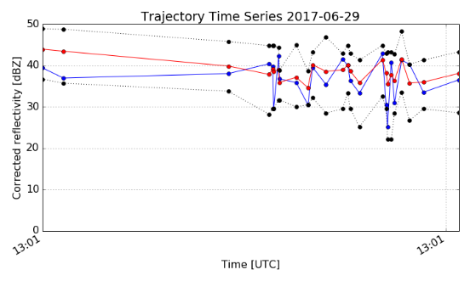
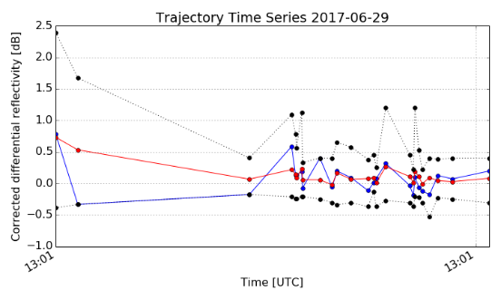
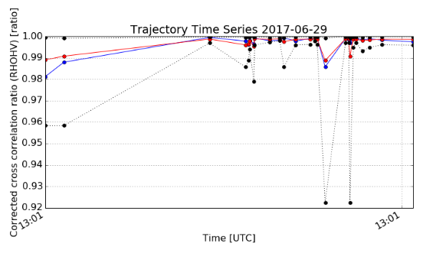
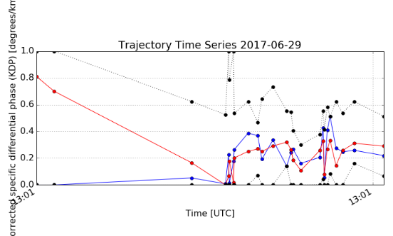
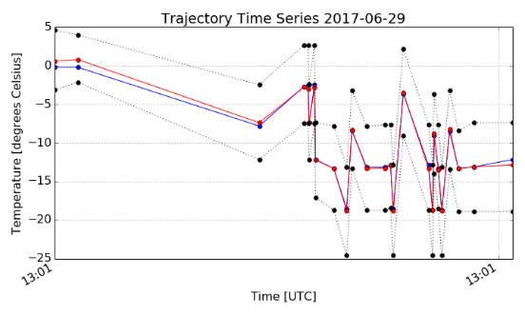
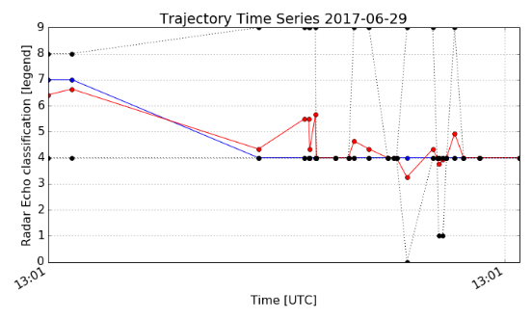
Example single flash
ZDR
Zh
RhoHV
KDP
T
Hydro class
Min/max in 3x3x3 neighbourhood
Mean in 3x3x3 neighbourhood
Value at flash position
0=NC, 1=DS, 2=CR, 3=LR, 4=RP, 5=RN, 6= VI, 7=WS, 8=MH, 9=IH/HDG

Slide 11
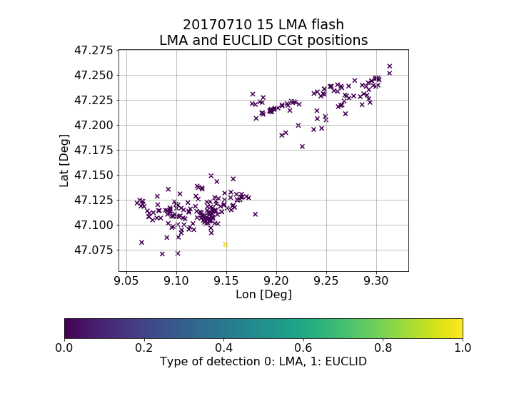
Association of LMA flash to EUCLID stroke
Time criteria:
+- 0.1 s from first/last LMA source
Area criteria:
1.2*min rectangle (min 25 km²)

Slide 12
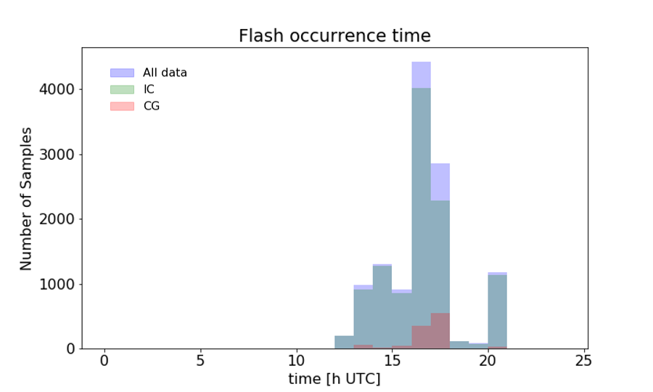
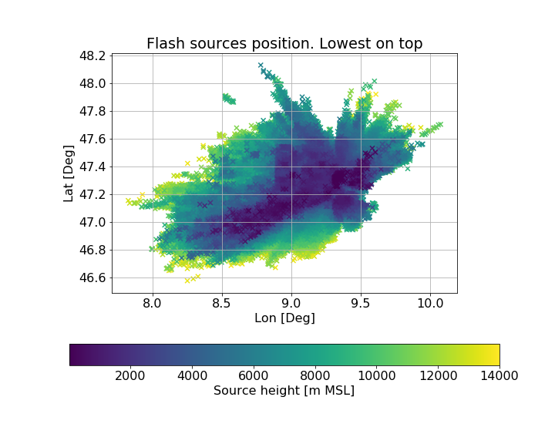
Relevant events
1586394 VHF sources corresponding to 12062 (1085 CG) flashes in 8 days

Slide 13
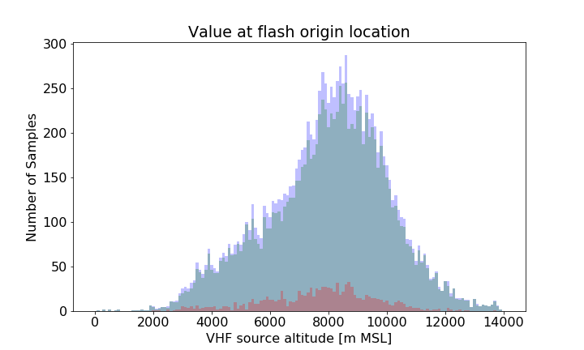
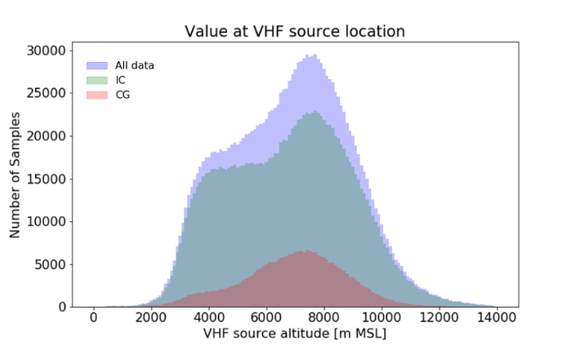
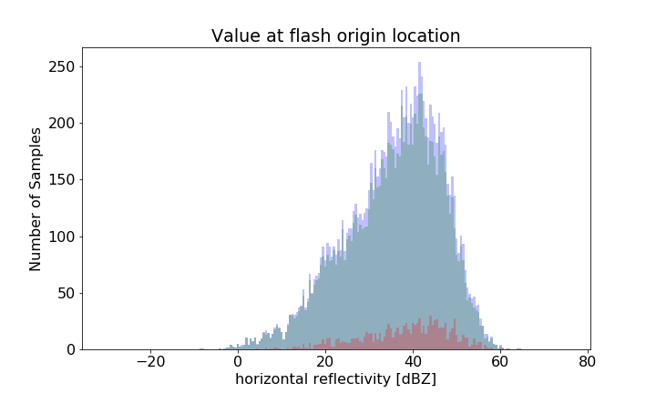
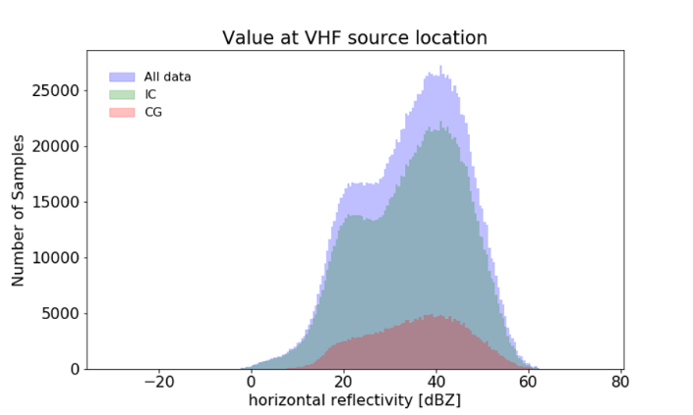
Flash origin and propagation habitat

Slide 14
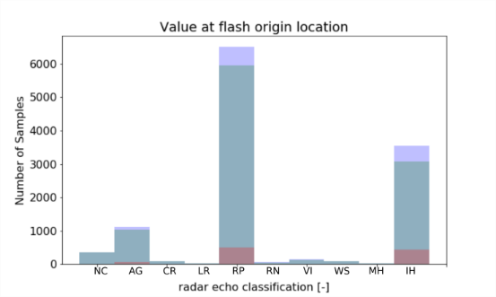
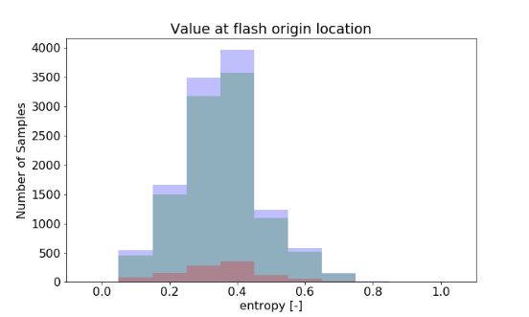
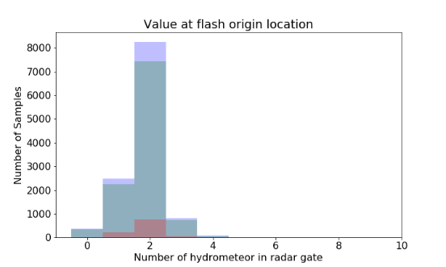
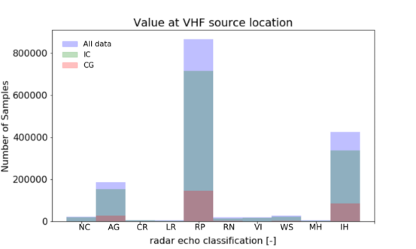
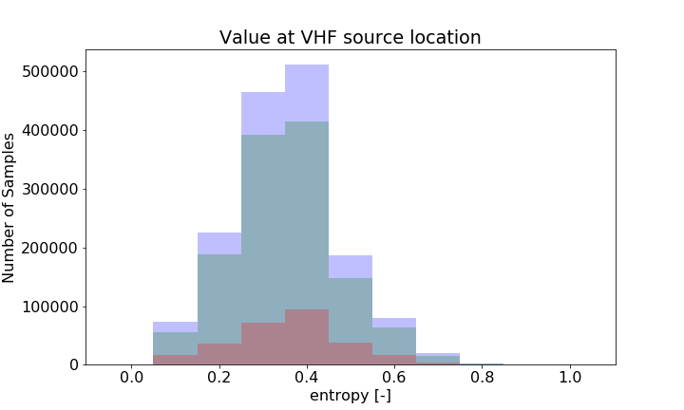
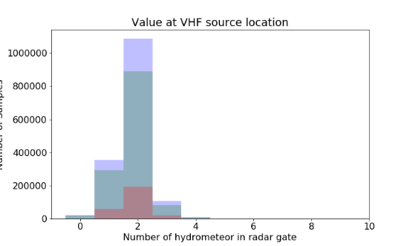
Flash origin and propagation habitat

Slide 15
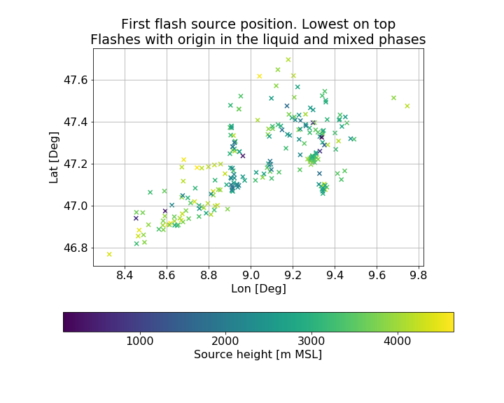
Upward lightning (UP)
Säntis tower
Only 241 flashes

Slide 16
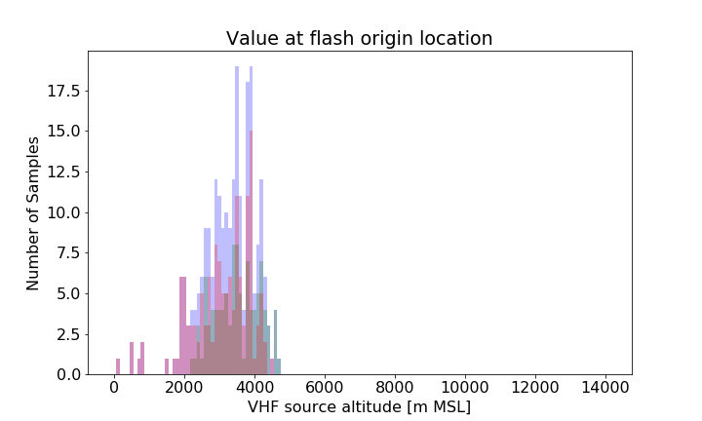
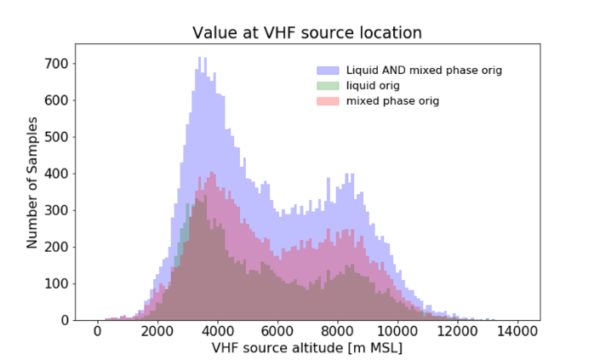
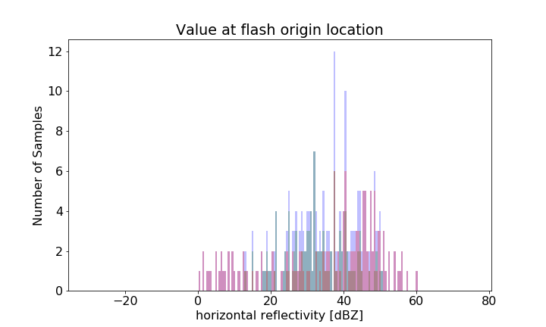
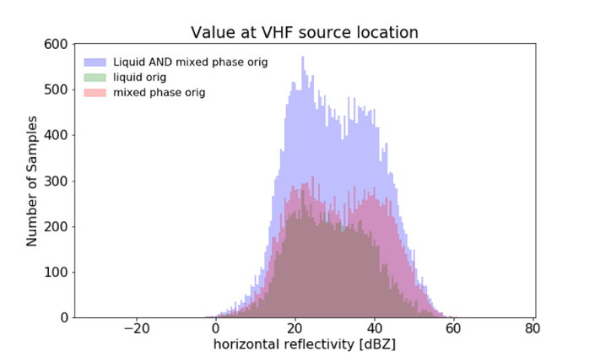
UP origin and propagation habitat

Slide 17
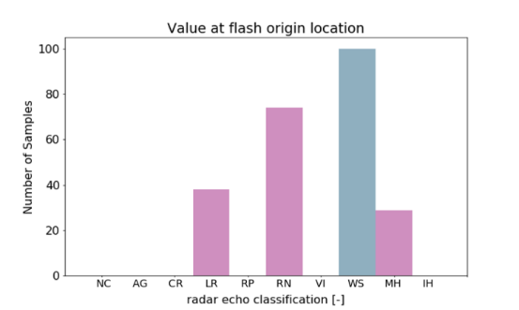
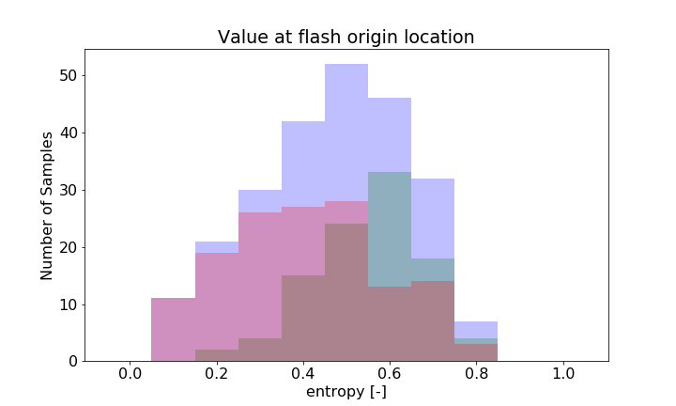
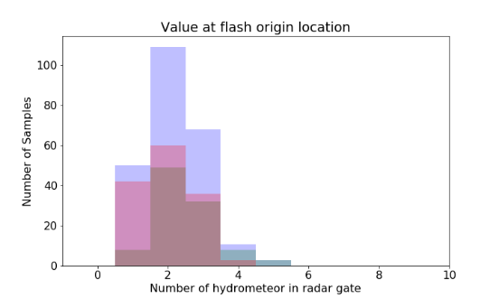
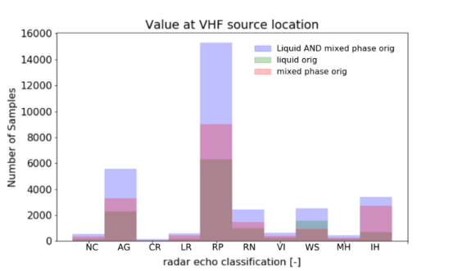
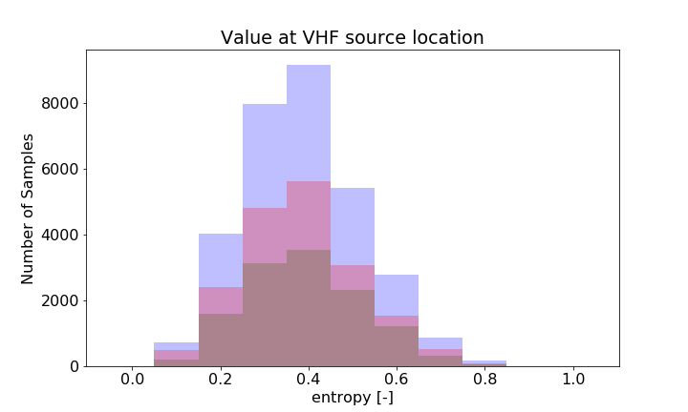
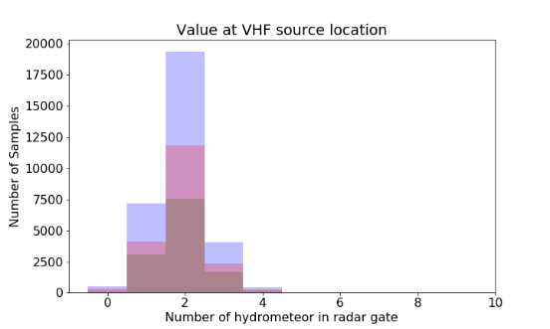
UP origin and propagation habitat

Slide 18
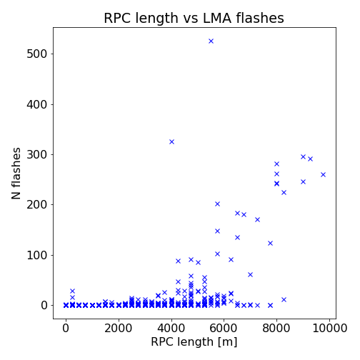
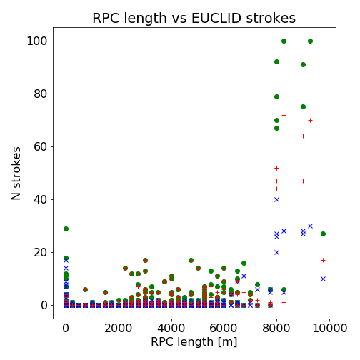
RPC as lightning descriptor
Rimed Particles Column Height: Height of the column inside a convective cell (as defined by TRT algorithm) where rimed particles or hail are dominant

Slide 19
Conclusion
A sudden increase in total lightning in a convective cell is a good predictor of increased cell severity
Most flashes being generated in areas of high reflectivity, well above the iso-0° and containing rimed particles or hail. They Propagate predominantly through areas of rimed particles or hail
Distinct characteristics of upward lightning
Height of rimed particles column good indicator of lightning activity

Slide 20
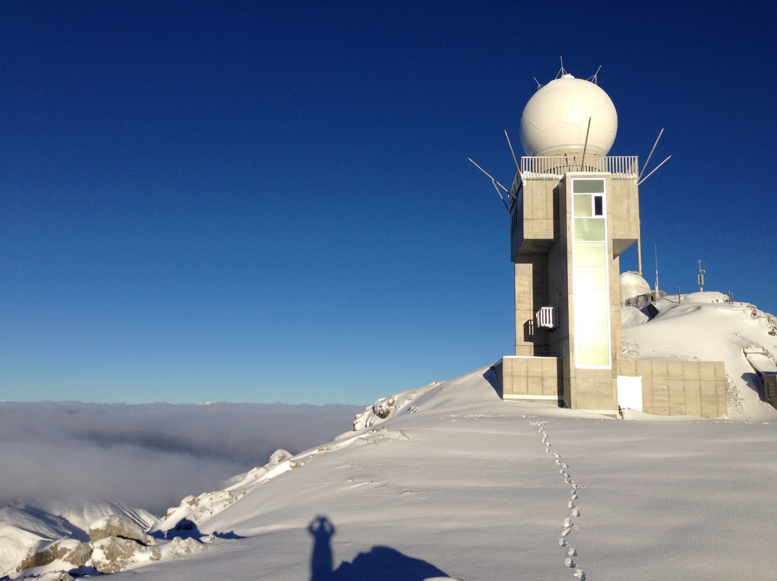
Thank you!
Grazie mille!
Moltes gràcies!
J. Figueras i Ventura et al., Polarimetric radar characteristics of lightning initiation and propagating channels, Atmos. Meas. Tech., 12, 2881-2911, https://doi.org/10.5194/amt-12-2881-2019, 2019
J. Figueras i Ventura et al., Analysis of the lightning production of convective cells, Atmos. Meas. Tech., 12, 5573-5591, https://doi.org/10.5194/amt-12-5573-2019, 2019

