Slide 1
Recent Progress in Polarimetric Radar QPE
Slide 1
Alexander Ryzhkov
University of Oklahoma, USA
With contributions from Jian Zhang, Pengfei Zhang, and Ju-Yu Chen
RealPEP meeting, 5 October 2020

Slide 2
Slide 2
Layout
Polarimetric QPE based on specific attenuation – R(A)
Current status and challenges
QPE at longer distances from the radar
Polarimetric VPR

Slide 3
Basic publications on R(A)
Slide 3
Ryzhkov, A., M. Diederich, P. Zhang, and C. Simmer, 2014: Utilization of specific attenuation for rainfall estimation, mitigation of partial beam blockage, and radar networking. J. Atmos. Oceanic Technol., 31, 599 – 619.
Diederich, M., S. Troemel, A. Ryzhkov, P. Zhang, and C. Simmer, 2015: Use of specific attenuation for rainfall measurements at X-band radar wavelengths. Part II: Rainfall estimates and comparison with rain gauges. J. Hydrometeorology, 16, 503 - 516
Wang, Y., S. Cocks, L. Tang, A. Ryzhkov, P. Zhang, J. Zhang, and K. Howard, 2019: A prototype quantitative precipitation estimation algorithm for operational S-band polarimetric radar utilizing specific attenuation and specific differential phase: Part I – Algorithm description and initial results. J. Hydrometeorology, 20, 985 – 997.
Cocks, S., Y. Wang, L. Tang, A. Ryzhkov, P. Zhang, J. Zhang, and K. Howard, 2019: A prototype quantitative precipitation estimation algorithm for operational S-band polarimetric radar utilizing specific attenuation and specific differential phase: Part II – Case study analysis and performance verification. J. Hydrometeorology, 20, 999 – 1014.
Zhang, J., L. Tang, S. Cocks, P. Zhang, A. Ryzhkov, K. Howard, C. Langston, and B. Kaney, 2020: A dual-polarization radar synthetic QPE for operations. J. Hydrometeorology, 22, doi: 10.1175/JHM-D-19-0194.1

Slide 4
How to estimate specific attenuation A?
Slide 4
Z_{a} (r) is a radial profile of attenuated (and possibly biased) reflectivity
PIA is a two-way path-integrated attenuation
In this formulation, the A(r) estimate is immune to the Z_{a} biases caused by radar miscalibration, partial beam blockage, and wet radome

Slide 5
Slide 5
How to measure PIA?
PIA is estimated using total differential phase shift along the propagation path in rain
Reliable estimation of the radial profile of A is possible for
ΔΦ_{DP} as low as 1 - 3°
Range

Slide 6
Slide 6
Sensitivity to the radar wavelength and temperature
Specific attenuation A is a function of the radar wavelength λ and temperature T, therefore, the multiplier γ in the power-law R(A) relation and the factor α = A/K_{DP} depend on λ and T as well
However, their product (and the R(A) estimate) is practically insensitive to the variability of temperature and radar wavelength (in a given frequency band: S, C, or X) if δ is close to 1
Therefore, a single R(A) relation can be used in a wide range of temperature and radar wavelength, e.g., R = 4120 A^{1.03} at S band

Slide 7
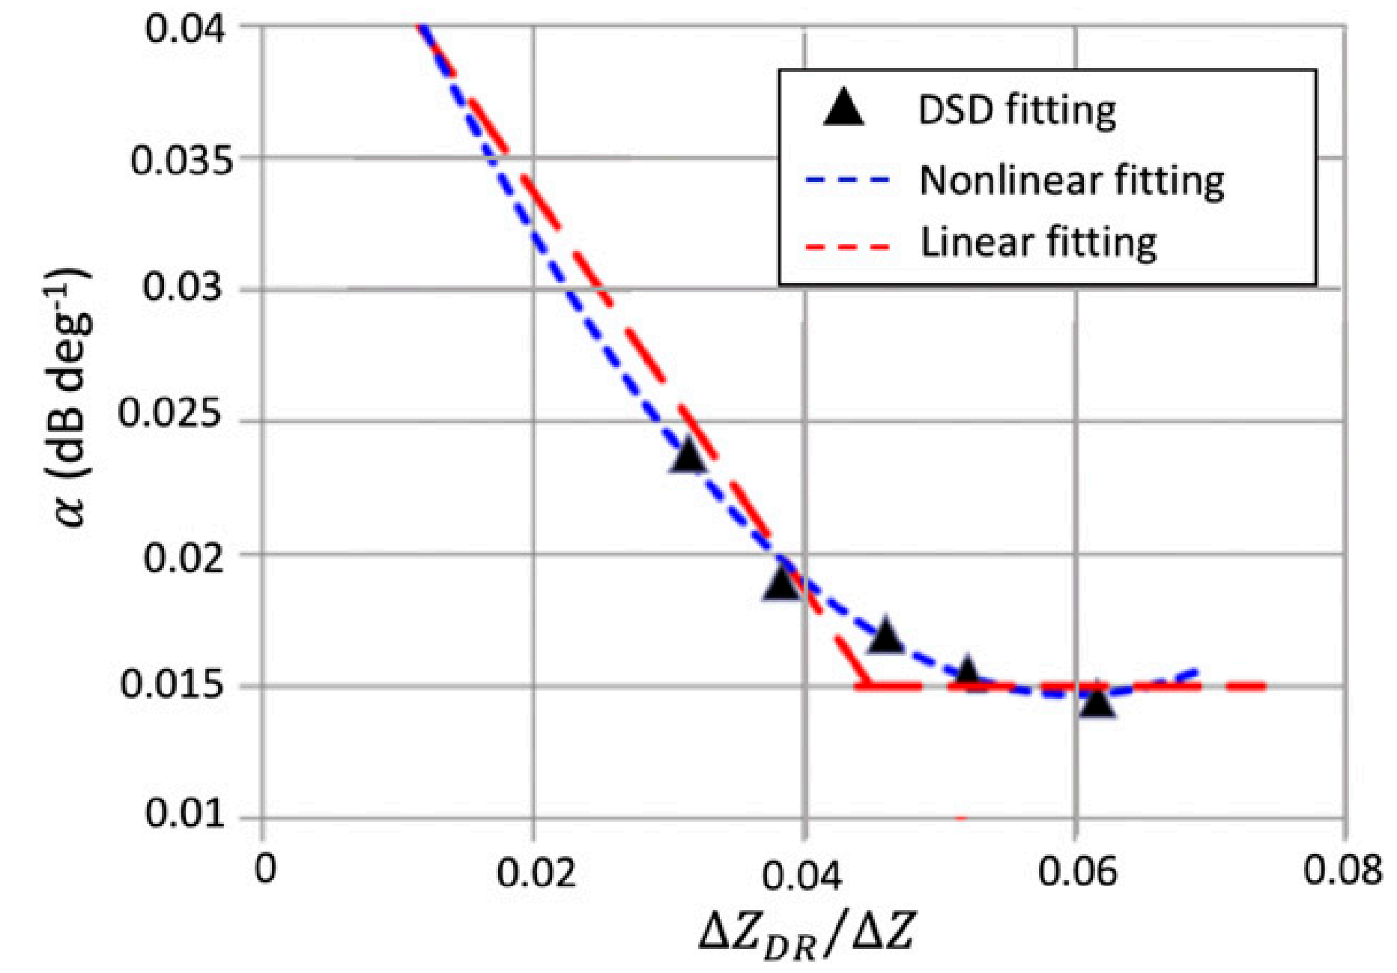
Slide 7
Sensitivity of the factor α to the DSD variability (Z_{DR})
In the current version of the R(A) algorithm employed at S band, the factor α is determined from a slope of the Z_{DR} dependency on Z (“Z_{DR} slope”)
T = 0°C – black dots
T = 30°C – grey dots
The estimate of the Z_{DR} slope is immune to calibration errors of Z and Z_{DR}

Slide 8
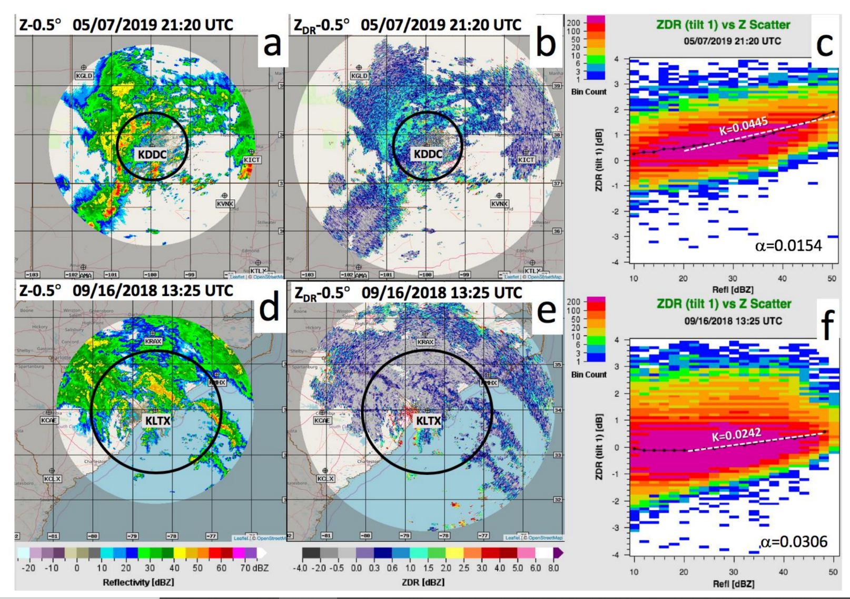
“Z_{DR} slope” for continental and tropical rain
Slide 8
Continental MCS
Kansas
Zdr slope is high
Black circles indicate the bottom of the ML
Zdr slope is low
Hurricane Florence North Carolina
From Zhang et al. 2020

Slide 9
Practical advantages of the R(A) method
Slide 9
Low sensitivity to the DSD variability
Immunity to radar miscalibration, partial beam blockage, attenuation, and impact of wet radome
High spatial resolution (similar to R(Z) )
Uniformly good performance for light and heavy rain
Ideal for networking and compositing (particularly for the radars operating at different wavelengths)
Caveats
Has to be complemented by R(Z) for ΔΦ_{DP} < 1 - 3° and by R(K_{DP}) in hail cores
Parameter α is variable depending on rain type and needs real time optimization

Slide 10
Partial blockage mitigation
Slide 10
Distance R(A)+R(KDP) data available dependent upon bottom of ML
230 km
~ 175 km
Partial Blockage
Partial Blockage
mitigated
R(A)
R(Z)
R(A)+R(KDP)
The impact of partial blockage of radar beam caused by trees is eliminated in a 24-hour rain total map obtained using a combination of the R(A) and R(K_{DP}) relations

Slide 11
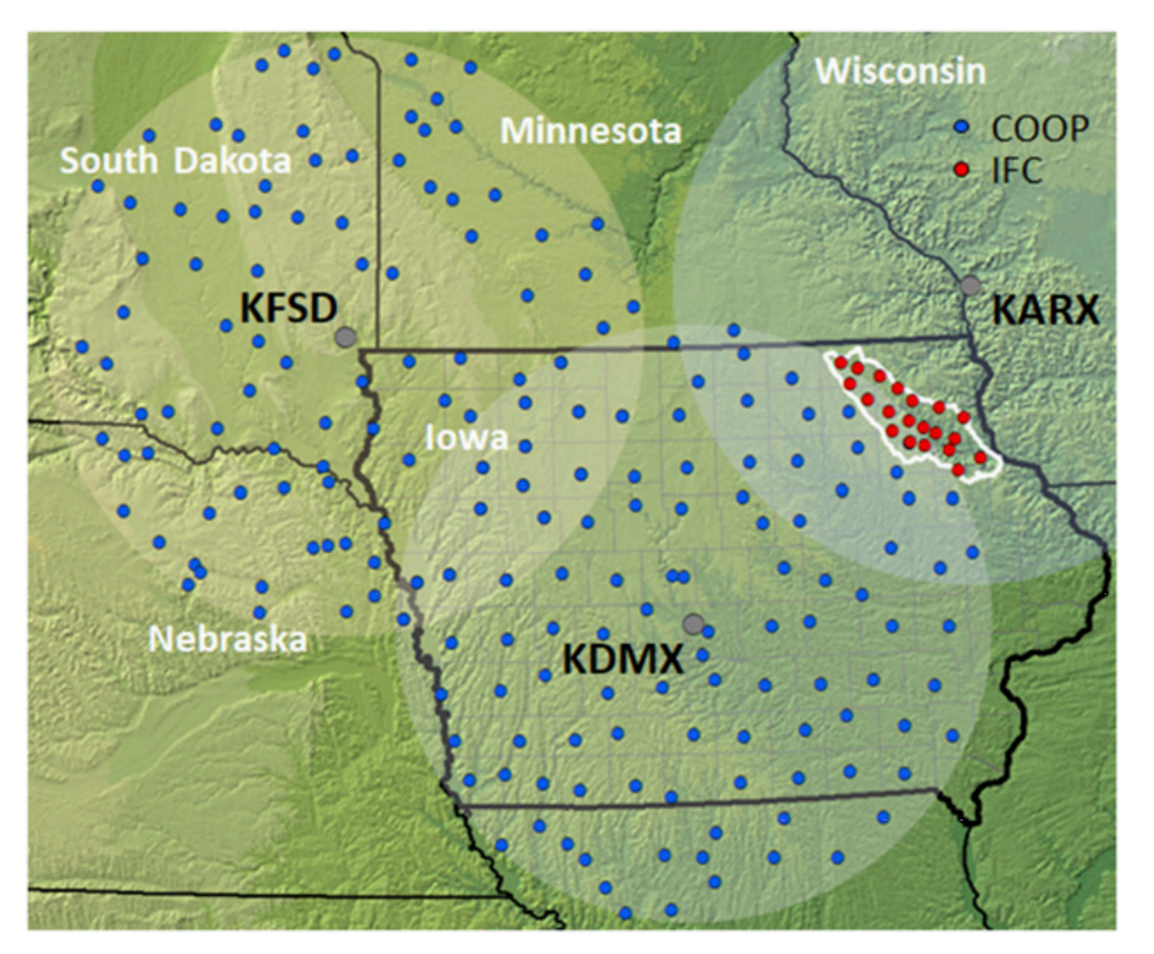
Evaluation of the R(A) algorithm in the Iowa Flood Center area
Slide 11
Seo, B., A. Ryzhkov, and W. Krajewski, 2020: Evaluation of the specific attenuation method for radar-based quantitative precipitation estimation: Improvements and practical challenges. J. Hydrometeorol., 21, 1333 – 1347.
Iowa Flood Center Area

Slide 12
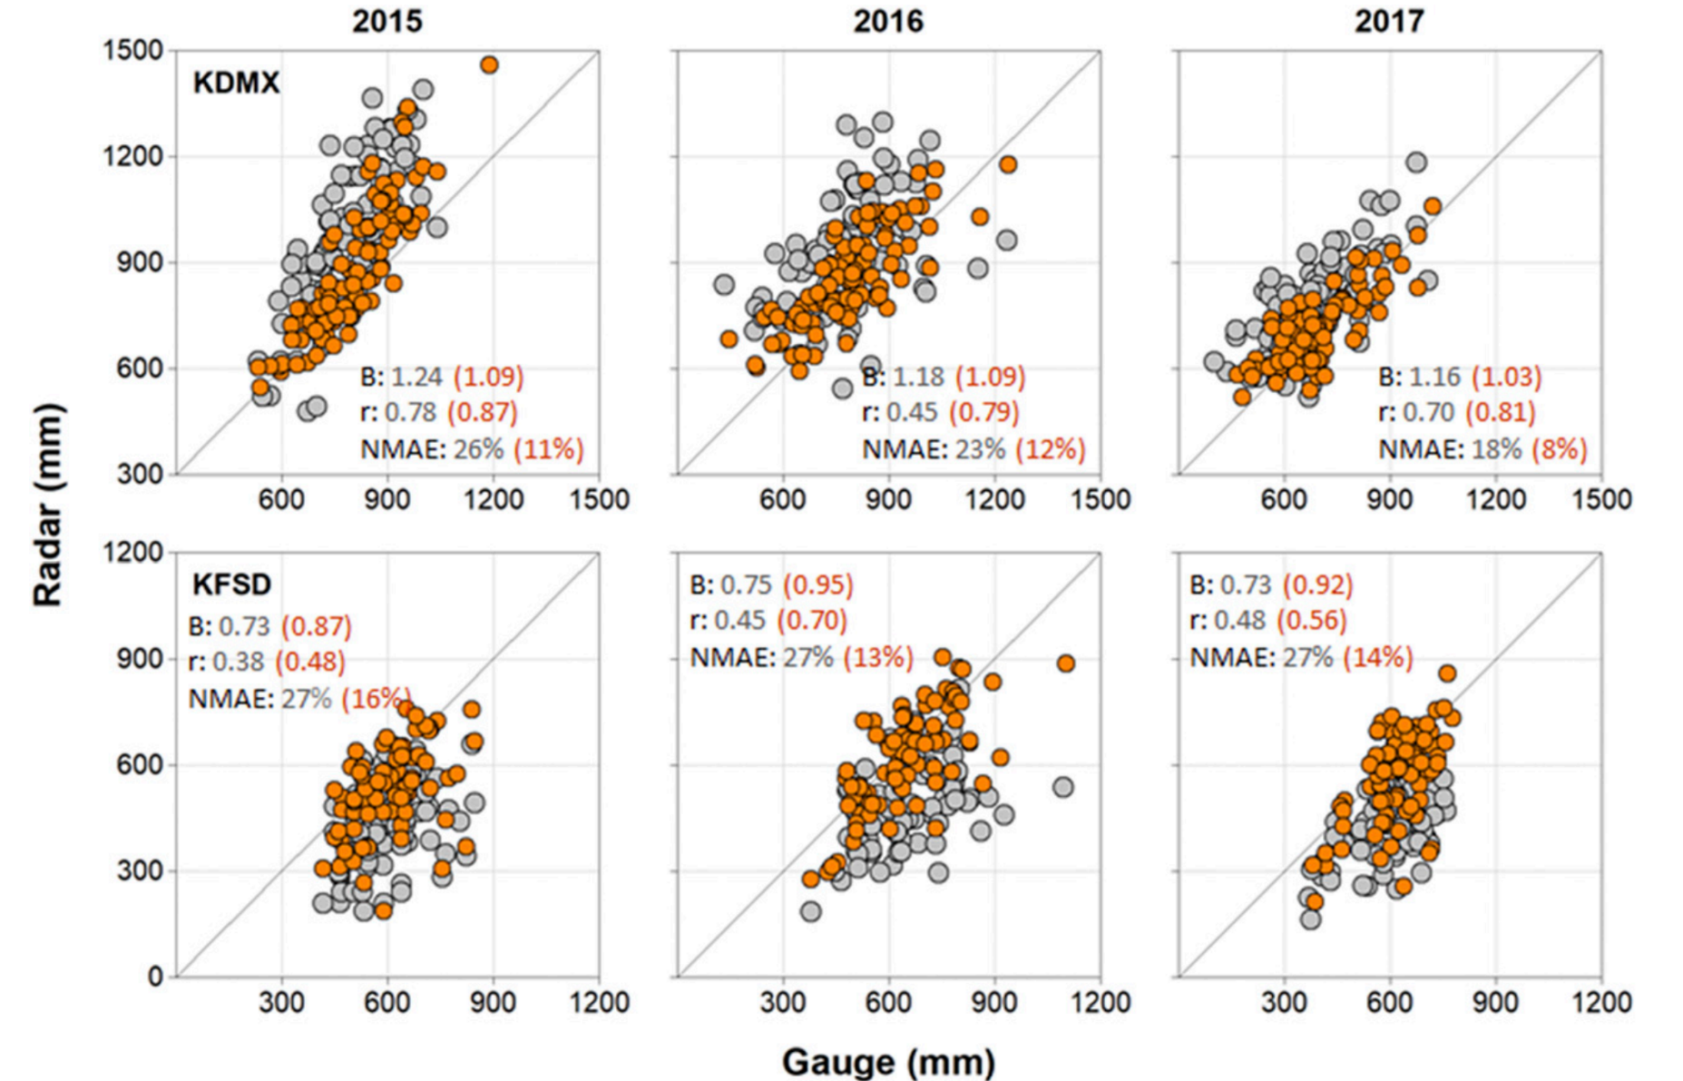
IFC validation results
Slide 12
Grey circles – R(Z)
Red circles – R(A)
NMAE is reduced about two times if R(A) is utilized

Slide 13
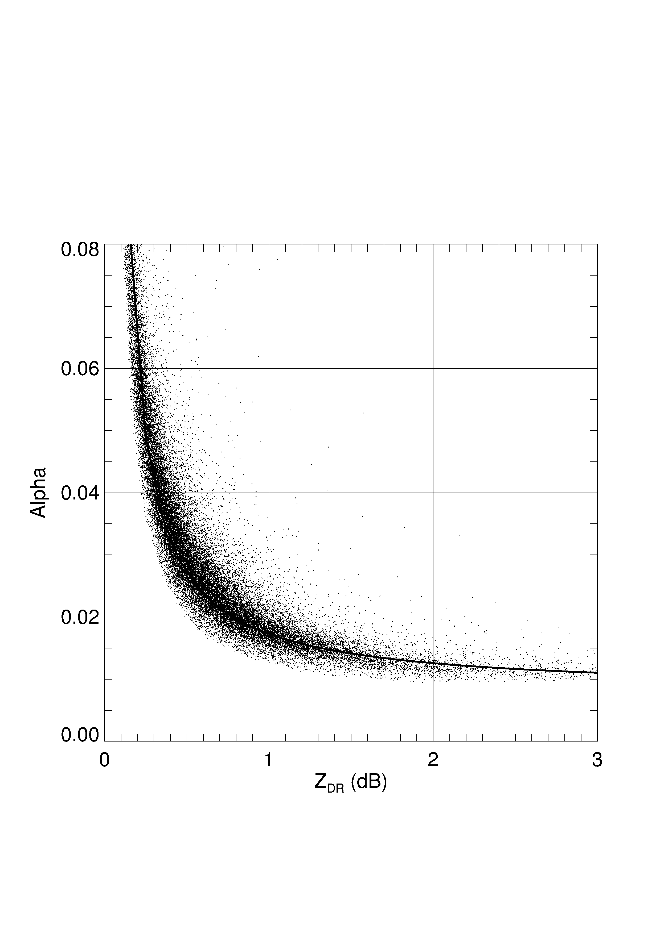
Limitation of using a single α for a whole radar coverage area
Slide 13
α vs Z_{DR} from disdrometer simulations.
For S band, T = 20°C
Convective line, α is smaller due to higher ZDR
Stratiform rain where α is larger due to lower ZDR
Smaller Drops Larger Drops
In the current S-band R(A) algorithm, a single value of α is used for a whole radar coverage area and spatial variability of α is ignored
This inevitably causes underestimation of rain dominated by smaller drops and overestimation of rain dominated by larger drops

Slide 14
Slide 14
Alternative way to determine the factor α
b = 0.62
S band
Two possible relations
d = 0.72
Pros: There is no need to estimate the Z_{DR} slope. Azimuthal variability of α is captured
Cons: Z_{DR} should be well calibrated; Z and Z_{DR} have to be corrected for attenuaton

Slide 15
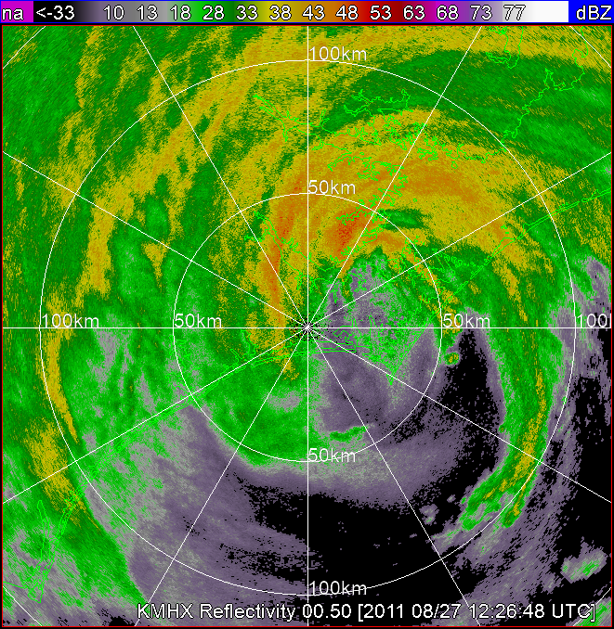
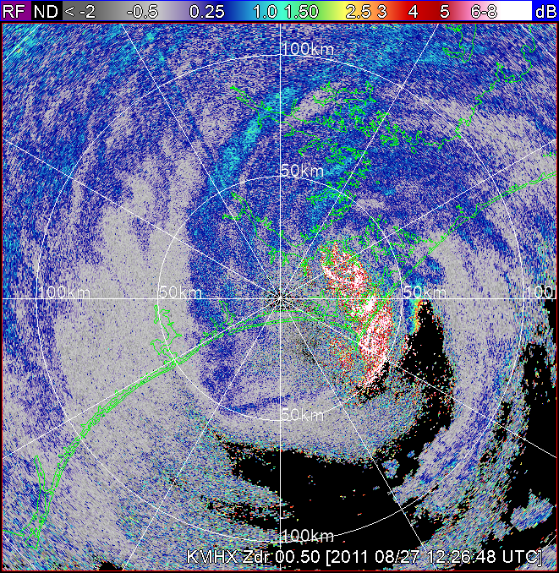
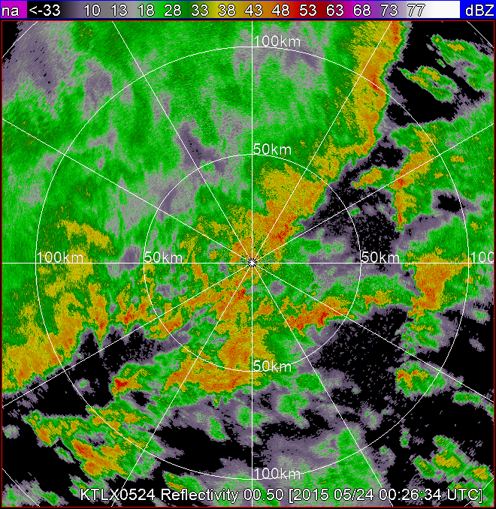
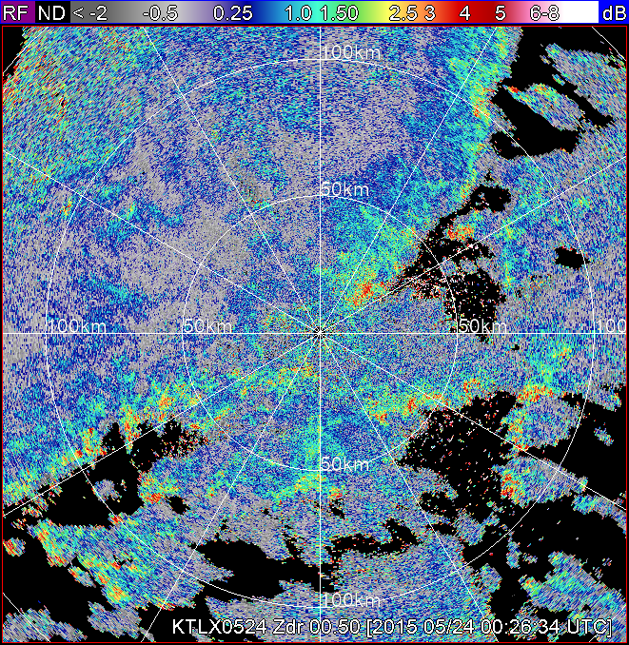
Slide 15
Z
Z_{DR}
Hurricane Irene
Tropical case
2011/08/27
12:26 UTC
El = 0.5°
Continental MCS
Z
Z_{DR}
Continental case
KTLX 2015/05/24
00:46 UTC

Slide 16
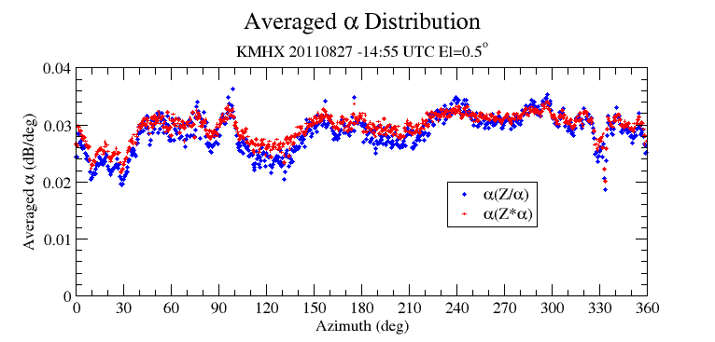
Slide 16
Tropical
α is generally higher for tropical rain
Continental

Slide 17
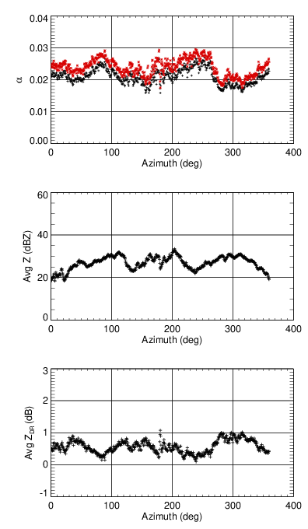
Slide 17
Correlation between azimuthal patterns of α and average values of Z and Z_{DR}
20150524-00:26 UTC
20150524-05:59 UTC
Black star:
Red star:
Obvious anti-correlation is observed

Slide 18
Slide 18
Scatterplots of R vs Z, K_{DP}, and A for very tropical (red dots) and very continental rain (blue dots)
Challenges at C band
R - Z
R - K_{DP}
R(A) is less efficient at C band than at S band
The reason for this is resonance scattering on large raindrops at C band
At C band, the R(A) relation is expected to be efficient for rain dominated by small drops
R - A
R - A
For rain dominated by large drops, the R(K_{DP}) relation is expected to work better

Slide 19
Slide 19
QPE at longer distances from the radar
Polarimetric VPR

Slide 20
Slide 20
Radial profiles of ΔZ for different heights and strengths of the ML at El = 0.5⁰
H_{b} = 1.0 km
2.0 km
H_{b} = 2.0 km
Thick ML
3.0 km
Thin ML
Range interval of BB contamination depends on the height of the ML and its strength / thickness
The VPR correction schemes are designed to eliminate a positive Z bias due to the BB contamination and a negative bias caused by rain overshooting at longer distances

Slide 21
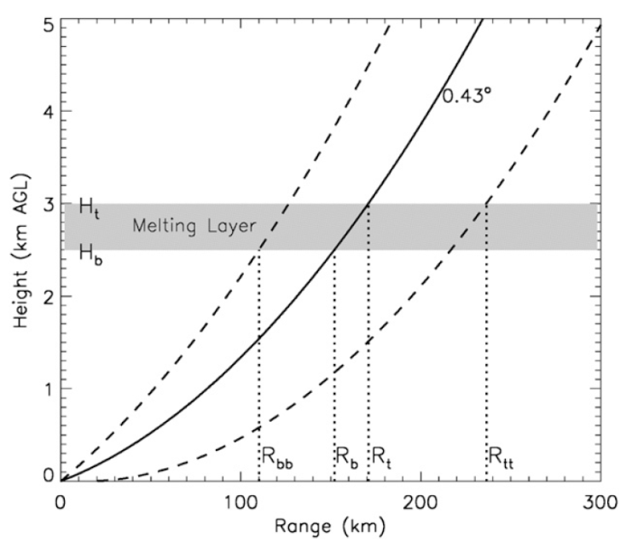
The origin of discontinuities in the existing WSR-88D QPE
Slide 21
1.0
0.6
2.8
R = 0.6 R(Z) wet snow
R = 1.0 R(Z) dry snow and r < R_{tt}
R = 2.8 R(Z) dry snow / crystals and r > R_{tt}
The use of a number of “fudge” factors in the R(Z) relations utilized in the existing WSR-88D QPE partially mitigates the bias but creates strong discontinuities in the retrieved rainfall fields. The QPE product is vulnerable to the hydrometeor misclassifcation

Slide 22
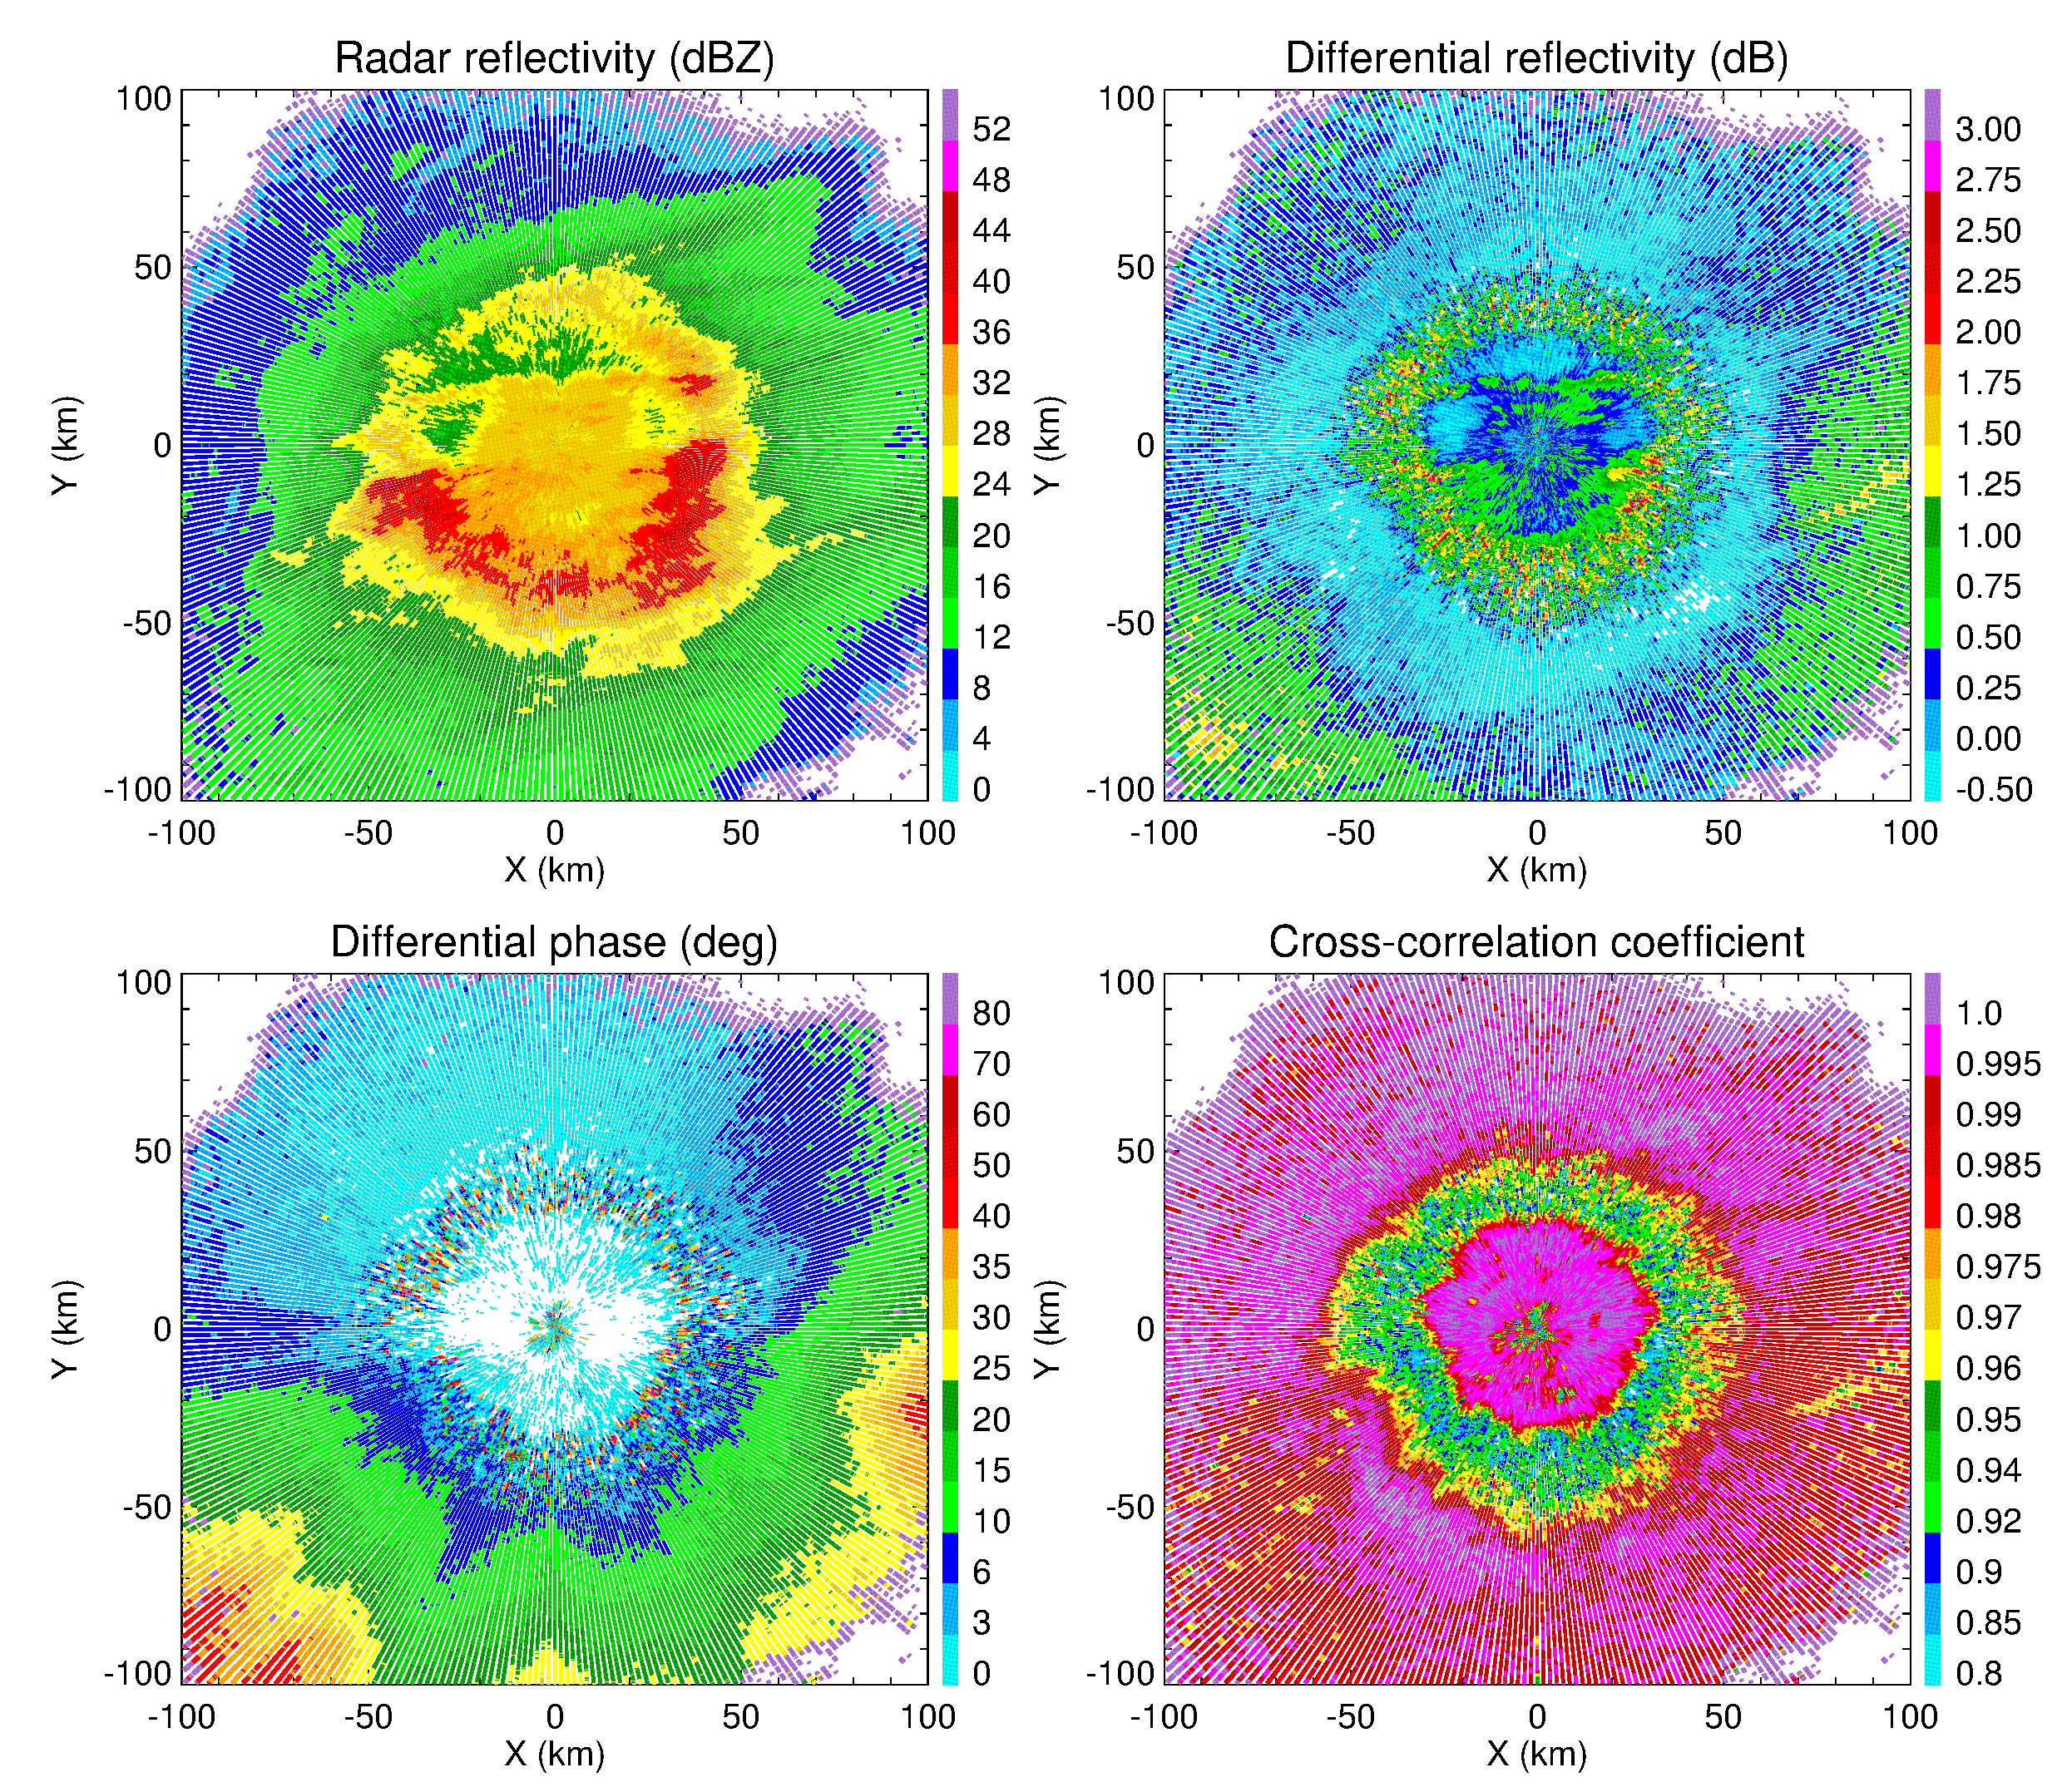
Melting layer signatures in a composite PPI at El = 2.4°
Slide 22
Polarimetry offers possible solution because the areas of BB contamination are very well delineated in the fields of polarimetric radar variables such as differential reflectivity Z_{DR} and cross-correlation coefficient ρ_{hv} (or CC)
The suggested methodology called “polarimetric VPR” or PVPR is based on the correlation of the radial profiles of Z and ρ_{hv} in the presence of the melting layer. Radial profiles of ρ_{hv} are used to detect the range intervals where contamination from BB occurs and to estimate the height of the ML. Therefore, MLDA and PVPR are closely linked in a new paradigm.

Slide 23
Radial profiles of Z, Z_{DR}, and ρ_{hv} at El = 0.5° for low-level, horizontally uniform melting layer
Impact of range and beam broadening
Slide 23
ρ_{hv}
Z_{rain} = 30 dBZ
Z
Z_{DR}
H_{FL} is the height of the freezing level (T_{w} = 0°C)
Radial profiles of Z bias, Z_{DR}, and ρ_{hv} are strongly correlated

Slide 24
Model radial profiles of Z bias and ρ_{hv}
Slide 24
1
2
Radial profiles of Z bias and ρ_{hv} are correlated. Deeper minimum of ρ_{hv} corresponds to higher Z bias and one can quantify the Z bias using radial profile of ρ_{hv}.
The whole idea of PVPR is to examine a measured radial profile of ρ_{hv} at a given elevation and find its best match in the family of model radial profiles stored in the lookup tables
2
1

Slide 25
New VPR concept (polarimetric VPR or PVPR)
Slide 25
Establish statistical correlations between intrinsic vertical profiles of Z and ρ_{hv} in the melting layer using the QVP methodology
Simulate a multitude of the model radial profiles of Z bias and ρ_{hv} at lowest antenna tilts for different heights and strengths of the melting layer and store them in lookup tables
Pick up an appropriate model profile of the Z bias at every azimuth by finding the best match between the model and observed radial profiles of ρ_{hv} and subtract this model profile of Z bias from the measured radial profile of Z

Slide 26
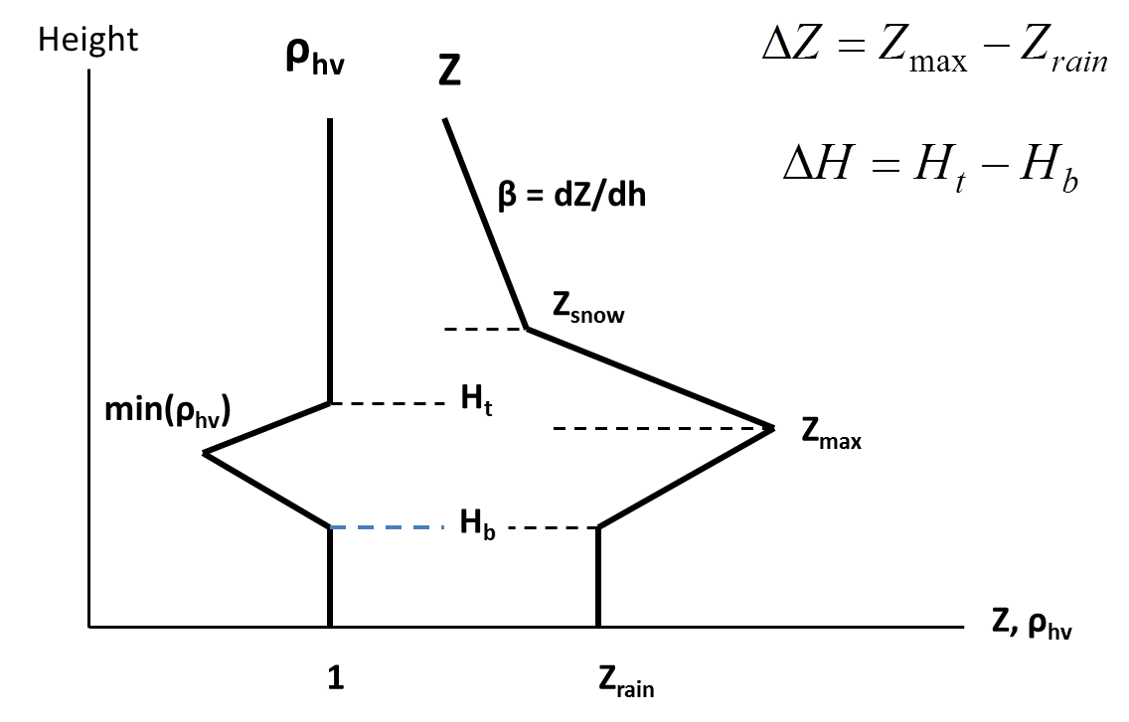
Simplified model of the melting layer
Slide 26
Every radial profile of CC is labeled by two parameters (or indexes): (1) height of the ML bottom H_{b} and (2) strength of the ML
In the current version of the algorithm, 120 radial profiles of CC and ΔZ are generated for a given antenna elevation
H_{b} = 0.2,0.4, ….3.0 km (15 values)
min(ρ_{hv}) = 0.80, 0.82, 0.84, 0.86, 0.88, 0.90, 0.92, 0.94 (8 values)
ΔH = 0.55, 0.53, 0.51, 0.49, 0.45, 0.40, 0.36, 0.32 km

Slide 27
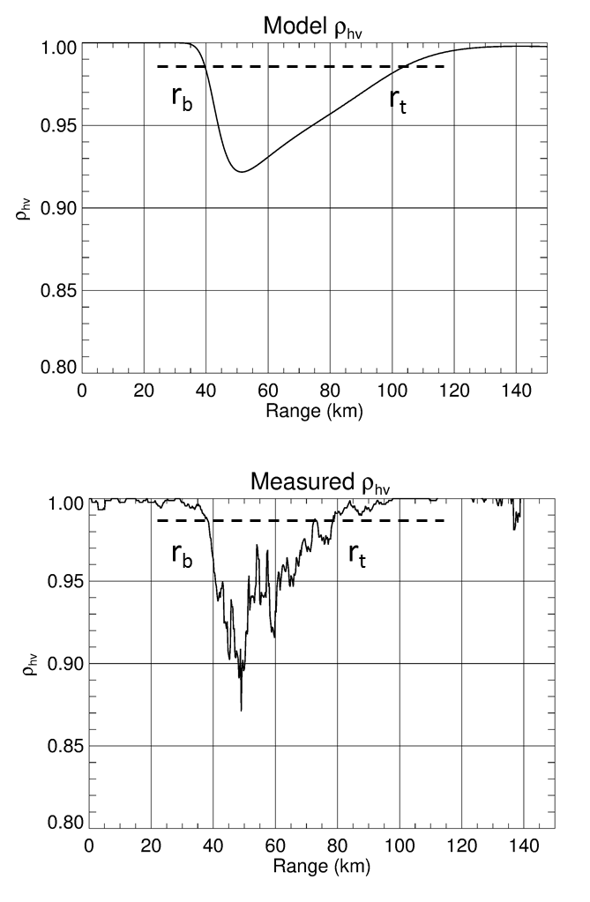
Slide 27
There is no need to store full 120 radial profiles of CC
Each profile of CC (model or measured) can be characterized by two parameters which can be robustly estimated from observations
These are r_{b} – the distance to the CC dip and the “strength” of the ML (S) defined as
The parameters r_{b} and S are stored in the two lookup tables or matrices 15 x 8 for each antenna elevation
Such lookup tables have to be generated only once

Slide 28
Slide 28
El = 2.4°
Lookup table for r_{b}
True depth of the ML (km)
H_{b} (km) | 0.55 | 0.53 | 0.51 | 0.49 | 0.45 | 0.40 | 0.36 | 0.32
Range to the ML bottom (km)
0.2 | 5.0 | 5.0 | 5.25 | 5.25 | 5.25 | 5.25 | 5.5 | 5.5
0.4 | 9.25 | 9.25 | 9.25 | 9.5 | 9.5 | 9.5 | 9.75 | 10.0
0.6 | 13.0 | 13.25 | 13.25 | 13.5 | 13.5 | 13.75 | 13.75 | 14.0
0.8 | 17.0 | 17.0 | 17.25 | 17.25 | 17.5 | 17.75 | 17.75 | 18.25
1.0 | 20.5 | 20.75 | 21.0 | 21.25 | 21.25 | 21.5 | 21.75 | 22.25
1.2 | 24.25 | 24.25 | 24.5 | 25.0 | 25.0 | 25.25 | 25.75 | 26.25
1.4 | 27.75 | 28.0 | 28.25 | 28.5 | 28.75 | 29.25 | 29.75 | 30.5
1.6 | 31.25 | 31.5 | 31.75 | 32.25 | 32.5 | 33.0 | 33.5 | 34.5
1.8 | 34.5 | 35.0 | 35.25 | 35.75 | 36.25 | 36.75 | 37.5 | 38.75
2.0 | 38.0 | 38.5 | 38.75 | 39.25 | 39.75 | 40.5 | 41.25 | 42.75
2.2 | 41.25 | 41.75 | 42.25 | 42.75 | 43.5 | 44.25 | 45.25 | 47.0
2.4 | 44.5 | 45.25 | 45.75 | 46.5 | 47.0 | 47.75 | 49.0 | 51.0
2.6 | 48.0 | 48.5 | 49.25 | 49.75 | 50.5 | 51.5 | 52.75 | 55.25
2.8 | 51.25 | 51.75 | 52.5 | 53.25 | 54.25 | 55.25 | 56.75 | 59.5
3.0 | 54.5 | 55.25 | 56.0 | 56.75 | 57.75 | 58.75 | 60.5 | 63.75

Slide 29
Slide 29
El = 2.4°
Lookup table for S
True depth of the ML (km)
H_{b} (km) | 0.55 | 0.53 | 0.51 | 0.49 | 0.45 | 0.40 | 0.36 | 0.32
Strength of the ML
0.2 | 4.66 | 3.94 | 3.24 | 2.63 | 1.97 | 1.31 | 0.84 | 0.46
0.4 | 4.93 | 4.13 | 3.35 | 2.69 | 1.99 | 1.31 | 0.82 | 0.43
0.6 | 5.30 | 4.39 | 3.52 | 2.79 | 2.05 | 1.32 | 0.81 | 0.40
0.8 | 5.72 | 4.71 | 3.72 | 2.92 | 2.12 | 1.34 | 0.80 | 0.37
1.0 | 6.17 | 5.04 | 3.94 | 3.06 | 2.19 | 1.36 | 0.79 | 0.34
1.2 | 6.62 | 5.37 | 4.16 | 3.21 | 2.27 | 1.39 | 0.78 | 0.31
1.4 | 7.08 | 5.71 | 4.38 | 3.35 | 2.34 | 1.41 | 0.76 | 0.28
1.6 | 7.52 | 6.03 | 4.60 | 3.48 | 2.41 | 1.42 | 0.75 | 0.26
1.8 | 7.96 | 6.35 | 4.81 | 3.61 | 2.47 | 1.43 | 0.73 | 0.23
2.0 | 8.39 | 6.11 | 5.01 | 3.74 | 2.53 | 1.44 | 0.71 | 0.20
2.2 | 8.80 | 6.96 | 5.21 | 3.85 | 2.59 | 1.45 | 0.69 | 0.18
2.4 | 9.21 | 7.25 | 5.39 | 3.96 | 2.64 | 1.45 | 0.67 | 0.15
2.6 | 9.60 | 7.53 | 5.57 | 4.07 | 2.68 | 1.45 | 0.65 | 0.13
2.8 | 9.98 | 7.81 | 5.74 | 4.17 | 2.72 | 1.45 | 0.63 | 0.11
3.0 | 10.4 | 8.07 | 5.91 | 4.26 | 2.76 | 1.45 | 0.61 | 0.09

Slide 30
MLDA. Sloping melting layer, KTLX 2019/04/13
Slide 30
CC
Z
Z
El = 0.9°
El = 0.9°
ML bottom height

Slide 31
Slide 31
MLDA. Sharp snow/rain frontal boundary. KTLX 2020/02/05
ρ_{hv}
ρ_{hv}
El = 0.9°
El = 0.5°
ML bottom height

Slide 32
Slide 32
Polarimetric VPR QPE
It is just one small step from MLDA to PVPR QPE
In addition to the MLDA lookup tables, 120 radial profiles of Z bias (ΔZ) are generated and stored for different heights and strengths of the ML: ΔZ (r, ih, is)
For any given azimuth and elevation, the indexes ih and is of the ML height and strength are determined from the MLDA output
A corrected radial profile of Z is obtained as

Slide 33
El = 0.5 deg
Slide 33
KBMX WSR-88D
2014/02/12
El = 1.45 deg

Slide 34
Before PVPR correction
Slide 34
El = 0.5⁰
El = 1.45⁰
KBMX WSR-88D
2014/02/12
After PVPR correction
El = 0.5⁰
El = 1.45⁰

Slide 35
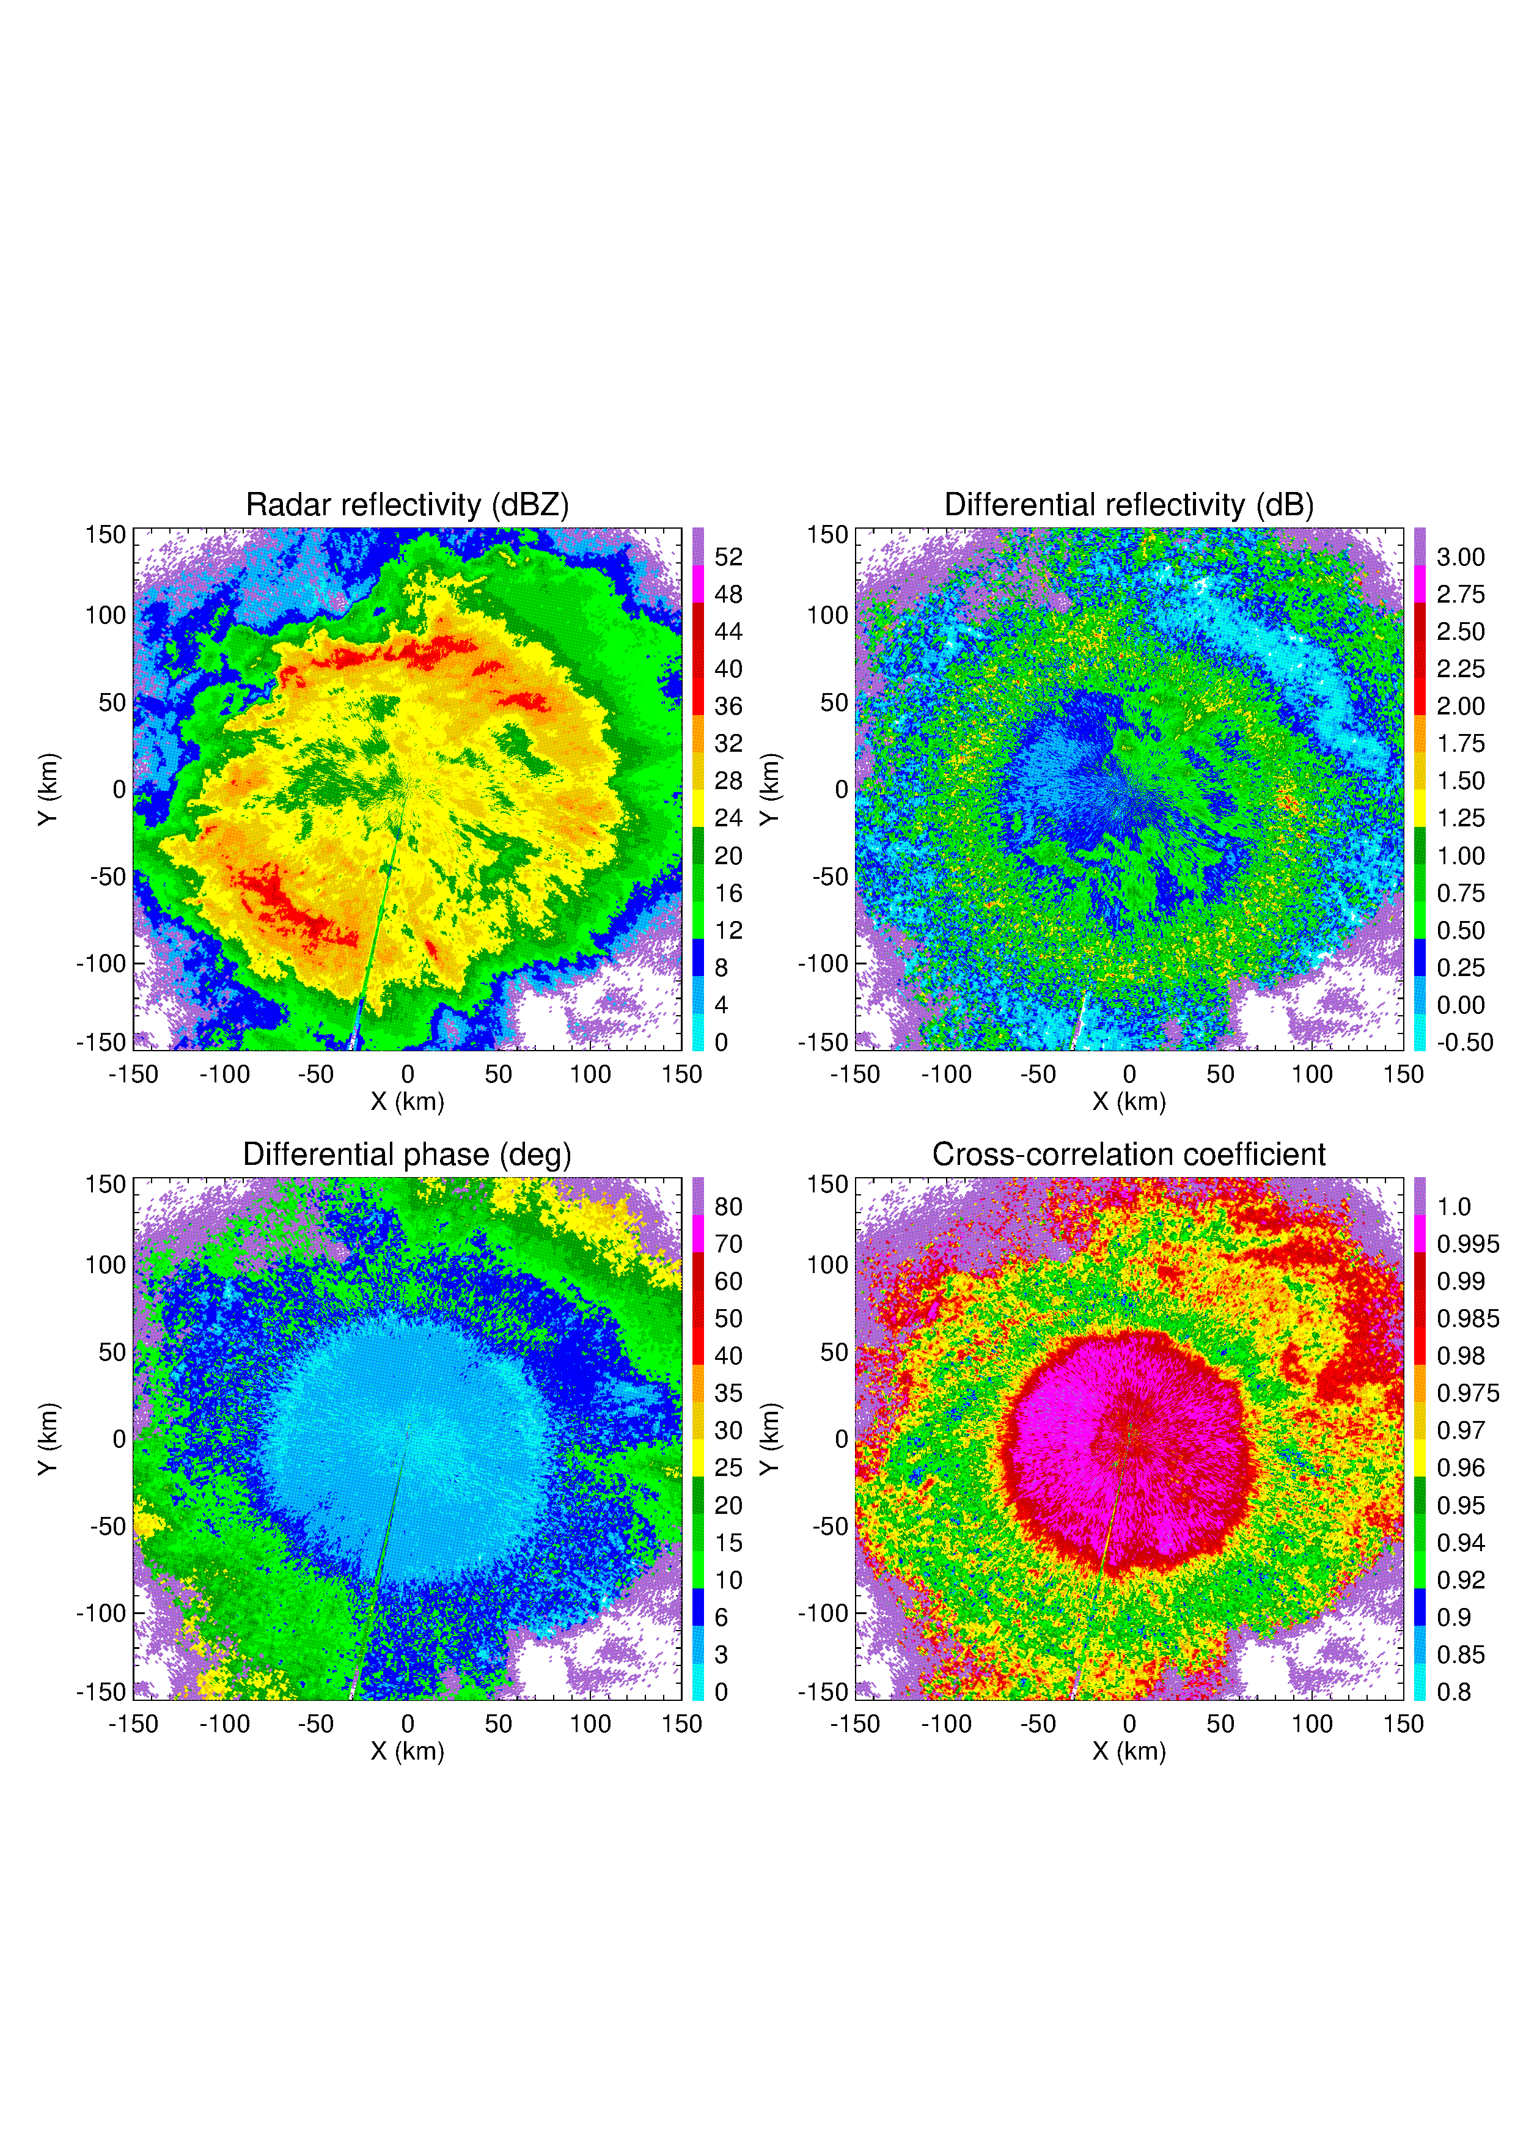
El = 1.3°
Slide 35
KINX WSR-88D
2020/01/17

Slide 36
Slide 36
KINX WSR-88D radar, 2020/01/17, El = 1.3°
Before correction
After correction

Slide 37
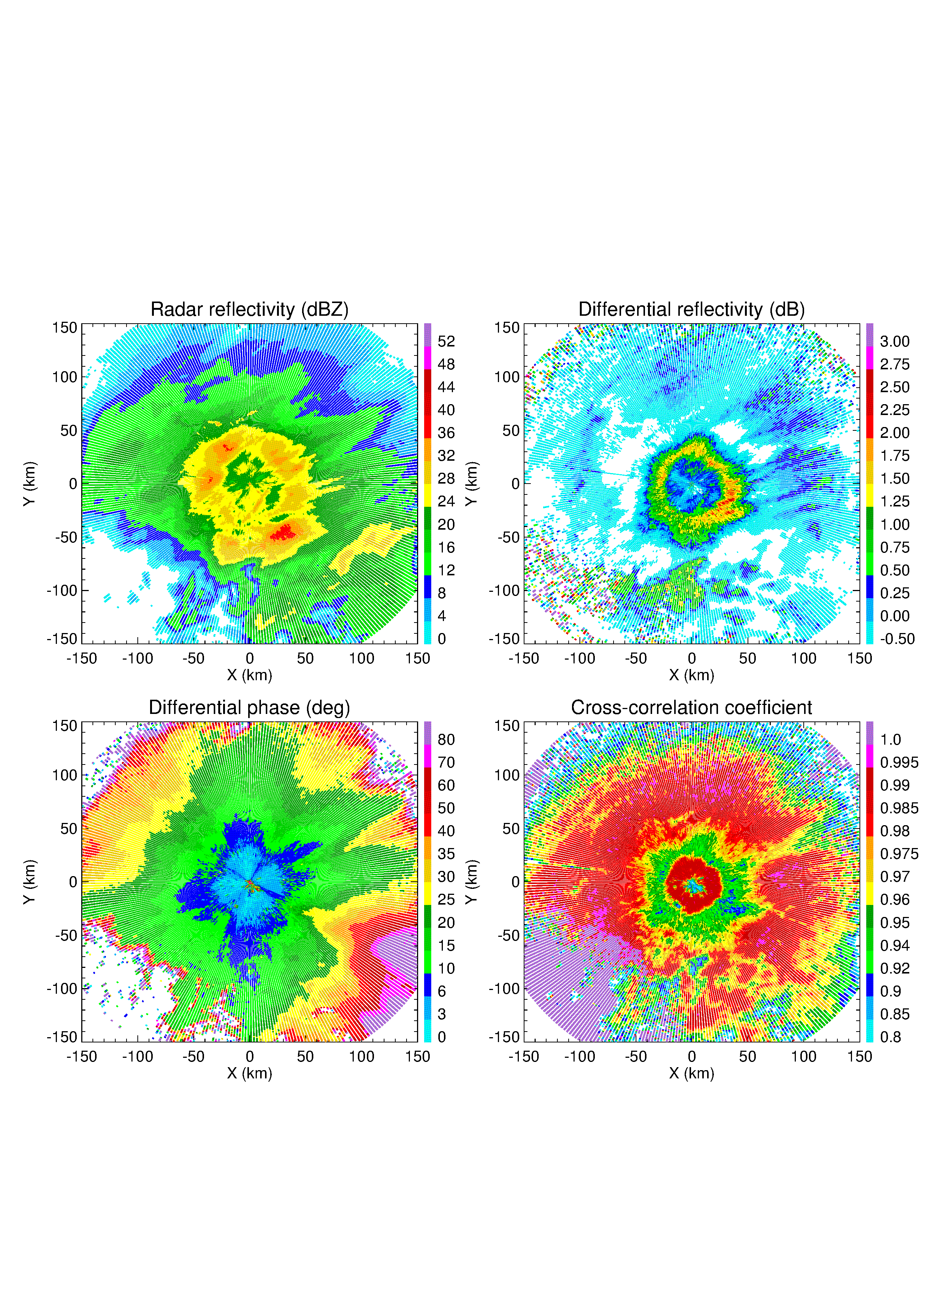
Composite PPI at El = 1.5⁰
Slide 37
DWD
C band

Slide 38
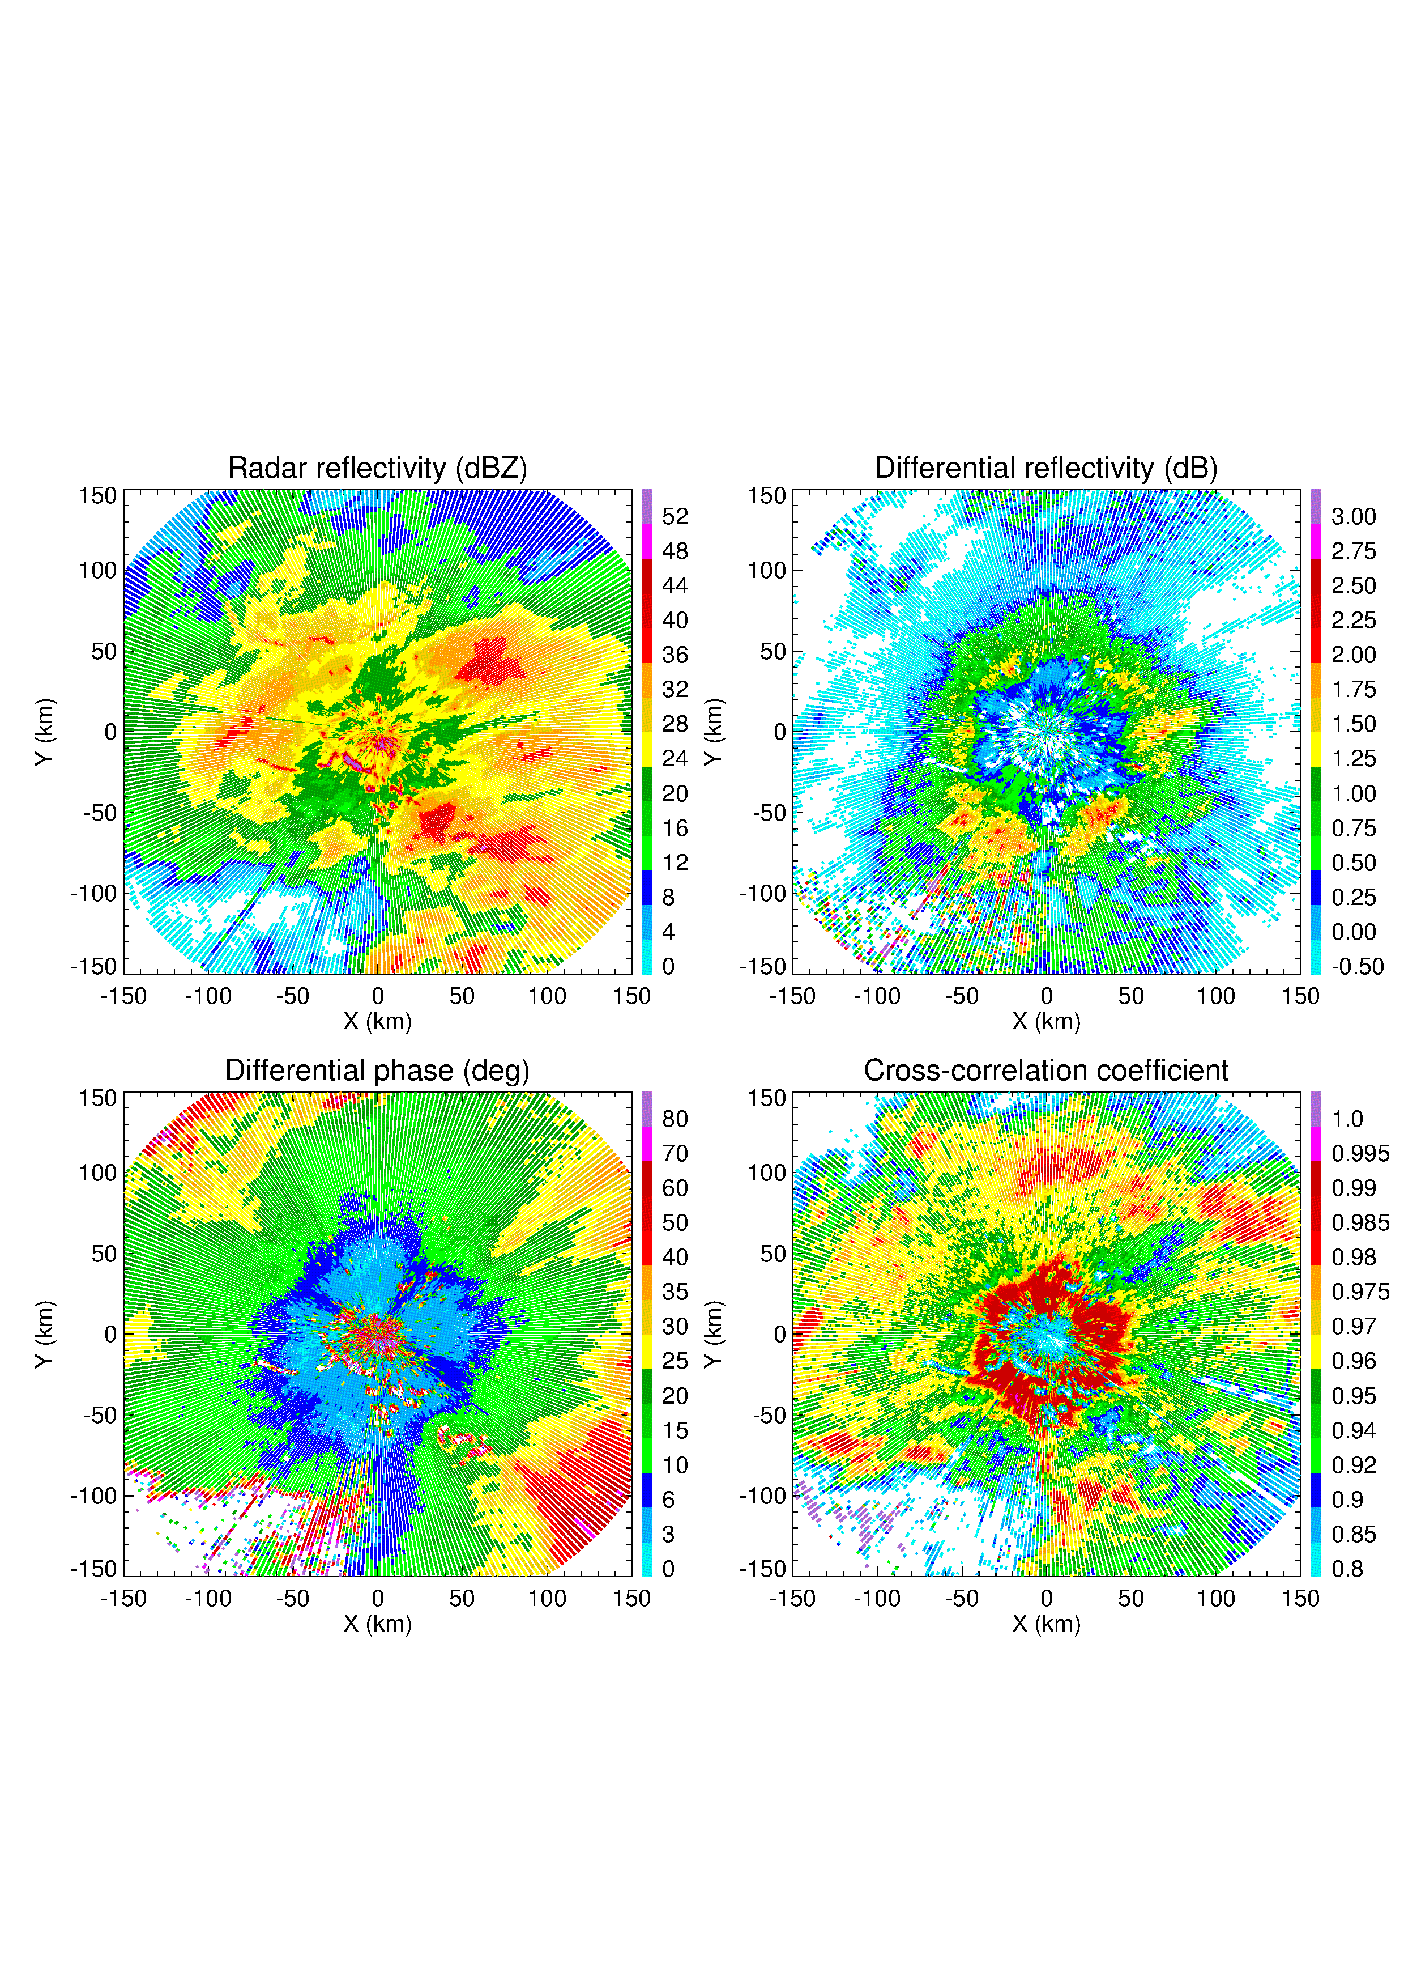
Composite PPI at El = 0.5⁰
Slide 38
DWD
C band

Slide 39
Before PVPR correction
Slide 39
El = 1.5⁰
El = 0.5°
DWD
C band
After PVPR correction
El = 1.5⁰
El = 0.5°

Slide 40
Slide 40
Courtesy of Ju-Yu Chen (UBonn)

Slide 41
Taking into account evaporation
Slide 41
X band radar
(BoxPol)
Martinitis, S., H. Grams, C. Langston, J. Zhang, and K. Howard, 2018: A real-time evaporation correction scheme for radar-derived mosaicked precipitation estimations. J. Hydrometeorology, 19, 87 – 111.
The Martinitis et al. (2018) scheme takes into account vertical profiles of humidity but not DSD

Slide 42
Taking into account evaporation
Slide 42
M. Kumjian and A. Ryzhkov, 2010: The impact of evaporation on polarimetric characteristics of rain. Theoretical model and practical implications. Journal of Applied Meteorology and Climatology, 49, 1247 – 1267.
For a given vertical profile of relative humidity, rain with lower Z_{DR} evaporates faster

Slide 43
Taking into account coalescence / breakup in warm (tropical) rain
Slide 43
Hurricane Irma, Florida, 10 September 2017
Strong vertical gradients of Z, Z_{DR}, K_{DP}, and corresponding rain rate indicate warm rain process

Slide 44
Conclusions on R(A)
Slide 44
The R(A) methodology demonstrates success at S band and is ready for operational implementation on the US NEXRAD network
Several issues remain such as utilization of a single factor α for a whole radar coverage area although this factor is updated from scan to scan. Such a choice of α inevitably leads to some underestimation of rain dominated by small drops and mild overestimation of rain characterized by large drops
A novel technique for optimization of α is suggested and its testing is underway
The R(A) technique seems to be less efficient at C band and the use of the R(A) relation has to be complemented by more aggressive utilization of the R(K_{DP}) relation

Slide 45
Conclusions on PVPR
Slide 45
The suggested PVPR technique passed the feasibility test and is applicable at S and C bands
It shows good promise in the two challenging situations: (a) BB enhancement of Z is mixed with the increase of Z due to embedded convection and (b) Z at lower tilts is biased by partial beam blockage
This version of PVPR takes into account azimuthal and radial heterogeneity of the rain field and melting layer
It makes a good use of higher antenna elevations for QPE in situations when the data at lowest elevation are of poor quality due to ground clutter contamination or beam blockage

