Slide 1
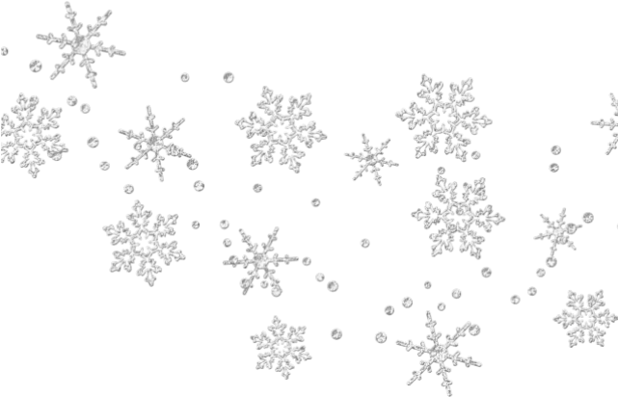
The synergistic use of polarimetric radar data and one-dimensional microphysical models for precipitation nowcasting
Jacob T. Carlin,
Alexander V. Ryzhkov, Lee Dunnavan, Jordan Brook, & Charles Kuster
RealPEP 2020 Online Conference
6 October 2020

Slide 2
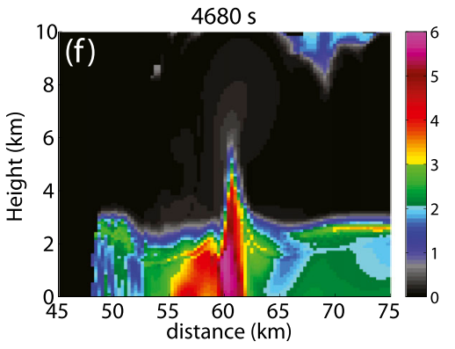
What are forward polarimetric radar operators?
Polarimetric radar signatures contain plentiful information about underlying microphysical processes.
Microphysical models can be linked to observations through the use of forward operators.
Use particle size distributions (PSDs), density, meltwater fractions, shapes, and canting angles to calculate what a hypothetical polarimetric radar would see
$f\left(D, ρ, f, AR, σ,…\right)=Z, Z_{DR}, K_{DP}, LDR$, etc.
Typically relies on mix of model-predicted variables (e.g., PSDs) and prescribed characteristics (e.g., shapes, canting angles)
Simulated Z_{DR} column using the Hebrew University Cloud Model (adapted from Kumjian et al. 2014).
Notes:
Different operator formulations handle these prescribed parameters differently (e.g., Jung et al. 2008; Ryzhkov et al. 2011)

Slide 3
Implementing these operators in simple microphysical models can be used to
Understand the cause of newly observed polarimetric signatures
Identify deficiencies in existing microphysics schemes/understanding
Over the past 10 years, such an approach has been used to study
Raindrop evaporation (e.g., Kumjian et al. 2010)
Raindrop collision-coalescence (e.g., Kumjian and Prat 2014)
Raindrop freezing (e.g., Kumjian et al. 2012)
Raindrop re-freezing (e.g., Kumjian et al. 2013)
Raindrop size sorting (e.g., Kumjian and Ryzhkov 2012)
Melting & shedding of hail (e.g., Ryzhkov et al. 2013a)
Depositional growth of ice crystals (e.g., Andric et al. 2013)
Riming (e.g., Kumjian et al. 2016)
Snow
Melting
Sublimation
Aggregation/Breakup
Hail
Downburst nowcasting
Hailswath nowcasting

Slide 4
One-Dimensional Snow Model
Microphysics
Radar Operator
Flux-conserving spectral bin model of snow aggregates
Includes sublimation, melting, and evaporation
Explicit prediction of meltwater fraction
PSD specified at top of model
Environment evolves with moisture and thermodynamic feedbacks
Excludes interactions between bins (for now)
Uses modified radar operator of Ryzhkov et al. (2011)
Aspect ratio and canting angle distribution varies linearly with meltwater fraction
T-matrix scattering calculations
Weighted Maxwell-Garnett mixing formula during melting
For more information: Carlin, J. T. and A. V. Ryzhkov, 2019: Estimation of melting layer cooling rate from dual-polarization radar: Spectral bin model simulations. J. Appl. Meteor. Climatol., 58, 1485-1508. doi: 10.1175/jamc-d-18-0343.1

Slide 5
What can the dual-polarization radar variables tell us about the cooling rate within the melting layer?
Cooling/moistening due to melting/sublimation/evaporation can alter the local environment:
Change the precipitation type at the surface (e.g., Kain et al. 2000)
Turbulence and gravity waves (e.g., Szeto et al. 1998)
Wind perturbations (e.g., Stewart et al. 1984)
Simulated 54,000 combinations of various lapse rates, humidity profiles, PSDs, and radar wavelengths
Notes:
Change in Z and ZDR show similar trends as Z

Slide 6
Nowcasting of sublimating snow
Twelve cases chosen that had operational significance
Antecedent dry layer often 5-6 km deep with RH_{i} below 10% at times
As snow falls, reflectivity gradually descends toward the surface
Reflectivity range-defined quasi-vertical profiles and RAP RH_{i} for each of the twelve cases:

Slide 7
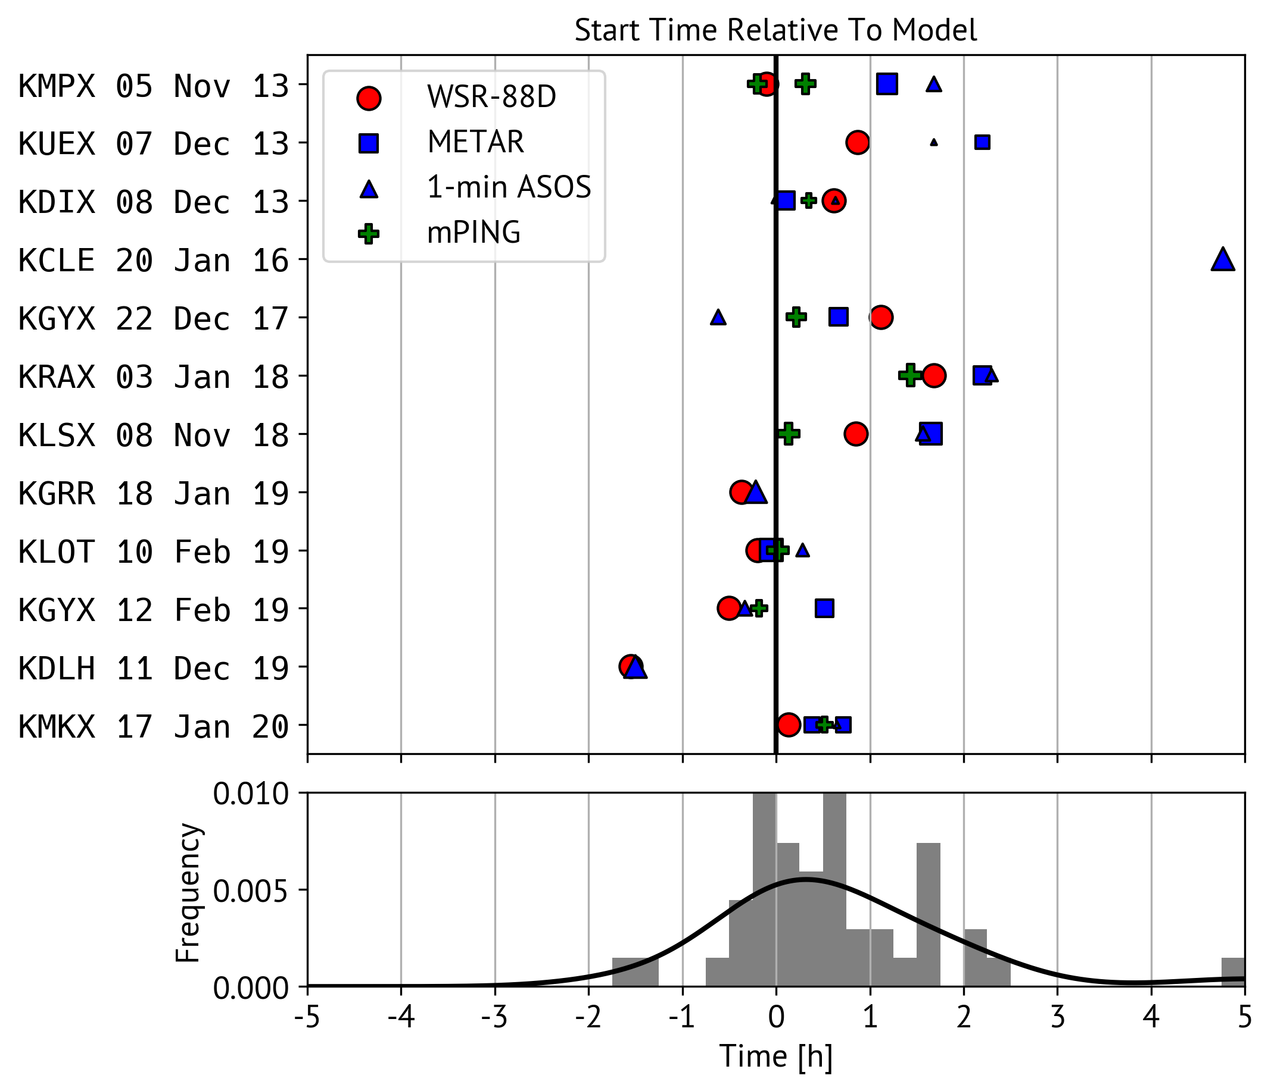
Nowcasting the start time of surface snowfall
Initialized model from RAP and polarimetric radar data following Ryzhkov and Zrnic (2018) and allowed environment to evolve
Results show generally good performance and are mostly unbiased
42% within 30 min
64% within 60 min
82% within 120 min
Lead time of 4-6+ hours
Notes:
Bad performance could be horizontal moisture advection (ignored in our model) or non-aggregates

Slide 8
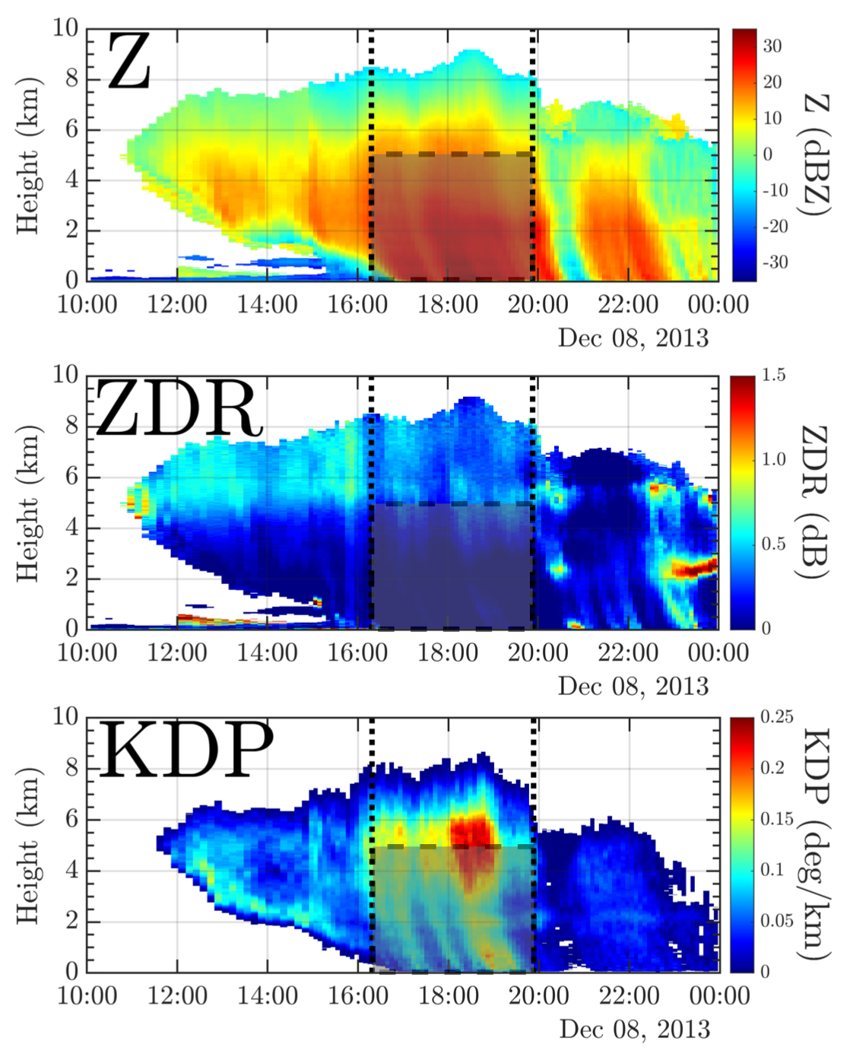
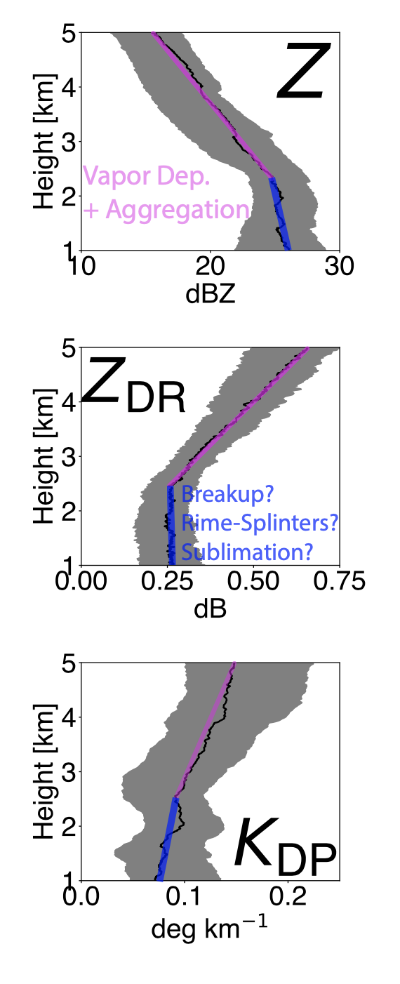
Implementation of aggregation + breakup in one-dimensional snow model
Work done with Lee Dunnavan (OU-CIMMS) to study the sensitivity of the polarimetric signature of aggregation
Prior work (e.g., Kennedy and Rutledge 2011) has struggled to realistically simulate all variables
Used RAP model environment, retrieved ice PSDs (Ryzhkov and Zrnic 2019) from median profiles, and mass-weighted fallspeeds to simulate profile
For more information:
Dunnavan, E. L., J. T. Carlin, P. Bukočić, and A. V. Ryzhkov, 2021: The Evolution of Dual-Polarization Radar Signatures Due to Ice Particle Aggregation and Breakup. In preparation.
QVP of KDIX 08 Dec 2013 snowstorm

Slide 9
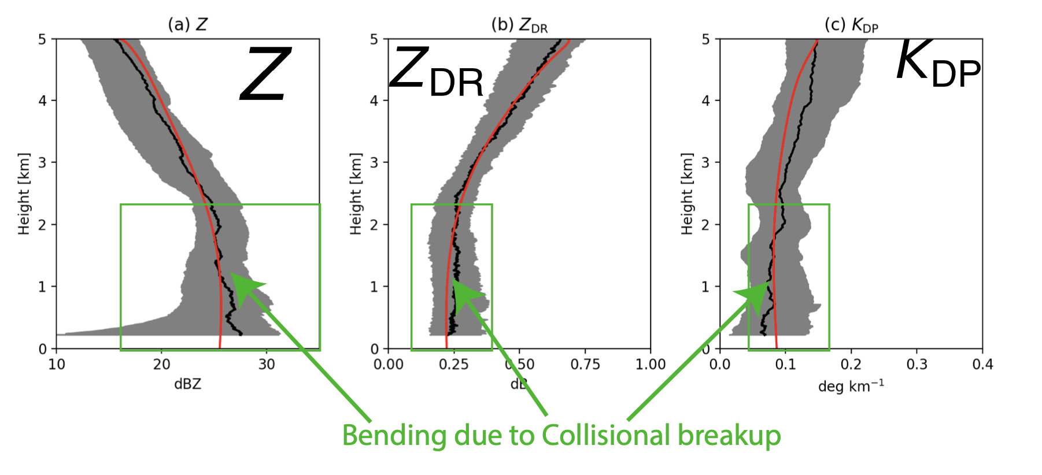
Implementation of aggregation + breakup in one-dimensional snow model
Polarimetric profiles are able to be simulated realistically
“Stagnation” point in profiles due to balance between aggregation and collisional breakup
Neither deposition/sublimation or aggregation alone can explain observed profiles
Resultant polarimetric profiles very sensitive to initial PSD!
For broader distributions (larger mu), vapor deposition and sublimation play lesser roles in determining profile
Currently:
Implementing into existing snow model code for linkage with melting layer, rain evaporation, etc.
Testing sensitivity to parameters (efficiencies, etc)
Red = simulation

Slide 10
One-Dimensional Hail Model
Microphysics
Radar Operator
Flux-conserving spectral bin model of graupel and hail particles (Ryzhkov et al. 2013a)
Includes sublimation, melting, evaporation, meltwater shedding, and drop breakup
Flow-dependent microphysics model based on Rasmussen and Heymsfield (1987)
Separately graupel and hail PSDs specified at top of model
Explicit prediction of meltwater fraction
Environment evolves with moisture and thermodynamic feedbacks
Uses modified radar operator of Ryzhkov et al. (2011)
Linear dependence on meltwater fraction for canting angle distribution and flow-dependent variation of aspect ratio
Two-layer T-matrix scattering calculations
Graupel assumed to be spongy; hail solid ice

Slide 11
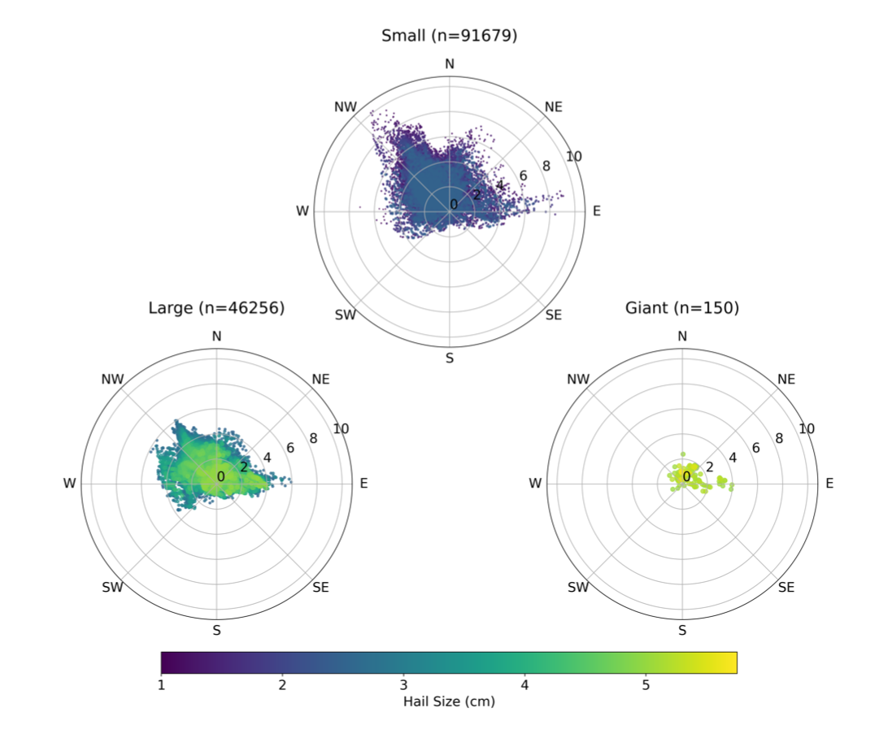
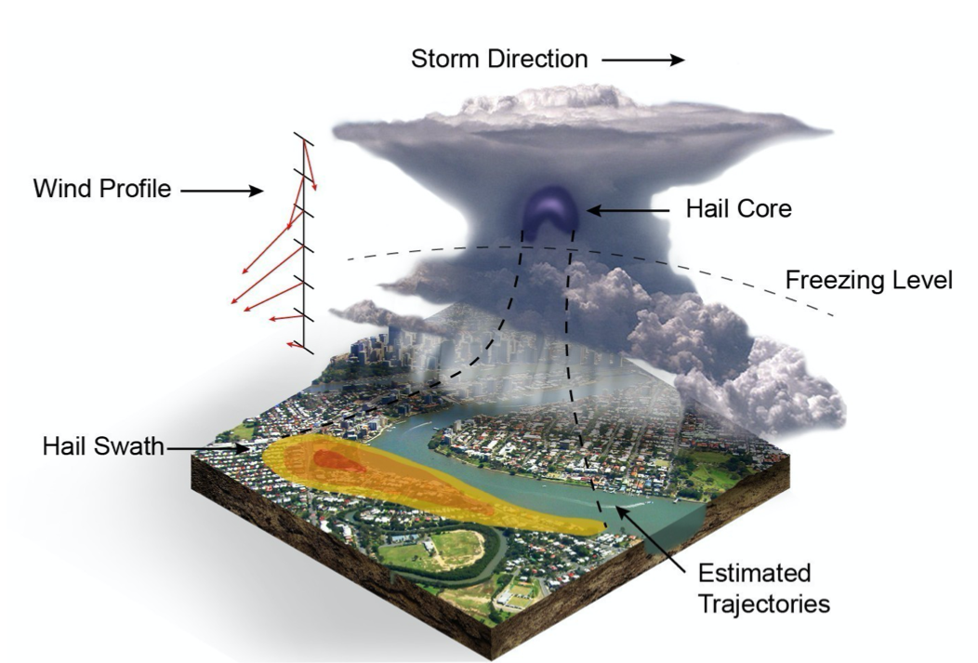
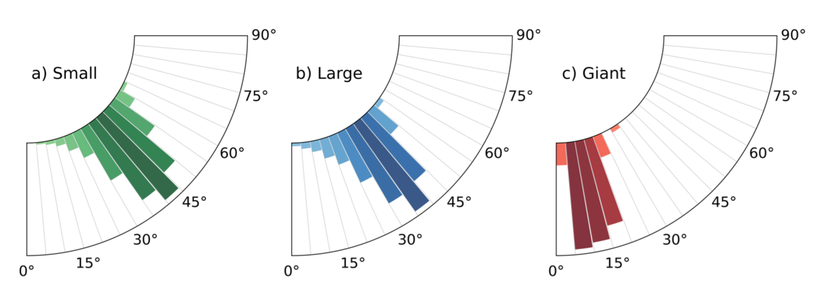
Nowcasting hailswaths
Work done with Jordan Brook (University of Queensland) analyzing role of hailstone advection in a damaging hail storm in Brisbane
Combined H_{DR} to initialize hailstones and used one-dimensional melting/shedding model combined with radar-derived dual-Doppler-derived winds to calculate trajectories.
Horizontal advection
More info:
Brook, J. P., A. Protat, J. Soderholm, J. T. Carlin, H. McGowan, R. A. Warren, 2020: HailTrack – Improving Radar-Based Hailfall Estimates by Modelling Hail Trajectories. J. Appl. Climatol. Meteor., under review.
Impact angle
Notes:
Over $1.5 billion in damages in AUD.

Slide 12
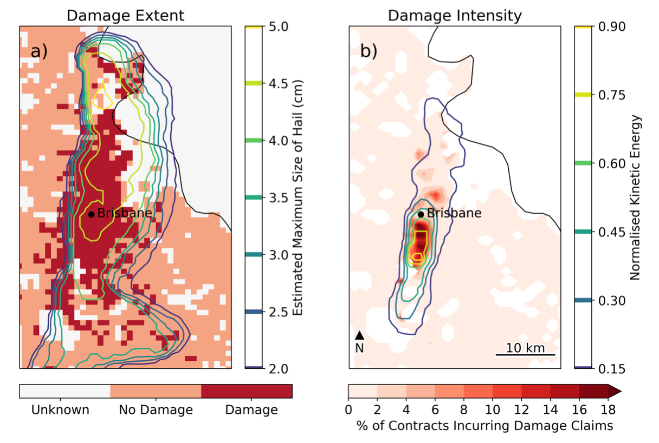
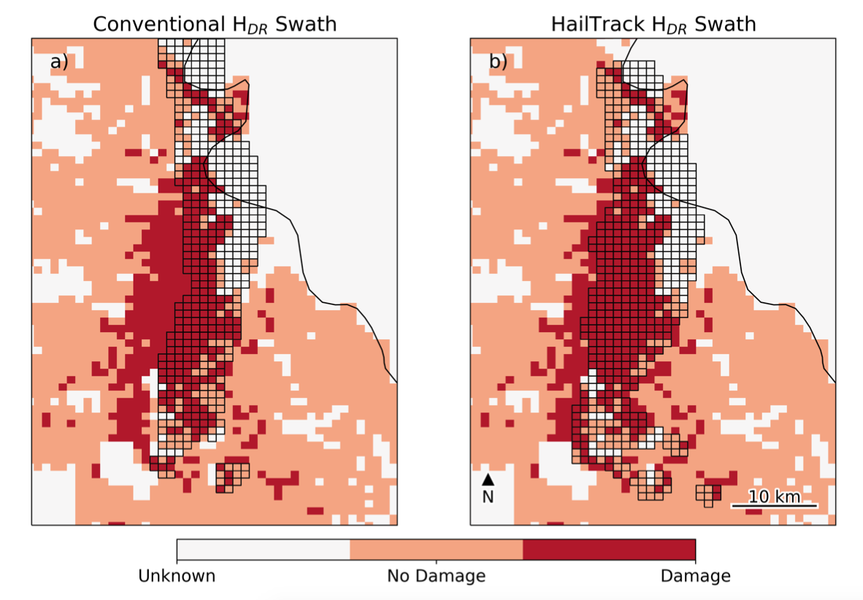
Nowcasting hailswaths
H_{DR}-initiated hail trajectories produced best results.
Both quantitative (HSS = 0.58 vs. 0.48) and qualitative results improved when incorporating model-based hailfall trajectories.
Lead times of 10-15 minutes were possible during this storm.
Notes:
Hail insurance claims.

Slide 13
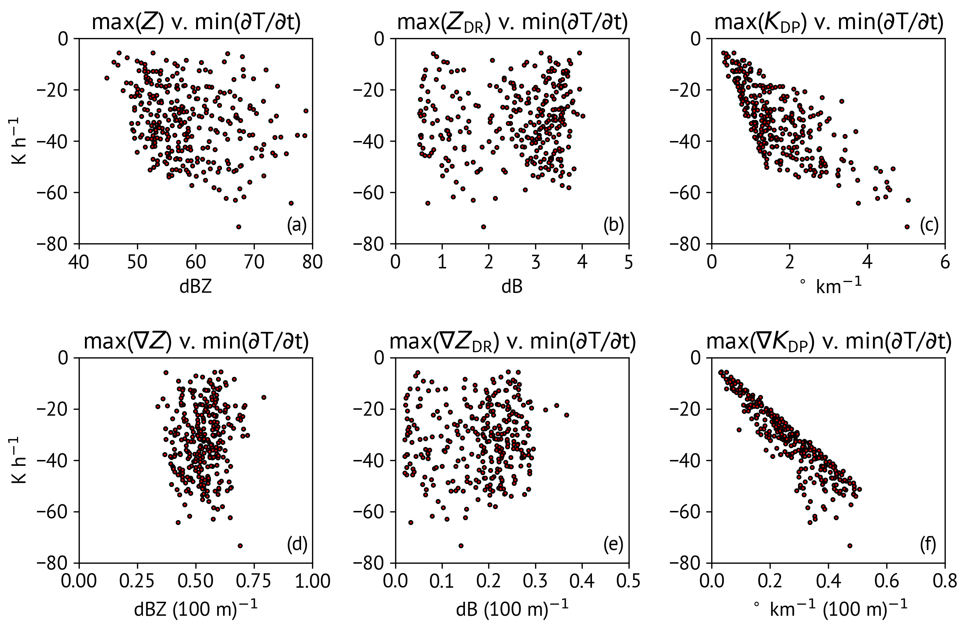
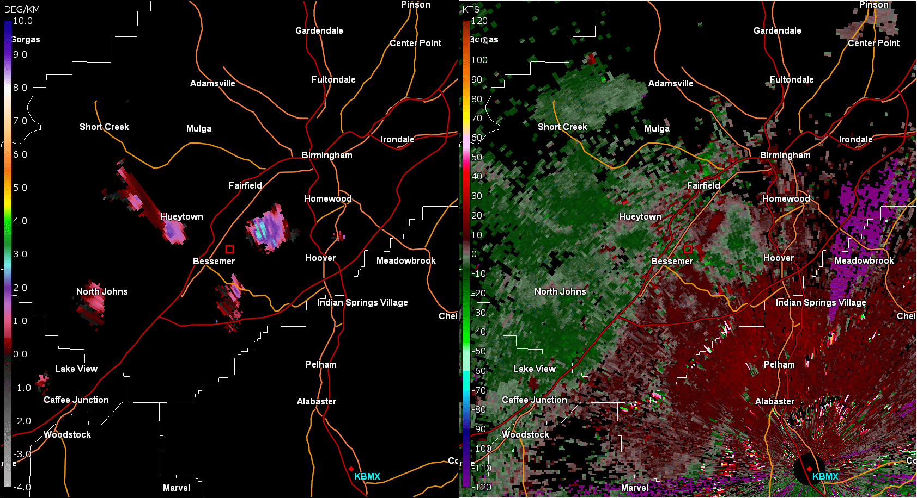
Nowcasting downbursts
Work done with Charles Kuster (OU-CIMMS) analyzing the use of K_{DP} as a downburst precursor.
Downbursts present major forecast challenge, particularly in low-shear environments.
Traditional radar metrics often struggle to provide enough lead time
Acceleration driven by:
K_{DP} (° km⁻¹)
V_{r} (kts)
Precipitation loading
Negative thermal buoyancy due to melting/evaporation
More info:
Kuster, C. M., B. R. Bowers, J. T. Carlin, T. J. Schuur, J. W. Brogden, R. Toomey, and A. Dean, 2021: Using K_{DP} Cores as a Downburst Precursor Signature. Wea. Forecasting, in preparation.
∝ K_{DP}?
∝ dK_{DP}/dz?

Slide 14
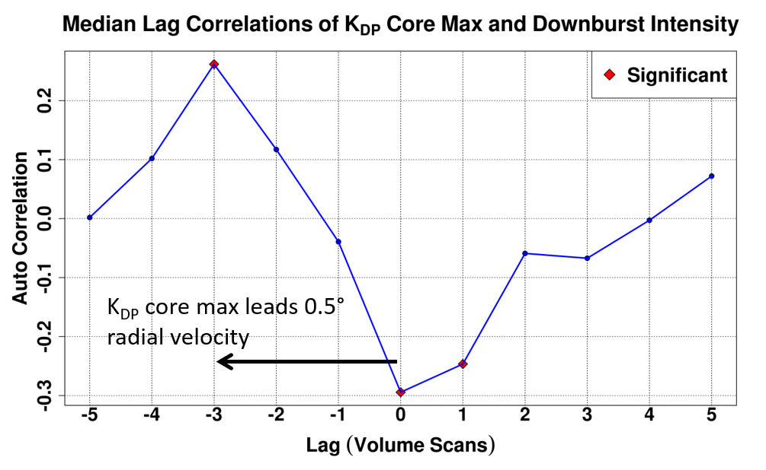
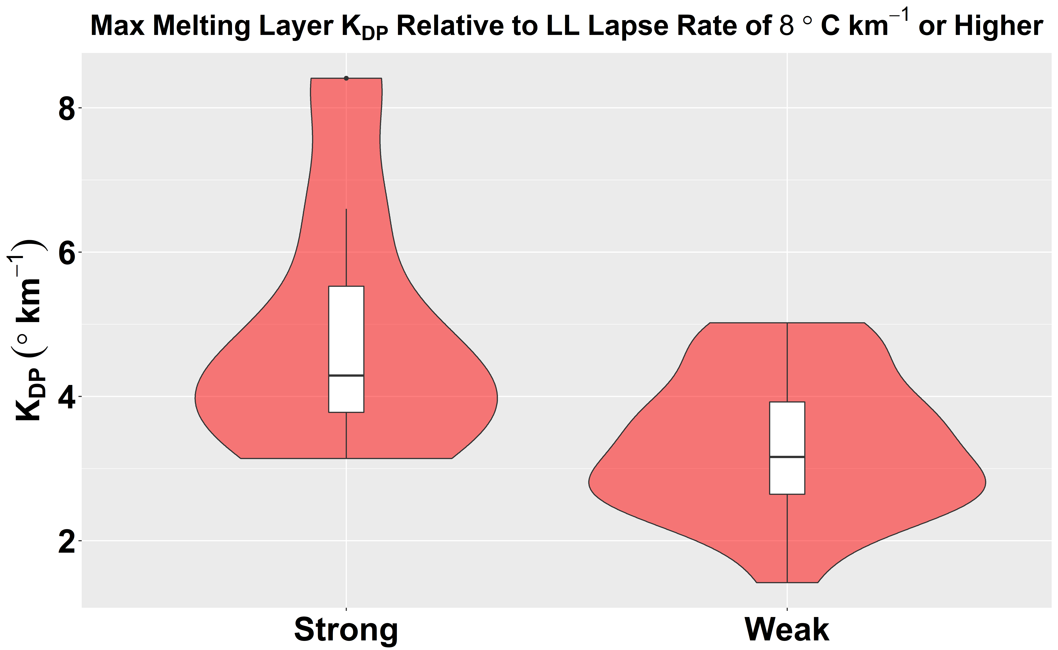
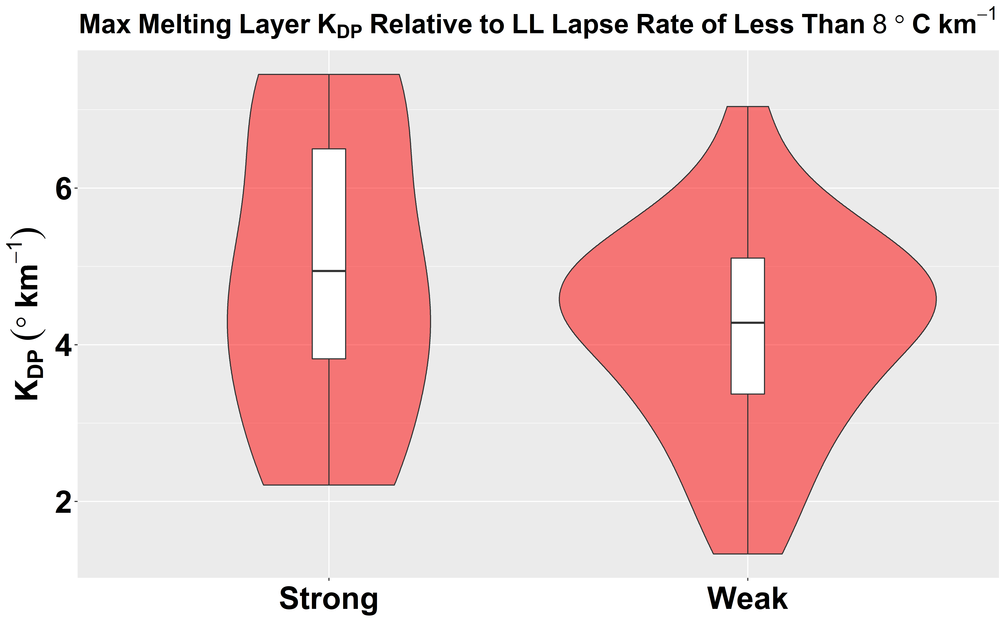
Nowcasting downbursts
“Favorable” Environments
Forecasting downburst intensity is much more challenging.
Environment matters!
Higher K_{DP} is “needed” in less favorable downburst environments to cause downbursts.
Within a given environment, higher K_{DP} → stronger downbursts.
Can be used to triage when many storms are present.
All 81 downbursts exhibited K_{DP} cores at the melting level, with only two false alarms.
K_{DP} core maxima lead the maximum radial velocity at the surface by ~3 volume scans (10-15 minutes).
“Unfavorable” Environments

Slide 15
Summary
Simple one-dimensional microphysical models coupled with forward polarimetric radar operators provide great value for gaining insight into microphysical processes
Snow model has yielded insights into:
Relationship between latent cooling and brightband signature in melting layer
Nowcasting erosion of dry air due to sublimating snow
Hail model has yielded insights into:
Which polarimetric variables may be valuable for downburst nowcasting
Improving hail swath trajectories
Ongoing improvements to snow model (+ eventual nucleation and riming) will allow sensitivity tests of full column microphysics

