Slide 1
Polarimetric radar QPE in aggregated snow
Petar Bukovčić^{1,2*}, Alexander Ryzhkov^{1,2}, and Dušan Zrnić²
The University of Oklahoma – CIMMS¹, and NSSL²
RealPEP 2020 Online Conference – Precipitation and Flash Flood Prediction from Minutes to Days
5 October 2020, Germany

Slide 2
Summary of Z(S) relations for dry snow listed in the literature and utilized by the WSR-88D network in the USA
Source | Z(S) relation for dry snow
Gunn and Marshall (1958) | Z = 448 S^2
Sekhon and Srivastava (1970) | Z = 399 S^2.21
Ohtake and Hemni (1970) | Z = (90 – 739) S^(1.5 – 1.7)
Puhakka (1975) | Z = 235 S^2
Koistinen et al. (2003) | Z = 400 S^2
Matrosov et al. (2009) | Z = (100 – 130) S^(1.3 – 1.55)
Huang et al. (2010) | Z = (106 – 305) S(^1.11 – 1.92)
Saltikoff et al. (2010) | Z = 100 S^2
Szyrmer and Zawadzki (2010) | Z = 494 S^1.44
Wolfe and Snider (2012) | Z = 110 S^2
Huang et al. (2015) | Z = (130 – 209) S^(1.44 – 1.81)
Von Lerber et al. (2017) | Z = (53 – 782) S^(1.19 - 1.61)
WSR-88D, Northeast | Z = 120 S^2
WSR-88D, Great Lakes | Z = 180 S^2
WSR-88D, North Plains / Upper Midwest | Z = 180 S^2
WSR-88D, High Plains | Z = 130 S^2
WSR-88D, Inter-mountain West | Z = 40 S^2
WSR-88D, Sierra Nevada | Z = 222 S^2
The variability of the multiplier in the power-law relations is an order of magnitude!
Very little progress has been made in radar measurements of snow during last decades

Slide 3
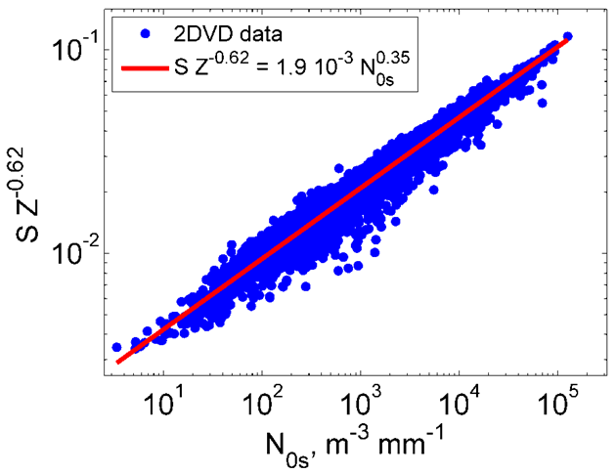
Basic formulas
Ice water content
Snow size distribution
Snow rate
Snow density
frim is the degree of riming
Radar reflectivity
Snow fall velocity
Analysis of snow disdrometer data
The multiplier in the S(Z) relation changes more than an order of magnitude because N0s varies 4 orders of magnitude
Bukovčić et al. (2018)

Slide 4
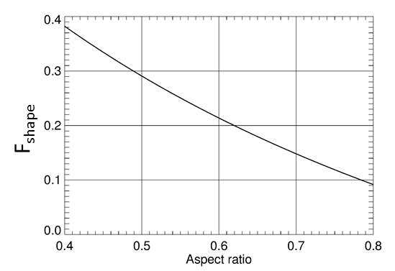
Polarimetric algorithms for snow estimation
Specific differential phase
Z is proportional to the 4th moment of snow SD whereas KDP is proportional to its 1st moment
Shape factor
Vivekanandan et al. (1994)
Bukovčić et al. (2020)
Ryzhkov et al. (1998, 2018)
Orientation factor
All polarimetric relations are less sensitive to the SD variability than IWC(Z) or S(Z) relations
The IWC(KDP) and IWC(KDP, Z) estimates are prone to the variability of particle shape and orientation, whereas the IWC(KDP, Zdr) estimate is not (affected by KDP and Zdr errors)
Airborne Convair-580 polarimetric and in situ measurements prove high efficiency of the IWC(KDP) and particularly IWC(KDP,Zdr) algorithms in ice clouds (Nguyen et al. 2017, 2019)

Slide 5
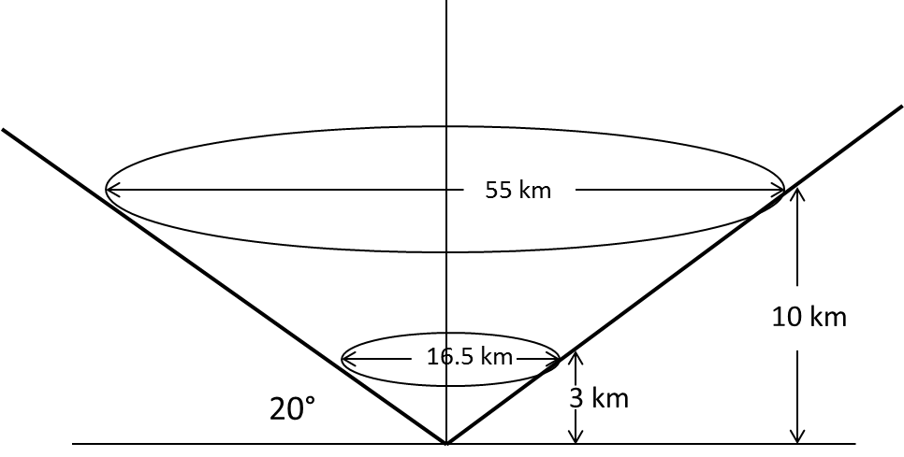
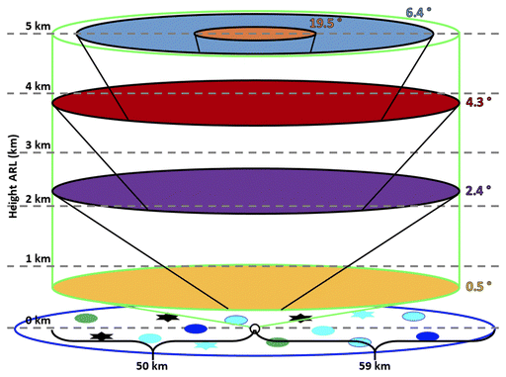
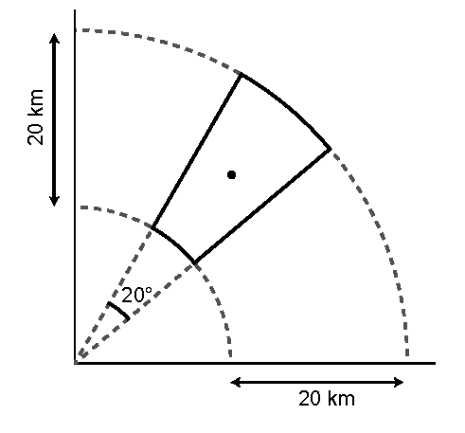
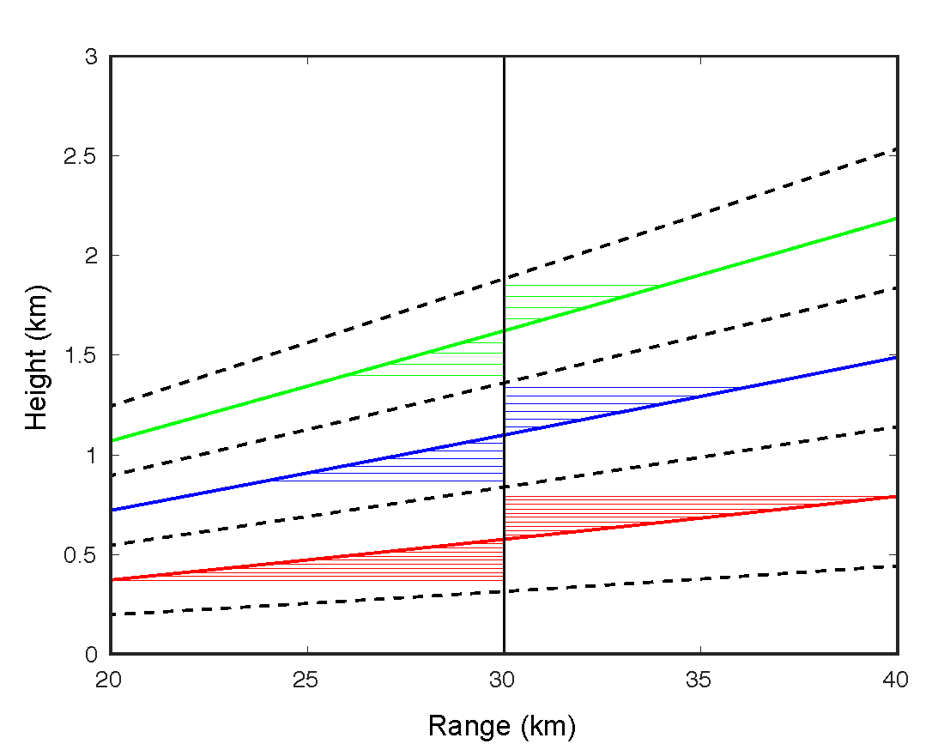
Radar snow relations used in this study
Eastern US
Western US, mountain areas
Bukovčić et al. (2020)
KDP is low and noisy in snow at S band, therefore, additional spatial averaging is required to obtain robust estimates of KDP (and ZDR)
Recently introduced radar products such as Quasi-Vertical Profiles (QVP), range-defined QVP (RD-QVP), and Column Vertical Profiles (CVP) imply aggressive spatial averaging and represent radar data in a height vs time format
QVP
RD-QVP
CVP
Ryzhkov et al. (2016)
Tobin et al. (2017)
Murphy et al. (2020)

Slide 6
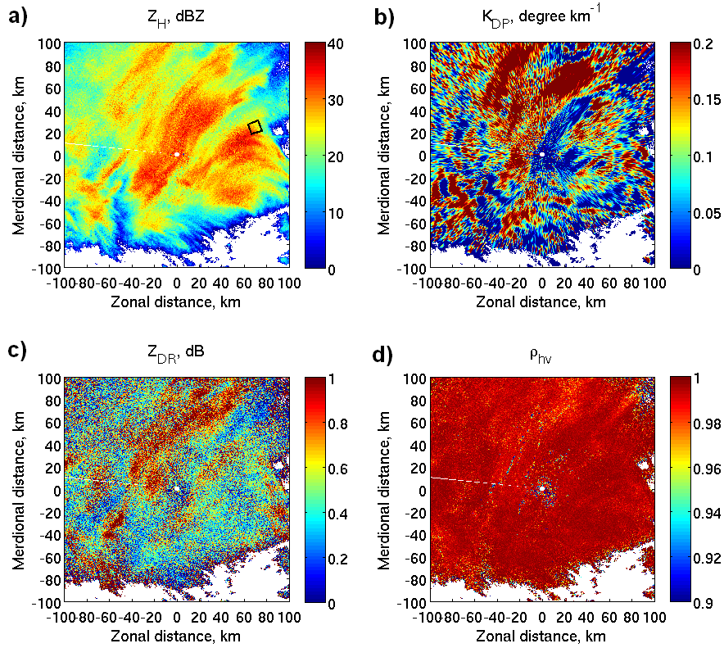
KLWX 1.45° PPI, Nor’easter, 2016-01-23

Slide 7
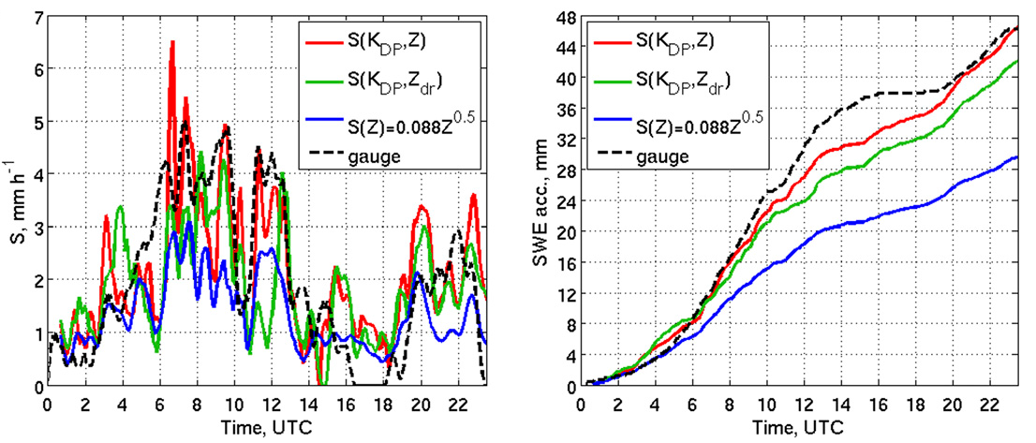
Snowfall rates and accumulations from 1.45° PPI, KLWX, 2016-01-23
S(Kdp, Z) – most realistic, very close to the gauge measurement; reproduces peaks in S
S(Kdp, Zdp) – slightly underestimates S, close to the ground measurement
S(Z) – moderately underestimates S, maximum < 3.1 mm/h

Slide 8
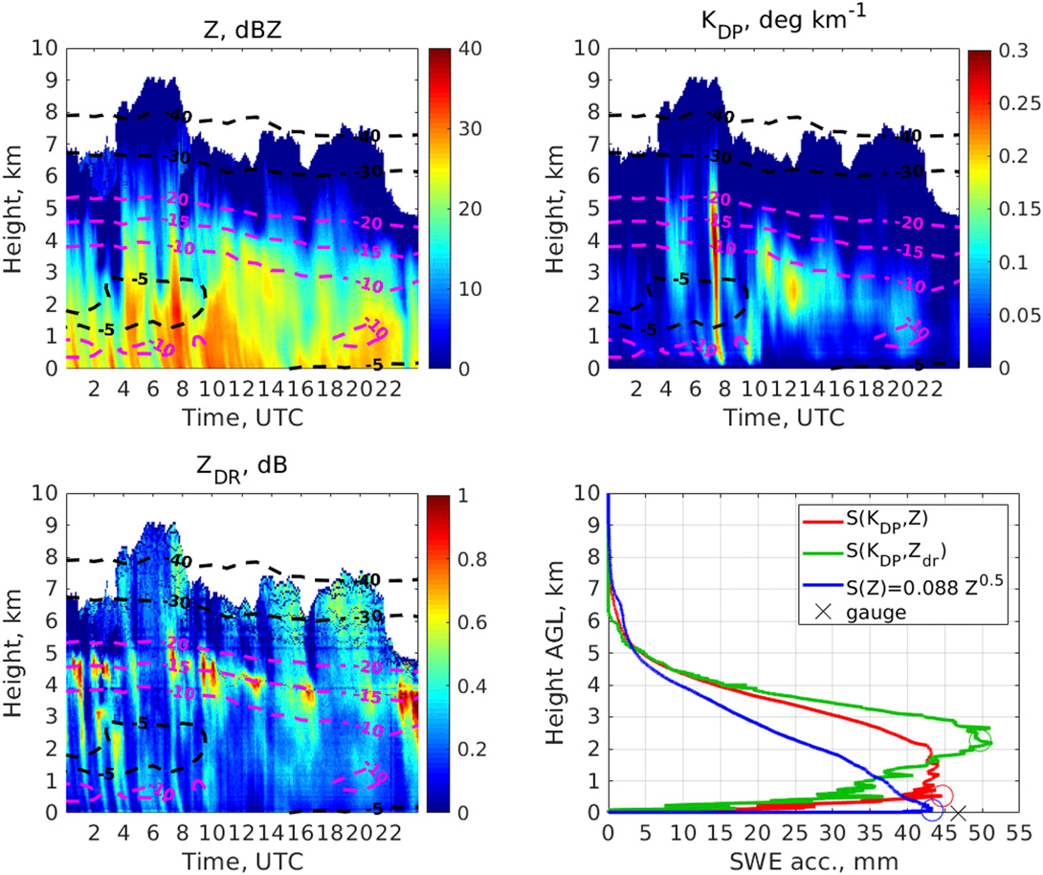
RD-QVP, KLWX, 2016-01-23
S(Kdp, Z) – realistic profile, S(Kdp, Zdp) perform well in DGL, S(Z) – unrealistic profile

Slide 9
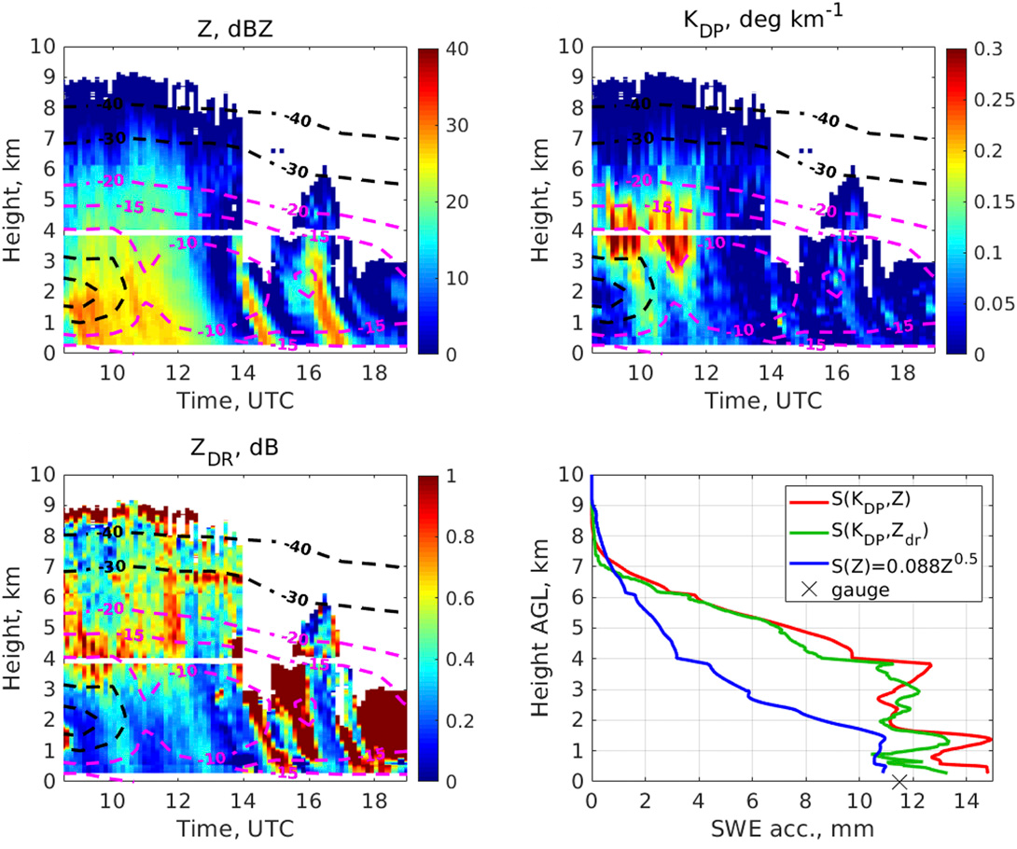
CVP, KOUN, 2011-02-01
S(Kdp, Zdr) and S(Kdp, Z) perform very well, S(Z) estimate has less realistic profile

Slide 10
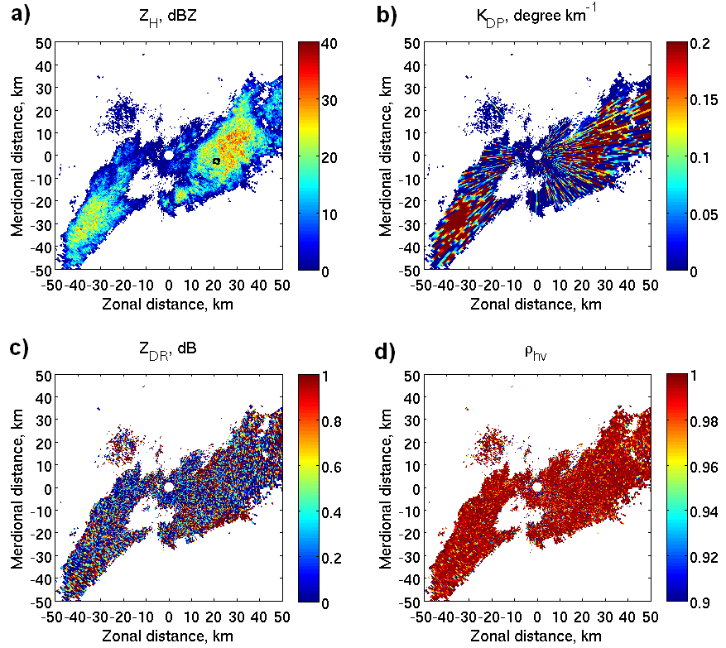
KGJX 2.4° PPI, orographic, 2013-01-28

Slide 11
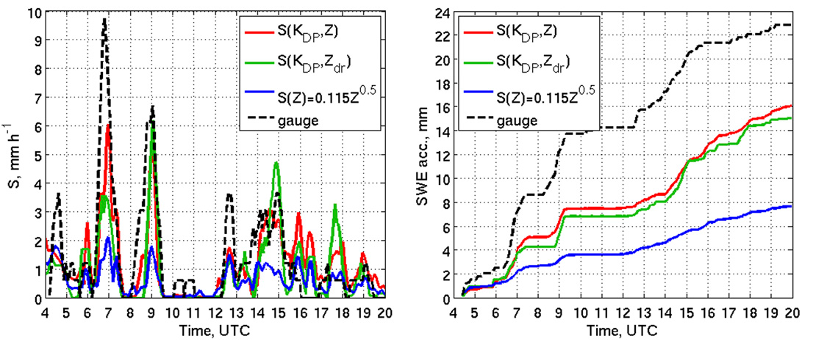
Snowfall rates and accumulations from 2.4° PPI, KGJX, 2013-01-28
S(Kdp, Z) – moderately close to the gauge measurement; most realistic peaks in S
S(Kdp, Zdp) – moderately close to the gauge measurement, slightly worse than S(Kdp, Z)
S(Z) – heavily underestimates S, maximum < 2.1 mm/h

Slide 12
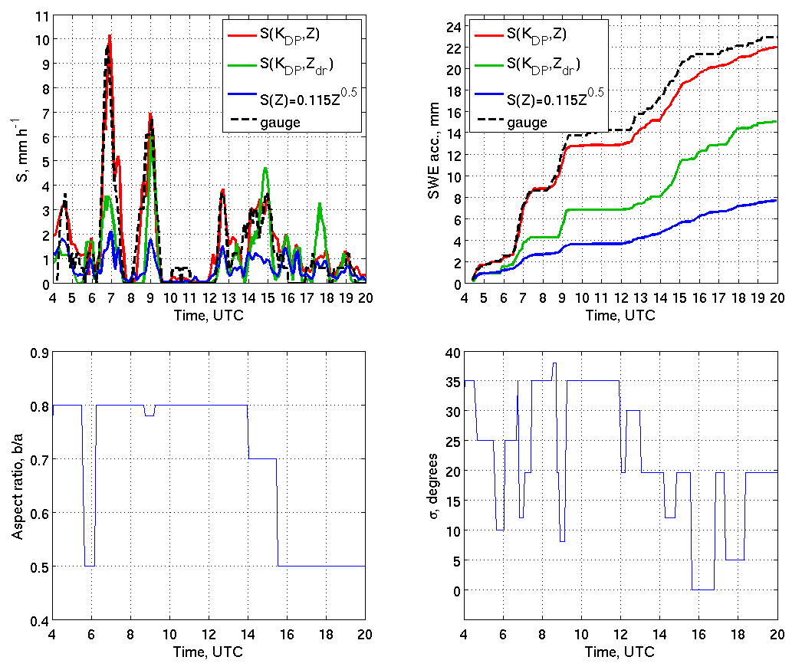
Snowfall rates and accumulations adjusted for b/a and σ, 2.4° PPI, KGJX, 2013-01-28
S(KDP, Z) tunable – much better comparison with gauge for “optimal” b/a and σ

Slide 13
Conclusions
Variability of the S(Z) relations is prohibitively large
S(Kdp, Z) derived from OK 2DVD snow measurements using wide range of b/a from 0.5 to 0.8, and σ form 0 to 40 deg
S(Kdp, Z) relation’s multiplier dependent on particle shape, and orientation – change in density is partially accounted for
S(Kdp, Z) relation’s exponents are almost invariant to particle shape and orientation
S(Kdp, Zdr) relation almost invariant to particle shape and orientation but vulnerable to error measurements of Kdp and ZDR (+ ZDR miscalibration)

Slide 14
Conclusions
Aggressive spatial averaging is required to obtain robust estimates of polarimetric variables in snow at S band – polarimetric algorithms depends on reliable Kdp, Z, and ZDR
Polarimetric relations for snowfall estimation are tested for several moderate/heavy snow events – show good potential for improvement in radar snow QPE
Further optimization and testing of polarimetric algorithms for snow QPE is needed to mitigate the existing deficiencies

Slide 15
Thank you!
Questions?
petar.bukovcic@noaa.gov

Slide 16
References
Vivekanandan, J., V. N. Bringi, M. Hagen, and P. Meischner, 1994: Polarimetric radar studies of atmospheric ice particles. IEEE Trans. Geosci. Remote Sens., 32, 1–10.
Ryzhkov, A. V., D. S. Zrnic, and B. A. Gordon, 1998: Polarimetric Method for Ice Water Content Determination. J. Appl. Meteor., 37, 125–134. doi: http://dx.doi.org/10.1175/1520-0450(1998)037<0125:PMFIWC>2.0.CO;2
Ryzhkov, A., P. Zhang, H. Reeves, M. Kumjian, T. Tschallener, S. Troemel, and C. Simmer, 2016: Quasi-Vertical Profiles - A New Way to Look at Polarimetric Radar Data. J. Atmos. Oceanic Technol., 33, 551-562, doi:10.1175/JTECH-D-15-0020.1
Nguyen, C. M., Wolde, M., Baibakov, K., and Korolev, A., 2017: Determination and estimation of high ice water content using X-band and W-band dual-polarization airborne radar data. In 38th Conference on Radar Meteorology, Chicago, IL (p. 89). American Meteorological Society.
Tobin, D.M. and M.R. Kumjian, 2017: Polarimetric Radar and Surface-Based Precipitation-Type Observations of Ice Pellet to Freezing Rain Transitions. Wea. Forecasting, 32, 2065–2082, https://doi.org/10.1175/WAF-D-17-0054.1
Ryzhkov, A., Bukovčić, P., Murphy, A., Zhang, P., and McFarquhar, G., 2018: Ice microphysical retrievals using polarimetric radar data. In 10th European Conference on Radar in Meteorology and Hydrology, 1–6 July, Netherlands, # 40, 2018. https://projects.knmi.nl/erad2018/ERAD2018_extended_abstract_040.pdf
Bukovčić, P., A. Ryzhkov, D. Zrnić, and G. Zhang, 2018: Polarimetric Radar Relations for Quantification of Snow Based on Disdrometer Data. J. Appl. Meteor. Climatol., 57, 103–120, https://doi.org/10.1175/JAMC-D-17-0090.1
Nguyen, C. M., Wolde, M., and Korolev, A., 2019: Determination of Ice Water Content (IWC) in tropical convective clouds from X-band dual-polarization airborne radar. Atmos. Meas. Tech., 12, 5897 – 5911.
Murphy, A., A. Ryzhkov, and P. Zhang, 2020: Columnar Vertical Profiles (CVP) methodology for validating polarimetric radar retrievals in ice using in situ aircraft measurements. J. Atmos. Oceanic Tech., 37, 1623-1642, https://doi.org/10.1175/JTECH-D-20-0011.1.
Bukovčić, P., A. Ryzhkov, and D. Zrnić, 2020: Polarimetric relations for snow estimation – radar verification. J. Appl. Meteor. Climatol., 2020, https://doi.org/10.1175/JAMC-D-19-0140.1

