Slide 1
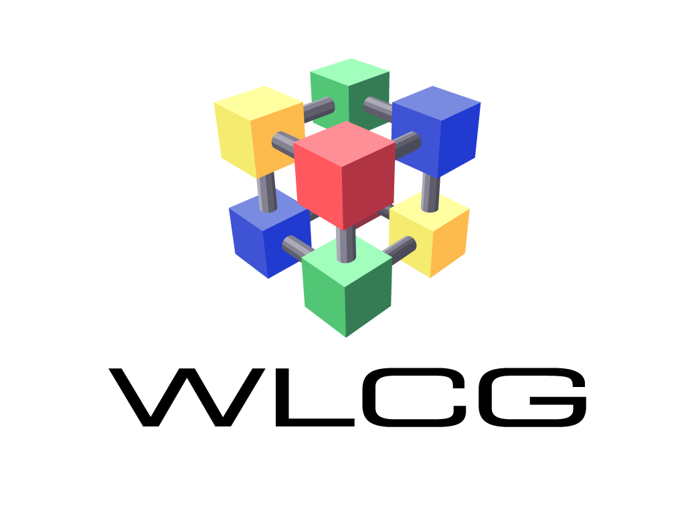
IT security in an IPv6 world
David Kelsey (STFC-RAL)
GridKa School, KIT
7 Sep 2015

Slide 2
David Kelsey
Leader HEP computing group at STFC-RAL (UK)
We run a WLCG/GridPP Tier 1 and Tier 2 sites
Not a security or networking technical professional!
BUT lots of experience working with experts
Networking – HEP DECnet/OSI, HEPiX IPv6 working group
Security Operations and Policy (WLCG, EGI, GridPP, IGTF…)
Here, I am sharing my personal views
HEPiX WG yet to formulate its “official” site guidance
EGI security team just started on IPv6 issues

Slide 3
Outline
Introduction to WLCG, IPv6 and IT security
Some IPv6 security threats
Some IPv6 protocol attacks
Issues for site network/security teams
Issues for sys admins
Where to find more information
Summary and outlook

Slide 4
Introduction: WLCG, IPv6, IT security

Slide 5
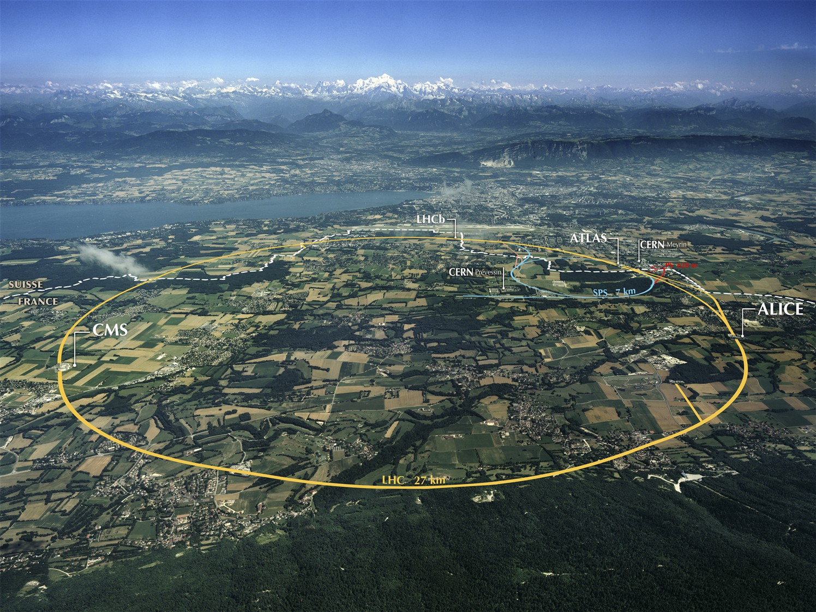
Computing for the LHC
Worldwide LHC Grid
Accelerating Science and Innovation
Notes:
5

Slide 6
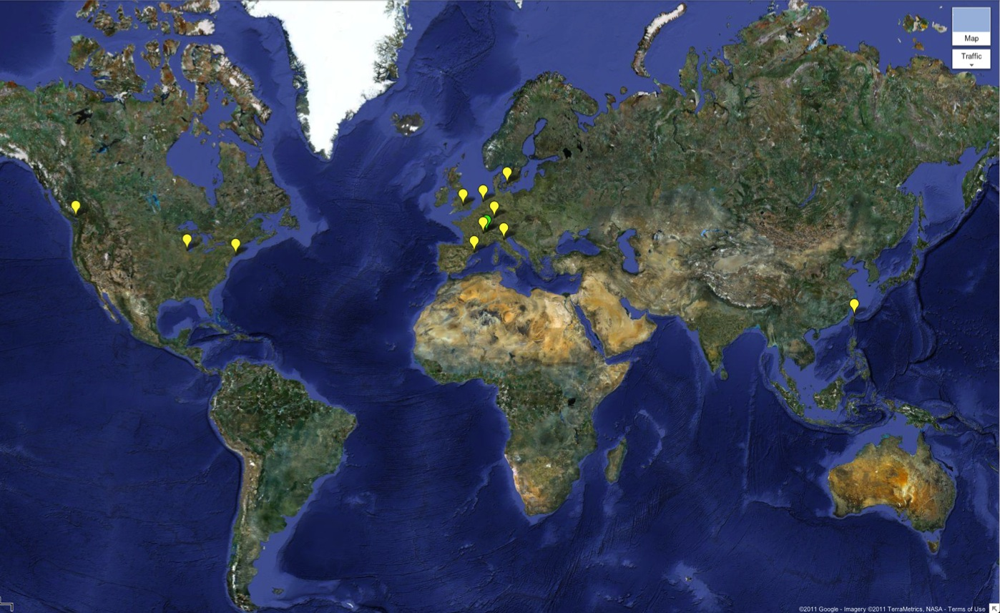
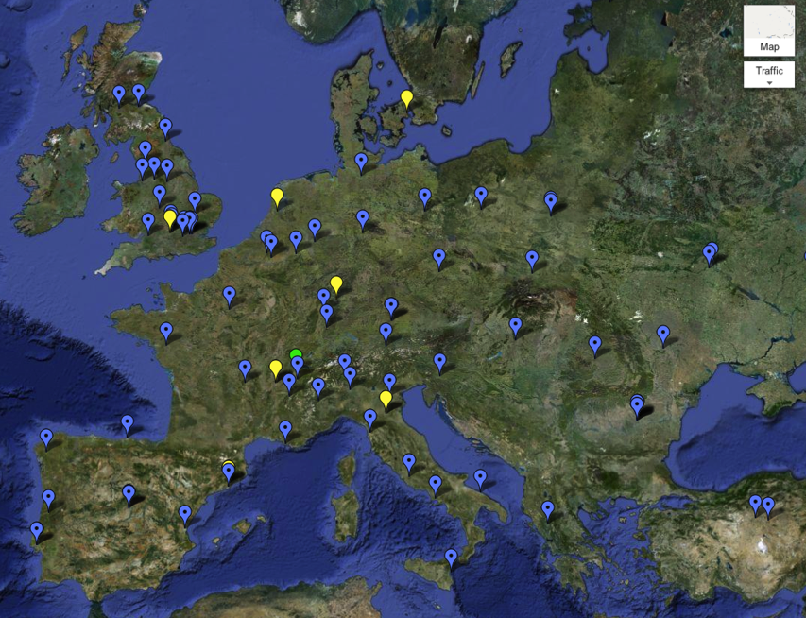
WLCG Grid Sites – Run 1
>140 sites
>320k CPU cores
>150 PB disk
Tier 0
Tier 1
Tier 2

Slide 7
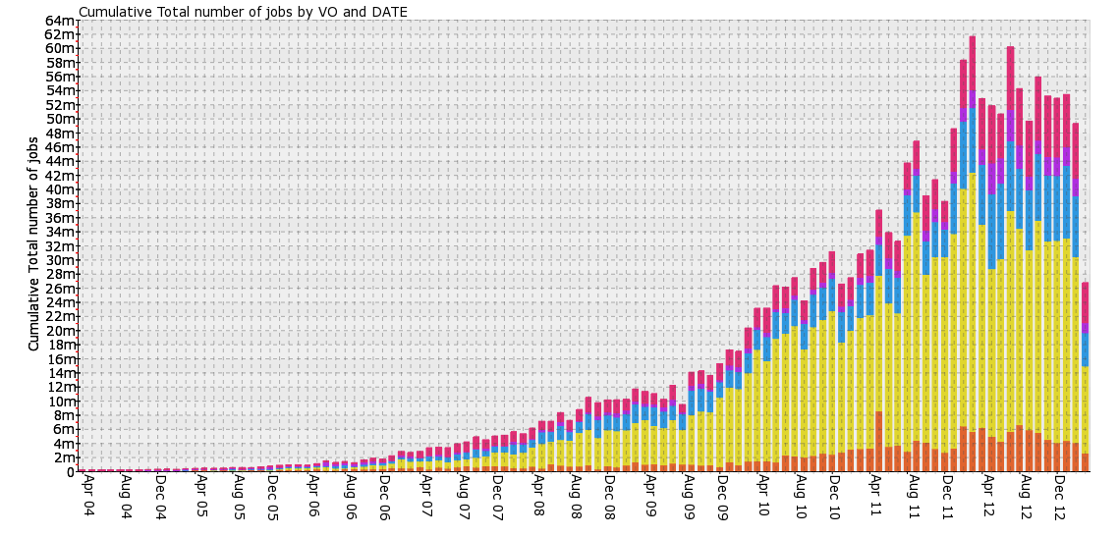
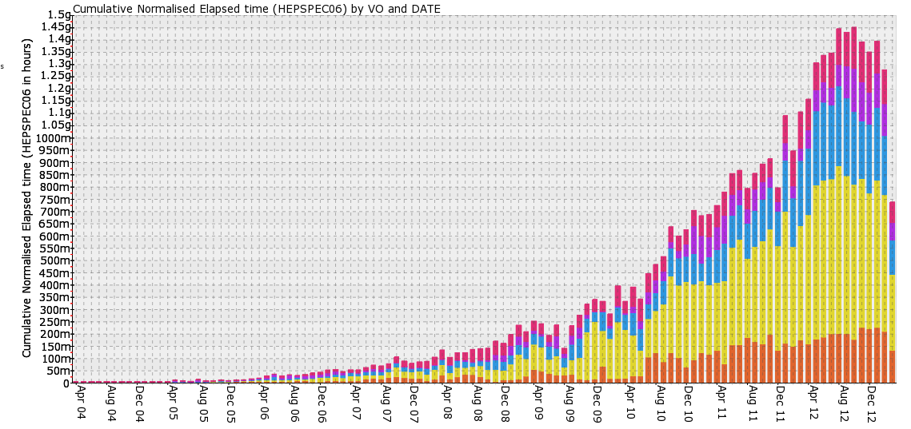
Processing WLCG - Run 1
1.5M jobs/day
Usage continues to grow…
# jobs/day
CPU usage
(~200 k CPU continuous use)
>150,000 years of CPU delivered each year

Slide 8
IPv4 address exhaustion
http://www.potaroo.net/tools/ipv4/

Slide 9
IPv6
Internet Protocol, Version 6 (IPv6) Specification – December 1998 (RFC2460)
Previously known as IPng (started Oct 1993)
Successor to IPv4
https://tools.ietf.org/rfc/rfc2460.txt
Much larger address space 32 bit to 128 bit
An opportunity to address other problems
E.g. security!

Slide 10
IPv6 growth (global Google clients)
https://www.google.com/intl/en/ipv6/statistics.html
Globally > 7% use IPv6 address
Largest national use: Belgium > 35% use IPv6 address

Slide 11
New features of IPv6
Larger address space
Streamlined protocol headers
Stateless auto-configuration
Multicast
Jumbograms
Network layer security
Quality of Service
Anycast
Mobility

Slide 12
Edoardo Martelli (CERN)

Slide 13
Edoardo Martelli (CERN)

Slide 14
IPv6 Neighbor Discovery
Edoardo Martelli (CERN)

Slide 15
WLCG – why use IPv6?
HEPiX IPv6 working group started work in 2011
To assess, evaluate, test and plan
Sites beginning to run out of routable IPv4 addresses (2014)
Large increase in use of virtualisation, multi-cores, etc.
~ 10% of sites report potential shortage of IPv4 addresses (incl. CERN)
Decided in 2012 that WLCG should move asap to dual-stack services
To support IPv6-only clients
A major activity
Need to consider all software, applications, operational tools
Only now, are storage systems fully supporting IPv6
Operational Security – an important issue!

Slide 16
IT security standards
Keep services & data running and secure
Availability, Confidentiality, Integrity
Standards-based approach - ISO 27K, NIST 800-53, …
Security risk assessment is crucial
Concentrate on most likely and highest impact issues
Mitigations: A security plan with controls
Technical, operational and management controls
Handle incidents and vulnerabilities to keep services up
An ongoing process!

Slide 17
Problems with IPv4 security
Design favoured interoperability over
Confidentiality, integrity, availability
No cryptographic protection from eavesdropping or manipulation
No end to end authentication
New technologies were added along the way
E.g. SSL/TLS, IPsec
With IPv6 these were designed in as mandatory components

Slide 18
IPv6 Security

Slide 19
IPv6 security pros/cons
Advantages of a new design
Security:important part of the IPv6 initial design
Down-sides
Lack of maturity
New vulnerabilities and attack vectors
Need IPv6-compliant monitoring and tools
Lack of education and experience
Problems of transition – dual-stack, tunnels
BUT - Many threats/attacks happen at layers above/below the network layer
And are therefore exactly the same as in IPv4
Malware, phishing, buffer overflows, cross-site scripting, DDoS etc etc

Slide 20
Immediate IPv6 concerns
IPv6 may be on by default (and not controlled or monitored)
End systems have multiple addresses
Searching logs will not always work
Formatting when writing the logs is still broken
Same address but different formats (drop zero or not)
What is wrong with tunnels?
Site may not be in control
Tunnels traverse the IPv4 perimeter firewall and NAT gateways
Reputation-based (IP address) web protection does not fully exist for IPv6

Slide 21
IPv6 security myths
Internet Society has published 10 myths of IPv6 security
https://www.internetsociety.org/deploy360/blog/tag/ipv6-security-myths/
Myth 2: IPv6 has security designed In
Reality: IPv6 was designed 15-20 years ago

Slide 22
IPsec
Was first developed in 1995 for IPv4 internet layer
SSL and TLS operate at Application Layer
A framework of standards
End to end authentication, data integrity and privacy (encryption)
Can be used site to site (gateway to gateway)
As a Virtual Private Network (VPN)
Or host to host
All major aspects are same in IPv6 as IPv4
Does not fully support protection for multicast traffic
Key management is one-to-one
No longer mandatory (rfc6434 – MUST -> SHOULD)

Slide 23
IPv6 problems in IPv4-only world
Turned on by default on many Operating Systems
Windows Vista was the first
Rogue router advertisements
Badly configured or malicious
Tunnels turned on (by default, by bad config.)
IPv6 and tunnels can bypass firewalls
Must filter IPv6 traffic and tunnels

Slide 24
IPv6 deployment risks
The attacker community can make good use of IPv6
They are IPv6 experts
E.g. for tunneling leaked info out from compromised systems
Vulnerabilities present in IPv6, including day zero issues inherent in any new or revised system
224 CVE entries with keyword “IPv6” since 2002
29 in 2015
Complexity added by dual IPv4/IPv6 operations
Immaturity of IPv6 security products and processes
Lack of vendor support.

Slide 25
NAT and IPv6
NAT has been essential to preserve the IPv4 address space
Many concerns about lack of NAT in IPv6
IPv4 address/port translation is not the main protection of the end systems
It is the stateful firewall that protects!

Slide 26
Network scanning
IPv6 Security Myth #4 – IPv6 Networks are Too Big to Scan (Internet Society)
Myth: IPv6 networks are too big to scan Reality: Many addressing techniques reduce the search space
Scanning an IPv4 /24 subnet (256 addresses) is trivial
An IPv6 /64 subnet has 1.8 * 10¹⁹ addresses
BUT - SLAAC, DHCPv6 and manual configuration all tend to introduce order into the sparse address space
For LANs, can use one compromised host to scan via use of Neighbor Discovery

Slide 27
Some IPv6 protocol attacks

Slide 28
Extension Header vulnerabilities
Routing Header Type 0
Source Routing
Lots of security issues with RH0
Destination address in packet is replaced at every Layer 3 hop
Difficult for firewalls to determine the actual destination and compare with policy
Can be used for DoS traffic amplification
RH0 depracated (rfc5095)
Fragmentation issues
Upper-layer info may be in second packet (and not inspected by firewall)
IPv6 standard defines every link to have MTU of at least 1280 bytes
Smaller fragments should be suspicious
Hop-by-hop extension header also dangerous
Solutions include
Filter on allowed and expected EH

Slide 29
Neighbor Discovery Protocol
NDP authenticates neither the requestor or responder
Spoofing is possible
SLAAC, NDP and DAD include protection mechanisms
Source address for RA and NS messages must be unspecified (::)
Hop limit must be 255 (the maximum)
RA and NA messages must be rejected if hop limit is not 255
This prevents a remote attacker sending forged RA or NA messages
scope is always local

Slide 30
Secure Neighbor Discovery
Secure Neighbor Discovery (SEND) (rfc3971)
Uses Cryptographically Generated Addresses (rfc3972)
SEND has a pair of public/private keys per IPv6 node
ND is extended with more options
Interface identifier is crypto generated based on current IPv6 prefix/public key
Signatures are generated and checked to authenticate nodes

Slide 31
Rogue RA
No authentication mechanism built into SLAAC
Malicious host can send rogue RA and pretend to be a router
Can capture or drop packets
Badly configured systems too

Slide 32
Detecting rogue RA messages
Use generic IDS with customised signatures
RA whose source MAC or IP is not in a configured list
Lots of manual configuration!
Use tool NDPMon
And check against XML config file
also monitor all NS and NA
To check when NA contradicts a previous one
Intelligent switches – known RA source
Cisco RA Guard
Rafixd (and ramond)
Detect all rogue RA messages and immediately transmit another forged RA with lifetime 0 seconds (to clear the rogue info on all nodes)

Slide 33
DAD
Duplicate Address Detection
Host checks whether its address is already in use
Sends NS asking for resolution of its own address
An attacker can launch a DoS attack by pretending to own all IPv6 addresses on the LAN

Slide 34
ICMPv6
Internet Control Message Protocol (rfc4443)
An important component of IPv6
Redefines ICMPv4 with additions and changes
Ping, destination unreachable, neighbor discovery, path MTU discovery
Error messages (message number 1 to 127)
Informational messages (128 to 255)
Essential to establish strict ICMP filtering policies
Define ICMPv6 messages that can/cannot pass between the site and the internet
E.g. PMTU and ND
Rfc4890 “Recommendation for Filtering ICMPv6 Messages in Firewalls”
Each site needs to consider carefully!

Slide 35
Issues for Sites

Slide 36
NIST 800-119 quote
The deployment of IPv6 reinforces the basic security lessons learned with IPv4. These security practices include defense in depth, diversity, patching, configuration management, access control, and system and network administrator best practices. Good security practices remain unchanged with the deployment of IPv6. Good security practices will reduce exposure and recovery time in case of a security event.

Slide 37
Critical Security Controls for Effective Cyber Defense
http://www.sans.org/critical-security-controls/ (© SANS, CC-BY-ND)
Top 20 Critical Security Controls (Version 5)
1: Inventory of Authorized and Unauthorized Devices
2: Inventory of Authorized and Unauthorized Software
3: Secure Configurations for Hardware and Software on Mobile Devices, Laptops, Workstations, and Servers
4: Continuous Vulnerability Assessment and Remediation
5: Malware Defenses
6: Application Software Security
7: Wireless Access Control
8: Data Recovery Capability
9: Security Skills Assessment and Appropriate Training to Fill Gaps
10: Secure Configurations for Network Devices such as Firewalls, Routers, and Switches
11: Limitation and Control of Network Ports, Protocols, and Services
12: Controlled Use of Administrative Privileges
13: Boundary Defense
14: Maintenance, Monitoring, and Analysis of Audit Logs
15: Controlled Access Based on the Need to Know
16: Account Monitoring and Control
17: Data Protection
18: Incident Response and Management
19: Secure Network Engineering
20: Penetration Tests and Red Team Exercises

Slide 38
ISSeG: Top 12 Recommendations
EU FP6 Project – partners: CERN, FZK (now KIT), STFC
(Integrated Site Security for Grids)
http://isseg-training.web.cern.ch/ISSeG-training/Recommendations/Top-Recommendations.htm
R0 : Perform a site security risk assessment
R1 : Create and review your information security policy
R8 : Encourage information security awareness, education and training
R14 : Separate your development, test, and operational facilities
R16 : Install and regularly update malicious code detection and repair software for example anti-virus
R18 : Establish backup and restore policies and procedures
R23 : Enable audit logging of user activities, exceptions and security events
R26 : Restrict and control the allocation of privileges
R28 : Enforce good practices in the selection and use of passwords
R29 : Ensure that unattended equipment is appropriately protected
R36 : Establish a CSIRT and incident response procedures
R39 : Protect your confidential and sensitive data
Copyright (c) Members of the ISSeG Collaboration 2008

Slide 39
IPv6 issues for security/network teams
Control IPv6 if not using it
Use Dual-stack and avoid use of tunnels wherever possible
Drop packets containing RH Type 0 and unknown option headers
Deny packets that do not follow rules for extension headers
Filter IPv6 packets that enter and leave your network
Restrict who can send messages to multicast group addresses
Create an Address management plan
Create a Security Policy for IPv6 (same as IPv4)
Block unnecessary ICMPv6
Protect against LAN RA, ND and DHCP attacks
Use SEND and authenticated DHCPv6
NDPMON and RAFIXD on critical segments
Check/modify all security monitoring, logging and parsing tools

Slide 40
Issues for Sys Admins

Slide 41
IPv6 issues for sys admins
Follow best practice security guidance
System hardening as in IPv4, see for example
https://access.redhat.com/documentation/en-US/Red_Hat_Enterprise_Linux/6/pdf/Security_Guide/Red_Hat_Enterprise_Linux-6-Security_Guide-en-US.pdf
Specific advice on IPv6 hardening, see for example
https://www.ernw.de/download/ERNW_Guide_to_Securely_Configure_Linux_Servers_For_IPv6_v1_0.pdf
Check for processes listening on open ports
# netstat, lsof
Review neighbour cache for unauthorised systems
# ip -6 neigh show
Check for undesired tunnel interfaces
# ip -6 tunnel show, # route –A inet6

Slide 42
Sys admins (2)
Ensure not unintentionally forwarding IPv6 packets
/proc/sys/net/ipv6/conf/*/forwarding files
Or net.ipv6.conf.*.forwarding sysctl
Use OS embedded IPv6 capable stateful firewall
filter based on EH and ICMPv6 message type
ip6tables
IPv6 aware intrusion detection
E.g. Snort, Suricata, Bro
https://www.sans.org/reading-room/whitepapers/detection/ipv6-open-source-ids-35957
Use IPsec between critical servers to secure communications

Slide 43
More Information?

Slide 44
More information
Many IETF RFC documents on IPv6
IPv6 Security – Protection measures for the next Internet Protocol, Scott Hogg and Eric Vyncke, Cisco Press (2009)
NIST Guidelines for the Security Deployment of IPv6 (NIST SP800-119) http://csrc.nist.gov/publications/nistpubs/800-119/sp800-119.pdf
Internet Society – top 10 IPv6 security myths https://www.internetsociety.org/deploy360/blog/tag/ipv6-security-myths/

Slide 45
Summary and Outlook
In many ways IPv6 security is similar to IPv4
But with new twists and new vulnerabilities
It has taken ~ 30 years to learn how to cope with IPv4 security
There will be lots of fun ahead with IPv6
Enjoy the next 20-30 years!

Slide 46
Questions?

