Slide 1
Apache Spark: Next Generation Data Processing for Hadoop
GridKA 2015 Mirko Kämpf | 2015-09-10

Slide 2
Agenda
The Data Science Process (DSP) - Why or when to use Spark
The role of: Apache Hadoop and Apache Spark - History & Hadoop Ecosystem
Apache Spark: Overview and Concepts
Practical Tips

Slide 3
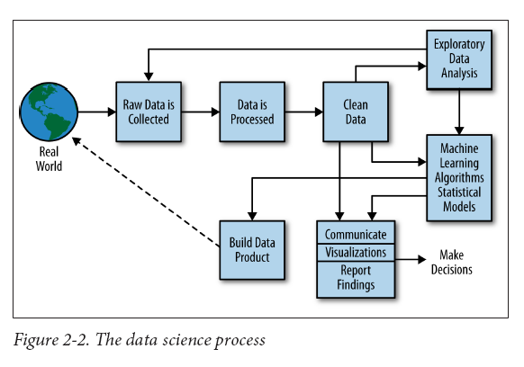
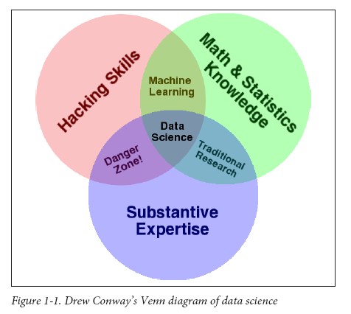
The Data Science Process
Application of Big-Data-Technology
Images from: http://semanticommunity.info/Data_Science/Doing_Data_Science

Slide 4
Huge Data Sets in Science
Application of Big-Data-Technology
Images from: http://semanticommunity.info/Data_Science/Doing_Data_Science

Slide 5
“Spark offers tools for Data Science and components for Data Products.”
—How can Apache Spark fit into my world?

Slide 6
Should I use Apache Spark?
If all my data fits into Excel-Spreadsheets?
If I have a special purpose application to work with?
If my current system is just a bit to slow?

Slide 7
Should I use Apache Spark?
If all my data fits into Excel-Spreadsheets?
If I have a special purpose application to work with?
If my current system is just a bit to slow?
Just export as CSV / JSSON and use a DataFrame to join with other DS.
Why not?

Slide 8
Should I use Apache Spark?
If all my data fits into Excel-Spreadsheets?
If I have a special purpose application to work with?
If my current system is just a bit to slow?
Just export as CSV / JSSON and use a DataFrame to join with other DS.
Think about additional analysis methods! Maybe it is build into Spark.
Why not?

Slide 9
Should I use Apache Spark?
If all my data fits into Excel-Spreadsheets?
If I have a special purpose application to work with?
If my current system is just a bit to slow?
Just export as CSV / JSSON and use a DataFrame to join with other DS.
Think about additional analysis methods! Maybe it is build into Spark.
OK, Spark will probably not help to speed up your system, but maybe you can offload data to Hadoop, which gives free some resources.
Why not?

Slide 10
“Spark offers fast in memory processing on huge distributed and even on heterogeneous datasets.”
—What type of data fits into Spark?

Slide 11
History of Spark
Spark is really young, but has a very
active community!

Slide 12
Timeline: Spark Adoption

Slide 13
Apache Spark: Overview & Concepts

Slide 14
Hadoop Ecosystem incl. Apache Spark
Spark can be an entry point to your Big Data world …

Slide 15
“Apache Spark is distributed on top of Hadoop and brings parallel processing to powerful workstations.”
—Do I need a Hadoop cluster to work with Apache Spark?

Slide 16
Spark vs. MapReduce

Slide 17
How to interact with Spark?

Slide 18
Spark Components

Slide 20
MLLib: GraphX:
Basic statistics
summary statistics, correlations, stratified sampling, hypothesis testing, random data generation
Classification and regression
linear models (SVMs, logistic / linear regression)
naive Bayes, decision trees
ensembles of trees (Random Forests / Gradient-Boosted Trees)
isotonic regression
Collaborative filtering
alternating least squares (ALS)
Clustering
k-means, Gaussian mixture, power iteration clustering (PIC)
latent Dirichlet allocation (LDA), streaming k-means
Dimensionality reduction
singular value decomposition (SVD)
principal component analysis (PCA)
…
PageRank
Connected Components
Triangle Counting
Pregel API

Slide 21
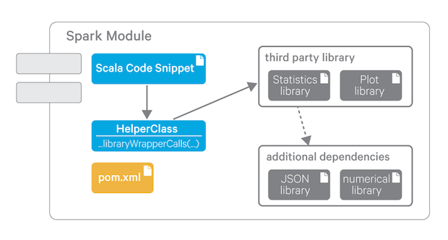
How to use my own algorithms in Spark?
Interactively, by using the spark-shell …
Contribute to existing Spark projects.
Create your module and use it in a spark-shell session…
Build a data-product which uses Apache Spark.
For simple and reliable usage of Java classes and complete third-party libraries, we define a Spark Module as a self-contained artifact created by Maven. This module can easily be shared by multiple users.

Slide 22
Apache Spark: Overview & Concepts

Slide 23
Spark Context

Slide 24
RDDs and DataFrames

Slide 25
Creation of RDDs

Slide 26
Datatypes in RDDs

Slide 29
Spark in a Cluster

Slide 30
Spark in a Cluster

Slide 33
DStream: The heart of Spark Streaming

Slide 34
“Efficient hardware utilization, caching, simple APIs, and access to a variety of data in Hadoop is key to success.”
—What makes Spark so different, compared to core MapReduce in core Hadoop?

Slide 35
Practical Tips

Slide 36
Development Techniques
Build your tools and analysis procedures in small cycles.
Test all phases of your work and document carefully.
Document what you expect! => Requirements management …
Collect what you get! => Operational logs …
Reuse well tested components and modularize your analysis scripts.
Learn „state of the art“ tools and share your work!

Slide 37
Data Management
Think about typical access patterns:
random access to each record
access to groups of records
variable or fixed sets?
„full table scan“
OPTIMIZE FOR YOUR DOMINANT ACCESS PATTERN!
Select efficient storage formats: Avro, Parquet
Index your data in SOLR for full text access and data exploration
Indexing can be done by just some clicks in HUE!

Slide 38
Collecting Sensor Data with Spark Streaming …
Spark Streaming works on fixed time slices only (in current version)
Use the original time stamp?
Additional storage and bandwidth
Original system clock defines resolution
Use „Spark-Time“:
You may lose information!
You have a limited resolution.
You can use a time reference instead of „Spark time“

Slide 39
Thank you !
Enjoy Apache Spark and all your data …

