Slide 1
Welcome to GridKa School 2015
Achim Streit
Notes:
Good afternoon! With best wishes from the KIT presidential board and my colleagues in the board of directors of the Steinbuch Centre for Computing (in short SCC) I‘ like to welcome you to Karlsruhe and the KIT.
My name is Achim Streit and I‘m director of the SCC, which is operating GridKa, the German Tier-1 data and computing centre in the WLCG.
In the following 10-15 minutes I would like to give you a very brief overview about KIT and the activities of our institute, the Steinbuch Centre for Computing.

Slide 2
Karlsruhe Institute of Technology
RESEARCH – TEACHING – INNOVATION

Slide 3
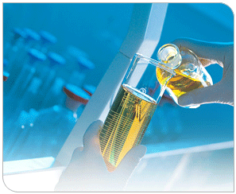
KIT – Our Mission
Research & Development
Higher Education
Innovation
„… to form a novel quality of cooperation, and to overcome the separation between federal research facilities and state universities …“

Slide 4
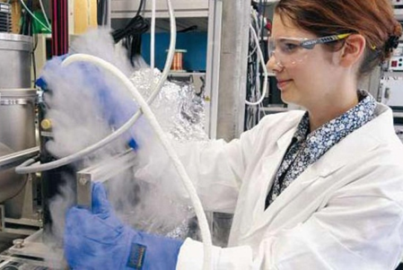
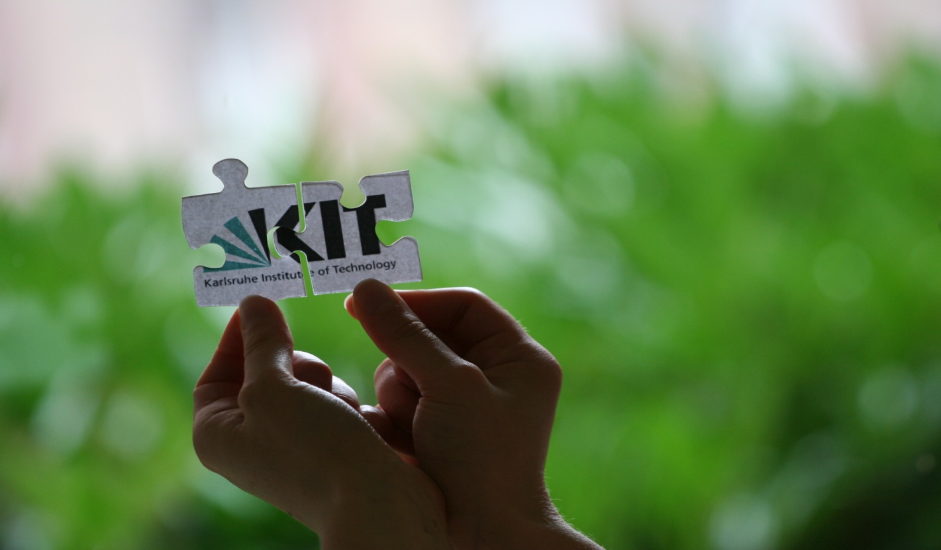
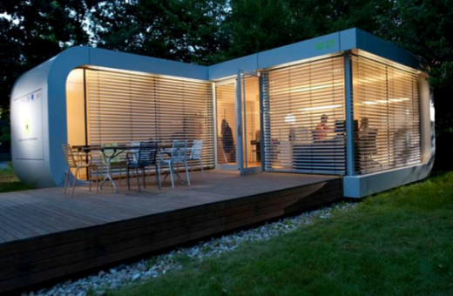
KIT – Facts and Figures
157 Institutes, 7 Centres
24 778 Students
9 491 Employees
355 Professors
6 035 Scientists
~3 200 PhD students
844 Mio. € Budget*
270 Mio. € Federal funds
216 Mio. € State funds
358 Mio. € 3rd party funds
129 Invention disclosures
52 Patent applications
25 Spin-offs
2.2 Mio. € Income from KIT
licenses
* Budget 2013

Slide 5
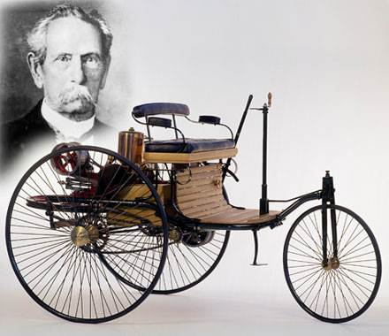
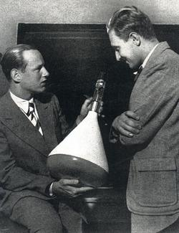
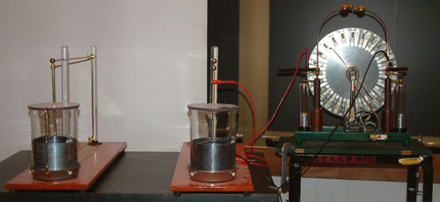
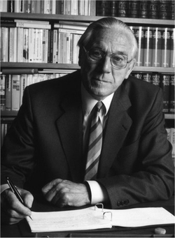
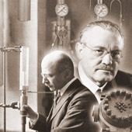
Engineering Tradition
Heinrich Hertz: confirmation of electromagnetic waves
Karl Benz: inventor of the modern automobile
Ferdinand Braun: inventor of cathode ray tube → television
Fritz Haber:
fixation of atmospheric
N2 → synthetic ammonia
Karl Steinbuch: coined the term Informatics in 1957
Notes:
KIT looks back on a long tradition of engineering. Many famous researchers worked at the university of Karlsruhe in former times….

Slide 6
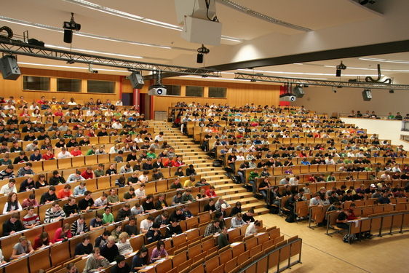
Broad Range of Educational Offers
Over 80 modern degree programs in 11 departments:
Civil Engineering, Geo- and Environmental Sciences
Mechanical Engineering
Informatics
Electrical Engineering and Information Technology
Chemical and Process Engineering
Economics and Business Engineering
Chemistry and Biosciences
Mathematics
Physics
Architecture
Humanities and Social Sciences
Envisaged student-scientist-ratio 5:1

Slide 7
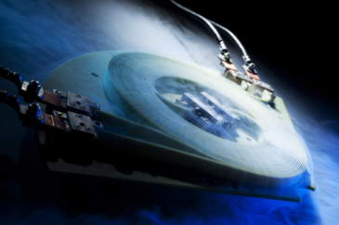
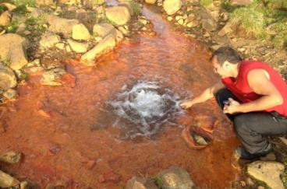
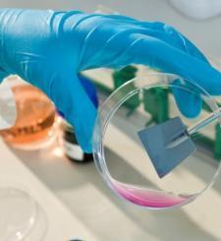
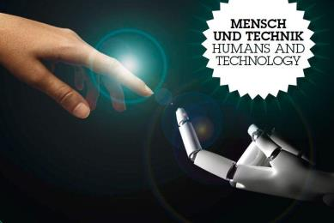
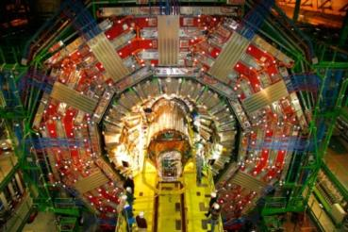
Energy
7 Topics
1250 Empl.
Climate and
Environment
7 Topics
500 Empl.
Mobility Systems
7 Topics
900 Empl.
Materials ∙ Structures ∙
Functions
14 Topics
1100 Empl.
Humans and Technology
6 Topics
400 Empl.
Elementary Particle and
Astroparticle Physics
9 Topics
400 Empl.
Information ∙ Systems ∙
Technologies
10 Topics
450 Empl.

Slide 8
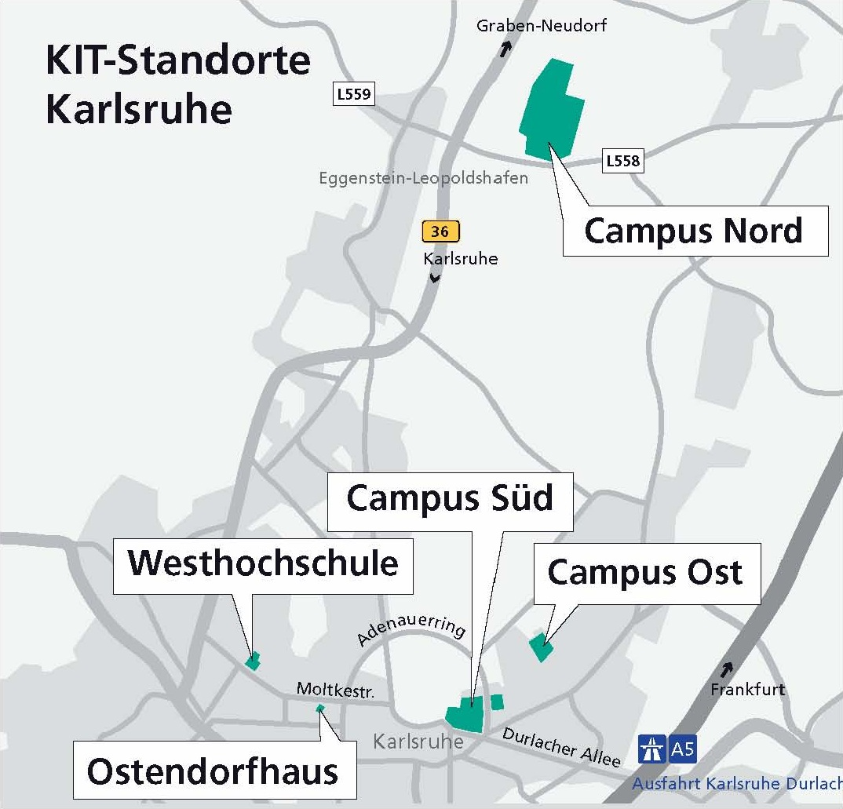
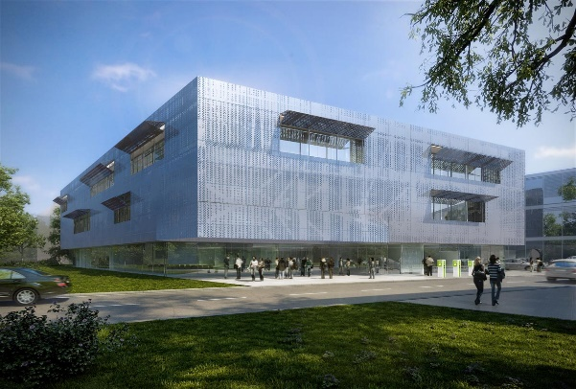
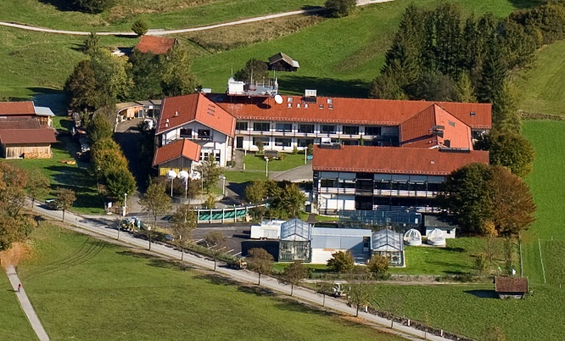
Helmholtz Institute Ulm
KIT Campus Alpine

Slide 9
Introduction to the Steinbuch Centre for Computing (SCC)

Slide 10
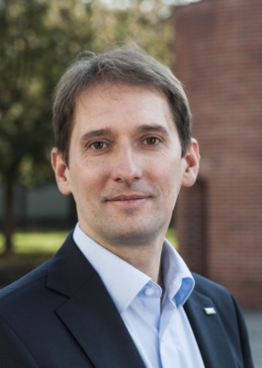
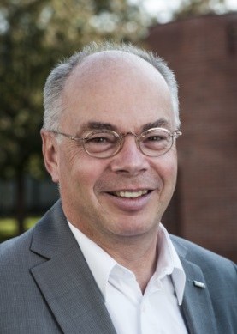
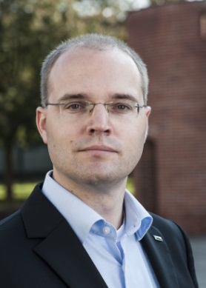
Facts and Figures
Founded on January 1st, 2008
Merger of the Computing Centers of former Karlsruhe University (URZ) and Research Center Karlsruhe (IWR)
Karl Steinbuch
Professor at Karlsruhe University, creator of the term “Informatik”, co-founder of the first German faculty of informatics
Two locations at KIT Campus South and North
189 people in total (as of 1.9.2015)
60% scientists, 40% technicians, administrative personnel, trainees
7 departments and 4 research groups
Board of directors
Prof. Dr. Hannes Hartenstein
Prof. Dr. Bernhard Neumair
Prof. Dr. Achim Streit

Slide 11
Steinbuch Centre for Computing
Which demands do we satisfy?
Computational Science & Engineering (CSE)
Data-Intensive Science (DIS)
For users in KIT, BaWü, Germany and international
Who are we?
Institute in KIT with
service tasks
What do we do?
Research, education and innovation in Supercomputing, Big Data and secure IT-federations
Operation of large scale research facilities
Operation of basic IT services
“Services for Science – Science for Services”

Slide 12
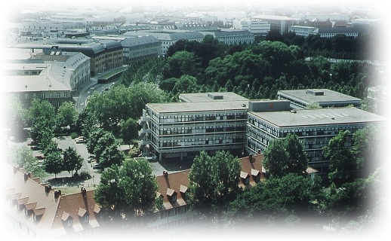
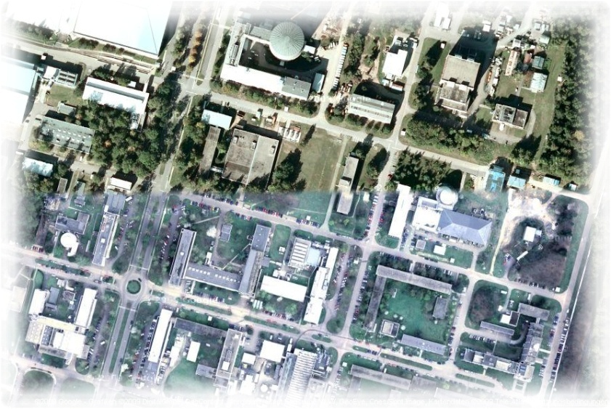
SCC IT-Services
Campus-wide IT-services for > 25.000 students and > 10.000 employees
Networks: 1700 switches/router, 600 WLAN APs
Server virtualisation: 800 virtual servers
HW server: ca. 400 servers in 80 racks
Backup/archive: 3000 Clients, 6 Libraries, 30000 Slots
E-Mail: 45.000 mail boxes, 450.000 incoming mails/d, 200.000 outgoing mails/d
Databases: ca. 1250 MS-SQL/Oracle DB
Web: 600.000 web pages, 500 virt. web servers
Computer rooms: 400 PCs, 250 courses
Portal for students/e-learning: 8.000 users/d, 26.000 users/a, 8.300 active courses

Slide 13
Cybersecurity and integration/federation:
R&I
Teaching
Basic services
Services (examples)
…
SDIL
bwUni- Cluster
ILIAS
Campus
(ASERV)
Web
Mail
Storage
…
Innovation projects: KIM-IDM, bwIDM, bwITSec, AARC
Research projects: CollabFuL, KASTEL
Operation and
Research and Innovation
Identity & Access Management (IAM)
Systems- and Network Security
Computer Incident Response Team (CERT)
membership / guidance
requirements / guidelines
State of Baden-Württemberg
HGF/National/ International
KIT
Policy

Slide 14
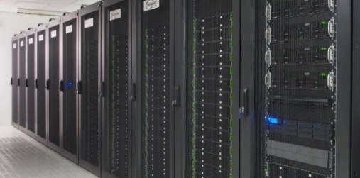
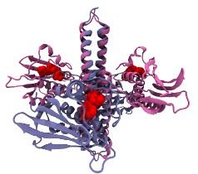
Enabling Computational Science & Engineering (CSE)
Operation of HPC systems
ForHLR: Tier-2 system in Germany phase-1 (11.000 core) + phase-2 (> 23.000 cores) total peak performance > 1,2 PetaFlop/s peer-review access for users in BaWü und D
bwUniCluster: Tier-3 system in the state BaWü HPC capacity system with 8.500 cores shareholder ownership with all 9 state universities
Joint R&D&I with scientific communities
Application optimisation, scaling, model enhancements
Simulation Labs in HGF Programm SBD
HYIG „Multiscale Biomolecular Simulation“
Innovation drivers for SMEs
Architect for HPC environment in BaWü

Slide 15
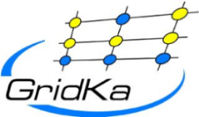
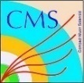
Enabling Data-Intensive Science (DIS)
Operation of GridKa
German Tier-1 in WLCG for an international community
Operation of the Large-Scale Data Facility
Multi-disciplinary data centre for climate research, systems biology, energy research, etc. in BaWü
Joint R&D&I with scientific communities
Generic data management research
Data Life Cycle Labs in Helmholtz Programm SBD
Innovation driver for SMEs, big industry und start-ups
Active role in national and international projects & initiatives

Slide 16
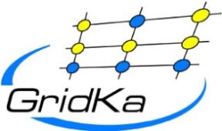
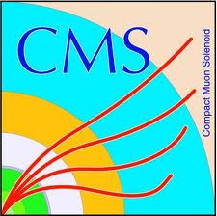
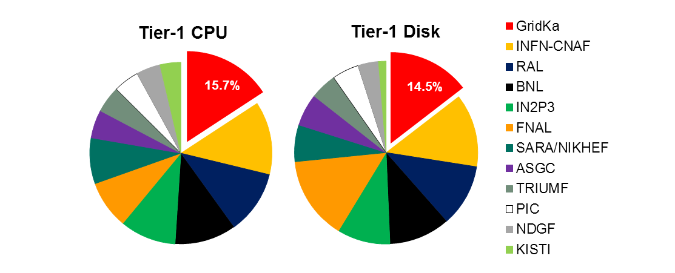
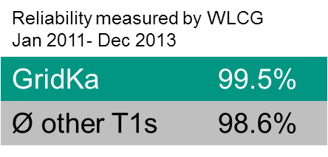
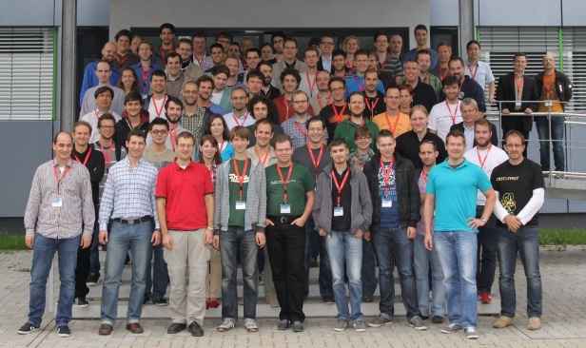
GridKa
German Tier-1 Center in WLCG
Supports all LHC experiments + Belle II + several small communities
Resources
Computing: ~ 10.000 cores (160 kHS’06)
Disk: 14 PB (netto)
Tape: 18 PB (used)
100 Gbit/s network connectivity to LHCOPN, LHCONE
14% of LHC data permanently stored at GridKa
Among the largest and best performing T1s
Annual international GridKa School
> 1300 participants in 12 years!
2014: 120 participants / 19 countries
Global Grid User Support (GGUS) for WLCG
If there is no ticket in GGUS, it is a not problem.

