Slide 1
EUDAT The European Collaborative Data Infrastructure (CDI)
GRIDKA School, 11 September 2015
Damien Lecarpentier
CSC-IT Center for Science

Slide 2
Outline
What is the EUDAT CDI?
Data Management & Open Access in the CDI
Moving forward - 2020

Slide 3
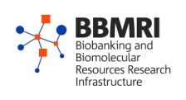
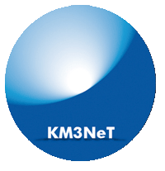
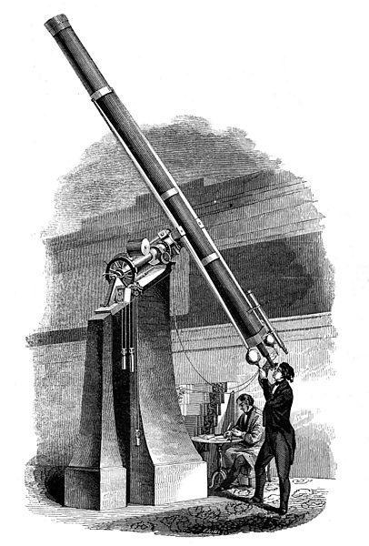
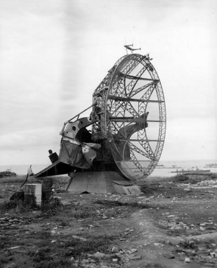
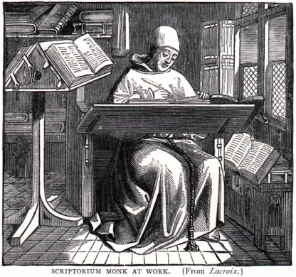
Research Infrastructures – Where is it going?
Research Infrastructure trends:
Internationalisation
Diversification
Increasingly relying on on ICT
Data deluge is a common challenge
European Ris:
Around 500
€ 100 billion investment
middle age 19th century 20th century 21st century

Slide 4
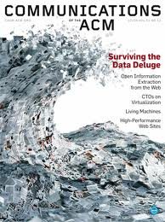
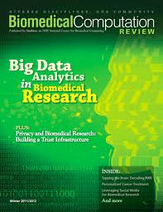
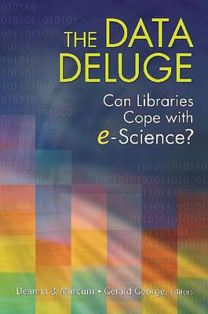
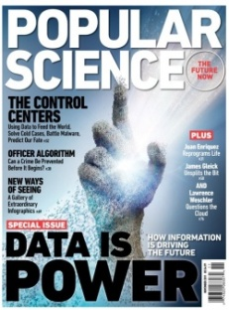
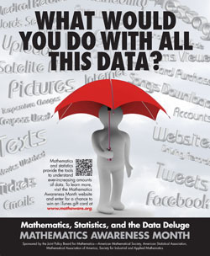
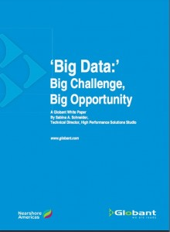
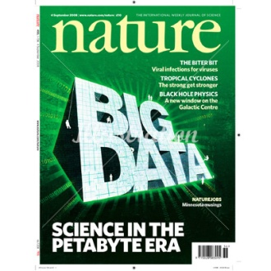
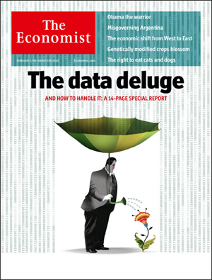
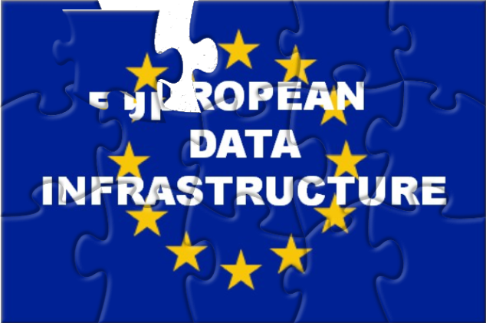
A pan-European e-Infrastructure solution for pan-European RI data Challenges
All Research Infrastructures are facing data challenges
Where to store the growing amount of data?
How to find it?
How to make the most of it?
Many research communities are developing own solutions
This is good…
… but we also need to make sure that the solutions remain interoperable
EUDAT mission is to fill this gap
Providing a set of services to help RIs managing their growing amount of data
Providing these services across communities to ensure maximum level of interoperability
Closer integration of data and computing (HPC centres core partners)

Slide 5
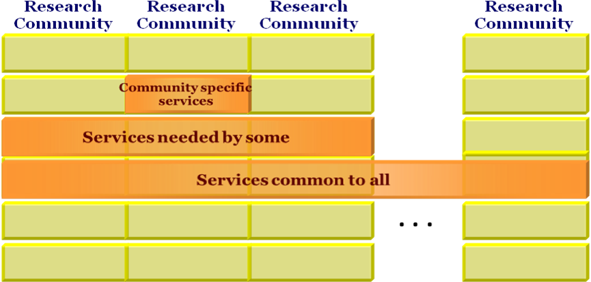
Promoting synergies
The worst case scenario: 500 RI with 500 incompatible self-made ICT and data management solutions
What can we do to promote collaboration and re-use of eInfrastructures?
EVERY RI NEEDS TO DEAL
WITH DATA MANAGEMENT

Slide 6
EUDAT2020 - 33 Partners

Slide 8
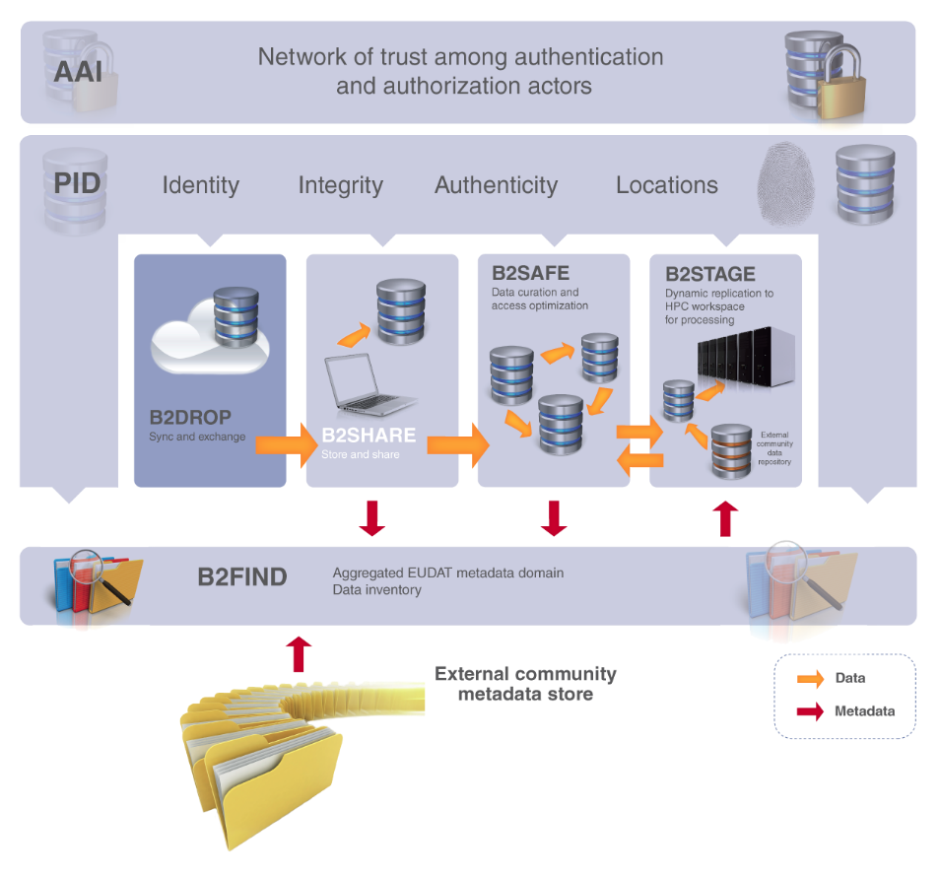
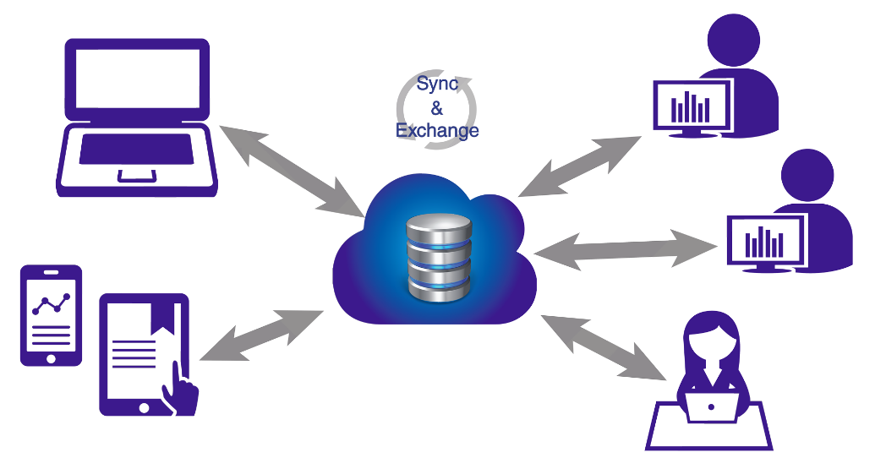
B2DROP is a secure and trusted data exchange service for researchers and scientists to keep their research data synchronized and up-to-date and to exchange with other researchers.
An ideal solution to:
b2drop.eudat.eu
Store and exchange data with colleagues and team
Synchronize multiple versions of data
Ensure automatic desktop synchronization of large files
8

Slide 10
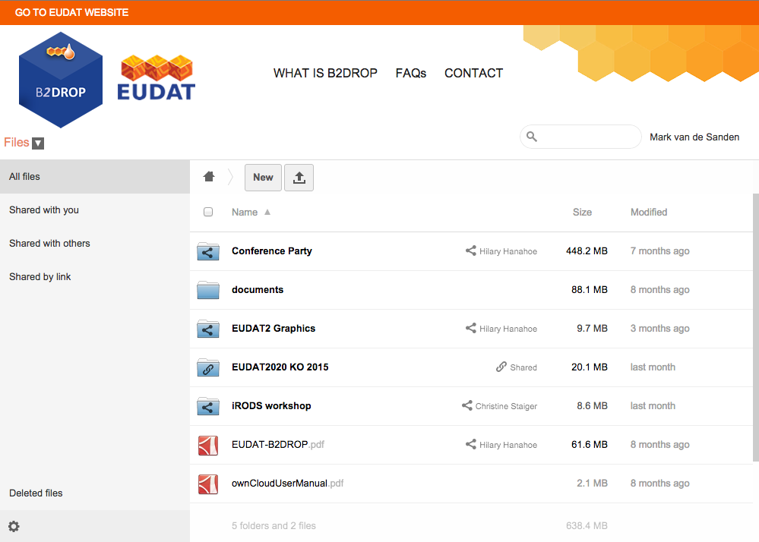

Slide 11
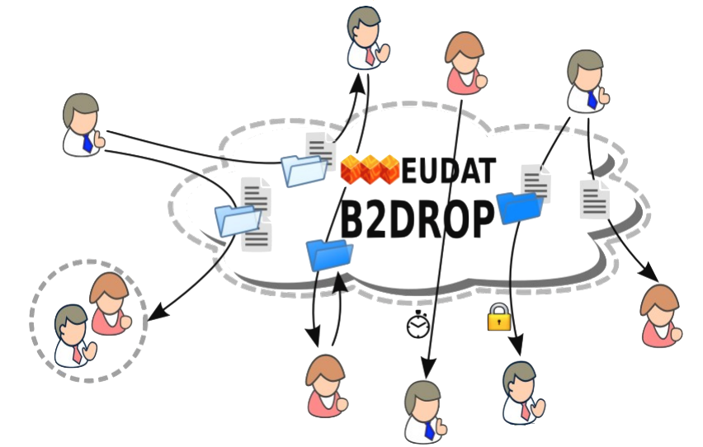
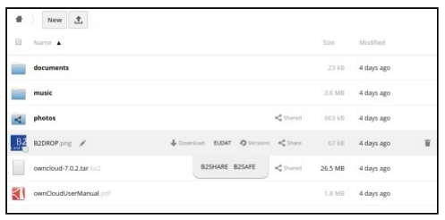
Based on ownCloud, open source (GNU AGPLv3)
access and manage permissions to files from any device and any location, via browser, desktop, mobile apps and WebDAV
up to 20GB of storage space for research data
simple to use and open to all researchers, scientists (e.g. self-registration)
synchronize and exchange data with one or multiple users
users decide with whom to exchange data, for how long and how
EUDAT2020
Further integration with EUDAT CDI (e.g. B2SHARE)
Integration with EUDAT Federated AAI, access via eduGAIN
Federation with community, institutional, regional and national instances
Assess B2DROP as workspace area to computing facilities
11

Slide 12
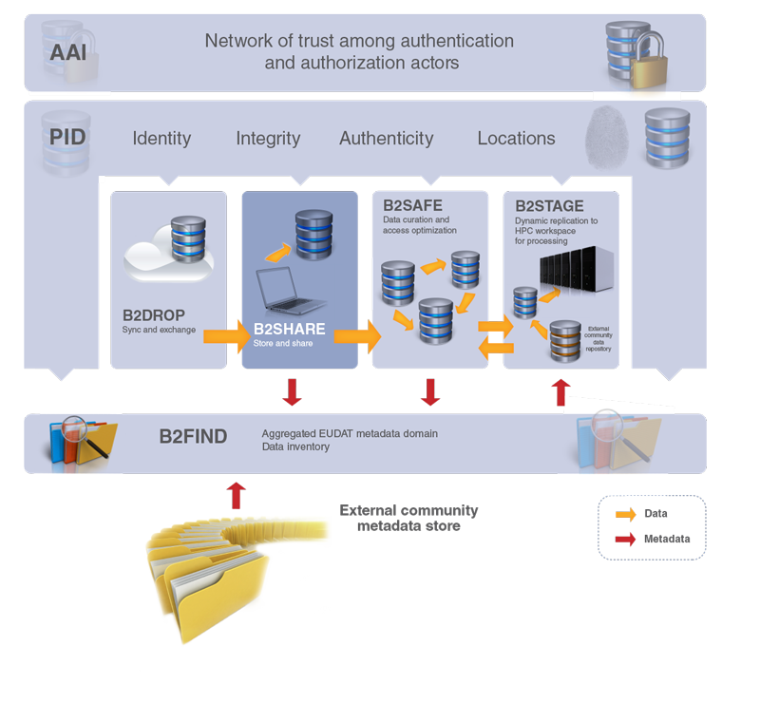
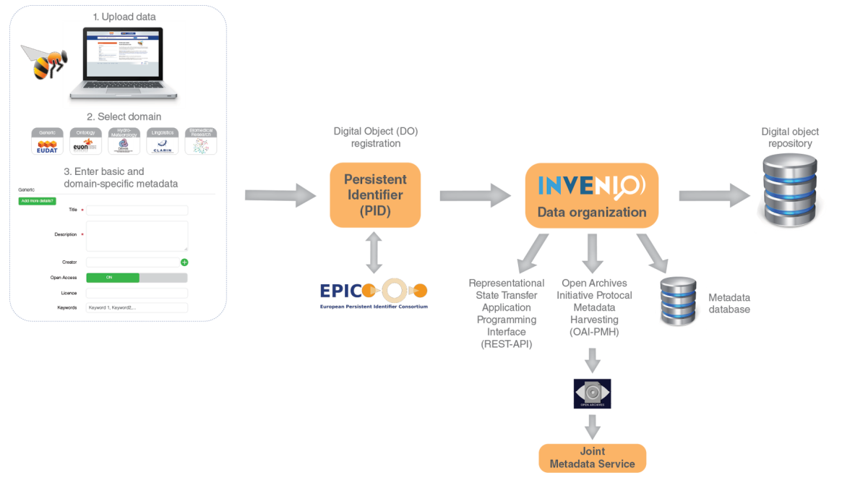
B2SHARE is a user-friendly, reliable and trustworthy way for researchers, scientific communities and citizen scientists to store and share small-scale research data from diverse contexts.
A winning solution to:
b2share.eudat.eu
Store: facilitates research data storage
Preserve: guarantees long-term persistence of data
Share: allows data, results or ideas to be shared worldwide
12

Slide 13
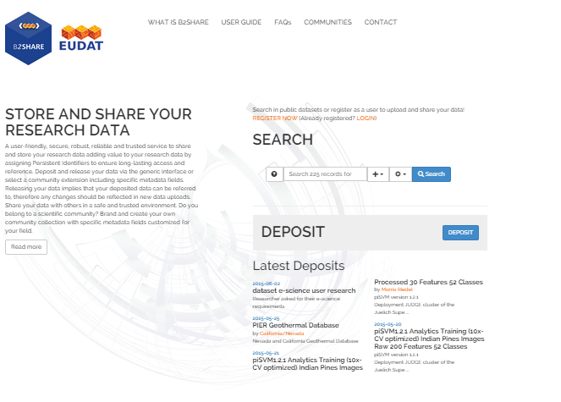

Slide 14
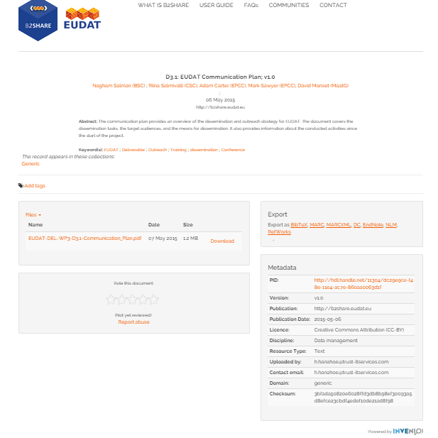
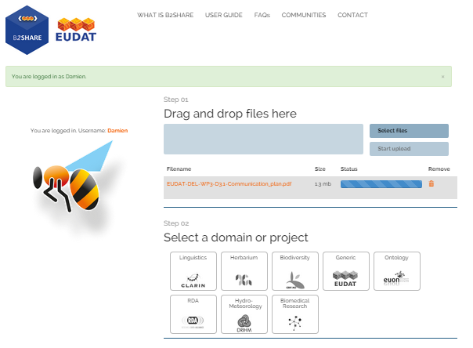
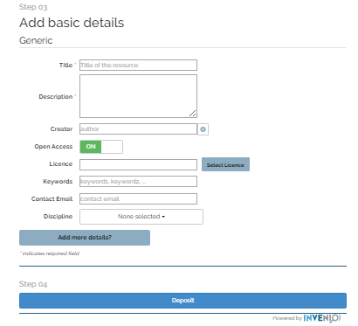

Slide 15
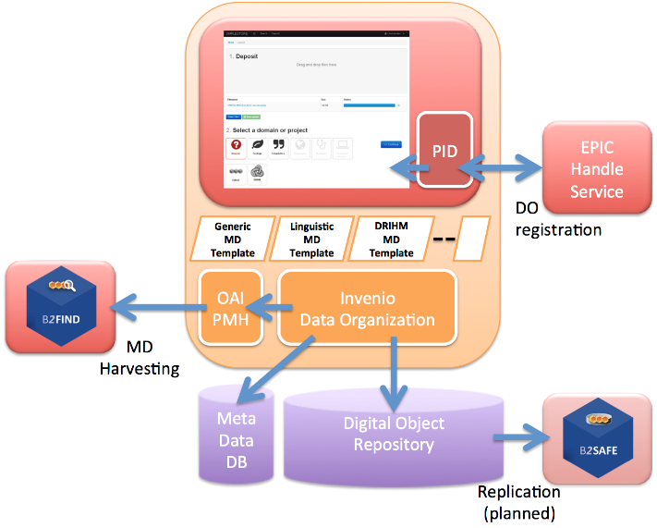
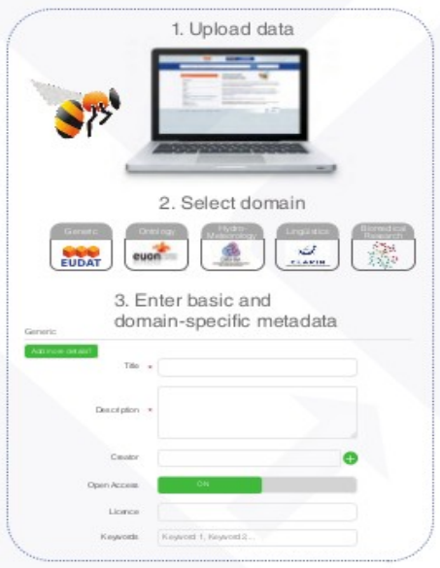
Based on Invenio, open source (GPL v3)
Supports 8 community-metadata templates
Data assigned a persistent identifier and a checksum
Access via a HTTP Rest API
Open accessible, user self-registration
Data owner defines access policy
Open access license choose feature
Discipline choose feature
Open harvestable metadata, harvested by B2FIND
EUDAT2020
Further integration with EUDAT CDI (e.g. B2SAFE)
Integration with EUDAT Federated AAI, focus on authorization
Access via eduGAIN
Data versioning
Extended HTTP Restful API interface
Easy installable software package
15

Slide 16
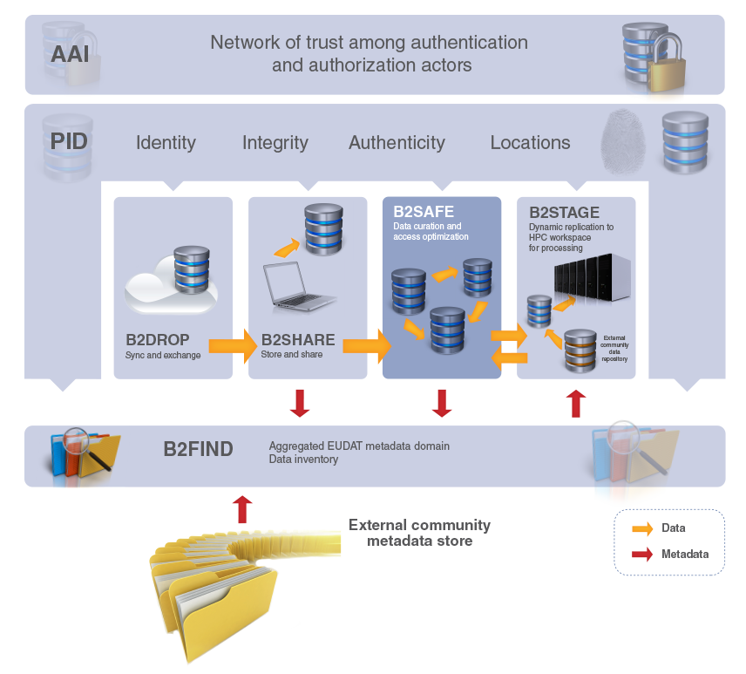
B2SAFE is a robust, safe and highly available service which allows community and departmental repositories to implement data management policies on their research data across multiple administrative domains in a trustworthy manner.
A solution to:
eudat.eu/b2safe
Provide an abstraction layer which virtualizes large-scale data resources
Guard against data loss in long-term archiving and preservation
Optimize access for users from different regions
Bring data closer to powerful computers for compute-intensive analysis
16

Slide 17
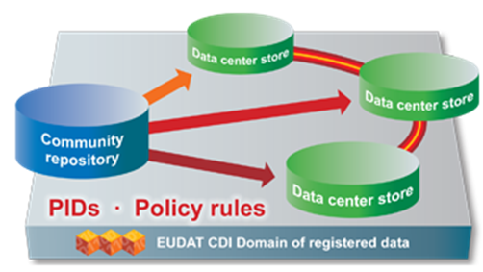
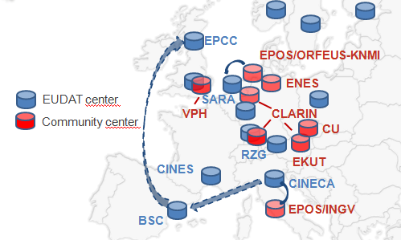
B2SAFE core
Based on iRODS, open source (BSD license)
able to aggregate data from different disciplines into a storage system of trustworthy and capable data service providers
Provide an abstraction layer which virtualizes large-scale data resources
Supports data replication and data integrity policies
EUDAT2020
Support iRODS v4
Support metadata
Optimize and extend policies to support data curation and provenance
Further integration with EUDAT Federated AAI
Support authorization on basis of community access rules
Assess B2SAFE as workspace area to computing facilities
17

Slide 18
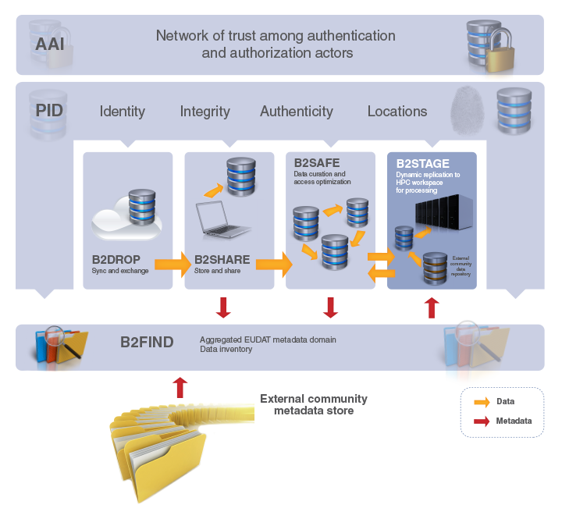
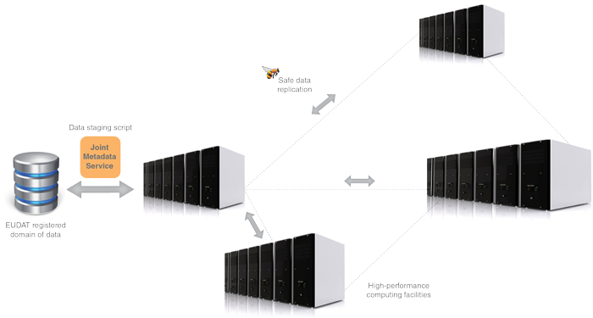
B2STAGE is a reliable, efficient, light-weight and easy-to-use service to transfer research data sets between EUDAT storage resources and high-performance computing (HPC) workspaces.
The service allows users to:
eudat.eu/b2stage
Transfer large data collections from EUDAT storage facilities to external HPC facilities for processing
In conjunction with B2SAFE, replicate community data sets, ingesting them onto EUDAT storage resources for long-term preservation
Ingest computation results into the EUDAT infrastructure
18

Slide 19
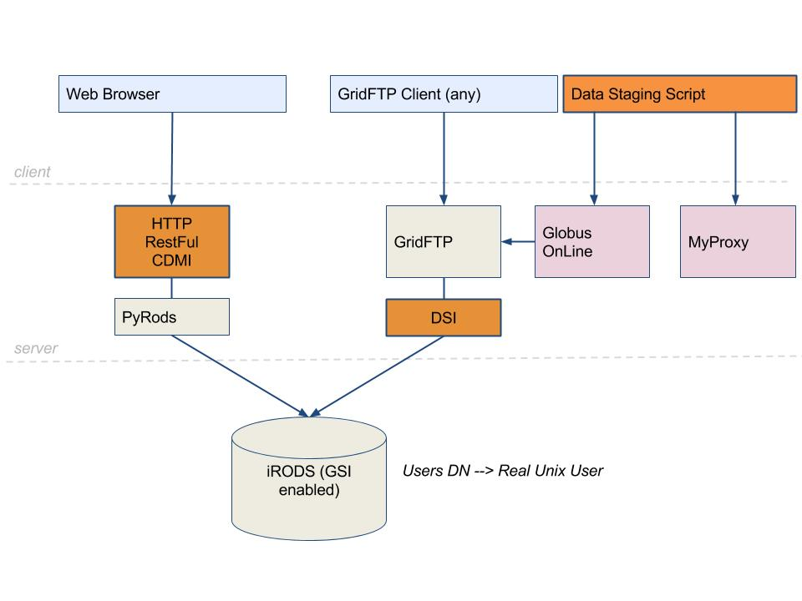
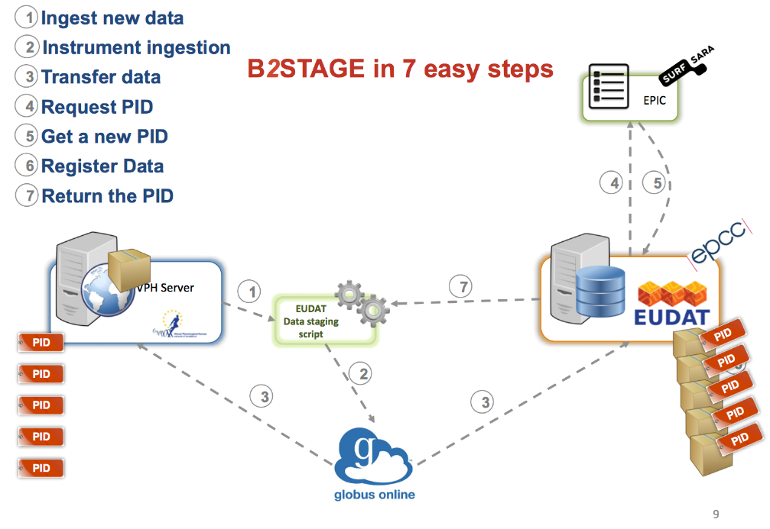
Extension of the B2SAFE and B2FIND services, which allow users to store, preserve and find data
Providing access via GridFTP and basic HTTP
data-staging script facilitates staging, ingestion and retrieval of persistent identifier (PID) information of transferred data
Start development of EUDAT client API library and command line tools
Integrated with EUDAT Federated AAI on basis of X.509 certificates
EUDAT2020
Further develop HTTP to a mature interface and extend functionality to metadata
Native support PIDs within GridFTP transfers
Extend EUDAT client API library to other B2 services (e.g. B2SHARE, B2FIND, PID)
Further integration with EUDAT Federated AAI
19

Slide 20
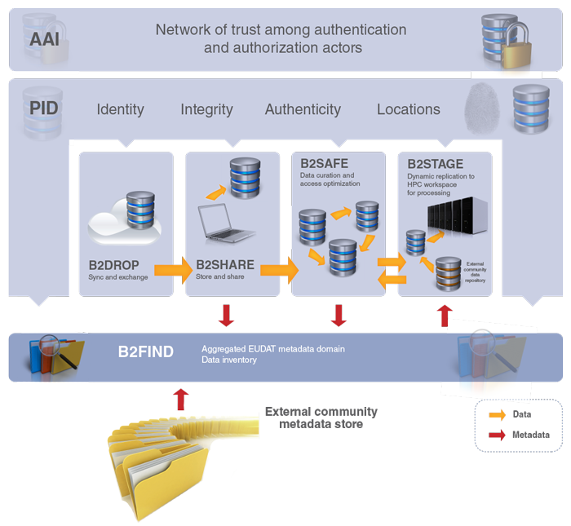
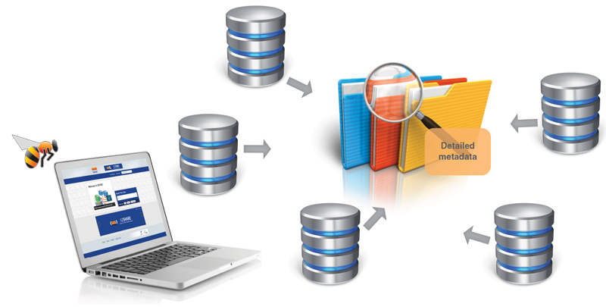
B2FIND is a simple, user-friendly metadata catalogue of research data collections stored in EUDAT data centres and other repositories.
A service which allows users to:
b2find.eudat.eu
Find collections of scientific data quickly and easily, irrespective of their origin, discipline or community
Get quick overviews of available data
Browse through collections using standardized facets
EUDAT Final Review, 21st May 2015, Brussels
20

Slide 21
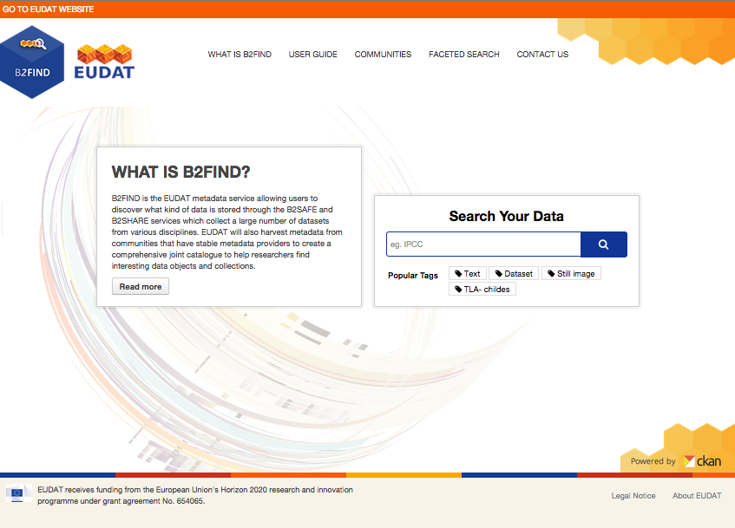

Slide 22
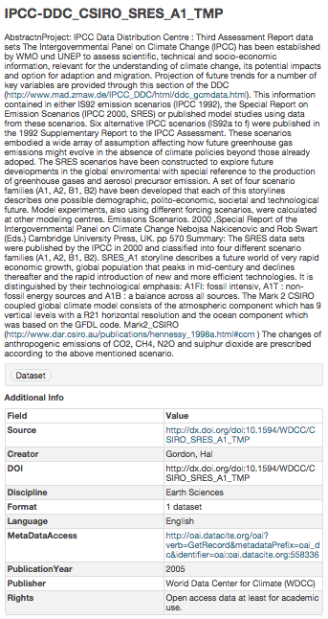

Slide 23
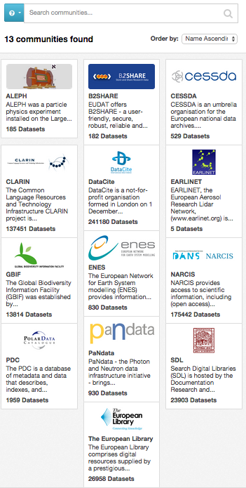
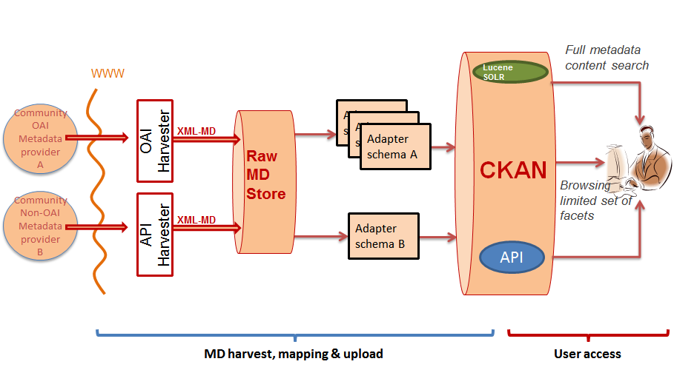
Based on CKAN, open source (GNU AGPL v3)
Facetted search (e.g. 10 facets) and full text search, recently added timeline search
Focus on community recommended metadata
13 community repositories harvested, more lined up
Open accessible, no registration needed
Open harvestable metadata
Searchable via Web-based GUI and HTTP RESTful API
EUDAT2020
Harvesting of metadata stored in B2SAFE
Community customizations
Further assess RDF and Linked Data
Further assess scalability and performance
23

Slide 24
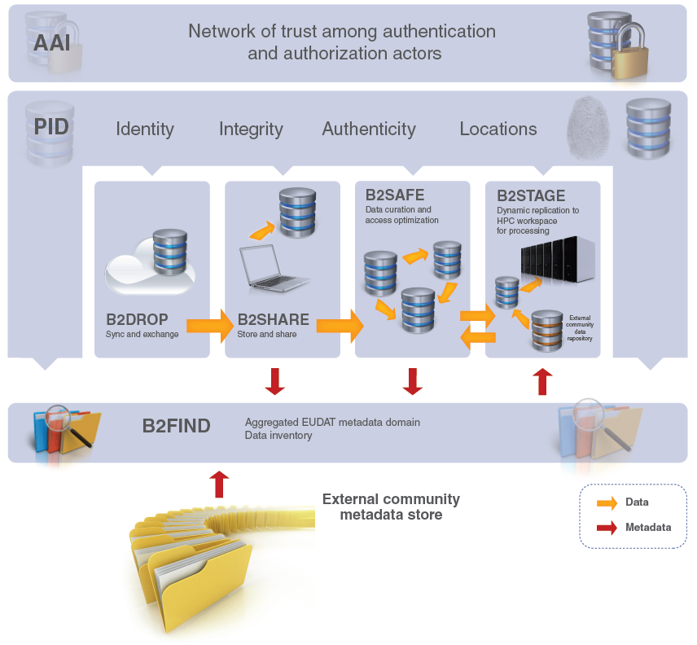
Integrated Suite

Slide 25
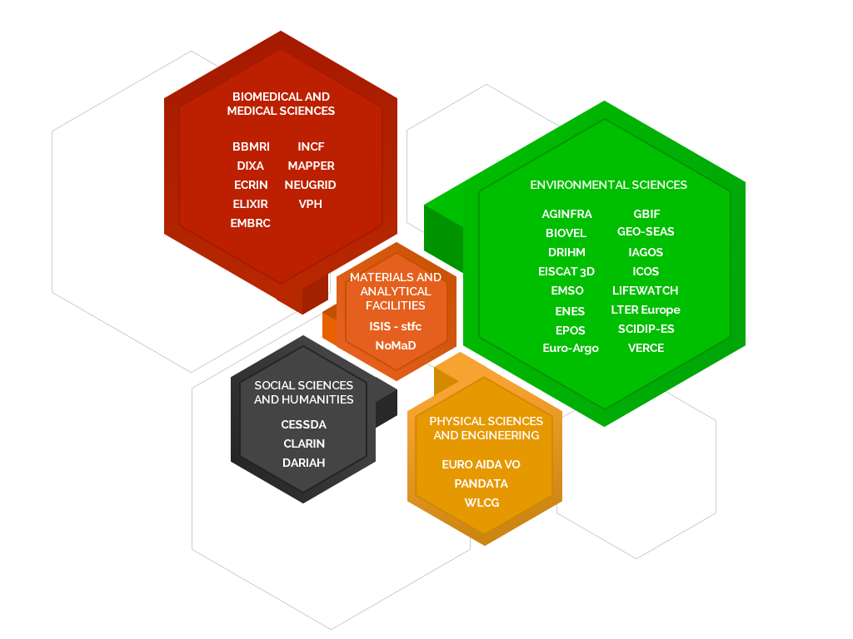
Working with research communities
EUDAT interacts / serves 32 scientific communities.
Target is 50!

Slide 26
EUDAT Call for Data Pilots
15 May – 30 Sept 2015
https://eudat.eu/eudat-call-data-pilots

Slide 27
Using or Joining: You Choose!
Using EUDAT services: finding and accessing data, for instance, or storing smaller data sets by interacting with one of the CDI public front-end services
vs
Joining the CDI: implies a tighter integration with at least one of the EUDAT centre → partnership between legal entities relying on OLAs and SLAs
Generic data
centres
Community
data sites

Slide 28
Data Management & Open ACCEss in the CDI

Slide 29
Data Management Planning (DMP)
DMPs are increasingly required as part of grant applications (e.g. European Commission H2020 grants) but are useful whenever you are creating data.
A DMP is a brief plan written at the start of your project to define:
How you data will be created
How it will be documented
Who will access it?
Where it will be stored
Who will back it up?
Whether (and how) it will be shared & preserved?

Slide 30
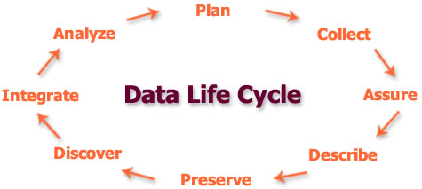
Research Data Lifecycle
"Research data management concerns the organisation of data, from its entry to the research cycle through to the dissemination and archiving of valuable results. It aims to ensure reliable verification of results, and permits new and innovative research built on existing information”
Whyte, A., Tedds, J. (2011). ‘Making the Case for Research Data Management’. DCC Briefing Papers.
DataONE data lifecycle

Slide 31
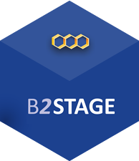
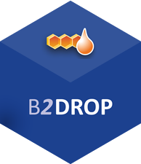
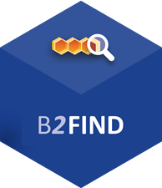
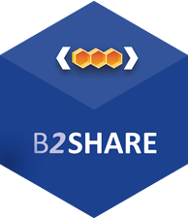
EUDAT & the DLC

Slide 32
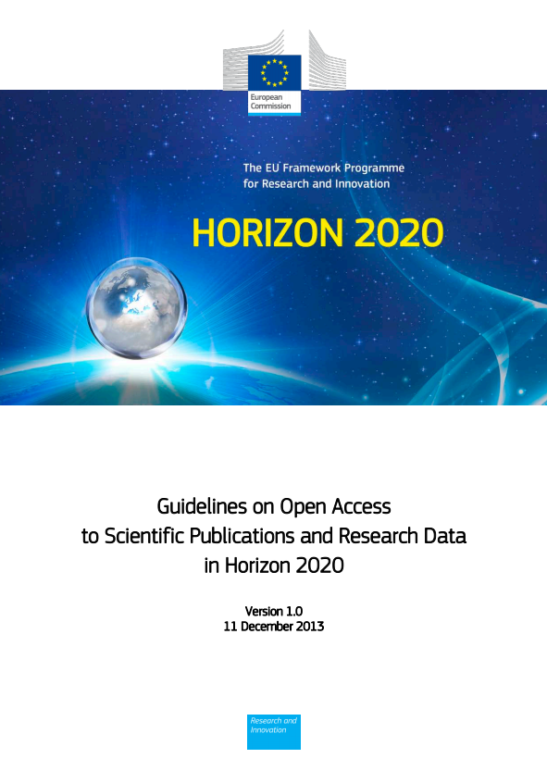
Why open access and open data?
“The European Commission’s vision is that information already paid for by the public purse should not be paid for again each time it is accessed or used, and that it should benefit European companies and citizens to the full.”
http://ec.europa.eu/research/participants/data/ ref/h2020/grants_manual/hi/oa_pilot/h2020-hi-oa-pilot-guide_en.pdf
Notes:
The background to this is about making the most of the data that has been created through publicly funded research. The guidelines speak of:
Improved quality of results
Greater efficiency
Faster to market = faster growth
Improved transparency of the scientific process
32

Slide 33
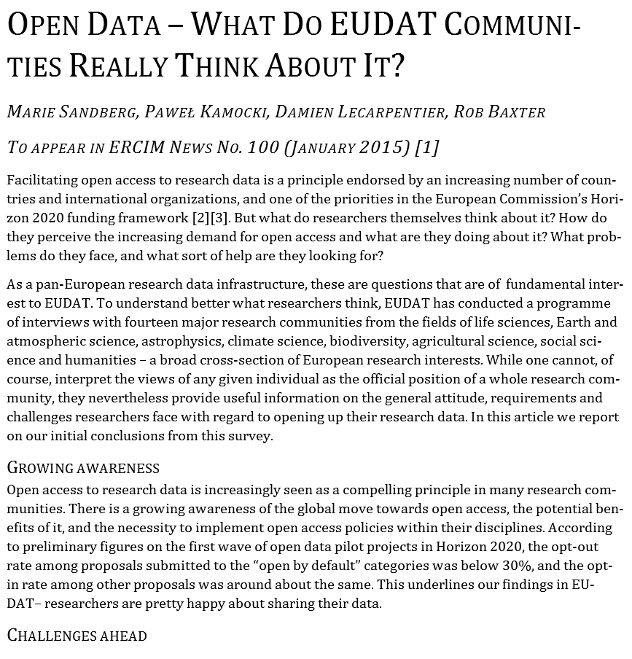
EUDAT & Open Access
Open Access?
Funders: “Yes, absolutely!”
Researchers: “Yes, but…”
Some data is “sensitive”
What about credit and merit?
How to find one’s way in the legal minefield?
What role for e-Infrastructure and service providers?
Providing tools and services to handle sensitive data
Licensing guidance, PIDs and usage statistics
Training, training, training

Slide 34
EUDAT & Open Access
EUDAT Policy on OA (an attempt):
1. All data in the CDI should, in time, become full open access. Open access is the norm for CDI data;
2. Embargo periods for original producers are fully supported, on condition that such data become openly accessible when the embargo period expires.

Slide 35
B2 Services & Open Access
B2DROP– No (definitely not!)
But enables sharing and reuse
B2SHARE – Yes (ideally)
Open is default but users can still restrict access
Licence wizard
B2SAFE – Yes (arguably)
At least metadata
Fine-grained authorisation
B2FIND – Yes (metadata)

Slide 36
Moving Forward - 2020

Slide 37
Make it easier for the researcher!
E-Infrastructure integration
Network
Data
Computing
Global solutions
Research Data Alliance (RDA)
Cross-country collaboration

Slide 38
Thank you! Questions?

