Slide 1
Data Preservation
Danah Tonne
Notes:
Prof. Dr. Max Mustermann | Name of Faculty
1

Slide 2
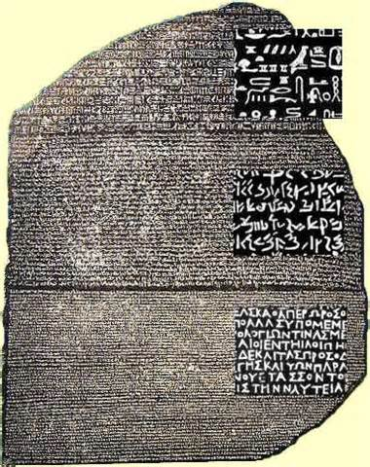
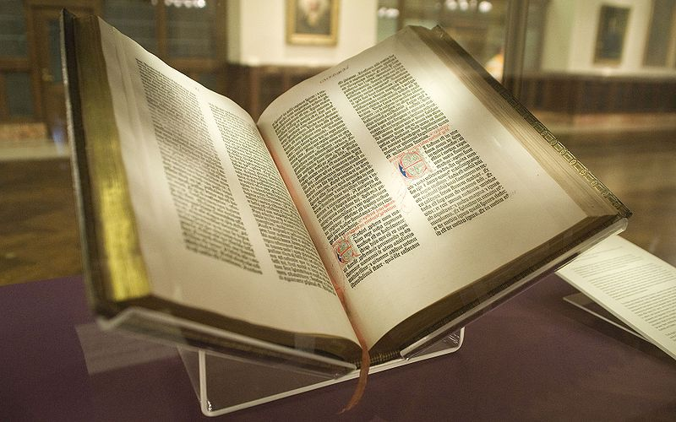
Analog Preservation
The Rosetta Stone in the British Museum. © Hans Hillewaert / CC-BY-SA-4.0
https://de.wikipedia.org/wiki/Datei:Rosetta_Stone.JPG
The Gutenberg Bible. Photo taken by NYC Wanderer (Kevin Eng), May 2009; https://de.wikipedia.org/wiki/Datei:Gutenberg_Bible,_Lenox_Copy,_New_York_Public_Library,_2009._Pic_01.jpg

Slide 3
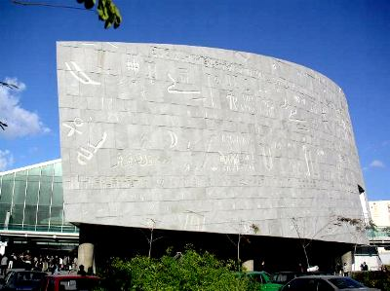
Why Do We Need Preservation?

Slide 4
Why Do We Need Preservation?
Bibliotheca Alexandrina
Once one of the largest and most significant libraries in the ancient world
More than 1,000,000 scrolls
Several fires and acts of destruction
Symbol of irretrievable loss of public knowledge
Exterior photo of the Bibliotheca Alexandrina library in Alexandria, Egypt.'''
Photo taken by Hajor, December 2002. Released under ccc-by-sa and/or GFDL.
https://de.wikipedia.org/wiki/Datei:Egypt.Alexandria.BibliothecaAlexandrina.01.jpg

Slide 5
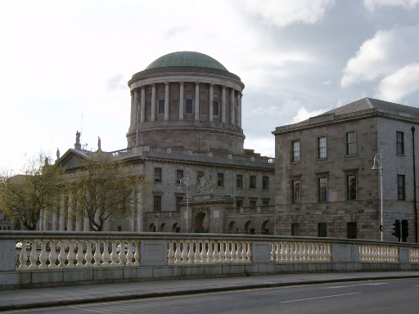
Why Do We Need Preservation?

Slide 6
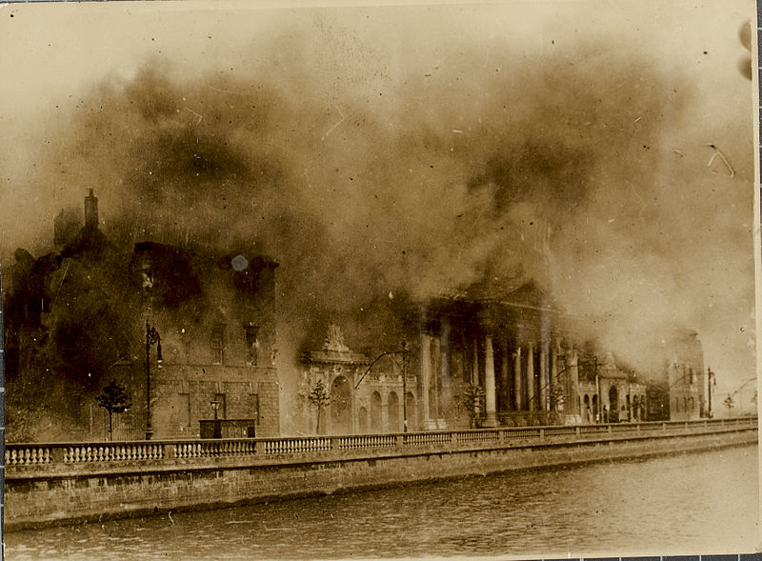
Why Do We Need Preservation?
Dublin‘s Four Courts
Ireland‘s main court building
June 1922: Explosion of the west wing
Destruction of the Public Record Office (hundreds of years of Irish history)

Slide 7
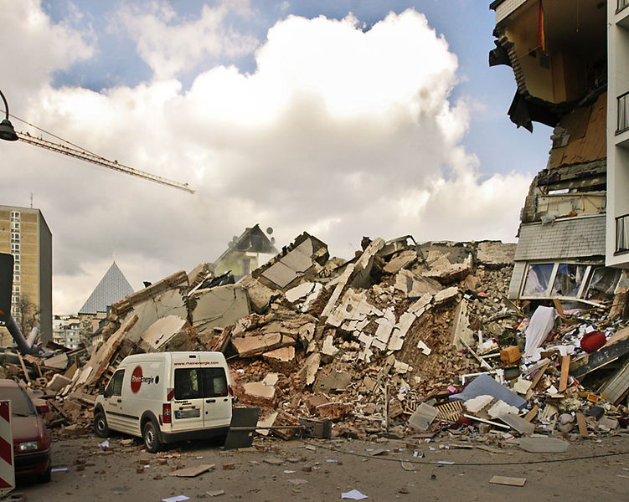
Why Do We Need Preservation?

Slide 8
Why Do We Need Preservation?
Historical Archive of the City of Cologne
March 2009: Collapse due to subway construction
90% of archival records buried by collapse
Restauration: 50 years + 400,000,000 €
Exterior photo after the collapse of the Historical Archive.
Photo taken by Frank Domahs, 3rd March 2009.
https://de.wikipedia.org/wiki/Datei:The_destroyed_sixstory_cologne_city_archive.jpg

Slide 9
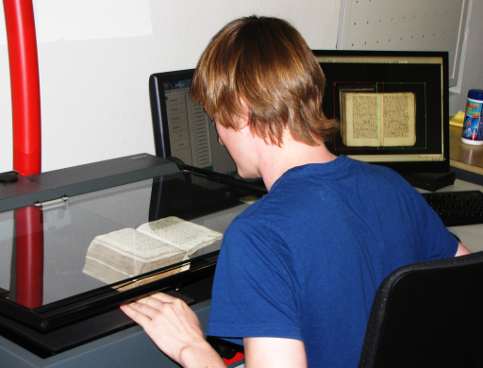
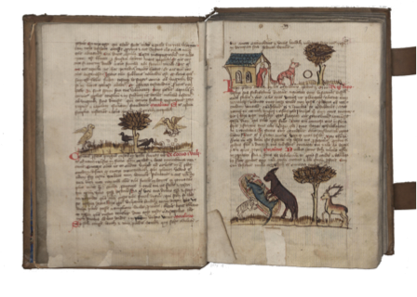
Digitization Projects
Public Library and Archive of Trier
Ms 1108/55 4° 6v and 7r
Transformation of analog material into the digital world
Recommended process guidelines
Enhanced access possibilities for scholars

Slide 10
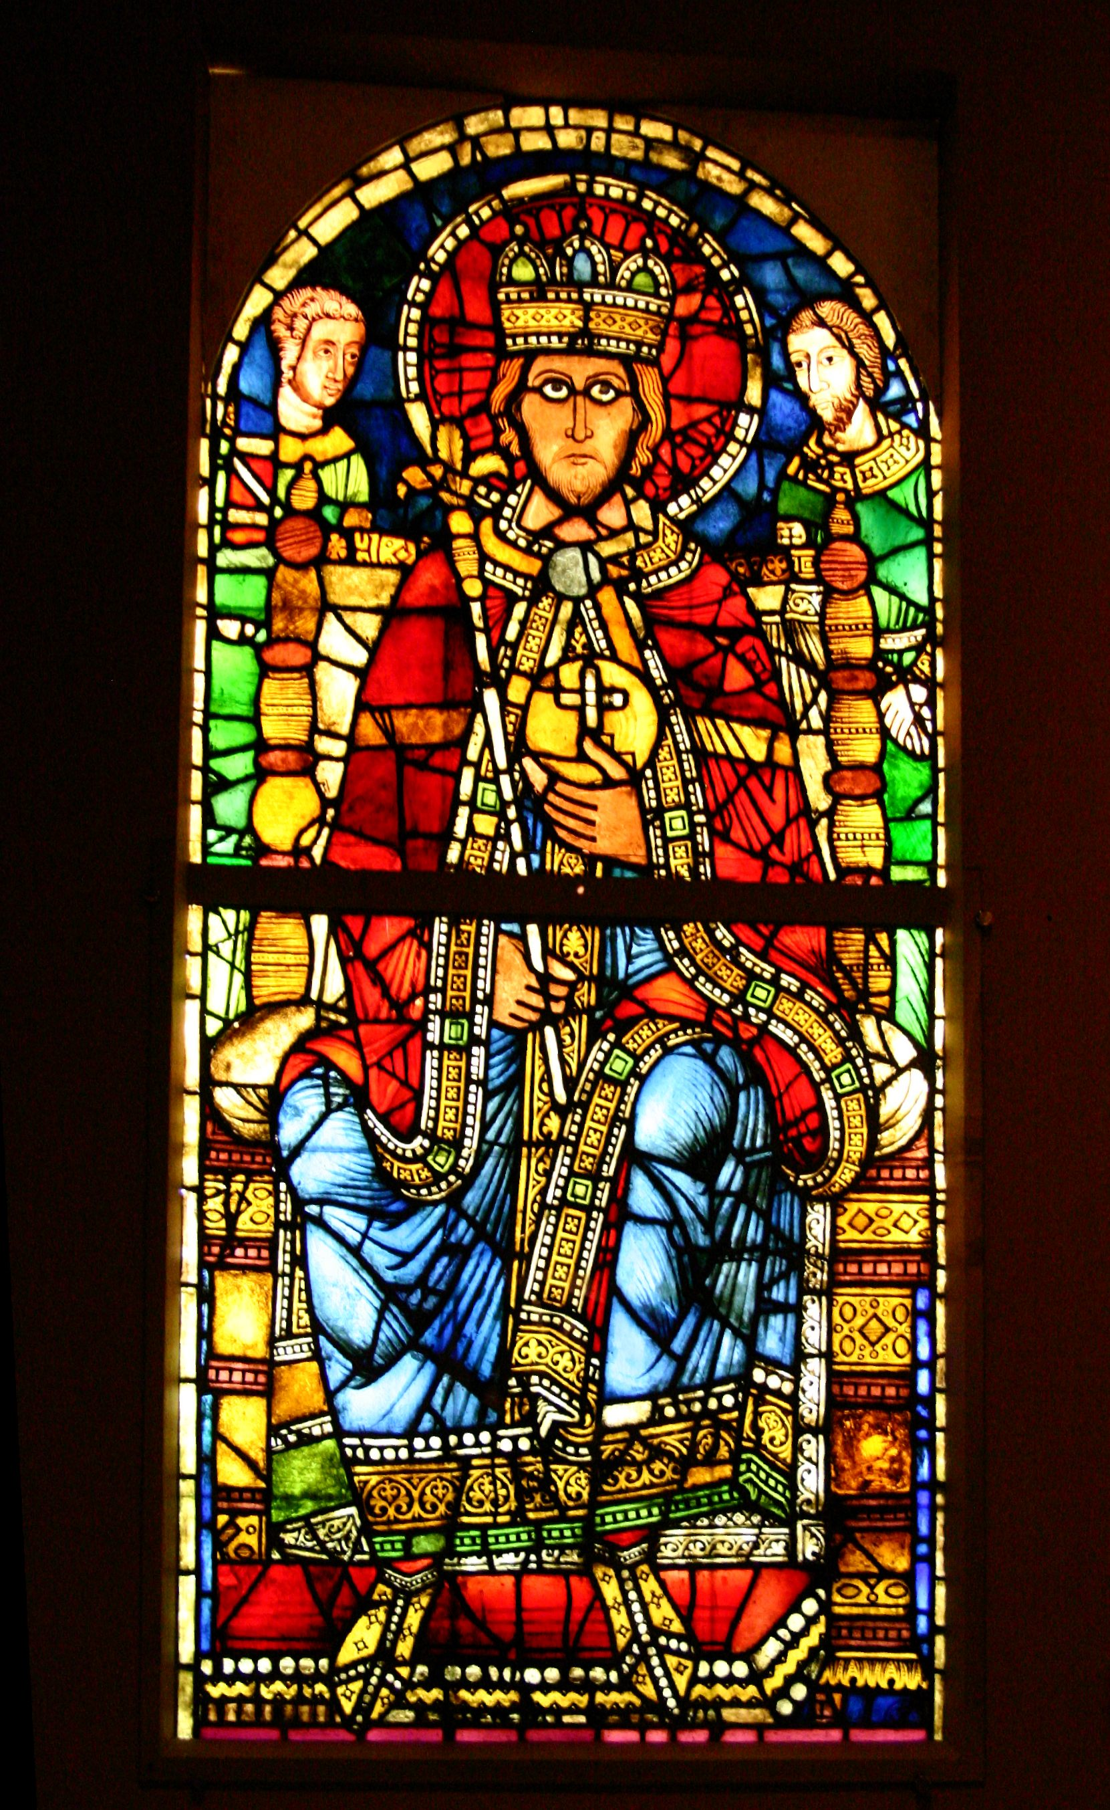
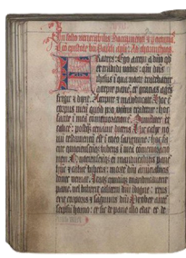
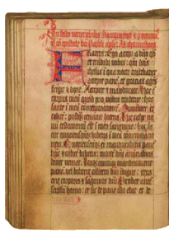
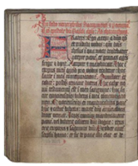
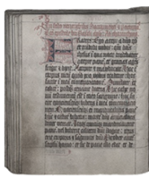
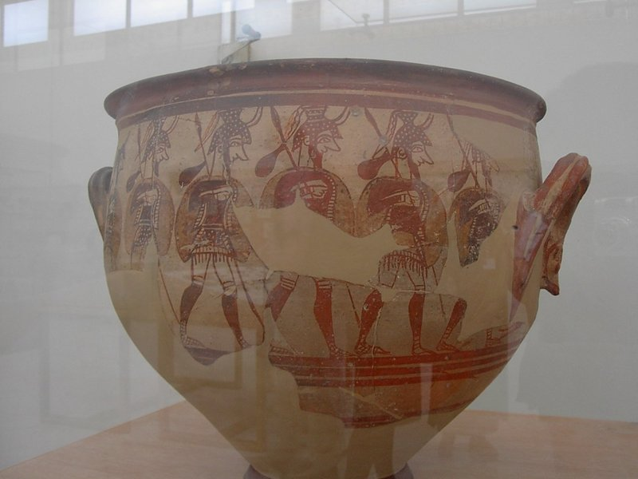
Digitization Projects – Exemplary Drawbacks
Scanner 1
Musée de l'Œuvre Notre-Dame de Strasbourg, © Rama
https://de.wikipedia.org/wiki/Datei:Musee-de-l-Oeuvre-Notre-Dame-Strasbourg-IMG_1465.jpg
M1
Scanned Image
?
Scanner 2
M1
Scanned Image
Preprocessing for comparability needed
Strategies for complex objects needed, haptics
Enhanced technologies result in re-digitization
Greek ancient vase. Athens, National Archaeological Museum. Photo by Adam Carr. https://de.wikipedia.org/wiki/Datei:Greec_ancient_vase.jpg

Slide 11
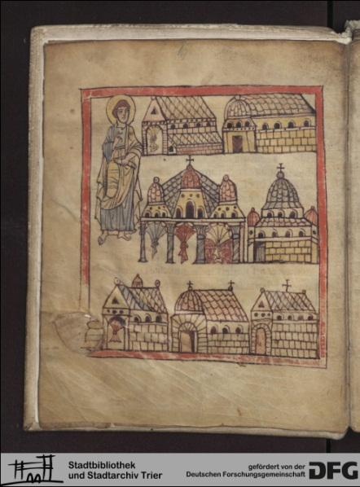
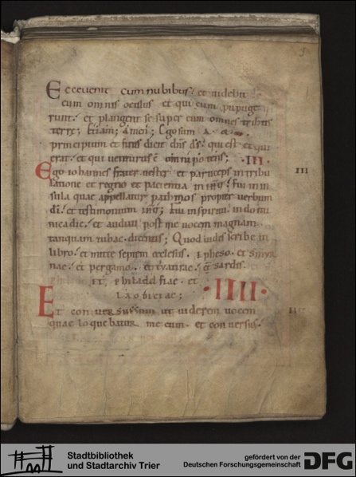
Examples of Research Endeavors
Scope: digital reconstruction of the library of the Benedictine abbey St. Matthias, Trier
Digitization of over 440 codices (8th – 16th century)
170,000 digitized codex pages
1,000,000 files in various formats
~ 5 Terabyte total volume
Online available: http://stmatthias.uni-trier.de
DFG-Viewer: http://dfg-viewer.de/show/?tx_dlf[page]=8&tx_
dlf[id]=http%3A%2F%2Fzimks68.uni-trier.de%2Fstmatthias%2FT0031 %2FT0031-digitalisat.xml&tx_dlf[double]=1&cHash=
897b41811c6581c4fc35ff161e52051f

Slide 12
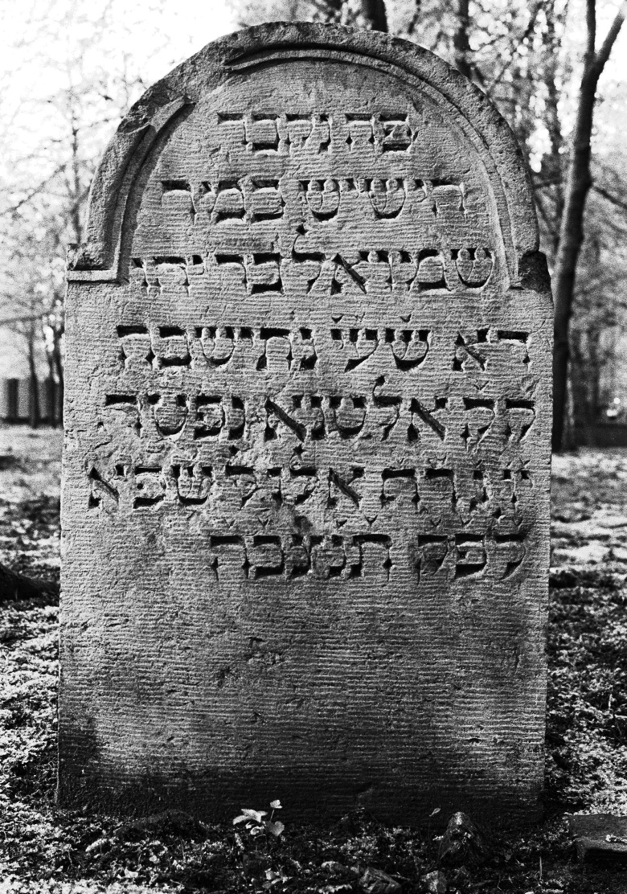
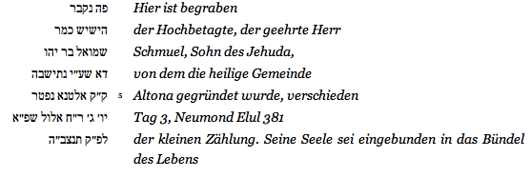
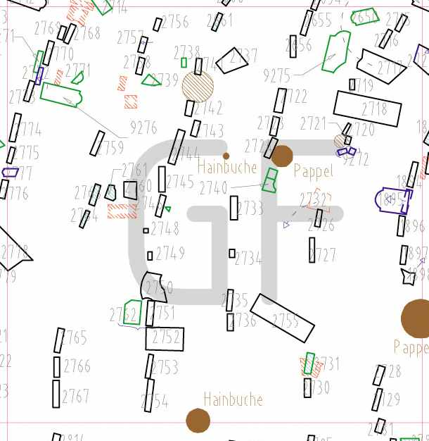
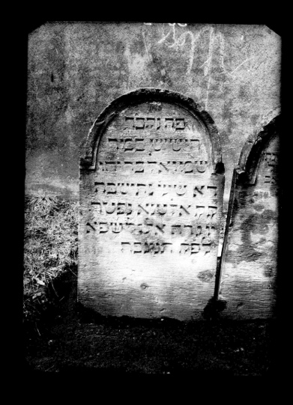
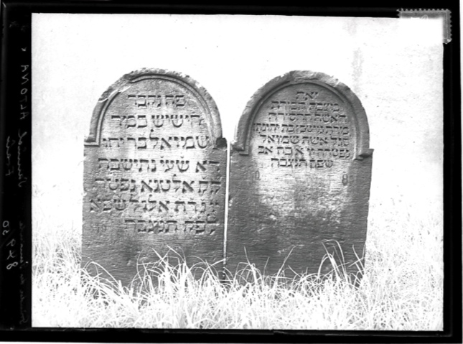
Examples of Research Endeavors
Digitale Edition - Jüdischer Friedhof Hamburg-Altona, Königstraße (1621-1871 / 5988 Einträge): Inv.-Nr. 3361
URL: http://www.steinheim-institut.de/cgi-bin/epidat?function=Ins&sel=hha&inv=3361 (2013-02-21)

Slide 13
What is Preservation?
Preservation: Series of managed activities to ensure continued access
to digital materials for as long as necessary

Slide 14
What is Preservation?
Preservation: Series of managed activities to ensure continued access
to digital materials for as long as necessary
Data Curation - Interpretability
Creation
Object management
Content Preservation - Readability
Versioning + provenance
Data formats
Integrity preservation (checks, error correction codes)
Replication
Bit Preservation
http://www.wissgrid.de/publikationen/deliverables/wp3/WissGrid-D3.1-LZA-Architektur-v1.1.pdf

Slide 15
Preservation Requirements
Digitale Edition - Jüdischer Friedhof Hamburg-Altona, Königstraße (1621-1871 / 5988 Einträge): Inv.-Nr. 3361
URL: http://www.steinheim-institut.de/cgi-bin/epidat?function=Ins&sel=hha&inv=3361 (2013-02-21)
Public Library and Archive of Trier
Ms 1108/55 4° 6v and 7r
Millions of image files + rich (bibliographic) meta data
Arrangement into a virtual codex
Need: transcription + vocabularies
Variety of materials
Access to (ancient) maps
Need: transcription + vocabularies
The Rosetta Stone in the British Museum. © Hans Hillewaert / CC-BY-SA-4.0
https://de.wikipedia.org/wiki/Datei:Rosetta_Stone.JPG

Slide 16
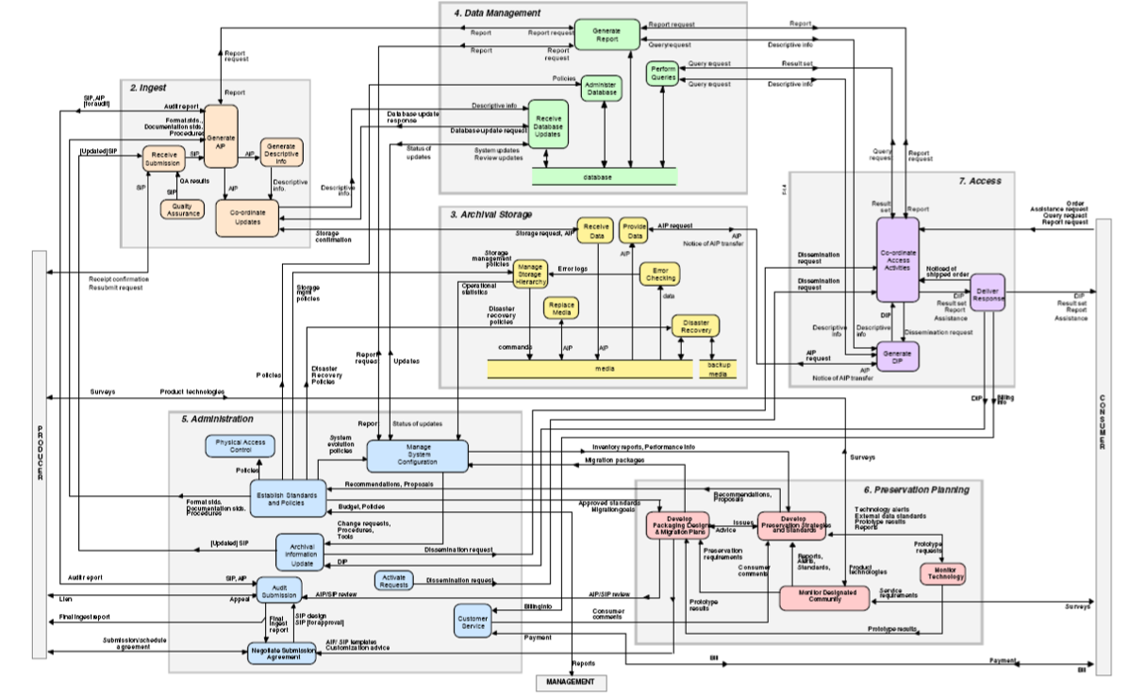
OAIS Reference Model
Stephan Strodl, Andreas Rauber: Digital Preservation, OAIS Reference Model, http://www.ifs.tuwien.ac.at/~strodl/lecture/03_dp_OAIS.pdf
CCSDS Magenta Book: Reference Model for an Open Archival Information System (OAIS), http://public.ccsds.org/publications/archive/650x0m2.pdf

Slide 17
OAIS Reference Model
Stephan Strodl, Andreas Rauber: Digital Preservation, OAIS Reference Model, http://www.ifs.tuwien.ac.at/~strodl/lecture/03_dp_OAIS.pdf
CCSDS Magenta Book: Reference Model for an Open Archival Information System (OAIS), http://public.ccsds.org/publications/archive/650x0m2.pdf

Slide 18
Vulnerabilities + Threats to Preservation
Vulnerabilities | Process | Software faults Software obsolescence
 | Data | Media faults Media obsolescence
 | Infrastructure | Hardware faults Hardware obsolescence Communication faults Network service failures
Threats | Disasters | Natural disasters Human operational errors
 | Attacks | Internal attacks External attacks
 | Management | Economic failures Organizational failures
 | Legislation | Legislative changes Legal requirements
José Barateiro, Gonçalo Antunes, Filipe Freitas und José Borbinha: Designing digital preservation solutions: A risk management-based approach. International Journal of Digital Curation, 5(1): pages 4–17, 2010.

Slide 19
Content Preservation Mechanisms
The University of Southern California neurobiologists couldn't read magnetic tapes from the 1976 Viking landings on Mars. With the data in an unknown format, he had to track down printouts and hire students to retype everything.
"All the programmers had died or left NASA," Miller said. "It was hopeless to try to go back to the original tapes.“ Coming Soon: A Digital Dark Age?. 2013. http://www.cbsnews.com/news/coming-soon-a-digital-dark-age/

Slide 20
Content Preservation Mechanisms
The University of Southern California neurobiologists couldn't read magnetic tapes from the 1976 Viking landings on Mars. With the data in an unknown format, he had to track down printouts and hire students to retype everything.
"All the programmers had died or left NASA," Miller said. "It was hopeless to try to go back to the original tapes.“ Coming Soon: A Digital Dark Age?. 2013. http://www.cbsnews.com/news/coming-soon-a-digital-dark-age/
(Format) Migration
Copying data from one hardware to another
Conversion of obsolete formats
Drawback: resource-intensive, information loss
Emulation
Mock-up of obsolete operating systems / environments
Drawback: resource-intensive, knowledge needed
Persistent Identifiers
Sustainable referenceability of research data (e.g. handles, DOI, ARK)

Slide 21
Bit Preservation Mechanisms
Public Library and Archive of Trier
Ms 1108/55 4° 6v and 7r
Replication
Creation of an exact copy of the file
Dedicated hardware / software available
Challenges: consistency, costs, access
Possible usage of persistent identifiers

Slide 22
Bit Preservation Mechanisms
Checksum: Meta data to verify data integrity
Errors introduced by transmission or storage
Detection of at least one error, sometimes correction possible
Comparison of multiple calculations
Variety of algorithms with different complexity
Good checksums change significantly
Input | MD5 checksum
‘Bit Preservation’ | 2c8eddf21ed2e7fd1ba35ca176225650
‘Bit preservation’ | dd031dbbbb223d3fd48d092d4cdf8d37

Slide 23
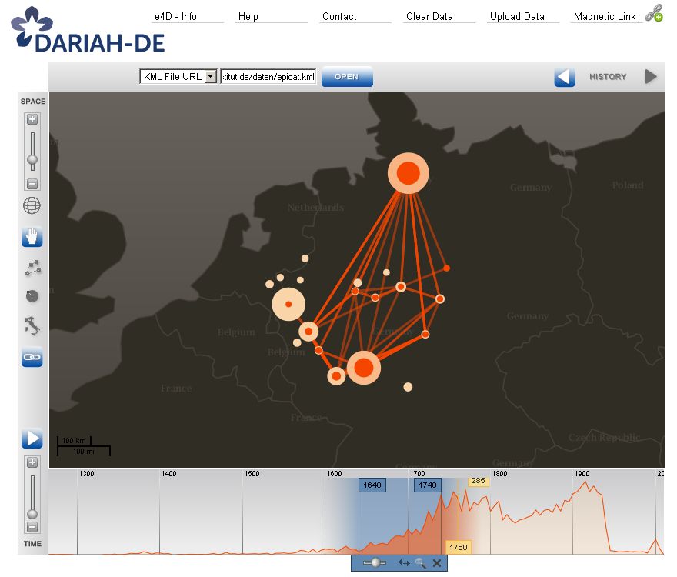
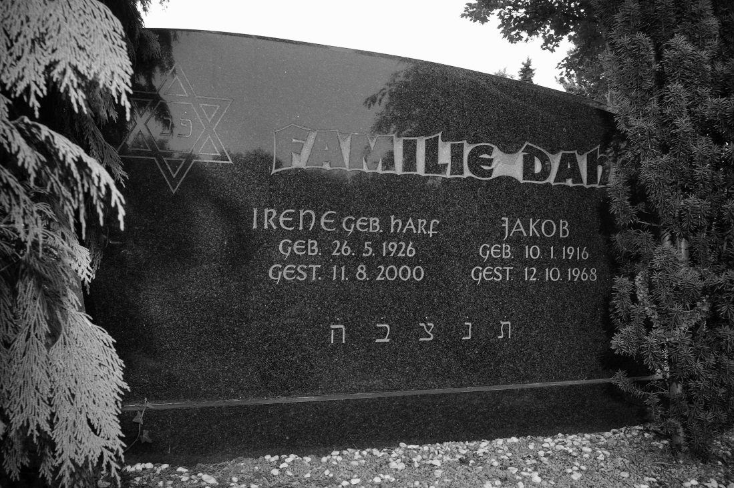
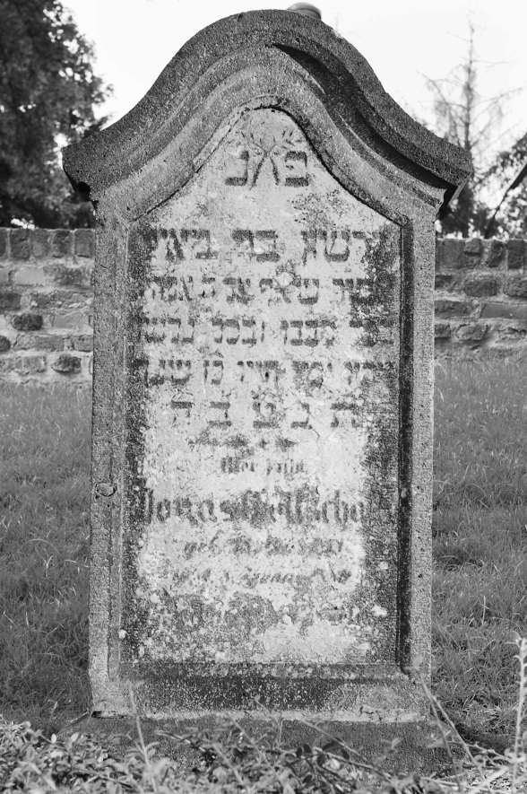
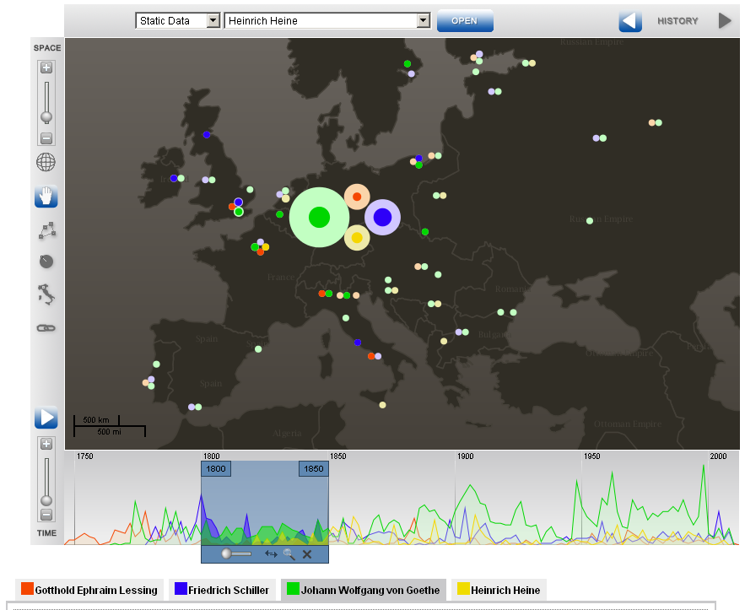
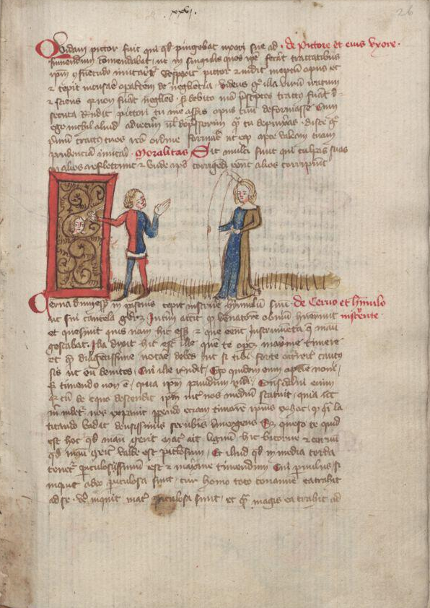
Principles and Challenges for Bit Preservation
The more copies the safer.
The more independent the copies the safer.
The more frequently the copies are audited the safer.
Limited resources for preserving an increasing amount of data in every scientific discipline
Need for reliable metrics to quantify bit preservation architectures
Need for recommendations for fitting bit preservation strategies
Source: Virtual Scriptorium St. Matthias, Epidat, DARIAH-DE Geobrowser
David SH Rosenthal: Bit preservation: a solved problem? International Journal of Digital Curation, 5(1): pages 134–148, 2010.

Slide 24
Reliability Metrics
Reliability: Probability of a correct return of the saved bitstream
Mean Time To Failure (MTTF)
Mean Time To Data Loss (MTTDL)
Unrecoverable Bit Error Rate (UBER)
Bit Half Life
Mean Latent Error Time (MLET)
Normalized Magnitude of Data Loss (NOMDL)
…
Undetectable Error Rate: Probability P_{uError} – a bitstream contains undetected errors despite of actions to ensure data integrity

Slide 25
Probability of Undetected Errors: Checksums
p: probability of a single bit error
n: Number of message bits
k: Number of information bits
 | Length | Probability Undetected Error
Parity Bit | 1
Cyclic Redundancy Check (CRC) | variable
CRC-32 | 32
Fletcher / Adler | 16, 32, 64 / 32
MD5 / SHA-256 | 128 / 256

Slide 26
Classification of Bit Preservation Mechanisms
Detected errors
Low importance
Detected errors
High importance
Status
of errors
Undetected errors
Low importance
Undetected errors
High importance
Importance
of data
Normal Preservation
Enhanced Preservation
Comprehensive Preservation
Based on: vulnerability of data formats – value of data – available
resources – number of files – duration of storage

Slide 27
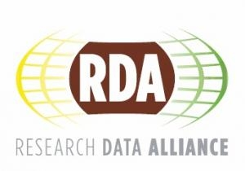
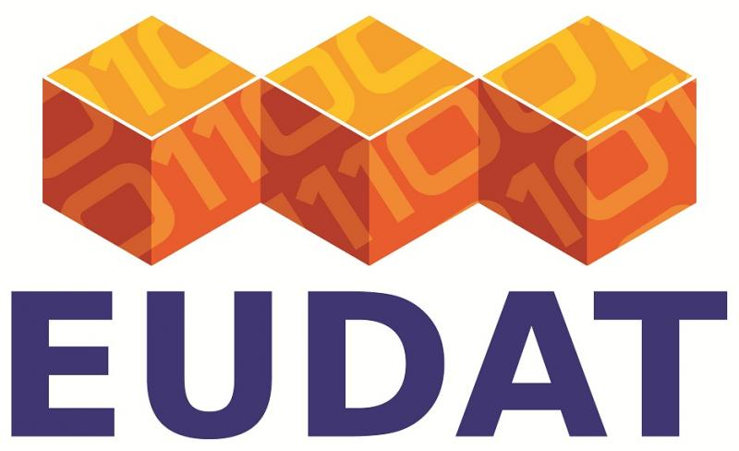
Conclusions
Data Preservation is a complex challenge which can only be solved in collaboration of computer and domain scientists.
Standards need to be agreed on world-wide: no isolated applications but benefit from experiences.
Data Preservation is a dynamic process as well as an active research field.

