Slide 1
Research Data Allience
Why and what
Peter Wittenburg

Slide 2








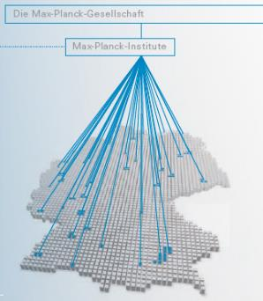

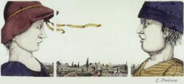

Who am I …
MPI for Psycholinguistics
Understand human language faculty
Experimental orientation
“Data intensive” from the start
Use all kind of parameters externally available
Simulations
Large archive online
MPI
Nijmegen
NL
Leading Methodology and Technology work
MPCDF
Garching
DE
MPCDF
Offer computing & data services to all MPIs
Offer HPC capacity and knowhow
Offer BDA capacity and knowhow
Help in data solutions
RDA, EUDAT, PRACE
Senior Advisor Data Systems

Slide 3
Content
Data Science and Infrastructures
Data Practices
Principles & Trends
RDA
RDA Results &Activities
Data Fabric IG

Slide 4
Research is changing
A few factors
nr. of researchers increases enormously
there is a pressure in the direction of Grand Challenges and those topics relevant for societies
research is increasingly often data intensive
border-crossing research is a fact (countries, disciplines)

Slide 5

Data is in Focus
data is the oil driving research and economy
data is key to understanding big challenges
crowd sourcing
observations
conclusions
store
experiments
simulations
combination
analysis
visualization

Slide 6
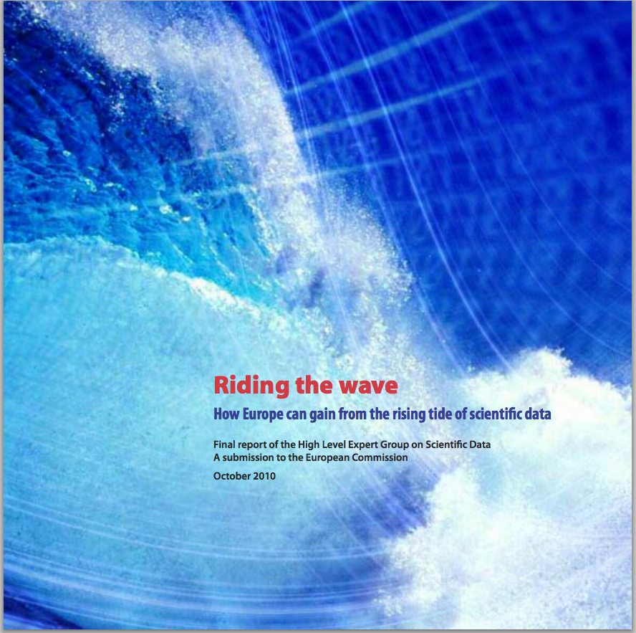
Many Activities at Policy Level
Digital Agenda to unlock the full value of scientific data
Typical report about measures to be taken

Slide 7
Requirements for Data Science
let’s use the G8 formulations – data should be
  searchable -> create useful metadata
  accessible -> deposit in trusted repository and use PIDs
  interpretable -> create metadata, register schema and semantics
  re-usable -> provide contextual metadata
  persistent -> provide persistent repositories
Funders request Data Management Plans?
What are the consequences of these principles?
How to design the necessary infrastructure?

Slide 8
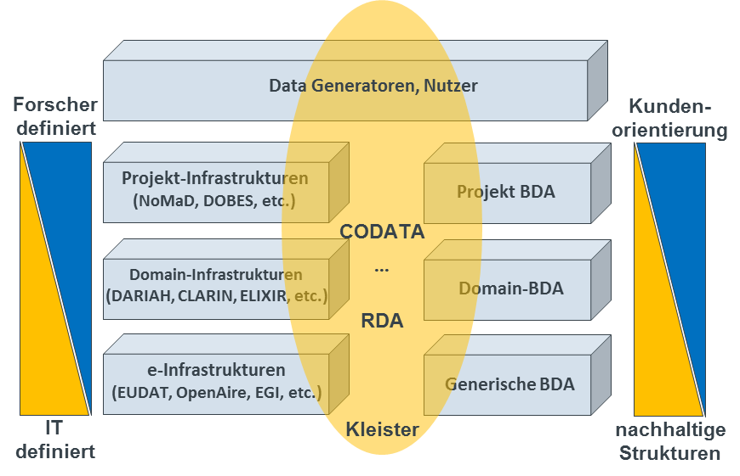
Infrastructure activities
DOBES
NoMaD

Slide 9
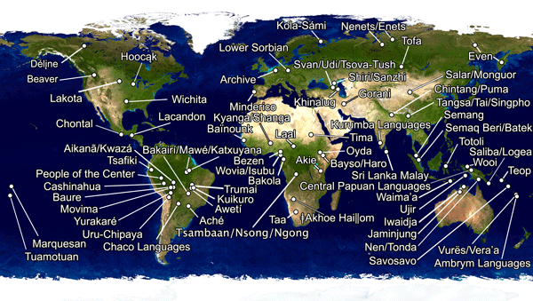
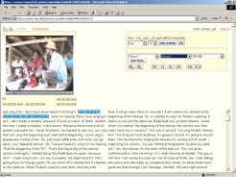
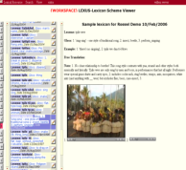
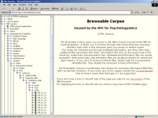
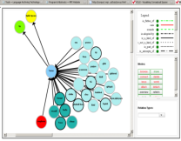
DOBES infrastructure
Documenting Endangered Languages
~70 global, independent teams
One archive with one copy of all data
Agreements (data flow, metadata, formats, etc.)
~80 TB in online archive
Web-based, open deposit
4 dynamic external copies
Complete tool suite supporting all major steps including repository system and metadata tools
(all based on standards, standoff, technology independence)

Slide 10
DOBES infrastructure
Documenting Endangered Languages
~70 global, independent teams
One archive with one copy of all data
Agreements (data flow, metadata, formats, etc.)
~80 TB in online archive
Web-based, open deposit
4 dynamic external copies
Changed culture globally in various dimensions
Complete tool suite supporting all major steps including repository system and metadata tools
(all based on standards, standoff, technology independence)

Slide 11
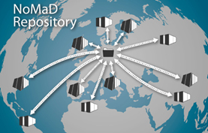
NoMaD infrastructure
Novel Materials Discovery project
Computational material science
Many labs create enormous amounts of data about materials and compounds
  Chemical compounds space is endless
  How to quickly find useful compounds in case of specific needs???
NoMaD brings together result data into one repository (incl. metadata etc.)
Finding patterns across measurements to detect hidden classes
Complementary to very large Materials Genome Initiative from Obama which is an infrastructure project to reduce time and effort (50%) to design suitable materials and deploy them
Structure is similar to DOBES
Group of specialists
find agreements
Offering services
Driven by research questions

Slide 12
NoMaD infrastructure
Novel Materials Discovery project
Computational material science
Many labs create enormous amounts of data about materials and compounds
  Chemical compounds space is endless
  How to quickly find useful compounds in case of specific needs???
NoMaD brings together result data into one repository (incl. metadata etc.)
Finding patterns across measurements to detect hidden classes
Complementary to very large Materials Genome Initiative from Obama which is an infrastructure project to reduce time and effort (50%) to design suitable materials and deploy them
Structure is similar to DOBES
Group of specialists
find agreements
Offering services
Driven by research questions
No doubt – it will change culture

Slide 13
Infrastructure activities
CLARIN

Slide 14
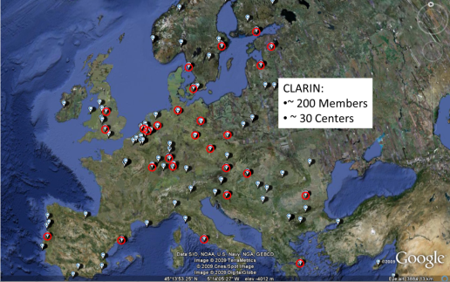
CLARIN RI
some old slides – still true
Scattered landscape of language resources and tools
Typical problems (not findable, not accessible, not interoperable, lack of services, lack of stability, etc.)
Situation in many LRT centers just chaotic
  project orientation
  project tweaking

Slide 15


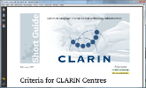
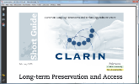
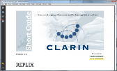
CLARIN RI
25 Centre Candidates
all are busy with restructuring plans
2 already give long-term preservation service
how to come to a persistent and stable infrastructure?
how to come to a federation and how to get access?
how to make all of their LRT visible?
how to come to interoperable services?
how to get it all together for user services?
community centres
service provider federation
CMDI future & short term solution
service oriented architecture
pan-European demo
cases
CLARIN Centres
Centres
Criteria
Long-term
Preservation
REPLIX Replication

Slide 16
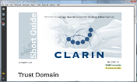
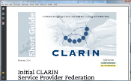
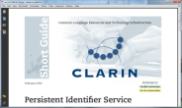
CLARIN RI
setup federation technology
build initial federation
central user attribute server
setup EPIC service
how to come to a persistent and stable infrastructure?
how to come to a federation and how to get access?
how to make all of their LRT visible?
how to come to interoperable services?
how to get it all together for user services?
community centres
service provider federation
CMDI future & short term solution
service oriented architecture
pan-European demo
cases
Trust Domain
Initial Federation
PID
Service

Slide 17
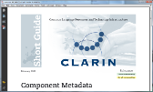


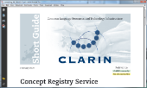
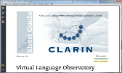
CLARIN RI
CMDI Infra
ARBIL MD Editor
Category Definition
ISOcat development
LRT Inventory
setup OAI PMH machinery
Virtual Language World
how to come to a persistent and stable infrastructure?
how to come to a federation and how to get access?
how to make all of their LRT visible?
how to come to interoperable services?
how to get it all together for user services?
community centres
service provider federation
CMDI future & short term solution
service oriented architecture
pan-European demo
cases
Component Metadata
Metadata now
Virtual Collection
ISOcat Registry
VLO Observatory

Slide 18
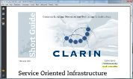
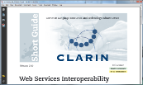

CLARIN RI
Service Framework Specification
Web Service and Processing Chains
Standards and Best Practices
how to come to a persistent and stable infrastructure?
how to come to a federation and how to get access?
how to make all of their LRT visible?
how to come to interoperable services?
how to get it all together for user services?
community centres
service provider federation
CMDI future & short term solution
service oriented architecture
pan-European demo
cases
Service Oriented Infrastructure
Web Services Interoperability
Standards & Best Practices

Slide 19
CLARIN RI
C4/WebLicht Corpus Case
EU Identity Index Case
Multimedia/multimodal Case
Folkstory Case
how to come to a persistent and stable infrastructure?
how to come to a federation and how to get access?
how to make all of their LRT visible?
how to come to interoperable services?
how to get it all together for user services?
It changed culture and will go on
Many EU RI do almost the same
community centres
service provider federation
CMDI future & short term solution
service oriented architecture
pan-European demo
cases

Slide 20
Infrastructure activities
EUDAT

Slide 21



















EUDAT infrastructure
some old slides

Slide 22
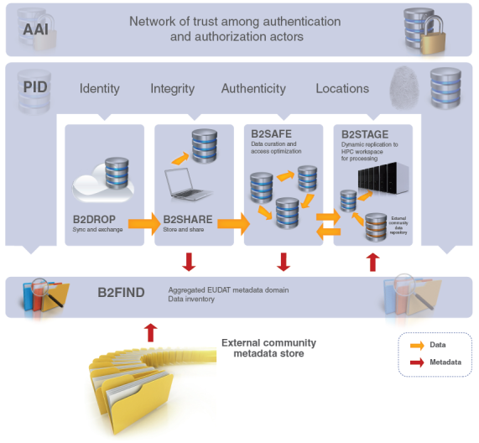
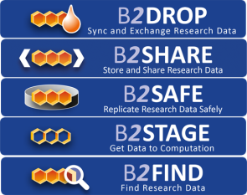
EUDAT infrastructure
Don’t know yet – far away from research

Slide 23
State of Infrastructure Building
Have a huge number of infrastructure initiatives in Europe and globally
  Created much awareness, initiated changes and allowed knowledge gathering
Many working in discipline and/or regional/national “silos” believing that their solutions are the best
There is still a lot of dynamics and despite all progress no satisfaction (EU Open Science Cloud)
Outreach is partly still poor (->120 interviews & interactions)
We can certainly say that much SW that has been built cannot be maintained
  Built one of the first full-fledged repository systems and other software – not maintainable
  How many PID, AAI, MD, etc. solutions do we want to support?
Funding and Sustainability in most cases not clarified
Costs are too high
  where can we reduce
  where can we extract commons?

Slide 24
Content
Data Science and Infrastructures
Data Practices
Principles & Trends
RDA
RDA Results &Activities
Data Fabric IG

Slide 25
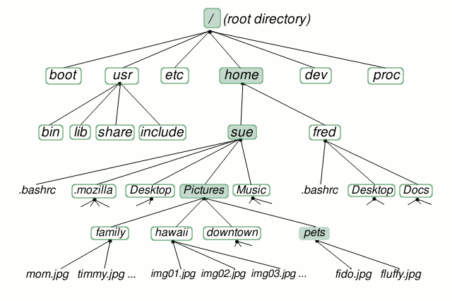
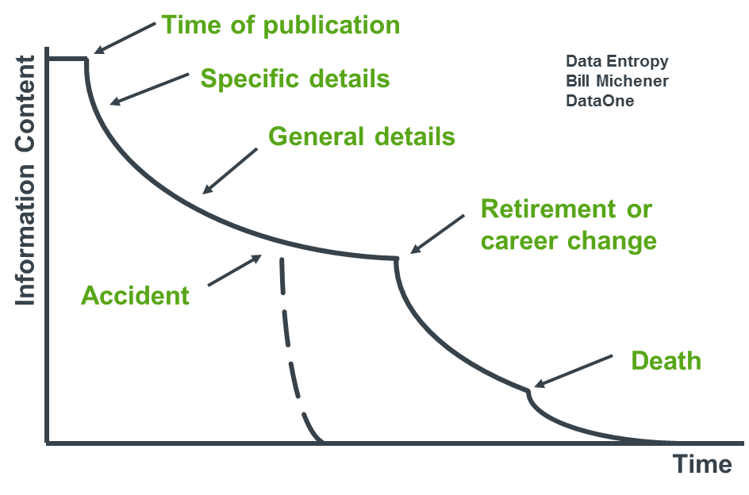
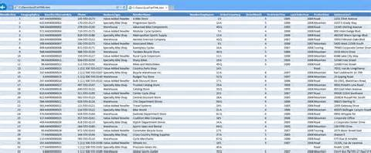
Data Practices – Data Entropy
lack of proper documentation, schemas, semantics, relations, etc.
directory structures, spreadsheets etc. are ad hoc creations and knowledge fades away
etc.

Slide 26
Data Practices - Metadata
Metadata standards
slide von Bill Michener, DataONE
Notes:
Suzie
Scientists want to be able to use other scientists’ datasets, they are willin to share their own data and they feel it is appropriate to create new datasets from shared data.

Slide 27
Data Practices – Survey
~120 Interviews/Interactions
2 Workshops with Leading Scientists (EU, US)
too much manual or via ad hoc scripts
too much in Legacy formats (no PID & MD)
there are lighthouse projects etc. but ...
DM and DP not efficient and too expensive
(Biologist for 75% of his time data manager)
federating data incl. logical information much too expensive
hardly usage of automated workflows and lack of reproducibility

Slide 28
Data Practices – Survey
~120 Interviews/Interactions
2 Workshops with Leading Scientists (EU, US)
too much manual or via ad hoc scripts
too much in Legacy formats (no PID & MD)
there are lighthouse projects etc. but ...
DM and DP not efficient and too expensive
(Biologist for 75% of his time data manager)
federating data incl. logical information much too expensive
hardly usage of automated workflows and lack of reproducibility
  DI research only available for Power-Institutes
  pressure towards DI research is high, but only some departments are fit for the challenges
  Senior Researchers: can’t continue like this!
  need to move towards proper data organization and automated workflows is evident
  but changes now are risky: lack of trained experts, guidelines and support

Slide 29
Content
Data Science and Infrastructures
Data Practices
Principles & Trends
RDA
RDA Results &Activities
Data Fabric IG

Slide 30
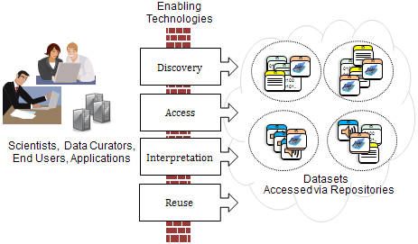
Trends - Principles
Comparison G8, FORCE11, FAIR & Nairobi principles
  Searchable/findable -> create useful metadata
  Accessible -> deposit in trusted repository, use PIDs, have
  proper AAI in place etc.
  Interpretable -> use metadata, registered schema and semantics
  Re-usable -> provide contextual metadata
  Manageable/persistent -> provide persistent repositories
Drawing by
Larry Lannom

Slide 31

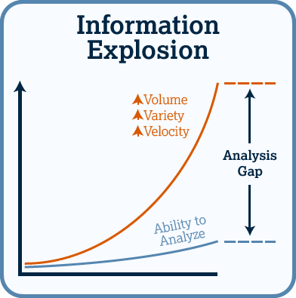
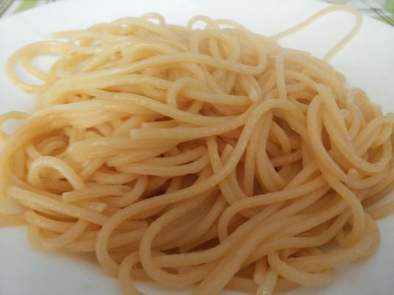
Trends – Volume, Complexity
from simple structures ...
... towards complex relationships

Slide 32

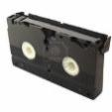
Trends – Anonymous use
direct exchange between known colleagues
Domain of Repositories
new mechanisms of building trust needed

Slide 33
Trends – Re-Usage
Domain of
trusted
Repositories
Data will be re-used in different contexts

Slide 34
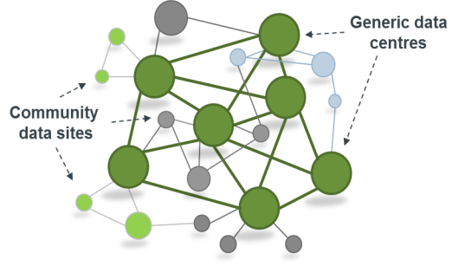
Trends – Structuring domains
Nores to be assessed to increase trustfulness

Slide 35
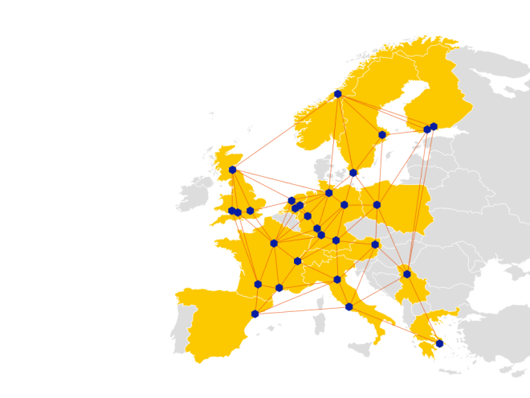
Trends – large federations
domain of registered data
various common data services (across countries & disciplines)
taken from
EUDAT

Slide 36
Trends – unified Data Management
management of data objects is widely type and discipline independent

Slide 37
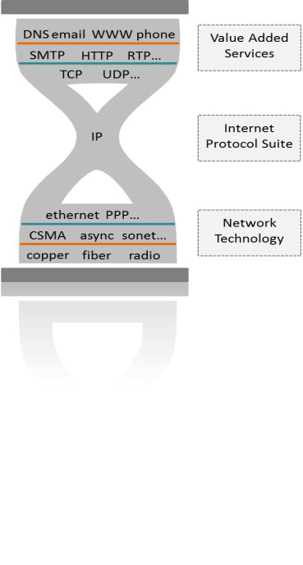
Trends – world-wide PID system
Internet Domain
nodes with IP numbers
packages being exchanged
standardized protocols
Data Domain
objects with PID numbers
objects being exchanged
standardized protocols
what

Slide 38
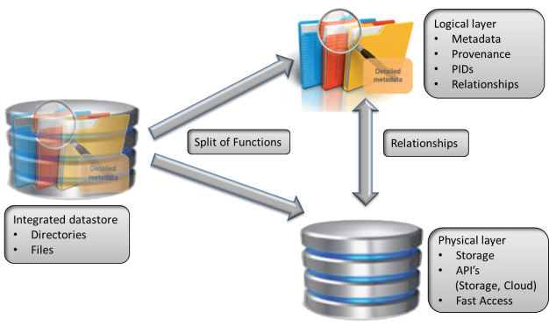
Trends – split of functions
“logical layer” operations are complex due to relations, etc.

Slide 39
BIG Questions
How to change inefficient practices?
How to overcome infrastructure barriers?
How to come to fundable infrastructure eco-system?
Ho to turn trends and principles into action?

Slide 40
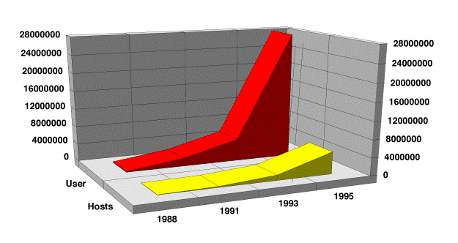
Network Example
20 years!
TCP/IP Specification
WWW-Mosaic available
TCP/IP Stress-test
worldwide
adoption
1973
1977
1990
1993
many different suggestion & protocols
first TCP/IP just one suggestion amongst many
at the beginning discussion about different email systems
at the beginning no interest from researchers and also industry
(toy of some freaks)
required some smart policy decisions to push unification

Slide 41
Content
Data Science and Infrastructures
Data Practices
Principles & Trends
RDA
RDA Results &Activities
Data Fabric IG

Slide 42
Role of RDA

Slide 43
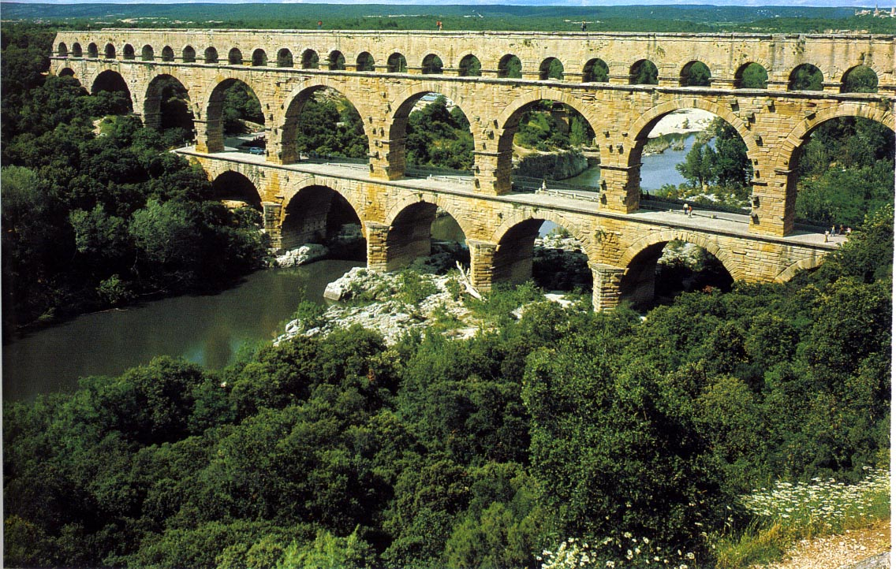
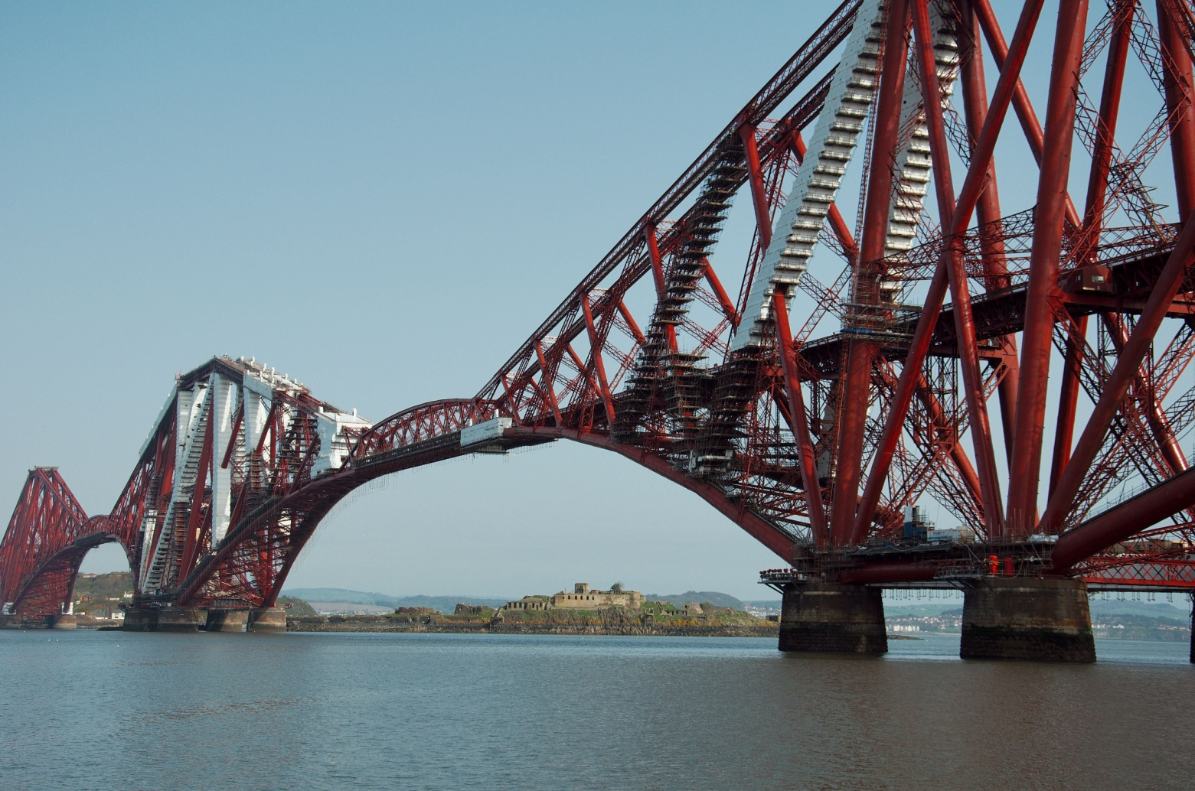
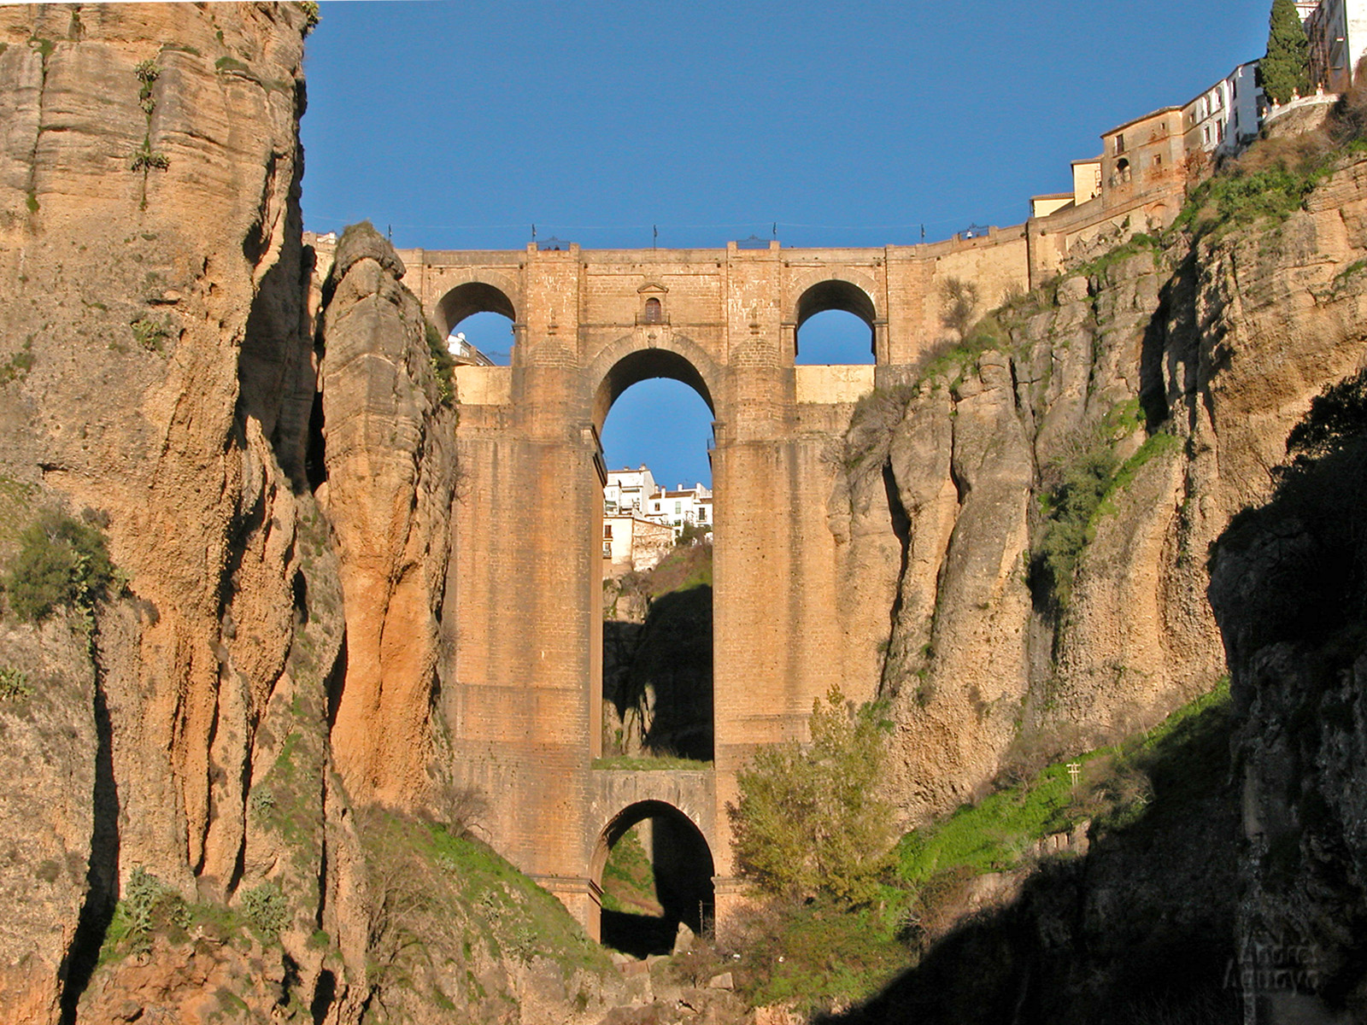
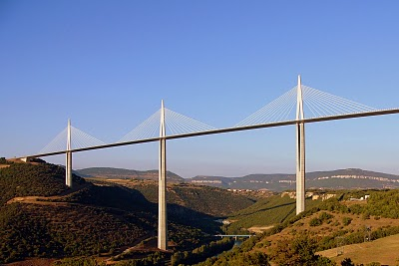
RDA is about changing data practices
  RDA is about building the social and technical bridges that enable global open sharing of data.
  Researchers, scientists, data practitioners from around the world are invited to work together to achieve the vision
  Funders: NSF, EC, AU , Japan, Brazil, DE?, UK?, ZA?, FI?, etc.

Slide 44
RDA is about changing data practices
THE
MACHINE
THE
SUPPORT
RDA Global
WG/IG/BoF
initiative
funding
RDA Europe
Project
funding
EC
owning
Data
Practitioners
commenting
Co-funding
funding
creating
testing
adopting
RDA
Results
Workshops/Sessions
Training
Helping
Knowledge Base
Leading Scientists WS
Policy Activities

Slide 45
RDA Governance
Working Groups
implementable, impactful outcomes
Interest Groups
domain coordination, idea generation, maintenance, …
Technical Advisory Board
socio-technical vision and strategy
Secretariat
administration and operations
Organisational
Advisory Board
needs, adoption, business advice
RDA Membership
Council
organisational vision and strategy

Slide 46
Use Cases are the basis!
 | Name | Institute | state
1 | Language Archive | Max Planck Institute NL | in operation
2 | Geodata Sharing Platform | Academy of China | In operation
3 | Datanet Federation Concortium | RENCI US | In operation
4 | ADCIRC Storm Forcasting | RENCI US | In operation
5 | EPOS Plate Observation | INGV/CINECA Italy | In operation
6 | ENVRI Environment Observation | U Helsinki, Finland | In design
7 | Nanoscopy Repository Cell structures | KIT, Germany | In design
8 | Human Brain Neuroinformatics | EPFL Switzerland | in testing
9 | ENES Climate Modeling | DKRZ Germany | In operation
10 | LIGO Gravitation Physics | NCSA US | In operation
11 | ECRIN Medical Trial Interoperation | U Düsseldorf Germany | In testing
12 | VPH Physiology Simulation | U London UK | In operation
13 | Species Archive | Nature Museum Germany | In operation
14 | International NeuroI Facility | INCF Sweden | In operation
15 | Molecular Genetics | MPI Germany | In operation
Use Case driven and not “theory driven”
all indicated nodes are centers of national, regional and even worldwide federations

Slide 47
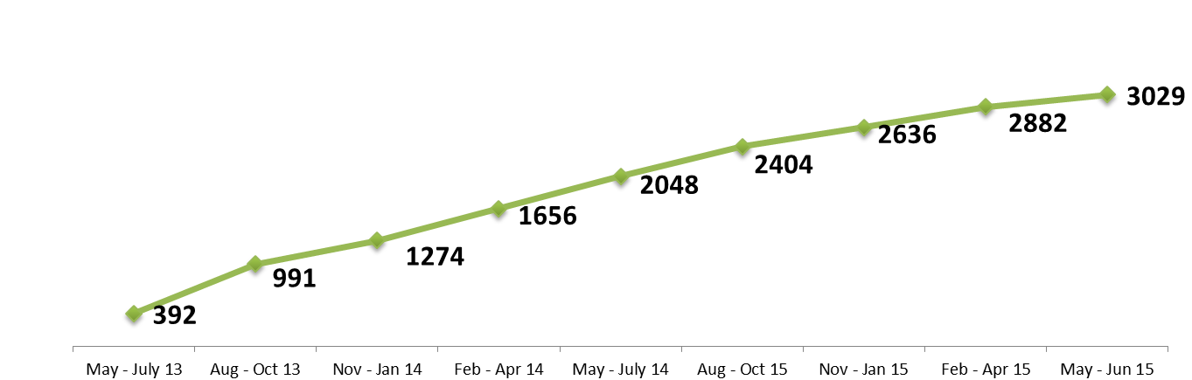

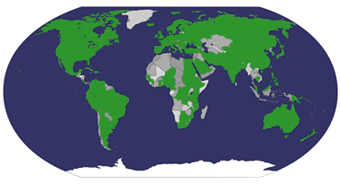
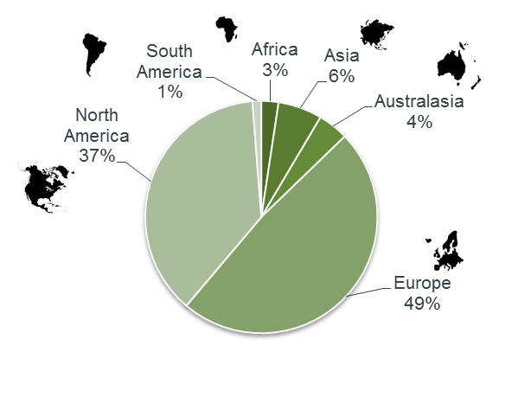
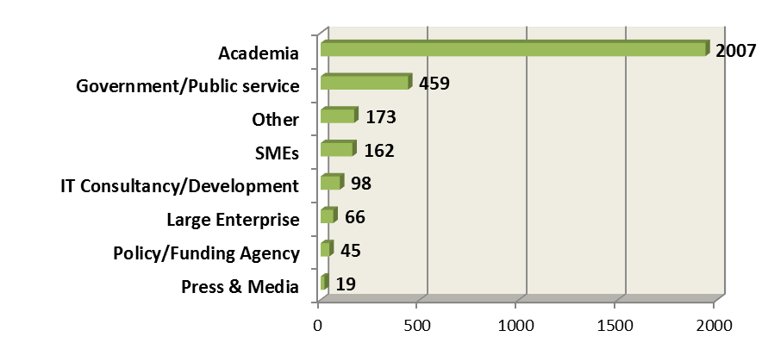
RDA Engagement
from 103 countries

Slide 48
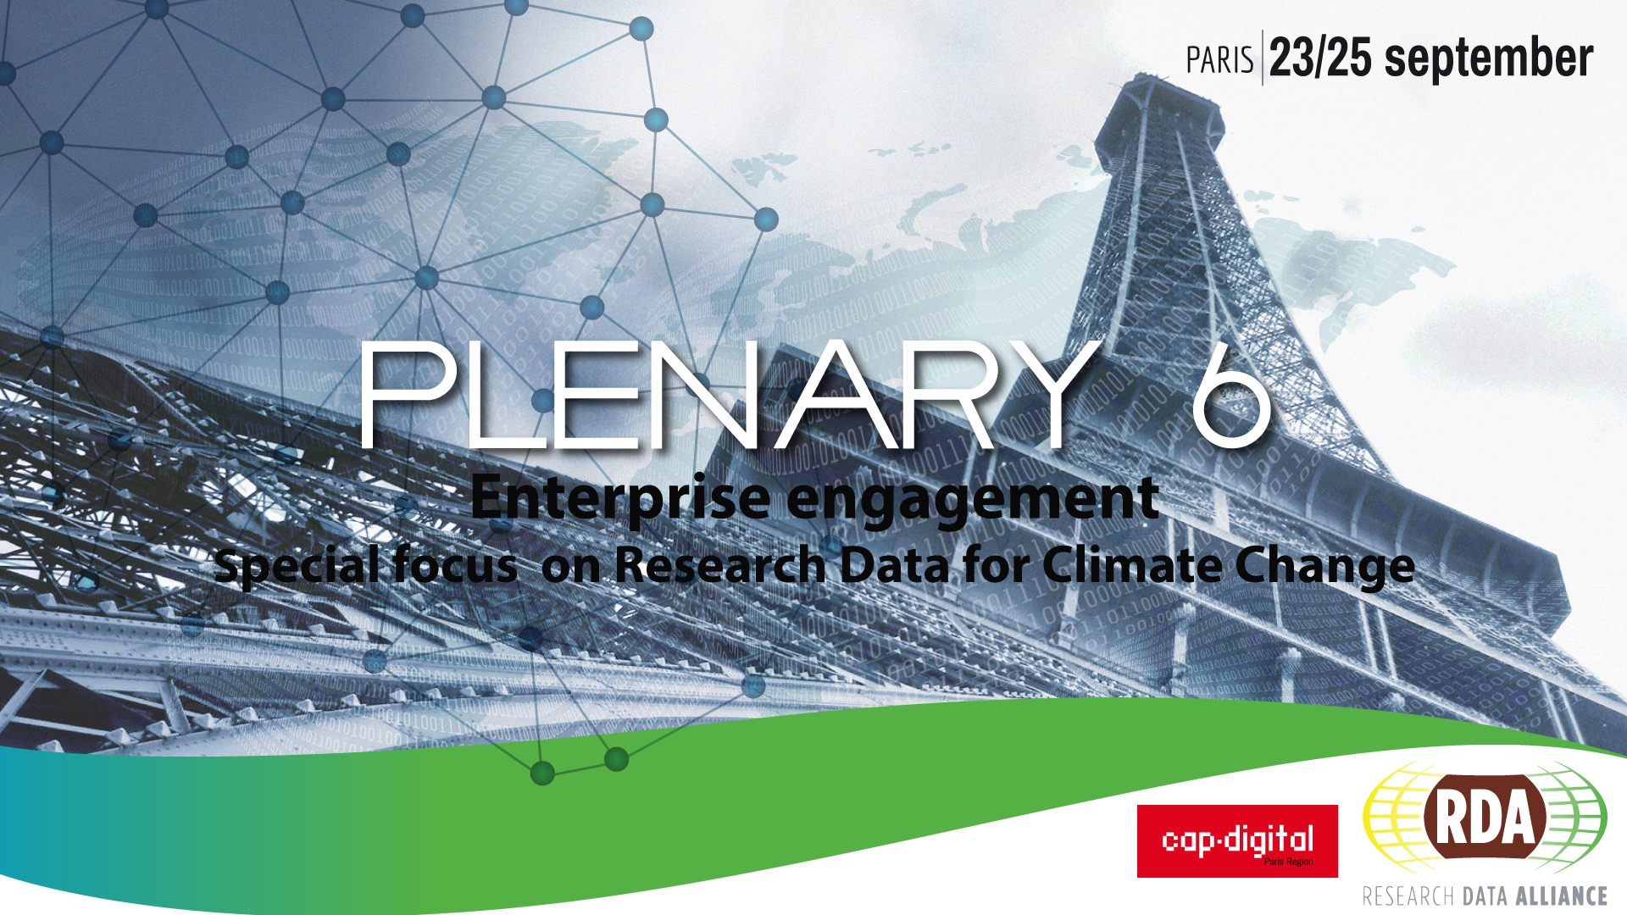
Plenary 6
  and Data Challenge!
CNAM, Paris, France
23 - 25 September 2015

Slide 49
Content
Data Science and Infrastructures
Data Practices
Principles & Trends
RDA
RDA Results & Activities
Data Fabric IG

Slide 50
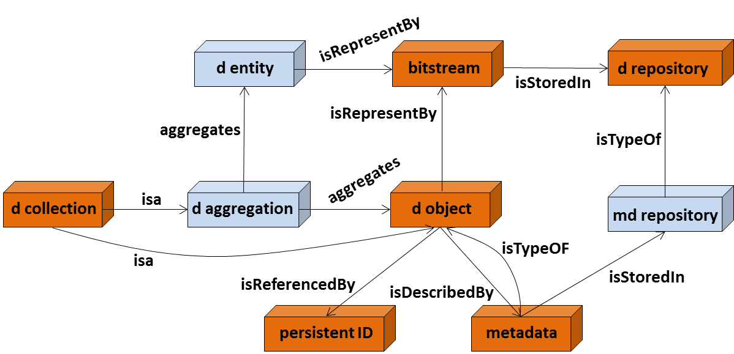
RDA Results I: simple common data model
If all would adhere to simple model much would be gained
Could define a simple repository API
Definition
A persistent identifier is a long-lasting ID represented by a string that uniquely identifies a DO and that is intended to be persistently resolved to meaningful state information about the identified DO.
Note: We use the term Persistent Resolvable Identifier as a synonym.

Slide 51
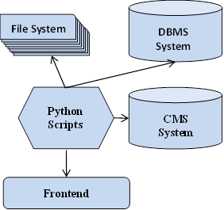
Impact of DFT Result
Federating this cost too much.
How to maintain?

Slide 52
RDA Results II: Data Type Registry
result: a registry for data types
you get an unknown file,
pull it on DTR and content is being
visualized
extended MIME Type concept
no free lunch: someone needs to
register and define type
code available begin 2015
PIT Demo already working with
DTR

Slide 53
RDA Results III: PID Information Types
result: a generic API and a set of basic attributes
a PID Record is like a Passport (Number, Photo, Exp-Date, etc.)
if all PID Service-Provider agree on one API and talk the same language (registered terms) SW development will become easy
Test-Installation
in operation
together with
DTR
working with PID and service providers much easier
worldwide interoperability

Slide 54
RDA Results IV: Practical Policies
due to unforeseen circumstances need until P5
Practical Policies = executable Workflow Statements
result at P5: a set of Best Practice PPs for a number of typical DM/DP tasks (Integrity Check, Replication, etc.)
currently a large collection of PPs, currently being evaluated
you could add your policies
huge simplification for data stewards
finally feasible quality checks and certification
huge step in trust improvement
one cornerstone towards reproducible data

Slide 55
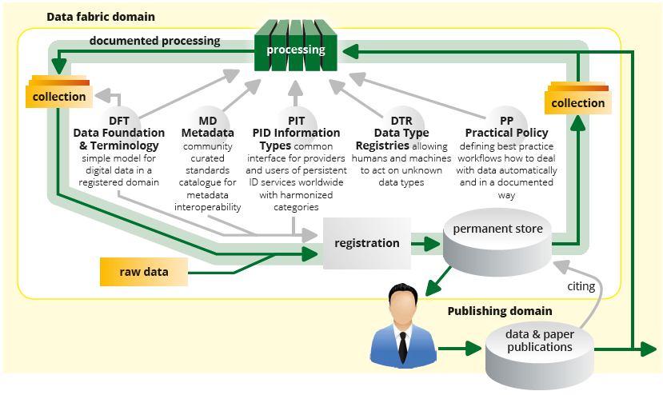
Data Fabric Interest Group
Data Fabric IG looks for common components and services to make this work as efficient and reproducible as possible
Other WG/IGs looking at data publication workflows and citation

Slide 56
RDA – first Working Group results
results achieved after ~20 months!

Slide 57
DFIG – grouping of WG/IGs
REPRO
Prov
PP
BDA
BROK
CERT
FIM
REP
DMP
DOM
CERT
CITDD

Slide 58
Position Paper “Paris.doc”
Recently paper a number of colleagues engaged in RDA
Data Management Trends, Principles and Components – What Needs to
be Done?
Co-authors don’t claim to own any ideas – but kick-off a broad discussion
Need to accelerate solution finding and convergence process
Doc: http://hdl.handle.net/11304/992fe6a0-fe34-11e4-8a18-f31aa6f4d448
Data Fabric Wiki: https://rd-alliance.org/node/44520/all-wiki-index-by-group
get involved in these discussions
https://rd-alliance.org/node/44520/all-wiki-index-by-group
8 Common Trends | Partly stable, some still in debate
G8+ Principles | Widely agreeed
Consequences of Principles | Not really thought through
19 Components | To be discussed now
Organizational Approaches | To be discussed now

Slide 59








DFIG Spinoff – Repository Registry
trusted Re-use
valid References
reproducible Science
machine usage
Safe Deposit
Scientists
Registry
(Humans,
Machines)
Funders
Publishers
Domain of Trusted
Repositories

Slide 60
Other “Clusters”
Community Groups
Agriculture / Wheat Interop
Biodiversity
Structural Biology
Biosharing Registry
ELIXIR
Toxicogenomics
Metabolomics
Geospatial
Materials Data
Photon&Neuron
Marine
History&Ethnogarphy
Urban Life
Social Groups
Community Capability
Data Re-use
Data Life Cycle
Engagement
Ethical Aspects
Legal Interoperability
Data Rescue
Data Handling Training
Data for Development
Cloud Worldwide Training

Slide 61
Uptake of results
Uptake session at P5 in San Diego
https://www.rd-alliance.org/plenary-meetings/fifth-
plenary/programme/adoption-day.html
Calls for Uptake Proposals from EUDAT and RDA Europe
http://eudat.eu/eudat-call-data-pilots
https://europe.rd-alliance.org/rda-europe-call-collaboration-projects
Possibilities in EC’s WP16/17
Proposal to NSF around National Data Service coming, activities in China, Japan, Germany, etc.
Establishment of Testbeds by NDS, EUDAT, etc.
get involved in testing/uptaking
https://rd-alliance.org/node/44520/all-wiki-index-by-group

Slide 62
References
RDA: http://rd-alliance.org
RDA Europe: http://europe.rd-alliance.org
Data Management Trends, Principles and Components - What Needs to be Done Next? V6.1: http://hdl.handle.net/11304/992fe6a0-fe34-11e4-8a18-f31aa6f4d448
Principles for Data Sharing and Re-use: are they all the same?
http://hdl.handle.net/11304/1aab3df4-f3ce-11e4-ac7e-860aa0063d1f
Living with Data Management Plans
http://hdl.handle.net/11304/ea286e5a-f3d1-11e4-ac7e-860aa0063d1f
RDA Europe: Data Practices Analysis
http://hdl.handle.net/11304/6e1424cc-8927-11e4-ac7e-860aa0063d1f
DFT: https://rd-alliance.org/groups/data-foundation-and-terminology-wg.html
Data Fabric: https://rd-alliance.org/group/data-fabric-ig.html
Data Fabric Wiki: https://rd-alliance.org/node/44520/all-wiki-index-by-group

Slide 63

Thanks for your attention.
http://www.rd-alliance.org
http://europe.rd-alliance.org

Slide 64
Components - Position Paper
PID System
Actor ID System
Registry S for Trusted Repositories
Metadata S
Schema Registry S
Registry S Semantic Categories, Vocabularies
Data Types Registry S
Registry S for Practical Policies
Prefabricated PP Modules
Distributed Authentication S
Authorisation Record Registry S
OAI-PMH, ResourceSync, SRU/CQL
Workflow Engine & Environment
Conversion Tool Registry
Analytics Component Registry
Repository API
Repository System
Certification & Trusted Repositories
Training Modules

Slide 65
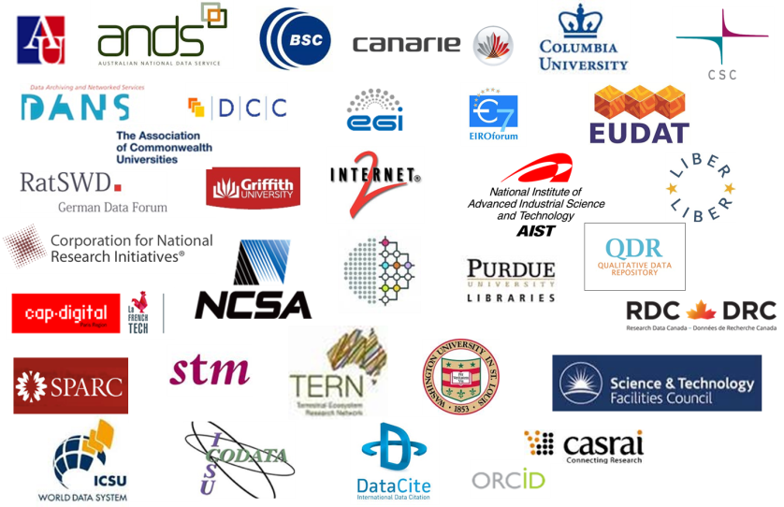
RDA is about changing data practices

