Slide 1
Reliability of Embedded FPGA-SoC Systems
in Long-Term Physics Experiments
Robin Bauknecht

Slide 2
ECHo
Measure Electron-Neutrino mass
15 boards
1 Year run time
Notes:
Goal is a more precise measurement of the e-neutrino mass
Possible that the experiment needs to be underground -> Hard to access
[Trans] The other experiment is CMS …
[Cave] https://www.appec.org/wp-content/uploads/2018/03/6pjhztby.jpg

Slide 3
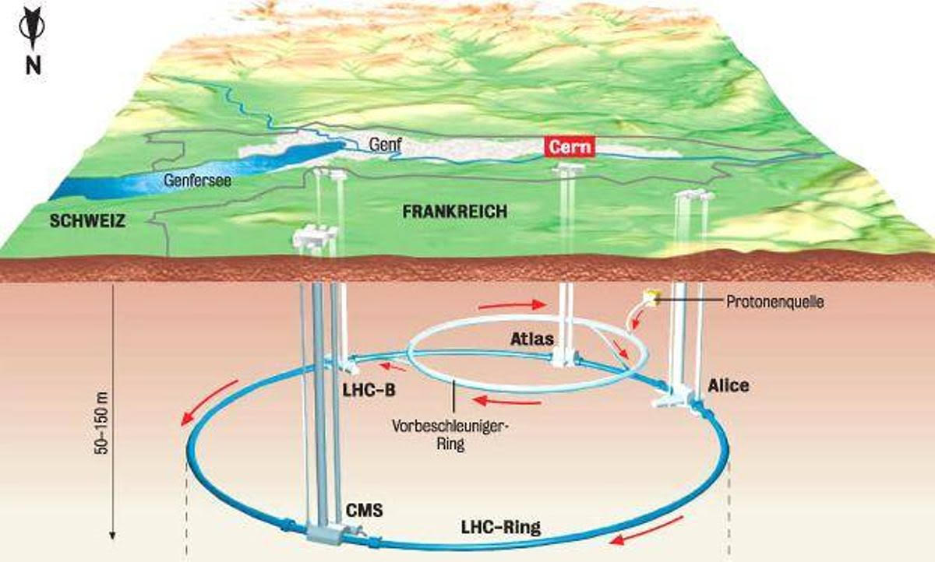
CMS Track Trigger
High energy particle physics
Over 100 boards
Multiple years run time
Notes:
[IN]…at the LHC in Switzerland.
Where high energy particle physics is researched.
[Trans]

Slide 4
CMS Track Trigger
High energy particle physics
Over 100 boards
Multiple years run time
Notes:
This machine is also hard to reach and not accessible while the beam is online.
Now it is quite clear, why we need more reliable processing system, meaning higher availability and maintainability:
Both: Expected to be hard to access during run-time
Both: Many processing systems and each of them can fail
[Trans] How does such a data processing system look like?
[cross-sec] https://upload.wikimedia.org/wikipedia/commons/thumb/2/2c/CMS_160312_06.png/1920px-CMS_160312_06.png

Slide 5
Target System
Notes:
[IN] Here is a photo:
Front -> ADC/DAC Components
Back: Development Board used for the Thesis
Center below Fan: FPGA-SoC
[Trans] The SoC really deserves the name, as you can see in this slide…

Slide 6
ZYNQ UltraScale+ Block Diagram
Notes:
[IN] These are all Components in the Package
Two large parts, the PS containing hard-wired processors and the PL where custom HW can be configured.
[Trans] As you can see, the system brings a lot of complexity and to review reliability properties, I needed to find a representation that allows to have an overview over the relations of all these blocks.
[source] https://www.xilinx.com/content/dam/xilinx/imgs/products/zynq/zynq-eg-block.PNG

Slide 7
Dependency Analysis

Slide 8
Dependency Analysis

Slide 9
Dependency Analysis

Slide 10
Dependency Analysis
Notes:
[Trans] I did this for the whole system…

Slide 11
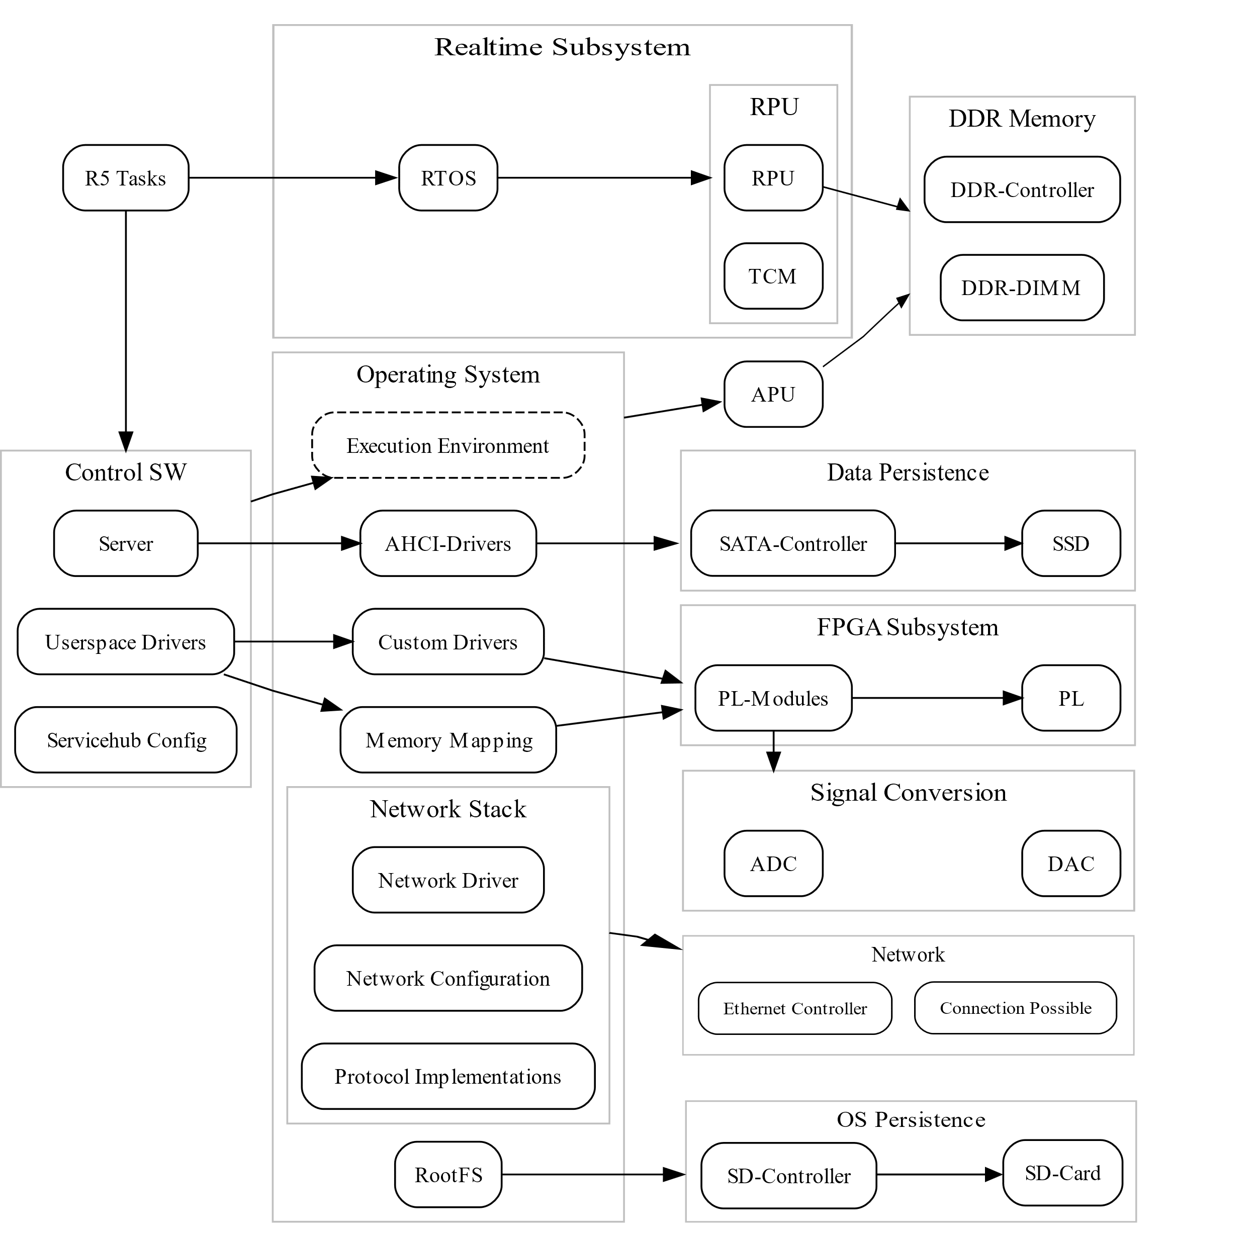
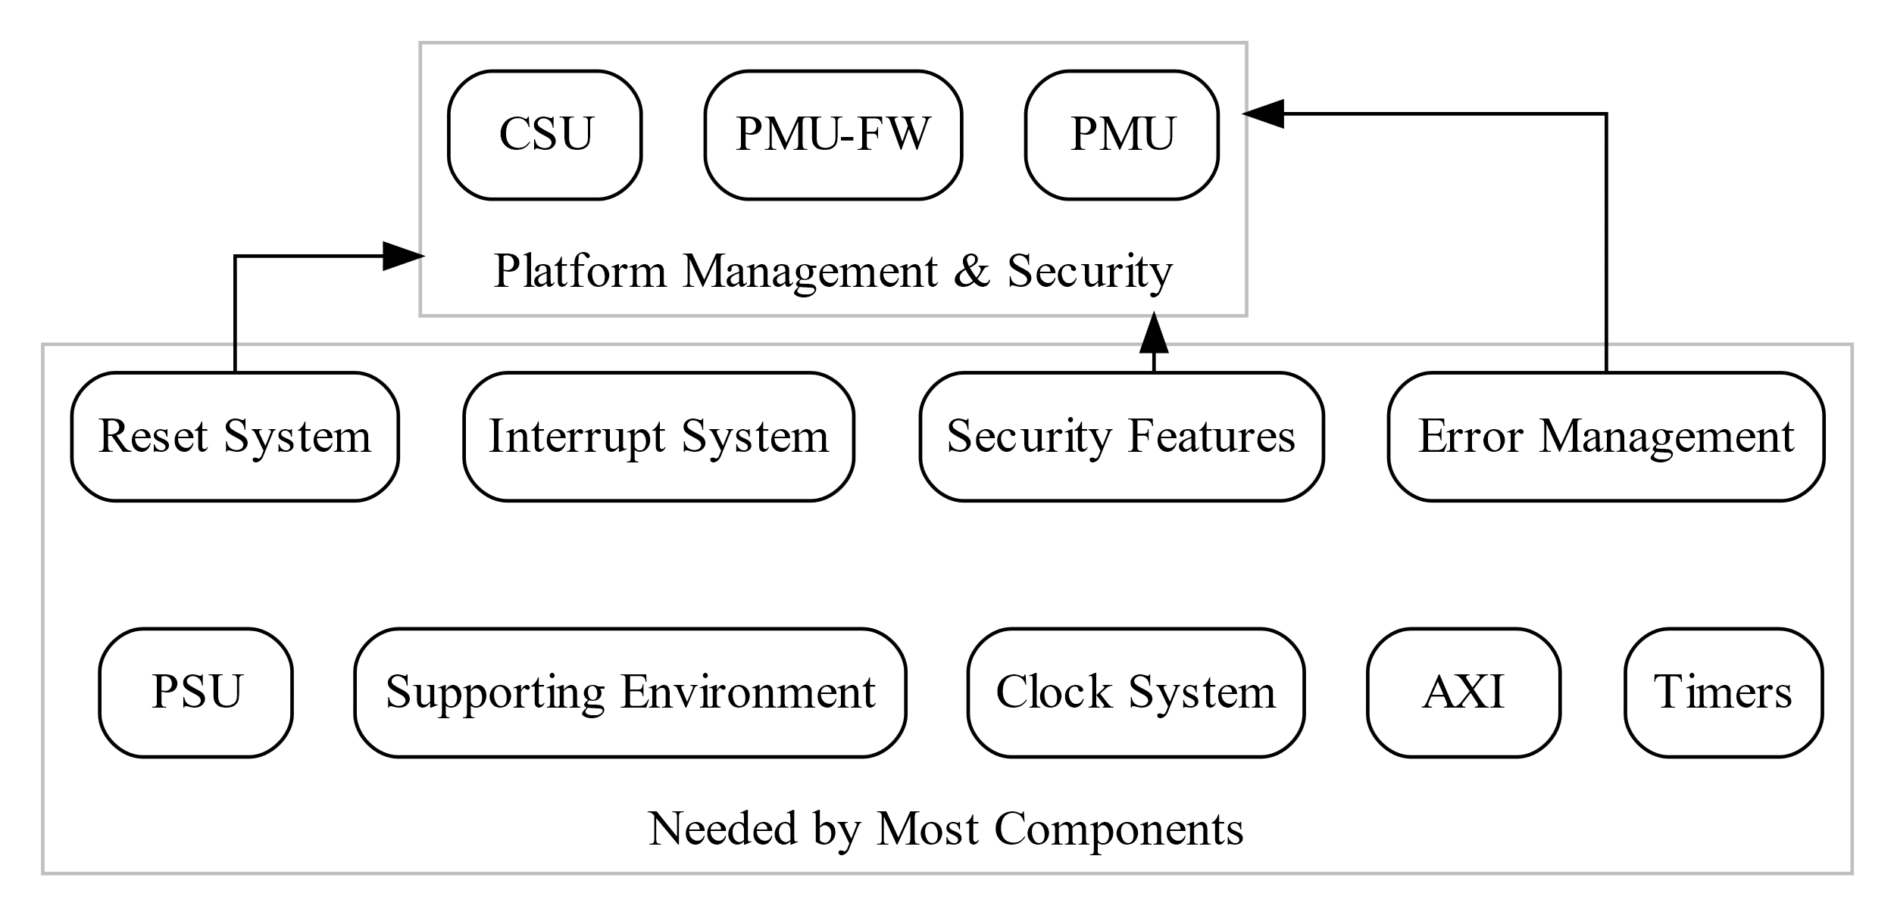
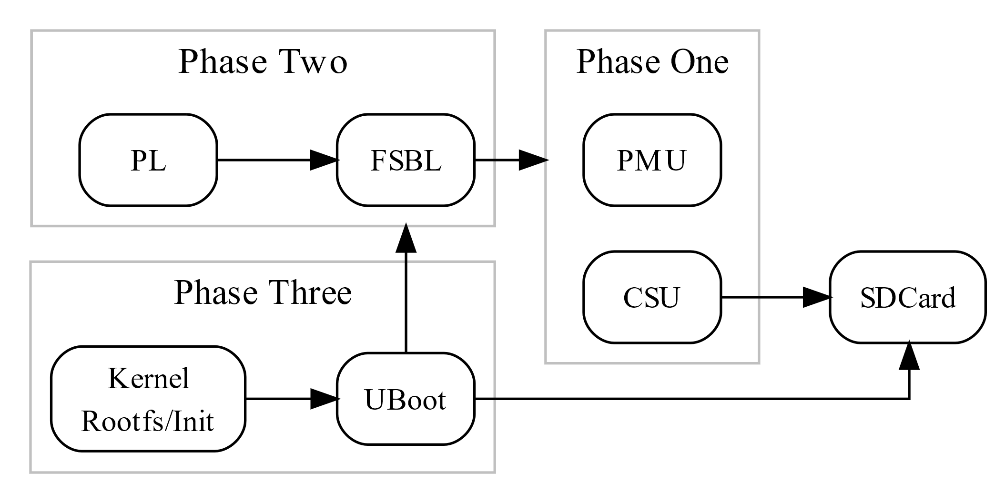
Created Dependency Graphs
Notes:
[IN] And this shows us the system structure regarding dependencies.
However, to identify single failure causes, this diagram is not fine grained enough but…
[Trans] It helps us to build a Fault Tree…

Slide 12
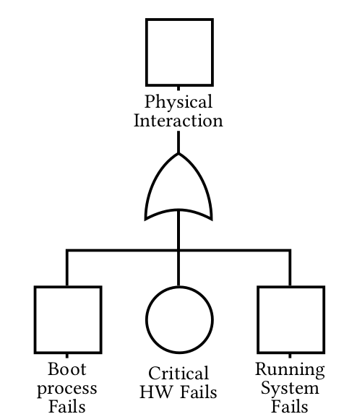
Fault Tree Analysis
Legend
Notes:
[IN]…Like This
Top event -> Fed by lower level events -> if one of these occurs -> the top event is triggered
[Trans] In this case, the top event is physical interaction…

Slide 13
Fault Tree Analysis
Legend
Avoid
Notes:
[IN] Which you remember from the beginning is something, we want to avoid
Hard to Access,
costs time, money and
leads to lower availability
How do we do this? By further splitting up the left and right nodes and search for methods to mitigate their occurrence.
[Trans] Especially for the Running System node, there are many children. So for each of the groups in the DG, an FTA was created.

Slide 14
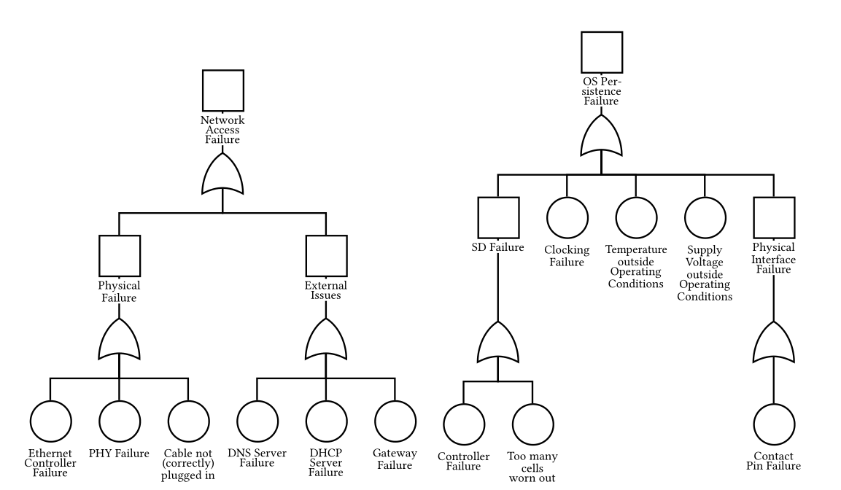
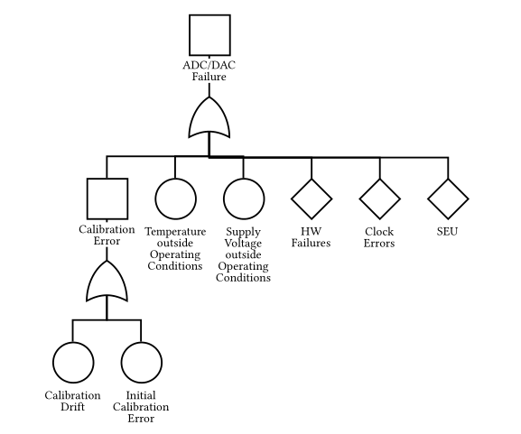
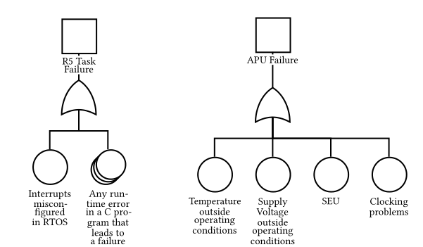
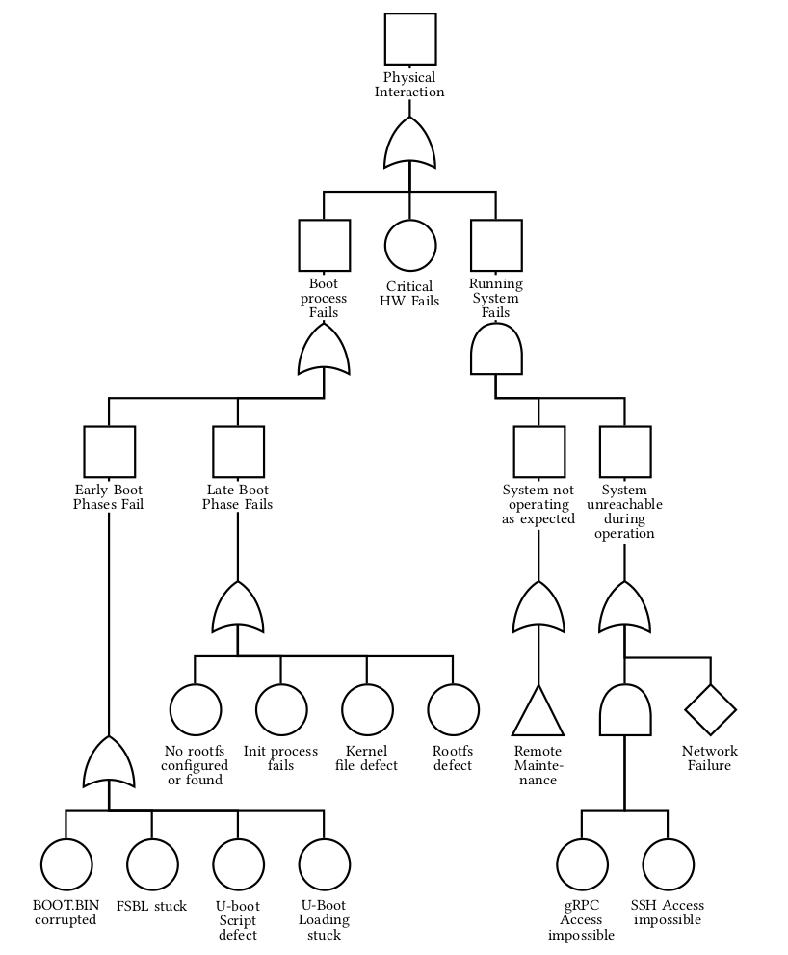
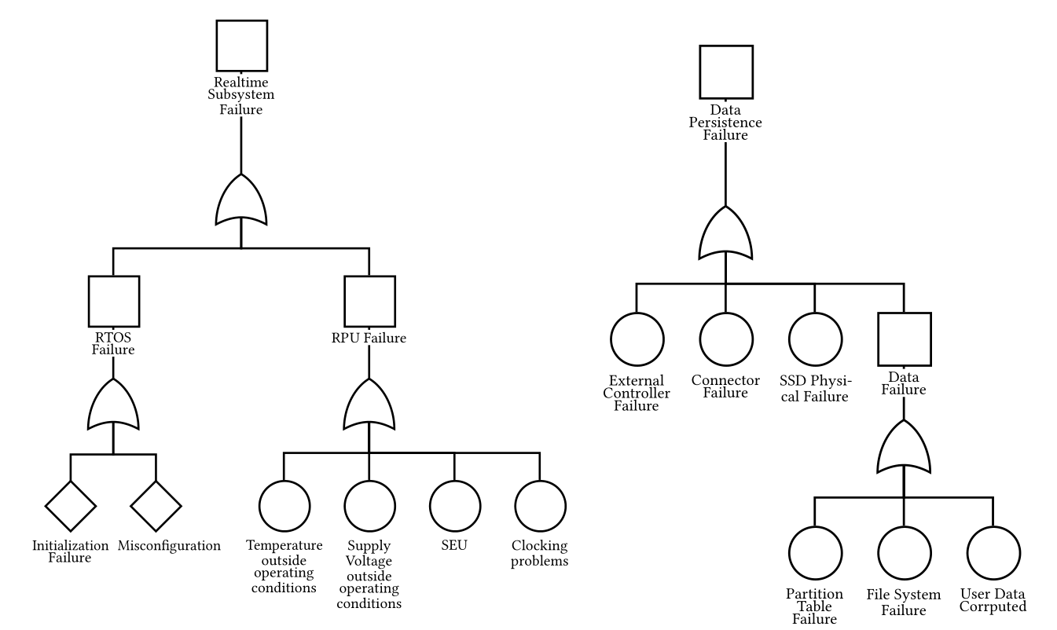
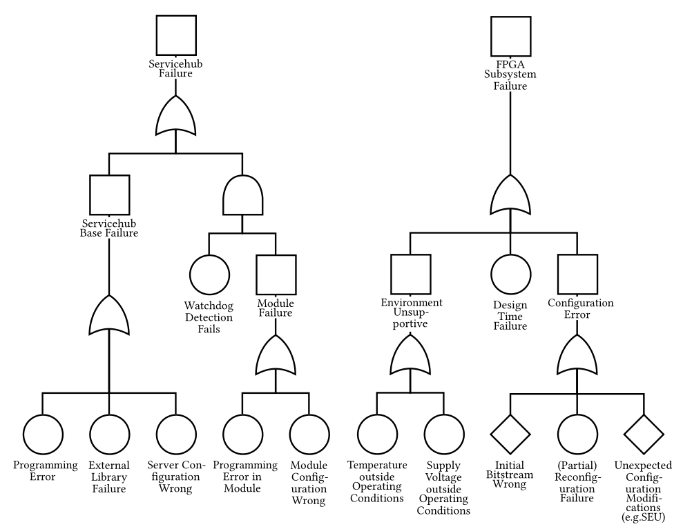
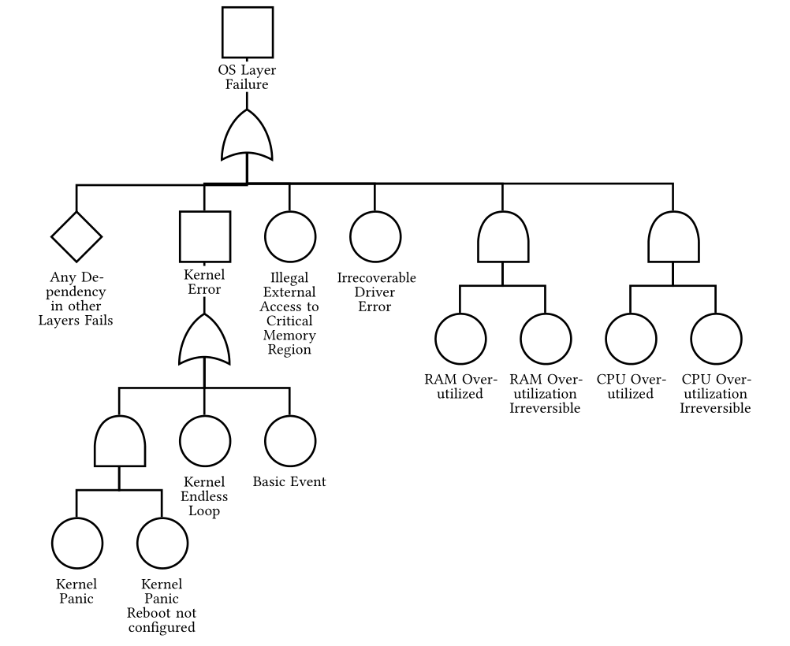
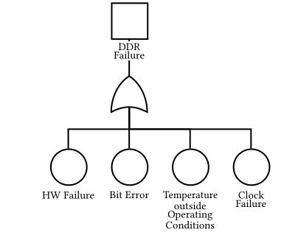
Created Fault Trees
12 Fault Trees

Slide 15
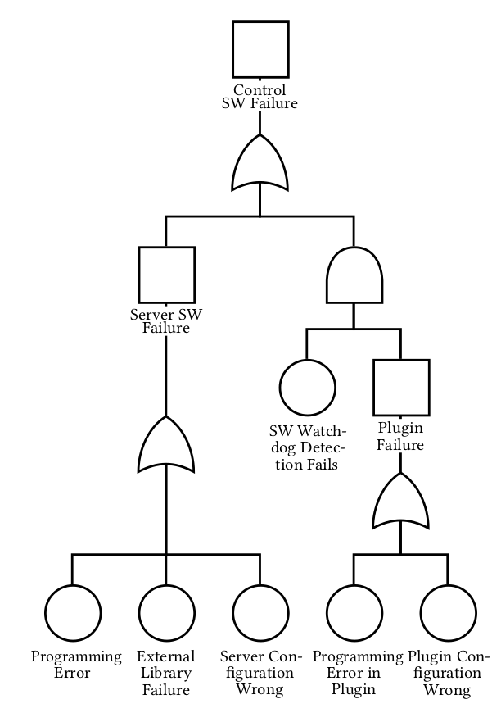
Fault Tree Example
No probability calculation
Failure causes in the leaf nodes
Notes:
[IN] You can see an example Tree here.
It shows possible failure events of the Control Software
In the bottom, only basic events exist -> If one of these occurs, it propagates up and might trigger the top event.
So in an ideal world…
[Trans] The information in the FTs and the DGs are collected in a List…

Slide 16
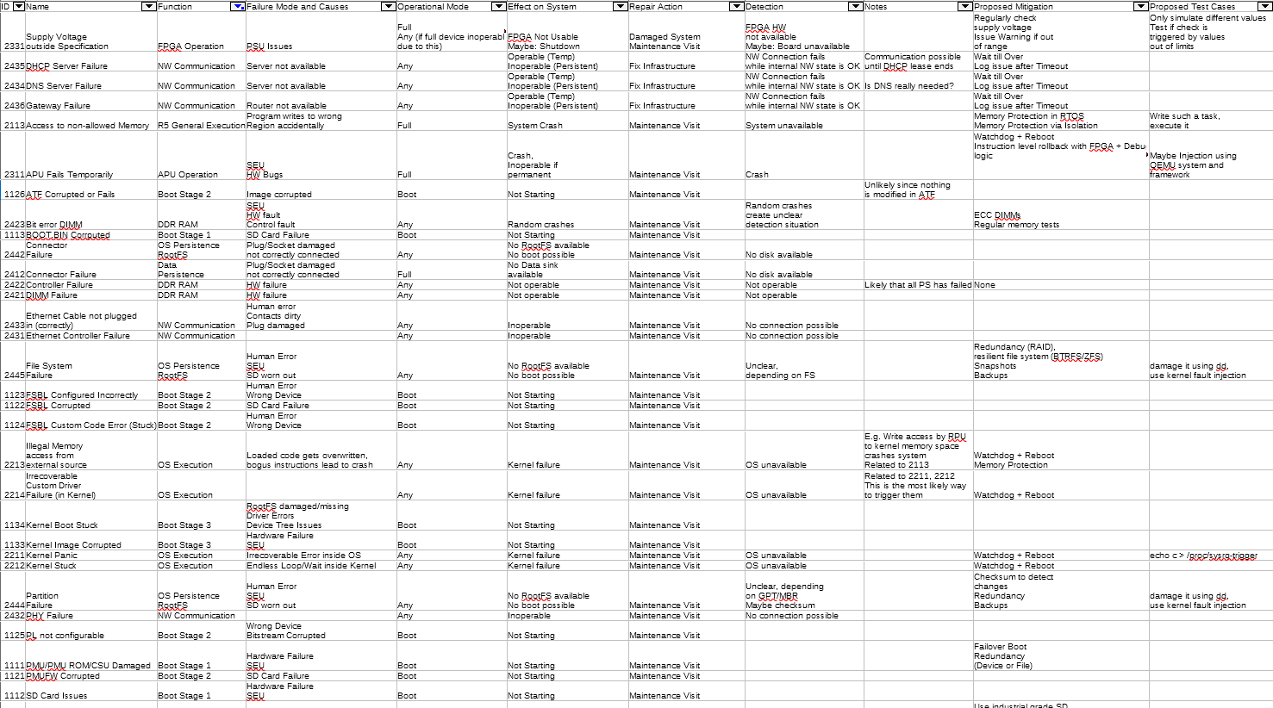
Failure Mode and Effect Analysis
73 Entries
Notes:
[IN] Called Failure Mode and Effect Analysis, short FMEA
[Trans] It contains 73 entries and as we can see here…

Slide 17
Failure Mode and Effect Analysis Details
Five device states
Operational
Warning
Degraded
Failover
Failed
Notes:
[IN] Here we can se one entry up close…
Important information stored in this list:
Failure mechanism
Effect on system
Mitigation
What is a Mitigation? A method to eliminate or reduce the impact of a certain failure/error.
Also, the list lead to a definition of device states that allows to judge the connected issue
Something that leads to a degraded state is not as bad as something that leads to the failure of the whole board
[Trans] A closer look into the information collected so far allowed to create a list of possible mitigations…

Slide 18
Possible Mitigation Techniques
Mitigation | Benefit | Overhead
Redundancy | Very High | Very High
Failover | High | Medium
Monitoring | High | Medium
APU Error Detection | Medium | High
DDR4 ECC | Medium | Low
FPGA TMR | Low | High
Memory Isolation | Low | Low
Modern File System | Low | Low
Plugin Reload | Low | Medium
RAID | Low | Low/High
FPGA Scrubbing | Very Low | Medium
Notes:
[IN] Which results in this table.
Explain How Benefit and Overhead combined result in the feasibility.
[Trans] [With fade in of blue rectangle] As we want to optimize the impact, the first implementations are the feasible ones with the highest benefit.

Slide 19
Possible Mitigation Techniques
Mitigation | Benefit | Overhead
Redundancy | Very High | Very High
Failover | High | Medium
Monitoring | High | Medium
APU Error Detection | Medium | High
DDR4 ECC | Medium | Low
FPGA TMR | Low | High
Memory Isolation | Low | Low
Modern File System | Low | Low
Plugin Reload | Low | Medium
RAID | Low | Low/High
FPGA Scrubbing | Very Low | Medium
Notes:
[Trans cont.] Since we need to detect errors or a degraded state before we can act to avoid a failure, we will first discuss…

Slide 20
Monitoring
Notes:
Erst Baum, Dann Auffächerung,
Dann auf Modularisierung hinweisen!
[Trans] This modularity is achieved by the following structure:

Slide 21
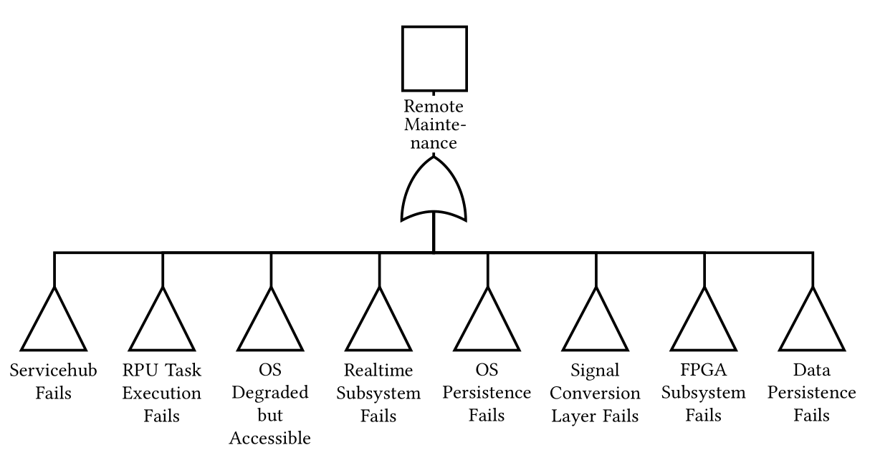
Monitoring
Notes:
Erst Baum, Dann Auffächerung,
Dann auf Modularisierung hinweisen!
[Trans] This modularity is achieved by the following structure:

Slide 22
Monitoring
Notes:
Erst Baum, Dann Auffächerung,
Dann auf Modularisierung hinweisen!
[Trans] This modularity is achieved by the following structure:

Slide 23
Monitoring
Modular & Extensible
Notes:
Erst Baum, Dann Auffächerung,
Dann auf Modularisierung hinweisen!
[Trans] This is achieved by the following structure:

Slide 24
Monitoring Framework
Monitor
Monit
Custom Checks

Slide 25
Failover
Improvement for 25 FMEA items possible
Notes:
What is the basic idea behind this mitigation?
Alternative OS from alternative Source
Watchdog that resets unresponsive board

Slide 26
Boot Sequence
HW Init
Boot Mode
SD
Load
U-Boot
Boot
OS
Notes:
Explain ordinary Boot Mode from SD
[Trans] To allow another OS to be loaded…

Slide 27
Failover Boot Sequence
HW Init
Boot Mode
QSPI
Load
U-Boot
Boot
FOS
Notes:
[IN] We change the boot mode via a physical switch on the board
In this case, we change it to QSPI Flash – which also stores the alternative FOS image
Notable: The image is intended to be readonly and is executed from a ramdisk. You can fully replace the image but you can not modify single files.
[Trans] Issue: Now we can only boot into the FOS

Slide 28
Failover Boot Sequence
Load
U-Boot
HW Init
Boot Mode
QSPI
Boot
FOS
Notes:
[IN] so we introduce
[Trans] a decision

Slide 29
Failover Boot Sequence
Load
U-Boot
HW Init
Boot Mode
QSPI
FOS?
Yes
Boot
FOS
Notes:
[IN] Which allows us, to decide whether we boot into FOS or into the normal mode
This decision is done in a script executed by U-Boot. And for now is based on a variable set manually.
[Trans]

Slide 30
Failover Boot Sequence
Load
U-Boot
HW Init
Boot Mode
QSPI
FOS?
Yes
Boot
FOS
No
Boot
OS
Notes:
[In] Which looks like this.
How do we do this? How do we ensure, that the SD image is not influenced by the configuration done by the previous initialization from QSPI?
[Trans] We use a small workaround…

Slide 31
Failover Boot Sequence
Load
U-Boot
HW Init
Boot Mode
QSPI
FOS?
Yes
Boot
FOS
No
Boot Mode Register
+
System Reset
Boot Mode
SD
Load
U-Boot
Boot
OS
Notes:
[In] The boot process is fixed by the boot mode switch -> every full reset, the switch is sampled into the boot mode register
However, using a different kind of reset keeps some state, including this register
So: If we write a different value to the reg. and then trigger the system reset -> We boot using the designated source written before
[Trans] But there is another issue. What if the normal OS crashes and is unresponsive repeatedly or fails during boot?
The watchdog will happily trigger and the board will reboot according to the setting here in the diamond.

Slide 32
Failover Boot Sequence
Load
U-Boot
Loop Counter++
HW Init
Boot Mode
QSPI
Count > 3?
Yes
Boot
FOS
No
Boot Mode
SD
Load
U-Boot
Boot
OS
Reset Loop
Counter
Notes:
[IN] This is fixed by counting boot processes
If we reach a limit, in this case 3, we boot to FOS
If we did not boot that often, we boot using the SD card
And eventually, if we decide the platform is stable, we reset the counter.

Slide 33
Failover Results
Tests
13 FMEA items covered
7 items not improved
5 items untested
Characteristics
Boot time increased from 21 to 28 seconds
Failover image size ~20 MB

Slide 34
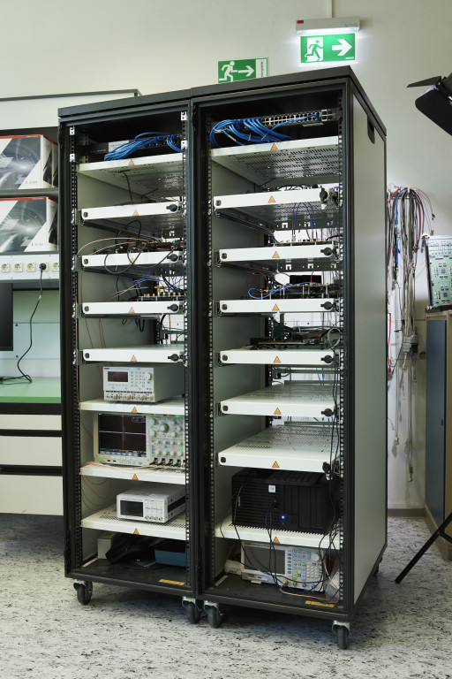
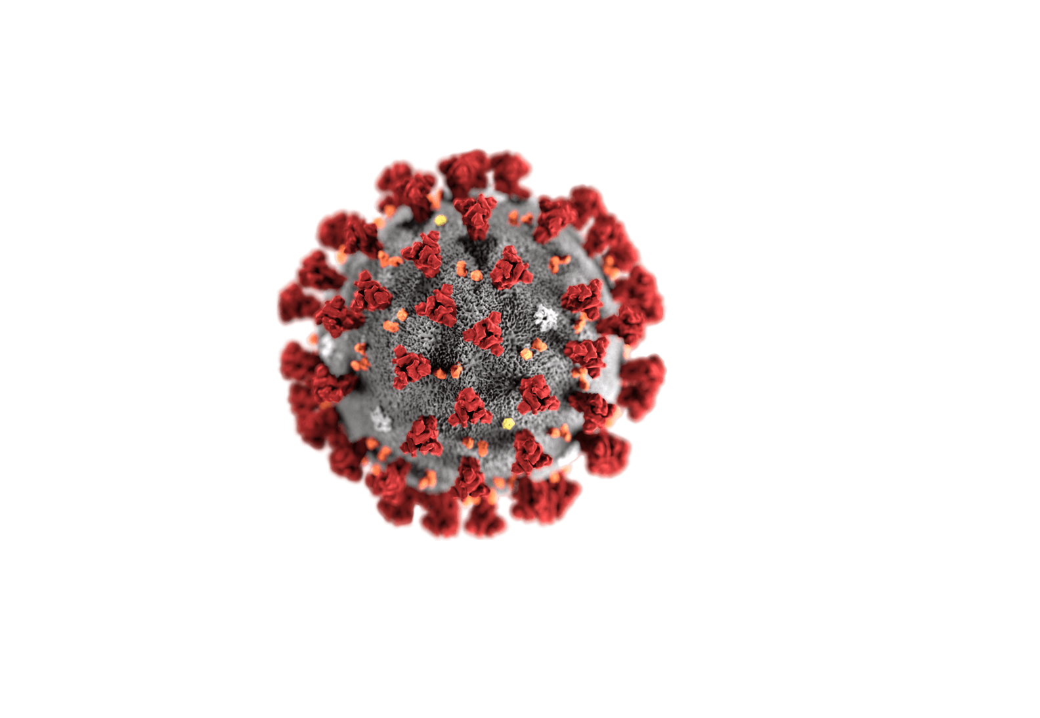
Failover Real Life Application
Remote hardware access without bricking
Notes:
[Virus] https://www.arcgis.com/sharing/rest/content/items/230e9a7935da40b18e1cf9222393f7c9/resources/1588258039159.png?w=2538
[homeoffice] https://www.viewsonic.com/library/wp-content/uploads/2020/04/LB0130-What-Is-Telecommuting.png

Slide 35
Conclusion
Analysis allows evaluation
Monitoring makes errors visible
Failover enables remote maintenance
Development usage demonstrates effectiveness
Notes:
Analysis: Helps to handle complexity, extract some reliability properties and also it allowed us to evaluate mitigation techniques
Monitoring: Visualises Errors and allows prevention in some cases
Failover: If a failure occurs, the system finds into a remotely maintainable state
Deployed: Shows that failover is usable and already affects development use cases + hopefully have same effect on experiment use cases

Slide 36
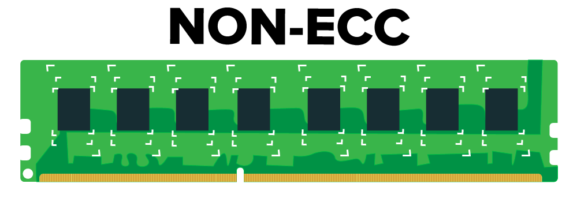
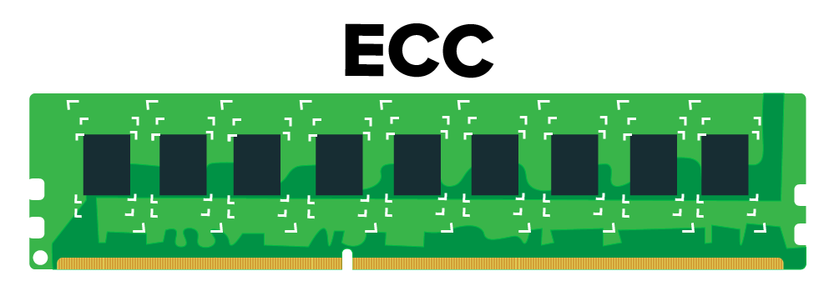
Further Improvements
Boot Loop Detection
Modern FS
Memory
Notes:
[ext4] https://4.bp.blogspot.com/_2rbhsHEyVVg/Sq2rhXebVJI/AAAAAAAAAWk/v8WXpIUAoB4/s400/ext4-file-system.png
[btrfs] https://seravo.fi/wp-content/uploads/2016/09/Btrfs_logo-e1474619419965.png
[ECC] https://www.atlantic.net/wp-content/uploads/2016/11/ecc-vs-nonecc.png
[C] https://www.pngfuel.com/free-png/aczlw
[bash] https://bashlogo.com/img/symbol/png/full_colored_dark.png

