Slide 1
Unity Experiment Framework (UXF)
Dr. Jack Brookes
Postdoc at UCL
PhD from University of Leeds, UK

Slide 2
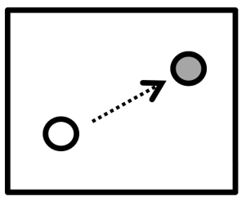
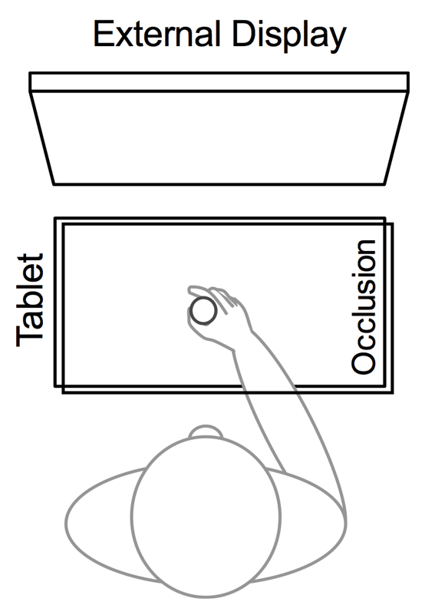
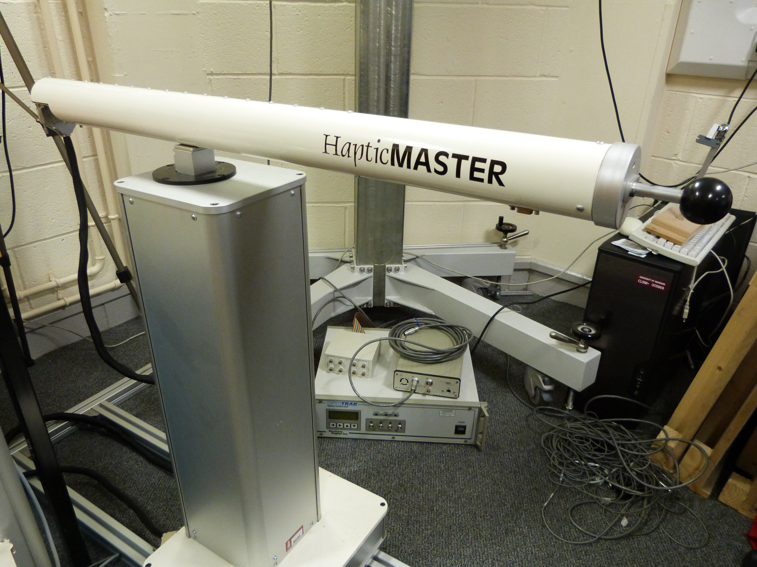
Background
UNITY EXPERIMENT FRAMEWORK
PhD investigating human movement errors

Slide 3
Background
UNITY EXPERIMENT FRAMEWORK
Frustrated with:
Clunky programming interfaces
Lack of reproducibility
Low ecological validity
Limited in movement (speed, space, portability)
Limited visual effects

Slide 4
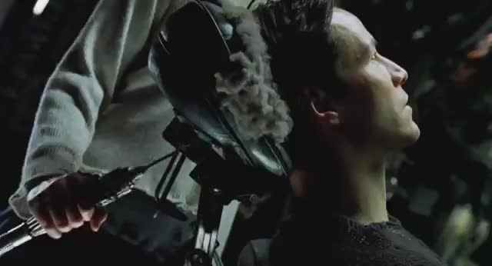
Behavioural Scientist’s dream
UNITY EXPERIMENT FRAMEWORK
Simulate a scenario
Social…
Learning…
Memory…
Manipulate senses realistically
‘Trick’ the brain
Measure all responses
Within our reach?

Slide 5
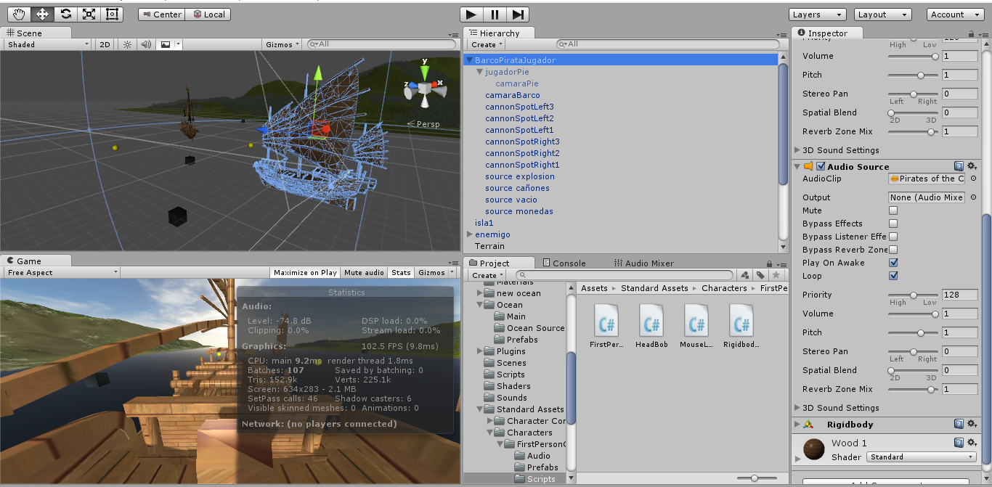
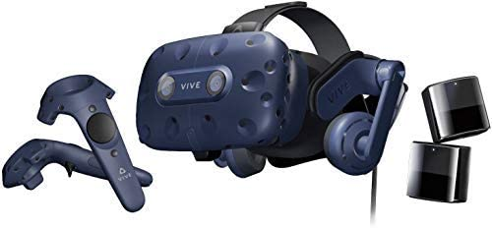
Unity + Virtual Reality
UNITY EXPERIMENT FRAMEWORK
High quality graphics
Accessible HW + SW
Most popular games engine
Experiment defined in software = reproducibility
Much greater ecological validity
Not convinced?

Slide 6
youtube.com/newsflare

Slide 7
VR + Unity for research
UNITY EXPERIMENT FRAMEWORK
Made for commercial games
Write code in C#
Researchers must write code to:
Create experiment structure
Collect data from participant
Write out & organise data files

Slide 9
Unity Experiment Framework goals
UNITY EXPERIMENT FRAMEWORK
Provides the core features for building an experiment
General, not experiment specific
Makes code readable and maintainable
Does nothing in terms of stimulus presentation
Not code-free

Slide 10
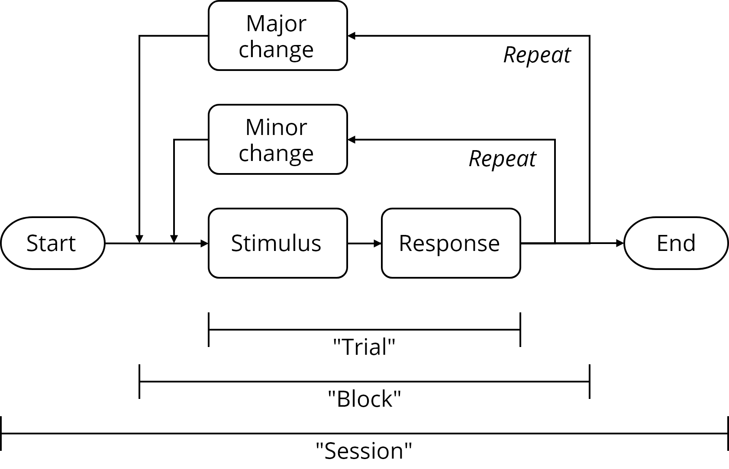
Structure of an experiment
UNITY EXPERIMENT FRAMEWORK
An experiment measures how independent variables affect dependent variables

Slide 11
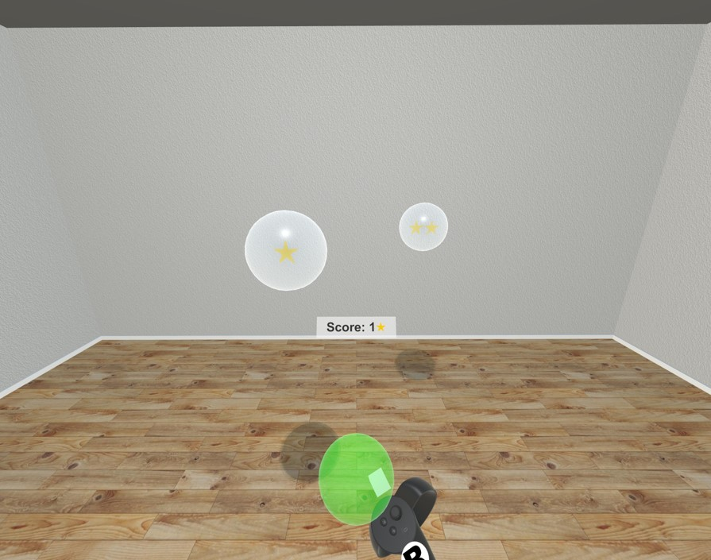
An example
UNITY EXPERIMENT FRAMEWORK
Which target do people choose? How fast? (DV)
Target may differ in size, reward, distance (IV)
How can UXF help us?

Slide 12
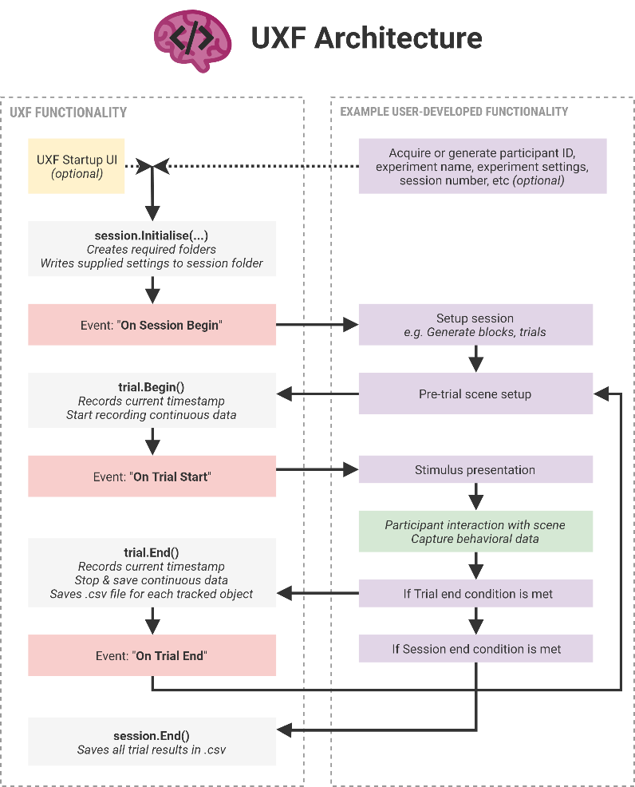
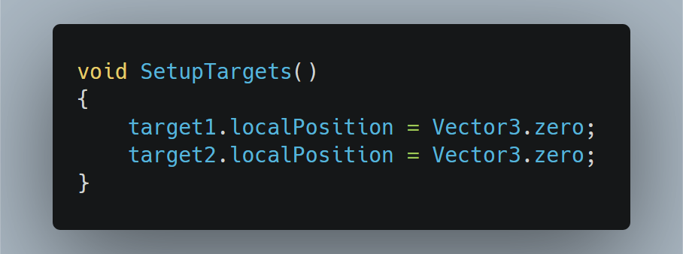
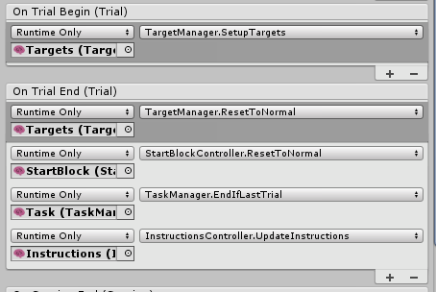
Events at key stages, assign them to your custom Unity functions

Slide 13
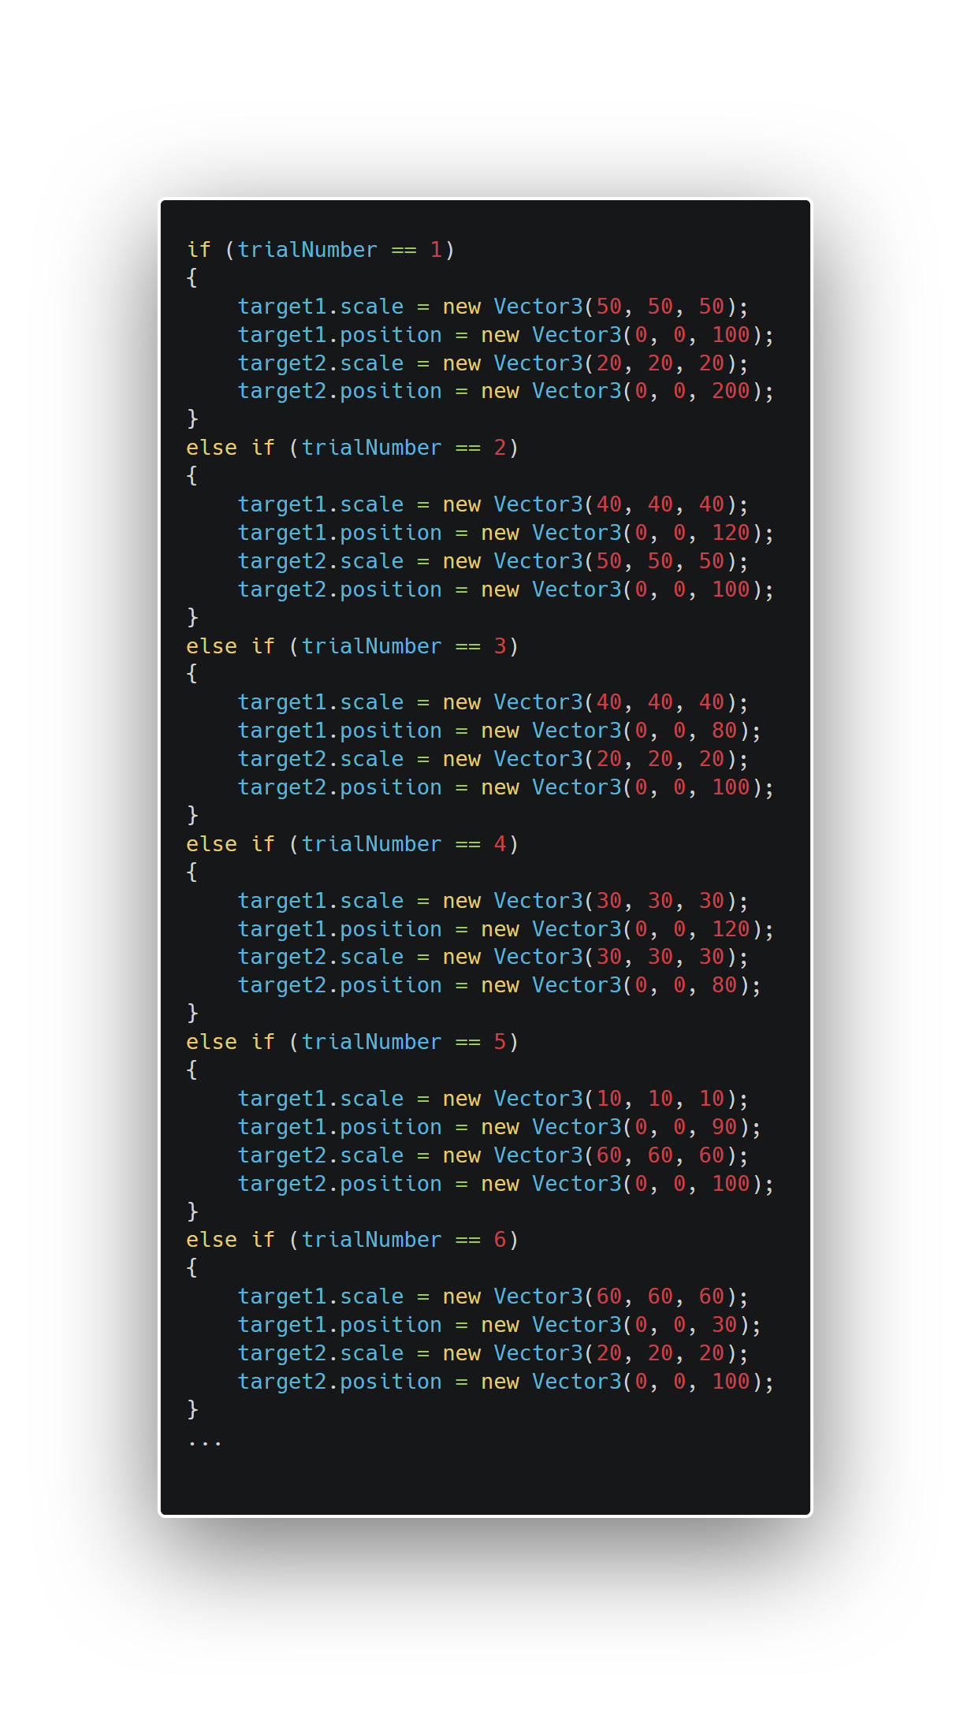
Example
Repetition
Difficult to see intent
Must be written up as methods section
Section of typical experiment code without UXF

Slide 14
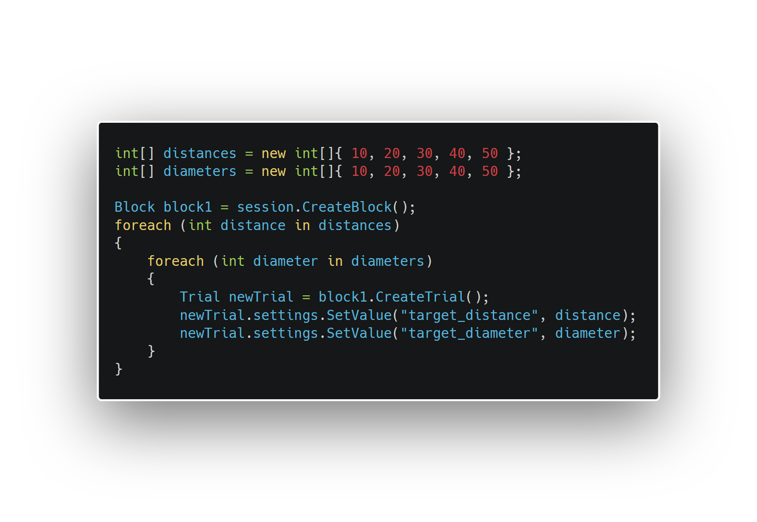
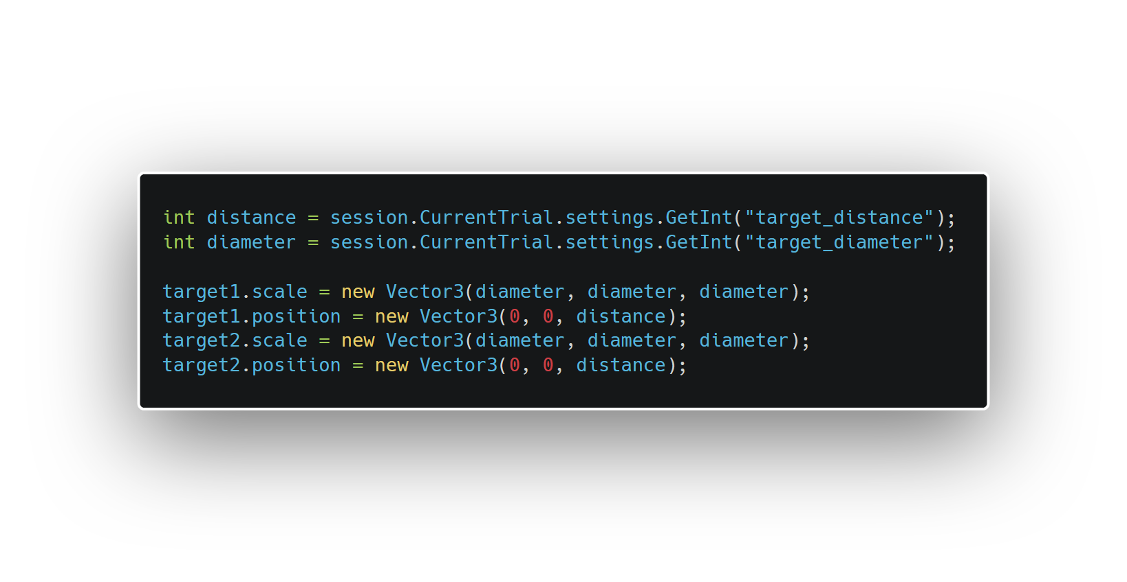
Example with UXF
Predefine independent variables
Runs once at the start of the experiment
Use variables to manipulate the 3D world
Runs on each trial
Experiment Specification
Experiment Implementation

Slide 15
Complex experiment definitions
UNITY EXPERIMENT FRAMEWORK
Examples
First block of trials have lower difficulty
10% of trials are different (“catch” trials)
Randomise order of trials

Slide 16
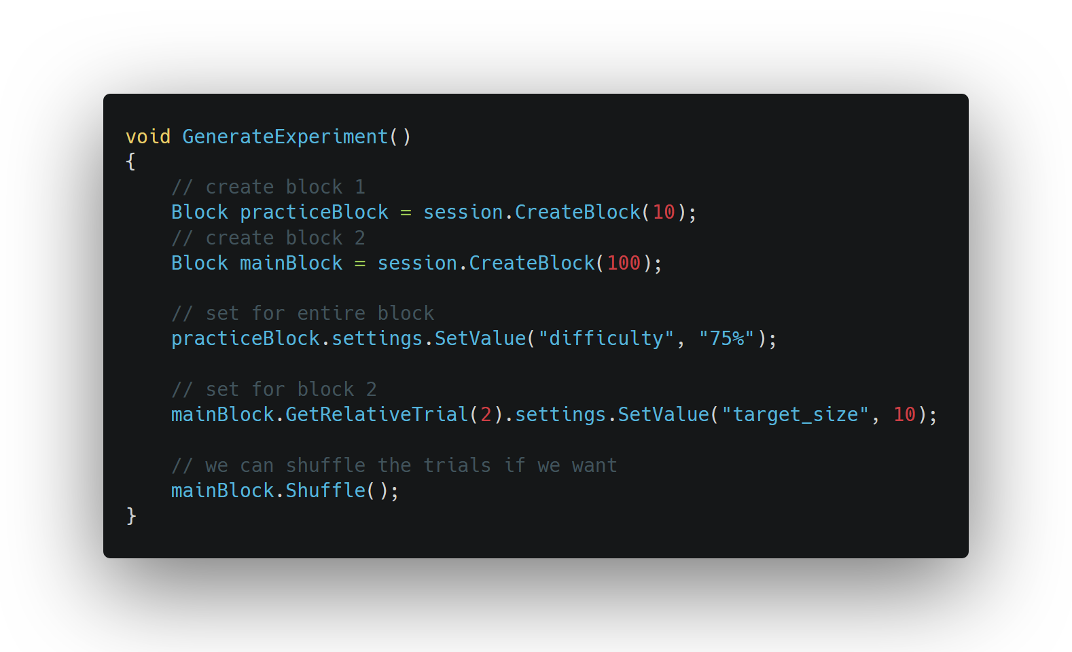
Example
Define experiment structure with code: Create your own rules

Slide 17
Dependent variables
UNITY EXPERIMENT FRAMEWORK
Saves data at 3 levels:
Per-participant (e.g. age, gender) – collected via a UI by default
Per-trial (responses, e.g. a selection, movement time)
Per-timestep within a trial (e.g. hand positions)
No hassle of making folders, naming files

Slide 18
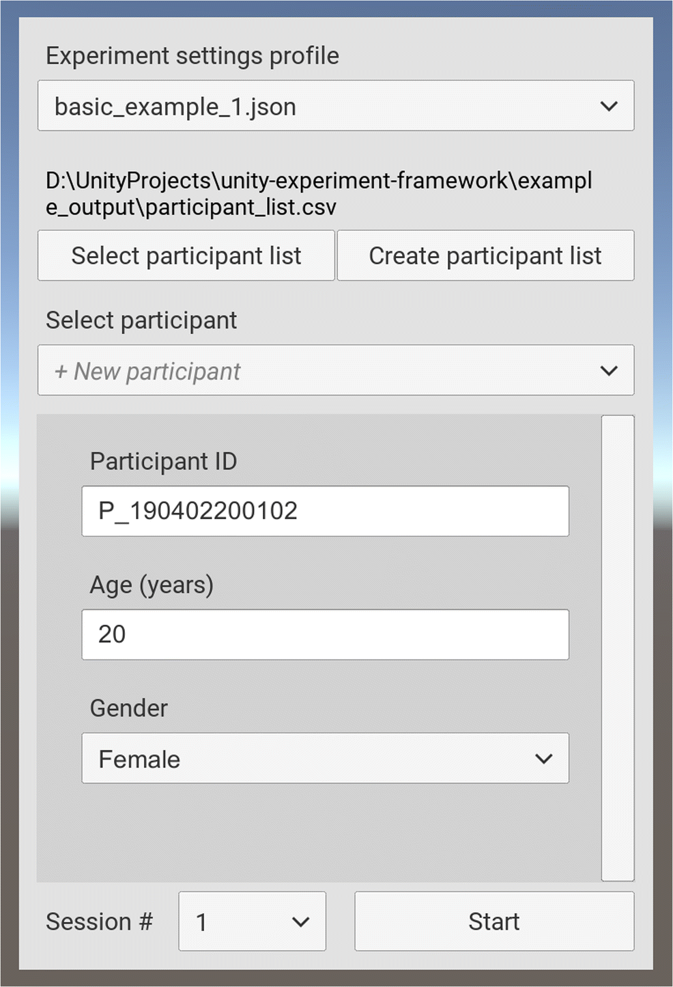
Example: Per-participant
User interface for researcher or participant
Allows input of per-participant datapoints
Age, gender, etc
Customisable

Slide 19
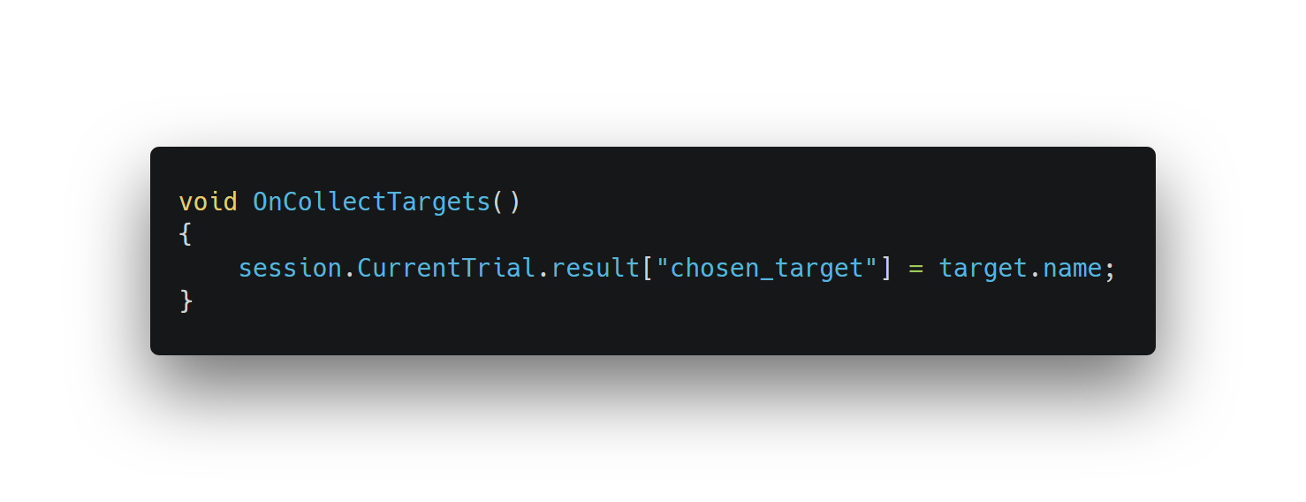
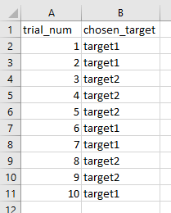
Example: Per-trial
Record a response on each trial
Automatically outputs properly formatted CSV

Slide 20
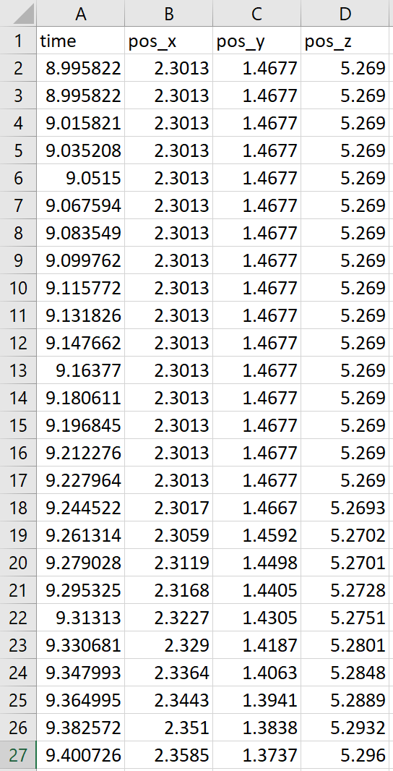
Example: Per-timestep
Pre-built component for tracking position & rotation

Slide 21
User Interface
UNITY EXPERIMENT FRAMEWORK
Designed for use by researchers on running the experiment
Allows selection of one or more “settings profiles”, stored as .json files
Allows easy collection of participant level data

Slide 22
Stimulus presentation / interaction
UNITY EXPERIMENT FRAMEWORK
UXF doesn’t interfere!
Leverage Unity’s suite of graphics, animation & physics tools
Unlimited possibilities

Slide 23
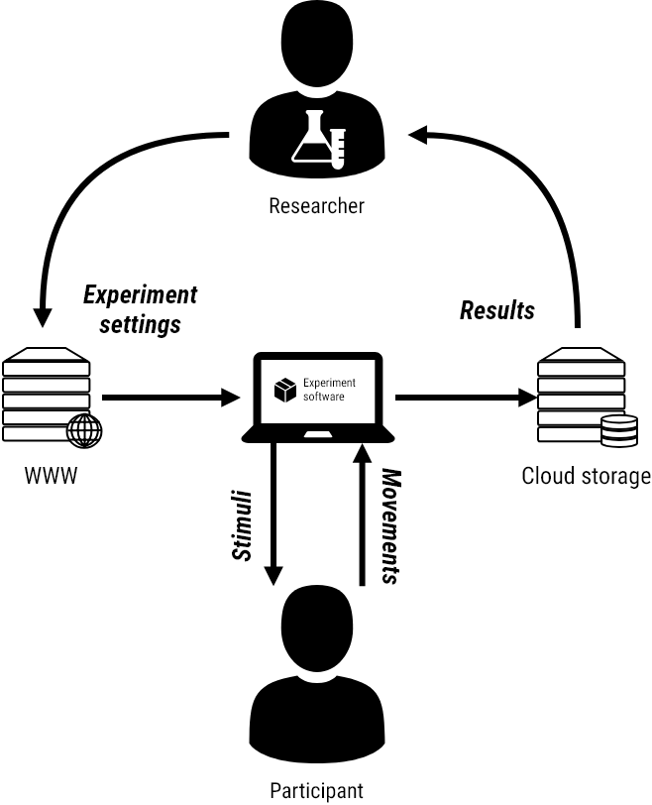
Experiments in the “cloud”
UNITY EXPERIMENT FRAMEWORK
https://s3.eu-west-2.amazonaws.com/jackb-test-bucket/experiment_settings/swipe_the_target.json
2 packages* to support this
Works invisibly
Can also support an end-user UI
* UXF Web Settings & UXF S3 Uploader

Slide 24
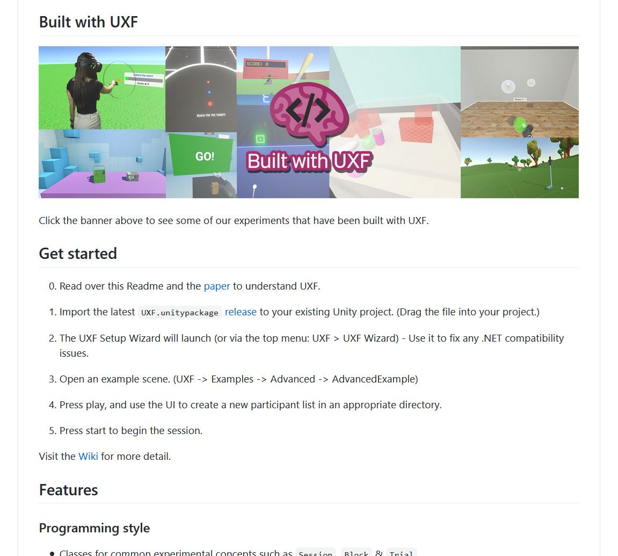
github.com/immersivecognition/unity-experiment-framework

Slide 25
Paper in Behavior Research Methods (2019)

Slide 26
Conclusion
UNITY EXPERIMENT FRAMEWORK
Experiment code is often messy
Separates Specification and Implementation
Boring parts are implemented (formatting output, organising directories)
Reproducible & portable → Scale
Revolutionary for movement & decision making tasks

Slide 27
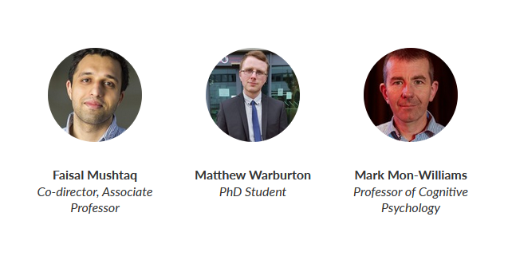
Thanks!
UNITY EXPERIMENT FRAMEWORK
Team from Immersive Cognition group, University of Leeds, UK

