Slide 1
What do we (not) know about RSE?
SORSE Workshop, 28 & 30 October 2020
Anna-Lena Lamprecht, Utrecht University
Carlos Martinez, Netherlands eScience Center
Michelle Barker, Research Software Alliance (ReSA)

Slide 2
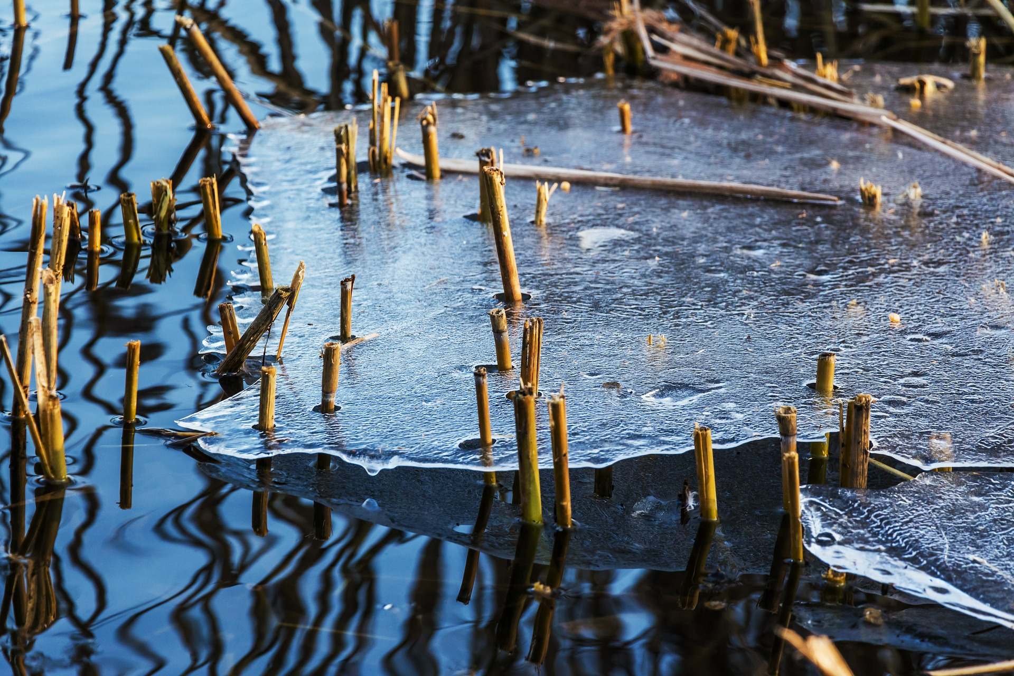
Icebreaker: https://www.menti.com/xz5awd4x5e

Slide 3
Why this workshop?
Research Software Engineering (RSE) increasingly being established as a field and profession.
Subject of (empirical) research and scientific discussion to gain insights about it.
Moving beyond “mere anecdotal” evidence
Basis for the (further) development of policies, infrastructure, communities, training, curricula, tools, technology …
But what do we actually know about RSE now?
And what research about RSE needs to be done?

Slide 4
Workshop goals
Today:
Collect questions about RSE, and the motivations for asking them.
Collect literature/references that provide answers to these questions.
Identify open questions.
Coming weeks:
Turn findings into a review paper and research agenda.

Slide 5
Program
3 short talks - examples of research about RSE (20 min)
“World Café” to collect research questions (3 x 20 min)
Break (30 min)
Breakout groups to discuss and prioritize questions (30 min)
Planning of paper writing process (20 min)
Closing (10 min)

Slide 6
Short talks
“How many RSEs?” (Simon Hettrick)
“Forming and Supporting RSE Groups and Communities” (Daniel S. Katz)
“Research Software Engineers and The Carpentries” (Zhian Kamvar, Toby Hodges and Serah Rono)

Slide 7
World Café: collecting questions
What do you want to know about RSE, and why?
3 x 20 mins in randomly assigned breakout groups, moderated by us
Three topics: People, Infrastructure, Policy
Topics will rotate
Appoint a note-taker
Take notes in shared G-Docs (links will be provided in the breakout rooms)
Add links to existing research where applicable.

Slide 8
World Café: quick poll
Which question is your personal favorite? (mentimeter)

Slide 9
Time for a break!

Slide 10
Breakout groups: prioritizing questions
Again in three thematic breakout groups (new random assignment)
Appoint a note-taker
Discuss the questions collected before the break and identify:
The three most important ones (and why)
The three most urgent ones (and why)
The three “lowest-hanging fruits” (and why)
Report back to the group after 15 min.

Slide 11
Paper writing process
Goal: A review paper and research agenda for RSE research.
Proposed timeline:
End November 2020: input for literature review (everybody)
Before Christmas 2020: first draft ready (organizers)
January 2021: revision (everybody)
End of January 2021: submission (organizers)
Organizers will e-mail you with updates and reminders about the process.

Slide 12
Which outlet?
What would be a good outlet to publish this paper? (mentimeter)

Slide 13
Closing
We hope you enjoyed the workshop!
We will be in touch about the paper writing process.
There is much to do for all of us!

Slide 14
Thanks and goodbye!

