Slide 1
Ultra-low mass silicon trackers for high-rate, high-multiplicity heavy-ion physics
Johann M. Heuser GSI Helmholtz Center for Heavy Ion Research, Darmstadt, Germany
607th Heraeus Seminar “Semiconductor detectors in astronomy, medicine,
particle physics and photon science”, Bad Honnef, 14-17 February 2016

Slide 2
Overview
What is Heavy-Ion Physics?
Challenge: Charged-particle tracking at high multiplicities and high rates
Silicon Detectors: Microstrips and pixels
Technical approach of two modern applications:
ALICE Inner Tracking System (Collider Experiment)
CBM Silicon Tracking System (Fixed-Target Experiment)

Slide 3
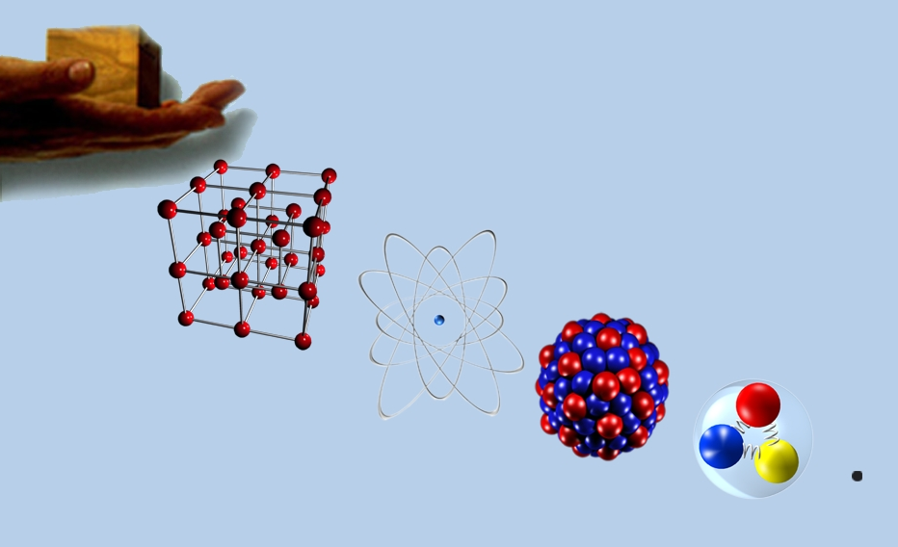
Heavy-ion physics
Collective term for research with energetic heavy ions.
Heavy ions are the nuclei of heavy elements (ionized atoms, e.g. Gold, Lead).
As projectiles they are important probes to study matter.
matter
Research fields
nuclear physics, atom and solid state physics
nuclear chemistry
astro physics
energy and material research
biology and medicine
crystal
(10⁻³ m)
atom
(10⁻¹⁰ m)
electron
nucleus
(10⁻¹⁴ m)
proton/neutron
(10^{–15} m)
quarks
cell
(10⁻⁵ m)
(<10⁻¹⁸ m)

Slide 4
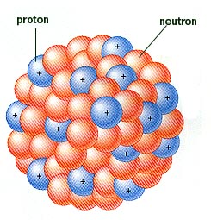
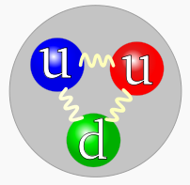
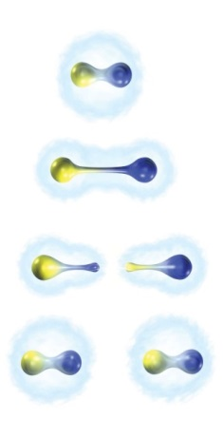
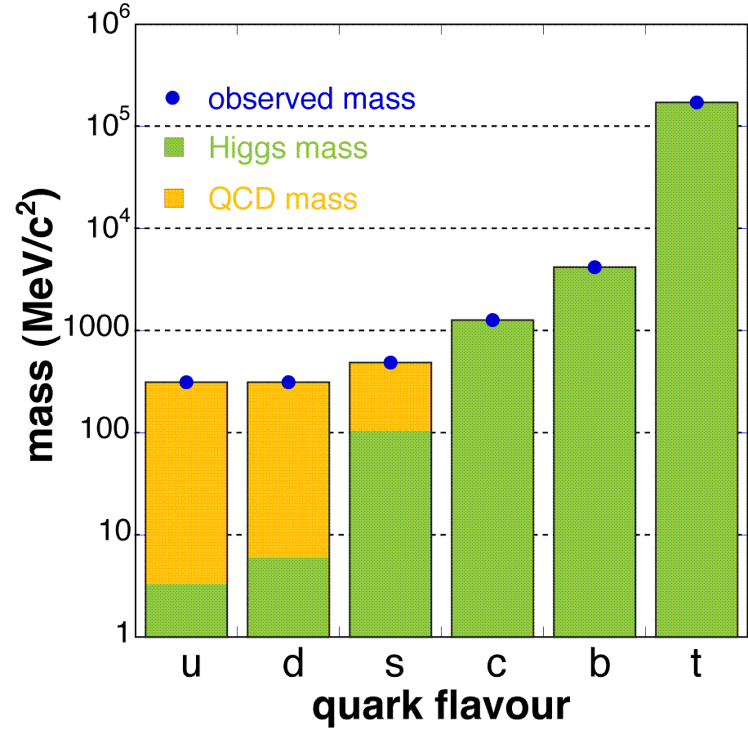
Nuclear matter
Hadrons: composite particles made of quarks held together by the strong force:
mesons (quark + anti-quark)
baryons (3 quarks)
wikipedia
proton
neutron
nucleus
Why are quarks confined in hadrons?
How is their mass generated?
Coupling strength between two quarks
Experimental approach: Measure the properties of hadrons inside nuclear matter under extreme conditions: heat, pressure.

Slide 5
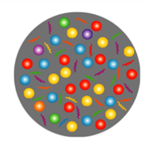
Exploring the QCD phase diagram
Quark-Gluon Plasma
Courtesy of K. Fukushima & T. Hatsuda
At very high temperature: → highest-energy ion collisions
N of baryons ≈ N of antibaryons Situation similar to early universe
Lattice-QCD finds crossover transition between hadronic matter and Quark-Gluon Plasma
Experiments: ALICE, ATLAS, CMS at LHC-Heavy-Ion program STAR, PHENIX at RHIC

Slide 6
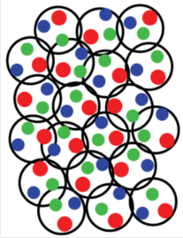
Exploring the QCD phase diagram
Compressed Baryonic Matter
Courtesy of K. Fukushima & T. Hatsuda
At high baryon density: → heavy-ion beams in range 7 to 45 GeV/nucleon
N of baryons >> N of antibaryons Densities like in neutron star cores
L-QCD not (yet) applicable Models predict first order phase transition with mixed or exotic phases
Experiments: RHIC-BES, NA61 at CERN SPS,
CBM at FAIR, NICA at JINR

Slide 7
Heavy-ion collisions

Slide 8
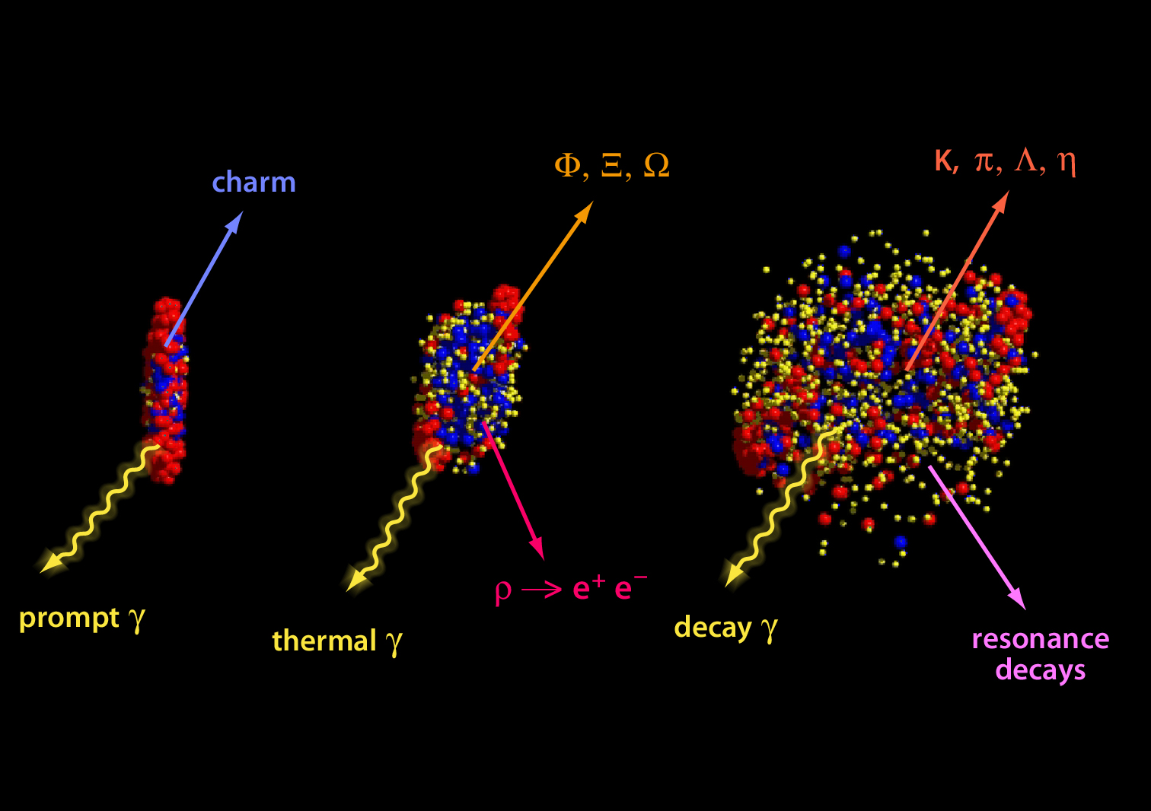
Diagnostic probes

Slide 9
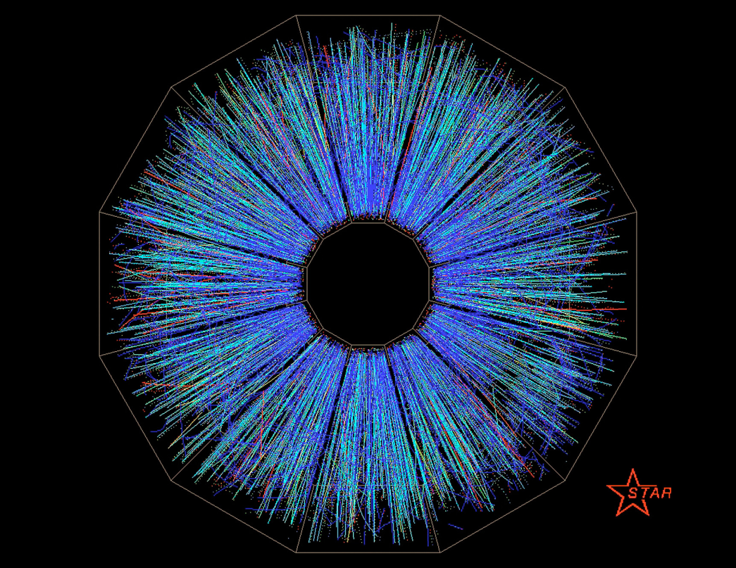
Charged-particle tracks, collider experiment
TPC detector

Slide 10
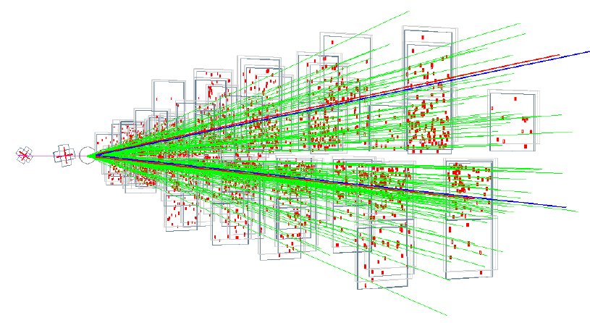
Charged-particle tracks, fixed-target experiment
Silicon pixel vertex tracker

Slide 11
Tracking challenge
high charged-particle multiplicities
example LHC Pb+Pb @ 5.5 TeV: dn_{ch} /dη | η=0.5 ≈ 1900
track densities up to 100 cm⁻²
high collision rates:
O(10 kHz) at LHC to 10 MHz at FAIR: due to rare probes
standalone tracking
high detector segmentation
low-mass detector → momentum resolution of O(1%)
fast read-out electronics: little or no pile-up of collisions
track-matching to other detectors
in-detector decay topology
vertex detection
particularly fine segmentation
especially thin detector layers
detection of short-lived decays
→ typically with inner layers of a tracking detector, or a specialized add-on to it.

Slide 12
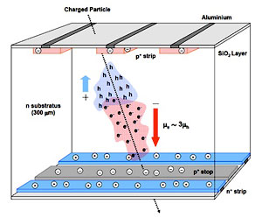
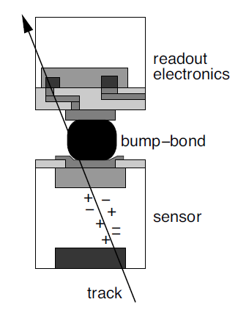
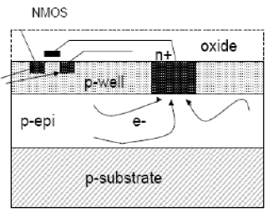
Silicon detectors
Silicon Microstrip Detector:
thickness typ. 300 μm
1 or 2-sided segmentation
fine sensor pitch, typ. 50 μm
1-d native hit pattern, 2-d combinatorial points
electronics separated from sensor
Pixel Detectors:
thickness < 300 μm
fine sensor pitch, typ. < 50 μm
2-d native hit pattern
hybrid detector: electronics sandwiched with sensor, fast
monolithic detector: thin, ~50 μm, electronics integrated in sensor, less fast

Slide 13
Two tracking detector systems under construction:
ALICE Inner Tracker Upgrade
CBM Silicon Tracking System

Slide 14
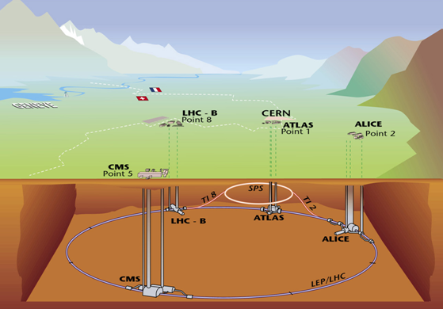
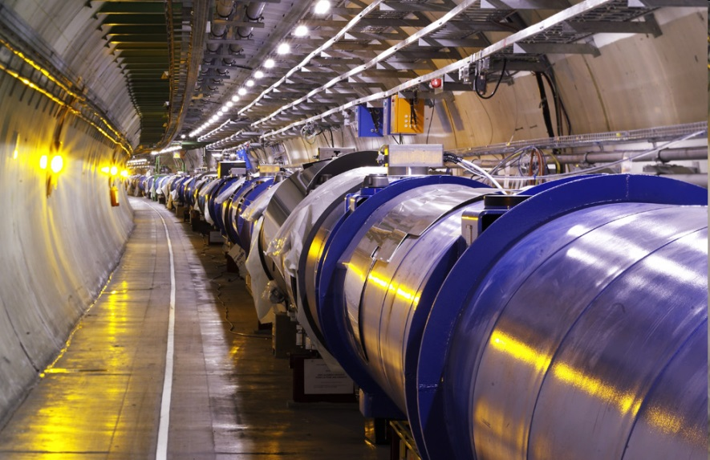
Large Hadron Collider @ CERN
largest and highest-energy particle accelerator,
27 km circumference
p+p, √ s = 14 TeV Pb+Pb, √ s_{NN} = 5.5 TeV/nucleon

Slide 15
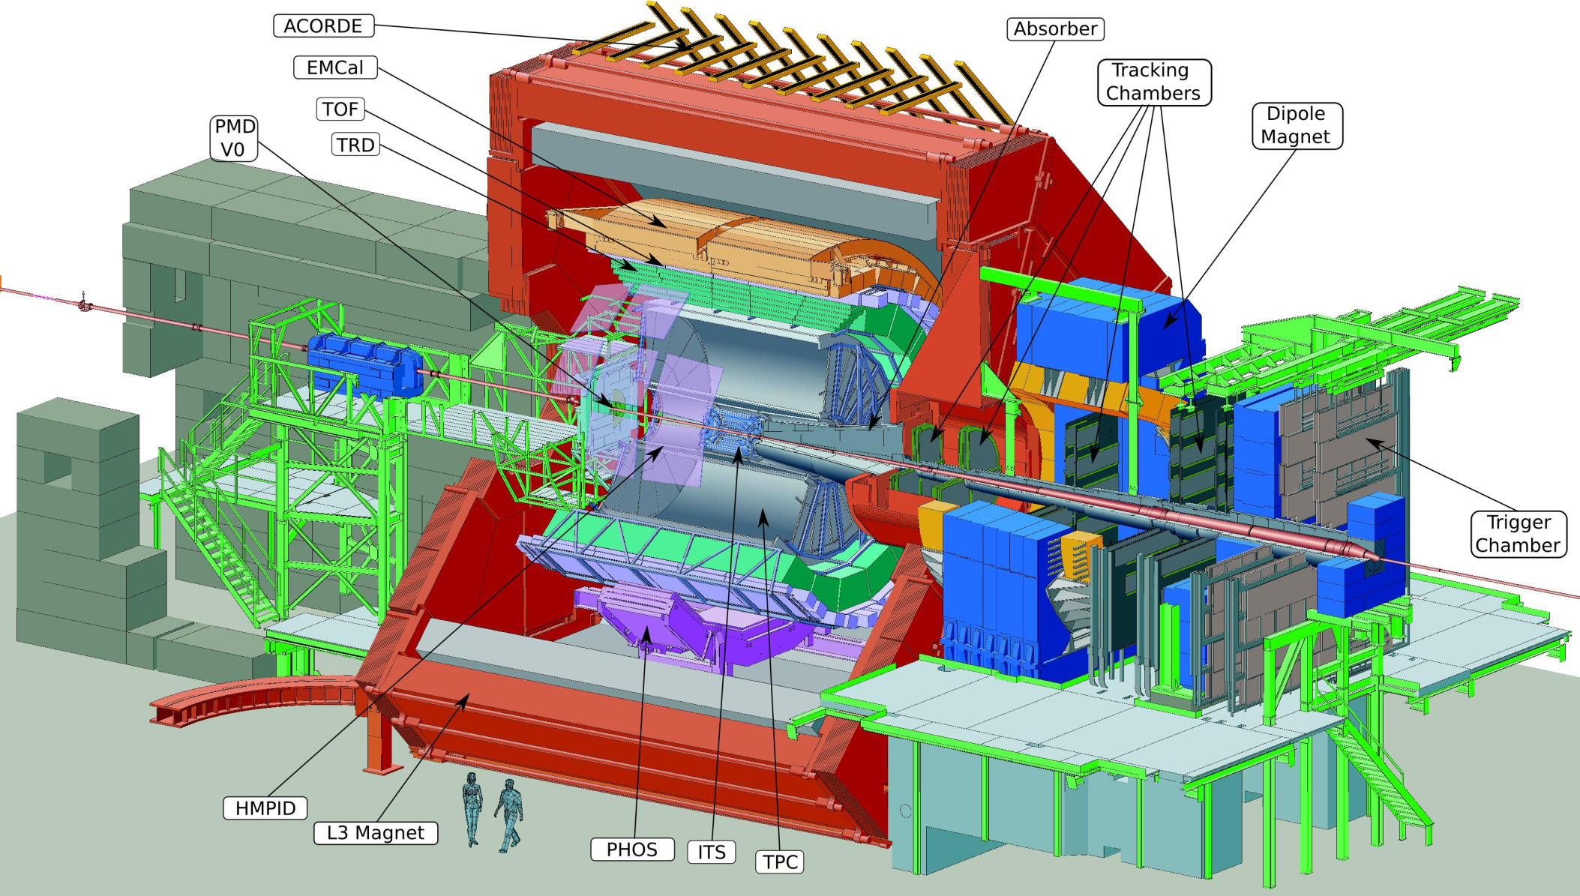
ALICE Experiment

Slide 16
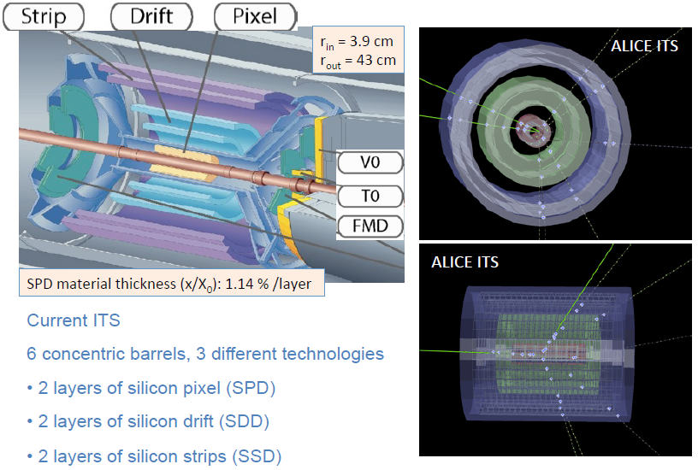
Current ALICE ITS
ALICE ITS slides: from L. Musa, ref. 5

Slide 17
ITS Upgrade Design Objectives
1. Improve impact parameter resolution by a factor of ~3
Get closer to IP (position of first layer): 39 mm → 23 mm
Reduce x/X0 /layer: ~1.14% → ~ 0.3% (for inner layers)
Reduce pixel size: currently 50 μm x 425 μm → O(30 μm x 30 μm)
2. Increase granularity:
6 layers → 7 layers
silicon drift and strips → (monolithic active) pixels
3. Increase readout speed (currently limited at 1 kHz with full ITS)
Pb+Pb interactions at > 100 kHz,
p+p interactions at ~ several 100 kHz
4. Fast insertion/removal for yearly maintenance
possibility to replace non-functioning detector modules during yearly shutdown

Slide 18
ALICE ITS Upgrade

Slide 19
ITS pixel detector

Slide 20
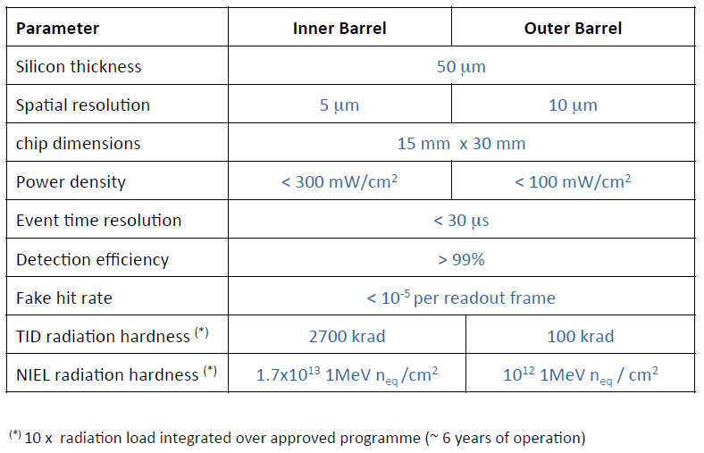
Pixel detector requirements

Slide 21
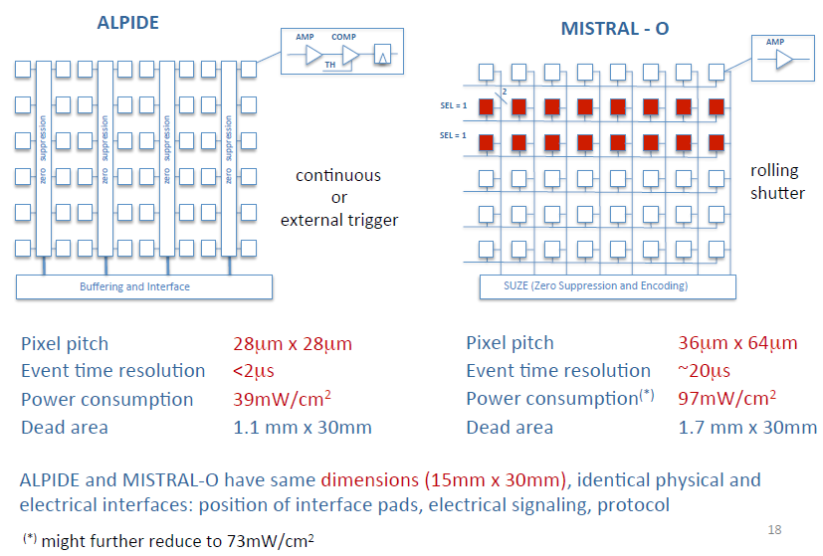
Pixel chip architecture

Slide 22
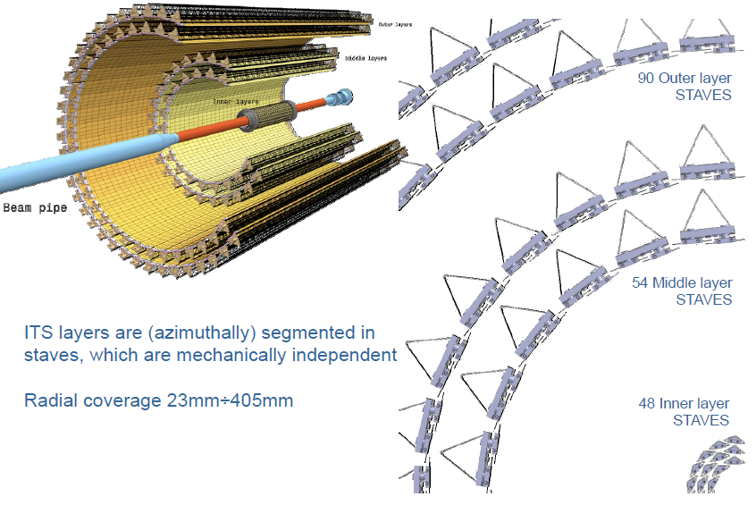
ITS Layout

Slide 23
Inner Barrel Staves

Slide 24
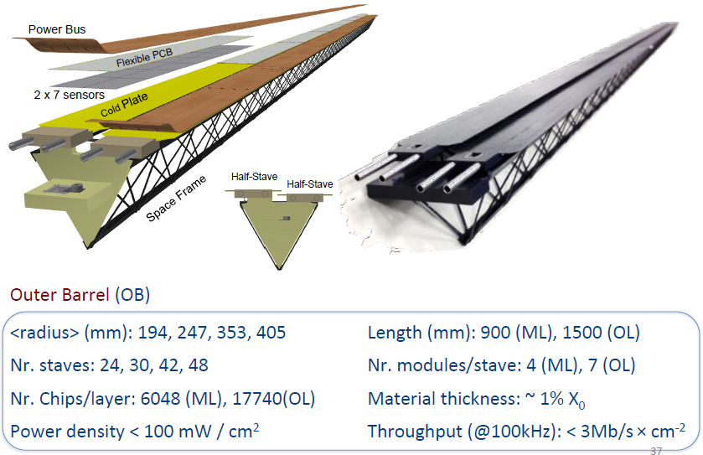
Outer Barrel Staves

Slide 25
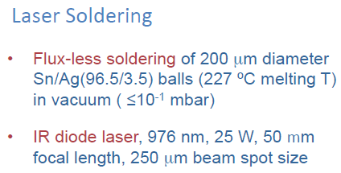
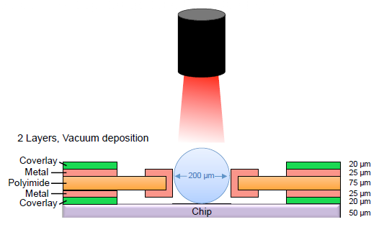
Interconnection of pixel chip to flex PCB
Powering and Read-out
Cooling
power dissipation: 300/100 mW per ASIC in inner/outer barrel
total power dissipation: 15 kW
cooling duct embedded in a carbon structure, de-mineralized water flow
detector operation at room temperature, dry air-flow to control humidity
external thermal shield towards the TPC detector

Slide 26
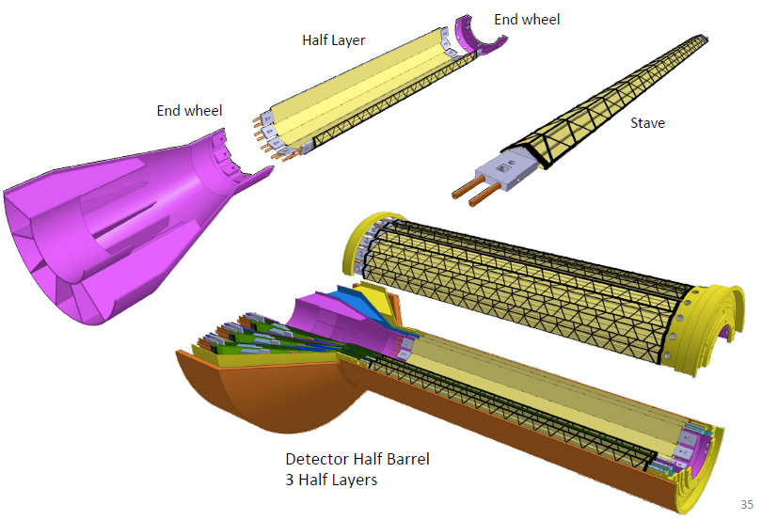
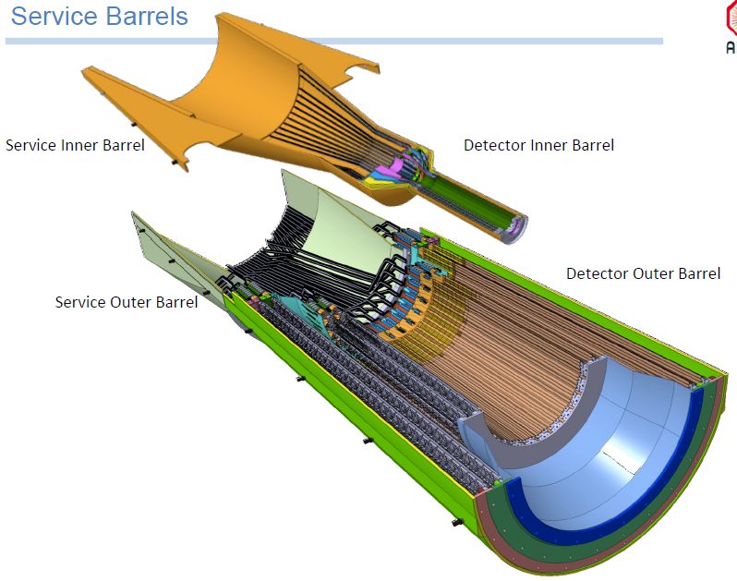
System Integration

Slide 27
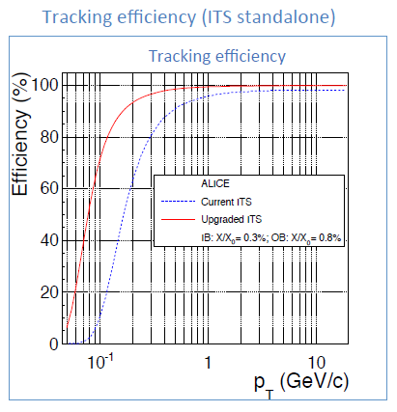
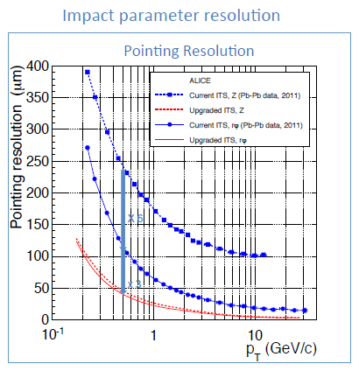
ITS Upgrade performance simulation

Slide 28
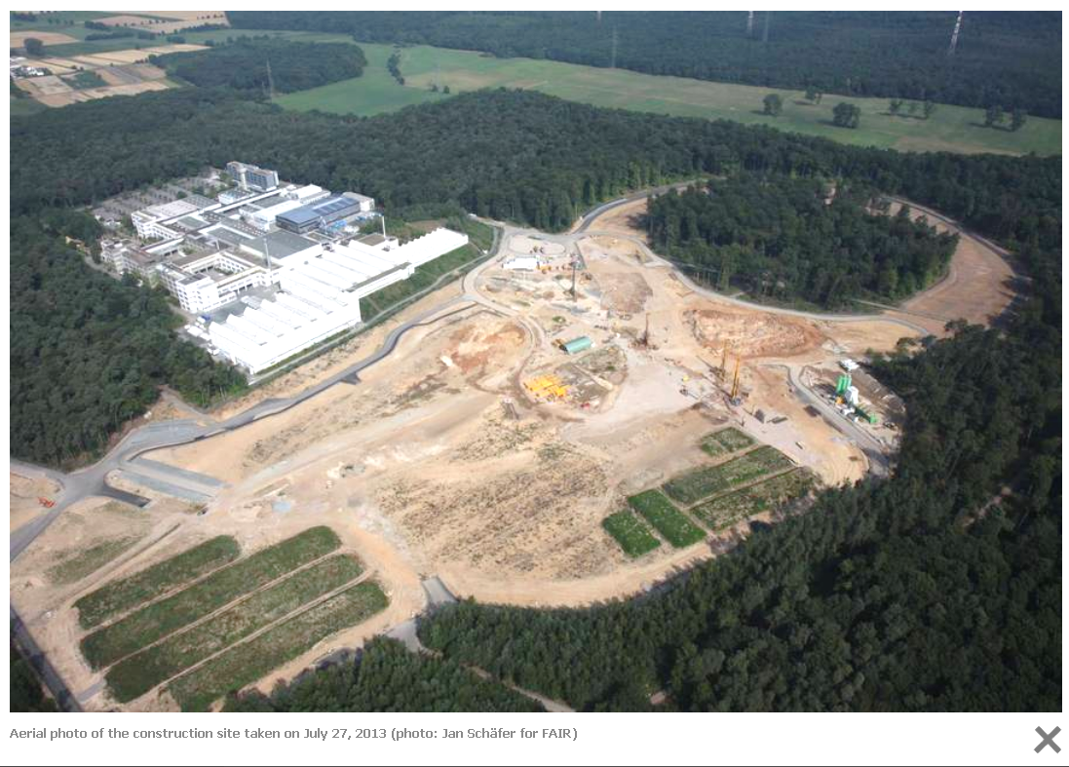
FAIR - Facility for Anti-Proton and Ion Research, Darmstadt

Slide 29
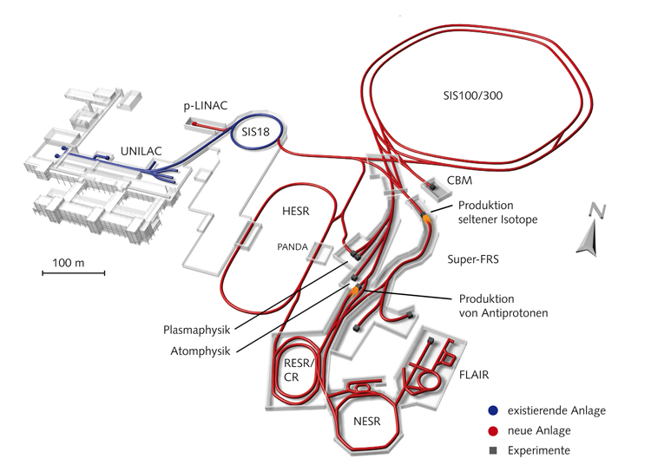
FAIR - Facility for Anti-Proton and Ion Research, Darmstadt
GSI Helmholtz Center for Heavy Ion Research GmbH, Darmstadt, Germany
1 km circumference
CBM
p to U beams,
2 – 45 GeV/nucleon
highest intensities

Slide 30
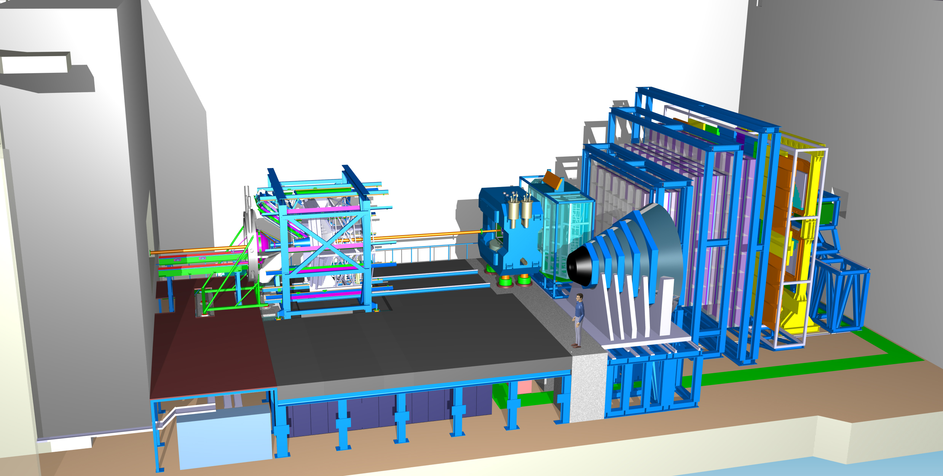
CBM Experiment
Ring
Imaging
Cherenkov Detector
Time-of-Flight Detector
Silicon
Tracking
System
Dipole
Magnet
HADES Detector
Transition
Radiation
Detector
Micro
Vertex
Detector
Beam Dump
beam
DAQ/FLES HPC cluster
Projectile
Spectator
Detector
Muon
Detector

Slide 31
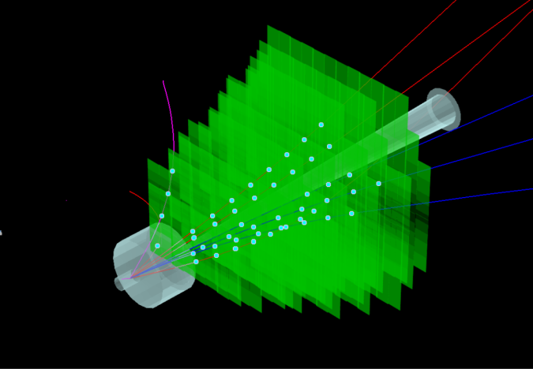
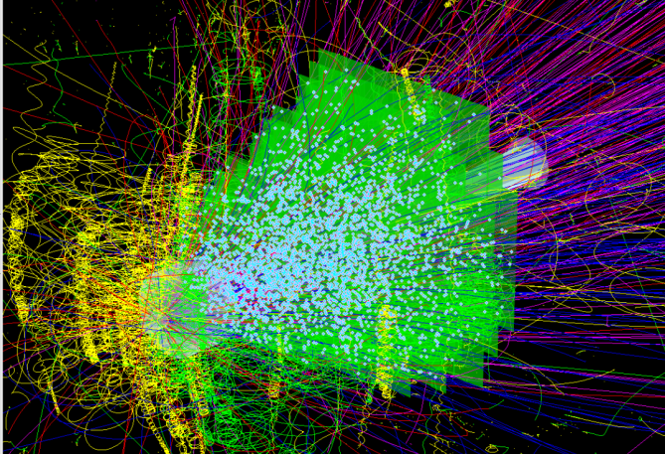
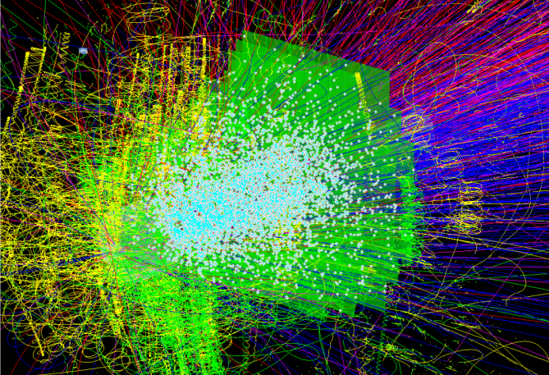
Silicon Tracking in CBM
STS task: track identification + momentum determination
from few charged particles in p+A collisions at SIS100
to hundreds of charged tracks in A+A collisions at SIS100 and SIS300
at 10⁵ to 10⁷/s collisions per second
identification of decay topologies within its aperture
links to further detectors: MVD (upstream) and MUCH/RICH (downstream)
UrQMD + GEANT + CbmRoot
p+C, 30 GeV
central Au+Au, 8 AGeV
central Au+Au, 25 AGeV
few charged particles
~350 charged particles
~700 charged particles

Slide 32
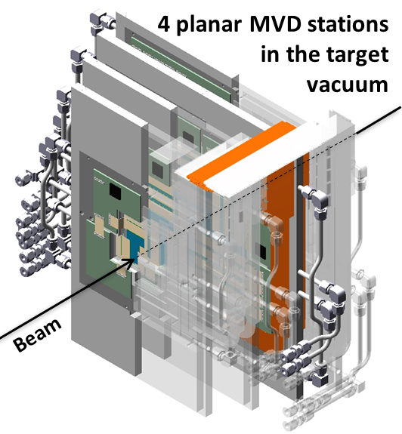
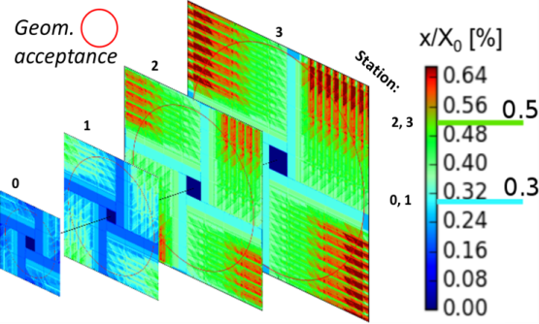
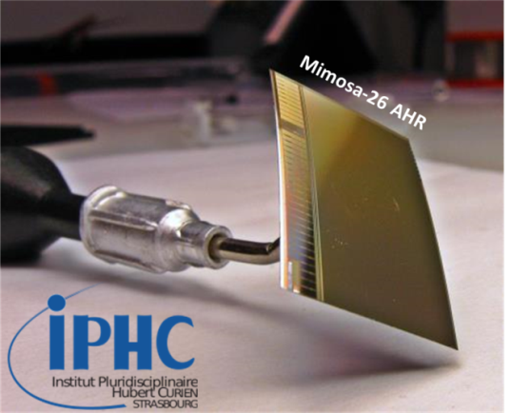
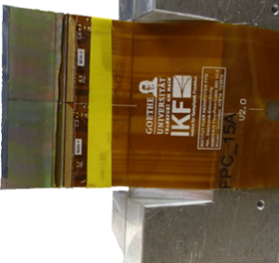
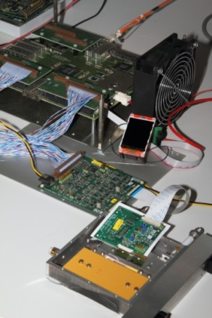
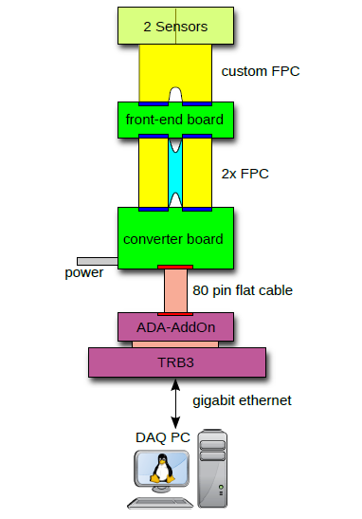
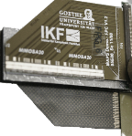
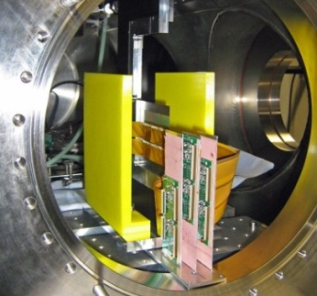
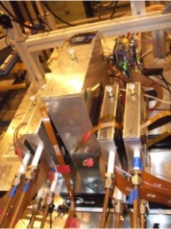
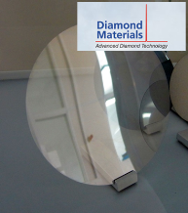
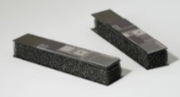
CBM Micro-Vertex Detector
Ultra-thin: CVD diamond, TPG
Sensors: CMOS MAPS
Radiation hard,
Thinned to 50 µm,
< 150 mW/cm²,
spatial resol. < 5 µm,
R/O several 10 µs/frame
Prototyping & test beam:
Customized FEE & DAQ:
TRB-based
MVD demonstrator
MVD prototype
PRESTO
RVC foam
Thermal Pyrolytic Graphite

Slide 33
STS design constraints
Coverage:
from center-of mass to close to beam rapitidies
aperture 2.5° < Θ < 25°
Momentum resolution
δp/p ≅ 1%
field integral 1 Tm, 8 tracking stations
25 µm single-hit spatial resolution
material budget per station 0.3 – max. ~1% X₀
No event pile-up
interaction rates 0.1 - 10 MHz
self-triggering read-out
timestamp resolution < 5 ns
signal shaping time < 20 ns
Efficient hit & track reconstruction
close to 100% hit efficiency
> 95% track eff. for p > 1GeV/c
Minimum granularity
at hit rates < 20 MHz/cm²:
maximum strip length compatible with hit occupancy and S/N performance
largest read-out pitch compatible with the required spatial resolution
Radiation hard sensors
compatible with CBM physics program:
1 × 10¹³ n_{eq}/cm² (SIS100)
1 × 10¹⁴ n_{eq}/cm² (SIS300)
Integration, operation, maintenance
compatible with the confined space in the dipole magnet
efficient cooling for electronics
cooling of sensors
system design including target chamber, MVD, beam pipe
extraction possible for maintenance

Slide 34
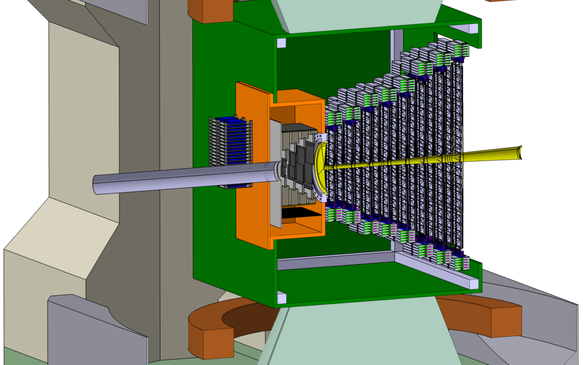
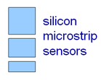
System concept
8 tracking stations in dipole magnet: between 0.3 m and 1 m from target.
Aperture: 2.5° < Θ < 25° (38° horizontal).
Double-sided micro-strip sensors in 3 sizes, arranged in modules on carbon-fiber supported ladders.
Readout electronics at periphery.
Target chamber/MVD/beam pipe.
Thermal enclosure, sensors at -5 ◦C.
STS
beam
2.5°
25°
target

Slide 35
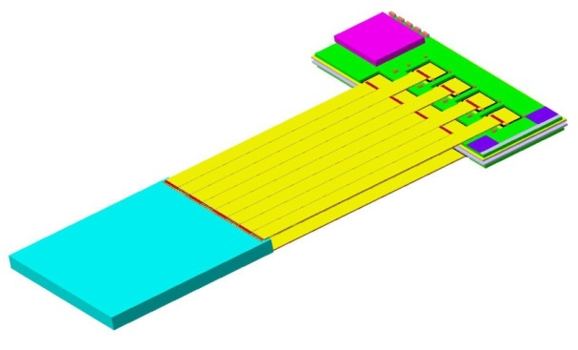
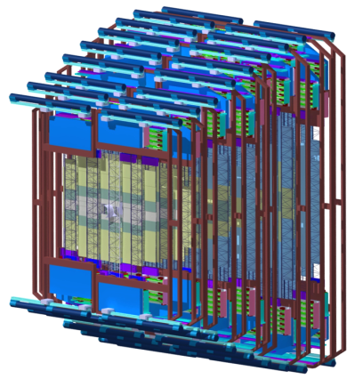
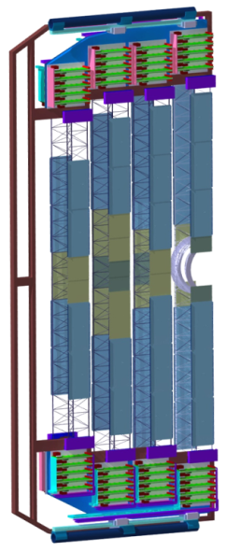
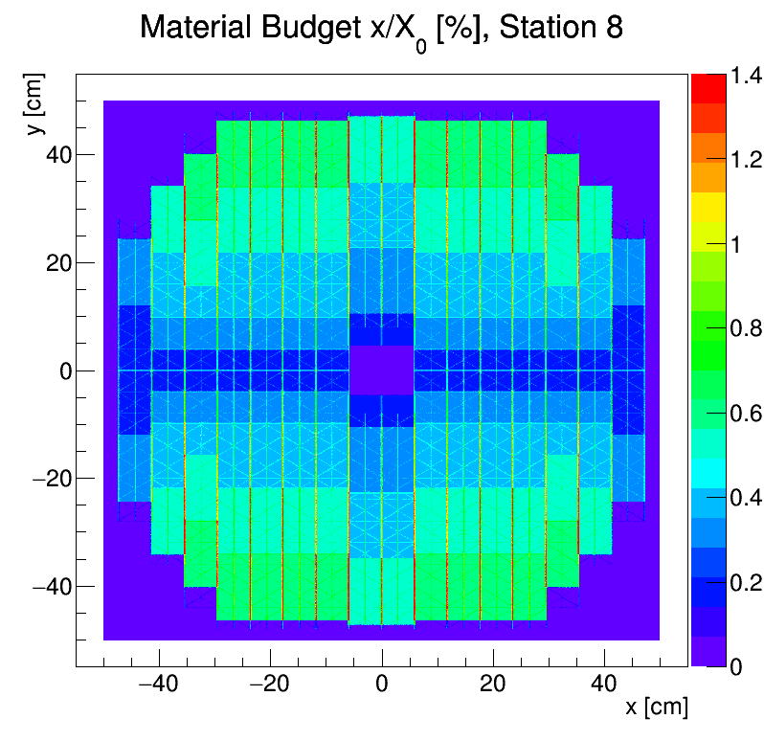
STS integration concept
building block: 4-5 modules per ladder
front-end board: 8 self-triggering r/o ASICs
8 stations, volume 2 m³, area 4 m²
896 detector modules
1220 double-sided microstrip sensors
~ 1.8 million read-out channels
~ 16 000 r/o STS-XYTER ASICs
~ 16 000 ultra-thin r/o cables (à 5 components)
106 detector ladders with 4-5 modules
power dissipation: 42 kW (CO₂ cooling)
ultra-thin r/o cables
sensor
x/X₀ [%]
1 m
8 tracking stations
mech. unit
ladder
material budget per station

Slide 36
Silicon microstrip sensors
300 µm thick, n-type silicon
double-sided segmentation
2nd metal routing lines
1024 strips of 58 µm pitch
strip length 2/4/6/12 cm
angle front/back: 7.5/0 deg
read-out from top edge
rad. tol. up to 10¹⁴ n_{eq}/cm²

Slide 37
Silicon microstrip sensors
300 µm thick, n-type silicon
double-sided segmentation
2nd metal routing lines
1024 strips of 58 µm pitch
strip length 2/4/6/12 cm
angle front/back: 7.5/0 deg
read-out from top edge
rad. tol. up to 10¹⁴ n_{eq}/cm²
6.2 × 6.2 cm²
6.2 × 12.4 cm²
6.2 × 4.2 cm²
6.2 × 2.2 cm²
prototype sensors from CiS, Germany, and Hamamatsu Photonics, Japan
prototype read-out sector with two daisy-chained sensors

Slide 38
Read-out cables
cable stack: thickness 0.230 % X₀
spacer layer
signal layer: 64 Al lines of 116 µm pitch, 10 µm thick on 14 µm polyimide, lengths up to 55 cm

Slide 39
Read-out ASIC “STS-XYTER”
purely data driven read-out
time-stamped data elements
every channel is divided into two sub-channels:
fast branch: time-stamp
slow branch: signal digitization
STS-XYTER ASIC
t_{s} = 30 ns
v1.0 produced (v2.0 under design) UMC 180 nm CMOS
r/o logic
CBM-NET
(v1.0 )
GBT (V2.0)
LSB veto
t_{s} = 80 ns
channels | 128, polarity +/-
noise | 1000 e⁻ under load
ADC range | 16 fC, 5 bit
clock | 250 MHz
power | < 10 mW/channel
timestamp | < 5 ns resolution
out interface | 4(5) × 500 Mbit/s LVDS
noise minimization in self-triggering system:
effective two-level discrimination
trigger to the timestamp latch is vetoed if ADC-LSB generated no signal
no transmission of data then

Slide 40
Detector module
integration of:
silicon sensors,
front-end electronics,
read-out cables
into the building block of the STS:
“module”
71 (+3) components/module
non-reworkable assembly
high-yield components essential
→ most work-intensive and critical part of STS construction effort:
896 modules required

Slide 41
Module assembly
TAB bonding of microcables to ASICs and sensors
dummy components (sensor, ASICs, FEBs)

Slide 42
Carbon fiber ladders

Slide 43
Engineering: units/cabling/cooling
ongoing activity
Cooling plate
Front-end Electronics Boards
Read-out Boards, Power Boards
FEB stack 200 W
bi-phase CO₂ cooling system
STS electronics total: 42 kW

Slide 44
Engineering: units/cabling/cooling
ongoing activity
distance piece
slide bearing
C-frame
rail

Slide 45
STS performance simulation
detailed, realistic detector model based on tested prototype components
CbmRoot simulation framework
using Cellular Automaton / Kalman Filter algorithms
track reconstruction efficiency
momentum resolution

Slide 46
Summary
Heavy-ion physics → nucleus-nucleus collision physics
investigation of the properties of nuclear matter in collisions of nuclear beams
high charged particle multiplicities, embedded in those: “rare probes”
challenge: charged-particle tracking, decay topology recognition,
additionally: micro vertex detection
Silicon detectors can meet the tracking requirements:
fine segmentation, low material budget, read-out, radiation tolerance
challenge: keep the sensor benefits in a realistic detector system
examples of two upcoming systems overviewed: ALICE-ITS Upgrade, CBM-STS
Outlook: New technologies are emerging that will allow forthcoming projects to push system performance even closer to physical limits: thinner passive structures, innovative cooling, new electronics concepts etc ...

Slide 47
References/further reading
Heavy –Ion physics
J. Bartke, Introduction to Relativistic Heavy Ion Physics, World Scientific (2008)
Compressed Baryonic Matter in Laboratory Experiments, Lecture Notes in Physics, Vol. 814 (2011), Electronic Authors version: http://www.gsi.de/documents/DOC-2009-Sep-120-1.pdf
Silicon Trackers
ALICE ITS Upgrade, J. Phys. G: Nucl. Part. Phys. 41 (2014) 087002
L. Musa, Upgrade of the ALICE Inner Tracking System, CERN Detector Seminar, 17 April 2015, http://indico.cern.ch/event/317211/
CBM STS Technical Design Report, GSI Report 2013-4 (2013), http://repository.gsi.de/record/54798
The STAR Heavy Flavor Tracker - Conceptual Design Report, STAR Note 0600 (2011), https://drupal.star.bnl.gov/STAR/starnotes/public/sn0600
Vertex Detectors
J. Heuser, Experience with the NA60 silicon pixel vertex tracker in a harsh radiation environment, Nucl. Instr. Meth. Phys. A 560, Issue 1 (2006) , 9-13
M. Koziel et al., The prototype of the Micro Vertex Detector of the CBM Experiment, Nucl. Instr. Meth. Phys. A 732 (2013), 515–518

